Slide 1
Nutrition

Slide 2
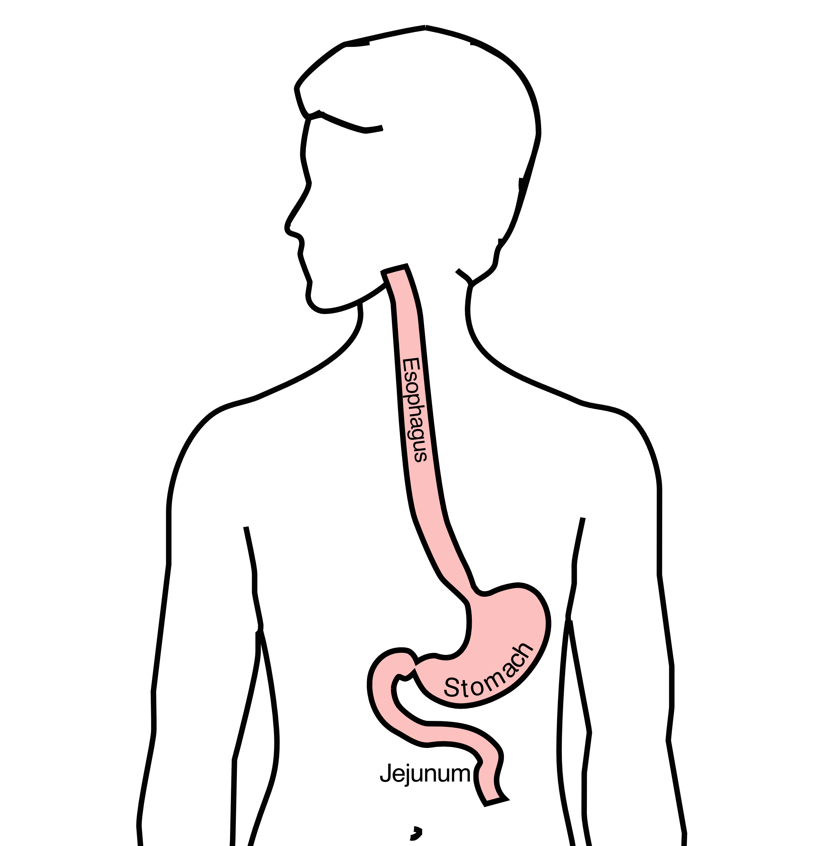
GI Tract Anatomy
Esophagus delivers food to the stomach
Stomach stores food and delivers it in small quantities to the jejunum
Jejunum begins digestion in the small intestines

Slide 3
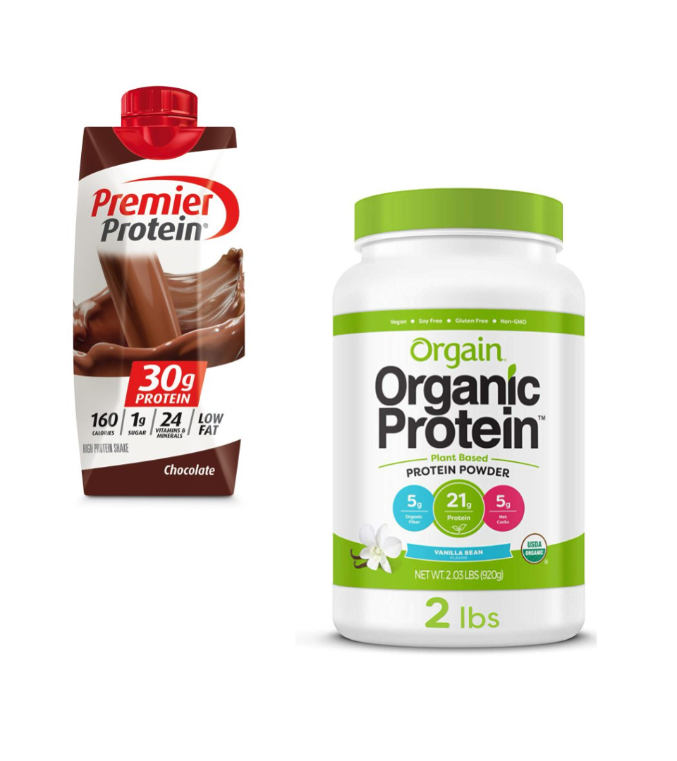
Protein Needs
Men: Average 75 grams/day
Women: Average 60 grams/day
Protein Shakes provide protein with minimal sugar

Slide 4
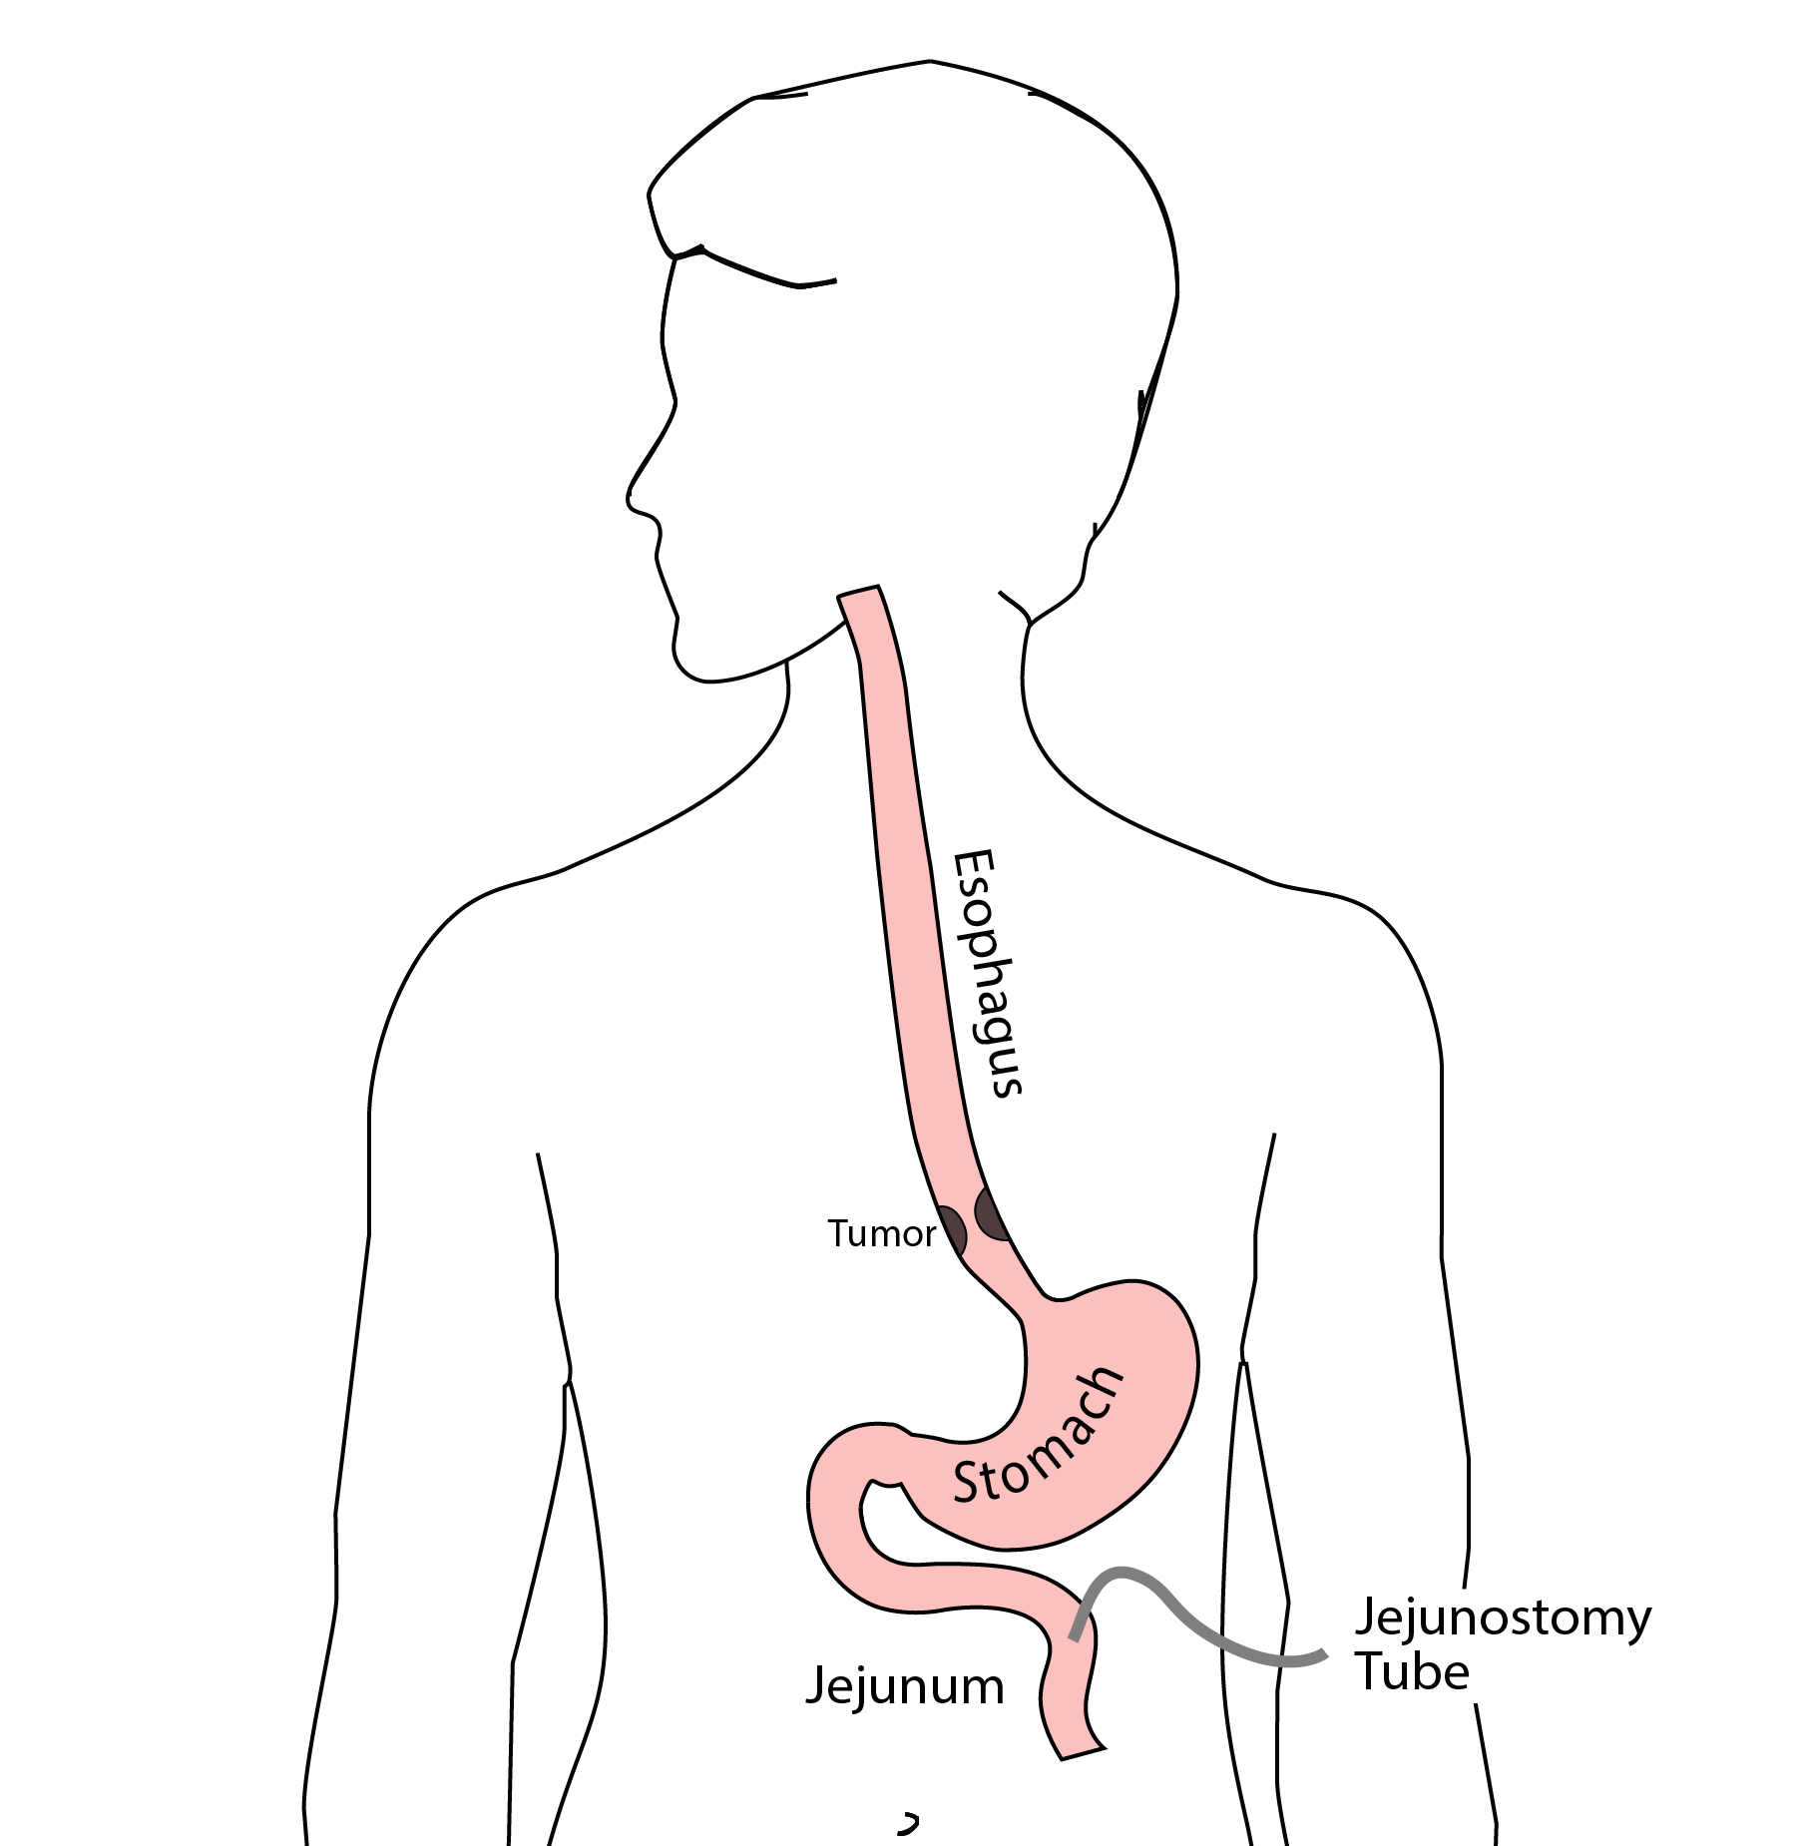
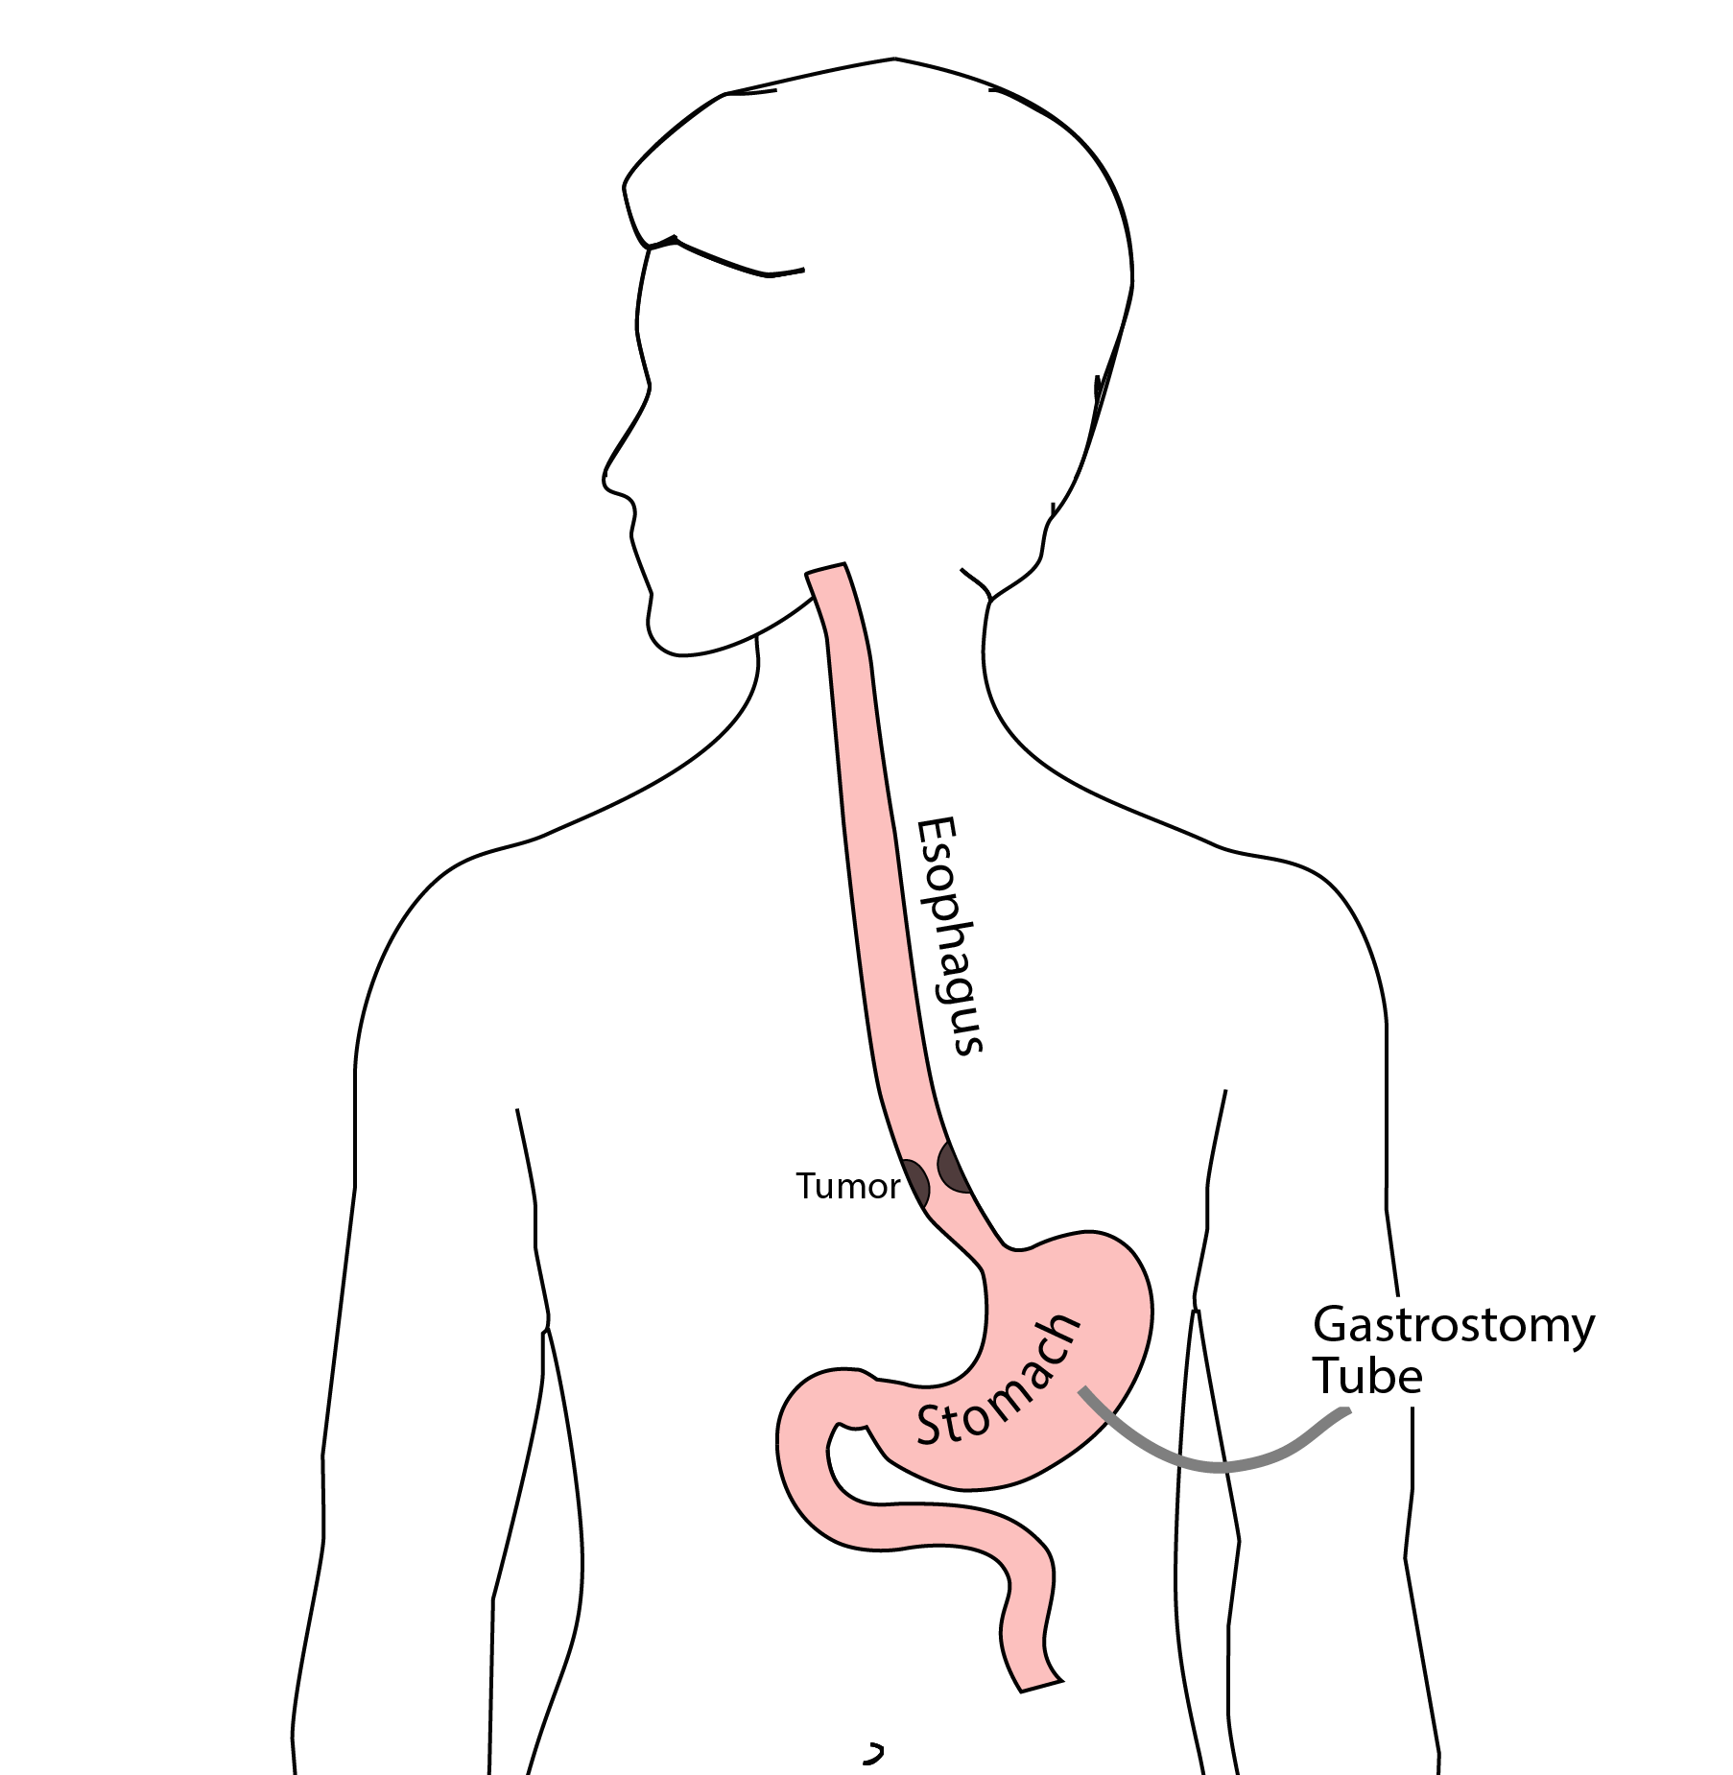
Feeding Tubes

Slide 5
Gastrostomy Tube
Feeding Gastrostomy
Feeding with a syringe several times per day.
Tube can be hidden underneath clothing
Tube does not interfere with eating by mouth
Removed easily in the office when no longer needed

Slide 6
Gastrostomy Tube Methods
A gastrostomy tube can be placed either by endoscopy, which is called a PEG tube
A gastrostomy tube can also be placed by laparoscopy, which is usually preferred if surgery on the esophagus is planned in the future.
Your surgeon will help you decide which kind of tube is best for you. This is especially important if you will need esophageal surgery in the future, as the stomach is frequently used to make a new esophagus

Slide 7
Gastrostomy Tube
Outpatient Placement (go home the same day)
Central venous port can be placed at the same time (if needed)

Slide 8
Jejunostomy Tube
Nutrition to bypasses the esophagus and stomach
Placed in small intestine
Pump administers feedings slowly
Feeding usually done at night

Slide 9
Jejunostomy Typical Regimen
Jejunostomy tube feeds for 16 hours (6pm-10am)
Men: 75mL/hour x 16 hours = 5 cartons
Women: 60mL/hour x 16 hours = 4 cartons
Water 240ml (8oz) via syringe 4x/day
Hospital nurses will teach use of the feeding tube

Slide 10
Jejunostomy Feeds with Diabetes
Jejunostomy feedings elevate blood sugars
Insulin may be required along with feeds
Typical Pattern for tube feeds
Feeds run via pump from 6pm to 10am
Insulin at 6pm (70/30 insulin)
Insulin at Midnight (70/30 insulin)
No insulin if tube feedings are not run

Slide 11
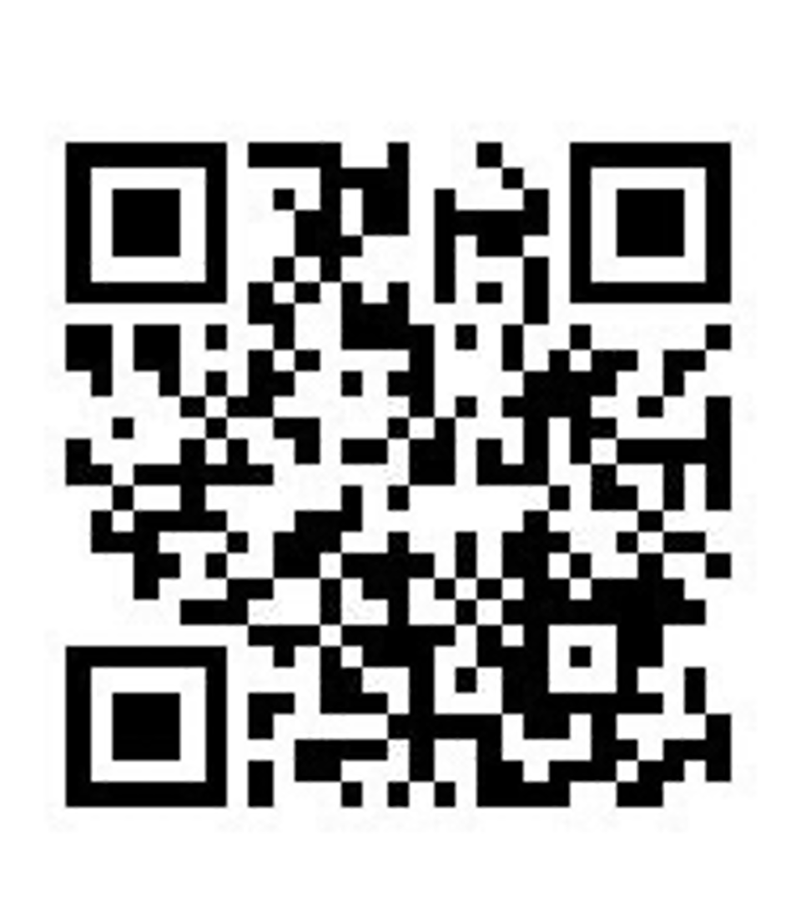
Jejunostomy Video
A video is available to help become familiar with the feeding jejunostomy

