Slide 1
Nutrition

Slide 2
GI Tract Anatomy
Normally, food passes from the mouth into the esophagus, and then into the stomach. The stomach serves as a reservoir for food, to allow you to eat a big Thanksgiving. The stomach starts digestion, and then after the meal slowly allows small portions of food to pass into the small intestines, where most of the digestion occurs.
Anatomy

Slide 3
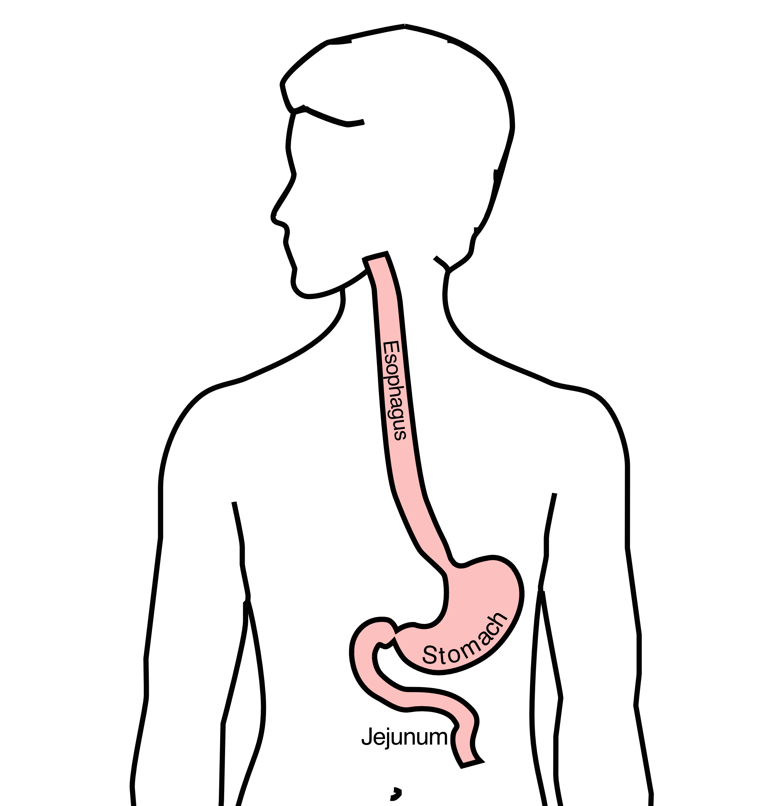
Esophagus delivers food to the stomach
Stomach stores food and delivers it in small quantities to the jejunum
Jejunum begins digestion in the small intestines

Slide 4
Nutrition Building Blocks

Slide 5
For patients with cancer of the esophagus or stomach, the most common feeding tube is a jejunostomy tube

Slide 6
For patients with cancer of the esophagus, there are two different kinds of feeding tube which can be used:
A gastrostomy tube is placed into the stomach
A jejunostomy tube is placed in the small intestines
Your dietitian and physician will help you decide which tube is best for your situation

Slide 7
Gastrostomy tube
• Placed into stomach
Jejunostomy tube
• Placed into small intestine

Slide 8
Feeding Gastrostomy
A gastrostomy tube allows feeding with a syringe, which can be done several times per day.
When it’s not being used, the gastrostomy tube can be hidden underneath clothing.
For patient who later need surgery on the esophagus, it will be necessary to remove the
gastrostomy tube and place a jejunostomy tube, as the stomach frequently used to create a new
esophagus

Slide 9
A gastrostomy tube can be placed either by endoscopy, which is called a PEG tube
A gastrostomy tube can also be placed by laparoscopy, which is usually preferred if
surgery on the esophagus is planned in the future.
Your surgeon will help you decide which kind of tube is best for you. This is especially important if you will need esophageal surgery in the future, as the stomach is frequently used to make a new esophagus

Slide 10
A gastrostomy tube is generally placed as an outpatient, which means you can go home the same day.
In some cases, a central venous port for chemotherapy is placed at the same time as a gastrostomy tube.

Slide 11
The other type of feeding tube is a jejunostomy.
A jejunostomy tube tube is placed into the small intestines. Because the small intestine is used to receiving food in small quantities, a jejunostomy tube requires the use of a pump to deliver feedings gradually over a matter of hours.
In general, feedings are done at night in order to allow you to be active during the day

Slide 12
A jejunostomy tube is used in cases where it’s not possible to place a gastrostomy tube, such as when there is a tumor in the stomach. A jejunostomy tube is routinely used after esophageal surgery, so in patients who need help with nutrition prior to surgery, it makes sense to put in a jejunostomy tube before surgery. The same tube can then be used for nutrition both before and after surgery.

Slide 13
We have a link here to a video that explains more
about the jejunostomy tube

Slide 14
I hope this video has been helpful.
Here are links to other videos you may find helpful.
Feel free to subscribe in order to be notified about new videos
Gastrostomy Jejunostomy

