Slide 1
Surgery of the Esophagus

Slide 2
Preparation for Surgery
Medical evaluation may be needed before surgery:
Pulmonary Function Tests to test lung function
Cardiology evaluation to test heart function
  Echocardiogram
  Stress Test
  Holter monitor

Slide 3
Esophagectomy for Cancers of the Esophagus or GE Junction
Primary Surgery
Superficial Tumors (T1) not completely removed by endoscopy
Localized Tumors (T2 N0 M0)
Surgery scheduled after medical evaluation
Aim for surgery within 6 weeks of consultation
Preoperative Therapy $→$ Surgery
Locally Advanced (T3 Nx M0)
Surgery scheduled after
  Recovery from preoperative therapy
  Restaging scans (CT or PET)
  Medical evaluation
Timing between end of preoperative therapy and surgery
  Chemotherapy + radiation: 6-8 weeks
  Chemotherapy: 4-8 weeks

Slide 4
Preoperative Visits
Medical Oncology - Monitor chemotherapy and side effects
Radiation Oncology - Monitor radiation and side effects
Surgical Oncology
Consult visit with Dr Salo
Mid-treatment visits with Dr Salo / Kate Duncan
Preop visit with Dr Salo (may be virtual)
In-person preop visit with Kate Duncan and Liz Koch

Slide 5
Surgery for Esophageal Cancer
Surgery for esophageal cancer is performed for:
Superficial Tumors (T1) not removed by endoscopy
Localized Tumors (T2 N0 M0)
Locally Advanced (T3 M0) after preop therapy

Slide 6
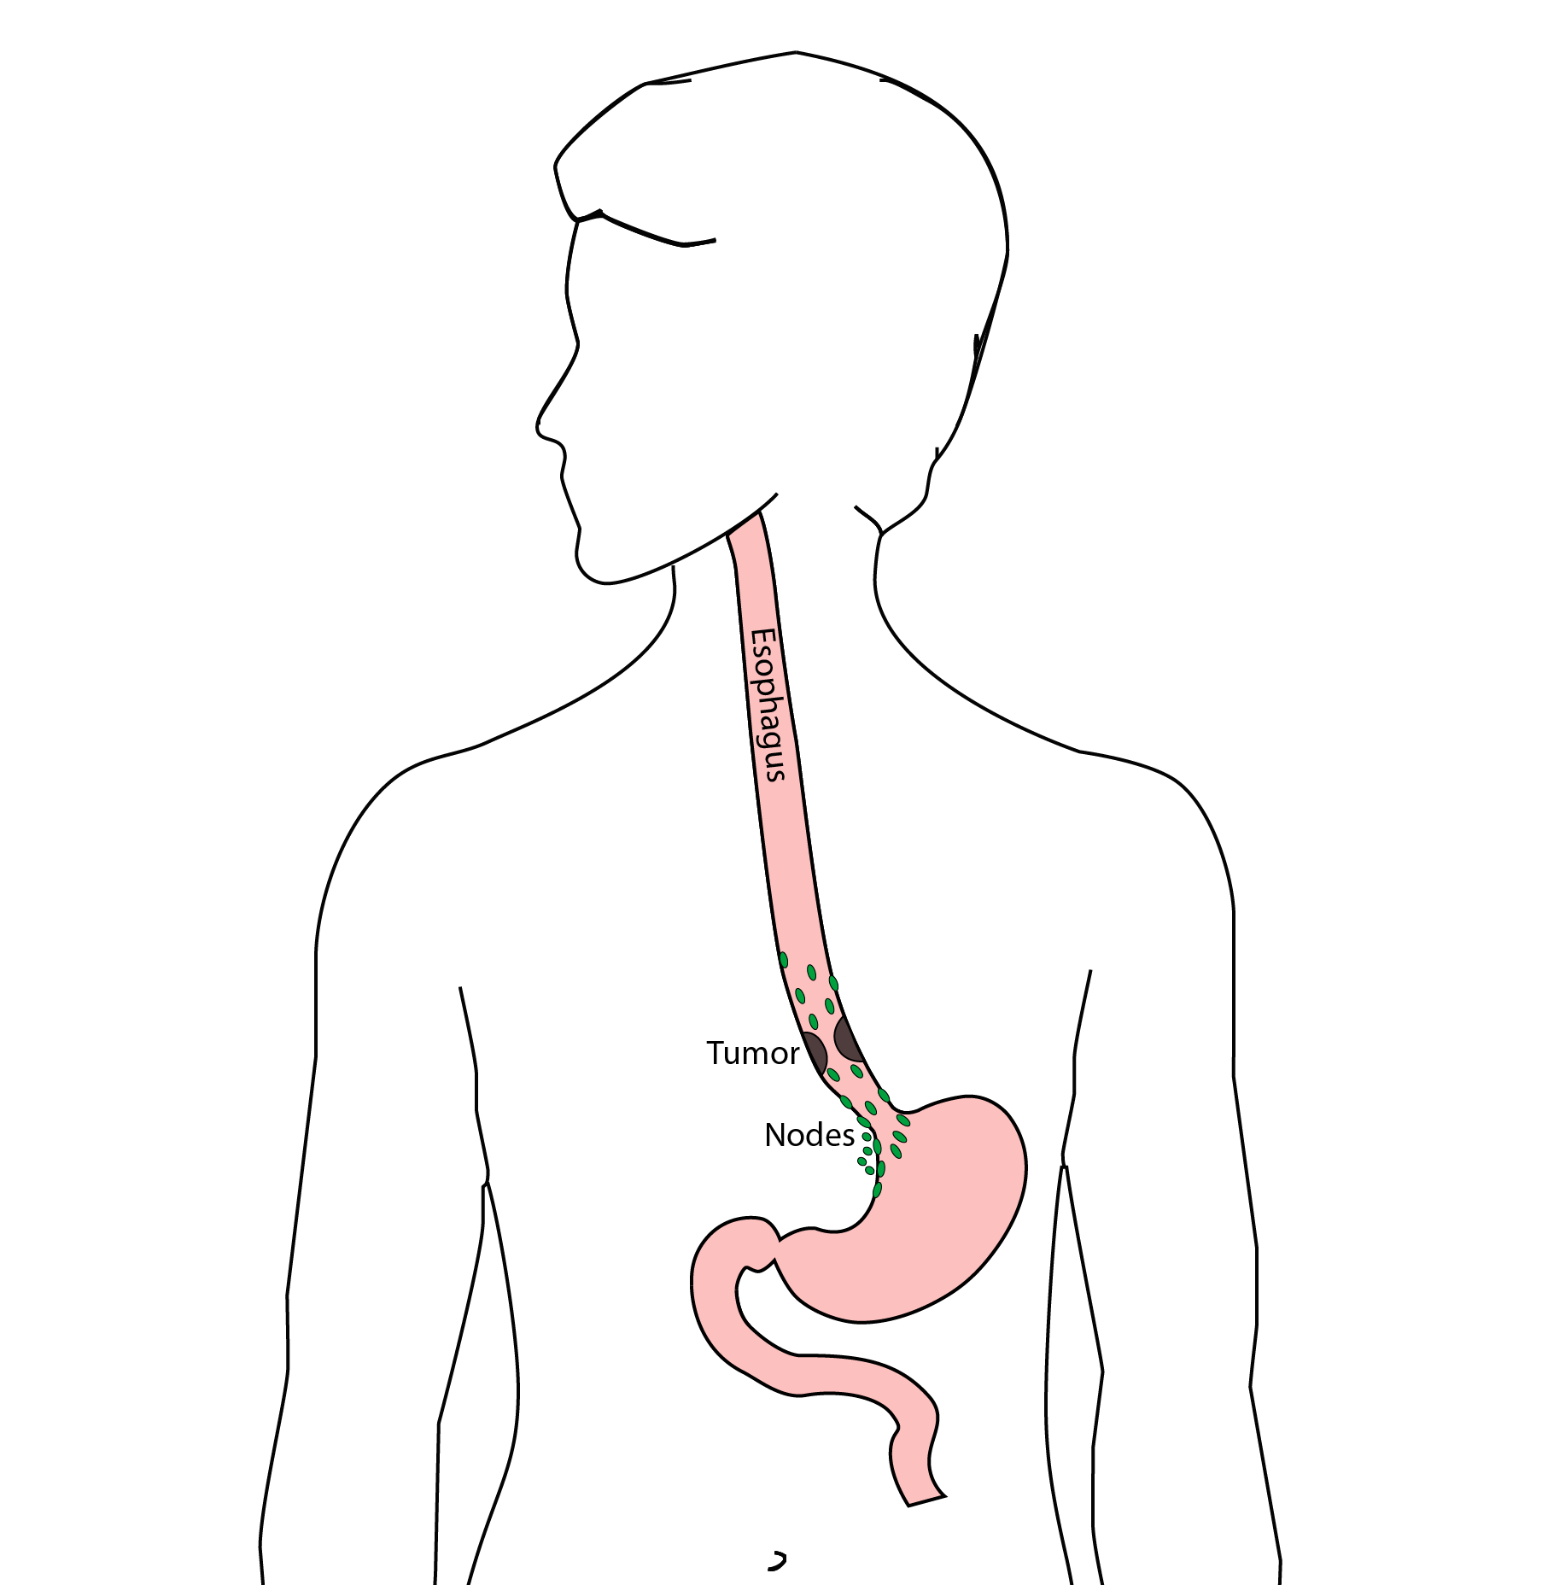
Goals of Surgery
Remove tumor from esophagus
Remove surrounding lymph nodes
Create a new esophagus

Slide 7
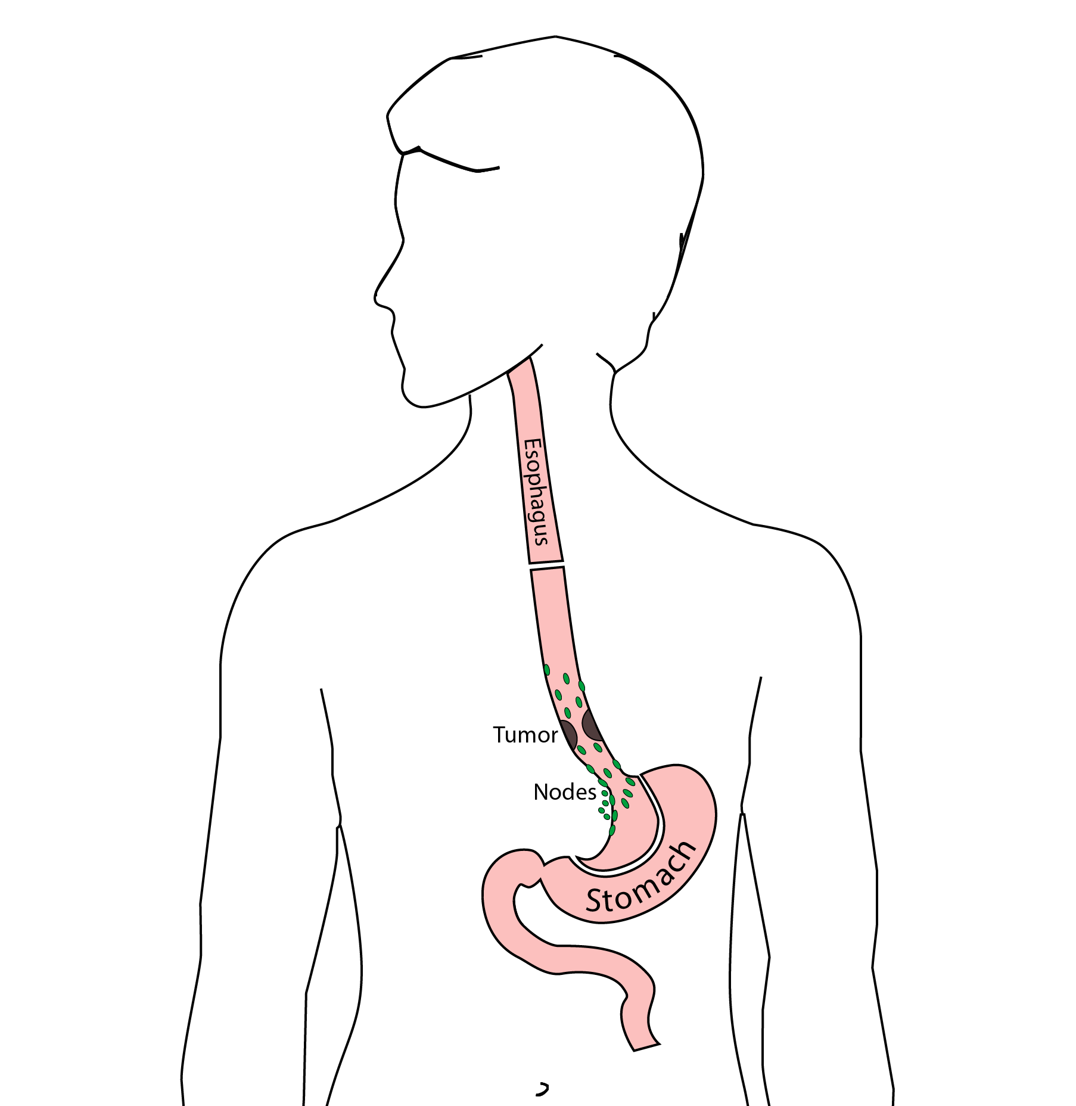
Ivor Lewis (Transthoracic) Esophagectomy
Removes tumor and lower 1/2 esophagus
Removes surrounding lymph nodes
GI tract reconstructed

Slide 8
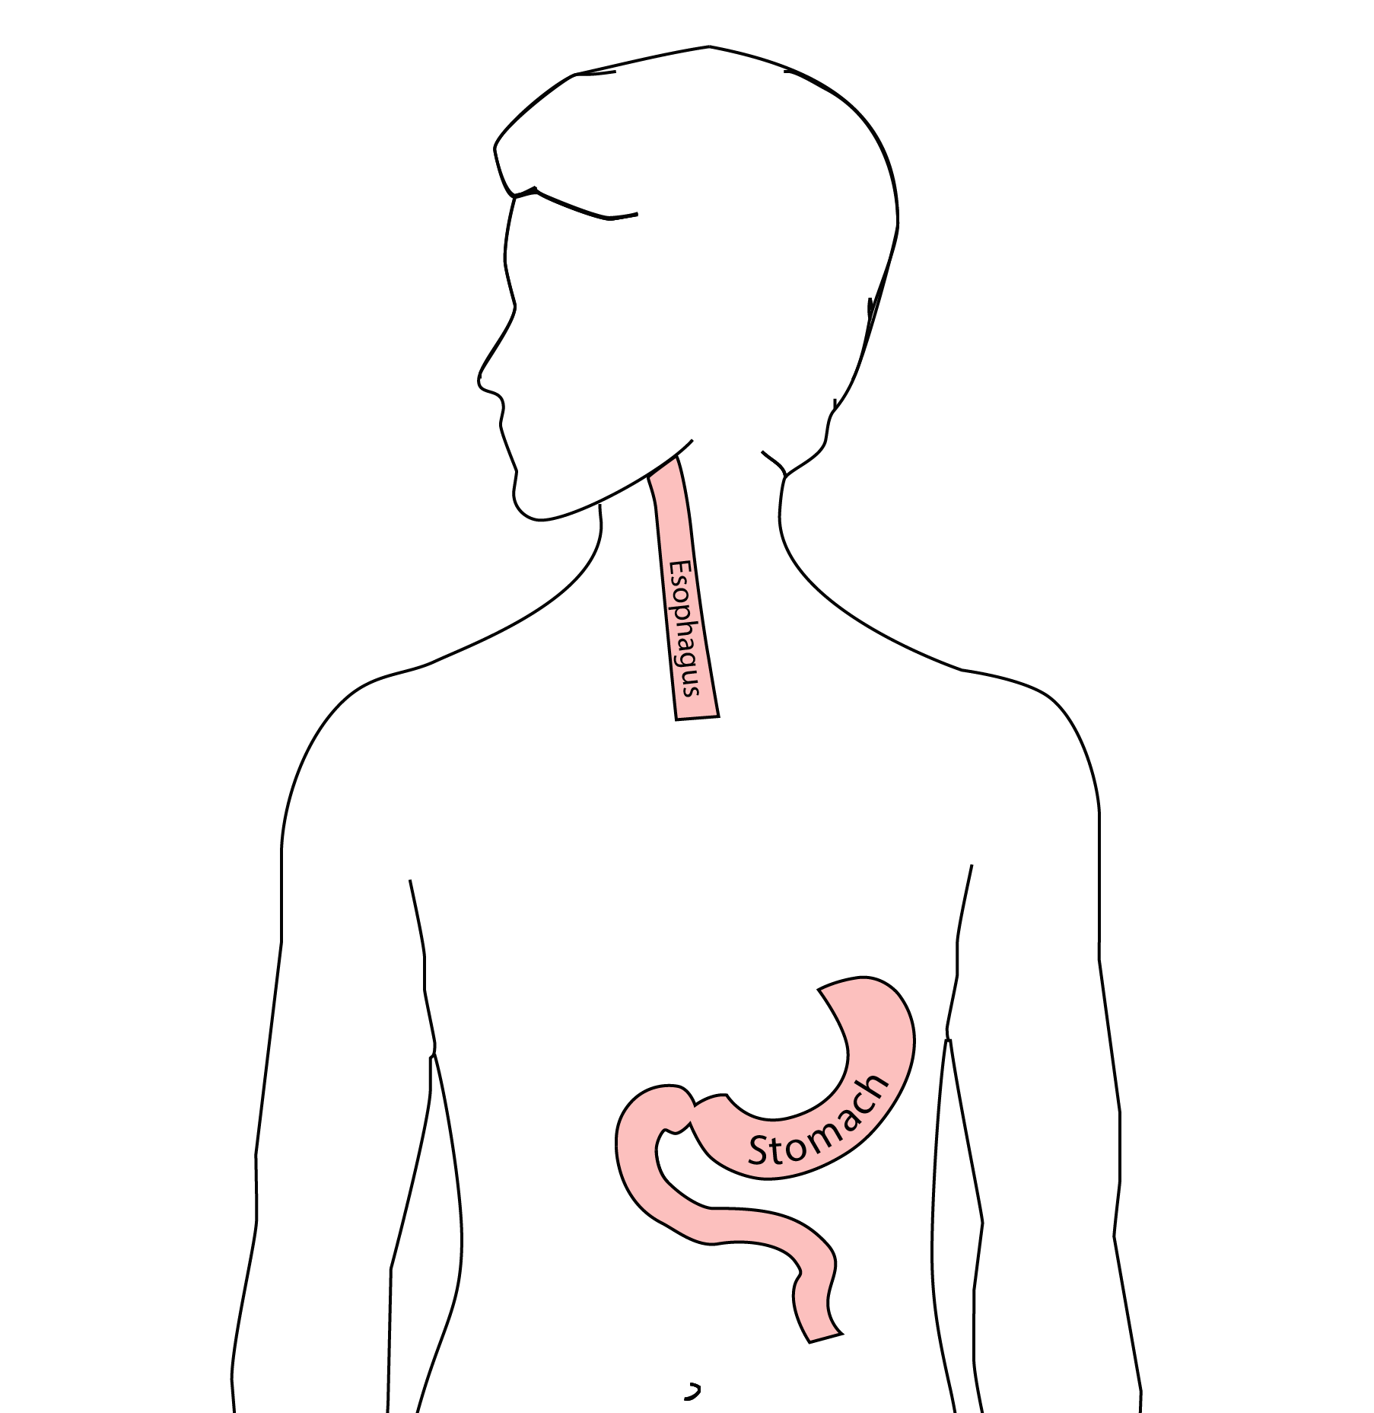
Reconstruction
New esophagus is created from the stomach in the abdomen by fashioning it into a tube.

Slide 9
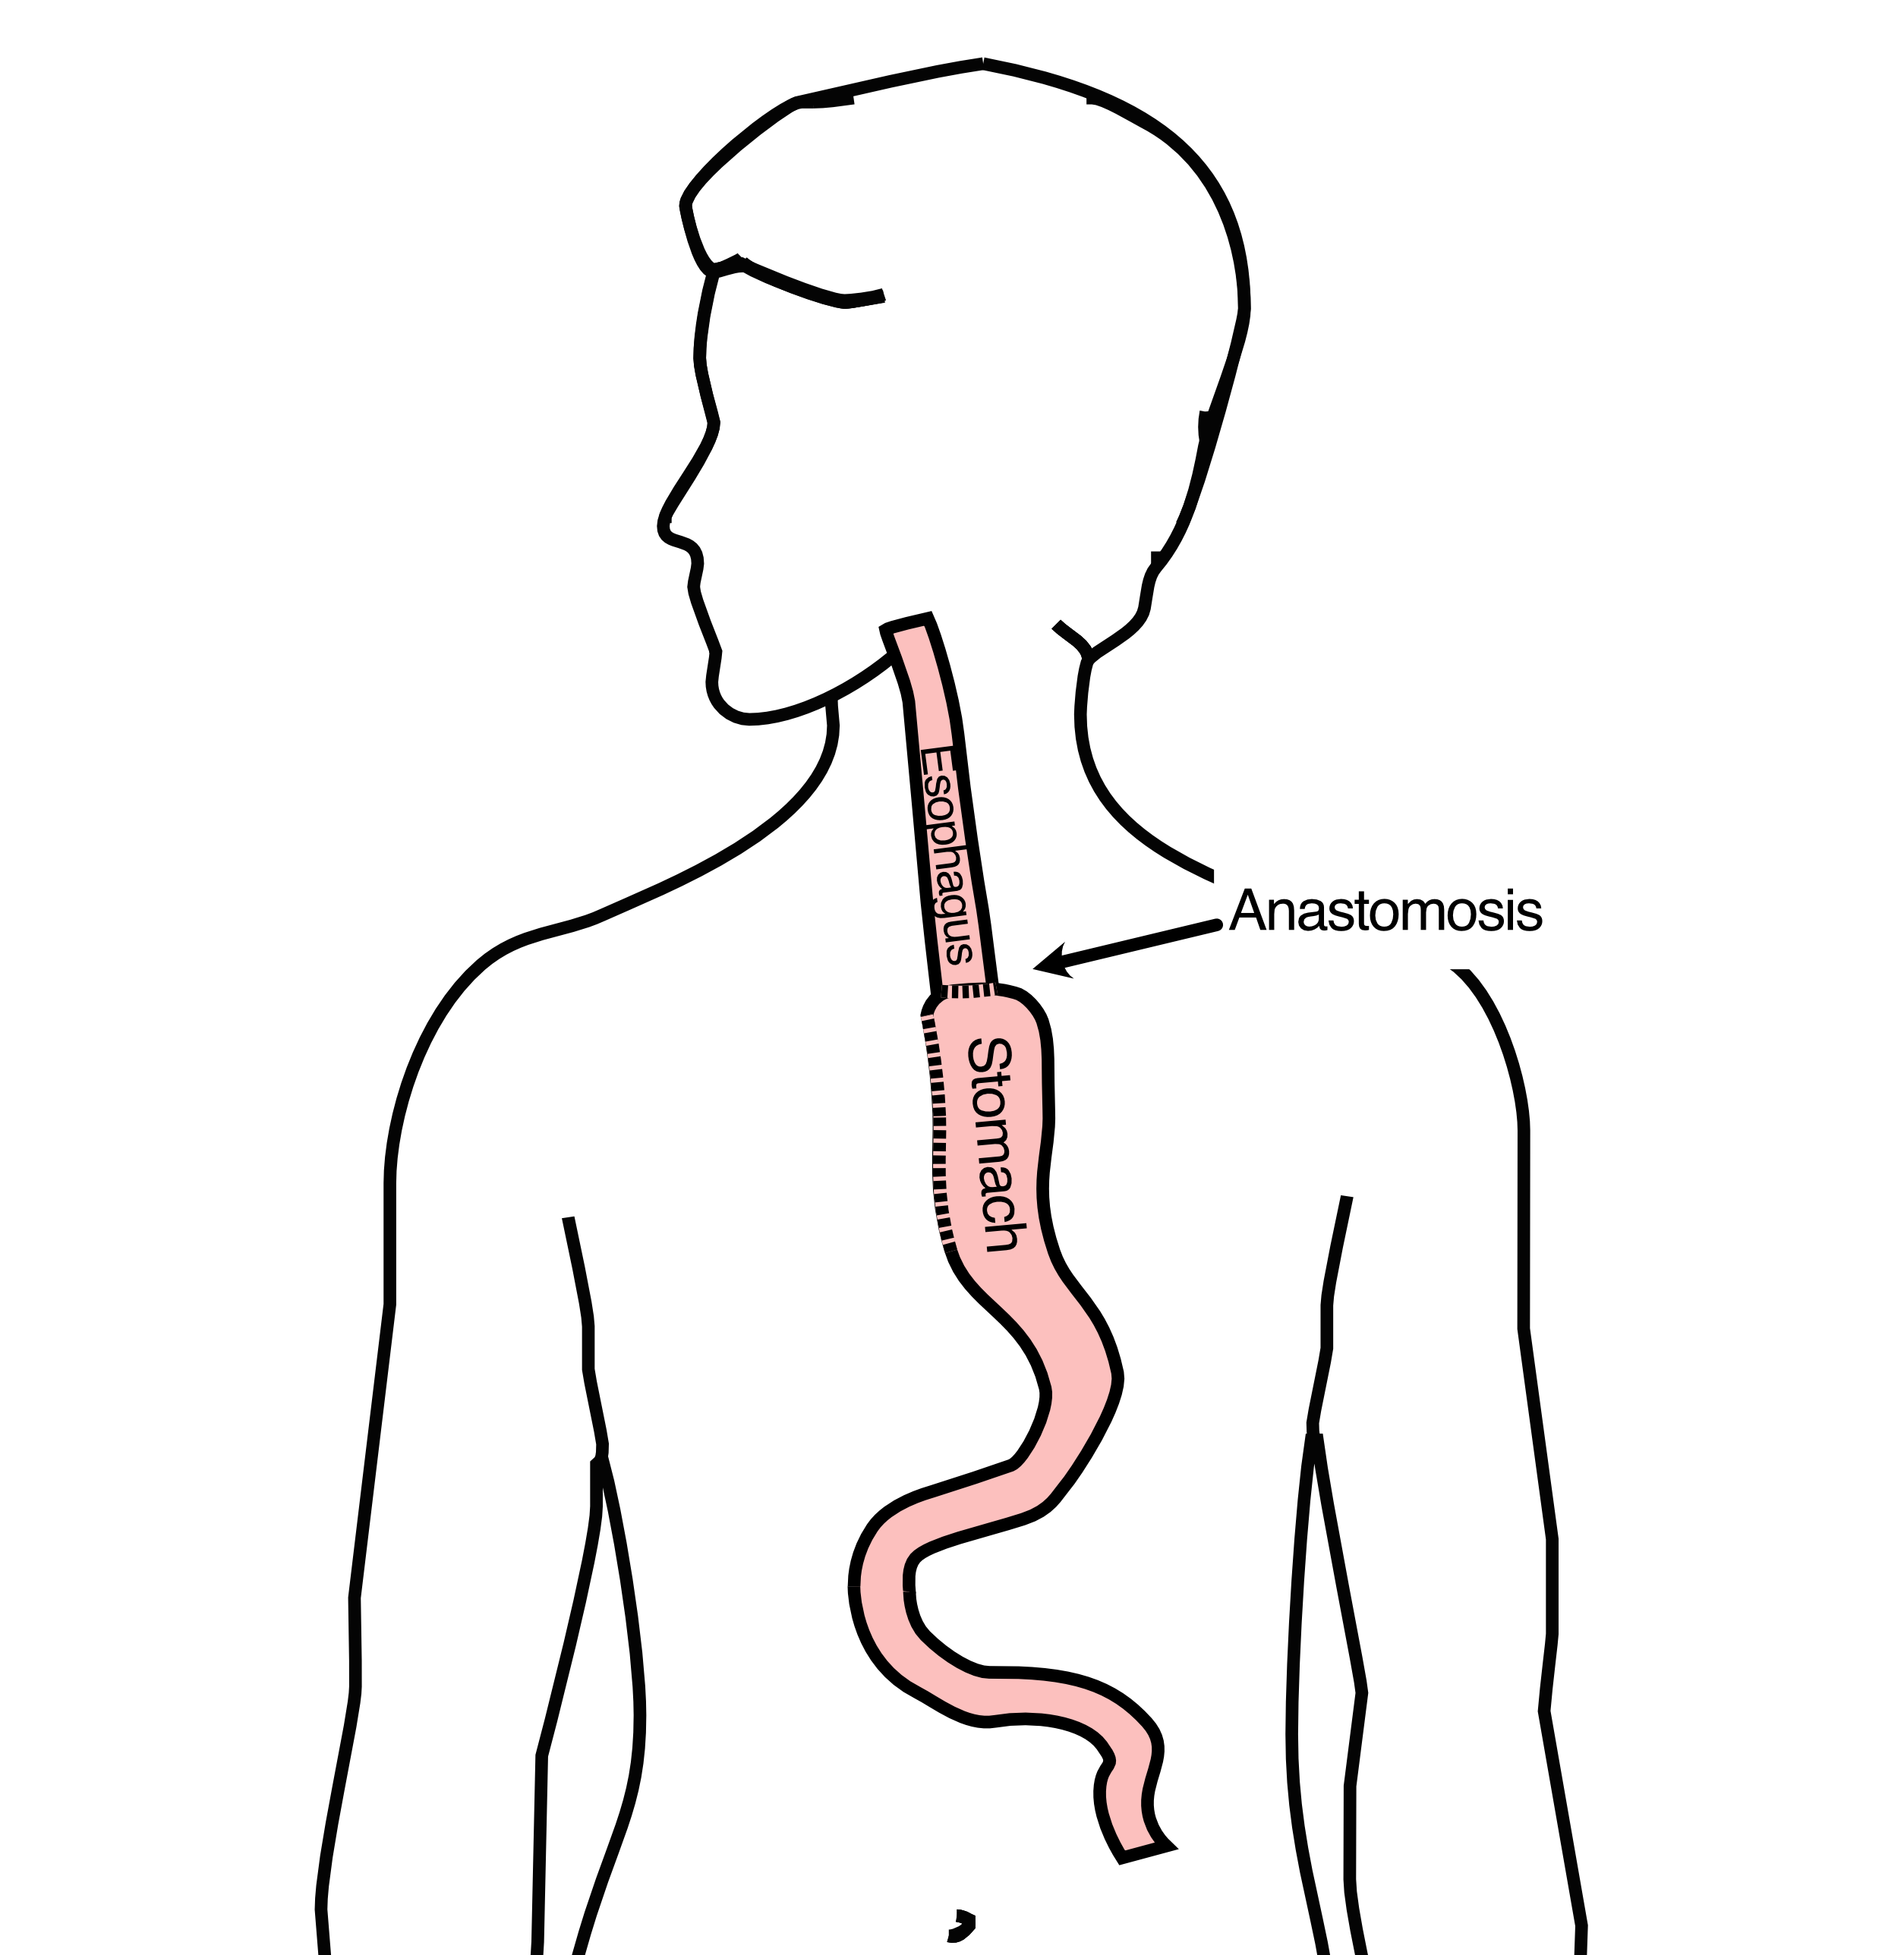
Ivor Lewis esophagectomy
The new esophagus is now brought up into the chest. A connection is made between the esophagus and the stomach, called an anastomosis.

Slide 10
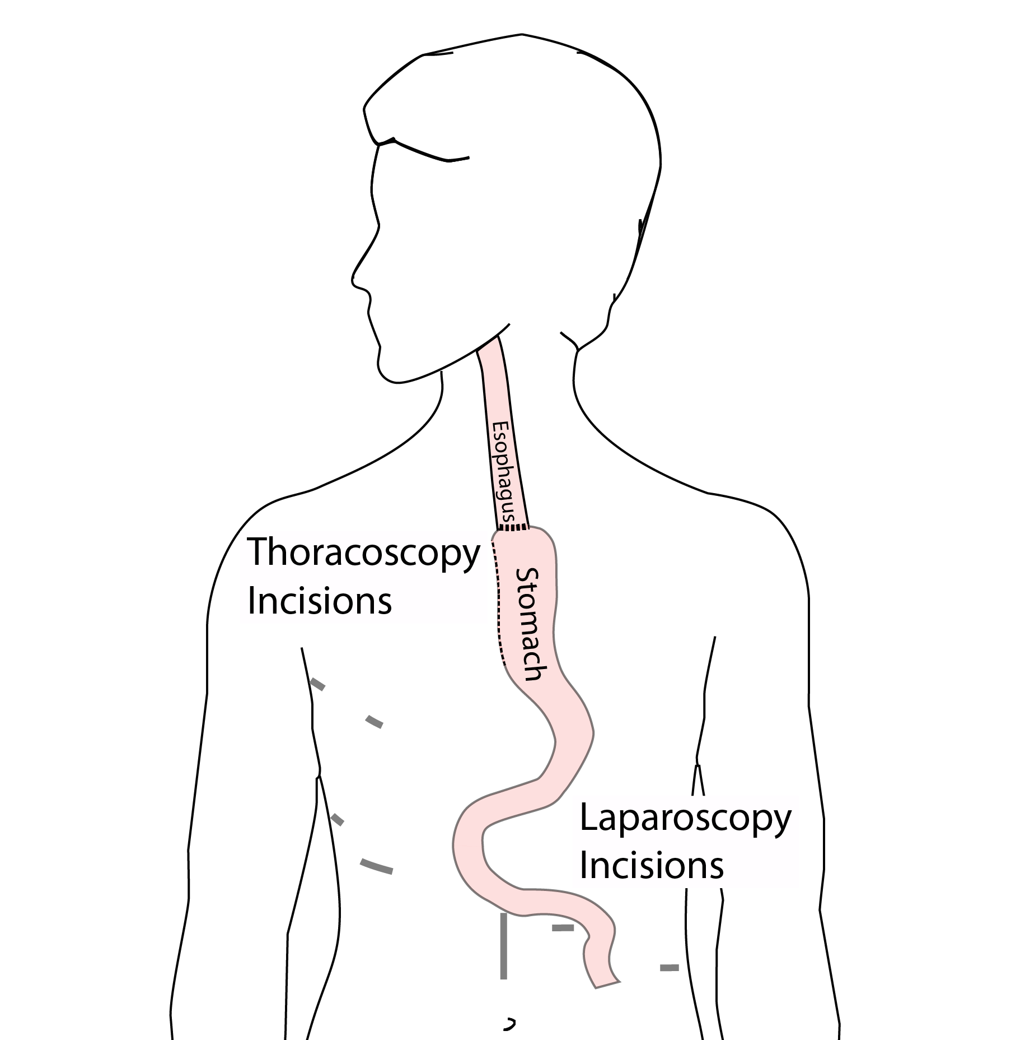
Minimally-invasive Ivor Lewis
Small incisions abdomen and chest
Surgical telescope and instruments
Smaller incisions $→$ faster recovery and less discomfort

Slide 11
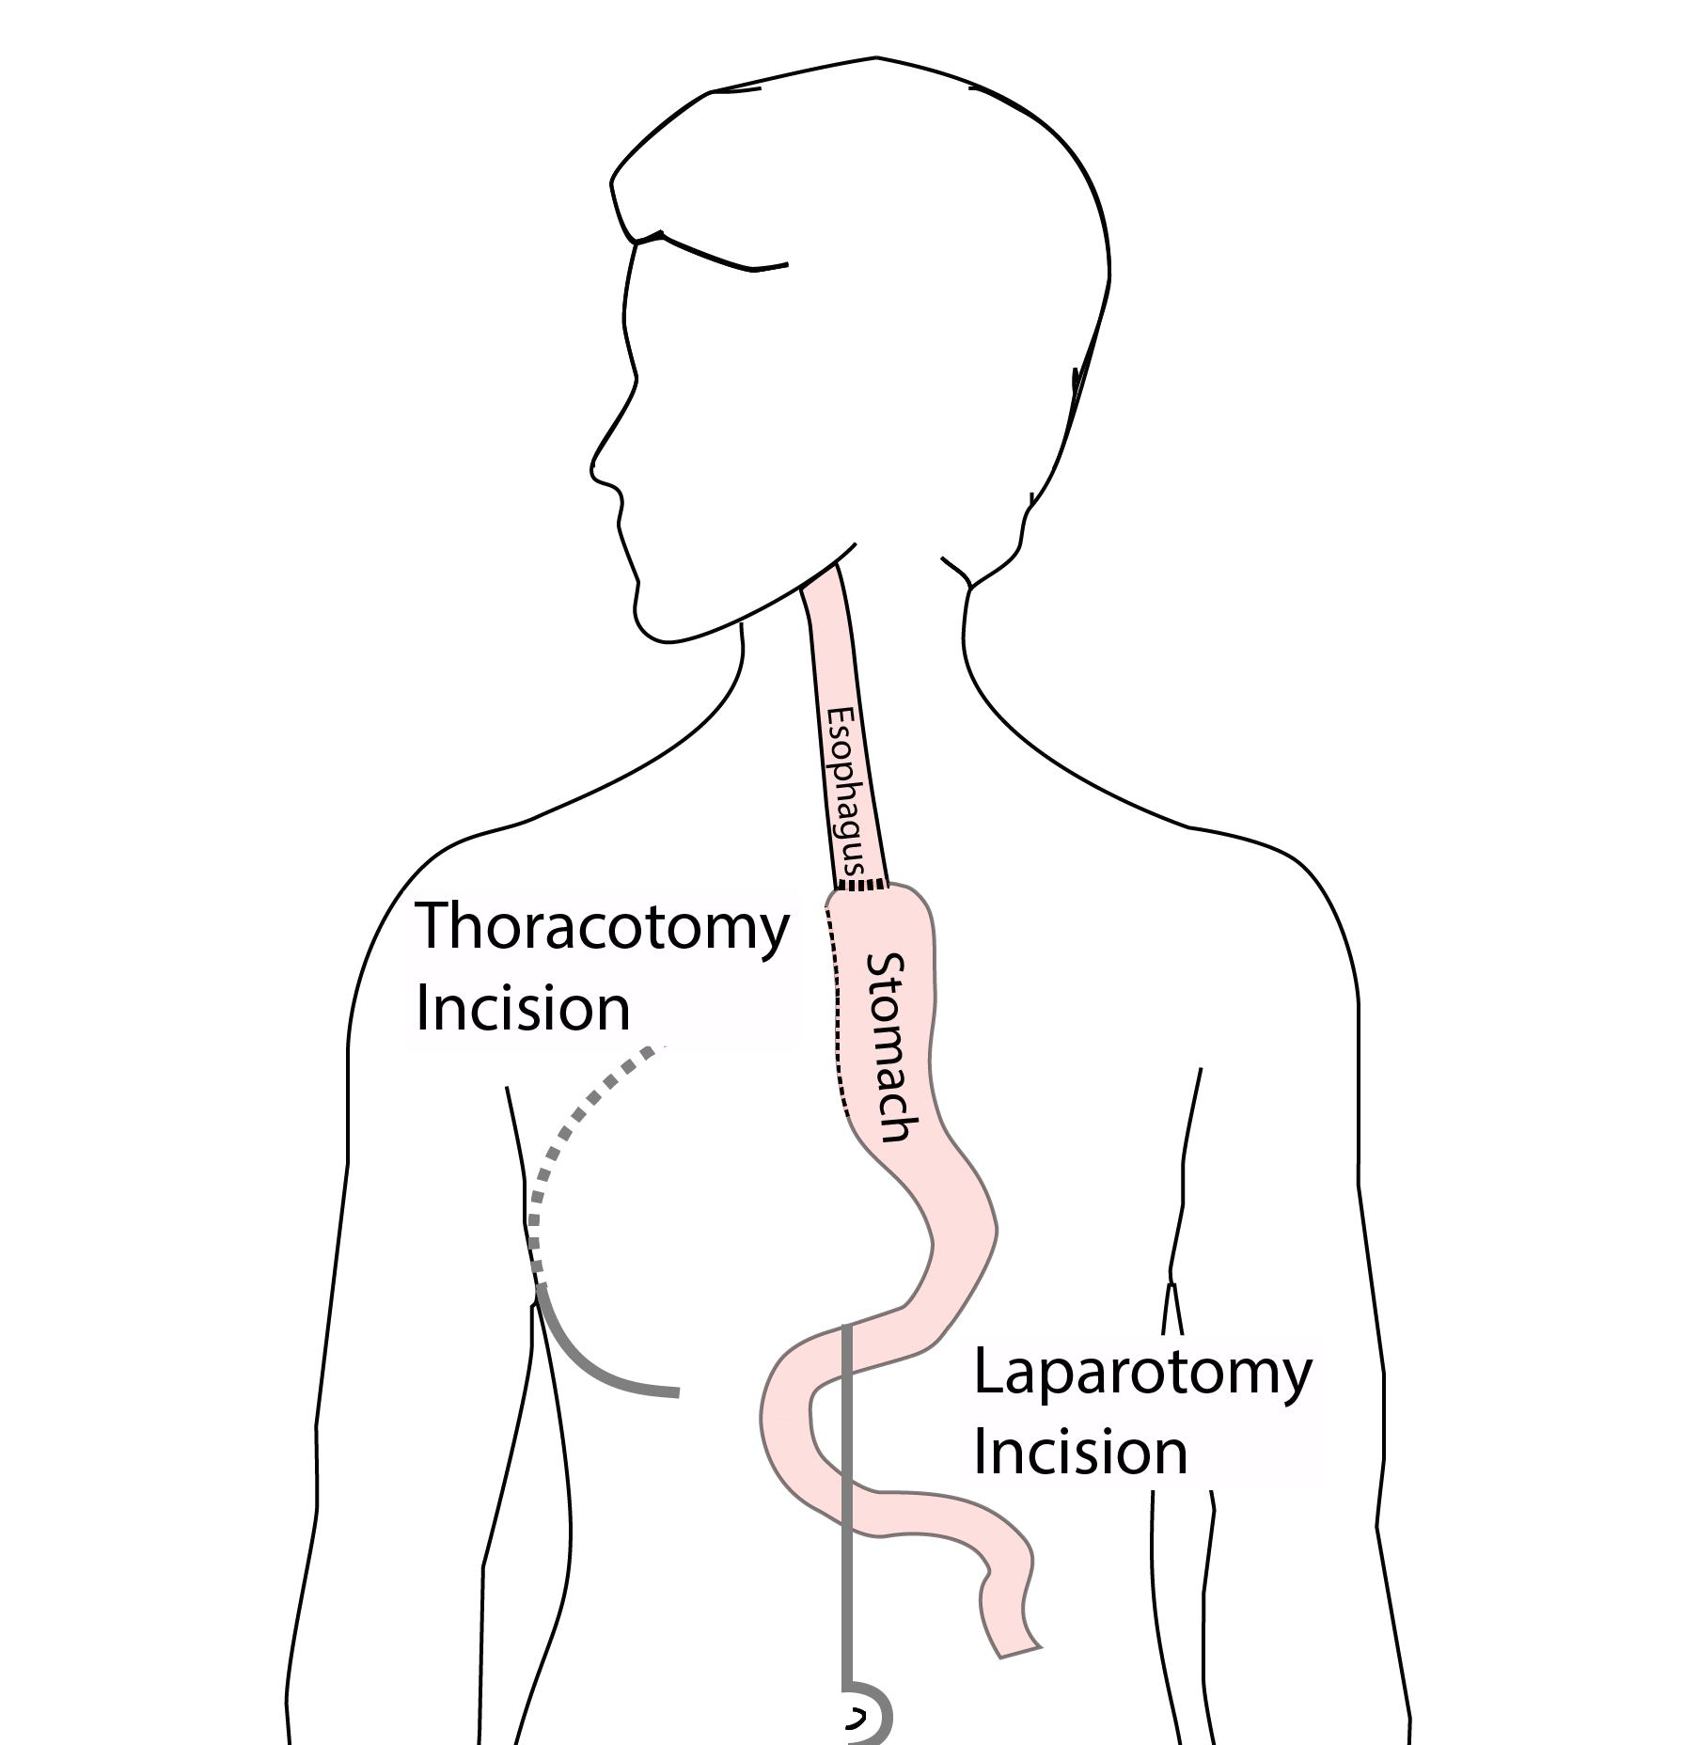
Open Ivor Lewis
Mininally-invasive approach feasible in 98% of cases
In some cases, an open approach is still necessary (2%)

Slide 12
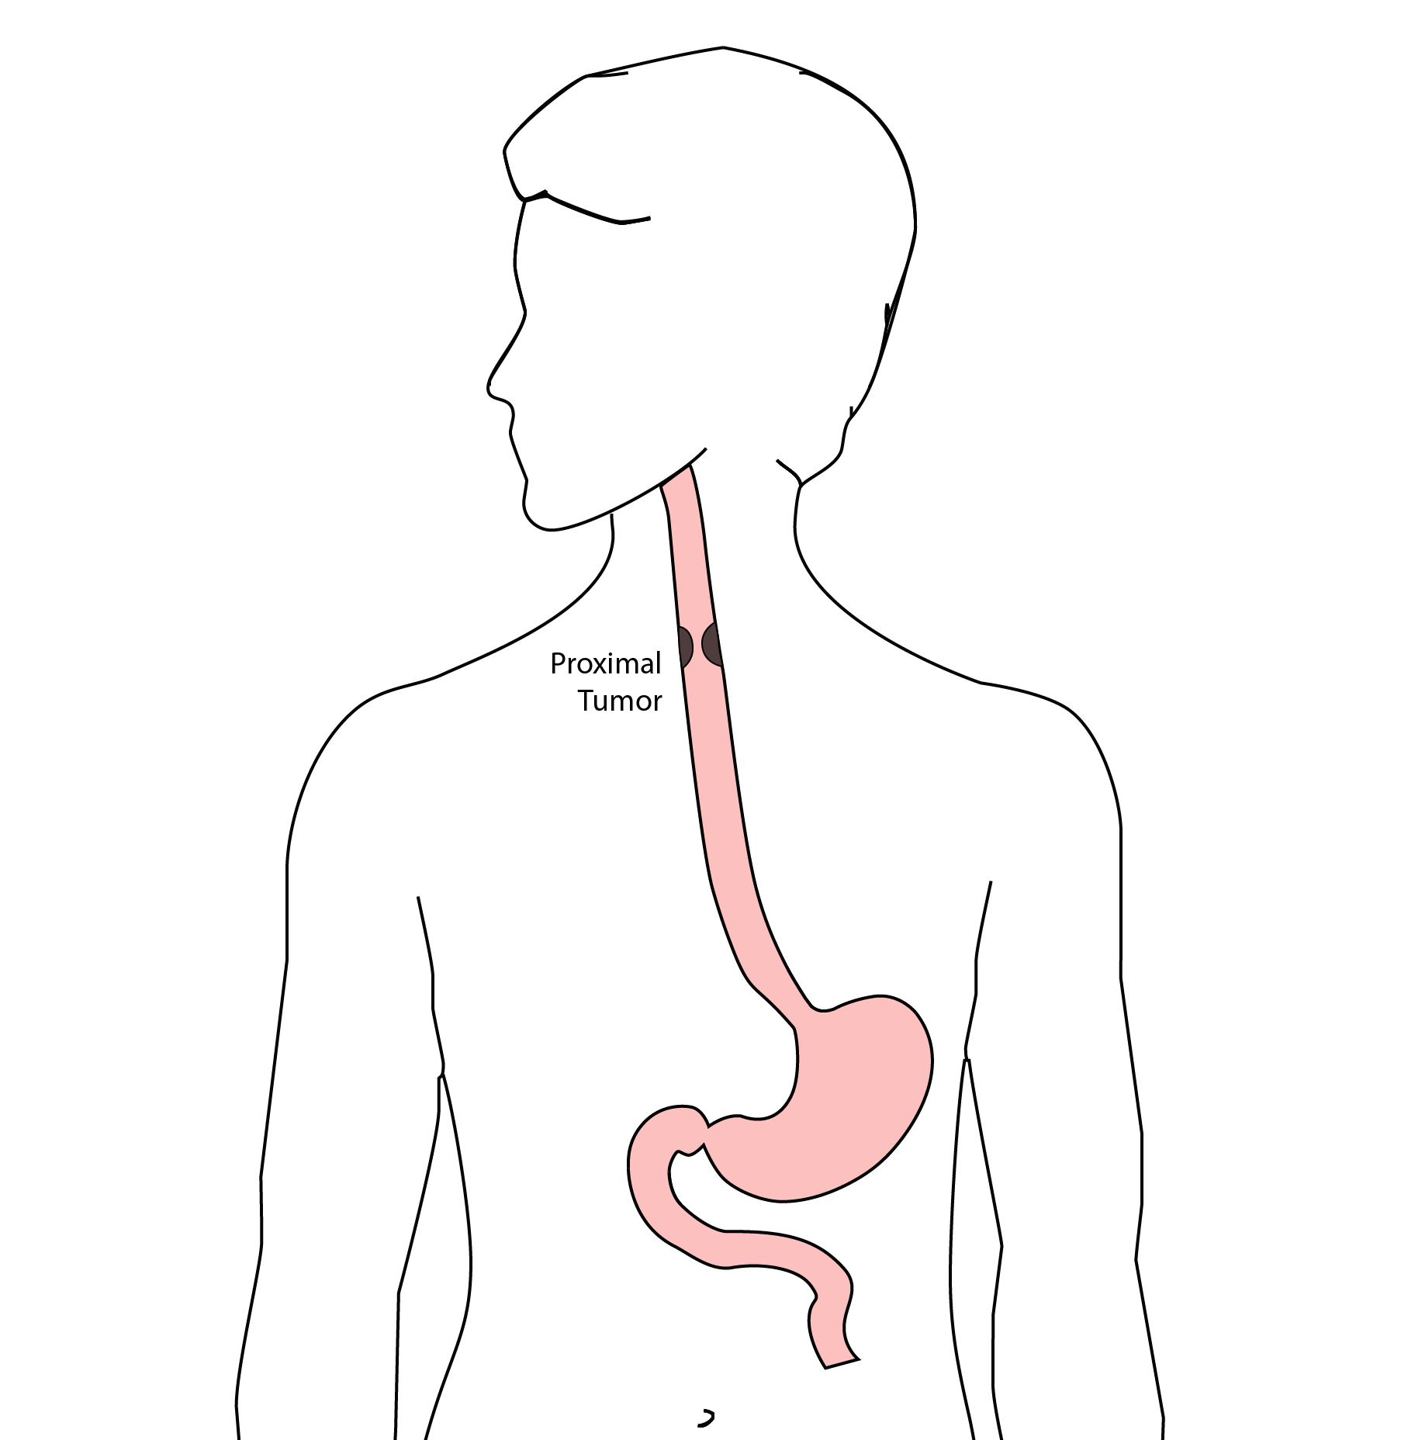
Total Esophagectomy
For patients with tumors in the upper esophagus, we need to remove more of the esophagus
We need to remove the whole esophagus, including the portion in the neck

Slide 13
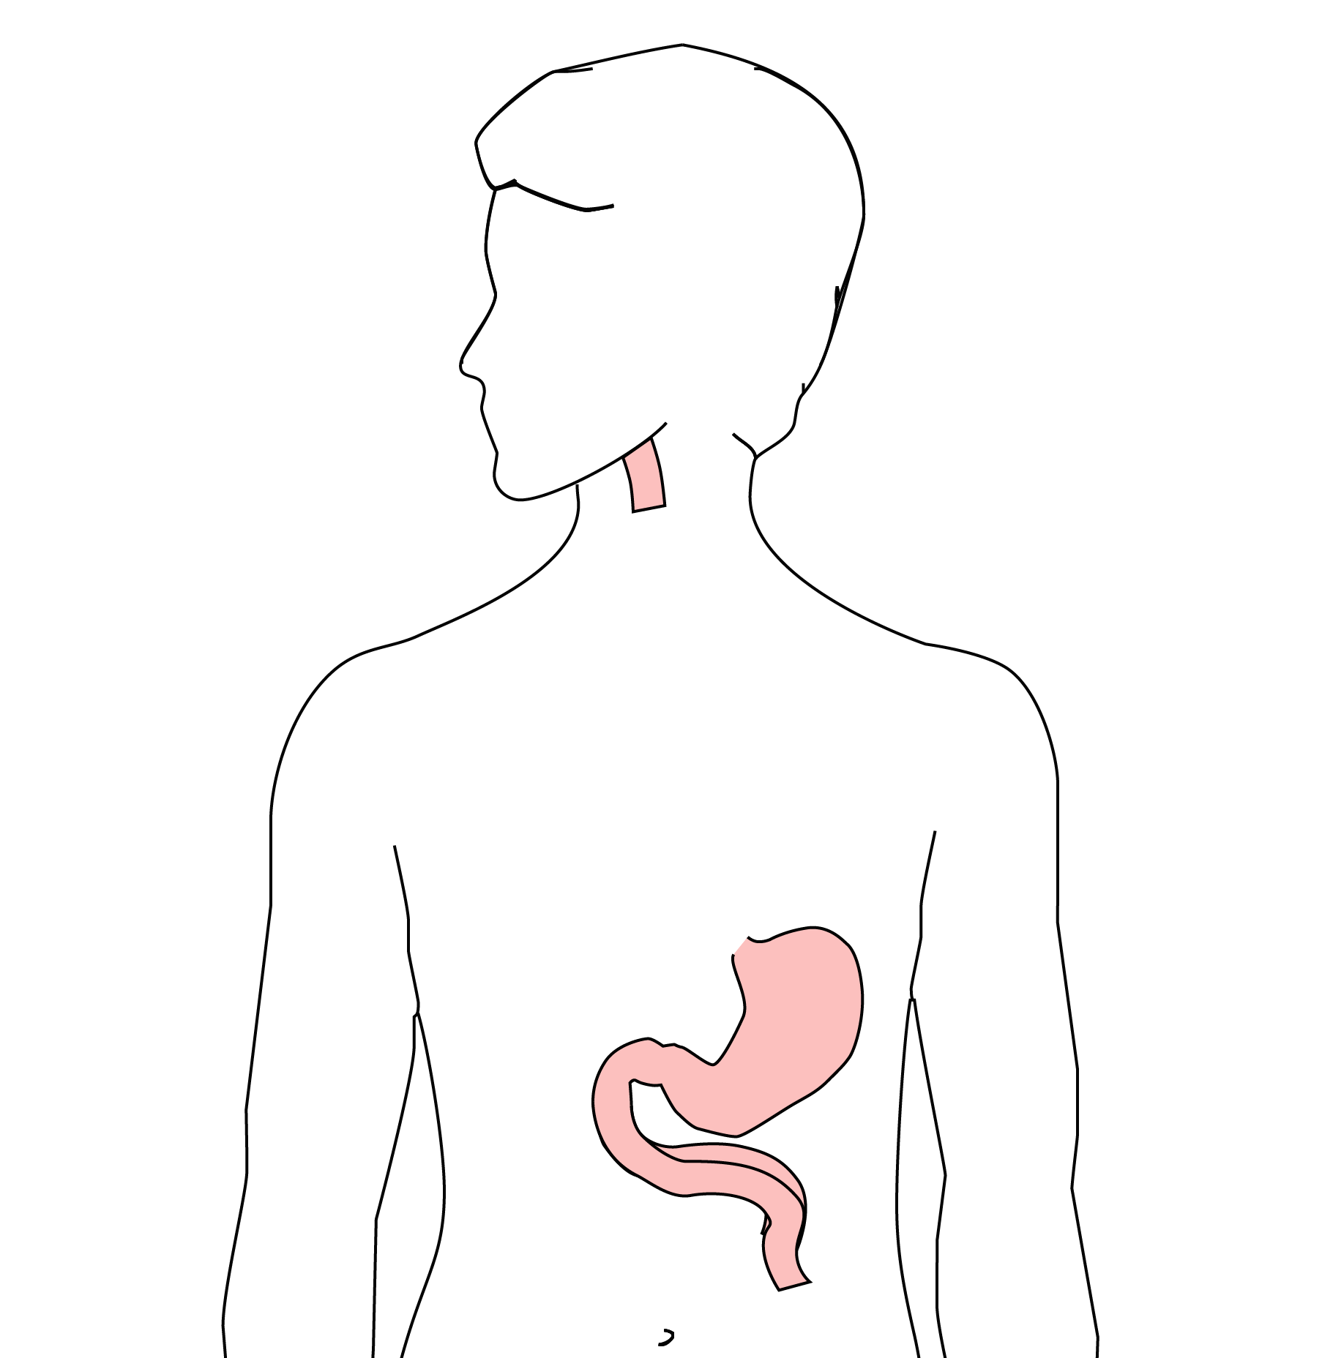
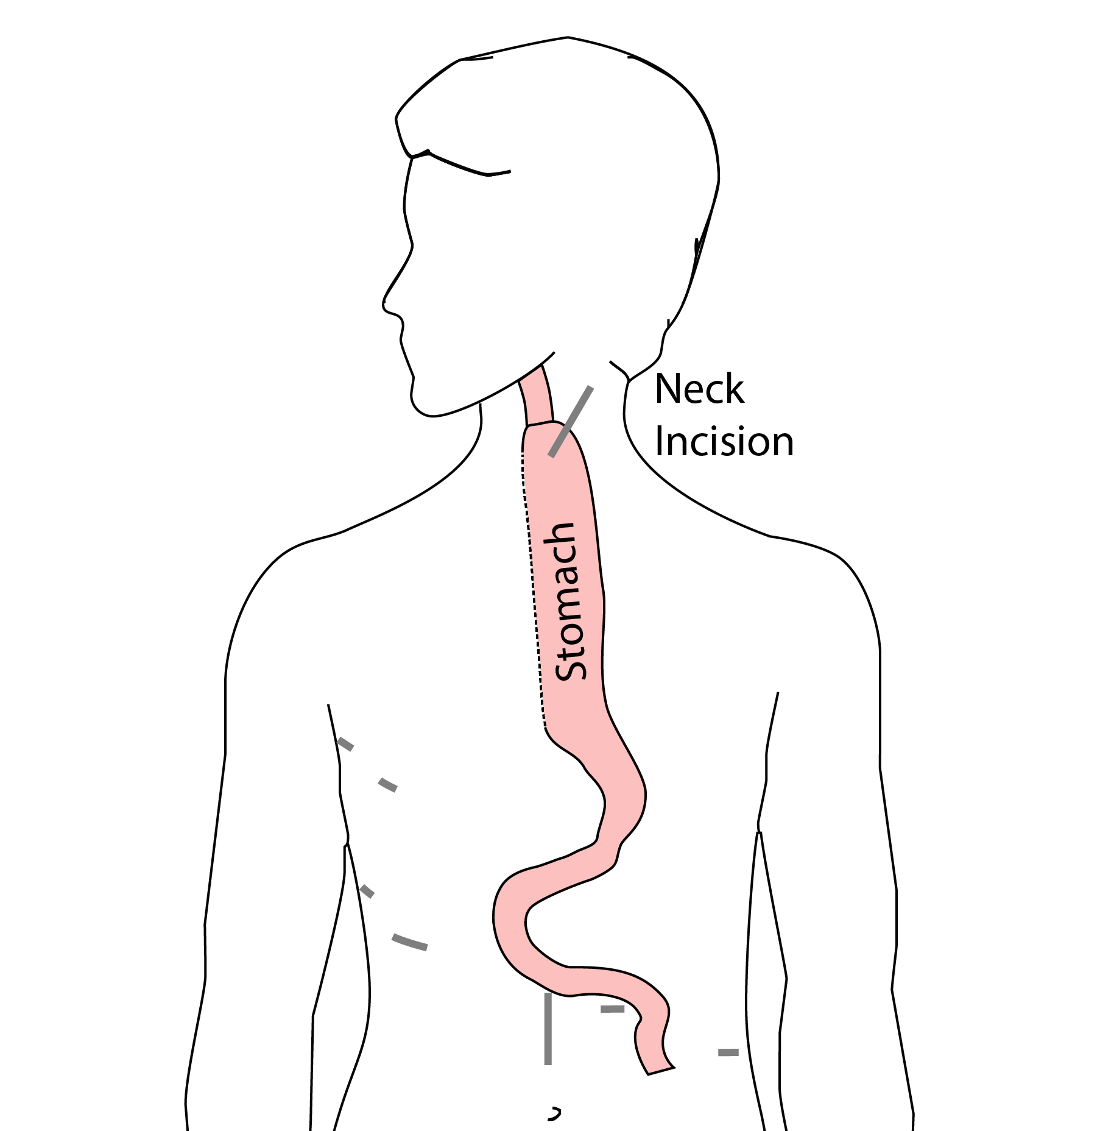
McKeown Esophagectomy

Slide 14
Risks of Esophagectomy
Esophagectomy is a complex operation, with a real risk of complications.
Two significant complications:
Anastomotic leak
Pneumonia

Slide 15
Anastomotic Leak
The anastomosis is surgical connection between the esophagus and the stomach.

Slide 16
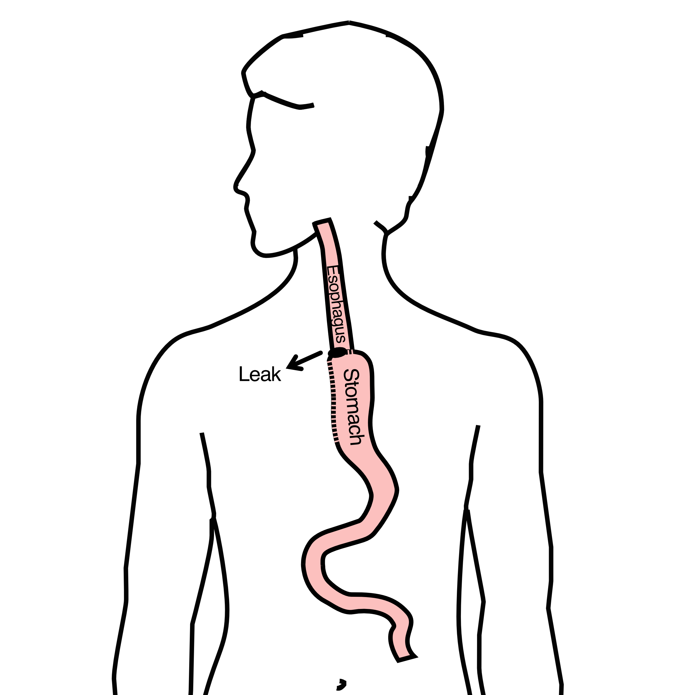
Anastomotic Leak
If healing doesn’t occur:
Leakage of fluid from the esophagus
Infection in the space between the lungs
Requires additional time in the hospital

Slide 17
Anastomotic Leak
If leak occurs:
Some leaks will seal
Stent may be required to help healing
Occasionally additional surgey is required

Slide 18
Anastomotic Leak
Risk of leak depends on:
Type of operation performed
Nutritional status of patient
Experience of the surgeon

Slide 19
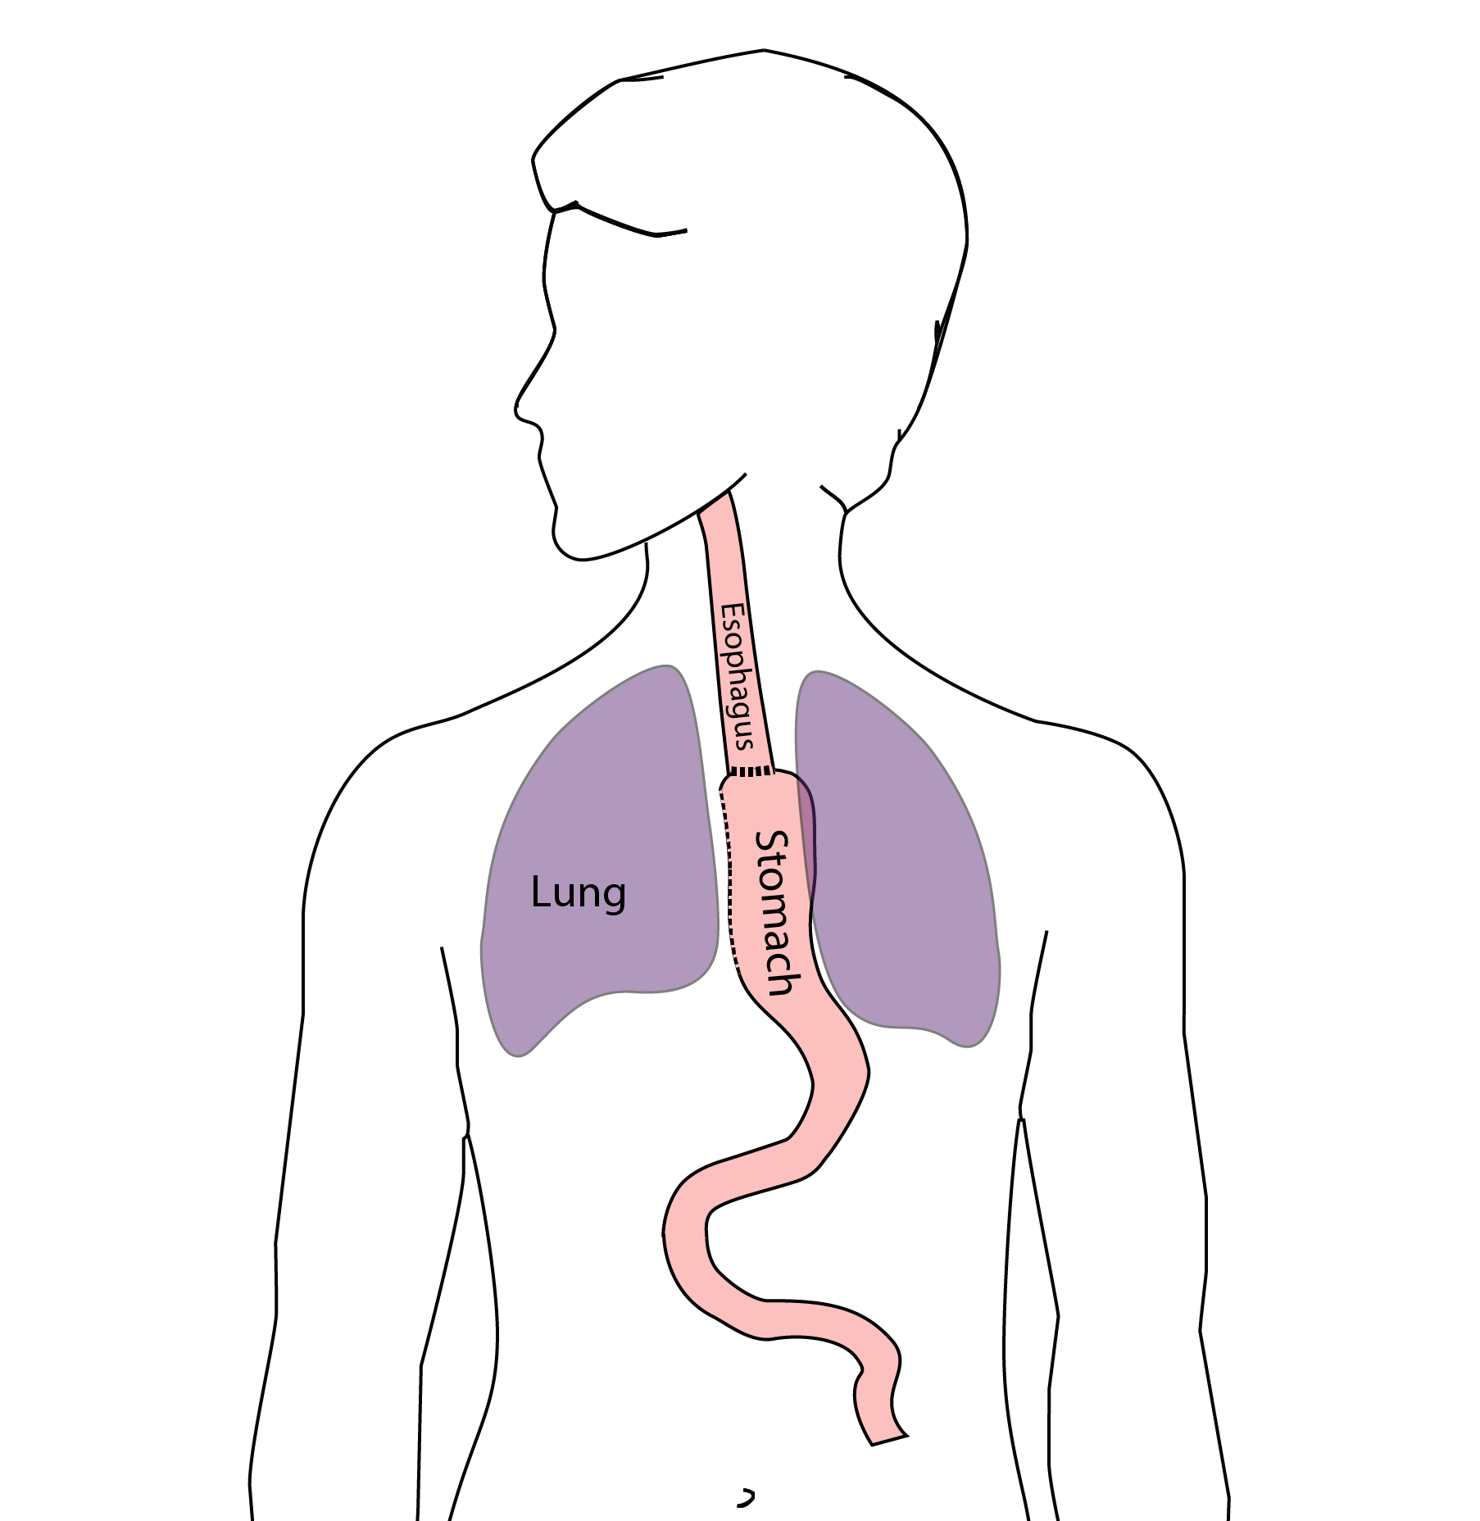
Pneumonia
Occurs in 10-15% of patients after esophagectomy.
Requires treatment with antibiotics
Requires a longer hospitalization.

Slide 20
Preventing Pneumonia
Several ways to help prevent pneumonia:
Deep breathing
Coughing
Walking
After surgery, this means:
Sitting in a chair most of the day
Walking in the halls as soon as possible

Slide 21
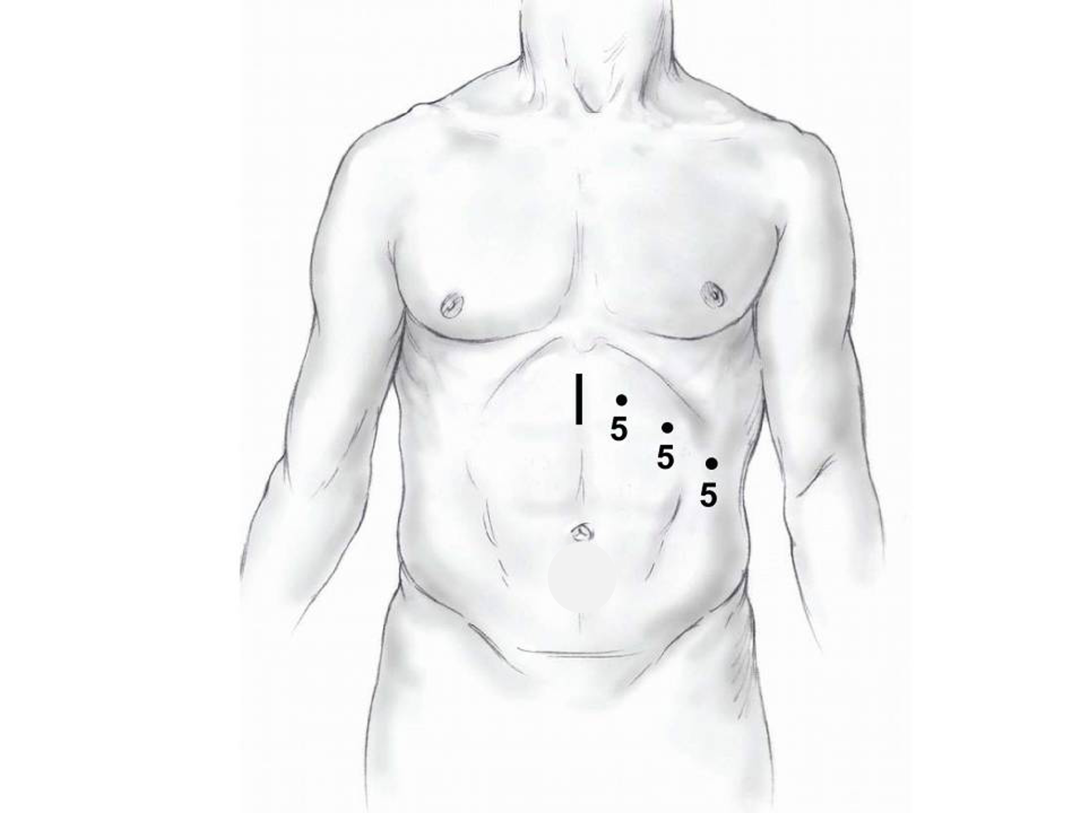
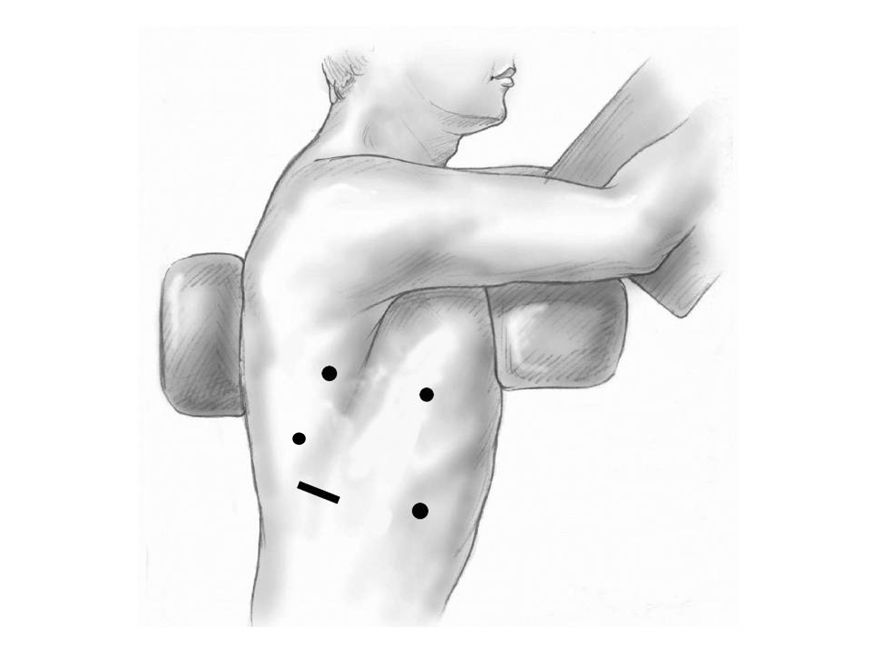
Minimally-invasive Esophagectomy

Slide 22
Risks of Surgery
Risks related to anesthesia
Heart attack (5%)
Irregular heart rhythm (15%)
Pneumonia (10%)
Blood clots in legs (<5%)
Pulmonary embolism (2%)

Slide 23
Risks of Surgery
Risks related to Surgery
Anastomotic leak (5%)
Stricture at anastomosis (15%)
Death within 90 days of surgery
  Low risk patients = 2%
  Intermediate risk = 10%
  High risk = 30%

Slide 24
Risks of Surgery
 | Age <75 | Age >75
Normal Muscle (75%) | 2% | 10%
Low Muscle (25%) | 10% | 30%
Risks of Death within 90 Days of Surgery

Slide 25
Epidural Catheter for Pain Control
Remains in place for 2-5 days
Dosage can be adjusted as needed
Can make it more difficult to urinate
May require foley catheter in bladder
Foley catheter removed after epidural removed

Slide 26
Intensive Care Unit (ICU) (2-4 days)
Surgical ICU on 11th floor
NG tube in nose to drain stomach and esophagus
Catheter in bladder
Chest tube right chest
Abdominal drains (usually 2)
Feeding jejunostomy (usually stays in 8 wks)

Slide 27
Intensive Care Unit (ICU)
Bladder catheter removed → check that bladder empties properly
Chest tube removed (day 2-4) → follow-up x-ray
Fluid emptied from drains every few hours
Start tube feedings by feeding
Feeding jejunostomy (stays in 8 weeks)

Slide 28
Ward - 6Tower
Jejunostomy feeds started
Up in a chair most of the day
Walking in the halls
  Start with assistance
  Improves lung function
  Prevents loss of muscle strength

Slide 29
Jejunostomy Feeds
Jejunostomy tube feeds
Start continuous (24 hours)
Convert to night-time only (16 hours)
Water administered through feeding tube
Usually 8oz 4 times/day
Important to prevent dehydration

Slide 30

Jejunostomy Tube
Nutrition to bypasses the esophagus and stomach
Placed in small intestine
Pump administers feedings slowly
Feeding done at night

Slide 31
Jejunostomy Typical Regimen
Jejunostomy tube feeds for 16 hours (6pm-10am)
  Men: 75mL/hour x 16 hours = 5 cartons
  Women: 60mL/hour x 16 hours = 4 cartons
Water 240ml (8oz) via syringe 4x/day
Hospital nurses will teach use of the feeding tube

Slide 32
Jejunostomy Feeds with Diabetes
Jejunostomy feedings elevate blood sugars
Insulin may be required along with feeds
Typical Pattern for tube feeds
Feeds run via pump from 6pm to 10am
Insulin at 6pm (70/30 insulin)
Insulin at Midnight (70/30 insulin)
No insulin if tube feedings are not run

Slide 33
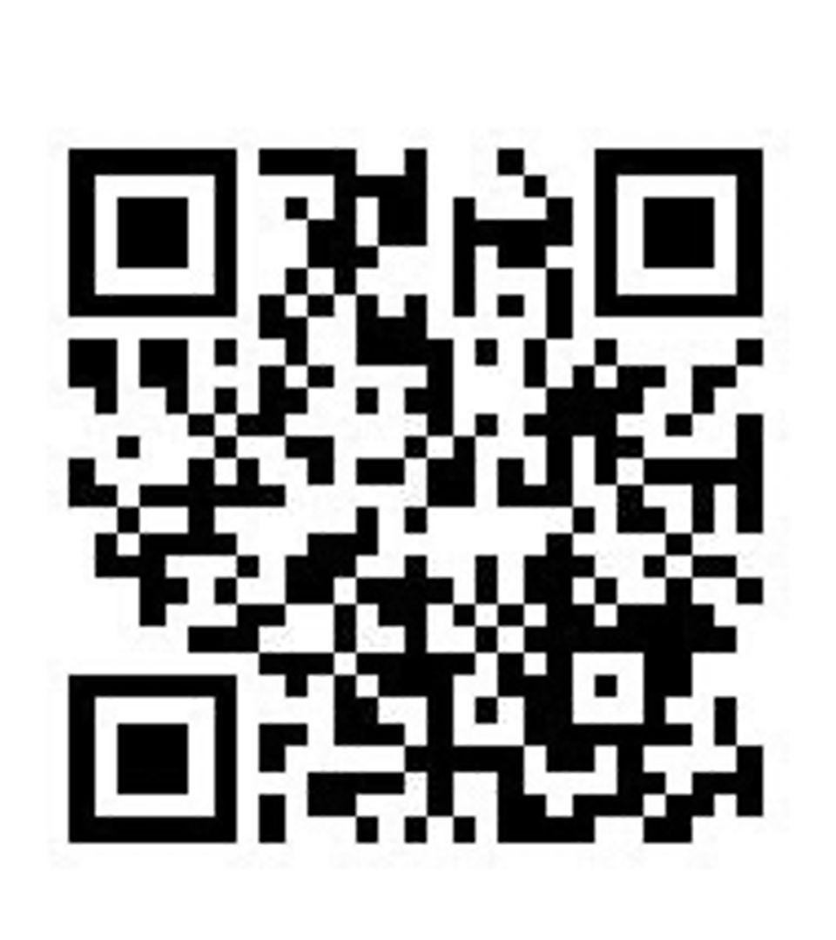
Jejunostomy Video
A video is available to help become familiar with the feeding jejunostomy

Slide 34
Activity after Surgery
Up in chair most of the day
Walking with help from nurse/Physical Therapist
Goals:
  Improve lung function
  Prevent muscle loss

Slide 35
Nasogastric (NG) Tube
Tube passed through nose into stomach
Drains fluid from stomach
Prevents vomiting
Upper GI X-ray on 2nd or 3rd day after surgery
If stomach empties well $→$ NG tube removed
Otherwise, X-ray repeated 2-3 days later

Slide 36
Swallowing Evaluation
Once NG tube has been removed:
Modified barium swallow in radiology
Drink a white chalky liquid (barium)
Look for proper swallowing function
80% of patients $⇒$ liquids started by mouth

Slide 37
Jejunostomy tube
Jejunostomy tube bypasses the stomach and injects tube feeding formula directly in to the small intestine (jejunum)
Pump administers the feedings slowly over hours

Slide 38
Jejunostomy feeding
Start with continuous feeds (24 hours/day)
Convert to nocturnal (night-time): 6pm to 10pm
The feeding bag holds only 4 cartons of feeds - May need to “top off’ bag after a few hours
Water through the tube - Important to prevent dehydration - 250mL (8 oz) 4 times per day

Slide 39
Oral Intake at Home
Most are taking protein shakes when they go home
Protein shakes are started after tolerating water
2 oz per hour to start
4 oz per hour if 2oz are tolerated well

Slide 40
Drains and Tubes
Chest Tube (right side): Removed 4-6 days after surgery (depending upon output) Abdomiaal drains: Removed 4-7 days after surgery Discharge with 1 abdominal drain in 10% of cases Epidural catheter: Removed 4-5 days after surgery Bladder catheter: Removed after epicura catheter removed

Slide 41
Discharge
Goal: ready to leave day #7 after surgery
Night-time tube feedings (6pm to 10am)
Nutrition by mouth (90% of patients)
  Protein shakes or water 4oz every 2 hours
Water through tube 8oz four times per day
Home care nursing (feeding tube teaching)
Home infusion (tube feeding supplies)

Slide 42
Nutrition after Surgery
At discharge home:
Protein shakes 4oz every 2 hrs
Tube feeds 4-5 cans at night (6pm-10am)
10-12 Days: Increase protein shakes
Tube feeds 3-4 cans at night
Three weeks: Post-esophagectomy Diet
8-12 weeks: Remove feeding tube (in office)

Slide 43
Transition from Tube Feeds $→$ Eating
Dietitian will calculate daily protein goal
Typically 60-75 grams protein/day
Each carton of tube feeding has 15 grams
  75 grams protein = 5 cartons/night
More intake by mouth $→$ tube feeds reduced
Spread out protein during the day (20gm/meal)
Three meals + 2-3 high-protein snacks

Slide 44
Post-esophagectomy Diet
Soft Consistency
High Protein
Avoid sugary liquids (can cause ‘dumping’)
Avoid raw vegetables (and salads)
Eating
  Small, frequent meals
  Sit up for 30-45 minutes after eating
  Avoid eating within 2 hours of bedtime

Slide 45
Medicines at Home - Pain
Acetaminophen (Tylenol) 1000mg 4x/day
Gabapentin 300mg 3 times/day
Oxycodone
As needed in addition to Tylenol/gabapentin
Will begin reducing dose at first postop visit
Can usually discontinue by 4 weeks
NO DRIVING WHILE ON OXYCODONE

Slide 46
Non-steroidals Anti Inflammatory (NSAID)
Non-steroidal anti-inflammatories (Celebrex)
200 mg every 12 hours starting at 2 weeks
NO GOODY POWDERS OR BCs
(Can cause permanent scarring at the surgery site)

Slide 47
Acid Blockers = Proton Pump Inhibitors
Examples include ompeprazole and pantoprazole
Will stay on for at 1-2 years to prevent acid reflux
Important in preventing scarring at anastomosis (new connection between esophagus and stomach)
To administer through feeding tube, open capsule and resuspend beads in 60mL (2oz) of water

Slide 48
Medicines at Home
Reglan – Helps stomach empty
Will plan to stop after six weeks
0.1% risk of tardive dyskinesia (nervous tic)
Remeron – Helps improve appetite
Can cause vivid dreams
Used for several weeks after surgery
Will stop within first three months of surgery

Slide 49
Metoprolol = Beta Blockers
Slows heart rate and lowers blood pressure
Used to prevent rapid heart rate
Patients not taking a beta blocker prior to surgery $→$ wean after after surgery
Patients taking a beta blockerprior to surgery $→$ return to prior dose and drug after surgery

Slide 50
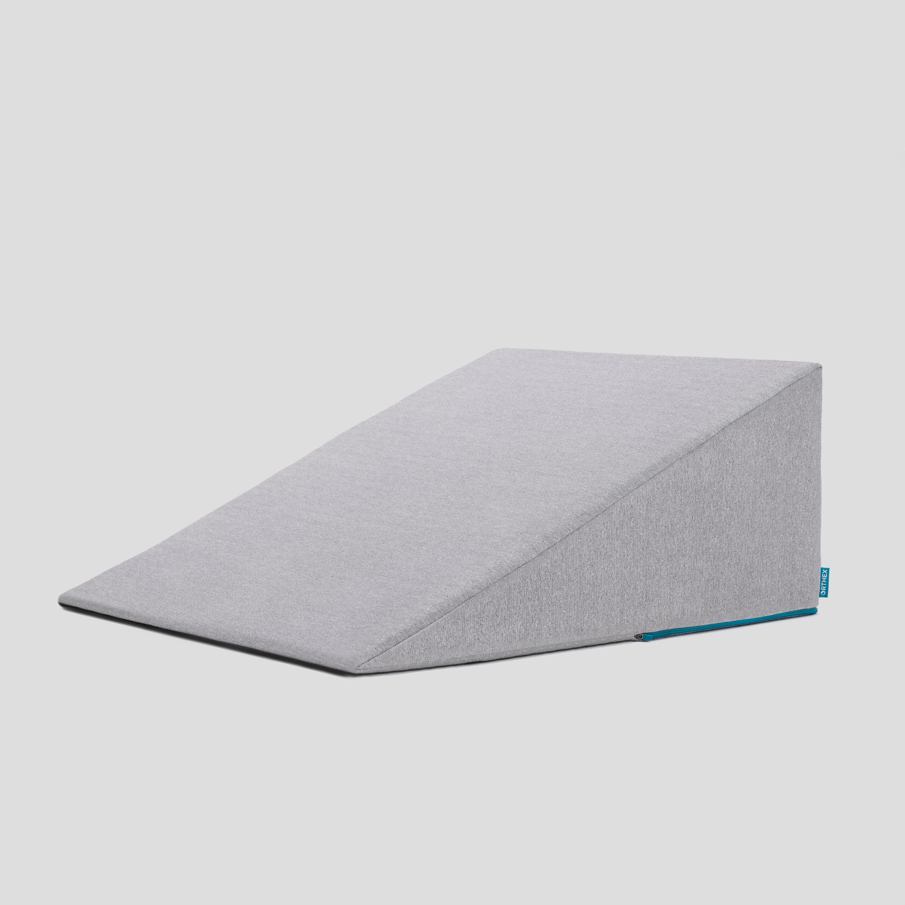
Sleeping at Home
Reflux can occur the first few weeks/months after surgery
This improves over the first few months
A wedge pillow can be helpful for sleep

Slide 51
Follow Up Clinic Visit 7-10 days after Discharge
In-person clinic visit with Dr Salo or Kate Duncan
Check surgical site
Remove staples (if needed)
Remove abdominal drains (if needed)
Meet with dietitian:
Reduce tube feeds
Advance diet by mouth

Slide 52
Adjust Medicines after Surgery
Reglan: Discontinue 6 weeks after surgery Remeron: Discontinue 12 weeks after surgery Pain Medicines:
Wean oxycodone within 6 weeks of surgery
Discontinue gabapentin and acetaminophen (Tylenol) within 8 weeks
Continue acid blockers (PPI) for at least 1 year
Reduce metoprolol to once/day for 7 dayus $→$ discontinue

Slide 53
Second Follow Up Visit
4-5 weeks after first post-operative visit
Discuss diet
Discuss medicines
Plan for jejunostomy removal
Evaluate readiness for chemotherapy after surgery (usually 6 weeks)

Slide 54
Eating after Surgery
First Postoperative Visit: Start soft foods (Phase I diet)
Weekly virtual visits with dietitian
Jejunostomy removal generally at 8 weeks after surgery

Slide 55
Jejunostomy Removal
Jejunostomy tube is removed in the office once you can take in enough nutrients by mouth
Removal usually around 8 weeks after surgery (may be longer if chemotherapy planned after surgery)
May take 30 minutes and some local anesthetic to loosen up the tube for removal.

Slide 56
Nutritional Monitoring after Surgery
You may have difficulty absorbing some nutrients:
Iron
Vitamin B12
Vitamin D

Slide 57
Nutritional Monitoring after Surgery
About 3 months after the jejunostomy tube is removed, we will check blood levels:
Iron (ferritin)
Vitamin B12
Vitamin D

Slide 58
Nutritional Replacements after Surgery
Vitamin or iron replacements can be ordered by:
Primary Care Provider (PCP)
Medical Oncologist
Surgeon
If levels are low
Replacement
Repeat testing in 3-6 months

Slide 59
Team Members - Physicians
Primary Care Provider
Gastroenterologist
Medical Oncologist (chemotherapy)
Radiation Oncologist (radiation)
Surgeons
Jonathan Salo MD
Kelli Salter MD
Michael Roach MD

Slide 60
Team Members - Support Staff
Physician Assistant - Kate Duncan PA-C
Dietitian - Liz Koch
Nurses
Matthew Carpenter RN
Brandon Galloway LPN
Navigators: Laura Swift RN & Lorna Espinal RN
Care Coordinator - Karen Julian-Martinez

