Slide 1
Surgery of the Esophagus

Slide 2
Surgery for Esophageal Cancer
Surgery for esophageal cancer is generally performed in several situations:
Superficial Tumors (T1) that can’t be completely removed by endoscopy
Localized Tumors (T2N0)
Locally Advanced Tumors (T3 or N+) after preoperative therapy.

Slide 3
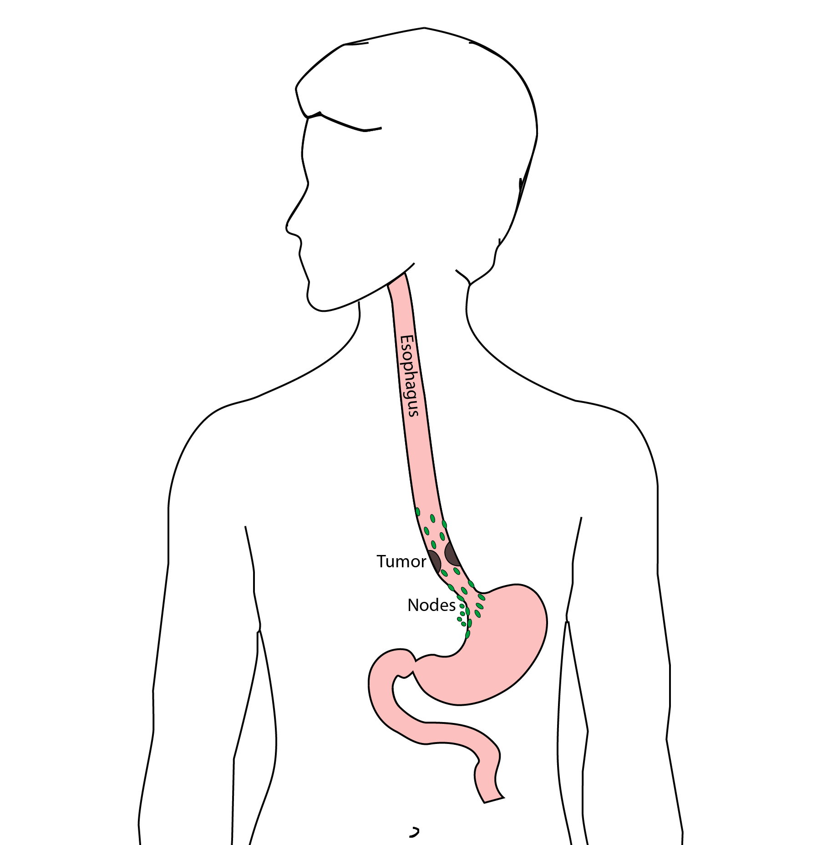
Goals of Surgery
Remove tumor from esophagus
Remove surrounding lymph nodes
Create a new esophagus

Slide 4
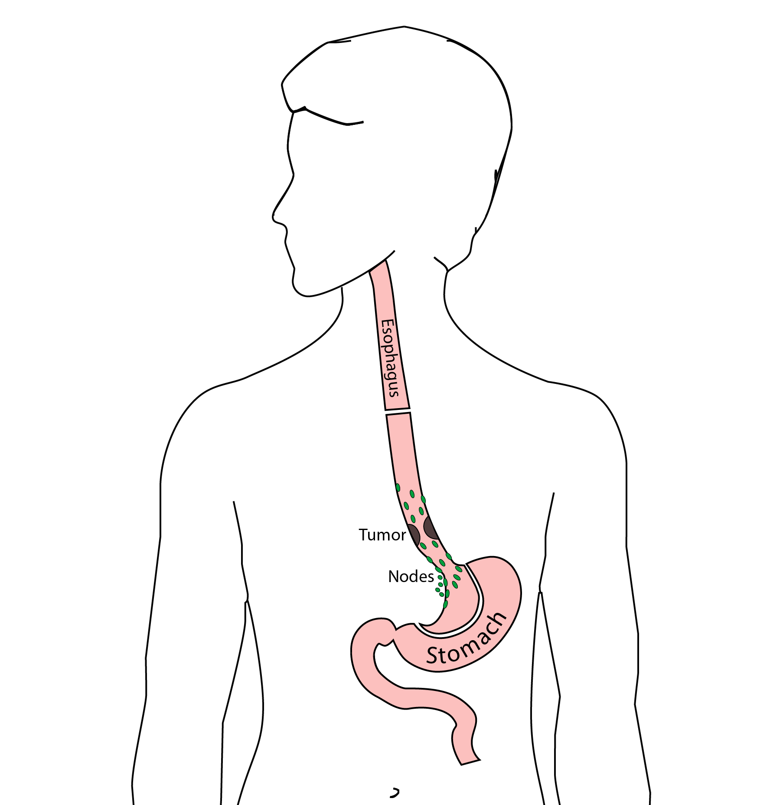
Resection
The Ivor Lewis esophagectomy, shown here, removes the lower 2/3 of the esophagus, the tumor, and the surrounding lymph nodes.

Slide 5
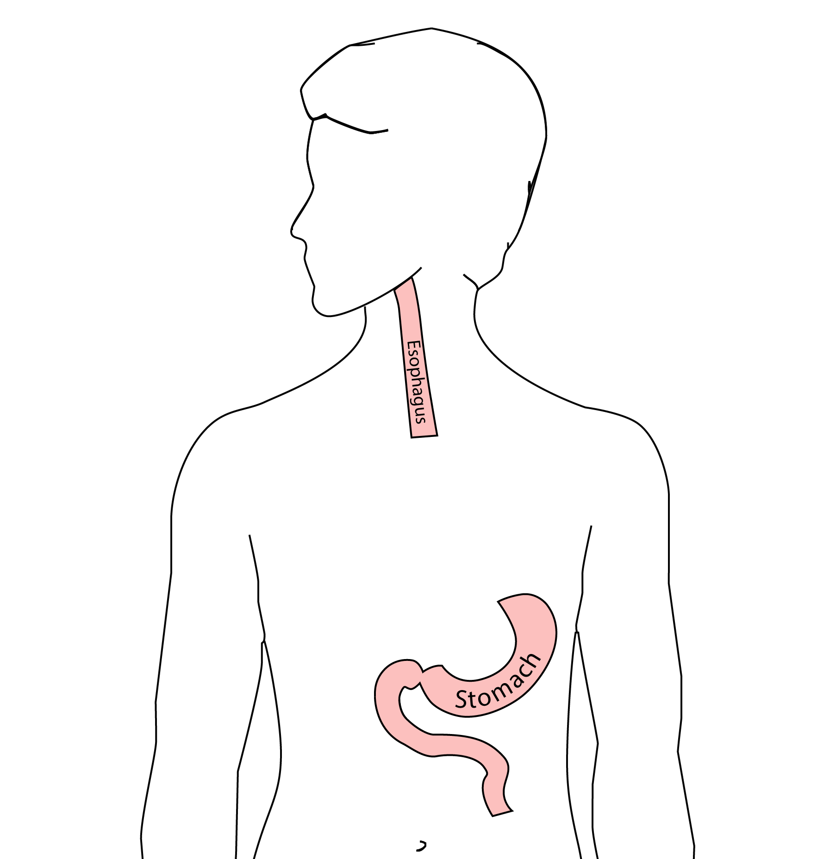
Reconstruction
A new esophagus is created from the stomach in the abdomen by fashioning it into a tube.

Slide 6
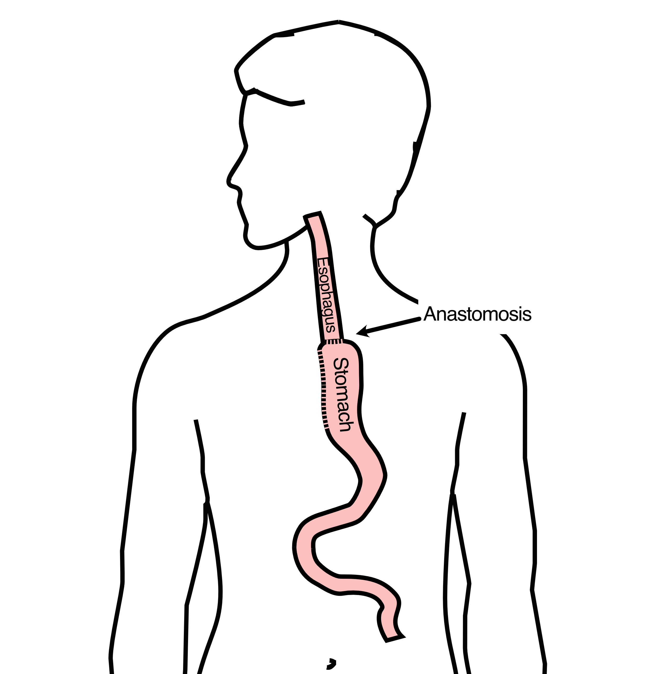
Ivor Lewis esophagectomy
The new esophagus is now brought up into the chest. A new connection is made between the esophagus and the stomach, called an anastomosis.

Slide 7
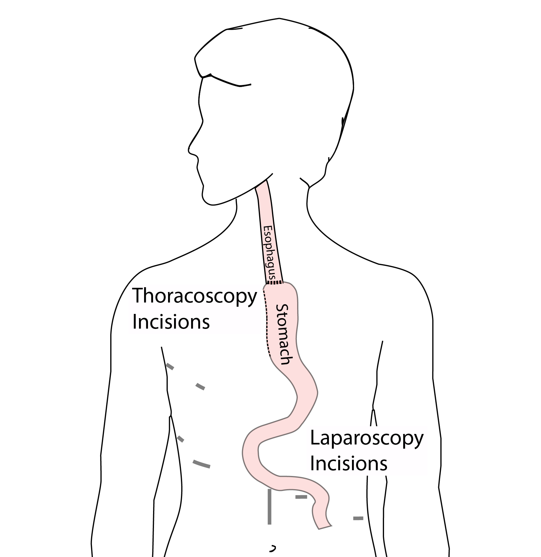
Minimally-invasive Ivor Lewis
Small incisions in the abdomen and chest
Surgical telescope and instruments inserged
The smaller incisions mean faster recovery and less discomfort

Slide 8
Minimally-invasive Ivor Lewis
We have found this is the best option for most of our patients. In some cases, an open approach is still necessary.

Slide 9
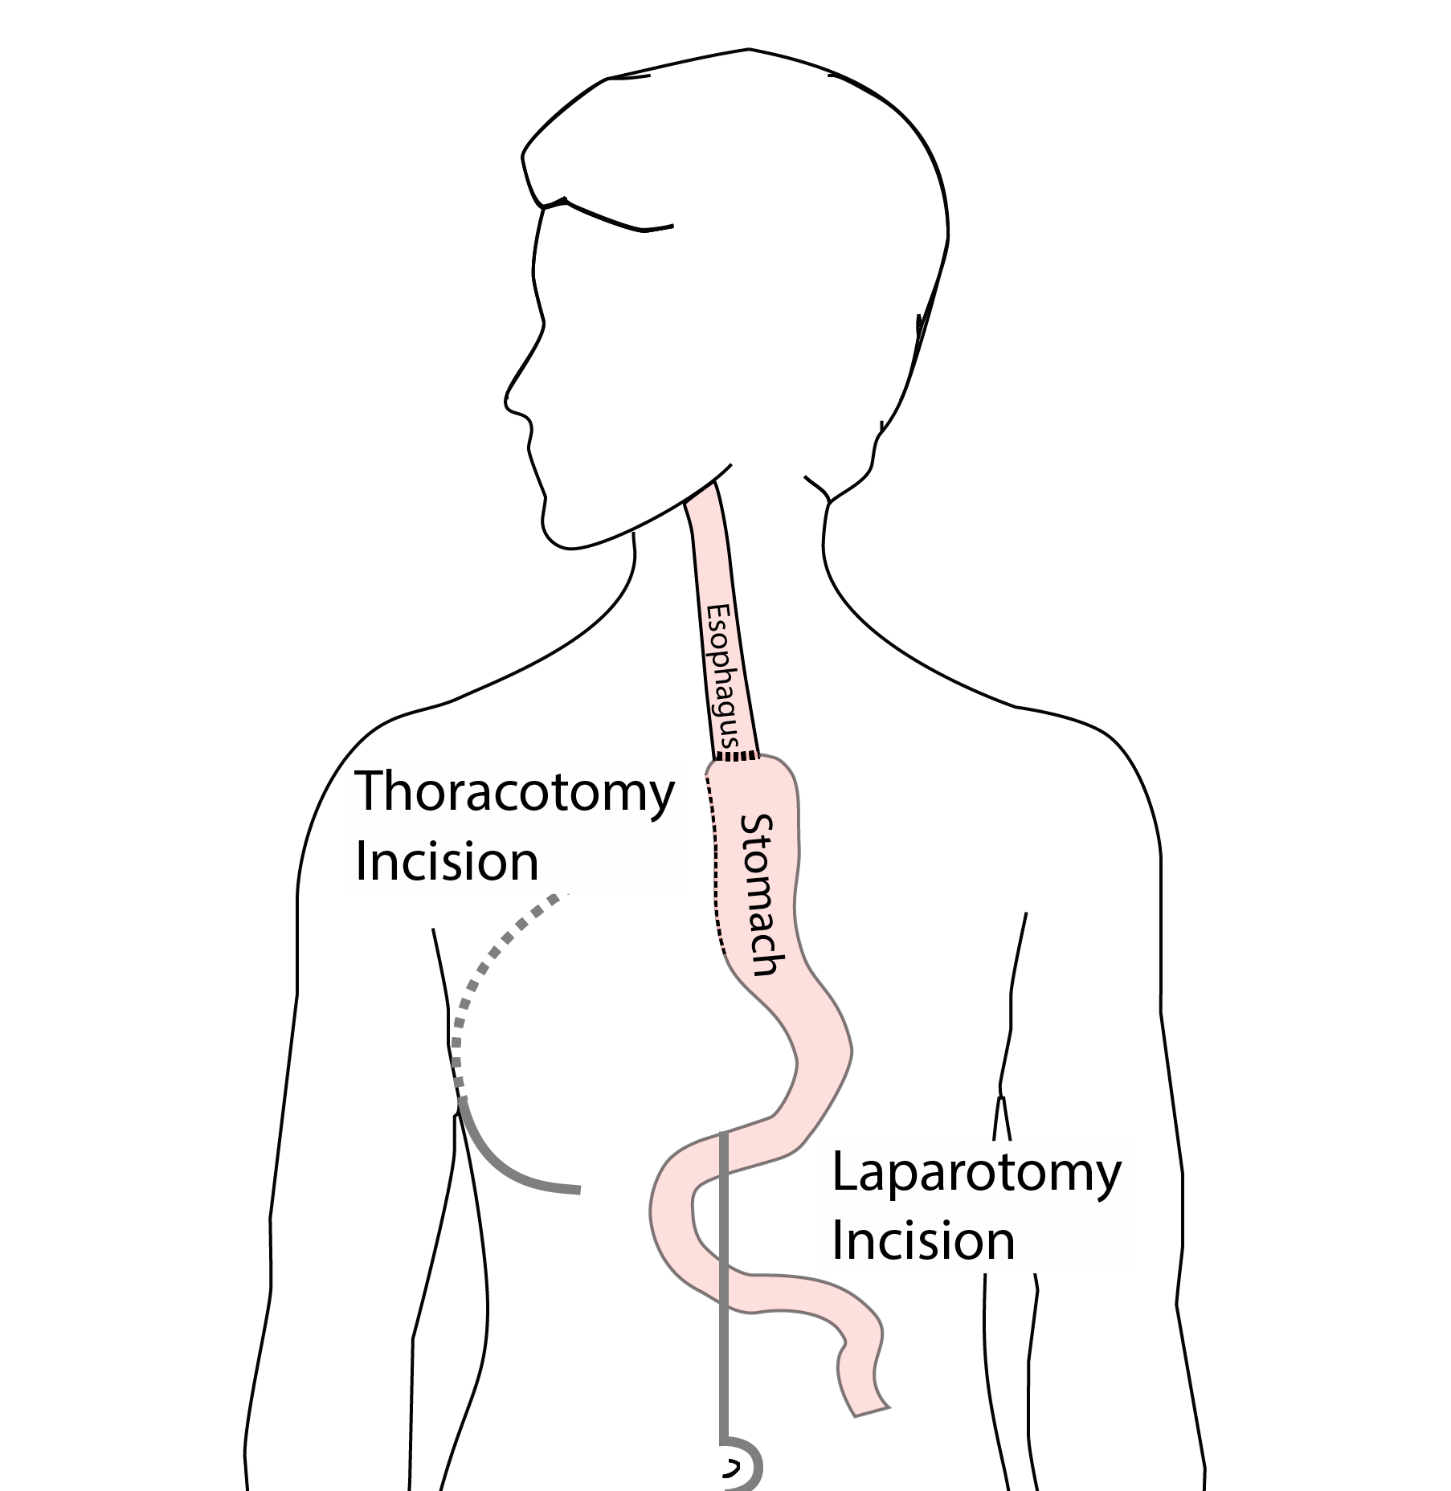
Open Ivor Lewis
In some cases, an open approach is still necessary.

Slide 10
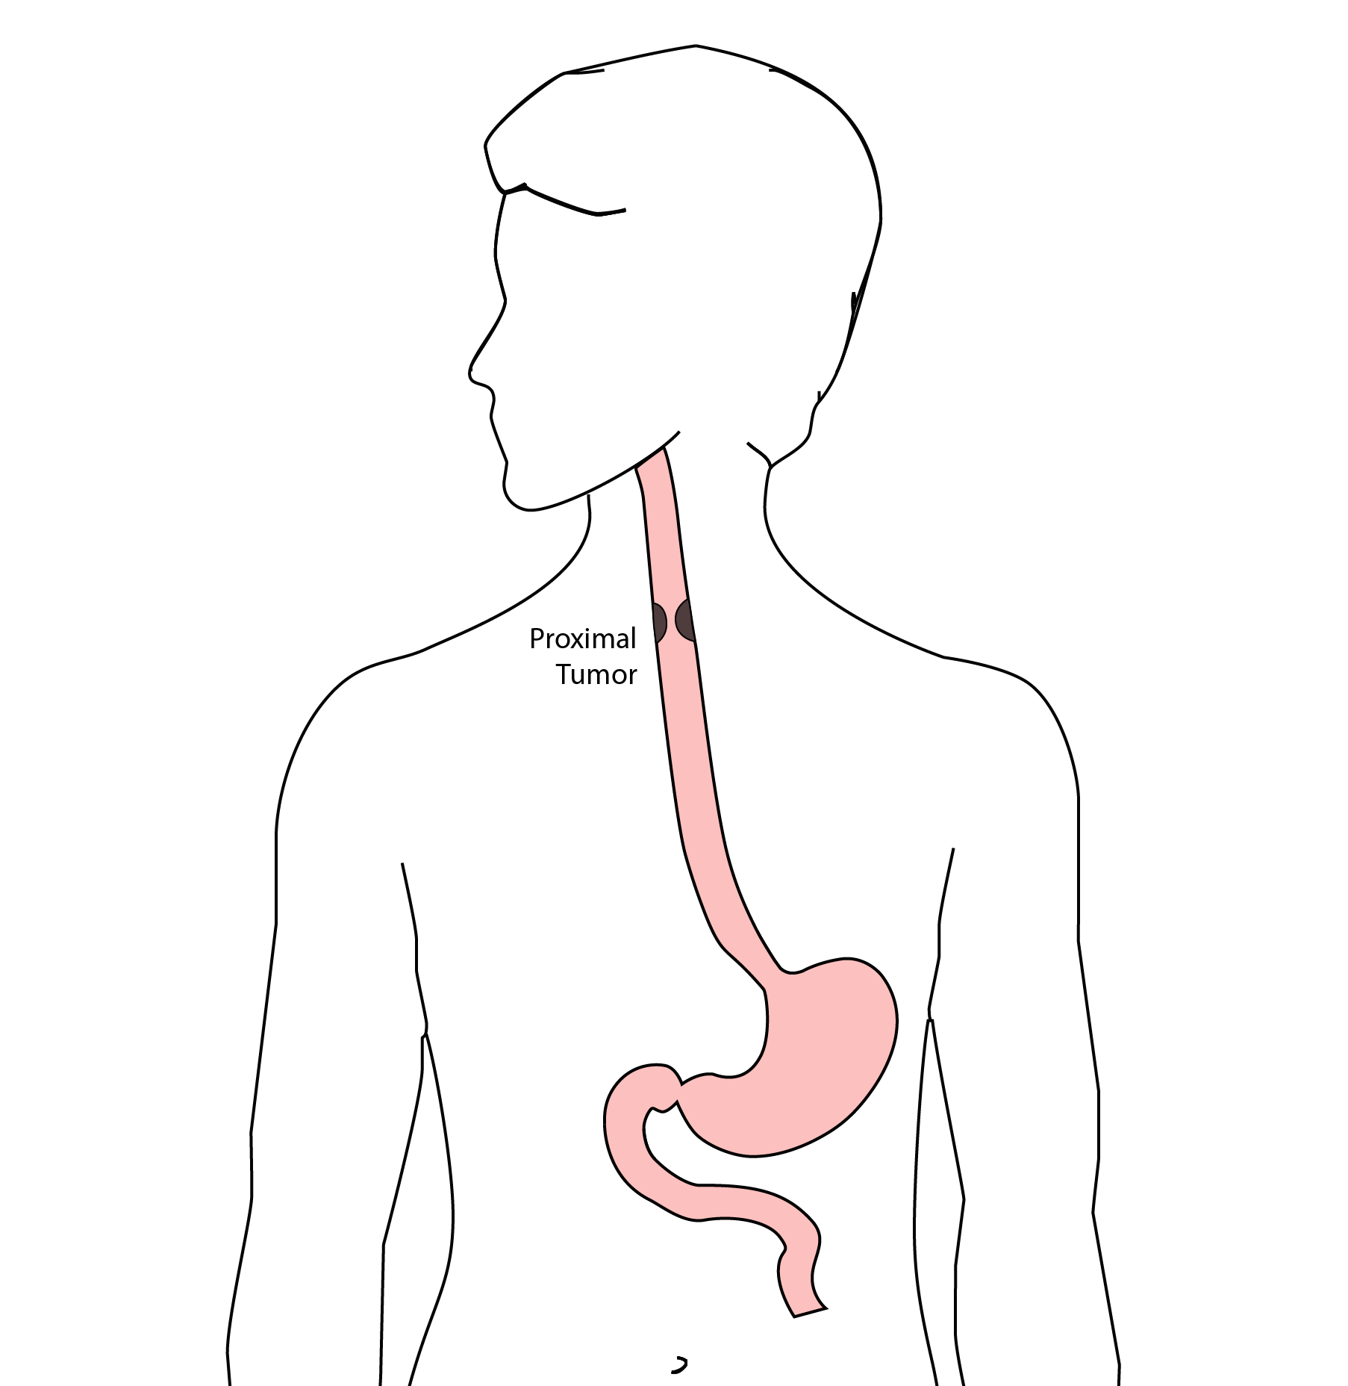
Total Esophagectomy
For patients with tumors in the upper esophagus, we need to remove more of the esophagus

Slide 11
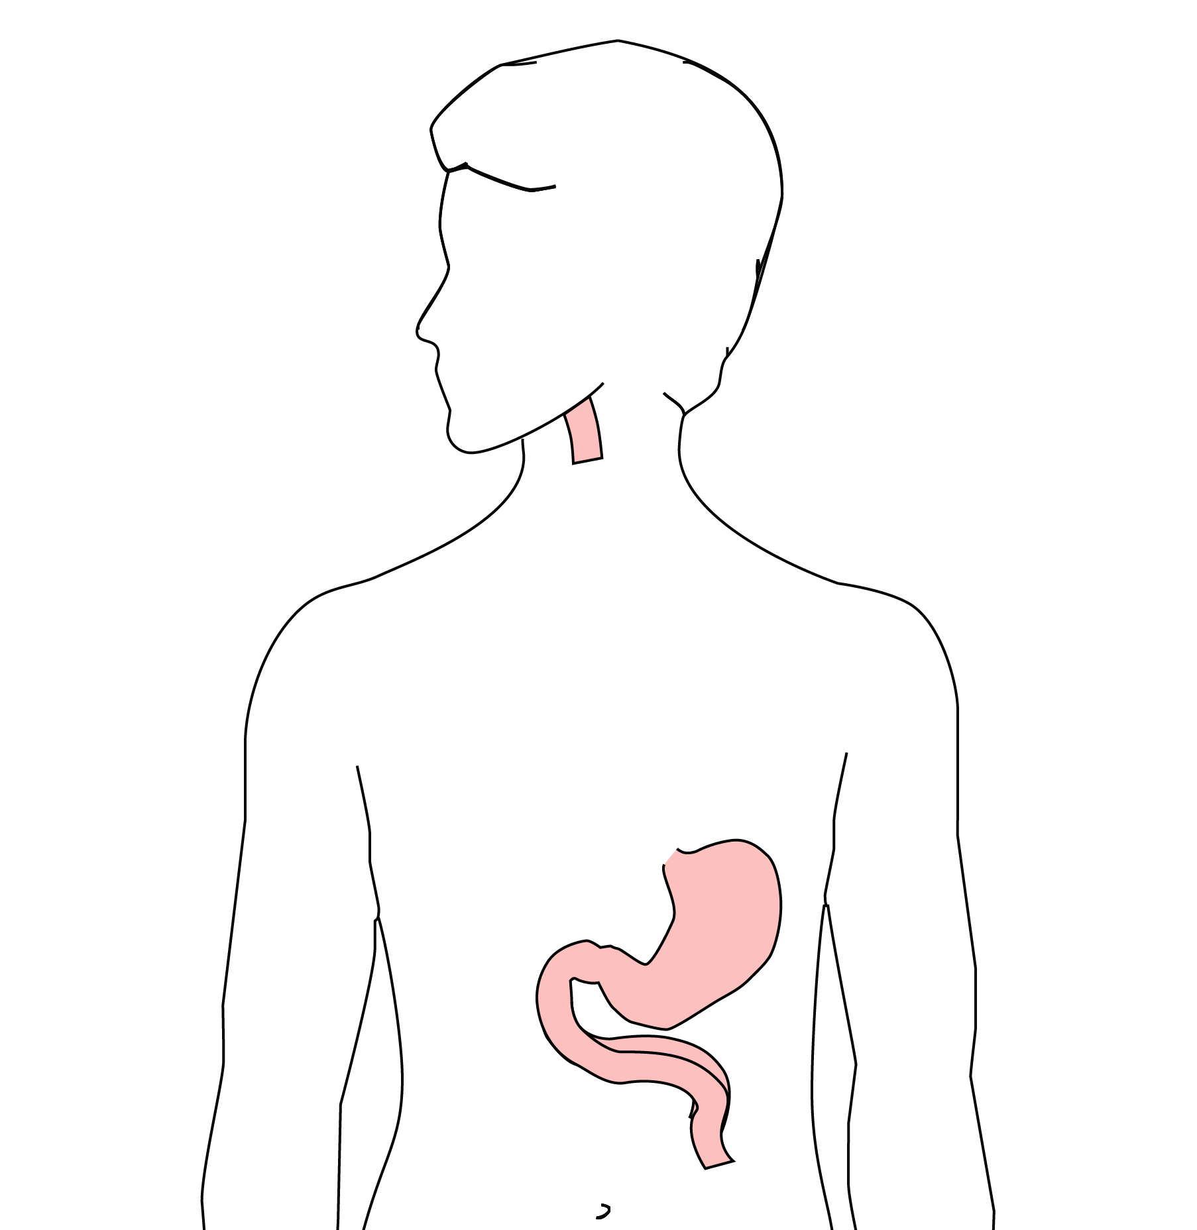
Total Esophagectomy
For those patients, we need to remove the whole esophagus

Slide 12
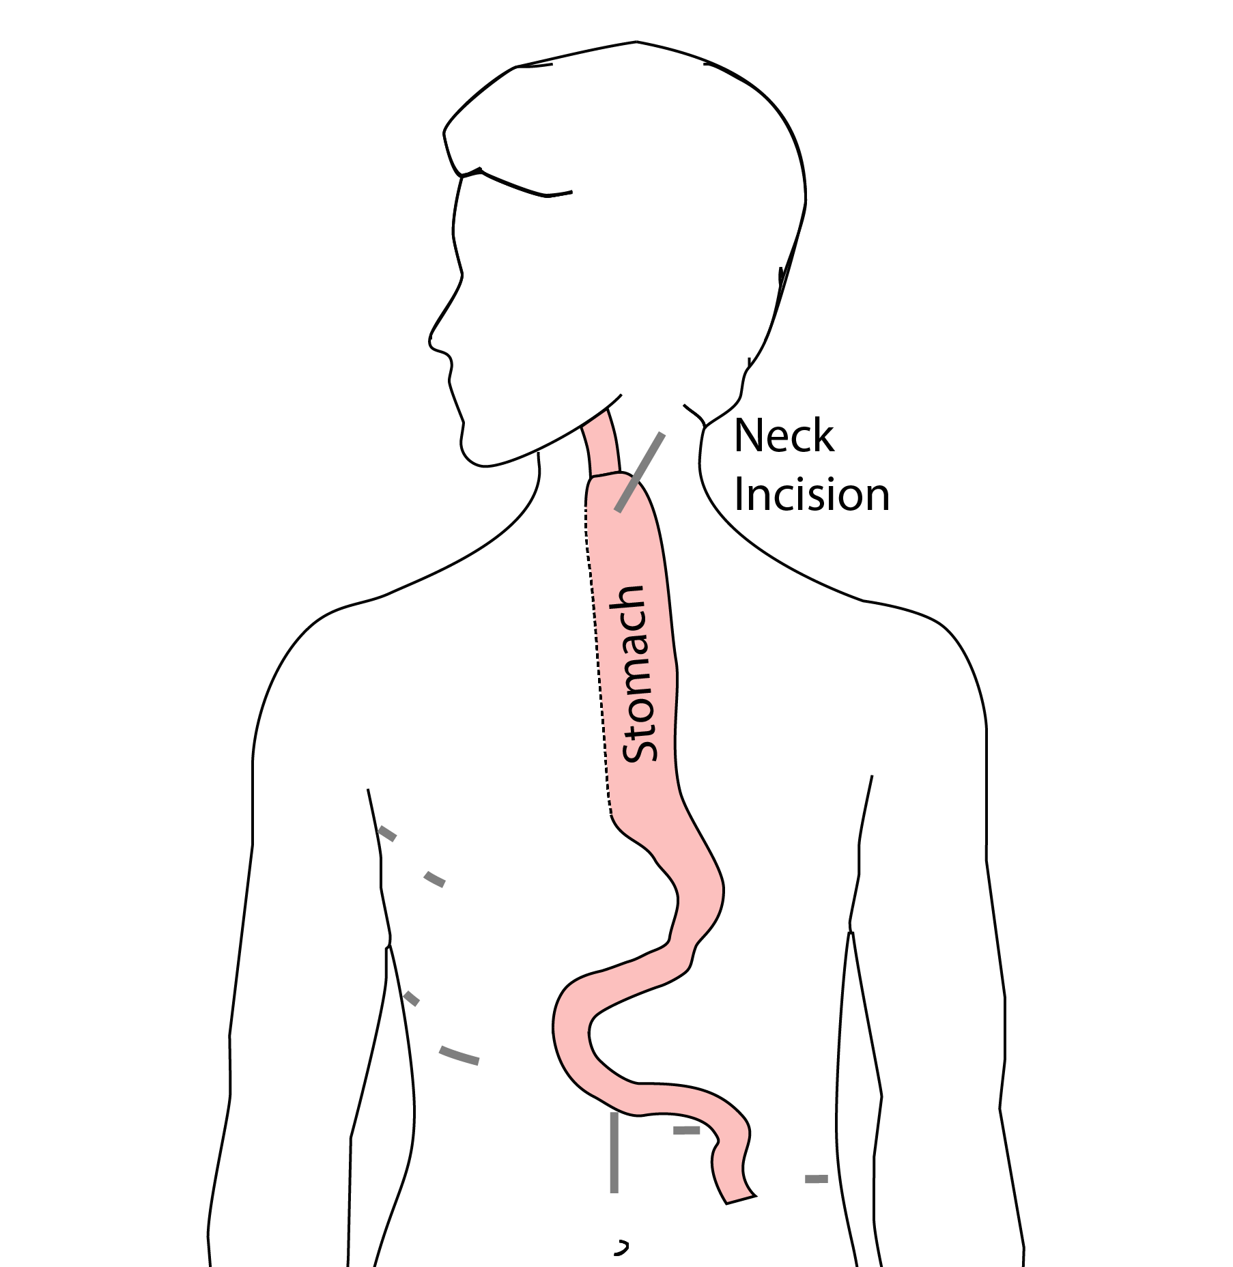
Minimally-invasive McKeown Esophagectomy
In this case, a connection between the esophagus and the stomach is made in the neck.

Slide 13
Risks of Surgery
An esophagectomy is a substantial operation, and in some cases there can be postoperative complications. We’re going to talk about two of these complications and what you can do to reduce your risk of complications:
Anastomotic leak
Pneumonia

Slide 14
Anastomotic Leak
The anastomosis is surgical connection between the esophagus and the stomach.

Slide 15
Anastomotic Leak
If anastomosis does not heal properly, this can cause a leakage of fluid from the esophagus, called an anastomotic leak. If this happens, an infection can occur in the mediastinum, which is the space near the heart between the lungs.
https://deidt7p41jzcy.cloudfront.net/Eso_IvorLewis_Leak.png

Slide 16
Anastomotic Leak
In some cases, the leak will heal on its own, but other cases may require additional procedures or even surgery. The risk of leak depends upon the operation performed but also depends upon the experience of the surgeon. At the end of this video we have a link to a video about how to choose a hospital and a surgeon, which talks further about the risks of a leak.

Slide 17
Pneumonia
Pneumonia is another complication which can occurs in about 10-15% of patients after esophagectomy. Pneumonia requires treatment with antibiotics and frequently requires a longer hospitalization.

Slide 18
Preventing Pneumonia
In normal circumstances, secretions from the mouth and throat aren’t able to enter the lungs because we clear our throat and if secretions do get into our airway, we tend to cough and keep those secretions out of our lungs. This happens constantly without our thinking about it.
After esophagectomy, however, there is a tendency for secretions to enter the airway, and if you can’t clear them, there is a risk that pneumonia will set in.
There are two important ways that pneumonia can be prevented:
Deep breathing
Walking

Slide 19
Deep breathing and coughing
After surgery, it’s important to breathe deeply to help your lungs recover after surgery. Deep breathing make the cough more effective and helps clear secretions. After surgery, deep breathing and coughing can be uncomfortable, so controlling your discomfort will be an important part of your recovery.

Slide 20
Walking
Walking after surgery is also an important way to help your lungs recover as well. When we walk, it’s easier for our lungs to function, and again, it makes the cough more frequently.

Slide 21
Preventing Pneumonia
How can we prevent pneumonia? Believe it or not, we can tell who is more likely to develop pneumonia after surgery simply by measuring their grip strength.
We think this is because someone with a strong grip has good muscle function of the muscles between the ribs so that they have a nice strong cough and can prevent pneumonia.

Slide 22
Strength
In our clinic, we actually measure out patient’s strength with a hand-held strength gauge called a dynamometer. Based upon these measurements, we can identify patients who may be at risk of pneumonia.

Slide 23
Patient Strength and Esophagectomy Outcomes
About half of our patients have good strength, shown in green. A quarter are have low strength, shown in red Another quarter are in the middle, shown in yellow

Slide 24
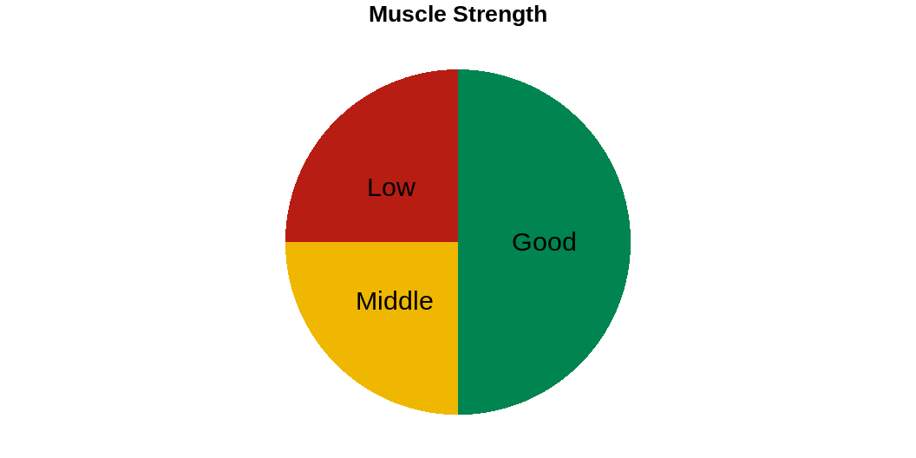

Slide 25
Pneumonia
Overall, the risk of pneumonia is about 10% in our patients who undergo esophagectomy. 90% of patients never experience pneumonia, but 10% will have pneumonia after surgery.

Slide 26
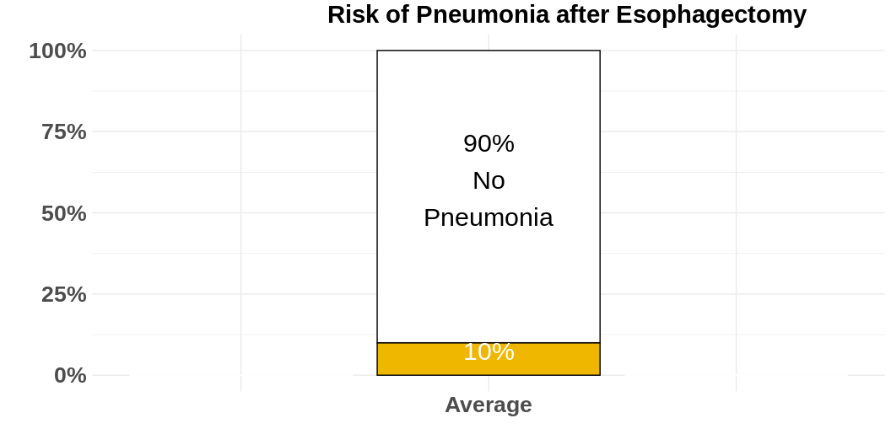

Slide 27
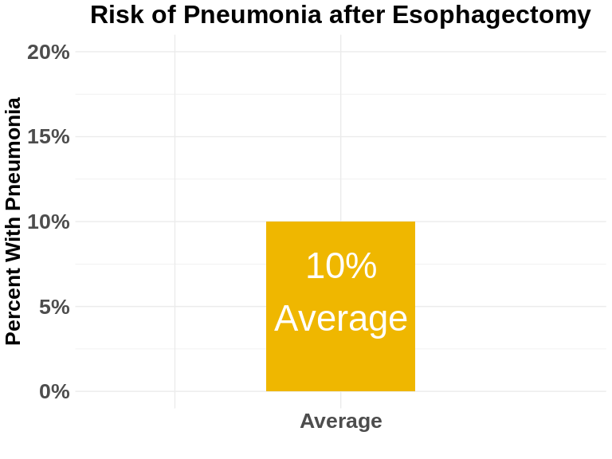

Slide 28
However the risk of pneumonia is not the same for everyone. Even though the average risk is 10%, the risk is much higher for our patients with low muscle strength and much lower for patients with good muscle strength.
For the half of our patients with good muscle strength, the risk of pneumonia is about 5%. On the other hand, the risk of pneumonia is 20% in the quarter of our patients who have low muscle strength.

Slide 29
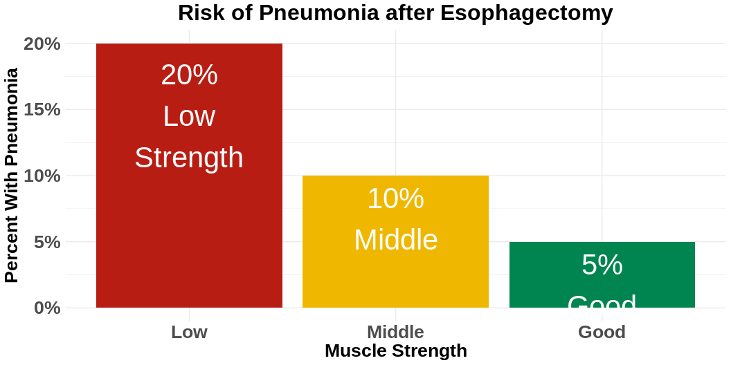

Slide 30

Muscle Strength and Risk after Esophagectomy
The results of our research suggest a simple answer: The risk of pneumonia is related to a patient’s muscle strength.

Slide 31

Now this doesn’t mean that you need to look like this to prevent pneumonia after your esophagectomy]

Slide 32
The good news is that you can increase your muscle strength before surgery in two very simple ways:
Good nutrition with adequate intake of protein
Exercise

Slide 33
Good News
with proper nutrition and exercise, you can increase your muscle strength, and we have good reason to believe this will reduce your risk of complications after esophagectomy.

Slide 34
Minimally-invasive Esophagectomy
https://deidt7p41jzcy.cloudfront.net/mie_abd.png
https://deidt7p41jzcy.cloudfront.net/mie_chest.png

Slide 35
Risks of Surgery
Risks related to anesthesia
Heart attack (5%)
Irregular heart rhythm (15%)
Pneumonia (10%)
Blood clots in legs (<5%)
Pulmonary embolism (2%)

Slide 36
Risks of Surgery
Risks related to Surgery
Anastomotic leak (5%)
Stricture at anastomosis (15%)
Death within 90 days of surgyer
Low risk patients 2%
Intermediate risk 10%
High risk 30%

Slide 37
Risks of Surgery
 | Age <75 | Age >75
Normal Muscle (75%) | 2% | 10%
Low Muscle (25%) | 10% | 30%
Risks of Death within 90 Days of Surgery

Slide 38
Day Prior to Surgery
Clear liquids for 24 hours prior to surgery
Check with Pre-op nurse regarding medicines day prior to surgery
No tube feedings the night before surgery

Slide 39
Day of Surgery
Arrive at 5am – nothing to eat or drink after midnight.
OK to take medicines with a sip of water (or coffee) but no cream. Surgery may be cancelled if you take even a sip of cream or milk the morning of surgery.
Waiting room on 5th floor
Post-operative care in STICU (11th floor)

Slide 40
Anesthesia
Epidural catheter for pain control
Remains in place for 2-5 days
Dose can be adjusted as needed
Can make it more difficult to empty the bladder
May require foley (bladder) catheter to stay in place until epidural

Slide 41
Intensive Care Unit (1-2 days)
Multiple lines and tubes:
NG tube in nose (stays in 2-7 days)
Catheter in bladder (2-5 days)
Chest tube right chest (2-4 days)
Abdominal drains (2 or 3)

Slide 42
ICU
Catheter in bladder removed → check to make certain the bladder empties properly
Chest tube removed (day 2-4) → follow-up chest x-ray
Fluid emptied from drains every few hours
Start tube feedings by feeding
Feeding jejunostomy (stays in 8 weeks()

