Slide 1
Surgery of the Esophagus

Slide 2
Surgery for Esophageal Cancer
Surgery for esophageal cancer is performed for:
Superficial Tumors (T1) not removed by endoscopy
Localized Tumors (T2 N0 M0)
Locally Advanced (T3 M0) after preop therapy

Slide 3
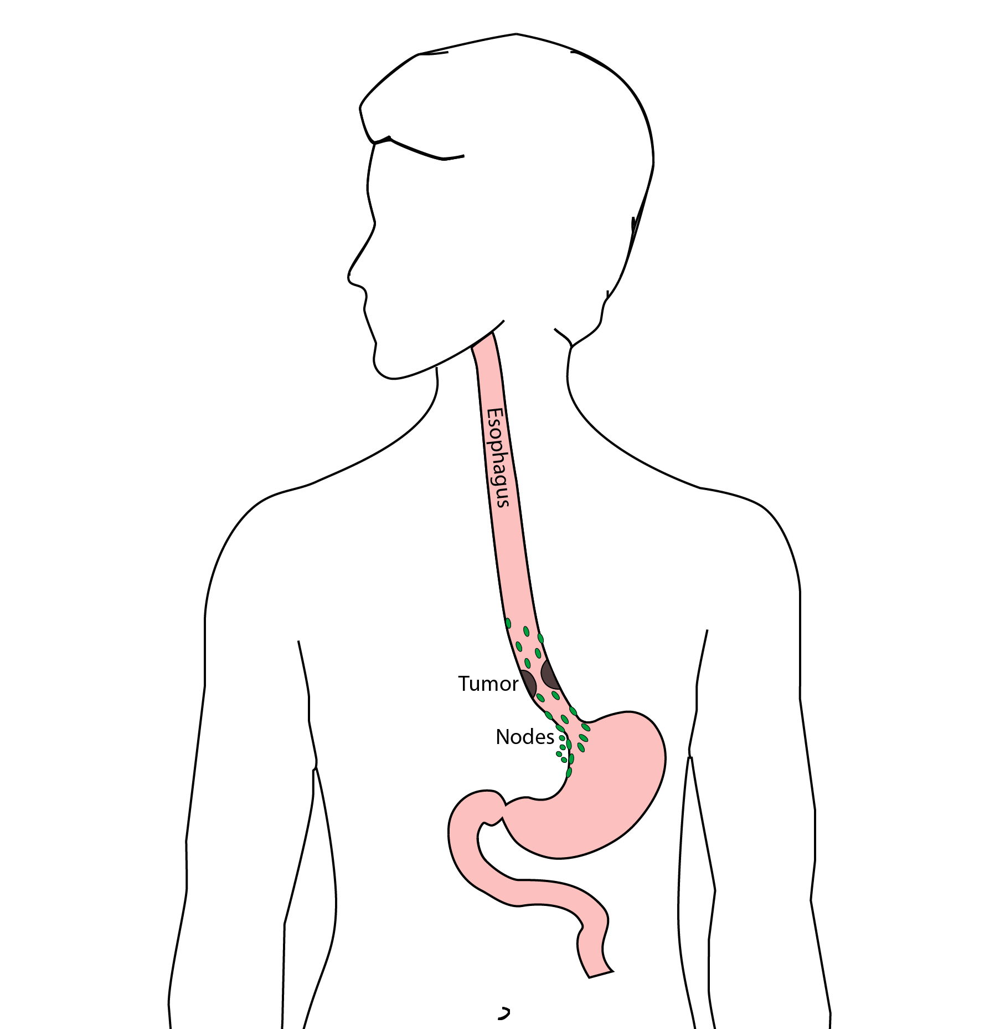
Goals of Surgery
Remove tumor from esophagus
Remove surrounding lymph nodes
Create a new esophagus

Slide 4
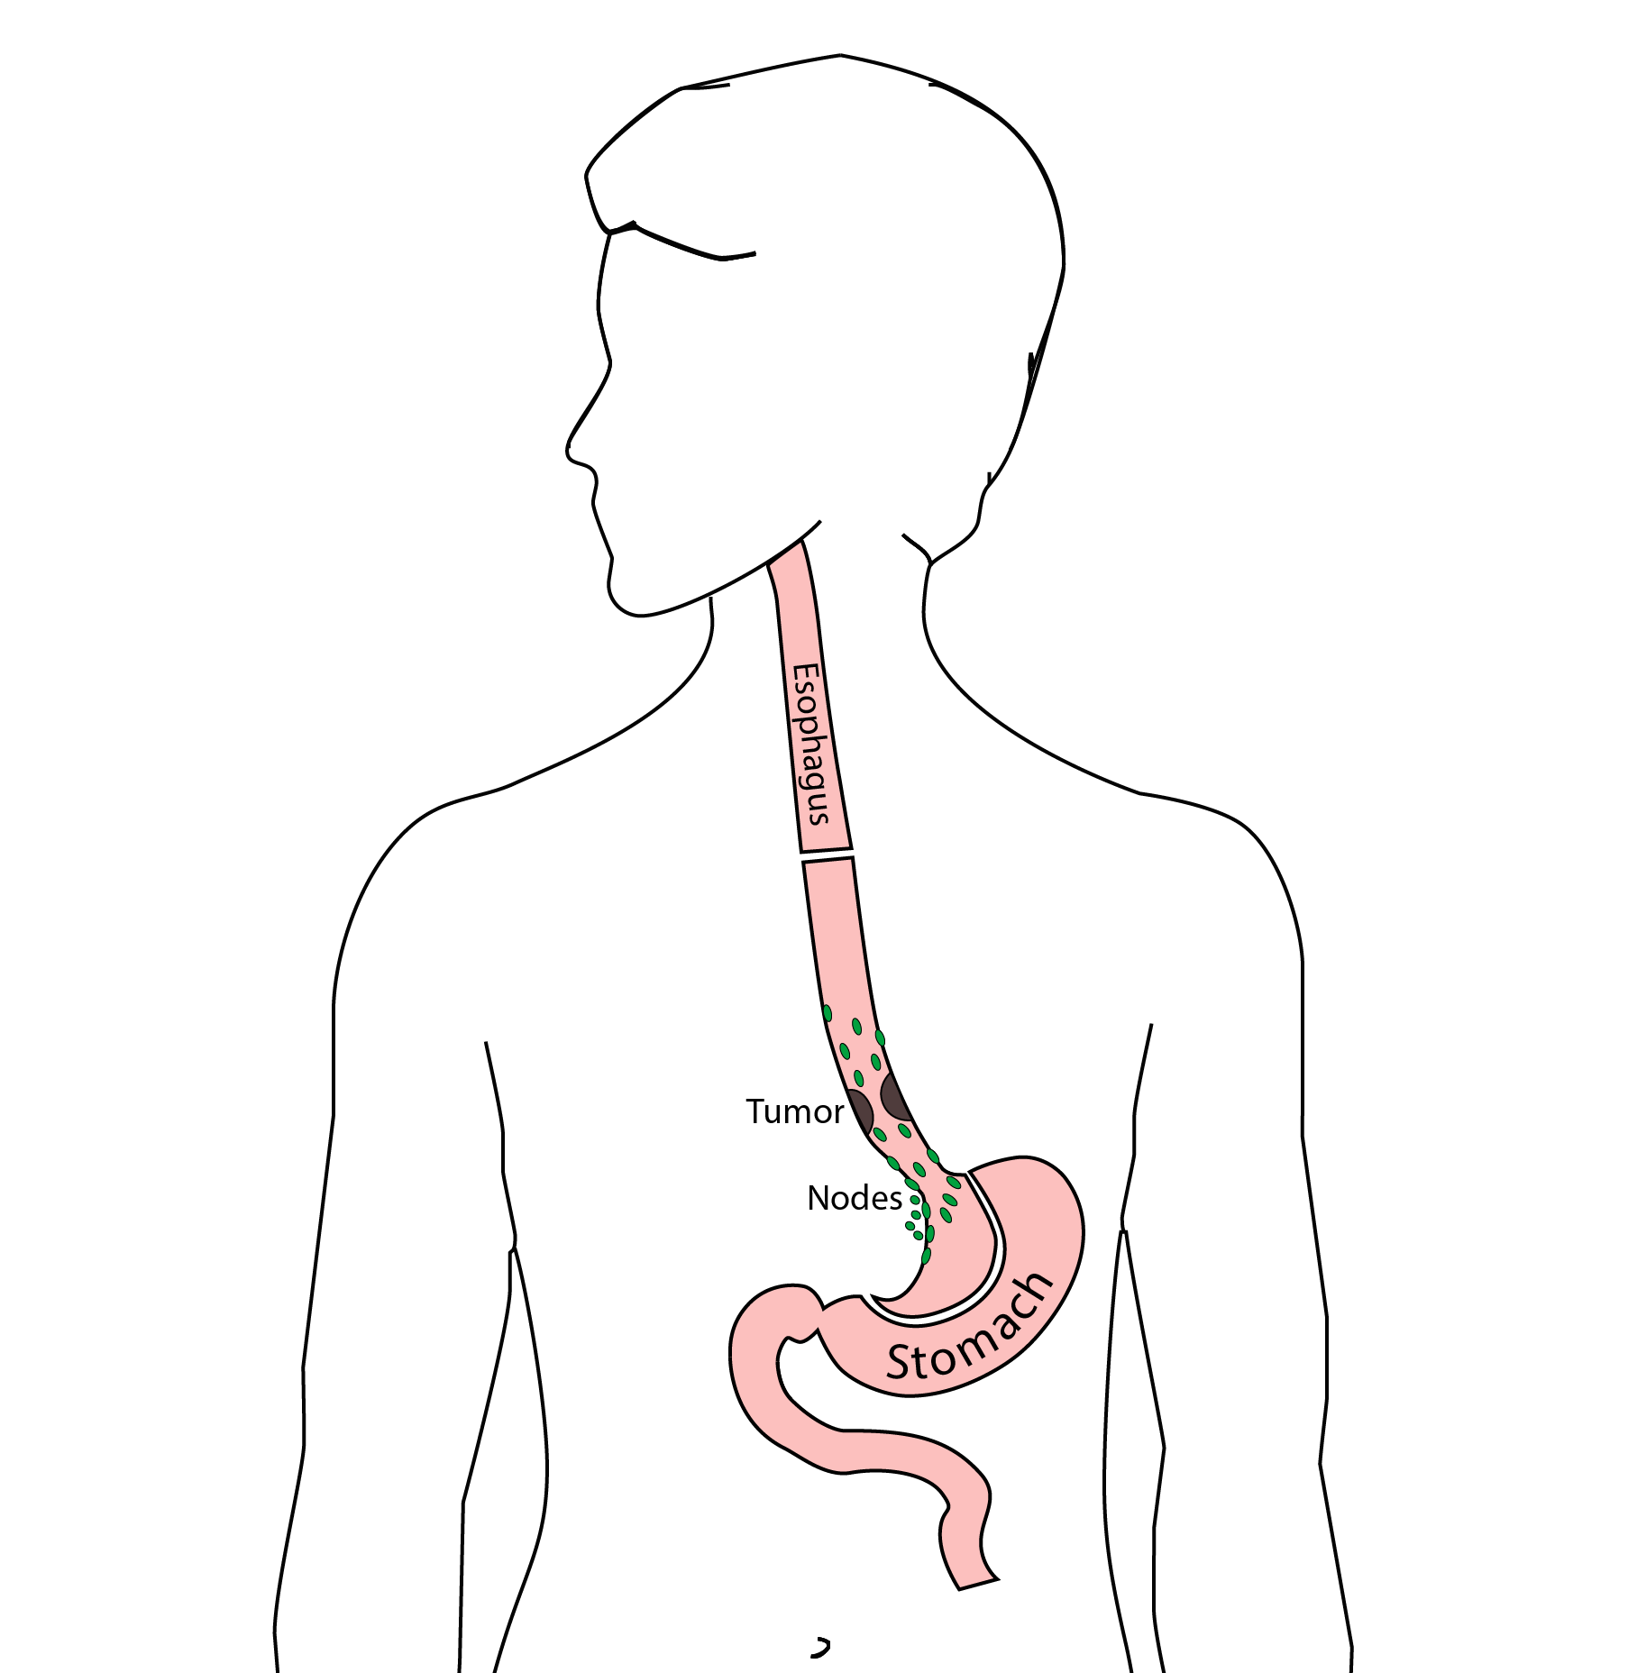
Ivor Lewis (Transthoracic) Esophagectomy
Removes tumor and lower 1/3 esophagus
Removes surrounding lymph nodes
GI tract reconstructed

Slide 5
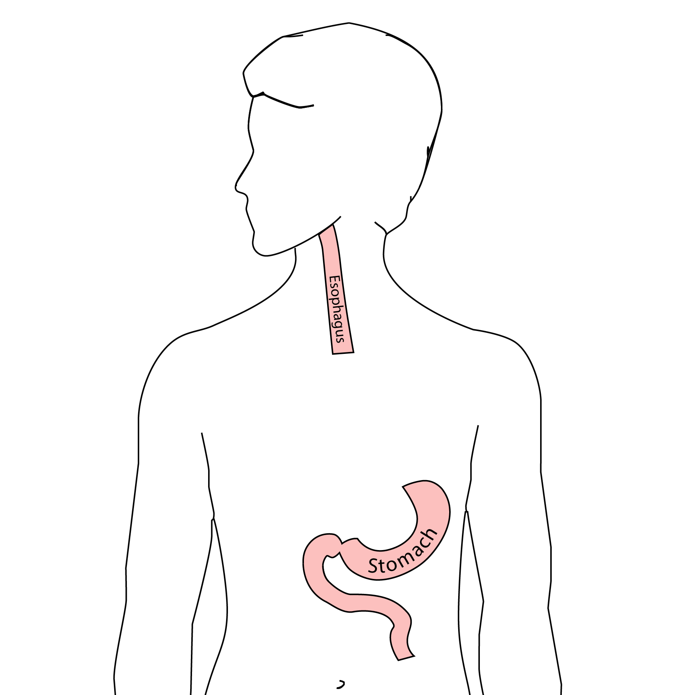
Reconstruction
New esophagus is created from the stomach in the abdomen by fashioning it into a tube.

Slide 6
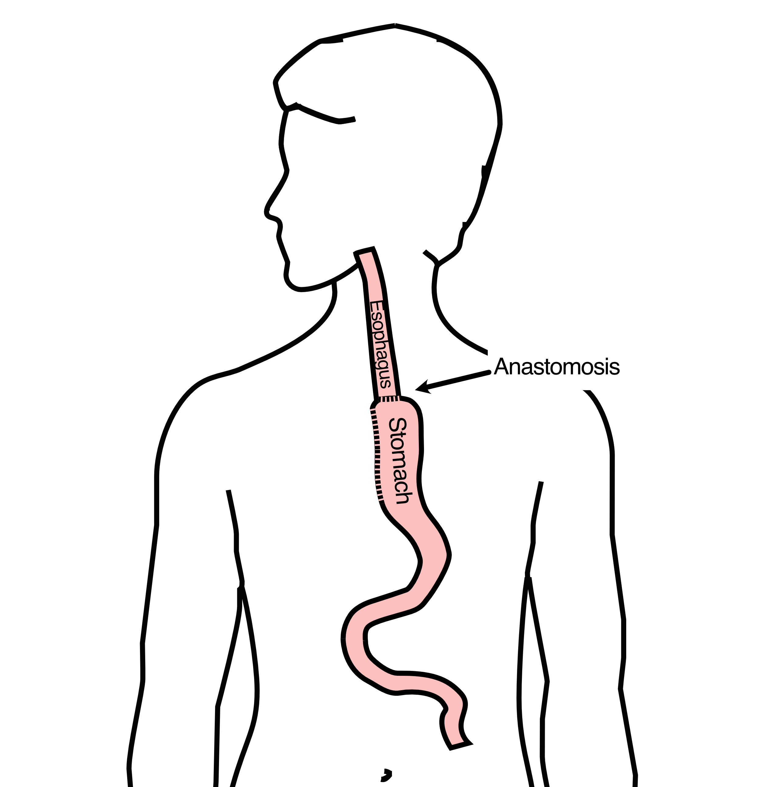
Ivor Lewis esophagectomy
The new esophagus is now brought up into the chest. A connection is made between the esophagus and the stomach, called an anastomosis.

Slide 7
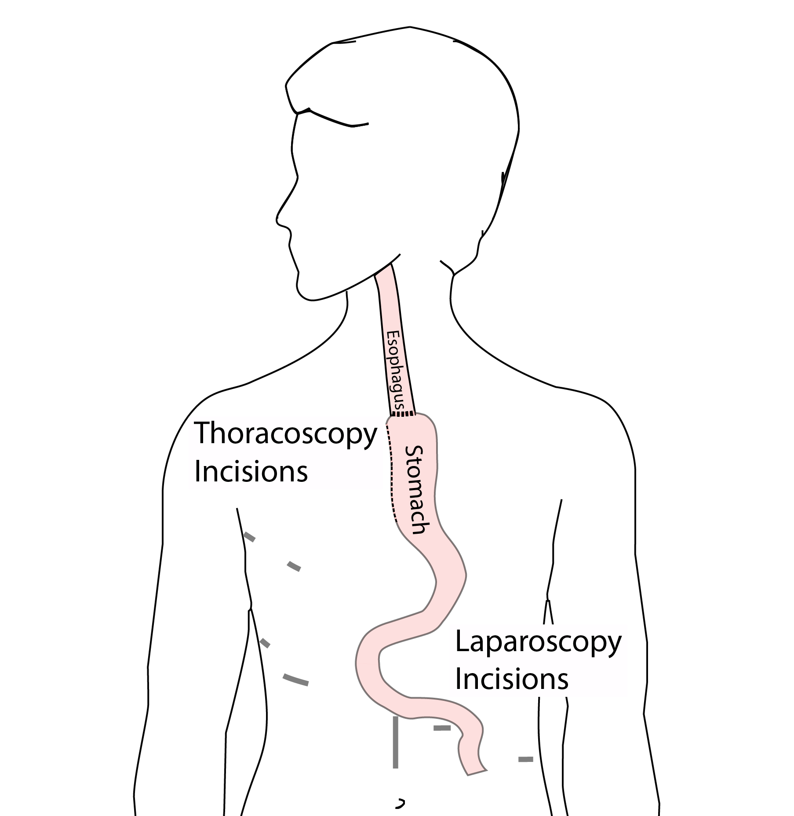
Minimally-invasive Ivor Lewis
Small incisions abdomen and chest
Surgical telescope and instruments
Smaller incisions $→$ faster recovery and less discomfort

Slide 8
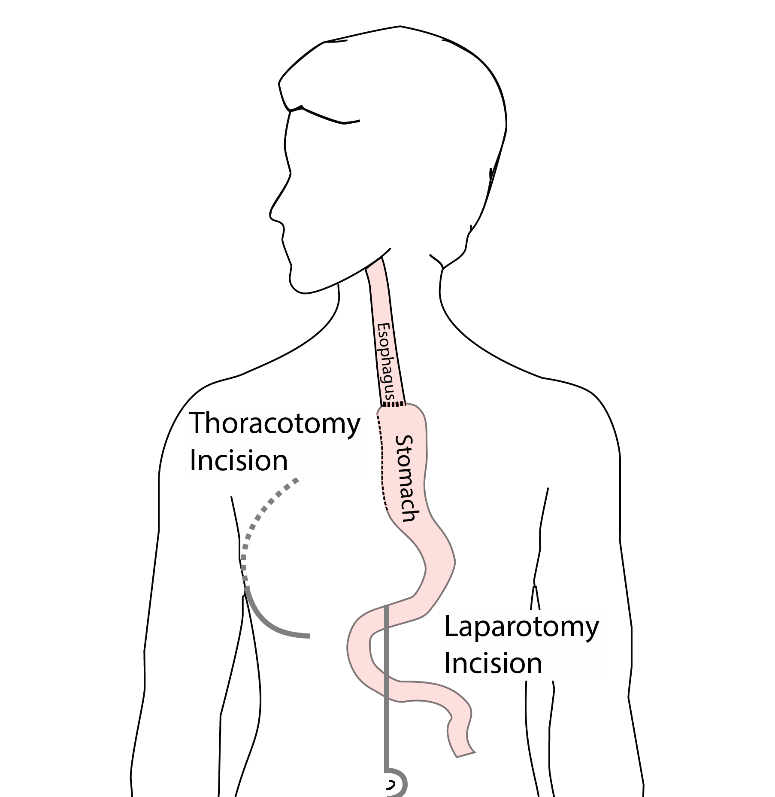
Open Ivor Lewis
Mininally-invasive approach feasible in 95% of cases
In some cases, an open approach is still necessary.

Slide 9
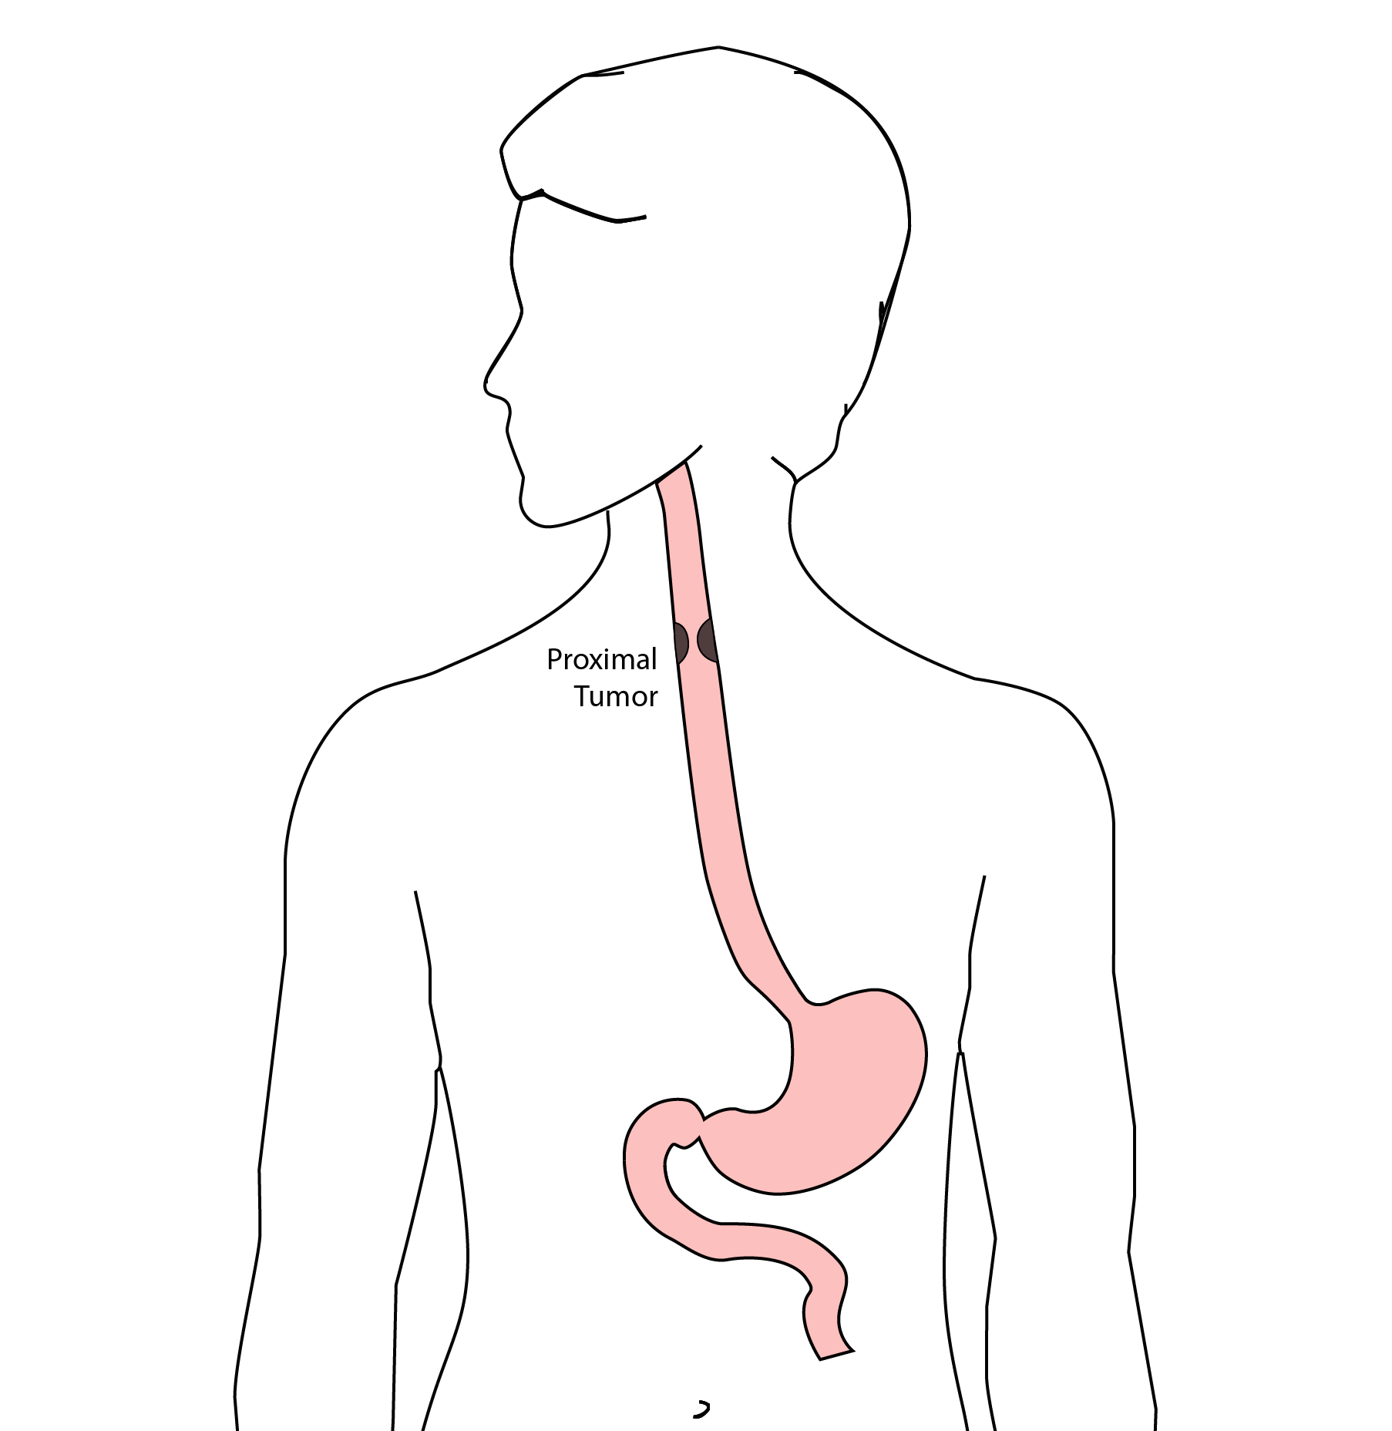
Total Esophagectomy
For patients with tumors in the upper esophagus, we need to remove more of the esophagus
We need to remove the whole esophagus, including the portion in the neck

Slide 10
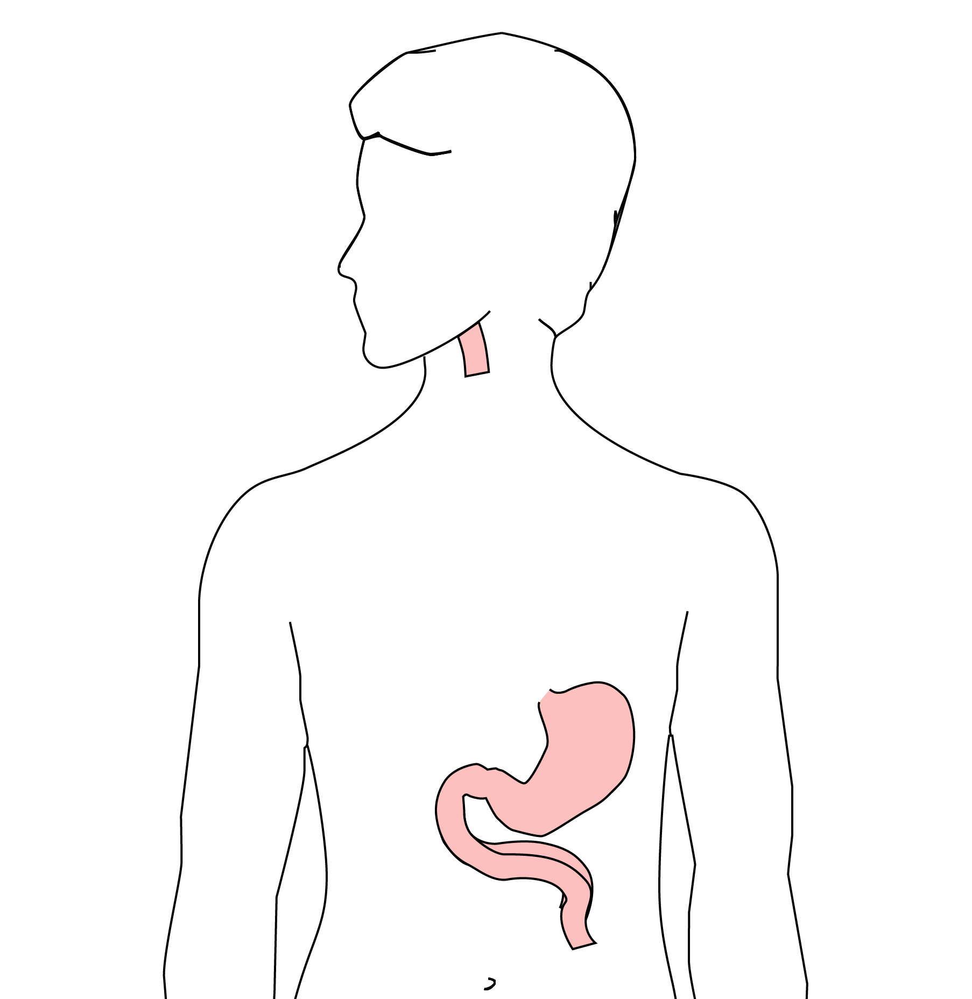
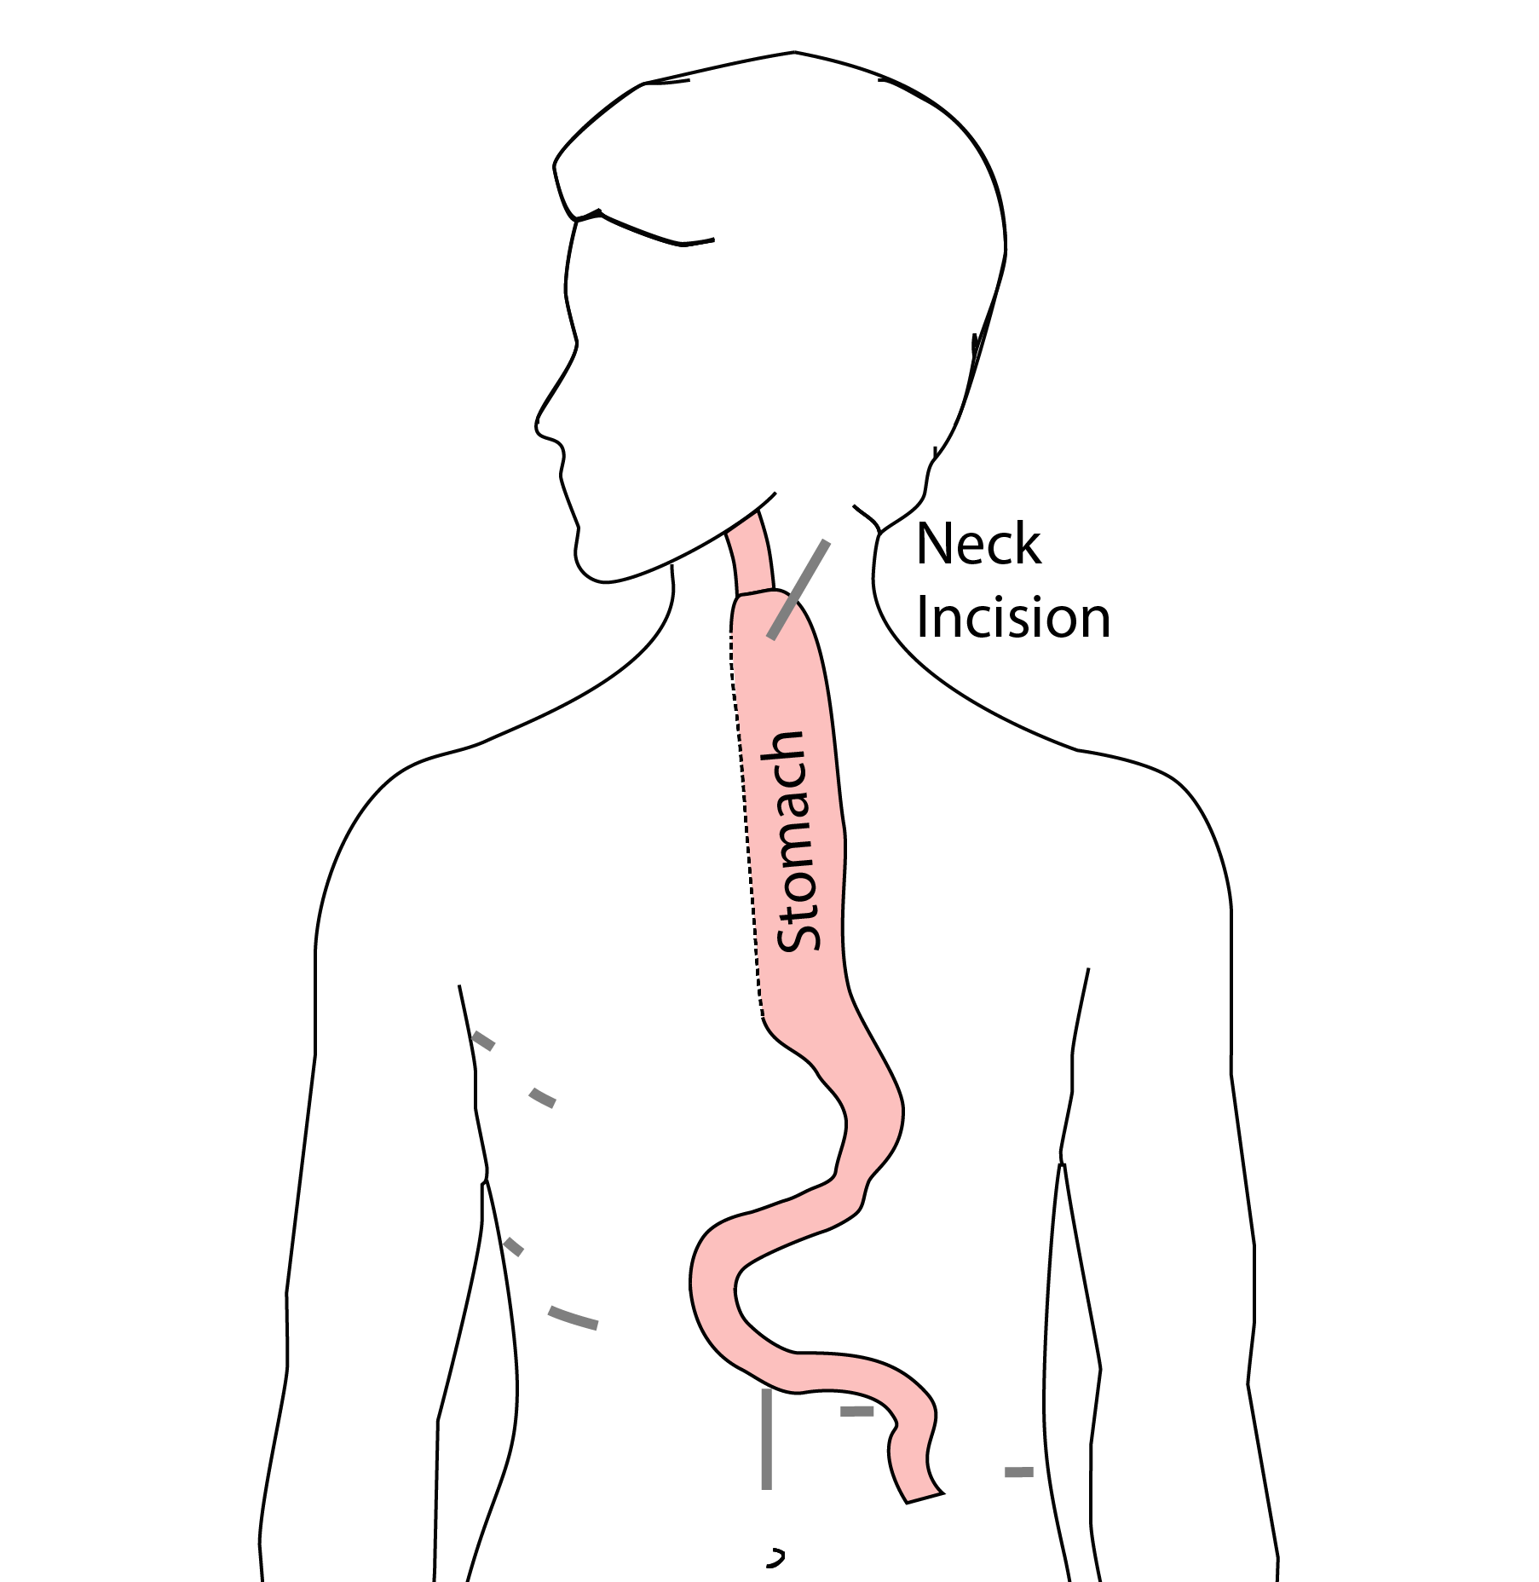
McKeown Esophagectomy

Slide 11
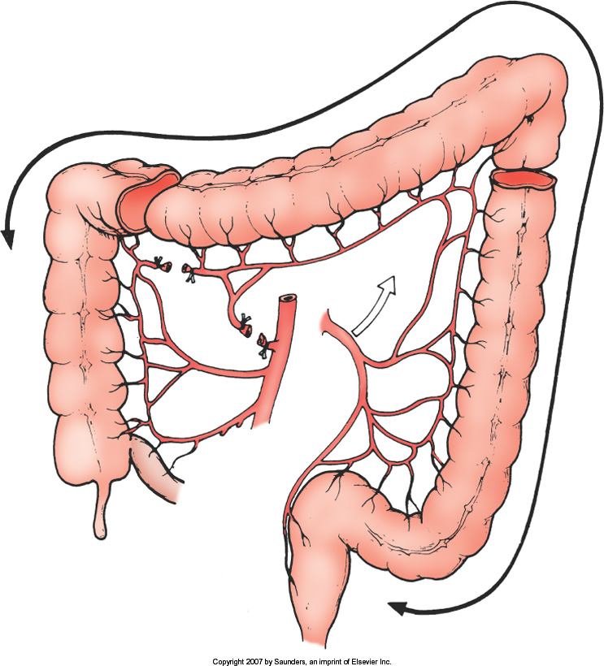
Colon Interposition
If the stomach is not suitable to make a new esophagus, the colon can be used to replace the esophagus

Slide 12
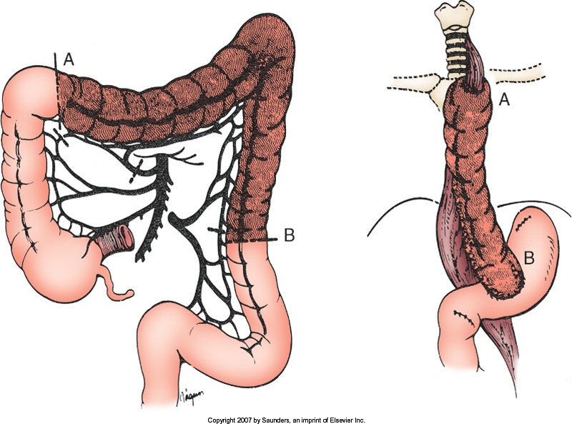
Colon Interposition

Slide 13
Risks of Esophagectomy
Esophagectomy is a complex operation, with a real risk of complications.
Two significant complications:
Anastomotic leak
Pneumonia

Slide 14
Anastomotic Leak
The anastomosis is surgical connection between the esophagus and the stomach.

Slide 15
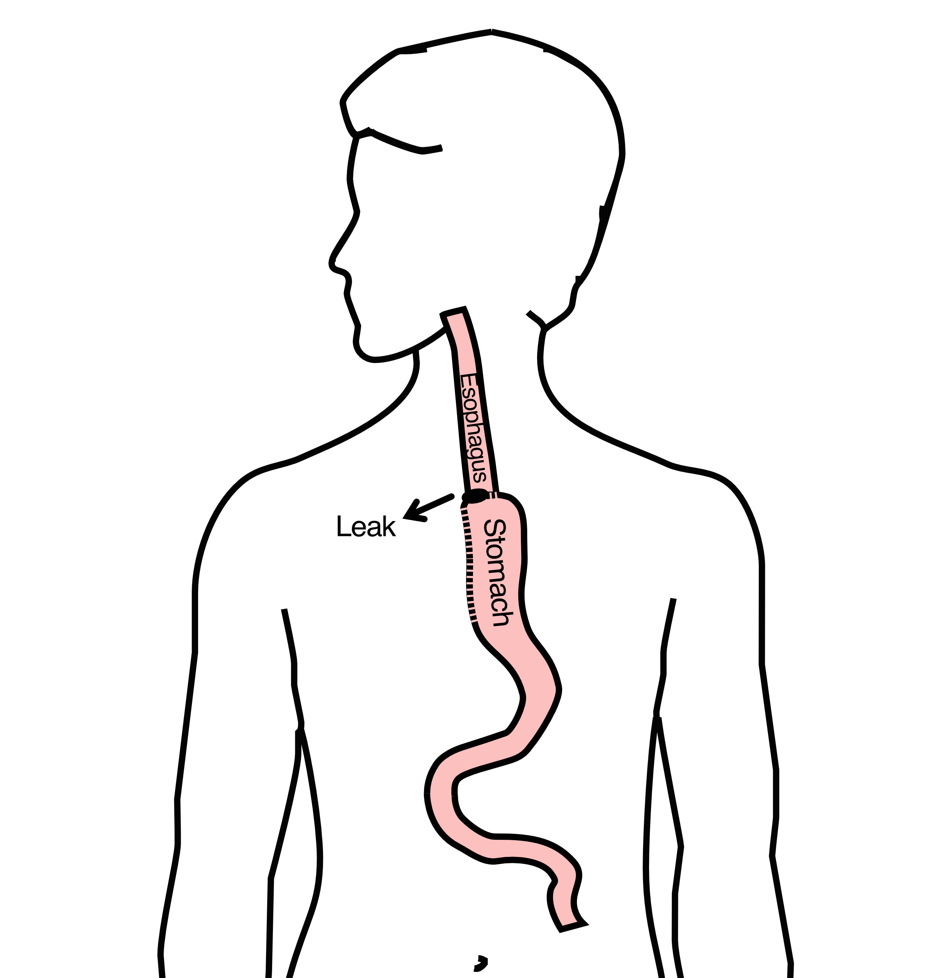
Anastomotic Leak
If healing doesn’t occur:
Leakage of fluid from the esophagus
Infection in the space between the lungs
Requires additional time in the hospital

Slide 16
Anastomotic Leak
If leak occurs:
Some leaks will seal
Stent may be required to help healing
Occasionally additional surgey is required

Slide 17
Anastomotic Leak
Risk of leak depends on:
Type of operation performed
Nutritional status of patient
Experience of the surgeon

Slide 18
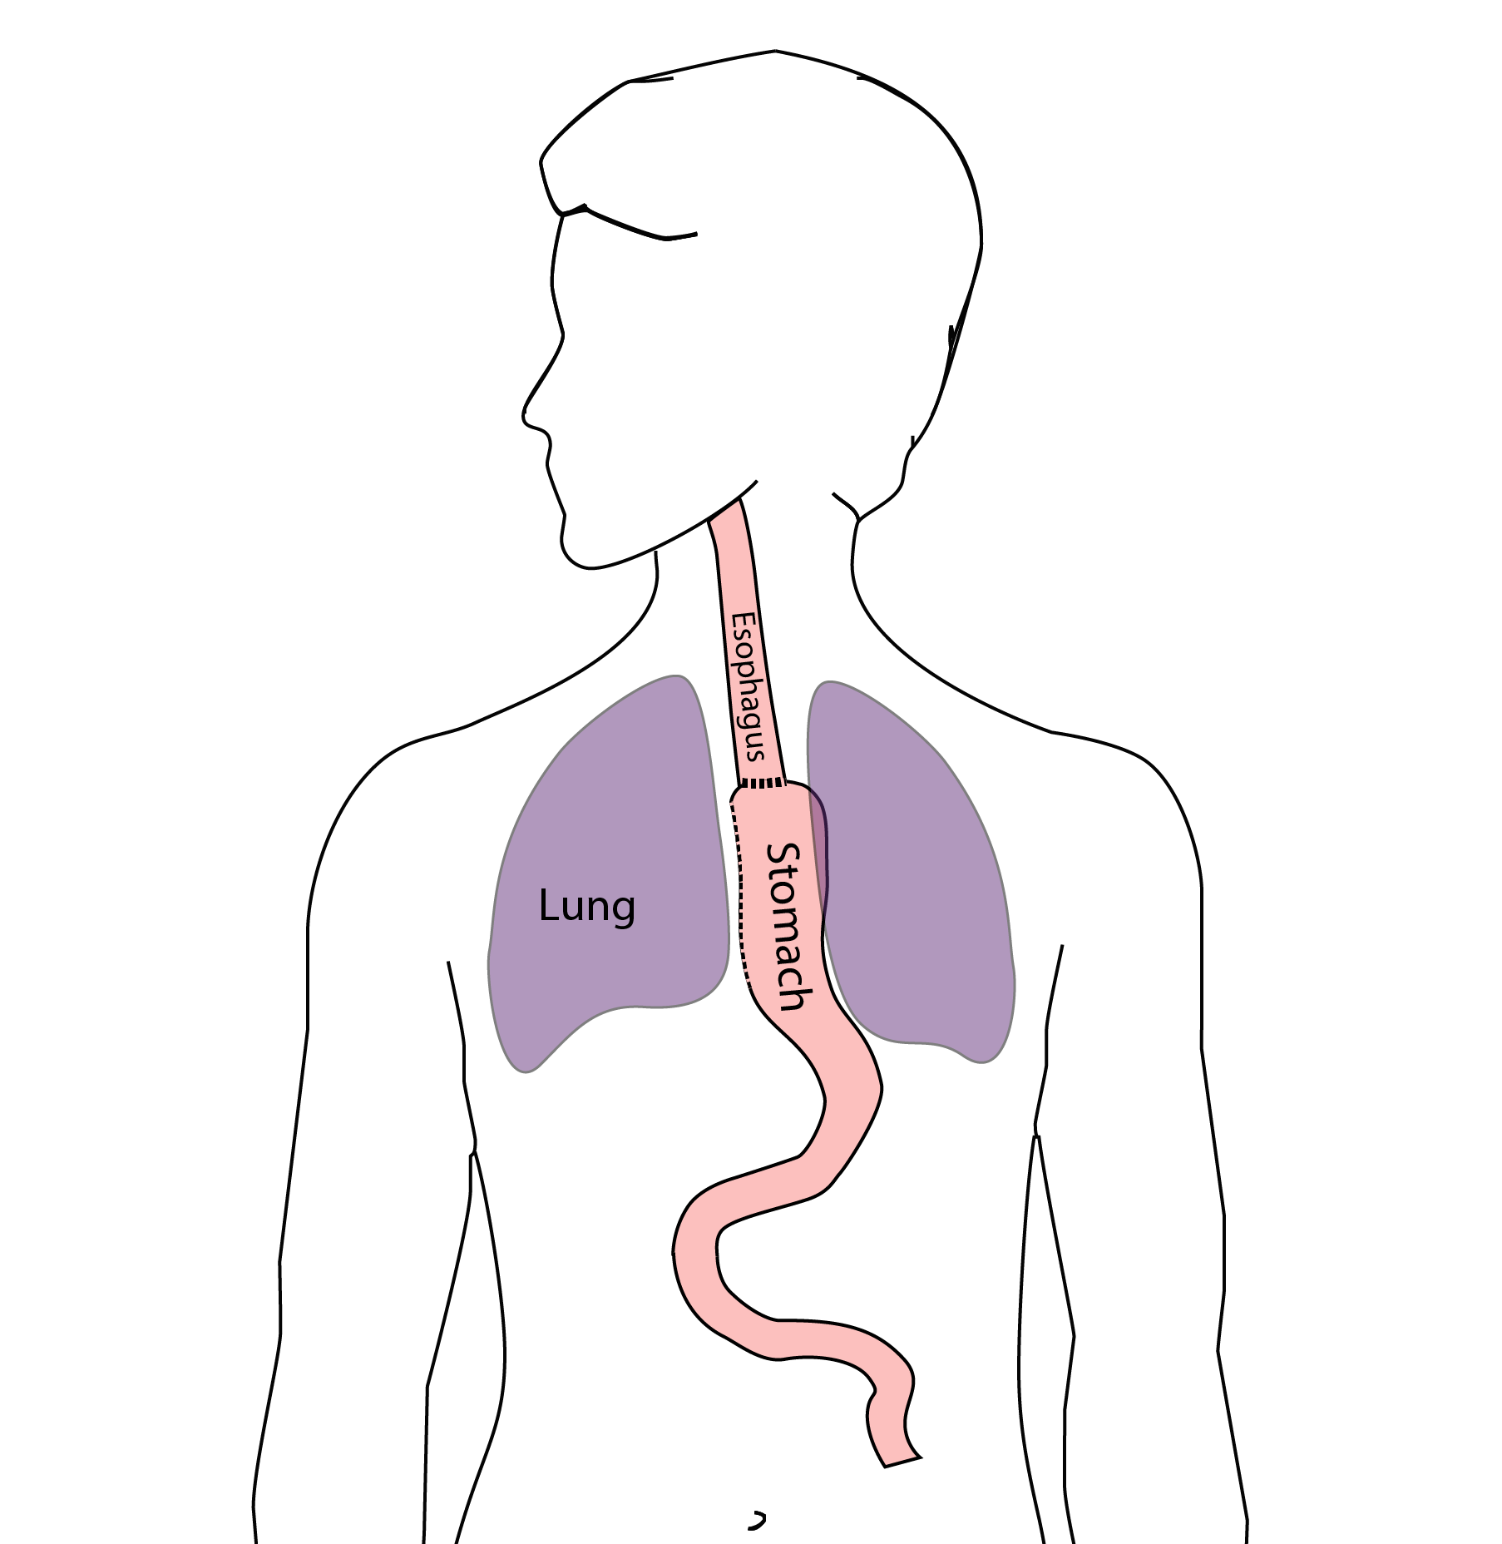
Pneumonia
Occurs in 10-15% of patients after esophagectomy.
Requires treatment with antibiotics
Requires a longer hospitalization.

Slide 19
Preventing Pneumonia
Several ways to help prevent pneumonia:
Deep breathing
Coughing
Walking
After surgery, this means:
Sitting in a chair most of the day
Walking in the halls as soon as possible

Slide 20
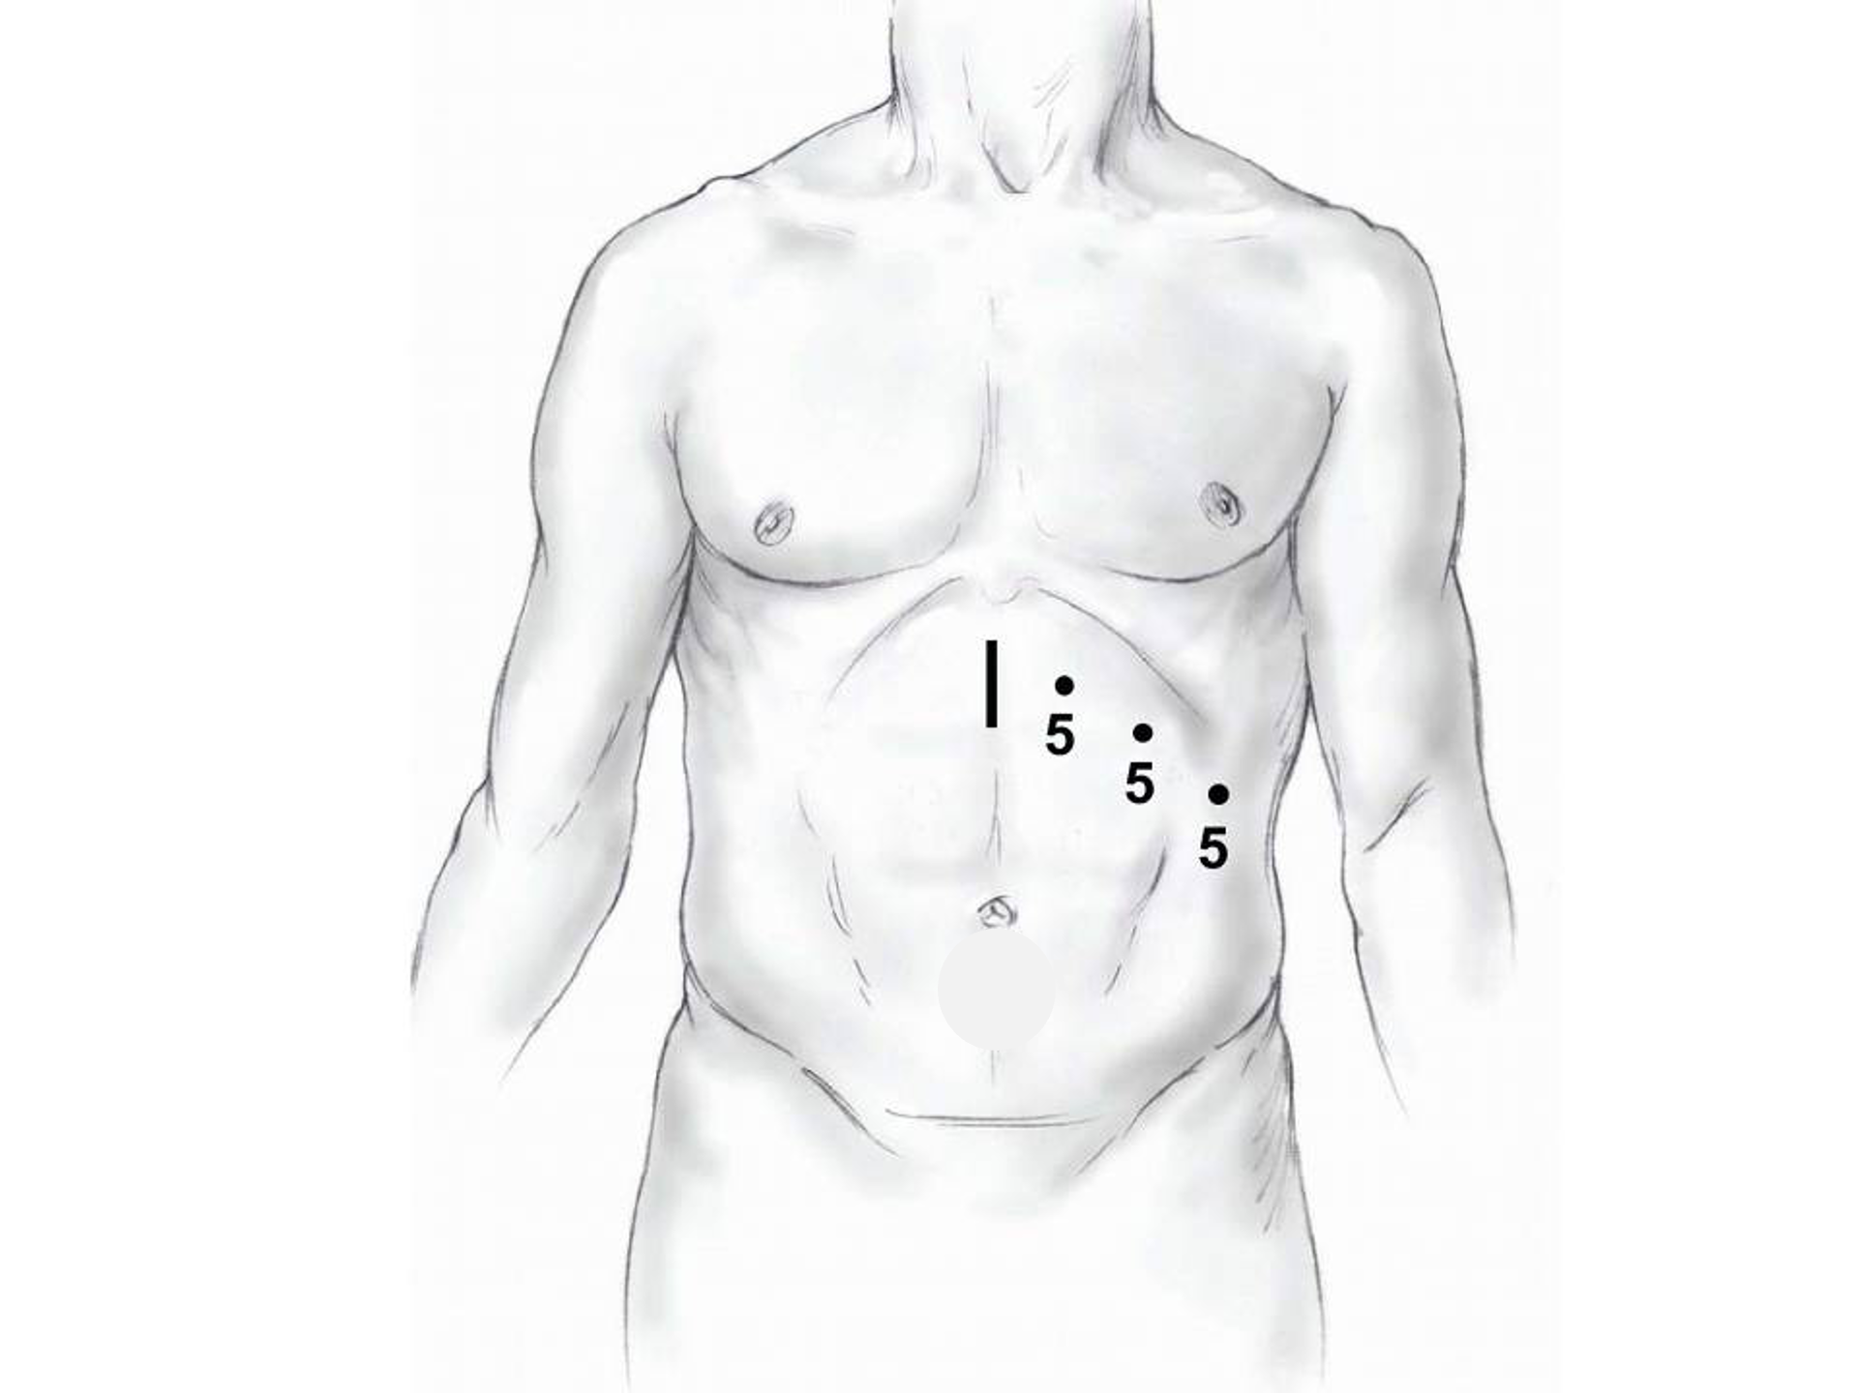
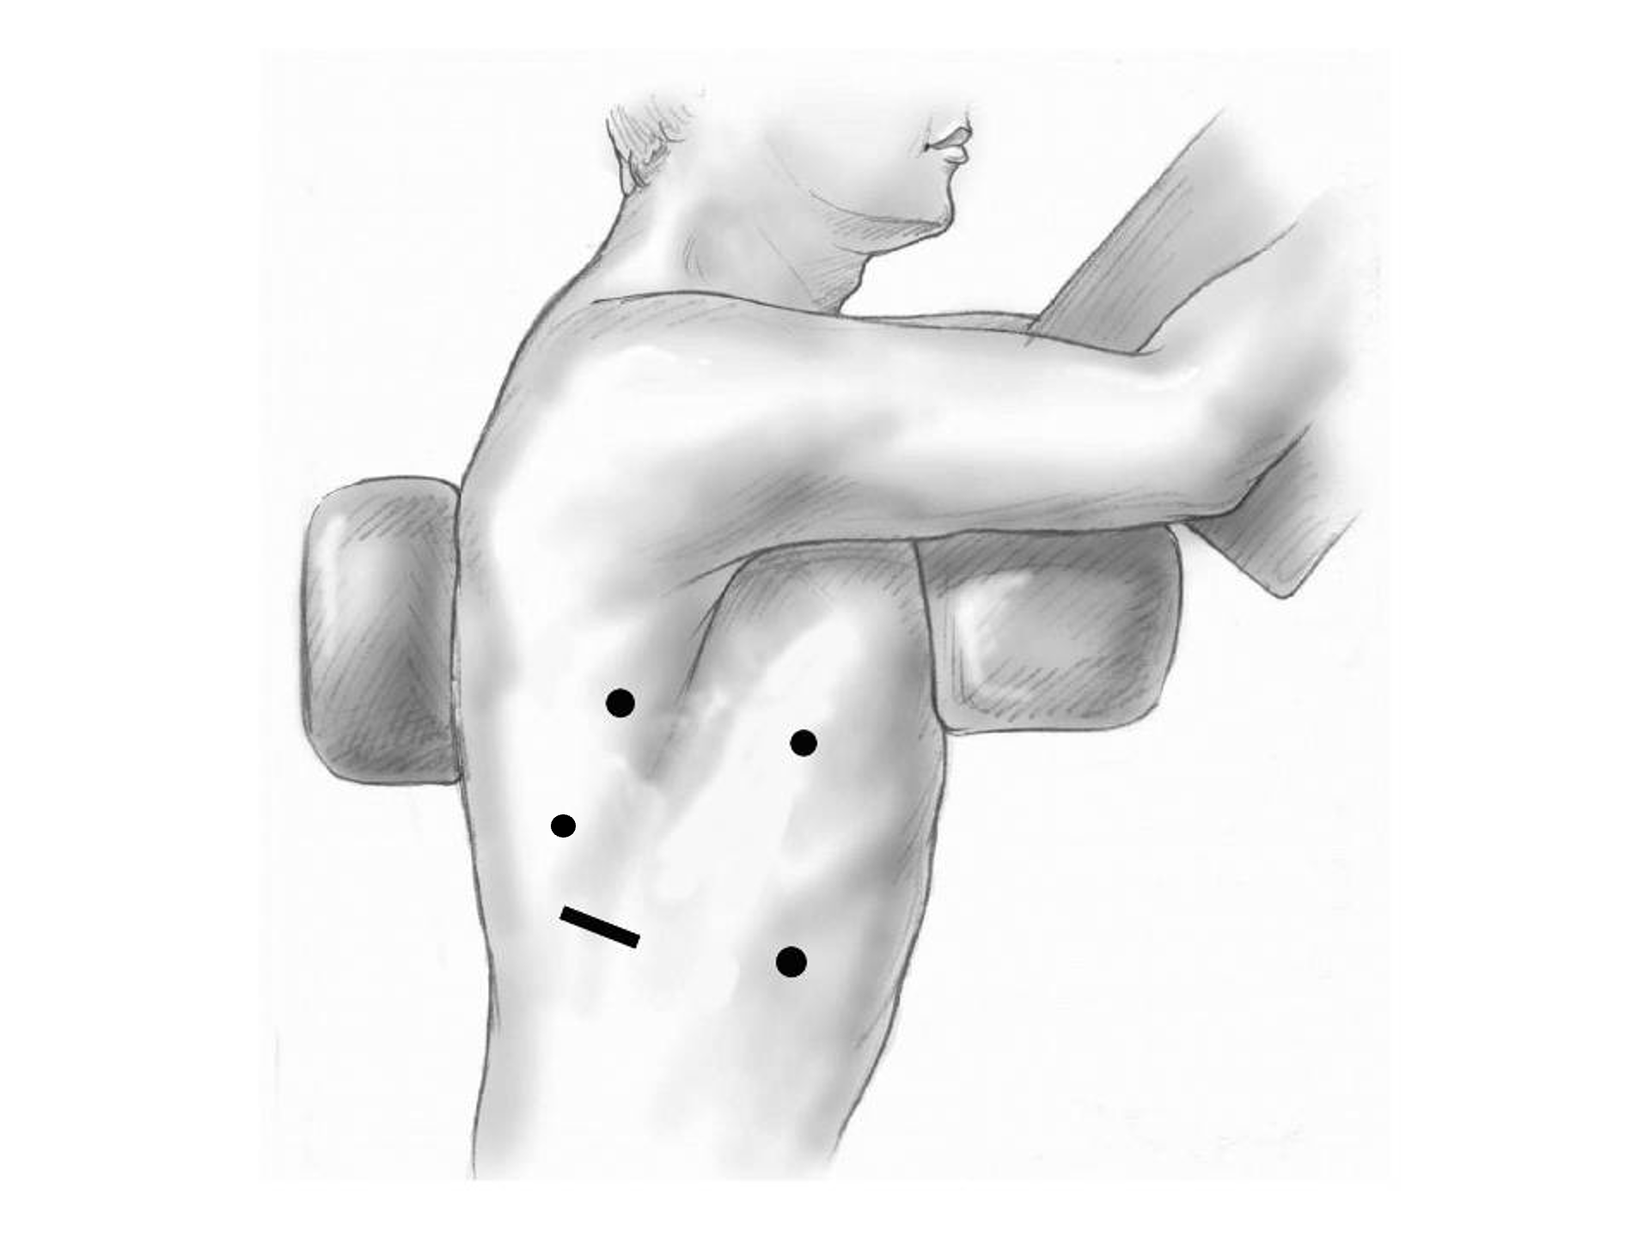
Minimally-invasive Esophagectomy

Slide 21
Risks of Surgery
Risks related to anesthesia
Heart attack (5%)
Irregular heart rhythm (15%)
Pneumonia (10%)
Blood clots in legs (<5%)
Pulmonary embolism (2%)

Slide 22
Risks of Surgery
Risks related to Surgery
Anastomotic leak (5%)
Stricture at anastomosis (15%)
Death within 90 days of surgery
Low risk patients = 2%
Intermediate risk = 10%
High risk = 30%

Slide 23
Risks of Surgery
 | Age <75 | Age >75
Normal Muscle (75%) | 2% | 10%
Low Muscle (25%) | 10% | 30%
Risks of Death within 90 Days of Surgery

Slide 24
Day Prior to Surgery
Clear liquids for 24 hours prior to surgery
Check with Pre-op nurse regarding medicines day prior to surgery
No tube feedings the night before surgery

Slide 25
Day of Surgery
Arrive at 5am – nothing to eat or drink after midnight.
Medicines OK w/ a sip of water
sip of black coffee but no cream.
Surgery will be cancelled if you have cream/milk
Waiting room for family and friends on 5th floor

Slide 26
Epidural Catheter for Pain Control
Remains in place for 2-5 days
Dosage can be adjusted as needed
Can make it more difficult to urinate
May require foley catheter in bladder
Foley catheter removed after epidural removed

Slide 27
ICU Stay (2-4 days)
Surgical ICU on 11th floor
NG tube in nose to drain stomach and esophagus
Catheter in bladder
Chest tube right chest
Abdominal drains (usually 2)
Feeding jejunostomy (usually stays in 8 wks)

Slide 28
ICU
Bladder catheter removed → check that bladder empties properly
Chest tube removed (day 2-4) → follow-up x-ray
Fluid emptied from drains every few hours
Start tube feedings by feeding
Feeding jejunostomy (stays in 8 weeks)

Slide 29
Ward - 6Tower
Jejunostomy feeds started
Up in a chair most of the day
Walking in the halls
Start with assistance
Improves lung function
Prevents loss of muscle strength

Slide 30
Jejunostomy Feeds
Jejunostomy tube feeds
Start continuous (24 hours)
Convert to night-time only (16 hours)
Water administered through feeding tube
Usually 8oz 4 times/day
Important to prevent dehydration

Slide 31
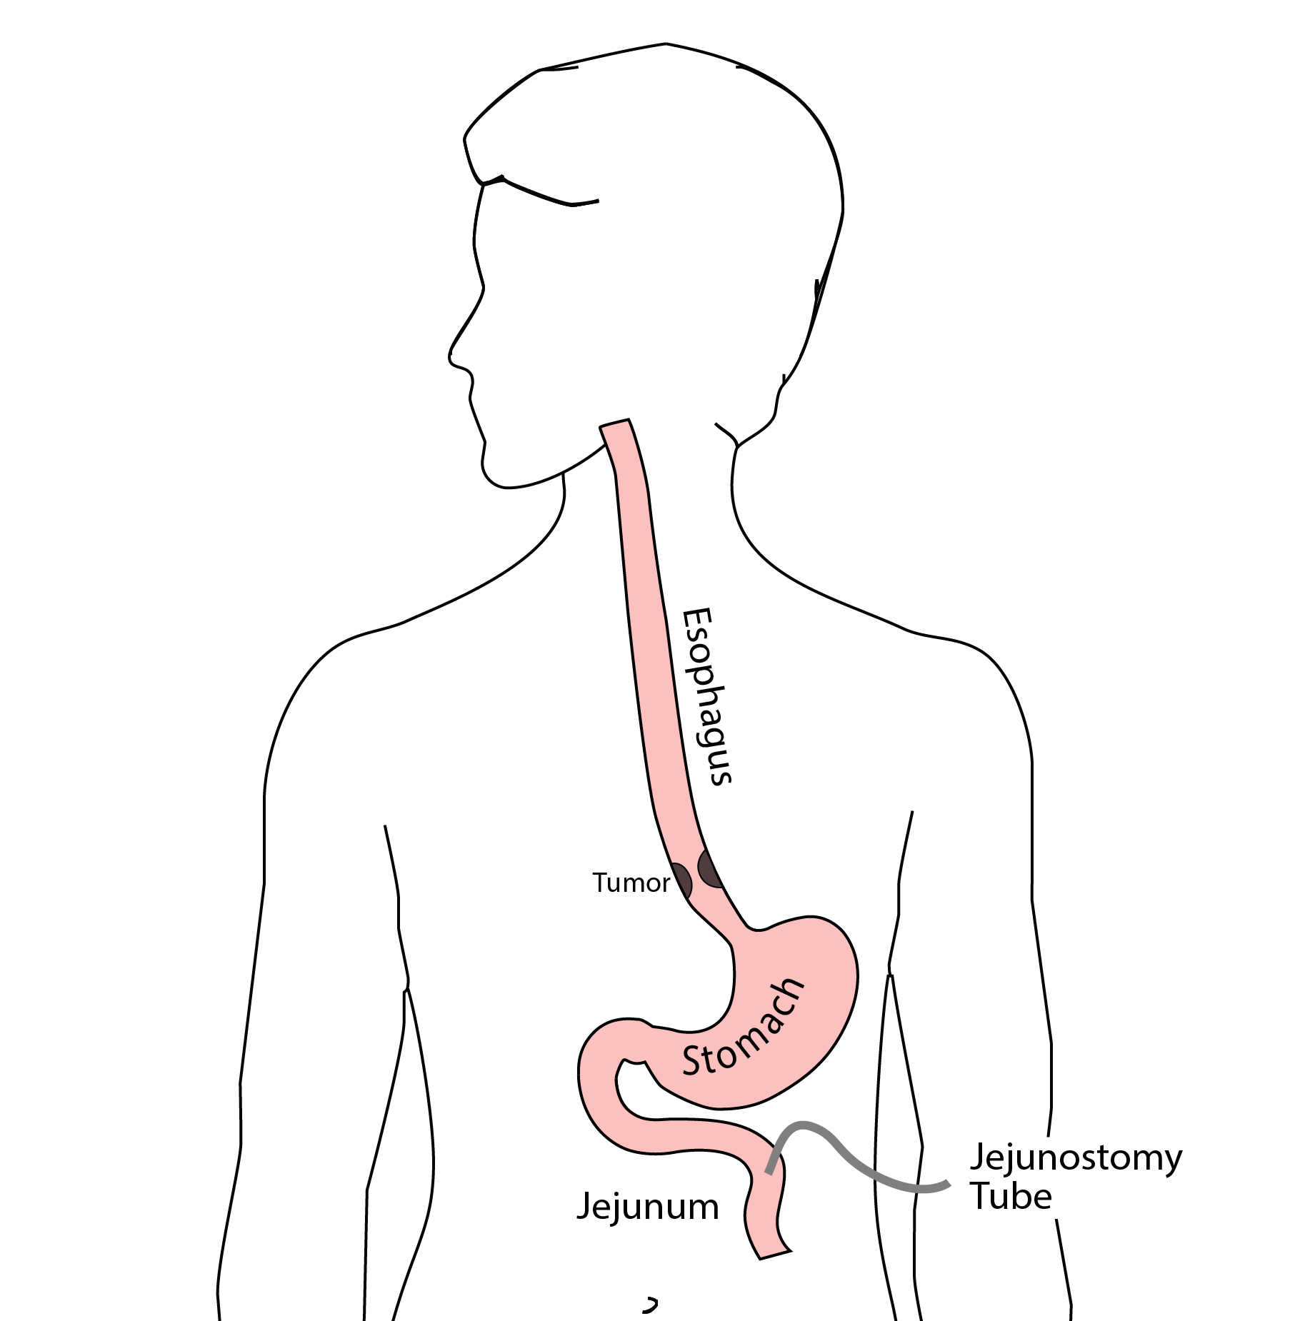
Jejunostomy Tube
Nutrition to bypasses the esophagus and stomach
Placed in small intestine
Pump administers feedings slowly
Feeding done at night

Slide 32
Jejunostomy Typical Regimen
Jejunostomy tube feeds for 16 hours (6pm-10am)
Men: 75mL/hour x 16 hours = 5 cartons
Women: 60mL/hour x 16 hours = 4 cartons
Water 240ml (8oz) via syringe 4x/day
Hospital nurses will teach use of the feeding tube

Slide 33
Jejunostomy Feeds with Diabetes
Jejunostomy feedings elevate blood sugars
Insulin may be required along with feeds
Typical Pattern for tube feeds
Feeds run via pump from 6pm to 10am
Insulin at 6pm (70/30 insulin)
Insulin at Midnight (70/30 insulin)
No insulin if tube feedings are not run

Slide 34
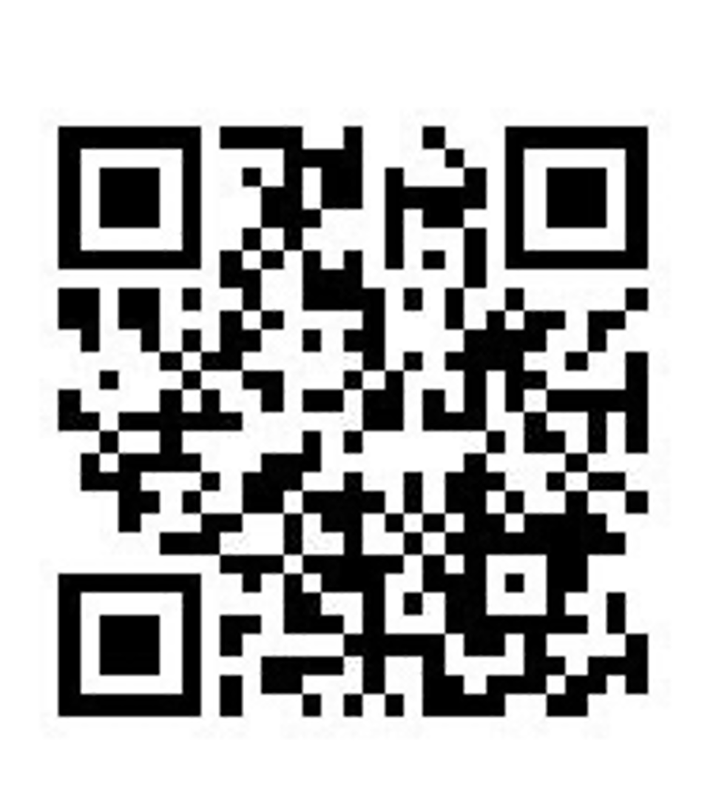
Jejunostomy Video
A video is available to help become familiar with the feeding jejunostomy

Slide 35
Activity
Up in chair most of the day
Walking with help from nurse/Physical Therapist
Goals:
Improve lung function
Prevent muscle loss

Slide 36
Nasogastric (NG) Tube
Tube passed through nose into stomach
Drains fluid from stomach
Prevents vomiting
Upper GI X-ray on 2nd or 3rd day after surgery
If stomach empties well $→$ NG tube removed
Otherwise, X-ray repeated 2-3 days later

Slide 37
Swallowing Evaluation
Once NG tube has been removed:
Modified barium swallow in radiology
Drink a white chalky liquid (barium)
Look for proper swallowing function
70% of patients $⇒$ liquids started by mouth

Slide 38
Protein Shakes
Most are taking protein shakes when they go home
Protein shakes are started after tolerating water
2 oz per hour to start
4 oz per hour if 2oz are tolerated well

Slide 39
Discharge
Goal: ready to leave day #6/7 after surgery
Night-time tube feedings (6pm to 10am)
Nutrition by mouth (70% of patients)
1 oz of water per hour by mouth OR
Protein shakes 4oz every 2 hours
Water through tube 8oz four times per day
Home care nursing (feeding tube teaching)
Home infusion (tube feeding supplies)

Slide 40
Nutrition after Surgery
At discharge home:
Protein shakes 4oz every 2 hrs
Tube feeds 4-5 cans at night (6pm-10am)
10-12 Days: Increase protein shakes
Tube feeds 3-4 cans at night
Three weeks: Post-esophagectomy Diet
8-12 weeks: Remove feeding tube (in office)

Slide 41
Transition from Tube Feeds $→$ Eating
Dietitian will calculate daily protein goal
Typically 60-75 grams protein/day
Each carton of tube feeding has 15 grams
75 grams protein = 5 cartons/night
More intake by mouth $→$ tube feeds reduced
Spread out protein during the day (20gm/meal)
Three meals + 2-3 high-protein snacks

Slide 42
Post-esophagectomy Diet
Soft Consistency
High Protein
Avoid sugary liquids (can cause ‘dumping’)
Avoid raw vegetables (and salads)
Eating
Small, frequent meals
Sit up for 30-45 minutes after eating
Avoid eating within 2 hours of bedtime

Slide 43
Medicines at Home - Pain
Acetaminophen (Tylenol) 1000mg 4x/day
Gabapentin 300mg 3 times/day
Oxycodone
As needed in addition to Tylenol/gabapentin
Will begin reducing dose at first postop visit
Can usually discontinue by 4 weeks
NO DRIVING WHILE ON OXYCODONE

Slide 44
Non-steroidals Anti Inflammatory (NSAID)
Non-steroidal anti-inflammatories (Celebrex)
200 mg every 12 hours starting at 2 weeks
NO GOODY POWDERS OR BCs
(Can cause permanent scarring at the surgery site)

Slide 45
Acid Blockers = Proton Pump Inhibitors
Examples include ompeprazole and pantoprazole
Will stay on for at 1-2 years to prevent acid reflux
Important in preventing scarring at anastomosis (new connection between esophagus and stomach)
To administer through feeding tube, open capsule and resuspend beads in 60mL (2oz) of water

Slide 46
Medicines at Home
Reglan – Helps stomach empty
Will plan to stop after six weeks
0.1% risk of tardive dyskinesia (nervous tic)
Remeron – Helps improve appetite
Can cause vivid dreams
Used for several weeks after surgery
Will stop within first three months of surgery

Slide 47
Metoprolol = Beta Blockers
Slows heart rate and lowers blood pressure
Used to prevent rapid heart rate
Patients not taking a beta blocker prior to surgery $→$ wean after after surgery
Patients taking a beta blockerprior to surgery $→$ return to prior dose and drug after surgery

Slide 48
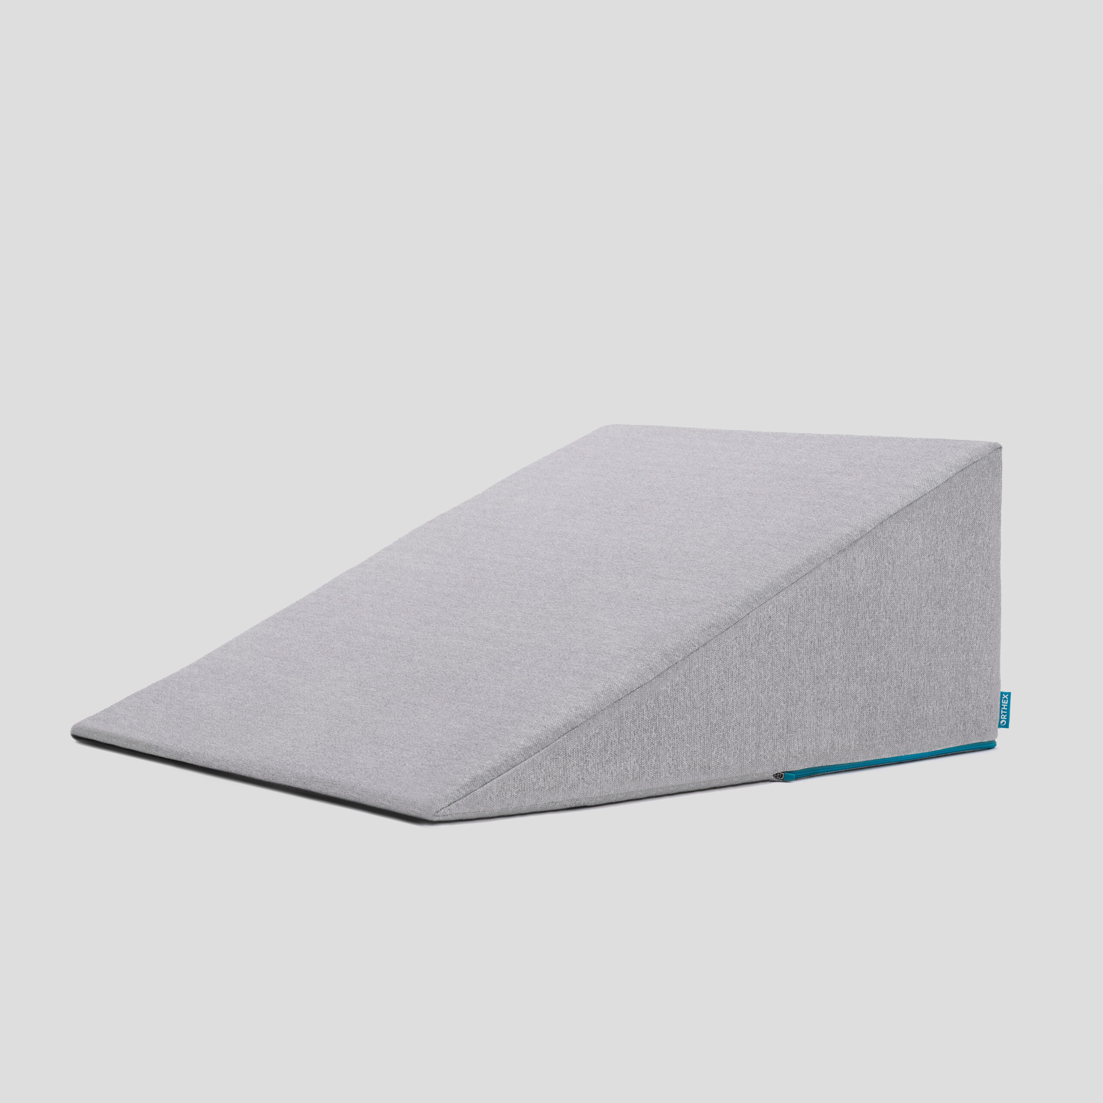
Sleeping
Reflux can occur the first few weeks/months after surgery
This improves over the first few months
A wedge pillow can be helpful for sleep

Slide 49
Postoperative Visit
Check surgical site
Remove staples (if needed)
Adjust medicines as needed
Insulin (for diabetic patients on insulin)
Reduce beta blocker medicines
Advance diet
Reduce tube feeds

Slide 50
After surgery
Wean off medicines added after surgery
Pain medicines
Beta-blockers
Reglan and Remeron
Continue acid blockers for at least 1 year

Slide 51
Jejunostomy Removal
Jejunostomy tube is removed in the office once you can take in enough nutrients by mouth
Removal usually around 8 weeks after surgery
May take 30 minutes and some local anesthetic to loosen up the tube for removal.

Slide 52
Nutritional Monitoring after Surgery
You may have difficulty absorbing some nutrients:
Iron
Vitamin B12
Vitamin D

Slide 53
Nutritional Monitoring after Surgery
About 3 months after the jejunostomy tube is removed, we will check blood levels:
Iron (ferritin)
Vitamin B12
Vitamin D

Slide 54
Nutritional Replacements after Surgery
Vitamin or iron replacements can be ordered by:
Primary Care Provider (PCP)
Medical Oncologist
Surgeon
If levels are low
Replacement
Repeat testing in 3-6 months

Slide 55
Team Members - Physicians
Primary Care Provider
Gastroenterologist
Medical Oncologist (chemotherapy)
Radiation Oncologist (radiation)
Surgeons
Jonathan Salo
Jeffrey Hagen
Michael Roach

Slide 56
Team Members - Support Staff
Dietitian - Liz Koch
Nurses - Brandon Galloway & Kit Sluder & Rebecca Wicks
Schedulers - Stacey Singleton & Tony Bethea
Navigator - Laura Swift

Slide 57
Day Prior to Surgery
Clear liquids for dinner evening prior
You will receive instructions regarding medicines

Slide 58
Day of Surgery
Unless instructed otherwise:
You will be notified regarding arrival time, which is usually 2-3 hours before the surgery time.
Nothing to eat or drink after midnight
OK to take medicines with a sip of water or black coffee

