Slide 1
Nutrition

Slide 2
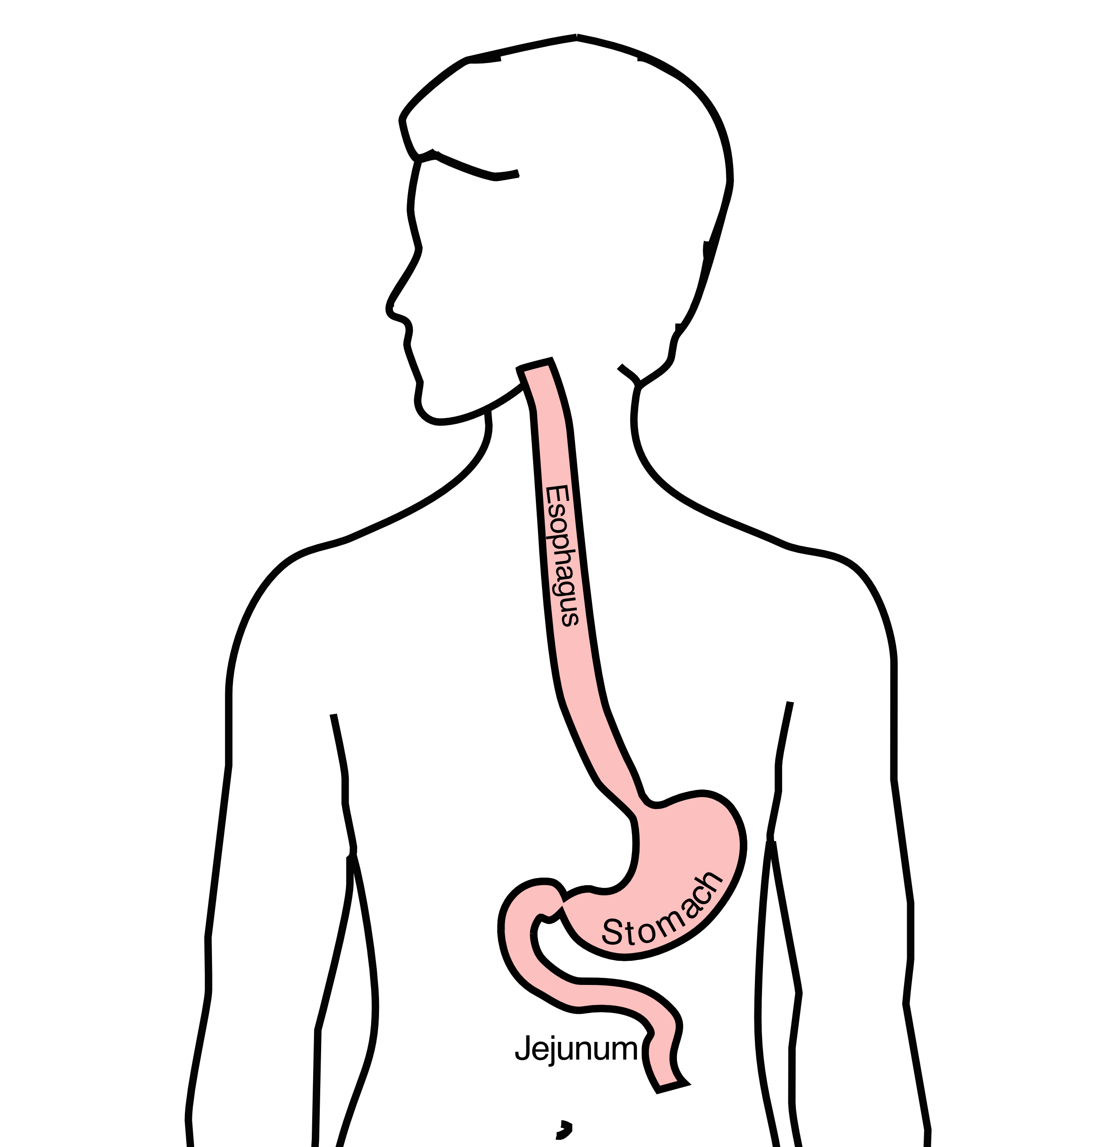
GI Tract Anatomy
Esophagus delivers food to the stomach
Stomach stores food and delivers it in small quantities to the jejunum
Jejunum begins digestion in the small intestines

Slide 3
Protein Needs
Men: Average 75 grams/day
Women: Average 60 grams/day

Slide 4
Protein Shakes
Protein Shakes can provide protein with minimal sugar
Protein Shakes

Slide 5
Feeding Tubes
Jejunostomy = Small Intestine
Gastrostomy = Stomach

Slide 6
Gastrostomy Tube
Feeding Gastrostomy
Feeding with a syringe several times per day.
Tube can be hidden underneath clothing
Tube does not interfere with eating by mouth
Removed easily in the office when no longer needed

Slide 7
Gastrostomy Tube Methods
A gastrostomy tube can be placed either by endoscopy, which is called a PEG tube
A gastrostomy tube can also be placed by laparoscopy, which is usually preferred if surgery on the esophagus is planned in the future.
Your surgeon will help you decide which kind of tube is best for you. This is especially important if you will need esophageal surgery in the future, as the stomach is frequently used to make a new esophagus

Slide 8
Gastrostomy Tube
Outpatient Placement (go home the same day)
Central venous port can be placed at the same time (if needed)

Slide 9
Jejunostomy tube
The other type of feeding tube is a jejunostomy.
A jejunostomy tube tube is placed into the small intestines. Because the small intestine is used to receiving food in small quantities, a jejunostomy tube requires the use of a pump to deliver feedings gradually over a matter of hours.
In general, feedings are done at night in order to allow you to be active during the day

Slide 10
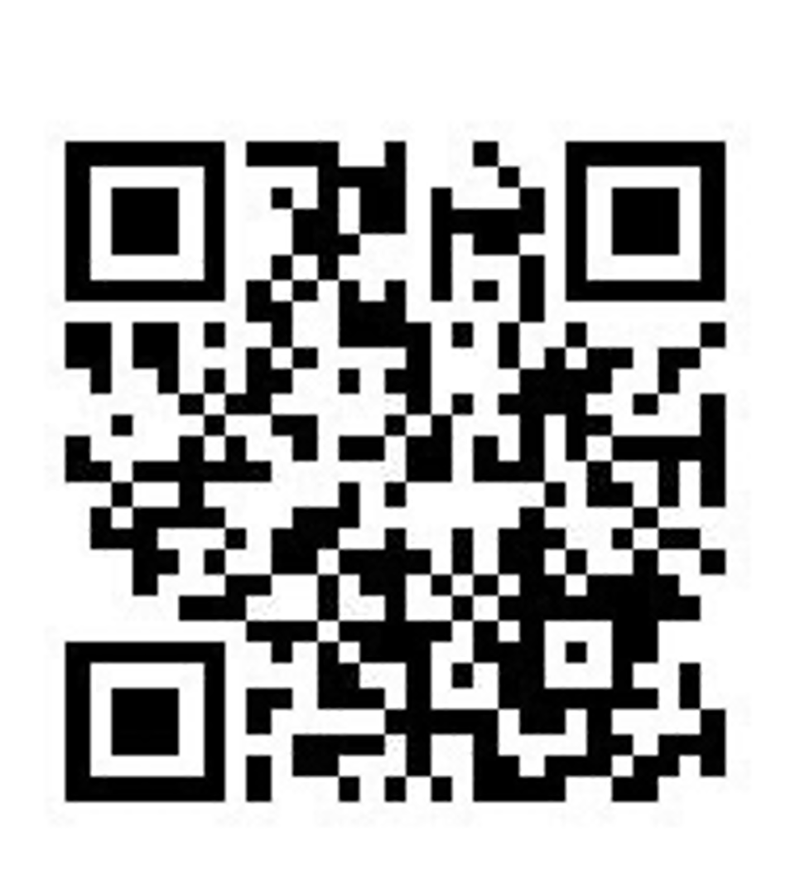
Jejunostomy Video
A video is available to help become familiar with the feeding jejunostomy

