Slide 1
Central Venous Port

Slide 2
Chemotherapy Administration
Most chemotherapy is administered by vein.
Several options exist to administer chemotherapy:
Intravenous catheter in peripheral veins
Peripheral Intravenous Central Catheter (PICC)
Central Venous port

Slide 3
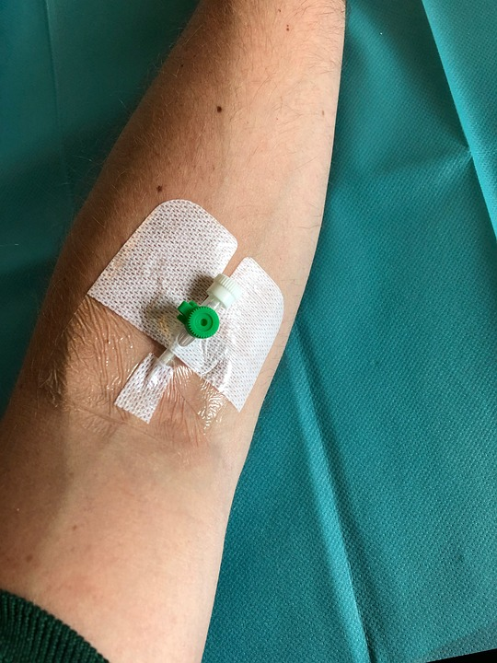
Intravenous Catheter in Peripheral Vein (“IV”)
IV catheter placed in vein of hand or arm
Allows administration of chemo and fluids
Placed for each dose
Removed that day
Not suitable for FLOT chemo

Slide 4
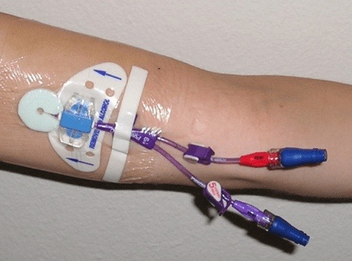
PICC Lines
Placed in Radiology
Stay in place during all of treatment
Needs to be kept clean and dry
Suitable for FLOT chemotherapy

Slide 5
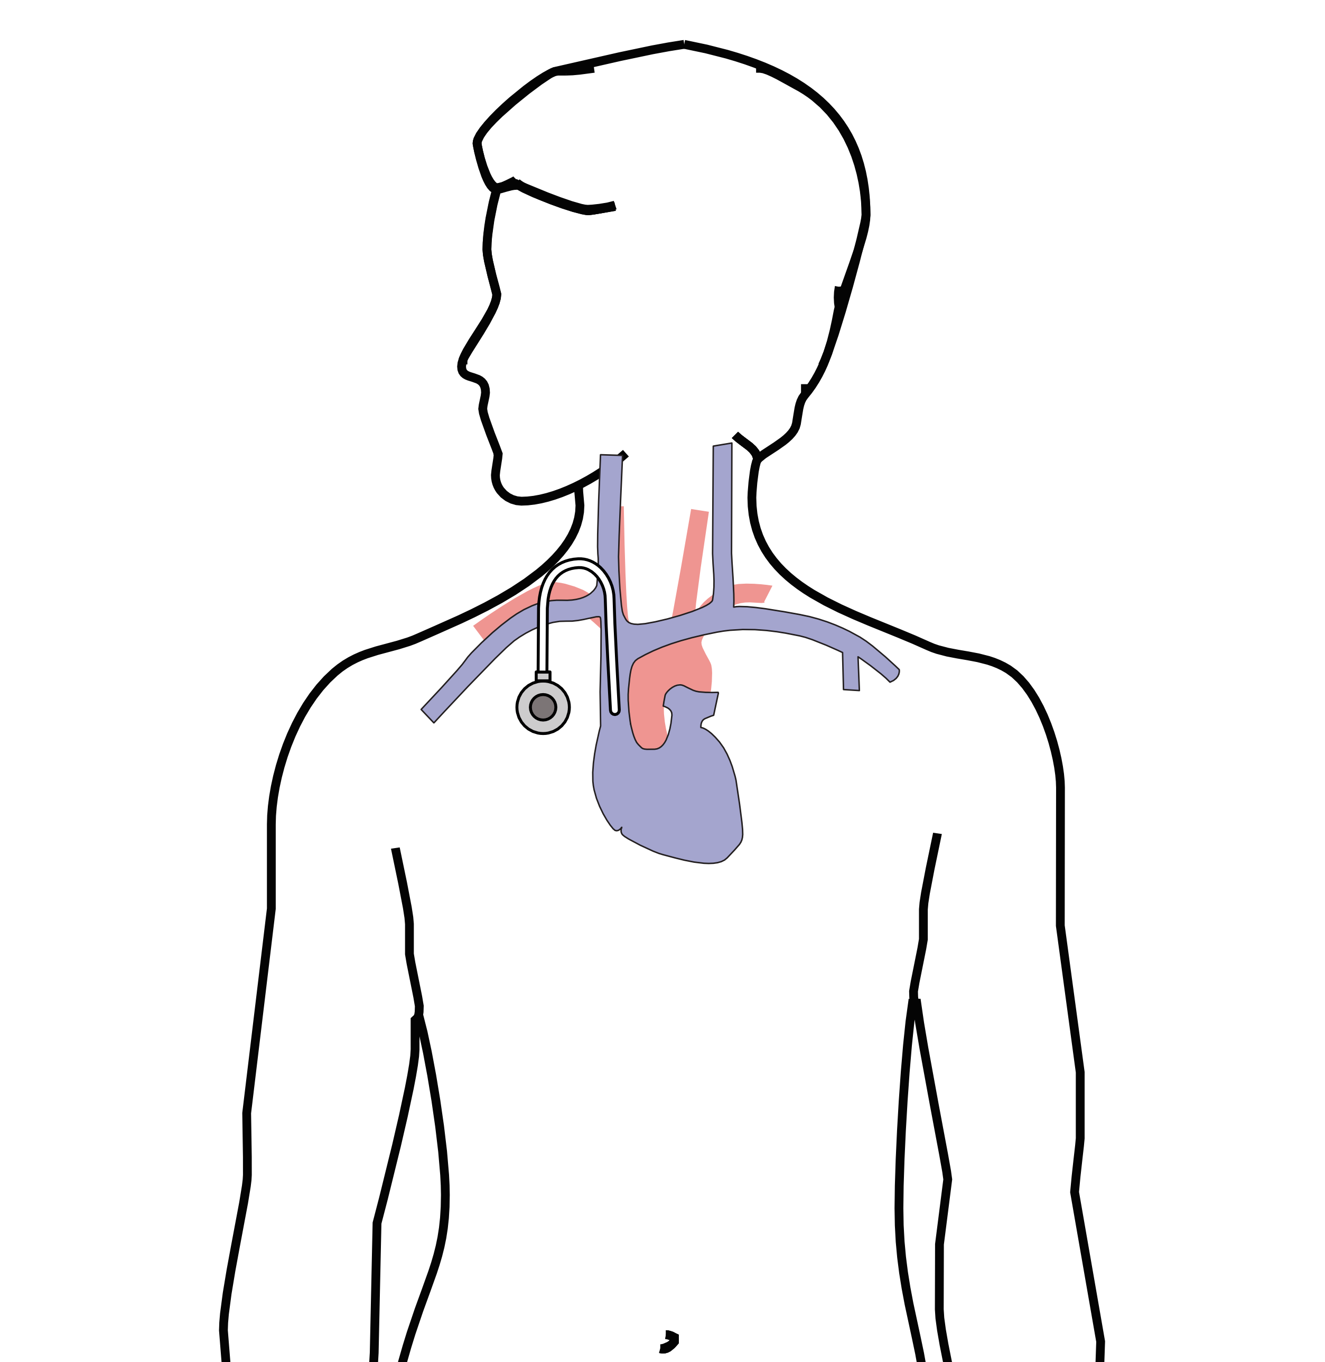
Central Venous Port
Implantable device makes chemo easier
May shower in 24 hrs
No special care at home
OK for FLOT chemo
Allows for blood draws

Slide 6
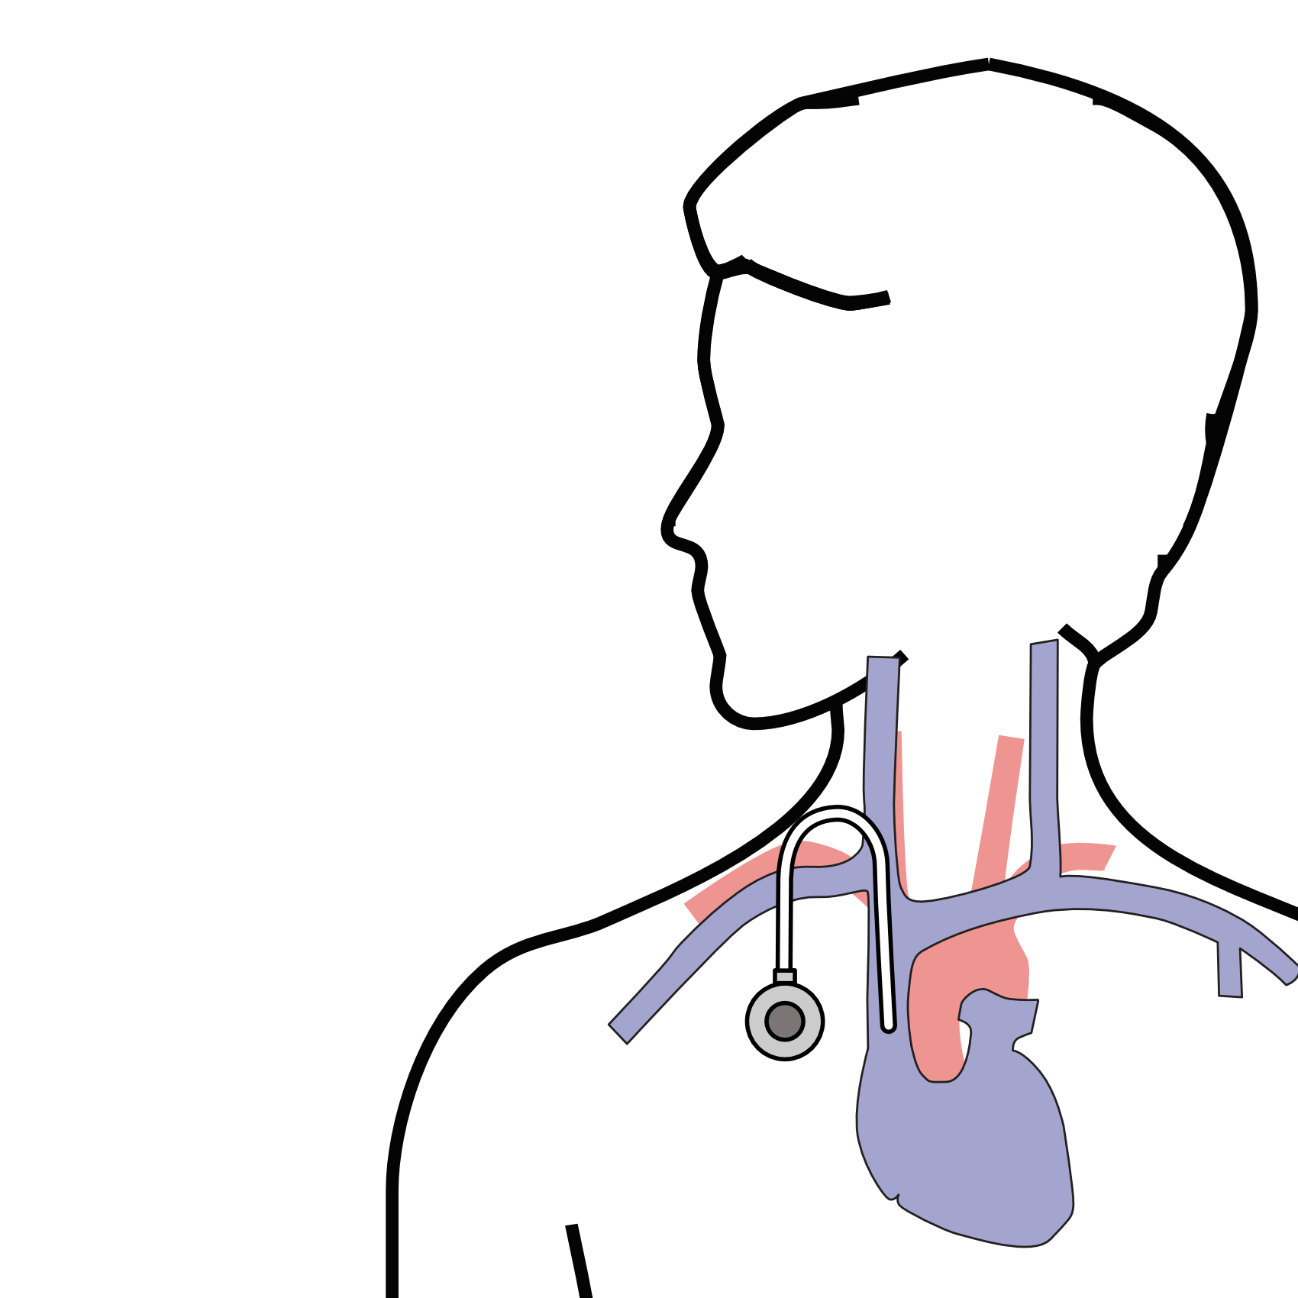
Central Venous Port
Implanted under the skin
Neck incision (1/4”)
Incision below the collarbone
Sutures dissolve
“Superglue” on incisions

Slide 7
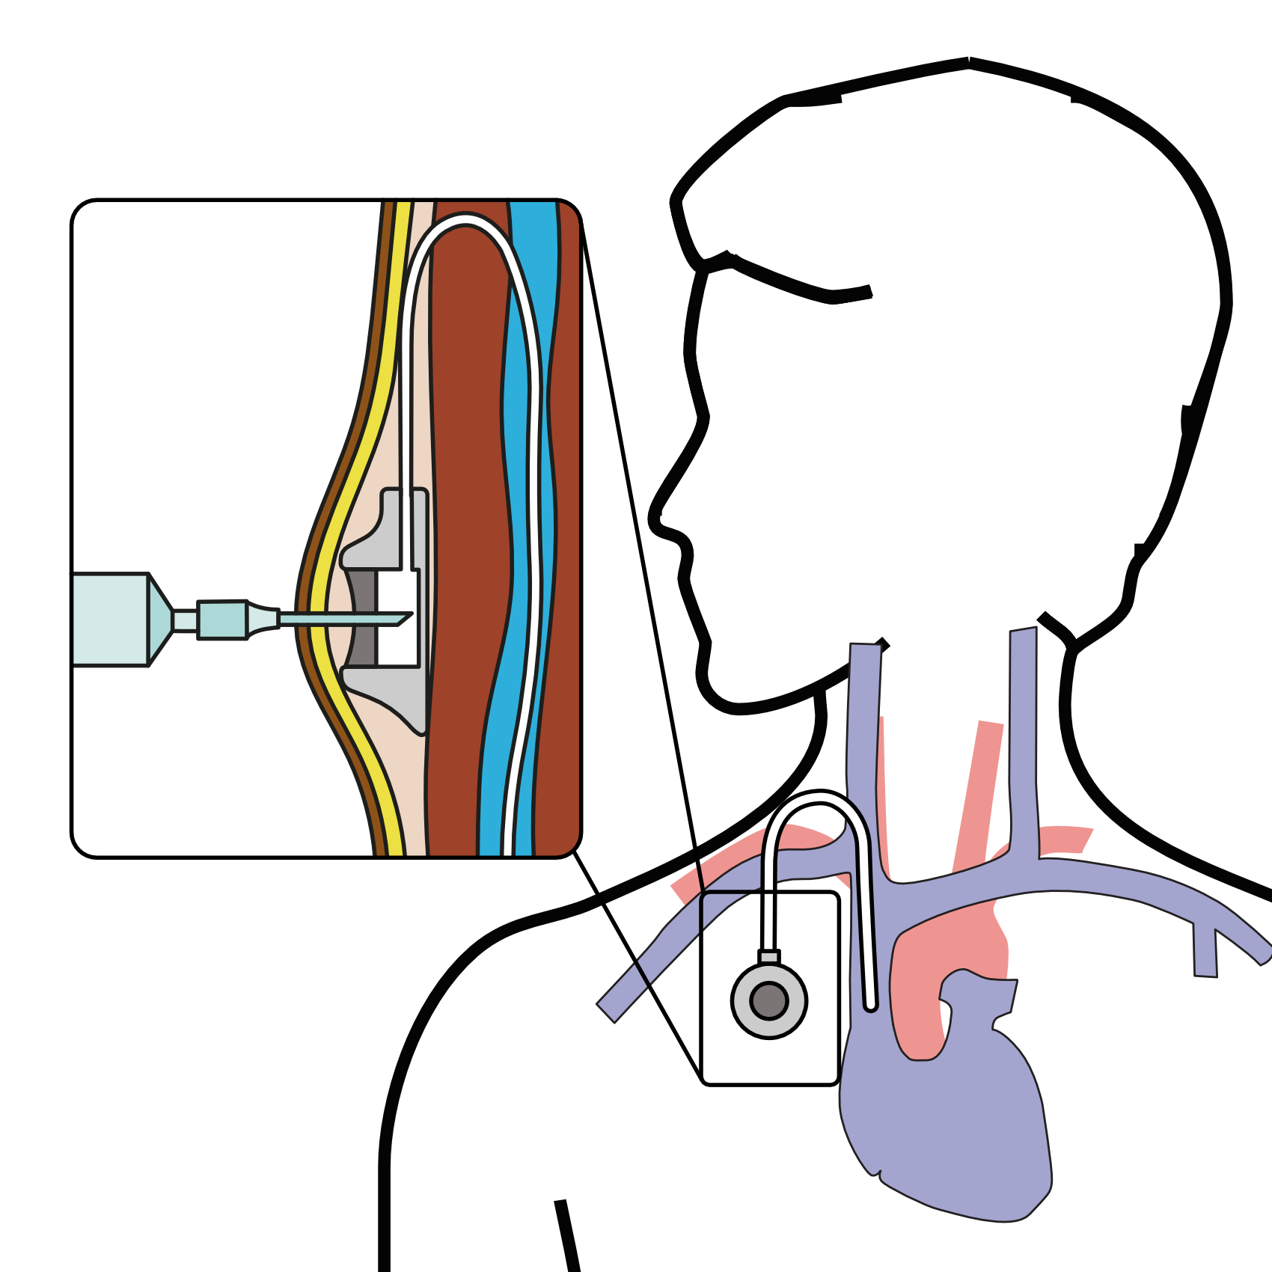
Central Venous Port
When it is time for chemotherapy, a needle is inserted through the skin into the port

