Slide 1
Stage IV Cancer of the Esophagus and GE Junction

Slide 2
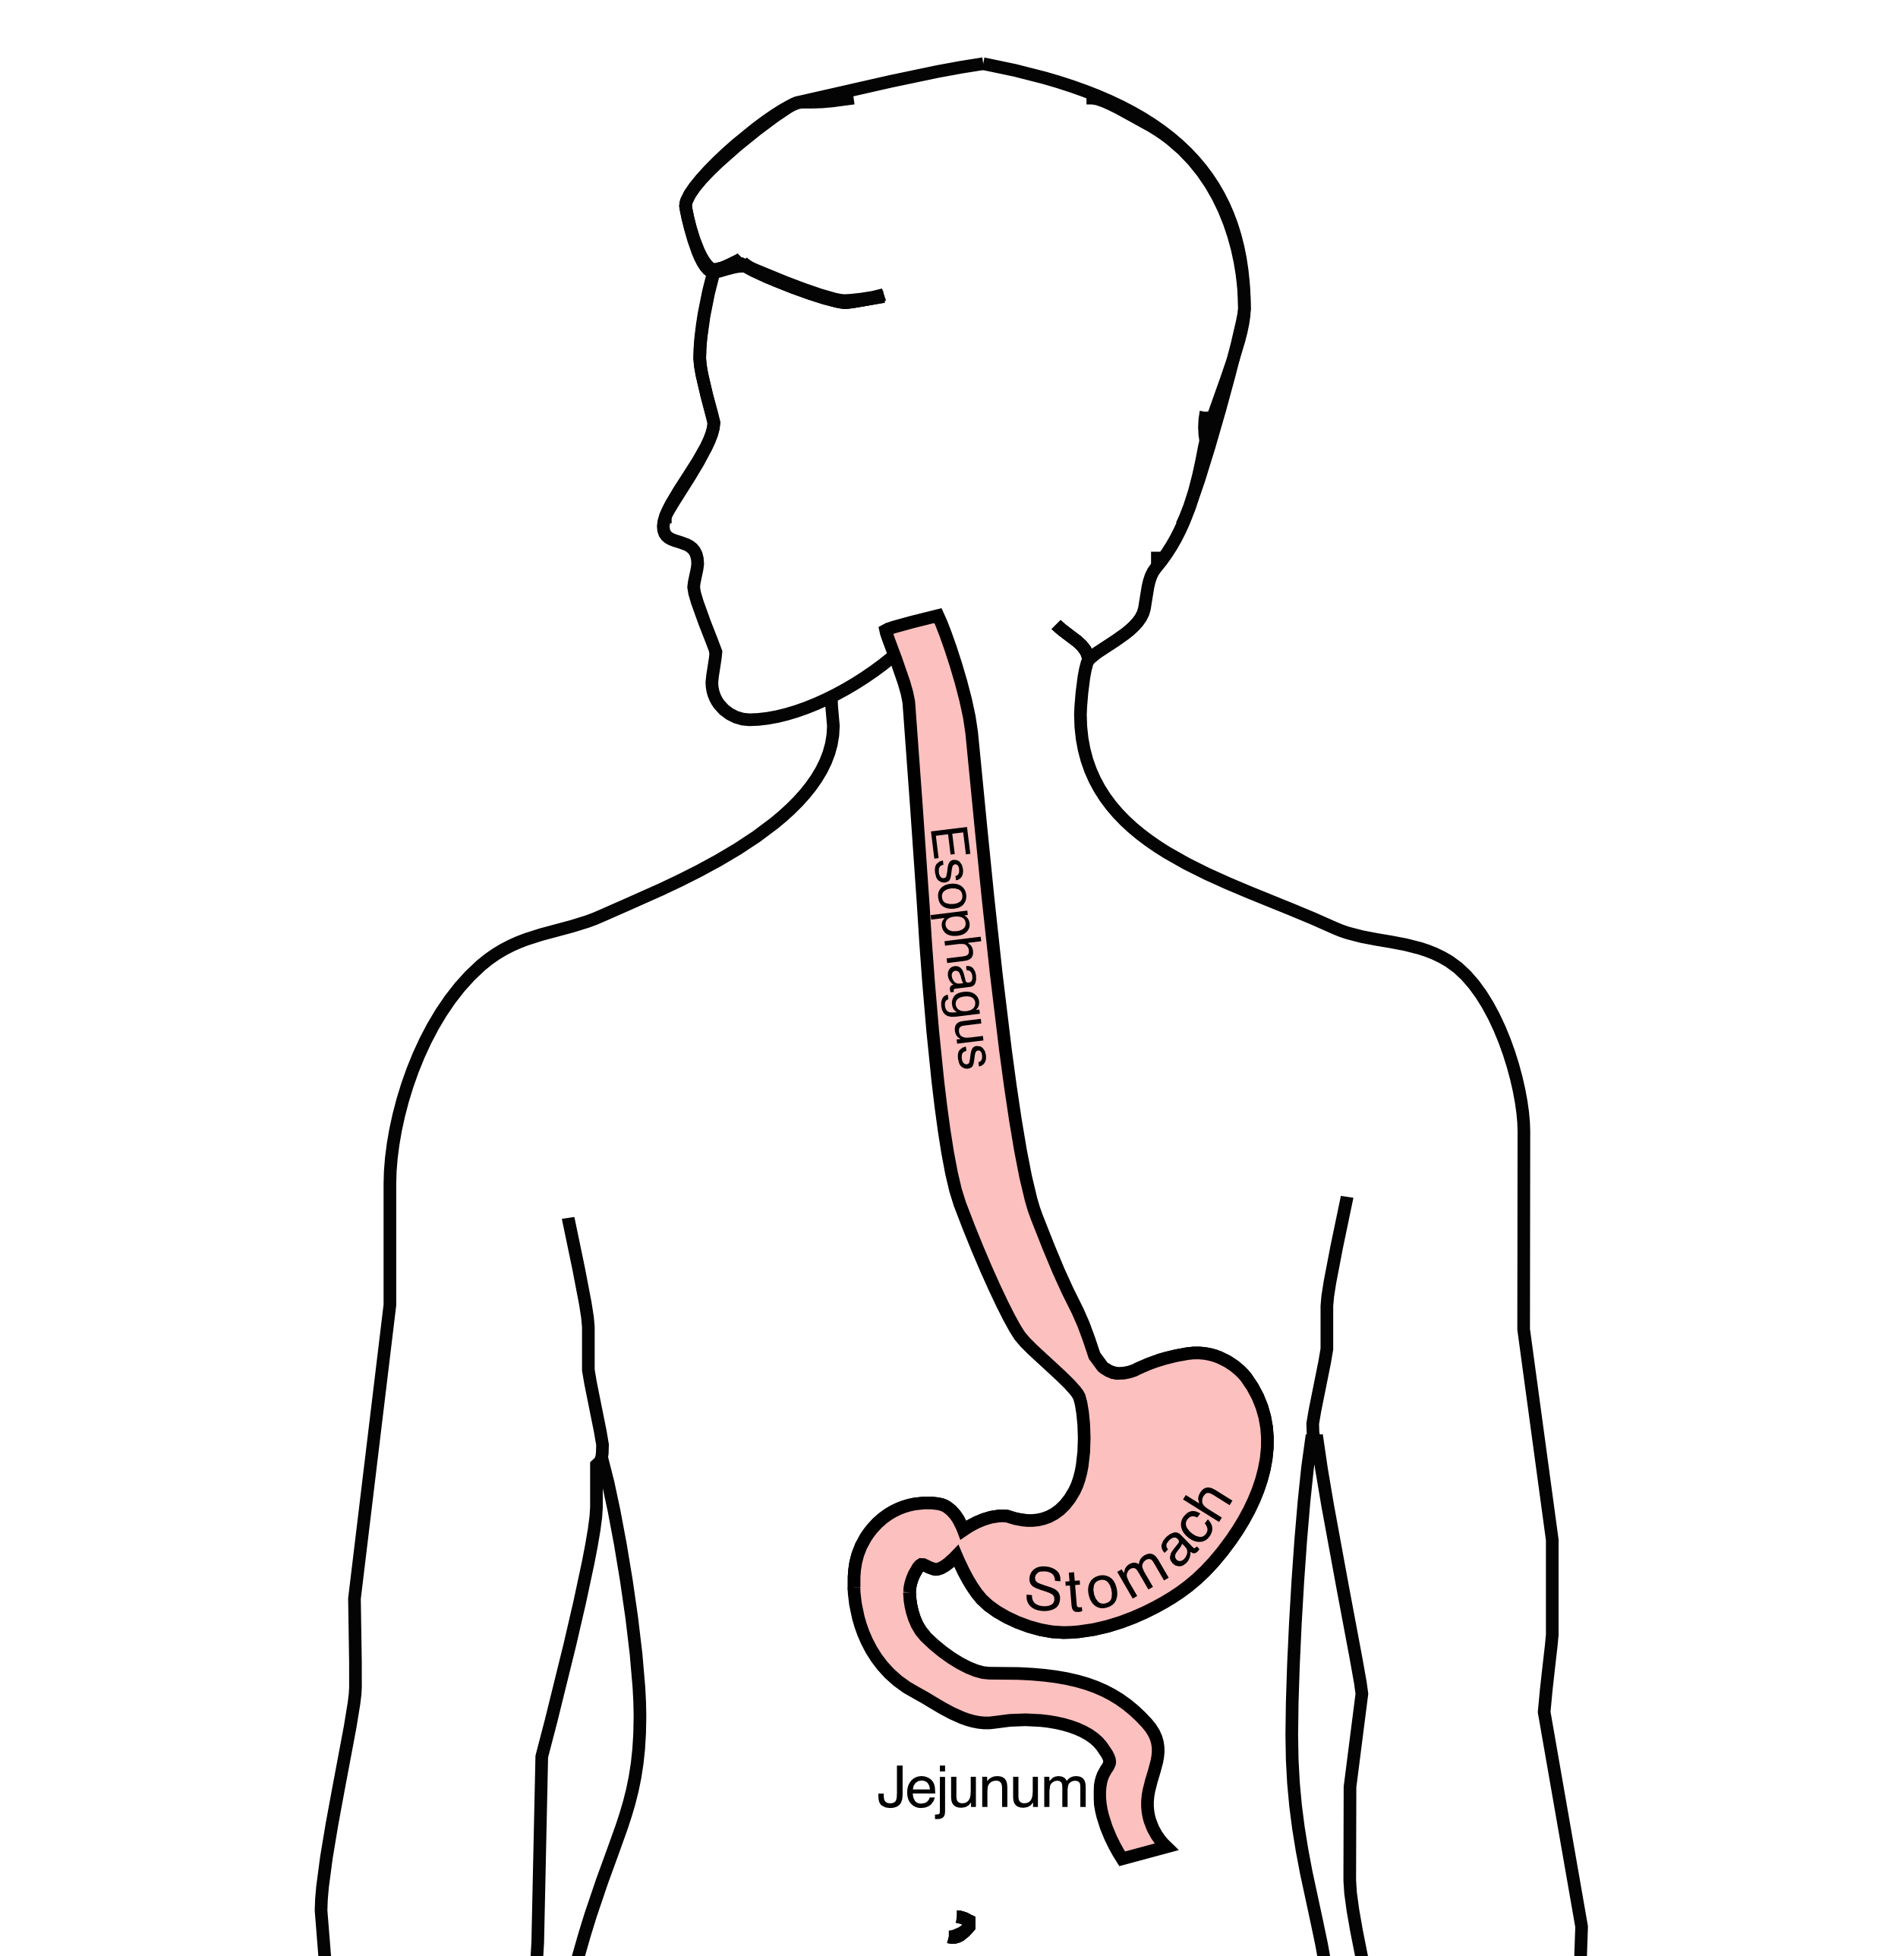
Anatomy
Food moves from the throat
$→$ esophagus
$→$ stomach
$→$ small bowel (jejunum)

Slide 3
Esophageal Cancer Staging
T = Tumor - Depth of growth into the wall of the esophagus
N = Nodes - Spread to the lymph nodes
M = Metastasis - Spread to liver, lungs, or bone

Slide 4
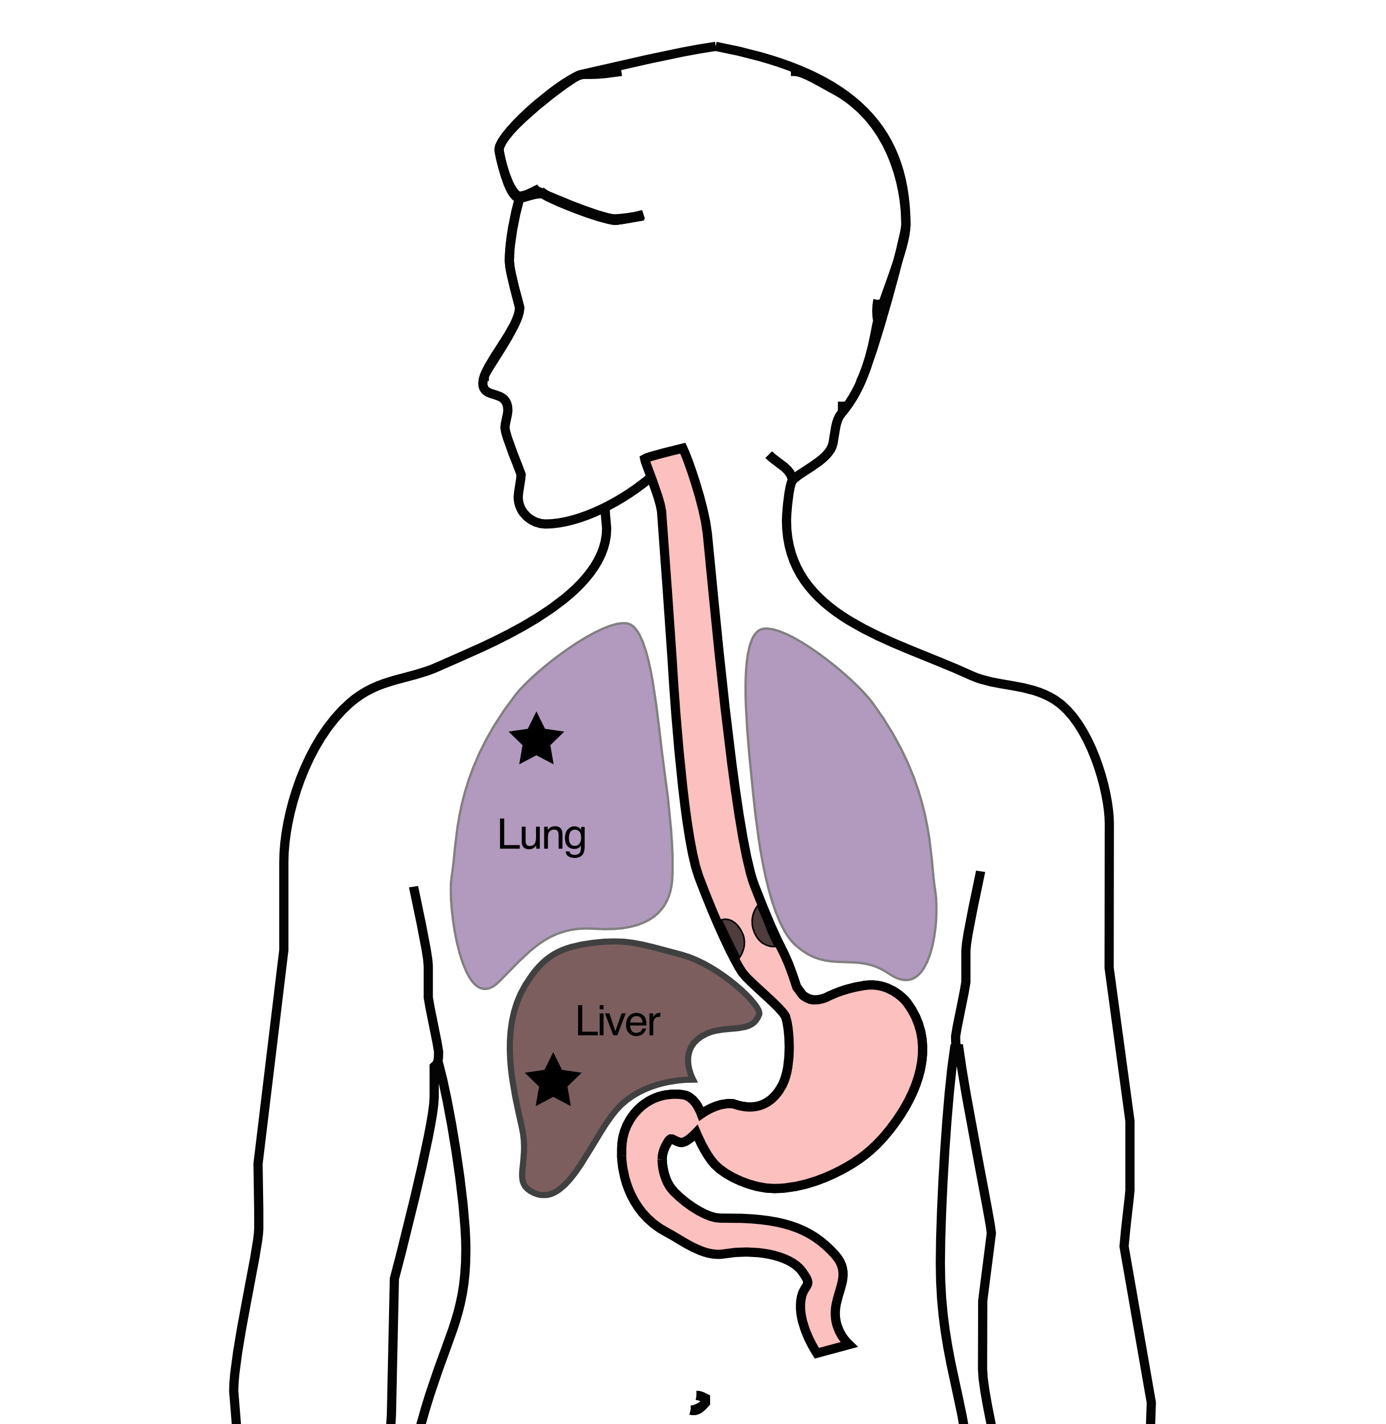
Metastatic Cancers
Metastatic cancers spread from the esophagus to other parts of the body
M0 cancers have not spread to other parts of the body
M1 cancers have spread lungs, liver, or bone
M1 cancers is also known as Stage 4

Slide 5
Treatment Plan
Superficial (T1) $Rightarrow$ Endoscopic Therapy
Localized (T1b/T2) $Rightarrow$ Surgery
Locally-advanced (T3/N1) $⇒$ Chemo $±$ Radiation $→$Surgery
Metastatic (M1) $⇒$ Systemic Therapy $±$ Radiation

Slide 6
Systemic Therapy
Systemic therapy is administered intravenously (or by mouth) and circulates to kill cancer cells anywhere in the body.
Chemotherapy (FOLFOX)
Immunotherapy (nivolumab, pembrolizumab)
Hormone therapy (herceptin)

Slide 7
Goals of Therapy
Symptom control
Prolong life
Minimize symptoms due to treatment

Slide 8
Systemic Therapy
By shrinking tumor and decreasing cancer burden
Can improve symptoms
Can prolong life
Goals:
Maximize cancer shrinkage
Minimize side-effects due to therapy

Slide 9
Radiation Therapy
Radiation uses high-energy x-rays to kill cancer cells
Bone metastasis: Can relieve pain
Esophagus: Can shrink tumor and improve eating

Slide 10
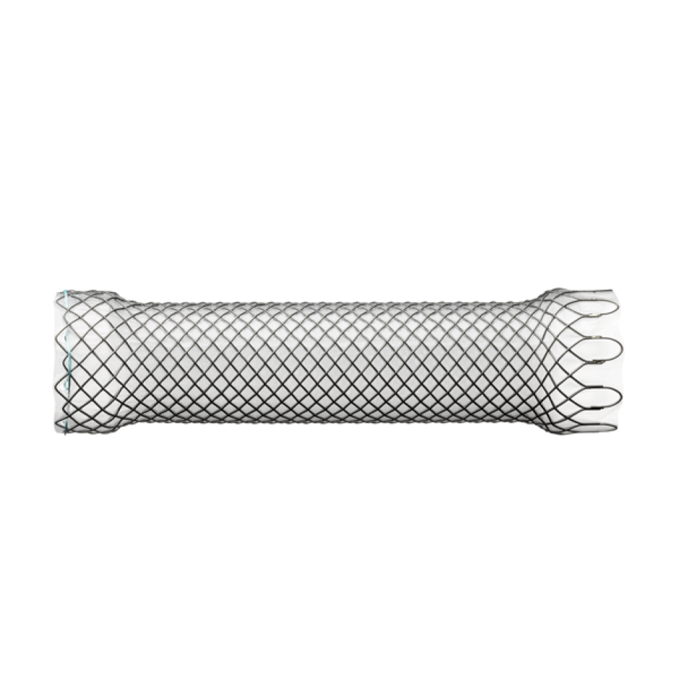
Endoluminal Stent
An endoluminal stent can be placed inside an esophageal cancer to improve eating

Slide 11
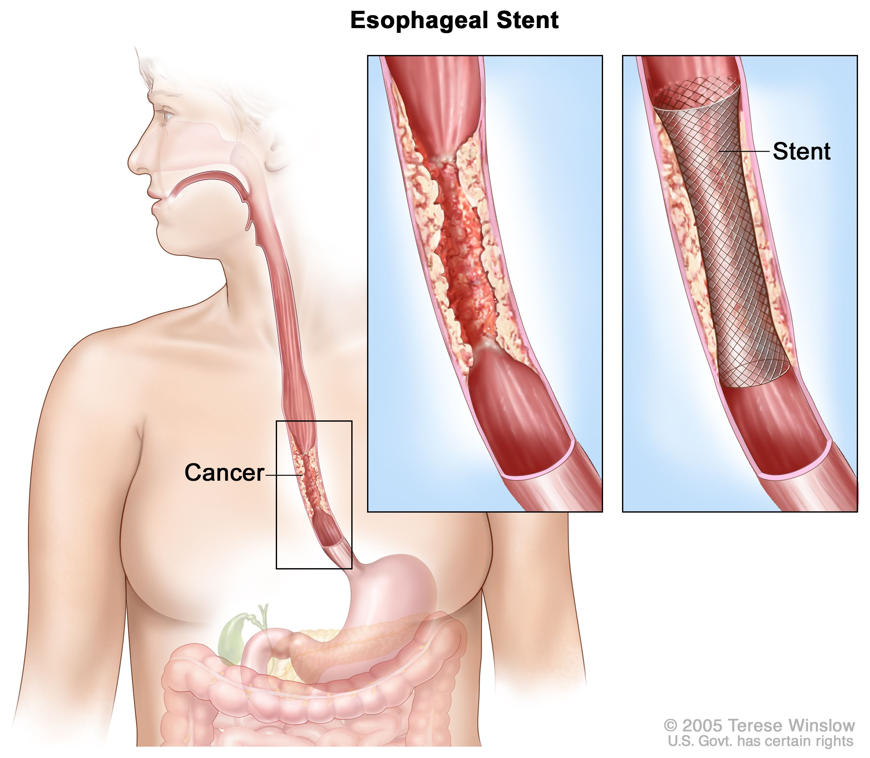
Endoluminal Stent
An endoluminal stent can be placed inside an esophageal cancer to improve eating

Slide 12
Endoluminal Stents
Advantages:
Outpatient endoscopic procedure (no surgery)
Can improve swallowing
Disadvantages:
Discomfort and reflux
Can make surgery to remove esophagus more complicated

Slide 13
Radiation Therapy - Esophagus
Radiation therapy to the esophagus can improve swallowing. There are two approaches:
Short Course
10 treatments over 2 weeks
Conventional Dosing
25-30 treatment over 5-6 weeks
Usually combined with low-dose chemo

Slide 14
Radiation Therapy - Bone
For patients with metastasis to bone causing pain
Radiation can provide pain relief
Typically 10 daily treatments over two weeks

Slide 15
Preparing for Cancer Treatment
Primary Care Physician
MyAtrium Portal
Exercise
Smoking Cessation

Slide 16
Primary Care Practitioner (PCP)
A PCP is critical to coordinate care between specialists.
We will update your PCP after each visit
If you do not have a PCP, call our referral line at (844) 235-6998

Slide 17
My Atrium Patient Portal
Critical to good communication with your cancer care team
Available for desktop or laptop or phone
Sign up at my.atriumhealth.org

Slide 18
Exercise
Important to reduce the risk of complications from cancer treatment
Goal is 30min/day of vigorous exercise 6 days/week
Working hard enough that you can’t carry a conversation
Start slow an build up
Every day counts! (Aim for some activity every day)

Slide 19
Smoking Cessation
Smoking makes it more difficult to get through cancer treatment
Increases risk of complications after surgery
Options for help with smoking cessation:
NC Quit Line 1-800-QUIT-NOW (1-800-784-8669)
American Lung Asssociation fredomfromsmoking.org
1:1 Smoking Cessation Counseling Clinics (Metro Charlotte)

Slide 20
GI Tract Anatomy
Esophagus delivers food to the stomach
Stomach stores food and delivers it in small quantities to the jejunum
Jejunum begins digestion in the small intestines

Slide 21
Protein Needs
Men: Average 75 grams/day
Women: Average 60 grams/day

Slide 22
Protein Shakes
Protein Shakes can provide protein with minimal sugar
Protein Shakes

Slide 23
Feeding Tubes
Jejunostomy = Small Intestine
Gastrostomy = Stomach

Slide 24
Gastrostomy Tube
Feeding Gastrostomy
Feeding with a syringe several times per day.
Tube can be hidden underneath clothing
Tube does not interfere with eating by mouth
Removed easily in the office when no longer needed

Slide 25
Gastrostomy Tube Methods
A gastrostomy tube can be placed either by endoscopy, which is called a PEG tube
A gastrostomy tube can also be placed by laparoscopy, which is usually preferred if surgery on the esophagus is planned in the future.
Your surgeon will help you decide which kind of tube is best for you. This is especially important if you will need esophageal surgery in the future, as the stomach is frequently used to make a new esophagus

Slide 26
Gastrostomy Tube
Outpatient Placement (go home the same day)
Central venous port can be placed at the same time (if needed)

Slide 27
Jejunostomy tube
The other type of feeding tube is a jejunostomy.
A jejunostomy tube tube is placed into the small intestines. Because the small intestine is used to receiving food in small quantities, a jejunostomy tube requires the use of a pump to deliver feedings gradually over a matter of hours.
In general, feedings are done at night in order to allow you to be active during the day

Slide 28
Jejunostomy Video
A video is available to help become familiar with the feeding jejunostomy
Gastrostomy = Stomach

Slide 29
Hospice
Hospice provides end-of-life care for patients whose priority is treatment of symptoms rather than systemic therapy of the cancer.
Usually provided in the home
Residential hospice is available as an alternative
Hospice team manages symptoms including pain managemnt

