Slide 1
GI Stromal Tumors of the Stomach

Slide 2
GI Stromal Tumors
Arise from the wall of the stomach
Grow slowly over time
Lymph nodes rarely involved
Not conventional stomach cancer

Slide 3
GIST vs Adenocarcinoma
GIST
Starts from wall of stomach
Slow growing
Rarely spreads to lymph nodes
Adenocarcinoma
Conventional “stomach cancer”
Starts from lining of stomach
Can spread to lymph nodes
More aggressive

Slide 4
Benign or Malignant?
GIST tumors have a range of behavior:
Small tumors tend to behave in a benign manner but can grow over time
Larger tumors tend to behave in a malignant (cancerous) manner

Slide 5
GIST Treatment
Initial treatment usually surgery
Gleevec pills after surgery for patients at high risk of recurrence
1 to 3 years depending upon risk
Large tumors treated with Gleevec before surgery

Slide 6
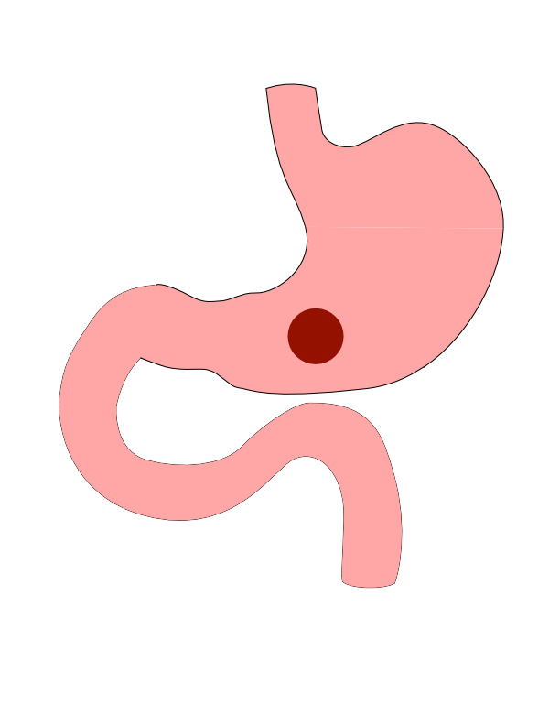
Patial Gastrectomy
GI Stromal Tumor can come in a variety of sizes

Slide 7
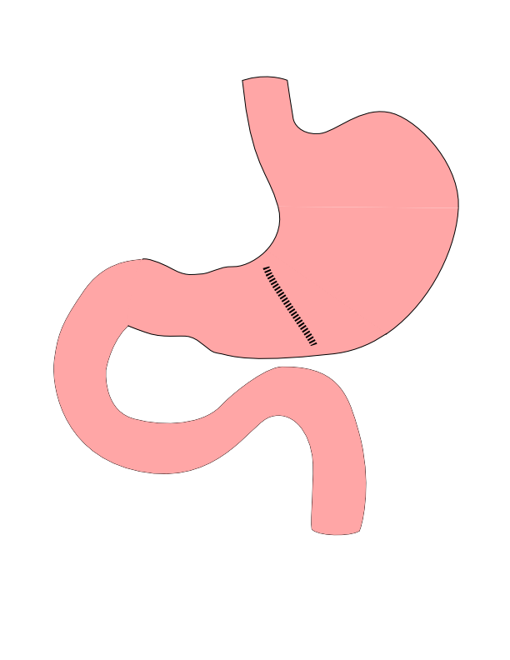
Partial Gastrectomy
- Tumor removed from wall - Stomach wall closed - Lymph nodes not removed

Slide 8
Partial Gastrectomy

Slide 9
Risks of Partial Gastrectomy
Leakage from closure of wall
Bleeding requiring return to surgery
Delayed stomach emptying

Slide 10
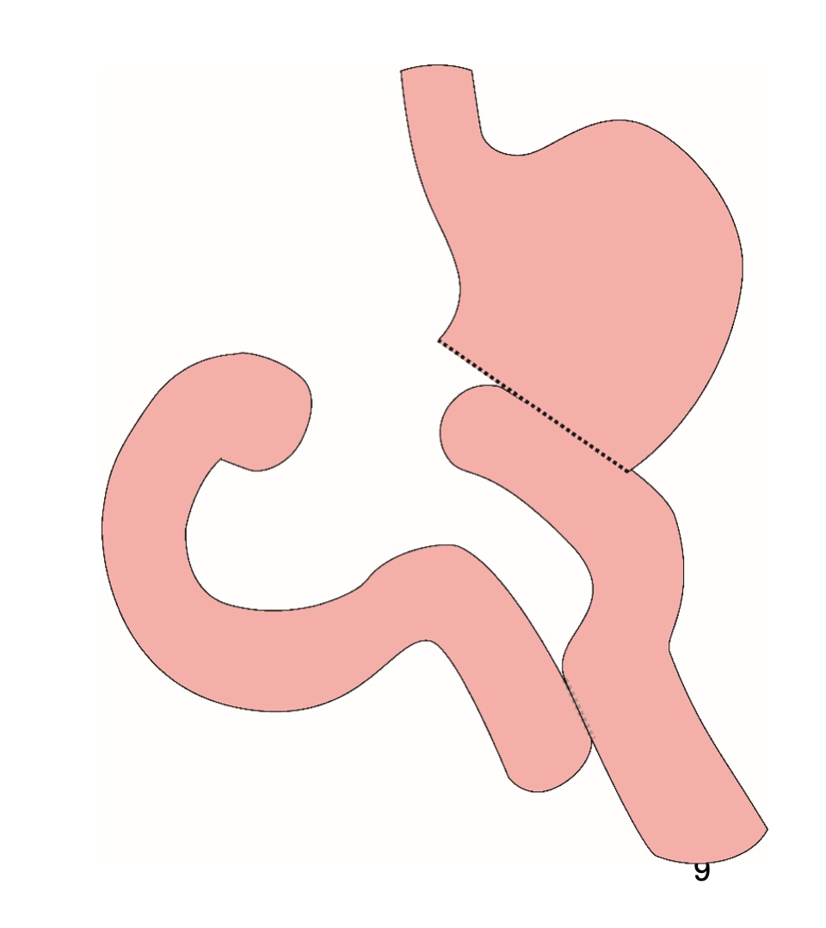
Distal Gastrectomy
Removes bottom half of the stomach
Rarely required for GI Stromal Tumors

Slide 11
Distal Gastrectomy

Slide 12
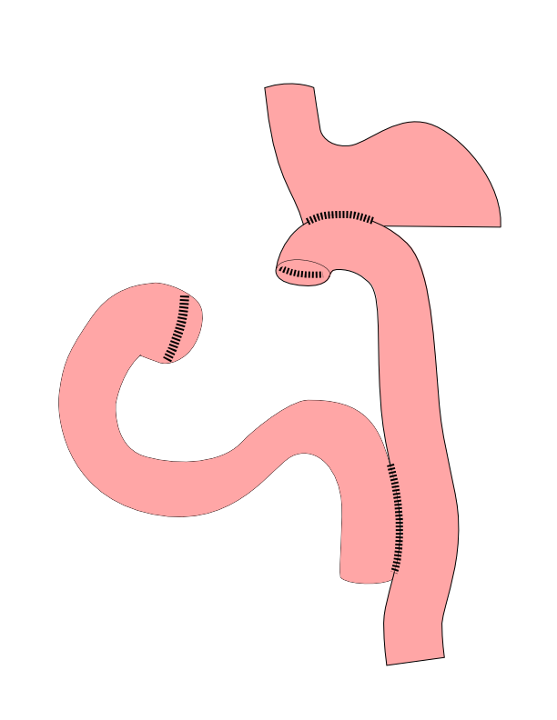
Subtotal Gastrectomy
Removes bottom 2/3 of stomach
Rarely required for GI Stromal Tumors

Slide 13
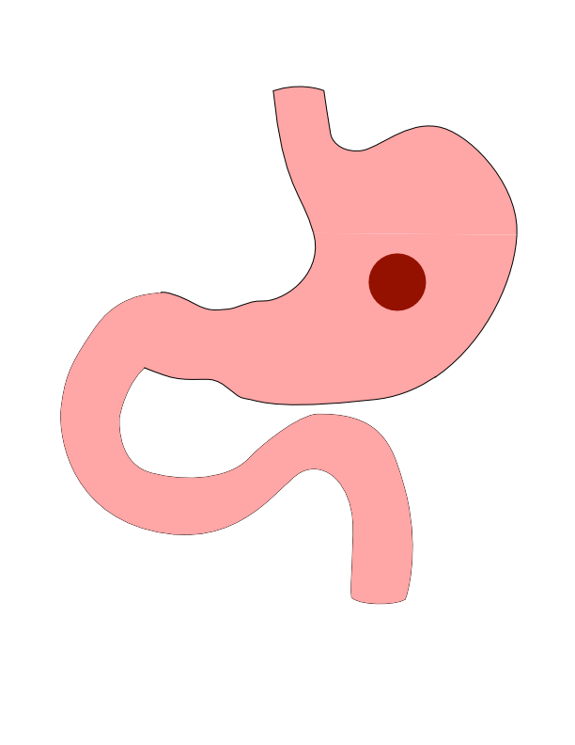
Subtotal Gastrectomy

Slide 14
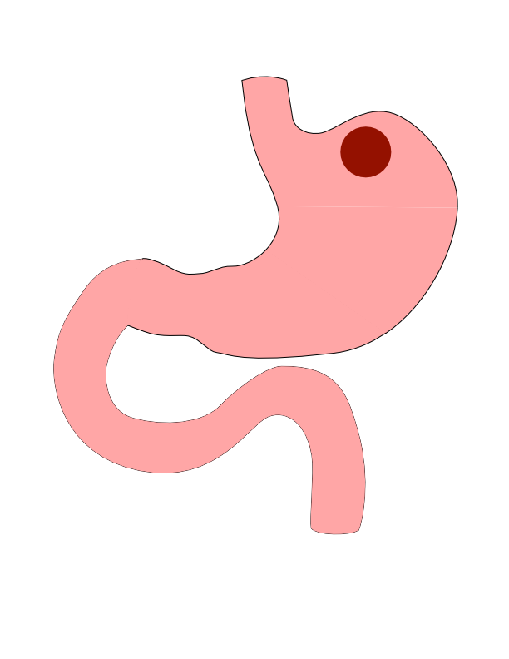
Proximal Tumors
Located near the top of the stomach
Challenging area for surgery

Slide 15
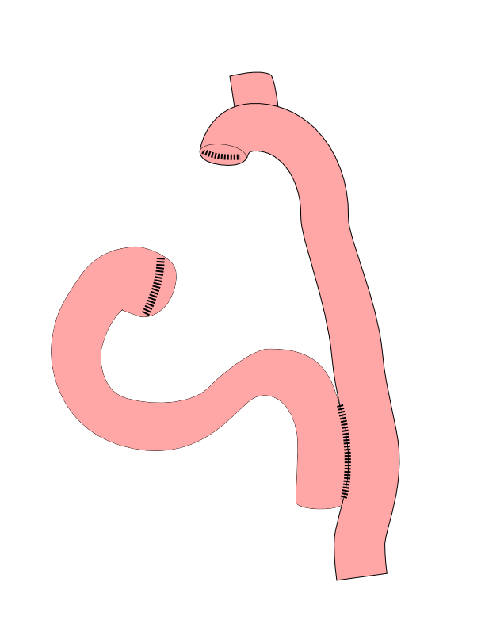
Total Gastrectomy
- Removes all of the stomach - Very rarely required for GI Stromal Tumors

Slide 16
Total Gastrectomy

Slide 17
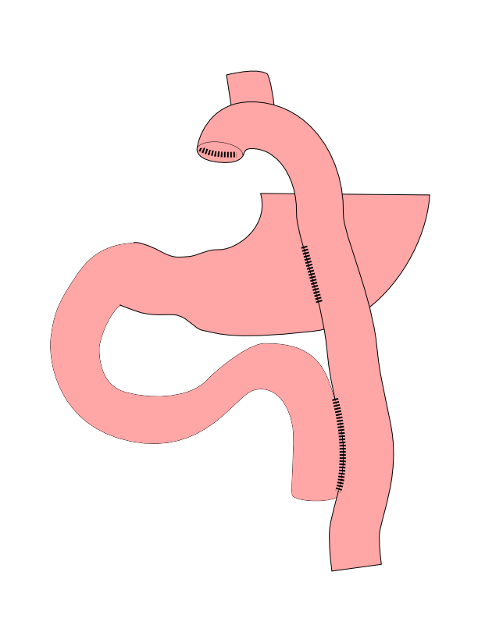
Dual Tract Gastrectomy
Alternative surgical approach for small tumors near the top of the stomach
Preserves the bottom of the stomach as a reservoir

Slide 18
Dual Tract Gastrectomy

Slide 19
Risks of Surgery
Leak where bowel is joined together (anastomosis)
Bleeding requiring reoperation
Delayed stomach function
Infection in the abdomen

Slide 20
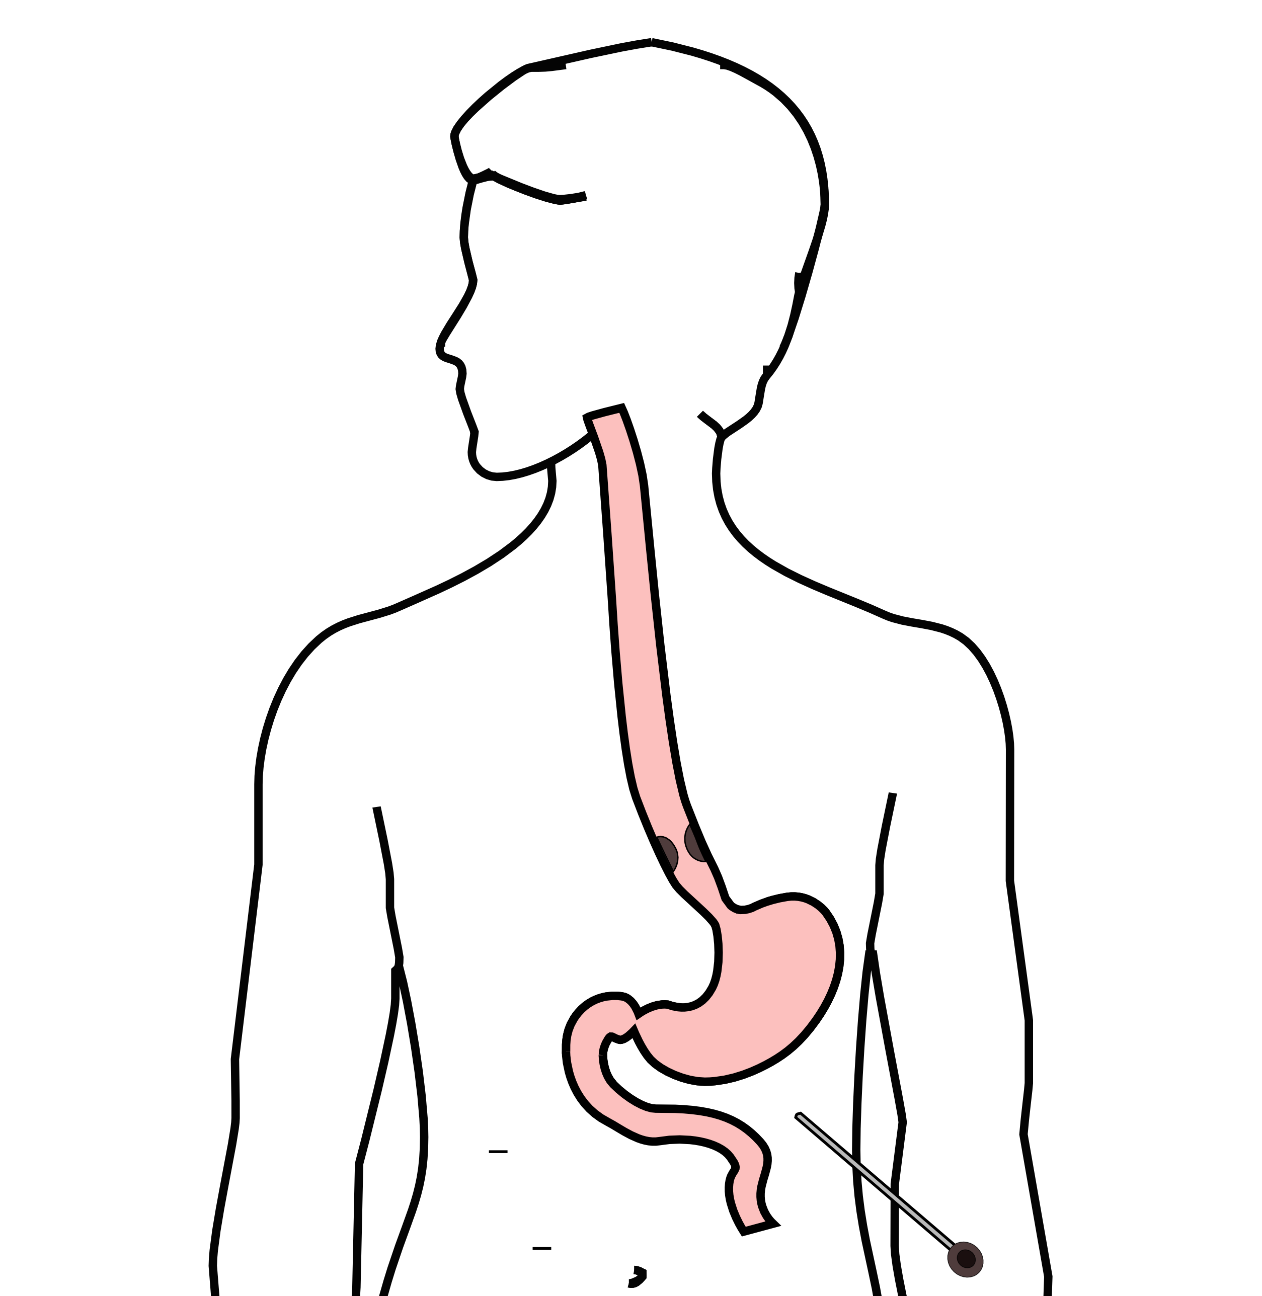
Laparoscopy
Some stomach cancers can spread inside the abdomen
Areas of spread can be very small (grain of rice)
Laparoscopy can detect spread inside the abdomen

Slide 21
Laparoscopy
A laparoscopy is performed under a general anesthetic.
Several incisions 1/4” long
A telescope is inserted to look inside the abdominal cavity.
Biopsies can be performed.

Slide 22
Preparing for Cancer Treatment
Primary Care Physician
MyAtrium Portal
Exercise
Smoking Cessation

Slide 23
Primary Care Practitioner (PCP)
A PCP is critical to coordinate care between specialists.
We will update your PCP after each visit
If you do not have a PCP, call our referral line at (844) 235-6998

Slide 24
My Atrium Patient Portal
Critical to good communication with your cancer care team
Available for desktop or laptop or phone
Sign up at my.atriumhealth.org

Slide 25
Exercise
Important to reduce the risk of complications from cancer treatment
Goal is 30min/day of vigorous exercise 6 days/week
Working hard enough that you can’t carry a conversation
Start slow an build up
Every day counts! (Aim for some activity every day)

Slide 26
Smoking Cessation
Smoking makes it more difficult to get through cancer treatment
Increases risk of complications after surgery
Options for help with smoking cessation:
NC Quit Line 1-800-QUIT-NOW (1-800-784-8669)
American Lung Asssociation fredomfromsmoking.org
1:1 Smoking Cessation Counseling Clinics (Metro Charlotte)

Slide 27
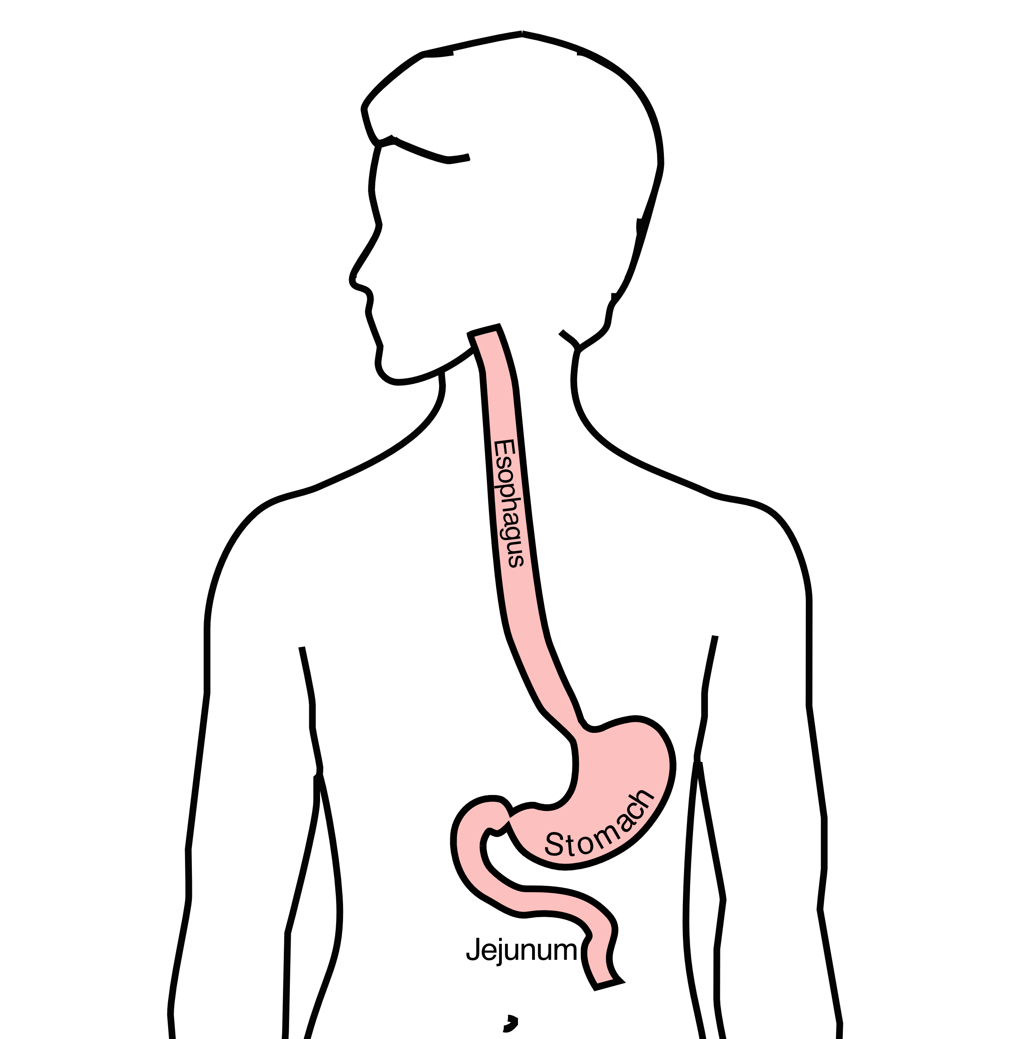
GI Tract Anatomy
Esophagus delivers food to the stomach
Stomach stores food and delivers it in small quantities to the jejunum
Jejunum begins digestion in the small intestines

Slide 28
Protein Needs
Men: Average 75 grams/day
Women: Average 60 grams/day

Slide 29
Protein Shakes
Protein Shakes can provide protein with minimal sugar
Protein Shakes

Slide 30
Feeding Tubes
Jejunostomy = Small Intestine
Gastrostomy = Stomach

Slide 31
Gastrostomy Tube
Feeding Gastrostomy
Feeding with a syringe several times per day.
Tube can be hidden underneath clothing
Tube does not interfere with eating by mouth
Removed easily in the office when no longer needed

Slide 32
Gastrostomy Tube Methods
A gastrostomy tube can be placed either by endoscopy, which is called a PEG tube
A gastrostomy tube can also be placed by laparoscopy, which is usually preferred if surgery on the esophagus is planned in the future.
Your surgeon will help you decide which kind of tube is best for you. This is especially important if you will need esophageal surgery in the future, as the stomach is frequently used to make a new esophagus

Slide 33
Gastrostomy Tube
Outpatient Placement (go home the same day)
Central venous port can be placed at the same time (if needed)

Slide 34
Jejunostomy tube
The other type of feeding tube is a jejunostomy.
A jejunostomy tube tube is placed into the small intestines. Because the small intestine is used to receiving food in small quantities, a jejunostomy tube requires the use of a pump to deliver feedings gradually over a matter of hours.
In general, feedings are done at night in order to allow you to be active during the day

Slide 35
Jejunostomy Video
A video is available to help become familiar with the feeding jejunostomy
Gastrostomy = Stomach

Slide 36
Gastrectomy Slideshow

