Slide 1
Stage IV Cancer of the Esophagus and GE Junction

Slide 2

Anatomy
Food moves from the throat
$→$ esophagus
$→$ stomach
$→$ small bowel (jejunum)

Slide 3
Esophageal Cancer Staging
T = Tumor - Depth of growth into the wall of the esophagus
N = Nodes - Spread to the lymph nodes
M = Metastasis - Spread to liver, lungs, or bone

Slide 4

Metastatic Cancers
Metastatic cancers spread to other parts of the body
M0 cancers have not spread to other parts of the body
M1 cancers have spread lungs, liver, or bone
M1 cancers is also known as Stage 4

Slide 5
Treatment Plan
Superficial (T1) $⇒$ Endoscopic Therapy
Localized (T1b/T2) $⇒$ Surgery
Locally-advanced (T3M0) $⇒$ Chemo $±$ Radiation $→$Surgery
Metastatic (M1) $⇒$ Systemic Therapy $±$ Radiation

Slide 6
Systemic Therapy
Systemic therapy is administered intravenously (or by mouth) and circulates to kill cancer cells anywhere in the body.
Chemotherapy (FOLFOX)
Immunotherapy (nivolumab, pembrolizumab)
Hormone therapy (herceptin)

Slide 7
Goals of Therapy
Symptom control
Prolong life
Minimize symptoms due to treatment

Slide 8
Systemic Therapy
By shrinking tumor and decreasing cancer burden
Can improve symptoms
Can prolong life
Goals:
Maximize cancer shrinkage
Minimize side-effects due to therapy

Slide 9
Chemotherapy Administration
Most chemotherapy is administered by vein.
Several options exist to administer chemotherapy:
Intravenous catheter in peripheral veins
Peripheral Intravenous Central Catheter (PICC)
Central Venous port

Slide 10

Intravenous Catheter in Peripheral Vein (“IV”)
IV catheter placed in vein of hand or arm
Allows administration of chemo and fluids
Placed for each dose
Removed that day
Not suitable for FLOT chemo

Slide 11

Central Venous Port
Implantable device makes chemo easier
May shower in 24 hrs
No special care at home
OK for FLOT chemo
Allows for blood draws

Slide 12

Central Venous Port
Implanted under skin
Neck incision (1/4”)
Incision below the collarbone
Sutures dissolve
“Superglue” on incisions

Slide 13

Central Venous Port
When it is time for chemotherapy, a needle is inserted through the skin into the port

Slide 14
Radiation Therapy
Radiation uses high-energy x-rays to kill cancer cells
Bone metastasis: Can relieve pain
Esophagus: Can shrink tumor and improve eating

Slide 15
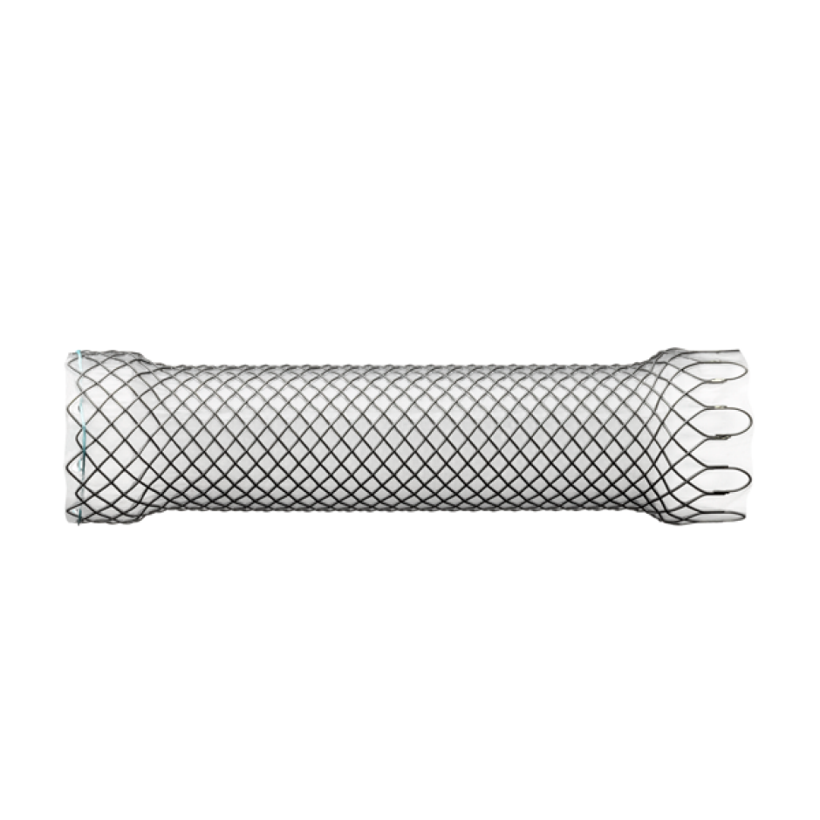
Endoluminal Stent
An endoluminal stent can be placed inside an esophageal cancer to improve eating

Slide 16
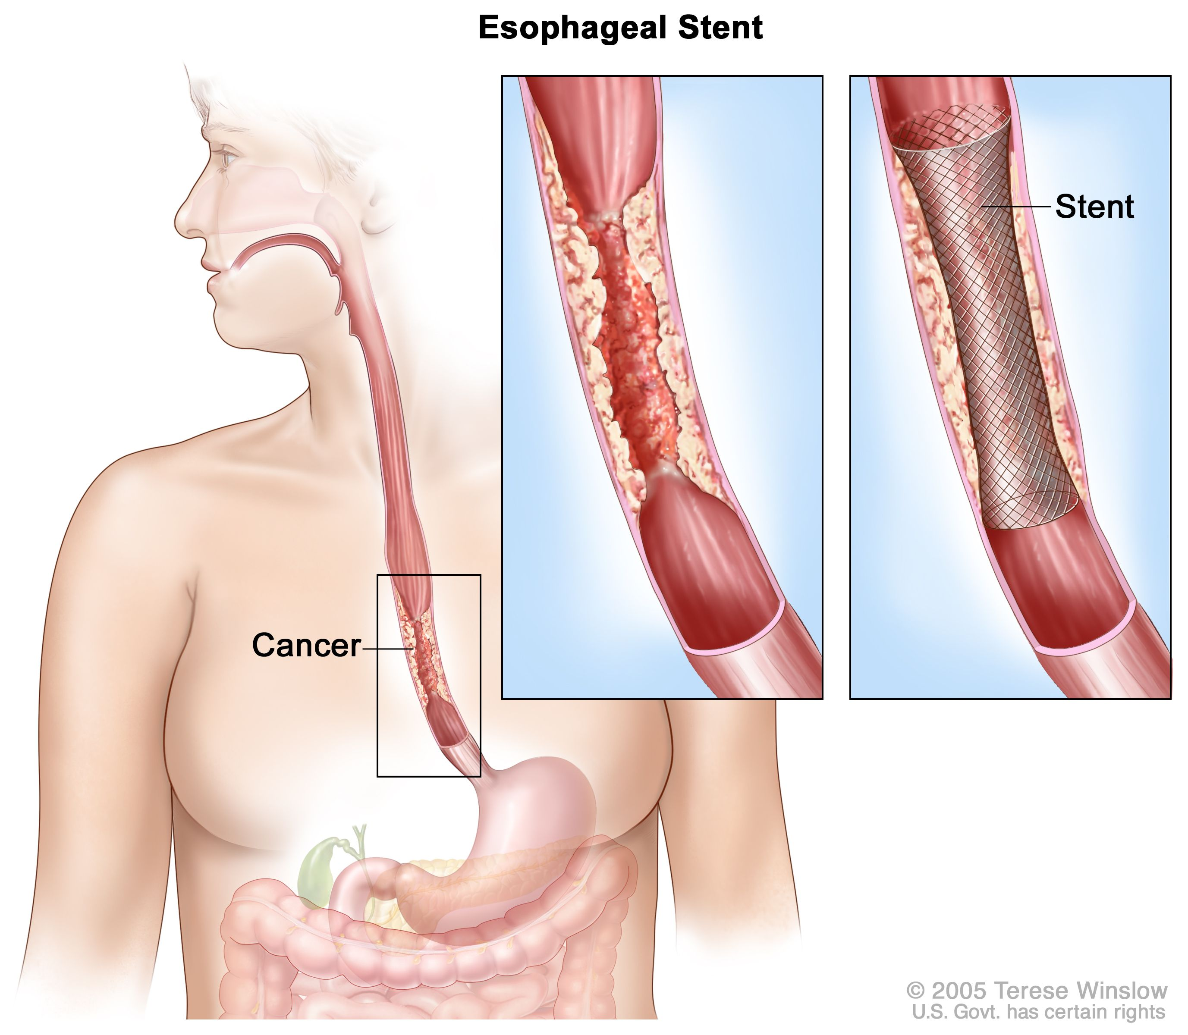
Endoluminal Stent
An endoluminal stent can be placed inside an esophageal cancer to improve eating

Slide 17
Endoluminal Stents
Advantages:
Outpatient endoscopic procedure (no surgery)
Can improve swallowing
Disadvantages:
Discomfort and reflux
Can make surgery to remove esophagus more complicated

Slide 18
Radiation Therapy - Esophagus
Radiation therapy to the esophagus can improve swallowing. There are two approaches:
Short Course
10 treatments over 2 weeks
Conventional Dosing
25-30 treatment over 5-6 weeks
Usually combined with low-dose chemo

Slide 19
Radiation Therapy - Bone
For patients with metastasis to bone causing pain
Radiation can provide pain relief
Typically 10 daily treatments over two weeks

Slide 20
Primary Care Practitioner (PCP)
Critical to coordinate care between specialists.
We will update your PCP after each visit
PCP Referral Line (844) 235-6998

Slide 21
My Atrium Patient Portal
Critical to good communication with your care team
Available for desktop or laptop or phone
Sign up at my.atriumhealth.org

Slide 22
Exercise
Reduces risk of complications from treatment
Goal is 30min/day of vigorous exercise 6 days/wk
  Working hard enough that you can’t converse
  Start slowly and build up
  Every day counts! (Aim for daily activity)

Slide 23
Smoking Cessation
Smoking makes cancer treatment more difficult
  Increases risk of complications after surgery
Options for help with smoking cessation:
  NC Quit Line 1-800-QUIT-NOW (1-800-784-8669)
  American Lung Assn www.freedomfromsmoking.org
  Smoking Cessation Counseling (Metro Charlotte)

Slide 24
Hospice
Hospice provides end-of-life care for patients whose priority is treatment of symptoms rather than systemic therapy of the cancer.
Usually provided in the home
Residential hospice is available as an alternative
Hospice team manages symptoms including pain managemnt

