Slide 1
Surgery of the Stomach

Slide 2
Stomach Cancer Surgery Goals
Staging refers to the tests to determine
Remove the tumor
Remove lymph nodes (depends upon tumor type)
Preserve stomach function
Reconstruct GI tract
Treatment options depend upon the cancer stage

Slide 3
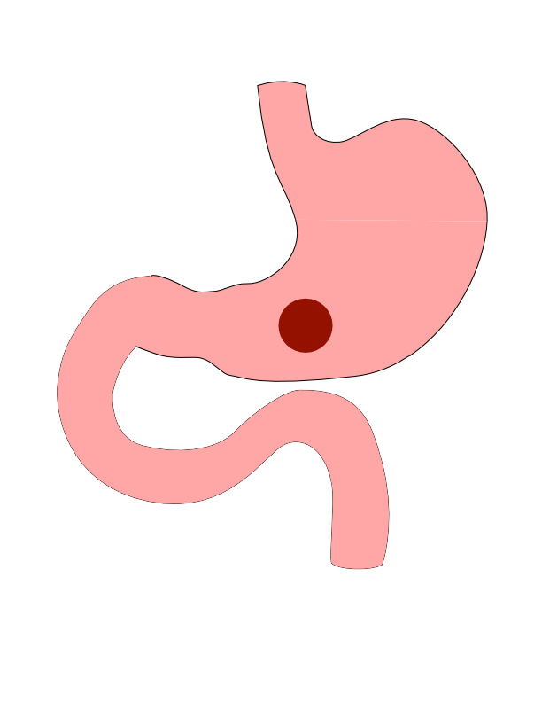
Distal Cancers
Distal cancers are those in the lower part of the stomach

Slide 4
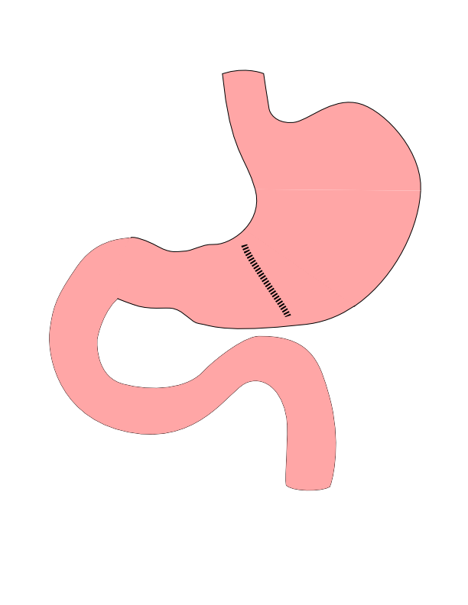
Partial Gastrectomy
- Removes the tumor - Does not remove lymph nodes - Best suited for: - Small adenocarcinoma - GI Stromal Tumors

Slide 5
Partial Gastrectomy

Slide 6
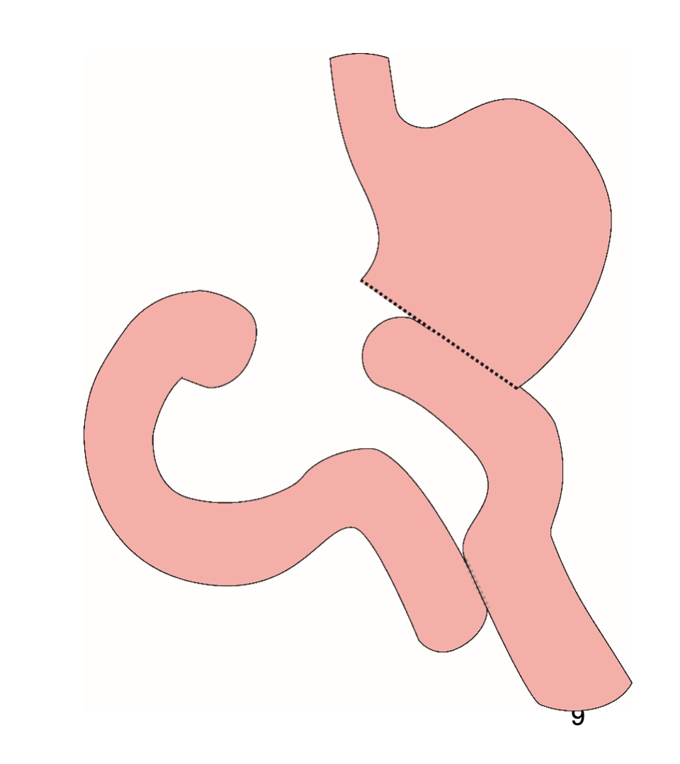
Distal Gastrectomy
Removes bottom half of the stomach
Does not remove all lymph nodes
Suitable for small tumors or GIST

Slide 7
Distal Gastrectomy

Slide 8
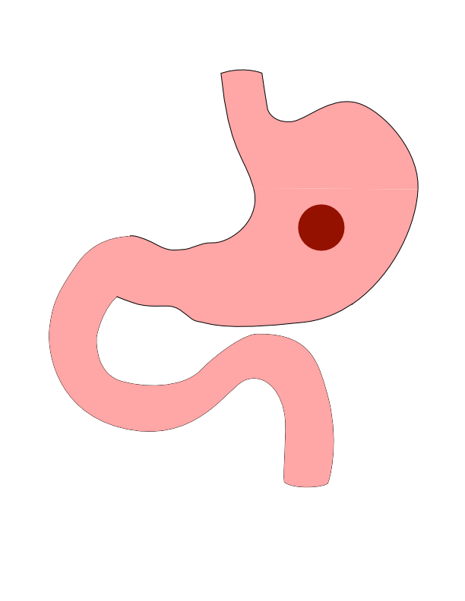
Body Cancers
Body is the mid-portion of the stomach

Slide 9
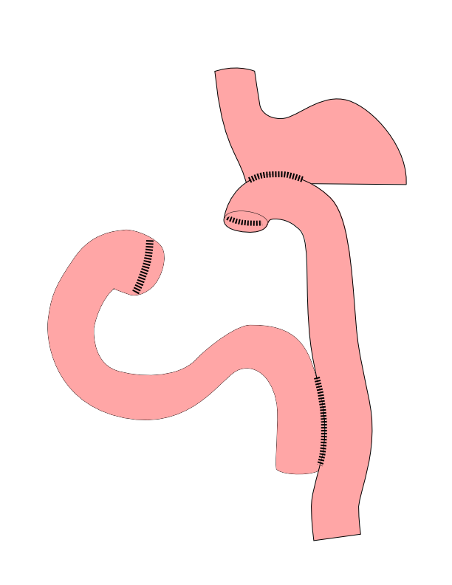
Subtotal Gastrectomy
- Removes bottom 2/3 of stomach - Removes nearby lymph nodes - Reconstruction with small intestine

Slide 10
Subtotal Gastrectomy

Slide 11
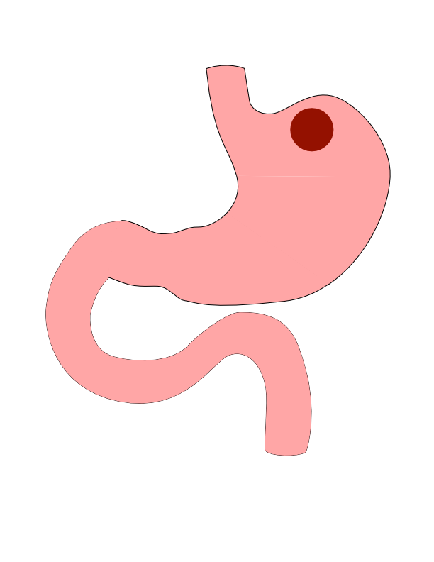
Proximal Tumors
- Located near the top of the stomach - Challenging area for surgery

Slide 12
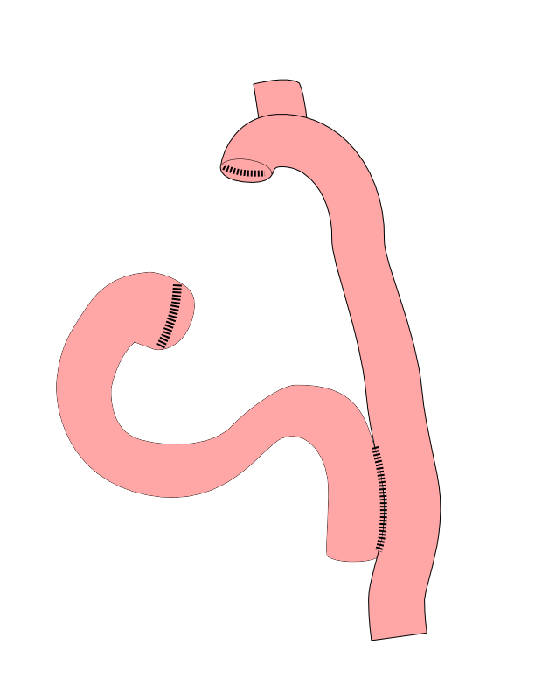
Total Gastrectomy
- Removes all of the stomach - Reconstruction with small intestine - Needed for those with CDH1 mutations

Slide 13
Total Gastrectomy

Slide 14
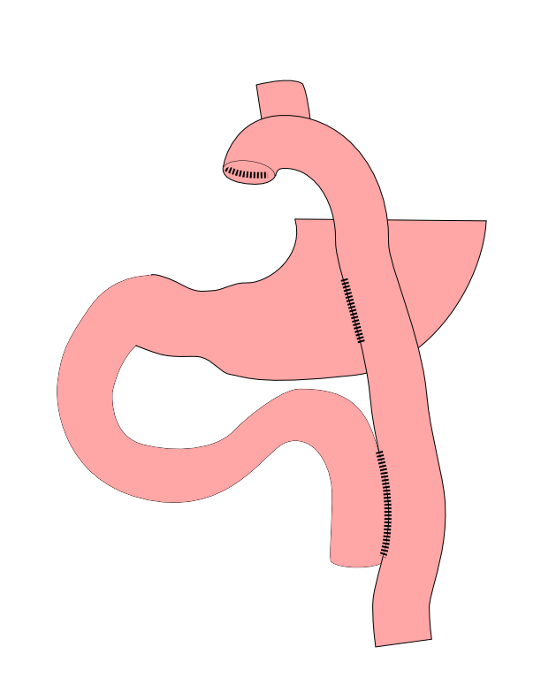
Dual Tract Gastrectomy
Alternative surgical approach for small tumors near the top of the stomach
Preserves the bottom of the stomach as a reservoir

Slide 15
Dual Tract Gastrectomy

Slide 16
Risks of Surgery
Leak where bowel is joined together (anastomosis)
Bleeding requiring reoperation
Delayed stomach function
Infection in the abdomen

Slide 17
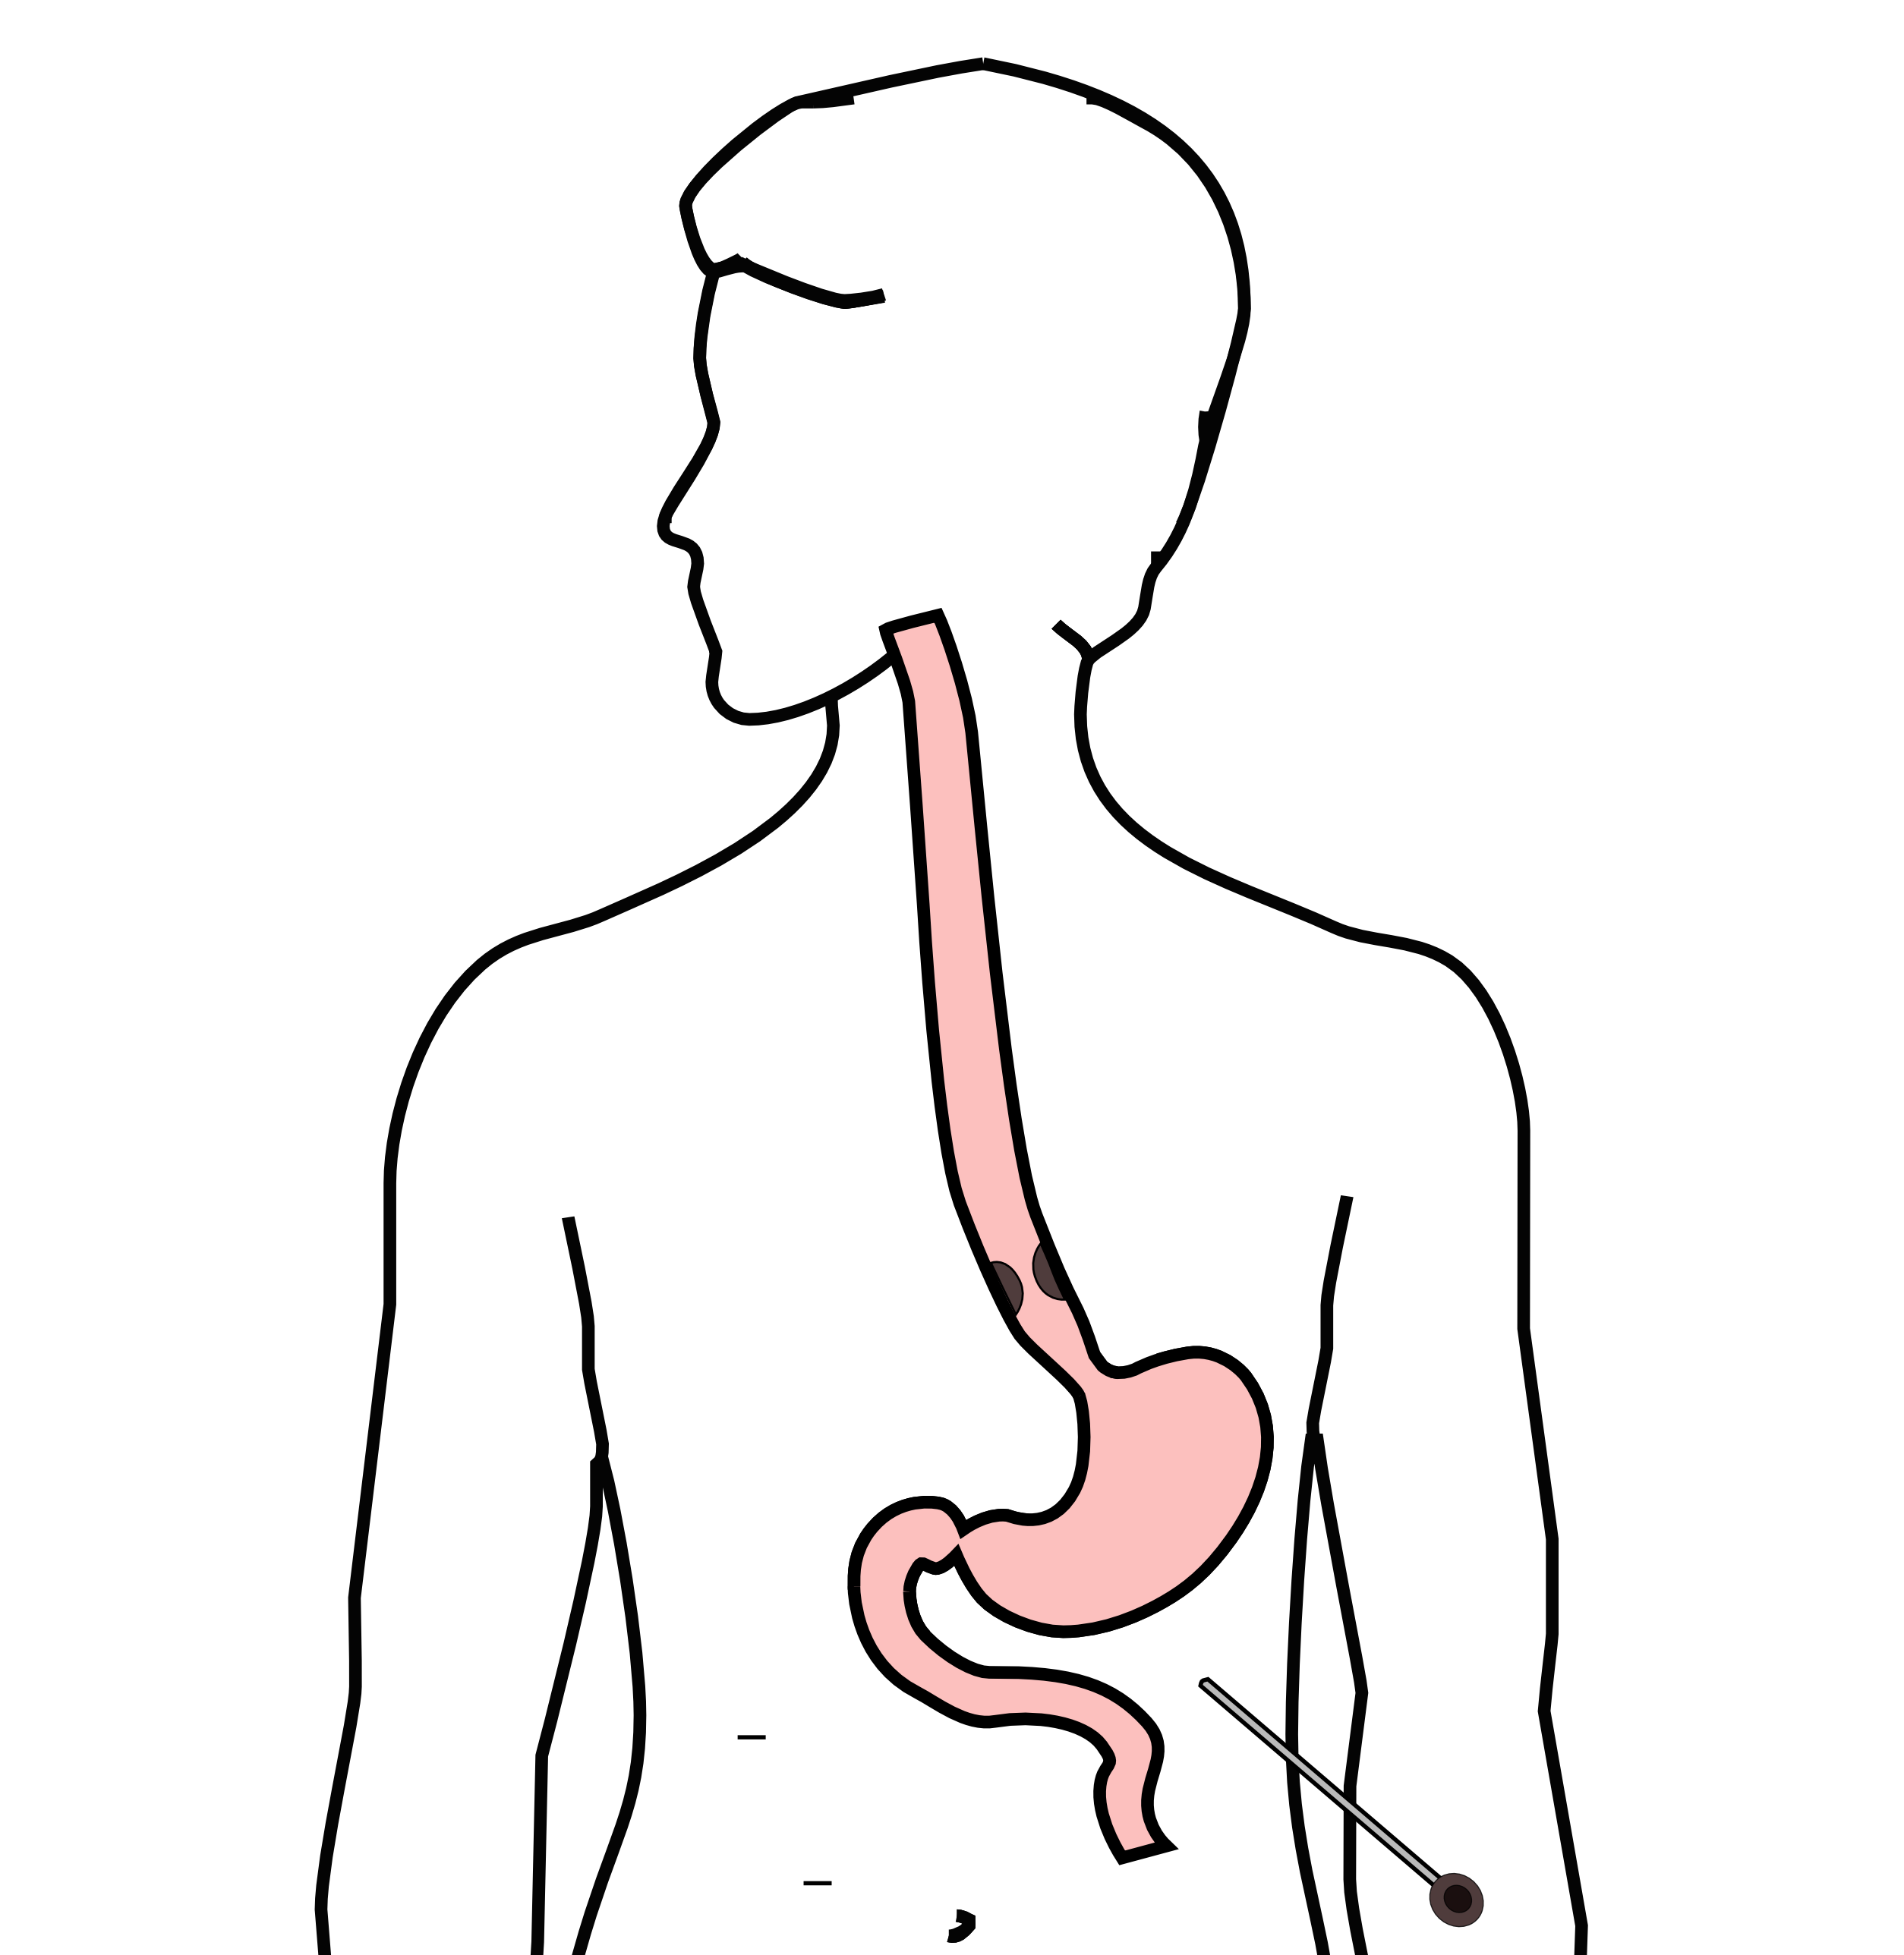
Laparoscopy
Some stomach cancers can spread inside the abdomen
Areas of spread can be very small (grain of rice)
Laparoscopy can detect spread inside the abdomen

Slide 18
Laparoscopy
A laparoscopy is performed under a general anesthetic.
Several incisions 1/4” long
A telescope is inserted to look inside the abdominal cavity.
Biopsies can be performed.

Slide 19
Exercise

Slide 20
Smoking

Slide 21
Other Presentations
Nutrition Slideshow
Gastrectomy Slideshow

