Slide 1
Nutrition

Slide 2
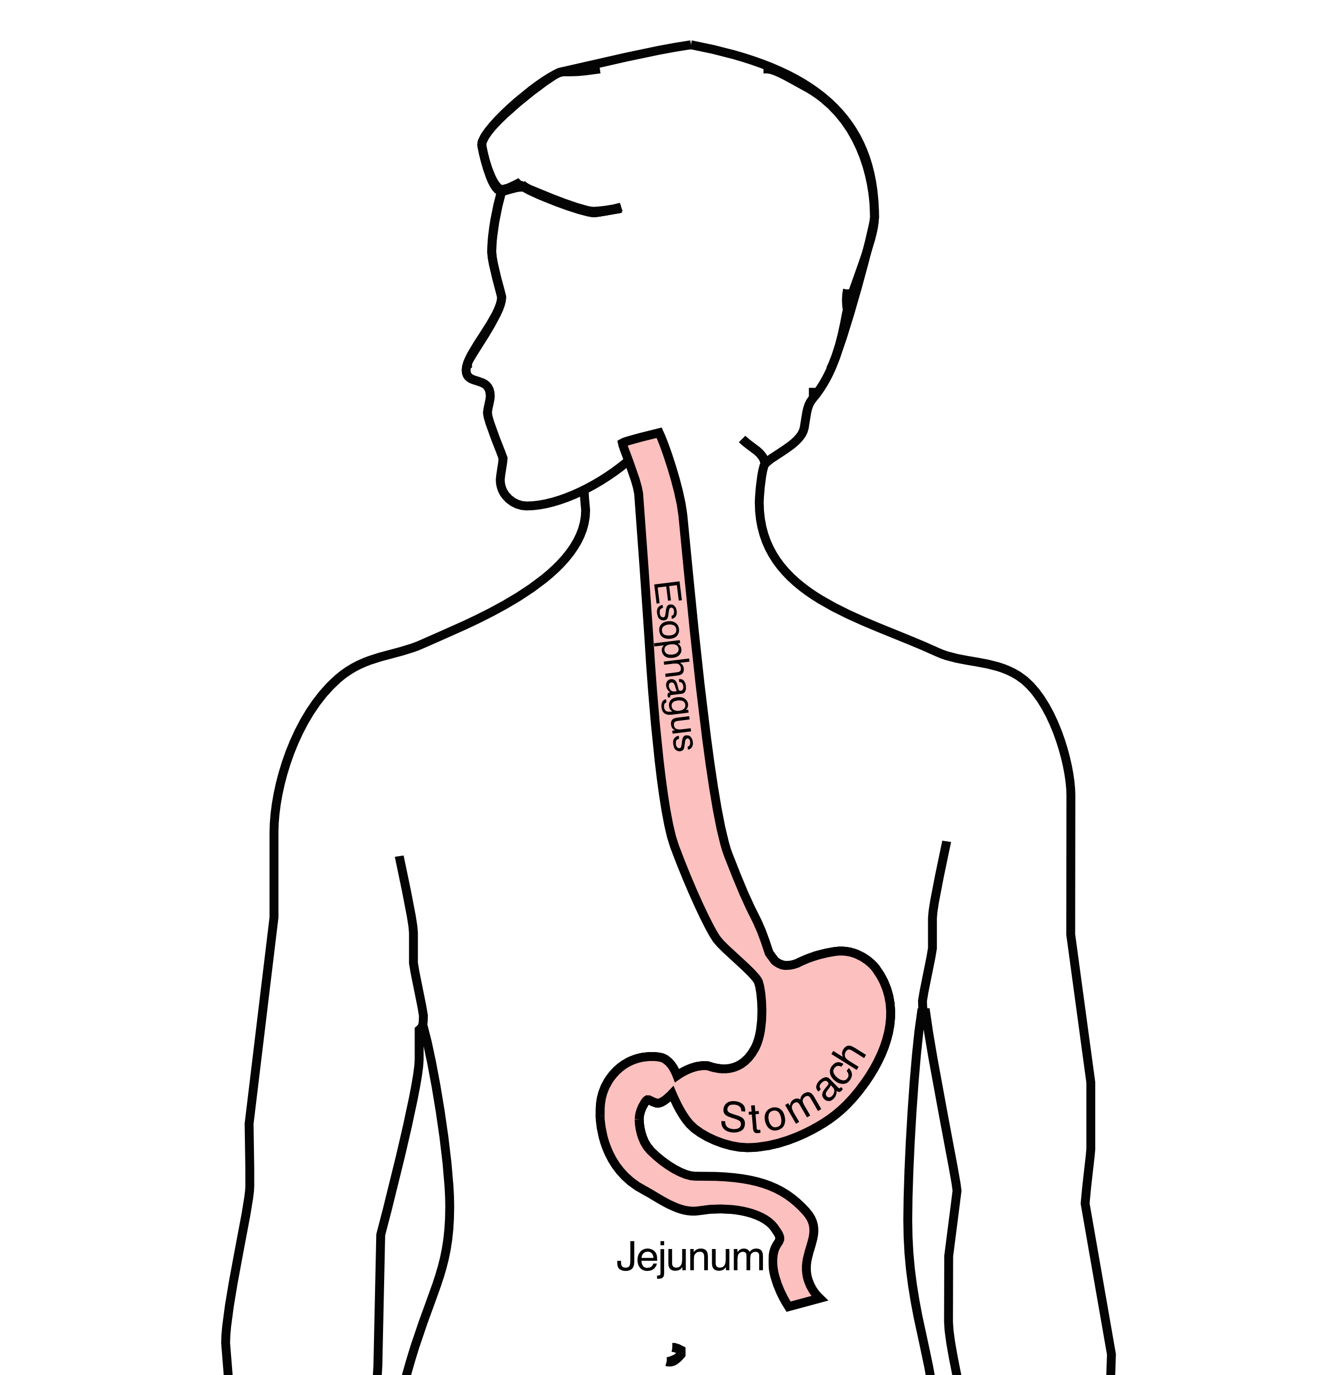
GI Tract Anatomy
Esophagus delivers food to the stomach
Stomach stores food and delivers it in small quantities to the jejunum
Jejunum begins digestion in the small intestines

Slide 3
Protein Needs
Men: Average 75 grams/day
Women: Average 60 grams/day

Slide 4
Protein Shakes
Protein Shakes can provide protein with minimal sugar
Protein Shakes

Slide 5
Feeding Tubes
Jejunostomy = Small Intestine
Gastrostomy = Stomach

Slide 6
Gastrostomy Tube
Feeding Gastrostomy
A gastrostomy tube allows feeding with a syringe, which can be done several times per day.
When it’s not being used, the gastrostomy tube can be hidden underneath clothing.
For patient who later need surgery on the esophagus, it will be necessary to remove the
gastrostomy tube and place a jejunostomy tube, as the stomach frequently used to create a new
esophagus

Slide 7
Gastrostomy Tube Methods
A gastrostomy tube can be placed either by endoscopy, which is called a PEG tube
A gastrostomy tube can also be placed by laparoscopy, which is usually preferred if surgery on the esophagus is planned in the future.
Your surgeon will help you decide which kind of tube is best for you. This is especially important if you will need esophageal surgery in the future, as the stomach is frequently used to make a new esophagus

Slide 8
Gastrostomy Tube
Outpatient Placement (go home the same day)
Central venous port can be placed at the same time (if needed)

Slide 9
Jejunostomy tube
The other type of feeding tube is a jejunostomy.
A jejunostomy tube tube is placed into the small intestines. Because the small intestine is used to receiving food in small quantities, a jejunostomy tube requires the use of a pump to deliver feedings gradually over a matter of hours.
In general, feedings are done at night in order to allow you to be active during the day

Slide 10
Jejunostomy
A jejunostomy tube is used in cases where it’s not possible to place a gastrostomy tube, such as when there is a tumor in the stomach. A jejunostomy tube is routinely used after esophageal surgery, so in patients who need help with nutrition prior to surgery, it makes sense to put in a jejunostomy tube before surgery. The same tube can then be used for nutrition both before and after surgery.

