Slide 1
Preparing for your Esophagectomy

Slide 2
Team Members - Physicians
Primary Care Provider
Gastroenterologist
Medical Oncologist (chemotherapy)
Radiation Oncologist (radiation)
Surgeons
Jonathan Salo MD
Kelli Salter MD
Michael Roach MD

Slide 3
Team Members - Support Staff
Physician Assistant: Kate Duncan PA-C
Dietitian: Liz Koch
Nurses
Matthew Carpenter RN
Brandon Galloway LPN
Navigators: Laura Swift RN & Lorna Espinal RN
Care Coordinator: Karen Julian-Martinez

Slide 4
Nutrition Prior to Surgery
High-protein diet (60-80 grams protein/day)
Protein shakes (Premier or Fairlife) with minimal sugar
Important to avoid weight loss prior to surgery
Good nutrition improves wound healing and recovery

Slide 5
Exercise Prior to Surgery
Goal: 30 minutes of vigorous exercise 6 days/week
Vigorous: Working hard enough you can’t talk
Types of Exercise:
Walking: Outside, Treadmilll, or an indoor Mall
Stationary Exercise Bike
Light weights and stretching are helpful in addition

Slide 6
Day Prior to Surgery
Clear liquids for dinner evening prior
You will receive instructions regarding medicines
Stop tube feeds at midnight night before

Slide 7
Morning of Surgery
Unless instructed otherwise:
Arrival time is usually 2-3 hours before the surgery time.
  Monday, Tuesday, Wednesday, Friday: Arrive 4am
  Thursday: Arrive 5am
Nothing to eat or drink after midnight

Slide 8
Medicines the Morning of Surgery
Medicines with a sip of water or black coffee
No milk or cream
Surgery will be cancelled if you take milk or cream the morning of surgery

Slide 9
Hospitality House
Guest house for patients and families
Located walking distance from hospital
Shuttle service available
Make reservation request through clinic nurses
Cost $50 per night

Slide 10
Parking and Arrival
Blue Parking Deck: 1716 Medical Center Drive, Charlotte NC 28204
Patient Drop Off: 1096 Blythe Blvd, Charlotte NC 28204
Dixon Tower entrance(Traffic circle with Fountains)
Check in and tell them you will have surgery
Staff will escort you to the Preoperative area on 5th floor

Slide 11
Day of Surgery
Waiting Room on 5th floor for families
Surgery completed 3pm - 5pm
Transfer to Surgical Intensive Care Unit 4pm - 6pm
Visitors permitted into the ICU 5pm - 7pm

Slide 12
What to Bring to the Hospital
No jewelery or valuables
Cell phone and charger
Insurance cards
Underwear you don’t mind discarding

Slide 13
Visitor’s Policy
Intensive Care Unit
Two visitors at a time 8am - 8pm
One “Care Partner” can stay overnight in ICU
Ward
All rooms are private rooms
Day bed available for a family member
Visiting hours 8am - 8pm
No visitors please who have a cough or fever!

Slide 14
Preparation for Surgery
Medical evaluation may be needed before surgery:
Pulmonary Function Tests to test lung function
Cardiology evaluation to test heart function
  Echocardiogram
  Stress Test
  Holter monitor

Slide 15
Esophagectomy for Cancers of the Esophagus or GE Junction
Primary Surgery
Superficial Tumors (T1) not removed by endoscopy
Localized Tumors (T2 N0 M0)
Surgery scheduled after medical evaluation
Aim for surgery within 6 weeks of consultation

Slide 16
Esophagectomy for Cancers of the Esophagus or GE Junction
Preoperative Therapy $→$ Surgery (T3 Nx M0)
Surgery scheduled after
  Recovery from preoperative therapy
  Restaging scans (CT or PET)
  Medical evaluation
Timing between end of preoperative therapy and surgery
  Chemotherapy + radiation: 6-8 weeks
  Chemotherapy: 4-8 weeks

Slide 17
Preoperative Visits
Medical Oncology - Monitor chemotherapy
Radiation Oncology - Monitor radiation
Surgical Oncology
Consult visit with Dr Salo
Mid-treatment visits with Dr Salo / Kate Duncan
Preop visit with Dr Salo (may be virtual)
Preop visit with Kate Duncan and Liz Koch

Slide 18
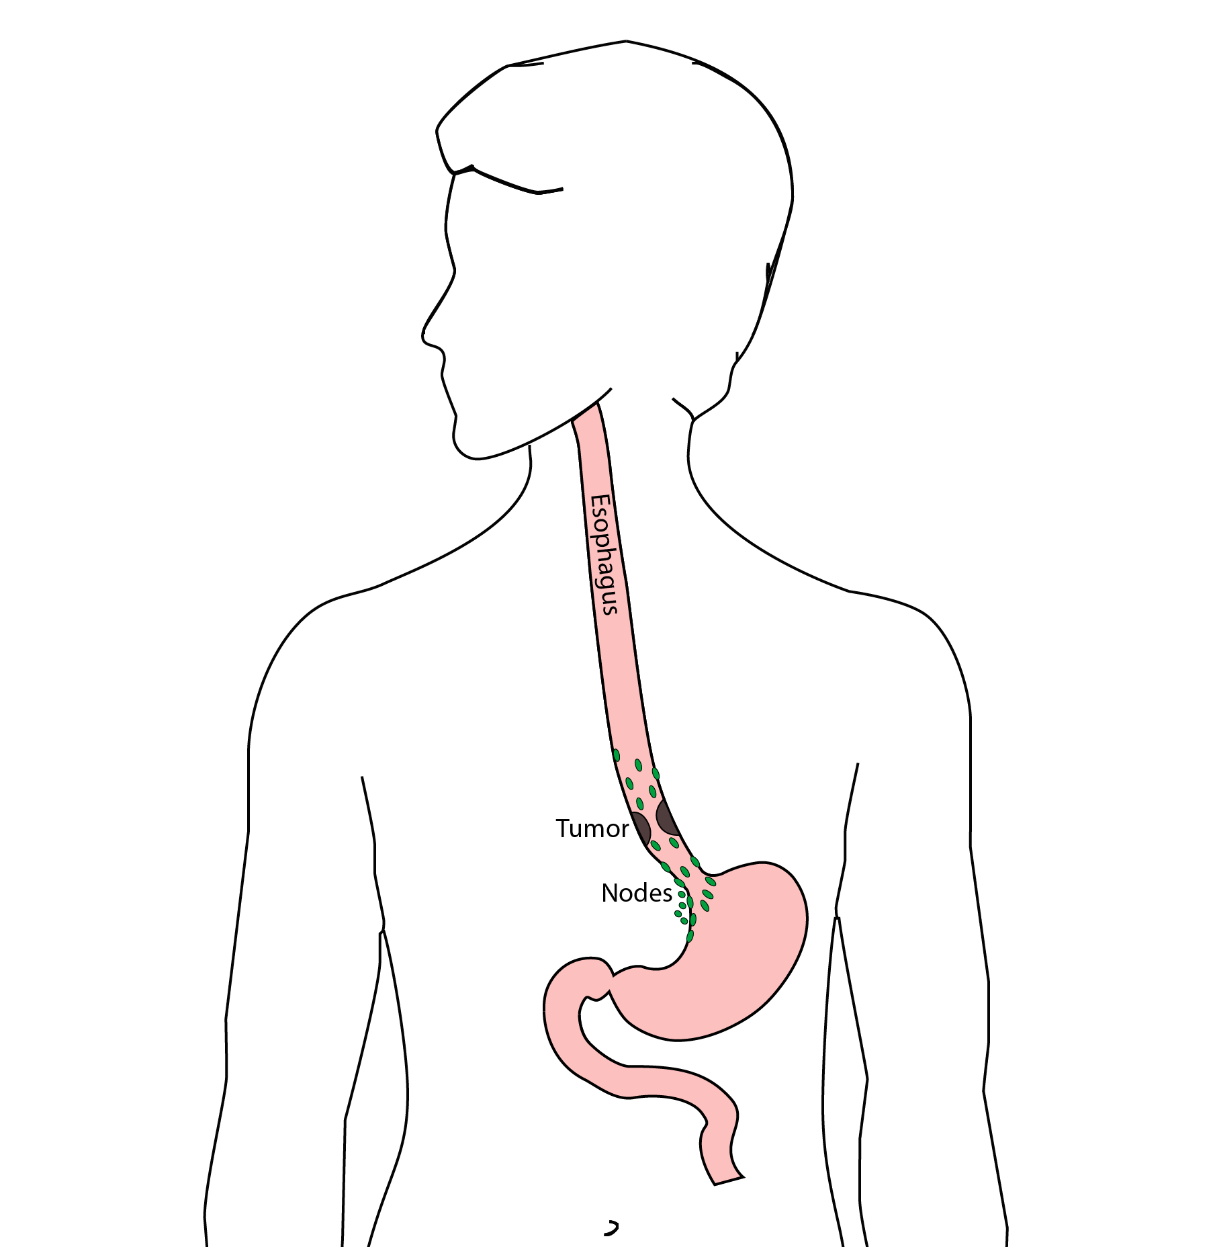
Goals of Surgery
Remove tumor from esophagus
Remove surrounding lymph nodes
Create a new esophagus

Slide 19
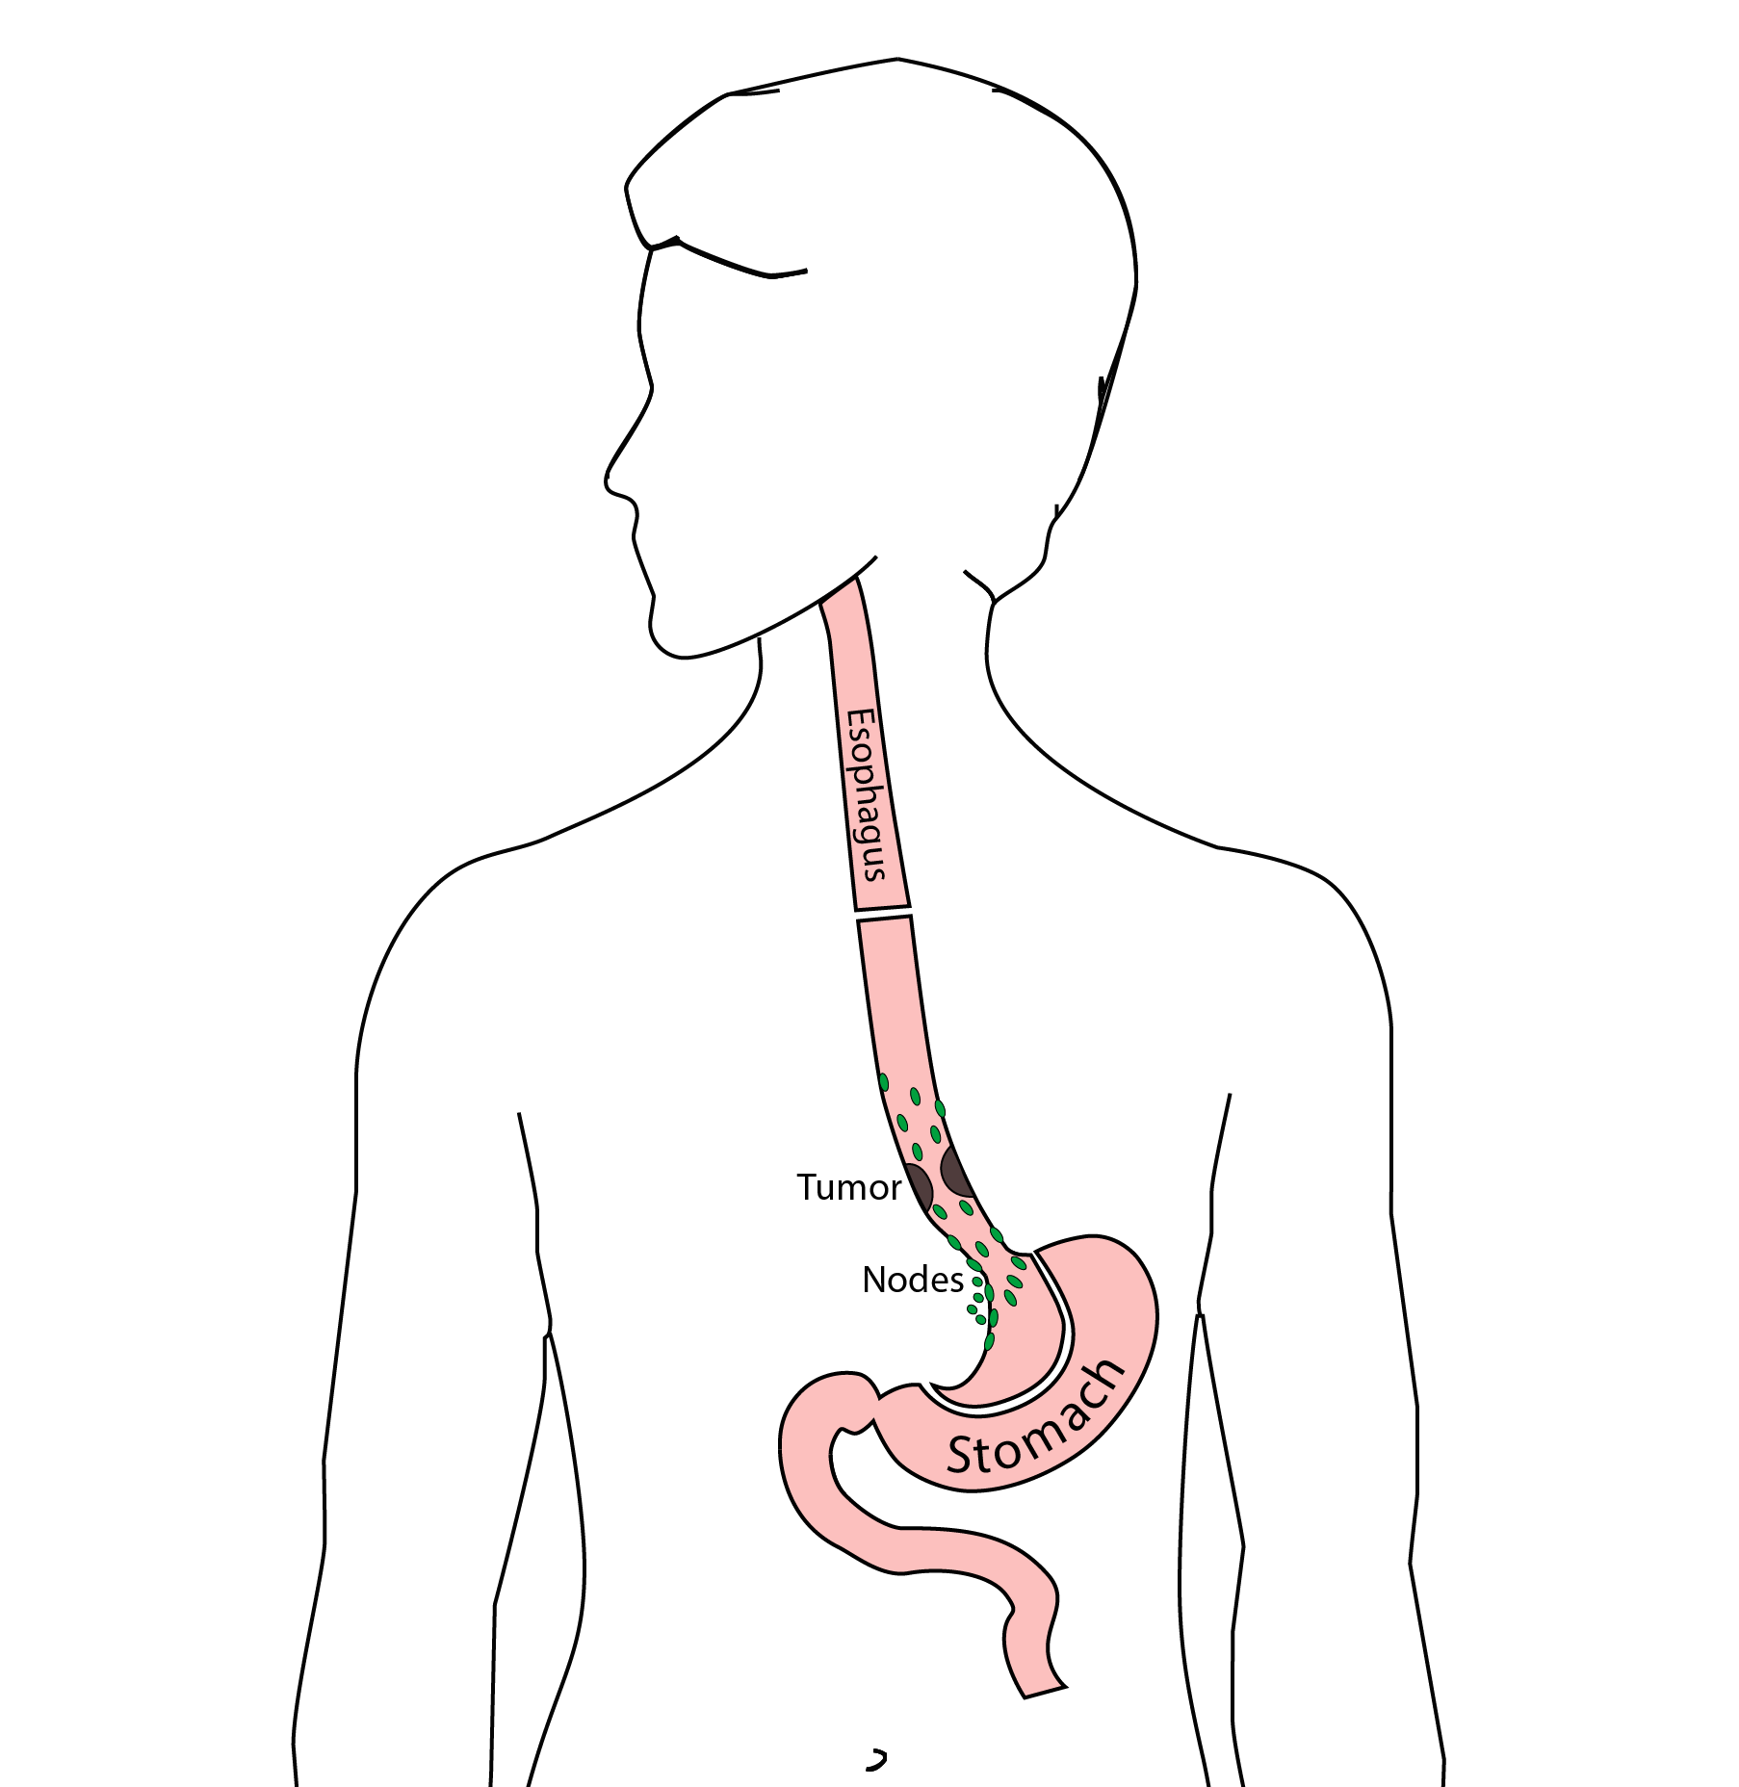
Ivor Lewis (Transthoracic) Esophagectomy
Removes tumor and lower 1/2 esophagus
Removes surrounding lymph nodes
GI tract reconstructed

Slide 20
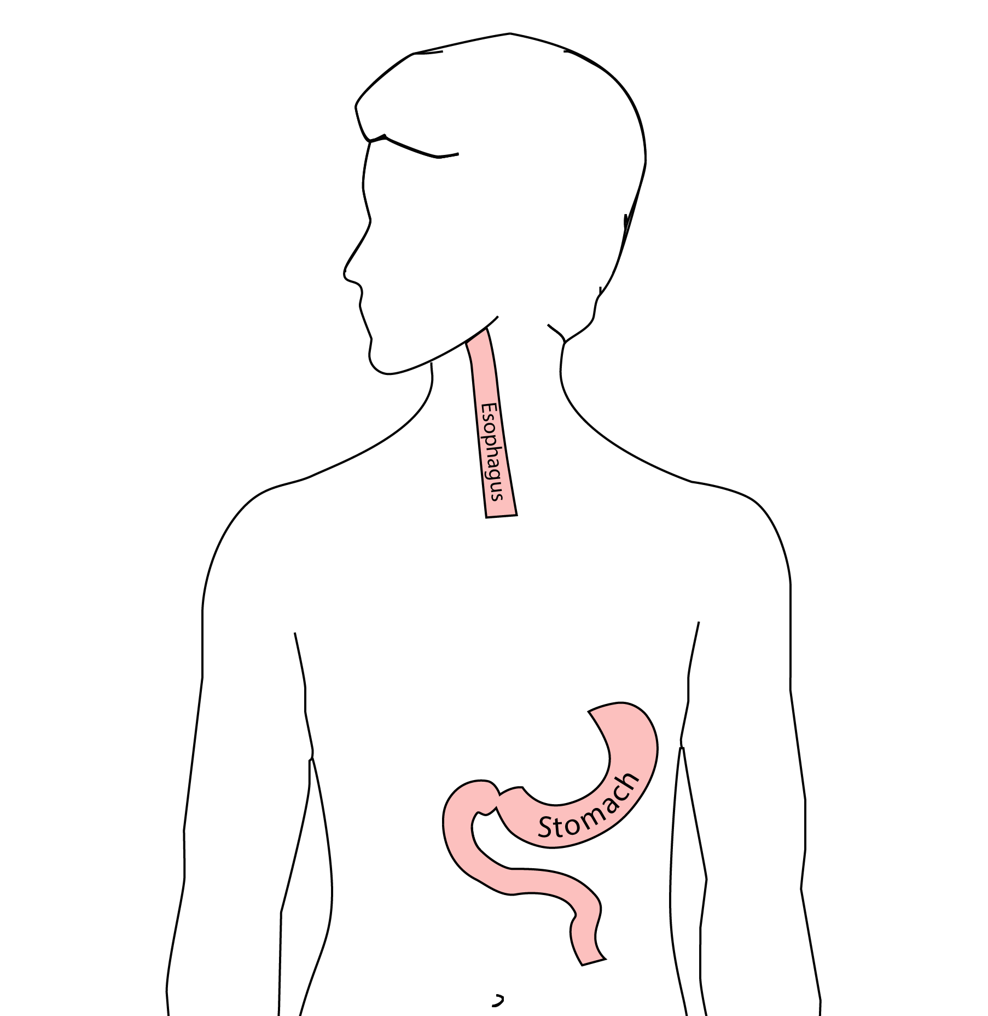
Reconstruction
New esophagus is created from the stomach in the abdomen by fashioning it into a tube.

Slide 21
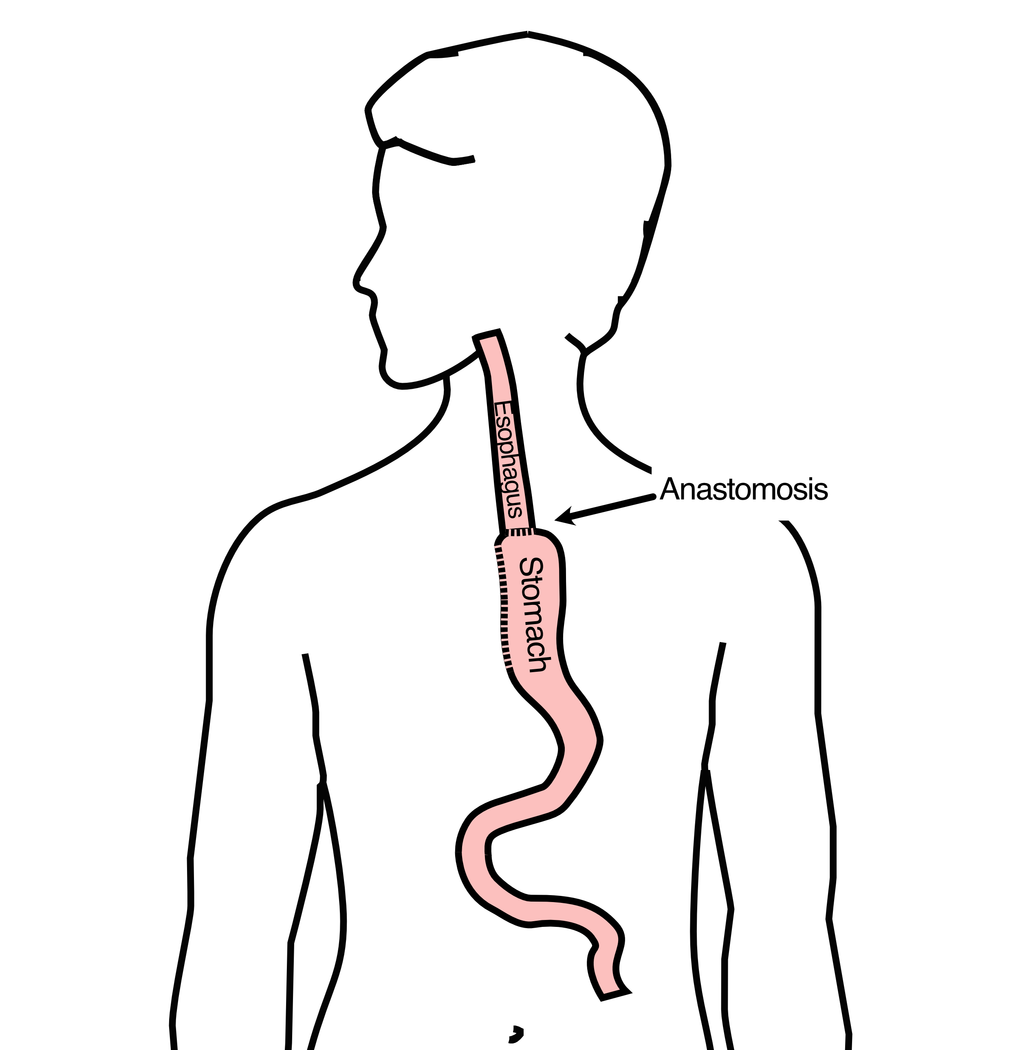
Ivor Lewis esophagectomy
The new esophagus is now brought up into the chest. A connection is made between the esophagus and the stomach, called an anastomosis.

Slide 22
Ivor Lewis esophagectomy

Slide 23
:::::
:::::

Slide 24
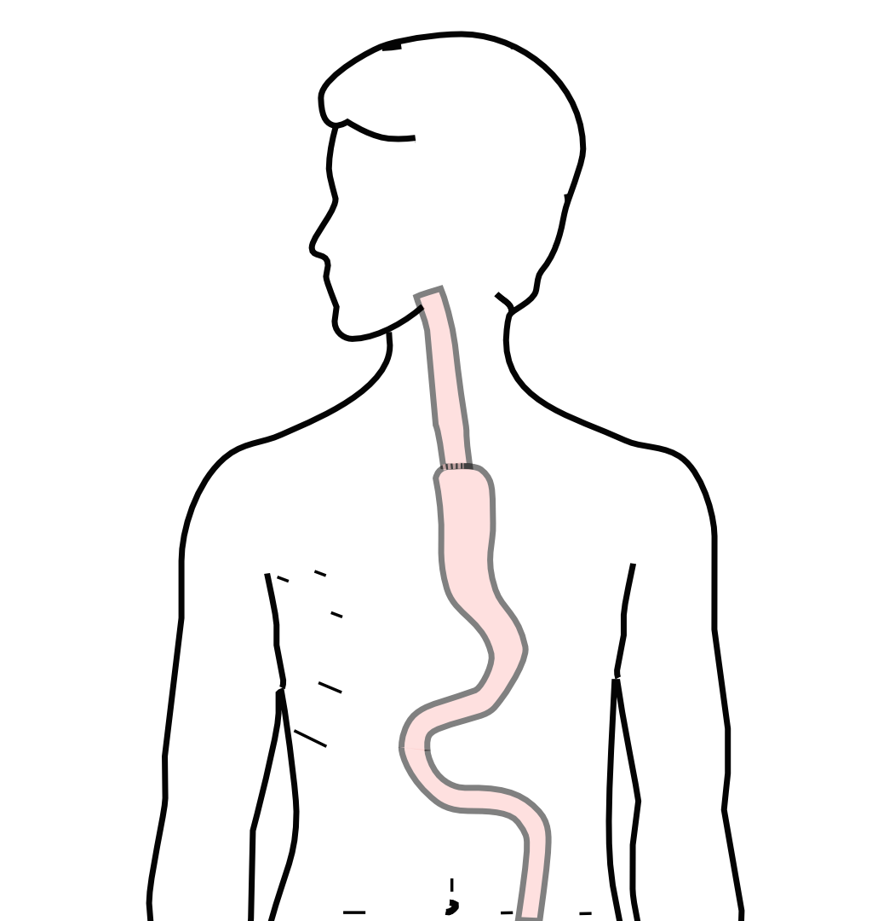
Minimally-invasive Ivor Lewis Esophagectomy
Small incisions abdomen and chest
Surgical telescope and instruments
Smaller incisions $→$ faster recovery and less discomfort

Slide 25
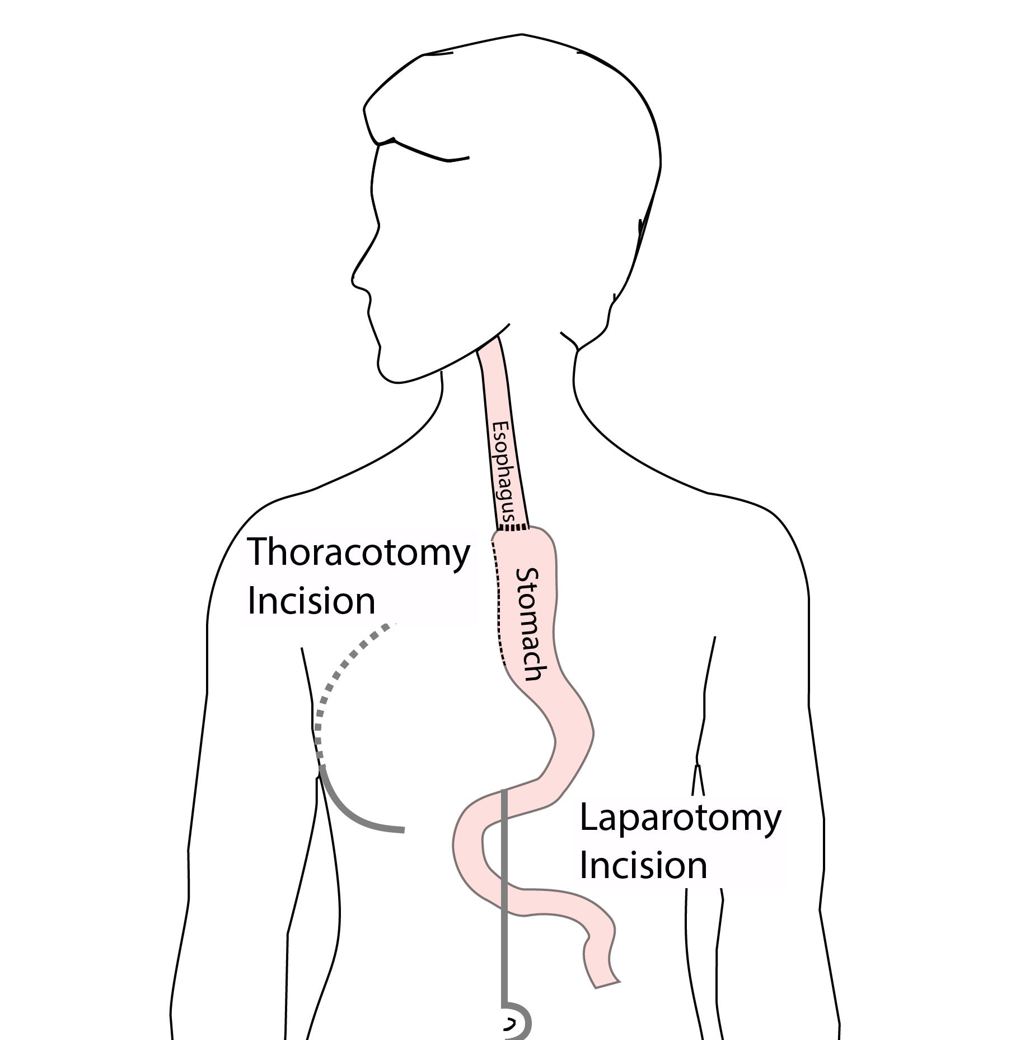
Open Ivor Lewis
Mininally-invasive approach feasible in 98% of cases
In some cases, an open approach is still necessary (2%)

Slide 26
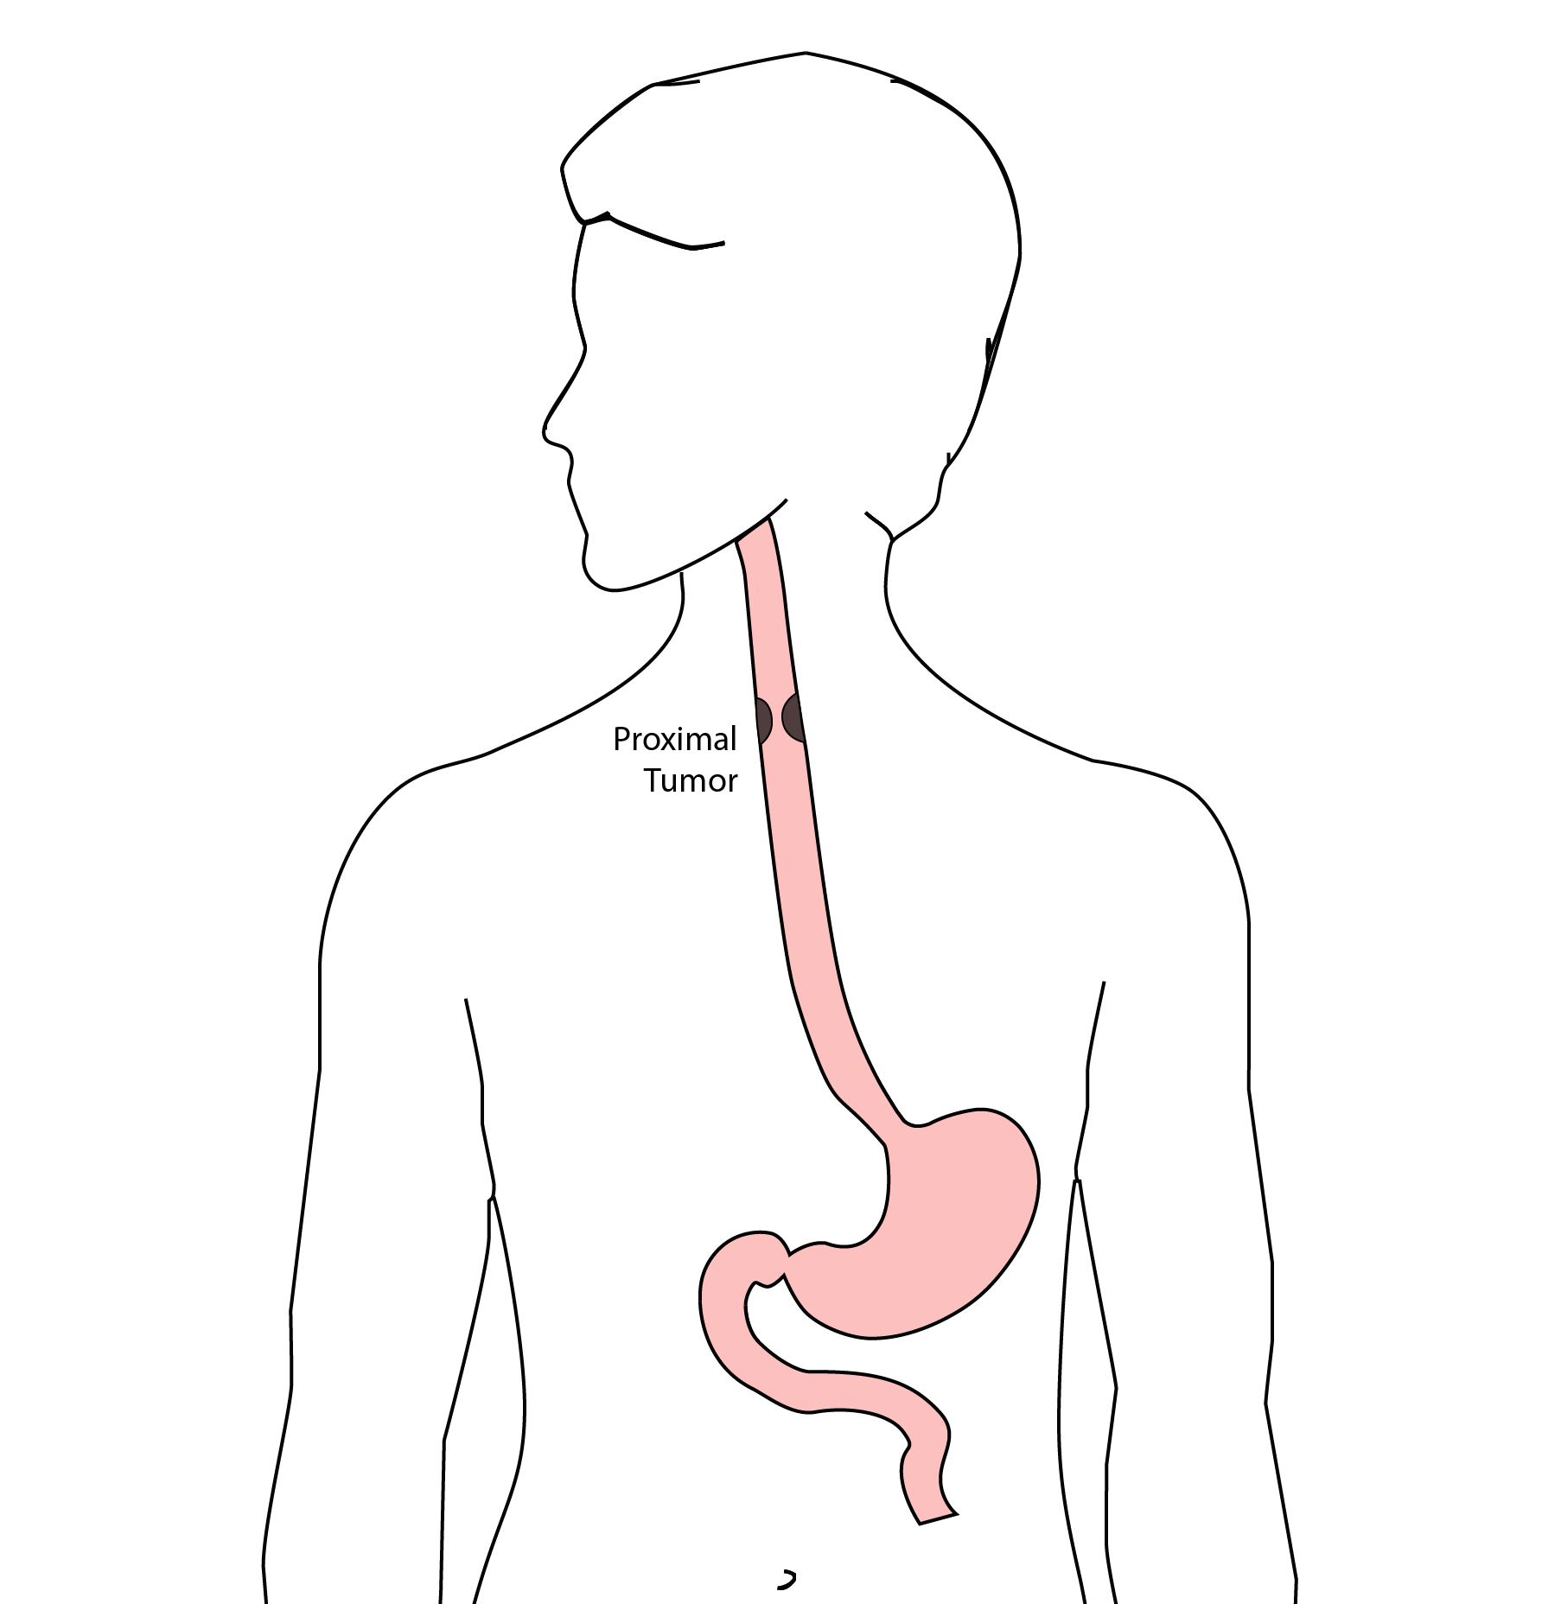
Total Esophagectomy
For patients with tumors in the upper esophagus, we need to remove more of the esophagus
We need to remove the whole esophagus, including the portion in the neck

Slide 27
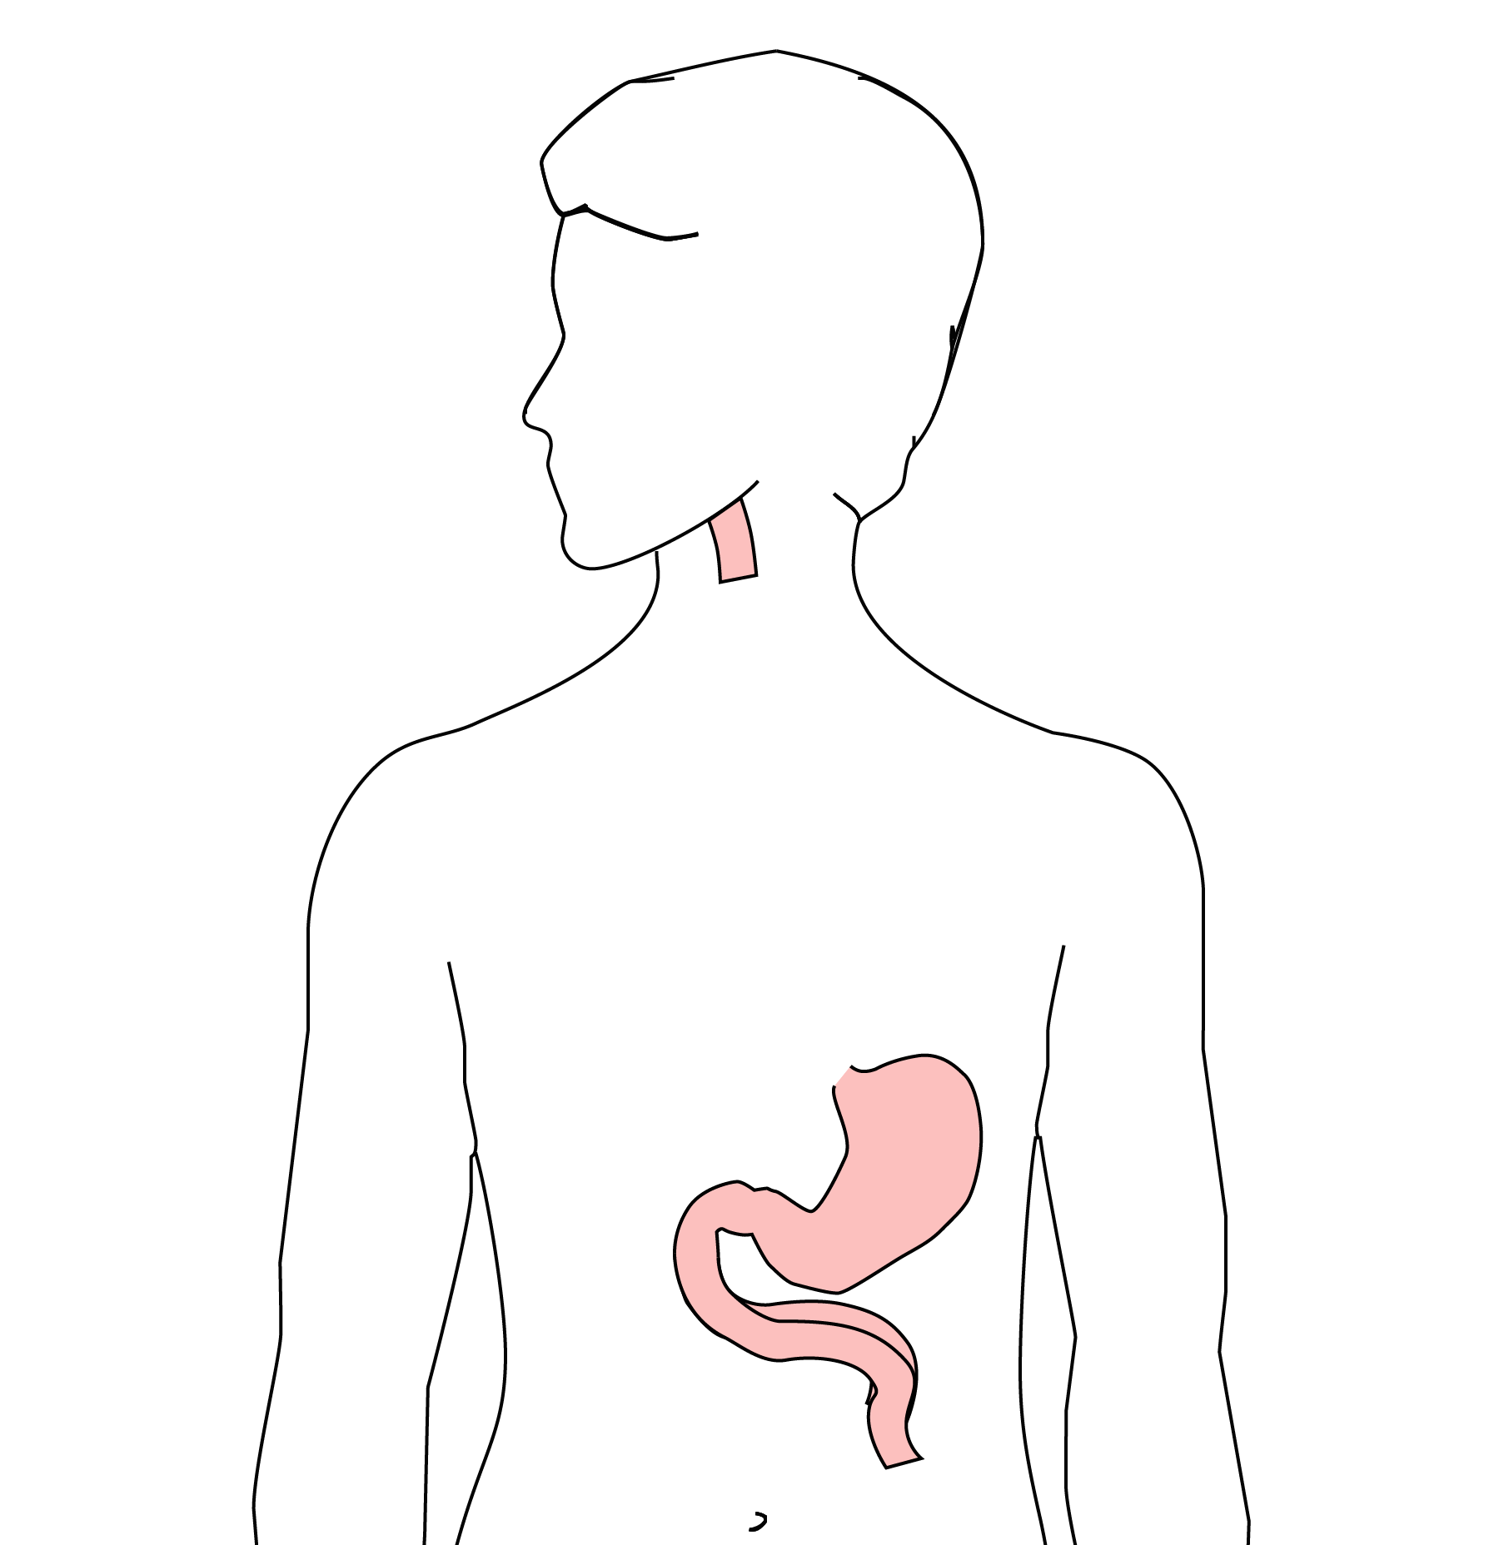
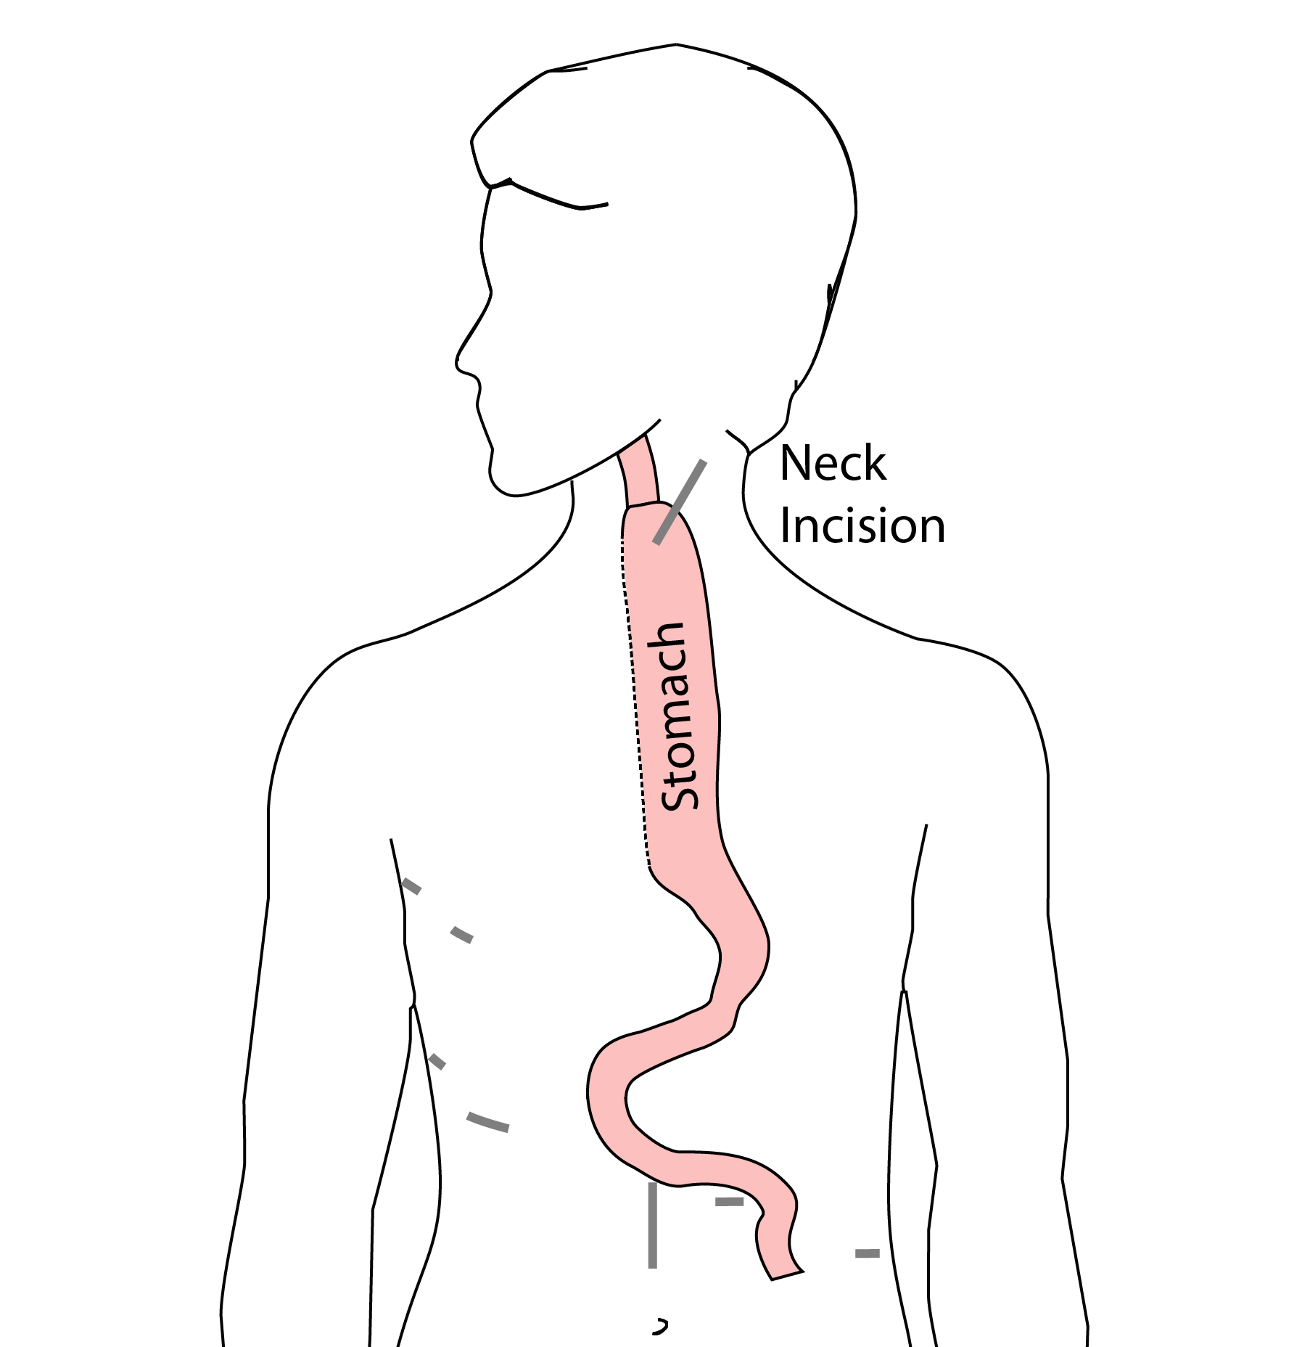
McKeown Esophagectomy

Slide 28
Risks of Esophagectomy
Esophagectomy is a complex operation, with a real risk of complications.
Two significant complications:
Anastomotic leak
Pneumonia

Slide 29
Anastomotic Leak
The anastomosis is surgical connection between the esophagus and the stomach.

Slide 30
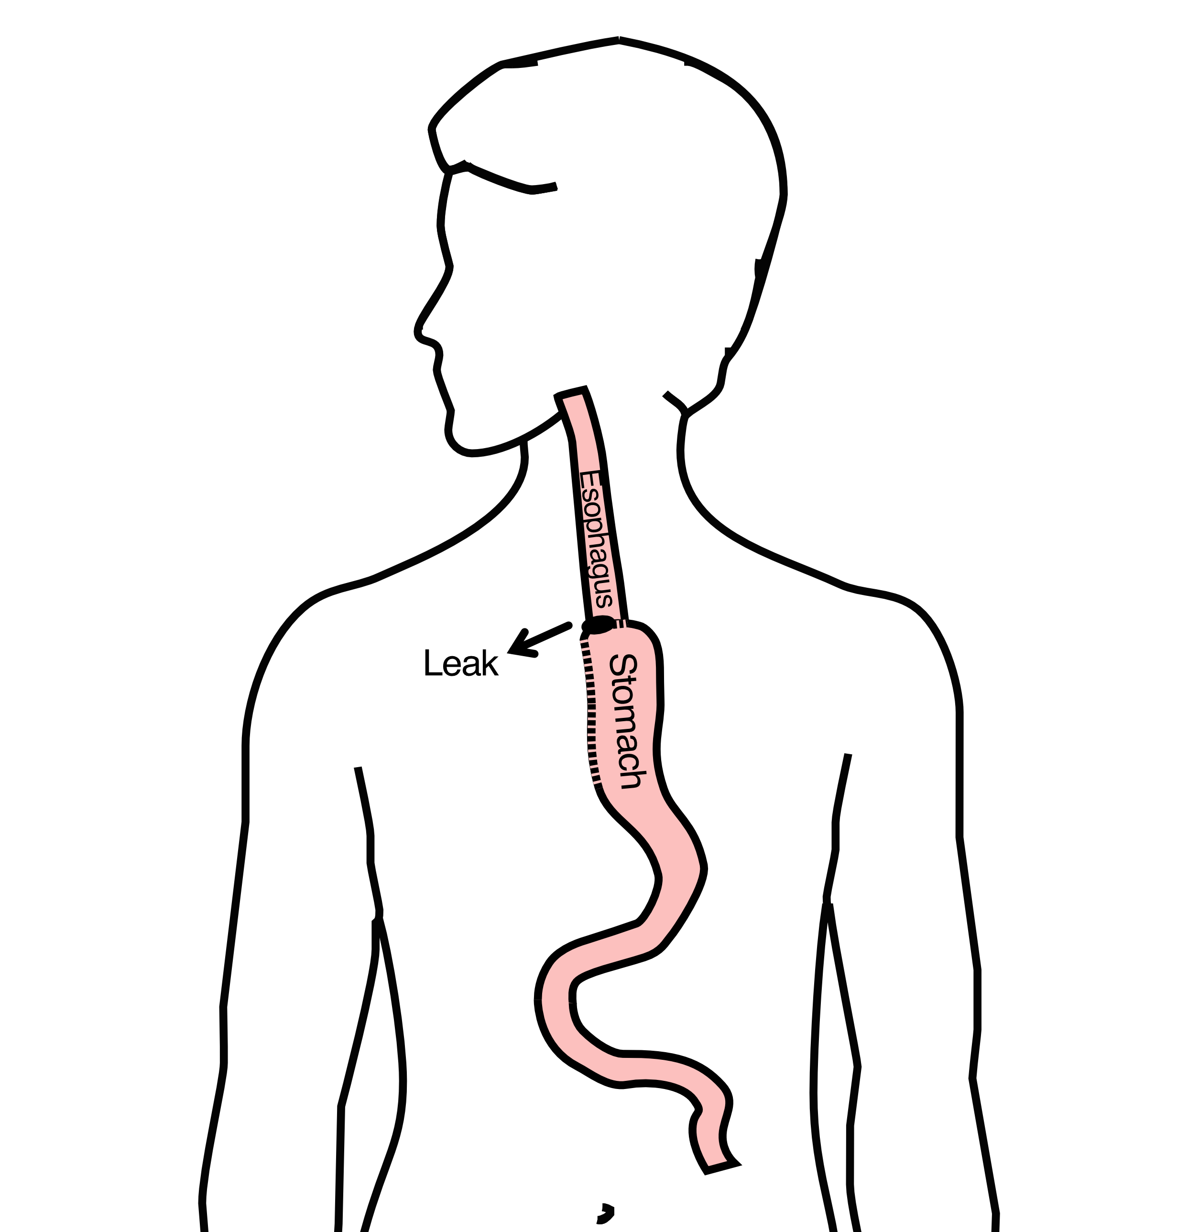
Anastomotic Leak
If healing doesn’t occur:
Leakage of fluid from the esophagus
Infection in the space between the lungs
Requires additional time in the hospital

Slide 31
Anastomotic Leak
If leak occurs:
Some leaks will seal
Stent may be required to help healing
Occasionally additional surgey is required

Slide 32
Anastomotic Leak
Risk of leak depends on:
Type of operation performed
Nutritional status of patient
Experience of the surgeon

Slide 33
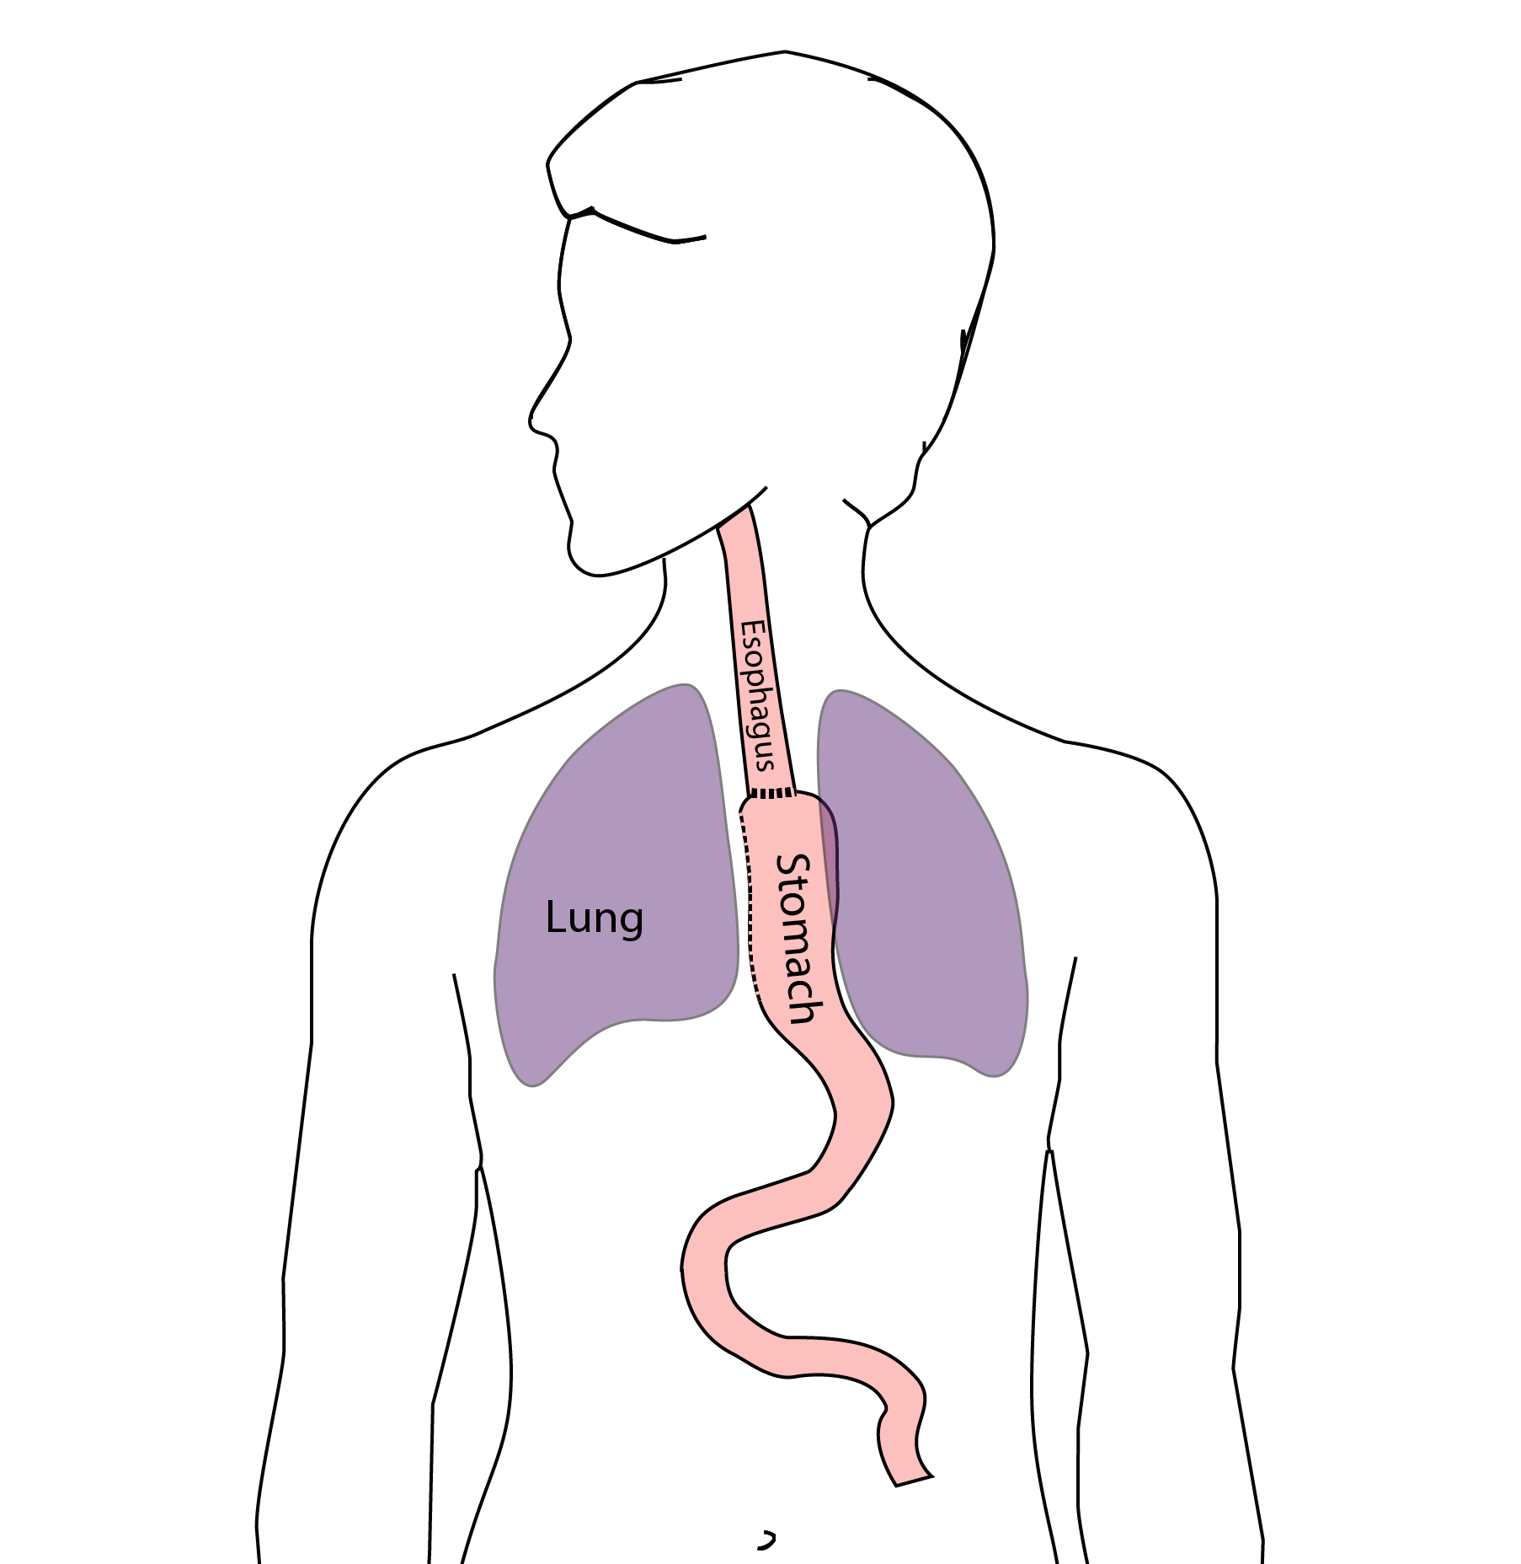
Pneumonia
Occurs in 10-15% of patients after esophagectomy.
Requires treatment with antibiotics
Requires a longer hospitalization.

Slide 34
Preventing Pneumonia
Several ways to help prevent pneumonia:
Deep breathing
Coughing
Walking
After surgery, this means:
Sitting in a chair most of the day
Walking in the halls as soon as possible

Slide 35
Risks of Surgery
Risks related to anesthesia
Heart attack (5%)
Irregular heart rhythm (15%)
Pneumonia (10%)
Blood clots in legs (<5%)
Pulmonary embolism (2%)

Slide 36
Risks of Surgery
Risks related to Surgery
Anastomotic leak (5%)
Stricture at anastomosis (15%)
Death within 90 days of surgery
  Low risk patients = 2%
  Intermediate risk = 10%
  High risk = 30%

Slide 37
Risks of Surgery
 | Age <75 | Age >75
Normal Muscle (75%) | 2% | 10%
Low Muscle (25%) | 10% | 30%
Risks of Death within 90 Days of Surgery

Slide 38
Epidural Catheter for Pain Control
Remains in place for 2-5 days
Dosage can be adjusted as needed
Can make it more difficult to urinate
May require foley catheter in bladder
Foley catheter removed after epidural removed

Slide 39
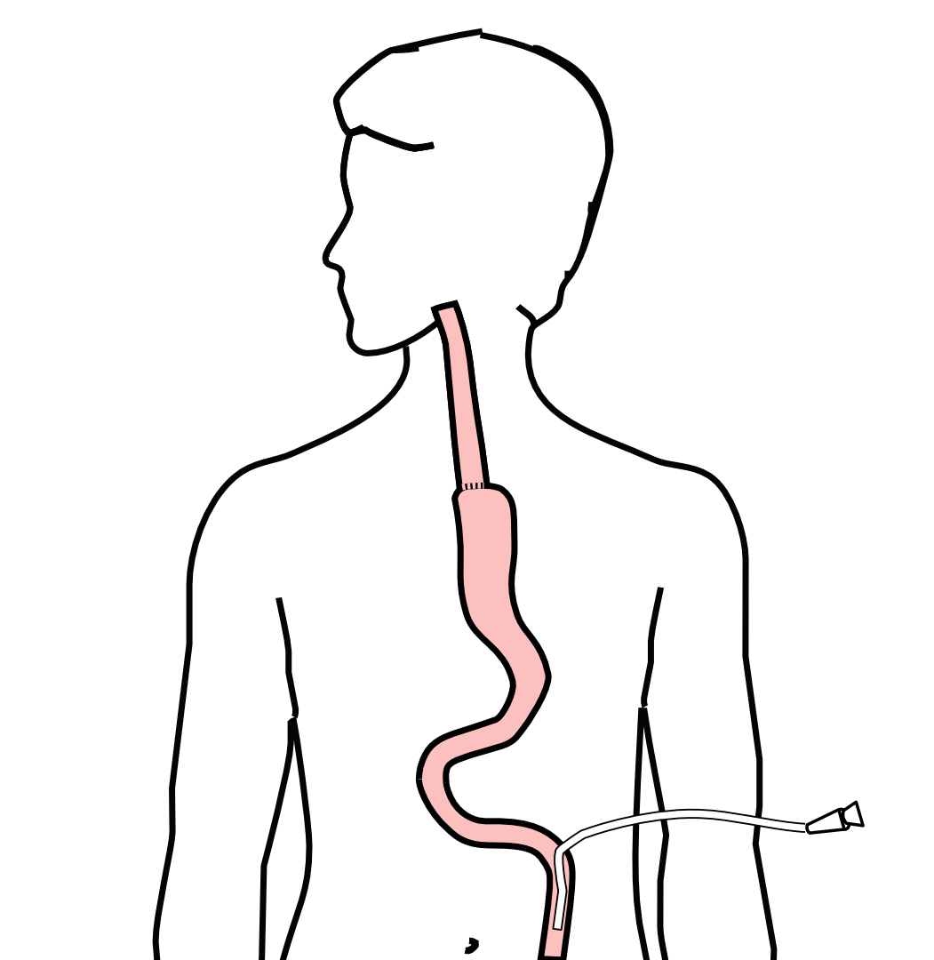
Jejunostomy Feeding Tube
A temporary feeding tube is placed to supplement nutrition by mouth.
This will stay in place for about 8 weeks after surgery

Slide 40
Intensive Care Unit (ICU) (2-4 days)
Surgical ICU on 11th floor
NG tube in nose to drain stomach and esophagus
Catheter in bladder
Chest tube right chest
Abdominal drains (usually 2)
Feeding jejunostomy (usually stays in 8 wks)

Slide 41
Intensive Care Unit (ICU)
Bladder catheter removed → check that bladder empties properly
Chest tube removed (day 2-4) → follow-up x-ray
Fluid emptied from drains every few hours
Start tube feedings by feeding
Feeding jejunostomy (stays in 8 weeks)

Slide 42
Ward - 6Tower
Up in a chair most of the day
Walking in the halls
  Start with assistance
  Improves lung function
  Prevents loss of muscle strength

Slide 43
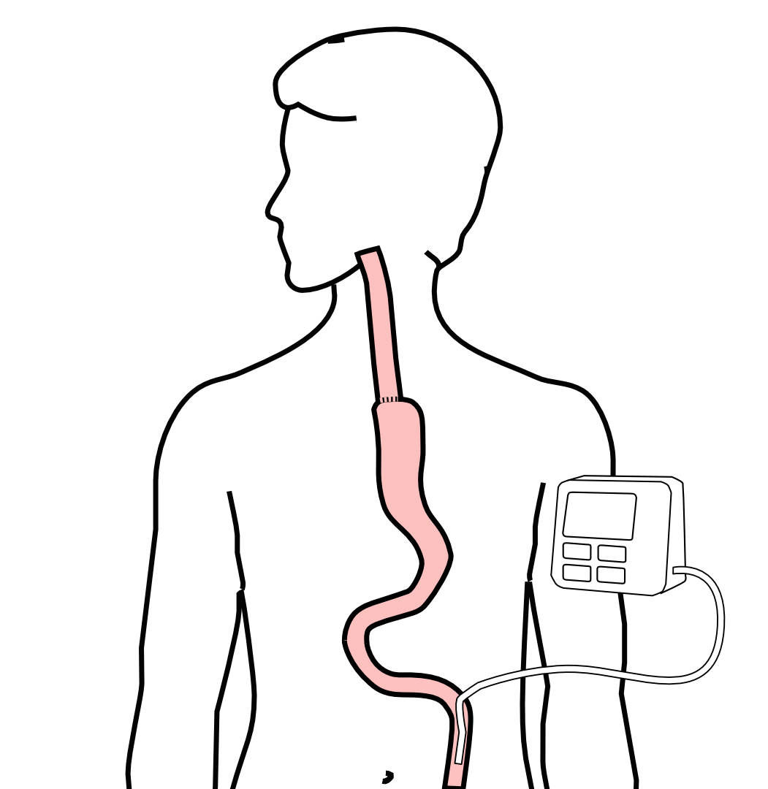
Jejunostomy Feeding Tube
Feedings are administered through the jejunostomy at night by a pump

Slide 44
Jejunostomy Feeding
Start with continuous feeds (24 hours/day)
Convert to nocturnal (night-time): 6pm to 10pm
The feeding bag holds only 4 cartons of feeds - May need to “top off’ bag after a few hours
Water through the tube
Important to prevent dehydration
240mL (8 oz) 4 times per day

Slide 45

Jejunostomy Tube
Nutrition to bypasses the esophagus and stomach
Placed in small intestine
Pump administers feedings slowly
Feeding done at night

Slide 46
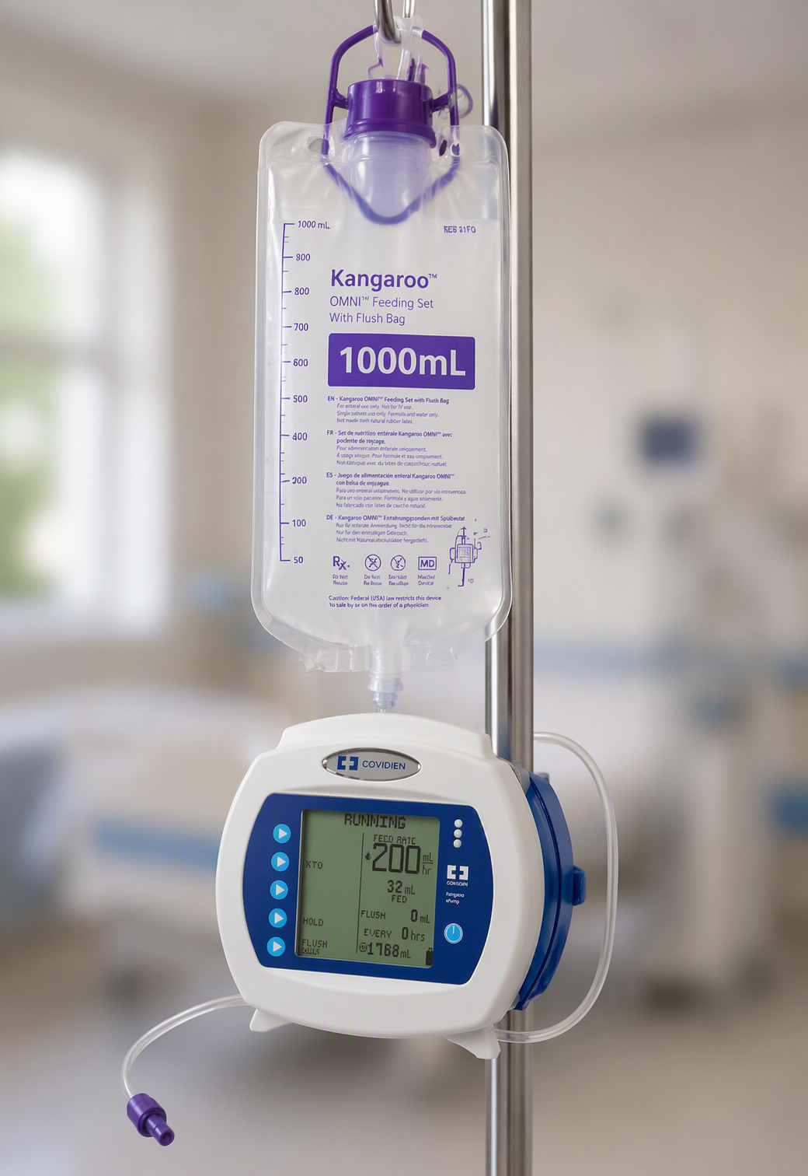
Jejunostomy Feeding Pump
Pump administers feedings slowly
Rate can be easily adjusted

Slide 47
Jejunostomy Typical Regimen
Jejunostomy tube feeds for 16 hours (6pm-10am)
  Men: 75mL/hour x 16 hours = 5 cartons
  Women: 60mL/hour x 16 hours = 4 cartons
Water 240ml (8oz) via syringe 4x/day
Hospital nurses will teach use of the feeding tube

Slide 48
Jejunostomy Feeds with Diabetes
Jejunostomy feedings elevate blood sugars
Insulin may be required along with feeds
Typical Pattern for tube feeds
Feeds run via pump from 6pm to 10am
Insulin at 6pm (70/30 insulin)
Insulin at Midnight (70/30 insulin)
No insulin if tube feedings are not run

Slide 49
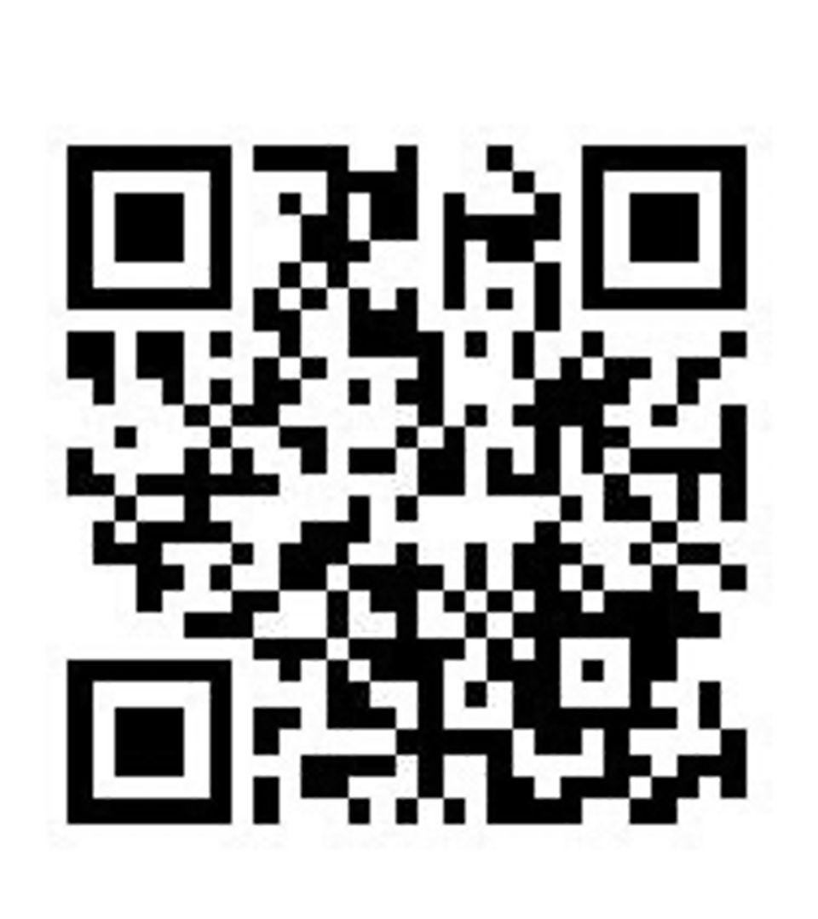
Jejunostomy Video
A video is available to help become familiar with the feeding jejunostomy

Slide 50
Activity after Surgery
Up in chair most of the day
Walking with help from nurse/Physical Therapist
Goals:
  Improve lung function
  Prevent muscle loss

Slide 51
Nasogastric (NG) Tube
Tube passed through nose into stomach
Drains fluid from stomach
Prevents vomiting
Upper GI X-ray on 2nd or 3rd day after surgery
If stomach empties well $→$ NG tube removed
Otherwise, X-ray repeated 2-3 days later

Slide 52
Swallowing Evaluation
Once NG tube has been removed:
Modified barium swallow in radiology
Drink a white chalky liquid (barium)
Look for proper swallowing function
80% of patients $⇒$ liquids started by mouth

Slide 53
Oral Intake at Home
Most are taking protein shakes when they go home
Protein shakes are started after tolerating water
2 oz per hour to start
4 oz per hour if 2oz are tolerated well

Slide 54
Drains and Tubes
Chest Tube (right side): Removed 4-6 days after surgery (depending upon output) Abdominal drains: Removed 4-7 days after surgery
Discharge with 1 abdominal drain in 10% of cases
Epidural catheter: Removed 4-5 days after surgery Bladder catheter: Removed after epidural catheter removed

Slide 55
Discharge
Goal: ready to leave day #7 after surgery
Night-time tube feedings (6pm to 10am)
Nutrition by mouth (90% of patients)
  Protein shakes or water 4oz every 2 hours
Water through tube 8oz four times per day
Home care nursing (feeding tube teaching)
Home infusion (tube feeding supplies)

Slide 56
Nutrition after Surgery
At discharge home:
Protein shakes 4oz every 2 hrs
Tube feeds 4-5 cans at night (6pm-10am)
10-12 Days: Increase protein shakes
Tube feeds 3-4 cans at night
Three weeks: Post-esophagectomy Diet
8-12 weeks: Remove feeding tube (in office)

Slide 57
Transition from Tube Feeds $→$ Eating
Dietitian will calculate daily protein goal
Typically 60-75 grams protein/day
Each carton of tube feeding has 15 grams
  75 grams protein = 5 cartons/night
More intake by mouth $→$ tube feeds reduced
Spread out protein during the day (20gm/meal)
Three meals + 2-3 high-protein snacks

Slide 58
Post-esophagectomy Diet
Soft Consistency
High Protein
Avoid sugary liquids (can cause ‘dumping’)
Avoid raw vegetables (and salads)
Eating
  Small, frequent meals
  Sit up for 30-45 minutes after eating
  Avoid eating within 2 hours of bedtime

Slide 59
Medicines at Home - Pain
Acetaminophen (Tylenol) 1000mg 4x/day
Gabapentin 300mg 3 times/day
Oxycodone
As needed in addition to Tylenol/gabapentin
Will begin reducing dose at first postop visit
Can usually discontinue by 4 weeks
NO DRIVING WHILE ON OXYCODONE

Slide 60
Non-steroidals Anti Inflammatory (NSAID)
Non-steroidal anti-inflammatories (Celebrex)
200 mg every 12 hours starting at 2 weeks
NO GOODY POWDERS OR BCs
(Can cause permanent scarring at the surgery site)

Slide 61
Acid Blockers = Proton Pump Inhibitors
Examples include ompeprazole and pantoprazole
Will stay on for at 1-2 years to prevent acid reflux
Important in preventing scarring at anastomosis (new connection between esophagus and stomach)
To administer through feeding tube, open capsule and resuspend beads in 60mL (2oz) of water

Slide 62
Medicines at Home
Reglan – Helps stomach empty
Will plan to stop after six weeks
0.1% risk of tardive dyskinesia (nervous tic)
Remeron – Helps improve appetite
Can cause vivid dreams
Used for several weeks after surgery
Will stop within first three months of surgery

Slide 63
Metoprolol = Beta Blockers
Slows heart rate and lowers blood pressure
Used to prevent rapid heart rate
Patients not taking a beta blocker prior to surgery $→$ wean after after surgery
Patients taking a beta blockerprior to surgery $→$ return to prior dose and drug after surgery

Slide 64
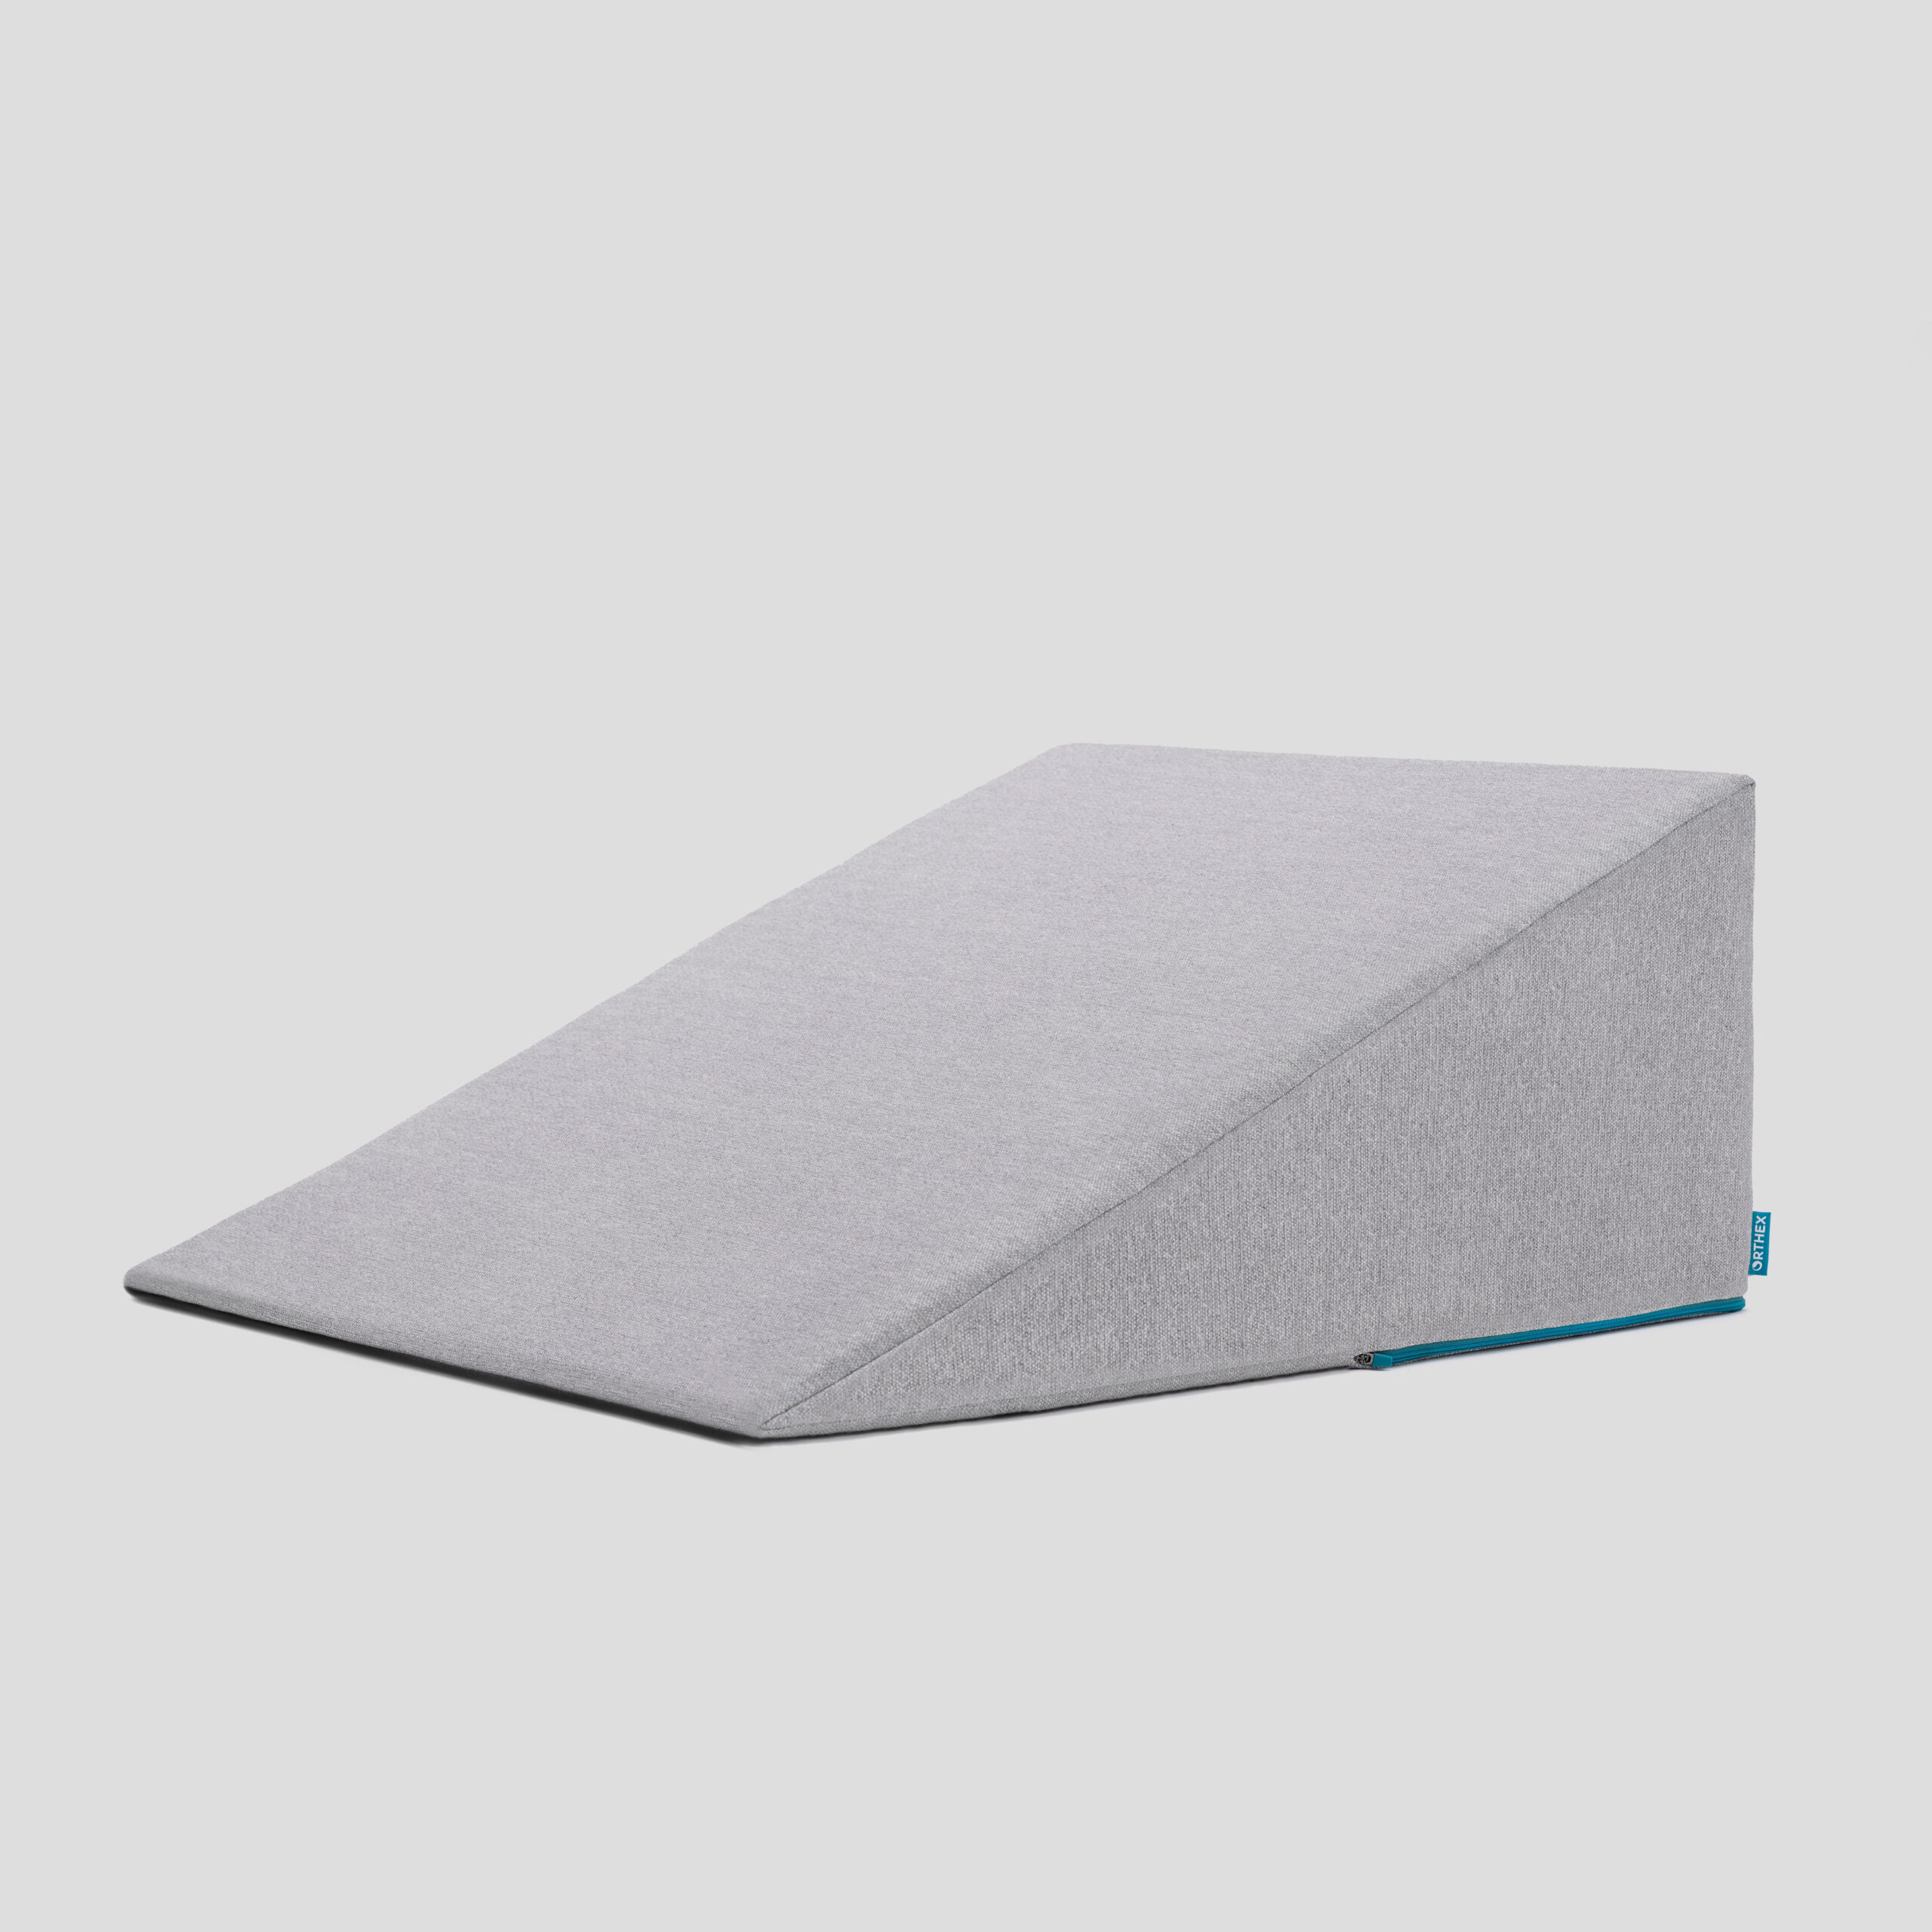
Sleeping at Home
Reflux can occur the first few weeks/months after surgery
This improves over the first few months
A wedge pillow can be helpful for sleep

Slide 65
Follow Up Visit 7-10 days after Discharge
In-person clinic visit with Dr Salo or Kate Duncan
Check surgical site
Remove staples (if needed)
Remove abdominal drains (if needed)
Meet with dietitian:
Reduce tube feeds
Advance diet by mouth

Slide 66
Adjust Medicines after Surgery
Reglan: Discontinue 6 weeks after surgery Remeron: Discontinue 12 weeks after surgery Pain Medicines:
Wean oxycodone within 6 weeks of surgery
Discontinue gabapentin and acetaminophen (Tylenol) within 8 weeks
Continue acid blockers (PPI) for at least 1 year
Reduce metoprolol to once/day for 7 dayus $→$ discontinue

Slide 67
Second Follow Up Visit
4-5 weeks after first post-operative visit
Discuss diet
Discuss medicines
Plan for jejunostomy removal
Evaluate readiness for chemotherapy after surgery (usually 6 weeks)

Slide 68
Eating after Surgery
First Postoperative Visit: Start soft foods (Phase I)
Weekly virtual visits with dietitian
Jejunostomy removal ~ 8 weeks after surgery

Slide 69
Jejunostomy Removal
Jejunostomy tube is removed in the office once you can take in enough nutrients by mouth
Removal usually around 8 weeks after surgery (may be longer if chemotherapy planned after surgery)
May take 30 minutes and some local anesthetic to loosen up the tube for removal.

Slide 70
Nutritional Monitoring after Surgery
You may have difficulty absorbing some nutrients:
Iron
Vitamin B12
Vitamin D

Slide 71
Nutritional Monitoring after Surgery
About 3 months after the jejunostomy tube is removed, we will check blood levels:
Iron (ferritin)
Vitamin B12
Vitamin D

Slide 72
Nutritional Replacements after Surgery
Vitamin or iron replacements can be ordered by:
Primary Care Provider (PCP)
Medical Oncologist
Surgeon
If levels are low
Replacement
Repeat testing in 3-6 months

