Slide 1
Diagnostic Laparoscopy

Slide 2
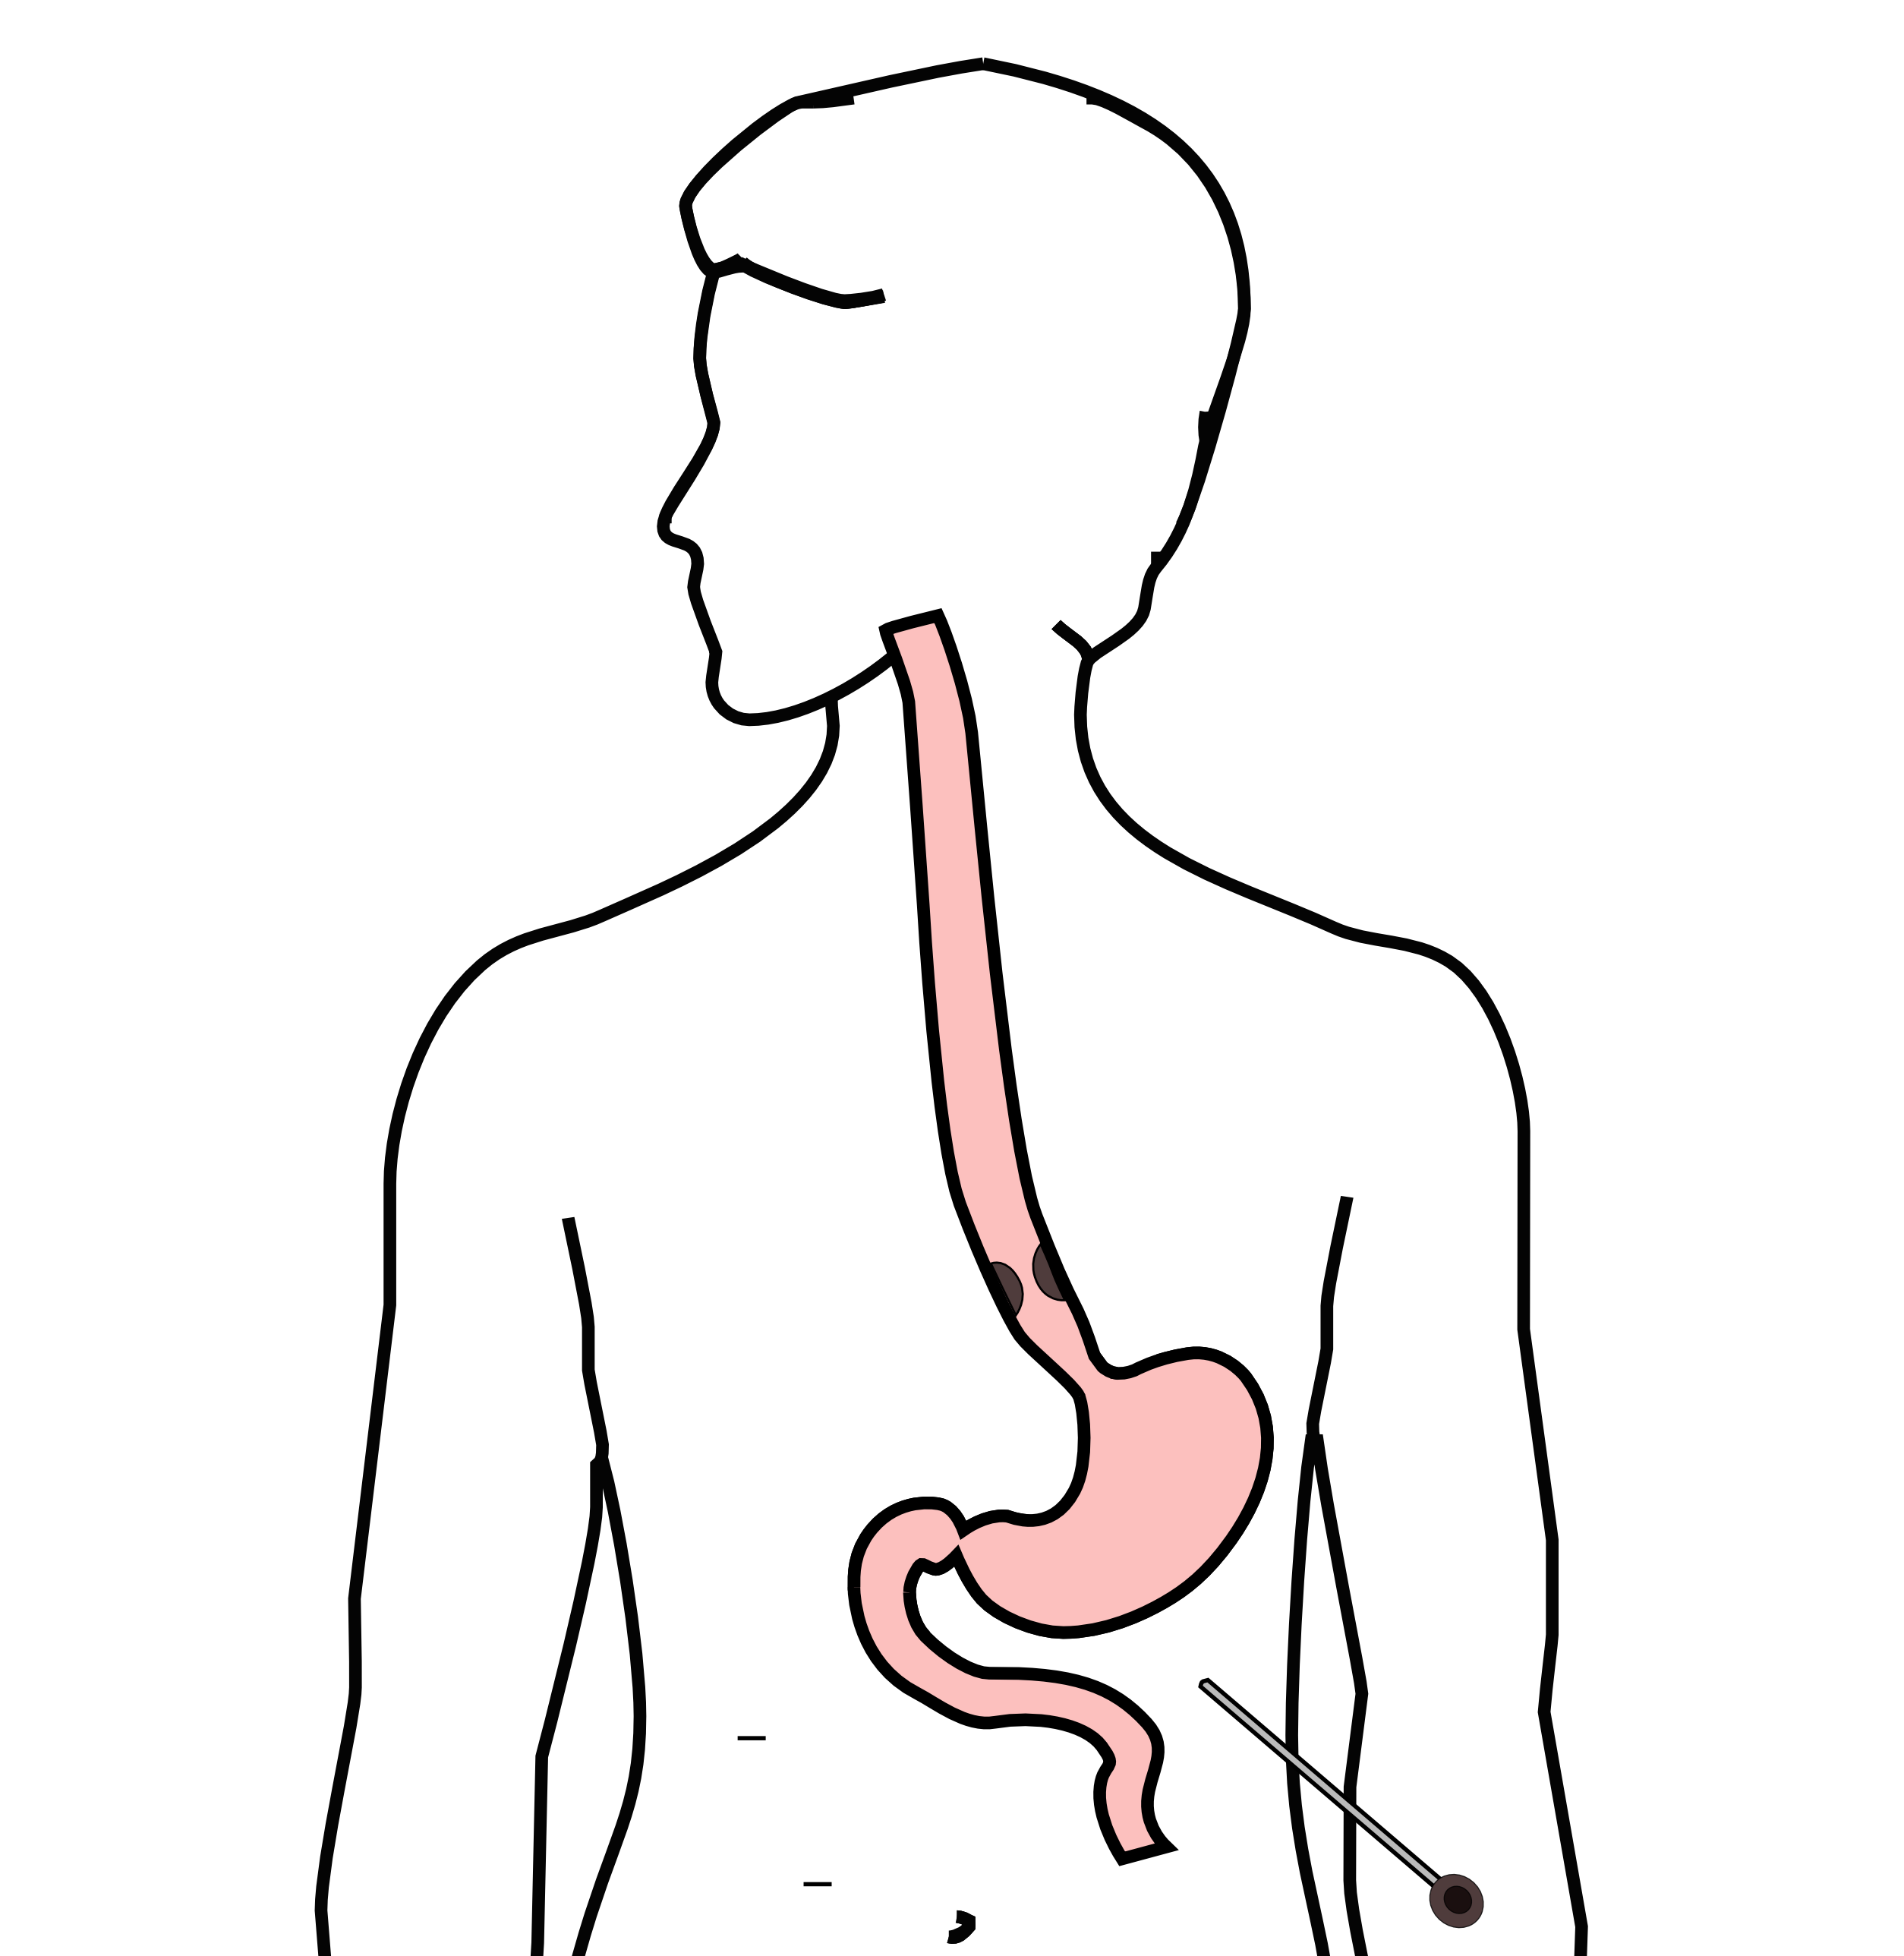
Laparoscopy
Some stomach cancers can spread inside the abdomen
Areas of spread can be very small (grain of rice)
Laparoscopy can detect spread inside the abdomen

Slide 3
Laparoscopy
General anesthetic
Several 1/4” incisions 1/4”
Telescope examines the abdomen
Biopsies can be performed.

