Slide 1
Central Venous Port

Slide 2
Chemotherapy Administration
Most chemotherapy is administered by vein.
Several options exist to administer chemotherapy:
Intravenous catheter in peripheral veins
Peripheral Intravenous Central Catheter (PICC)
Central Venous port

Slide 3
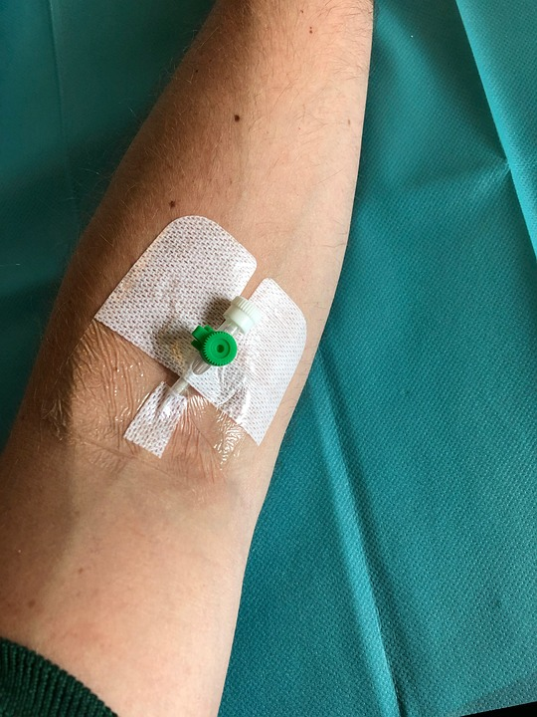
Intravenous Catheter in Peripheral Vein (“IV”)
IV catheter placed in vein of hand or arm
Allows administration of chemo and fluids
Placed for each dose
Removed that day
Not suitable for FLOT chemo

Slide 4
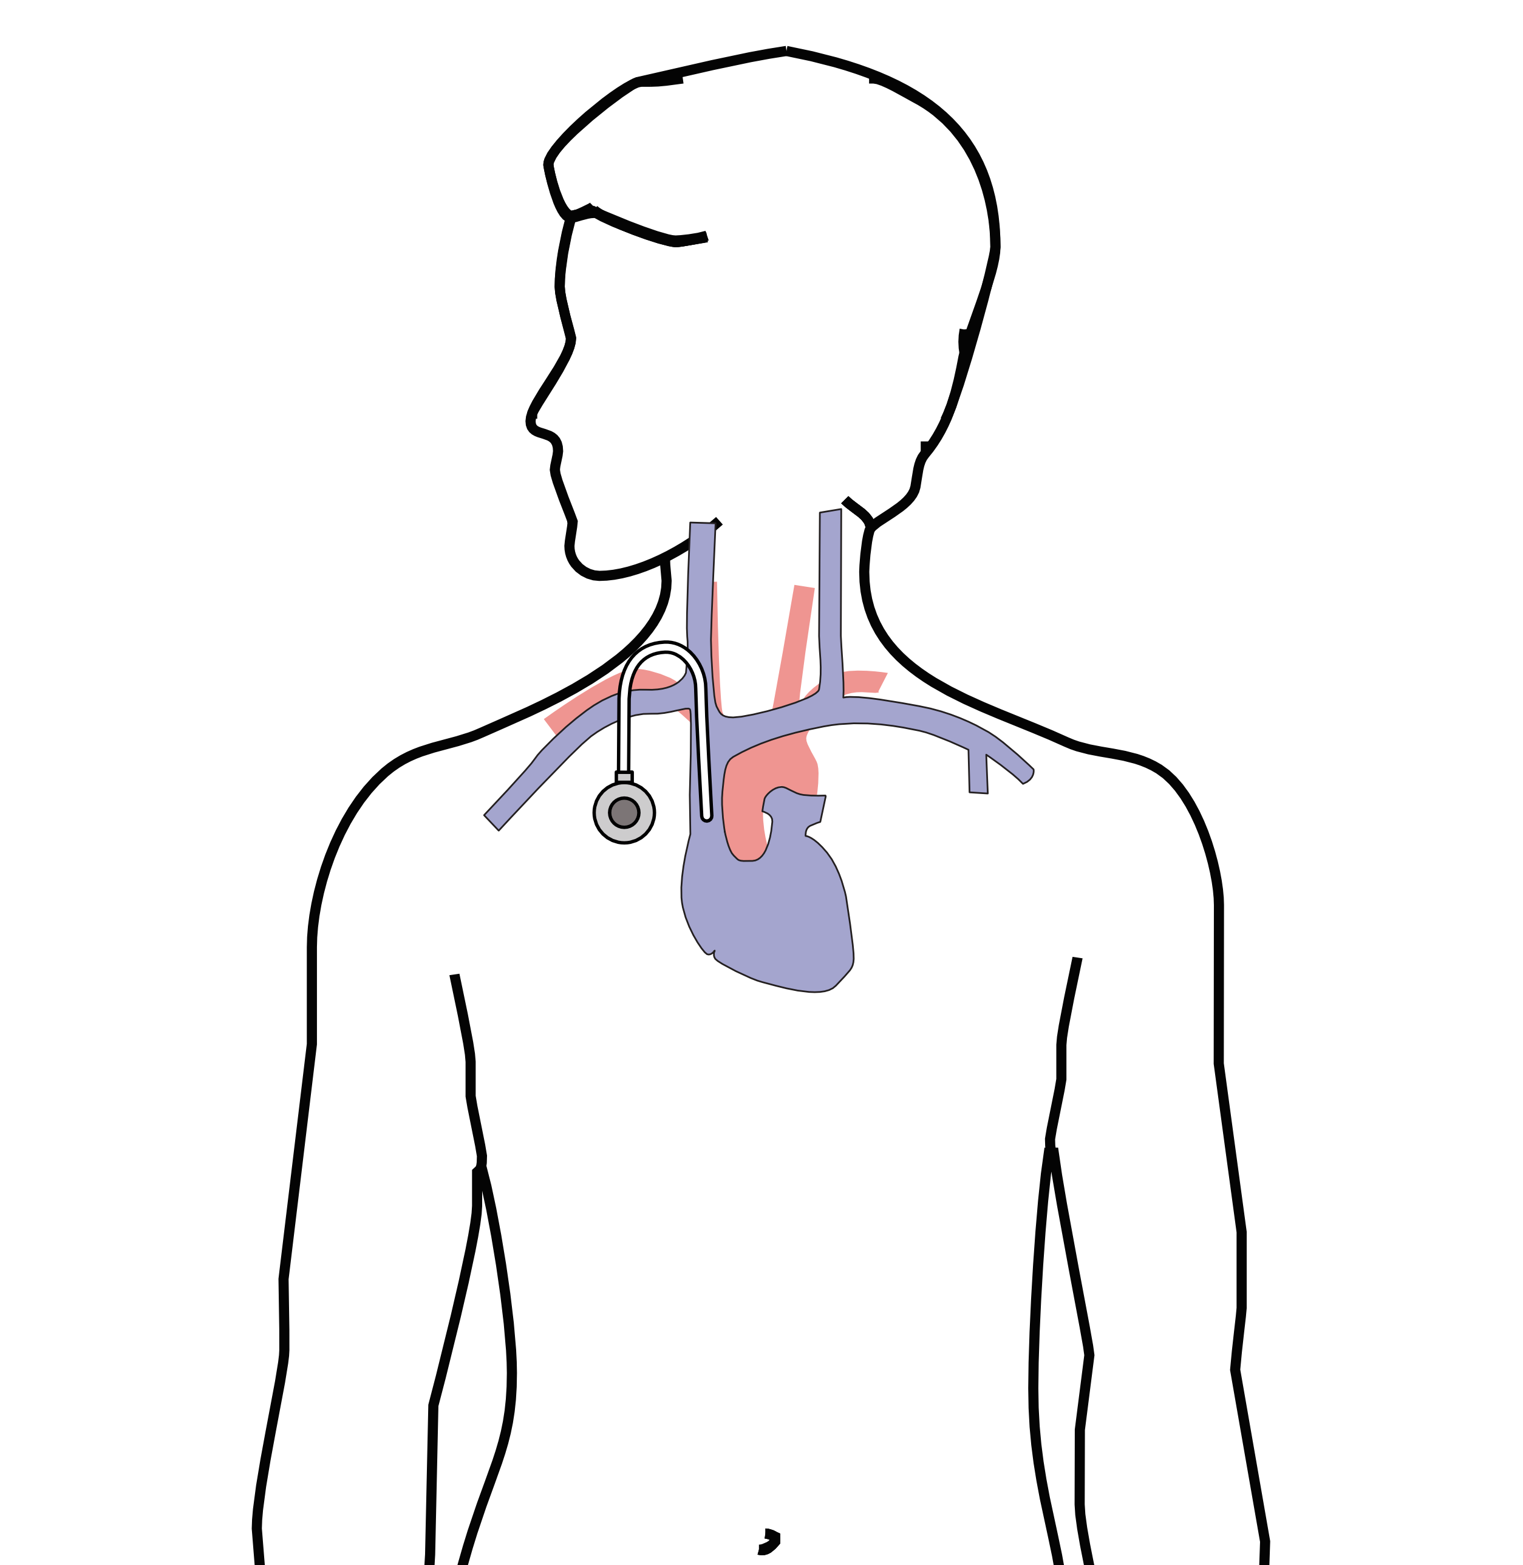
Central Venous Port
Implantable device makes chemo easier
May shower in 24 hrs
No special care at home
OK for FLOT chemo
Allows for blood draws

Slide 5
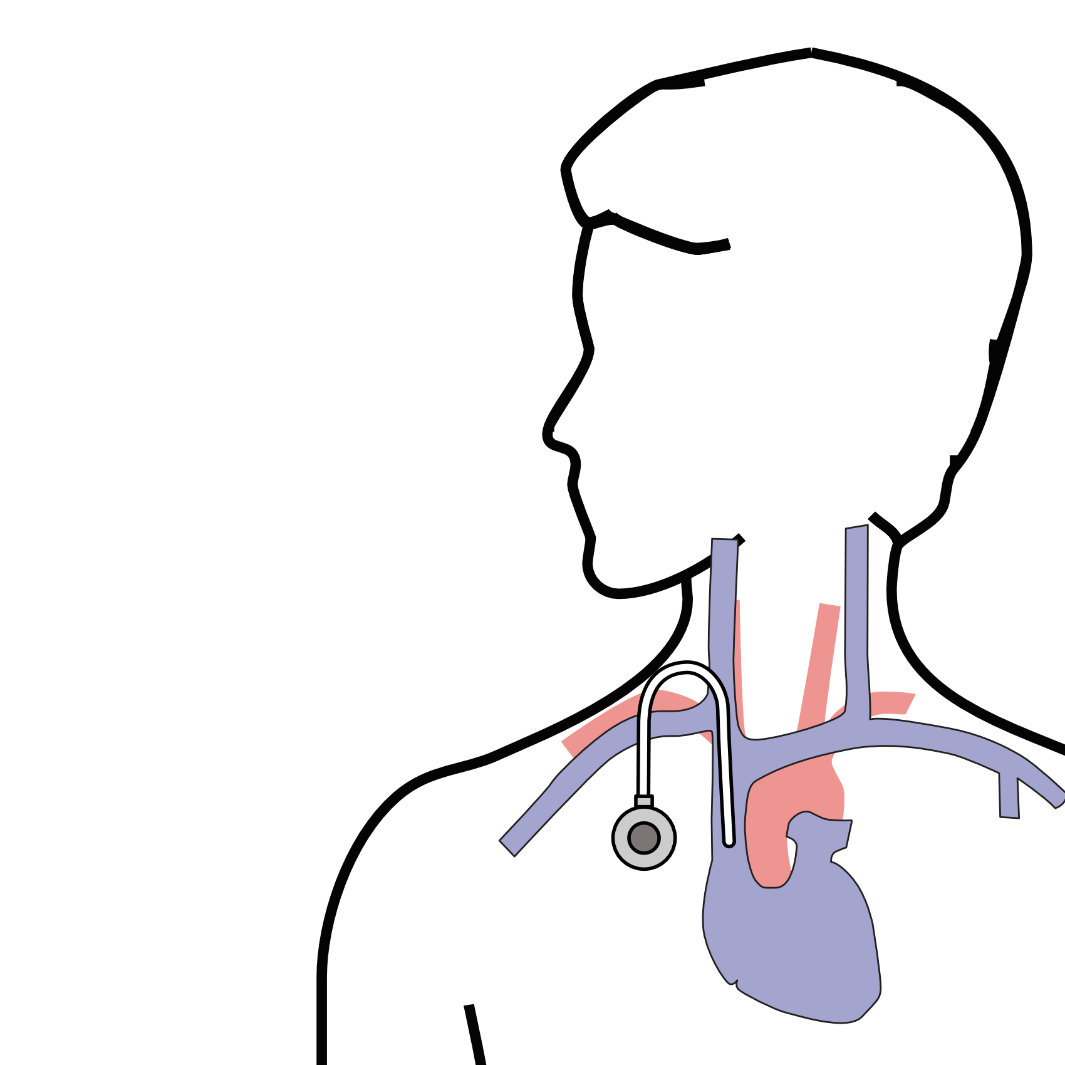
Central Venous Port
Implanted under skin
Neck incision (1/4”)
Incision below the collarbone
Sutures dissolve
“Superglue” on incisions

Slide 6
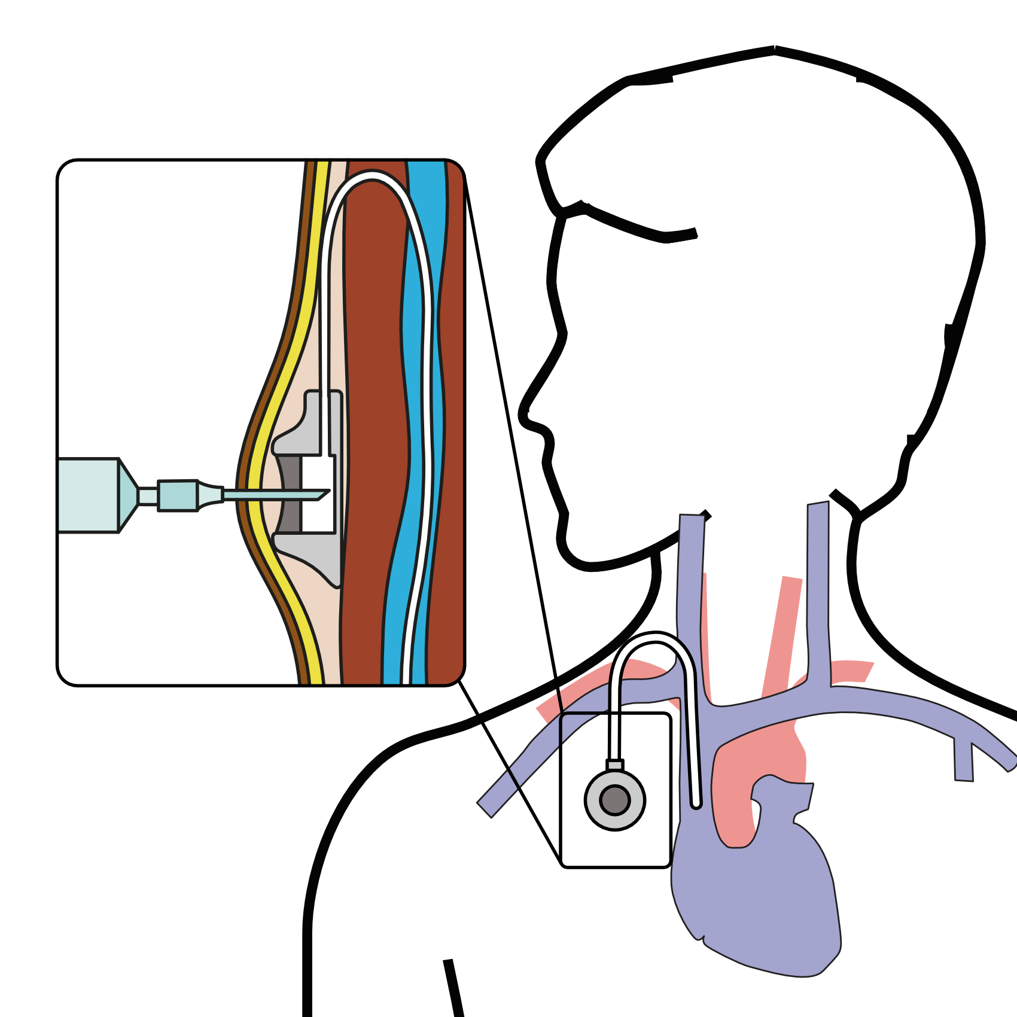
Central Venous Port
When it is time for chemotherapy, a needle is inserted through the skin into the port

Slide 7
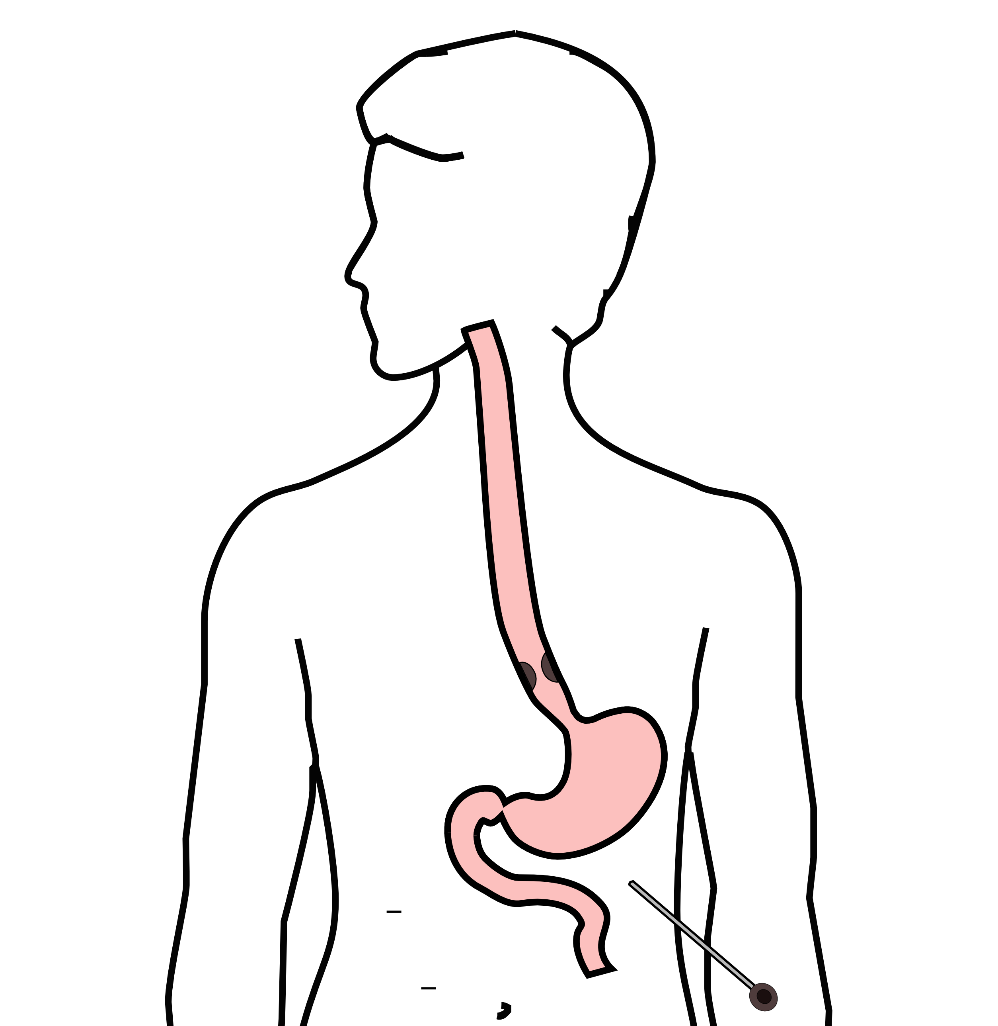
Laparoscopy
Some stomach cancers can spread inside the abdomen
Areas of spread can be very small (grain of rice)
Laparoscopy can detect spread inside the abdomen

Slide 8
Laparoscopy
General anesthetic
1/4” incisions
Telescope examines the abdomen
Biopsies performed
Fluid sampled

Slide 9
Team Members - Physicians
Primary Care Provider
Gastroenterologist
Medical Oncologist (chemotherapy)
Radiation Oncologist (radiation)
Surgeons
Jonathan Salo MD
Jeffrey Hagen MD
Michael Roach MD

Slide 10
Team Members - Support Staff
Physician Assistant - Kate Duncan PA-C
Dietitian - Liz Koch
Nurses
Matthew Carpenter RN
Brandon Galloway LPN
Navigators
Laura Swift
Lorna Espinal
Care Coordinator - Karen Julian-Martinez

