Slide 1
Superficial Cancer of the Esophagus and GE Junction

Slide 2
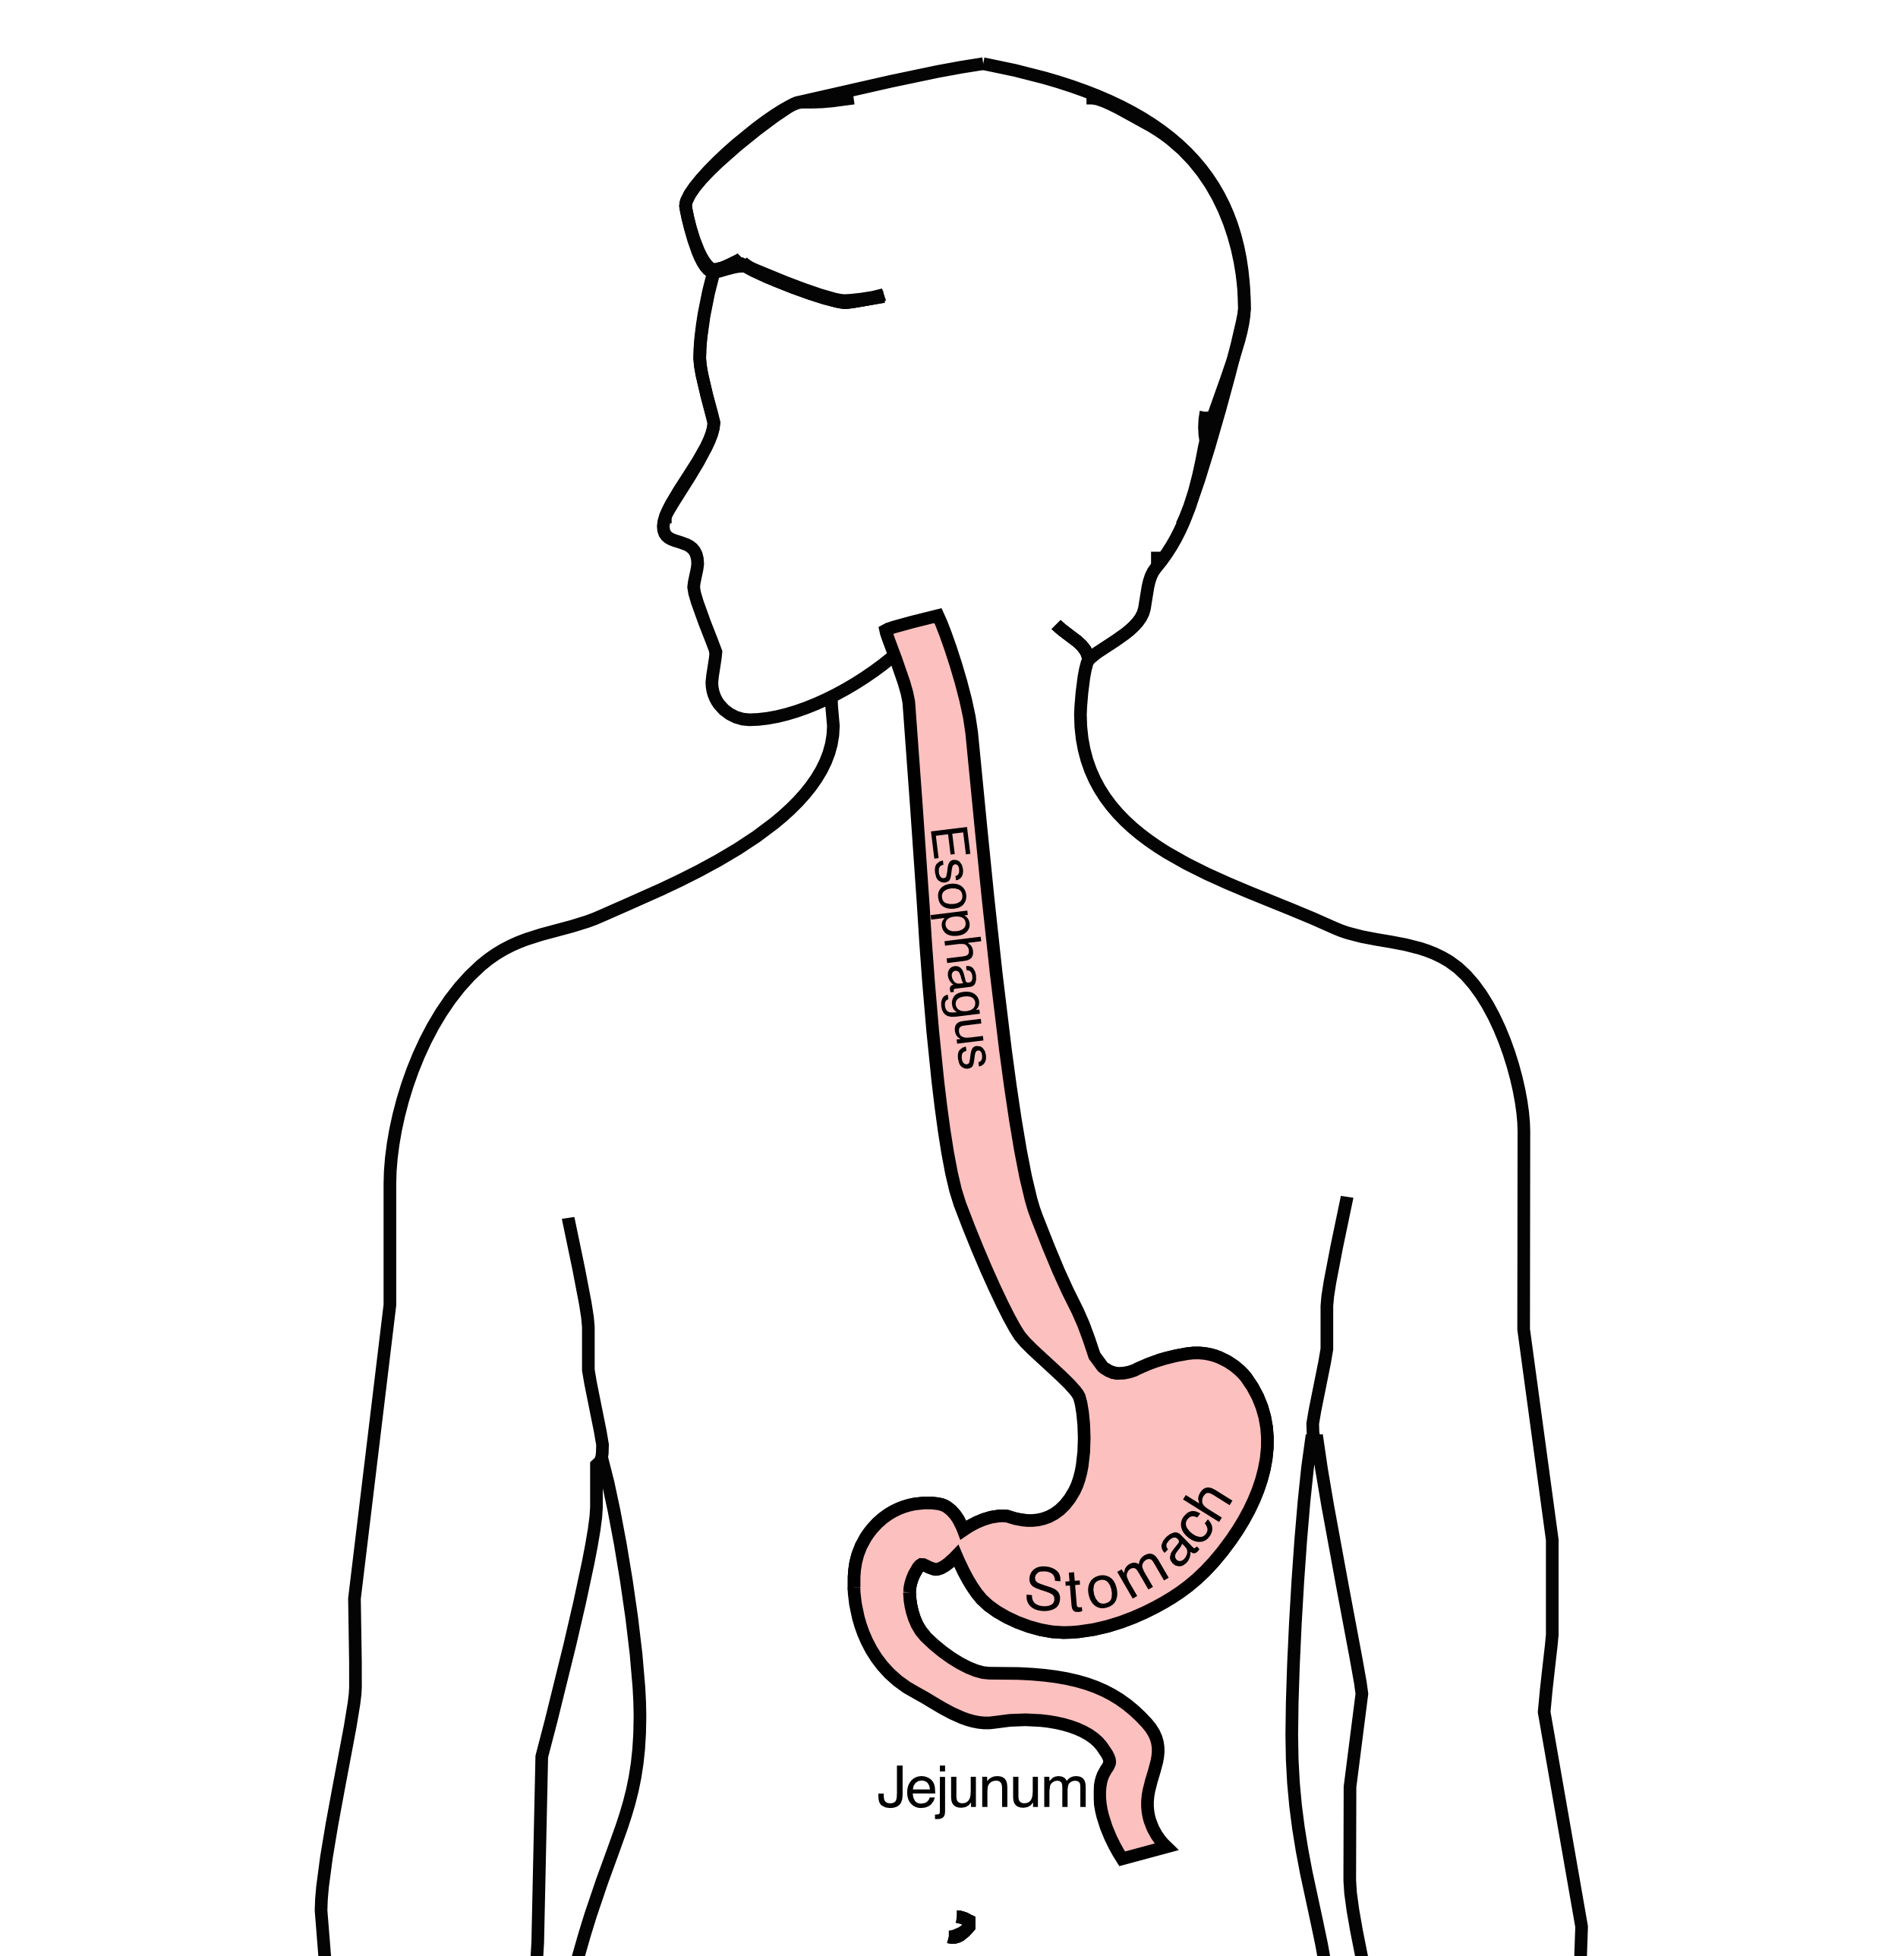
Anatomy
Food moves from the throat
$→$ esophagus
$→$ stomach
$→$ small bowel (jejunum)

Slide 3
Types of Esophageal Cancer
There are two common types of esophageal cancer
Adenocarcinoma
Squamous Cell Carcinoma
In many ways, these to different types of esophageal cancer behave the same.

Slide 4
Cancer Staging
Staging refers to the tests to determine
How large is the tumor?
Has there been spread to lymph nodes?
Has it spread to other parts of the body?
Treatment options depend upon the cancer stage

Slide 5
Cancer Staging
T = Tumor - Depth of growth into the wall
N = Nodes - Spread to the lymph nodes
M = Metastasis - Spread to liver, lungs, or bone

Slide 6
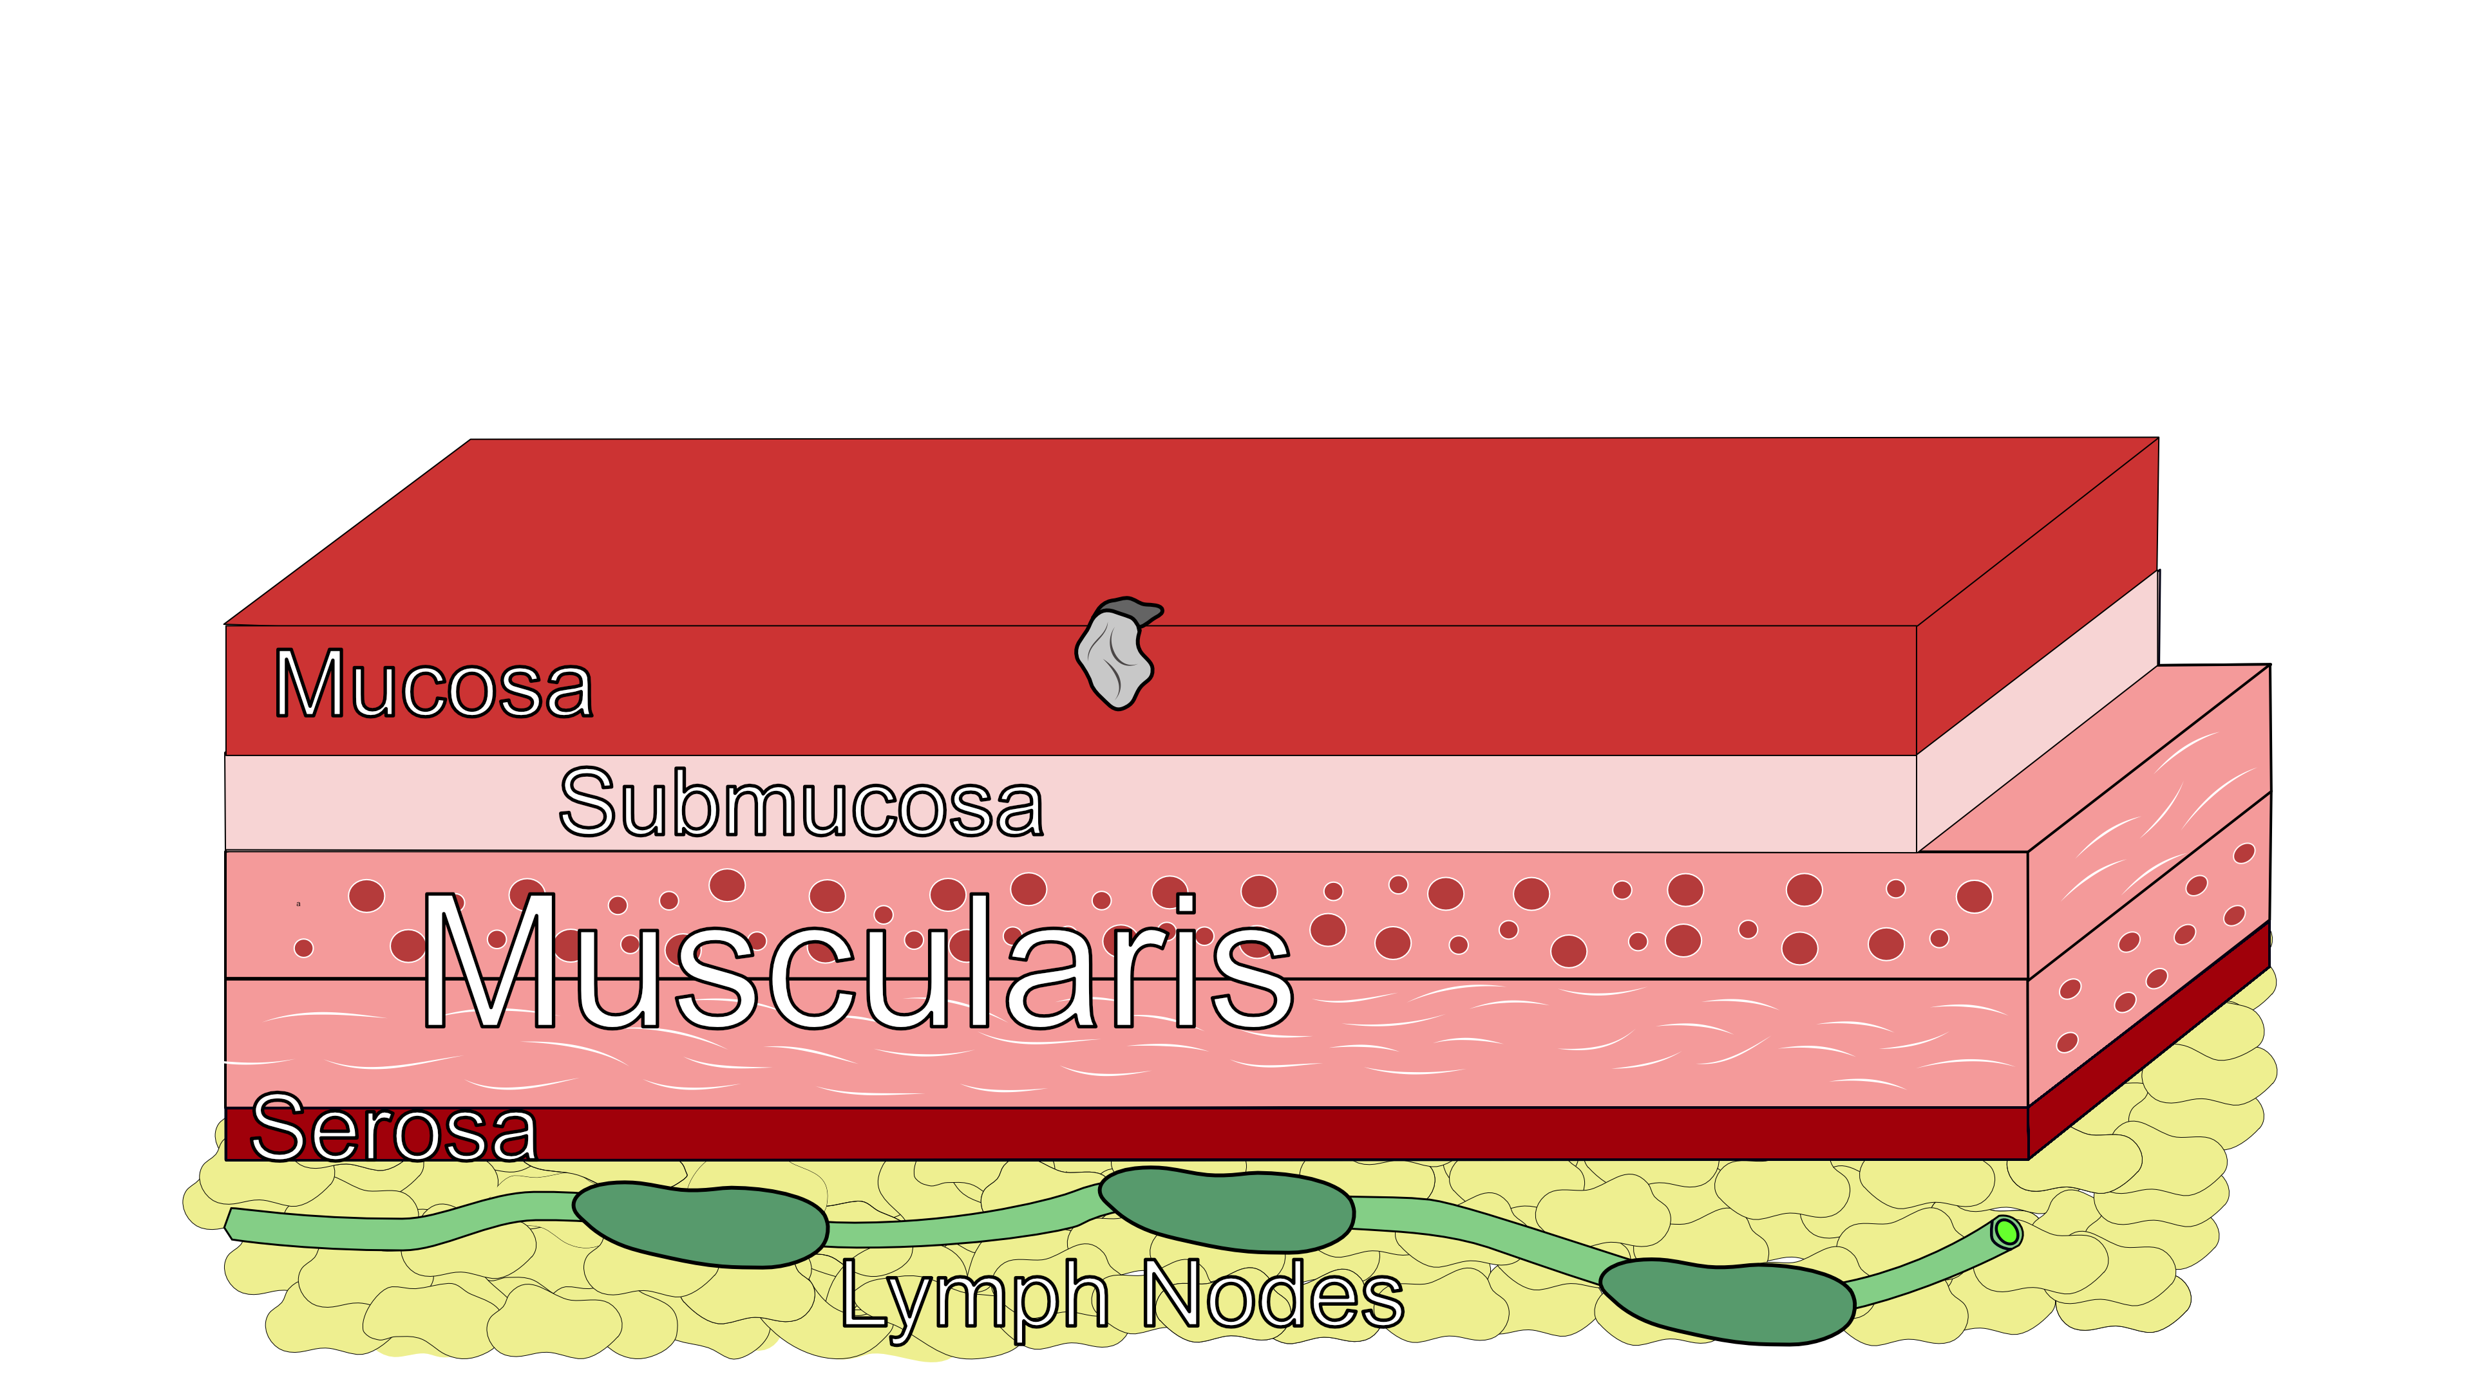
Early Stage Cancers
Cancers start on the very inside layer called the mucosa

Slide 7

Locally-advanced Cancers
Over time, cancers can grow into the muscular wall

Slide 8
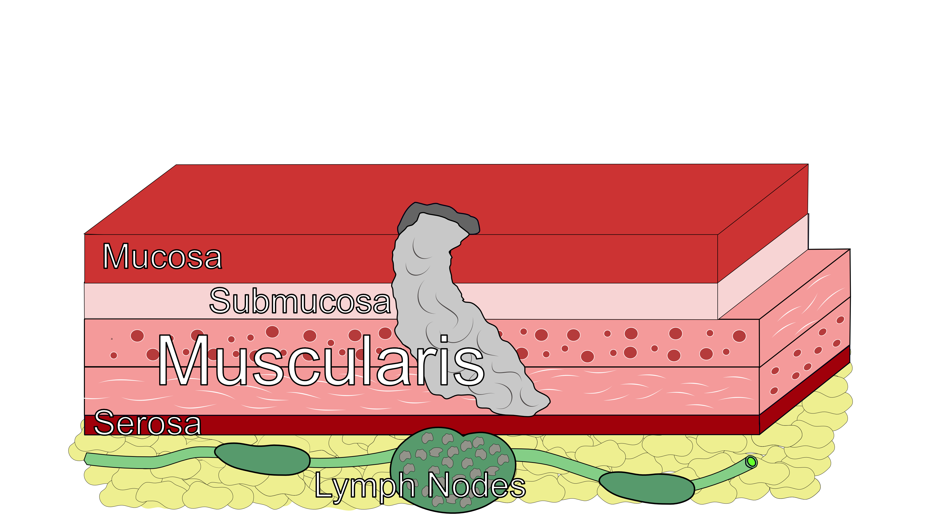
Lymph Nodes
In some cases, cancer cells can break off from the main tumor and spread to lymph nodes

Slide 9
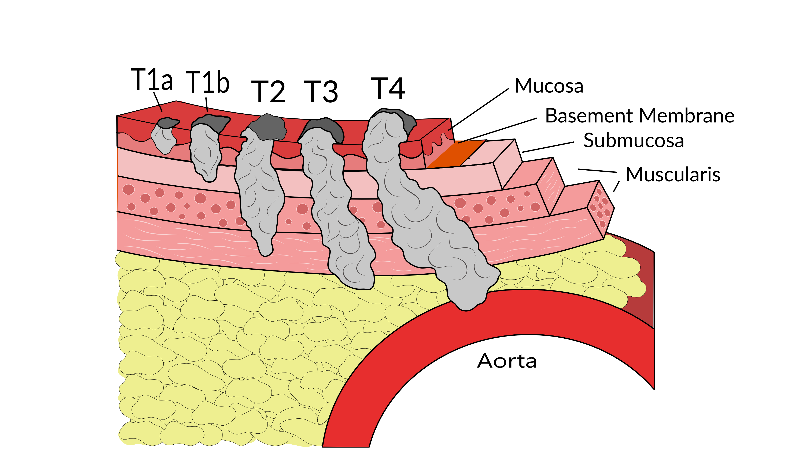
T Stage
Cancers are categorized based upon the thickness of the tumor, known as the T stage

Slide 10
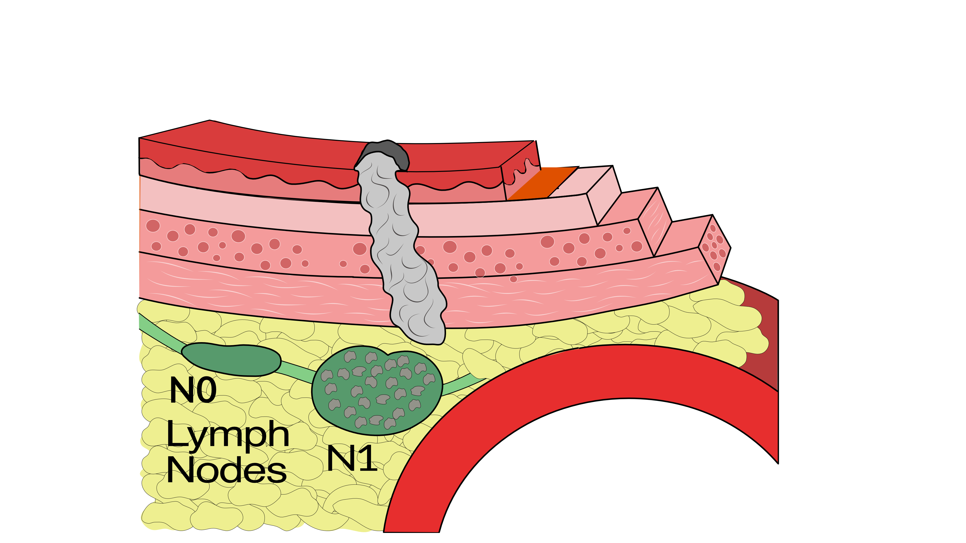
N Stage
Cancers are categorized by whether there is spread to the nodes.
N0 cancers have not spread to the nodes
N1 cancers have spread to the nodes.

Slide 11
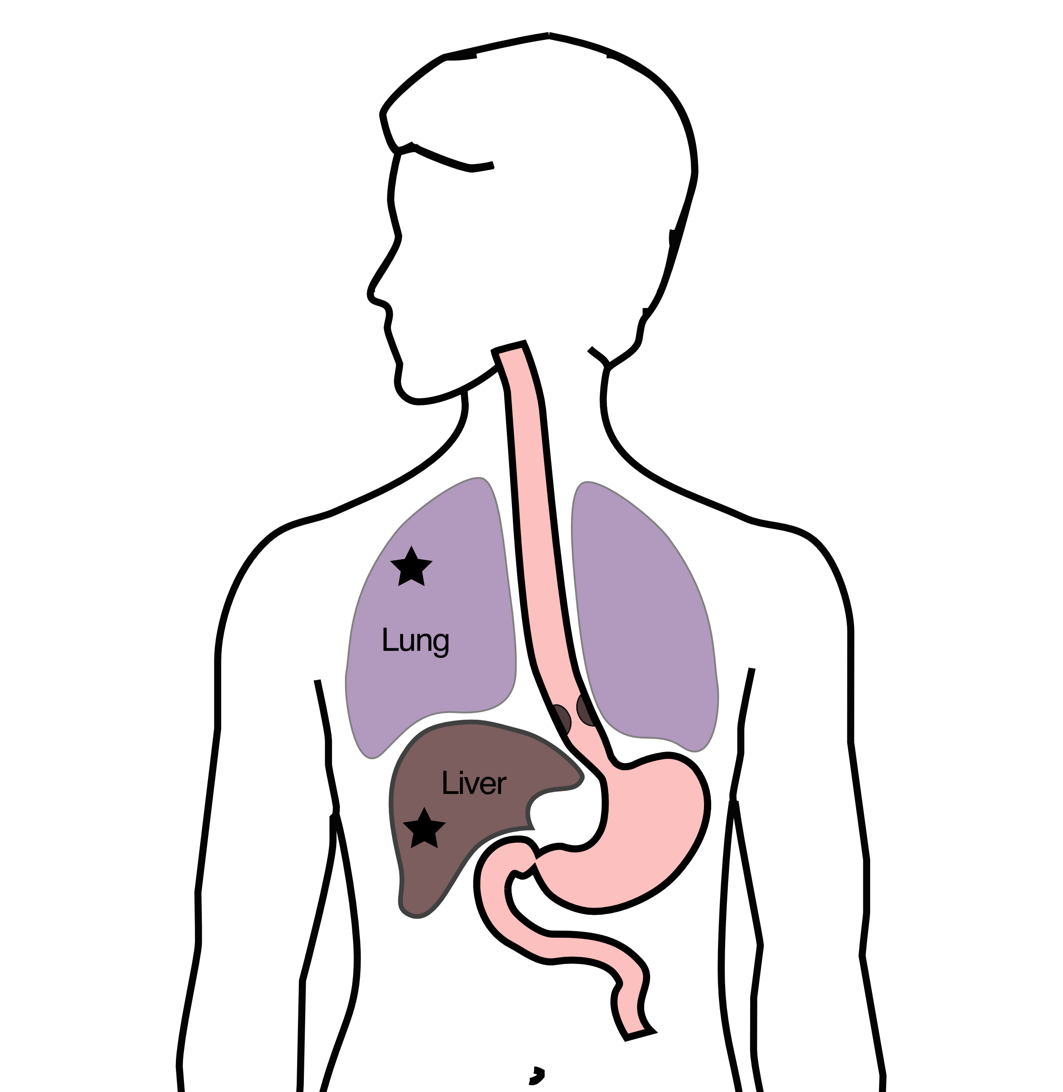
M Stage
Some cancers spread to other parts of the body
M0 cancers have not spread
M1 cancers have spread to lungs, liver, bone, or within the abdomen

Slide 12
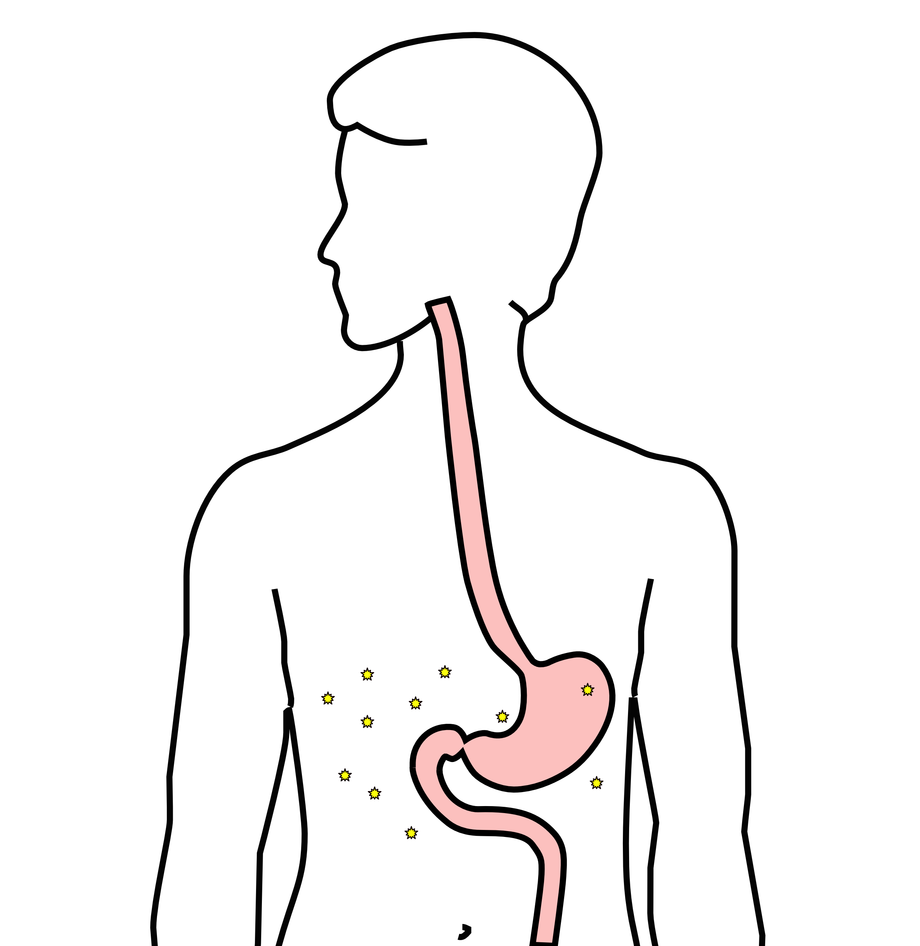
Carcinomatosis (M1)
Spread within the abdomen is carcinomatosis
Tumors can be very small (grain of rice)
Fluid can also build up: ascites

Slide 13
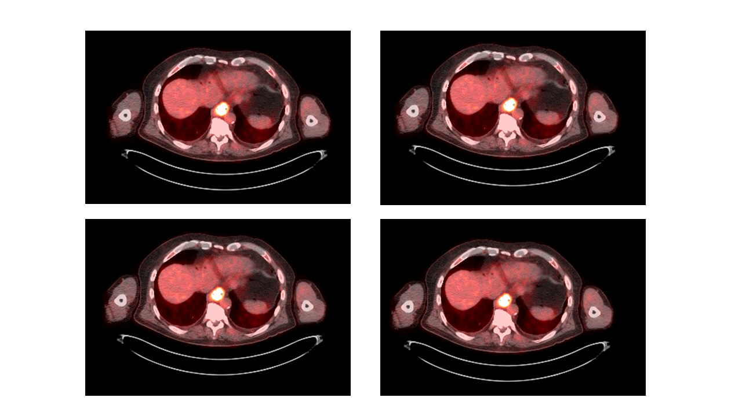
PET scan
Similar to CT scan
Tracer shows ‘hot spots’
Cancer
Inflammation or infection
Normal organs (heart, kidneys)

Slide 14
PET scan Preparation
Nothing to eat or drink for 4 hours prior to exam
High-protein low-carbohydrate diet the day prior
No strenous activity day prior to study

Slide 15
PET scan Prepration - Diabetic Patients
PET scan uses a modified sugar as a tracer $⇒$ you will need to be careful about blood sugar and insulin before the study
No insulin within 4 hours of the exam
OK to take diabetes pills the day of the exam
PET scans are generally best in the morning
Plan to eat a meal after the PET scan, with half the usual morning dose of insulin

Slide 16
PET scan Prepration - Diabetic Patients
If PET is scheduled after 10AM:
low-carbohydrate breakfast at least 4 hours before
half the usual regular (short-acting) insulin
No long-acting insulin after midnight.
Insulin pump: turn it off 4 hours before the study (or turn it down to basal/night-time rate)

Slide 17
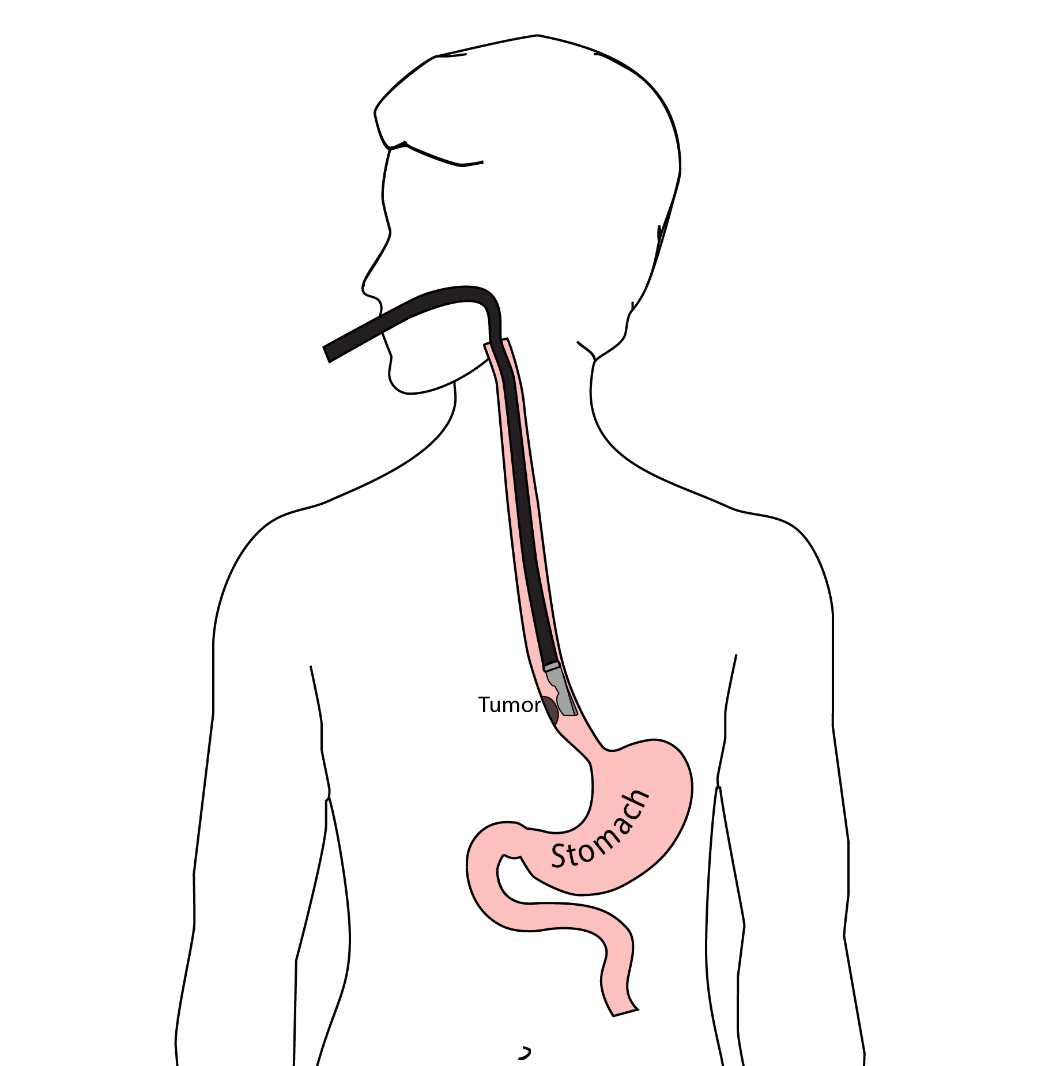
Endoscopic Ultrasound
Similar to upper endoscopy (EGD)
Ultrasound in scope
Evaluates T stage

Slide 18
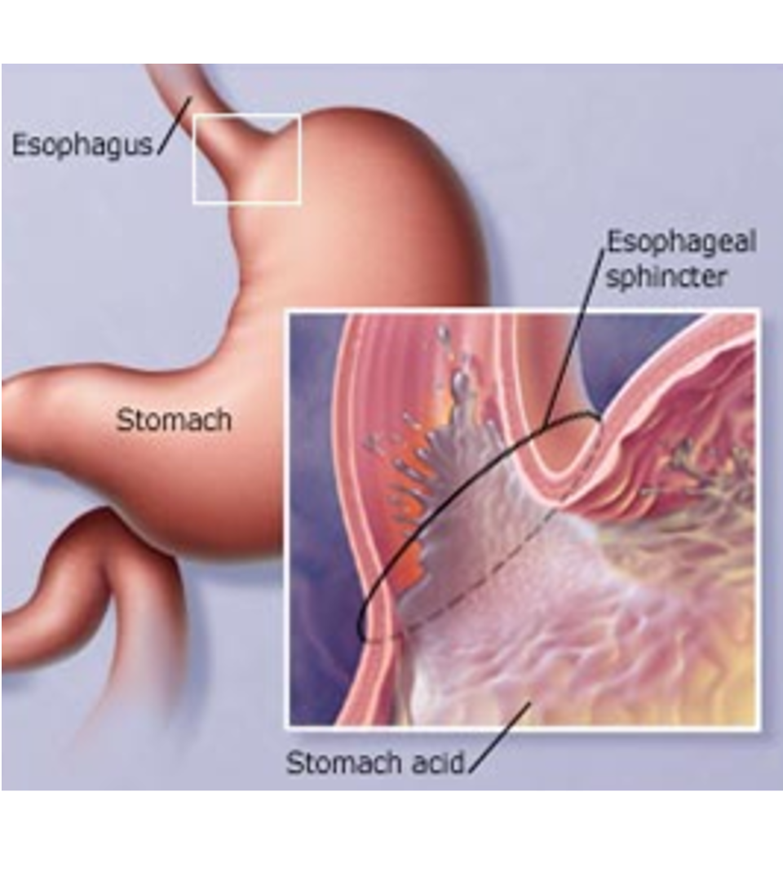
Gastroesophageal Reflux
A one-way valve normally keeps acid within the stomach and prevents it from entering the esophagus

Slide 19
Gastroesophageal Reflux
A one-way valve normally keeps acid within the stomach
If the valve does not work properly, acid enters the esophagus and cause heartburn and damage to the lining of the esophagus.

Slide 20
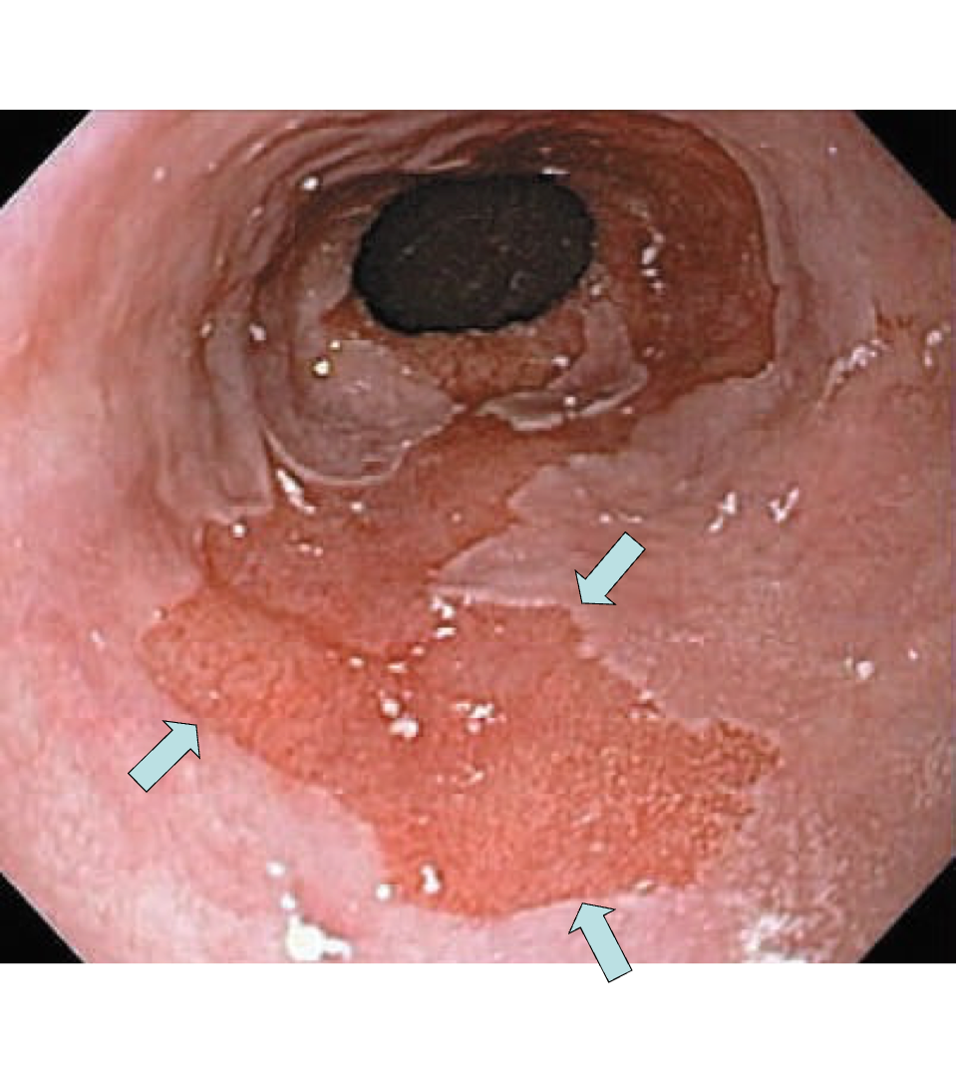
Barrett’s Esophagus
Over time, the lining of the esophagus undergoes change in response to the acid.

Slide 21
Dysplasia
Over a period of years, pre-cancerous changes can develop within Barrett’s esopahgus.
These changes can be seen by the pathologist from biopsies taken from the esophagus
Over time, low-grade dysplasia can progress to high-grade dysplasia

Slide 22
Dysplasia $→$ Cancer
Low grade dysplasia: Risk of cancer 0.5% per year
High-grade dysplasia: Risk of cancer 5% per year
$⇒$ Surveillance with upper endoscopy is critical

Slide 23
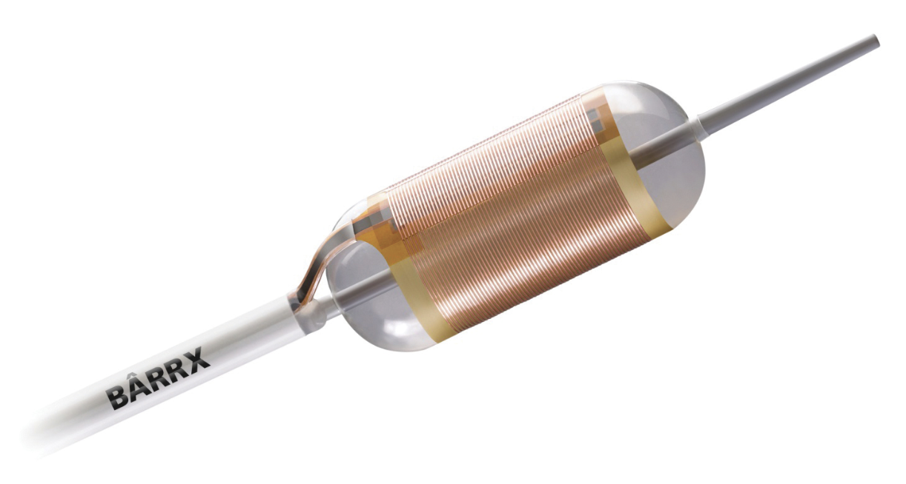
Radiofrequency ablation for Dysplasia
Dysplasia can be treated with destroying the mucosa, the inner layer of esophgus
Ablation of the mucosa with microwave energy
Circular balloon with an antenna used to ablate the mucosa

Slide 24
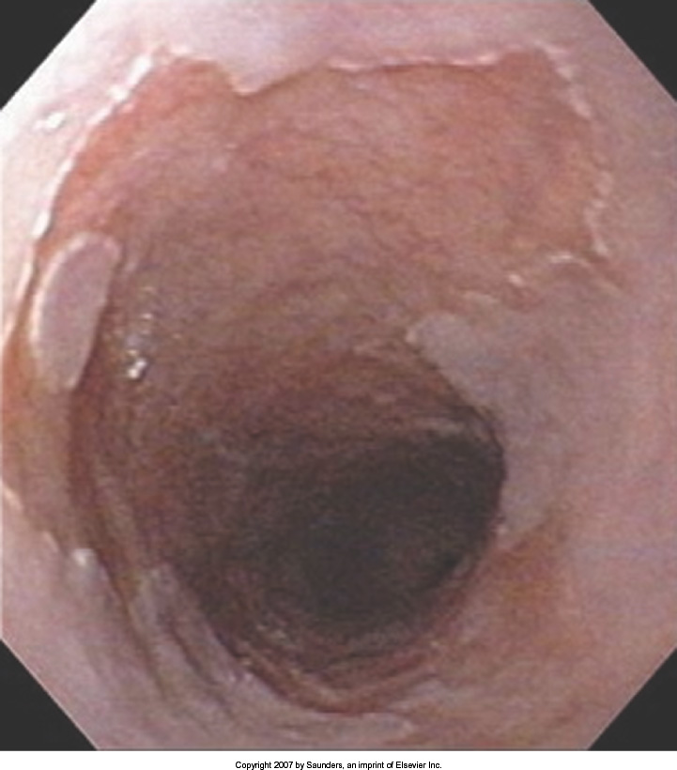
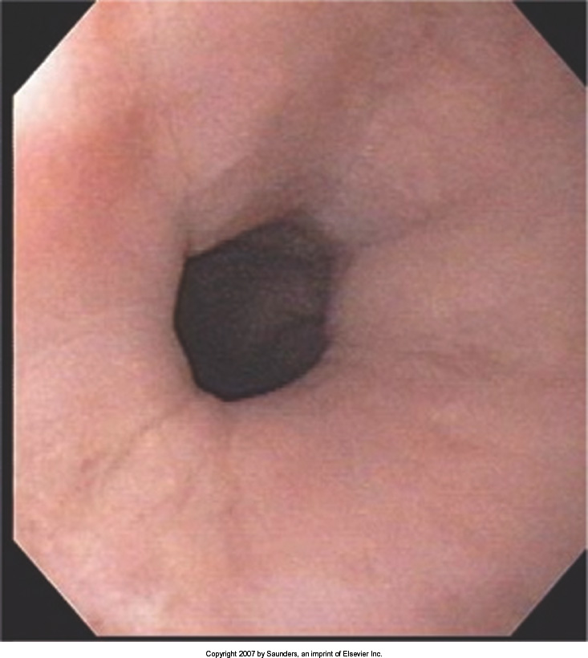
Radiofrequency ablation for Dysplasia
Before Ablation
After Ablation

Slide 25
Treatment Plan
Superficial (T1)
Endoscopic Therapy
Localized (T1b/T2)
Surgery (esophagectomy)
Locally-advanced (T3M0)
Chemo$±$Radiation $→$Surgery
Metastatic (M1)
Chemotherapy

Slide 26
Superficial Cancers = T1a
Treatment is often with by endoscopic resection without the need for surgery.

Slide 27
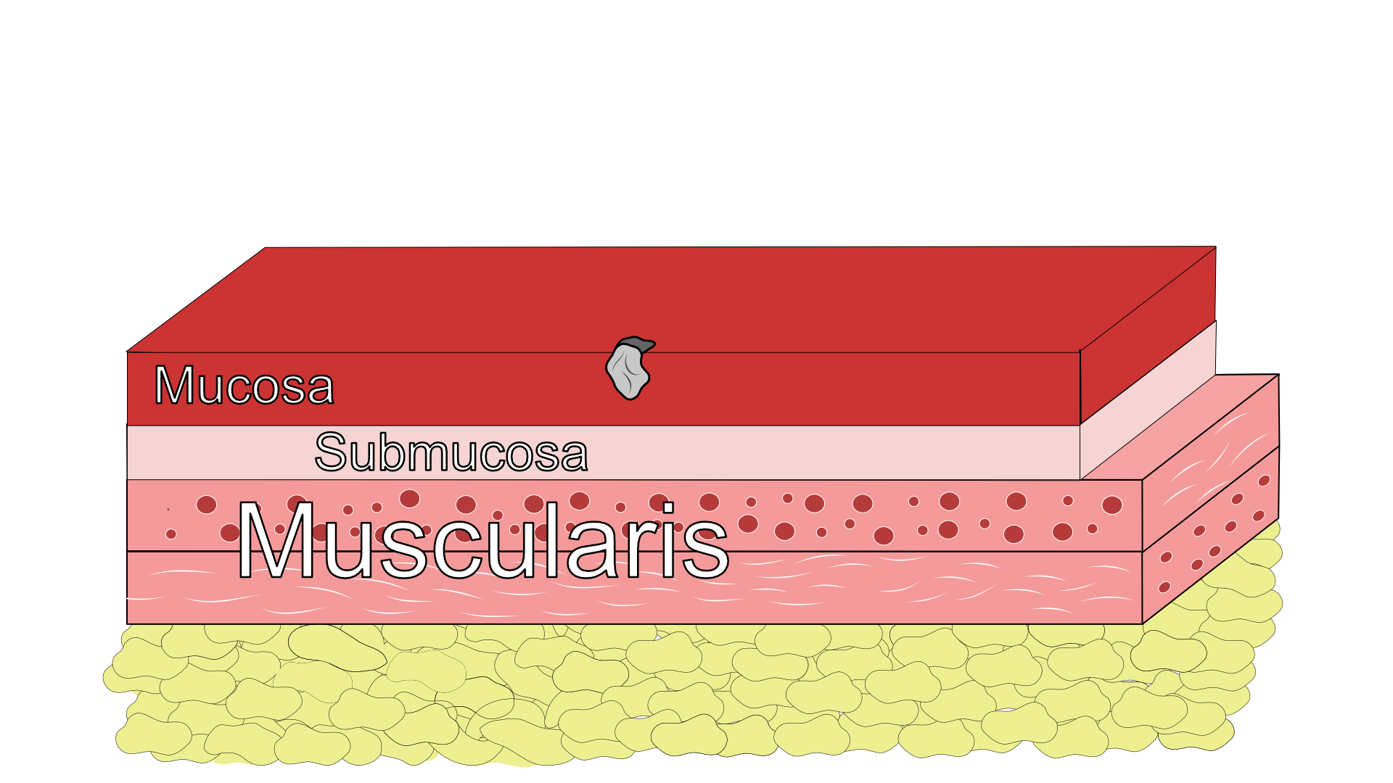
Endoscopic Resection

Slide 28
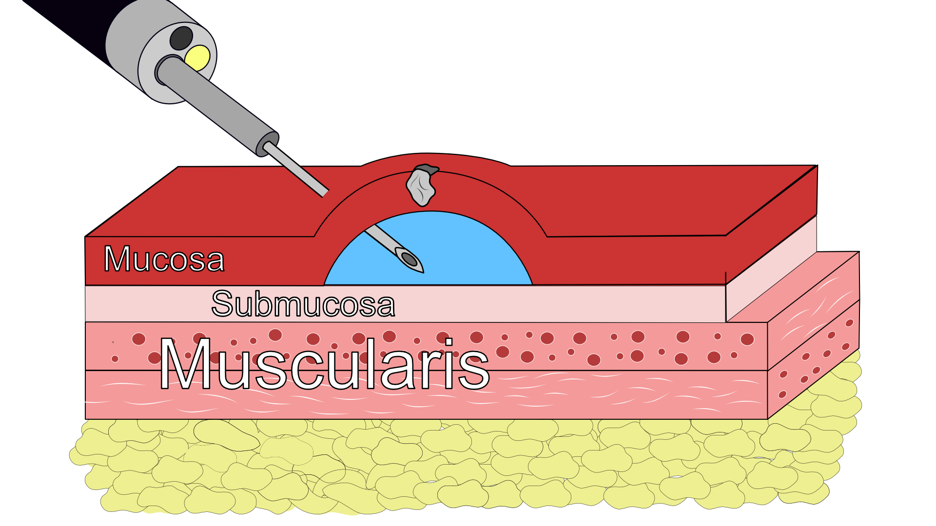
Tumor Lift

Slide 29
Tumor Lift

Slide 30
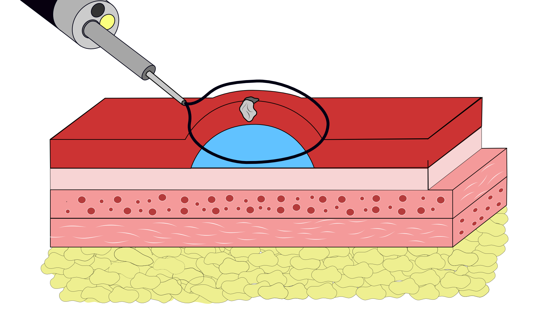
Tumor Removal - Resection

Slide 31
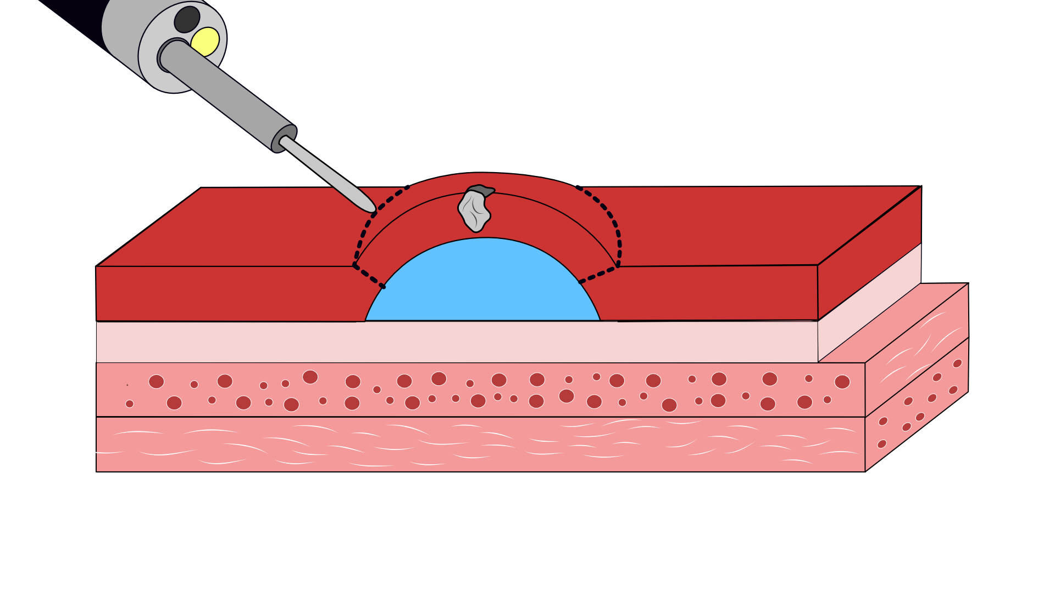
## Tumor Removal - Dissection

Slide 32
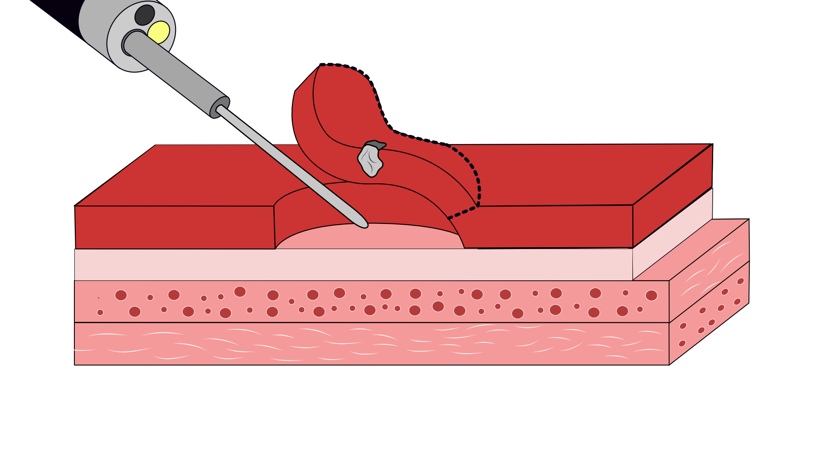
## Tumor Removal - Dissection

Slide 33
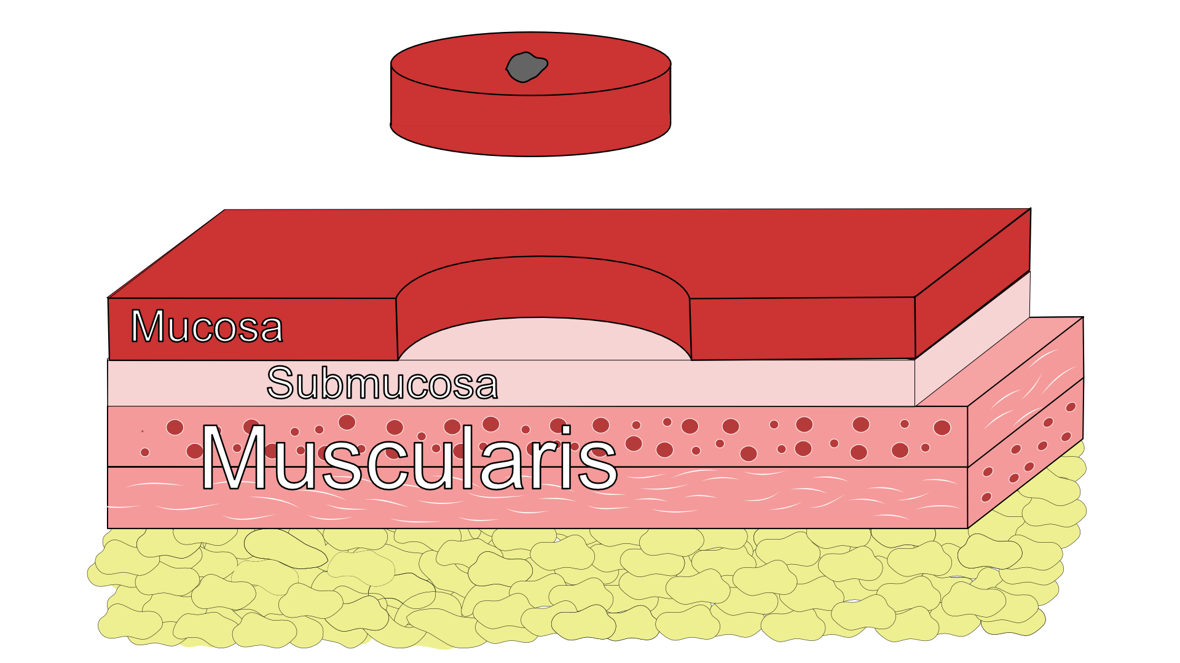
Endoscopic Resection - Favorable
Clear edge margin AND
Clear deep margin AND
Tumor slow-growing under microscope

Slide 34
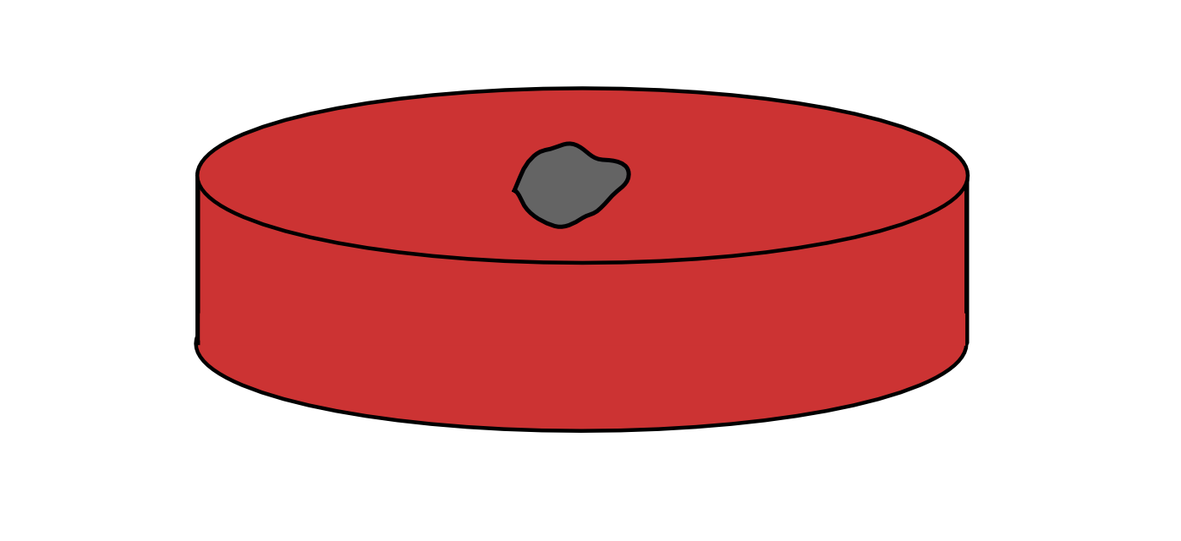
Endoscopic Resection - Favorable
Clear edge margin AND
Clear deep margin AND
Tumor slow-growing under microscope

Slide 35
Endoscopic Resection - Favorable
May be the only treatment required
Requires endoscopic surveillance

Slide 36
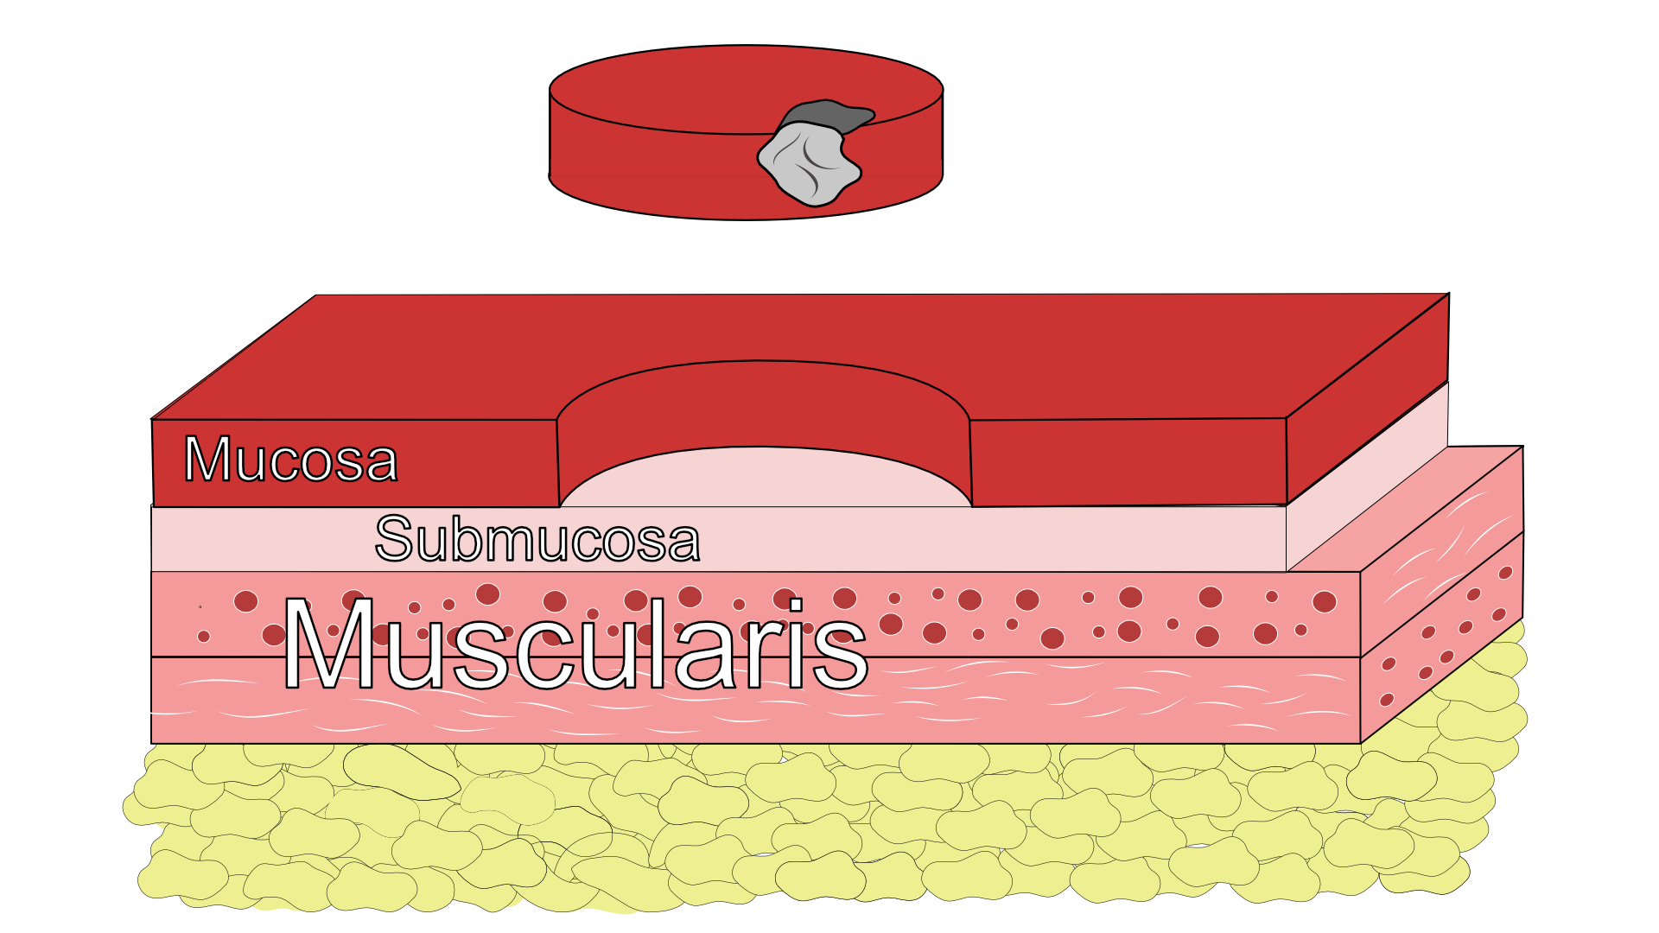
Endoscopic Resection - Unfavorable

Slide 37
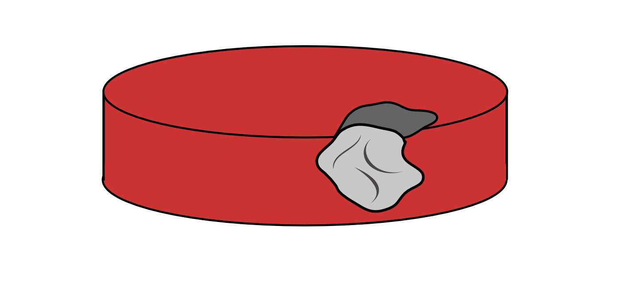
Endoscopic Resection - Unfavorable
Tumor at edge margin OR
Tumor at deep margin OR
Tumor rapidly-growing under microscope

Slide 38
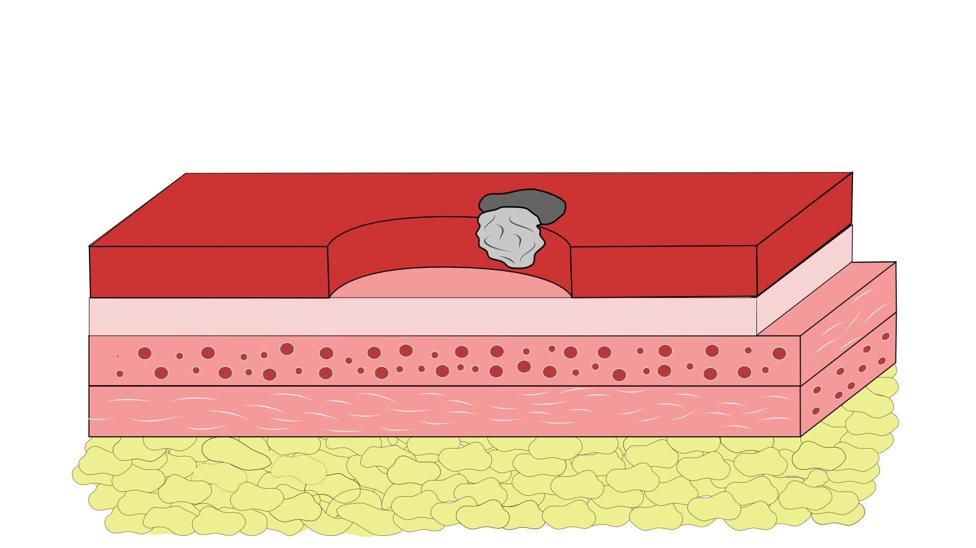
Endoscopic Resection - Unfavorable
Esophagectomy (surgery) is standard recommendation

Slide 39
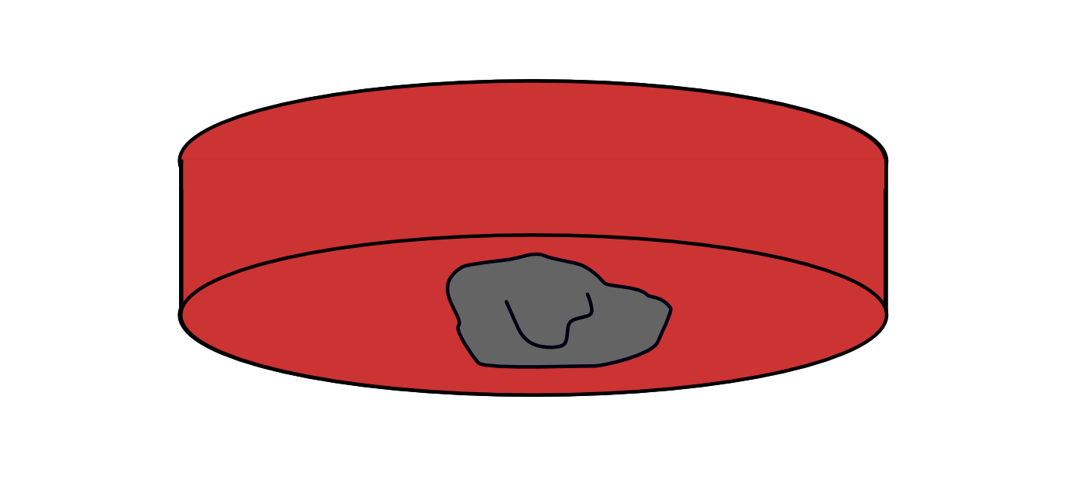
Endoscopic Resection - Positive Deep Margin
Tumor at edge margin OR
Tumor at deep margin OR
Tumor rapidly-growing under microscope

Slide 40
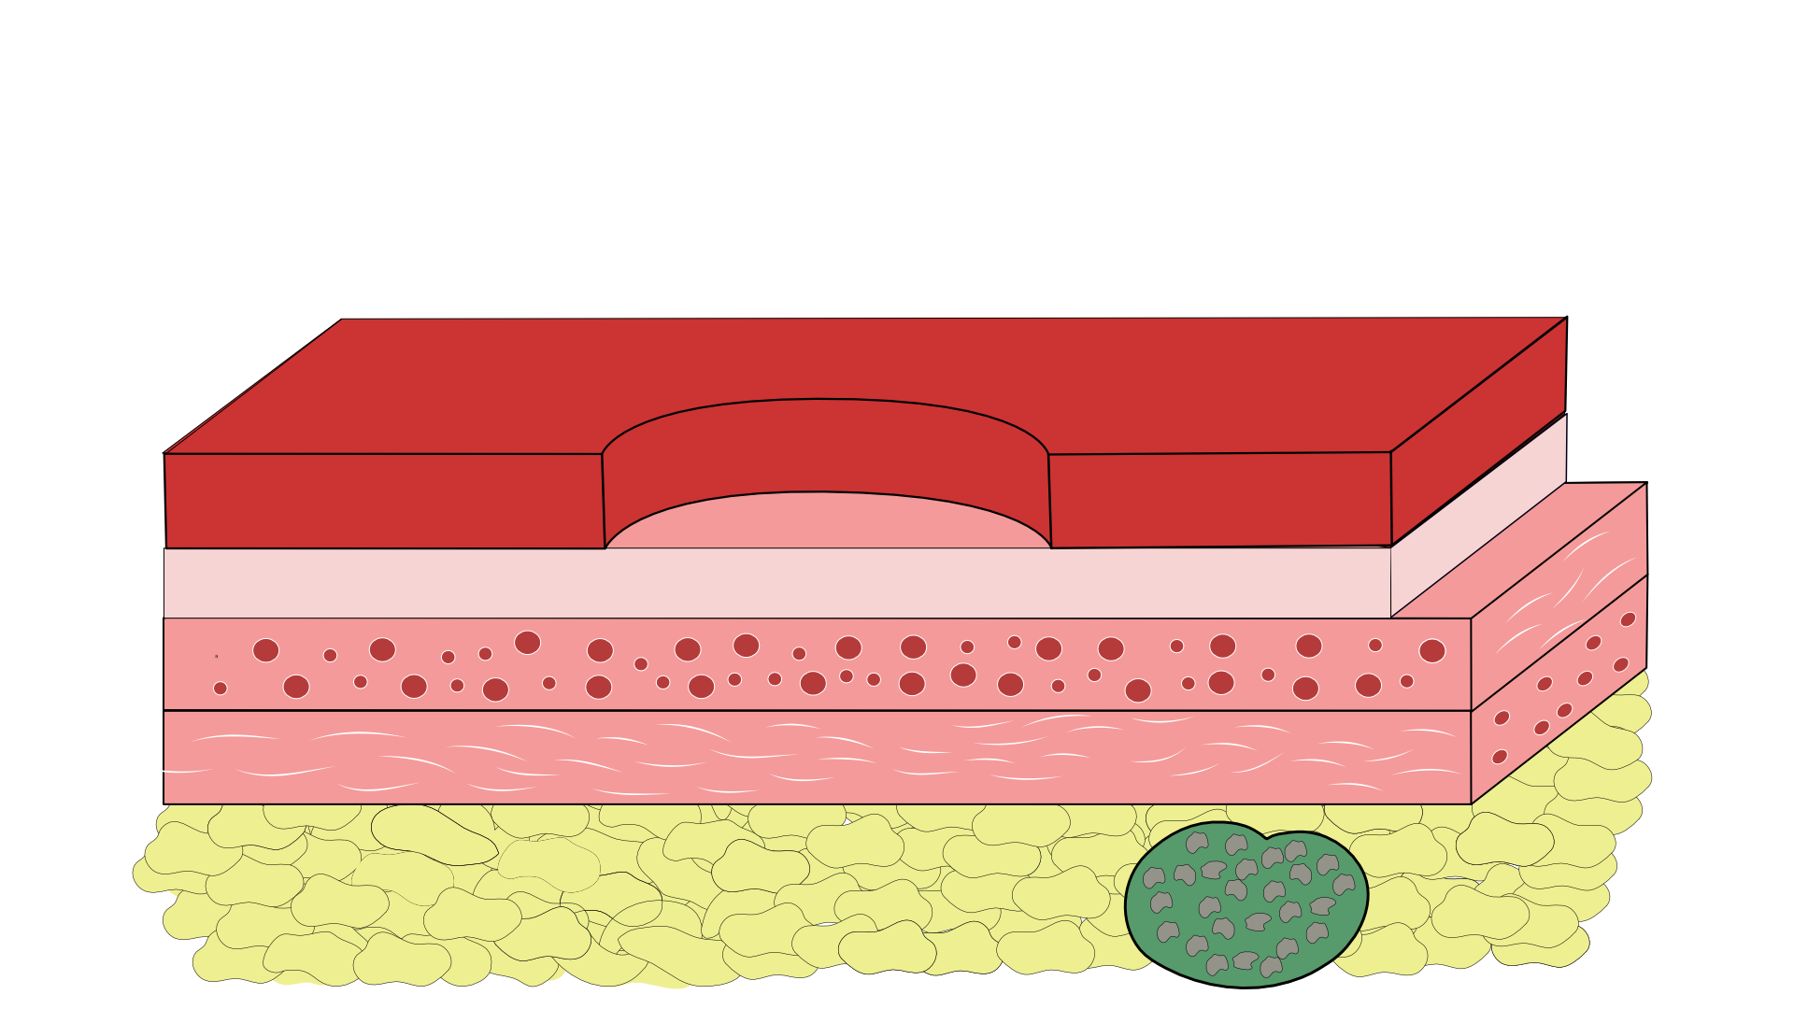
Endoscopic Resection - Positive Deep Margin
Tumor at edge margin OR
Tumor at deep margin OR
Tumor rapidly-growing under microscope

Slide 41
Endoscopic Resection - Positive Deep Margin
Tumor at edge margin OR
Tumor at deep margin OR
Tumor rapidly-growing under microscope

Slide 42
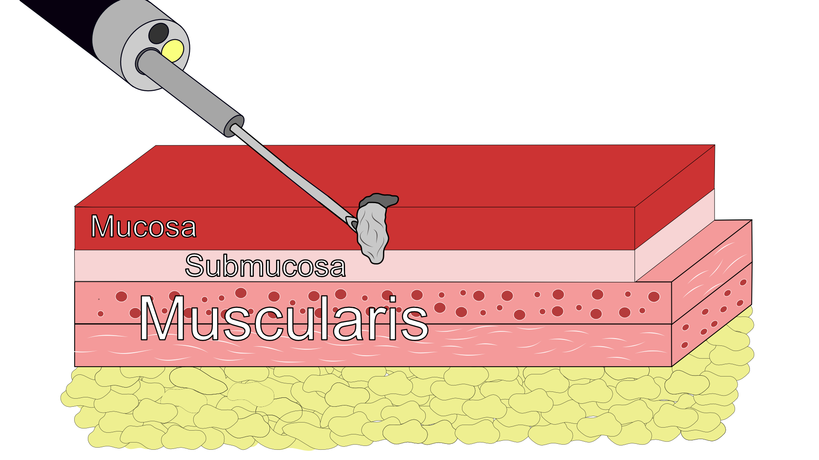
Unable to Lift Tumor

