Slide 1
Early-Stage Cancer of the Esophagus and GE Junction

Slide 2
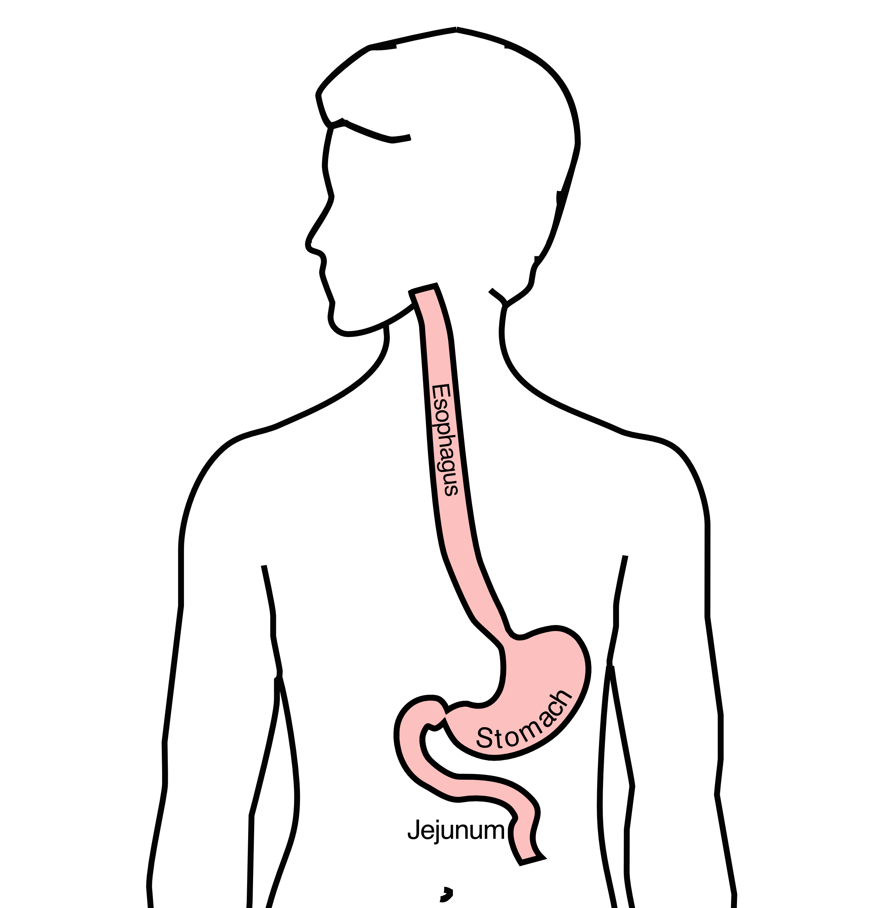
Anatomy
Food moves from the throat
$→$ esophagus
$→$ stomach
$→$ small bowel (jejunum)

Slide 3
Types of Esophageal Cancer
There are two common types of esophageal cancer
Adenocarcinoma
Squamous Cell Carcinoma
In many ways, these to different types of esophageal cancer behave the same.
We will see later in this video, however, that the treatment can be different depending upon whether the cancer is adenocarcinoma or squamous cell carcinoma.

Slide 4
Cancer Staging
Staging refers to the tests to determine
How large is the tumor?
Has there been spread to lymph nodes?
Has it spread to other parts of the body?
Treatment options depend upon the cancer stage

Slide 5
Esophageal Cancer Staging
T = Tumor - How deep has cancer grown into the wall of the esophagus?
N = Nodes - Has cancer spread to the lymph nodes?
M = Metastasis - Has the cancer spread to other parts of the body? lungs or liver?

Slide 6
Layers of the Wall of the Esophagus
Mucosa - Inner layer
Muscle Wall (muscularis)
Lymph nodes located in fat outside the muscle

Slide 7
Early Stage Cancers
Cancers start on the very inside of the layer called the mucosa

Slide 8
Locally-advanced Cancers
Over time, cancers can grow into the muscular wall

Slide 9
Lymph Nodes
In some cases, cancer cells can break off from the main tumor and spread to lymph nodes

Slide 10
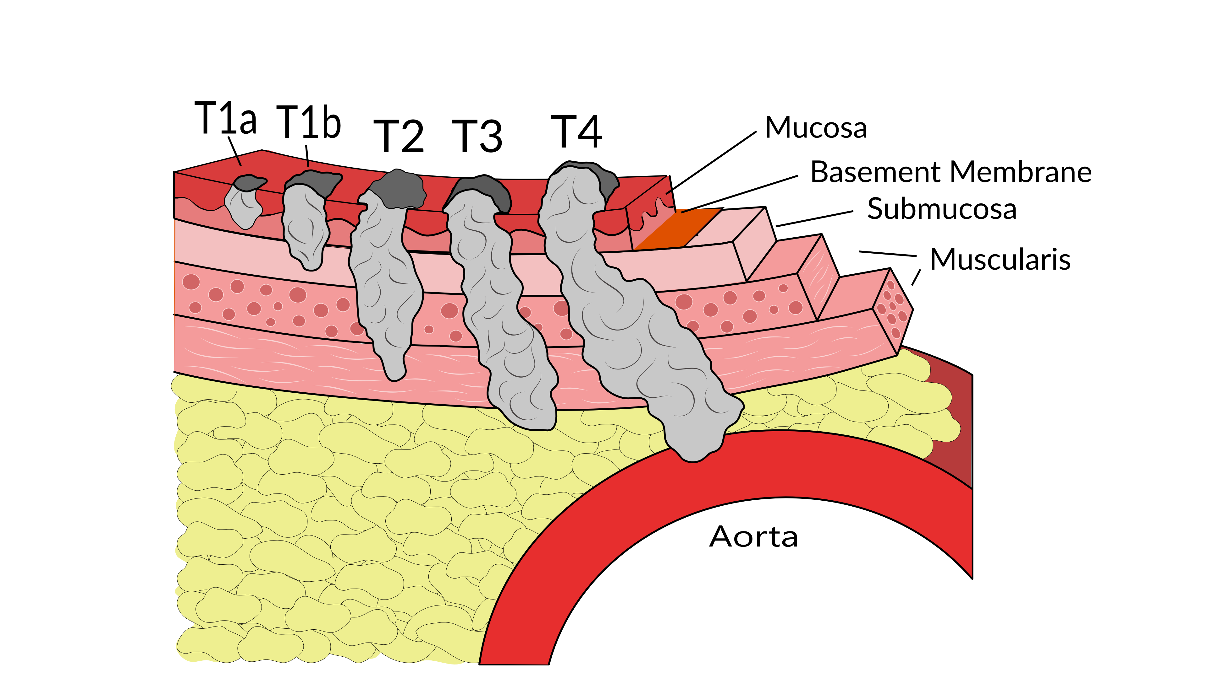
T Stage
Cancers are categorized based upon the thickness of the tumor, known as the T stage

Slide 11
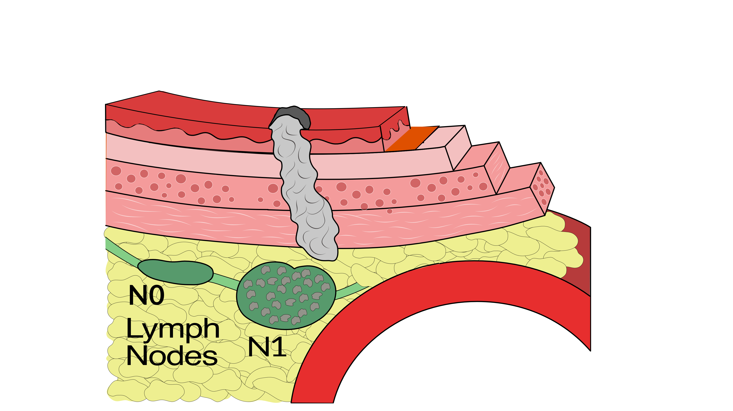
N Stage
Cancers are categorized by whether there is spread to the lymph nodes.
N0 cancers have not spread to the lymph nodes
N1 cancers have spread to the lymph nodes.

Slide 12
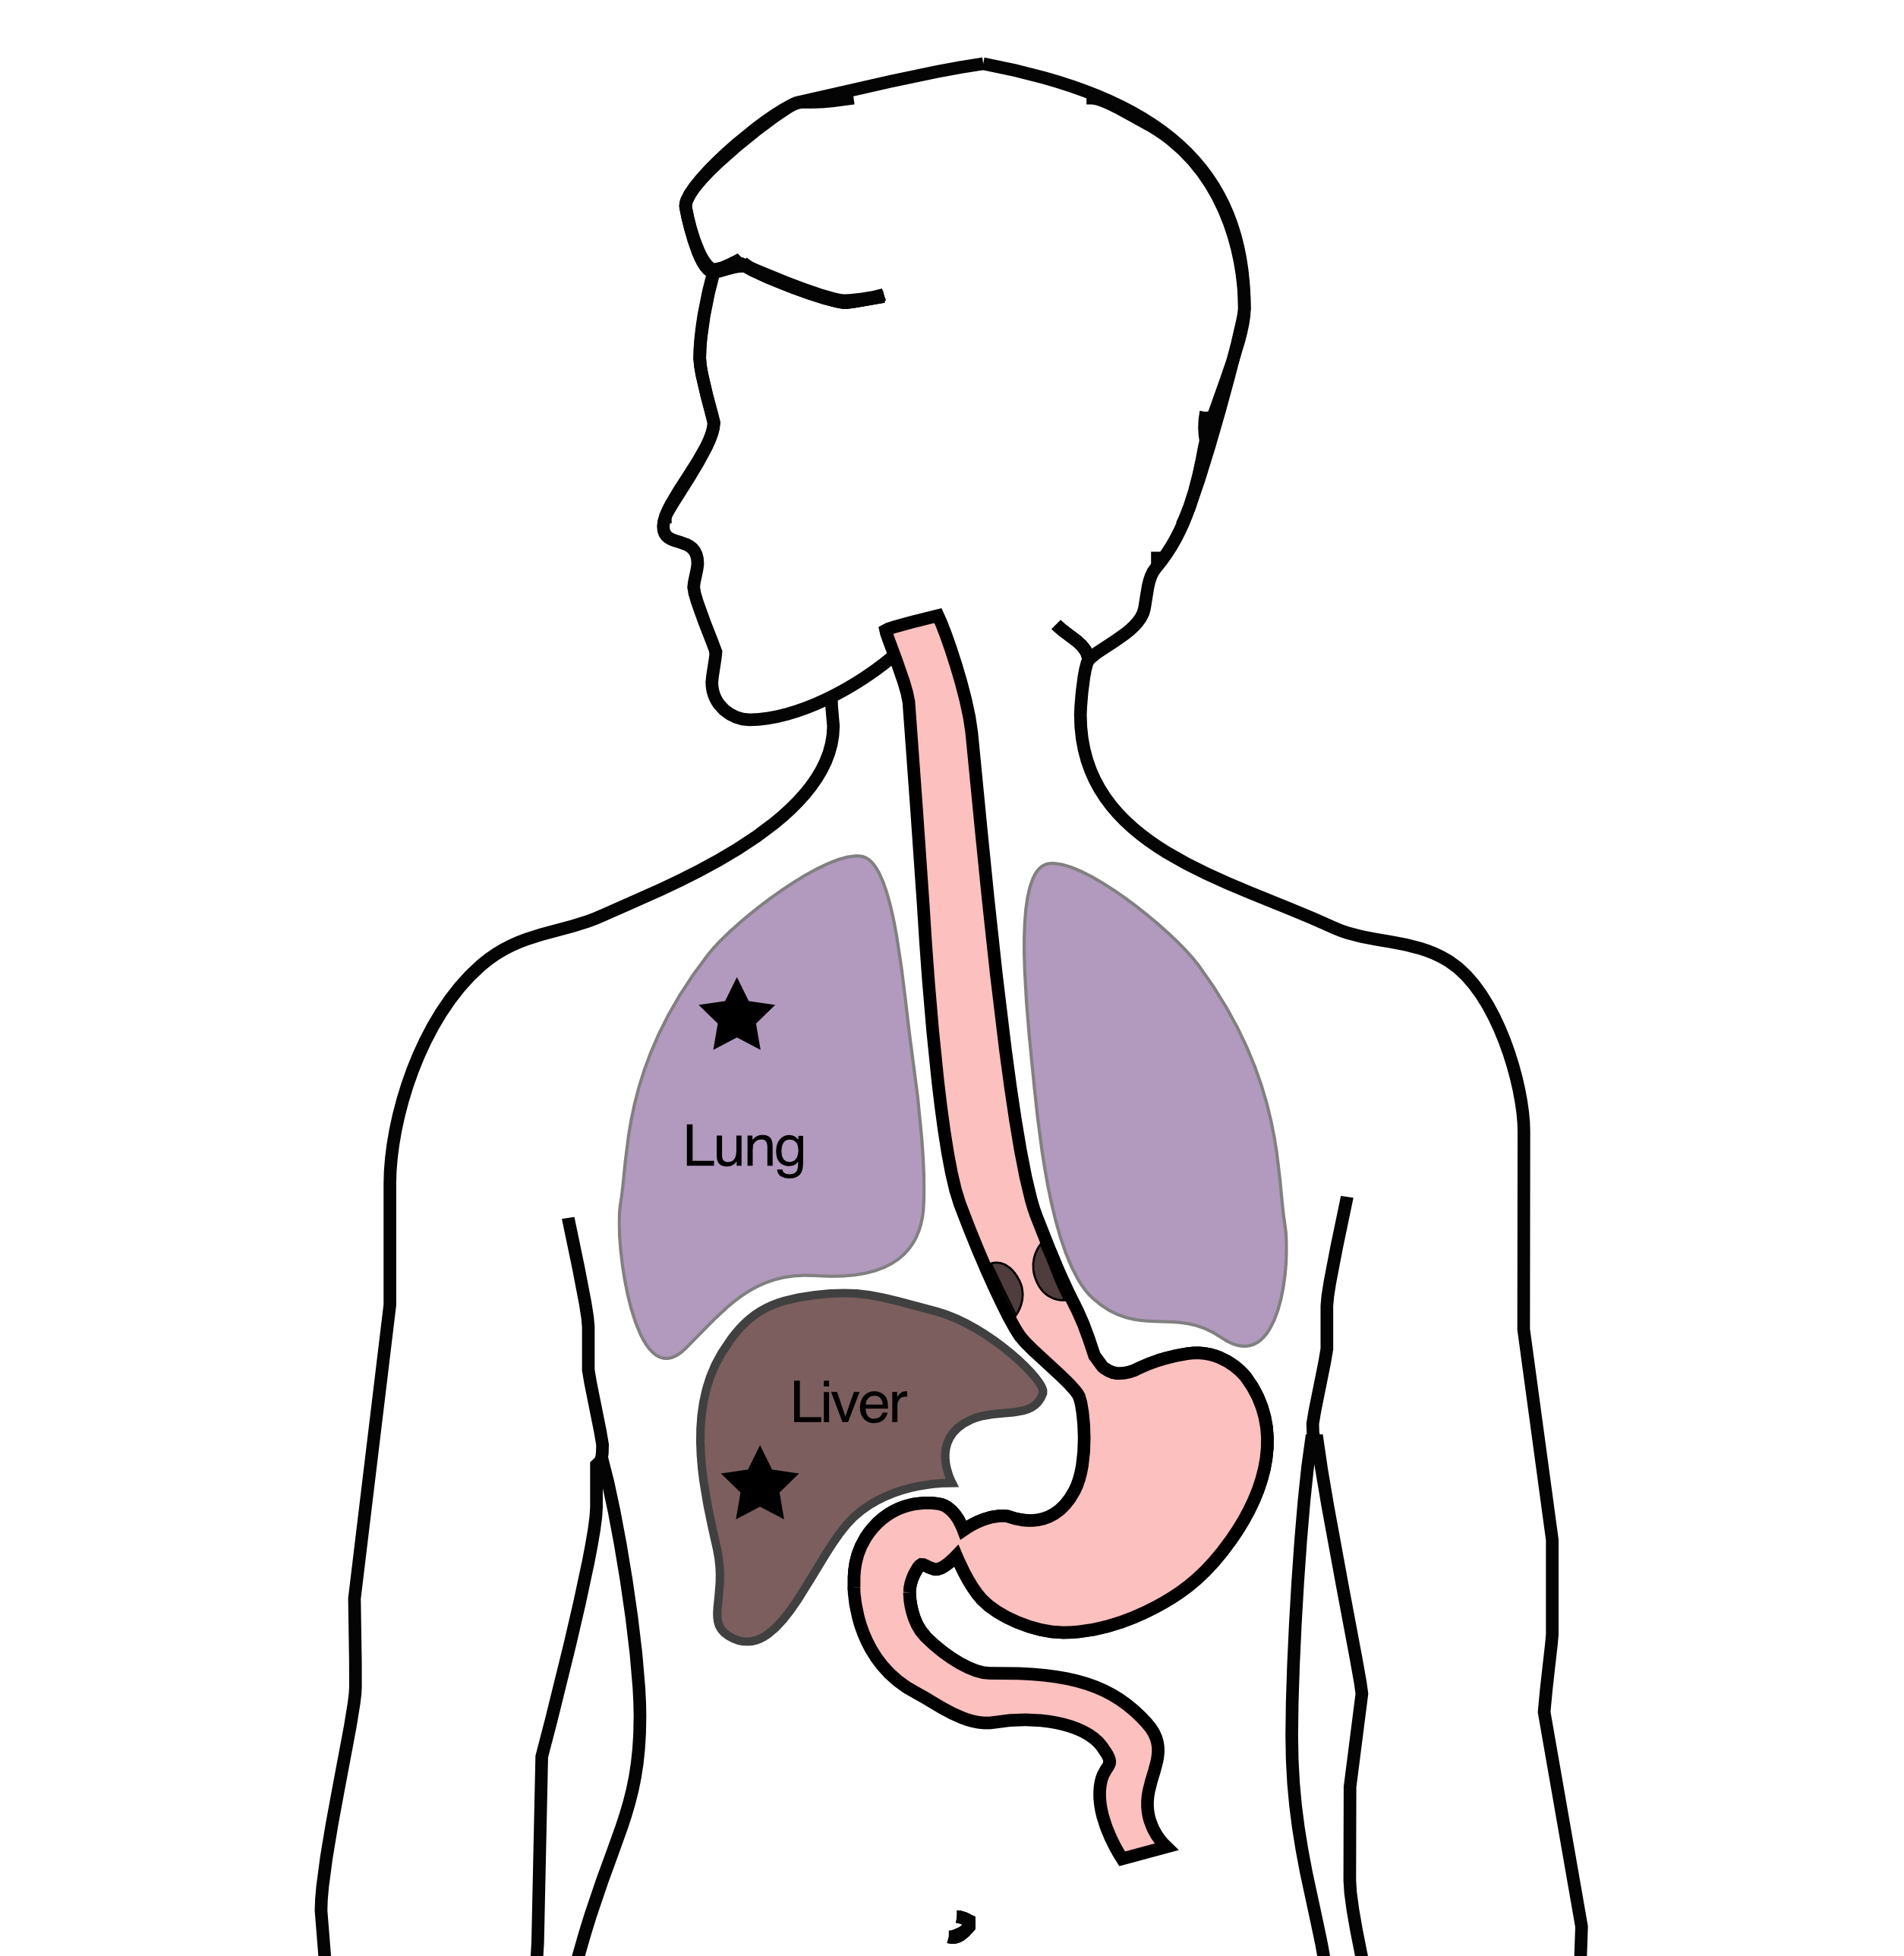
M Stage
Some cancers can also spread from the esophagus to the lungs or liver
M0 cancers have not spread to other parts of the body
N1 cancers have spread to other parts of the body such as lungs or liver

Slide 13
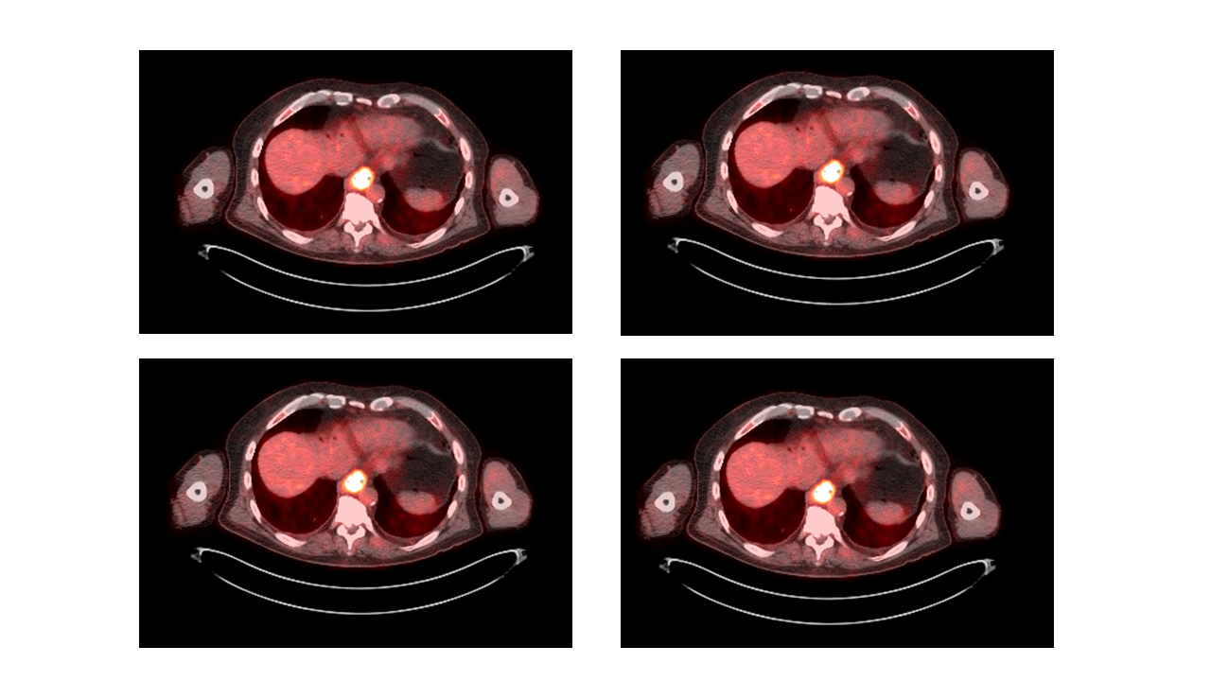
PET scan
A PET scan is similar to a CT scan, and uses a small amount of tracer to light up areas of cancer.

Slide 14
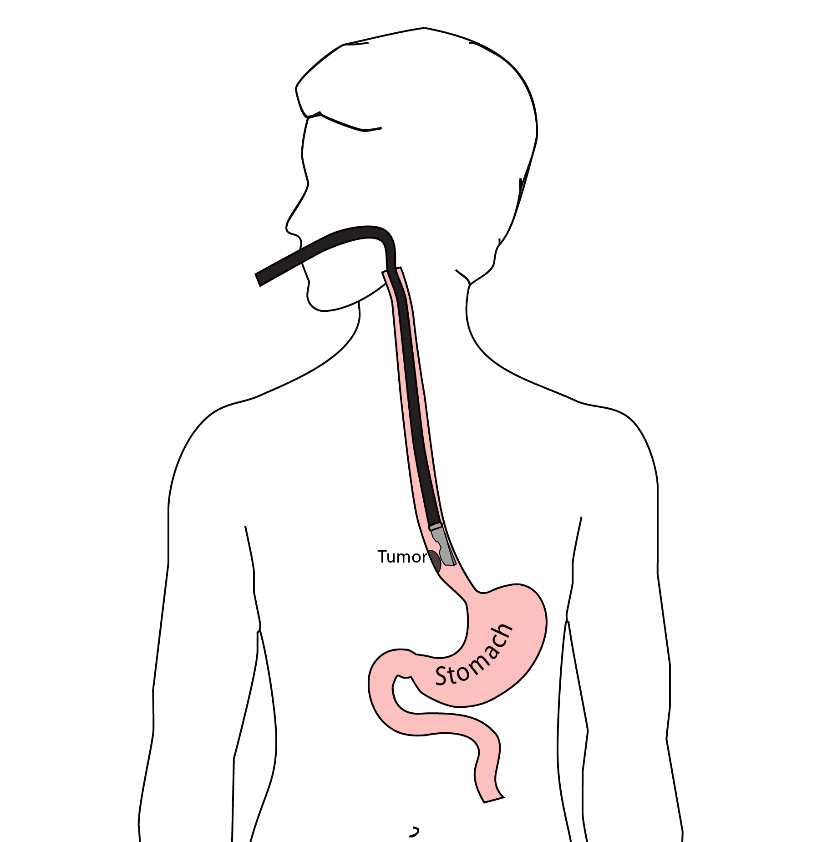
Endoscopic Ultrasound
Endoscopic ultrasound (EUS) is a procedure similar to upper endoscopy (EGD) which has an ultrasound probe at the bottom of the scope. This allows measuring the thickness of the cancer. Endoscopic ultrasound can help determine the T stage of the cancer.

Slide 15
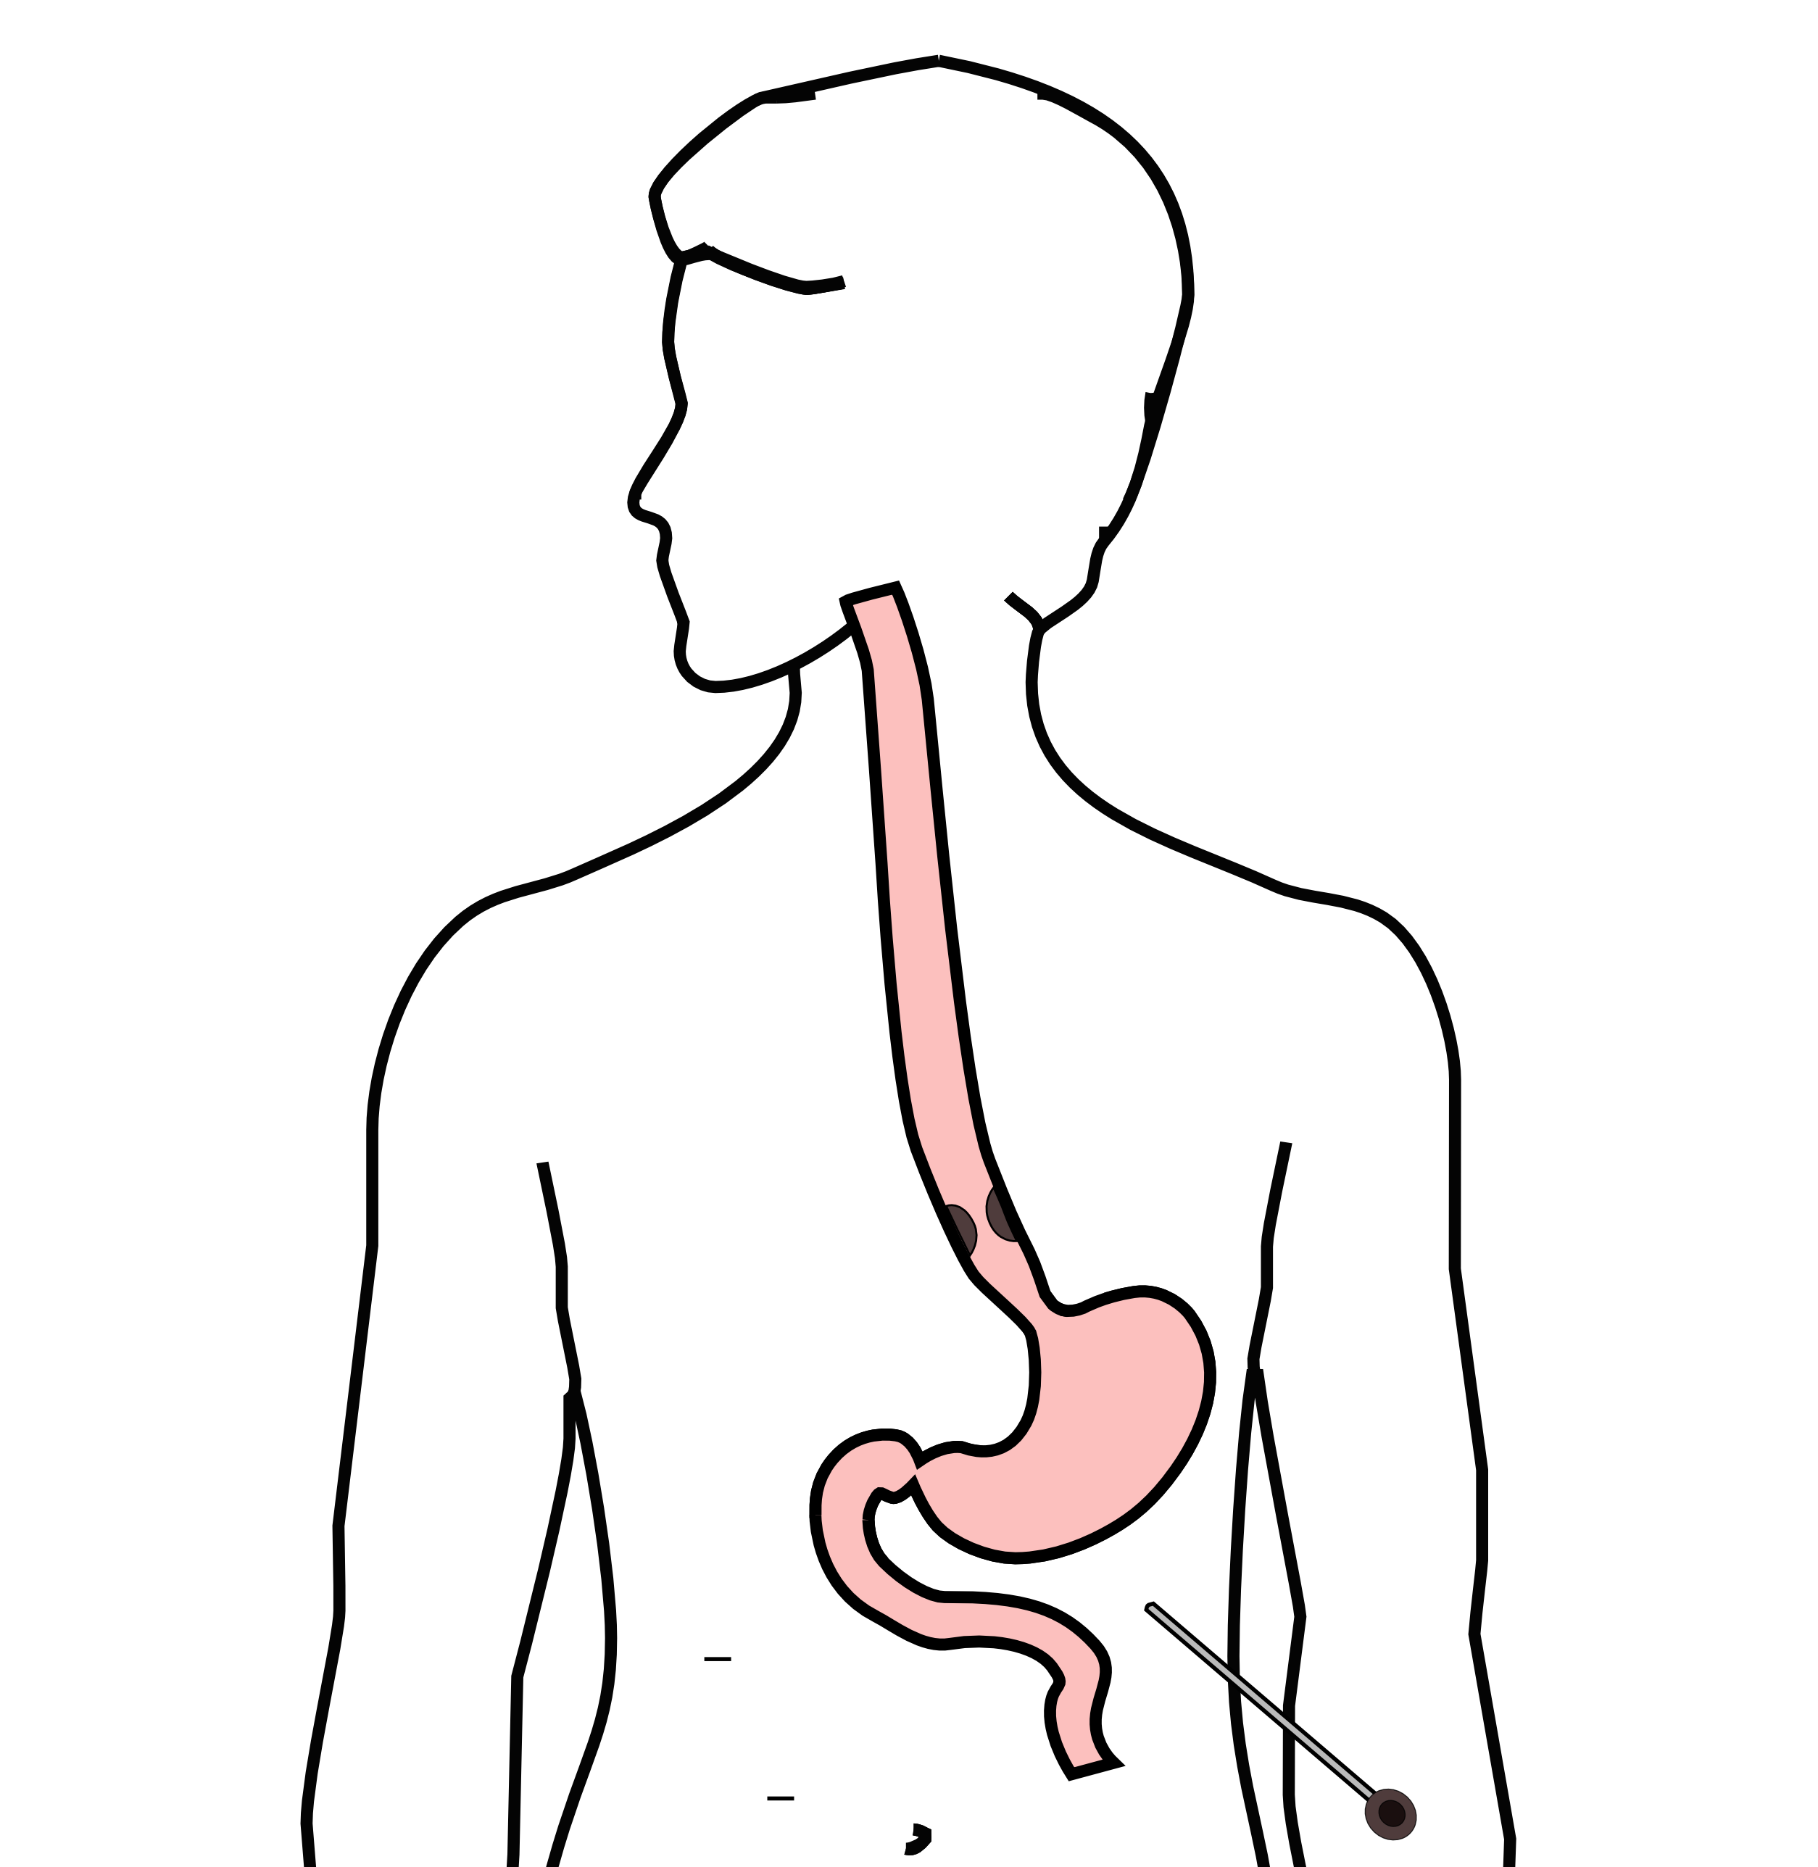
Laparoscopy
Some esophageal cancers can spread inside the abdominal cavity. These areas of spread can be very small, as small as a grain of rice.
In order to detect spread within the abdominal cavity, a proceduce called a laparoscopy can be performed in some some patients.

Slide 16
Laparoscopy
A laparoscopy is performed under a general anesthetic.
Several incisions 1/4” long
A telescope is inserted to look inside the abdominal cavity.
Biopsies can be performed.

Slide 17
Treatment Plans
Superficial (T1) $⇒$ Endoscopic Therapy
Localized (T1b/T2) $⇒$ Surgery
Locally-advanced (T3/N1) $⇒$ Chemo $±$ Radiation $→$Surgery
Metastatic (M1) $⇒$ Chemotherapy

Slide 18
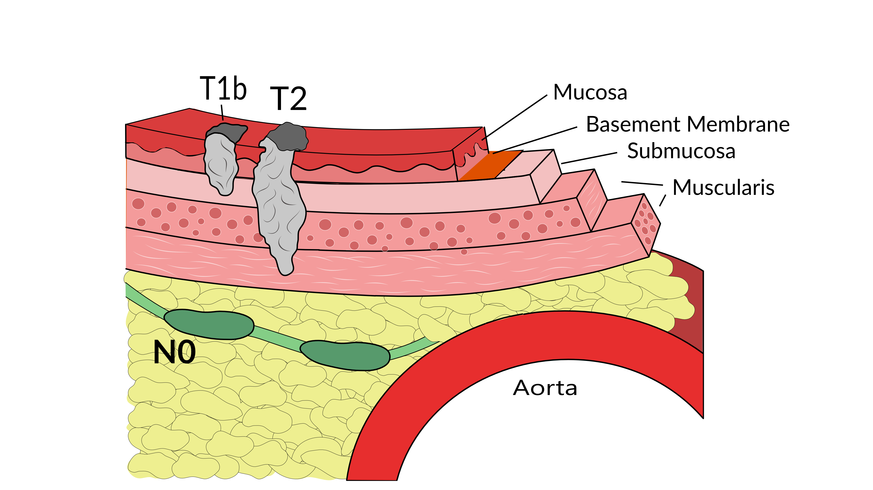
Localized Cancers
Patients with locally-advanced esophageal cancer have smaller tumors which have not invaded all the way throug the muscle wall and are too large to remove by endoscopic therapy

Slide 19
Localized Cancers
Localized cancers rarely spread to the lymph nodes, which means that surgery alone can often remove the cancer completely.
Localized cancers are less likely to need chemotherapy or radiation because the cancer is localized to the wall of the esophagus.

Slide 20
Localized Cancers
Localized cancers are not very common, because most people don’t know that they have esophageal cancer until they have difficulty eating. The majority of patients who have difficulty eating have a T3 tumor and usually need either chemotherapy and/or radiation to prevent recurrences

Slide 21
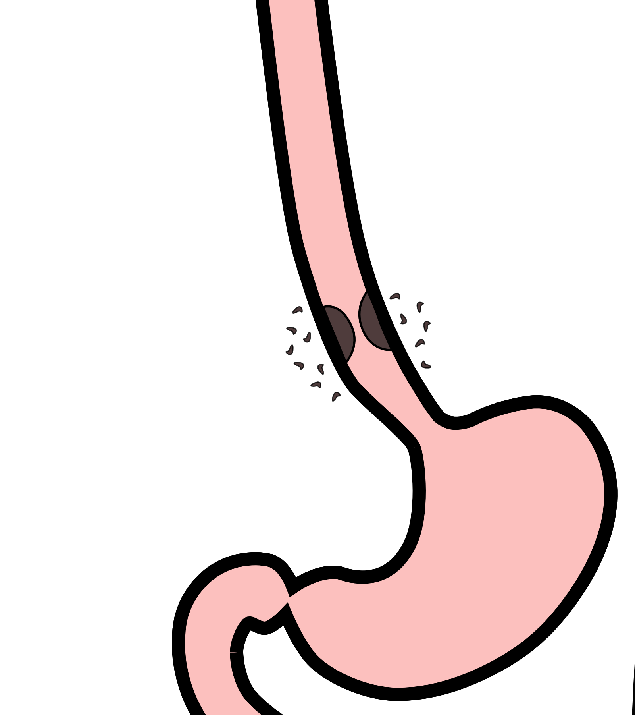
Diagnosis
Localized cancers are generally diagnosed with a combination of endoscopic ultrasound and PET scan.
Endoscopic ultrasound can determine the T stage
PET scan can look at the nearby lymph nodes

Slide 22
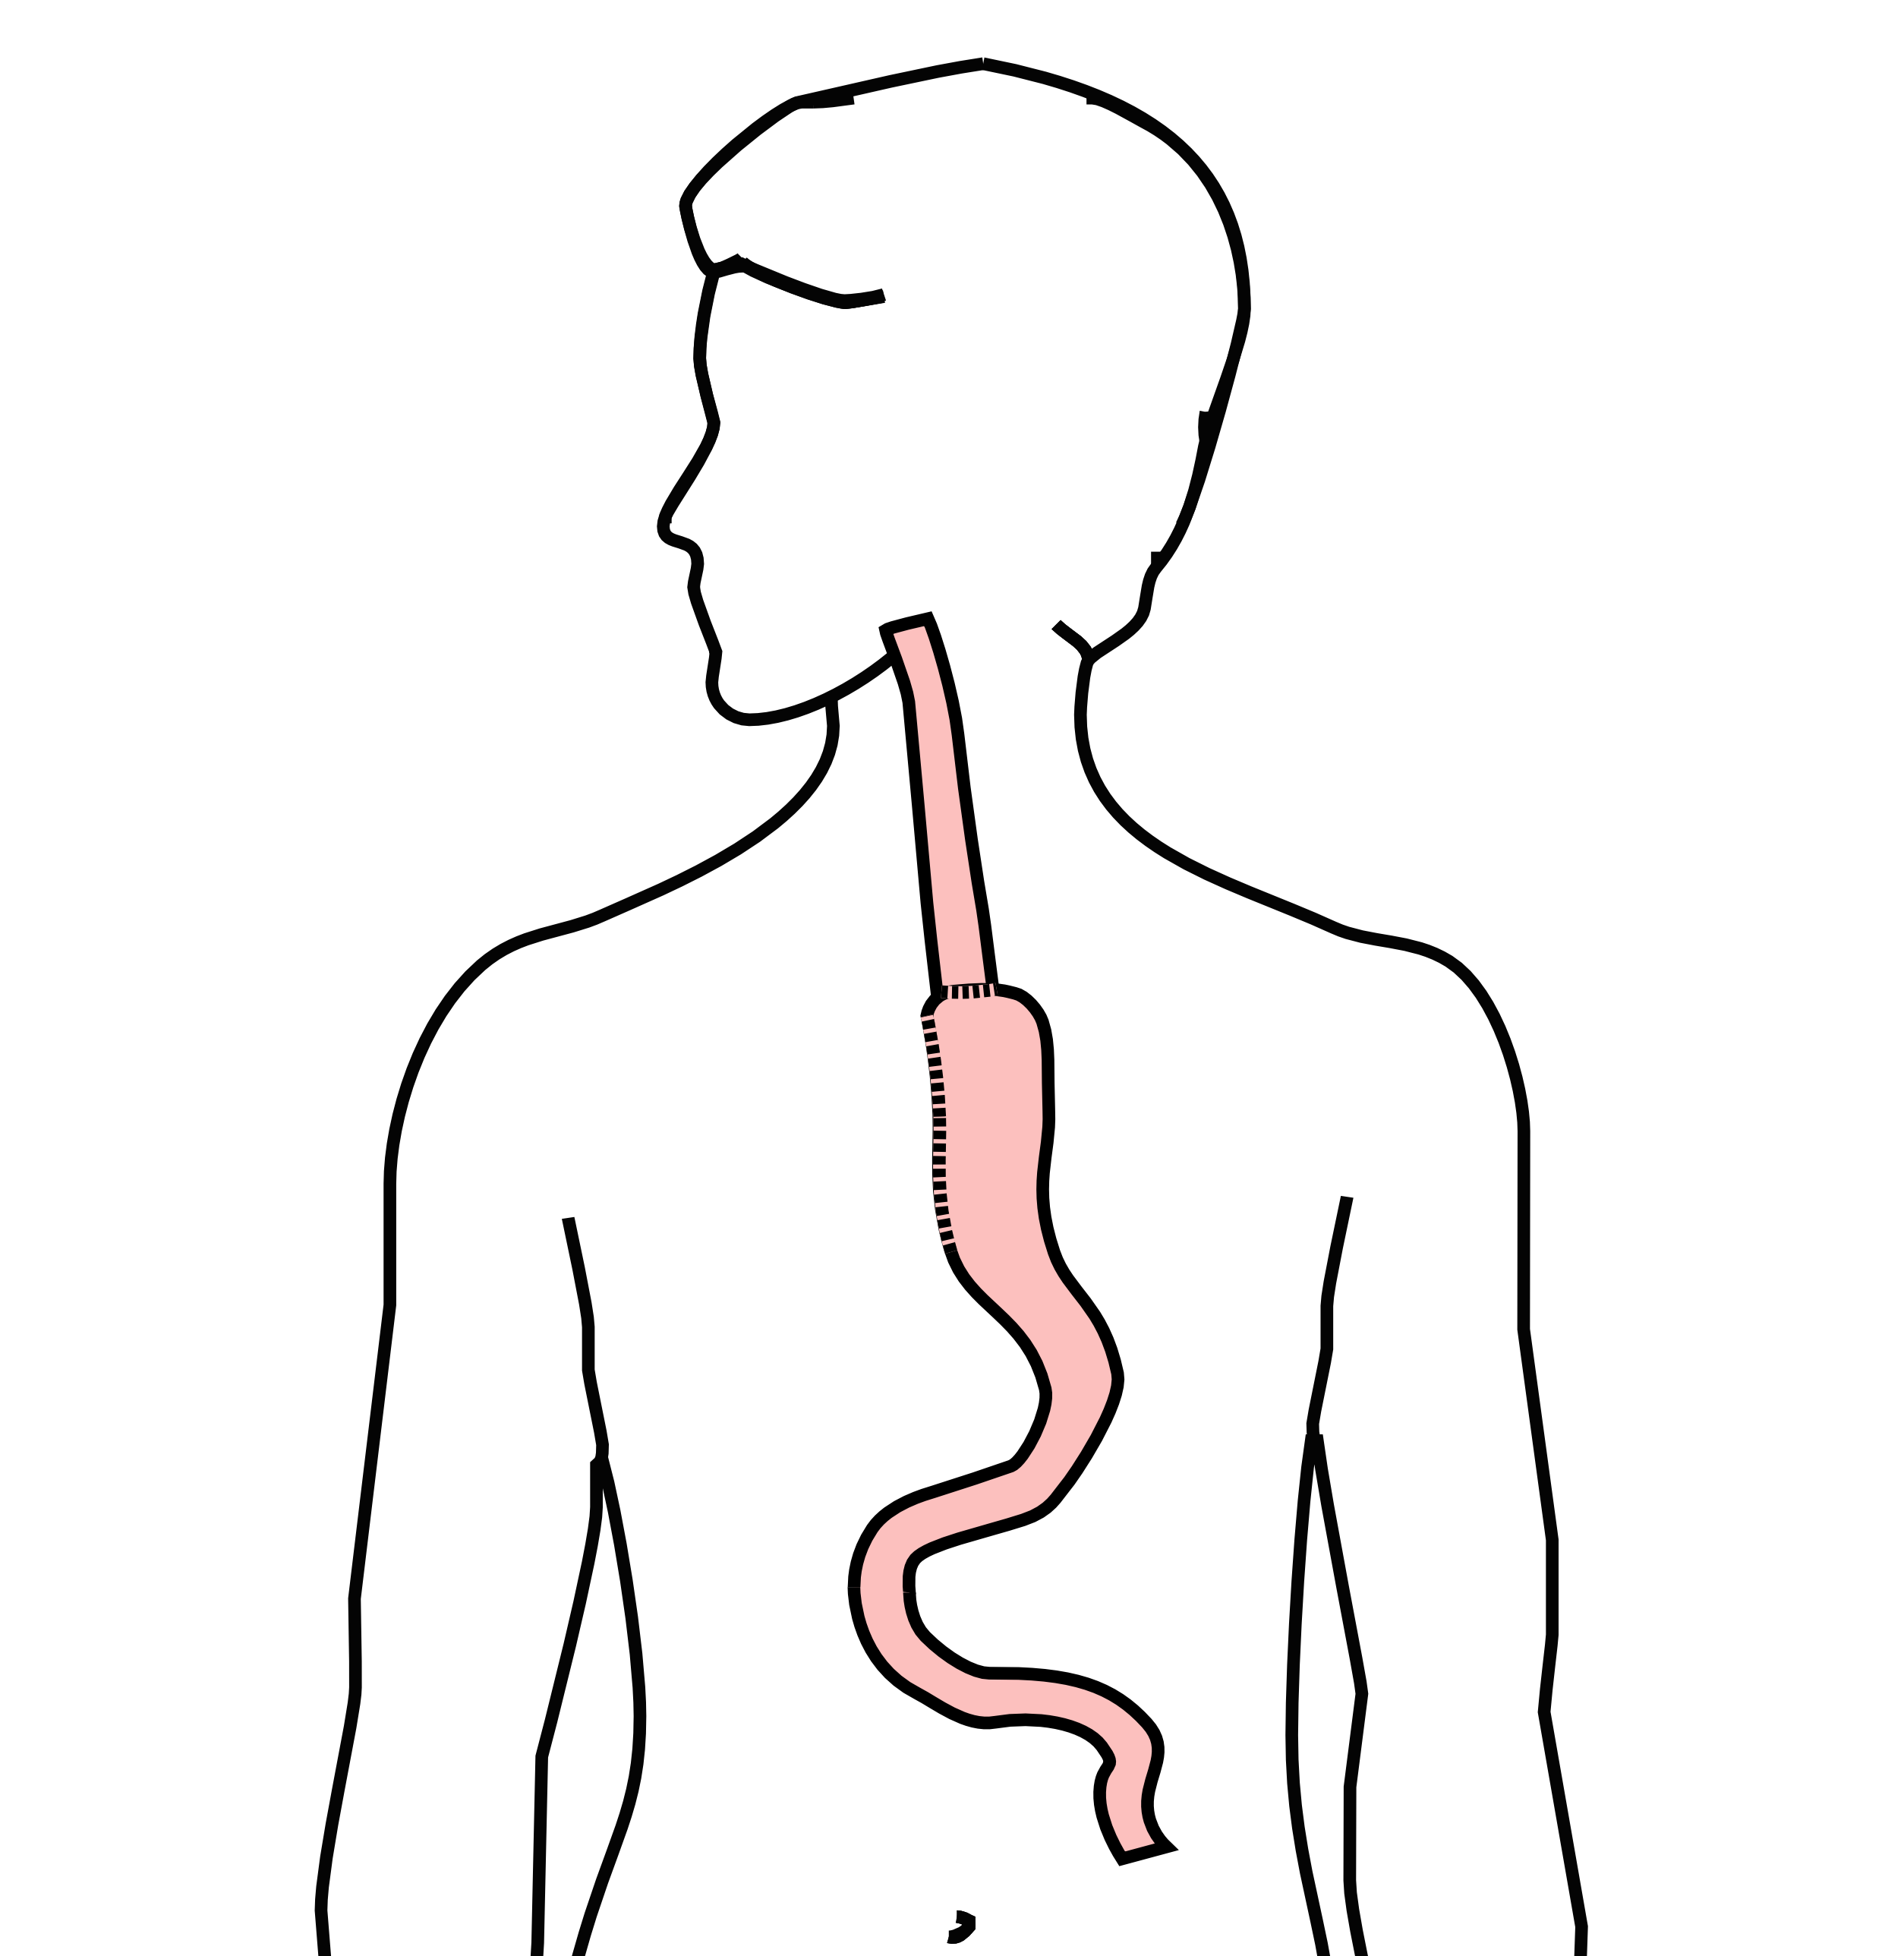
Surgery
Surgery to remove the esophagus is frequently done for localized esophageal cancers

Slide 23
Surgery for Localized Esophageal Cancer
If surgery is performed, the cancer in the esophagus is examined by the pathologist to confirm the precise thickness of the tumor and its T stage
About 25% of the time, the pathologist finds that the tumor is actually T3 or N1, in which case chemotherapy and/or radiation is needed after surgery.
On the other hand, in 75% of cases surgery is all the therapy that is required and there is no need for chemotherapy and/or radiation

Slide 24
Chemotherapy + Radiation for Localized Esophageal Cancer
An alternative to surgery is to start with a combination of chemotherapy and radiation therapy.
We know that in some cases, chemotherapy + radiation can be curative for esophageal cancer without the need for surgery.
For adenocarcicnoma, about 25% of cases are cured with chemotherapy + radiation
For squmaous cell carcinoma, about 40% of cases are cured with chemotherapy + radiation

Slide 25
Followup after Chemotherapy + Radiation
The challenge here is that it’s difficult to know right away whether chemotherapy + radiation has been effective for esophageal cancer.
In most cases, scans and upper endoscopy performed after chemotherapy + radiation show no signs of cancer, but only a minority of cases are actually cured.
In can take up to two years to know with certainty whether or not an esophageal cancer has been cured by chemotherapy + radiation.

Slide 26
Chemotherapy + Radiation CROSS Trial
Chemotherapy + Radiation $→$Surgery $⇒$ Longer Survival
Chemotherapy and radiation were given together over six weeks

Slide 27
Chemotherapy + Radiation CROSS Trial
A typical schedule for chemotherapy + radiation:
Chemotherapy once per week for six weeks
Radiation five days per week for six weeks (28 treatments)
PET scan 4 weeks after the end of radiation
EGD every 3-6 months for 2 years
CT scan every 6-12 months

Slide 28
Chemotherapy + Radiation - Side Effects
Radiation kills cancer cells, but can also cause irritation of the lining of the esophagus.
This can make swallowing more challenging the last two weeks of therapy.
A feeding tube is sometimes needed to help with hydration and nutrition.

Slide 29
Chemotherapy
Chemotherapy drugs are administered intravenously.
There are several options for intravenous access:
Peripheral IVs in the hand
PICC line (Peripheral Inserted Central Catheter)
Central Venous Port

Slide 30
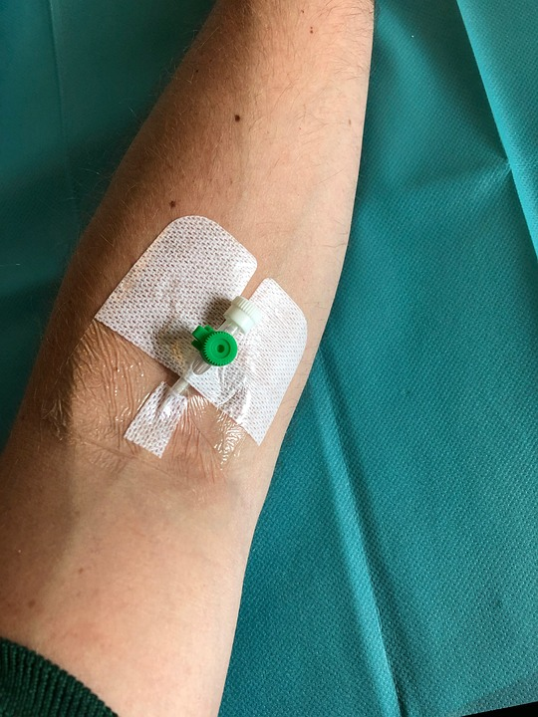
Peripheral IVs
Some patients can be treated with an intravenous line placed in the hand or arm for each dose of chemotherapy. The catheter is placed at the beginning of each dose and removed that day.

Slide 31
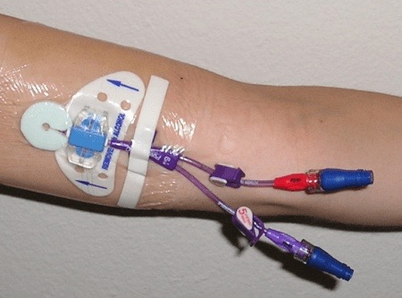
PICC Lines
A PICC line is placed in Radiology and stays in place during the treatment course

Slide 32
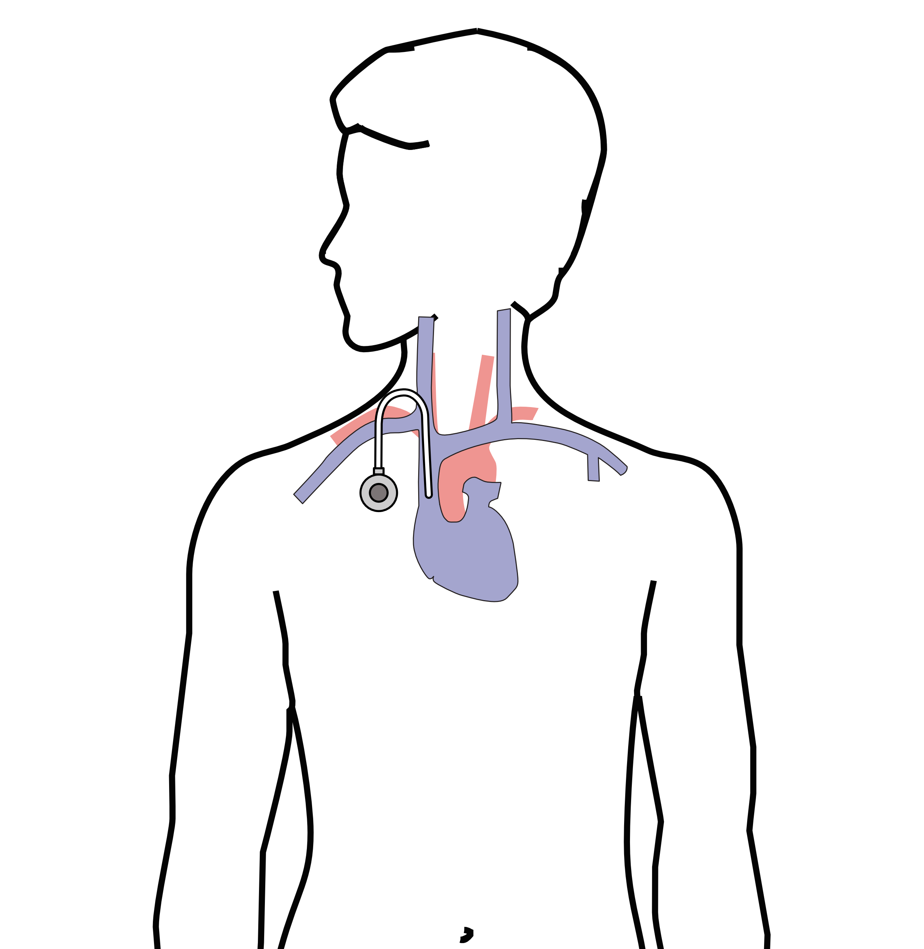
Central Venous Port
A central venous port is an implantable device that makes the administration of chemotherapy easier

Slide 33
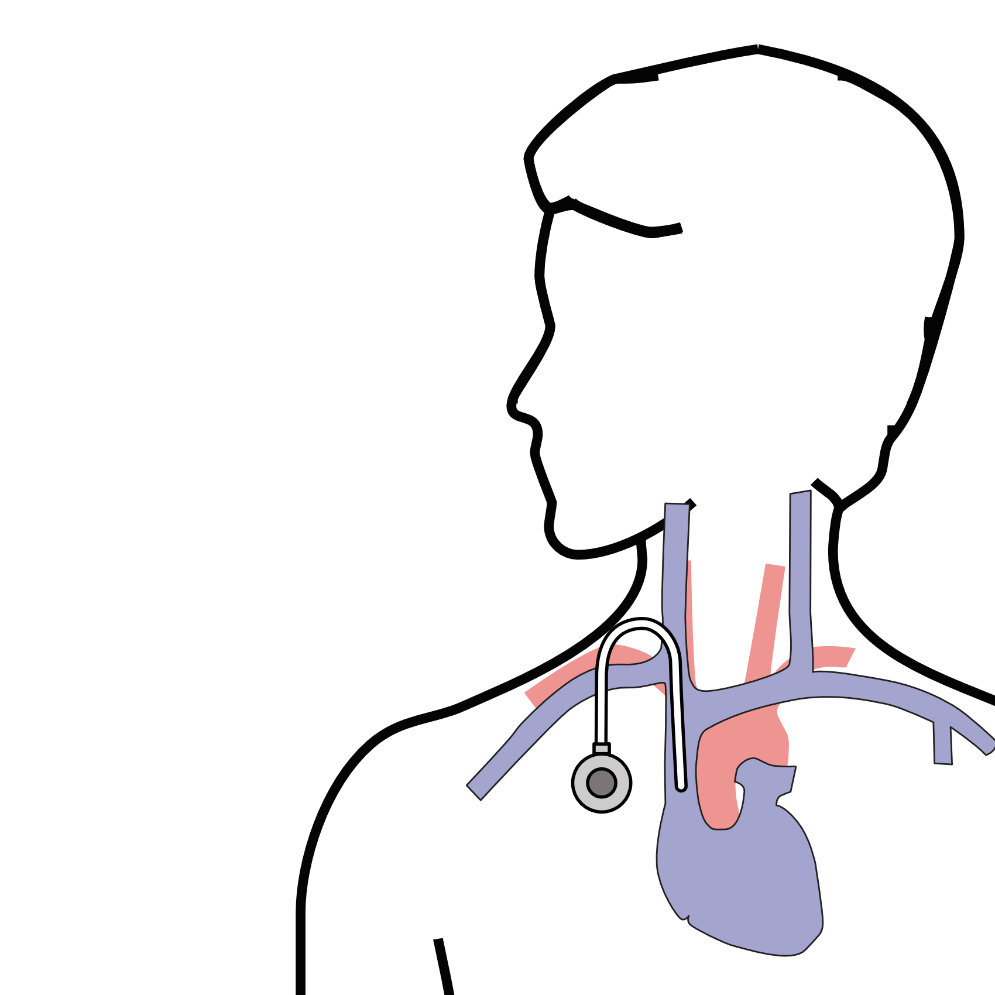
Central Venous Port
A central venous port is typically placed underneath the skin below the right collarbone

Slide 34
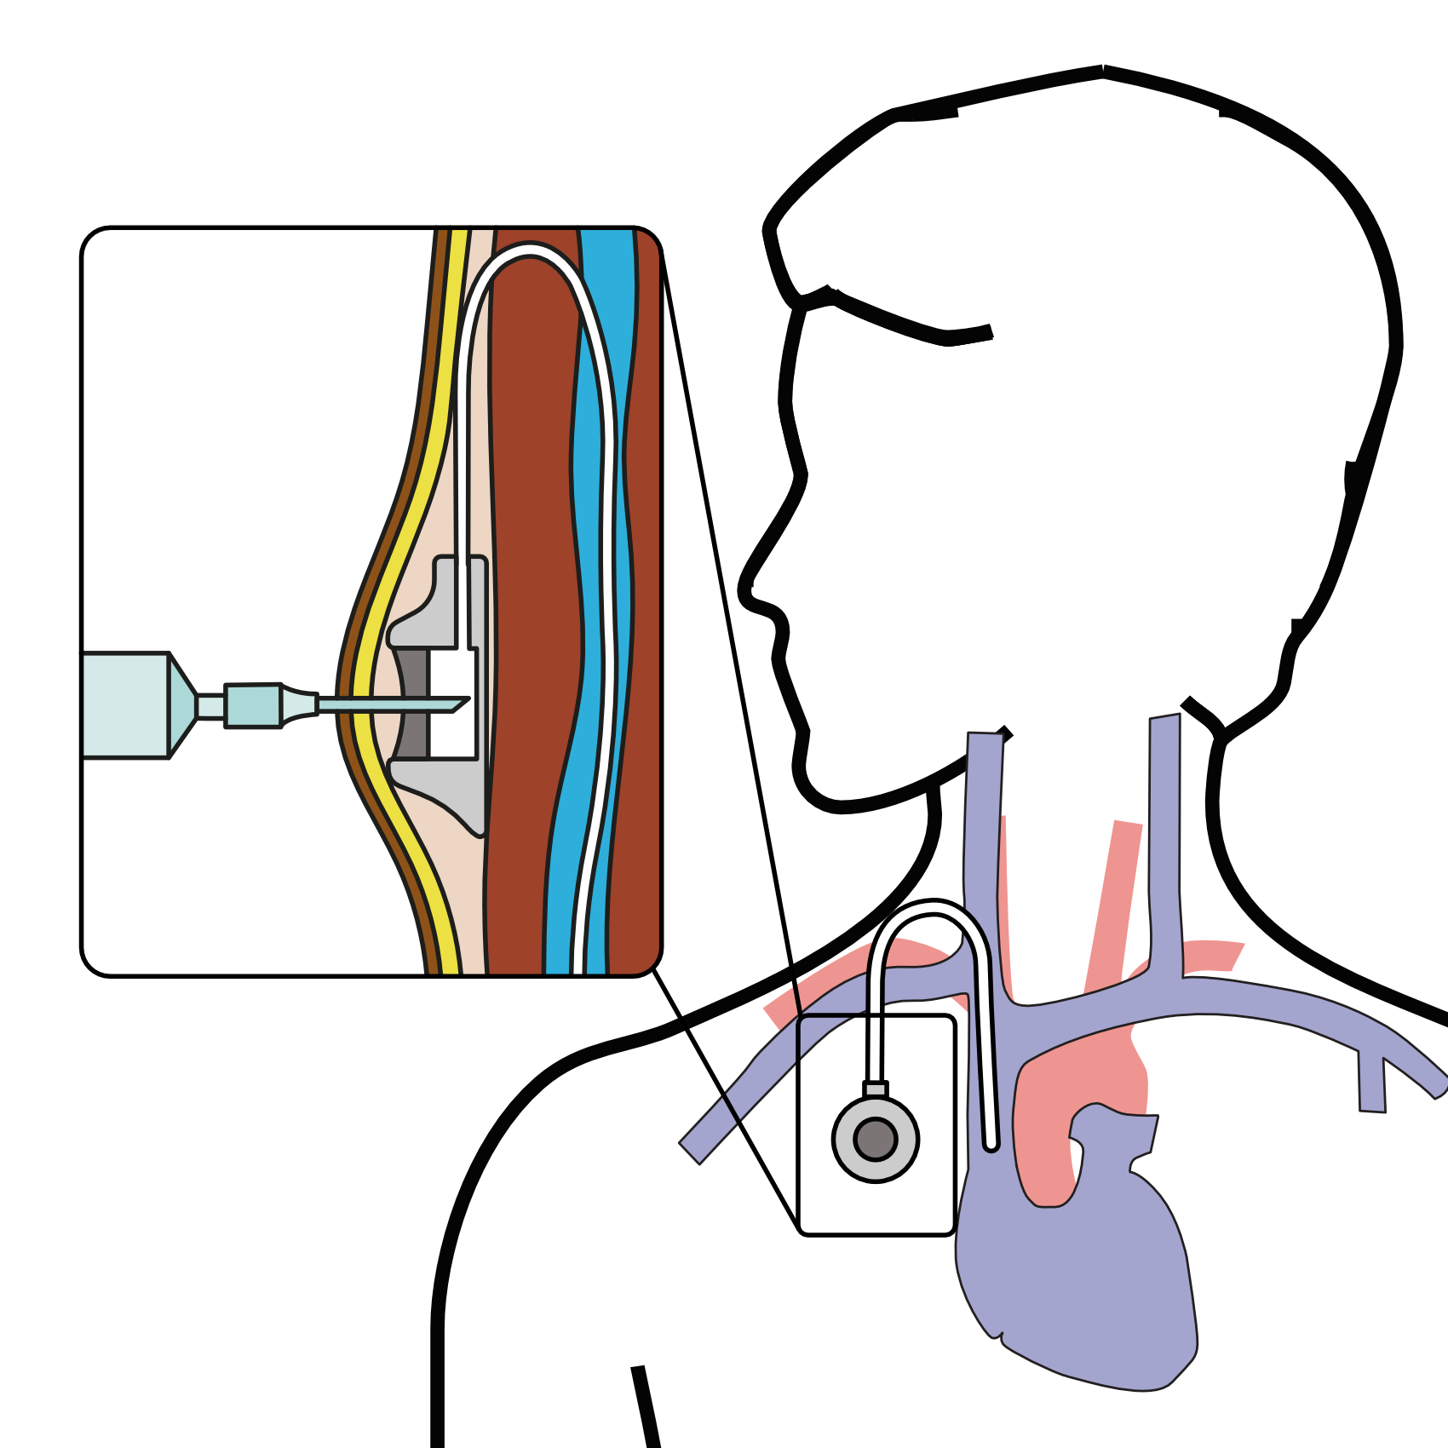
Central Venous Port
When it is time for chemotherapy, a needle is inserted through the skin into the port

Slide 35
Restaging
CT or PET scan will be performed after preoperative therapy

Slide 36
Surgery for Esophageal Cancer
Surgery for esophageal cancer is performed for:
Superficial Tumors (T1) not removed by endoscopy
Localized Tumors (T2 N0 M0)
Locally Advanced (T3 M0) after preop therapy

Slide 37
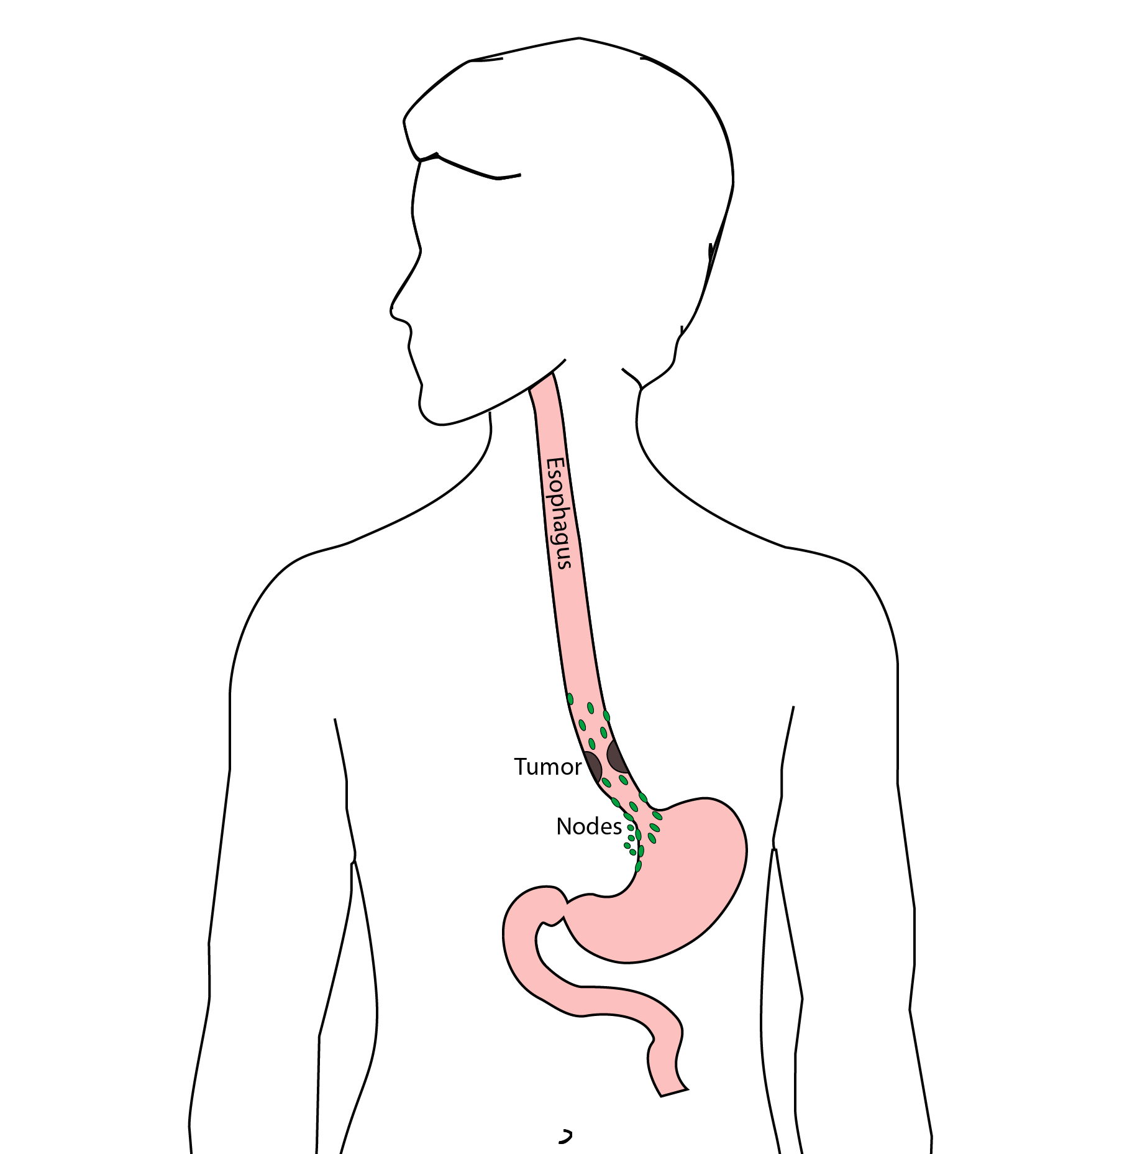
Goals of Surgery
Remove tumor from esophagus
Remove surrounding lymph nodes
Create a new esophagus

Slide 38
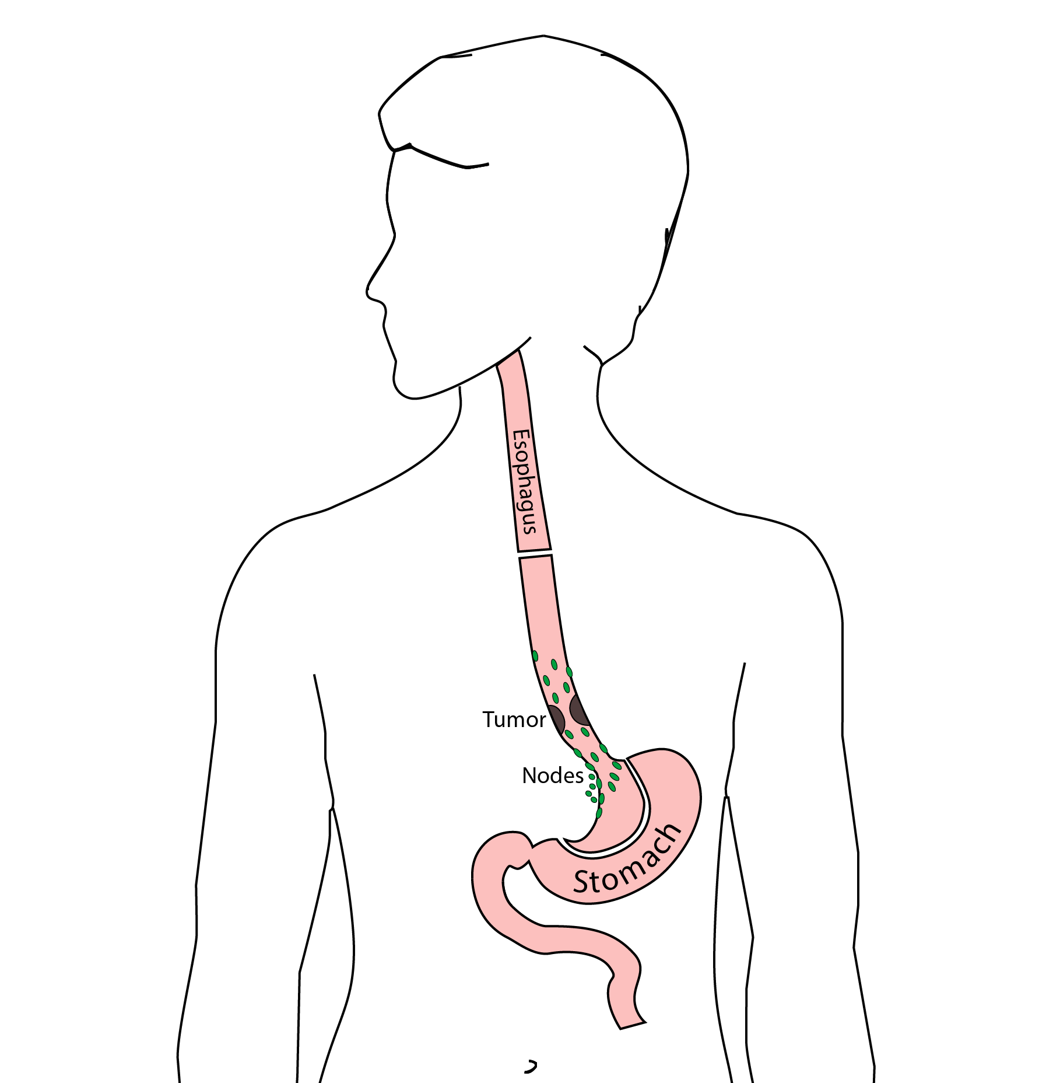
Ivor Lewis (Transthoracic) Esophagectomy
Removes tumor and lower 1/3 esophagus
Removes surrounding lymph nodes
GI tract reconstructed

Slide 39
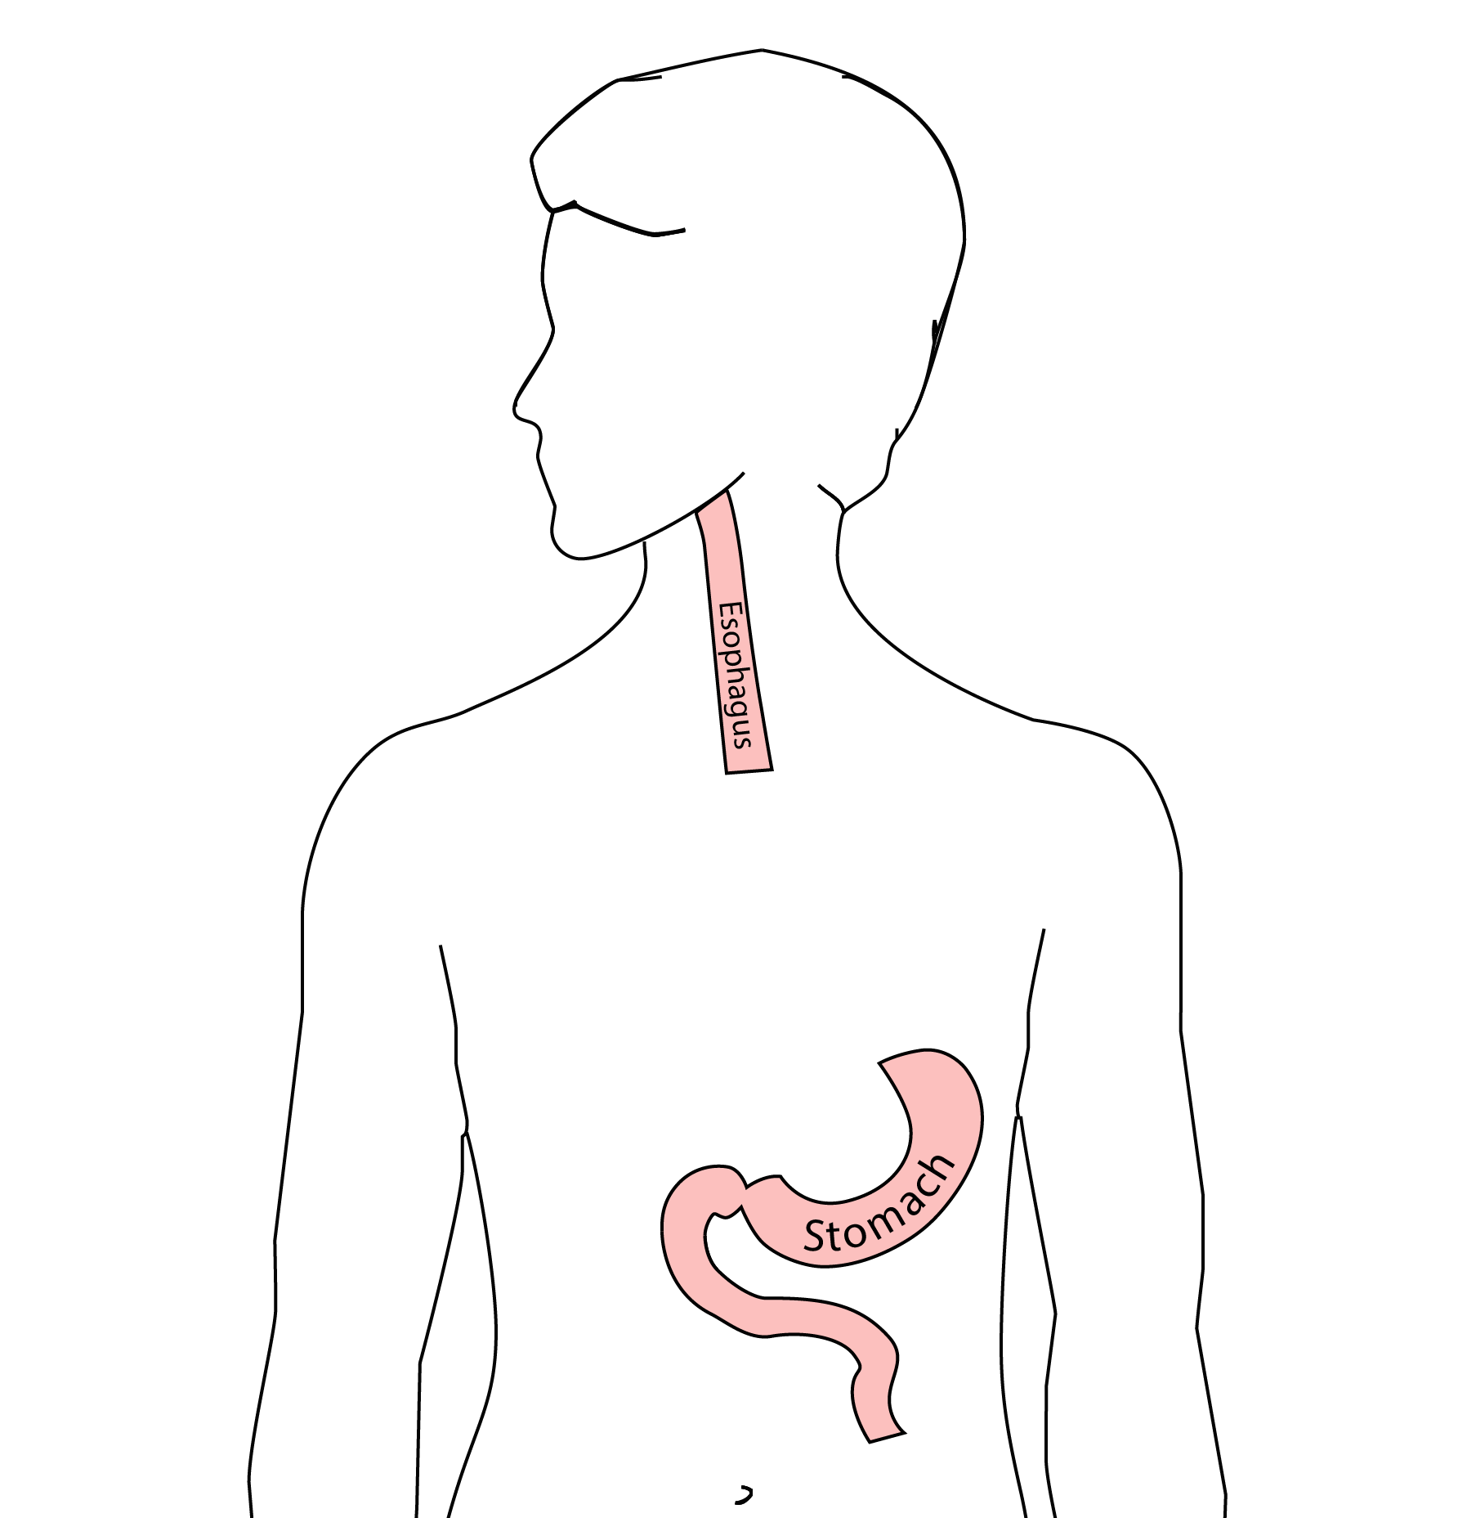
Reconstruction
New esophagus is created from the stomach in the abdomen by fashioning it into a tube.

Slide 40
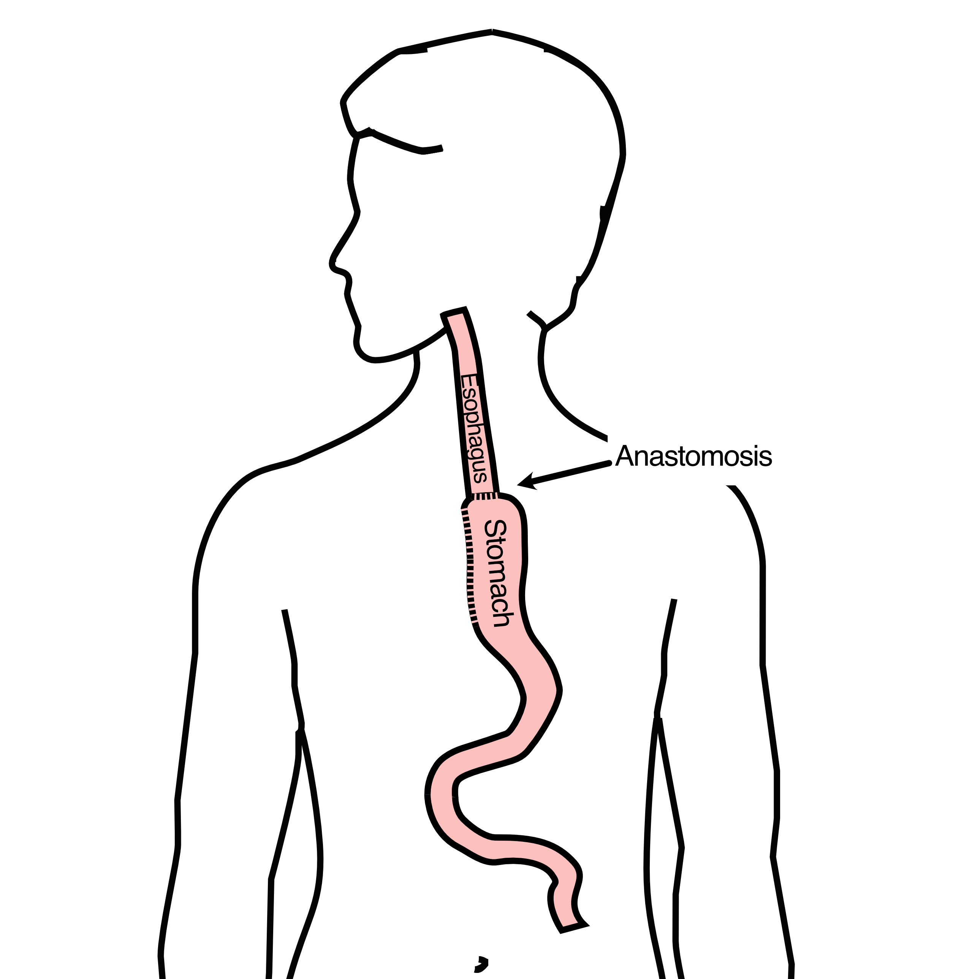
Ivor Lewis esophagectomy
The new esophagus is now brought up into the chest. A connection is made between the esophagus and the stomach, called an anastomosis.

Slide 41
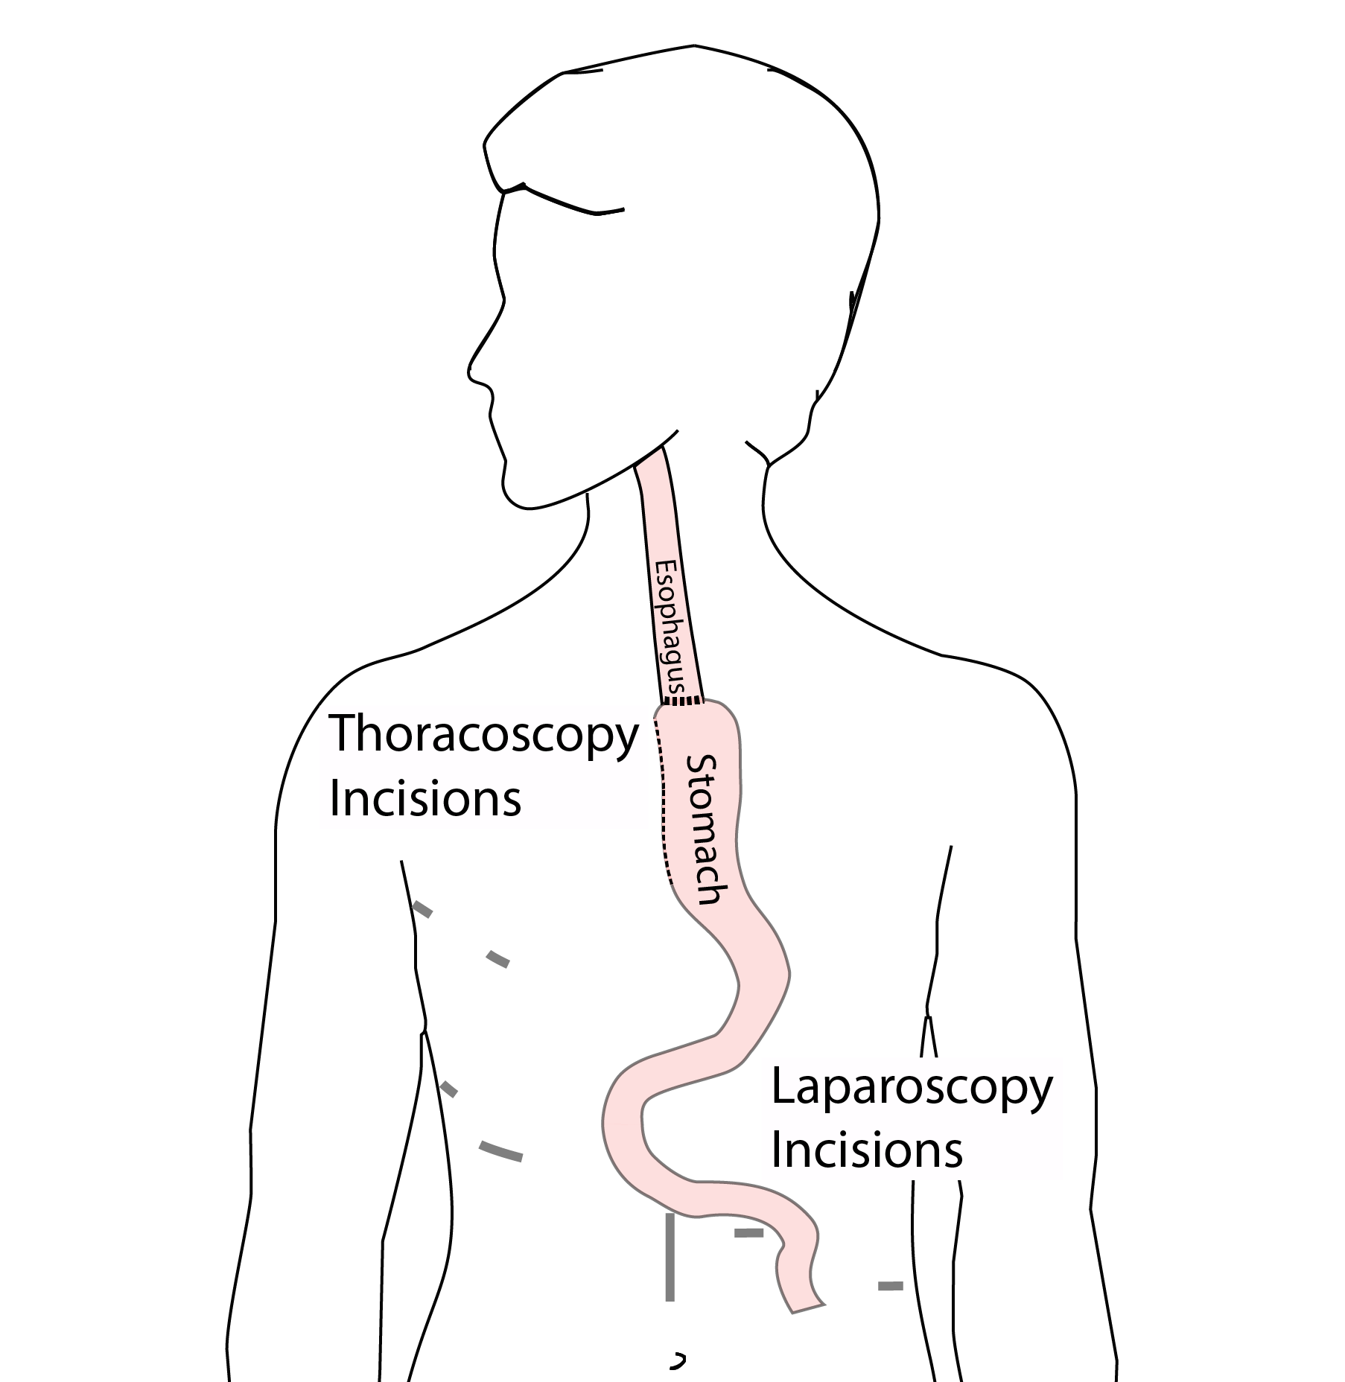
Minimally-invasive Ivor Lewis
Small incisions abdomen and chest
Surgical telescope and instruments
Smaller incisions $→$ faster recovery and less discomfort

Slide 42
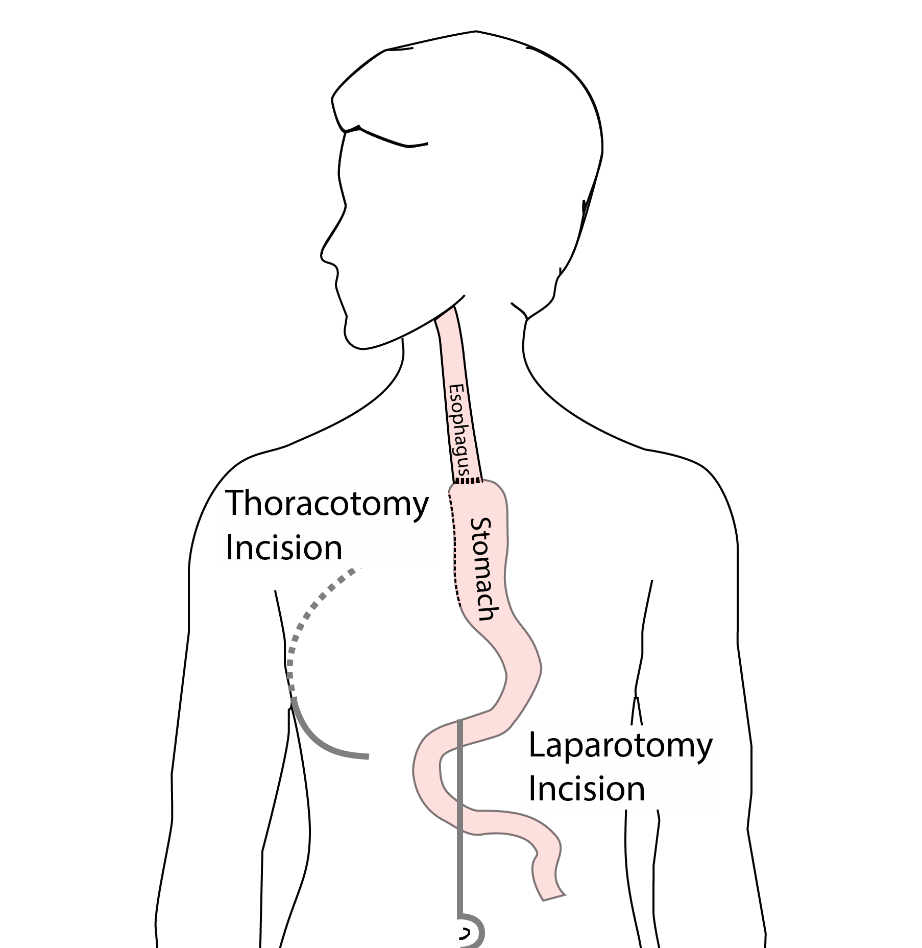
Open Ivor Lewis
Mininally-invasive approach feasible in 95% of cases
In some cases, an open approach is still necessary.

Slide 43
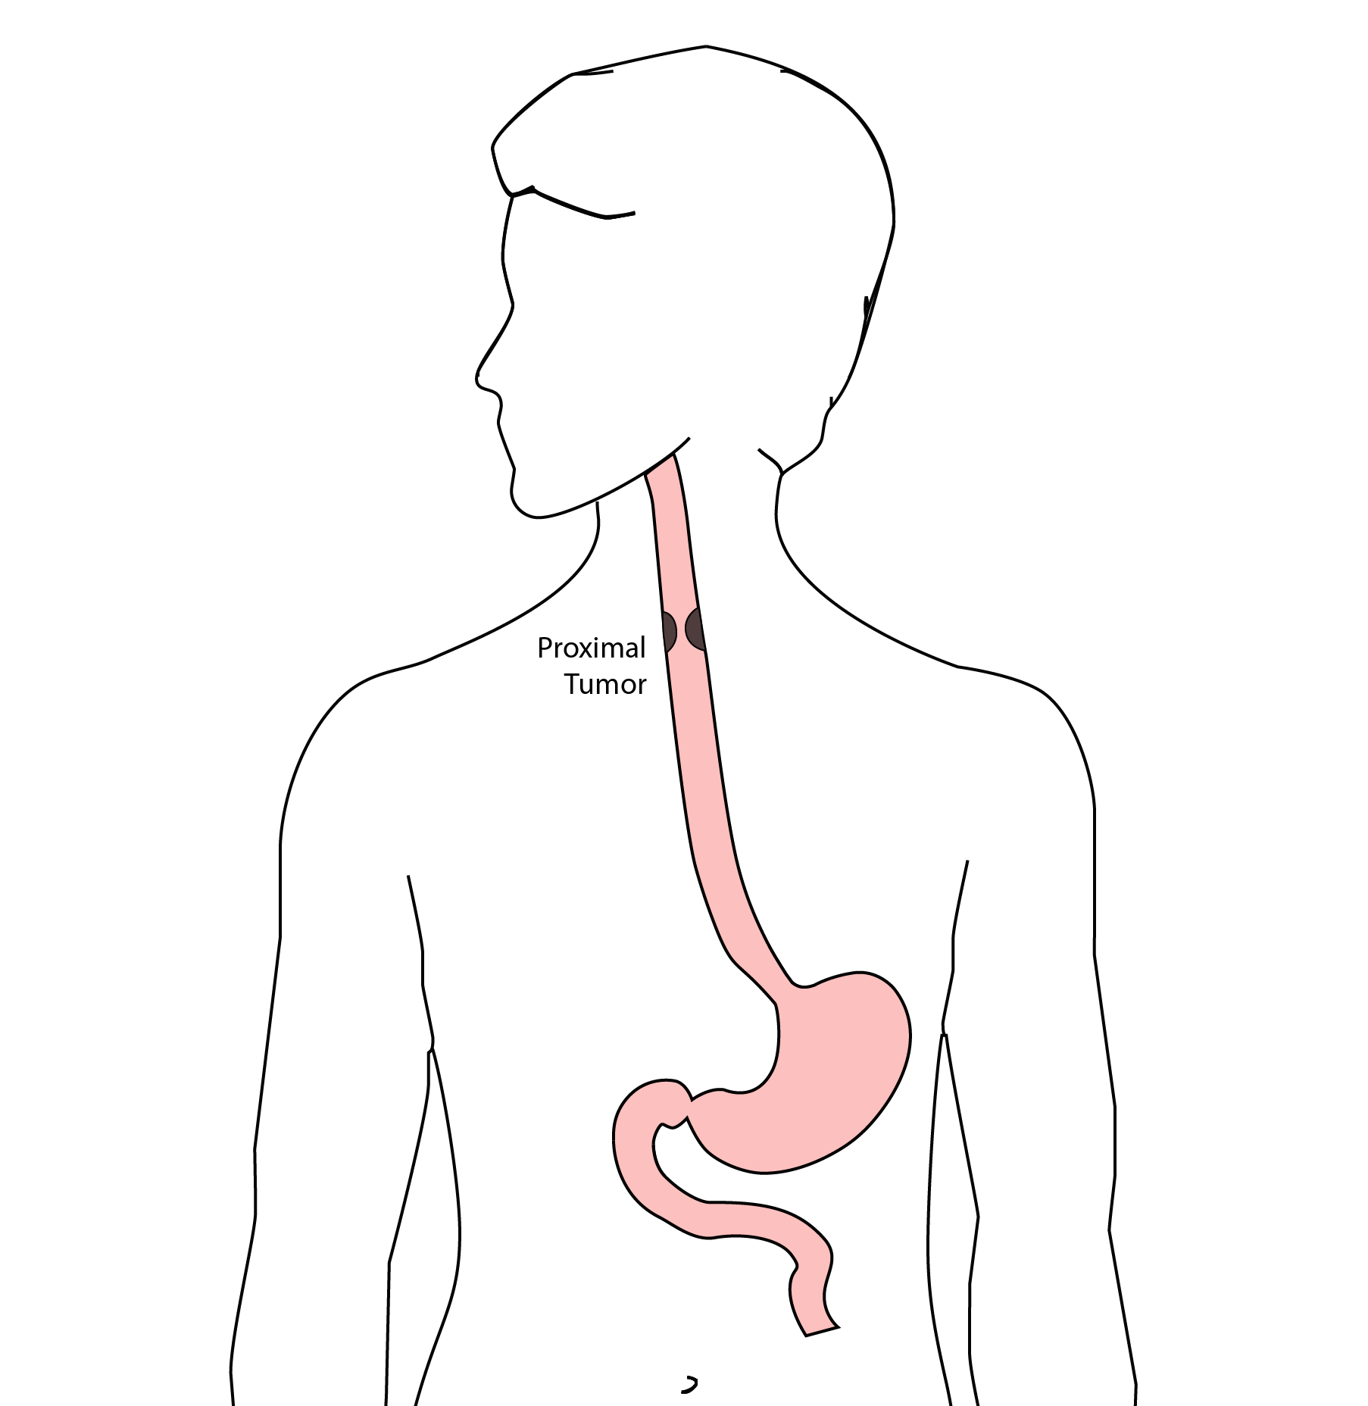
Total Esophagectomy
For patients with tumors in the upper esophagus, we need to remove more of the esophagus
We need to remove the whole esophagus, including the portion in the neck

Slide 44
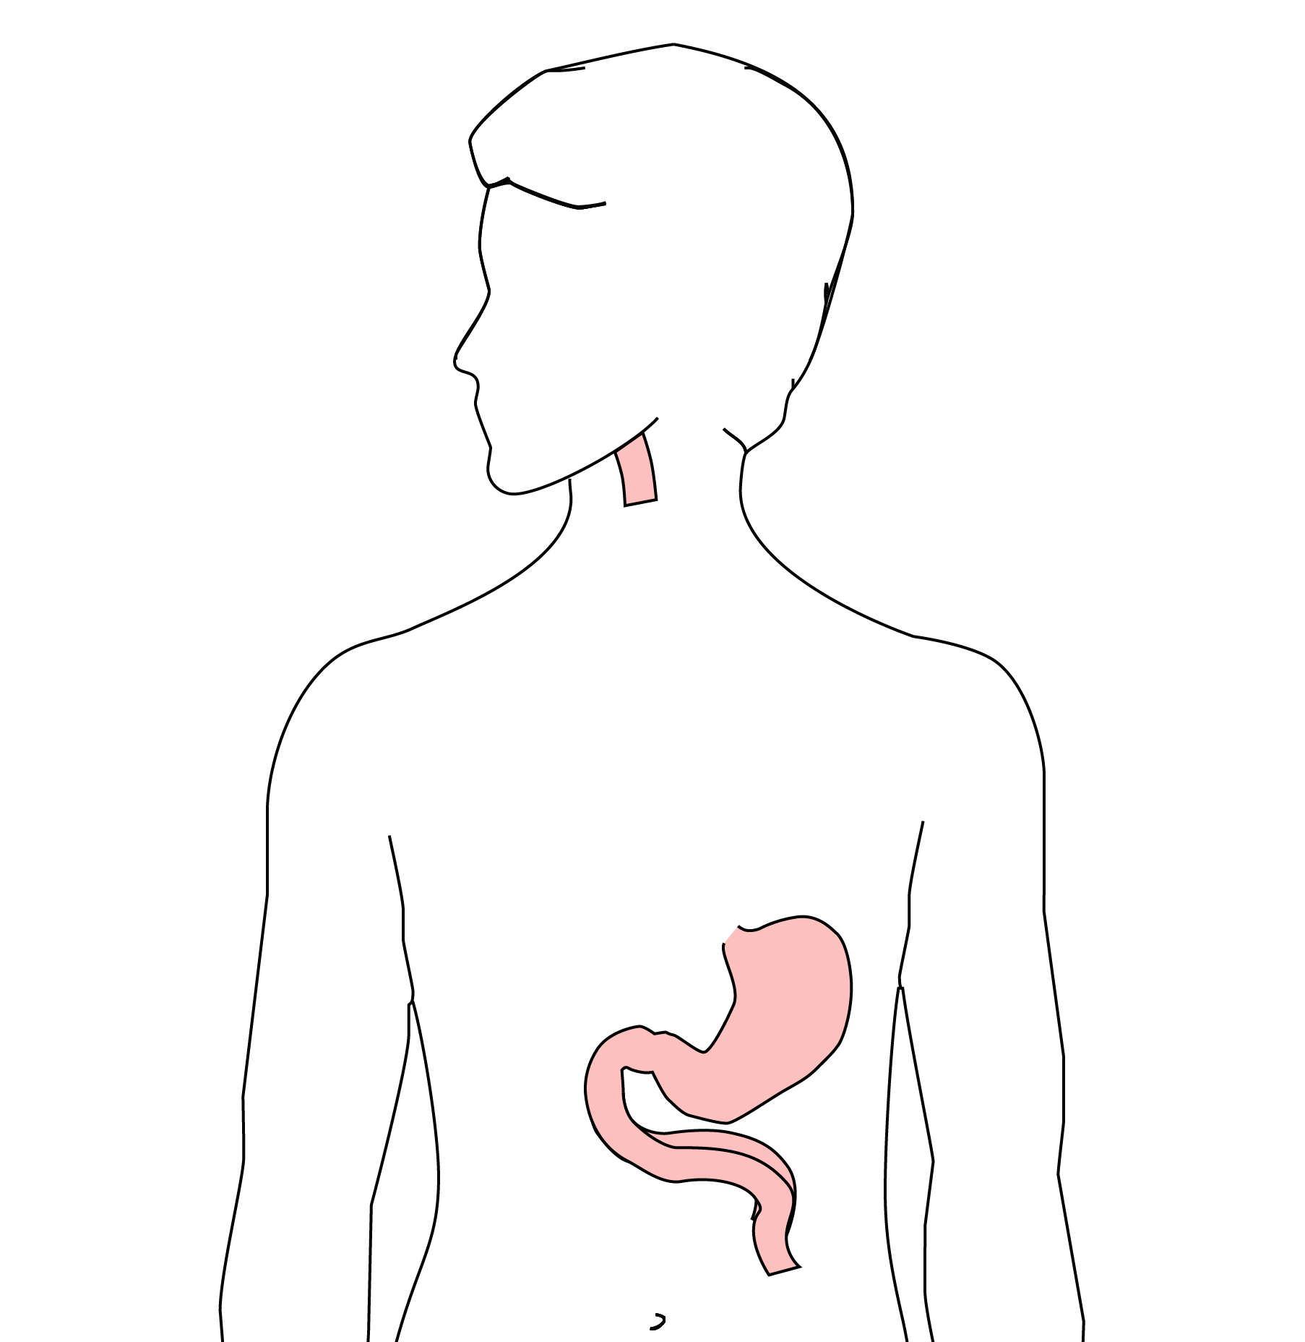
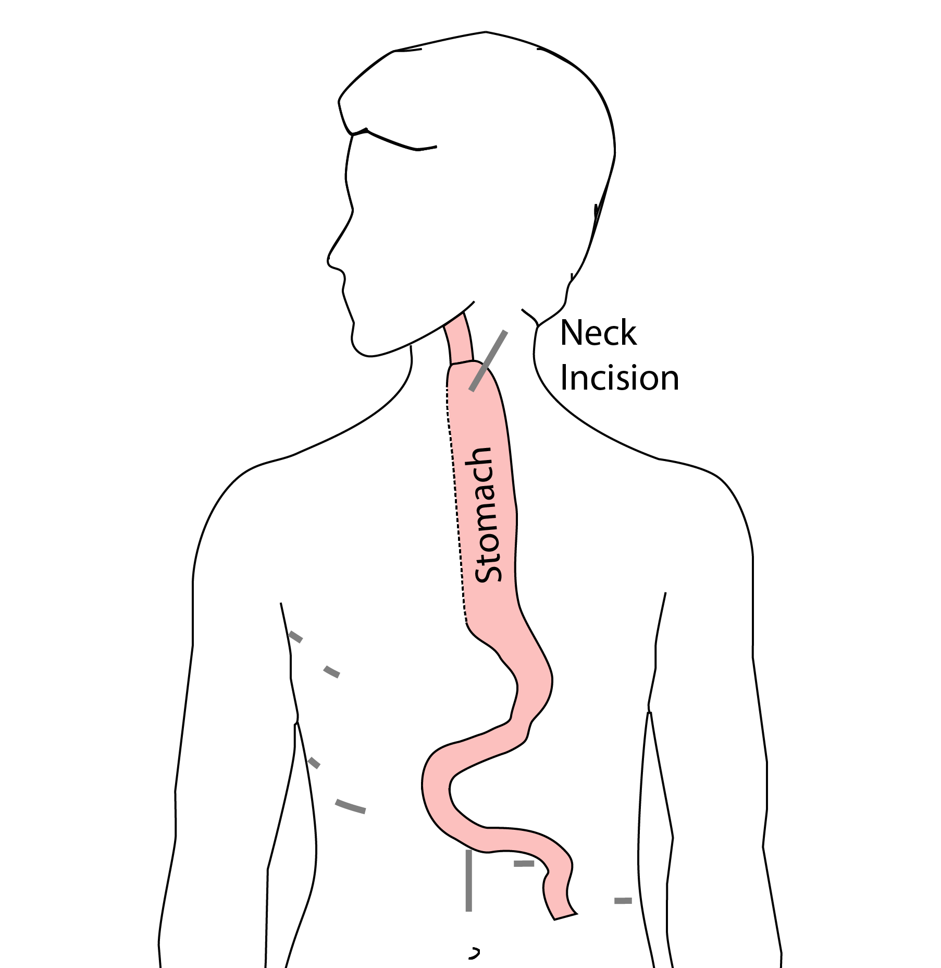
McKeown Esophagectomy

Slide 45
Risks of Esophagectomy
Esophagectomy is a complex operation, with a real risk of complications.
Two significant complications:
Anastomotic leak
Pneumonia

Slide 46
Anastomotic Leak
The anastomosis is surgical connection between the esophagus and the stomach.

Slide 47
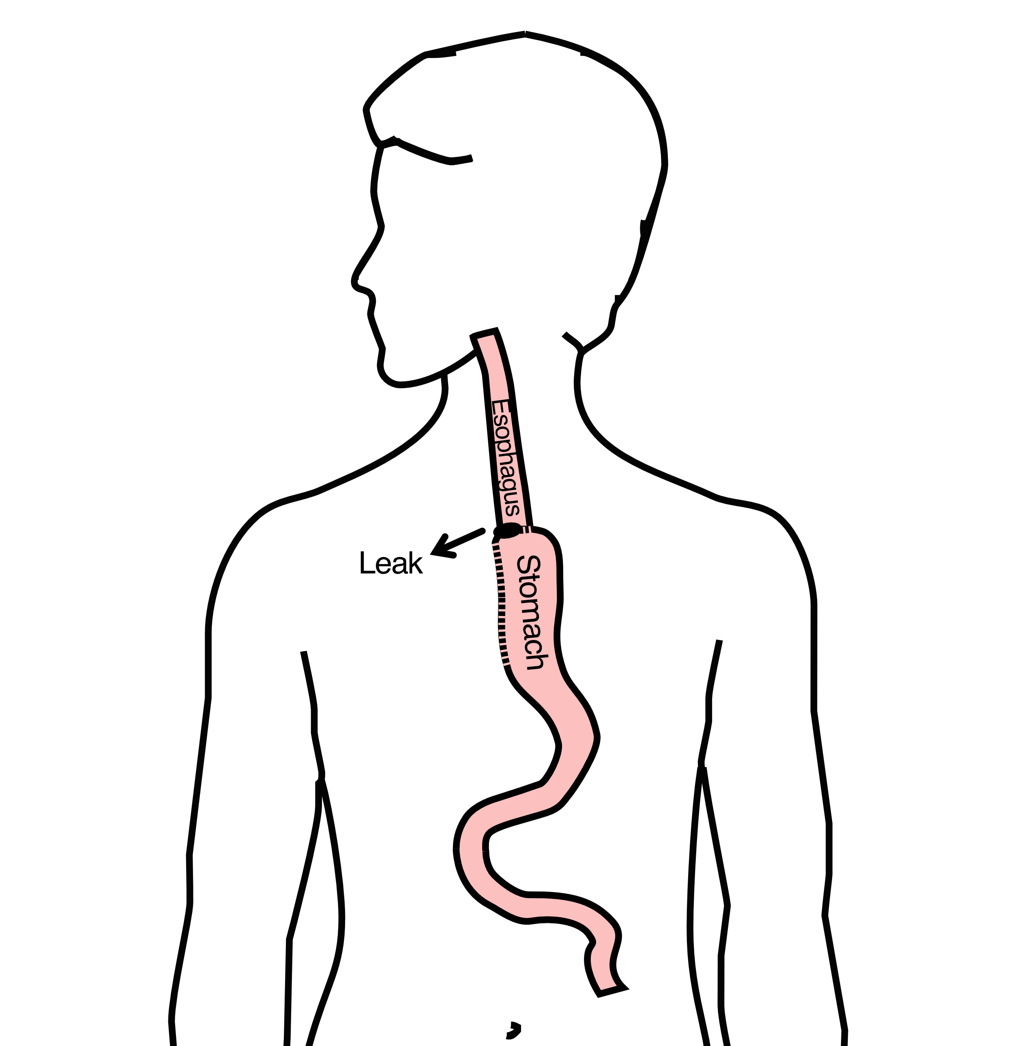
Anastomotic Leak
If healing doesn’t occur:
Leakage of fluid from the esophagus
Infection in the space between the lungs
Requires additional time in the hospital

Slide 48
Anastomotic Leak
If leak occurs:
Some leaks will seal
Stent may be required to help healing
Occasionally additional surgey is required

Slide 49
Anastomotic Leak
Risk of leak depends on:
Type of operation performed
Nutritional status of patient
Experience of the surgeon

Slide 50
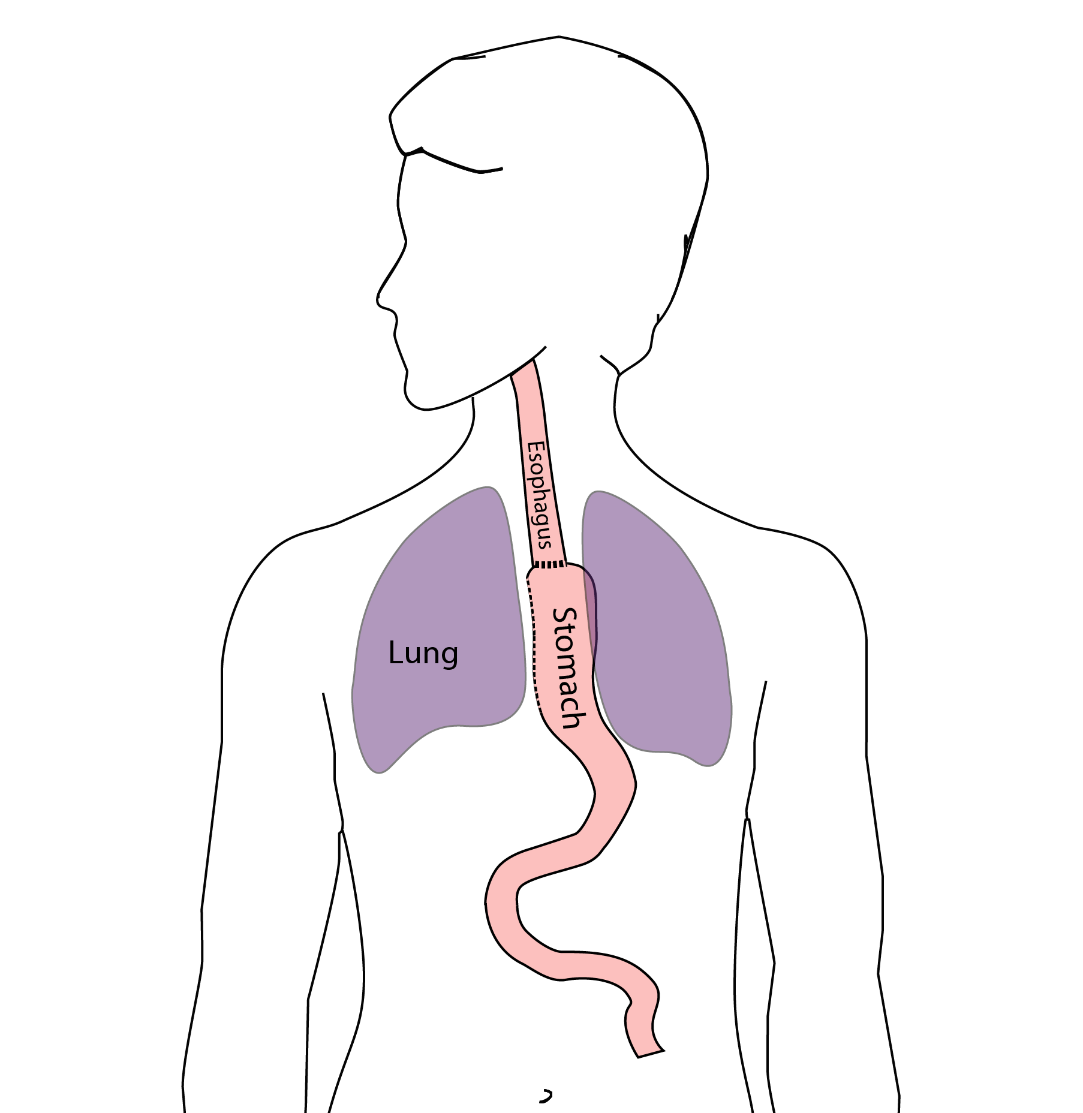
Pneumonia
Occurs in 10-15% of patients after esophagectomy.
Requires treatment with antibiotics
Requires a longer hospitalization.

Slide 51
Preventing Pneumonia
Several ways to help prevent pneumonia:
Deep breathing
Coughing
Walking
After surgery, this means:
Sitting in a chair most of the day
Walking in the halls as soon as possible

Slide 52
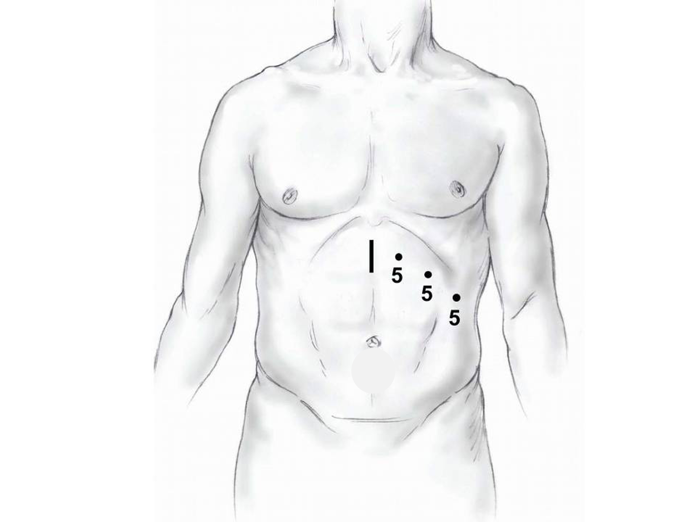
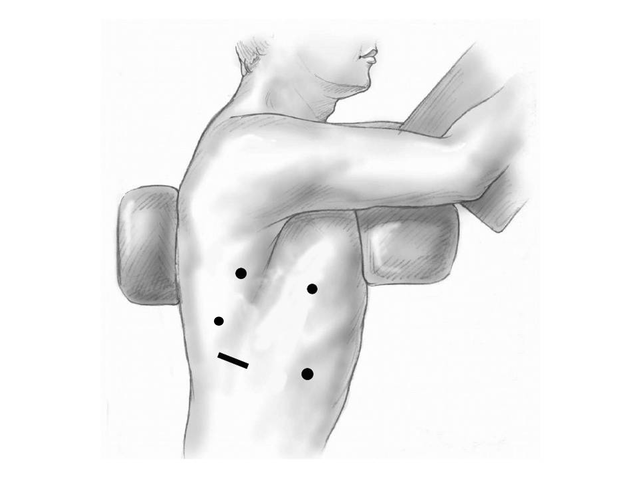
Minimally-invasive Esophagectomy

Slide 53
Risks of Surgery
Risks related to anesthesia
Heart attack (5%)
Irregular heart rhythm (15%)
Pneumonia (10%)
Blood clots in legs (<5%)
Pulmonary embolism (2%)

Slide 54
Risks of Surgery
Risks related to Surgery
Anastomotic leak (5%)
Stricture at anastomosis (15%)
Death within 90 days of surgery
Low risk patients = 2%
Intermediate risk = 10%
High risk = 30%

Slide 55
Risks of Surgery
 | Age <75 | Age >75
Normal Muscle (75%) | 2% | 10%
Low Muscle (25%) | 10% | 30%
Risks of Death within 90 Days of Surgery

Slide 56
Day Prior to Surgery
Clear liquids for 24 hours prior to surgery
Check with Pre-op nurse regarding medicines day prior to surgery
No tube feedings the night before surgery

Slide 57
Day of Surgery
Arrive at 5am – nothing to eat or drink after midnight.
Medicines OK w/ a sip of water
sip of black coffee but no cream.
Surgery will be cancelled if you have cream/milk
Waiting room for family and friends on 5th floor

Slide 58
Epidural Catheter for Pain Control
Remains in place for 2-5 days
Dosage can be adjusted as needed
Can make it more difficult to urinate
May require foley catheter in bladder
Foley catheter removed after epidural removed

Slide 59
Intensive Care Unit (ICU) (2-4 days)
Surgical ICU on 11th floor
NG tube in nose to drain stomach and esophagus
Catheter in bladder
Chest tube right chest
Abdominal drains (usually 2)
Feeding jejunostomy (usually stays in 8 wks)

Slide 60
Intensive Care Unit (ICU)
Bladder catheter removed → check that bladder empties properly
Chest tube removed (day 2-4) → follow-up x-ray
Fluid emptied from drains every few hours
Start tube feedings by feeding
Feeding jejunostomy (stays in 8 weeks)

Slide 61
Ward - 6Tower
Jejunostomy feeds started
Up in a chair most of the day
Walking in the halls
Start with assistance
Improves lung function
Prevents loss of muscle strength

Slide 62
Jejunostomy Feeds
Jejunostomy tube feeds
Start continuous (24 hours)
Convert to night-time only (16 hours)
Water administered through feeding tube
Usually 8oz 4 times/day
Important to prevent dehydration

Slide 63
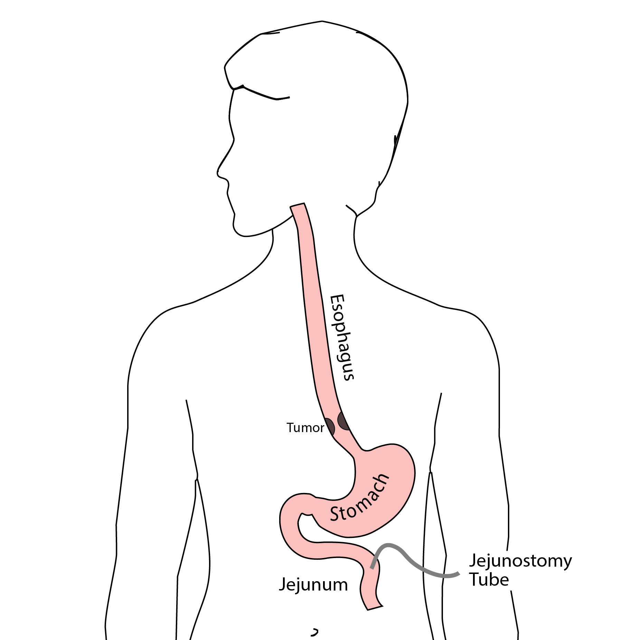
Jejunostomy Tube
Nutrition to bypasses the esophagus and stomach
Placed in small intestine
Pump administers feedings slowly
Feeding done at night

Slide 64
Jejunostomy Typical Regimen
Jejunostomy tube feeds for 16 hours (6pm-10am)
Men: 75mL/hour x 16 hours = 5 cartons
Women: 60mL/hour x 16 hours = 4 cartons
Water 240ml (8oz) via syringe 4x/day
Hospital nurses will teach use of the feeding tube

Slide 65
Jejunostomy Feeds with Diabetes
Jejunostomy feedings elevate blood sugars
Insulin may be required along with feeds
Typical Pattern for tube feeds
Feeds run via pump from 6pm to 10am
Insulin at 6pm (70/30 insulin)
Insulin at Midnight (70/30 insulin)
No insulin if tube feedings are not run

Slide 66

Jejunostomy Video
A video is available to help become familiar with the feeding jejunostomy

Slide 67
Activity after Surgery
Up in chair most of the day
Walking with help from nurse/Physical Therapist
Goals:
Improve lung function
Prevent muscle loss

Slide 68
Nasogastric (NG) Tube
Tube passed through nose into stomach
Drains fluid from stomach
Prevents vomiting
Upper GI X-ray on 2nd or 3rd day after surgery
If stomach empties well $→$ NG tube removed
Otherwise, X-ray repeated 2-3 days later

Slide 69
Swallowing Evaluation
Once NG tube has been removed:
Modified barium swallow in radiology
Drink a white chalky liquid (barium)
Look for proper swallowing function
70% of patients $⇒$ liquids started by mouth

Slide 70
Oral Intake at Home
Most are taking protein shakes when they go home
Protein shakes are started after tolerating water
2 oz per hour to start
4 oz per hour if 2oz are tolerated well

Slide 71
Discharge
Goal: ready to leave day #6/7 after surgery
Night-time tube feedings (6pm to 10am)
Nutrition by mouth (70% of patients)
1 oz of water per hour by mouth OR
Protein shakes 4oz every 2 hours
Water through tube 8oz four times per day
Home care nursing (feeding tube teaching)
Home infusion (tube feeding supplies)

Slide 72
Nutrition after Surgery
At discharge home:
Protein shakes 4oz every 2 hrs
Tube feeds 4-5 cans at night (6pm-10am)
10-12 Days: Increase protein shakes
Tube feeds 3-4 cans at night
Three weeks: Post-esophagectomy Diet
8-12 weeks: Remove feeding tube (in office)

Slide 73
Transition from Tube Feeds $→$ Eating
Dietitian will calculate daily protein goal
Typically 60-75 grams protein/day
Each carton of tube feeding has 15 grams
75 grams protein = 5 cartons/night
More intake by mouth $→$ tube feeds reduced
Spread out protein during the day (20gm/meal)
Three meals + 2-3 high-protein snacks

Slide 74
Post-esophagectomy Diet
Soft Consistency
High Protein
Avoid sugary liquids (can cause ‘dumping’)
Avoid raw vegetables (and salads)
Eating
Small, frequent meals
Sit up for 30-45 minutes after eating
Avoid eating within 2 hours of bedtime

Slide 75
Medicines at Home - Pain
Acetaminophen (Tylenol) 1000mg 4x/day
Gabapentin 300mg 3 times/day
Oxycodone
As needed in addition to Tylenol/gabapentin
Will begin reducing dose at first postop visit
Can usually discontinue by 4 weeks
NO DRIVING WHILE ON OXYCODONE

Slide 76
Non-steroidals Anti Inflammatory (NSAID)
Non-steroidal anti-inflammatories (Celebrex)
200 mg every 12 hours starting at 2 weeks
NO GOODY POWDERS OR BCs
(Can cause permanent scarring at the surgery site)

Slide 77
Acid Blockers = Proton Pump Inhibitors
Examples include ompeprazole and pantoprazole
Will stay on for at 1-2 years to prevent acid reflux
Important in preventing scarring at anastomosis (new connection between esophagus and stomach)
To administer through feeding tube, open capsule and resuspend beads in 60mL (2oz) of water

Slide 78
Medicines at Home
Reglan – Helps stomach empty
Will plan to stop after six weeks
0.1% risk of tardive dyskinesia (nervous tic)
Remeron – Helps improve appetite
Can cause vivid dreams
Used for several weeks after surgery
Will stop within first three months of surgery

Slide 79
Metoprolol = Beta Blockers
Slows heart rate and lowers blood pressure
Used to prevent rapid heart rate
Patients not taking a beta blocker prior to surgery $→$ wean after after surgery
Patients taking a beta blockerprior to surgery $→$ return to prior dose and drug after surgery

Slide 80
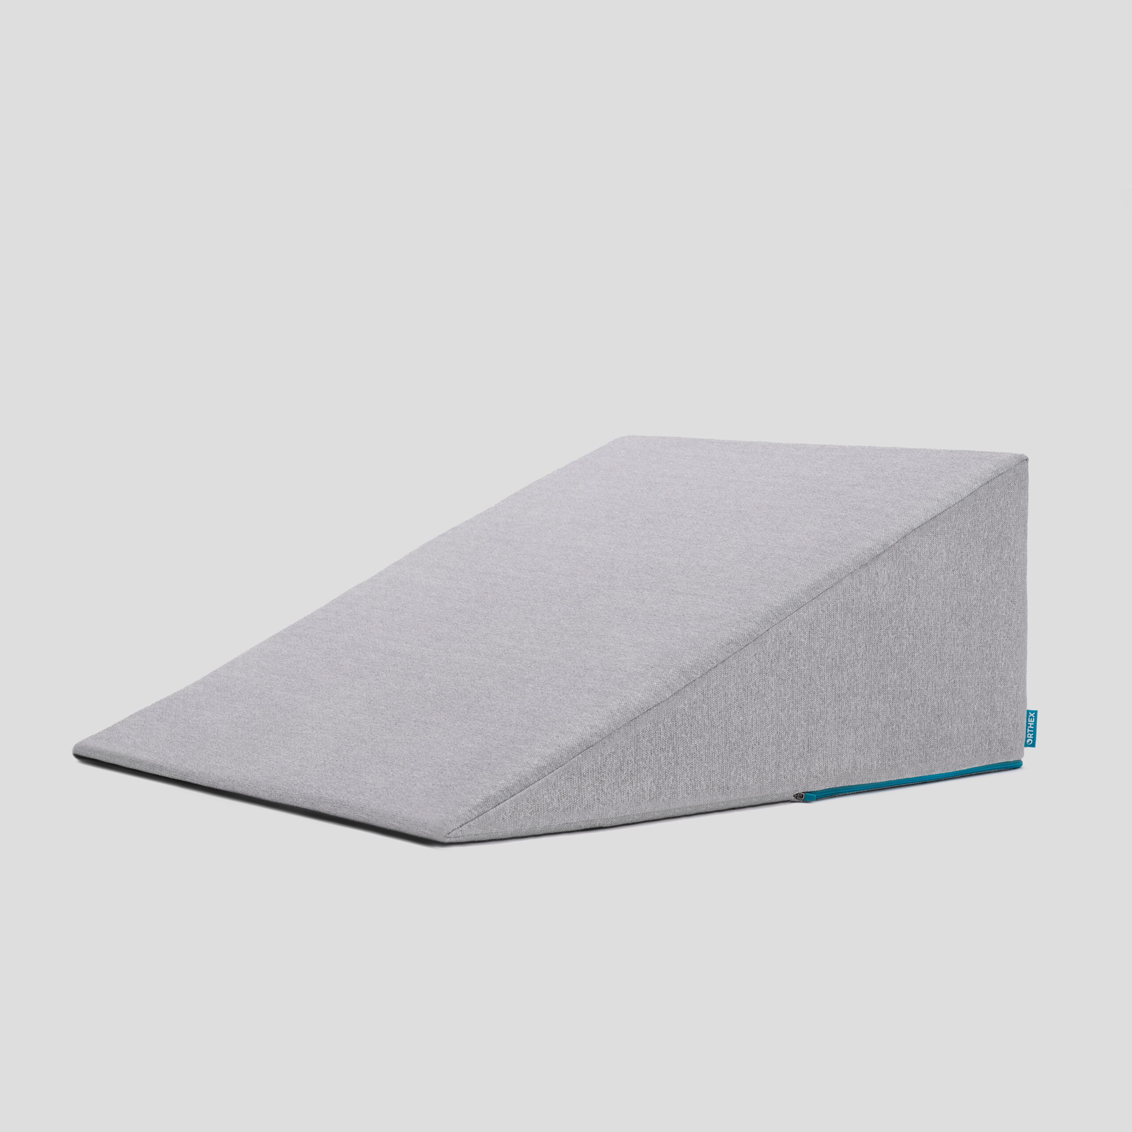
Sleeping at Home
Reflux can occur the first few weeks/months after surgery
This improves over the first few months
A wedge pillow can be helpful for sleep

Slide 81
Postoperative Visit at 7-10 Days
Check surgical site
Remove staples (if needed)
Adjust medicines as needed
Insulin (for diabetic patients on insulin)
Reduce beta blocker medicines
Advance diet
Reduce tube feeds

Slide 82
After surgery
Wean off medicines added after surgery
Pain medicines
Beta-blockers
Reglan and Remeron
Continue acid blockers for at least 1 year

Slide 83
Jejunostomy Removal
Jejunostomy tube is removed in the office once you can take in enough nutrients by mouth
Removal usually around 8 weeks after surgery
May take 30 minutes and some local anesthetic to loosen up the tube for removal.

Slide 84
Nutritional Monitoring after Surgery
You may have difficulty absorbing some nutrients:
Iron
Vitamin B12
Vitamin D

Slide 85
Nutritional Monitoring after Surgery
About 3 months after the jejunostomy tube is removed, we will check blood levels:
Iron (ferritin)
Vitamin B12
Vitamin D

Slide 86
Nutritional Replacements after Surgery
Vitamin or iron replacements can be ordered by:
Primary Care Provider (PCP)
Medical Oncologist
Surgeon
If levels are low
Replacement
Repeat testing in 3-6 months

Slide 87
Team Members - Physicians
Primary Care Provider
Gastroenterologist
Medical Oncologist (chemotherapy)
Radiation Oncologist (radiation)
Surgeons
Jonathan Salo MD
Jeffrey Hagen MD
Michael Roach MD

Slide 88
Team Members - Support Staff
Physician Assistant - Kate Duncan PA-C
Dietitian - Liz Koch
Nurses
Matthew Carpenter RN
Brandon Galloway LPN
Navigators
Laura Swift
Lorna Espinal
Care Coordinator - Karen Julian-Martinez

