Slide 1
T3 Cancer of the Esophagus and GE Junction

Slide 2
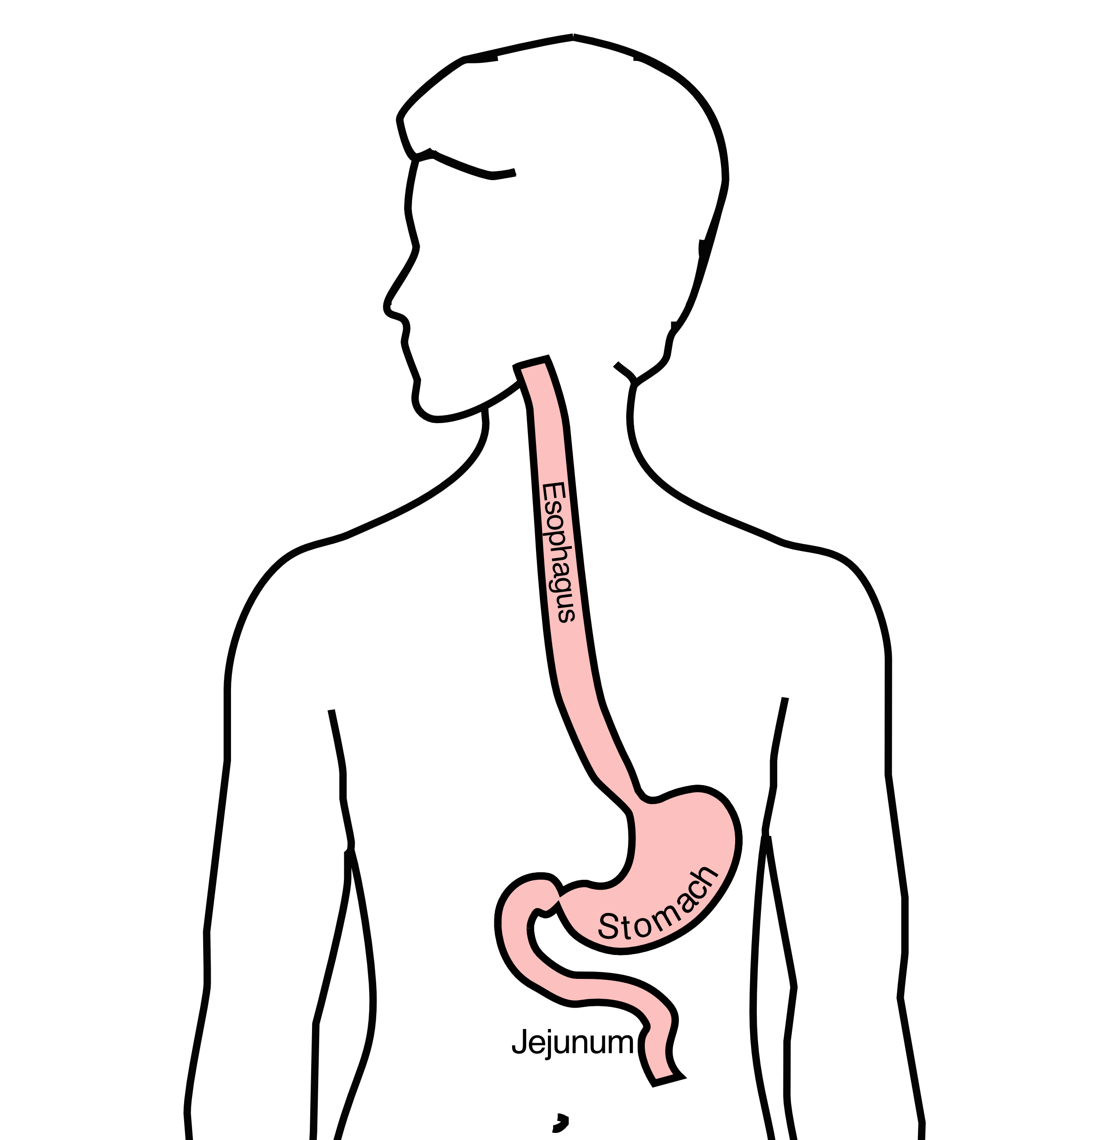
Anatomy
Food moves from the throat
$→$ esophagus
$→$ stomach
$→$ small bowel (jejunum)

Slide 3
Types of Esophageal Cancer
There are two common types of esophageal cancer
Adenocarcinoma
Squamous Cell Carcinoma

Slide 4
Cancer Staging
Staging refers to the tests to determine
How large is the tumor?
Has there been spread to lymph nodes?
Has it spread to other parts of the body?
Treatment options depend upon the cancer stage

Slide 5
Cancer Staging
T = Tumor - Depth of growth into the wall
N = Nodes - Spread to the lymph nodes
M = Metastasis - Spread to liver, lungs, or bone

Slide 6
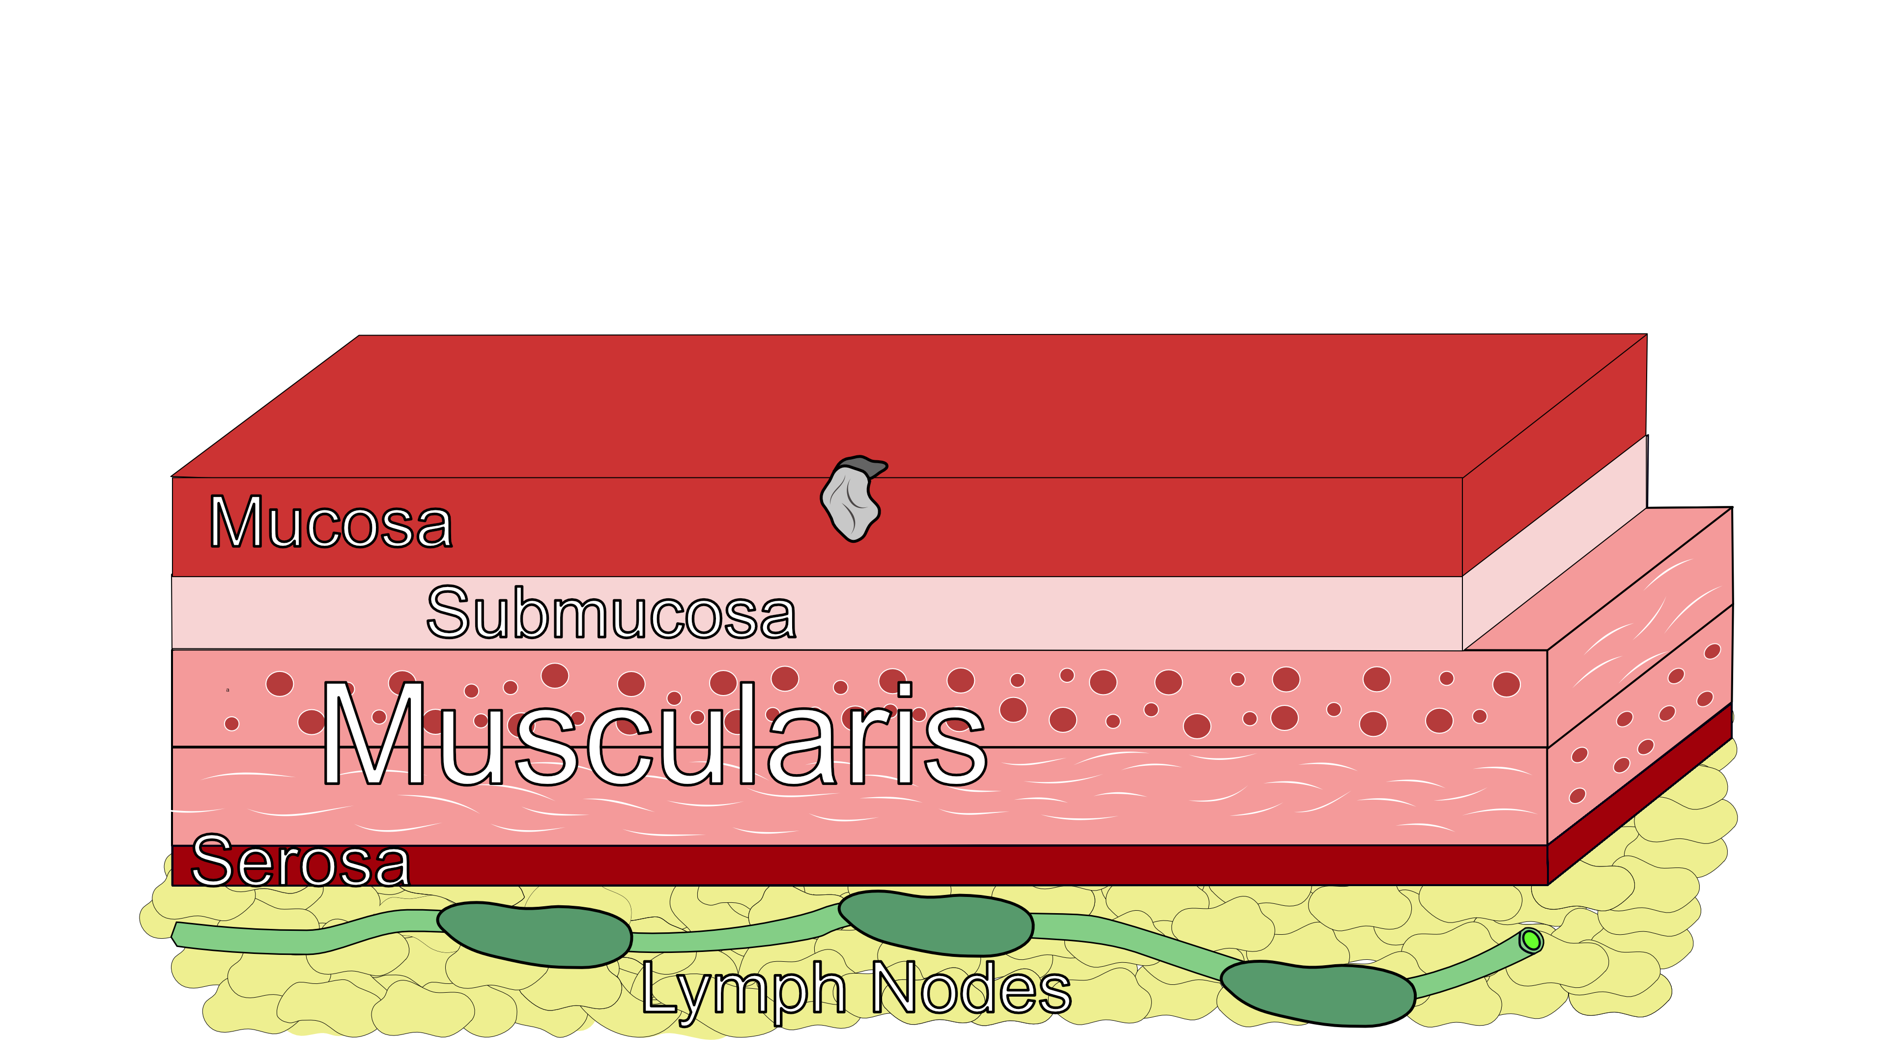
Early Stage Cancers
Cancers start on the very inside layer called the mucosa

Slide 7

Locally-advanced Cancers
Over time, cancers can grow into the muscular wall

Slide 8
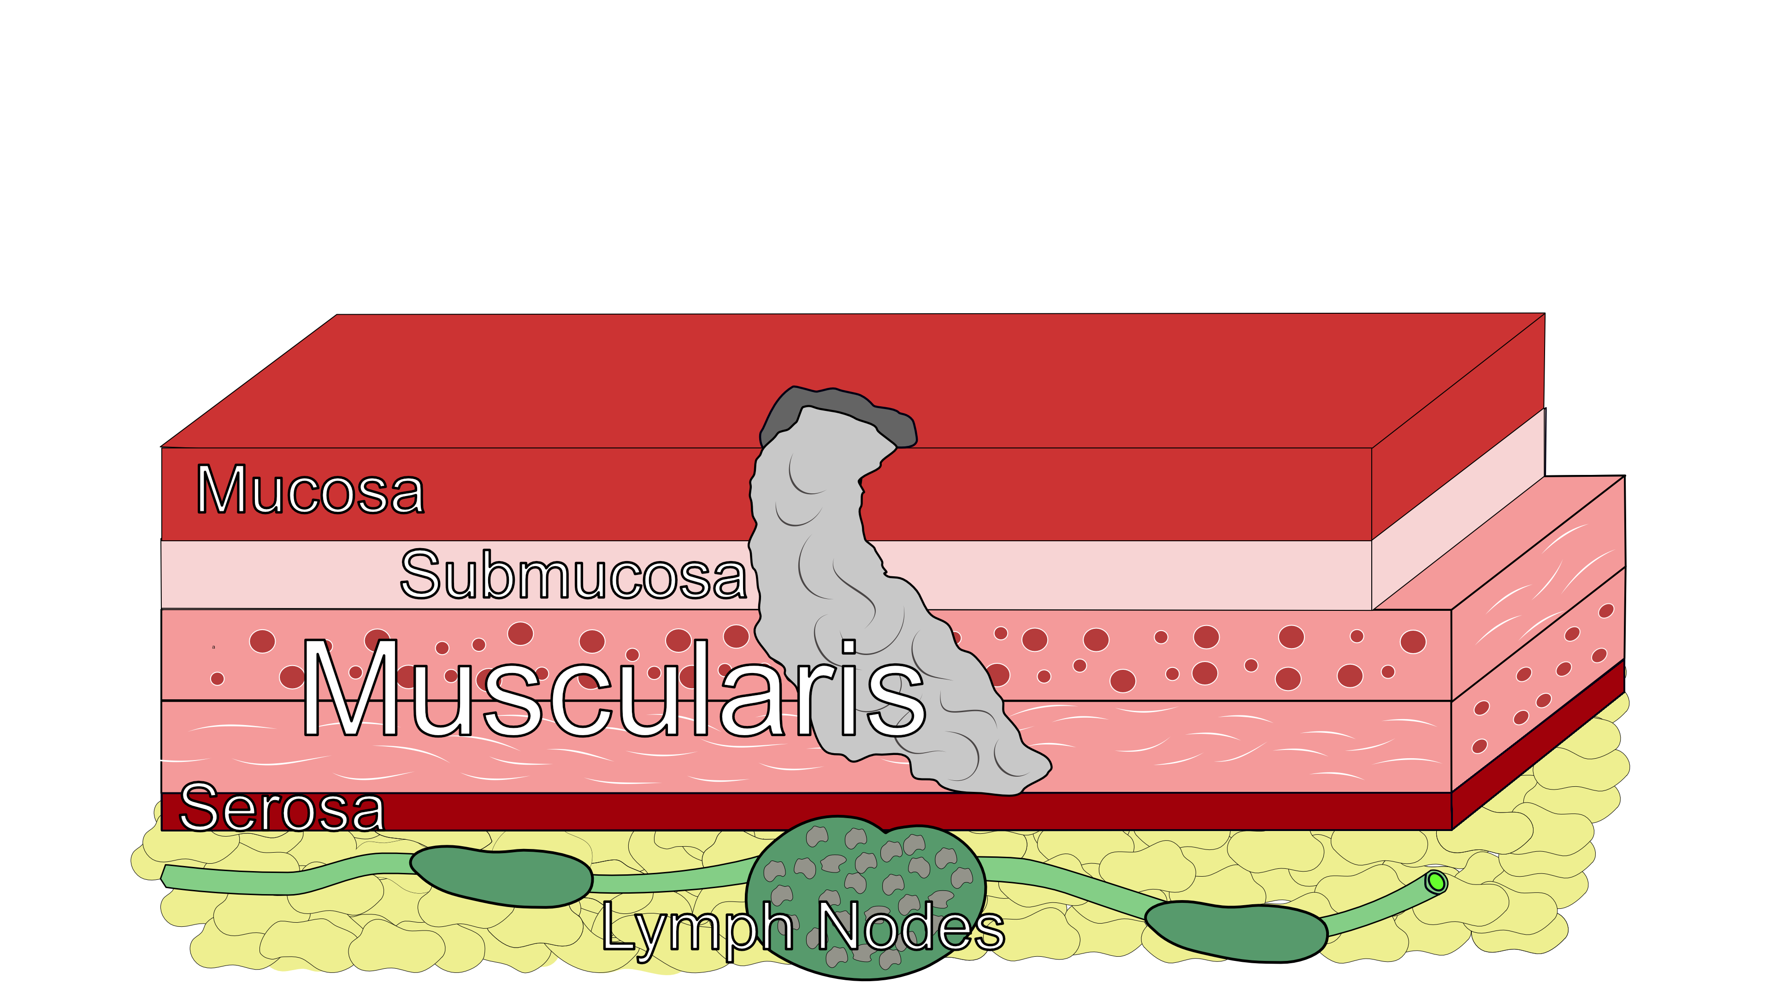
Lymph Nodes
In some cases, cancer cells can break off from the main tumor and spread to lymph nodes

Slide 9
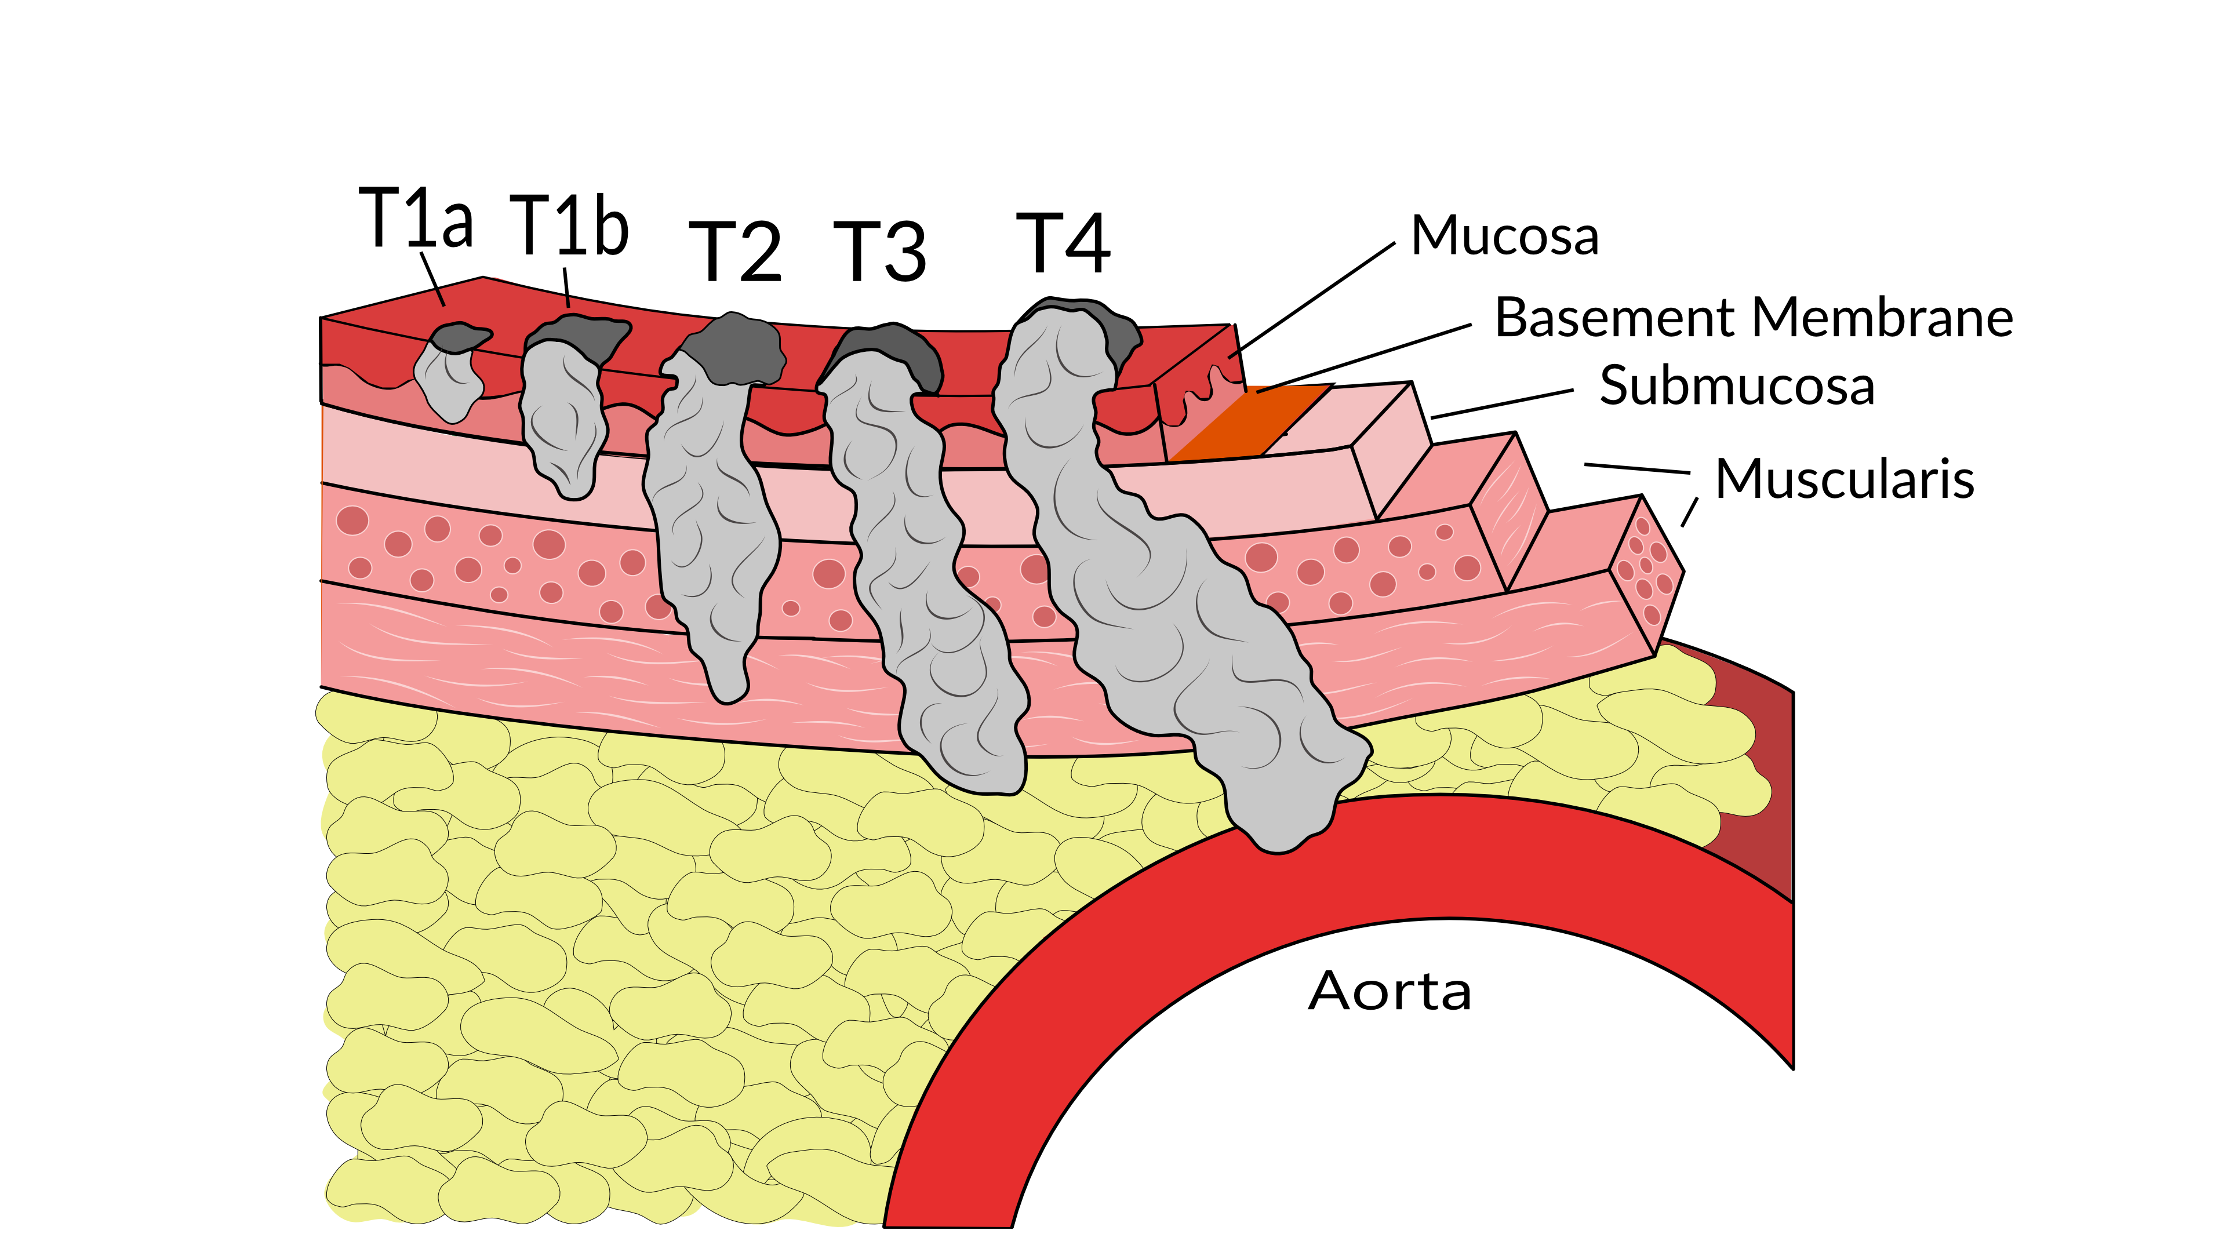
T Stage
Cancers are categorized based upon the thickness of the tumor, known as the T stage

Slide 10
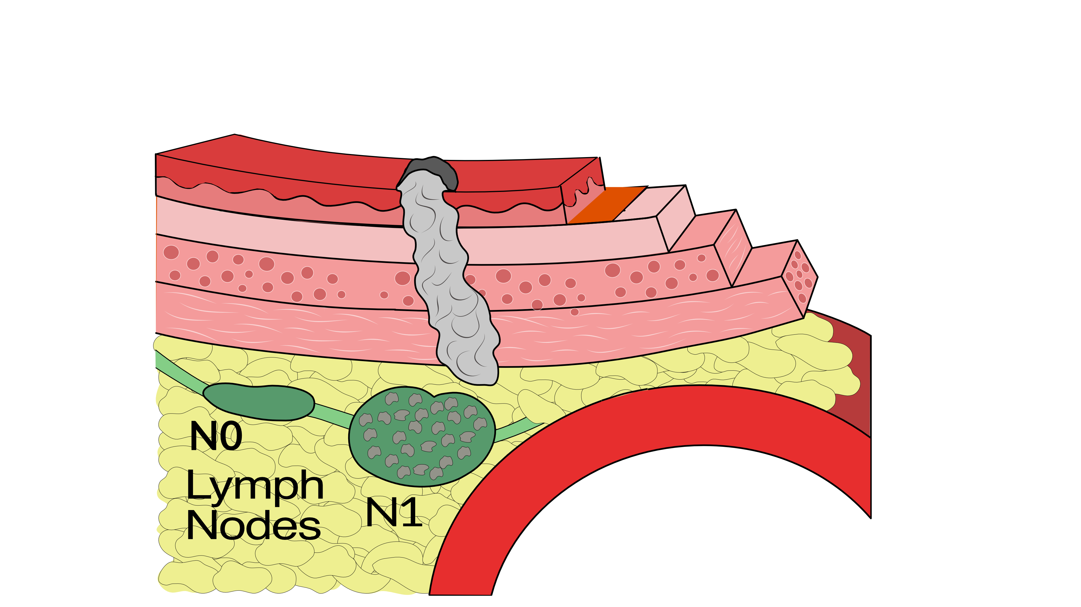
N Stage
Cancers are categorized by whether there is spread to the nodes.
N0 cancers have not spread to the nodes
N1 cancers have spread to the nodes.

Slide 11
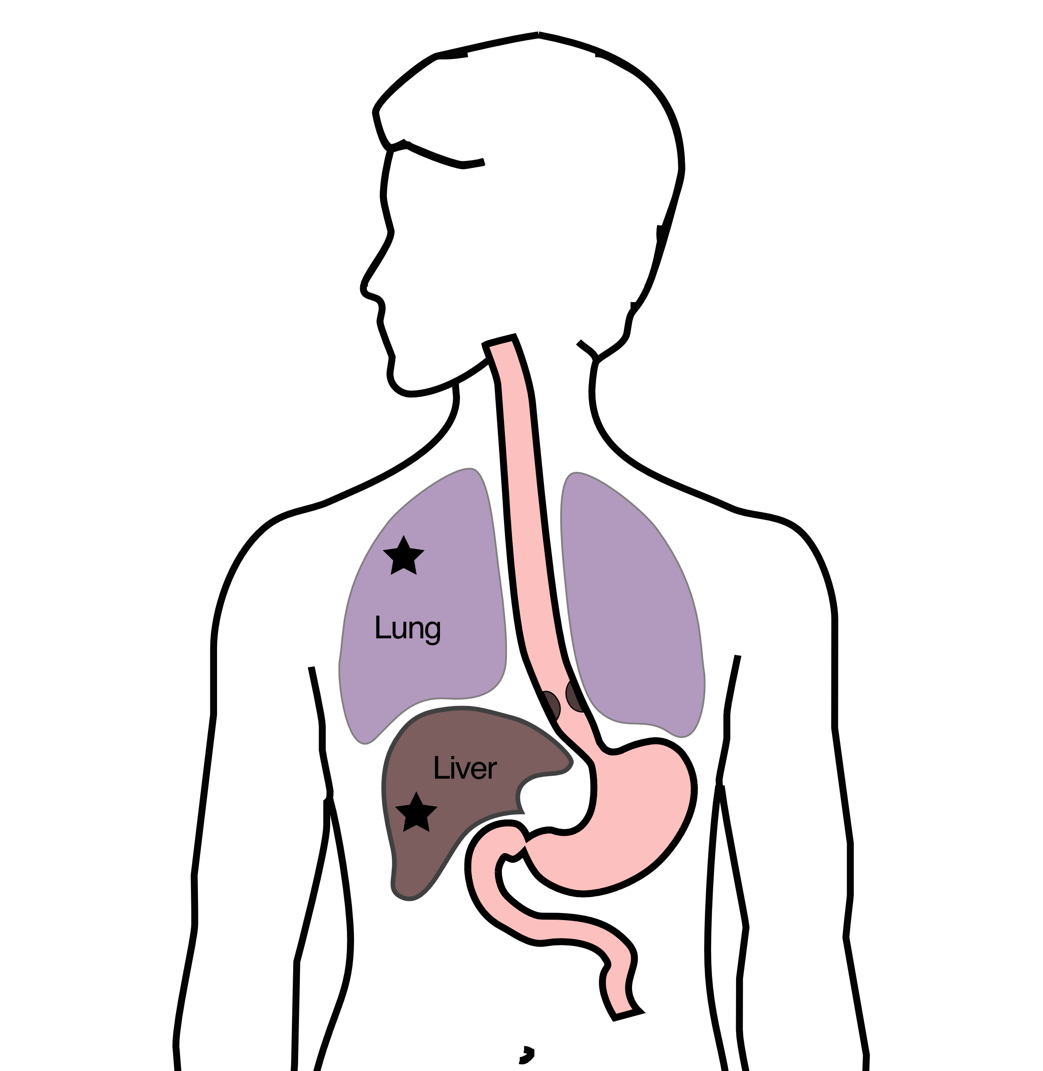
M Stage
Some cancers spread to other parts of the body
M0 cancers have not spread
M1 cancers have spread to lungs, liver, bone, or within the abdomen

Slide 12
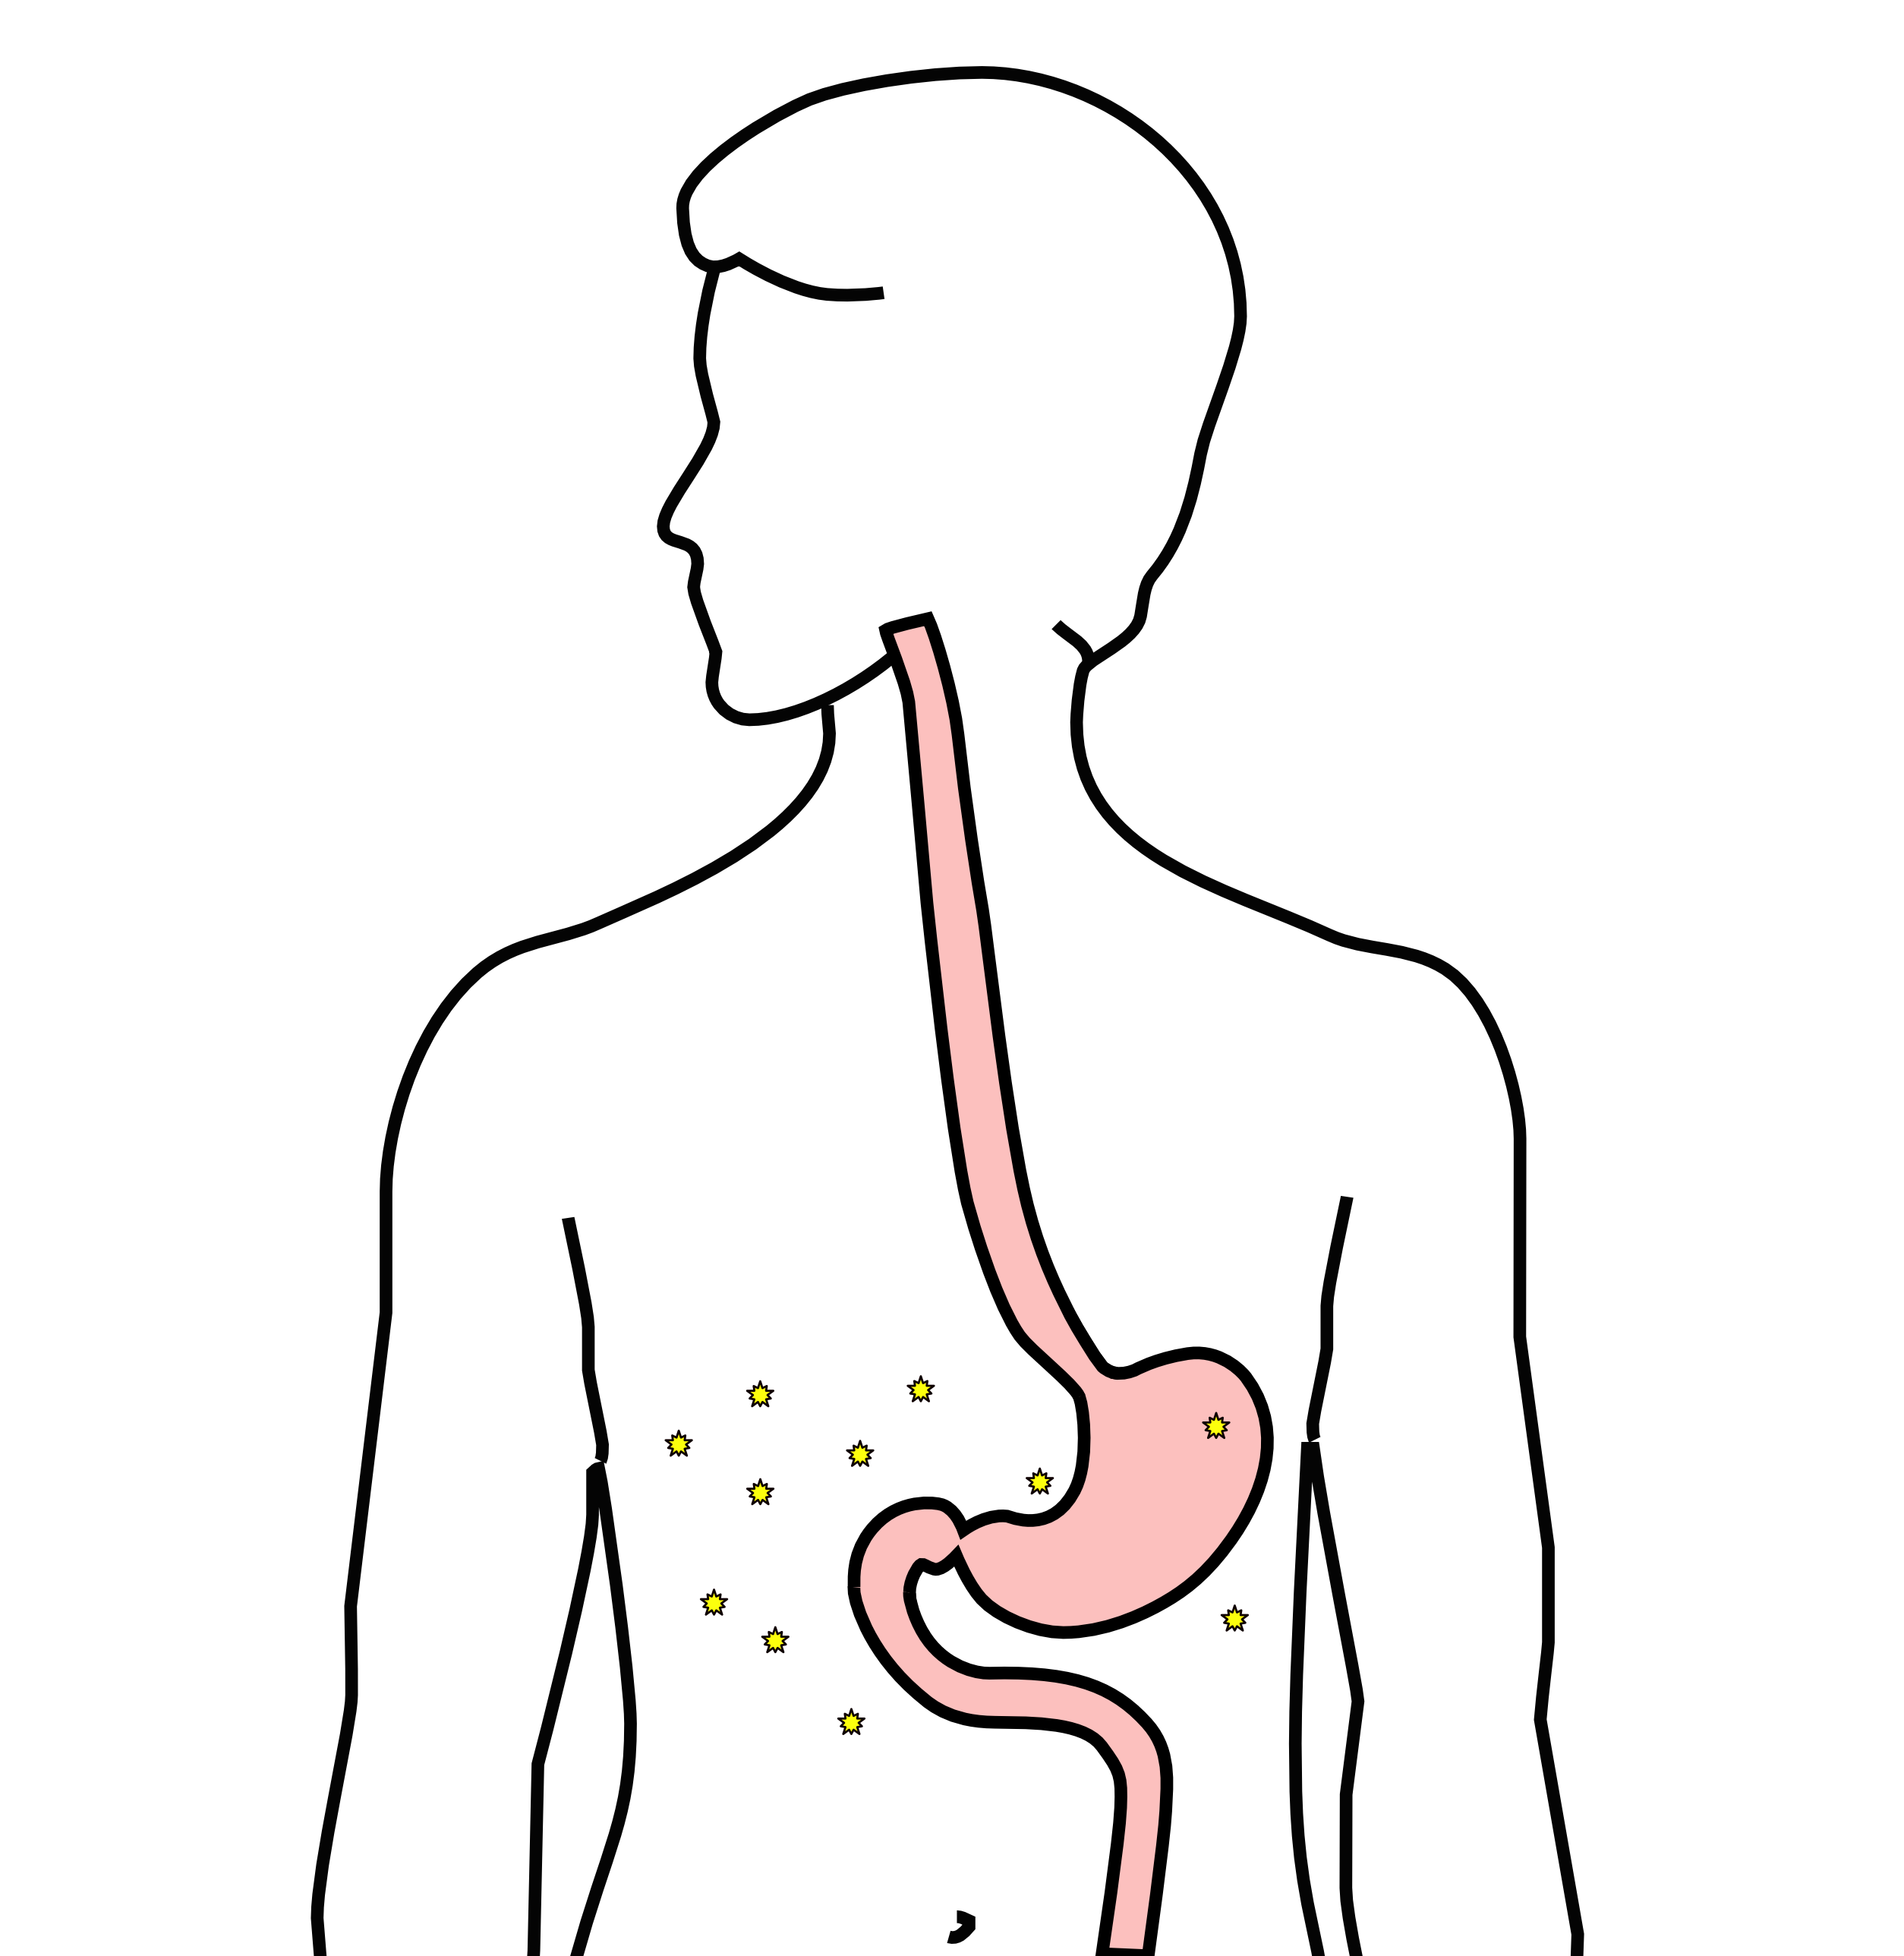
Carcinomatosis (M1)
Spread within the abdomen is carcinomatosis
Tumors can be very small (grain of rice)
Fluid can also build up: ascites

Slide 13
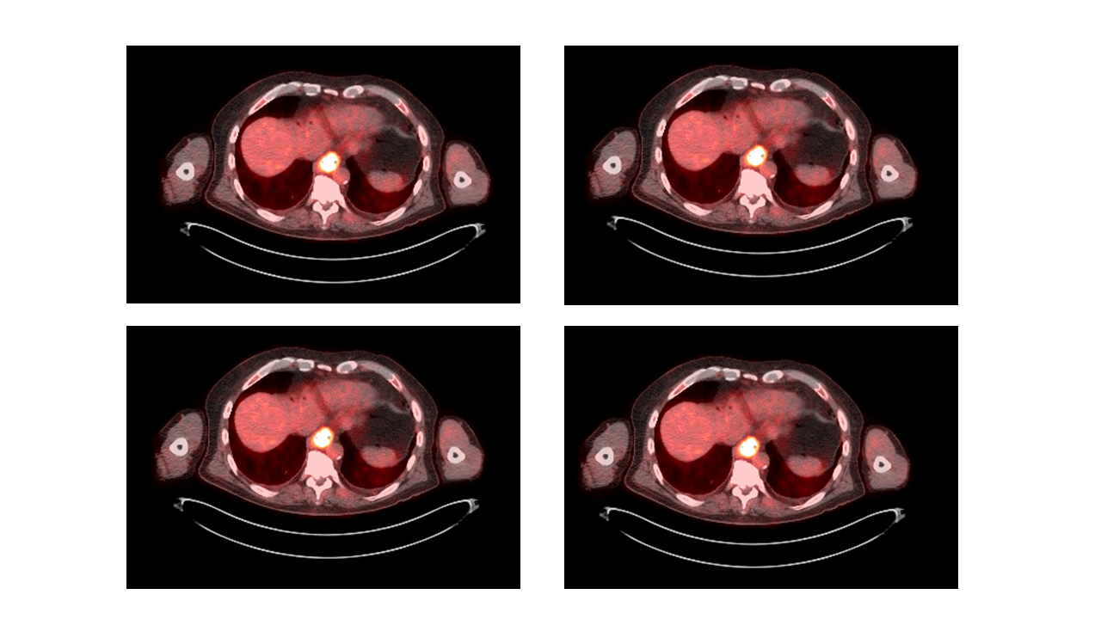
PET scan
Similar to CT scan
Tracer shows ‘hot spots’
Cancer
Inflammation or infection
Normal organs (heart, kidneys)

Slide 14
PET scan Preparation
Nothing to eat or drink for 4 hours prior to exam
High-protein low-carbohydrate diet the day prior
No strenous activity day prior to study

Slide 15
PET scan Prepration - Diabetic Patients
PET scan uses a modified sugar as a tracer $⇒$ you will need to be careful about blood sugar and insulin before the study
No insulin within 4 hours of the exam
OK to take diabetes pills the day of the exam
PET scans are generally best in the morning
Plan to eat a meal after the PET scan, with half the usual morning dose of insulin

Slide 16
PET scan Prepration - Diabetic Patients
If PET is scheduled after 10AM:
low-carbohydrate breakfast at least 4 hours before
half the usual regular (short-acting) insulin
No long-acting insulin after midnight.
Insulin pump: turn it off 4 hours before the study (or turn it down to basal/night-time rate)

Slide 17
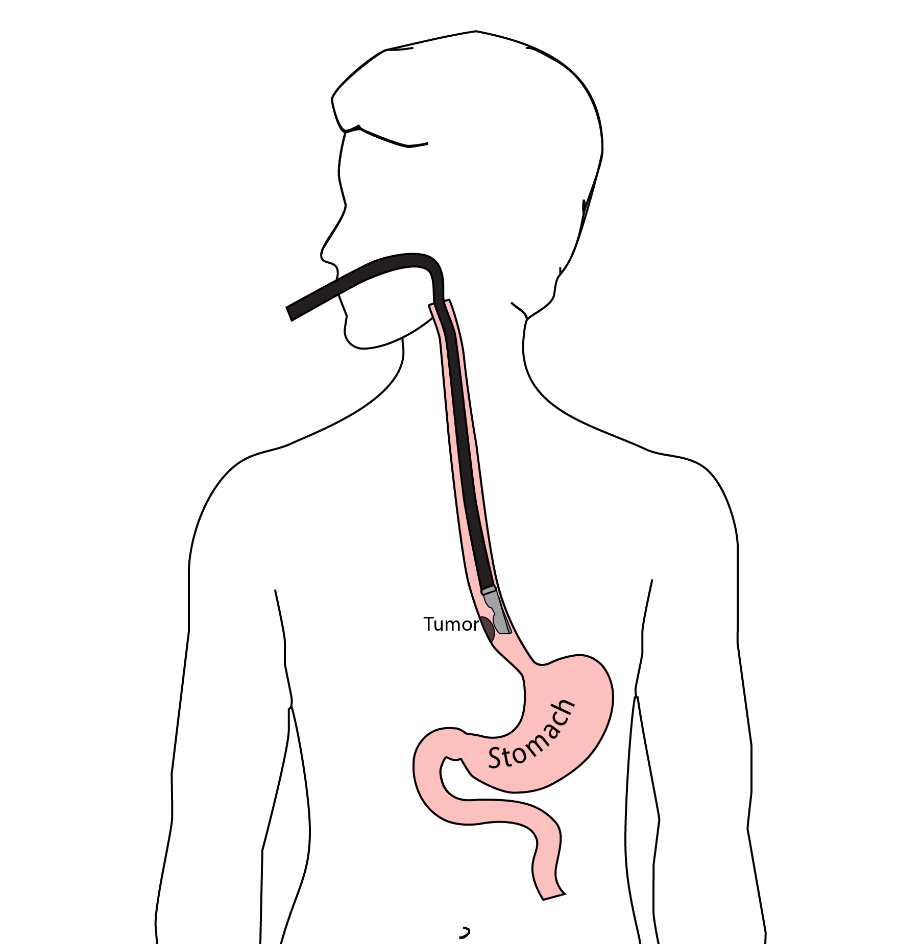
Endoscopic Ultrasound
Similar to upper endoscopy (EGD)
Ultrasound in scope
Evaluates T stage

Slide 18
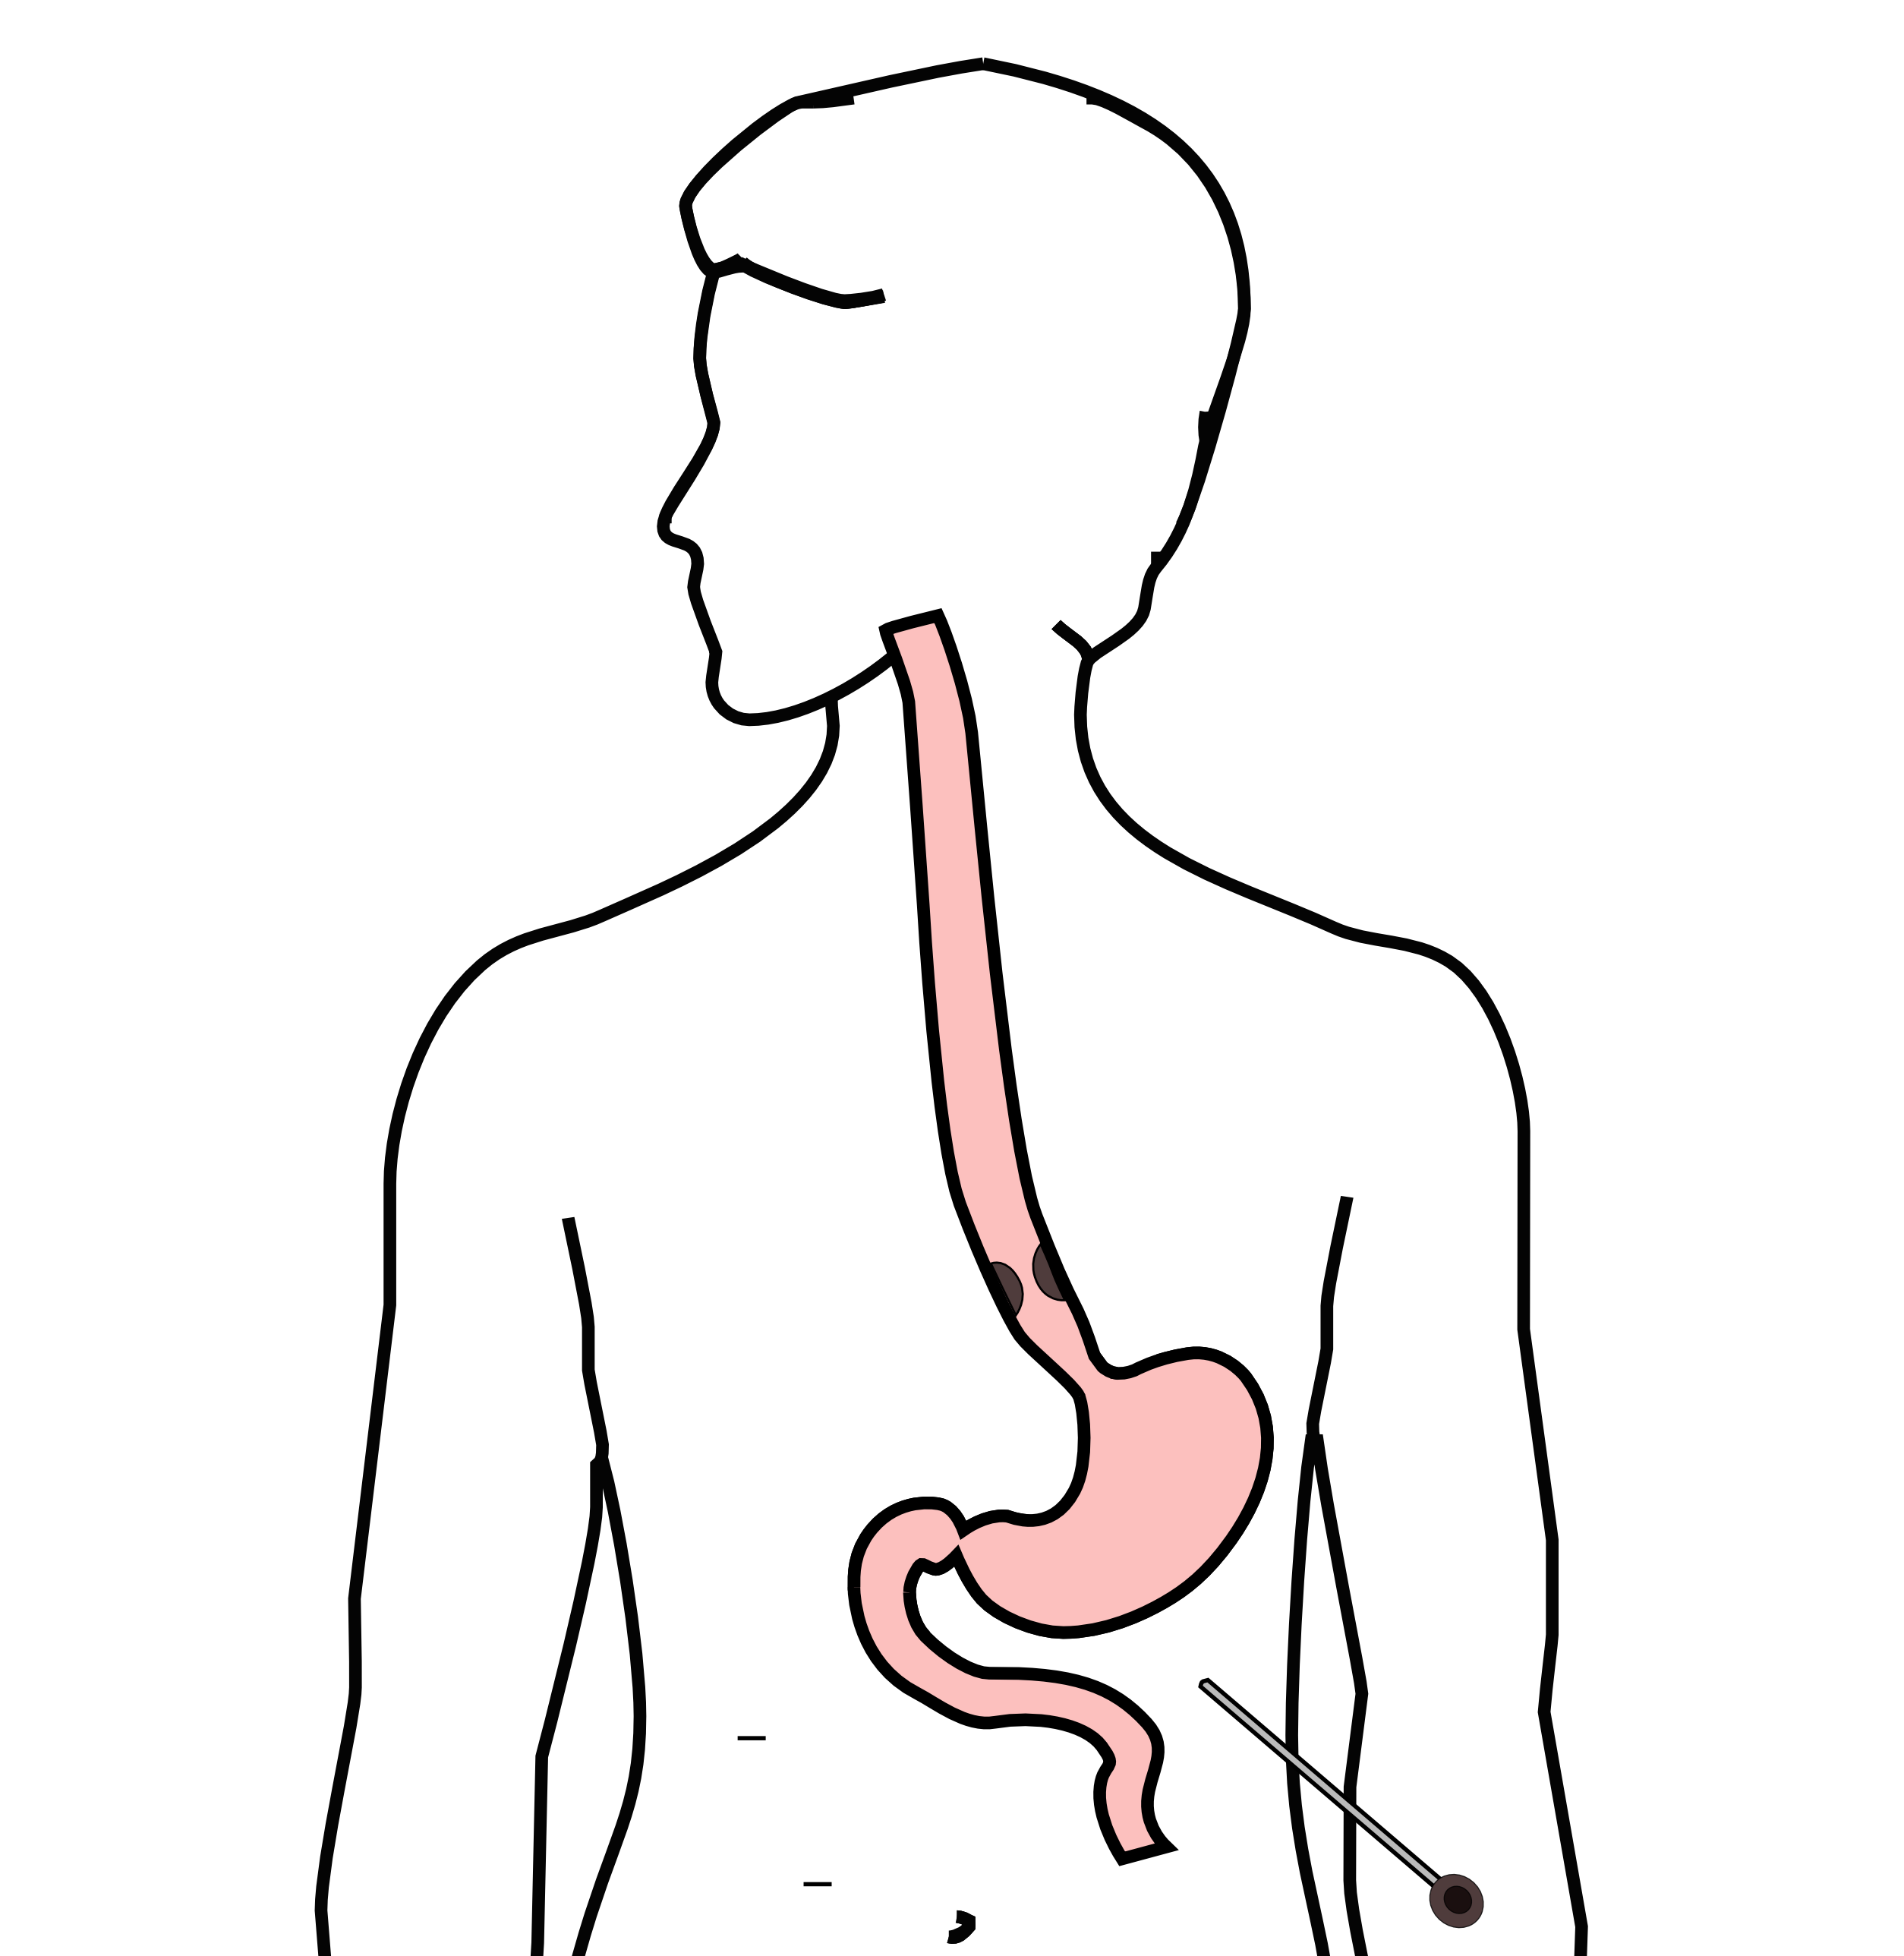
Laparoscopy
Some stomach cancers can spread inside the abdomen
Areas of spread can be very small (grain of rice)
Laparoscopy can detect spread inside the abdomen

Slide 19
Laparoscopy
General anesthetic
1/4” incisions
Telescope examines the abdomen
Biopsies performed
Fluid sampled

Slide 20
Treatment Plan
Superficial (T1): Endoscopic Therapy
Localized (T1b/T2): Surgery (esophagectomy)
Locally-advanced (T3M0): Chemo$±$Radiation $→$Surgery
Metastatic (M1): Chemotherapy

Slide 21
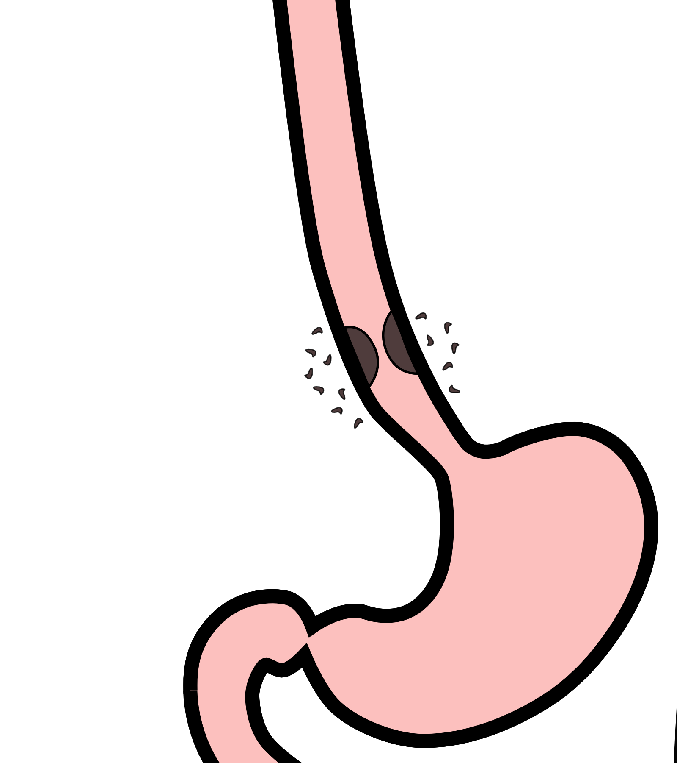
Locally-advanced cancers
Patients with locally-advanced esophageal cancer often have localized spread of cancer cells in the surrounding area

Slide 22
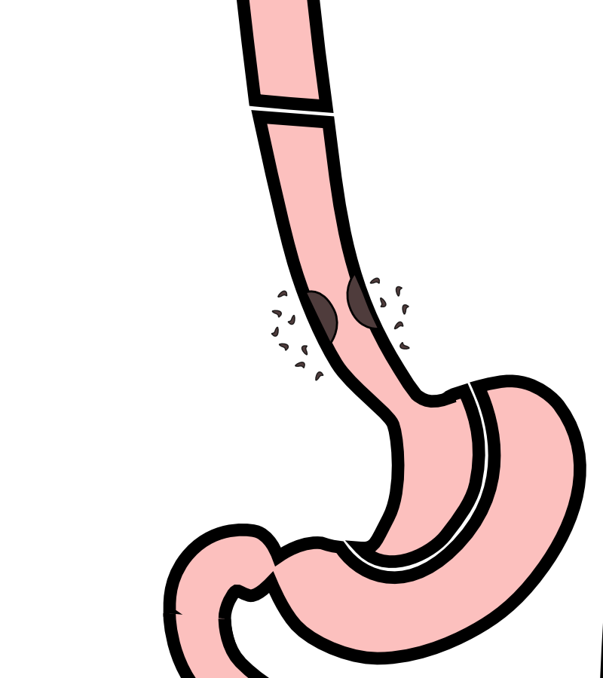
Locally-advanced cancers
If locally-advanced cancers are treated with surgery alone…

Slide 23
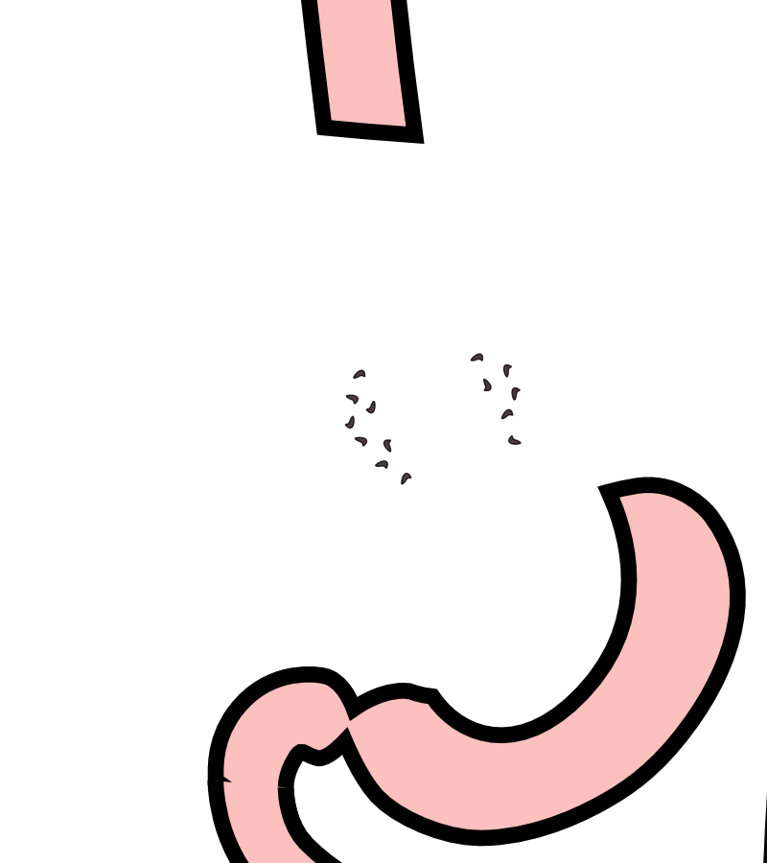
Locally-advanced cancers
If locally-advanced cancers are treated with surgery alone…
There is a risk that cancer cells can be left behind

Slide 24
Preoperative Therapy
It is helpful to start with therapy before surgery that will shrink the cancer.

Slide 25
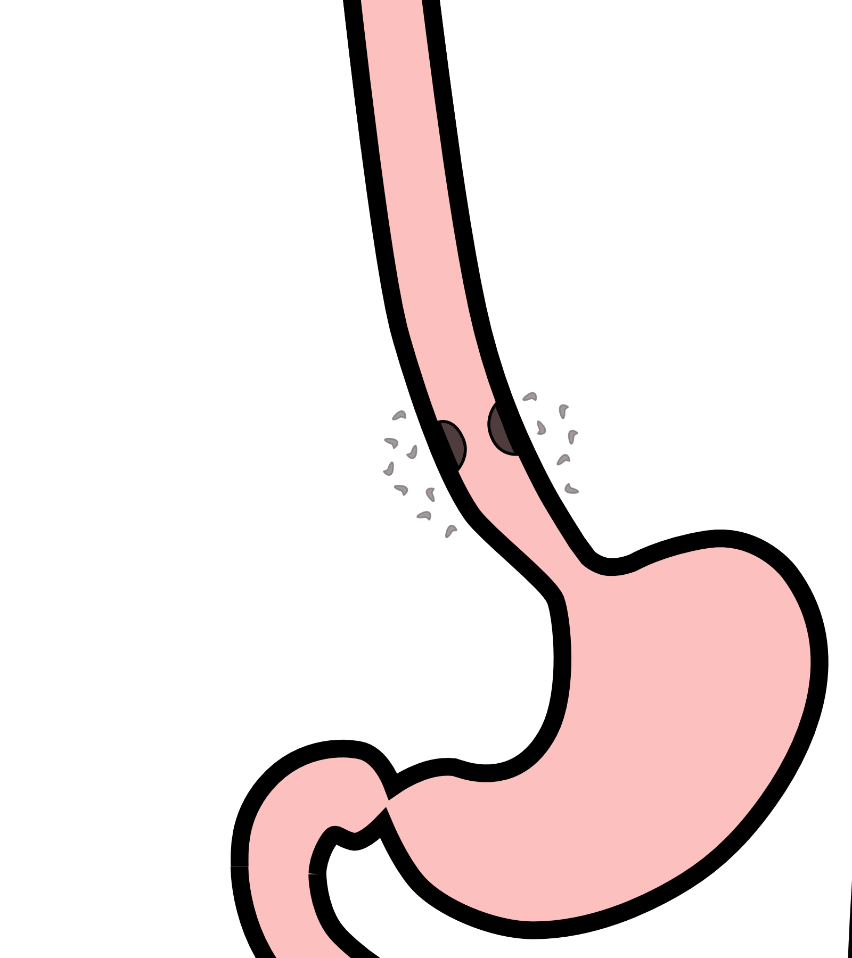
Preoperative Therapy
It is helpful to start with therapy before surgery that will shrink the cancer.

Slide 26

Preoperative Therapy
It is helpful to start with therapy before surgery that will shrink the cancer.

Slide 27
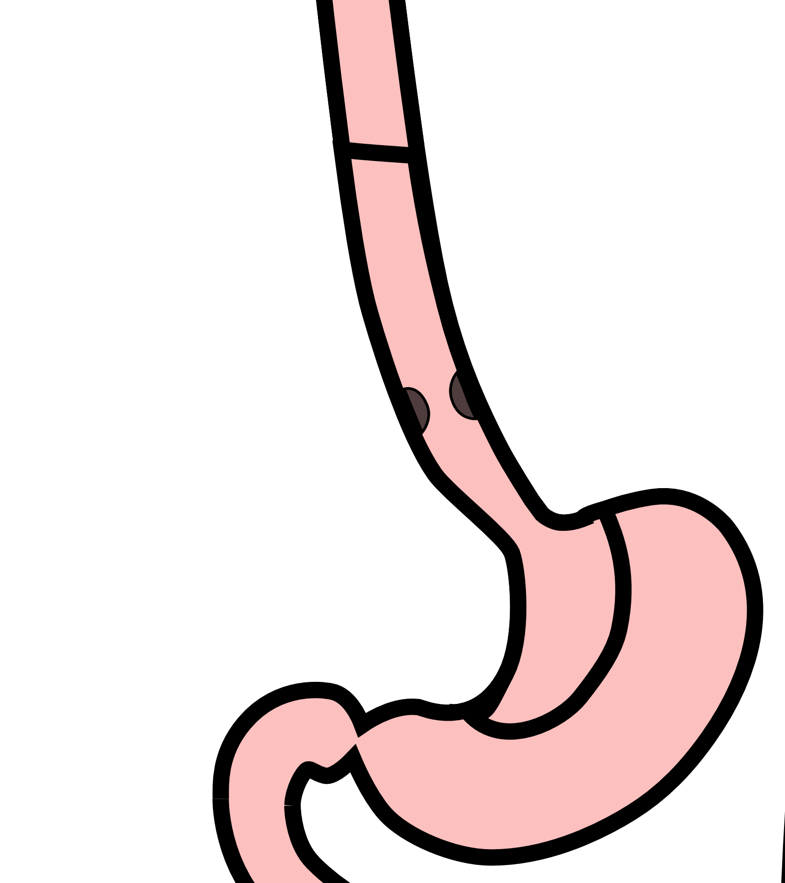
Surgery after Preoperative Therapy
When surgery is then performed…

Slide 28

Preoperative Therapy
When surgery is then performed…
The risk of cancer recurrence is minimized

Slide 29
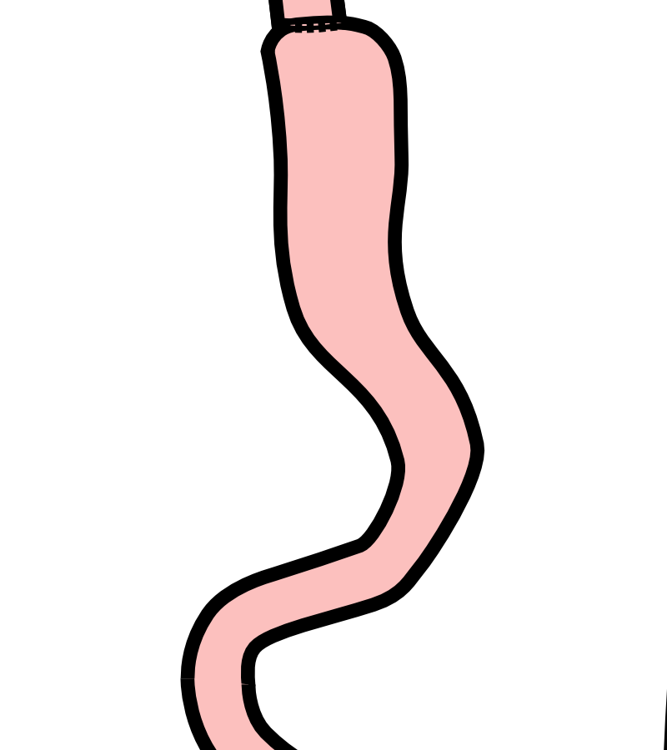
Preoperative Therapy
When surgery is then performed…
The risk of cancer recurrence is minimized

Slide 30
Chemotherapy + Radiation CROSS Trial
363 patients with esophageal cancer studied
Patients were treated in two groups:
Surgery Alone
vs
Chemo + Radiation $→$ Surgery

Slide 31
Chemotherapy + Radiation CROSS Trial
363 patients with esophageal cancer studied
Chemotherapy + radiation together over 6 wks
Surgery Alone
vs
Chemo + Radiation$→$Surgery $⇒$ Longer Survival

Slide 32
Chemo + Radiation CROSS Trial
Typical schedule for chemotherapy + radiation:
Chemotherapy once per week for six weeks
Radiation five days per week for six weeks (28)
PET scan (or CT) 4 weeks after the end of radiation
Surgery 8 weeks after the end of radiation

Slide 33
Chemo + Radiation - Side Effects
Kills cancer cells in the esophagus and lymph nodes
Can also irritate the lining of the esophagus.
Swallowing can be difficult the last 2 weeks.
Feeding tube may be needed for hydration/nutrition.

Slide 34
Adenocarcinoma Treatment Options
For patients with adenocarcinoma an alternative to chemotherapy + radiation is “Sandwich” chemotherapy

Slide 35
Locally-advanced Adenocarcinoma
“Sandwich” chemotherapy before + after surgery:
Chemo (8 wks) $→$ Surgery $→$ Chemo (8 wks)
Two different drug combinations:
FLOT (more effective)
FOLFOX (better tolerated)

Slide 36
“Sandwich” Chemotherapy Drugs
FLOT
5-FU
Leucovorion
Oxaliplatin
Taxotere
FOLFOX
5-FU
Leucovorin
Oxaliplatin

Slide 37
FLOT Treatment Plan
FLOT Chemo every 2 weeks x 4 (=8 weeks total)
Surgery (4-6 weeks later)
FLOT Chemo every 2 weeks x 4 (=8 weeks total)

Slide 38
Durvalumab Immunotherapy
Cancer cells can turn off immune cells using a protein PD-L1
Darvalumab turns on immune cells by counteracting PD-L1
Durvalumab strengthens the immmune system to fight cancer

Slide 39
Matterhorn Trial
The Matterhorn clinical trial compared two types of treatment:
FLOT $→$ Surgery $→$ FLOT
FLOT + Durvalumab $→$ Surgery $→$ FLOT + Durvalumab
Better survival with addition of durvalumab to FLOT
Treatment with durvalumab depends upon approval from insurance company

Slide 40
FLOT Chemo ± Durvalumab
FLOT Chemotherapy
FLOT (8 weeks)
Surgery (4-6 weeks later)
FLOT (8 weeks)
FLOT + Durvalumab
FLOT + Durvalumab (8 wks)
Surgery (4-6 weeks later)
FLOT + Durvalumab (8 wks)
Durvalumab monthly x10

Slide 41
Tumor Biomarkers - Pathology Tests
Show whether other drugs may be helpful:
HER-2 $→$ Herceptin can be helpful
PD-L1 $→$ Immunotherapy can be helpful
MMR $→$ Immunotherapy can be very helpful
Biomarkers reported in a separate pathology report
Your medical oncologist will review these with you

Slide 42
Adenocarcinoma Treatment Options
Chemo + Radiation
Chemo+Radiation (6 wks)
Surgery
Chemotherapy
Chemotherapy (8 wks)
Surgery
Chemotherapy (8 wks)

Slide 43
Adenocarcinoma Treatment Options
CROSS Chemo + Radiation
Longer track record
Better tolerated
Port usually placed
Eating worse $→$ better
May need feeding tube
FLOT Chemotherapy
More effective
More side effects
Port always required
Eating gets slowly better
Feeding tube less likely

Slide 44
Chemotherapy Administration
Most chemotherapy is administered by vein.
Several options exist to administer chemotherapy:
Intravenous catheter in peripheral veins
Peripheral Intravenous Central Catheter (PICC)
Central Venous port

Slide 45
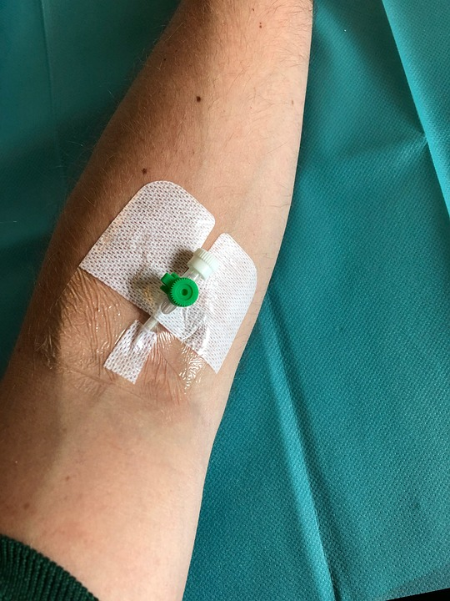
Intravenous Catheter in Peripheral Vein (“IV”)
IV catheter placed in vein of hand or arm
Allows administration of chemo and fluids
Placed for each dose
Removed that day
Not suitable for FLOT chemo

Slide 46
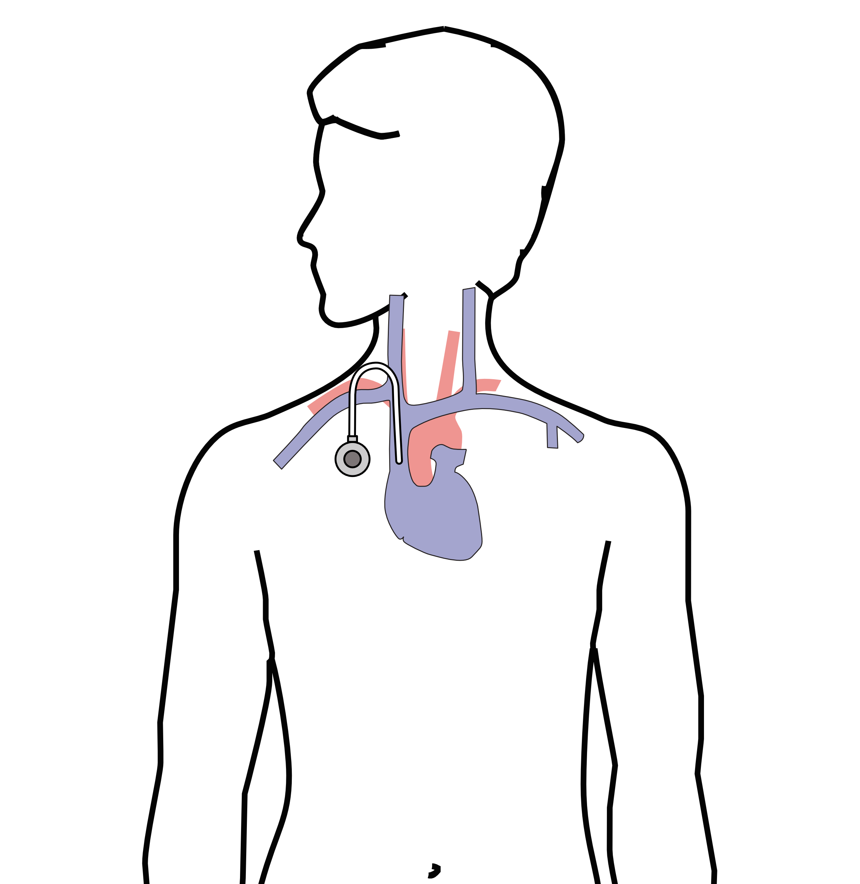
Central Venous Port
Implantable device makes chemo easier
May shower in 24 hrs
No special care at home
OK for FLOT chemo
Allows for blood draws

Slide 47
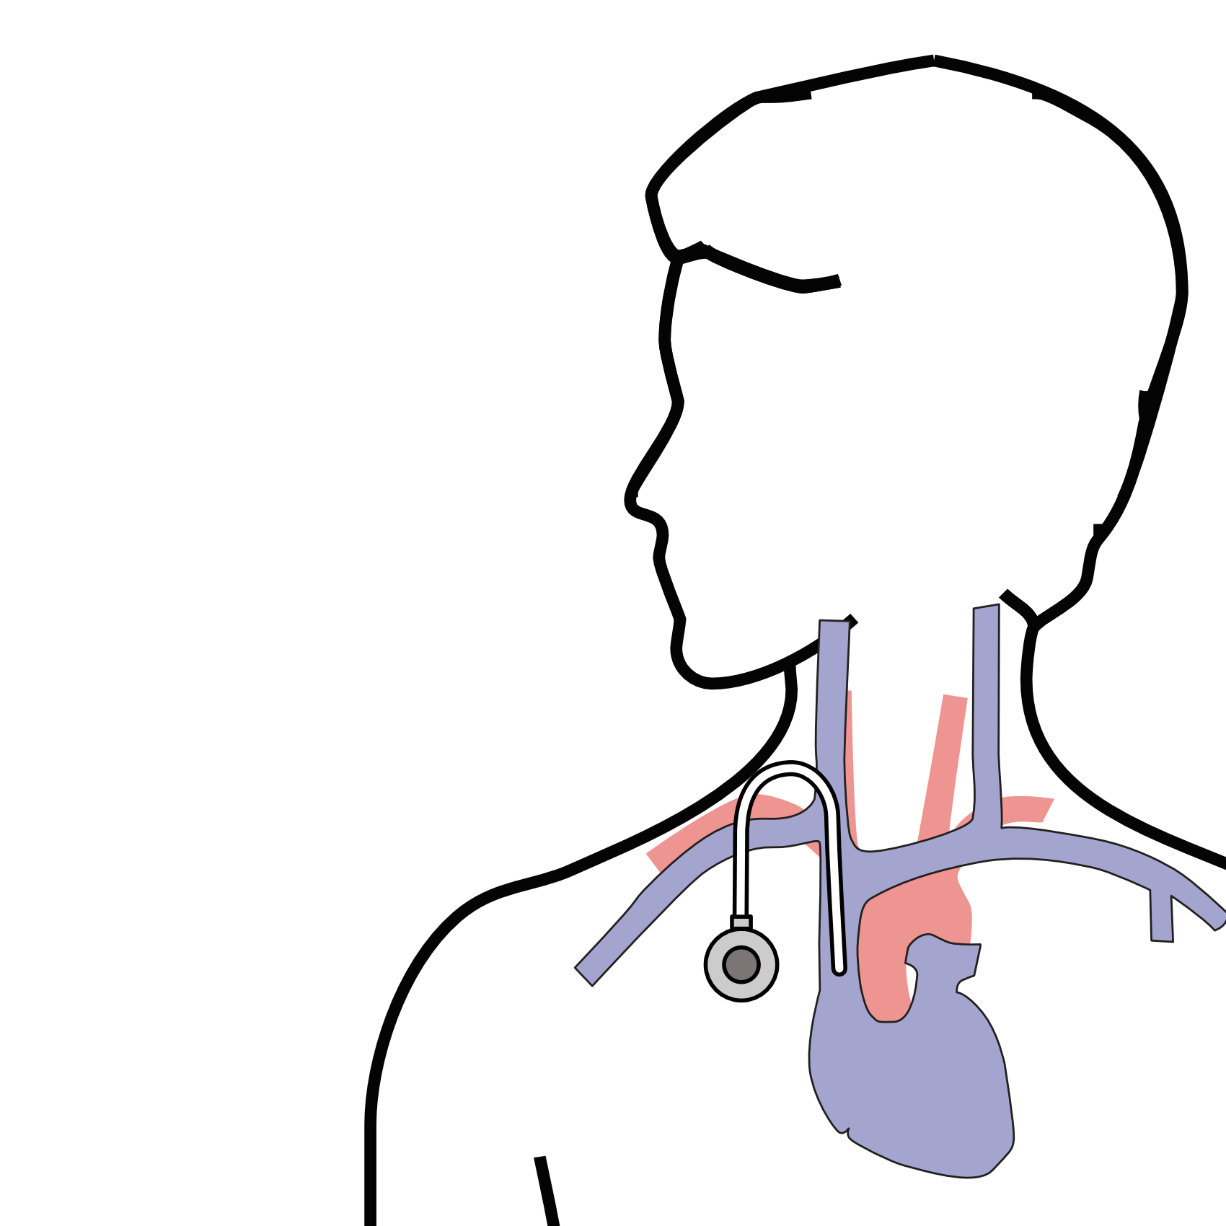
Central Venous Port
Implanted under skin
Neck incision (1/4”)
Incision below the collarbone
Sutures dissolve
“Superglue” on incisions

Slide 48
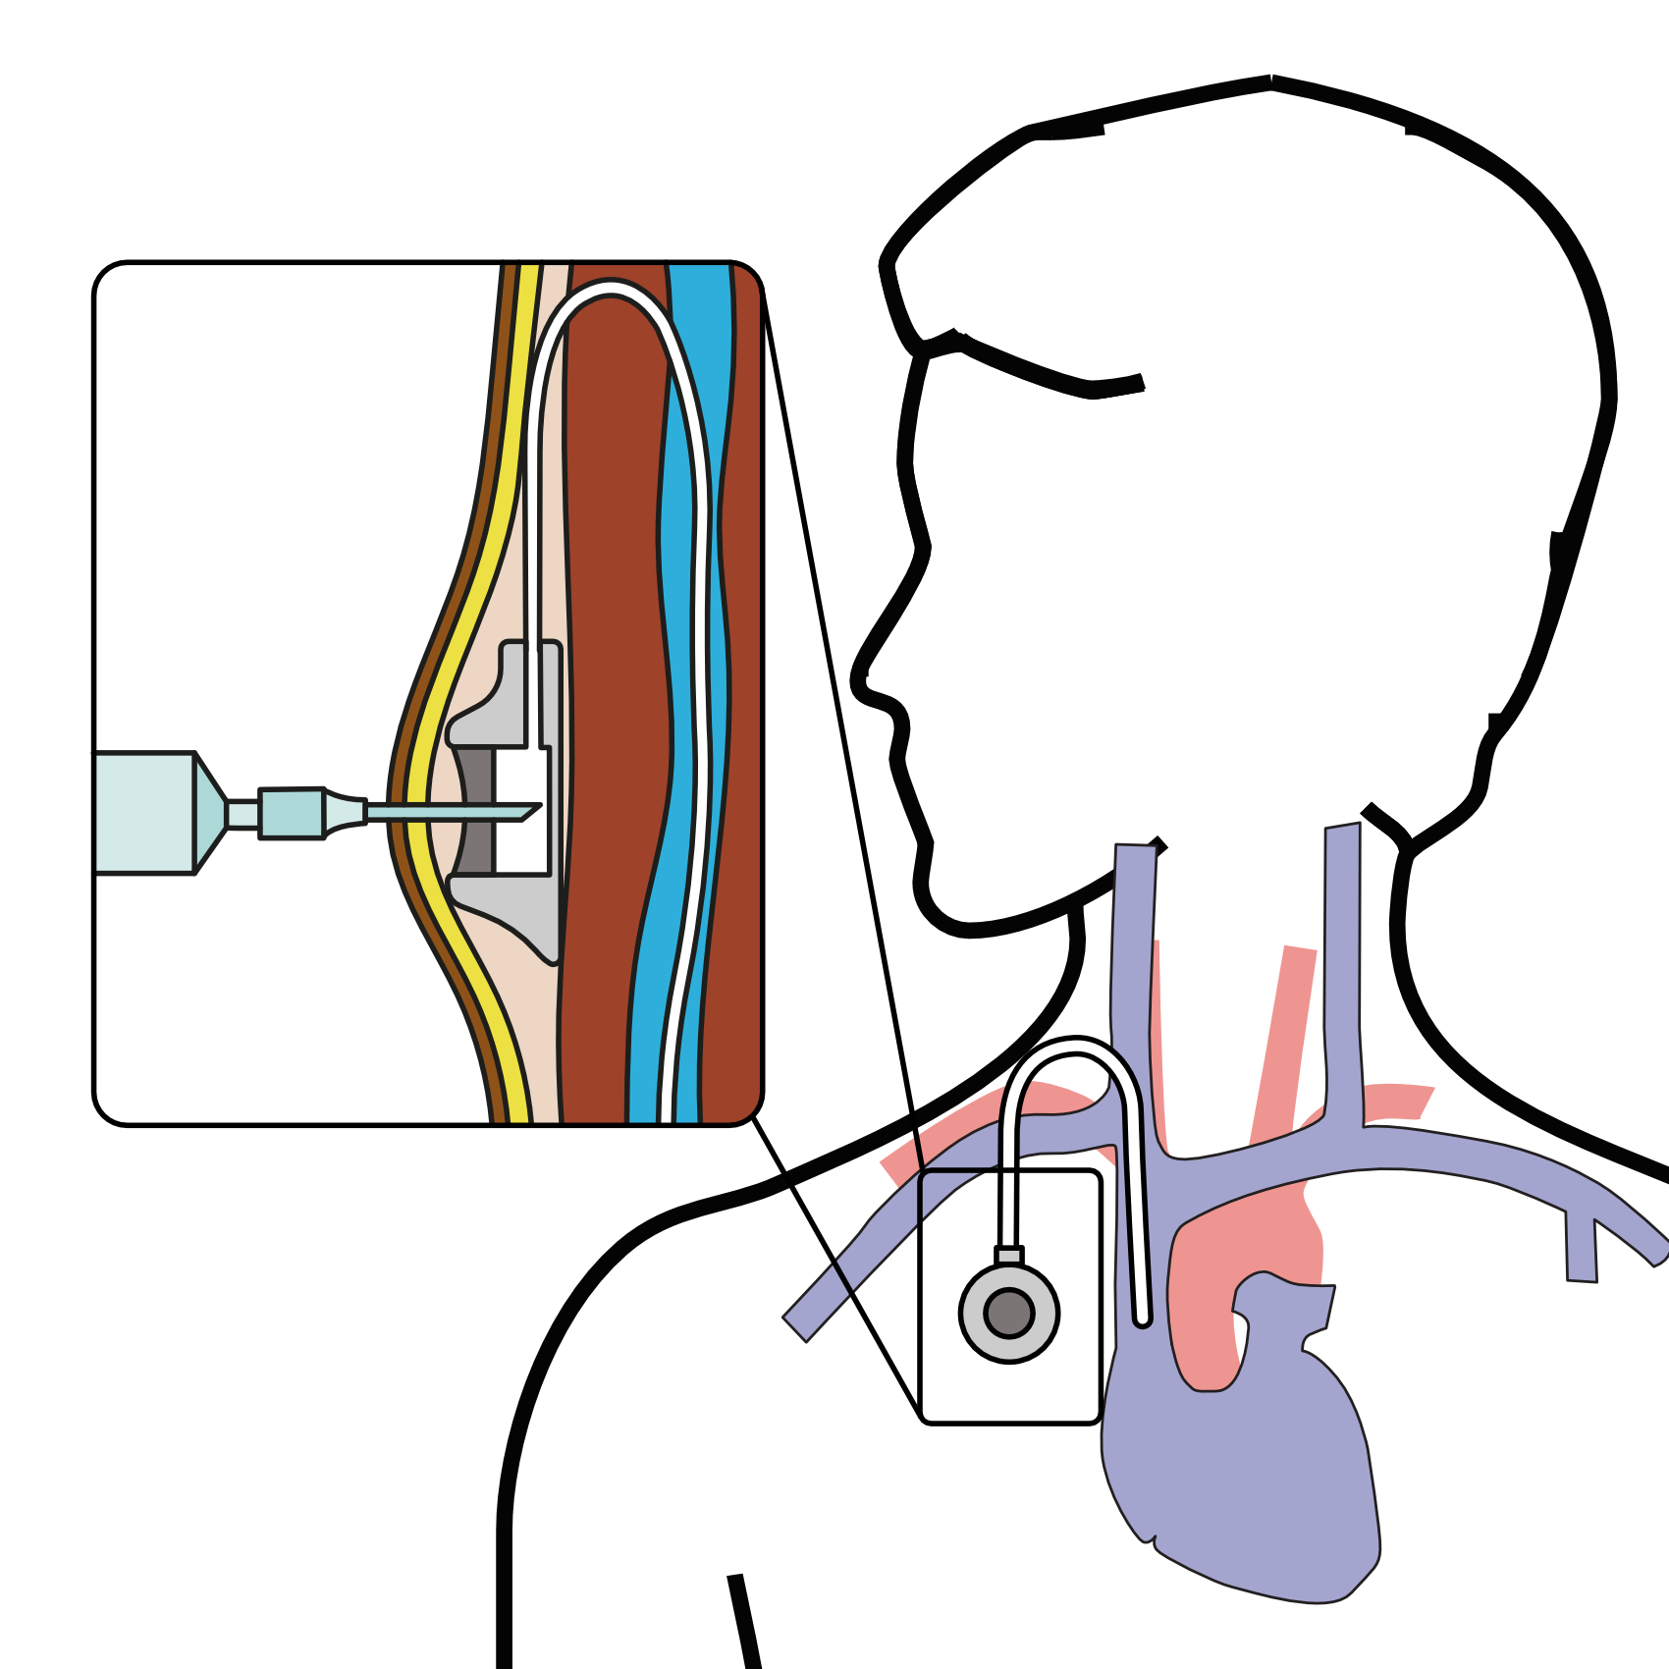
Central Venous Port
When it is time for chemotherapy, a needle is inserted through the skin into the port

Slide 49
Restaging
CT (or PET) scan performed after preoperative therapy
Surgery performed after restaging
Timing depends upon recovery from therapy

Slide 50
Primary Care Practitioner (PCP)
Critical to coordinate care between specialists.
We will update your PCP after each visit
PCP Referral Line (844) 235-6998

Slide 51
My Atrium Patient Portal
Critical to good communication with your care team
Available for desktop or laptop or phone
Sign up at my.atriumhealth.org

Slide 52
Exercise
Reduces risk of complications from treatment
Goal is 30min/day of vigorous exercise 6 days/wk
Working hard enough that you can’t converse
Start slowly and build up
Every day counts! (Aim for daily activity)

Slide 53
Smoking Cessation
Smoking makes cancer treatment more difficult
Increases risk of complications after surgery
Options for help with smoking cessation:
NC Quit Line 1-800-QUIT-NOW (1-800-784-8669)
American Lung Assn www.freedomfromsmoking.org
Smoking Cessation Counseling (Metro Charlotte)

Slide 54
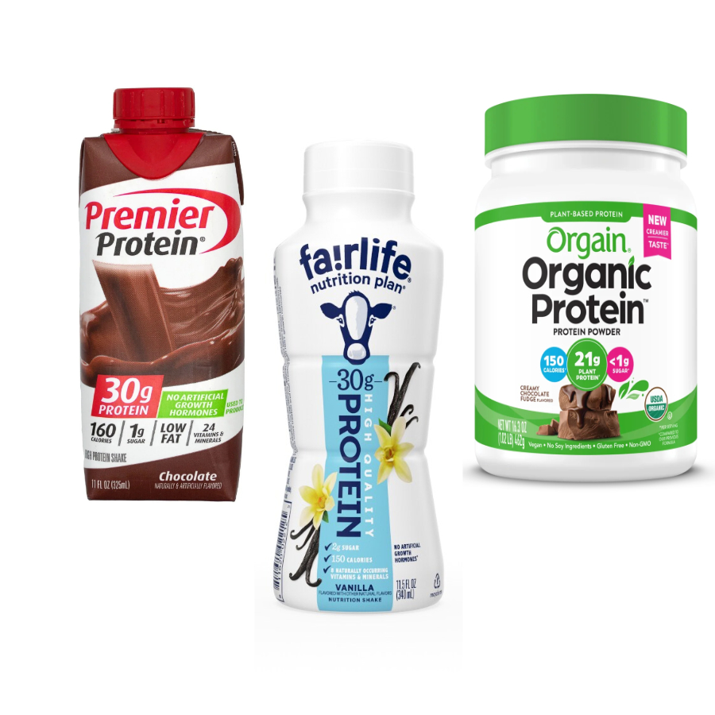
Protein Needs
Men: Average 75 grams/day
Women: Average 60 grams/day
Protein Shakes provide protein with minimal sugar

Slide 55
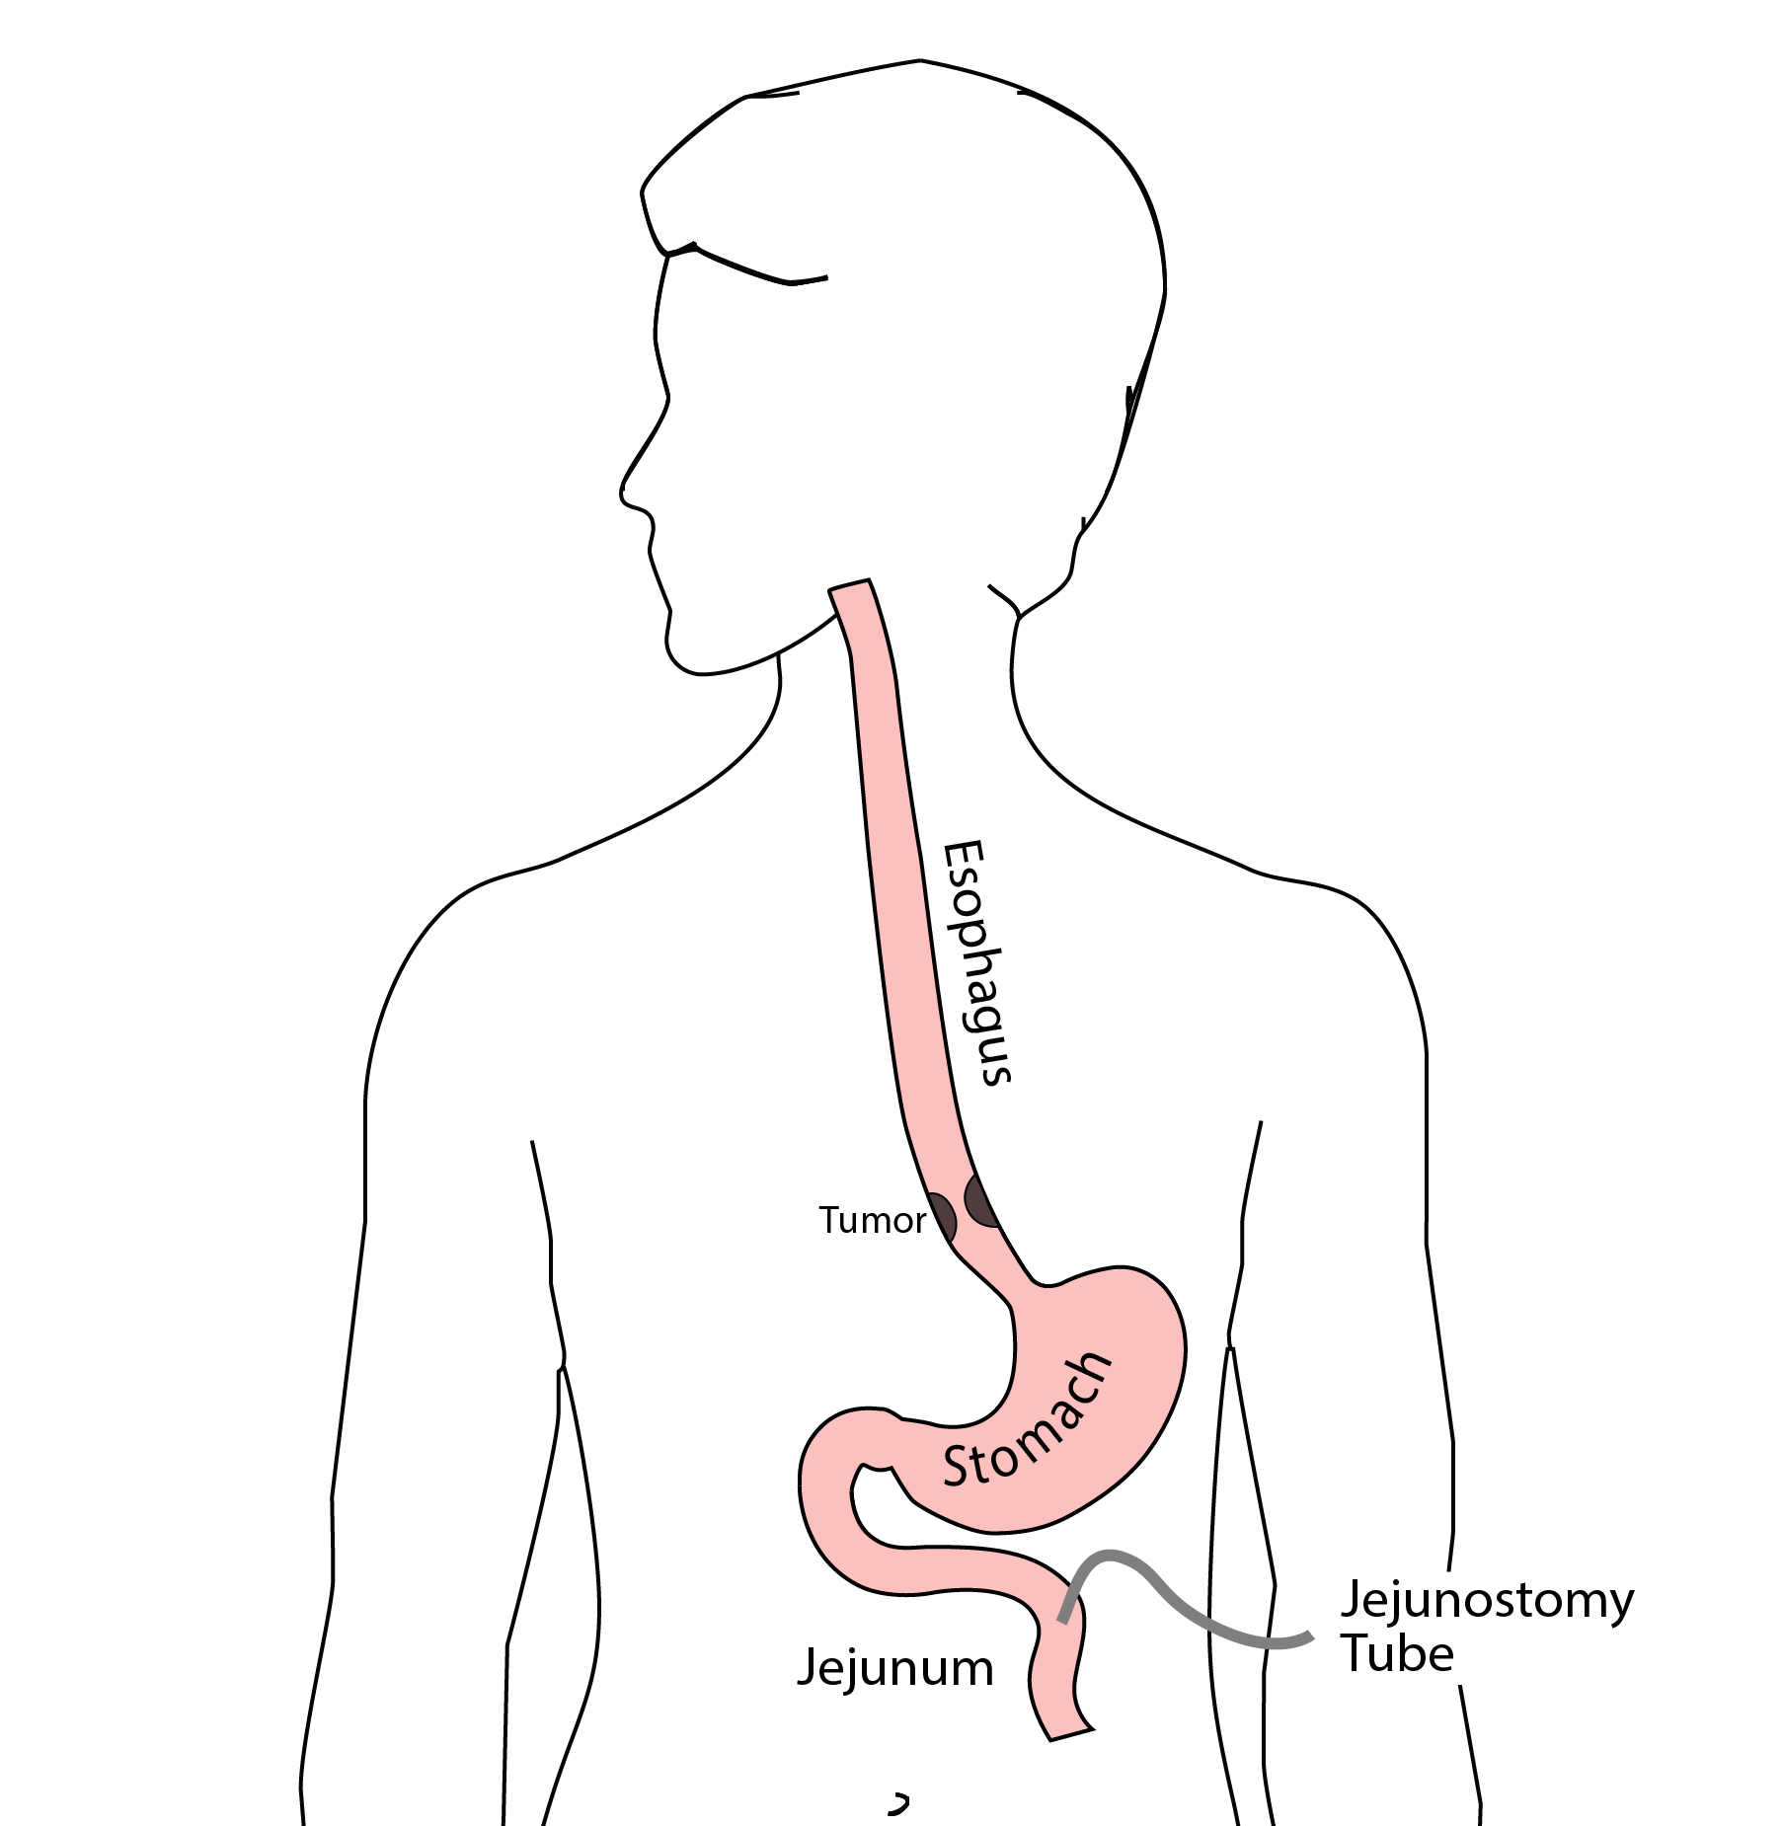
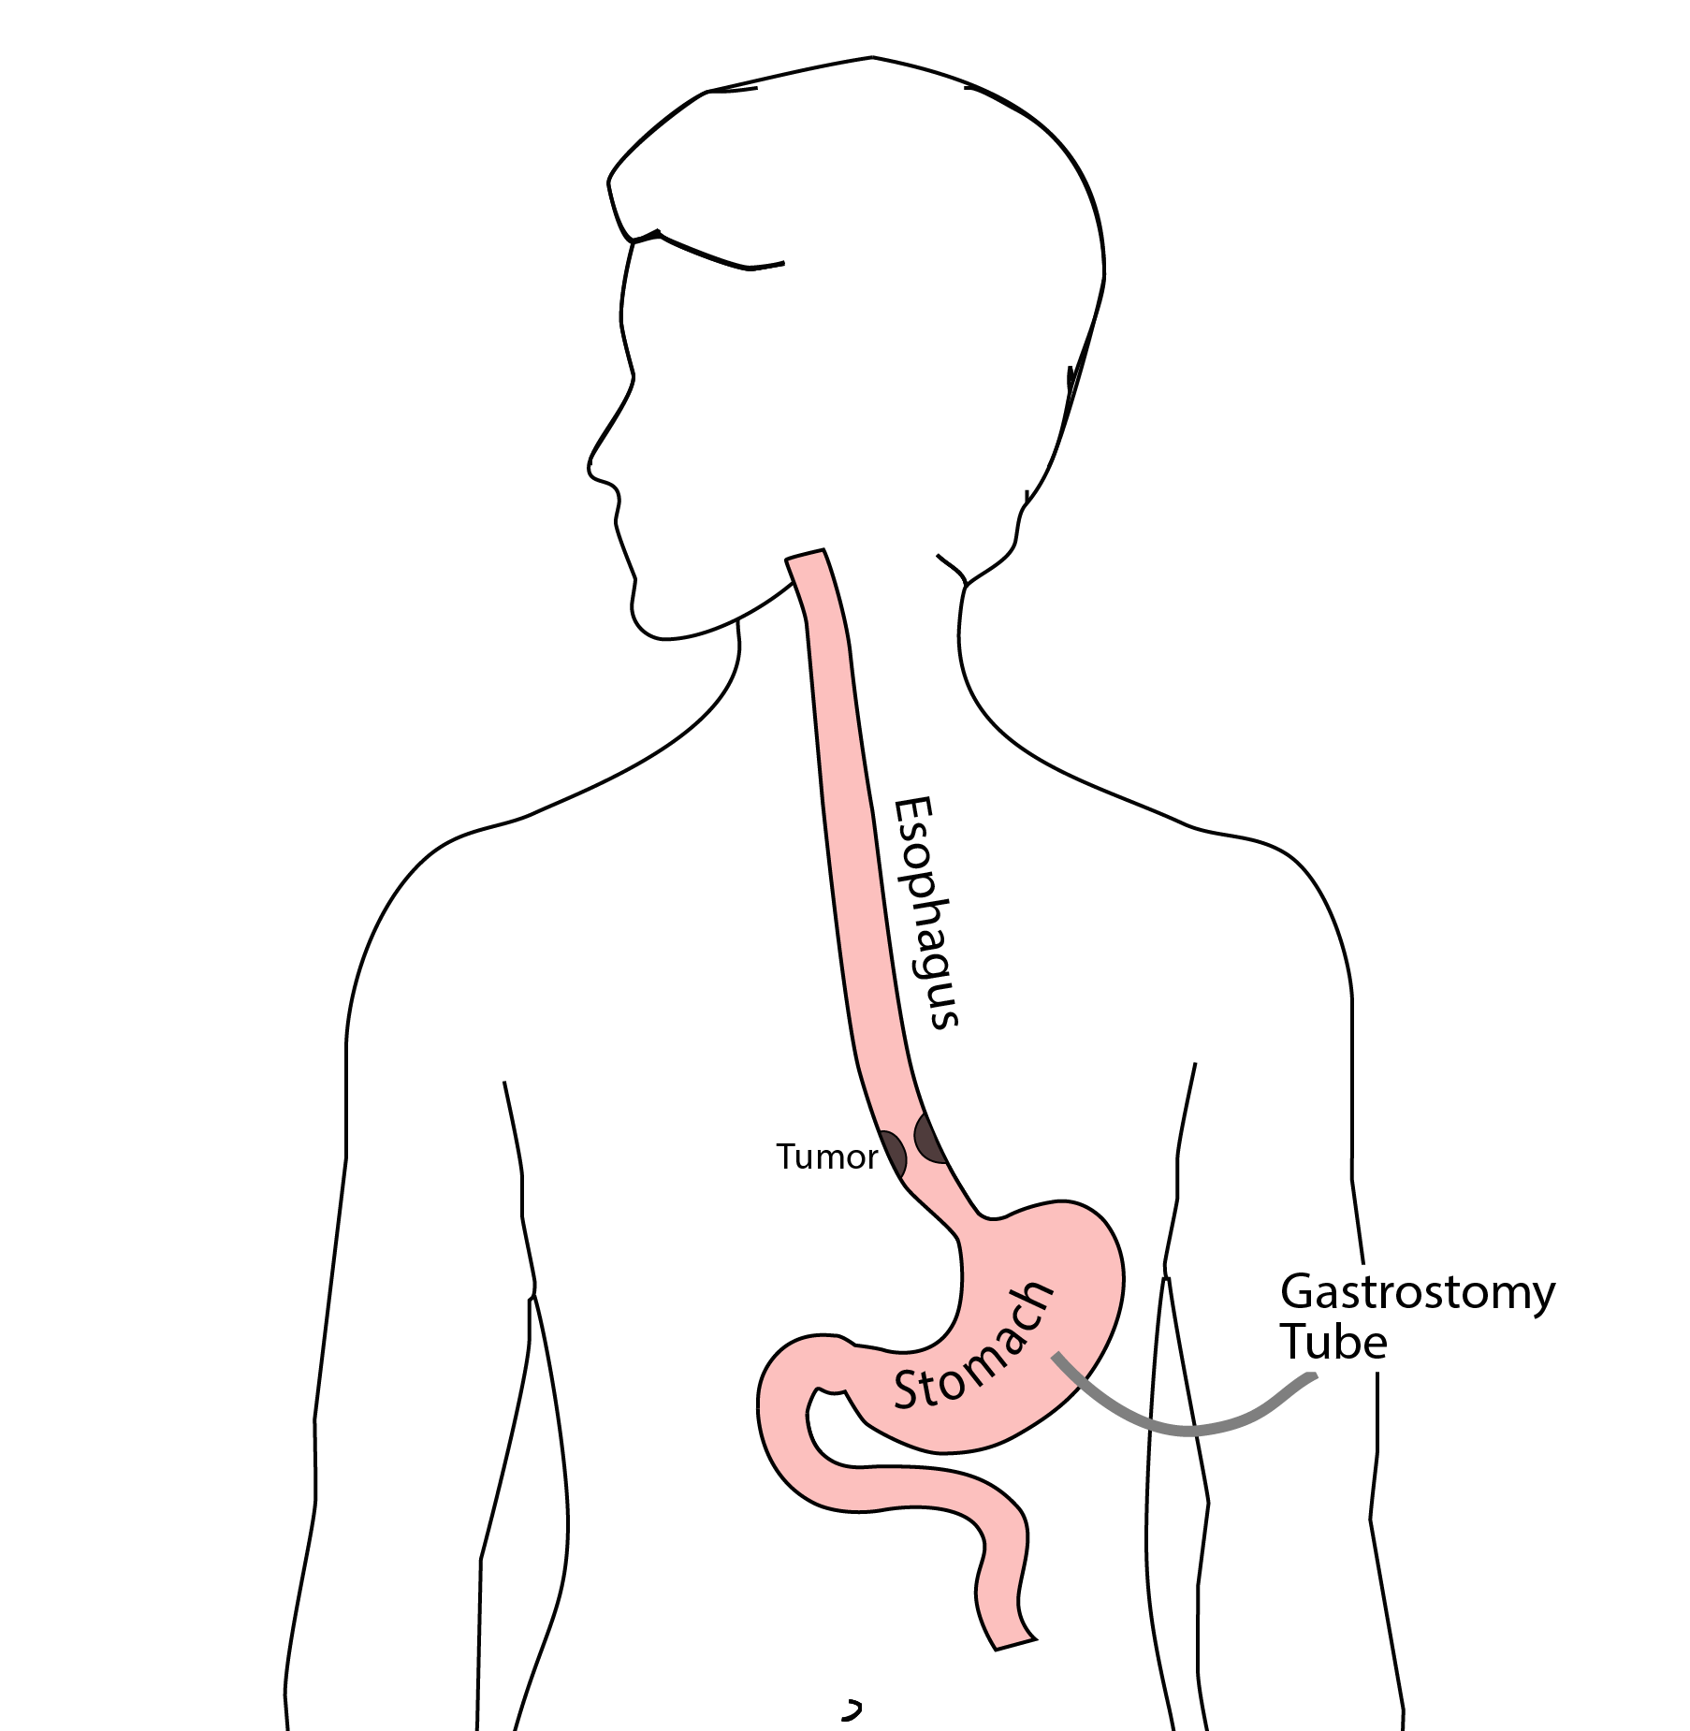
Feeding Tubes

Slide 56
Gastrostomy Tube
Feeding Gastrostomy
Feeding with a syringe several times per day.
Tube can be hidden underneath clothing
Tube does not interfere with eating by mouth
Removed easily in the office when no longer needed

Slide 57
Gastrostomy Tube Methods
PEG: Tube placed by endoscopy
Laparoscopic: Tube placed surgically by laparoscopy
Preferred method depends upon whether esophagectomy is planned

Slide 58
Gastrostomy Tube
Outpatient Placement (go home the same day)
Central venous port can be placed at the same time (if needed)

Slide 59
Jejunostomy Tube
Nutrition to bypasses the esophagus and stomach
Placed in small intestine
Pump administers feedings slowly
Feeding done at night

Slide 60
Jejunostomy Typical Regimen
Jejunostomy tube feeds for 16 hours (6pm-10am)
Men: 75mL/hour x 16 hours = 5 cartons
Women: 60mL/hour x 16 hours = 4 cartons
Water 240ml (8oz) via syringe 4x/day
Hospital nurses will teach use of the feeding tube

Slide 61
Jejunostomy Feeds with Diabetes
Jejunostomy feedings elevate blood sugars
Insulin may be required along with feeds
Typical Pattern for tube feeds
Feeds run via pump from 6pm to 10am
Insulin at 6pm (70/30 insulin)
Insulin at Midnight (70/30 insulin)
No insulin if tube feedings are not run

Slide 62
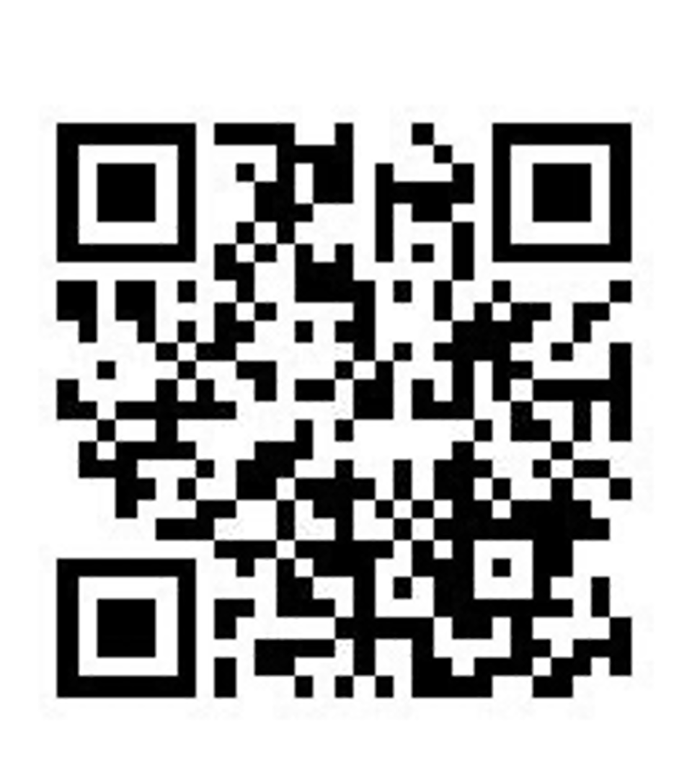
Jejunostomy Video
A video is available to help become familiar with the feeding jejunostomy

Slide 63
Surgery for Esophageal Cancer
Surgery for esophageal cancer is performed for:
Superficial Tumors (T1) not removed by endoscopy
Localized Tumors (T2 N0 M0)
Locally Advanced (T3 M0) after preop therapy

Slide 64
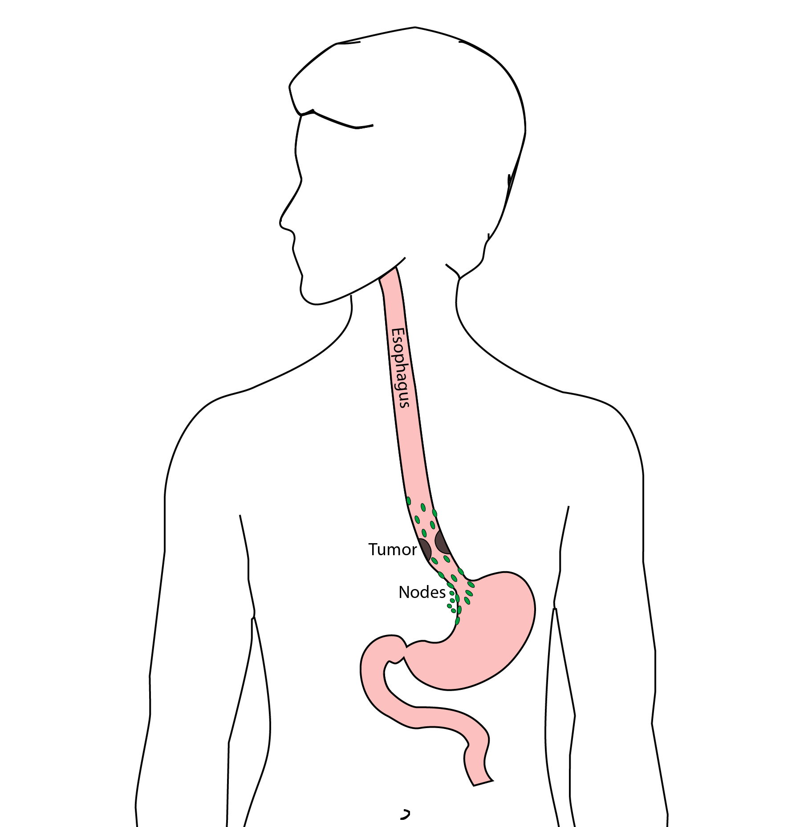
Goals of Surgery
Remove tumor from esophagus
Remove surrounding lymph nodes
Create a new esophagus

Slide 65
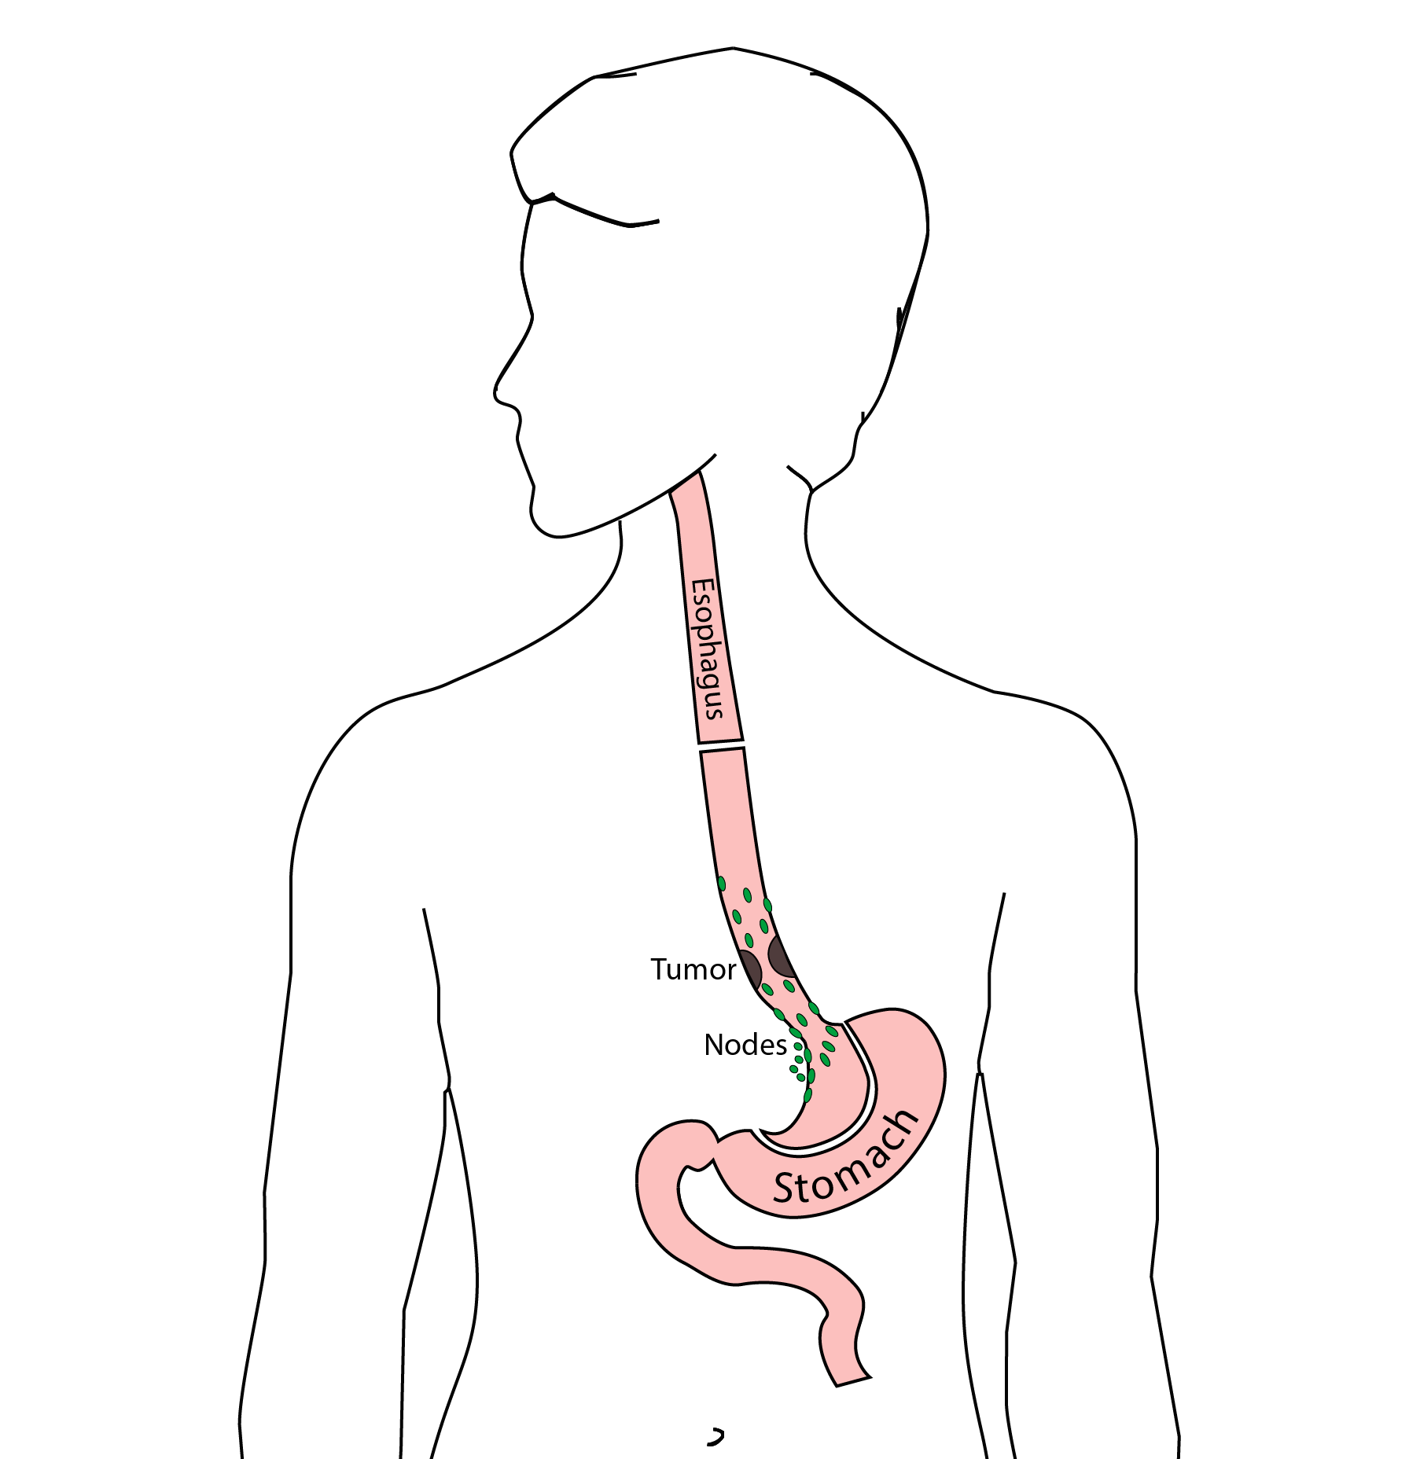
Ivor Lewis (Transthoracic) Esophagectomy
Removes tumor and lower 1/3 esophagus
Removes surrounding lymph nodes
GI tract reconstructed

Slide 66
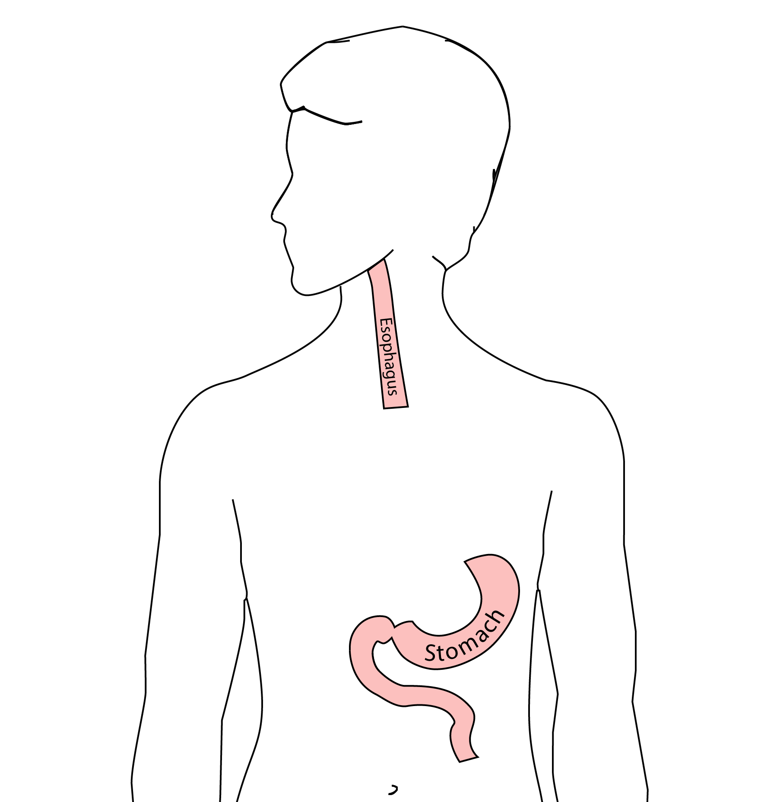
Reconstruction
New esophagus is created from the stomach in the abdomen by fashioning it into a tube.

Slide 67
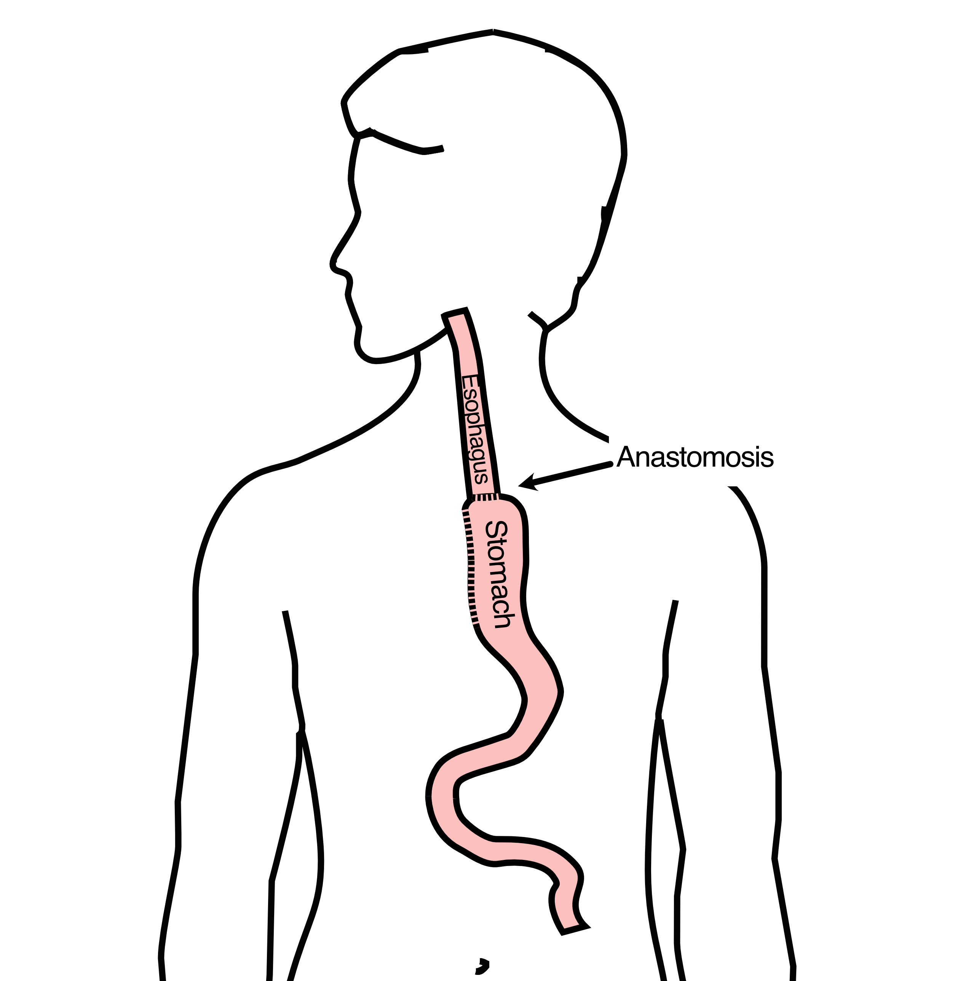
Ivor Lewis esophagectomy
The new esophagus is now brought up into the chest. A connection is made between the esophagus and the stomach, called an anastomosis.

Slide 68
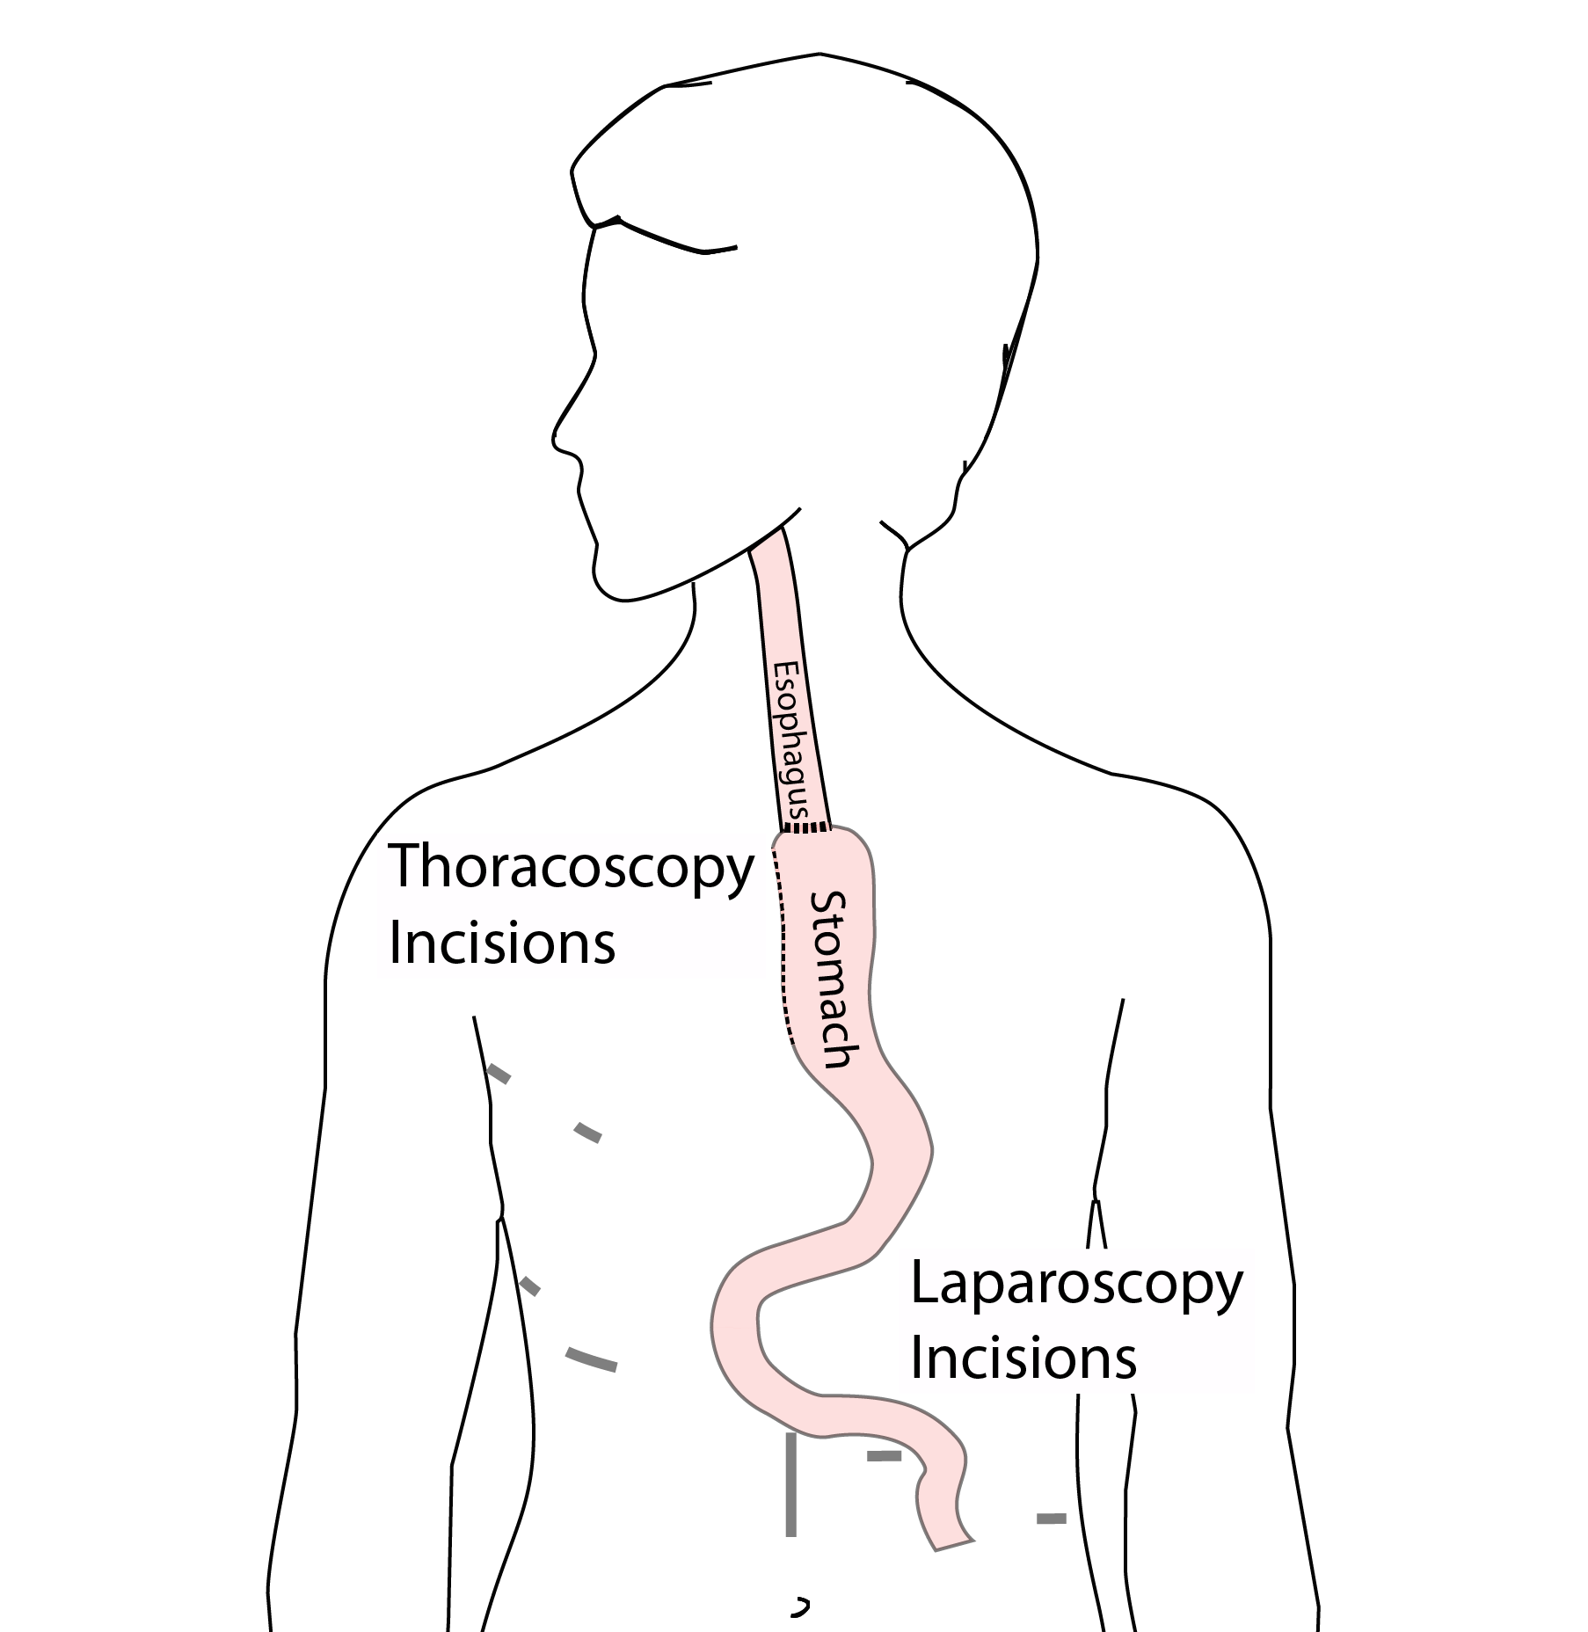
Minimally-invasive Ivor Lewis
Small incisions abdomen and chest
Surgical telescope and instruments
Smaller incisions $→$ faster recovery and less discomfort

Slide 69
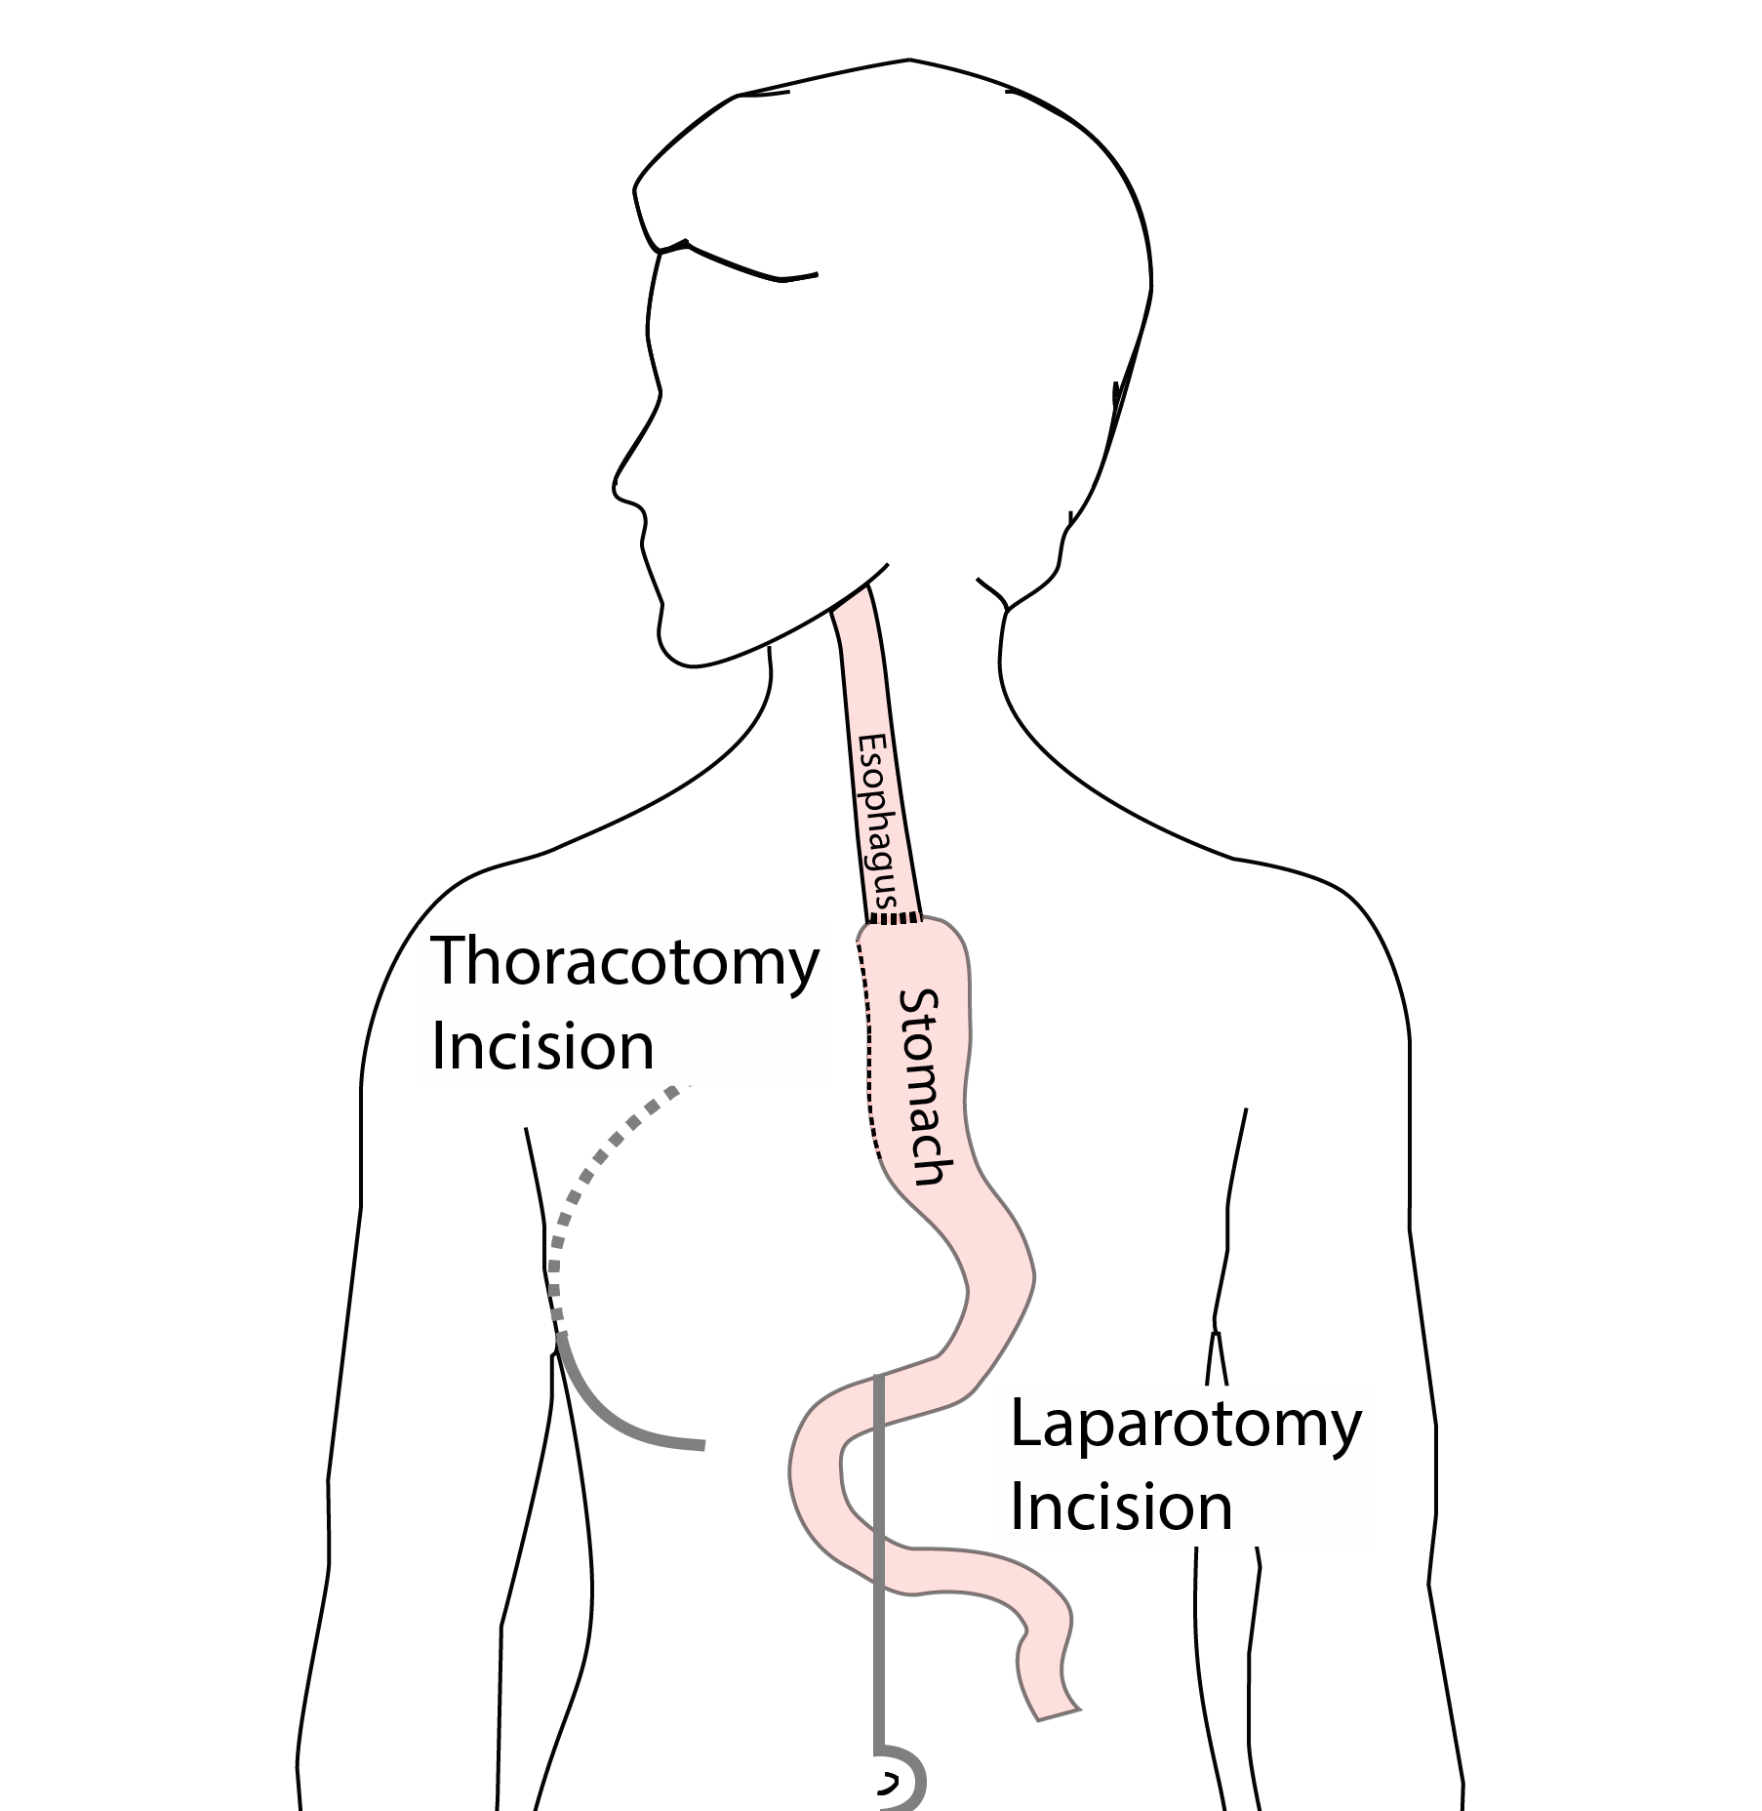
Open Ivor Lewis
Mininally-invasive approach feasible in 95% of cases
In some cases, an open approach is still necessary.

Slide 70
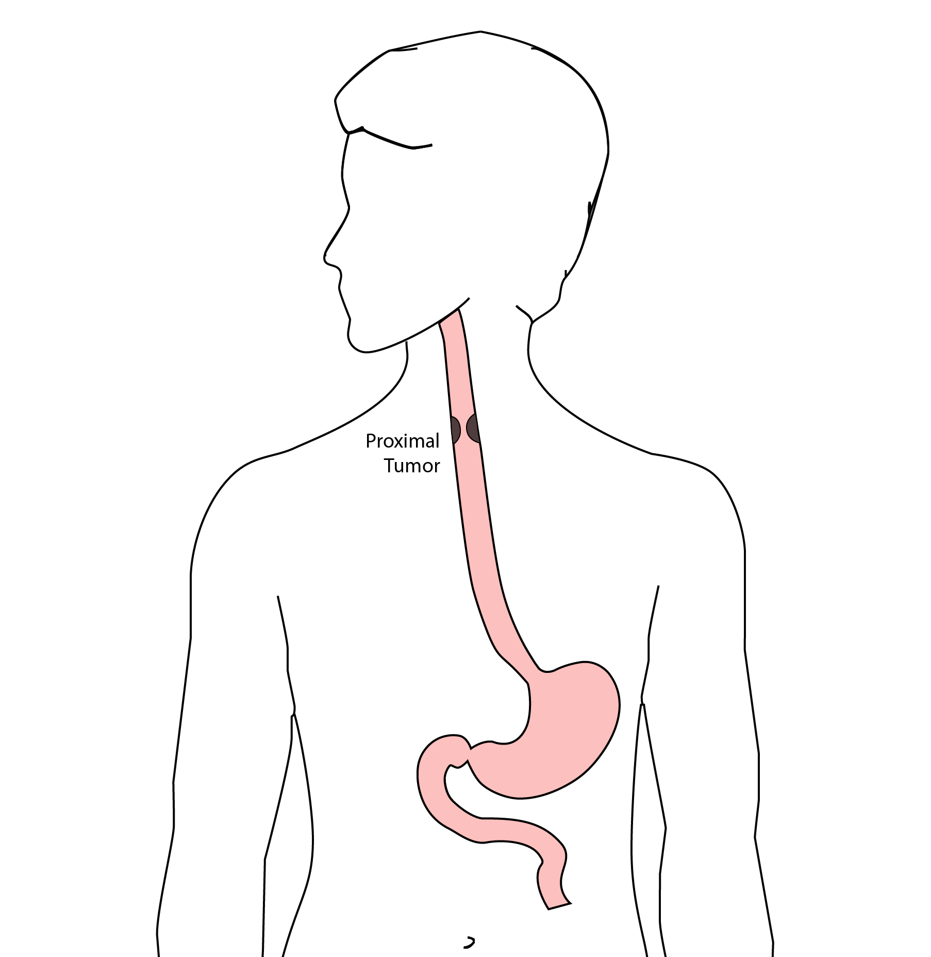
Total Esophagectomy
For patients with tumors in the upper esophagus, we need to remove more of the esophagus
We need to remove the whole esophagus, including the portion in the neck

Slide 71
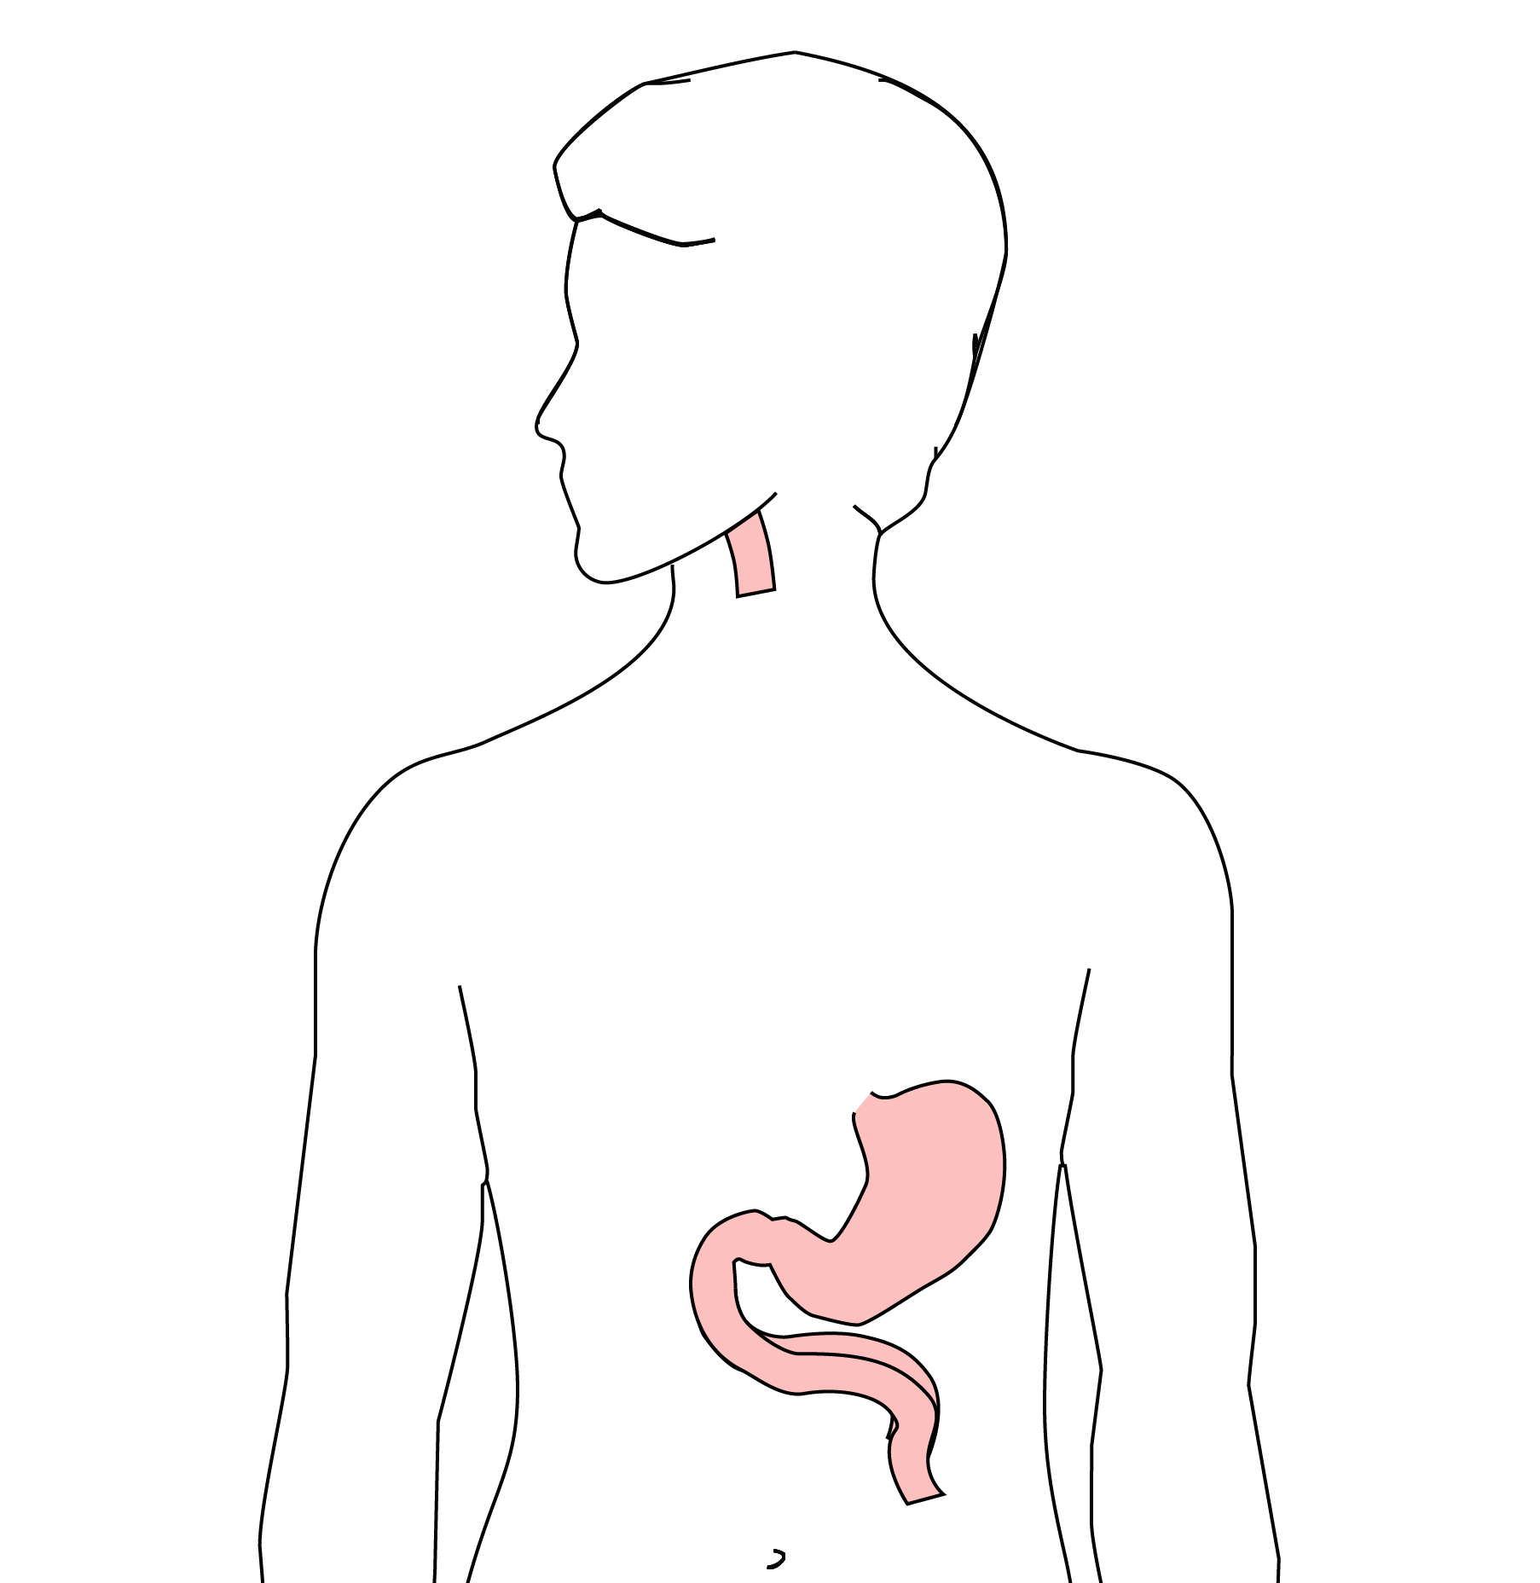
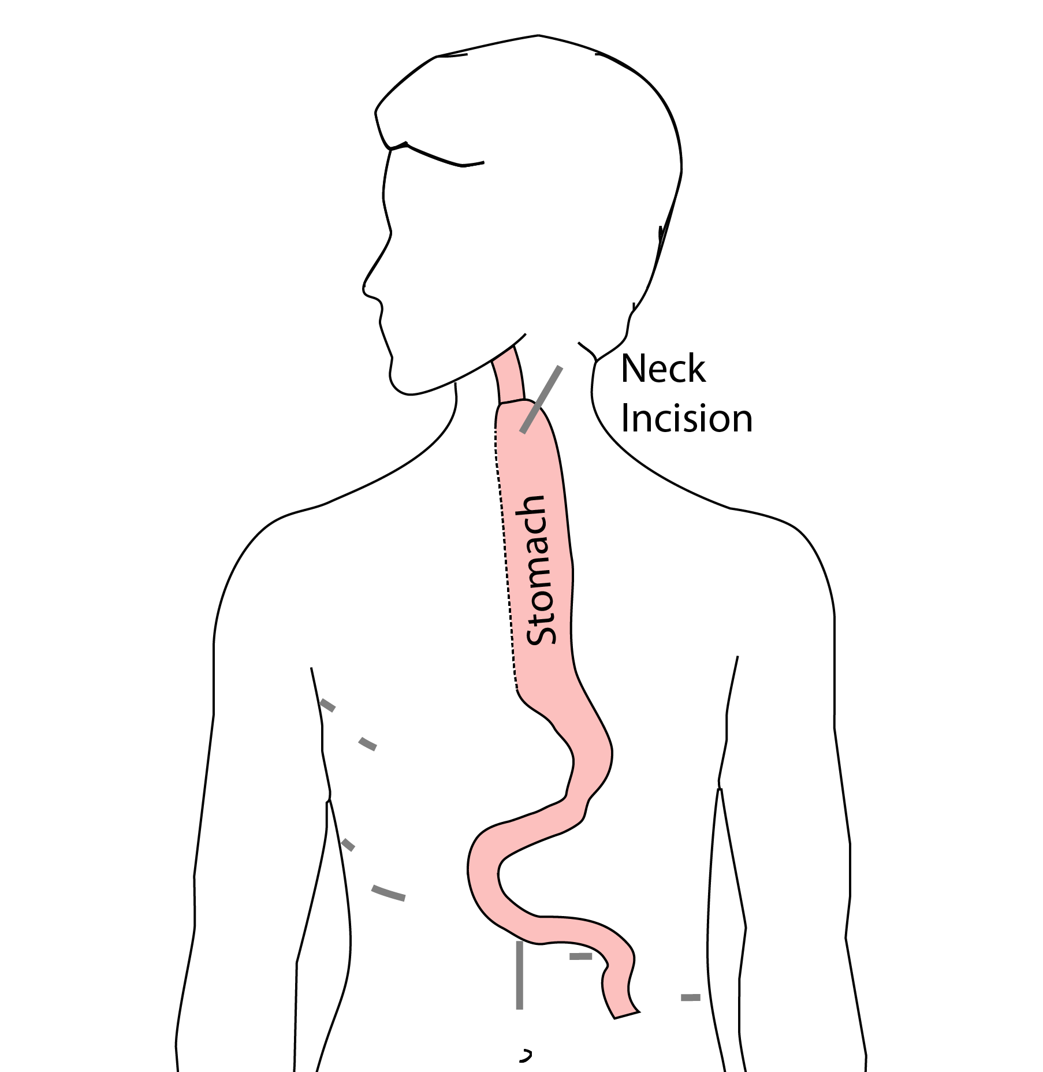
McKeown Esophagectomy

Slide 72
Risks of Esophagectomy
Esophagectomy is a complex operation, with a real risk of complications.
Two significant complications:
Anastomotic leak
Pneumonia

Slide 73
Anastomotic Leak
The anastomosis is surgical connection between the esophagus and the stomach.

Slide 74
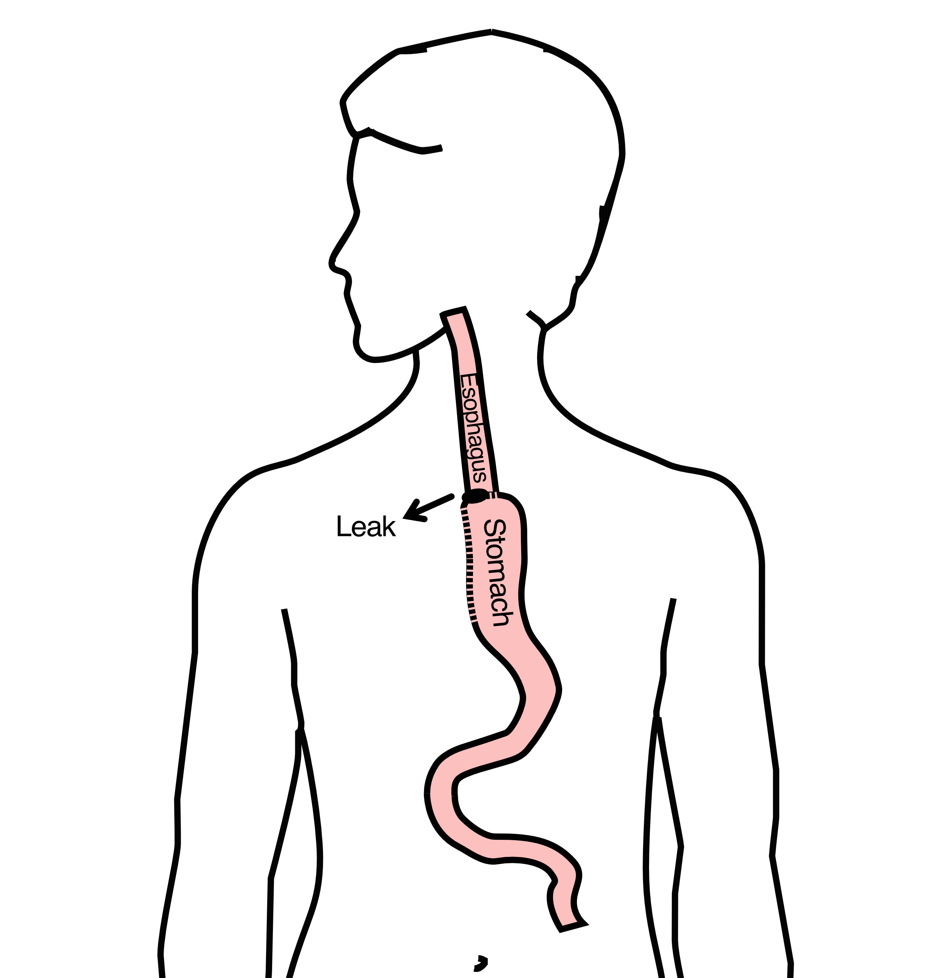
Anastomotic Leak
If healing doesn’t occur:
Leakage of fluid from the esophagus
Infection in the space between the lungs
Requires additional time in the hospital

Slide 75
Anastomotic Leak
If leak occurs:
Some leaks will seal
Stent may be required to help healing
Occasionally additional surgey is required

Slide 76
Anastomotic Leak
Risk of leak depends on:
Type of operation performed
Nutritional status of patient
Experience of the surgeon

Slide 77
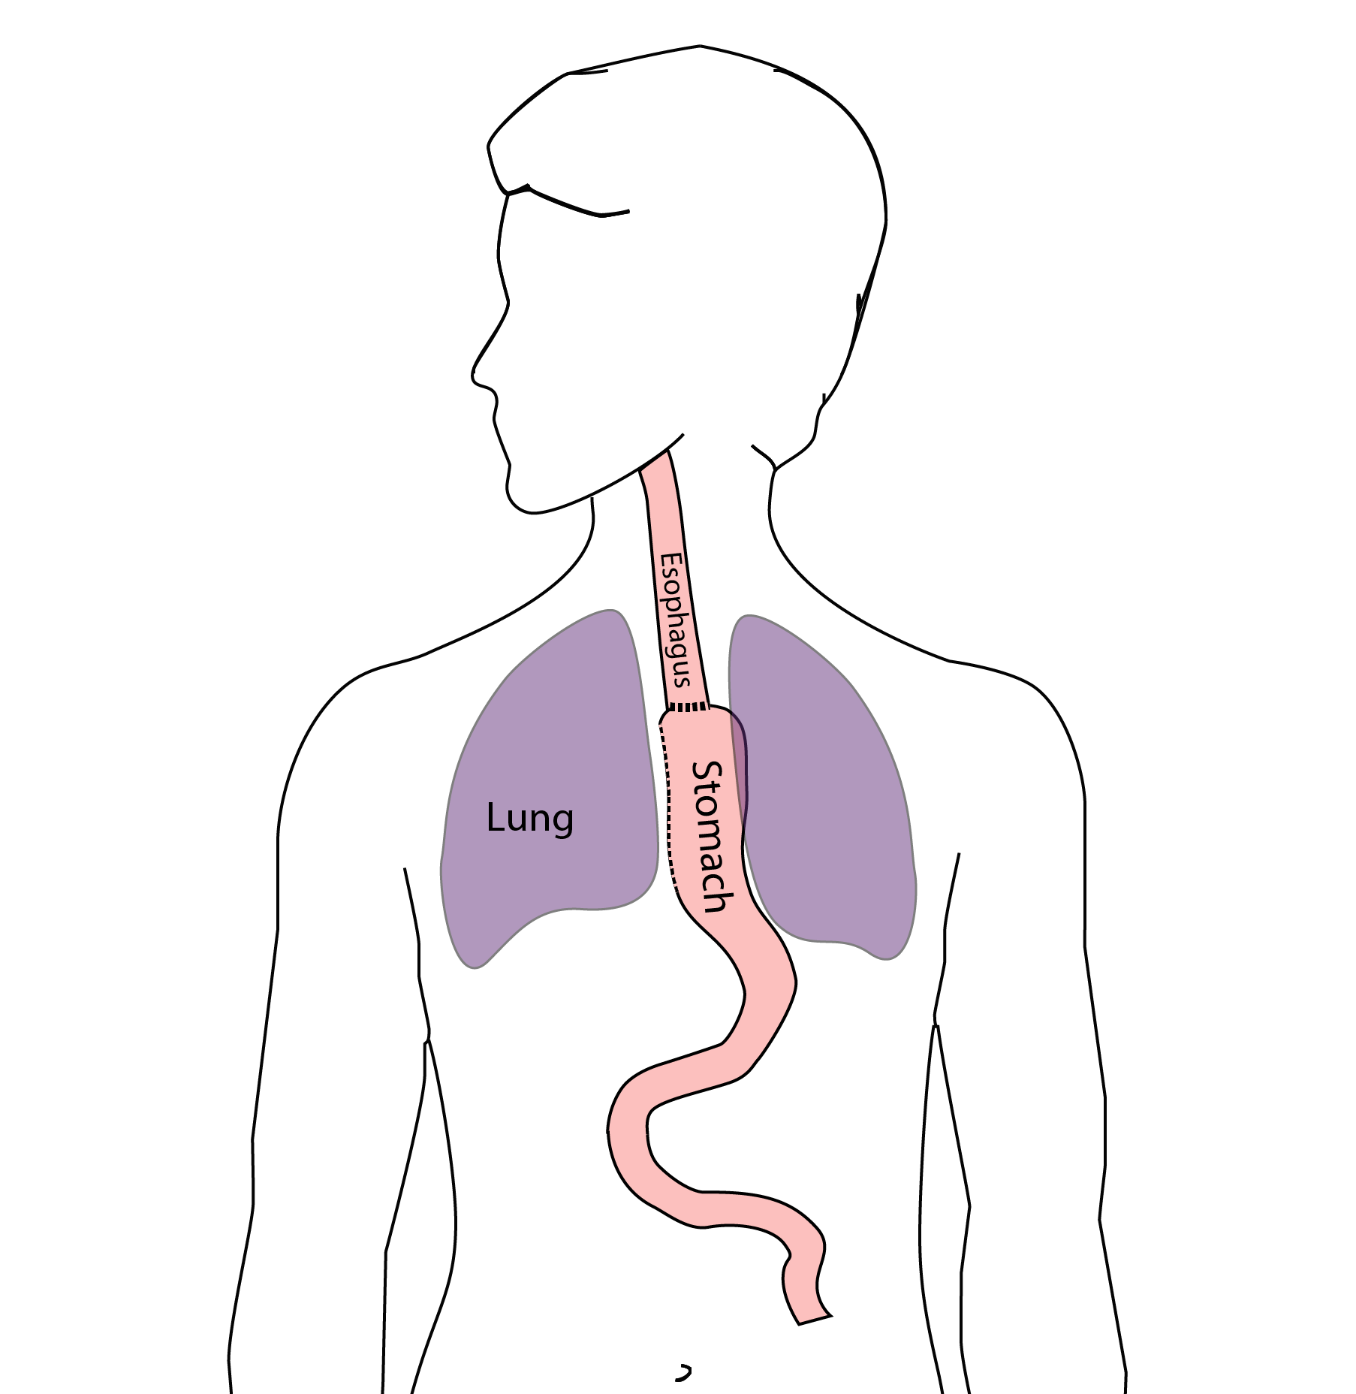
Pneumonia
Occurs in 10-15% of patients after esophagectomy.
Requires treatment with antibiotics
Requires a longer hospitalization.

Slide 78
Preventing Pneumonia
Several ways to help prevent pneumonia:
Deep breathing
Coughing
Walking
After surgery, this means:
Sitting in a chair most of the day
Walking in the halls as soon as possible

Slide 79
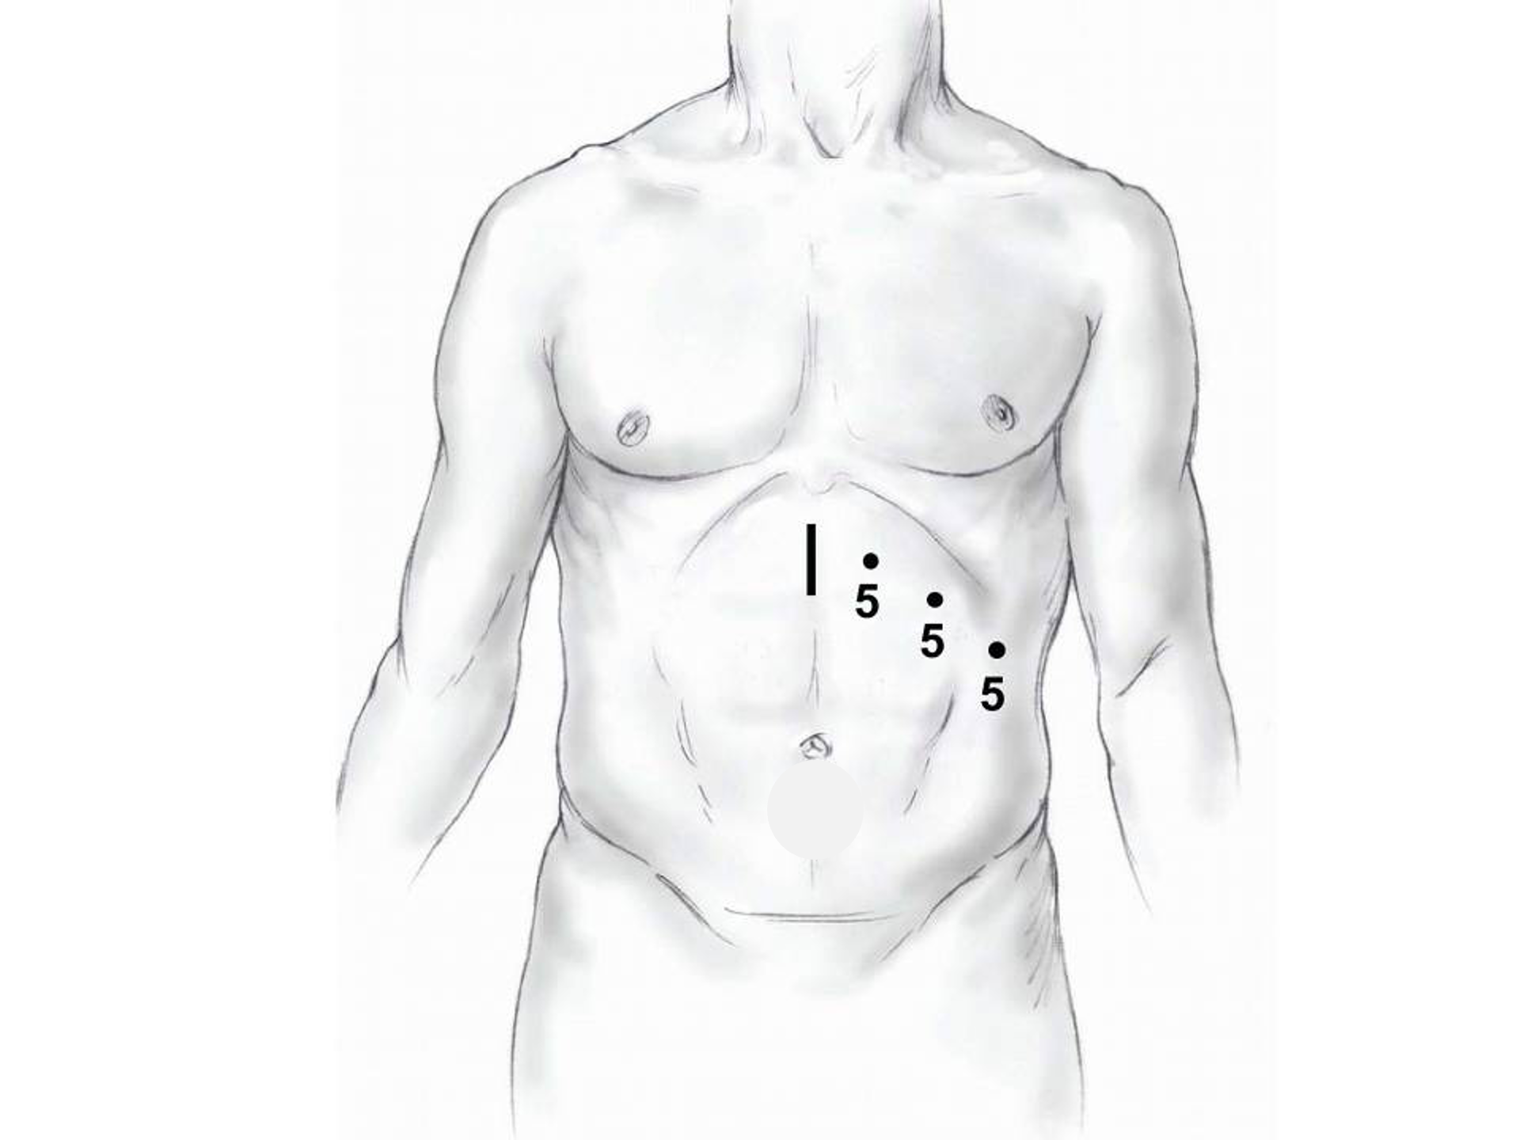
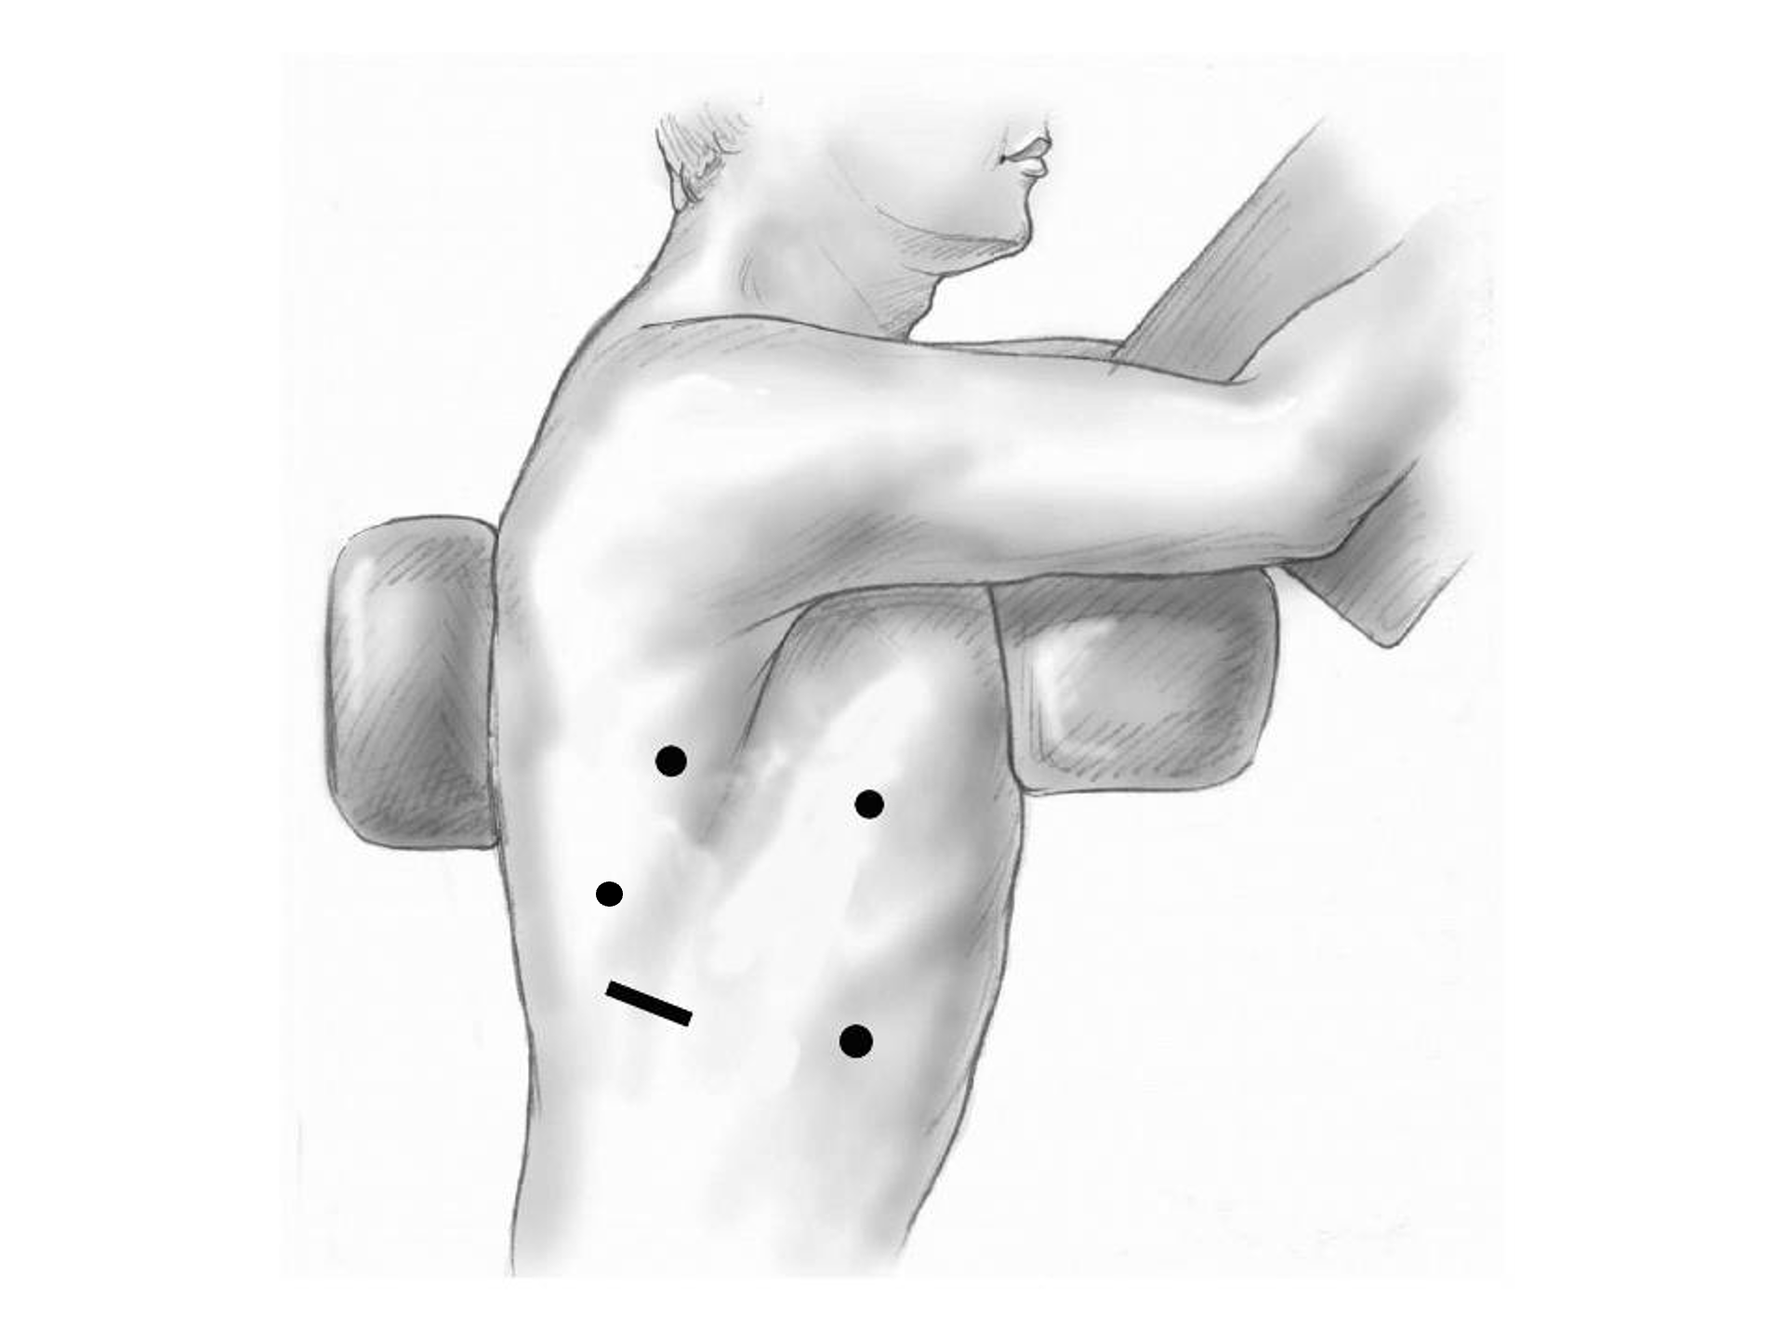
Minimally-invasive Esophagectomy

Slide 80
Risks of Surgery
Risks related to anesthesia
Heart attack (5%)
Irregular heart rhythm (15%)
Pneumonia (10%)
Blood clots in legs (<5%)
Pulmonary embolism (2%)

Slide 81
Risks of Surgery
Risks related to Surgery
Anastomotic leak (5%)
Stricture at anastomosis (15%)
Death within 90 days of surgery
Low risk patients = 2%
Intermediate risk = 10%
High risk = 30%

Slide 82
Risks of Surgery
 | Age <75 | Age >75
Normal Muscle (75%) | 2% | 10%
Low Muscle (25%) | 10% | 30%
Risks of Death within 90 Days of Surgery

Slide 83
Day Prior to Surgery
Clear liquids for 24 hours prior to surgery
Check with Pre-op nurse regarding medicines day prior to surgery
No tube feedings the night before surgery

Slide 84
Day of Surgery
Arrive at 5am – nothing to eat or drink after midnight.
Medicines OK w/ a sip of water
sip of black coffee but no cream.
Surgery will be cancelled if you have cream/milk
Waiting room for family and friends on 5th floor

Slide 85
Epidural Catheter for Pain Control
Remains in place for 2-5 days
Dosage can be adjusted as needed
Can make it more difficult to urinate
May require foley catheter in bladder
Foley catheter removed after epidural removed

Slide 86
Intensive Care Unit (ICU) (2-4 days)
Surgical ICU on 11th floor
NG tube in nose to drain stomach and esophagus
Catheter in bladder
Chest tube right chest
Abdominal drains (usually 2)
Feeding jejunostomy (usually stays in 8 wks)

Slide 87
Intensive Care Unit (ICU)
Bladder catheter removed → check that bladder empties properly
Chest tube removed (day 2-4) → follow-up x-ray
Fluid emptied from drains every few hours
Start tube feedings by feeding
Feeding jejunostomy (stays in 8 weeks)

Slide 88
Ward - 6Tower
Jejunostomy feeds started
Up in a chair most of the day
Walking in the halls
Start with assistance
Improves lung function
Prevents loss of muscle strength

Slide 89
Jejunostomy Feeds
Jejunostomy tube feeds
Start continuous (24 hours)
Convert to night-time only (16 hours)
Water administered through feeding tube
Usually 8oz 4 times/day
Important to prevent dehydration

Slide 90
Jejunostomy Tube
Nutrition to bypasses the esophagus and stomach
Placed in small intestine
Pump administers feedings slowly
Feeding done at night

Slide 91
Jejunostomy Typical Regimen
Jejunostomy tube feeds for 16 hours (6pm-10am)
Men: 75mL/hour x 16 hours = 5 cartons
Women: 60mL/hour x 16 hours = 4 cartons
Water 240ml (8oz) via syringe 4x/day
Hospital nurses will teach use of the feeding tube

Slide 92
Jejunostomy Feeds with Diabetes
Jejunostomy feedings elevate blood sugars
Insulin may be required along with feeds
Typical Pattern for tube feeds
Feeds run via pump from 6pm to 10am
Insulin at 6pm (70/30 insulin)
Insulin at Midnight (70/30 insulin)
No insulin if tube feedings are not run

Slide 93
Jejunostomy Video
A video is available to help become familiar with the feeding jejunostomy

Slide 94
Activity after Surgery
Up in chair most of the day
Walking with help from nurse/Physical Therapist
Goals:
Improve lung function
Prevent muscle loss

Slide 95
Nasogastric (NG) Tube
Tube passed through nose into stomach
Drains fluid from stomach
Prevents vomiting
Upper GI X-ray on 2nd or 3rd day after surgery
If stomach empties well $→$ NG tube removed
Otherwise, X-ray repeated 2-3 days later

Slide 96
Swallowing Evaluation
Once NG tube has been removed:
Modified barium swallow in radiology
Drink a white chalky liquid (barium)
Look for proper swallowing function
70% of patients $⇒$ liquids started by mouth

Slide 97
Oral Intake at Home
Most are taking protein shakes when they go home
Protein shakes are started after tolerating water
2 oz per hour to start
4 oz per hour if 2oz are tolerated well

Slide 98
Discharge
Goal: ready to leave day #6/7 after surgery
Night-time tube feedings (6pm to 10am)
Nutrition by mouth (70% of patients)
1 oz of water per hour by mouth OR
Protein shakes 4oz every 2 hours
Water through tube 8oz four times per day
Home care nursing (feeding tube teaching)
Home infusion (tube feeding supplies)

Slide 99
Nutrition after Surgery
At discharge home:
Protein shakes 4oz every 2 hrs
Tube feeds 4-5 cans at night (6pm-10am)
10-12 Days: Increase protein shakes
Tube feeds 3-4 cans at night
Three weeks: Post-esophagectomy Diet
8-12 weeks: Remove feeding tube (in office)

Slide 100
Transition from Tube Feeds $→$ Eating
Dietitian will calculate daily protein goal
Typically 60-75 grams protein/day
Each carton of tube feeding has 15 grams
75 grams protein = 5 cartons/night
More intake by mouth $→$ tube feeds reduced
Spread out protein during the day (20gm/meal)
Three meals + 2-3 high-protein snacks

Slide 101
Post-esophagectomy Diet
Soft Consistency
High Protein
Avoid sugary liquids (can cause ‘dumping’)
Avoid raw vegetables (and salads)
Eating
Small, frequent meals
Sit up for 30-45 minutes after eating
Avoid eating within 2 hours of bedtime

Slide 102
Medicines at Home - Pain
Acetaminophen (Tylenol) 1000mg 4x/day
Gabapentin 300mg 3 times/day
Oxycodone
As needed in addition to Tylenol/gabapentin
Will begin reducing dose at first postop visit
Can usually discontinue by 4 weeks
NO DRIVING WHILE ON OXYCODONE

Slide 103
Non-steroidals Anti Inflammatory (NSAID)
Non-steroidal anti-inflammatories (Celebrex)
200 mg every 12 hours starting at 2 weeks
NO GOODY POWDERS OR BCs
(Can cause permanent scarring at the surgery site)

Slide 104
Acid Blockers = Proton Pump Inhibitors
Examples include ompeprazole and pantoprazole
Will stay on for at 1-2 years to prevent acid reflux
Important in preventing scarring at anastomosis (new connection between esophagus and stomach)
To administer through feeding tube, open capsule and resuspend beads in 60mL (2oz) of water

Slide 105
Medicines at Home
Reglan – Helps stomach empty
Will plan to stop after six weeks
0.1% risk of tardive dyskinesia (nervous tic)
Remeron – Helps improve appetite
Can cause vivid dreams
Used for several weeks after surgery
Will stop within first three months of surgery

Slide 106
Metoprolol = Beta Blockers
Slows heart rate and lowers blood pressure
Used to prevent rapid heart rate
Patients not taking a beta blocker prior to surgery $→$ wean after after surgery
Patients taking a beta blockerprior to surgery $→$ return to prior dose and drug after surgery

Slide 107
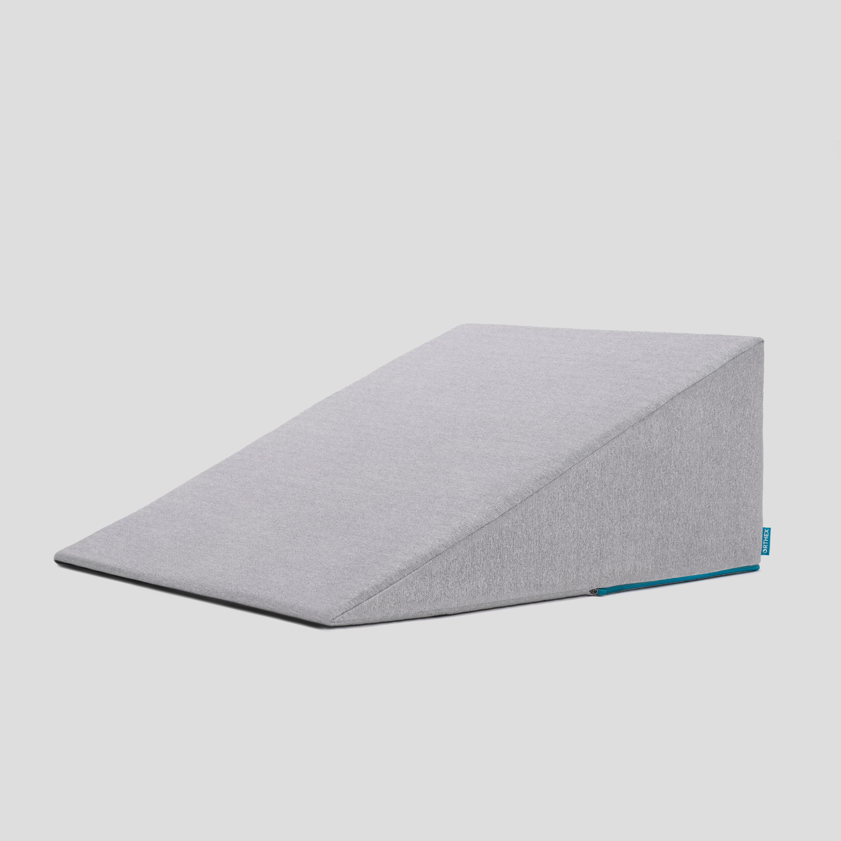
Sleeping at Home
Reflux can occur the first few weeks/months after surgery
This improves over the first few months
A wedge pillow can be helpful for sleep

Slide 108
Postoperative Visit at 7-10 Days
Check surgical site
Remove staples (if needed)
Adjust medicines as needed
Insulin (for diabetic patients on insulin)
Reduce beta blocker medicines
Advance diet
Reduce tube feeds

Slide 109
After surgery
Wean off medicines added after surgery
Pain medicines
Beta-blockers
Reglan and Remeron
Continue acid blockers for at least 1 year

Slide 110
Jejunostomy Removal
Jejunostomy tube is removed in the office once you can take in enough nutrients by mouth
Removal usually around 8 weeks after surgery
May take 30 minutes and some local anesthetic to loosen up the tube for removal.

Slide 111
Nutritional Monitoring after Surgery
You may have difficulty absorbing some nutrients:
Iron
Vitamin B12
Vitamin D

Slide 112
Nutritional Monitoring after Surgery
About 3 months after the jejunostomy tube is removed, we will check blood levels:
Iron (ferritin)
Vitamin B12
Vitamin D

Slide 113
Nutritional Replacements after Surgery
Vitamin or iron replacements can be ordered by:
Primary Care Provider (PCP)
Medical Oncologist
Surgeon
If levels are low
Replacement
Repeat testing in 3-6 months

Slide 114
Team Members - Physicians
Primary Care Provider
Gastroenterologist
Medical Oncologist (chemotherapy)
Radiation Oncologist (radiation)
Surgeons
Jonathan Salo MD
Jeffrey Hagen MD
Michael Roach MD

Slide 115
Team Members - Support Staff
Physician Assistant - Kate Duncan PA-C
Dietitian - Liz Koch
Nurses
Matthew Carpenter RN
Brandon Galloway LPN
Navigators
Laura Swift
Lorna Espinal
Care Coordinator - Karen Julian-Martinez

