Slide 1
Adenocarcinoma of the Esophagus and GE Junction

Slide 2
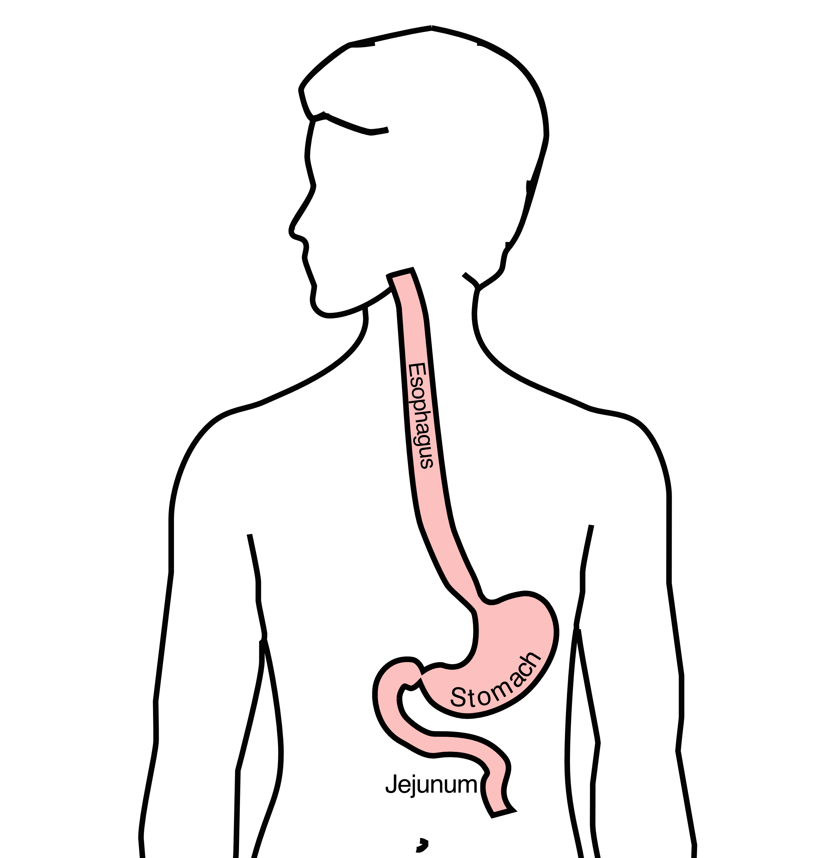
Anatomy
Food moves from the throat
$→$ esophagus
$→$ stomach
$→$ small bowel (jejunum)

Slide 3
Cancer Staging
Staging refers to the tests to determine
How large is the tumor?
Has there been spread to lymph nodes?
Has it spread to other parts of the body?
Treatment options depend upon the cancer stage

Slide 4
Cancer Staging
T = Tumor - Depth of growth into the wall
N = Nodes - Spread to the lymph nodes
M = Metastasis - Spread to liver, lungs, or bone

Slide 5
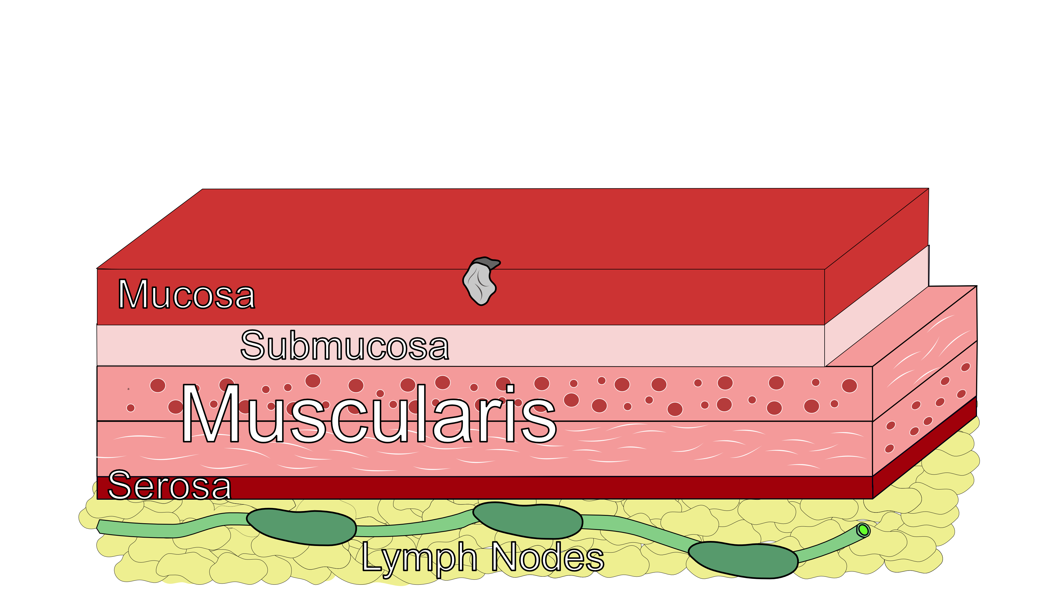
Early Stage Cancers
Cancers start on the very inside layer called the mucosa

Slide 6

Locally-advanced Cancers
Over time, cancers can grow into the muscular wall

Slide 7
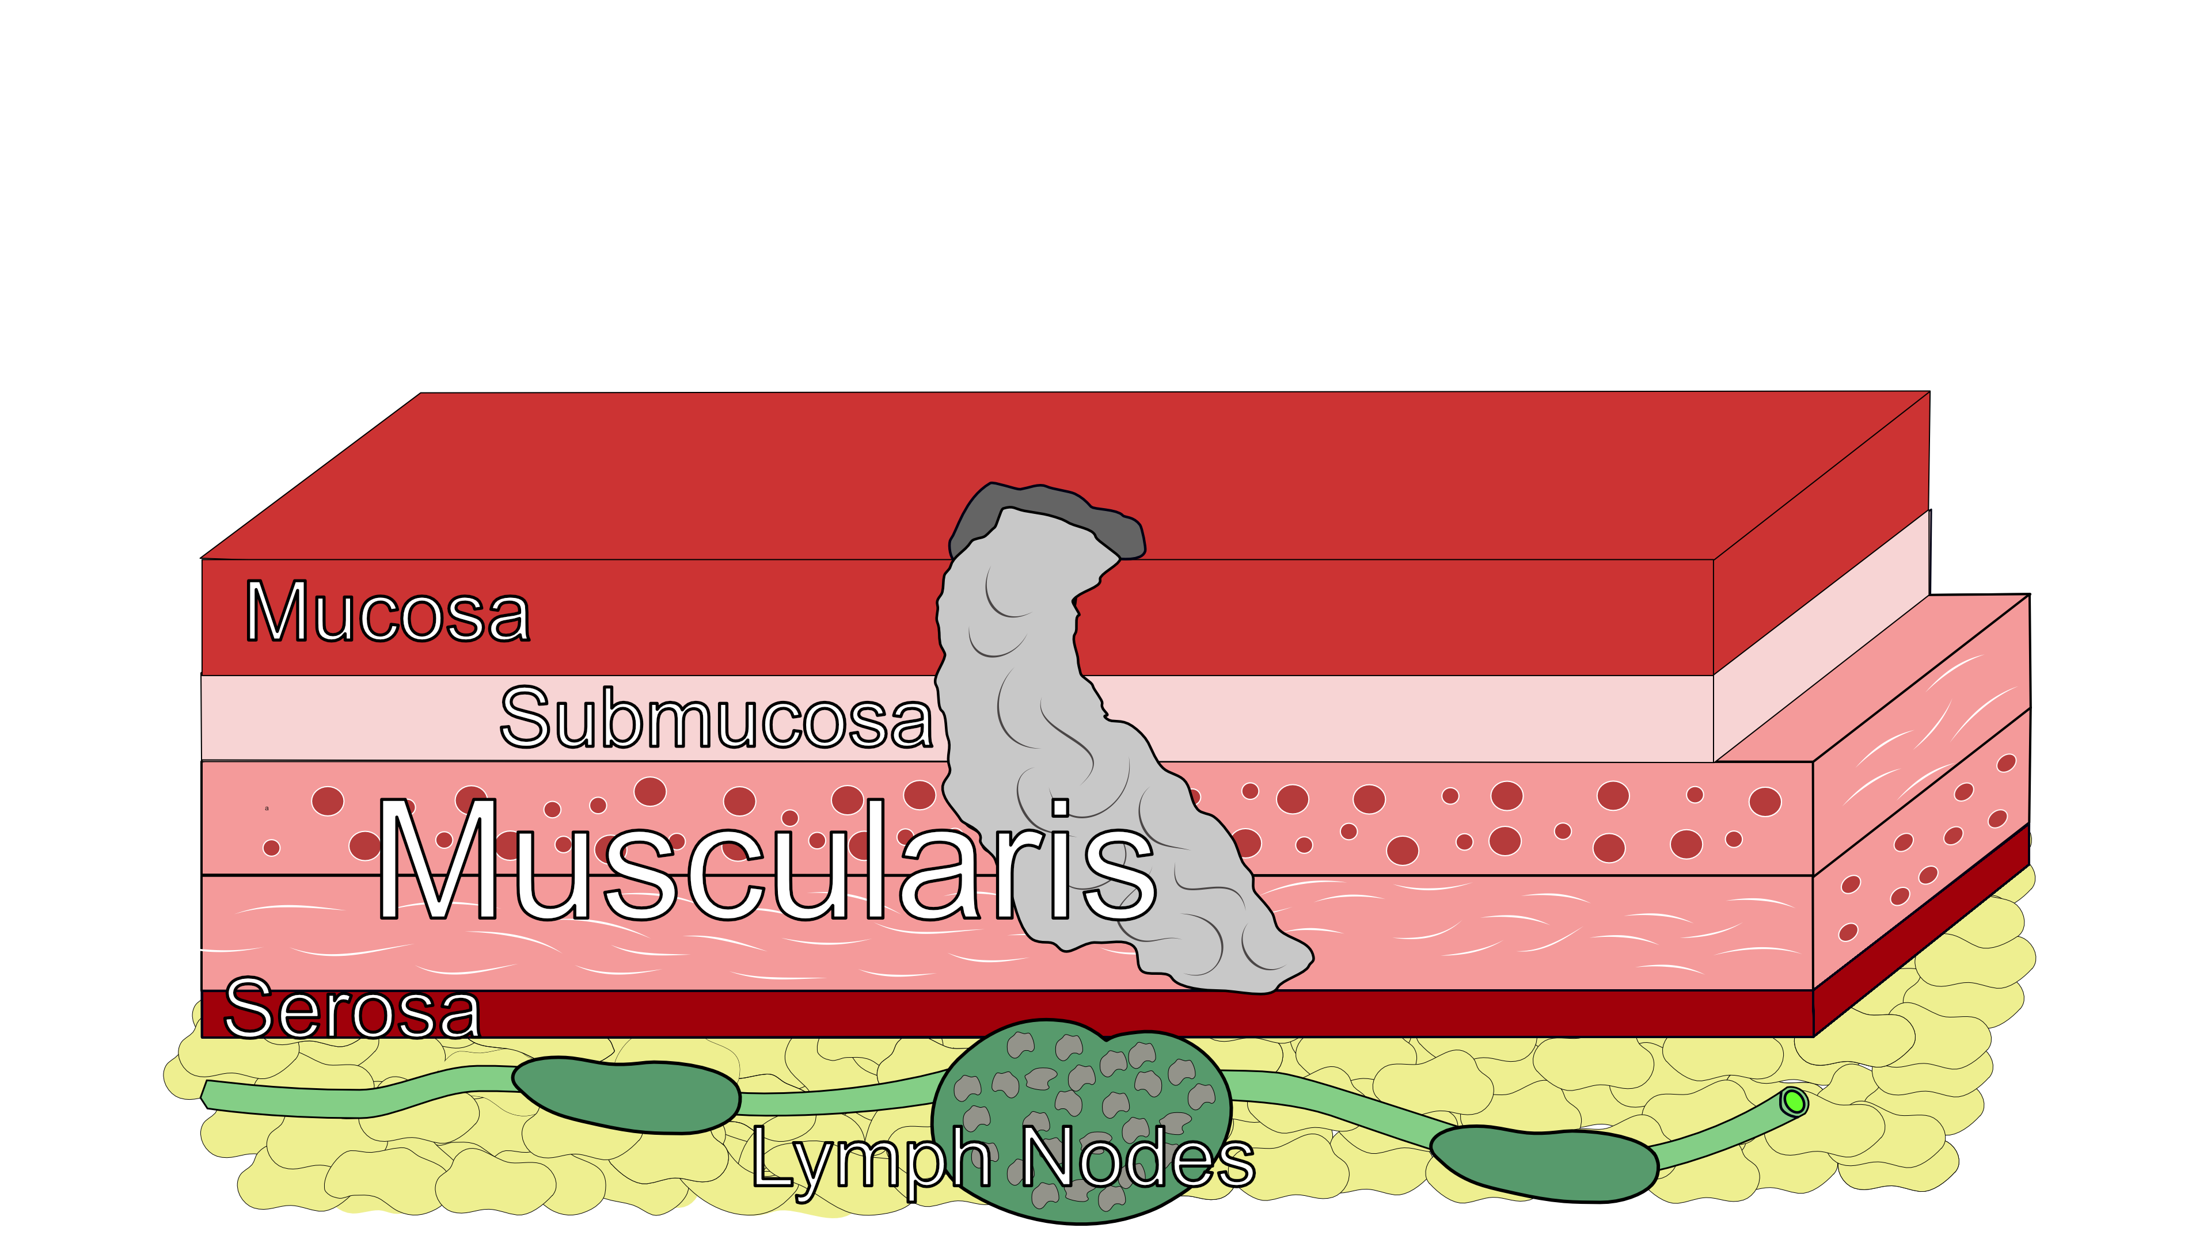
Lymph Nodes
In some cases, cancer cells can break off from the main tumor and spread to lymph nodes

Slide 8
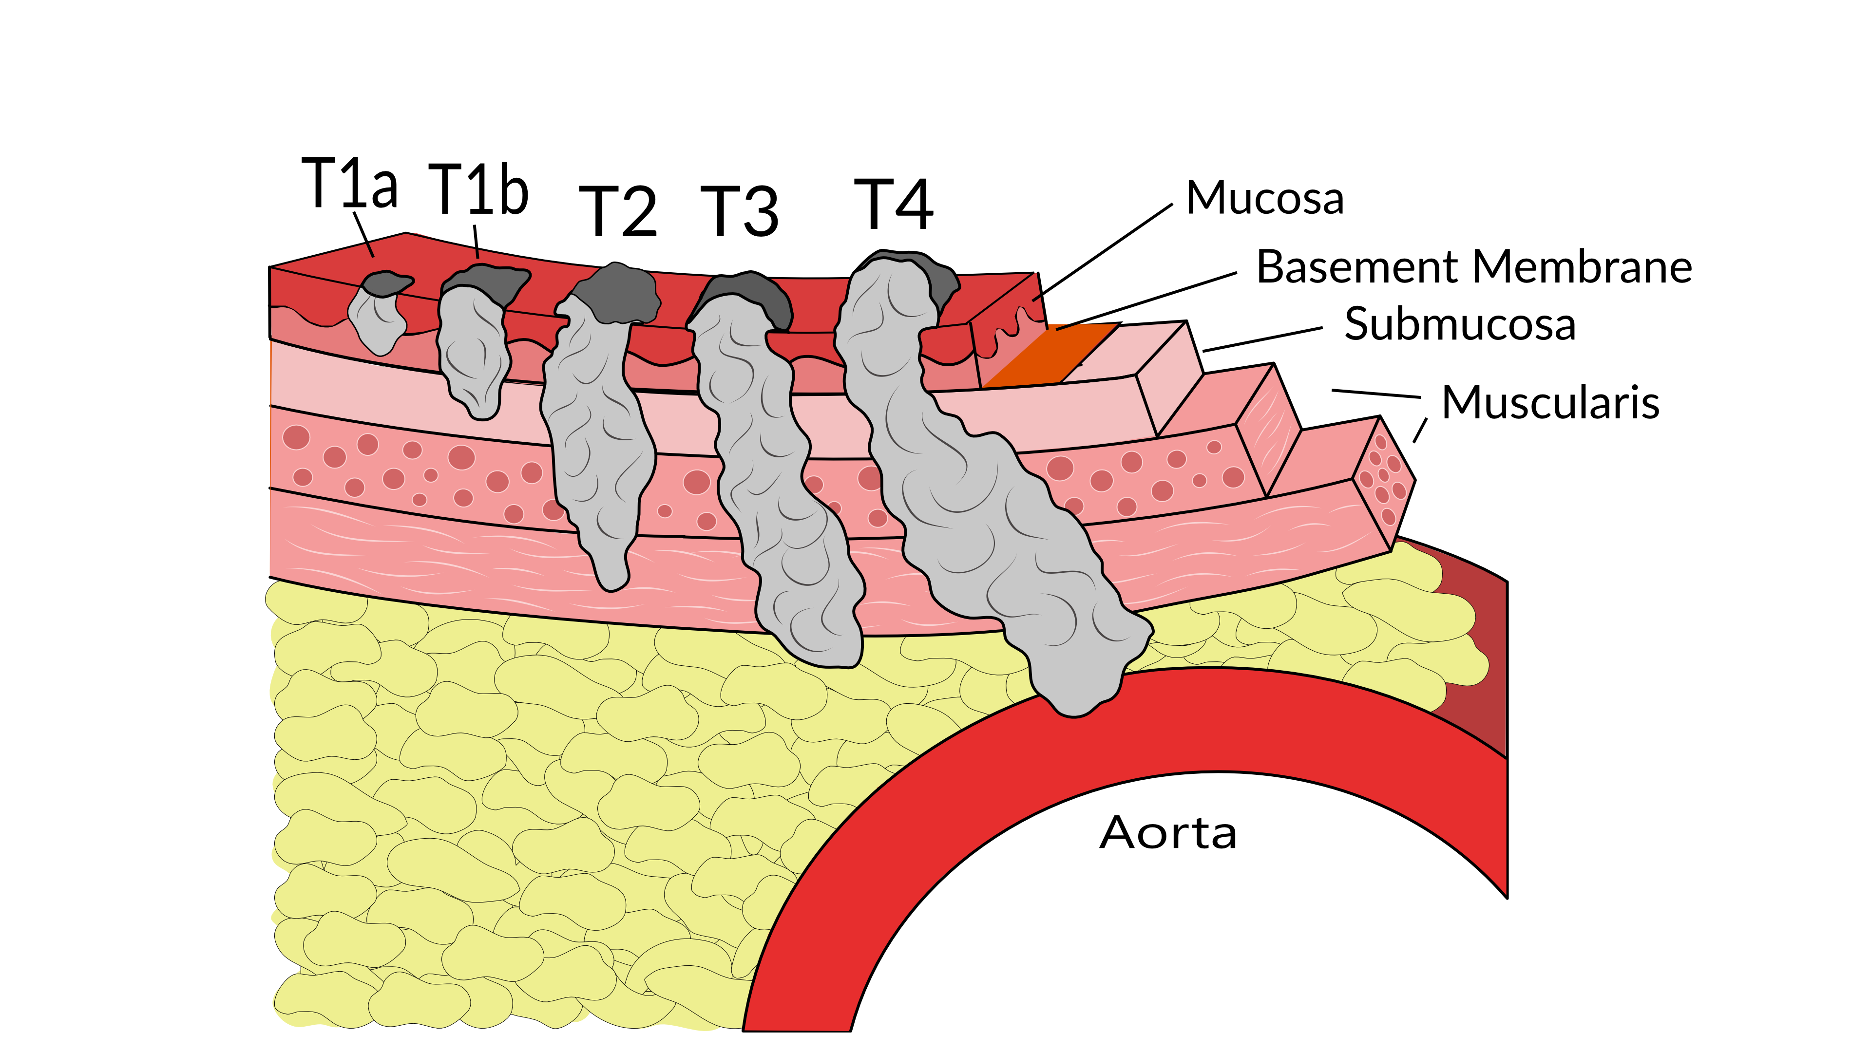
T Stage
Cancers are categorized based upon the thickness of the tumor, known as the T stage

Slide 9
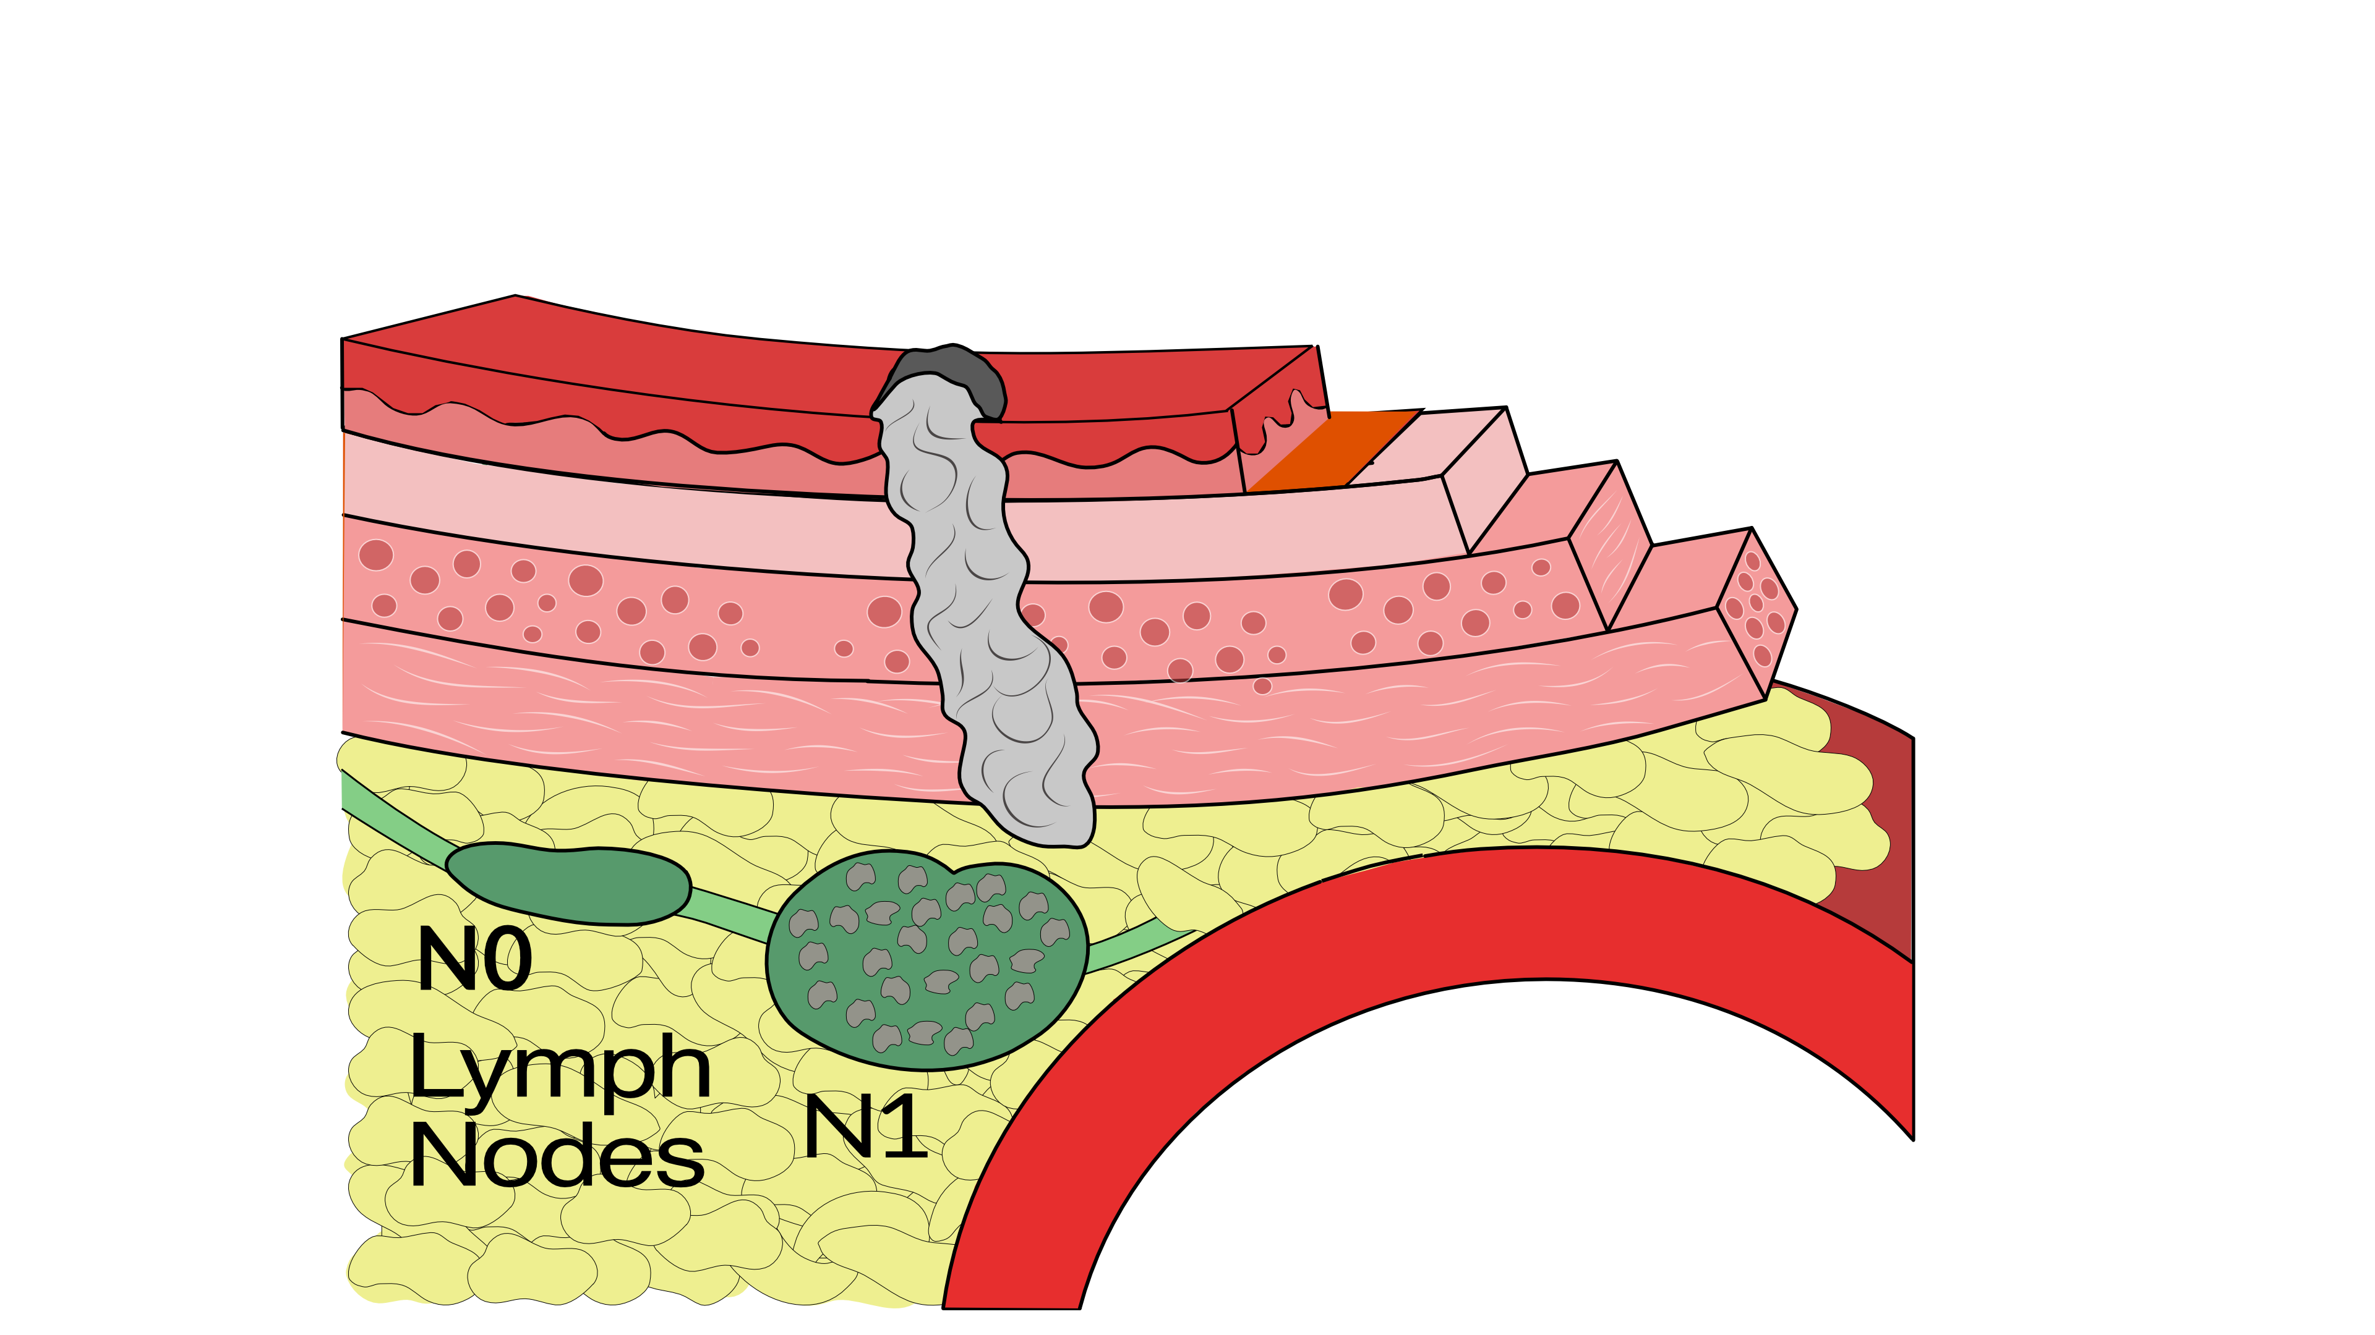
N Stage
Cancers are categorized by whether there is spread to the nodes.
N0 cancers have not spread to the nodes
N1 cancers have spread to the nodes.

Slide 10
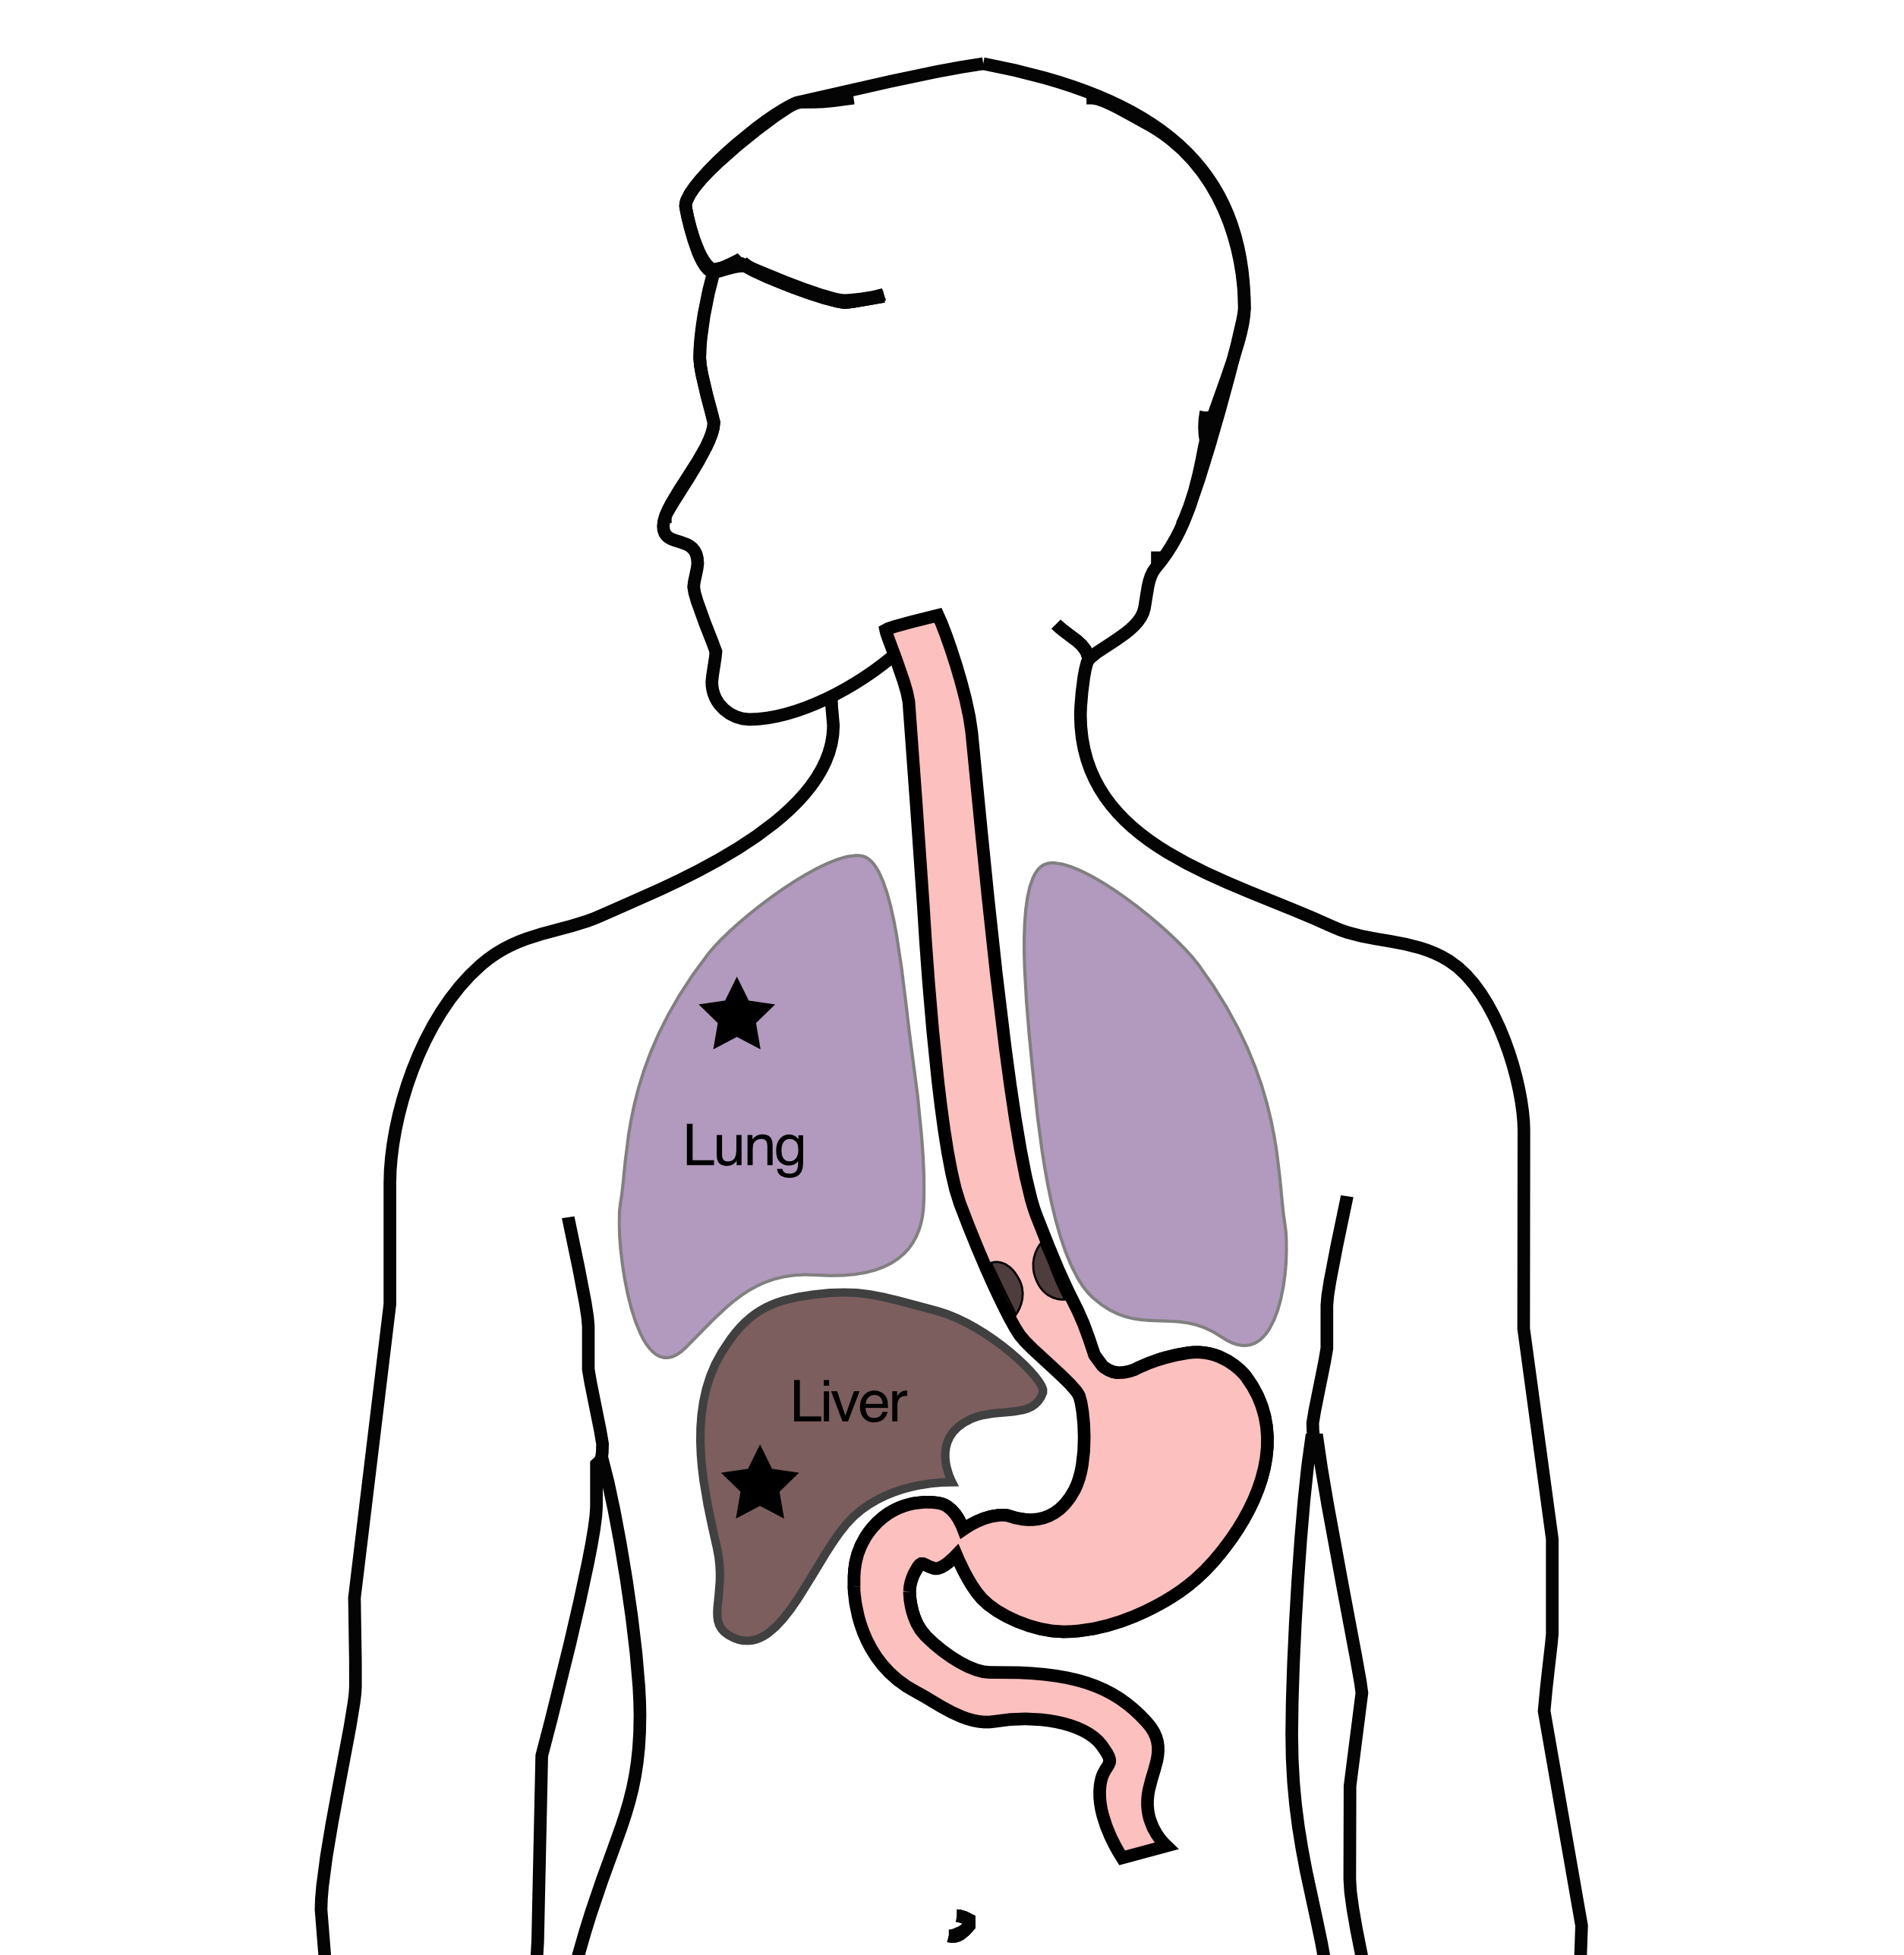
M Stage
Some cancers spread to other parts of the body
M0 cancers have not spread
M1 cancers have spread to lungs, liver, bone, or within the abdomen

Slide 11
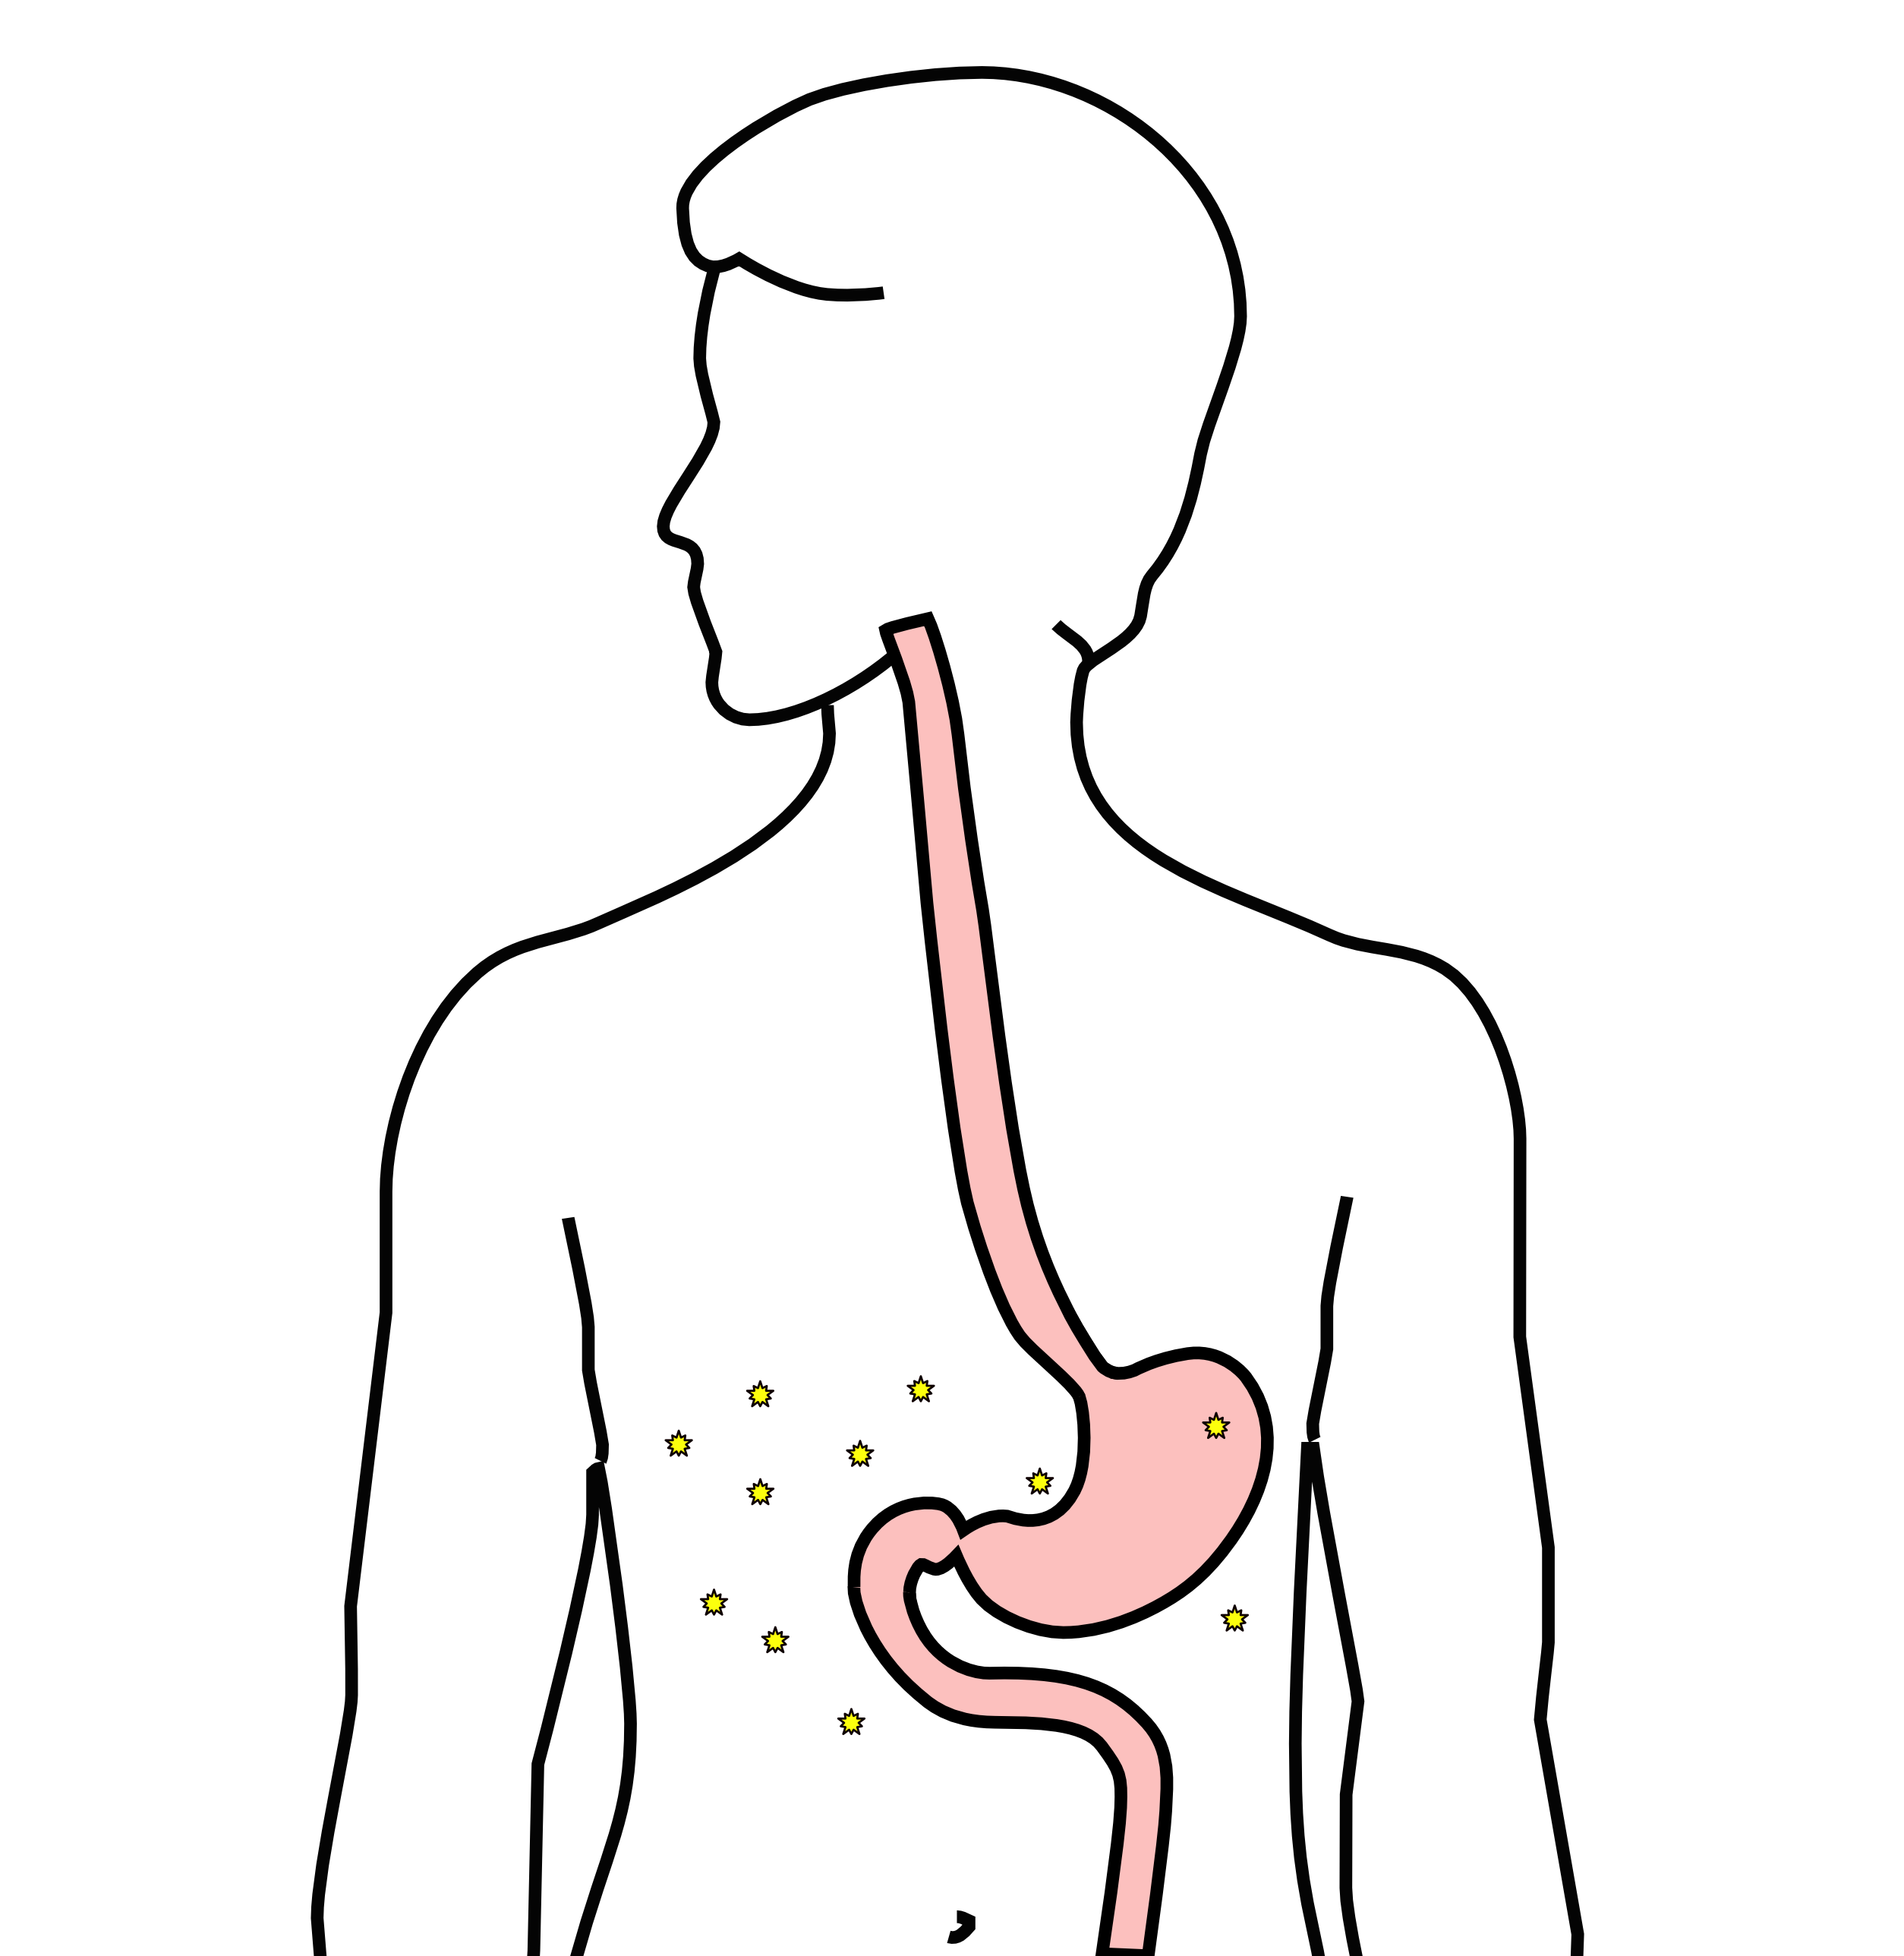
Carcinomatosis (M1)
Spread within the abdomen is carcinomatosis
Tumors can be very small (grain of rice)
Fluid can also build up: ascites

Slide 12
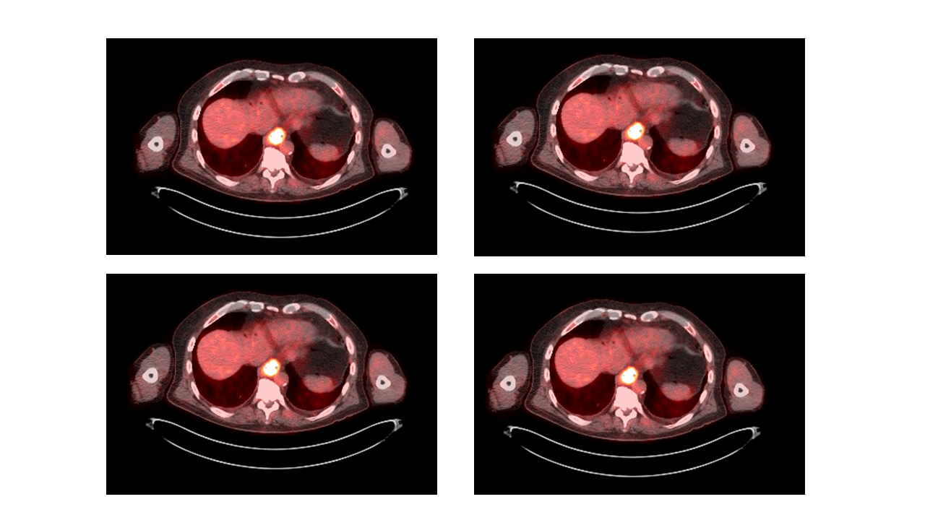
PET scan
Similar to CT scan
Tracer shows ‘hot spots’
Cancer
Inflammation or infection
Normal organs (heart, kidneys)

Slide 13
PET scan Preparation
Nothing to eat or drink for 4 hours prior to exam
High-protein low-carbohydrate diet the day prior
No strenous activity day prior to study

Slide 14
PET scan Prepration - Diabetic Patients
PET scan uses a modified sugar as a tracer $⇒$ you will need to be careful about blood sugar and insulin before the study
No insulin within 4 hours of the exam
OK to take diabetes pills the day of the exam
PET scans are generally best in the morning
Plan to eat a meal after the PET scan, with half the usual morning dose of insulin

Slide 15
PET scan Prepration - Diabetic Patients
If PET is scheduled after 10AM:
low-carbohydrate breakfast at least 4 hours before
half the usual regular (short-acting) insulin
No long-acting insulin after midnight.
Insulin pump: turn it off 4 hours before the study (or turn it down to basal/night-time rate)

Slide 16
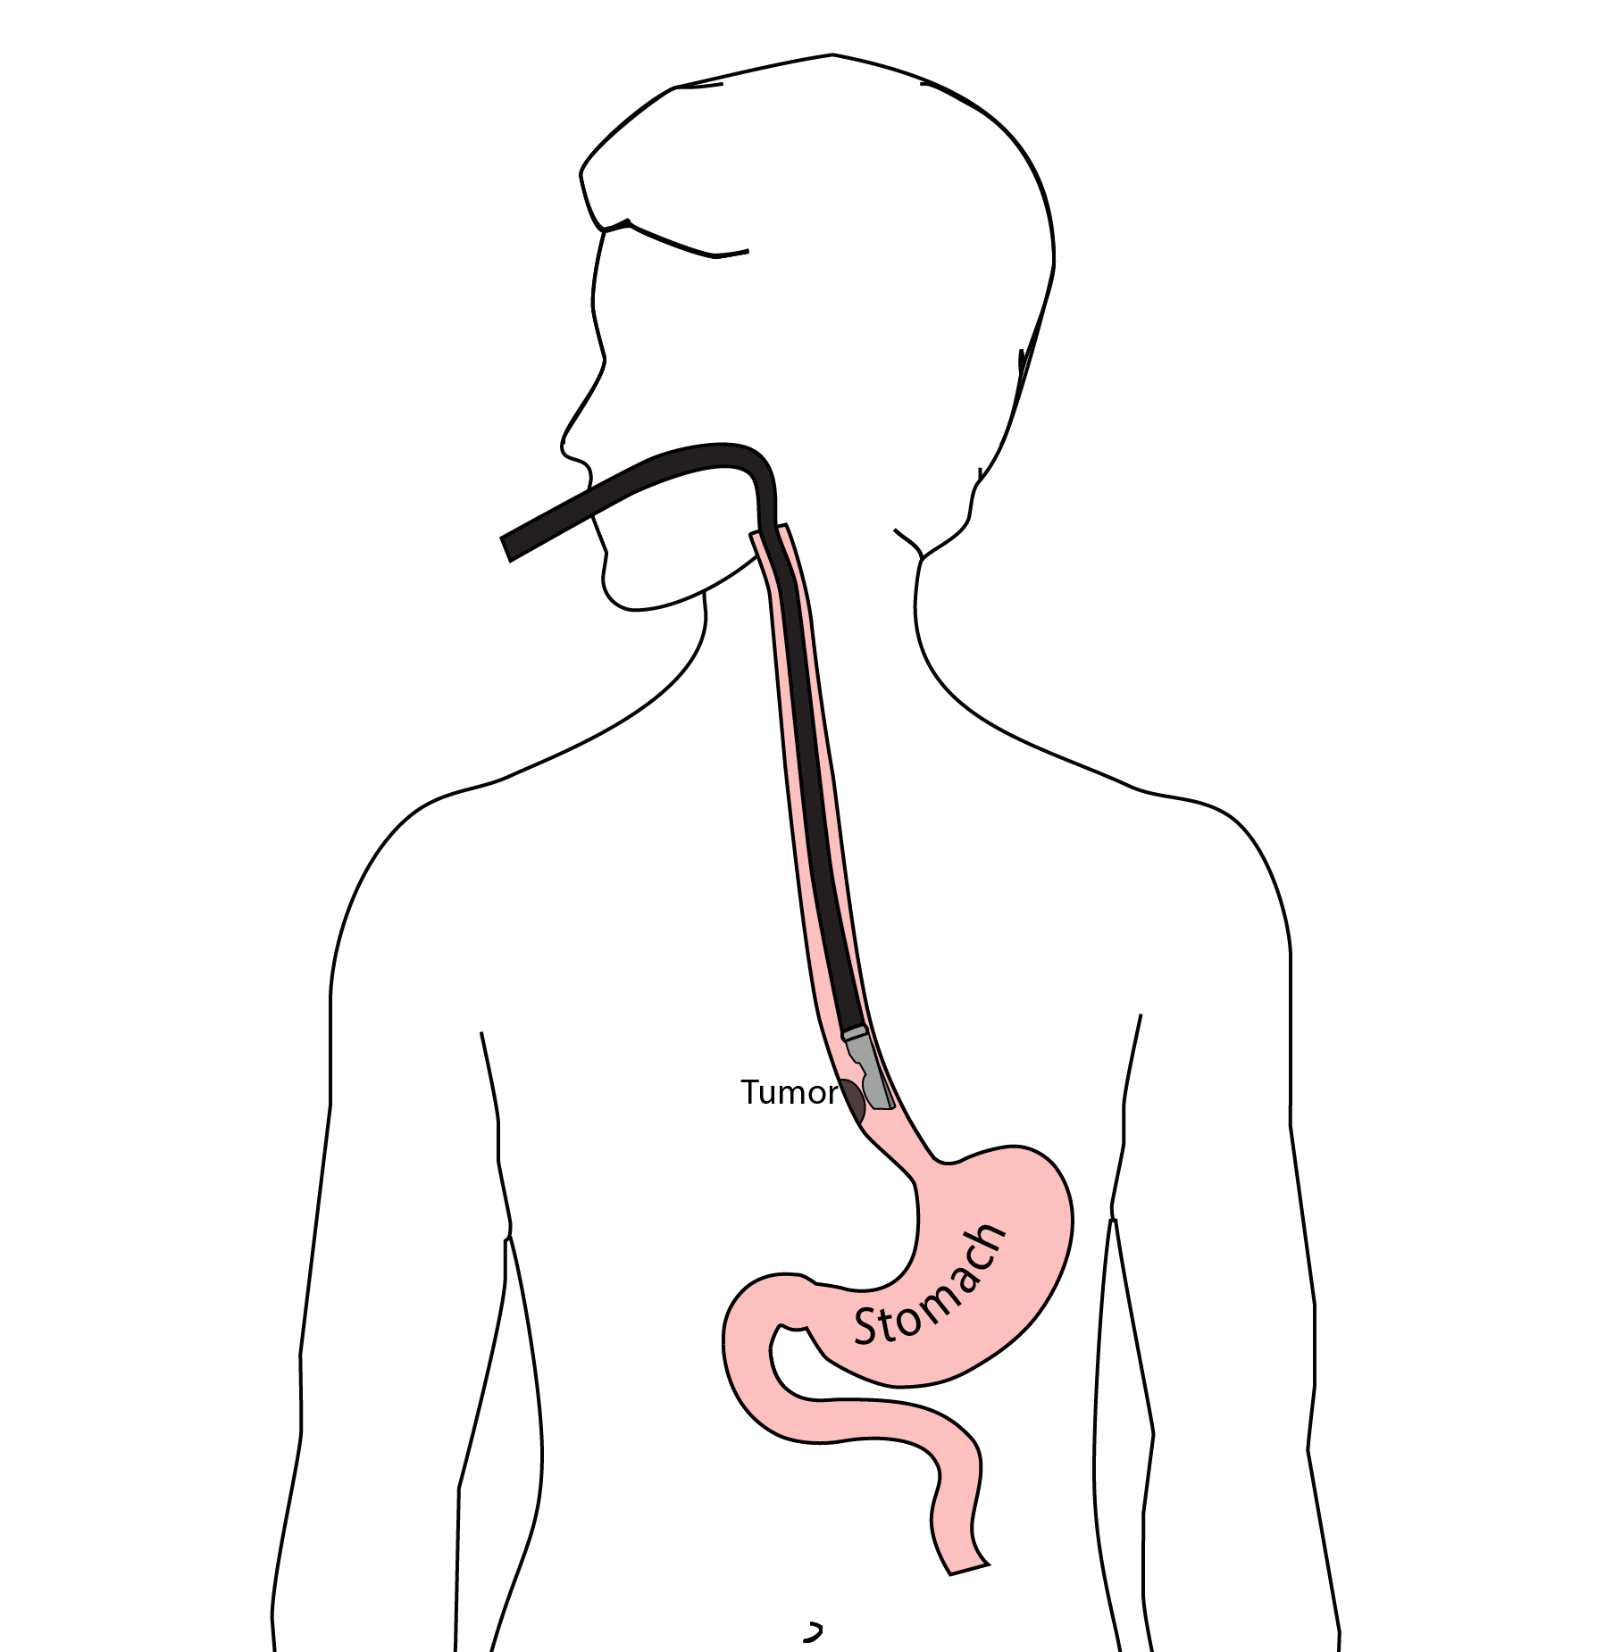
Endoscopic Ultrasound
Similar to upper endoscopy (EGD)
Ultrasound in scope
Evaluates T stage

Slide 17
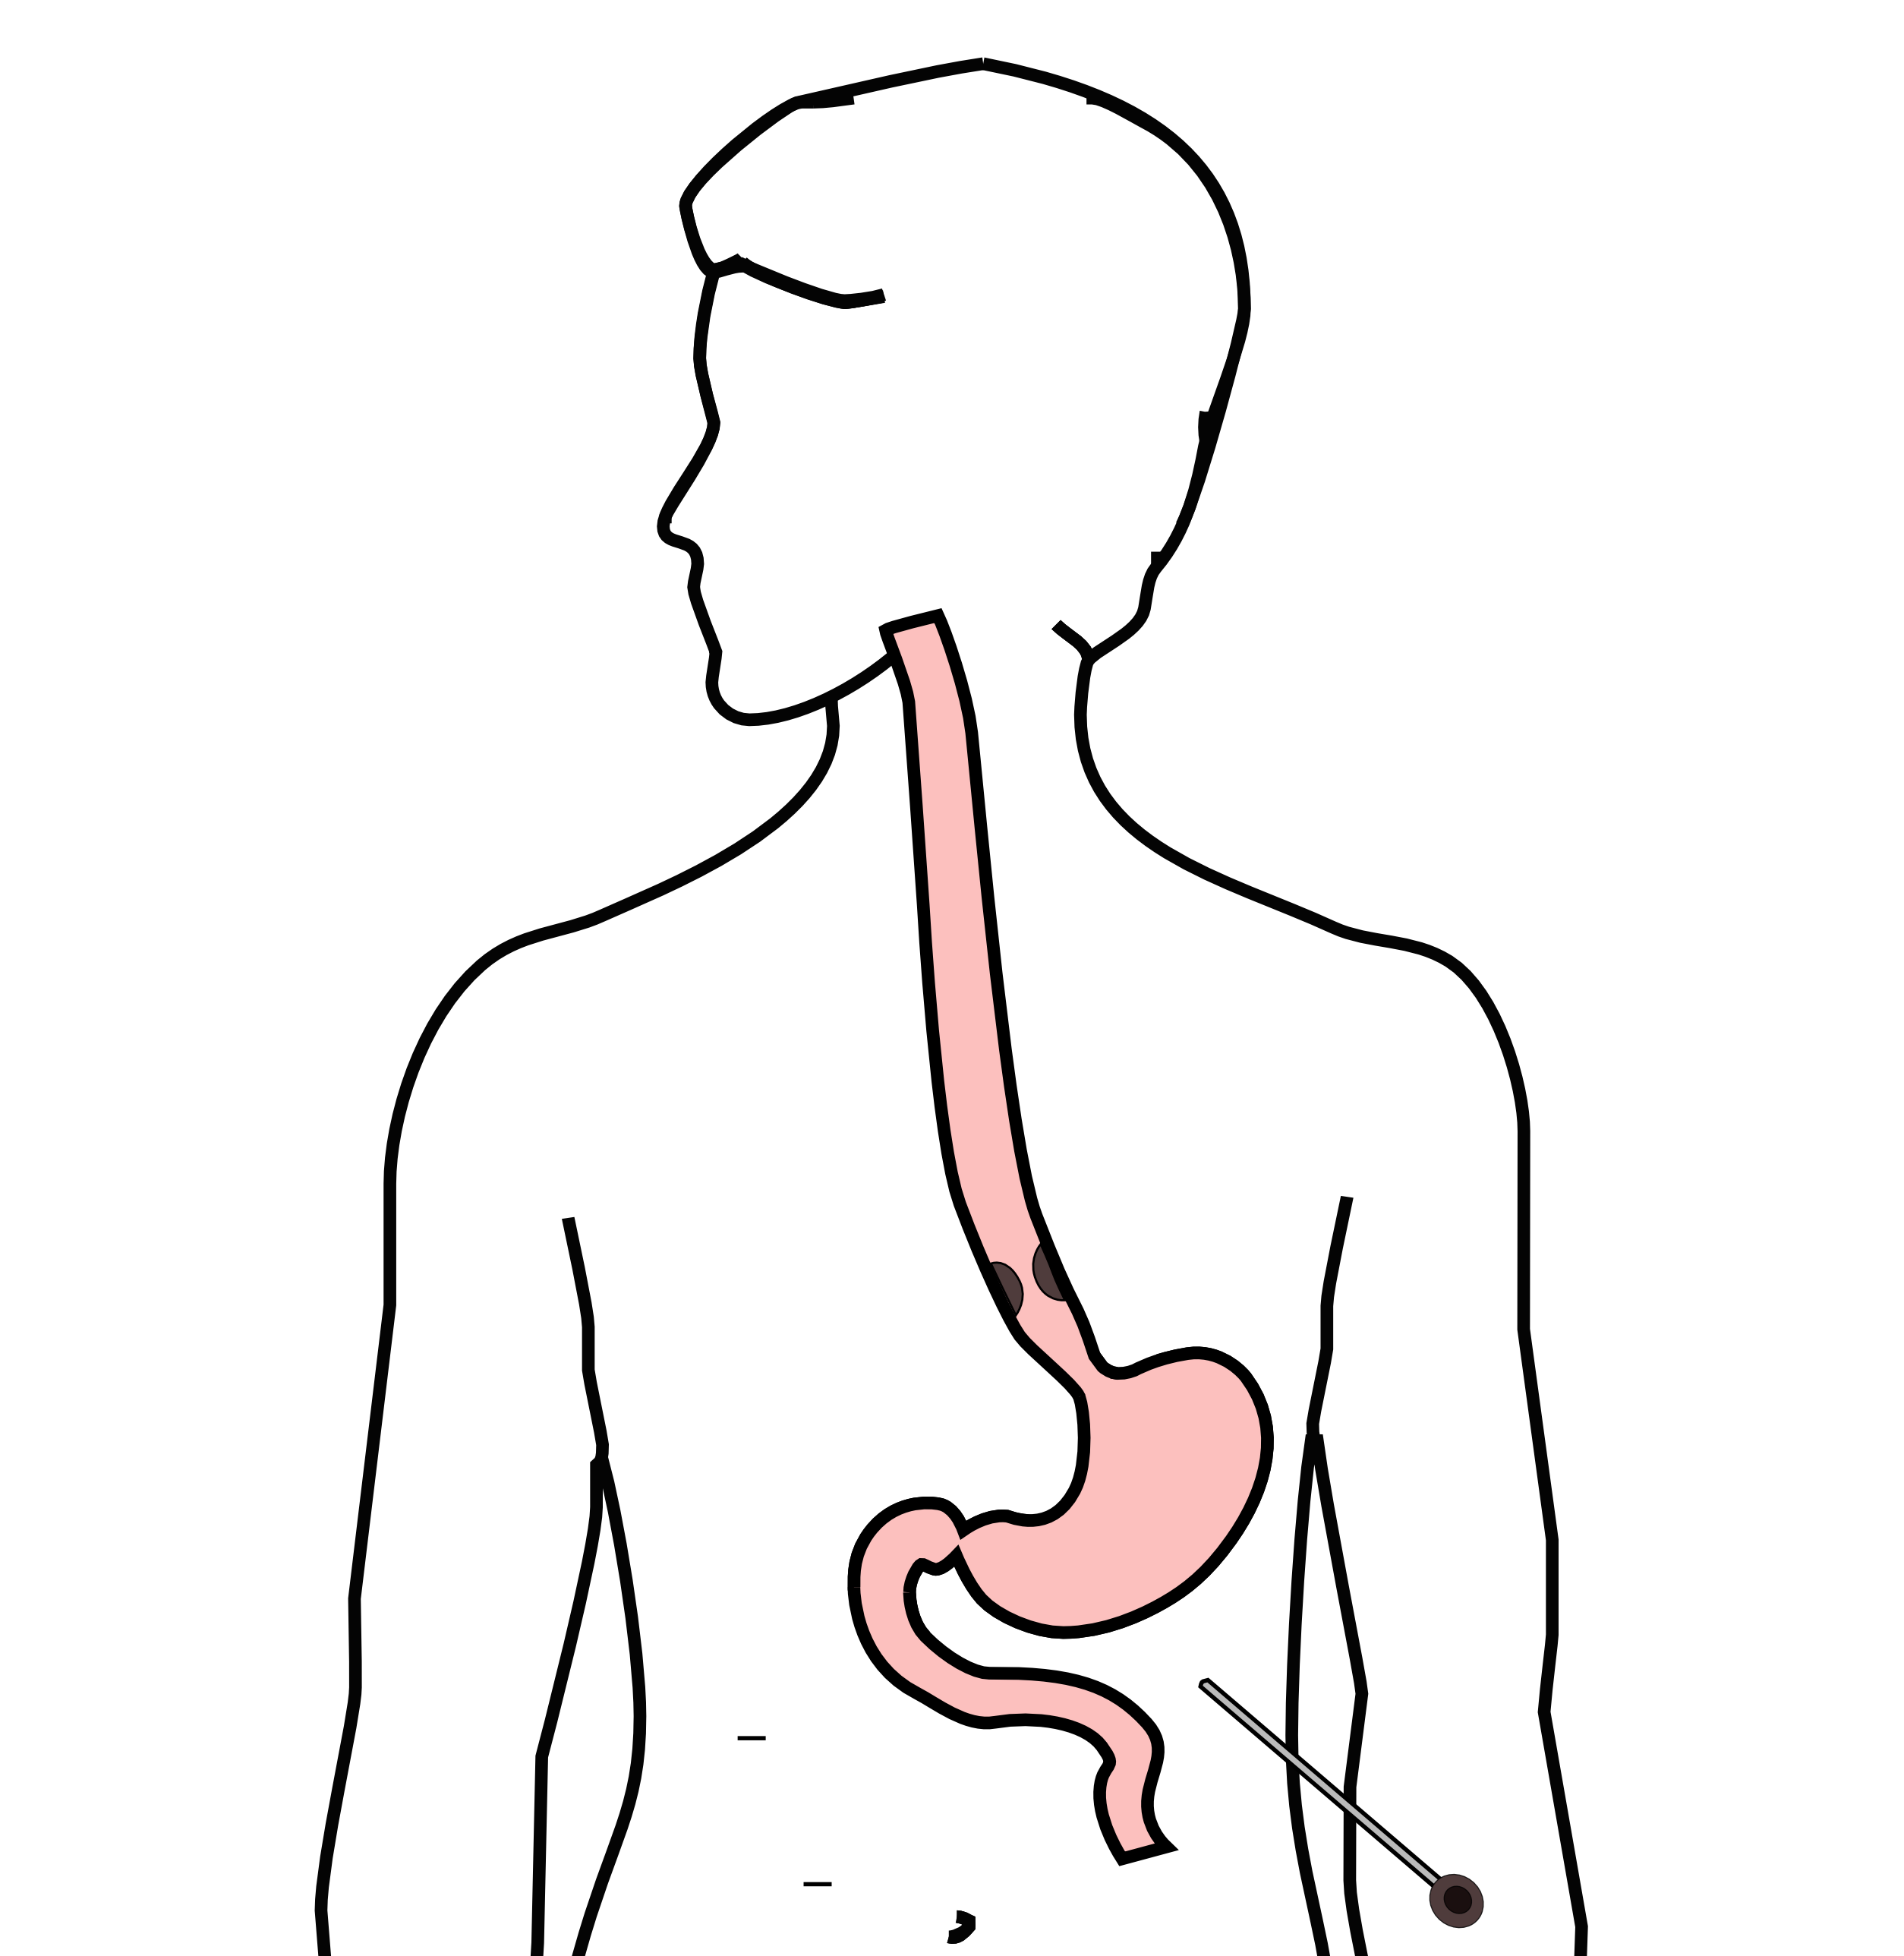
Laparoscopy
Some stomach cancers can spread inside the abdomen
Areas of spread can be very small (grain of rice)
Laparoscopy can detect spread inside the abdomen

Slide 18
Laparoscopy
General anesthetic
1/4” incisions
Telescope examines the abdomen
Biopsies performed
Fluid sampled

Slide 19
Treatment Plan
Superficial (T1)
Endoscopic Therapy
Localized (T1b/T2)
Surgery (esophagectomy)
Locally-advanced (T3M0)
Chemo$±$Radiation $→$Surgery
Metastatic (M1)
Chemotherapy

Slide 20
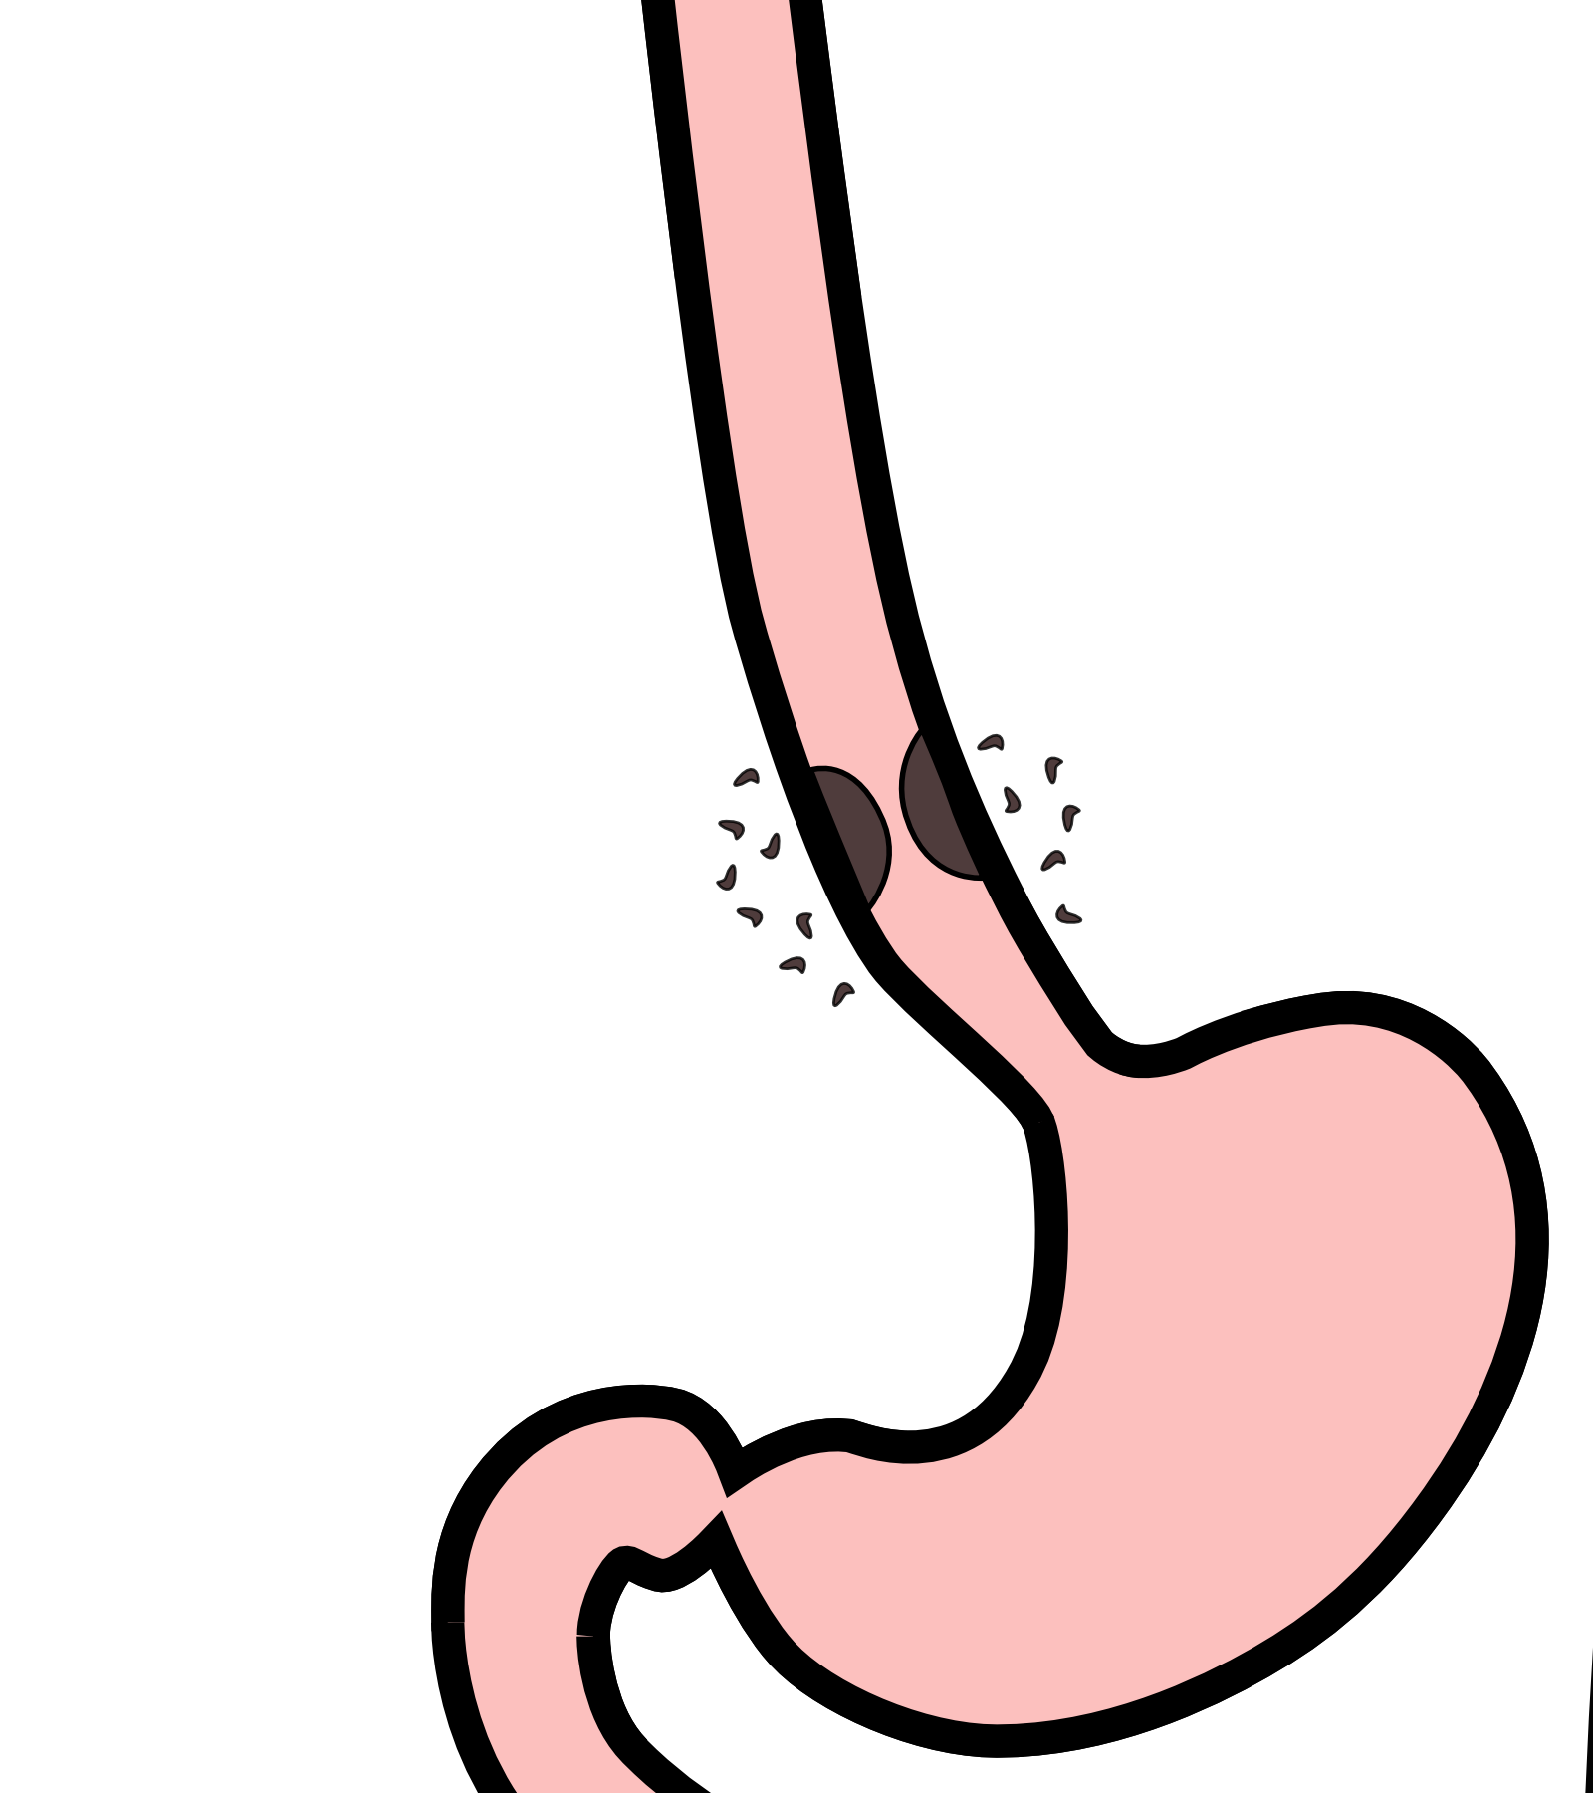
Locally-advanced cancers
Patients with locally-advanced esophageal cancer often have localized spread of cancer cells in the surrounding area

Slide 21
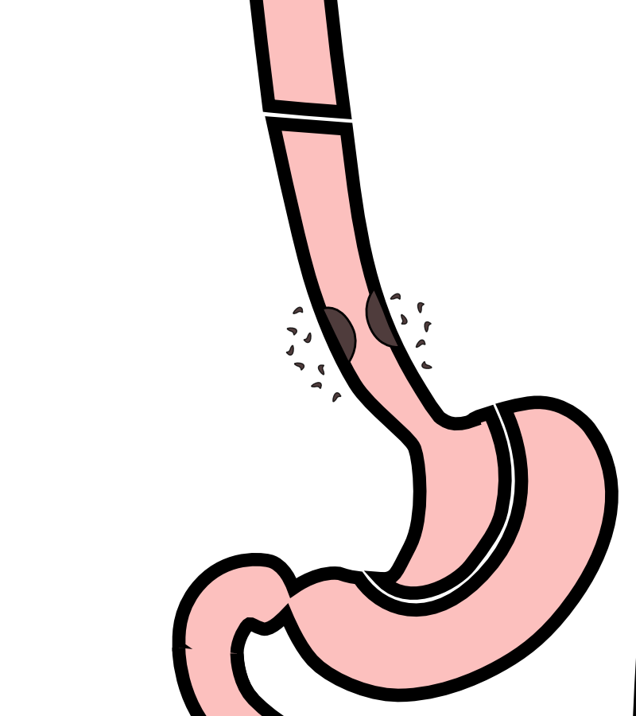
Locally-advanced cancers
If locally-advanced cancers are treated with surgery alone…

Slide 22
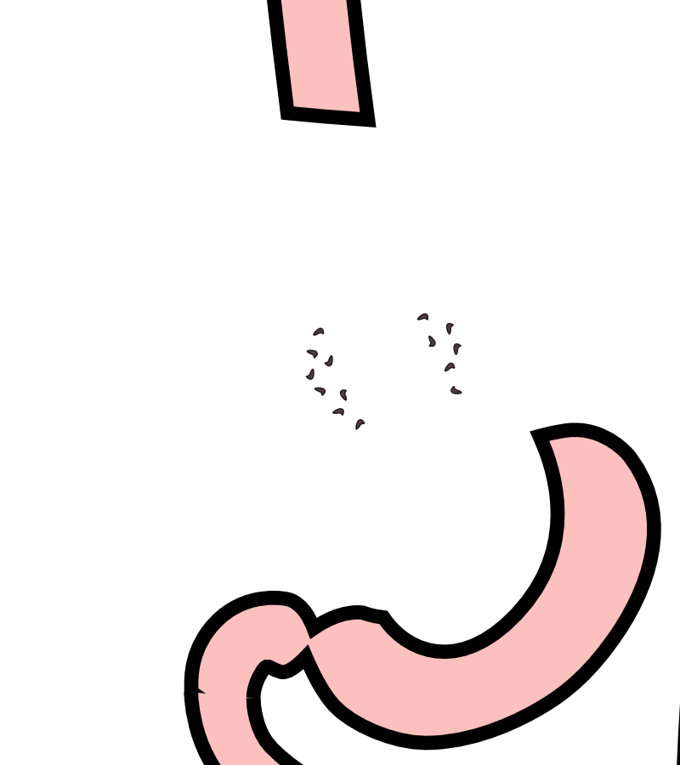
Locally-advanced cancers
If locally-advanced cancers are treated with surgery alone…
There is a risk that cancer cells can be left behind

Slide 23
Preoperative Therapy
It is helpful to start with therapy before surgery that will shrink the cancer.

Slide 24
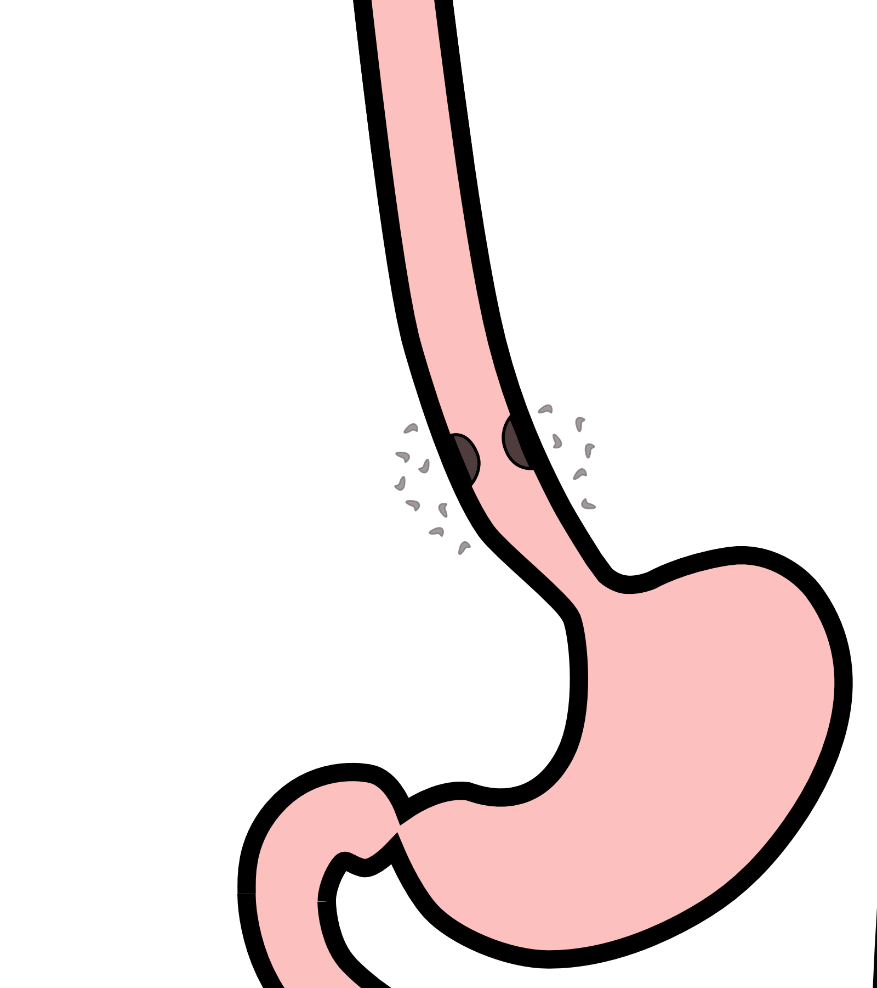
Preoperative Therapy
It is helpful to start with therapy before surgery that will shrink the cancer.

Slide 25

Preoperative Therapy
It is helpful to start with therapy before surgery that will shrink the cancer.

Slide 26
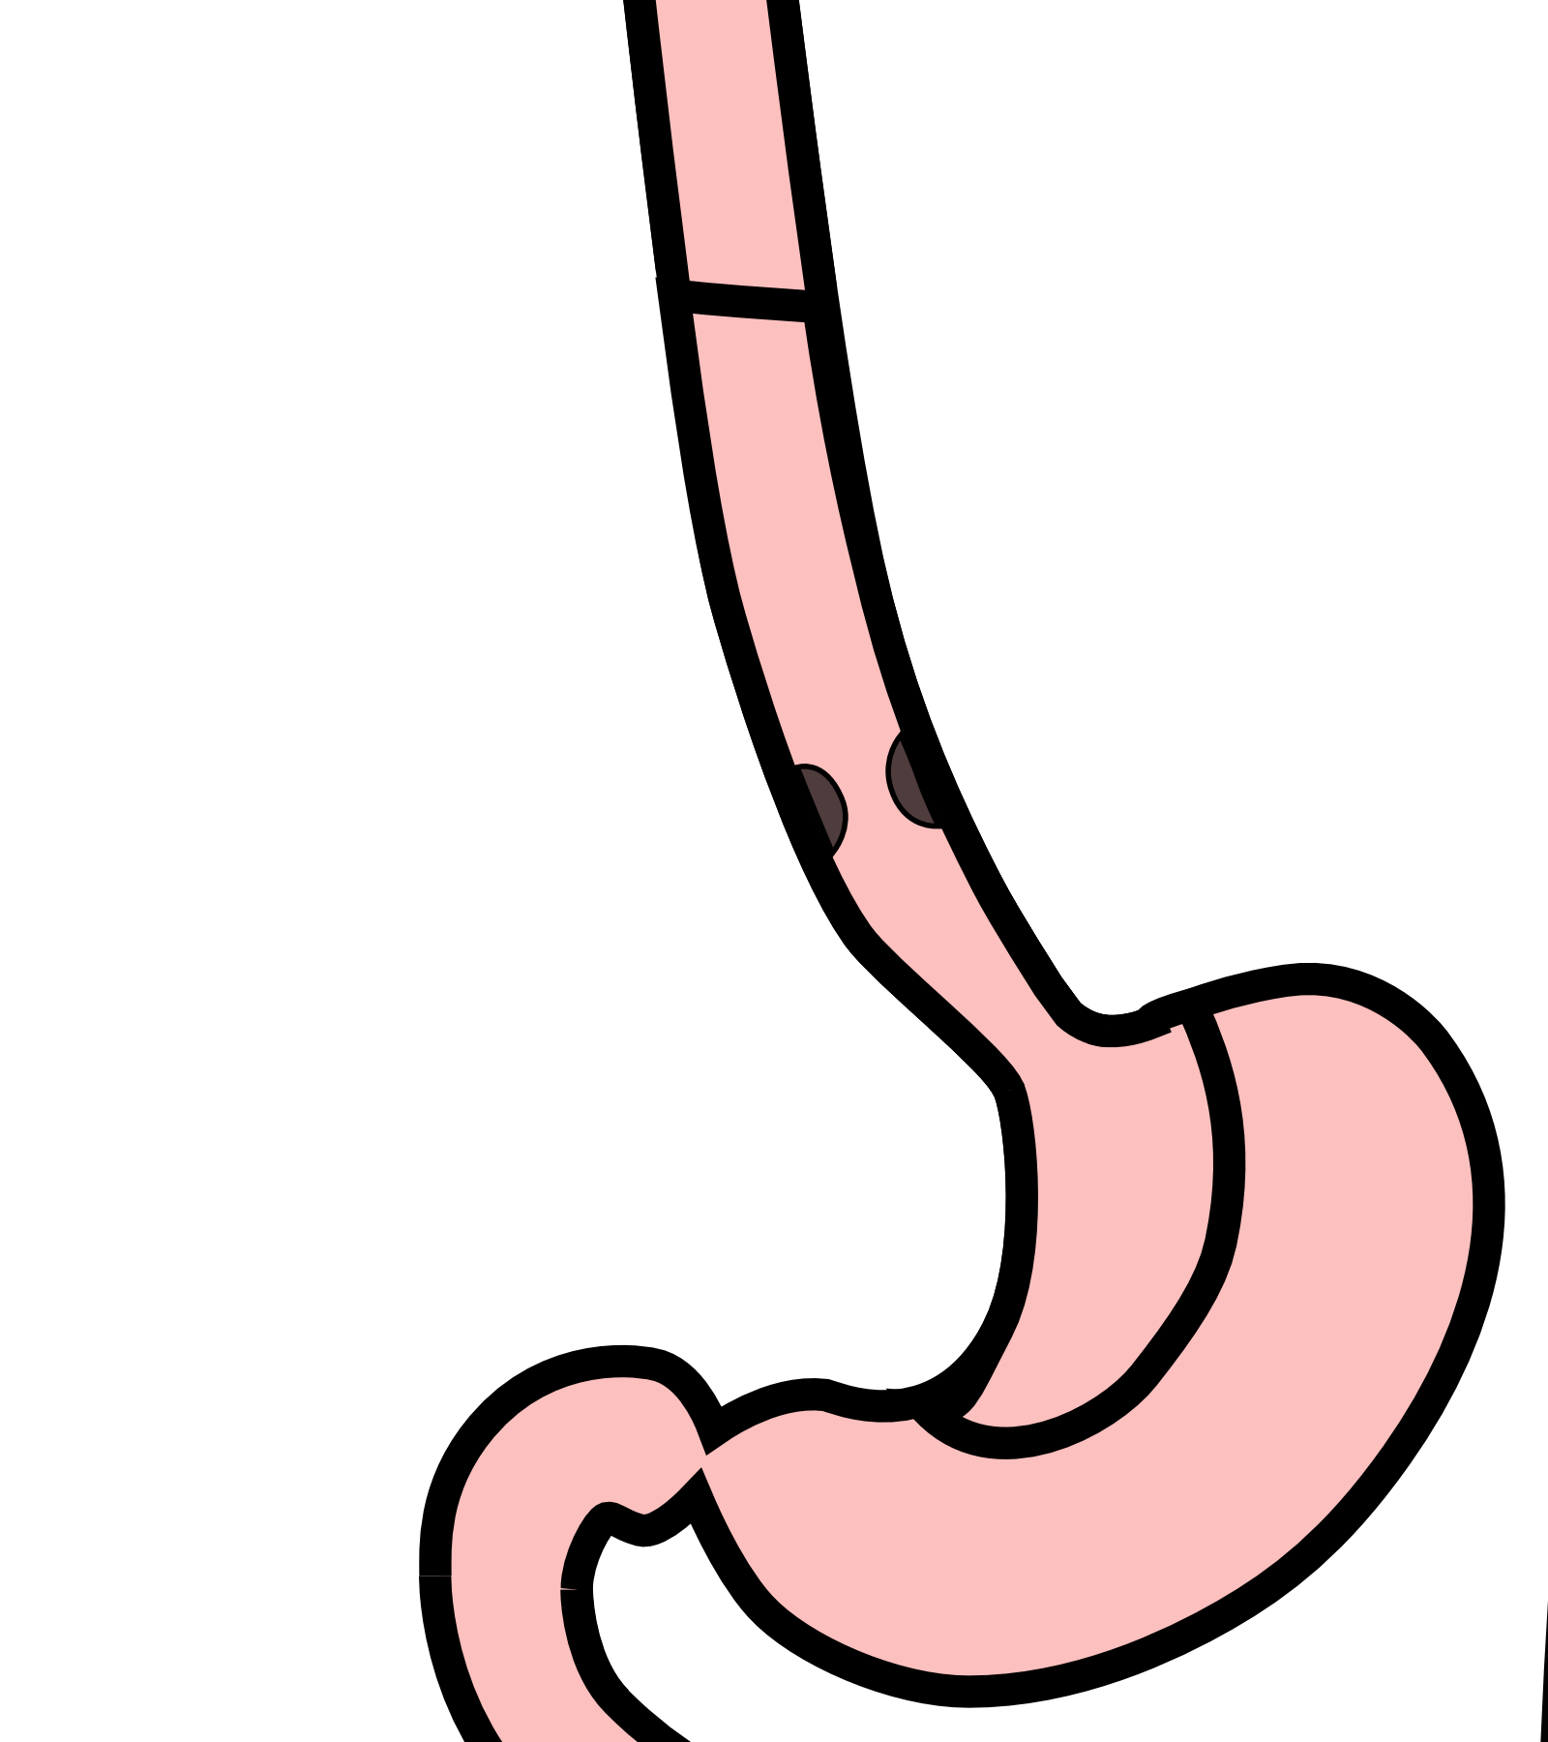
Surgery after Preoperative Therapy
When surgery is then performed…

Slide 27

Preoperative Therapy
When surgery is then performed…
The risk of cancer recurrence is minimized

Slide 28
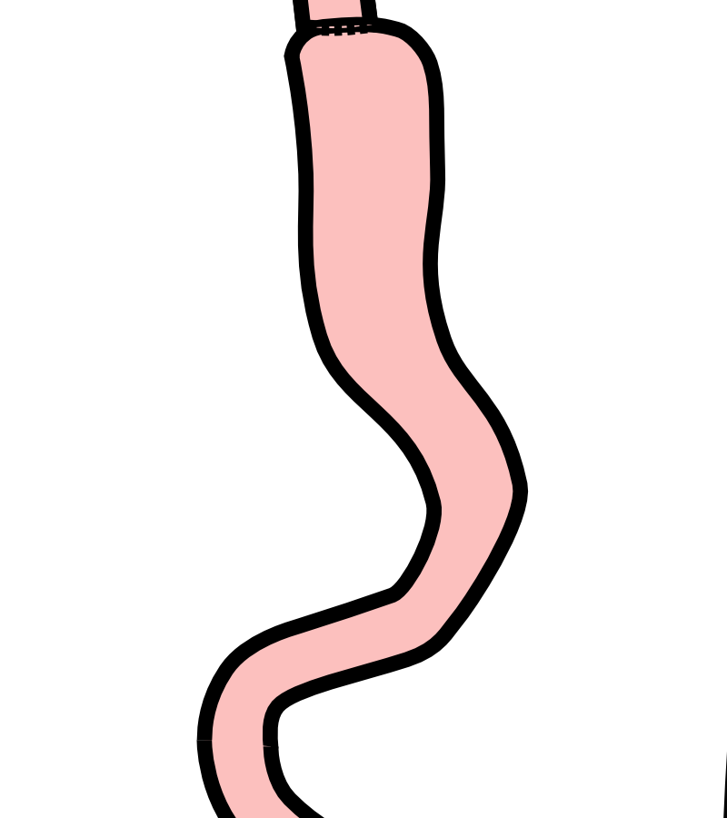
Preoperative Therapy
When surgery is then performed…
The risk of cancer recurrence is minimized

Slide 29
Chemotherapy + Radiation CROSS Trial
363 patients with esophageal cancer studied
Patients were treated in two groups:
Surgery Alone
vs
Chemo + Radiation $→$ Surgery

Slide 30
Chemotherapy + Radiation CROSS Trial
363 patients with esophageal cancer studied
Chemotherapy + radiation together over 6 wks
Surgery Alone
vs
Chemo + Radiation$→$Surgery $⇒$ Longer Survival

Slide 31
Chemo + Radiation CROSS Trial
Typical schedule for chemotherapy + radiation:
Chemotherapy once per week for six weeks
Radiation five days per week for six weeks (28)
PET scan (or CT) 4 weeks after the end of radiation
Surgery 8 weeks after the end of radiation

Slide 32
Chemo + Radiation - Side Effects
Kills cancer cells in the esophagus and lymph nodes
Can also irritate the lining of the esophagus.
Swallowing can be difficult the last 2 weeks.
Feeding tube may be needed for hydration/nutrition.

Slide 33
Locally-advanced Adenocarcinoma
“Sandwich” chemotherapy before + after surgery:
Chemo (8 wks) $→$ Surgery $→$ Chemo (8 wks)
Two different drug combinations:
FLOT (more effective)
FOLFOX (better tolerated)

Slide 34
“Sandwich” Chemotherapy Drugs
FLOT
5-FU
Leucovorion
Oxaliplatin
Taxotere
FOLFOX
5-FU
Leucovorin
Oxaliplatin

Slide 35
FLOT Treatment Plan
FLOT Chemo every 2 weeks x 4 (=8 weeks total)
Surgery (4-6 weeks later)
FLOT Chemo every 2 weeks x 4 (=8 weeks total)

Slide 36
Durvalumab Immunotherapy
Cancer cells can turn off immune cells using a protein PD-L1
Darvalumab turns on immune cells by counteracting PD-L1
Durvalumab strengthens the immmune system to fight cancer

Slide 37
Matterhorn Trial
The Matterhorn clinical trial compared two types of treatment:
FLOT $→$ Surgery $→$ FLOT
FLOT + Durvalumab $→$ Surgery $→$ FLOT + Durvalumab
Better survival with addition of durvalumab to FLOT
Treatment with durvalumab depends upon approval from insurance company

Slide 38
FLOT Chemo ± Durvalumab
FLOT Chemotherapy
FLOT (8 weeks)
Surgery (4-6 weeks later)
FLOT (8 weeks)
FLOT + Durvalumab
FLOT + Durvalumab (8 wks)
Surgery (4-6 weeks later)
FLOT + Durvalumab (8 wks)
Durvalumab monthly x10

Slide 39
Tumor Biomarkers - Pathology Tests
Show whether other drugs may be helpful:
HER-2 $→$ Herceptin can be helpful
PD-L1 $→$ Immunotherapy can be helpful
MMR $→$ Immunotherapy can be very helpful
Biomarkers reported in a separate pathology report
Your medical oncologist will review these with you

Slide 40
Adenocarcinoma Treatment Options
Chemo + Radiation
Chemo + Radiation (6wk)
Surgery
Chemotherapy
Chemo (8wk)
Surgery
Chemo (8wk)

Slide 41
Adenocarcinoma Treatment Options
Chemo + Radiation
Longer track record
Better tolerated
Port usually placed
Eating worse $→$ better
May need feeding tube
Chemotherapy
More effective
More side effects
Port always required
Eating slowly improves
Less likely to need feeding tube

Slide 42
Chemotherapy Administration
Most chemotherapy is administered by vein.
Several options exist to administer chemotherapy:
Intravenous catheter in peripheral veins
Peripheral Intravenous Central Catheter (PICC)
Central Venous port

Slide 43
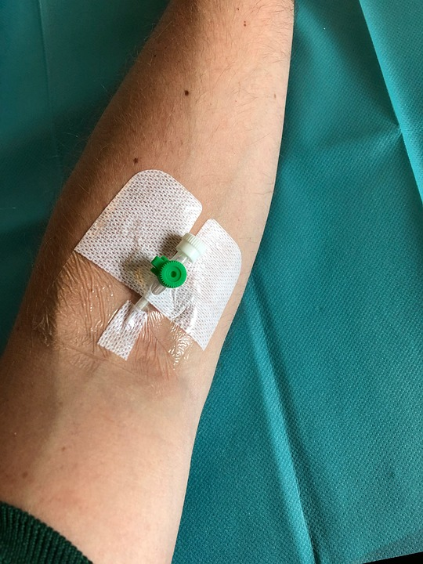
Intravenous Catheter in Peripheral Vein (“IV”)
IV catheter placed in vein of hand or arm
Allows administration of chemo and fluids
Placed for each dose
Removed that day
Not suitable for FLOT chemo

Slide 44
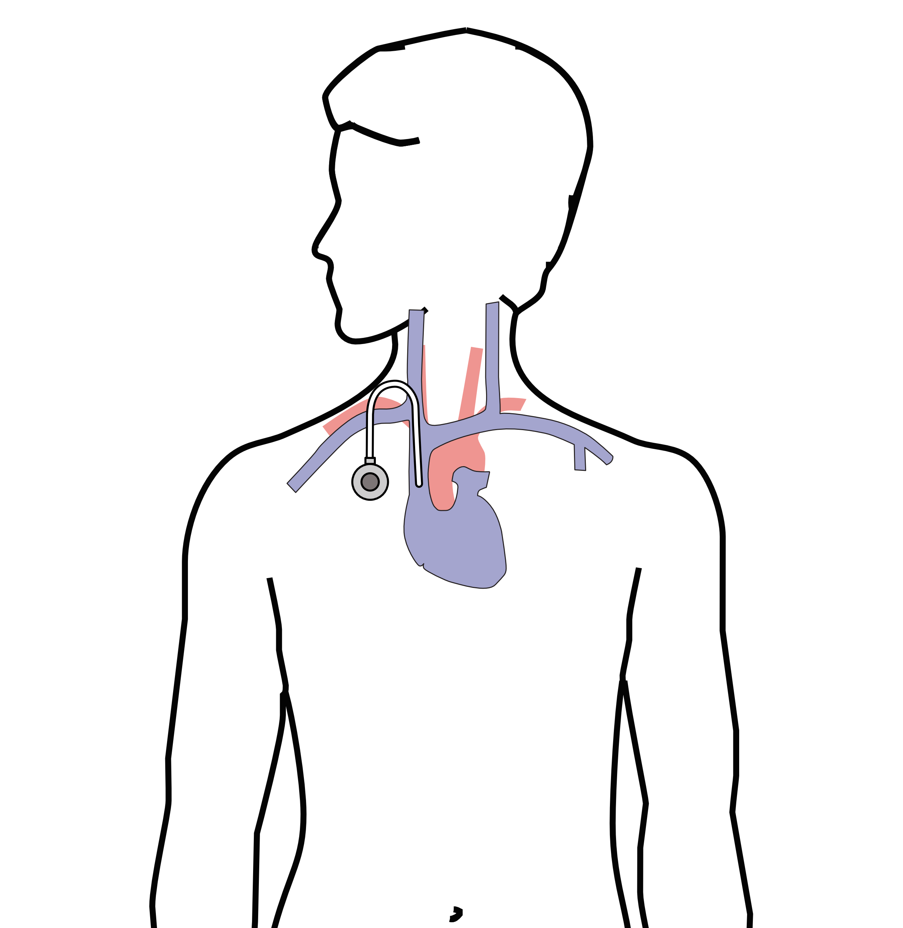
Central Venous Port
Implantable device makes chemo easier
May shower in 24 hrs
No special care at home
OK for FLOT chemo
Allows for blood draws

Slide 45
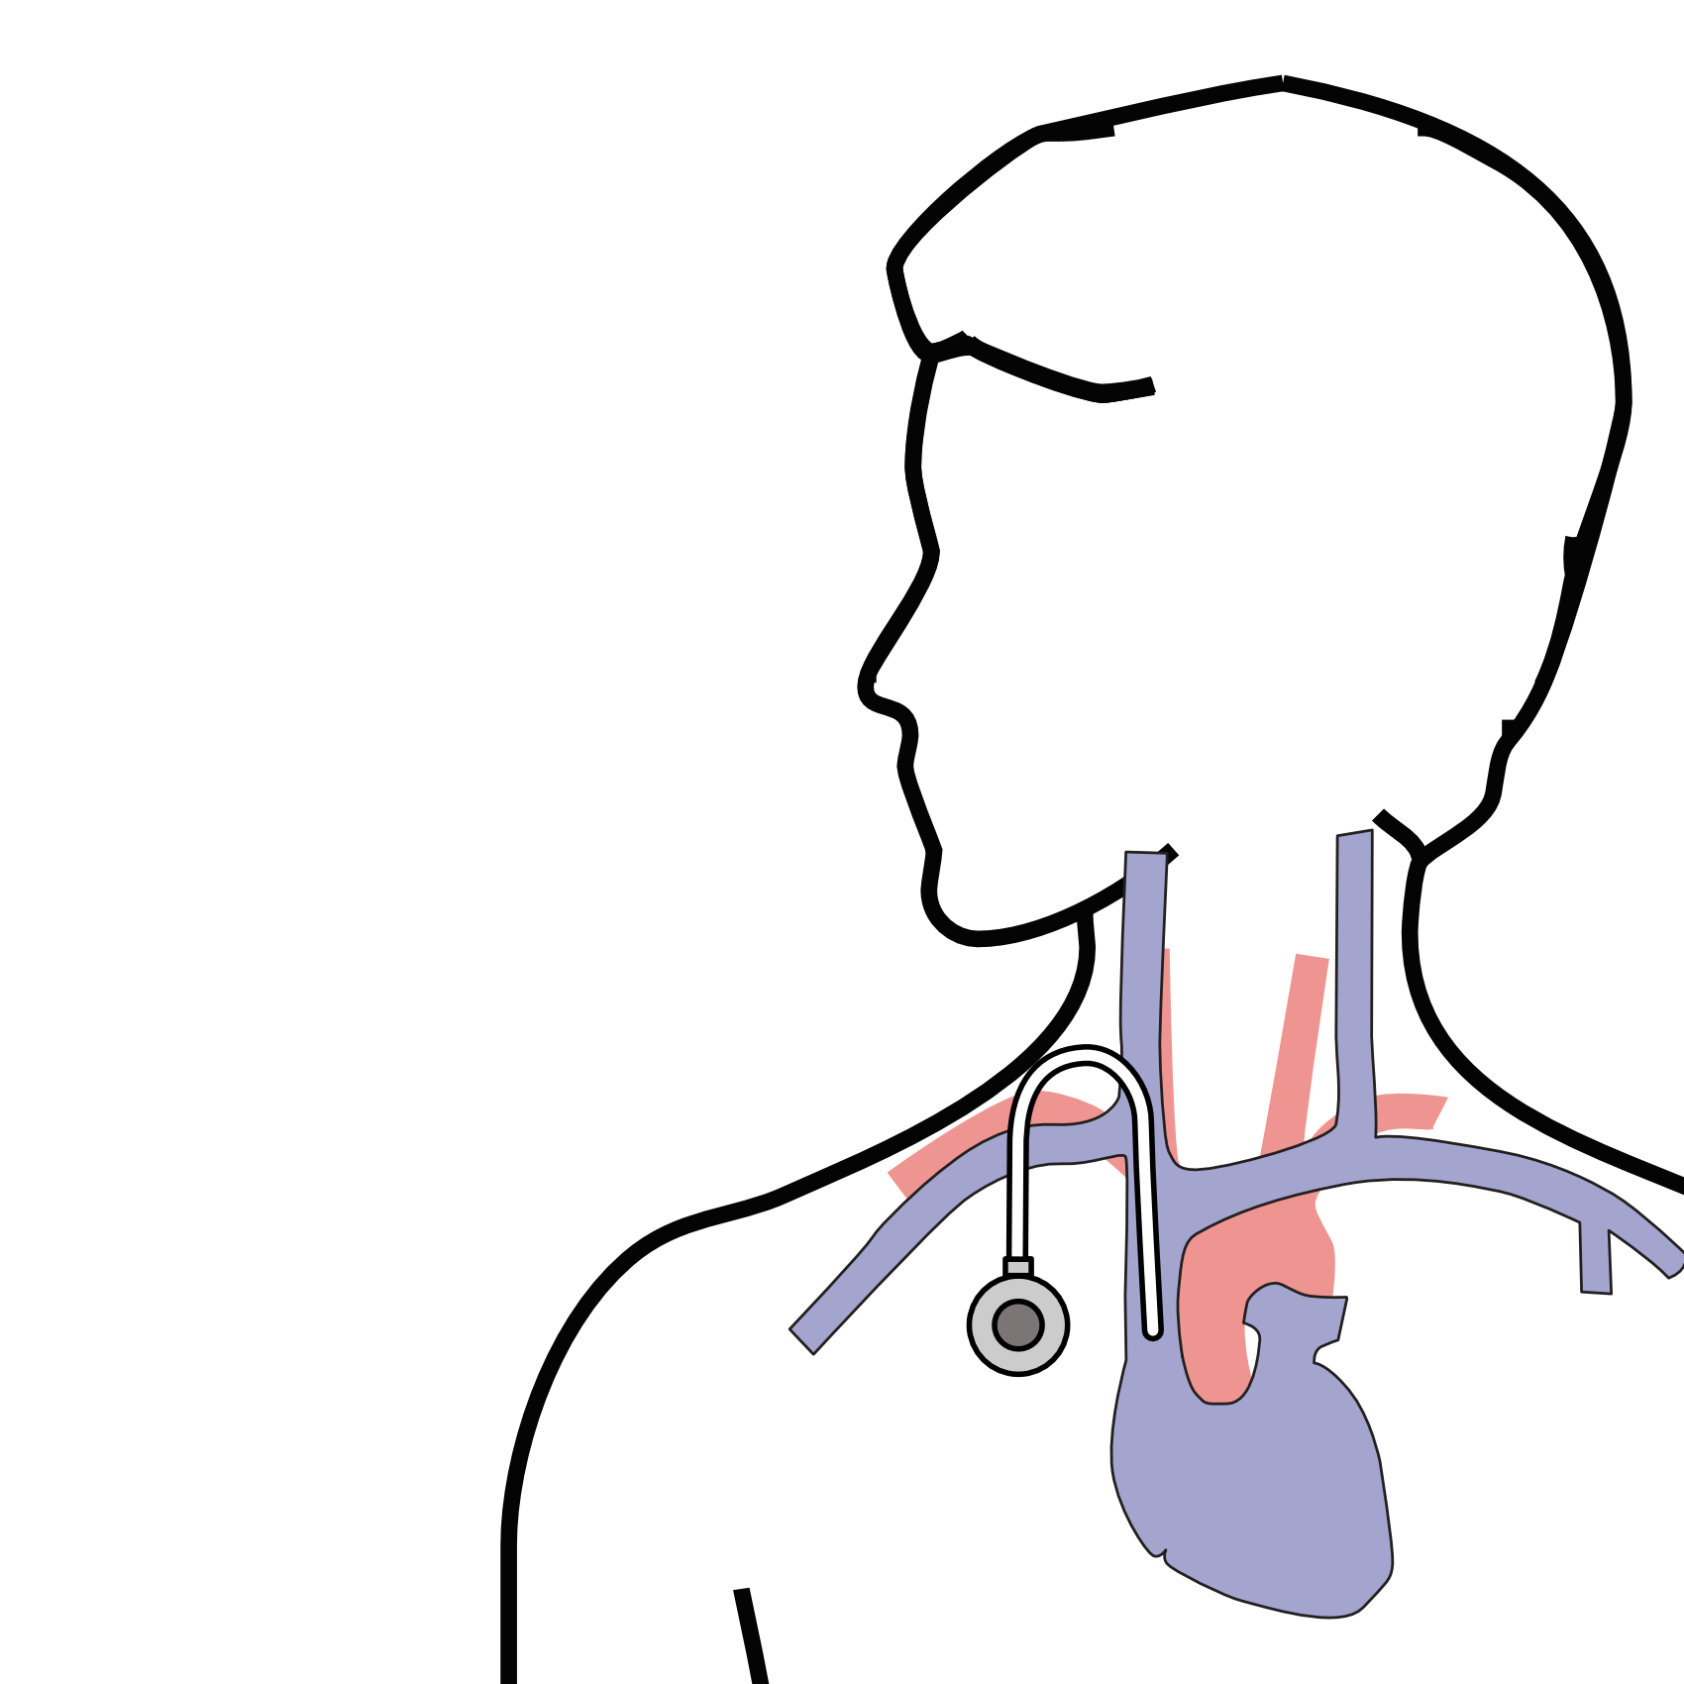
Central Venous Port
Implanted under skin
Neck incision (1/4”)
Incision below the collarbone
Sutures dissolve
“Superglue” on incisions

Slide 46
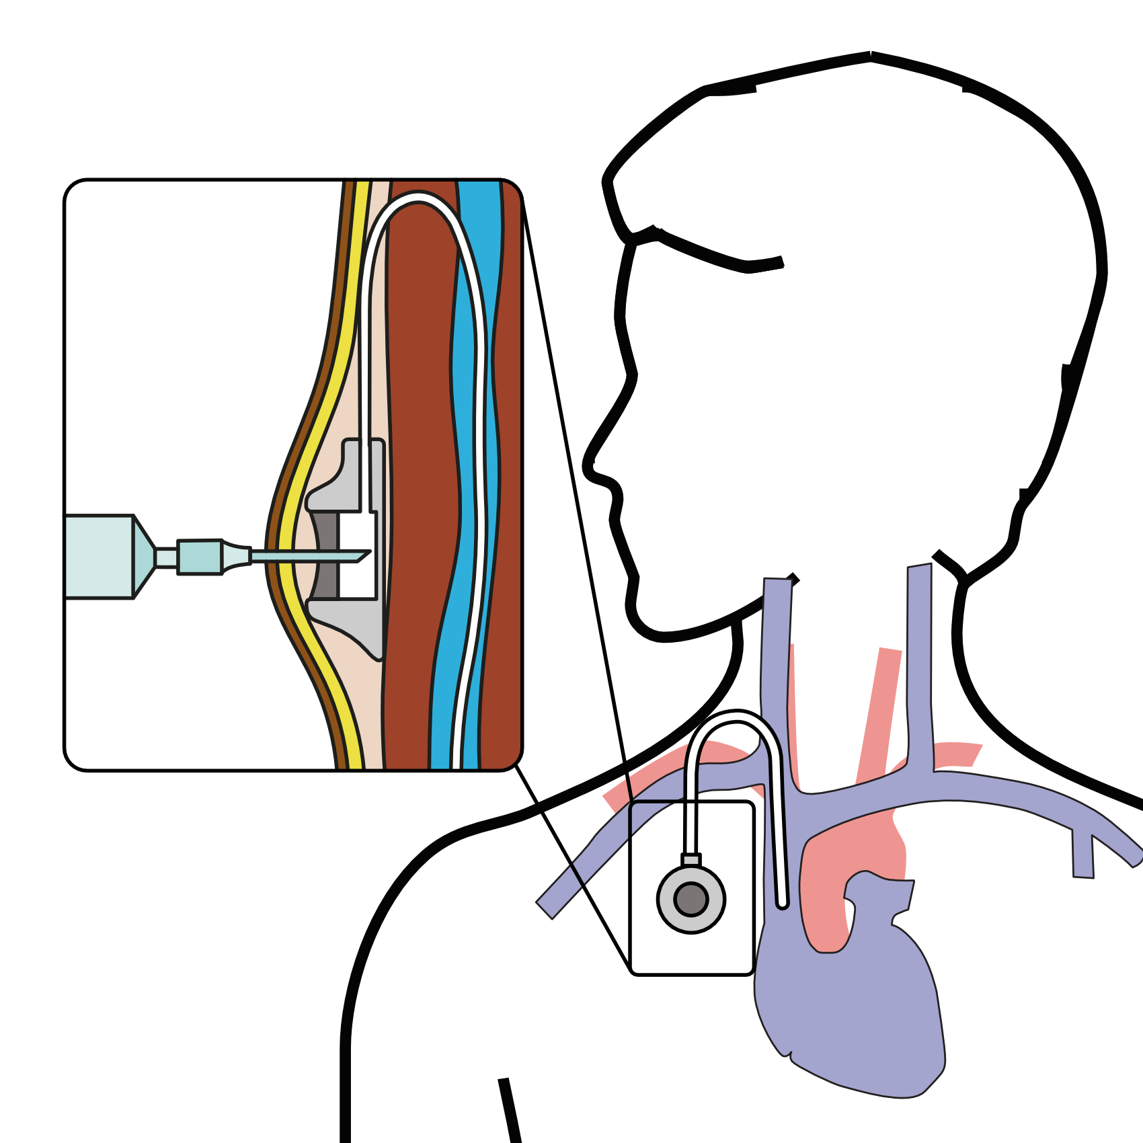
Central Venous Port
When it is time for chemotherapy, a needle is inserted through the skin into the port

Slide 47
Restaging
CT or PET scan will be performed after preoperative therapy
Surgery performed after restaging
Timing depends upon recovery from therapy

Slide 48
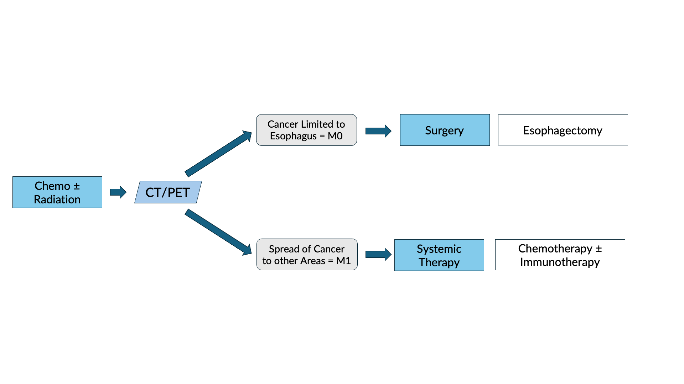
Restaging after Chemotherapy $±$ Radiation

Slide 49
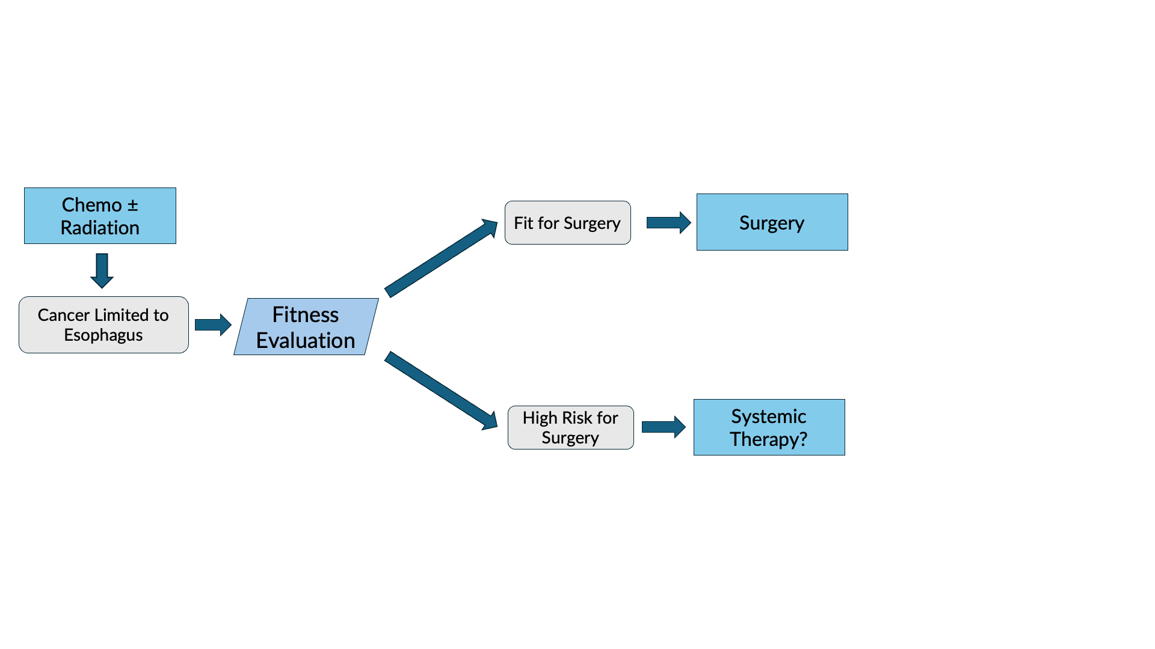
Fitness Evaluation prior to Surgery

Slide 50
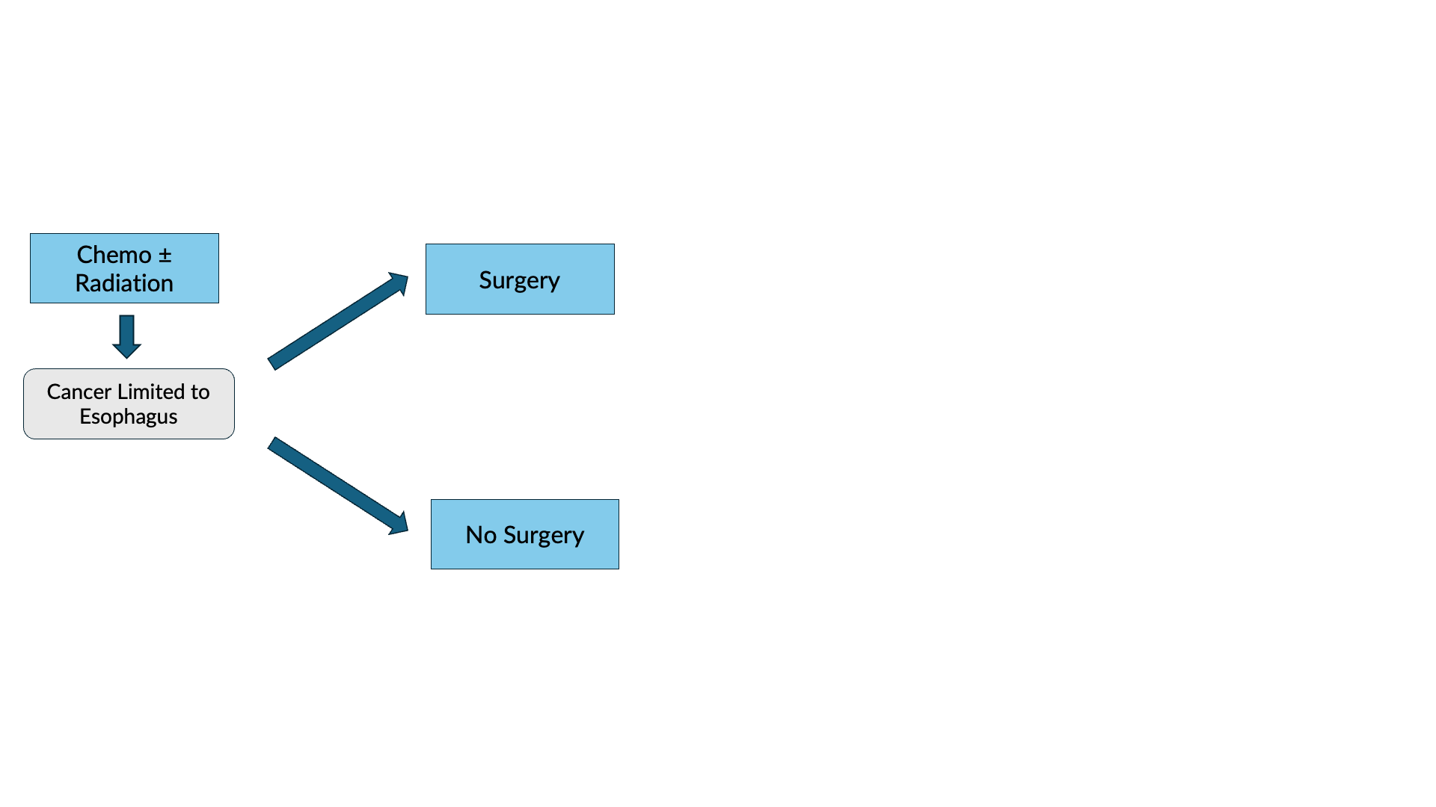
Surgery vs No Surgery

Slide 51
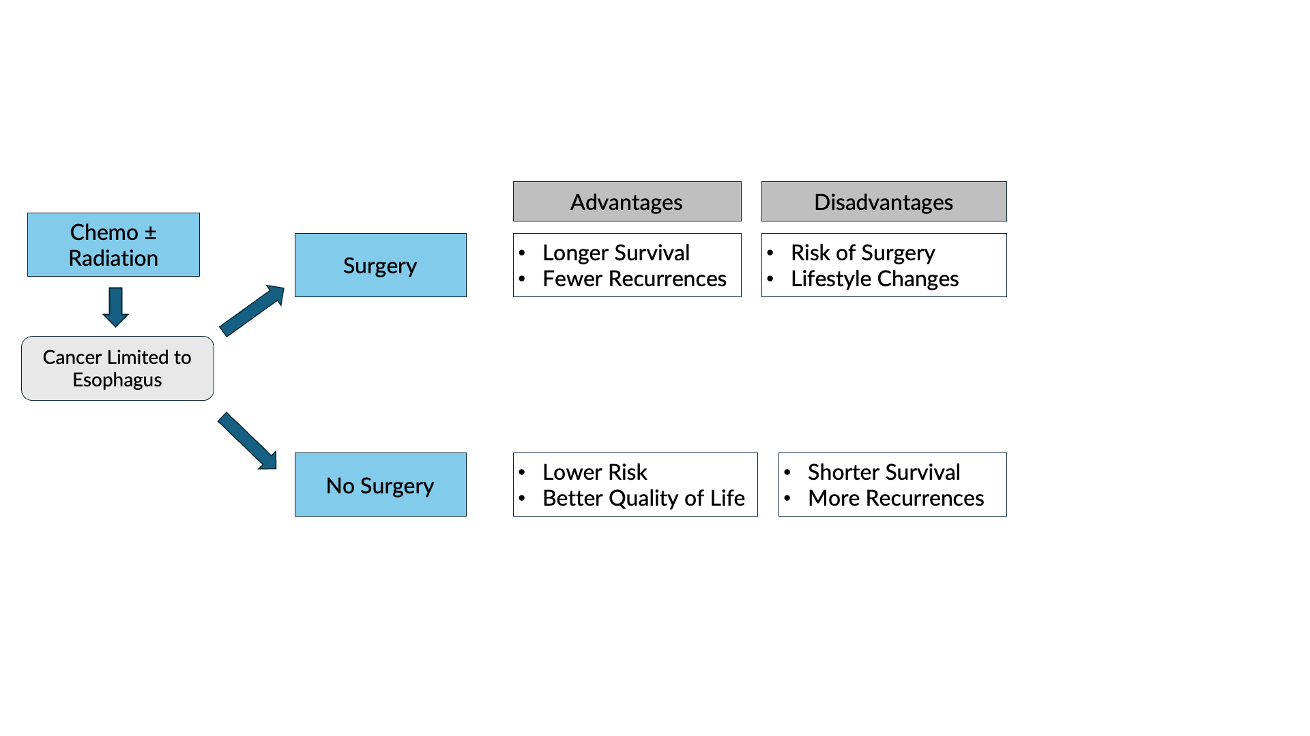
Surgery Advantages + Disadvantages

Slide 52
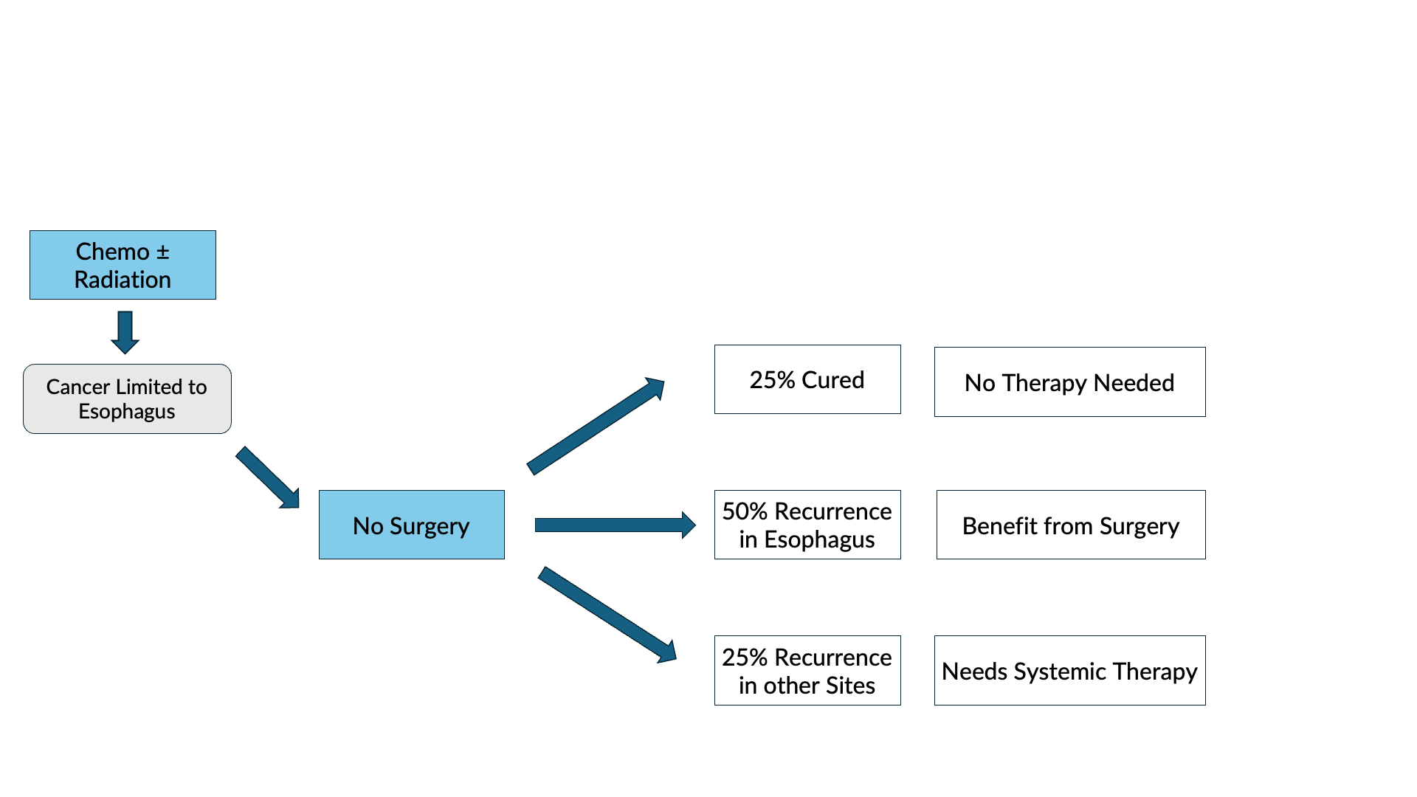
Outcomes after Chemotherapy $±$ Radiation

Slide 53
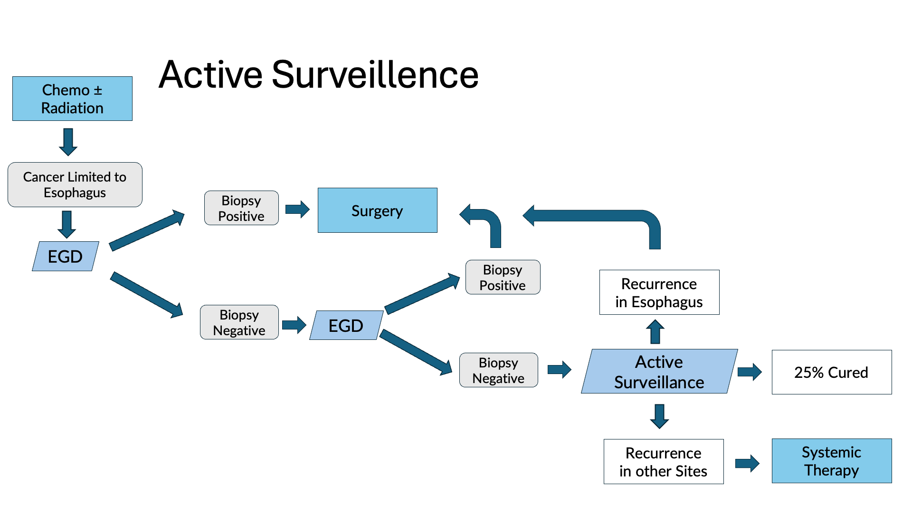

Slide 54
Active Surveillance
Active Surveillance is appropriate when:
CT/PET shows no signs of spread
EGD biopsies are negative
Active Surveillance reduces the need for surgery by 50% but survival and disease control is probably better with immediate surgery.

Slide 55
Primary Care Practitioner (PCP)
Critical to coordinate care between specialists.
We will update your PCP after each visit
PCP Referral Line (844) 235-6998

Slide 56
My Atrium Patient Portal
Critical to good communication with your care team
Available for desktop or laptop or phone
Sign up at my.atriumhealth.org

Slide 57
Exercise
Reduces risk of complications from treatment
Goal is 30min/day of vigorous exercise 6 days/wk
Working hard enough that you can’t converse
Start slowly and build up
Every day counts! (Aim for daily activity)

Slide 58
Smoking Cessation
Smoking makes cancer treatment more difficult
Increases risk of complications after surgery
Options for help with smoking cessation:
NC Quit Line 1-800-QUIT-NOW (1-800-784-8669)
American Lung Assn www.freedomfromsmoking.org
Smoking Cessation Counseling (Metro Charlotte)

Slide 59
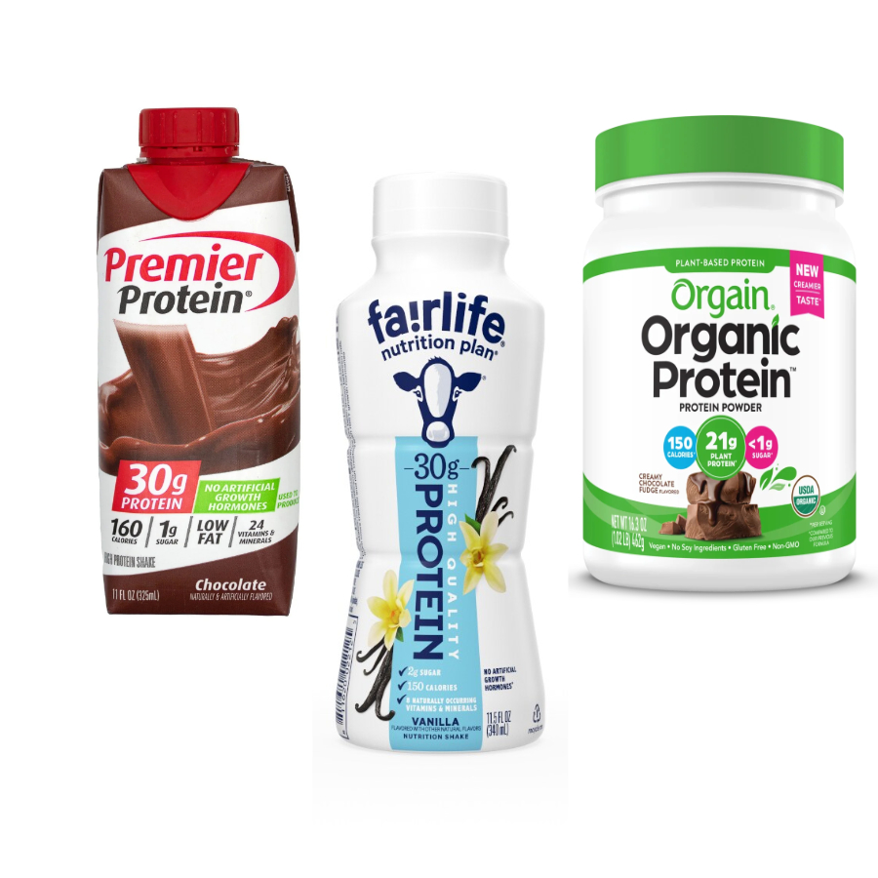
Protein Needs
Men: Average 75 grams/day
Women: Average 60 grams/day
Protein Shakes provide protein with minimal sugar

Slide 60
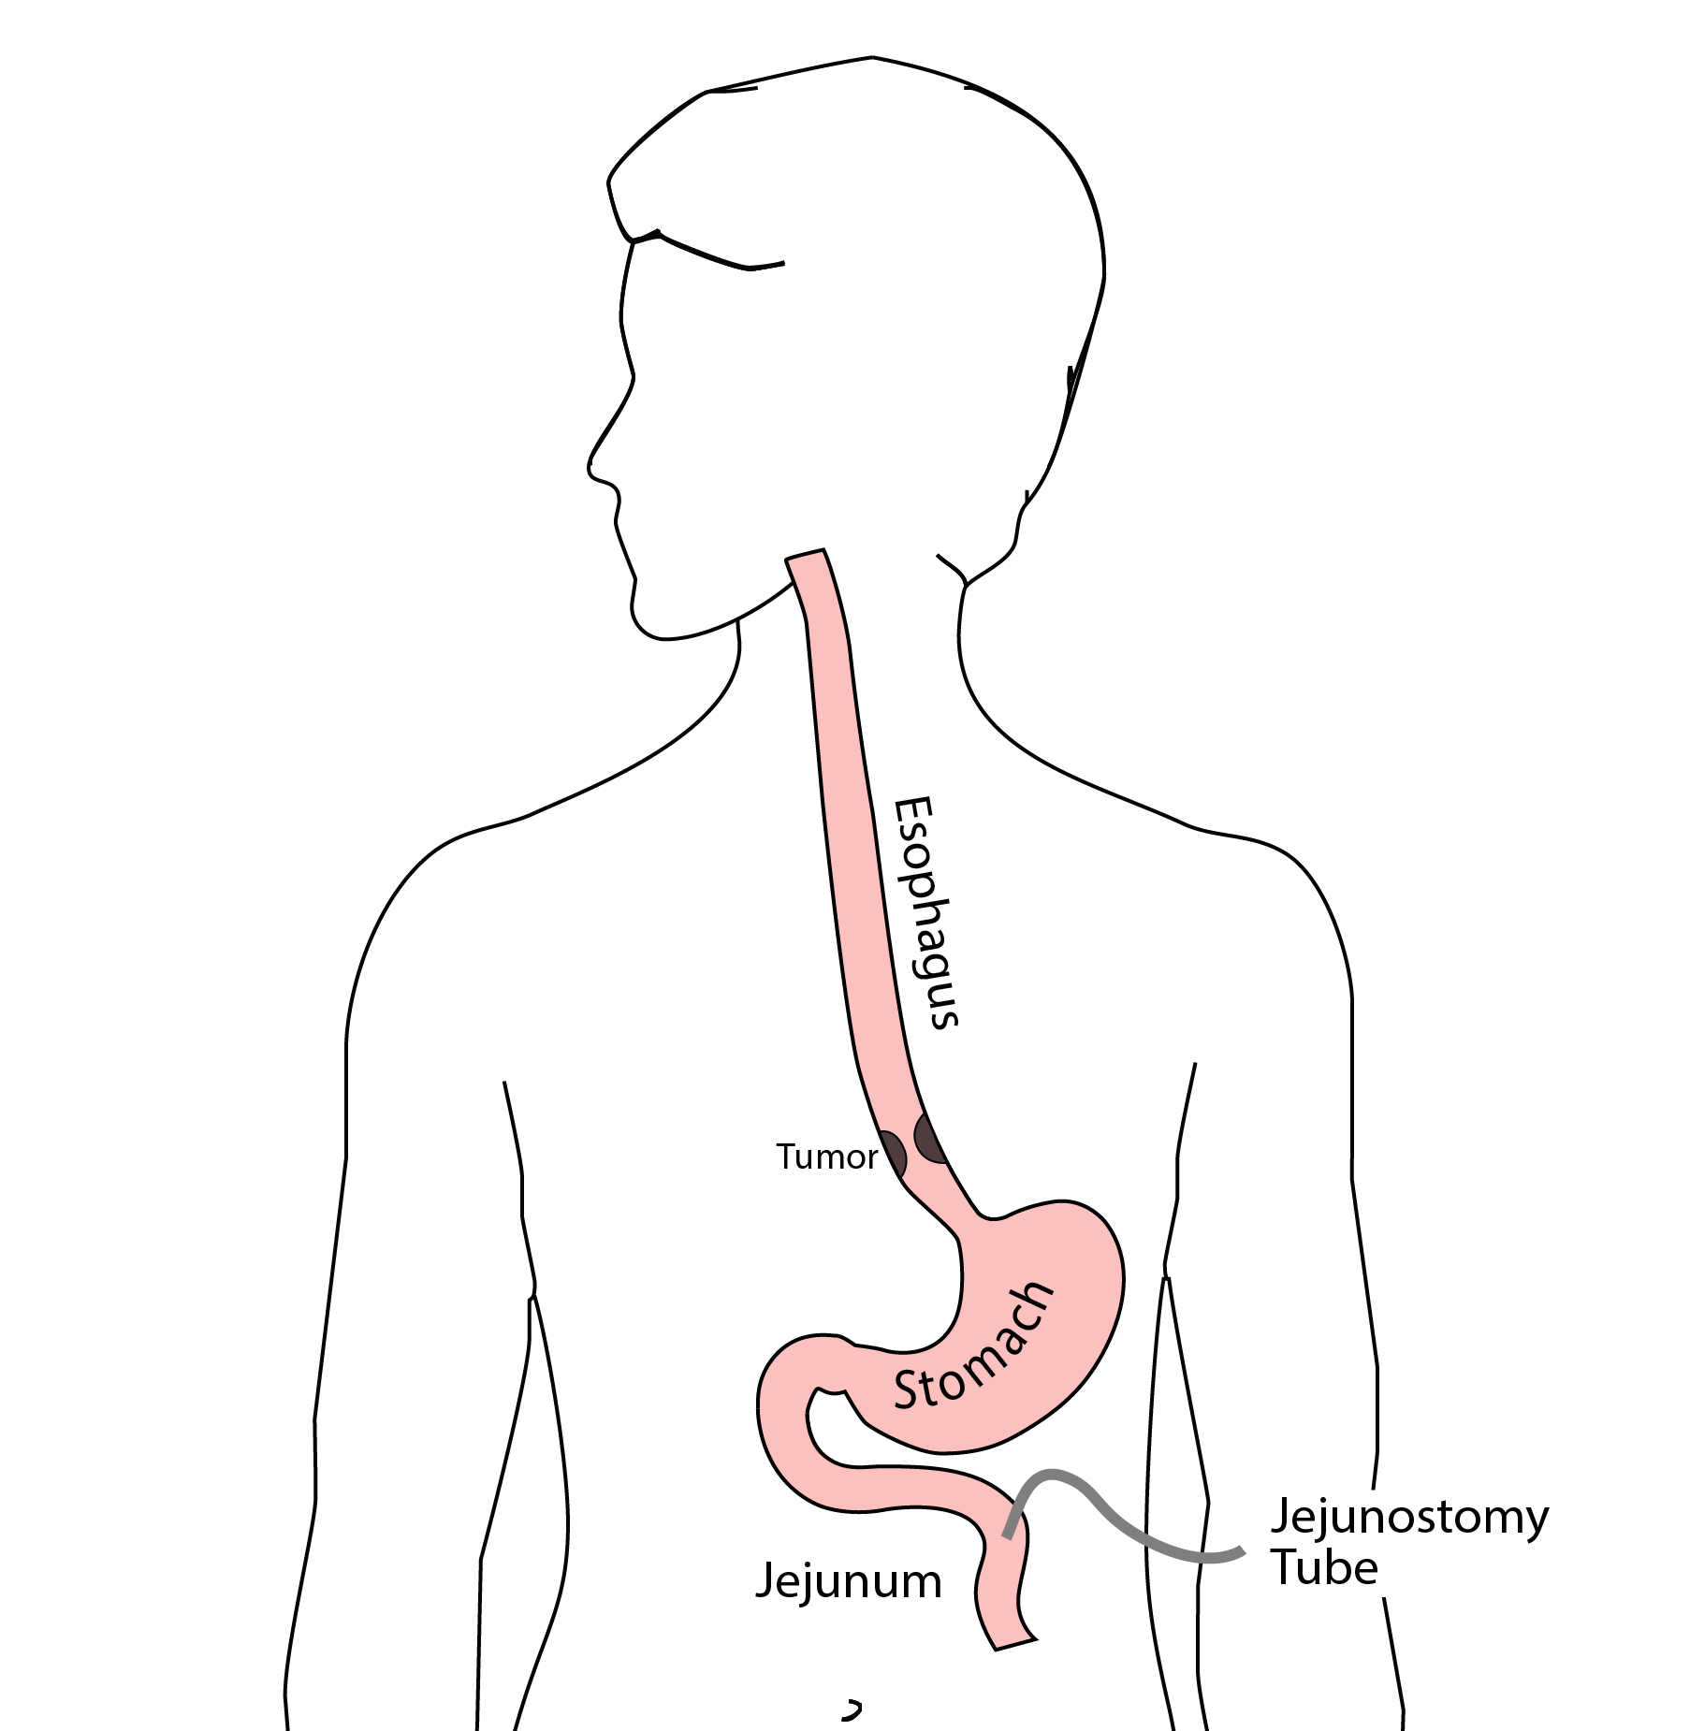
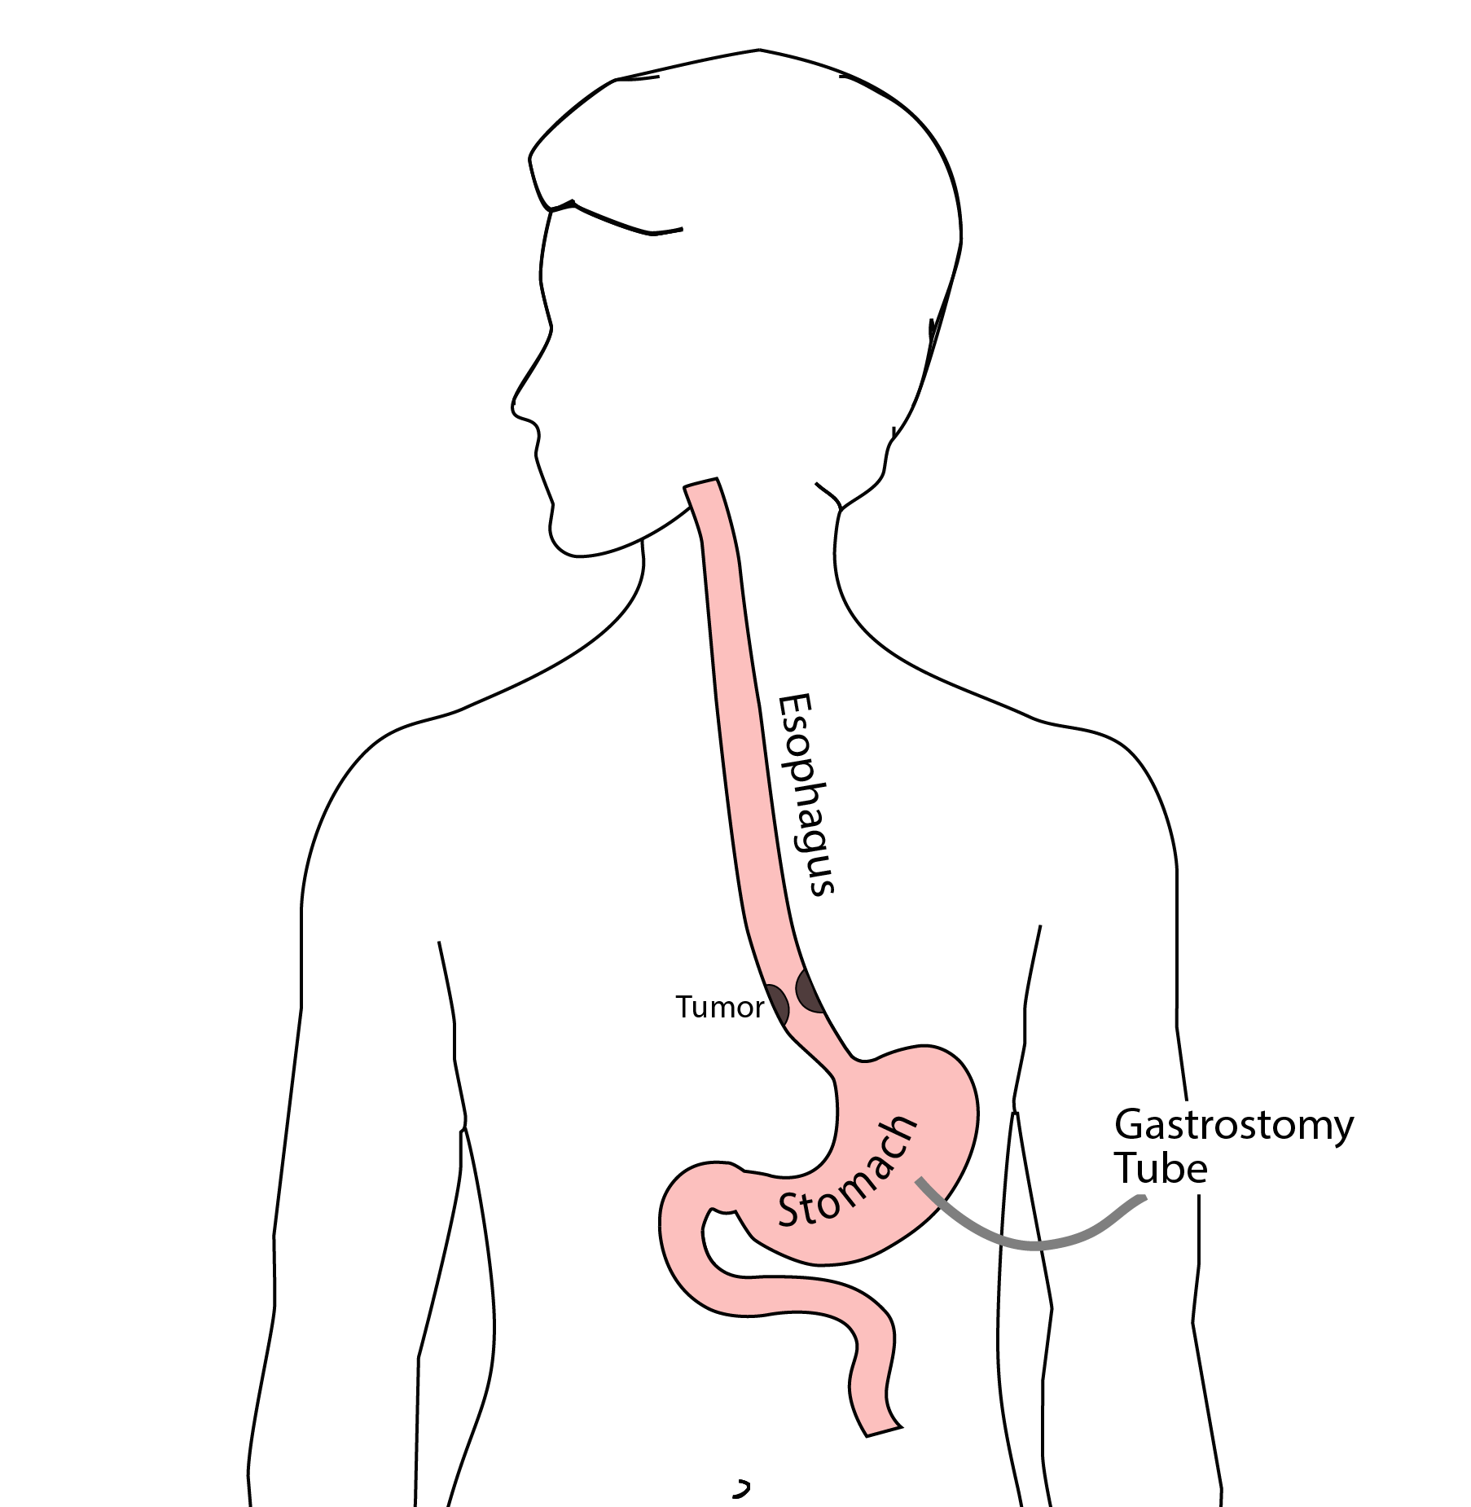
Feeding Tubes

Slide 61
Gastrostomy Tube
Feeding Gastrostomy
Feeding with a syringe several times per day.
Tube can be hidden underneath clothing
Tube does not interfere with eating by mouth
Removed easily in the office when no longer needed

Slide 62
Gastrostomy Tube Methods
PEG: Tube placed by endoscopy
Laparoscopic: Tube placed surgically by laparoscopy
Preferred method depends upon whether esophagectomy is planned

Slide 63
Gastrostomy Tube
Outpatient Placement (go home the same day)
Central venous port can be placed at the same time (if needed)

Slide 64
Jejunostomy Tube
Nutrition to bypasses the esophagus and stomach
Placed in small intestine
Pump administers feedings slowly
Feeding done at night

Slide 65
Jejunostomy Typical Regimen
Jejunostomy tube feeds for 16 hours (6pm-10am)
Men: 75mL/hour x 16 hours = 5 cartons
Women: 60mL/hour x 16 hours = 4 cartons
Water 240ml (8oz) via syringe 4x/day
Hospital nurses will teach use of the feeding tube

Slide 66
Jejunostomy Feeds with Diabetes
Jejunostomy feedings elevate blood sugars
Insulin may be required along with feeds
Typical Pattern for tube feeds
Feeds run via pump from 6pm to 10am
Insulin at 6pm (70/30 insulin)
Insulin at Midnight (70/30 insulin)
No insulin if tube feedings are not run

Slide 67
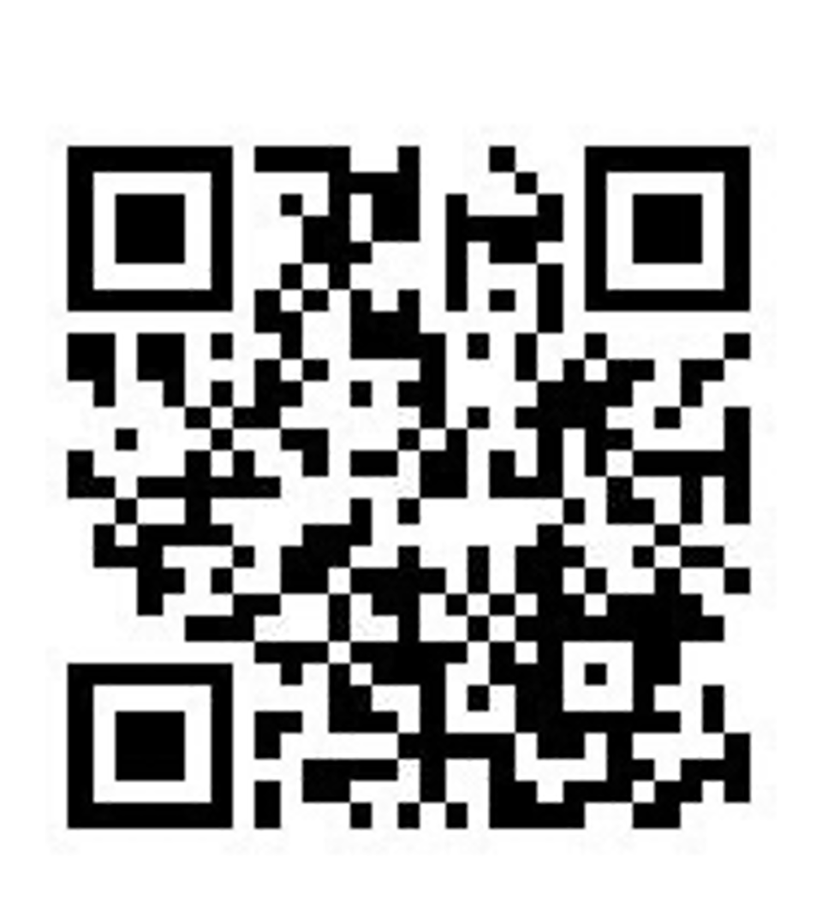
Jejunostomy Video
A video is available to help become familiar with the feeding jejunostomy

Slide 68
Team Members - Physicians
Primary Care Provider
Gastroenterologist
Medical Oncologist (chemotherapy)
Radiation Oncologist (radiation)
Surgeons
Jonathan Salo MD
Jeffrey Hagen MD
Michael Roach MD

Slide 69
Team Members - Support Staff
Physician Assistant - Kate Duncan PA-C
Dietitian - Liz Koch
Nurses
Matthew Carpenter RN
Brandon Galloway LPN
Navigators
Laura Swift
Lorna Espinal
Care Coordinator - Karen Julian-Martinez

