Slide 1
M1 Cancer of the Stomach

Slide 2
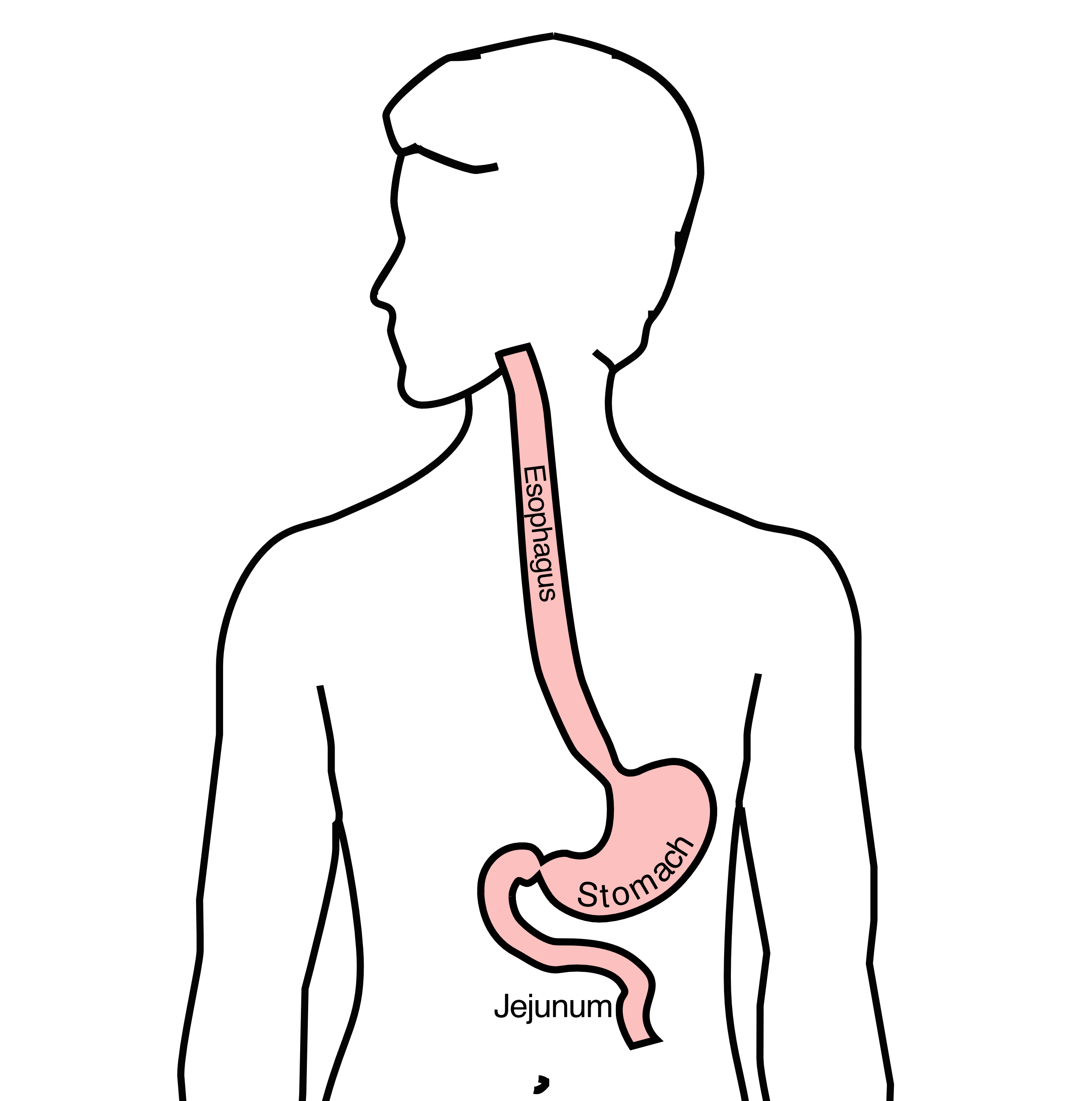
Anatomy
Food moves from the throat
$→$ esophagus
$→$ stomach
$→$ small bowel (jejunum)

Slide 3
Cancer Staging
Staging refers to the tests to determine
How large is the tumor?
Has there been spread to lymph nodes?
Has it spread to other parts of the body?
Treatment options depend upon the cancer stage

Slide 4
Cancer Staging
T = Tumor - Depth of growth into the wall
N = Nodes - Spread to the lymph nodes
M = Metastasis - Spread to liver, lungs, or bone

Slide 5
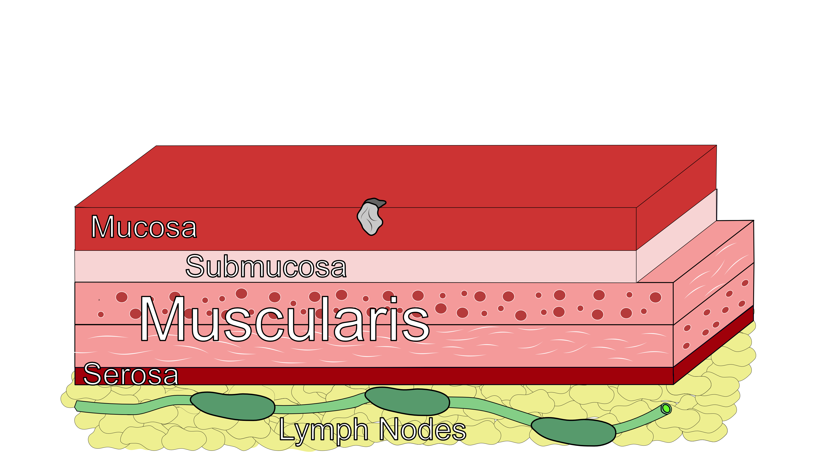
Early Stage Cancers
Cancers start on the very inside layer called the mucosa

Slide 6

Locally-advanced Cancers
Over time, cancers can grow into the muscular wall

Slide 7
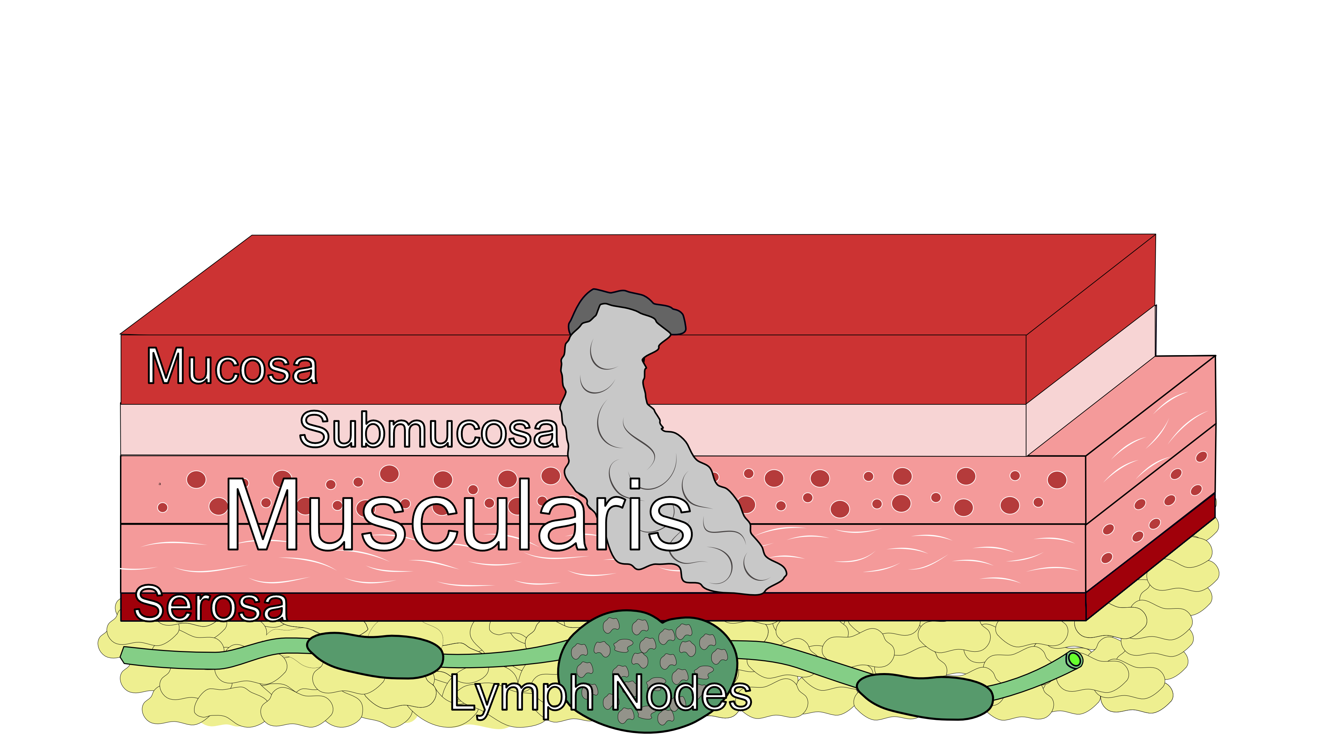
Lymph Nodes
In some cases, cancer cells can break off from the main tumor and spread to lymph nodes

Slide 8
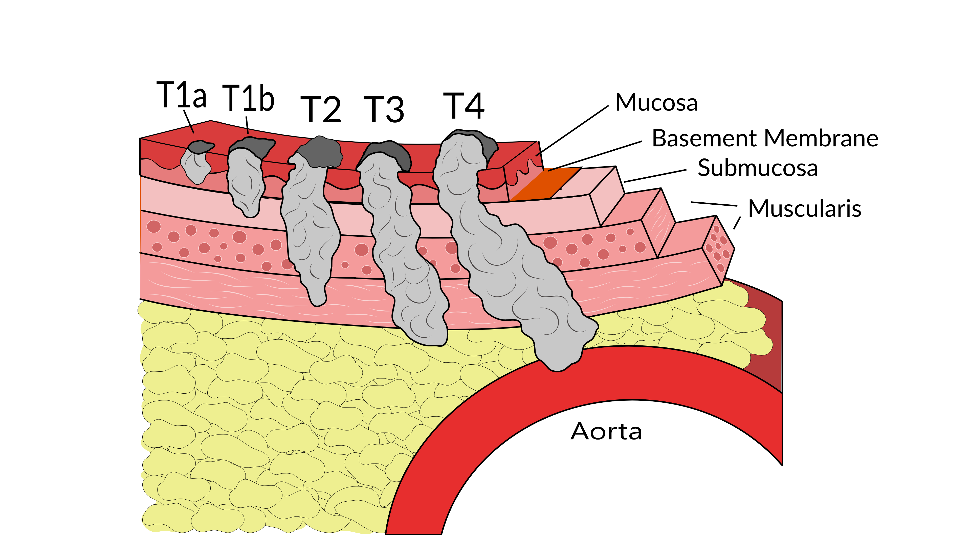
T Stage
Cancers are categorized based upon the thickness of the tumor, known as the T stage

Slide 9
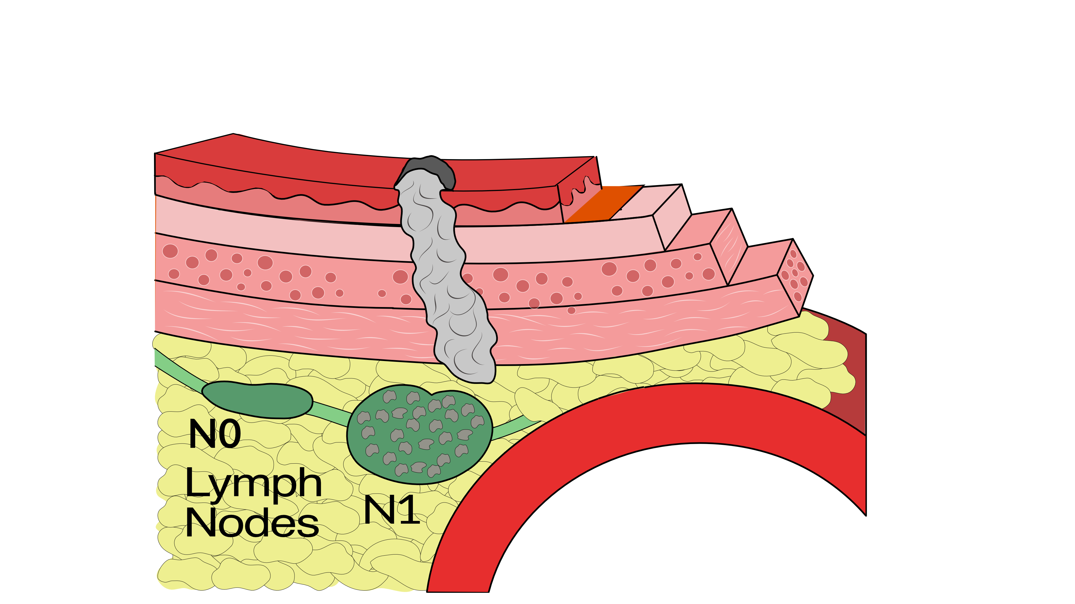
N Stage
Cancers are categorized by whether there is spread to the nodes.
N0 cancers have not spread to the nodes
N1 cancers have spread to the nodes.

Slide 10
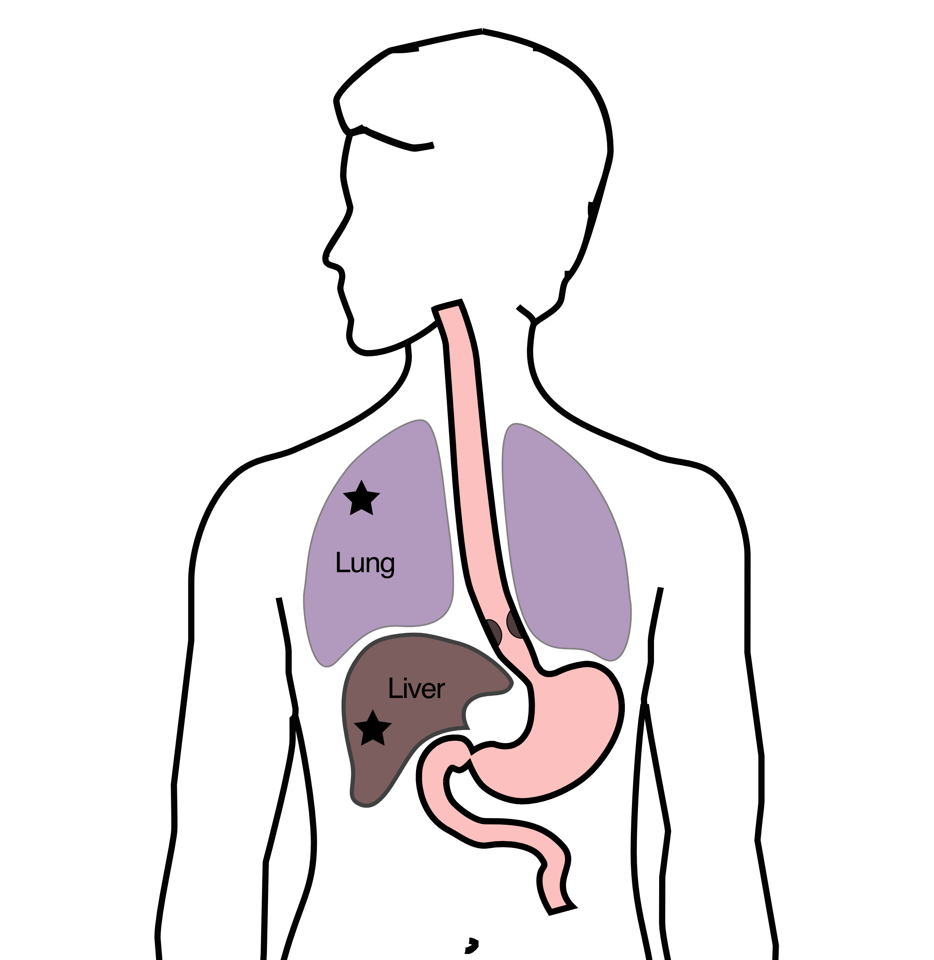
M Stage
Some cancers spread to other parts of the body
M0 cancers have not spread
M1 cancers have spread to lungs, liver, bone, or within the abdomen

Slide 11
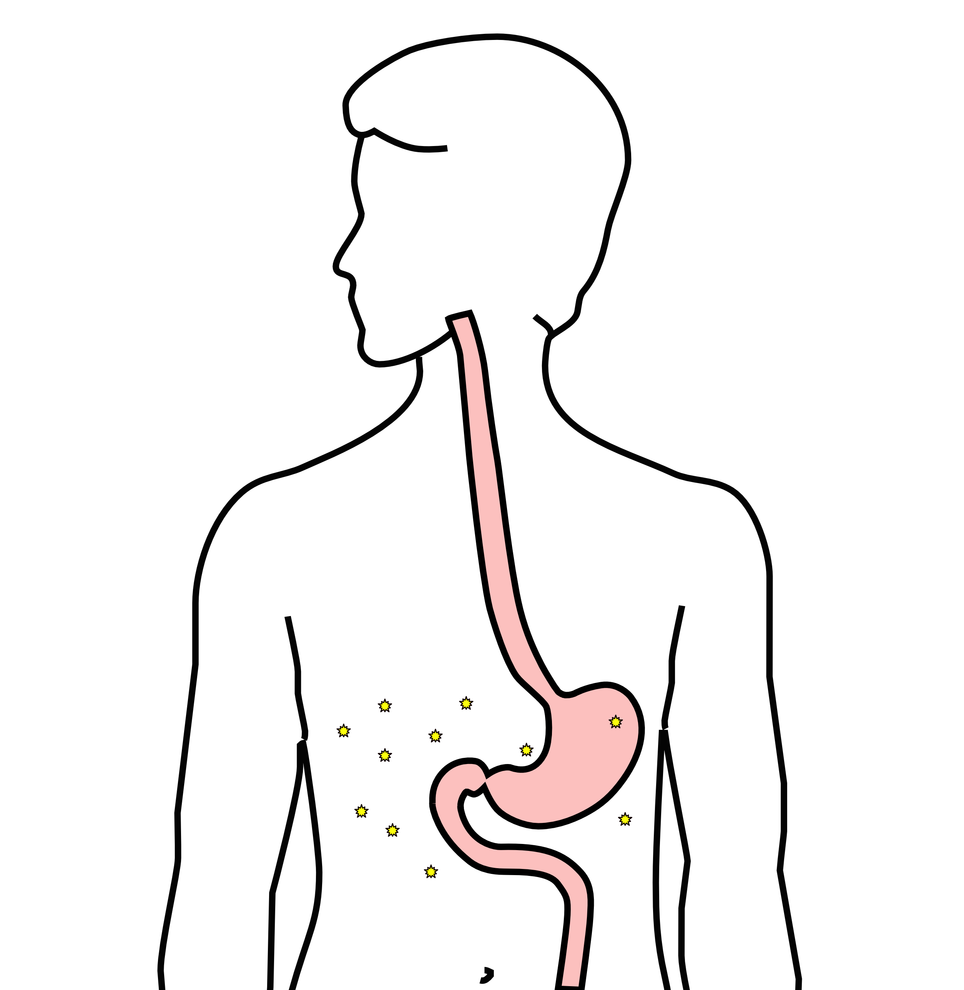
Carcinomatosis (M1)
Spread within the abdomen is carcinomatosis
Tumors can be very small (grain of rice)
Fluid can also build up: ascites

Slide 12
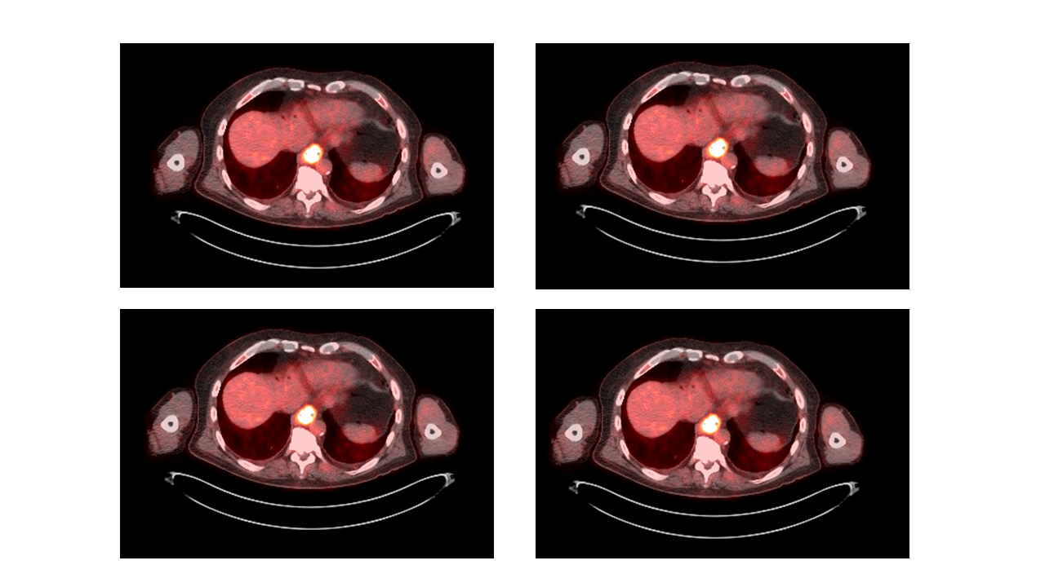
PET scan
Similar to CT scan
Tracer shows ‘hot spots’
Cancer
Inflammation or infection
Normal organs (heart, kidneys)

Slide 13
PET scan Preparation
Nothing to eat or drink for 4 hours prior to exam
High-protein low-carbohydrate diet the day prior
No strenous activity day prior to study

Slide 14
PET scan Prepration - Diabetic Patients
PET scan uses a modified sugar as a tracer $⇒$ you will need to be careful about blood sugar and insulin before the study
No insulin within 4 hours of the exam
OK to take diabetes pills the day of the exam
PET scans are generally best in the morning
Plan to eat a meal after the PET scan, with half the usual morning dose of insulin

Slide 15
PET scan Prepration - Diabetic Patients
If PET is scheduled after 10AM:
low-carbohydrate breakfast at least 4 hours before
half the usual regular (short-acting) insulin
No long-acting insulin after midnight.
Insulin pump: turn it off 4 hours before the study (or turn it down to basal/night-time rate)

Slide 16
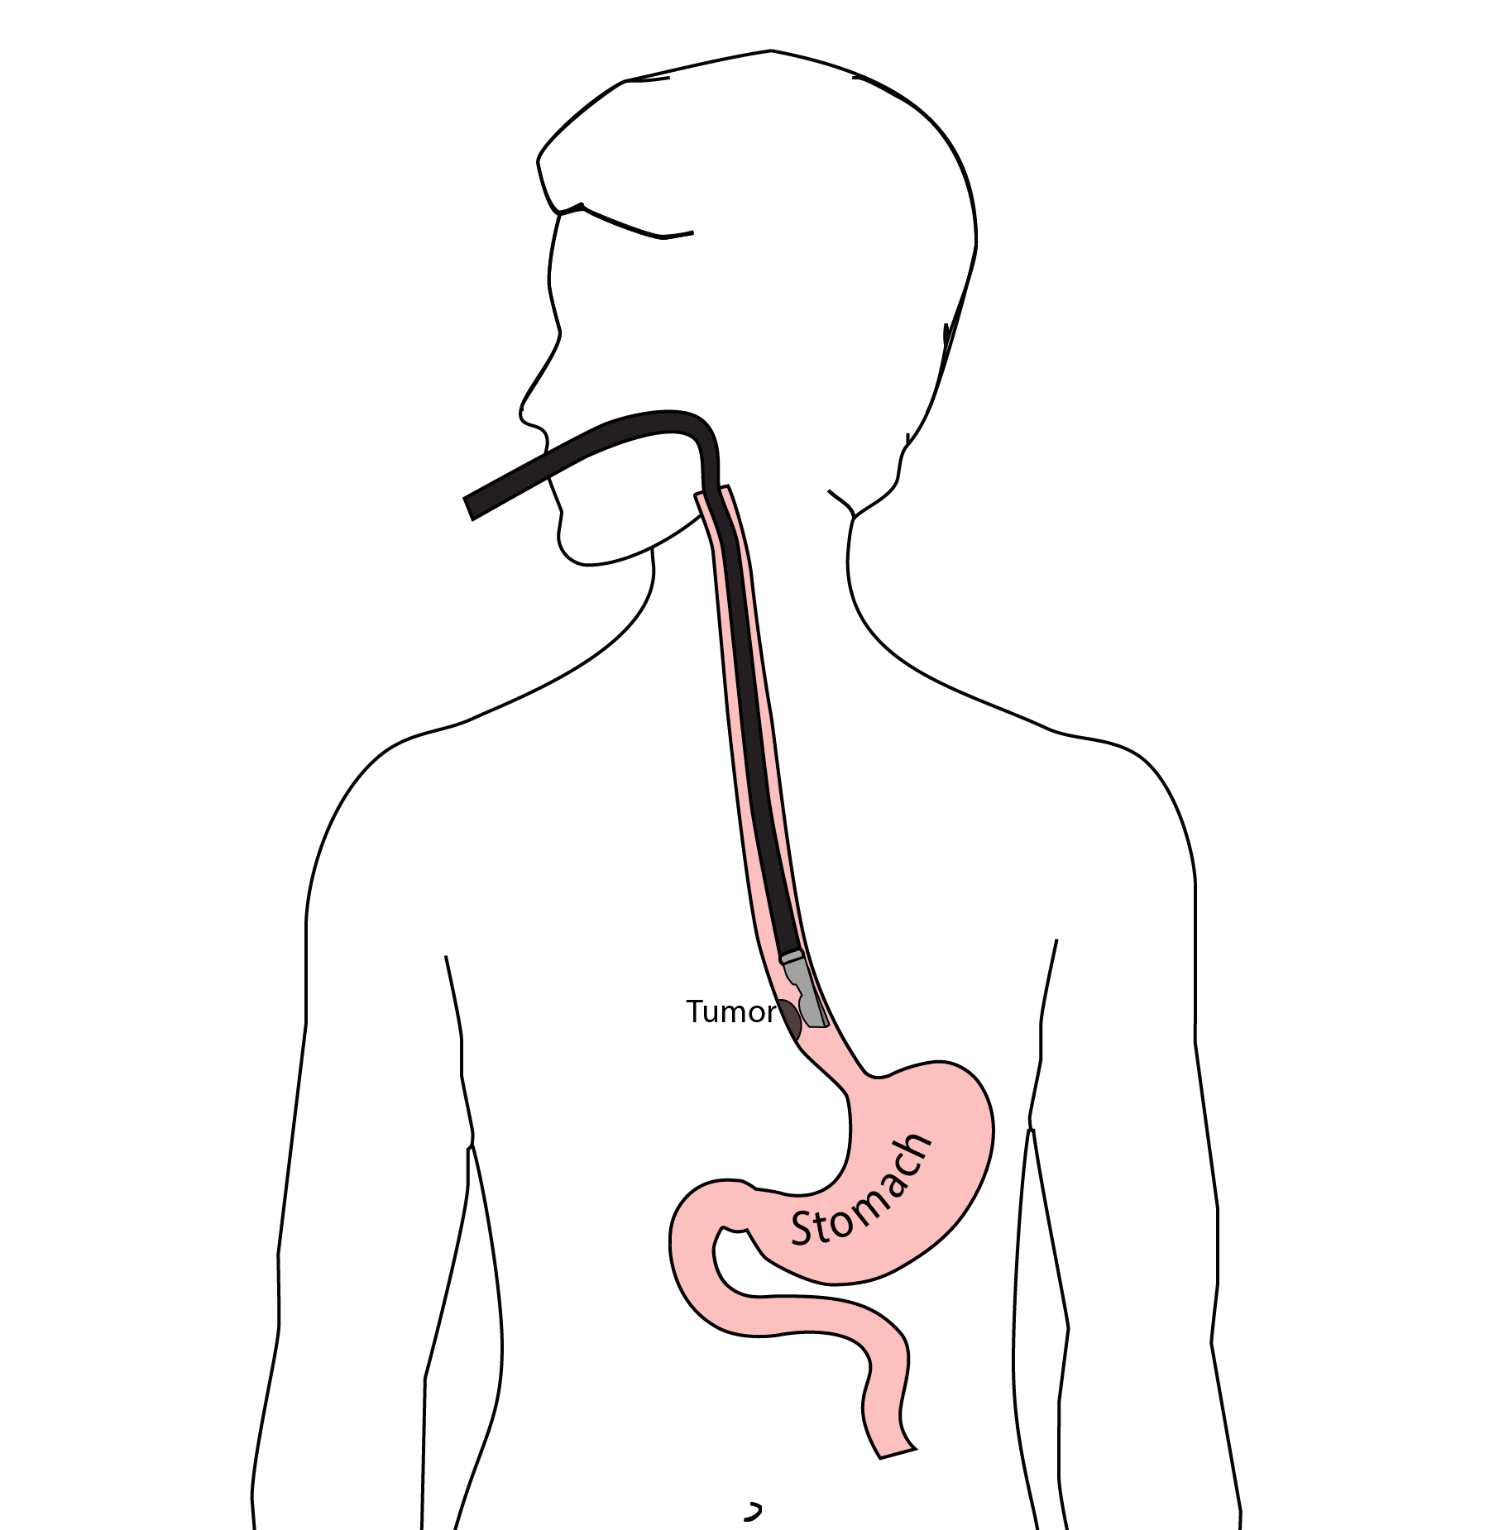
Endoscopic Ultrasound
Similar to upper endoscopy (EGD)
Ultrasound in scope
Evaluates T stage

Slide 17
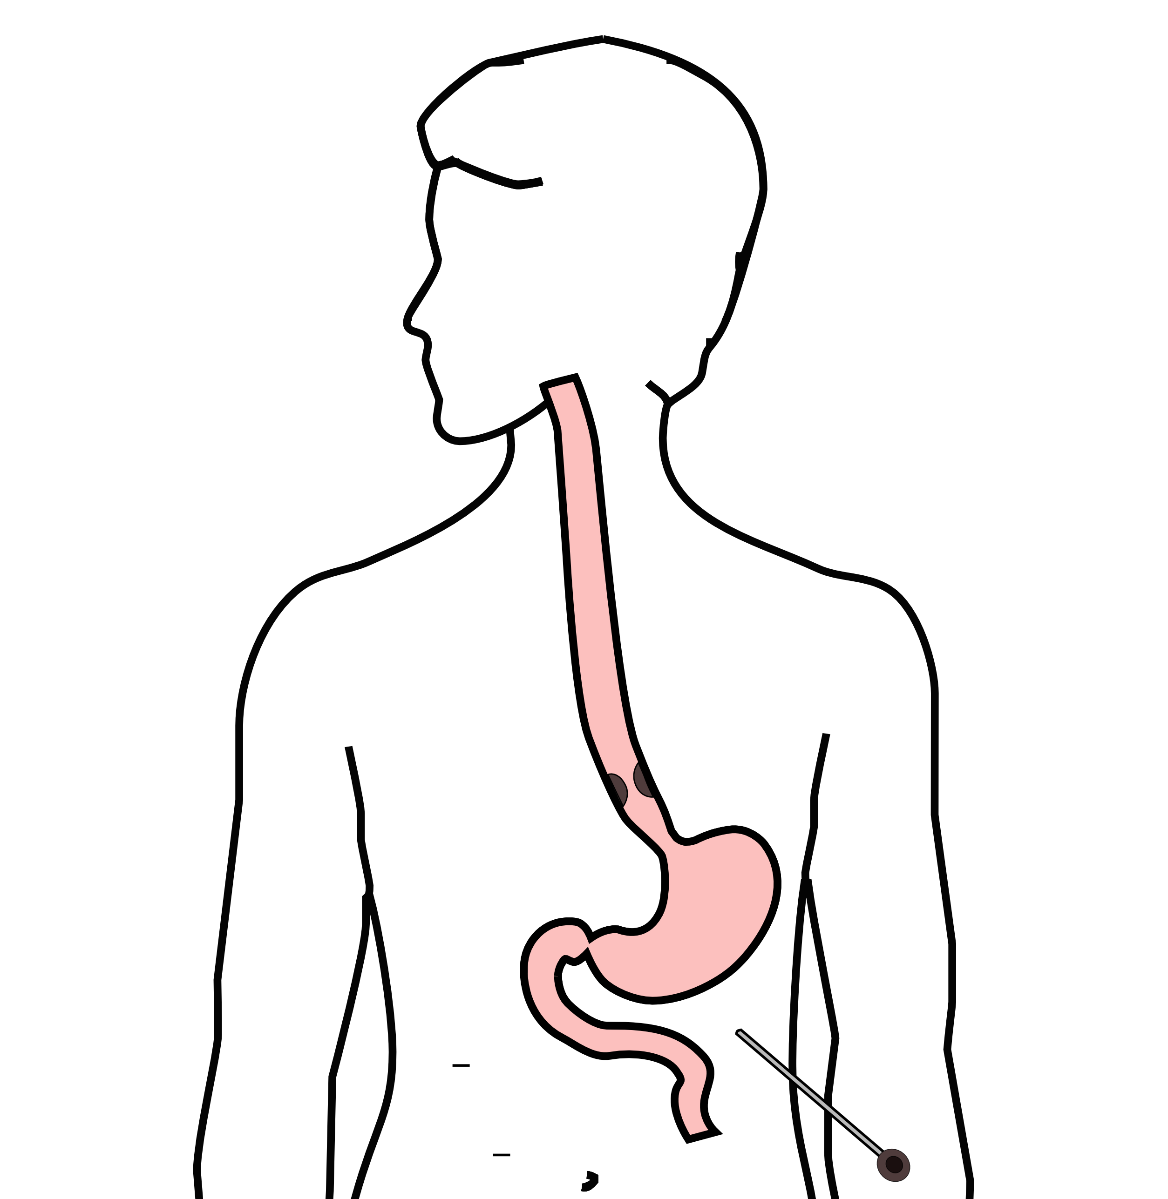
Laparoscopy
Some stomach cancers can spread inside the abdomen
Areas of spread can be very small (grain of rice)
Laparoscopy can detect spread inside the abdomen

Slide 18
Laparoscopy
General anesthetic
1/4” incisions
Telescope examines the abdomen
Biopsies performed
Fluid sampled

Slide 19
Treatment Plan
Superficial (T1a): Endoscopic Therapy Localized (T1b/T2): Surgery Locally-advanced (T3M0): Chemo $→$ Surgery Metastatic (M1): Chemotherapy

Slide 20
Tumor Biomarkers - Additional Pathology
PD-L1 $→$ Immunotherapy can be helpful
MMR $→$ Immunotherapy can be very helpful
HER-2 $→$ Herceptin (Stage IV)
Claudin 18.2 $→$ zolbetuximab (Stage IV)
Biomarkers reported in a separate pathology report
Your medical oncologist will review these with you

Slide 21
Tumor Genetic Analysis
For patients with Stage IV disease, genetic testing of the cancer can be performed:
May help identify effective drugs
Your medical oncologist will review these with you

Slide 22
Chemotherapy Administration
Most chemotherapy is administered by vein.
Several options exist to administer chemotherapy:
Intravenous catheter in peripheral veins
Peripheral Intravenous Central Catheter (PICC)
Central Venous port

Slide 23
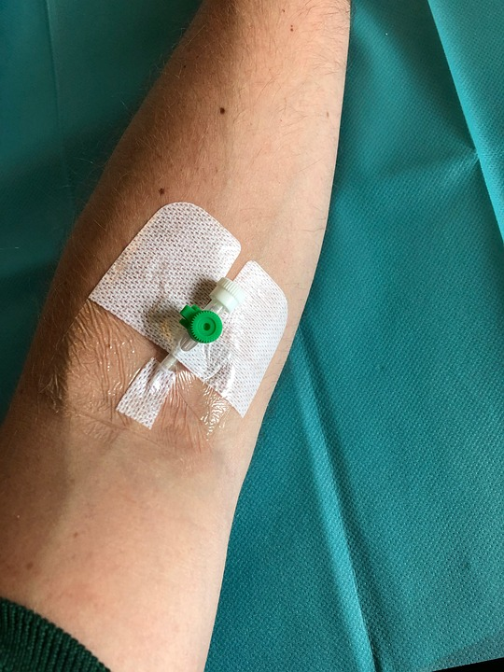
Intravenous Catheter in Peripheral Vein (“IV”)
IV catheter placed in vein of hand or arm
Allows administration of chemo and fluids
Placed for each dose
Removed that day
Not suitable for FLOT chemo

Slide 24
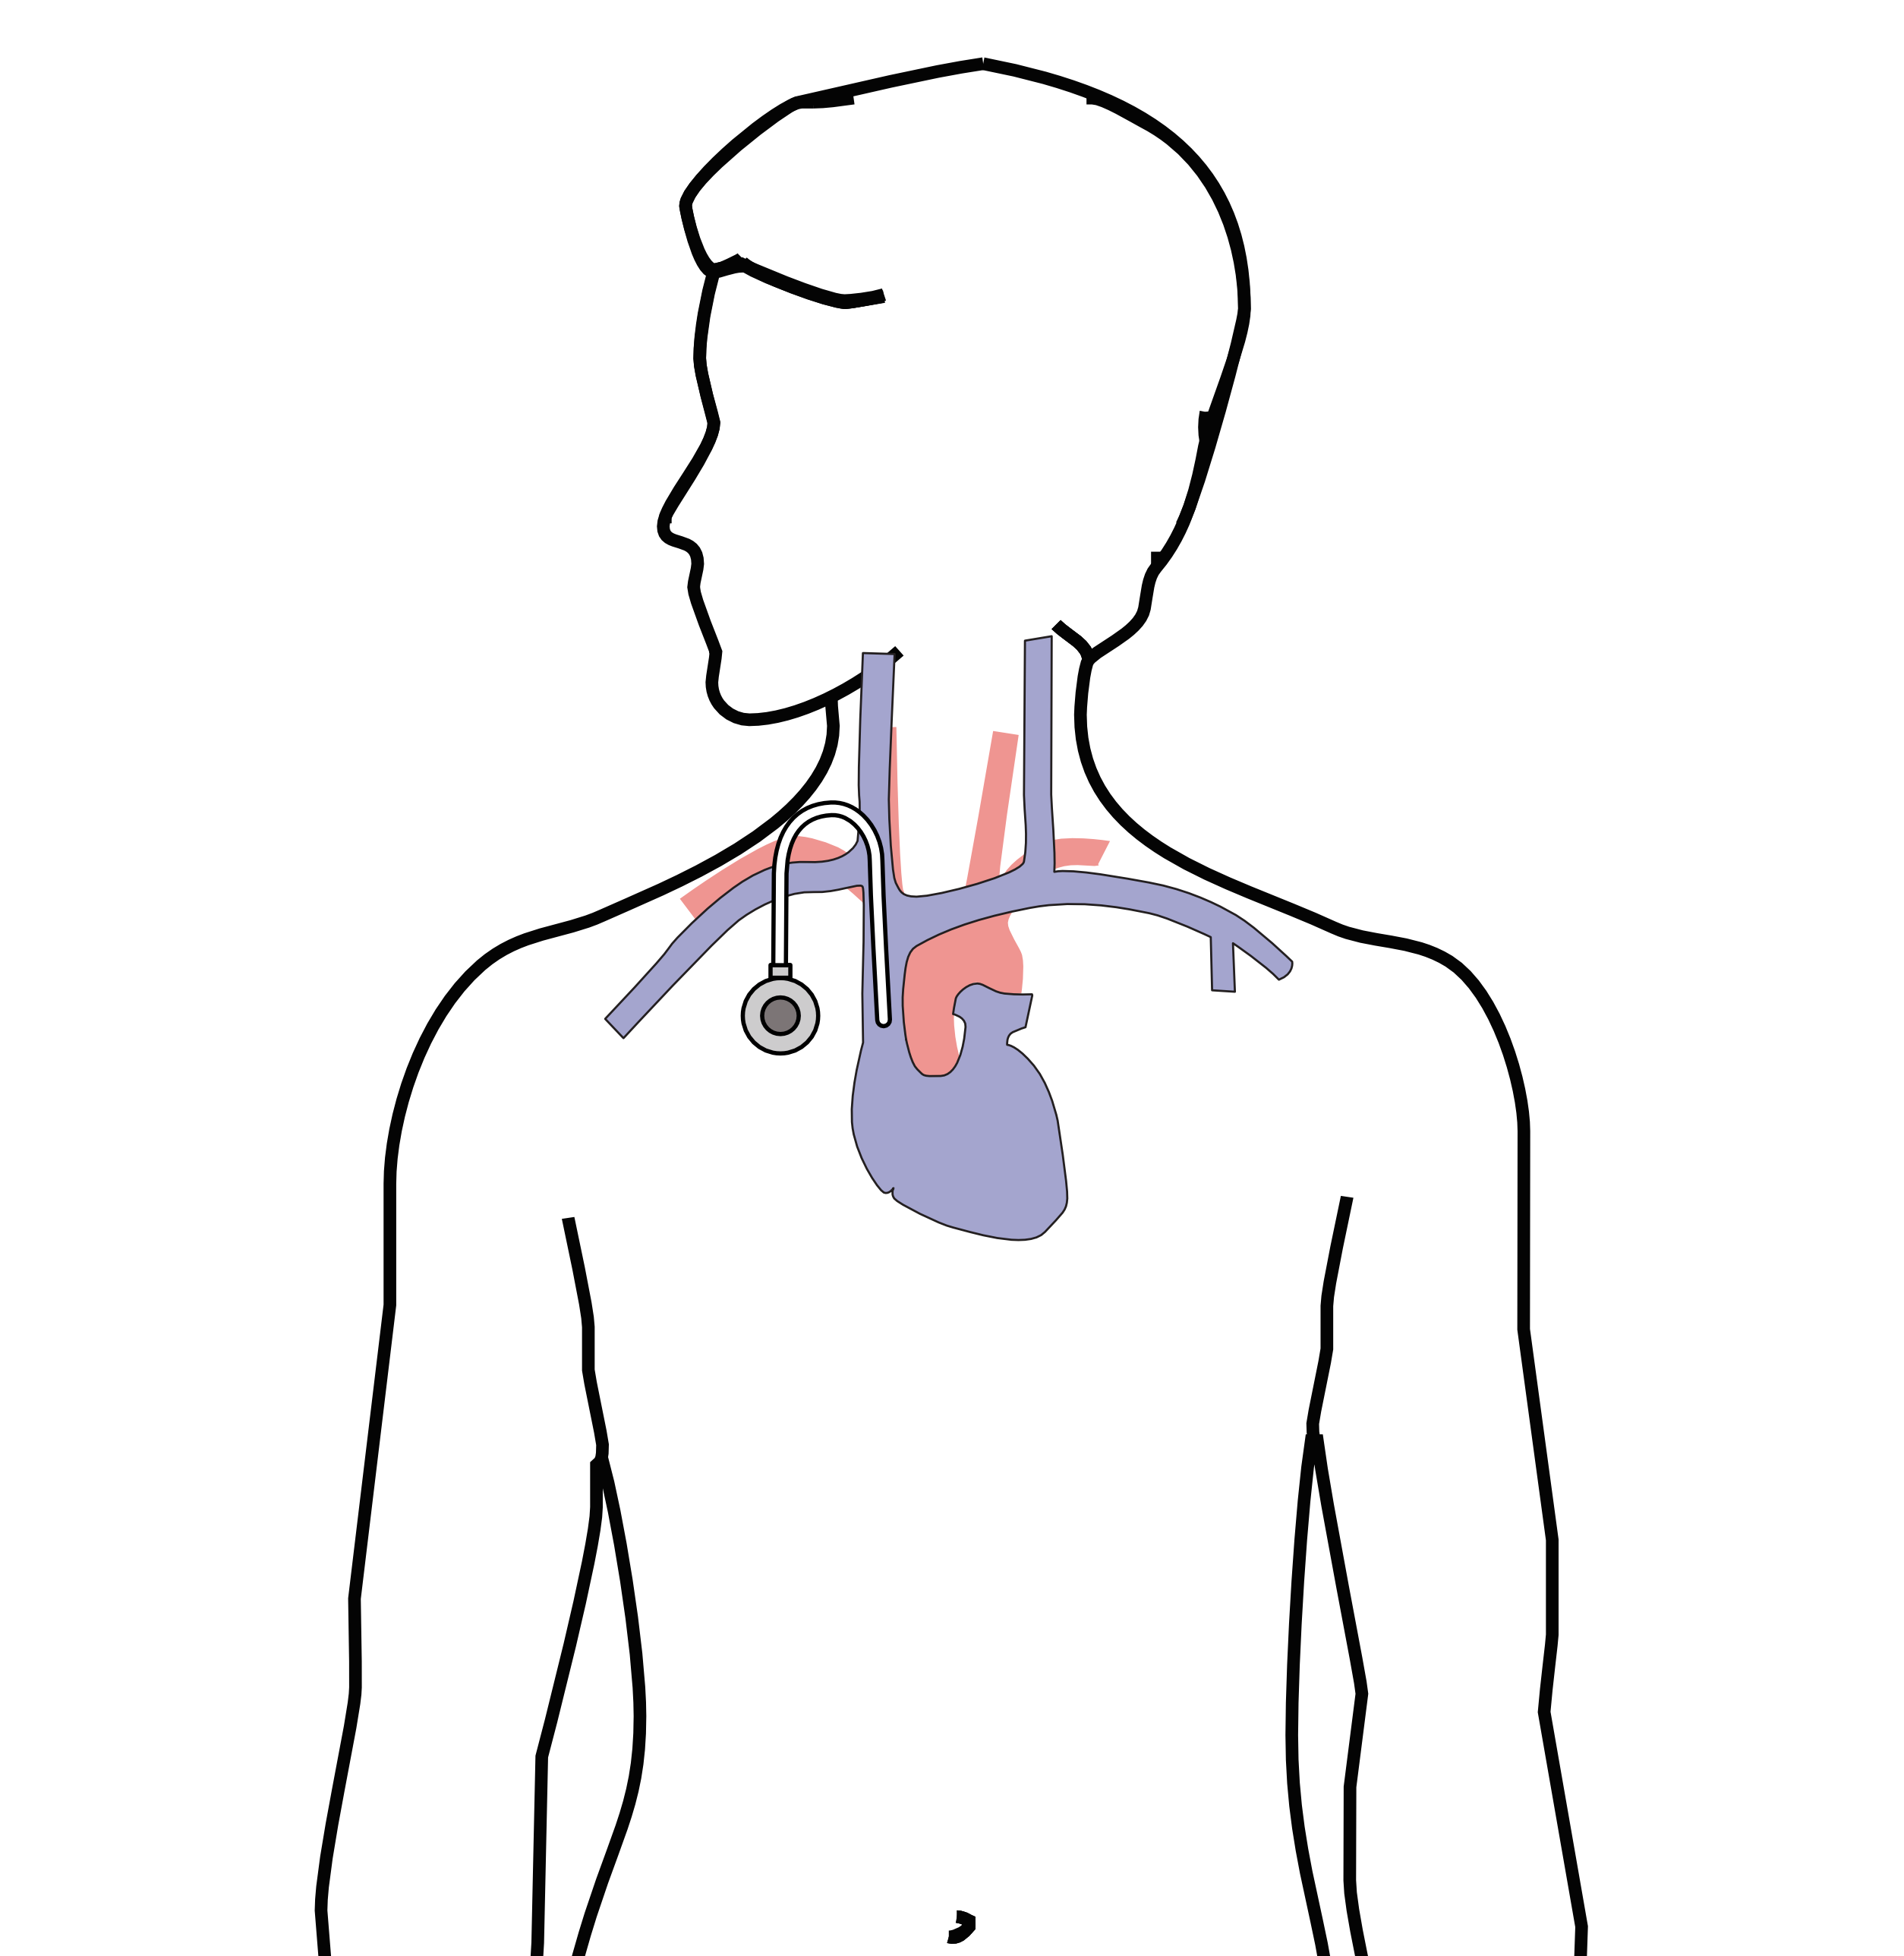
Central Venous Port
Implantable device makes chemo easier
May shower in 24 hrs
No special care at home
OK for FLOT chemo
Allows for blood draws

Slide 25
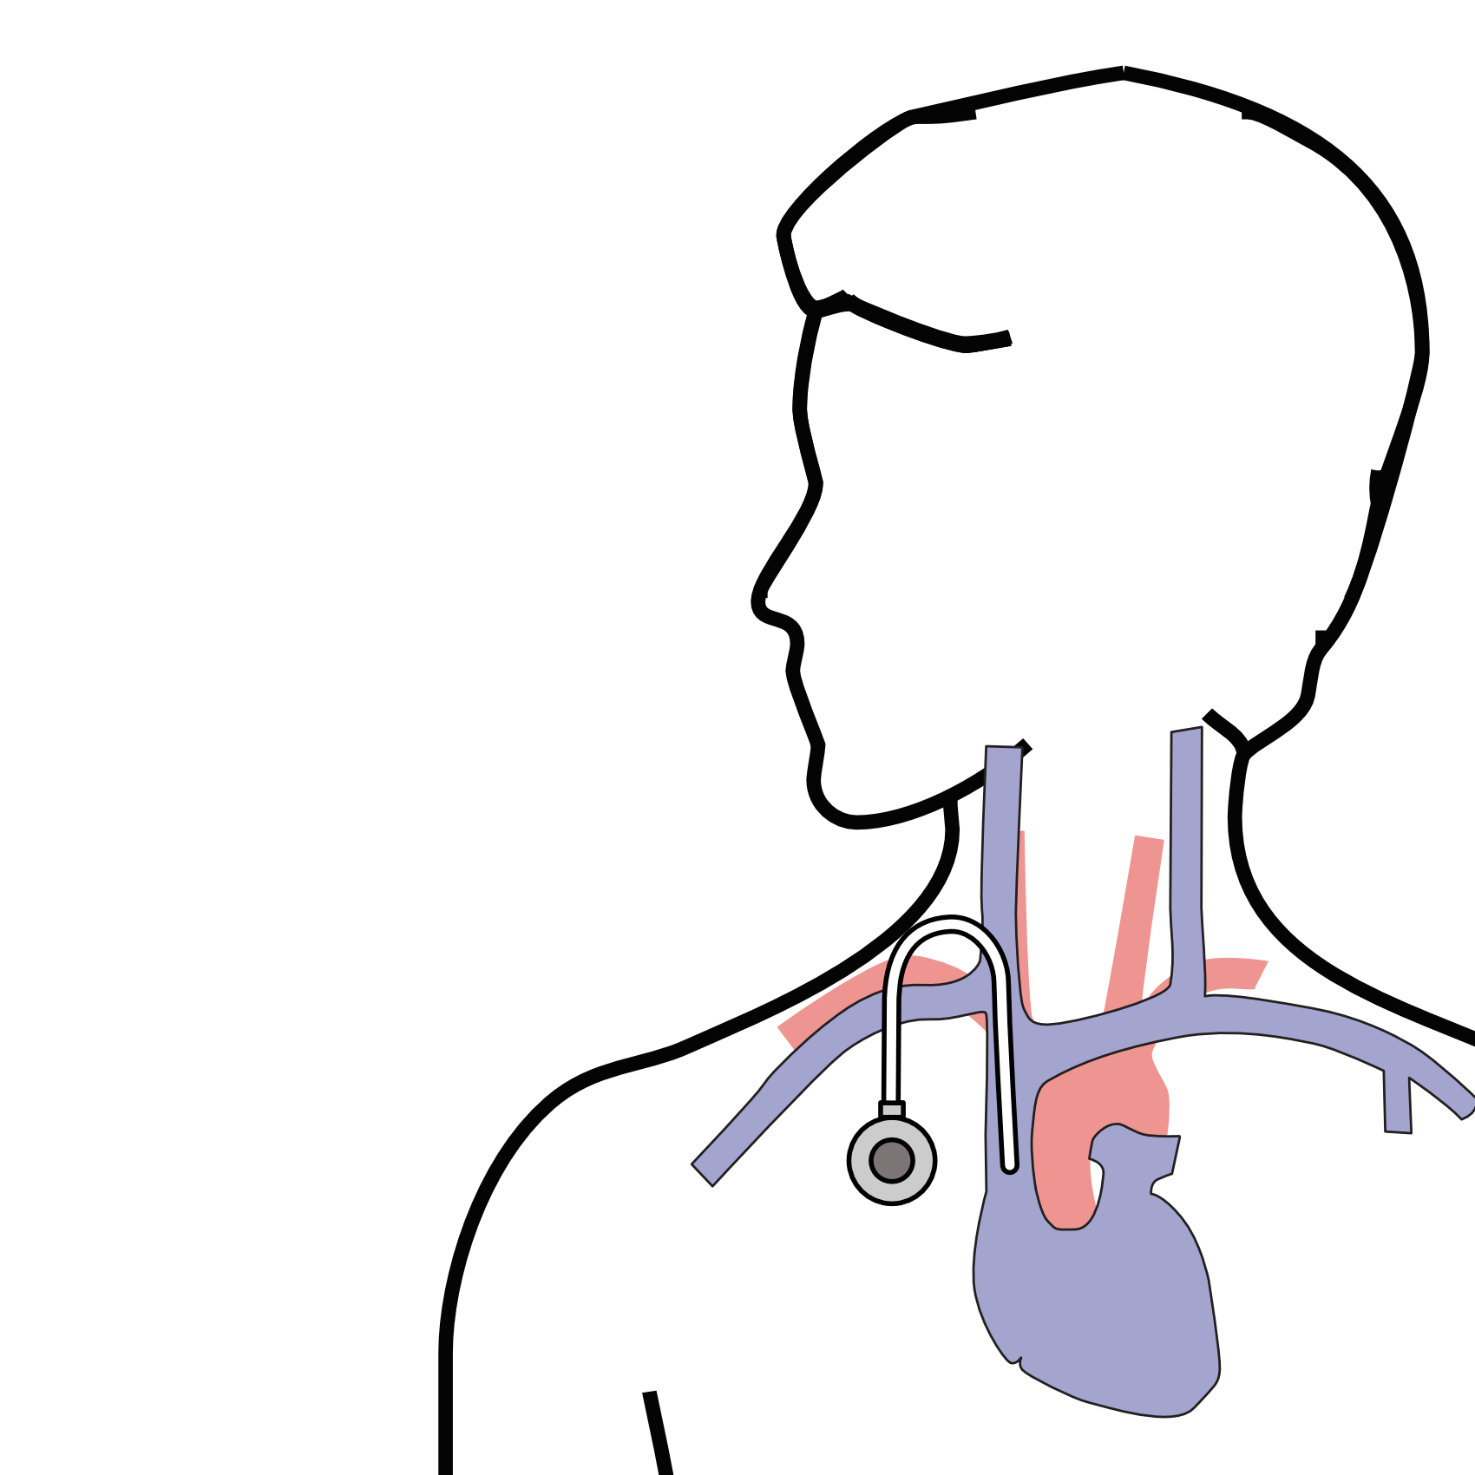
Central Venous Port
Implanted under skin
Neck incision (1/4”)
Incision below the collarbone
Sutures dissolve
“Superglue” on incisions

Slide 26
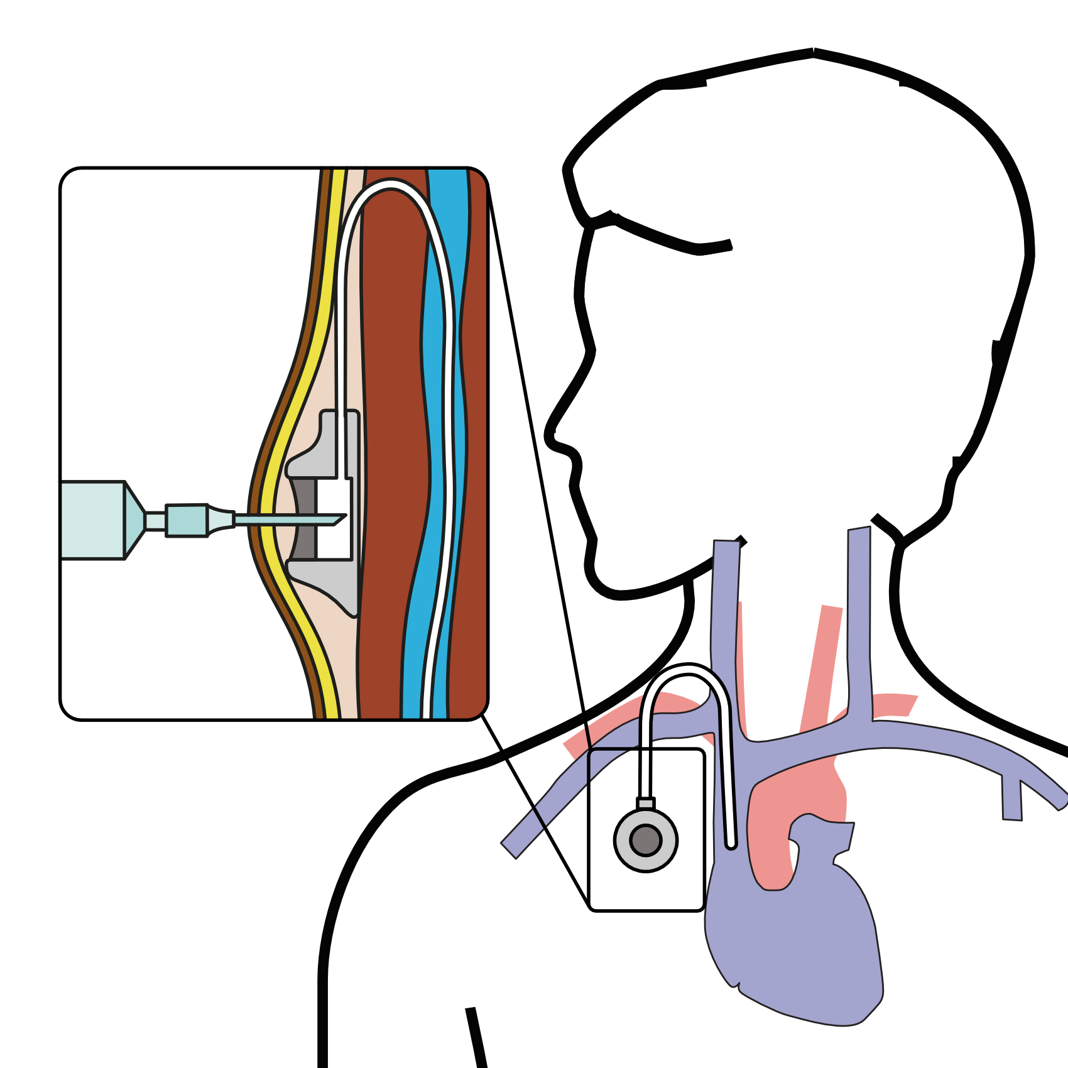
Central Venous Port
When it is time for chemotherapy, a needle is inserted through the skin into the port

Slide 27
Restaging
CT performed every 3-6 months to guide therapy
If CT shows shrinkage of tumor $→$ continue
If CT shows growth of tumor $→$ switch drugs

Slide 28
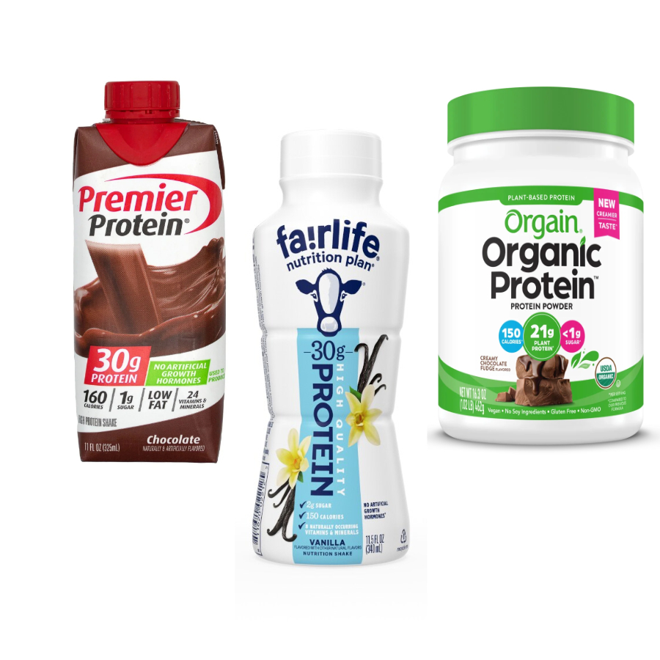
Protein Needs
Men: Average 75 grams/day
Women: Average 60 grams/day
Protein Shakes provide protein with minimal sugar

Slide 29
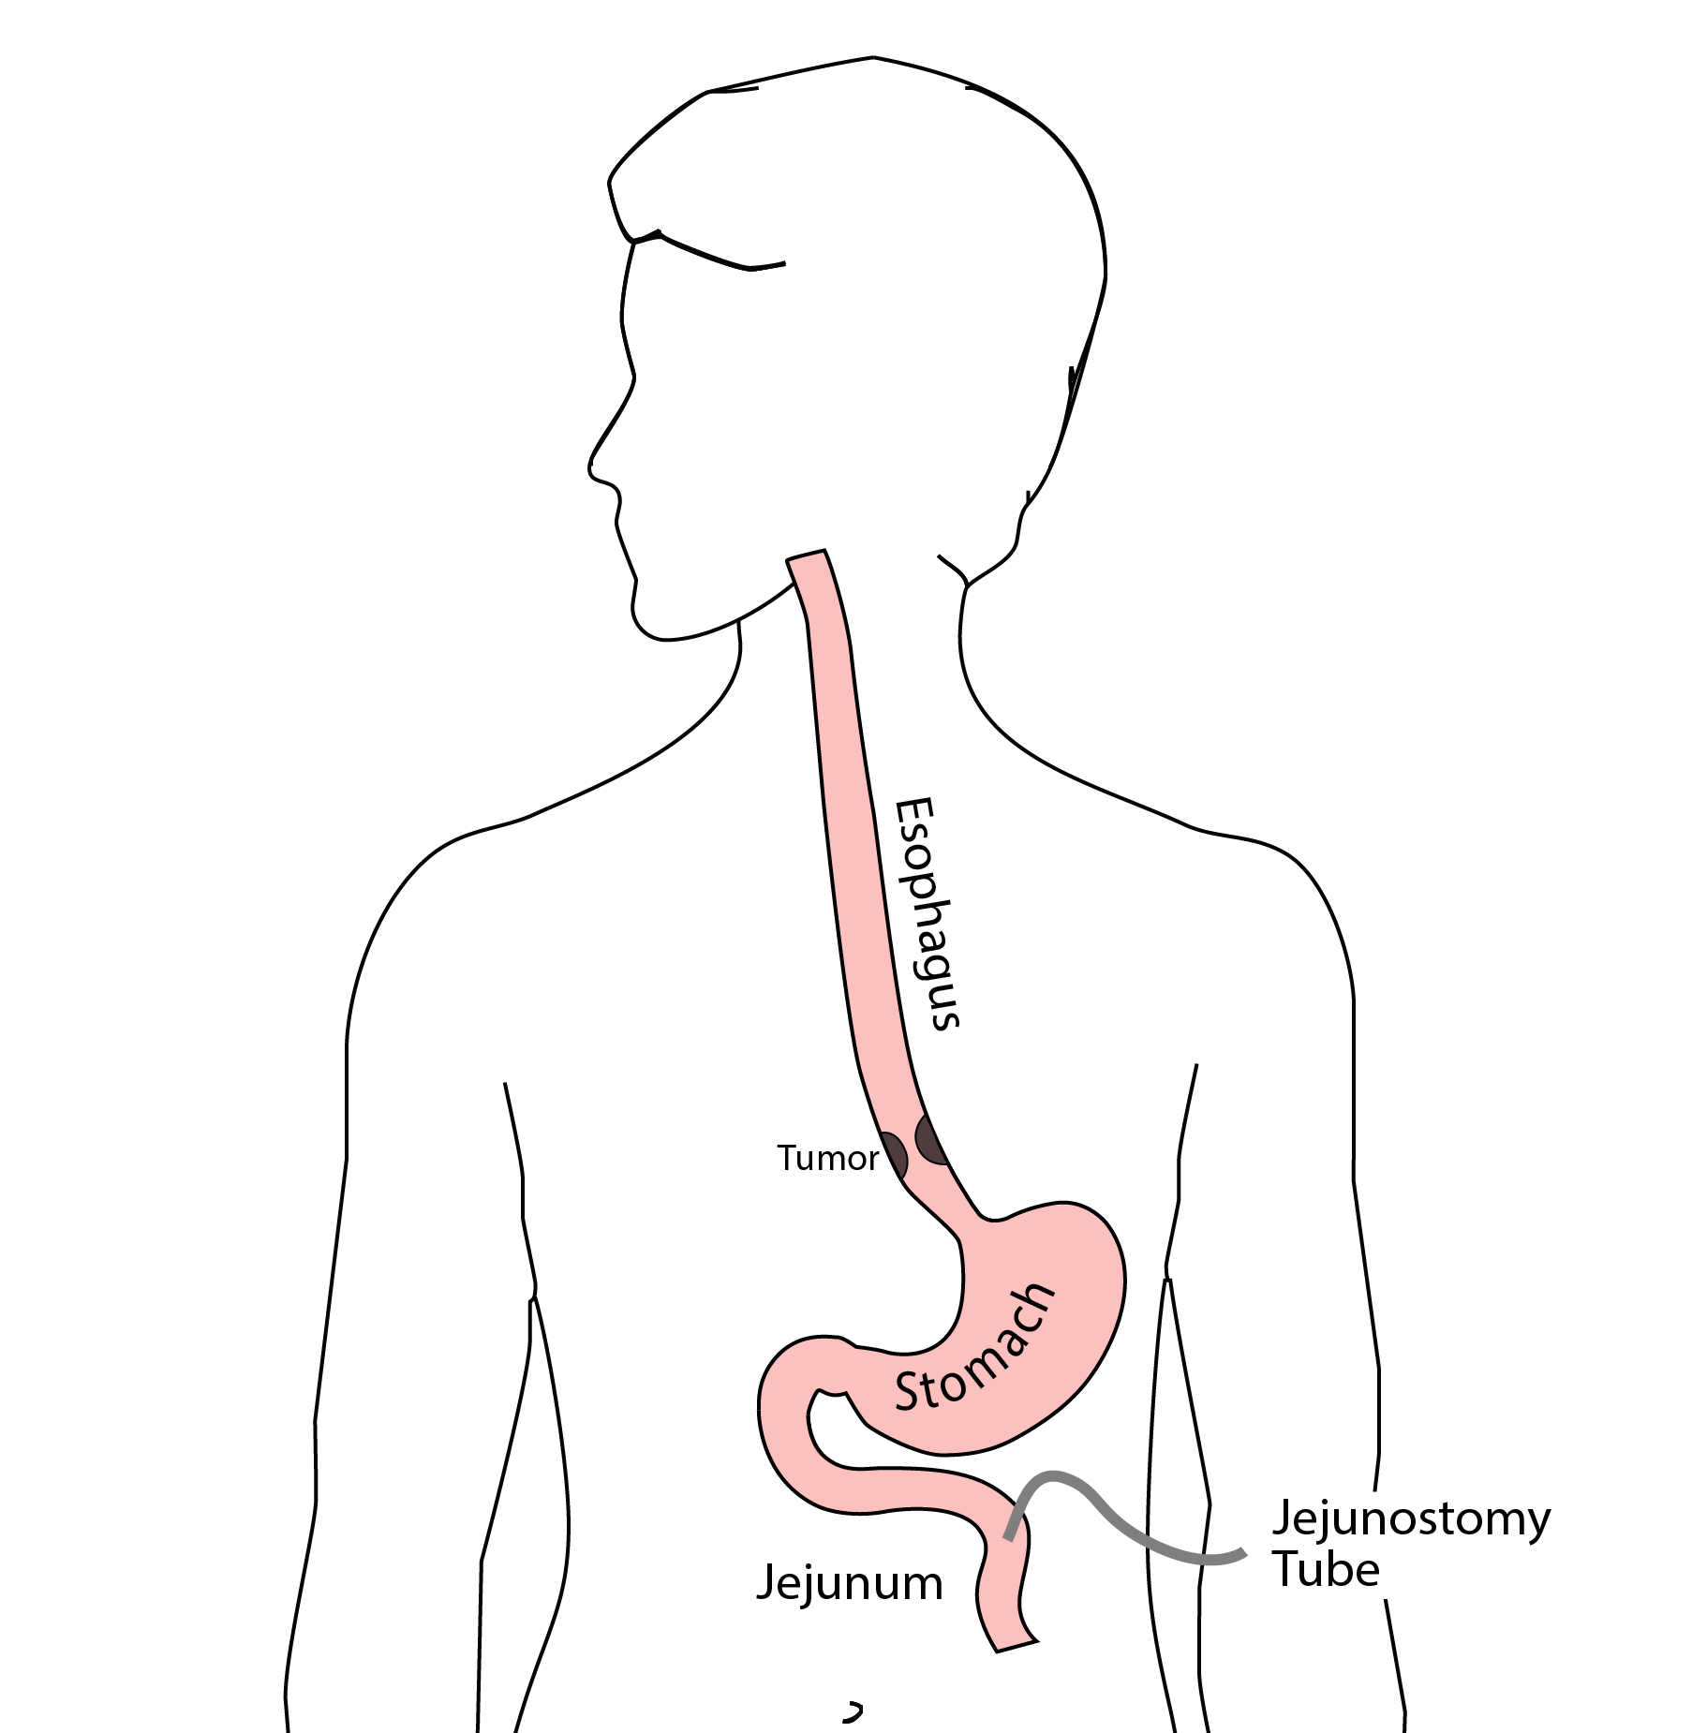
Jejunostomy Tube
Nutrition to bypasses the esophagus and stomach
Placed in small intestine
Pump administers feedings slowly
Feeding done at night

Slide 30
Jejunostomy Typical Regimen
Jejunostomy tube feeds for 16 hours (6pm-10am)
Men: 75mL/hour x 16 hours = 5 cartons
Women: 60mL/hour x 16 hours = 4 cartons
Water 240ml (8oz) via syringe 4x/day
Hospital nurses will teach use of the feeding tube

Slide 31
Jejunostomy Feeds with Diabetes
Jejunostomy feedings elevate blood sugars
Insulin may be required along with feeds
Typical Pattern for tube feeds
Feeds run via pump from 6pm to 10am
Insulin at 6pm (70/30 insulin)
Insulin at Midnight (70/30 insulin)
No insulin if tube feedings are not run

Slide 32

Jejunostomy Video
A video is available to help become familiar with the feeding jejunostomy

Slide 33
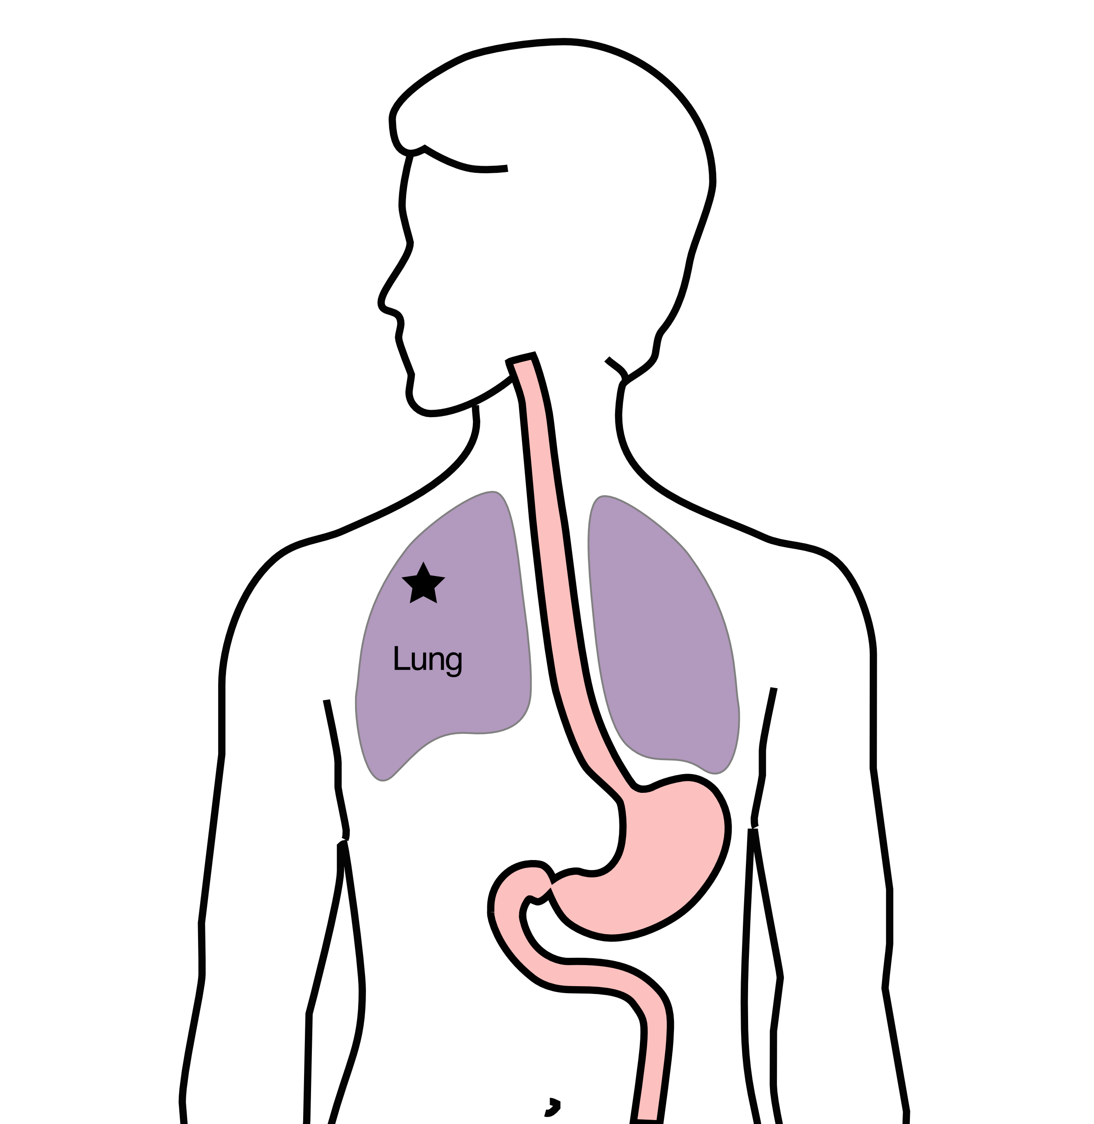
Additional Therapy - Lung Metastasis
If there is a solitary spread of cancer to the lung:
Stereotactic radiation can be performed
Treatment will take 2-3 sessions

Slide 34
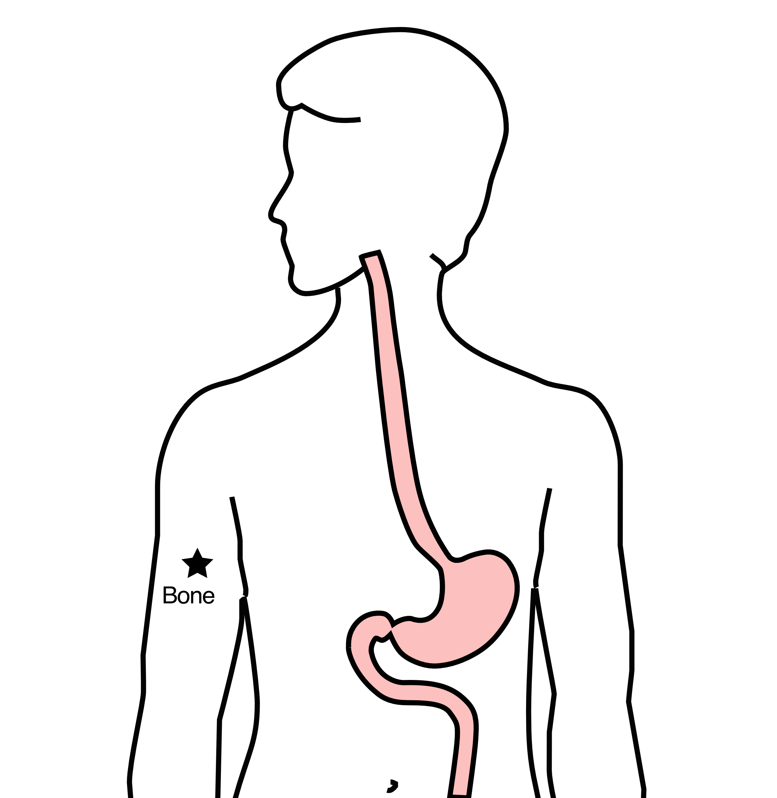
Additional Therapy - Bone Metastasis
Spread of cancer to bone can be painful
Radiation therapy can be very effective
Treatment can be one in 1 to 10 doses

Slide 35
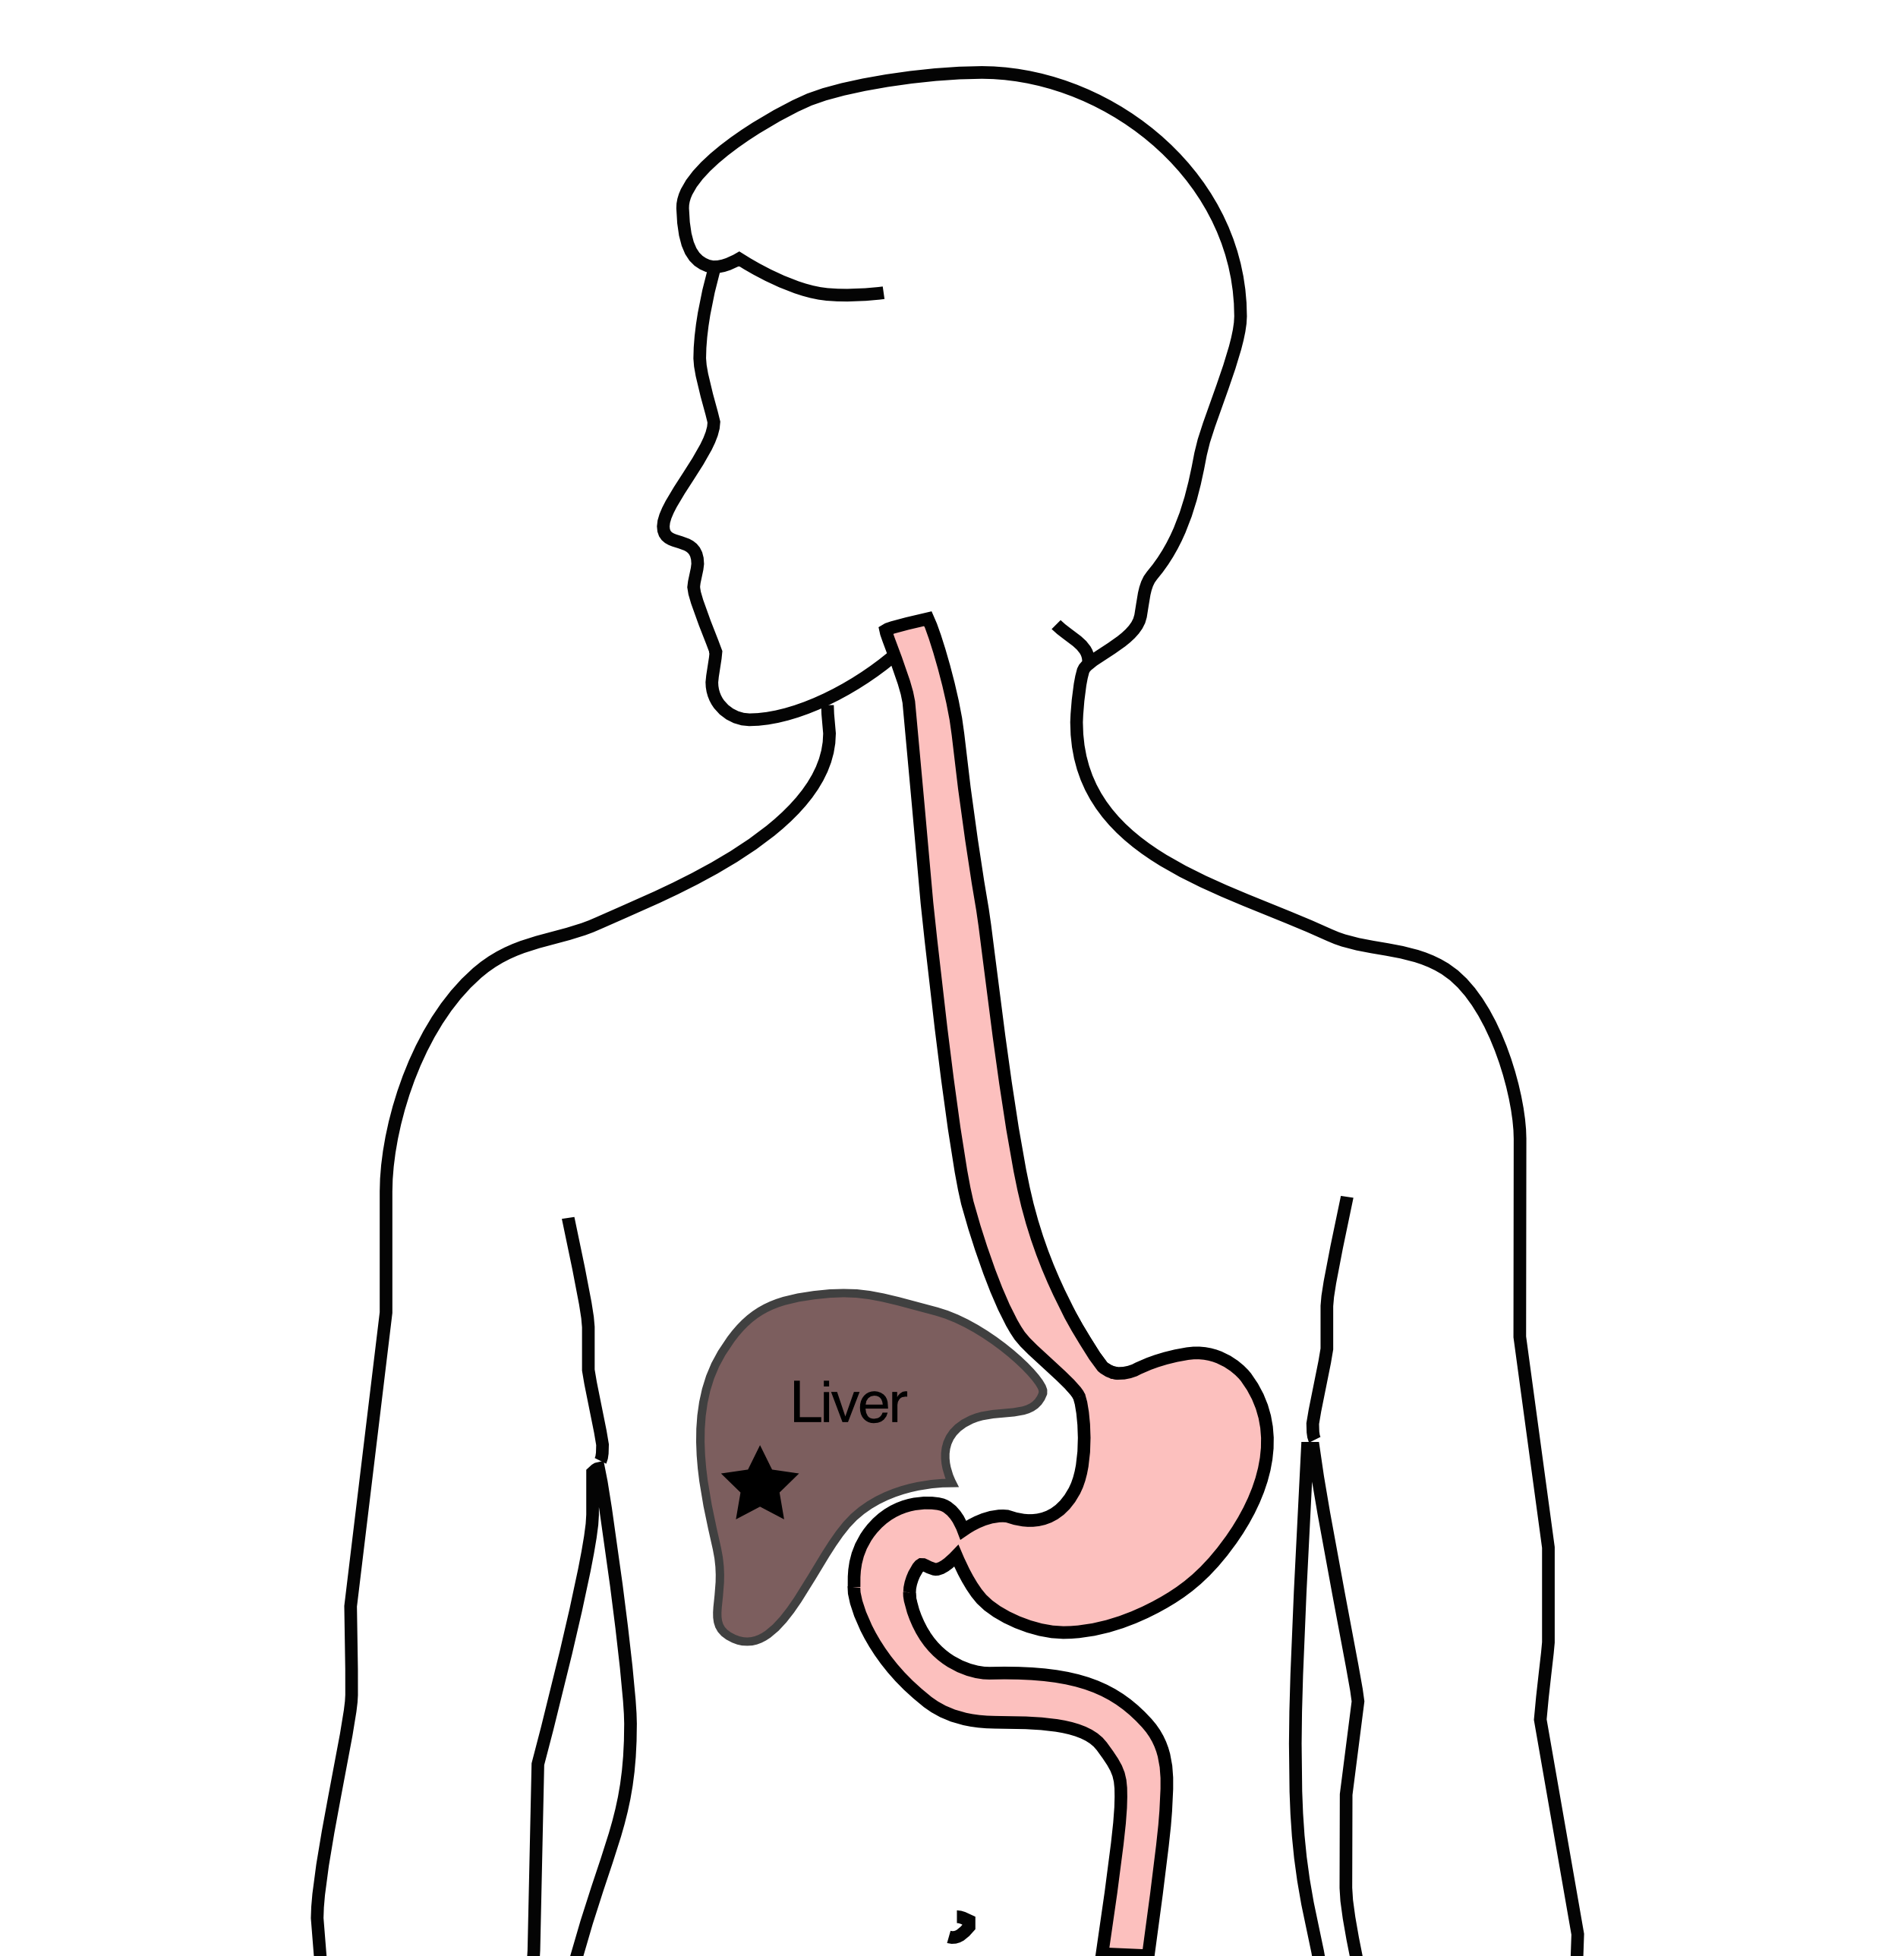
Additional Therapy - Liver Metastasis
Several treatment options for spread of cancer to the liver that does not respond to chemotherapy:
Stereotactic radiation
Microwave ablation
Radioactive beads

Slide 36
Additional Therapy - Carcinomatosis
Treatment for spread of cancer within the abdomen:
Intraperitoneal chemo via catheter (Taxol)
Heated intraperitoneal chemotherapy (HIPEC)
Cytoreductive surgery (often in combination with HIPEC)

Slide 37
Additional Therapy - Surgery
Surgery can be performed in selected circumstances:
Perforation
Obstruction
Removal of cancer and a portion of the stomach
Bypass of the cancer
Residual disease in the stomach in patients responding to chemotherapy

Slide 38
Primary Care Practitioner (PCP)
Critical to coordinate care between specialists.
We will update your PCP after each visit
PCP Referral Line (844) 235-6998

Slide 39
My Atrium Patient Portal
Critical to good communication with your care team
Available for desktop or laptop or phone
Sign up at my.atriumhealth.org

Slide 40
Exercise
Reduces risk of complications from treatment
Goal is 30min/day of vigorous exercise 6 days/wk
Working hard enough that you can’t converse
Start slowly and build up
Every day counts! (Aim for daily activity)

Slide 41
Smoking Cessation
Smoking makes cancer treatment more difficult
Increases risk of complications after surgery
Options for help with smoking cessation:
NC Quit Line 1-800-QUIT-NOW (1-800-784-8669)
American Lung Assn www.freedomfromsmoking.org
Smoking Cessation Counseling (Metro Charlotte)

Slide 42
Team Members - Physicians
Primary Care Provider
Gastroenterologist
Medical Oncologist (chemotherapy)
Radiation Oncologist (radiation)
Surgeons
Jonathan Salo MD
Jeffrey Hagen MD
Michael Roach MD

Slide 43
Team Members - Support Staff
Physician Assistant - Kate Duncan PA-C
Dietitian - Liz Koch
Nurses
Matthew Carpenter RN
Brandon Galloway LPN
Navigators
Laura Swift
Lorna Espinal
Care Coordinator - Karen Julian-Martinez

