Slide 1
Stomach Cancer and CDH1 Gene

Slide 2
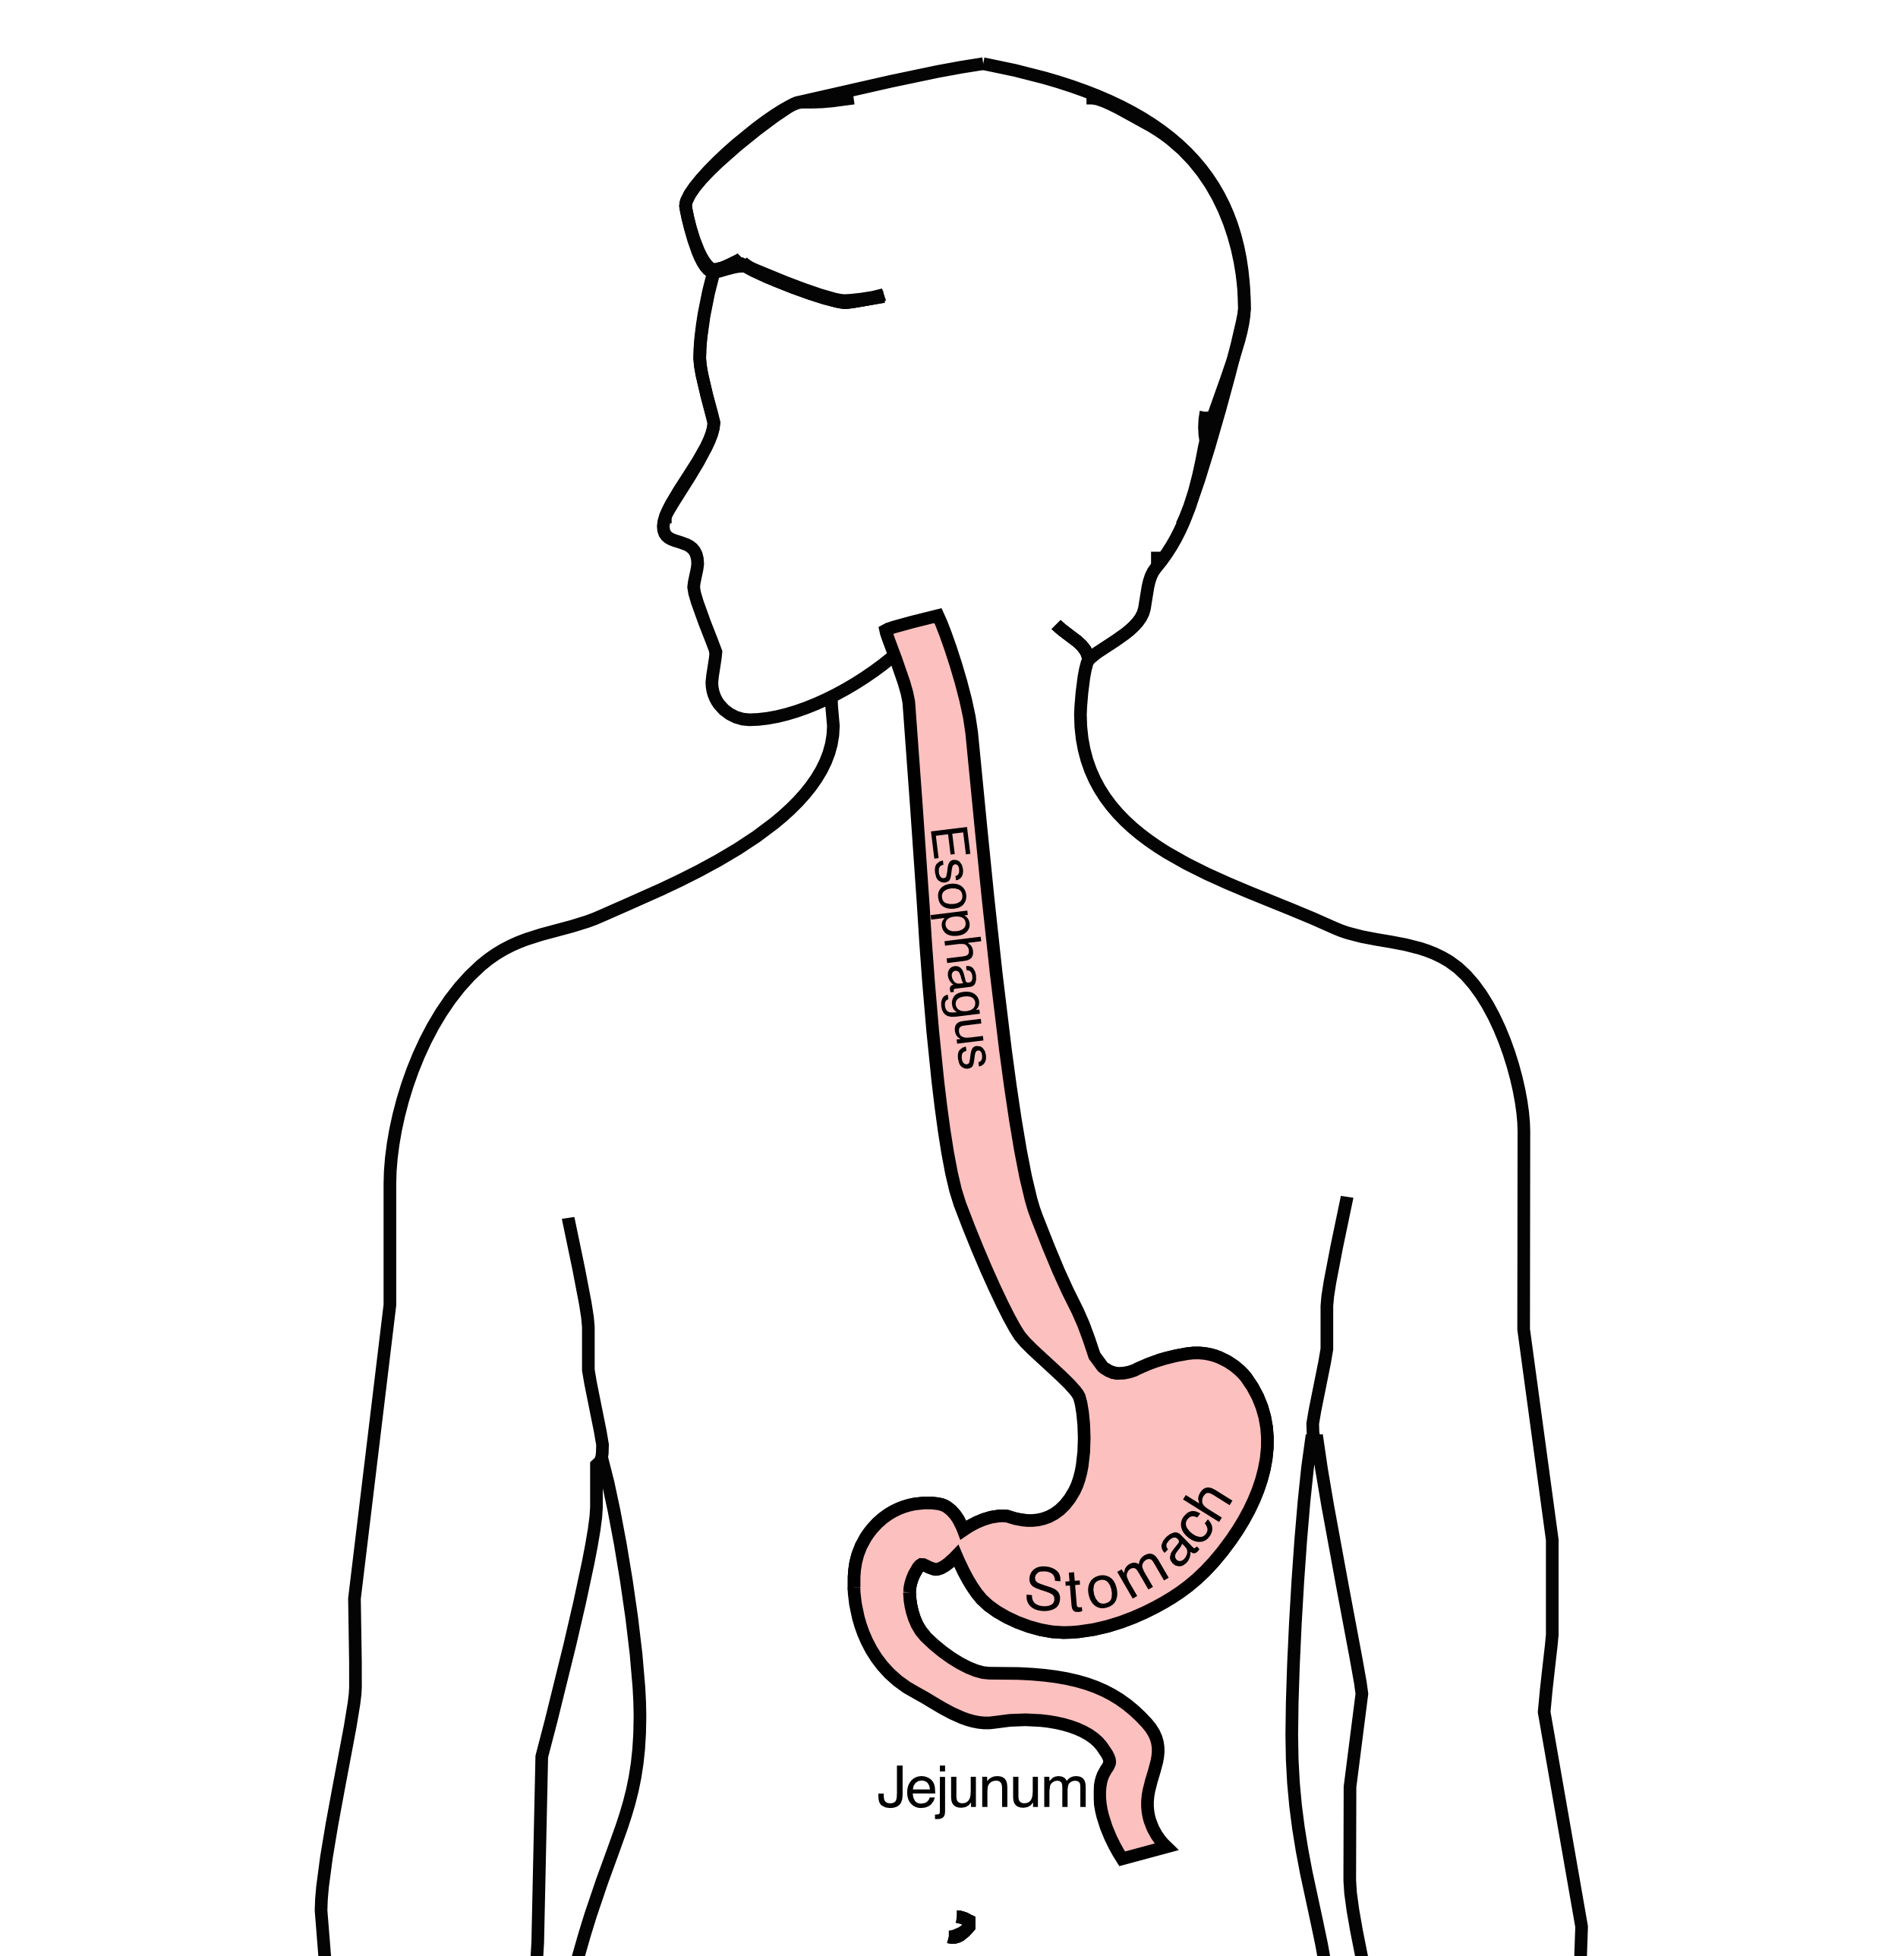
Anatomy
Food moves from the throat
$→$ esophagus
$→$ stomach
$→$ small bowel (jejunum)

Slide 3
Hereditary Diffuse Gastric Cancer
Genetic condition in which family members have high rates of gastric cancer
Most affected members develop gastric cancer by age 40
Affected family members pass the susceptibility to half their children

Slide 4
Genetics of Hereditary Diffuse Gastric Cancer
Altered copy of the CDH1 gene found to be responsible
We each carry two copies of the CDH1 gene
Altered copy is passed on to half of children
Family members with the altered CDH1 gene tend to develop cancer

Slide 5
Clinically Apparent Gastric Cancer
Among patients with HDGC who have visible stomach cancer, this is termed “clinically apparent”

Slide 6
Cancer Risk in HDGCd
Among family members in HDGC families with an altered CDH1 gene:
Men have 70% risk of stomach cancer by age 80
Women have 50-80% risk of stomach cancer by age 80
Increased risk of endometrial cancer

Slide 7
Genetic Testing
Blood test can detect copies of the altered CDH1 gene
Recommended in all patients under age 50 with stomach cancer
Requires meeting with a genetic counselor

Slide 8
Prophylactic Gastrectomy in HDGC
Preventive surgery to remove the stomach can be performed
Surgery dramatically reduces risk of gastric cancer
Surgery is usually done before age 40

Slide 9
Prophylactic Gastrectomy in HDGC
Among family members with HDGC who carry the CDH1 gene
If preventive surgery is performed, 90-95% of cases have microscopic tumor in the removed stomach

Slide 10
Hereditary Diffuse Gastric Cancer
Inherited condition in which an altered copy of the CDH1 gene is passed from generation to generation
Presence of the gene can be detected by genetic testing
Affected person can pass the gene to (on average) half of their children
Affected persons carry the CDH1

Slide 11
Hereditry Diffuse Gastric Cancer
Affected individuals have microscopic cancers beginning to form in the top layer of the stomach at an early age
Majority of affected individuals will develop visible cancer by age 40
By age 80, 70% of men and 56-83% of women are estimated to be at risk to develop visible cancer however some recent studies place this risk at 50%/33%

Slide 12
CDH1
CDH1 carriers with visible cancer are termed “clinically apparent”
CDH1 carriers with clinically apparent cancers which are large enough to cause symptoms generally are likely to have spread to lymph nodes at the time of diagnosis

Slide 13
Prophylactic Gastrectomy
Recommended for CDH1 carriers between ages 18-40
Cancer rarely is found to have spread to lymph nodes
Requires removing all of stomach tissue

Slide 14
CH1 and Family History
Among patients with CDH1 mutation and a family history of gastric cancer who undergo preventive total gastrectomy, 90% have early stages of gastric cancer
Among patients with CDH1 mutation without a family history of gastric cancer, 2 out of 3 (67%) are estimated to have early stages of gastric cancer

Slide 15
Treatment options for CDH1 Carriers
Total Gastrectomy
Surgical removal of all of stomach
Permanent alteration in eating
Requires Small Frequent meals
Feeding jejunostomy (temporary)
Surveillance
Endoscopy every 6-12 months
Unknown how long this is required.

Slide 16
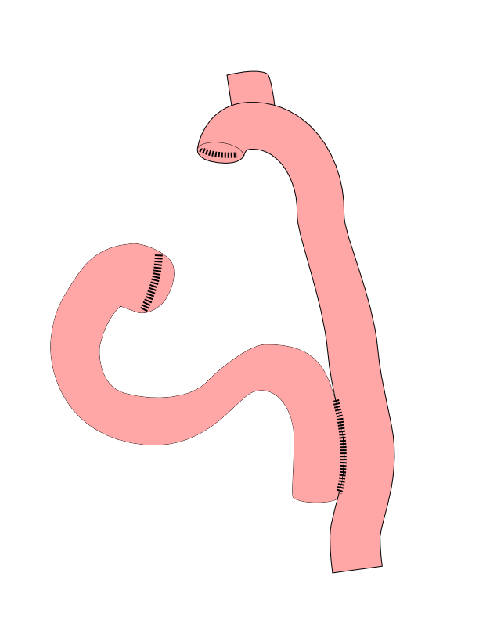
Total Gastrectomy
Removes all of the stomach
Reconstruction with small intestine
Needed for those with CDH1 mutations

Slide 17

Total Gastrectomy

