Slide 1
Surgery of the Stomach

Slide 2
Stomach Cancer Surgery Goals
Staging refers to the tests to determine
Remove the tumor
Remove lymph nodes (depends upon tumor type)
Preserve stomach function
Reconstruct GI tract
Treatment options depend upon the cancer stage

Slide 3
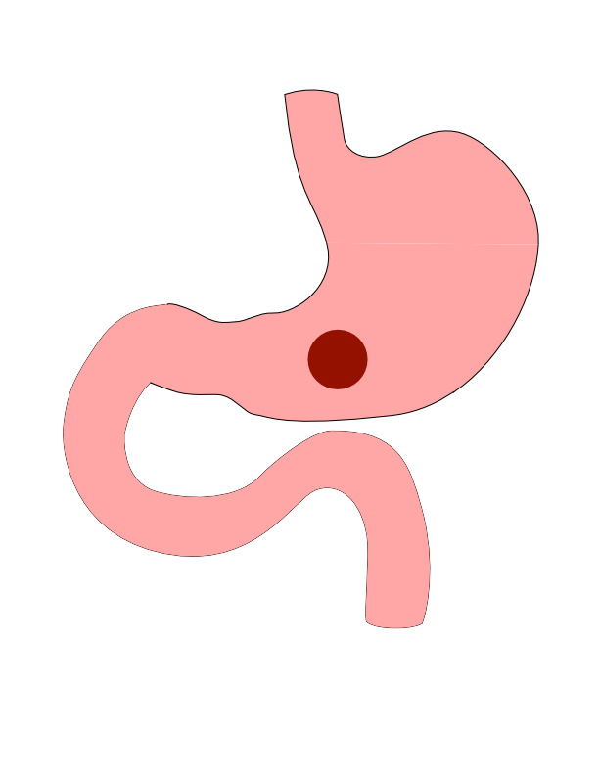
Distal Cancers
Distal cancers are those in the lower part of the stomach

Slide 4
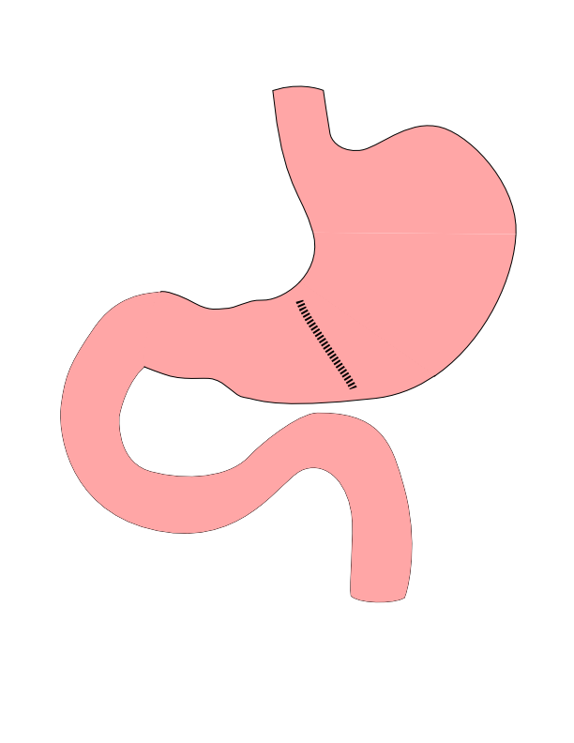
Partial Gastrectomy
Removes the tumor
Does not remove lymph nodes
Best suited for:
Small adenocarcinoma
GI Stromal Tumors

Slide 5
Partial Gastrectomy

Slide 6
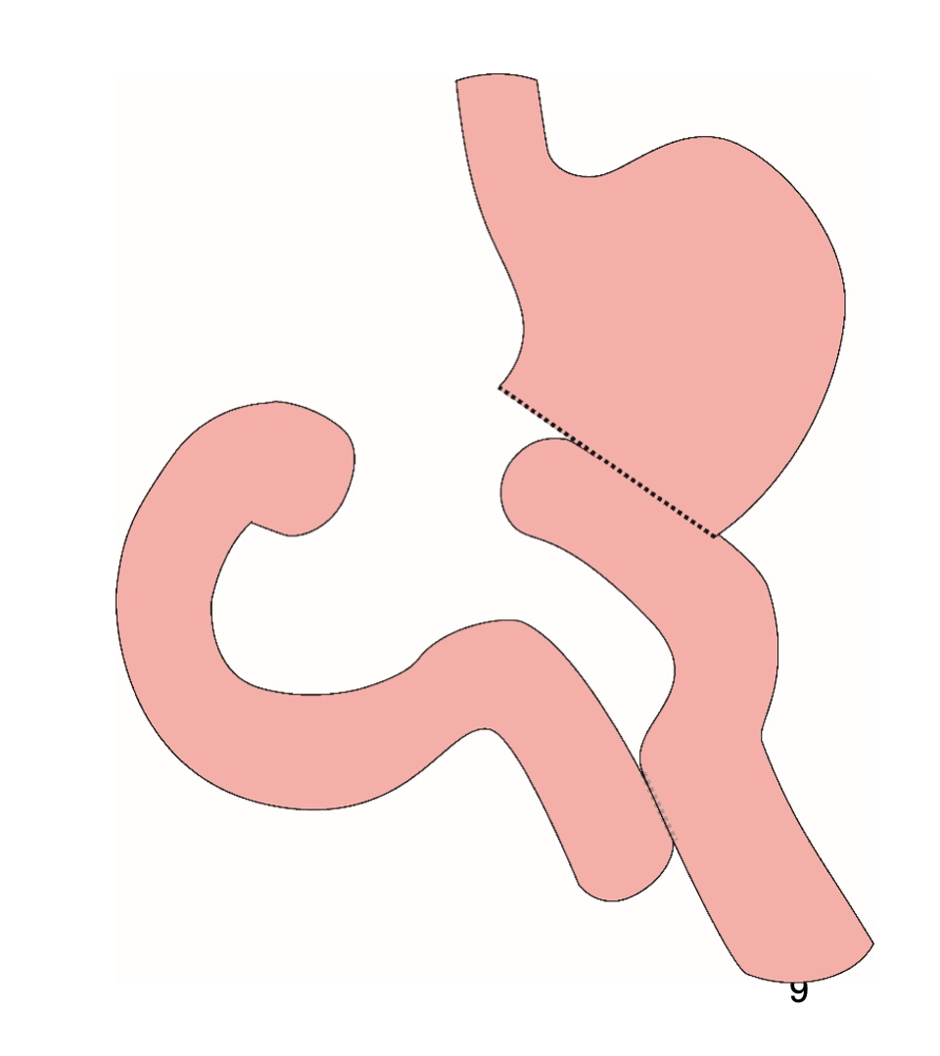
Distal Gastrectomy
Removes bottom half of the stomach
Does lower lymph nodes

Slide 7
Distal Gastrectomy

Slide 8
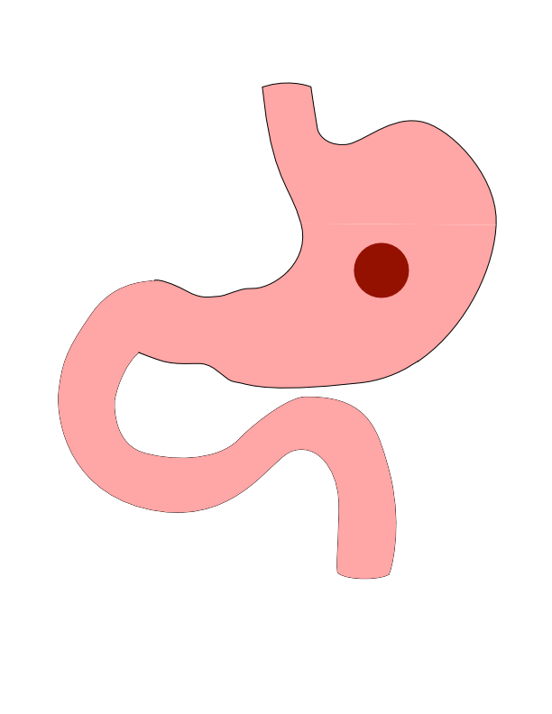
Body Cancers
Body is the mid-portion of the stomach

Slide 9
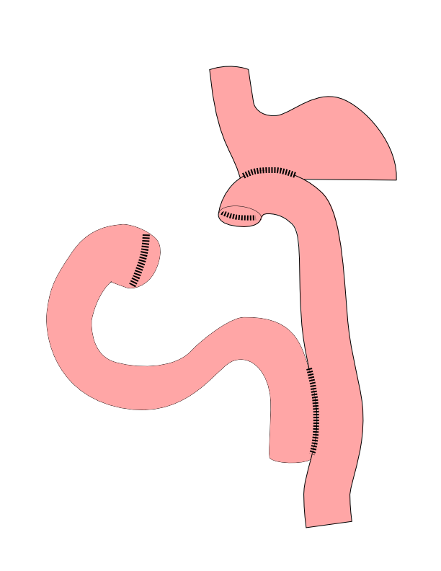
Subtotal Gastrectomy
Removes bottom 2/3 of stomach
Removes nearby lymph nodes
Reconstruction with small intestine

Slide 10
Subtotal Gastrectomy

Slide 11
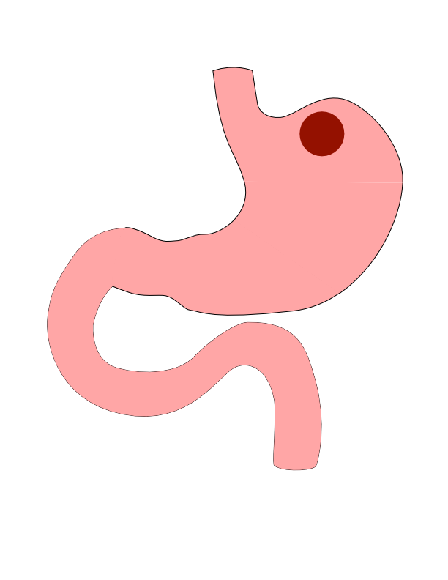
Proximal Tumors
Located near the top of the stomach
Challenging area for surgery

Slide 12
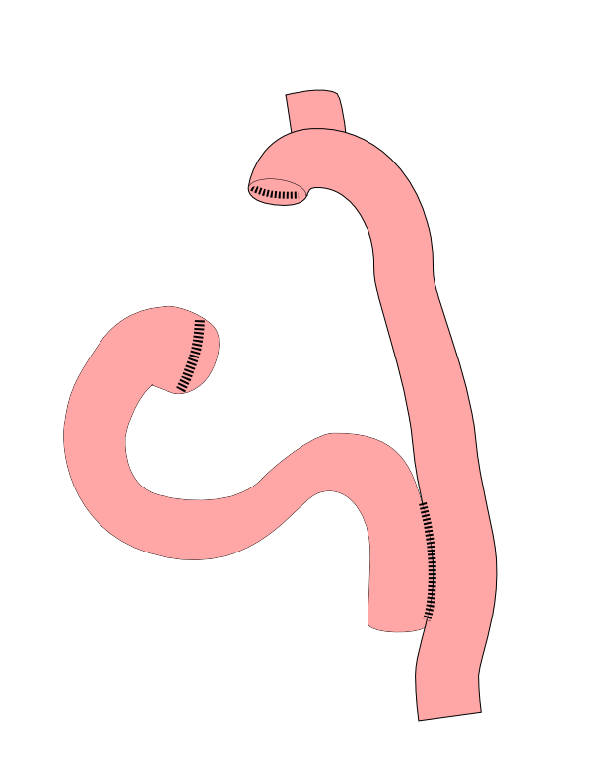
Total Gastrectomy
Removes all of the stomach
Reconstruction with small intestine
Needed for those with CDH1 mutations

Slide 13
Total Gastrectomy

Slide 14

Esophagogastrectomy
Removes top part of stomach
Remove bottom half of esophagus
Surgery in both abdomen and chest

Slide 15
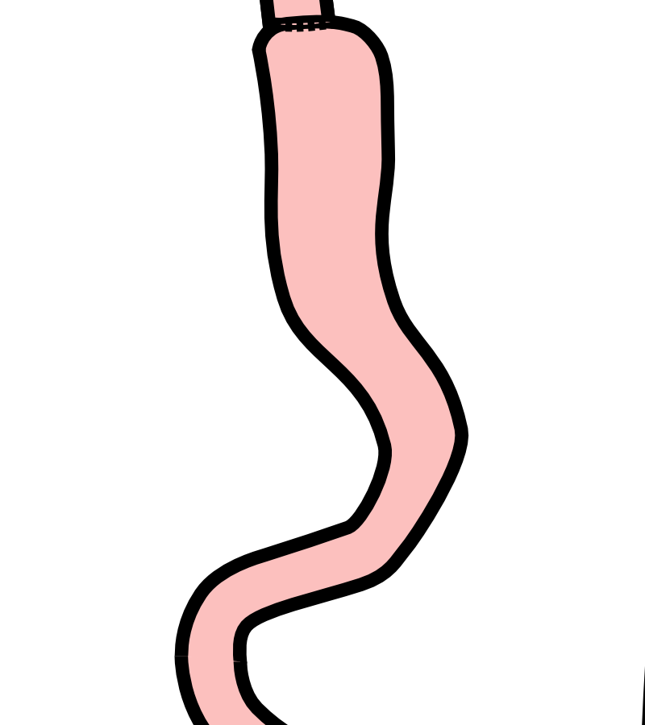
Esophagogastrectomy
Removes top part of stomach
Remove bottom half of esophagus
Surgery in both abdomen and chest

Slide 16
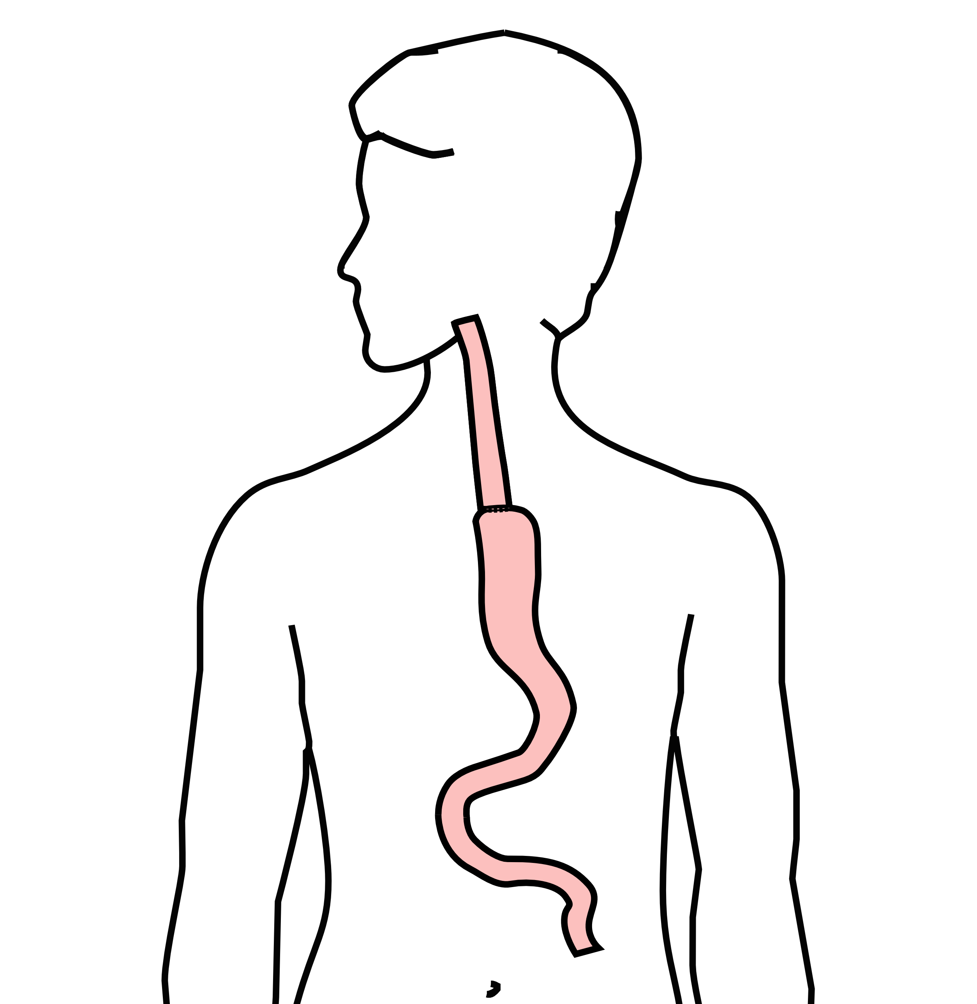
Esophagogastrectomy
Removes top part of stomach
Remove bottom half of esophagus
Surgery in both abdomen and chest

Slide 17
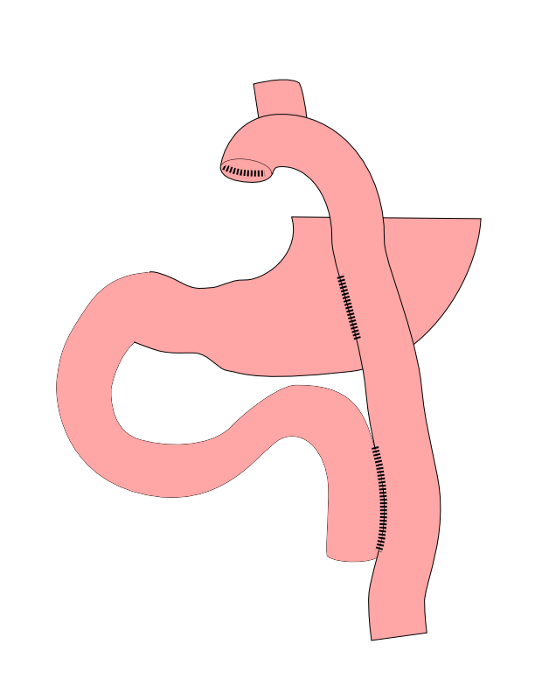
Dual Tract Gastrectomy
Alternative surgical approach for small tumors near the top of the stomach
Preserves the bottom of the stomach as a reservoir

Slide 18
Dual Tract Gastrectomy

Slide 19
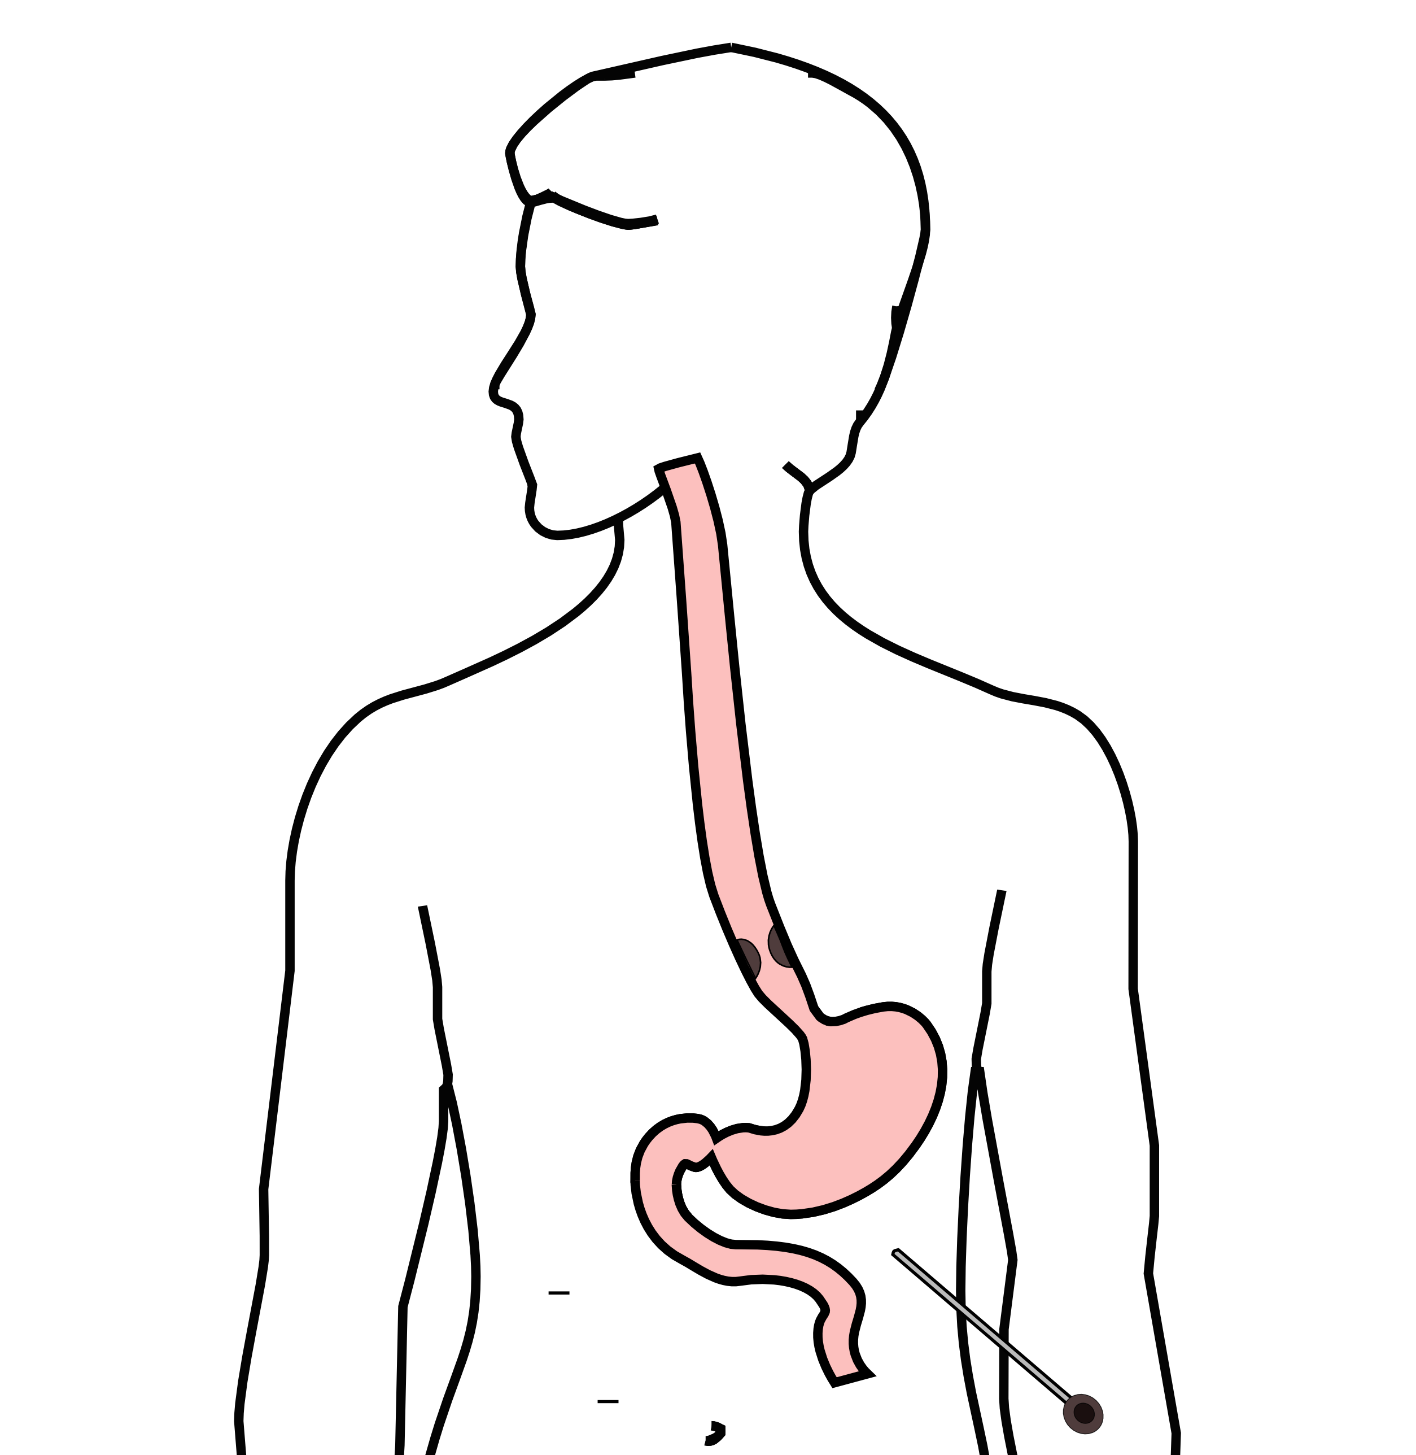
Laparoscopy
Some stomach cancers can spread inside the abdomen
Areas of spread can be very small (grain of rice)
Laparoscopy can detect spread inside the abdomen

Slide 20
Laparoscopy
General anesthetic
Several 1/4” incisions
Telescope examines the abdomen
Biopsies can be performed.

Slide 21
Risks of Surgery
Leak where bowel is joined together (anastomosis)
Bleeding requiring reoperation
Delayed stomach function
Infection in the abdomen

Slide 22
Primary Care Practitioner (PCP)
Critical to coordinate care between specialists.
We will update your PCP after each visit
PCP Referral Line (844) 235-6998

Slide 23
My Atrium Patient Portal
Critical to good communication with your care team
Available for desktop or laptop or phone
Sign up at my.atriumhealth.org

Slide 24
Exercise
Reduces risk of complications from treatment
Goal is 30min/day of vigorous exercise 6 days/week
Working hard enough that you can’t converse
Start slowly and build up
Every day counts! (Aim for daily activity)

Slide 25
Smoking Cessation
Smoking makes cancer treatment more difficult
Increases risk of complications after surgery
Options for help with smoking cessation:
NC Quit Line 1-800-QUIT-NOW (1-800-784-8669)
American Lung Assn www.freddomfromsmoking.org
Smoking Cessation Counseling (Metro Charlotte)

