Slide 1
Surgery for Esophageal and GE Junction Cancers

Slide 2
Team Members - Physicians
Primary Care Provider
Gastroenterologist
Medical Oncologist (chemotherapy)
Radiation Oncologist (radiation)
Surgeons
Jonathan Salo MD
Kelli Salter MD
Michael Roach MD

Slide 3
Team Members - Support Staff
Physician Assistant - Kate Duncan PA-C
Dietitian - Liz Koch
Nurses
Matthew Carpenter RN
Brandon Galloway LPN
Navigators
Laura Swift
Lorna Espinal
Care Coordinator - Karen Julian-Martinez

Slide 4
Nutrition Prior to Surgery
High-protein diet (most people need 60-80 grams protein/day)
Protein shakes (Permier or Fairlife) with protein and minimal sugar
Important to avoid weight loss prior to surgery
Good nutrition before surgery improves wound healing and recovery

Slide 5
Exercies Prior to Surgery
Goal: 30minutes/day of vigorous exercise 6 days/week
Vigorous: Working hard enough you can’t carry a conversation
Types of Exercise:
Walking: Outside, Treadmilll, or an indoor Mall
Stationary Exercise Bike
Lifting light weights and stretching are helpful in addition

Slide 6
Day Prior to Surgery
Clear liquids for dinner evening prior
You will receive instructions regarding medicines

Slide 7
Day of Surgery
Unless instructed otherwise:
You will be notified regarding arrival time, which is usually 2-3 hours before the surgery time.
  Surgery Monday, Tuesday, Wednesday, Friday: Arrive 4am
  Surgery Thursday: Arrive 5am
Nothing to eat or drink after midnight

Slide 8
Medicines the Day of Surgery
Medicines with a sip of water or black coffee
No milk or cream
Surgery will be cancelled for milk/cream

Slide 9
Preparation for Surgery
Medical evaluation may be needed before surgery:
Pulmonary Function Tests to test lung function
Cardiology evaluation to test heart function
  Echocardiogram
  Stress Test
  Holter monitor

Slide 10
Esophagectomy for Cancers of the Esophagus or GE Junction
Primary Surgery
Superficial Tumors (T1) not completely removed by endoscopy
Localized Tumors (T2 N0 M0)
Surgery scheduled after medical evaluation
Preoperative Therapy $→$ Surgery
Locally Advanced (T3 Nx M0)
Surgery scheduled after
  Recovery from preoperative therapy
  Restaging scans (CT or PET)
  Medical evaluation

Slide 11
Preoperative Visits
Medical Oncology - Monitor chemotherapy and side effects
Radiation Oncology - Monitor radiation and side effects
Surgical Oncology
Consult visit with Dr Salo
Mid-treatment visits with Dr Salo / Kate Duncan
Preop visit with Dr Salo (may be virtual)
In-person preop visit with Kate Duncan and Liz Koch

Slide 12
Surgery for Esophageal Cancer
Surgery for esophageal cancer is performed for:
Superficial Tumors (T1) not removed by endoscopy
Localized Tumors (T2 N0 M0)
Locally Advanced (T3 M0) after preop therapy

Slide 13
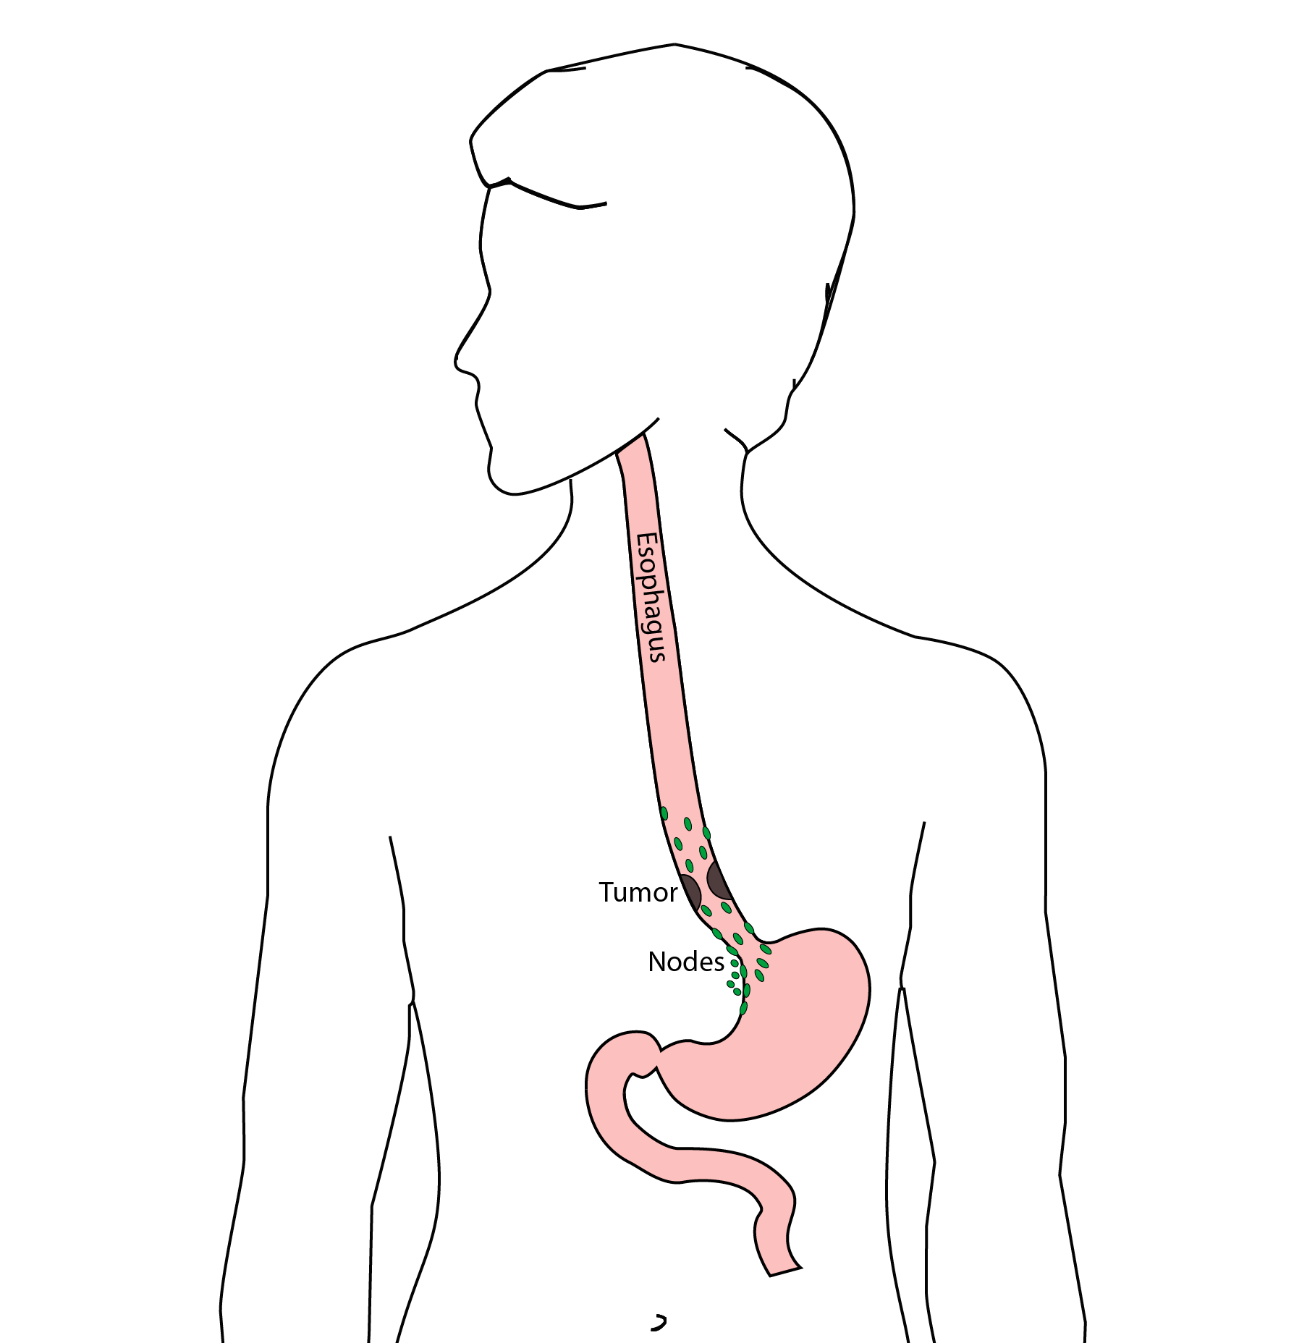
Goals of Surgery
Remove tumor from esophagus
Remove surrounding lymph nodes
Create a new esophagus

Slide 14
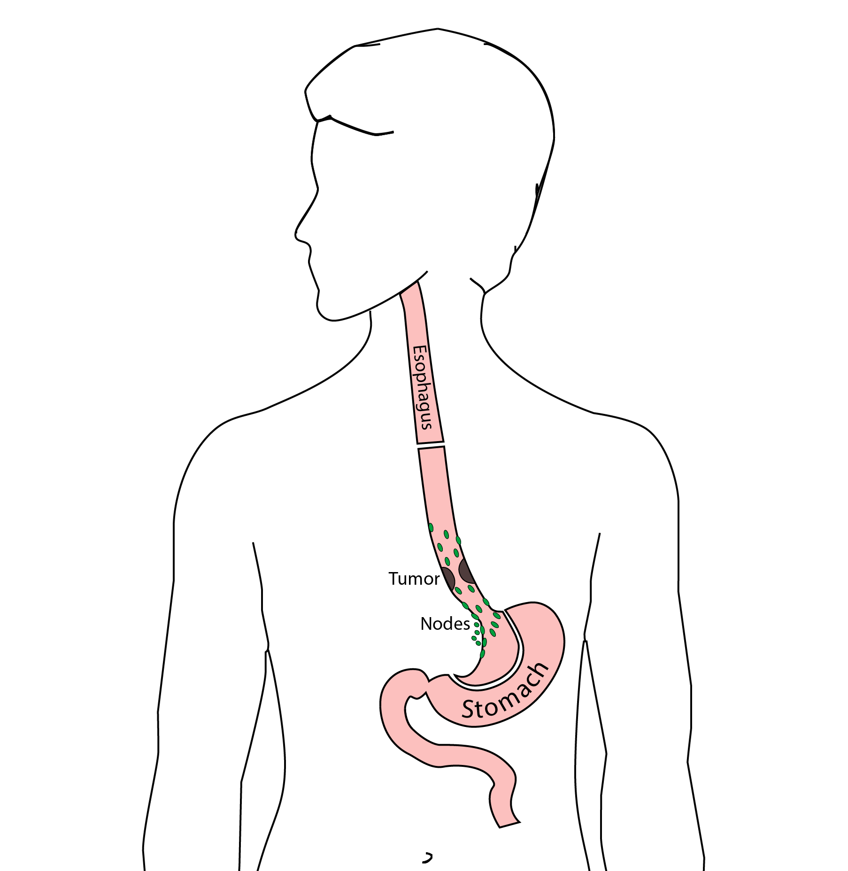
Ivor Lewis (Transthoracic) Esophagectomy
Removes tumor and lower 1/3 esophagus
Removes surrounding lymph nodes
GI tract reconstructed

Slide 15
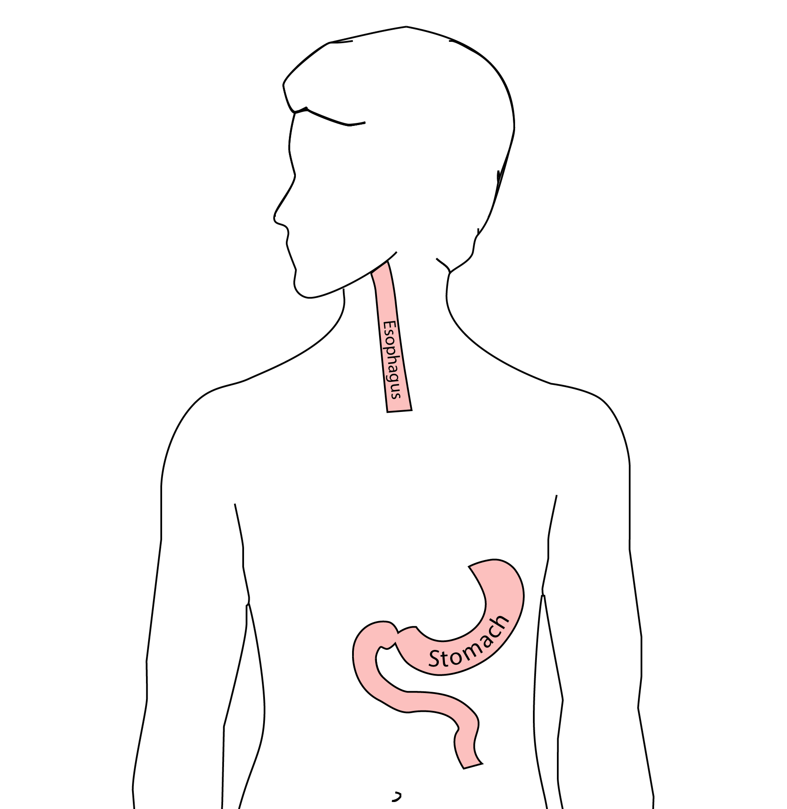
Reconstruction
New esophagus is created from the stomach in the abdomen by fashioning it into a tube.

Slide 16
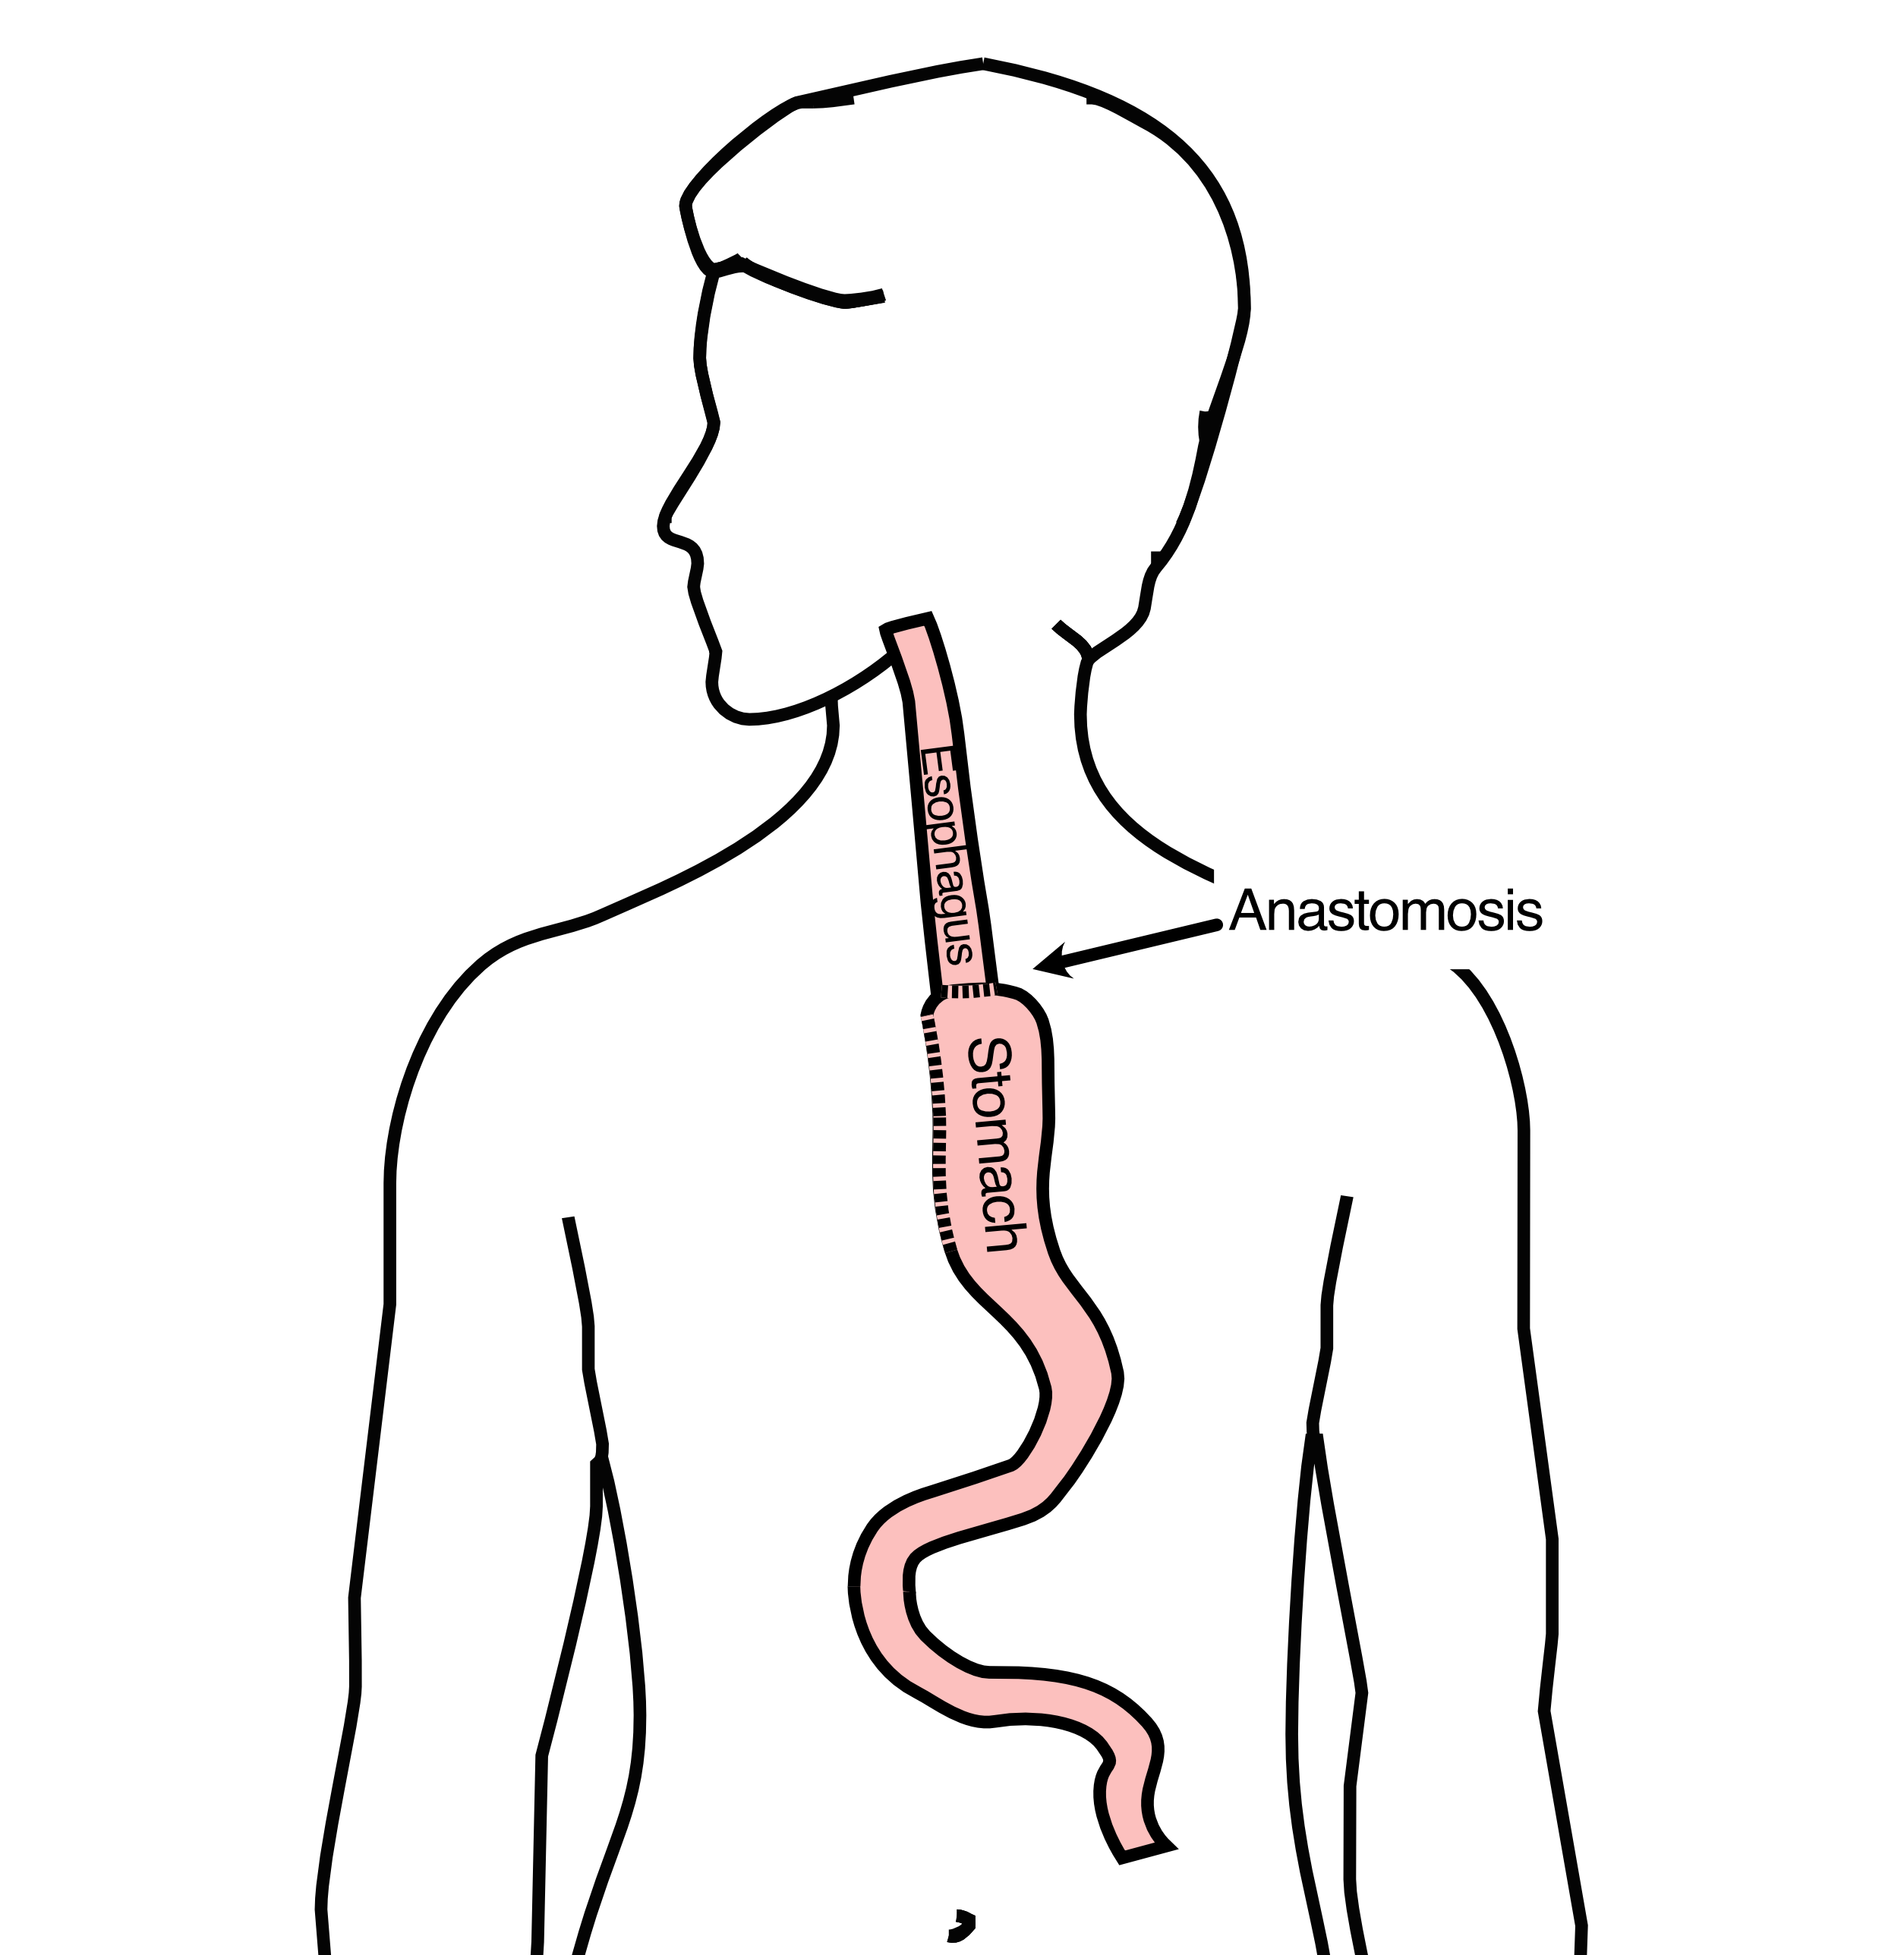
Ivor Lewis esophagectomy
The new esophagus is now brought up into the chest. A connection is made between the esophagus and the stomach, called an anastomosis.

Slide 17
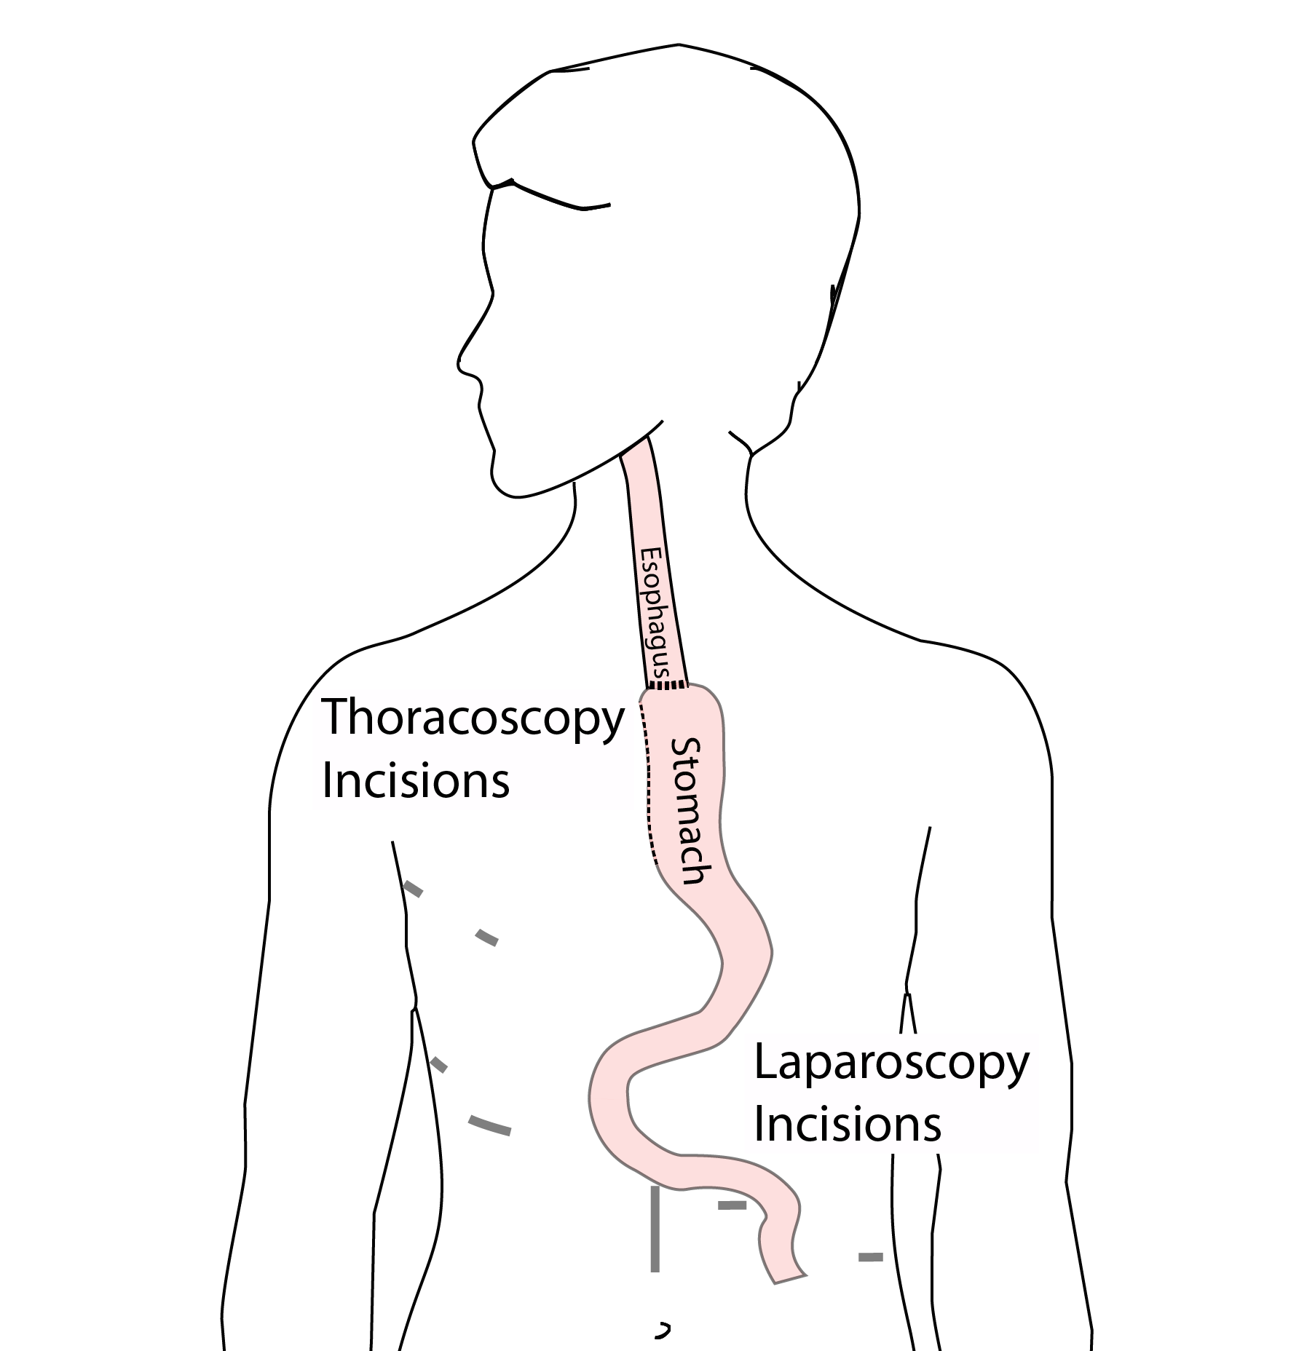
Minimally-invasive Ivor Lewis
Small incisions abdomen and chest
Surgical telescope and instruments
Smaller incisions $→$ faster recovery and less discomfort

Slide 18
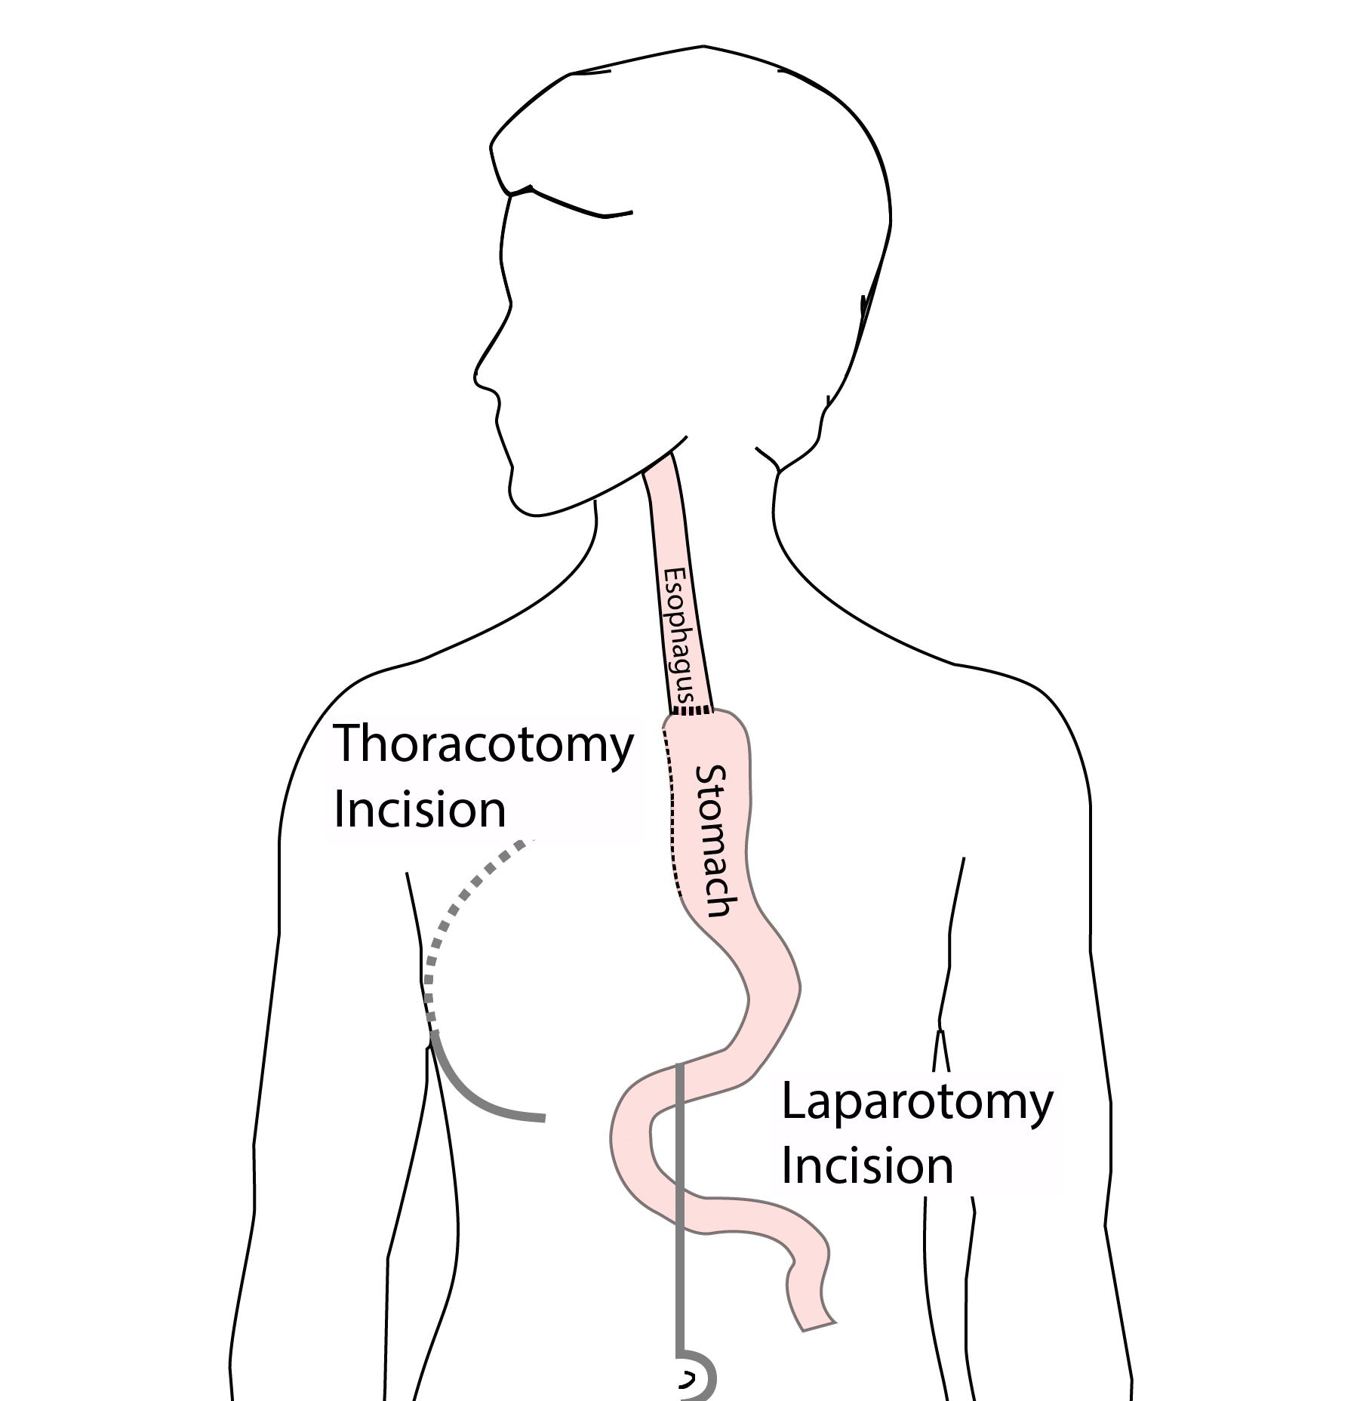
Open Ivor Lewis
Mininally-invasive approach feasible in 95% of cases
In some cases, an open approach is still necessary.

Slide 19
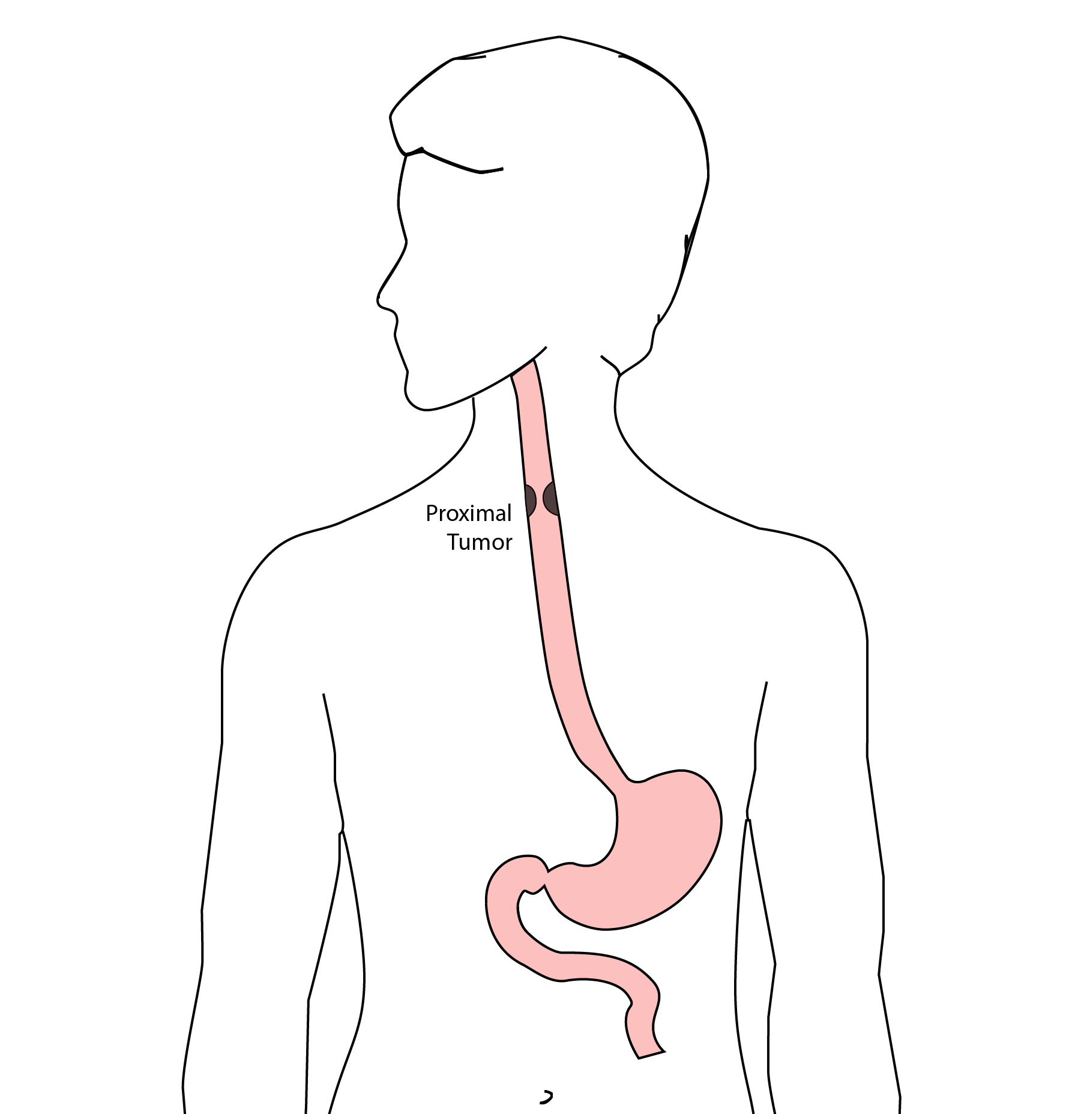
Total Esophagectomy
For patients with tumors in the upper esophagus, we need to remove more of the esophagus
We need to remove the whole esophagus, including the portion in the neck

Slide 20
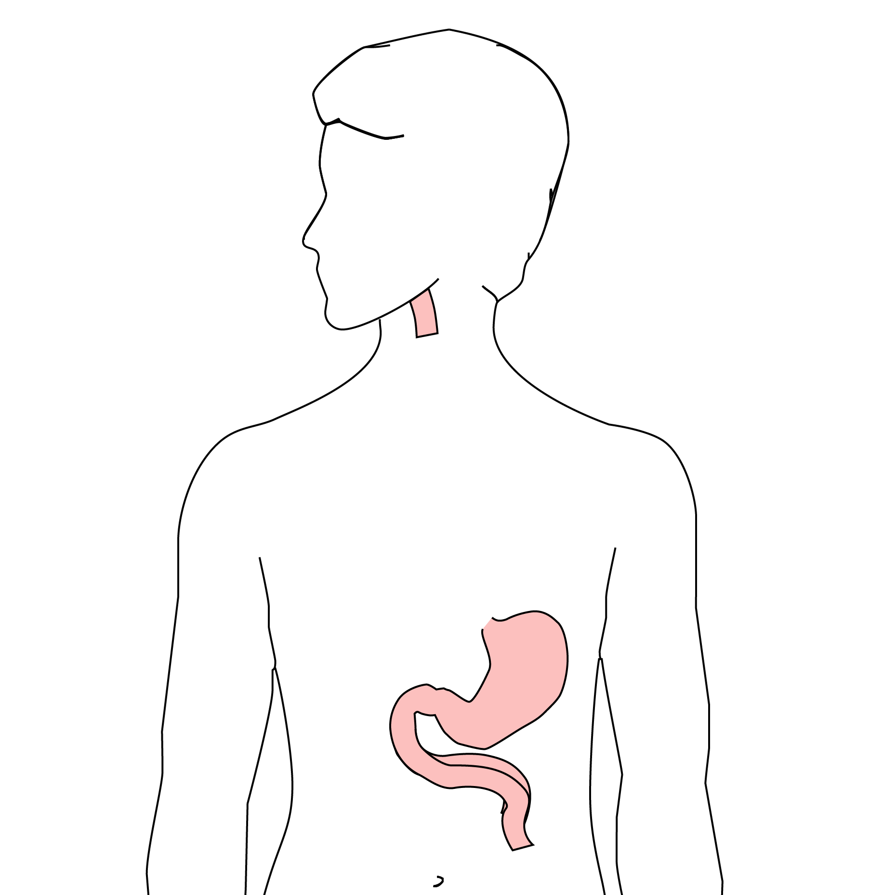
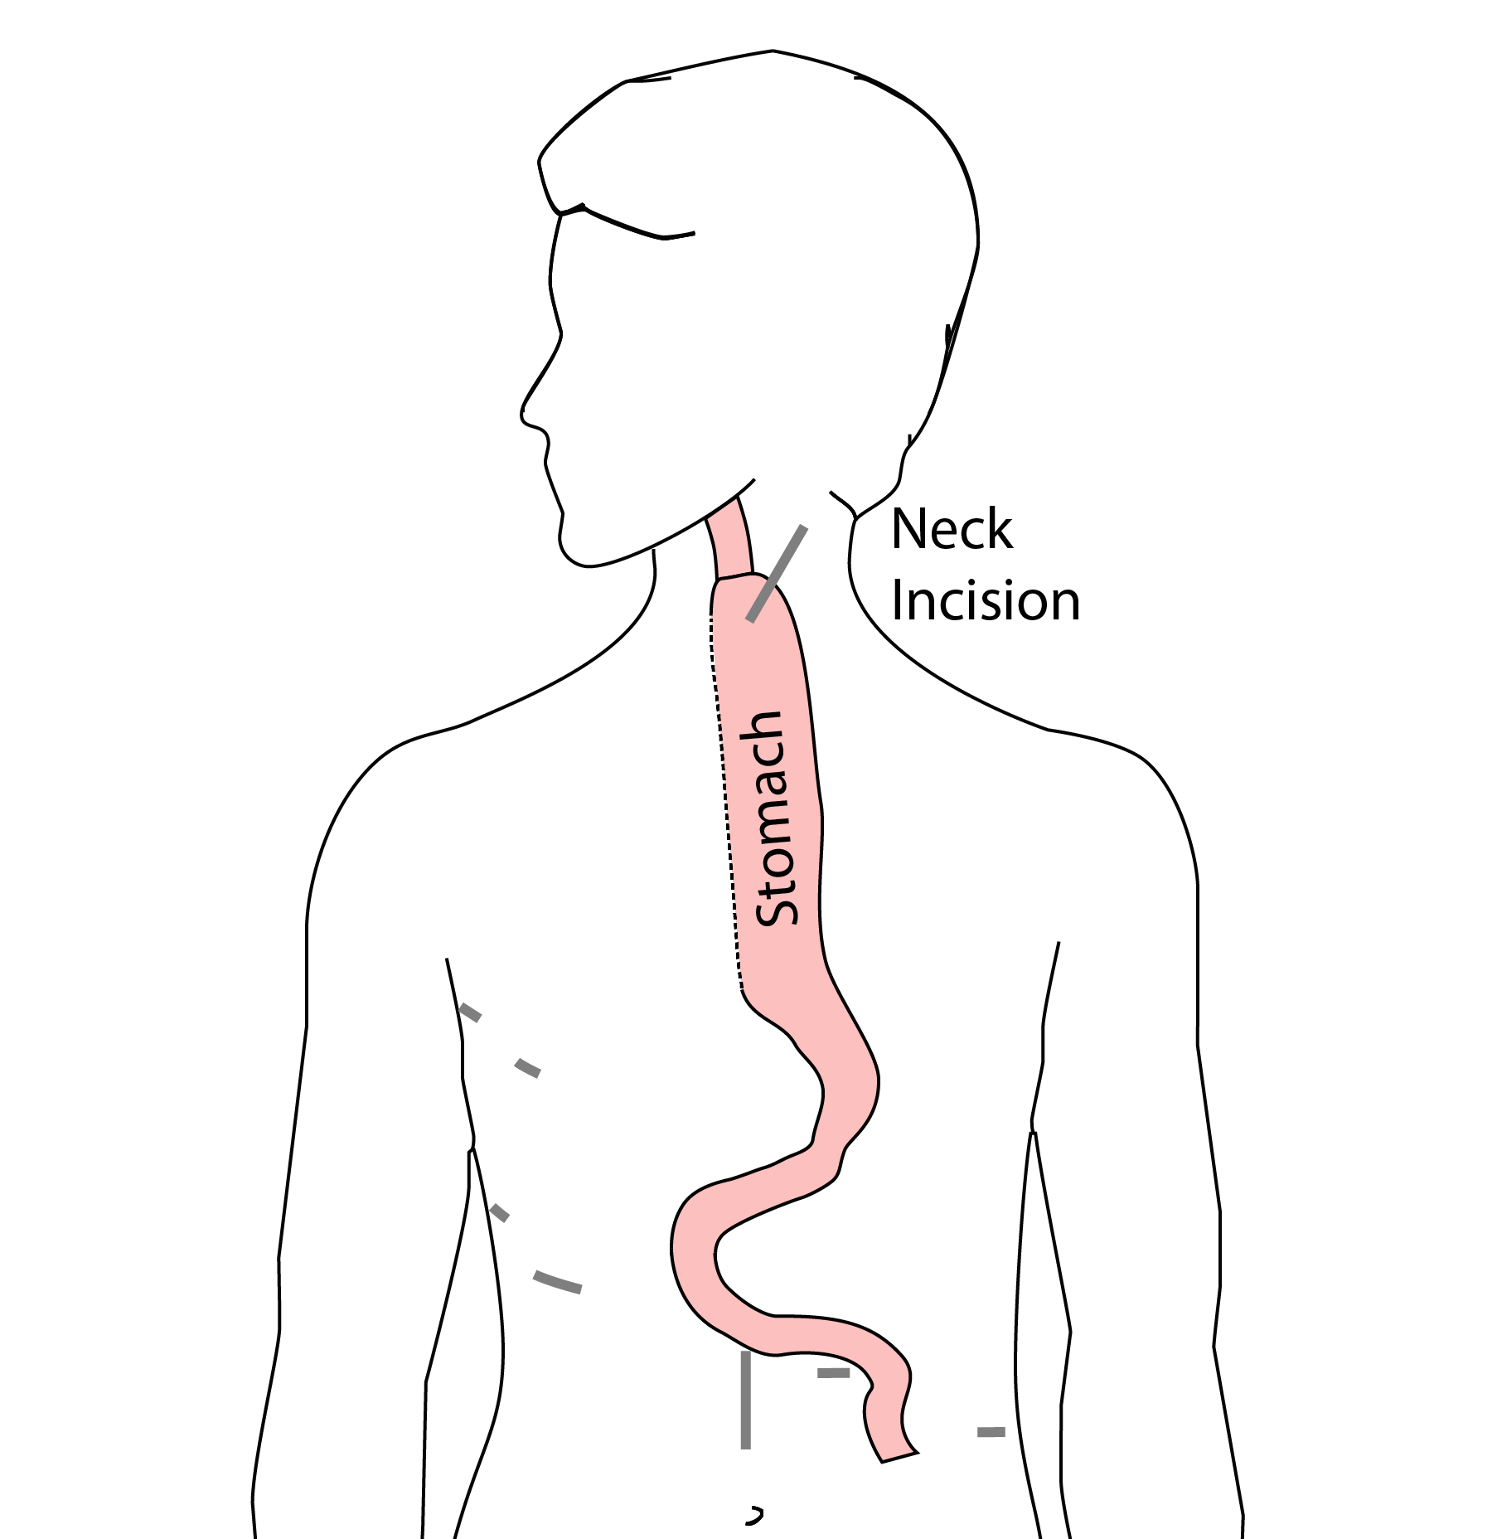
McKeown Esophagectomy

Slide 21
Risks of Esophagectomy
Esophagectomy is a complex operation, with a real risk of complications.
Two significant complications:
Anastomotic leak
Pneumonia

Slide 22
Anastomotic Leak
The anastomosis is surgical connection between the esophagus and the stomach.

Slide 23
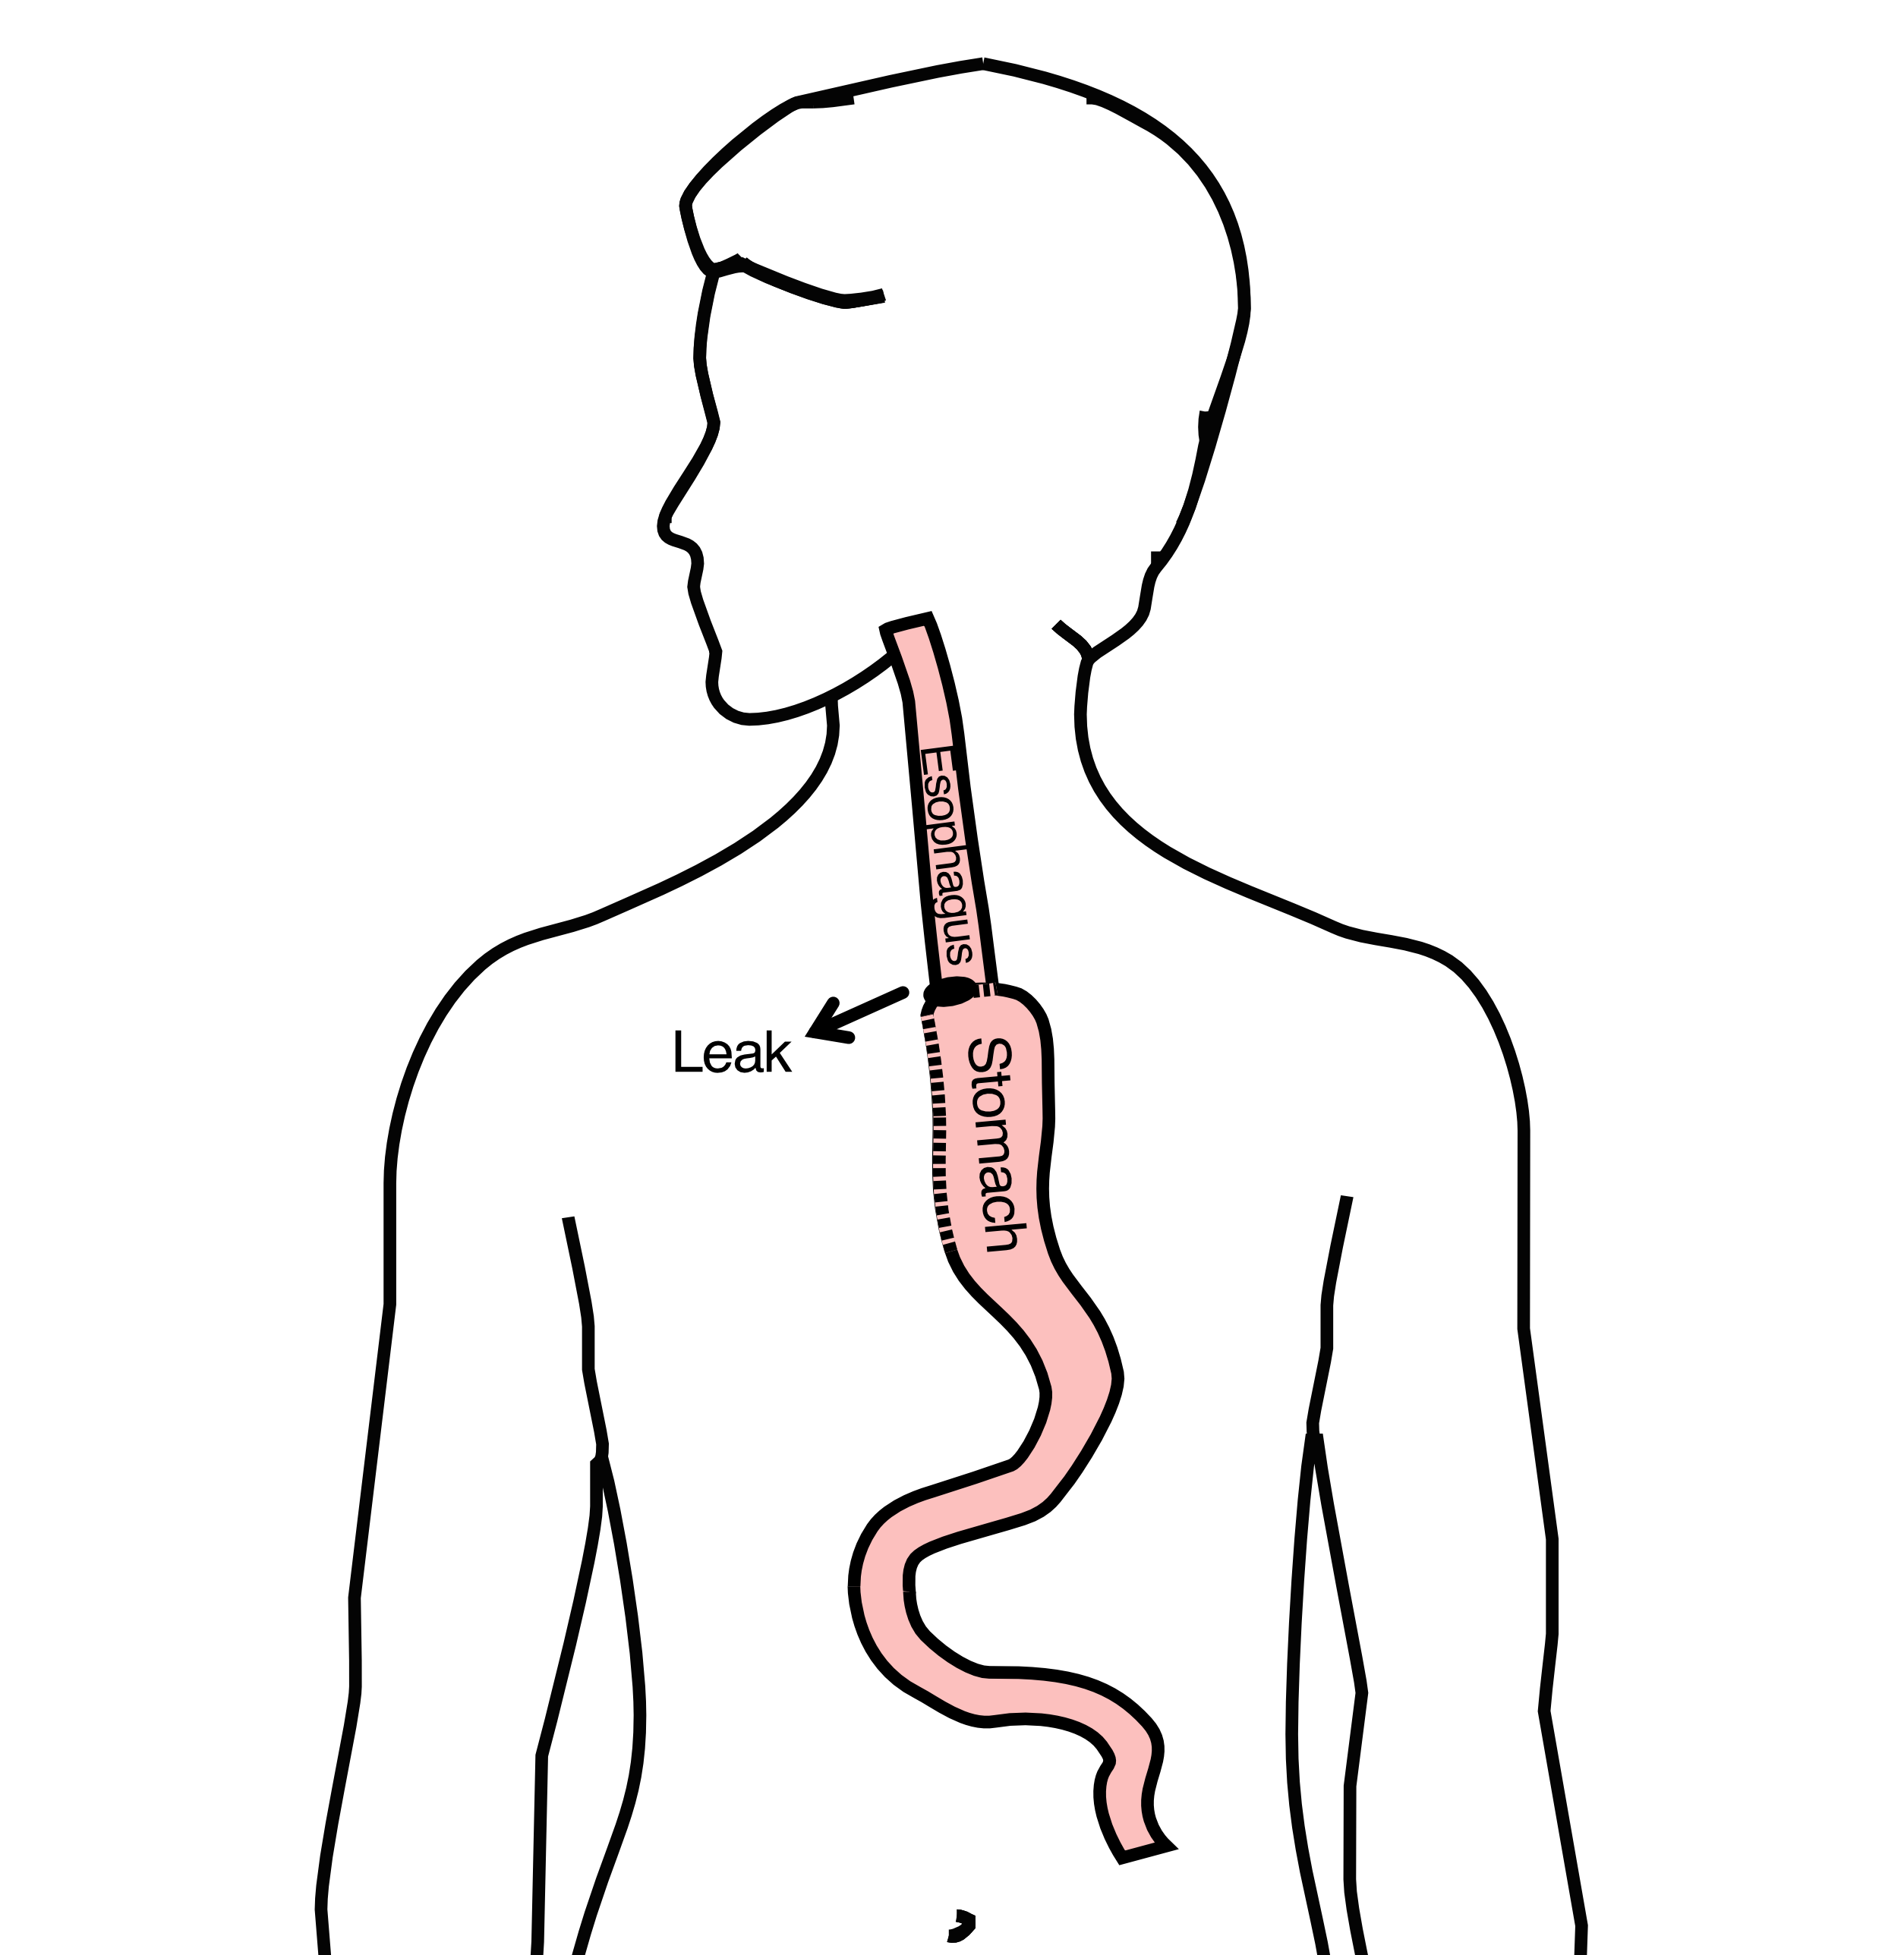
Anastomotic Leak
If healing doesn’t occur:
Leakage of fluid from the esophagus
Infection in the space between the lungs
Requires additional time in the hospital

Slide 24
Anastomotic Leak
If leak occurs:
Some leaks will seal
Stent may be required to help healing
Occasionally additional surgey is required

Slide 25
Anastomotic Leak
Risk of leak depends on:
Type of operation performed
Nutritional status of patient
Experience of the surgeon

Slide 26
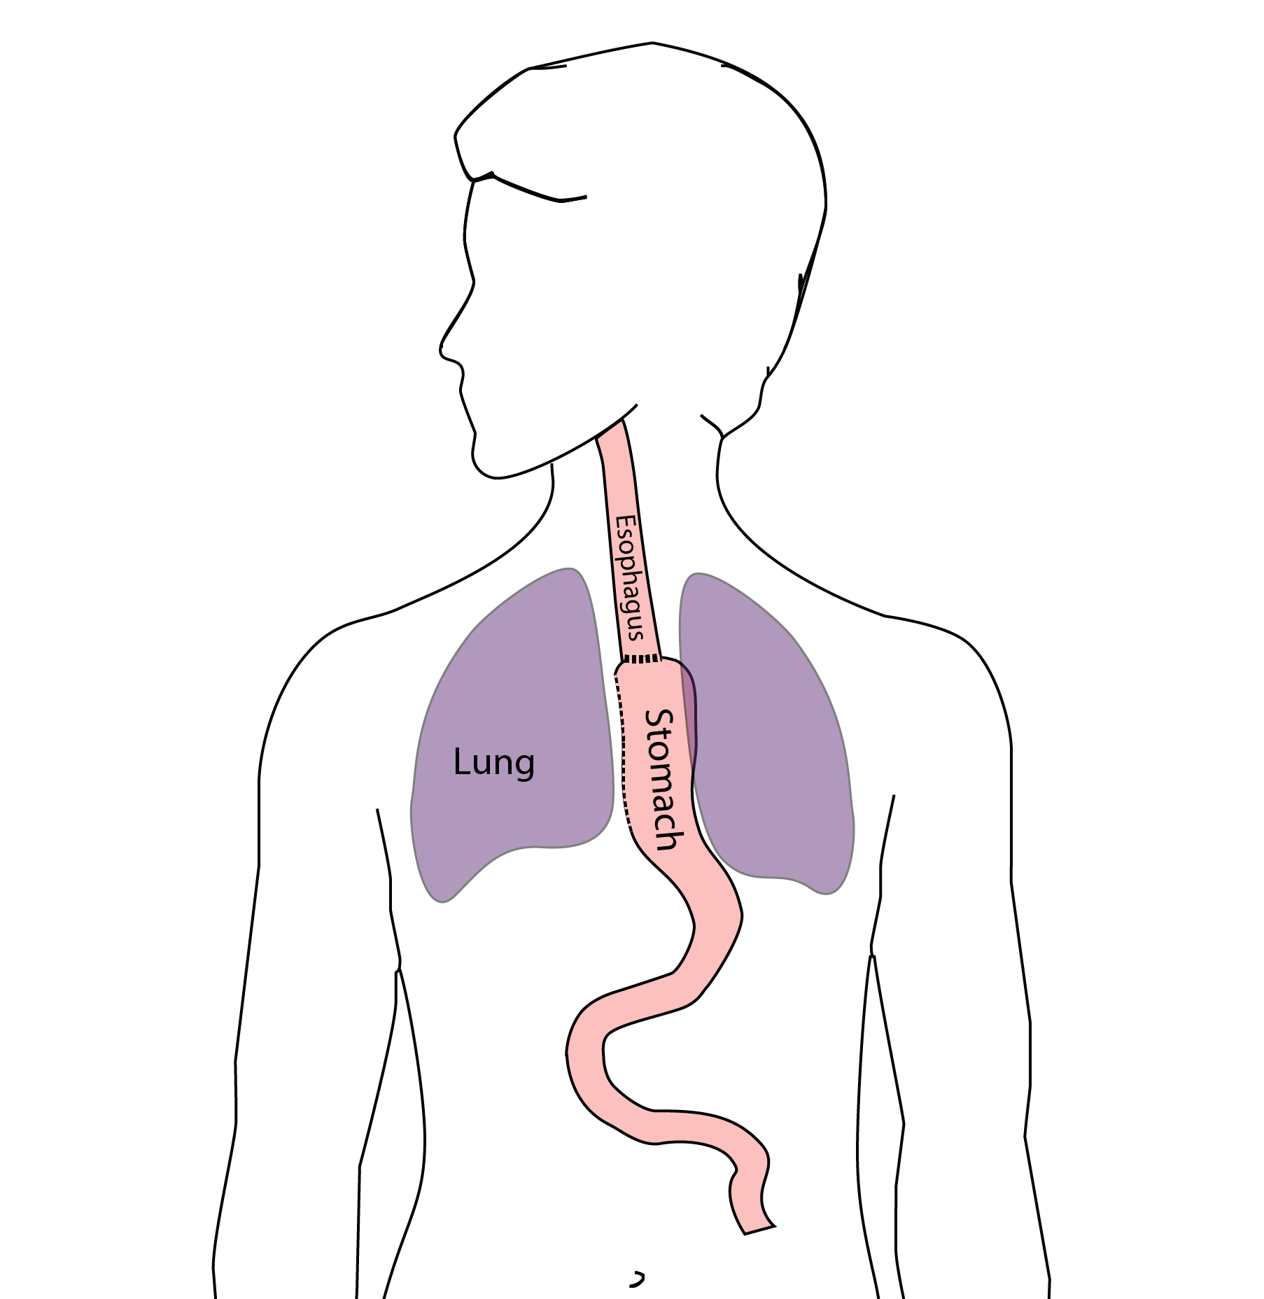
Pneumonia
Occurs in 10-15% of patients after esophagectomy.
Requires treatment with antibiotics
Requires a longer hospitalization.

Slide 27
Preventing Pneumonia
Several ways to help prevent pneumonia:
Deep breathing
Coughing
Walking
After surgery, this means:
Sitting in a chair most of the day
Walking in the halls as soon as possible

Slide 28
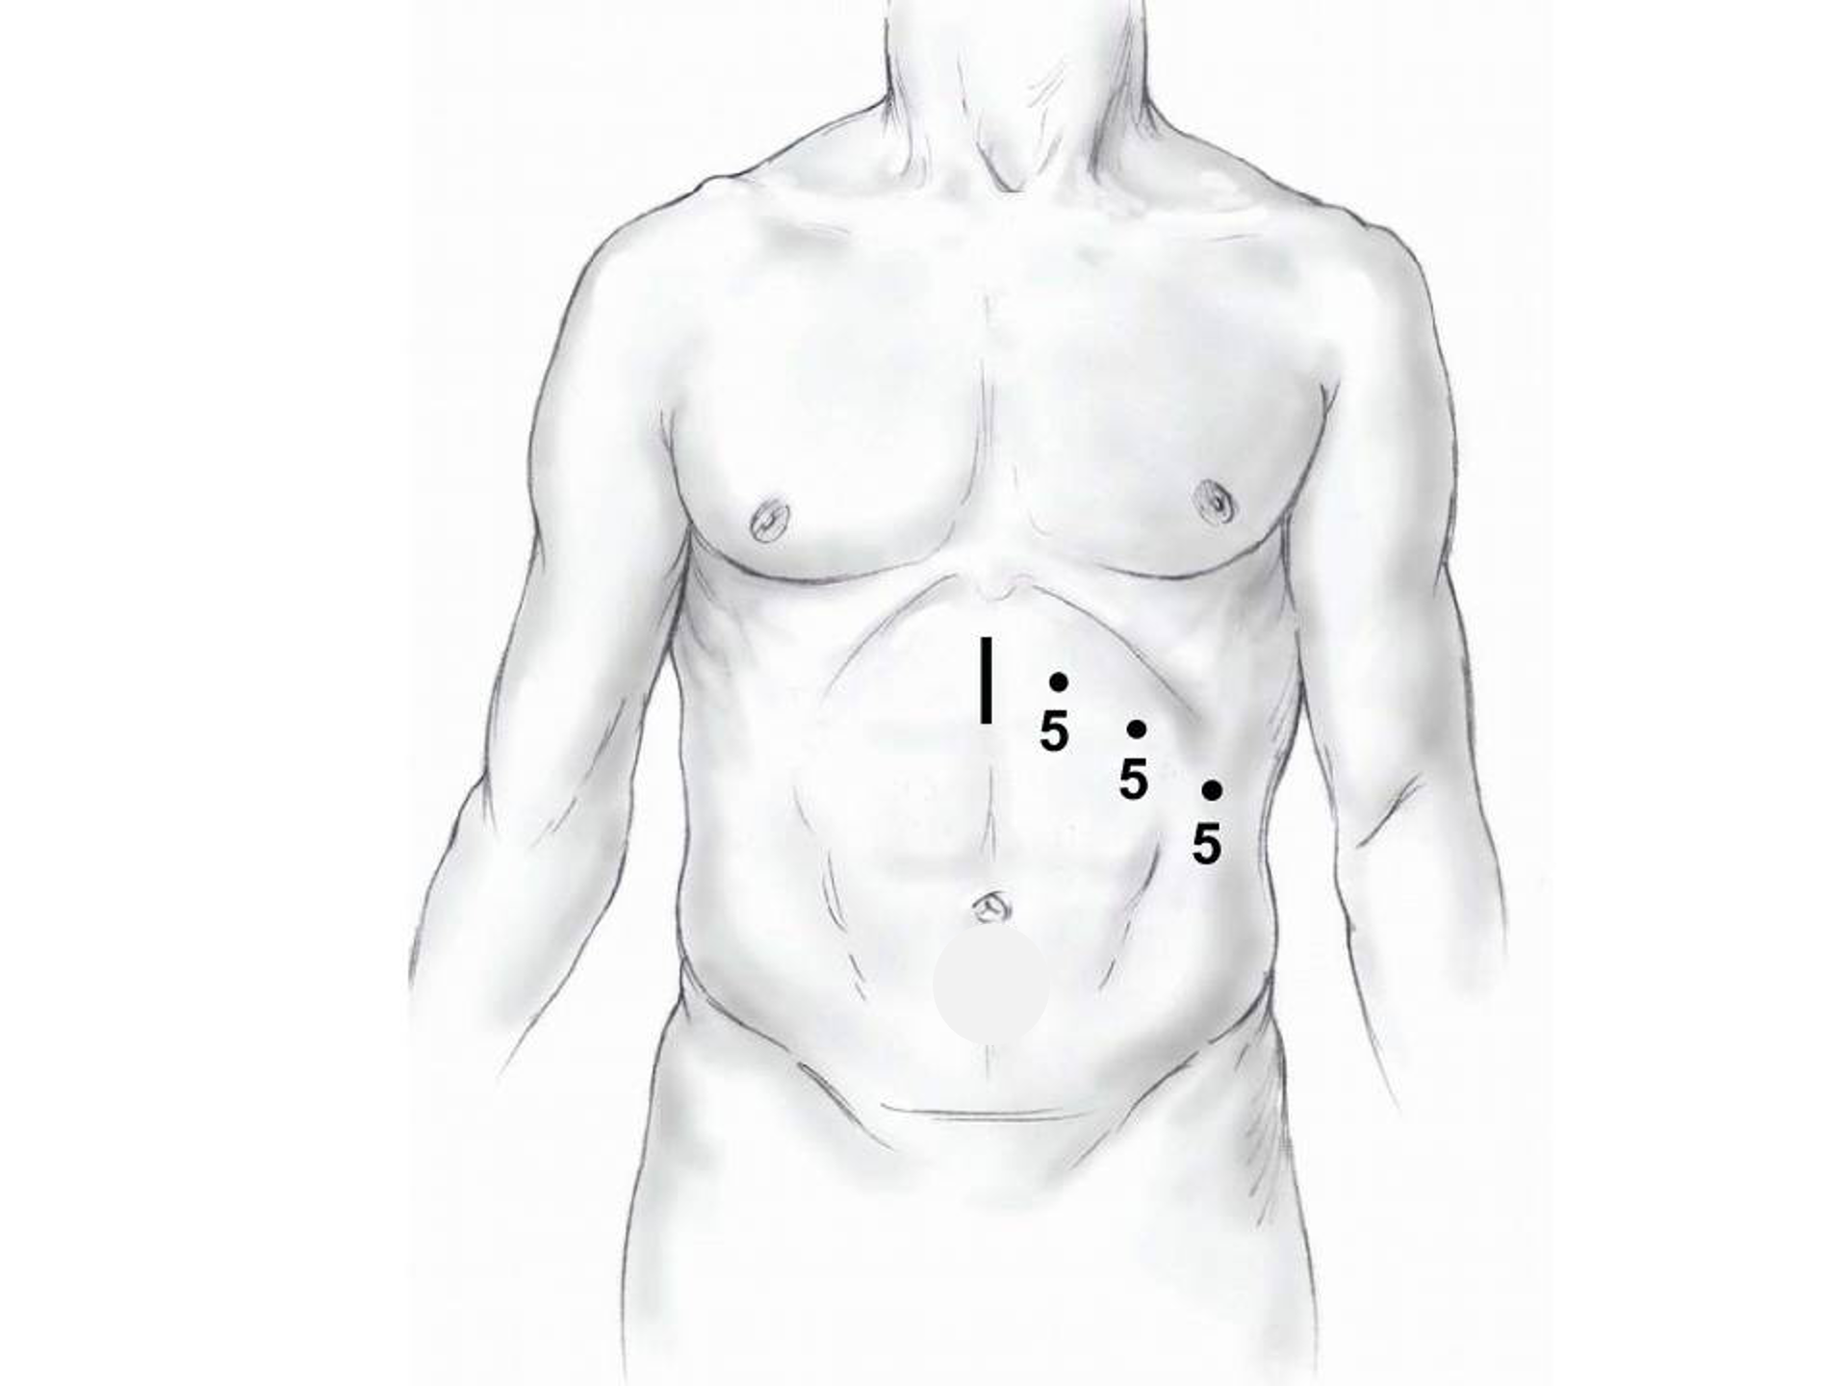
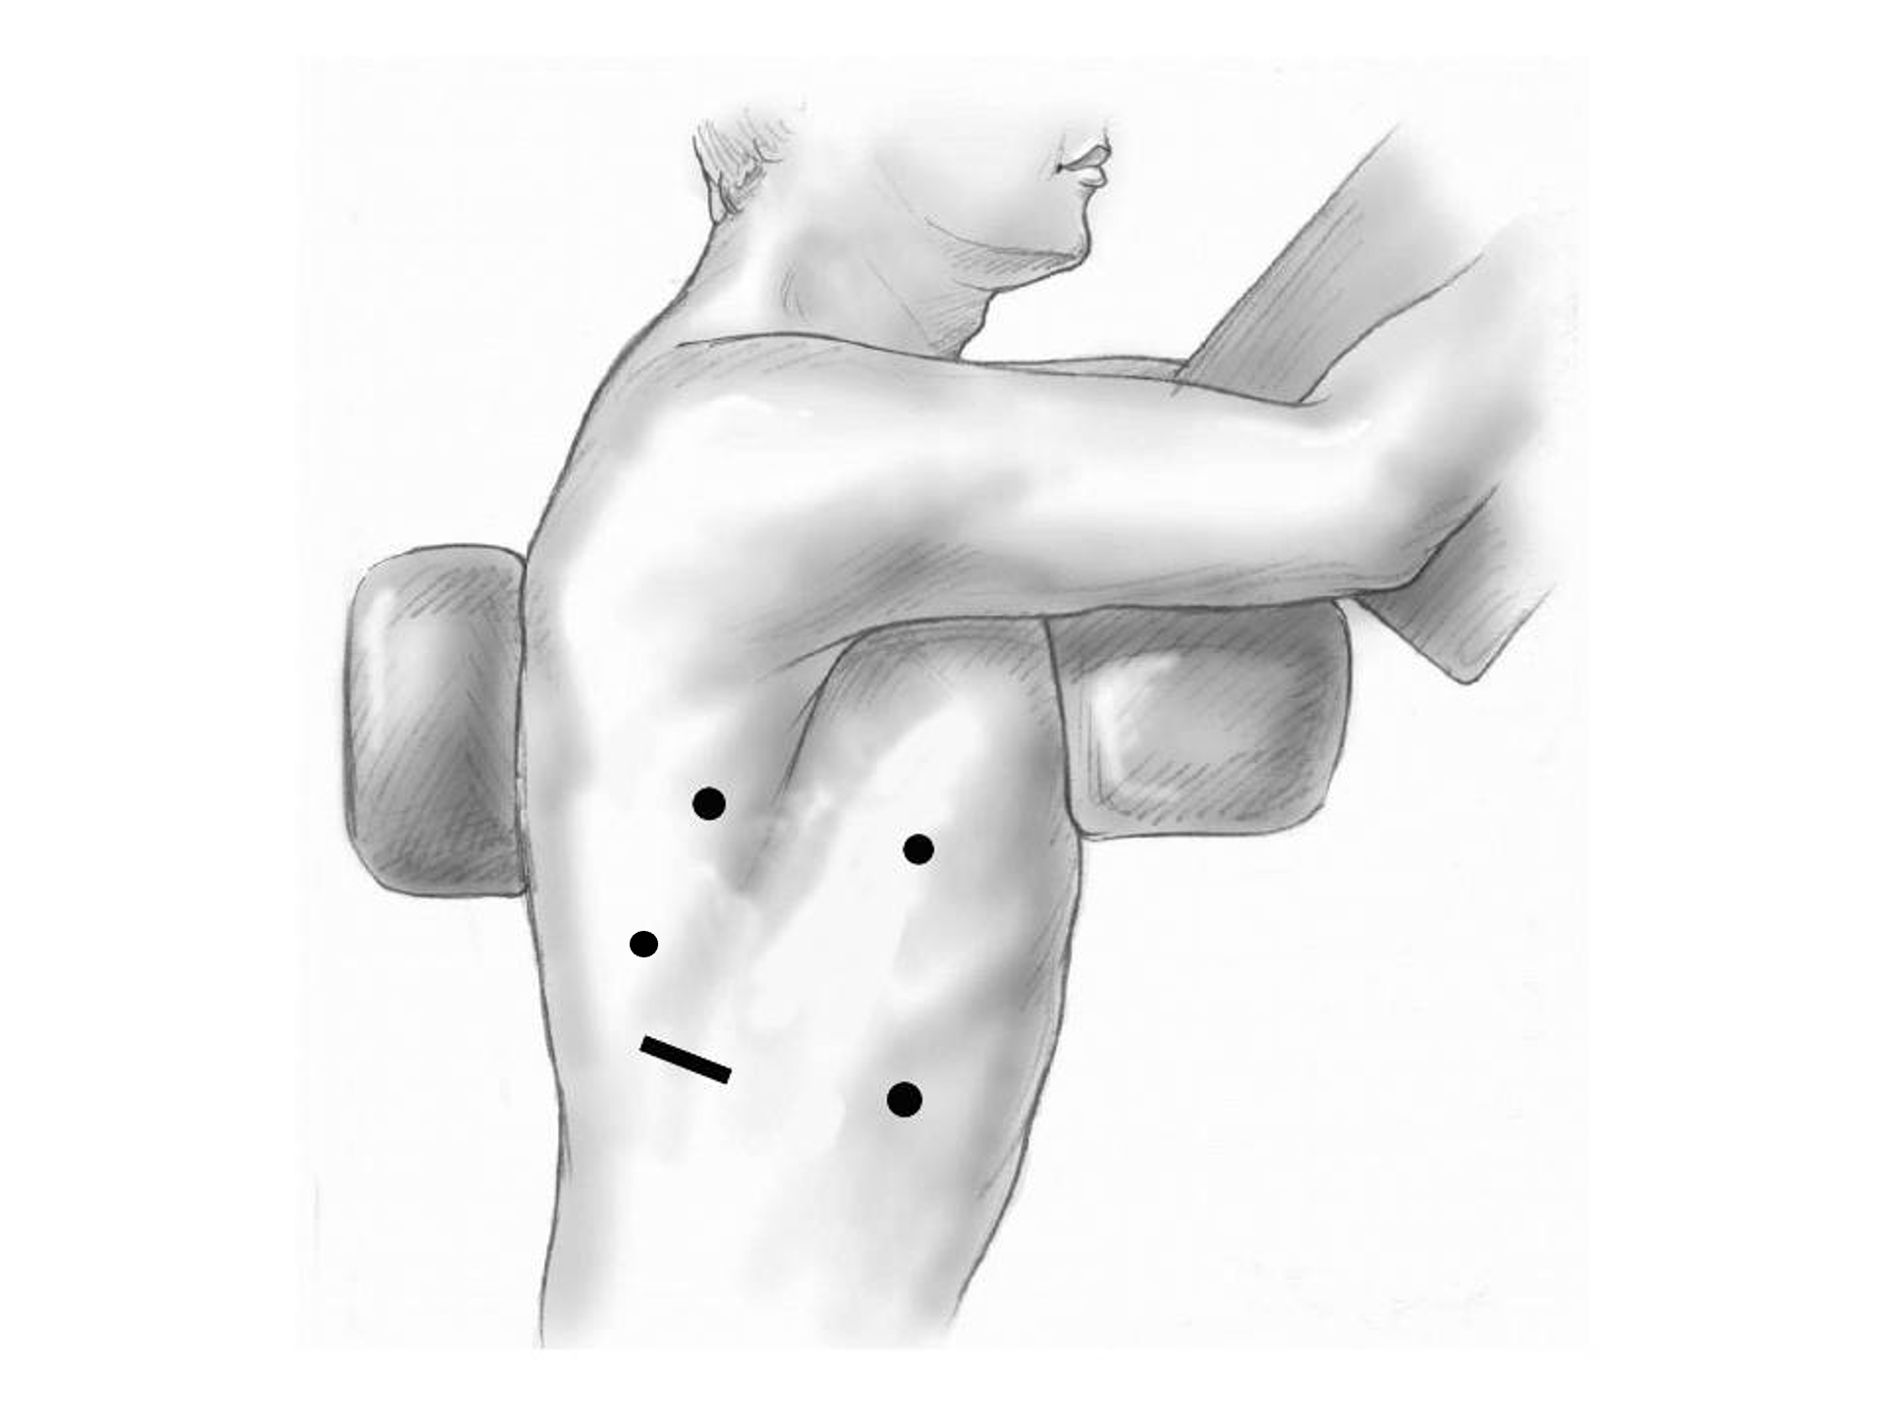
Minimally-invasive Esophagectomy

Slide 29
Risks of Surgery
Risks related to anesthesia
Heart attack (5%)
Irregular heart rhythm (15%)
Pneumonia (10%)
Blood clots in legs (<5%)
Pulmonary embolism (2%)

Slide 30
Risks of Surgery
Risks related to Surgery
Anastomotic leak (5%)
Stricture at anastomosis (15%)
Death within 90 days of surgery
  Low risk patients = 2%
  Intermediate risk = 10%
  High risk = 30%

Slide 31
Risks of Surgery
 | Age <75 | Age >75
Normal Muscle (75%) | 2% | 10%
Low Muscle (25%) | 10% | 30%
Risks of Death within 90 Days of Surgery

Slide 32
Day Prior to Surgery
Clear liquids for 24 hours prior to surgery
Check with Pre-op nurse regarding medicines day prior to surgery
No tube feedings the night before surgery

Slide 33
Day of Surgery
Arrive at 5am – nothing to eat or drink after midnight.
Medicines OK w/ a sip of water
sip of black coffee but no cream.
Surgery will be cancelled if you have cream/milk
Waiting room for family and friends on 5th floor

Slide 34
Epidural Catheter for Pain Control
Remains in place for 2-5 days
Dosage can be adjusted as needed
Can make it more difficult to urinate
May require foley catheter in bladder
Foley catheter removed after epidural removed

Slide 35
Intensive Care Unit (ICU) (2-4 days)
Surgical ICU on 11th floor
NG tube in nose to drain stomach and esophagus
Catheter in bladder
Chest tube right chest
Abdominal drains (usually 2)
Feeding jejunostomy (usually stays in 8 wks)

Slide 36
Intensive Care Unit (ICU)
Bladder catheter removed → check that bladder empties properly
Chest tube removed (day 2-4) → follow-up x-ray
Fluid emptied from drains every few hours
Start tube feedings by feeding
Feeding jejunostomy (stays in 8 weeks)

Slide 37
Ward - 6Tower
Jejunostomy feeds started
Up in a chair most of the day
Walking in the halls
  Start with assistance
  Improves lung function
  Prevents loss of muscle strength

Slide 38
Jejunostomy Feeds
Jejunostomy tube feeds
Start continuous (24 hours)
Convert to night-time only (16 hours)
Water administered through feeding tube
Usually 8oz 4 times/day
Important to prevent dehydration

Slide 39

Jejunostomy Tube
Nutrition to bypasses the esophagus and stomach
Placed in small intestine
Pump administers feedings slowly
Feeding done at night

Slide 40
Jejunostomy Typical Regimen
Jejunostomy tube feeds for 16 hours (6pm-10am)
  Men: 75mL/hour x 16 hours = 5 cartons
  Women: 60mL/hour x 16 hours = 4 cartons
Water 240ml (8oz) via syringe 4x/day
Hospital nurses will teach use of the feeding tube

Slide 41
Jejunostomy Feeds with Diabetes
Jejunostomy feedings elevate blood sugars
Insulin may be required along with feeds
Typical Pattern for tube feeds
Feeds run via pump from 6pm to 10am
Insulin at 6pm (70/30 insulin)
Insulin at Midnight (70/30 insulin)
No insulin if tube feedings are not run

Slide 42
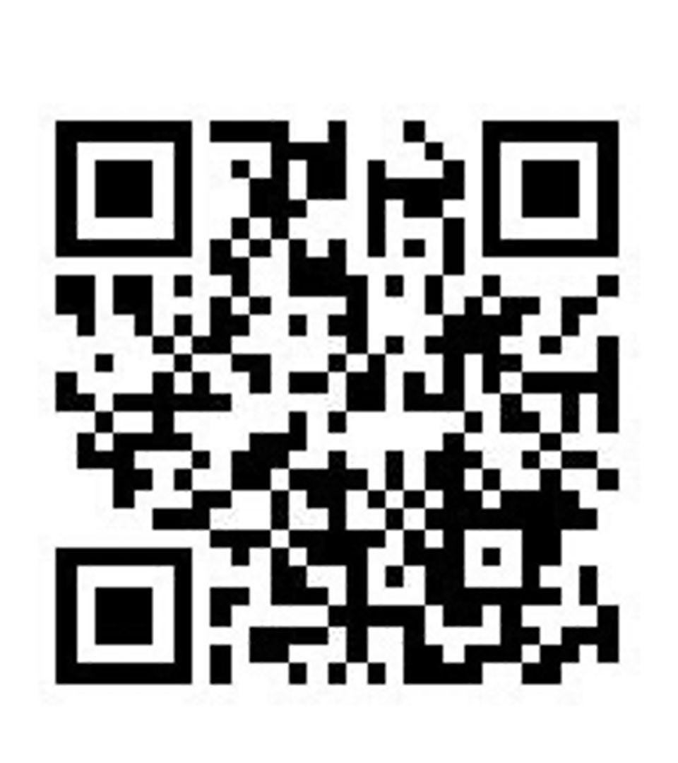
Jejunostomy Video
A video is available to help become familiar with the feeding jejunostomy

Slide 43
Activity after Surgery
Up in chair most of the day
Walking with help from nurse/Physical Therapist
Goals:
  Improve lung function
  Prevent muscle loss

Slide 44
Nasogastric (NG) Tube
Tube passed through nose into stomach
Drains fluid from stomach
Prevents vomiting
Upper GI X-ray on 2nd or 3rd day after surgery
If stomach empties well $→$ NG tube removed
Otherwise, X-ray repeated 2-3 days later

Slide 45
Swallowing Evaluation
Once NG tube has been removed:
Modified barium swallow in radiology
Drink a white chalky liquid (barium)
Look for proper swallowing function
70% of patients $⇒$ liquids started by mouth

Slide 46
Oral Intake at Home
Most are taking protein shakes when they go home
Protein shakes are started after tolerating water
2 oz per hour to start
4 oz per hour if 2oz are tolerated well

Slide 47
Discharge
Goal: ready to leave day #6/7 after surgery
Night-time tube feedings (6pm to 10am)
Nutrition by mouth (70% of patients)
  1 oz of water per hour by mouth OR
  Protein shakes 4oz every 2 hours
Water through tube 8oz four times per day
Home care nursing (feeding tube teaching)
Home infusion (tube feeding supplies)

Slide 48
Nutrition after Surgery
At discharge home:
Protein shakes 4oz every 2 hrs
Tube feeds 4-5 cans at night (6pm-10am)
10-12 Days: Increase protein shakes
Tube feeds 3-4 cans at night
Three weeks: Post-esophagectomy Diet
8-12 weeks: Remove feeding tube (in office)

Slide 49
Transition from Tube Feeds $→$ Eating
Dietitian will calculate daily protein goal
Typically 60-75 grams protein/day
Each carton of tube feeding has 15 grams
  75 grams protein = 5 cartons/night
More intake by mouth $→$ tube feeds reduced
Spread out protein during the day (20gm/meal)
Three meals + 2-3 high-protein snacks

Slide 50
Post-esophagectomy Diet
Soft Consistency
High Protein
Avoid sugary liquids (can cause ‘dumping’)
Avoid raw vegetables (and salads)
Eating
  Small, frequent meals
  Sit up for 30-45 minutes after eating
  Avoid eating within 2 hours of bedtime

Slide 51
Medicines at Home - Pain
Acetaminophen (Tylenol) 1000mg 4x/day
Gabapentin 300mg 3 times/day
Oxycodone
As needed in addition to Tylenol/gabapentin
Will begin reducing dose at first postop visit
Can usually discontinue by 4 weeks
NO DRIVING WHILE ON OXYCODONE

Slide 52
Non-steroidals Anti Inflammatory (NSAID)
Non-steroidal anti-inflammatories (Celebrex)
200 mg every 12 hours starting at 2 weeks
NO GOODY POWDERS OR BCs
(Can cause permanent scarring at the surgery site)

Slide 53
Acid Blockers = Proton Pump Inhibitors
Examples include ompeprazole and pantoprazole
Will stay on for at 1-2 years to prevent acid reflux
Important in preventing scarring at anastomosis (new connection between esophagus and stomach)
To administer through feeding tube, open capsule and resuspend beads in 60mL (2oz) of water

Slide 54
Medicines at Home
Reglan – Helps stomach empty
Will plan to stop after six weeks
0.1% risk of tardive dyskinesia (nervous tic)
Remeron – Helps improve appetite
Can cause vivid dreams
Used for several weeks after surgery
Will stop within first three months of surgery

Slide 55
Metoprolol = Beta Blockers
Slows heart rate and lowers blood pressure
Used to prevent rapid heart rate
Patients not taking a beta blocker prior to surgery $→$ wean after after surgery
Patients taking a beta blockerprior to surgery $→$ return to prior dose and drug after surgery

Slide 56
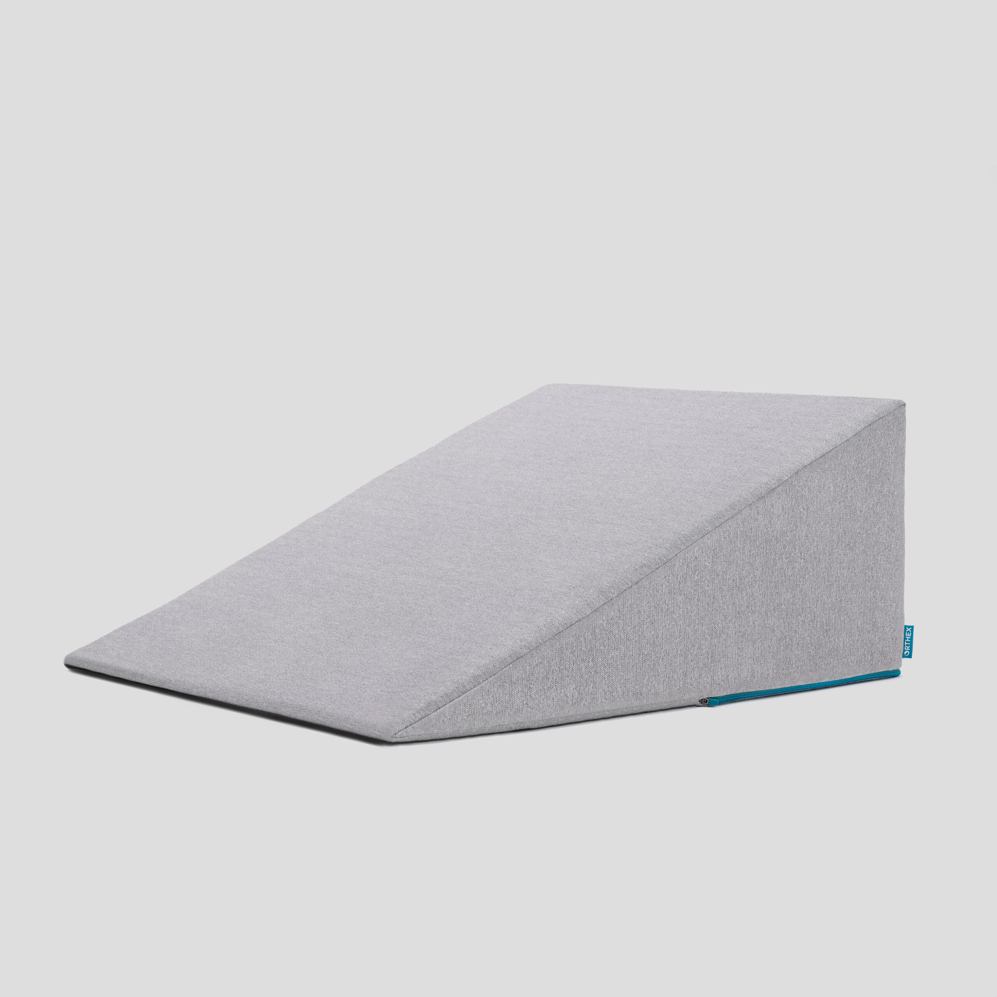
Sleeping at Home
Reflux can occur the first few weeks/months after surgery
This improves over the first few months
A wedge pillow can be helpful for sleep

Slide 57
Postoperative Visit at 7-10 Days
Check surgical site
Remove staples (if needed)
Adjust medicines as needed
Insulin (for diabetic patients on insulin)
Reduce beta blocker medicines
Advance diet
Reduce tube feeds

Slide 58
After surgery
Wean off medicines added after surgery
Pain medicines
Beta-blockers
Reglan and Remeron
Continue acid blockers for at least 1 year

Slide 59
Jejunostomy Removal
Jejunostomy tube is removed in the office once you can take in enough nutrients by mouth
Removal usually around 8 weeks after surgery
May take 30 minutes and some local anesthetic to loosen up the tube for removal.

Slide 60
Nutritional Monitoring after Surgery
You may have difficulty absorbing some nutrients:
Iron
Vitamin B12
Vitamin D

Slide 61
Nutritional Monitoring after Surgery
About 3 months after the jejunostomy tube is removed, we will check blood levels:
Iron (ferritin)
Vitamin B12
Vitamin D

Slide 62
Nutritional Replacements after Surgery
Vitamin or iron replacements can be ordered by:
Primary Care Provider (PCP)
Medical Oncologist
Surgeon
If levels are low
Replacement
Repeat testing in 3-6 months

Slide 63
Team Members - Physicians
Primary Care Provider
Gastroenterologist
Medical Oncologist (chemotherapy)
Radiation Oncologist (radiation)
Surgeons
Jonathan Salo MD
Kelli Salter MD
Michael Roach MD

Slide 64
Team Members - Support Staff
Physician Assistant - Kate Duncan PA-C
Dietitian - Liz Koch
Nurses
Matthew Carpenter RN
Brandon Galloway LPN
Navigators
Laura Swift
Lorna Espinal
Care Coordinator - Karen Julian-Martinez

