Slide 1
Surgery of the Esophagus

Slide 2
Surgery for Esophageal Cancer
Surgery for esophageal cancer is generally performed in several situations:
Superficial Tumors (T1) that can’t be completely removed by endoscopy
Localized Tumors (T2N0)
Locally Advanced Tumors (T3 or N+) after the completion of preoperative therapy. Preoperative therapy is generally some combination of chemotherapy and radiation.

Slide 3
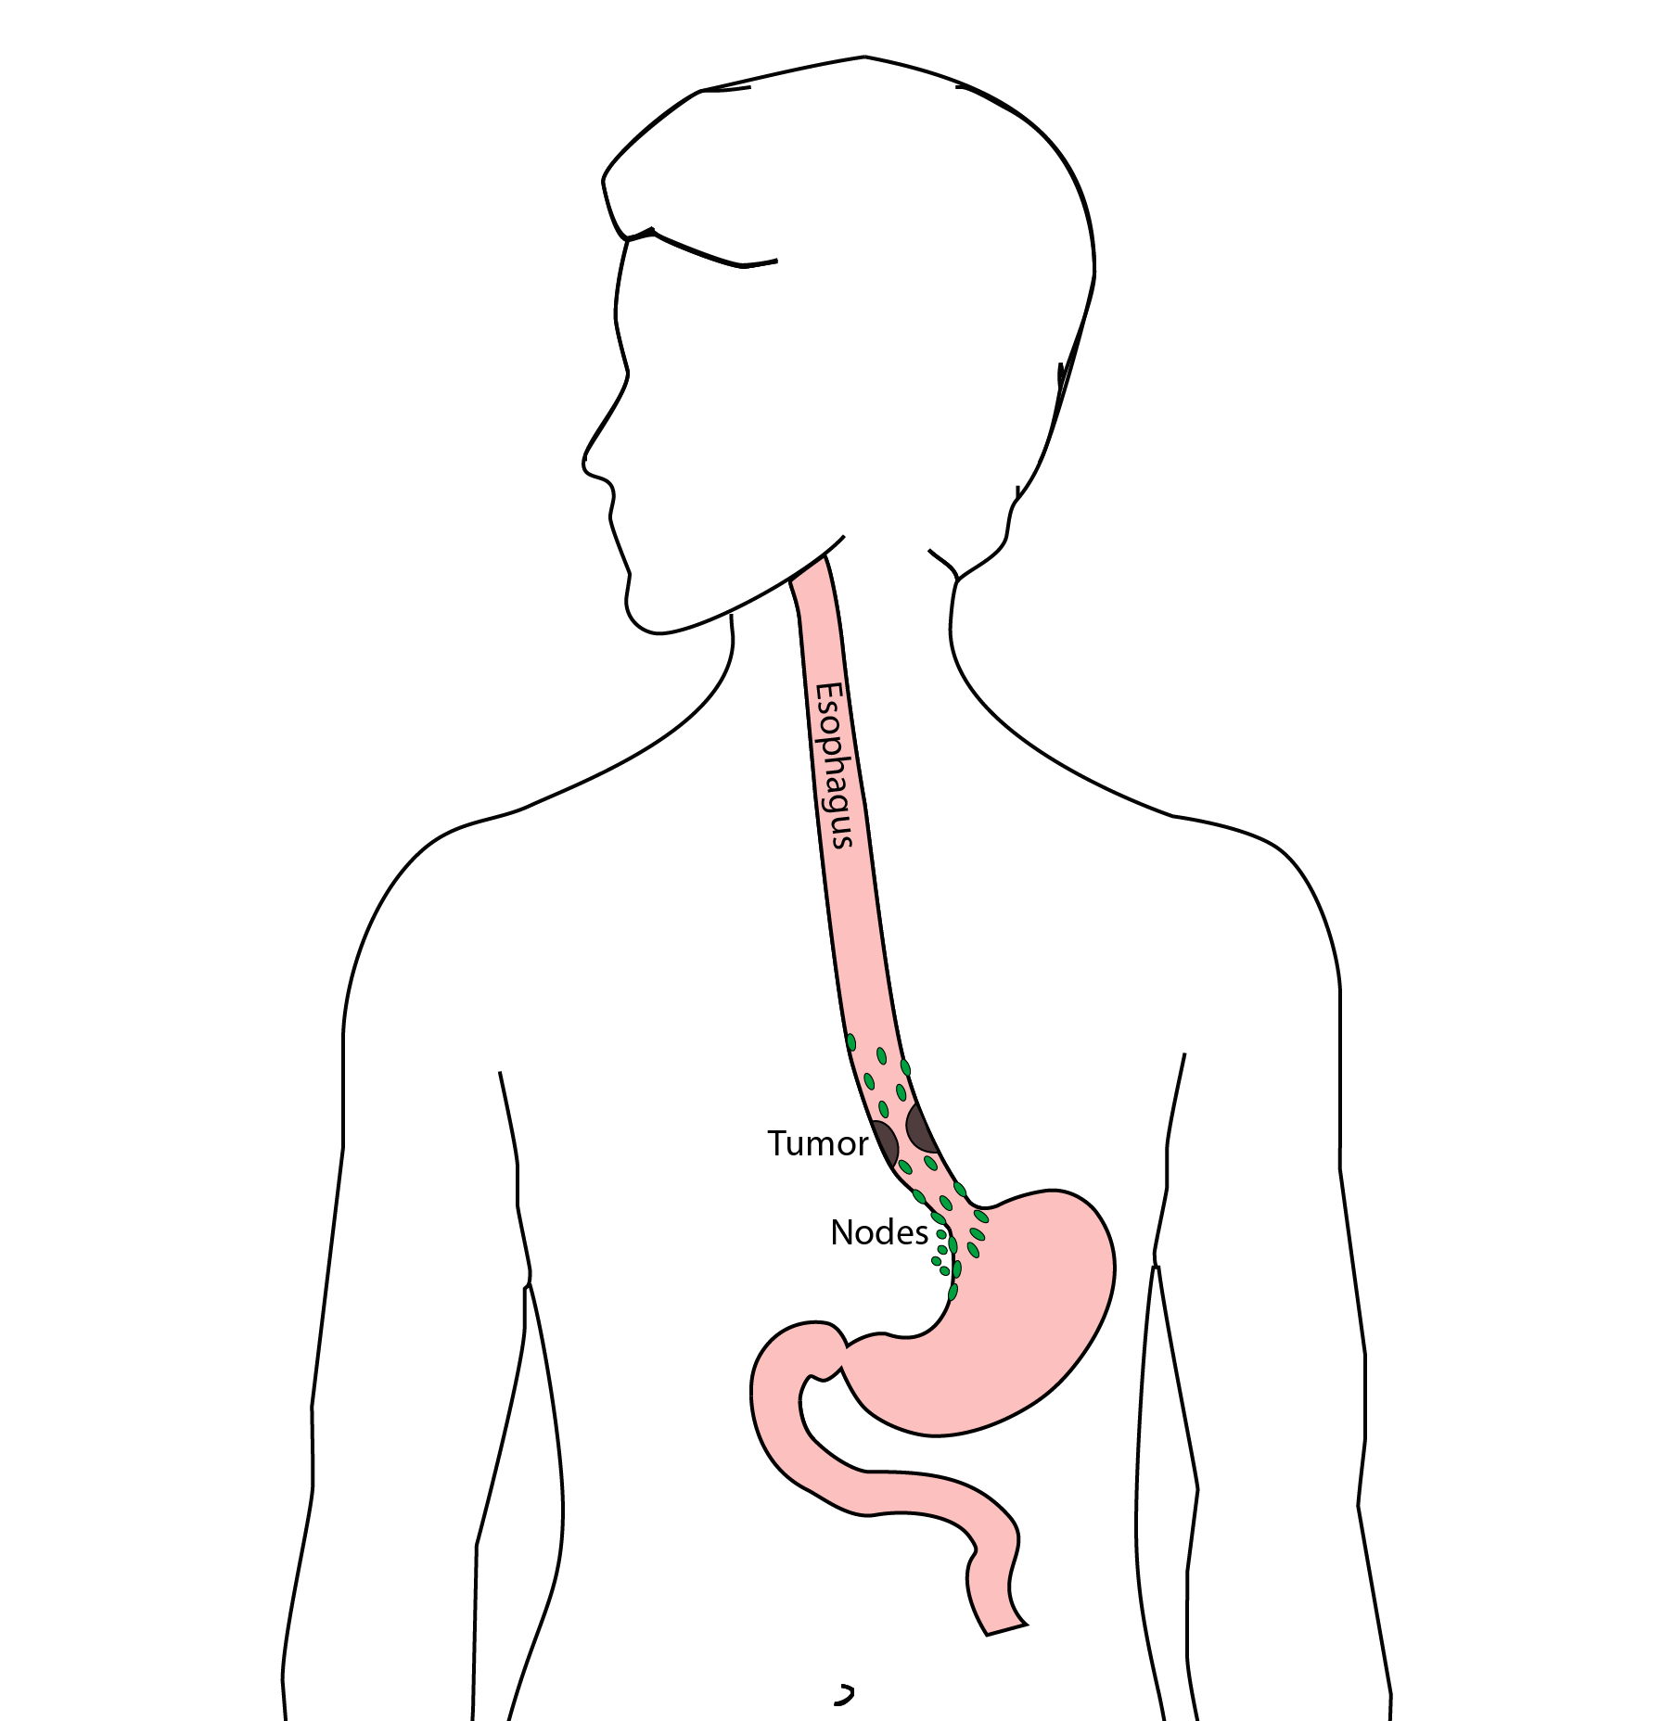
Goals of Surgery
Remove tumor from esophagus
Remove surrounding lymph nodes
Create a new esophagus

Slide 4
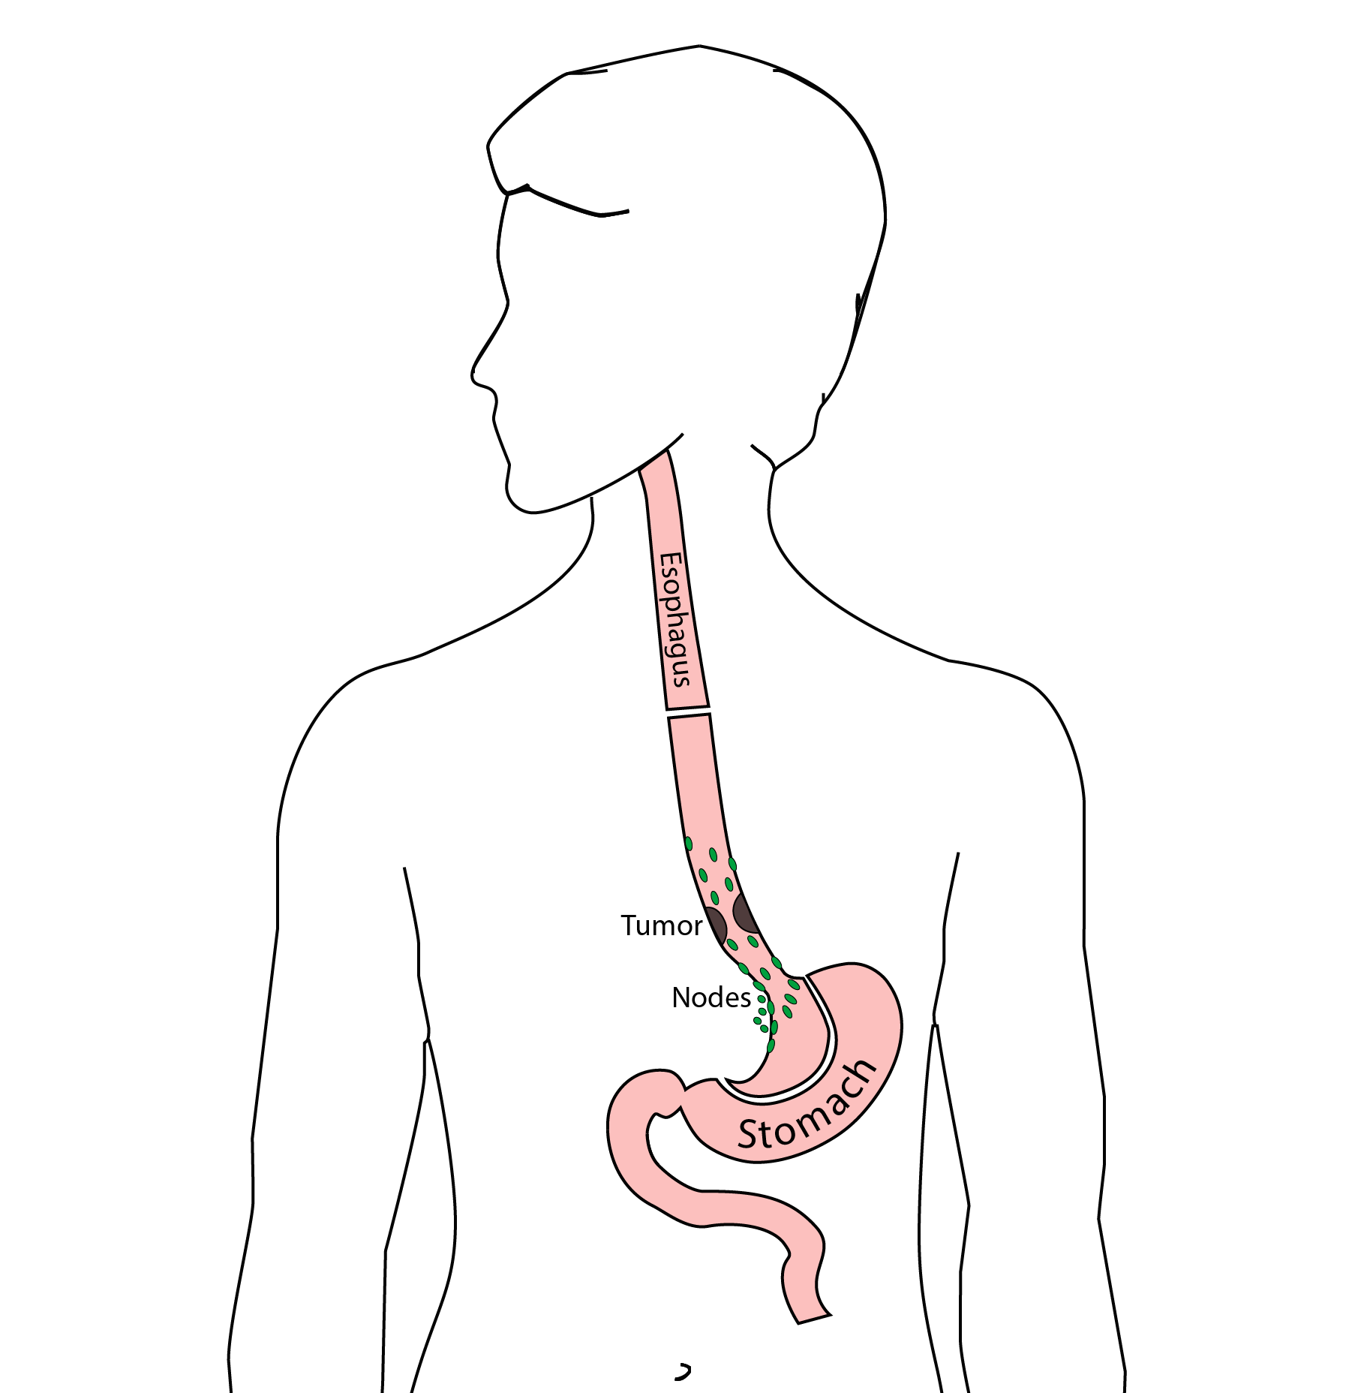
Resection
The Ivor Lewis esophagectomy, shown here, removes the lower 2/3 of the esophagus, the tumor, and the surrounding lymph nodes.

Slide 5
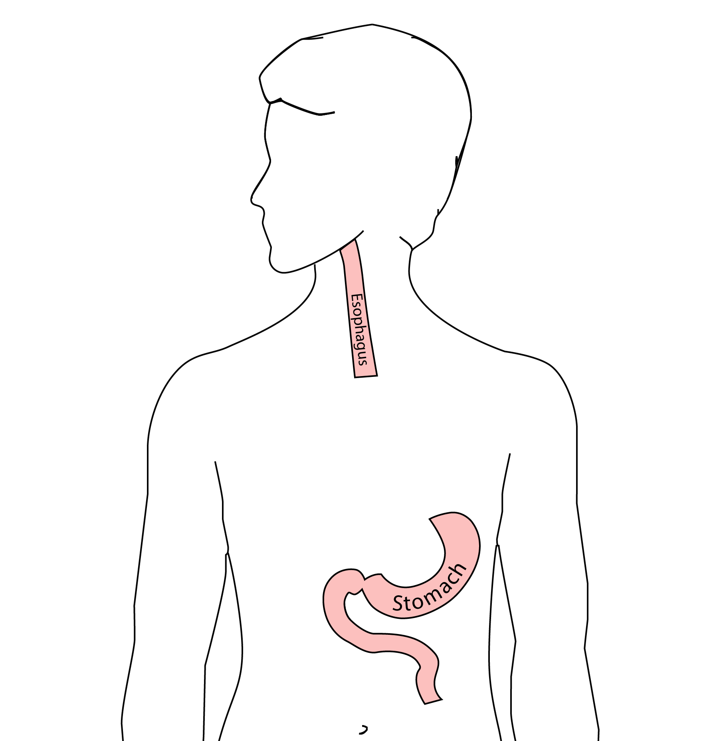
Reconstruction
A new esophagus is created from the stomach in the abdomen by fashioning it into a tube.

Slide 6
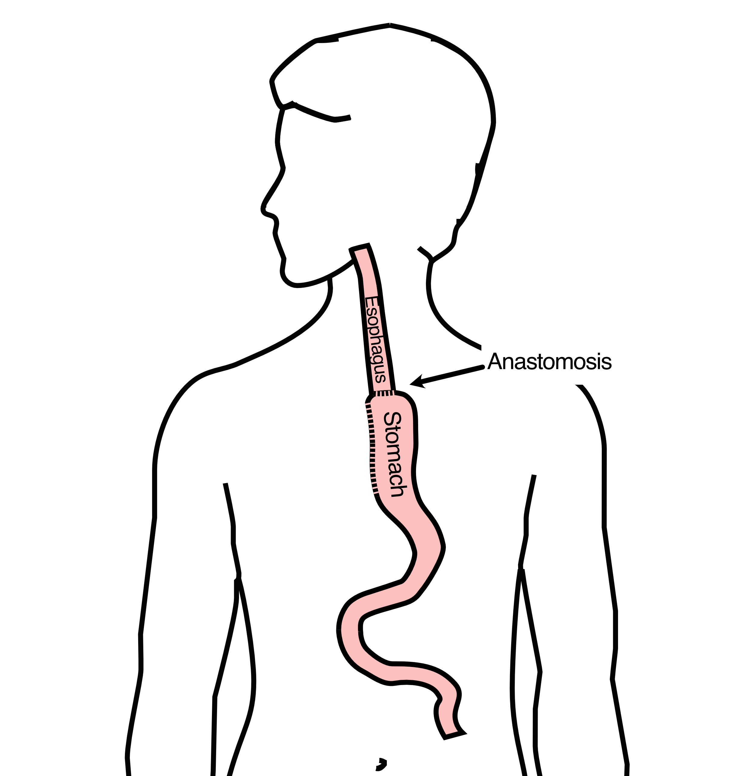
Ivor Lewis esophagectomy
The new esophagus is now brought up into the chest. A new connection is made between the esophagus and the stomach, called an anastomosis.

Slide 7
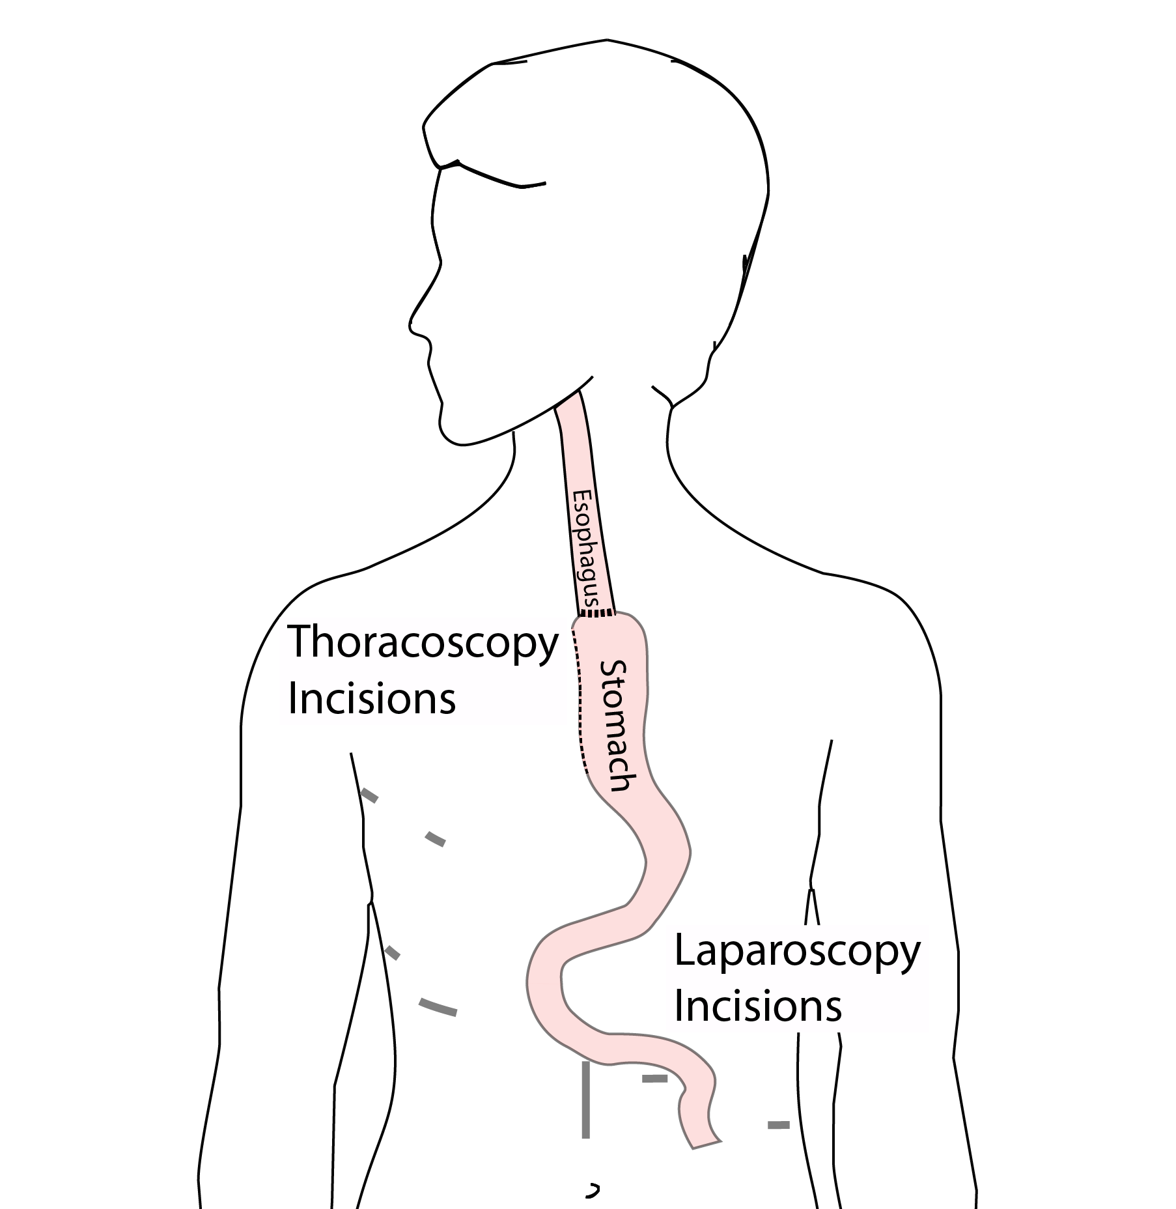
Minimally-invasive Ivor Lewis
Mininally-invasive esophagectomy uses small incisions in the abdomen and chest. A surgical telescope and special instruments are used to perform the operations. This operation is a more recent innovation and can be used in many cases instead of an open approach.
The smaller incisions mean faster recovery and less discomfort

Slide 8
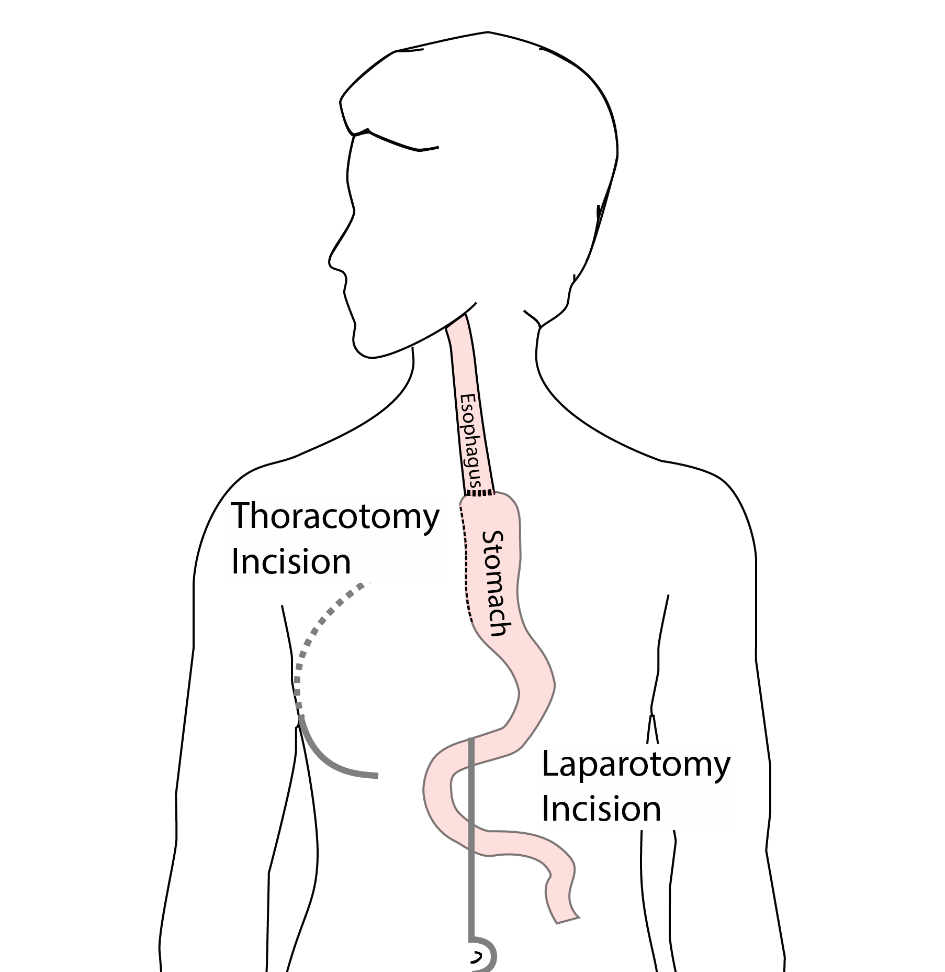
Minimally-invasive Ivor Lewis
We have found this is the best option for most of our patients. In some cases, an open approach is still necessary.

Slide 9
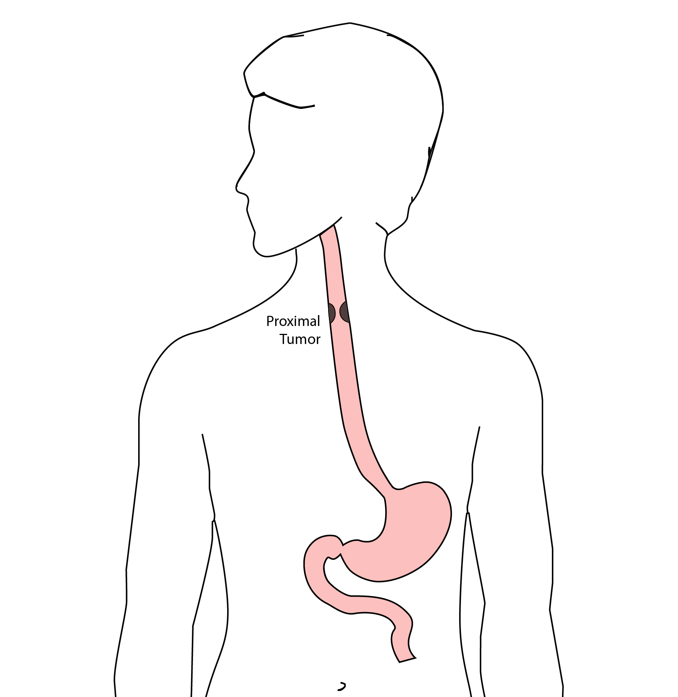
Total Esophagectomy
For patients with tumors in the upper esophagus, we need to remove more of the esophagus

Slide 10
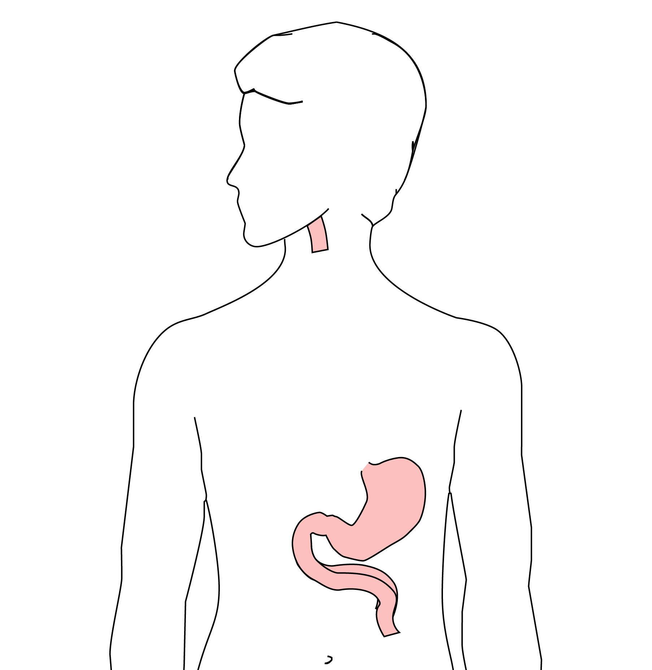
Total Esophagectomy
For those patients, we need to remove the whole esophagus

Slide 11
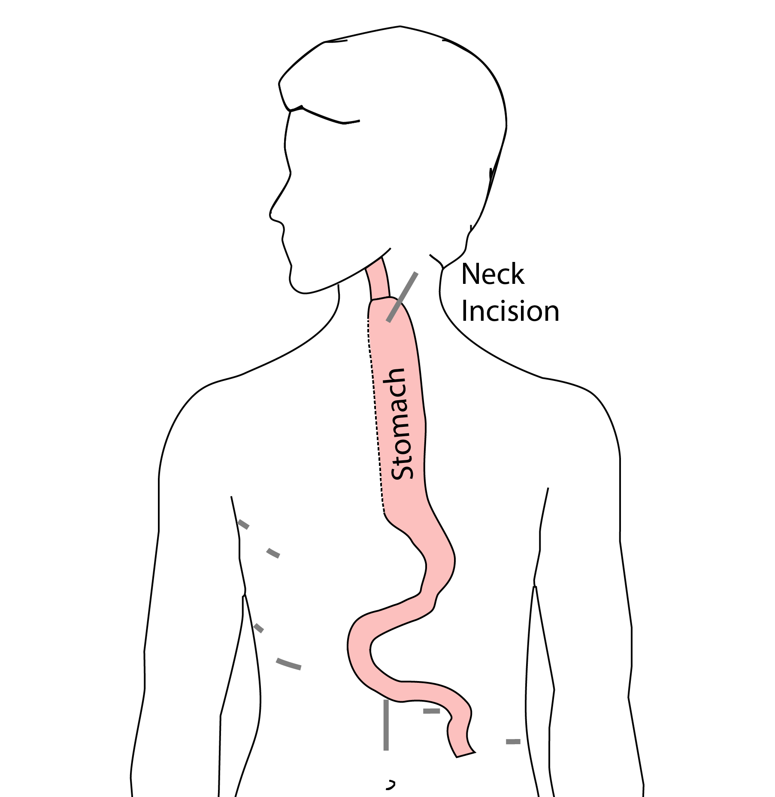
Minimally-invasive McKeown Esophagectomy
In this case, a connection between the esophagus and the stomach is made in the neck.

Slide 12
Risks of Surgery
An esophagectomy is a substantial operation, and in some cases there can be postoperative complications. We’re going to talk about two of these complications and what you can do to reduce your risk of complications:
Anastomotic leak
Pneumonia

Slide 13
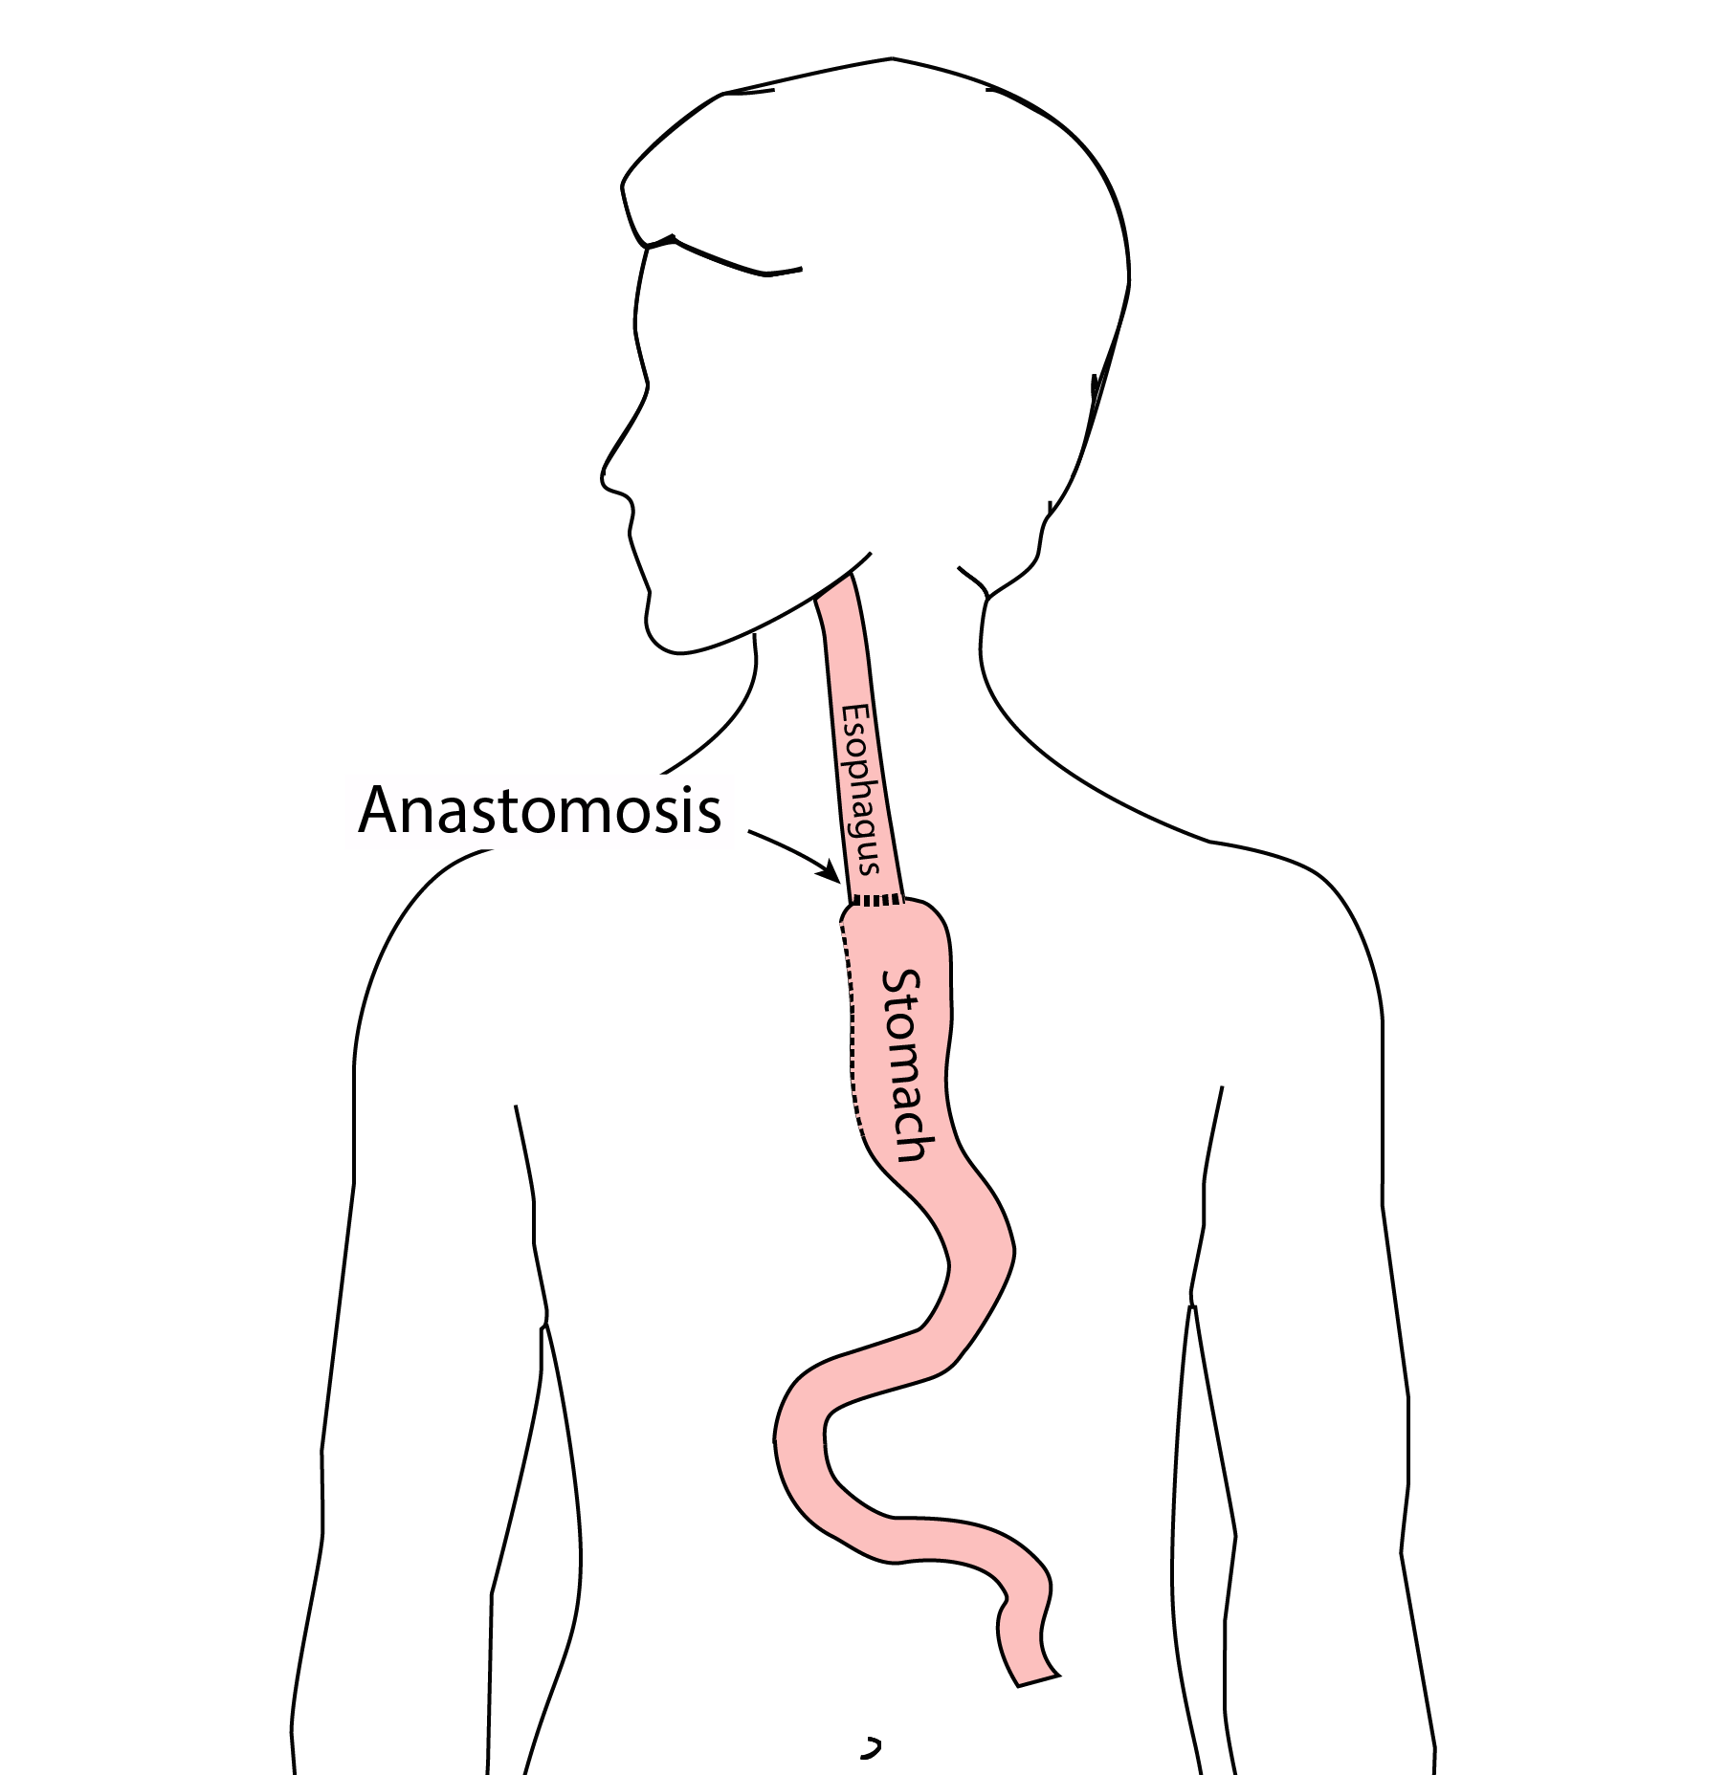
Anastomotic Leak
The anastomosis is surigcal connection between the esophagus and the stomach.

Slide 14
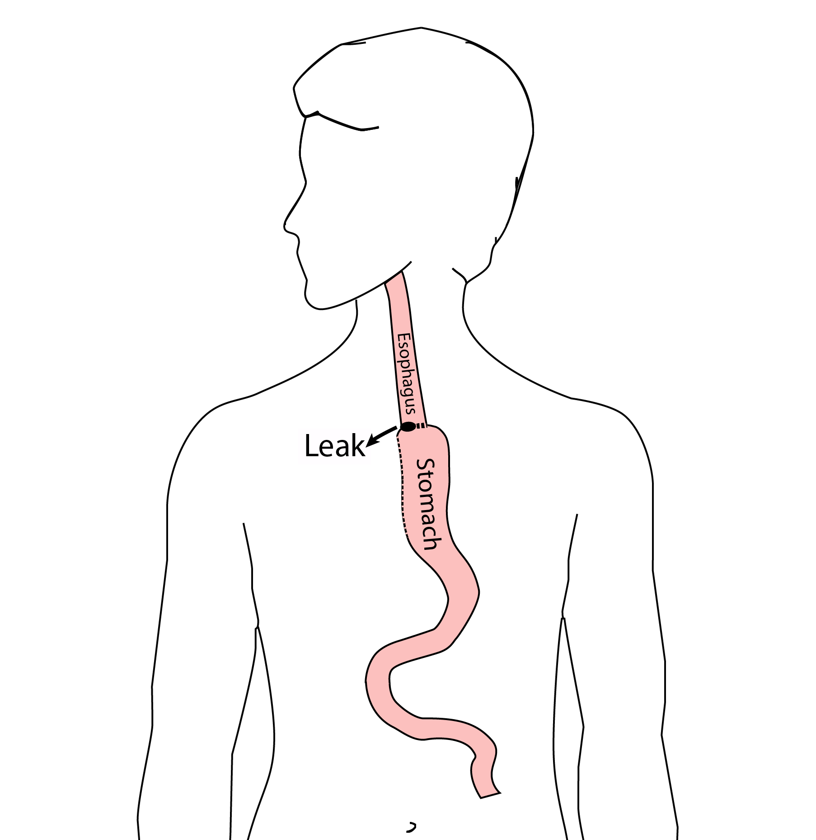
Anastomotic Leak
If anastomosis does not heal properly, this can cause a leakage of fluid from the esophagus, called an anastomotic leak. If this happens, an infection can occur in the mediastinum, which is the space near the heart between the lungs.

Slide 15
Anastomotic Leak
In some cases, the leak will heal on its own, but other cases may require additional procedures or even surgery. The risk of leak depends upon the operation performed but also depends upon the experience of the surgeon. At the end of this video we have a link to a video about how to choose a hospital and a surgeon, which talks further about the risks of a leak.

Slide 16
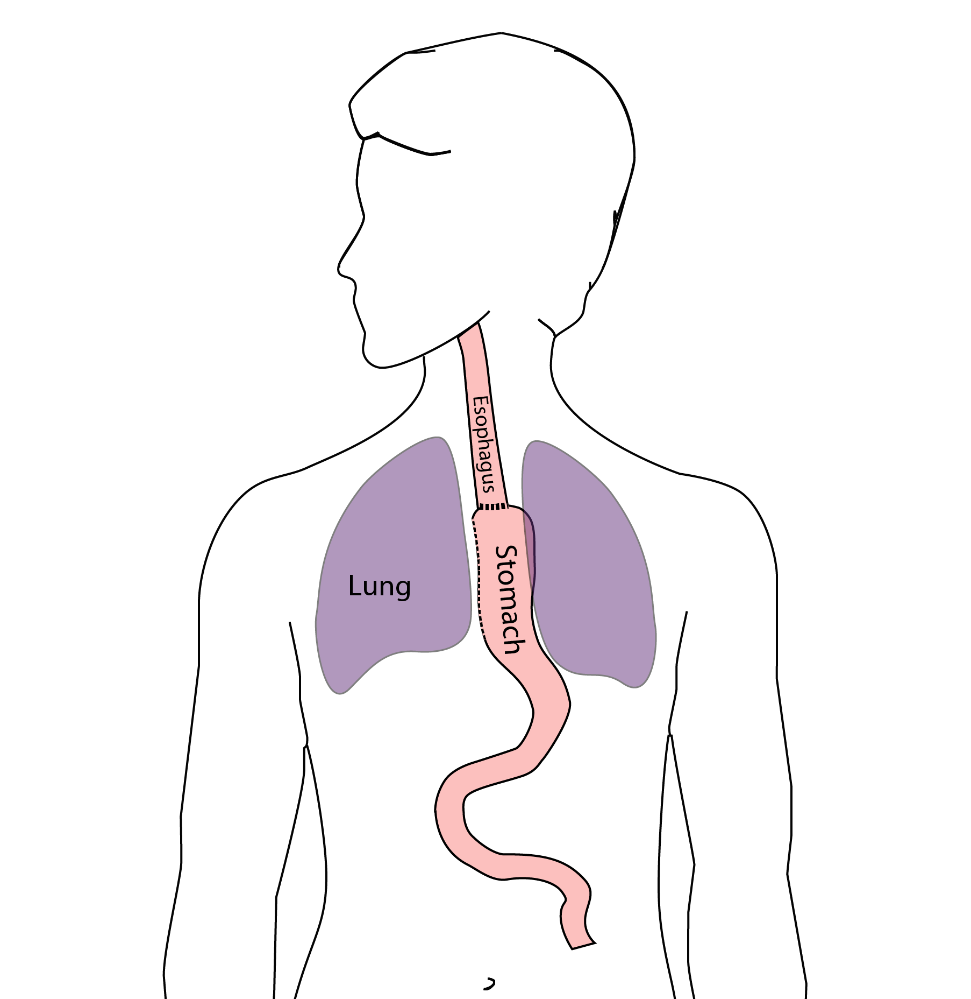
Pneumonia
Pneumonia is another complication which can occurs in about 10-15% of patients after esophagectomy. Pneumonia requires treatment with antibiotics and frequently requires a longer hospitalization.

Slide 17
Preventing Pneumonia
In normal circumstances, secretions from the mouth and throat aren’t able to enter the lungs because we clear our throat and if secretions do get into our airway, we tend to cough and keep those secretions out of our lungs. This happens constantly without our thinking about it.
After esophagectomy, however, there is a tendency for secretions to enter the airway, and if you can’t clear them, there is a risk that pneumonia will set in.
There are two important ways that pneumonia can be prevented:
Deep breathing
Walking

Slide 18
Deep breathing and coughing
After surgery, it’s important to breathe deeply to help your lungs recover after surgery. Deep breathing make the cough more effective and helps clear secretions. After surgery, deep breathing and coughing can be uncomfortable, so controlling your discomfort will be an important part of your recovery.

Slide 19
Walking
Walking after surgery is also an important way to help your lungs recover as well. When we walk, it’s easier for our lungs to function, and again, it makes the cough more frequently.

Slide 20
Preventing Pneumonia
How can we prevent pneumonia? Believe it or not, I can tell who is more likely to develop pneumonia after surgery when I first meet them and shake their hand. Someone with a firm handshake has a lower risk of pneumonia. We think this is because someone with a firm handshake has good muscle tone, and someone with good muscle tone probably has good function of the muscles between the ribs so that they have a nice strong cough and can prevent pneumonia.

Slide 21
Strength
In our clinic, we actually measure out patient’s strength with a hand-held strength gauge called a dynamometer. Based upon these measurements, we can identify patients who may be at risk of pneumonia.

Slide 22
Patient Strength and Esophagectomy Outcomes
About half of our patients have good strength, shown in green. A quarter are have low strength, shown in red Another quarter are in the middle, shown in yellow

Slide 23
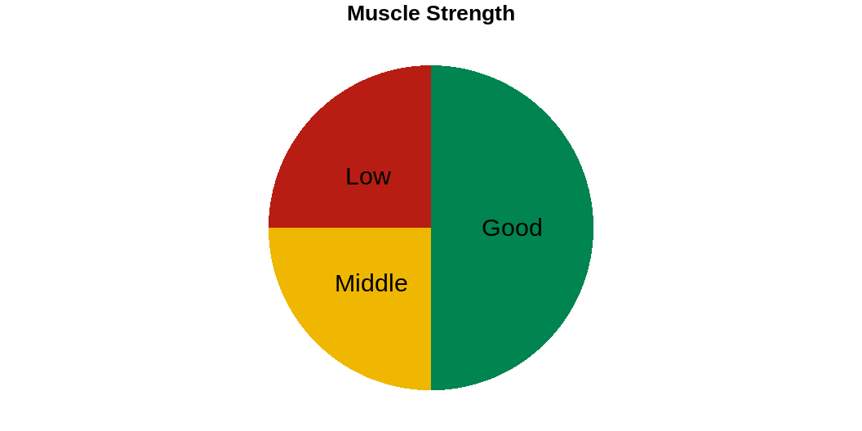

Slide 24
Pneumonia
Overall, the risk of pneumonia is about 10% in our patients who undergo esophagectomy. 90% of patients never experience pneumonia, but 10% will have pneumonia after surgery.

Slide 25
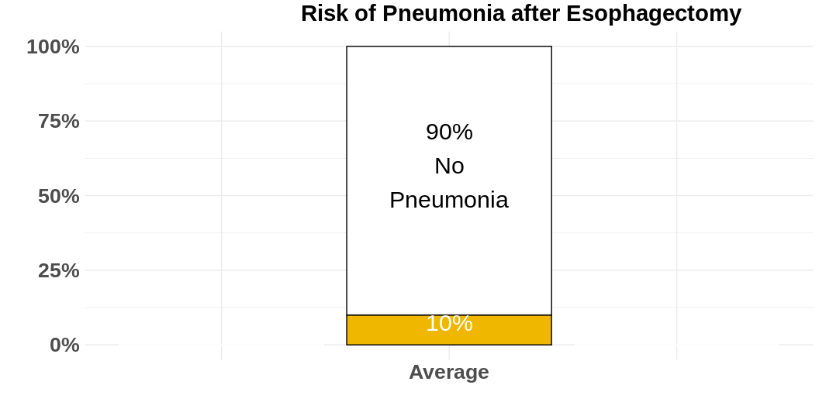

Slide 26
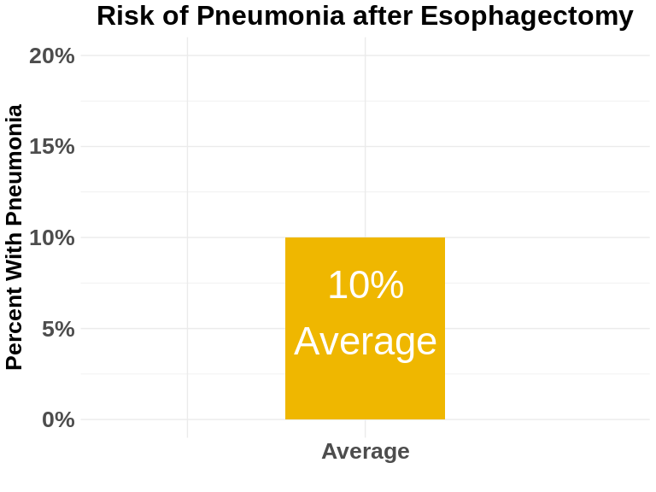

Slide 27
However the risk of pneumonia is not the same for everyone. Even though the average risk is 10%, the risk is much higher for our patients with low muscle strength and much lower for patients with good muscle strength.
For the half of our patients with good muscle strength, the risk of pneumonia is about 5%. On the other hand, the risk of pneumonia is 20% in the quarter of our patients who have low muscle strength.

Slide 28
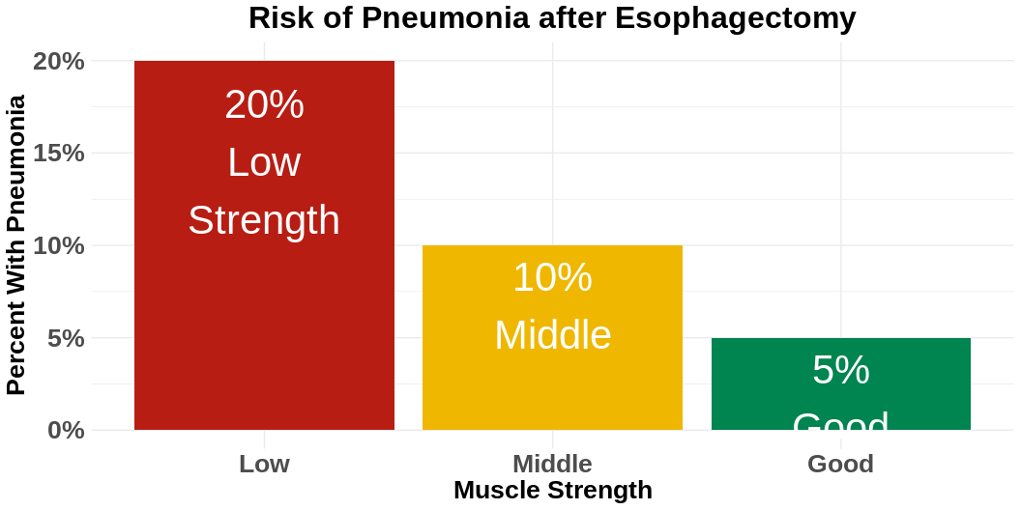

Slide 29

Muscle Strength and Risk after Esophagectomy
The results of our research suggest a simple answer: The risk of pneumonia is related to a patient’s muscle strength.]

Slide 30
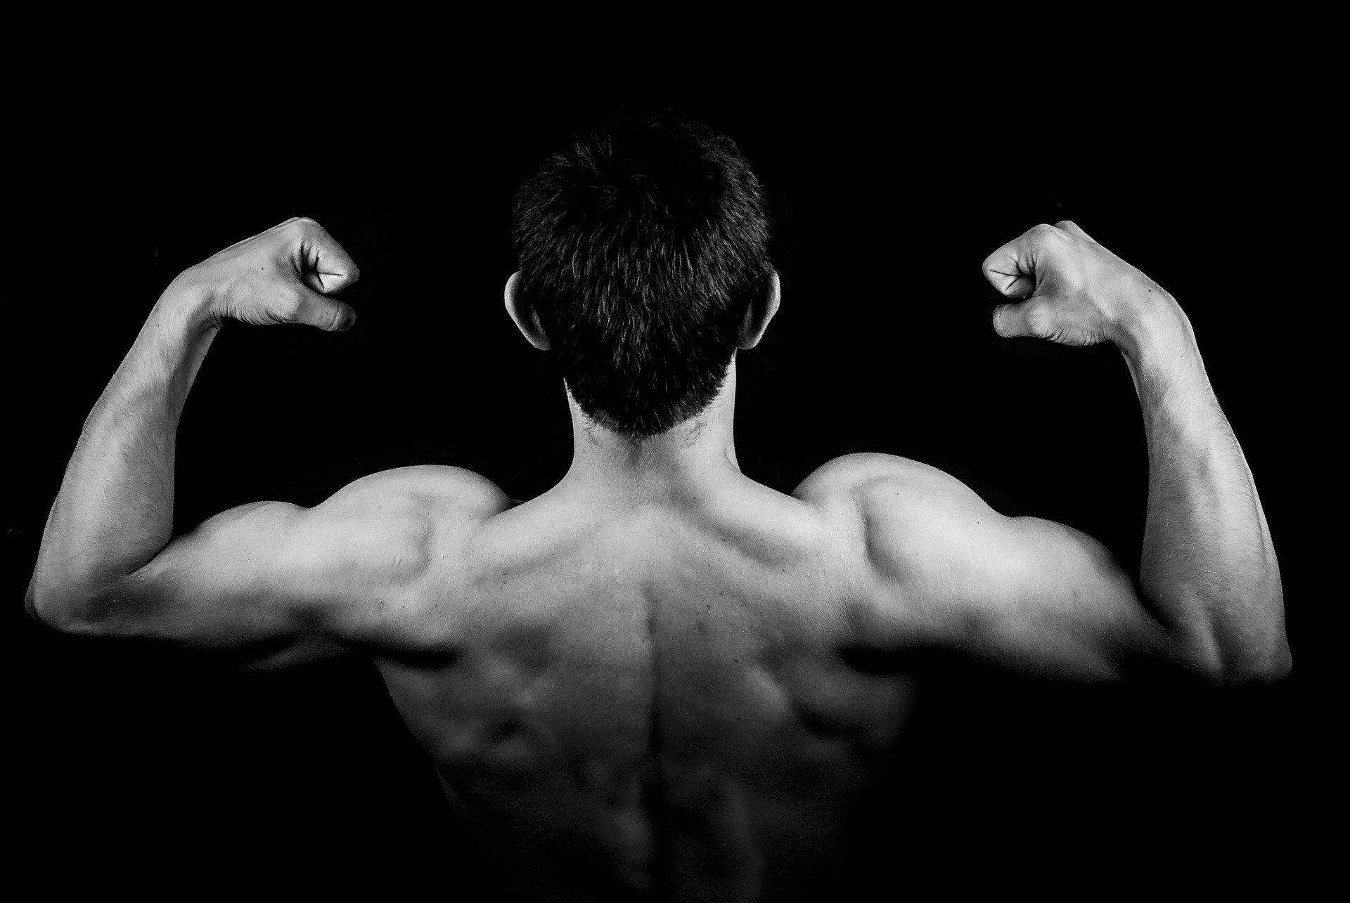
Now this doesn’t mean that you need to look like this to prevent pneumonia after your esophagectomy]

Slide 31
The good news is that you can increase your muscle strength before surgery in two very simple ways:
Good nutrition with adequate intake of protein
Exercise

Slide 32
Good News
with proper nutrition and exercise, you can increase your muscle strength, and we have good reason to believe this will reduce your risk of complications after esophagectomy.
When you meet with your surgery team, be sure to ask them about pain control after surgery and how you can increase your muscle strength.

Slide 33
In the next video in our series, you will learn about how to choose a hospital and a surgeon for esophageal surgery:
Choosing a Hospital and Surgeon for Esophagectomy

Slide 34
We hope you have found this video helpful. This videos and others like it are designed to
educate patients and families about esophageal cancer
and equip them for their discussions with their esophageal cancer care team.
As always, these videos are no substitute for expert medical advice.

Slide 35
Feel free to leave a comment or a question, or if you have suggestions for future videos.

