Slide 1
GI Stromal Tumors of the Stomach

Slide 2
GI Stromal Tumors
Arise from the wall of the stomach
Remove lymph nodes (depends upon tumor type)
Preserve stomach function
Reconstruct GI tract
Treatment options depend upon the cancer stage

Slide 3
GIST vs Adenocarcinoma
FLOT
5-FU
Leucovorion
Oxaliplatin
Taxotere
FOLFOX
5-FU
Leucovorin
Oxaliplatin

Slide 4
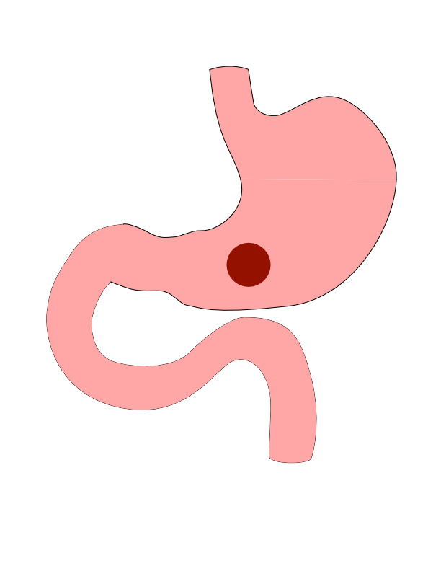
Distal Cancers
Distal cancers are those in the lower part of the stomach

Slide 5
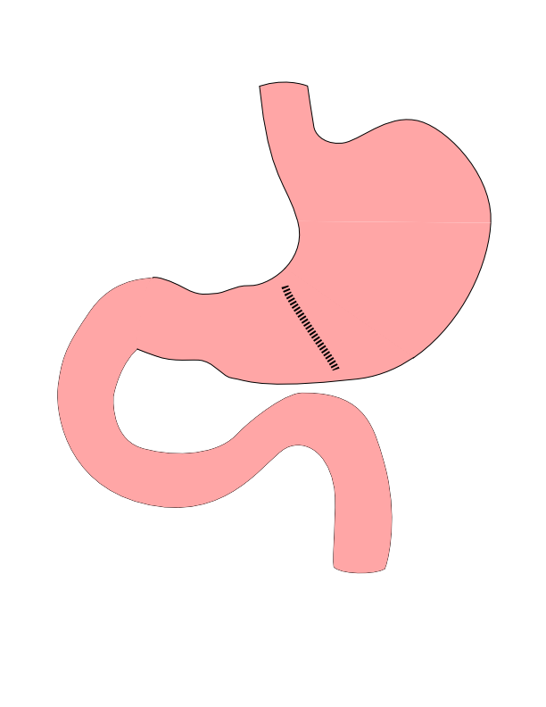
Partial Gastrectomy
- Removes the tumor - Does not remove lymph nodes - Best suited for: - Small adenocarcinoma - GI Stromal Tumors

Slide 6
Partial Gastrectomy

Slide 7
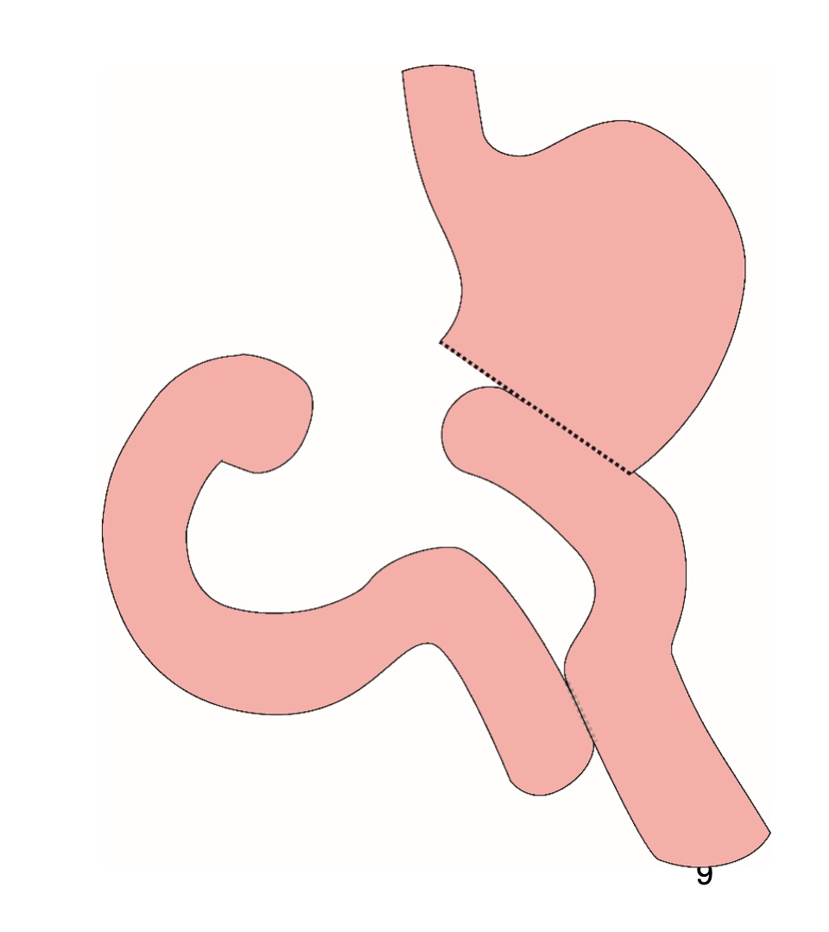
Distal Gastrectomy
Removes bottom half of the stomach
Does not remove all lymph nodes
Suitable for small tumors or GIST

Slide 8
Distal Gastrectomy

Slide 9
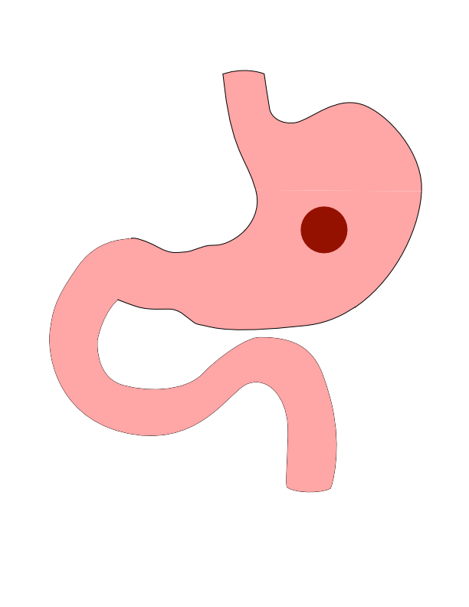
Body Cancers
Body is the mid-portion of the stomach

Slide 10
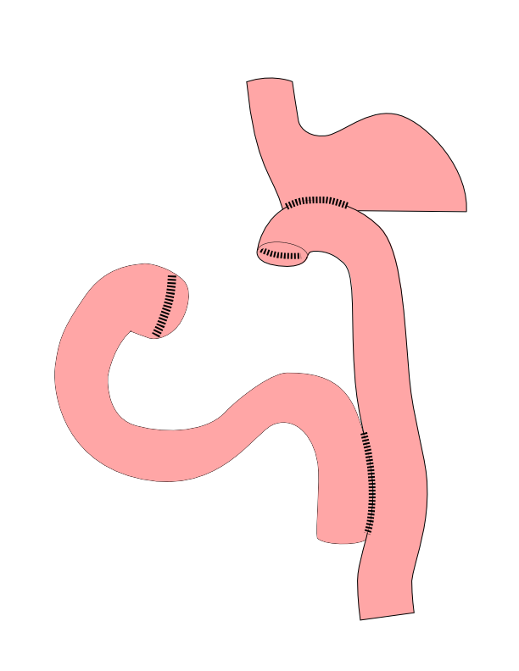
Subtotal Gastrectomy
- Removes bottom 2/3 of stomach - Removes nearby lymph nodes - Reconstruction with small intestine

Slide 11
Subtotal Gastrectomy

Slide 12
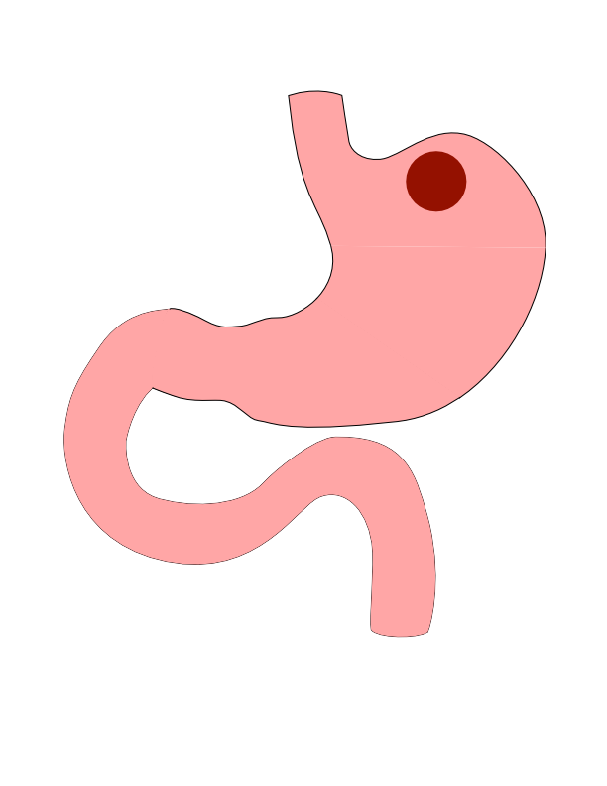
Proximal Tumors
- Located near the top of the stomach - Challenging area for surgery

Slide 13
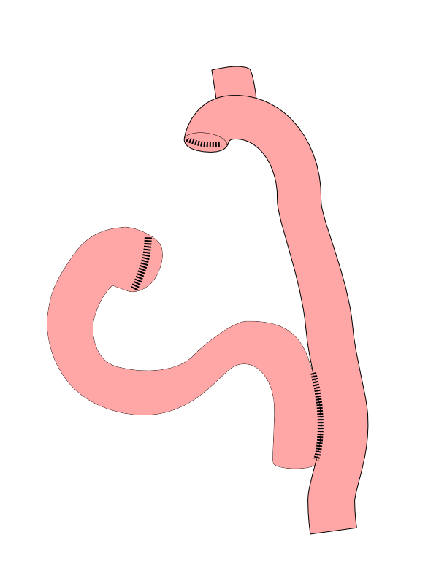
Total Gastrectomy
- Removes all of the stomach - Reconstruction with small intestine - Needed for those with CDH1 mutations

Slide 14
Total Gastrectomy

Slide 15
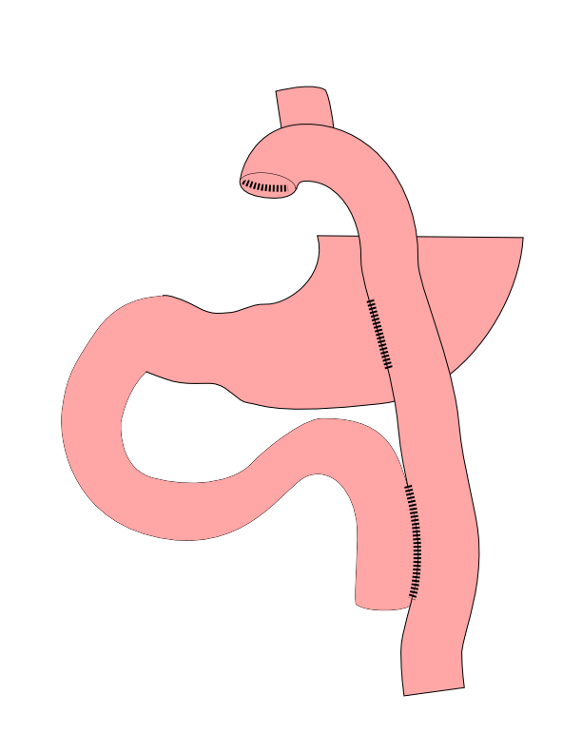
Dual Tract Gastrectomy
Alternative surgical approach for small tumors near the top of the stomach
Preserves the bottom of the stomach as a reservoir

Slide 16
Dual Tract Gastrectomy

Slide 17
Risks of Surgery
Leak where bowel is joined together (anastomosis)
Bleeding requiring reoperation
Delayed stomach function
Infection in the abdomen

Slide 18
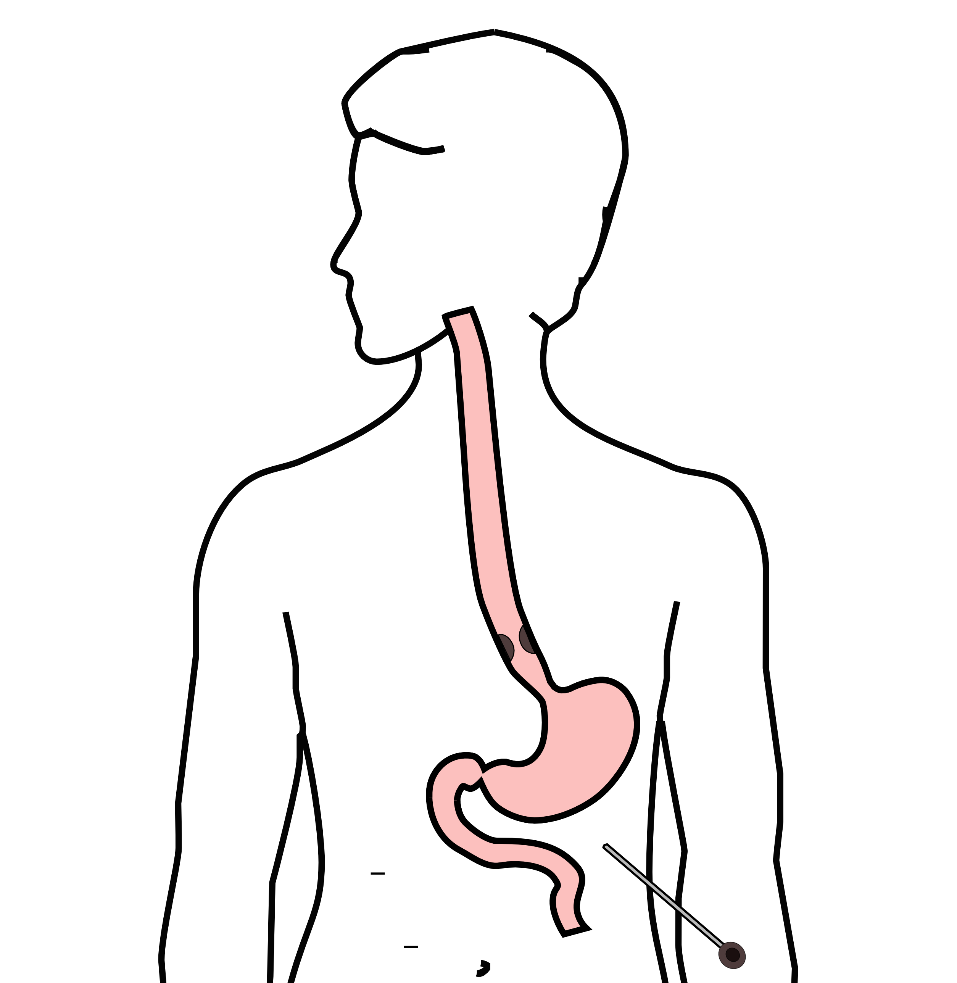
Laparoscopy
Some esophageal cancers can spread inside the abdomen
Areas of spread can be very small (grain of rice)
Laparoscopy can detect spread inside the abdomen

Slide 19
Laparoscopy
A laparoscopy is performed under a general anesthetic.
Several incisions 1/4” long
A telescope is inserted to look inside the abdominal cavity.
Biopsies can be performed.

Slide 20
Other Presentations
Nutrition Slideshow
Gastrectomy Slideshow

