Slide 1
Stage IV Cancer of the Esophagus and GE Junction

Slide 2
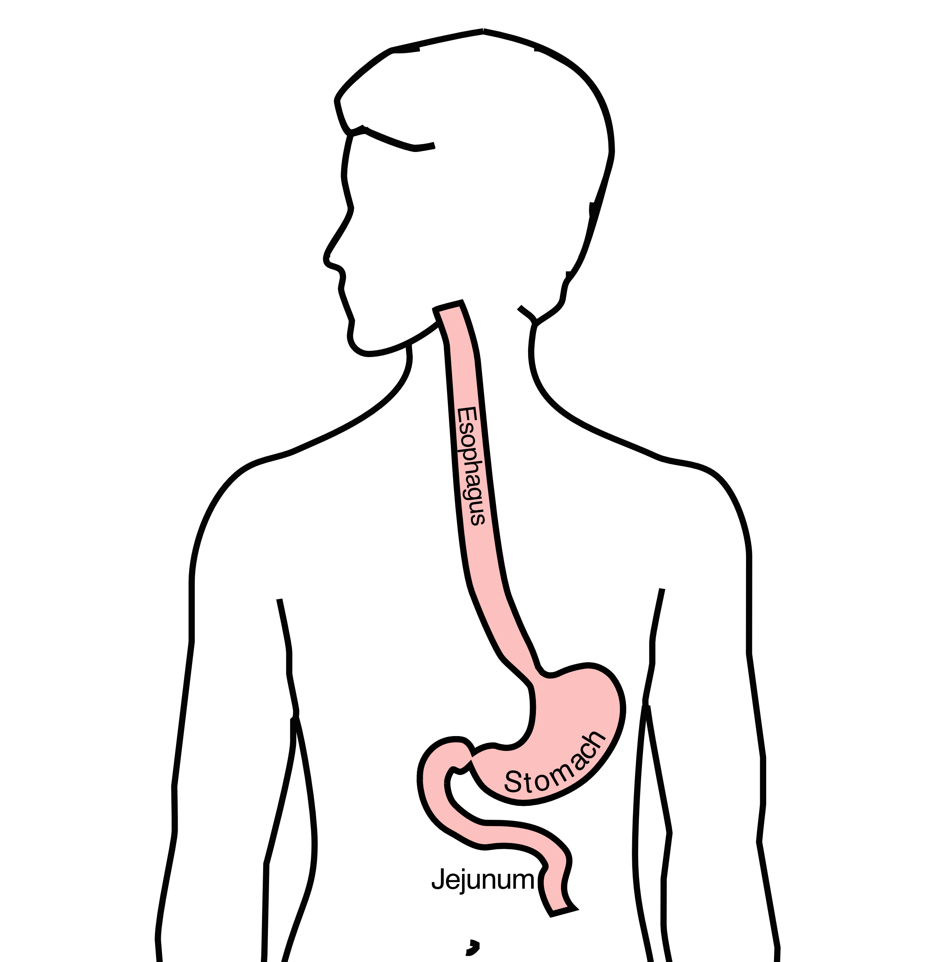
Anatomy
Food moves from the throat
$→$ esophagus
$→$ stomach
$→$ small bowel (jejunum)

Slide 3
Esophageal Cancer Staging
T = Tumor - Depth of growth into the wall of the esophagus
N = Nodes - Spread to the lymph nodes
M = Metastasis - Spread to liver, lungs, or bone

Slide 4
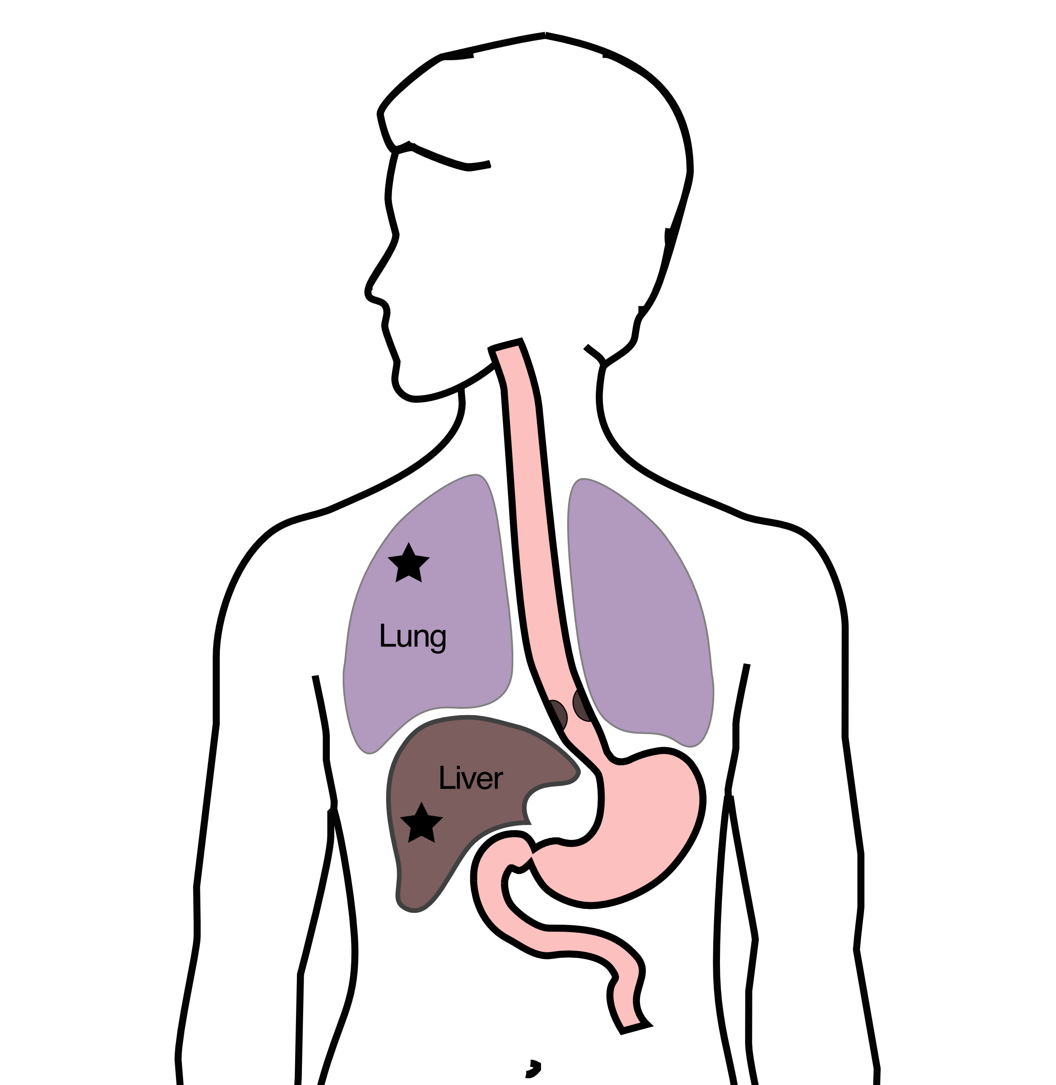
Metastatic Cancers
Metastatic cancers spread from the esophagus to other parts of the body
M0 cancers have not spread to other parts of the body
M1 cancers have spread lungs, liver, or bone
M1 cancers is also known as Stage 4

Slide 5
Treatment Plan
Superficial (T1) $Rightarrow$ Endoscopic Therapy
Localized (T1b/T2) $Rightarrow$ Surgery
Locally-advanced (T3/N1) $⇒$ Chemo $±$ Radiation $→$Surgery
Metastatic (M1) $⇒$ Systemic Therapy $±$ Radiation

Slide 6
Systemic Therapy
Systemic therapy is administered intravenously (or by mouth) and circulates to kill cancer cells anywhere in the body.
Chemotherapy (FOLFOX)
Immunotherapy (nivolumab, pembrolizumab)
Hormone therapy (herceptin)

Slide 7
Goals of Therapy
Symptom control
Prolong life
Minimize symptoms due to treatment

Slide 8
Systemic Therapy
By shrinking tumor and decreasing cancer burden
Can improve symptoms
Can prolong life
Goals:
Maximize cancer shrinkage
Minimize side-effects due to therapy

Slide 9
Chemotherapy Administration
Most chemotherapy is administered by vein.
Several options exist to administer chemotherapy:
Intravenous catheter in peripheral veins
Peripheral Intravenous Central Catheter (PICC)
Central Venous port

Slide 10
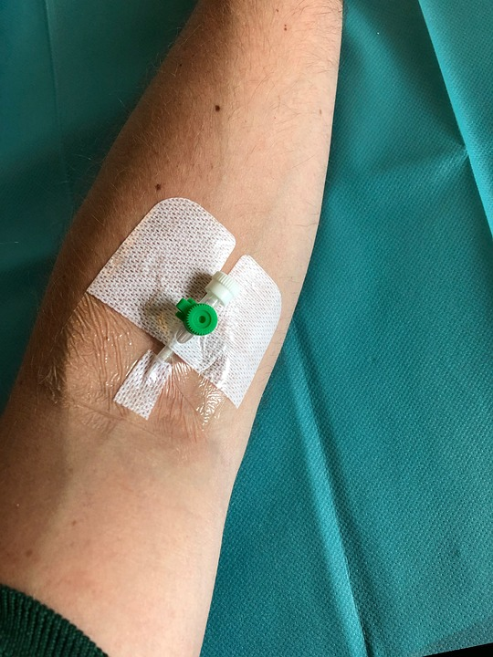
Intravenous Catheter in Peripheral Vein (“IV”)
IV catheter placed into a vein in the hand or arm
Allows administration of chemotherapy and fluids
Placed at the beginning of each dose
Removed that day at the end of treatment
Not suitable for FLOT chemotherapy

Slide 11
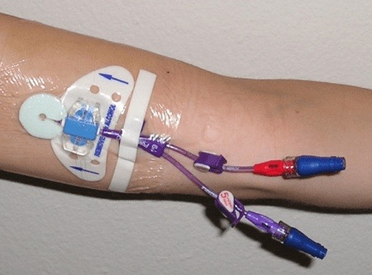
PICC Lines
Placed in Radiology
Stay in place during all of treatment
Needs to be kept clean and dry
Suitable for FLOT chemotherapy

Slide 12
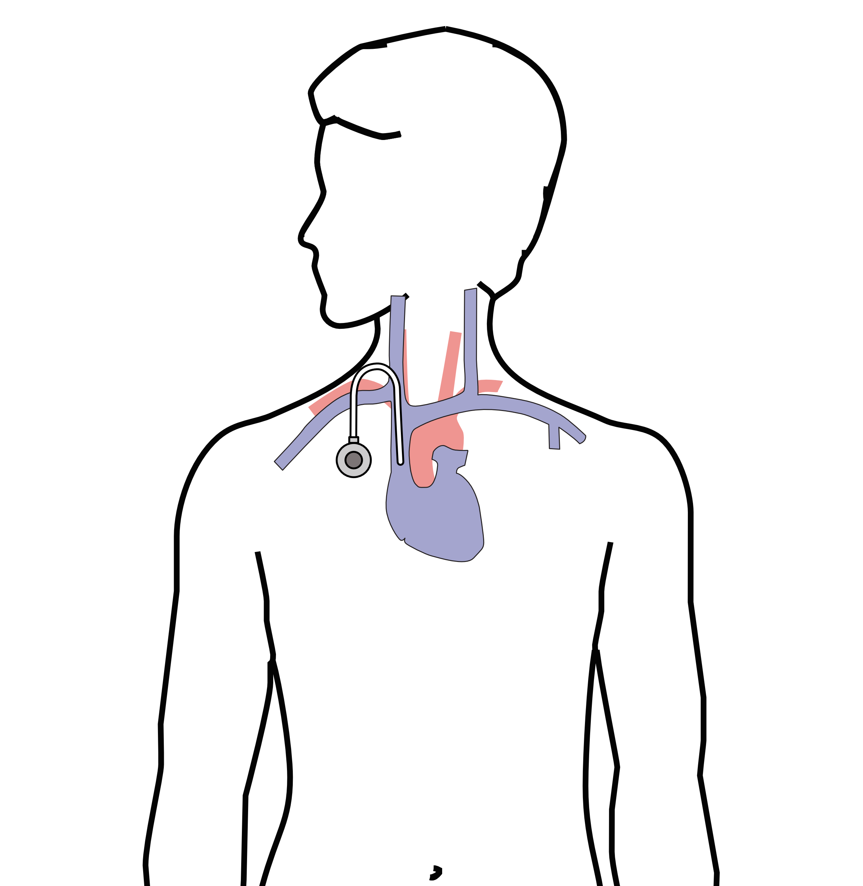
Central Venous Port
Implantable device that makes the administration of chemotherapy easier
May shower within 24 hrs
No special care at home
Suitable for FLOT chemo
Allows for blood draws

Slide 13
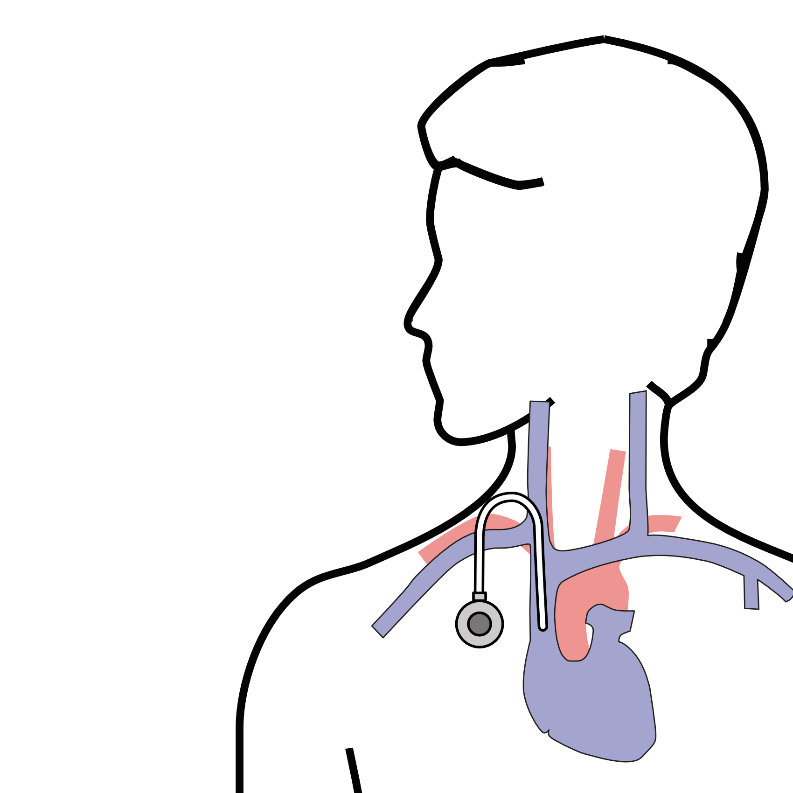
Central Venous Port
Placed underneath the skin below the right collarbone
Incision in the neck (1/4”)
Incision below the collarbone
Sutures dissolve on their own
“Superglue” on incisions

Slide 14
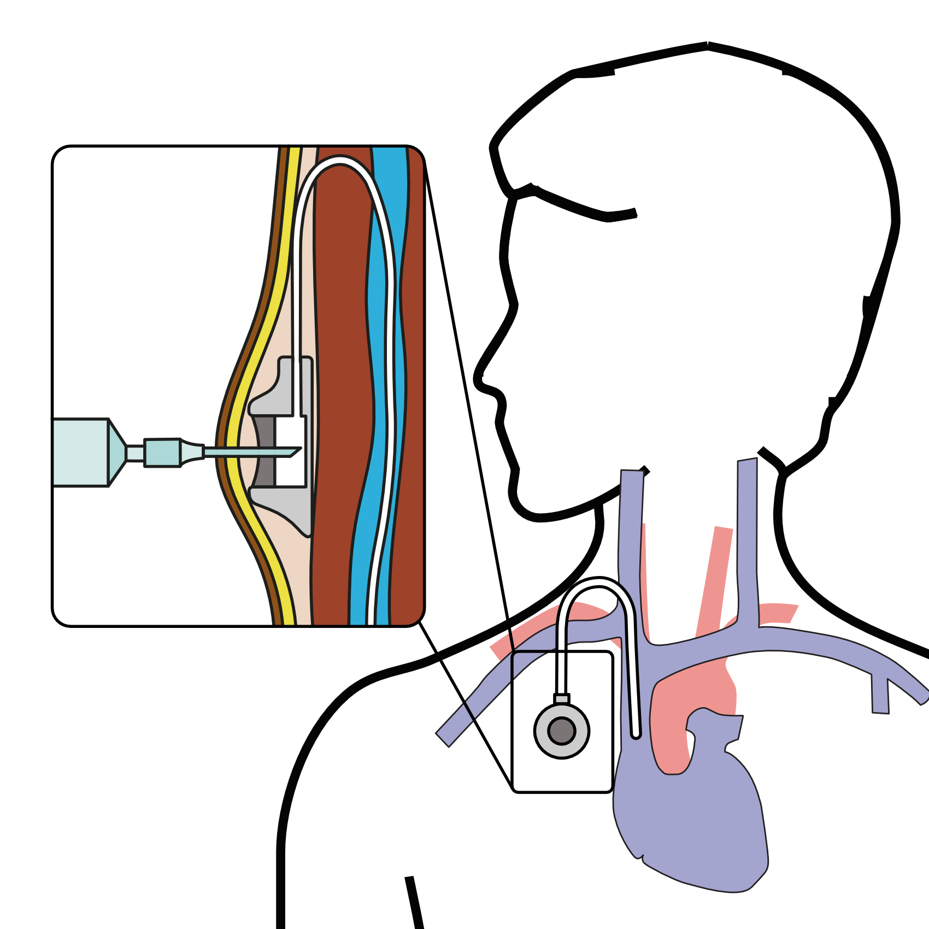
Central Venous Port
When it is time for chemotherapy, a needle is inserted through the skin into the port

Slide 15
Radiation Therapy
Radiation uses high-energy x-rays to kill cancer cells
Bone metastasis: Can relieve pain
Esophagus: Can shrink tumor and improve eating

Slide 16
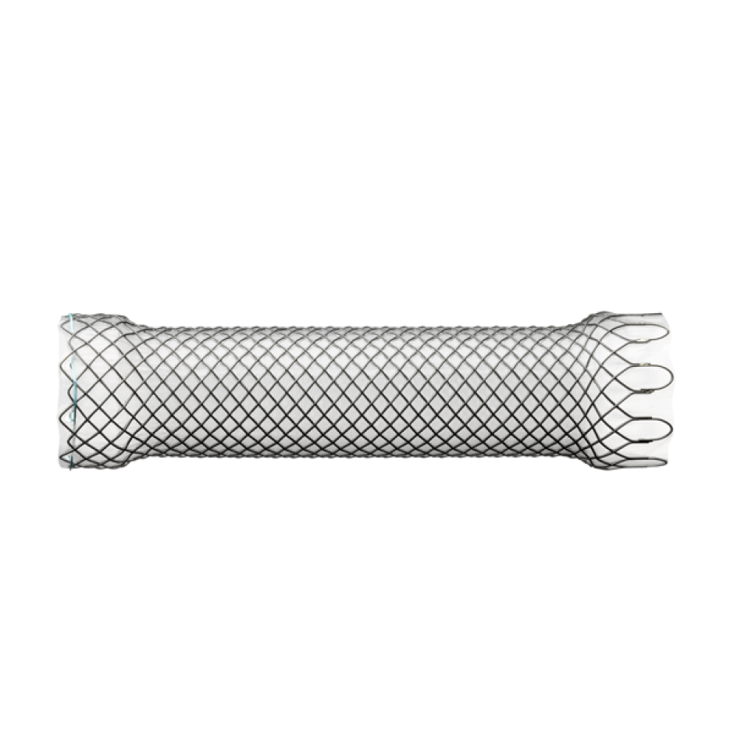
Endoluminal Stent
An endoluminal stent can be placed inside an esophageal cancer to improve eating

Slide 17
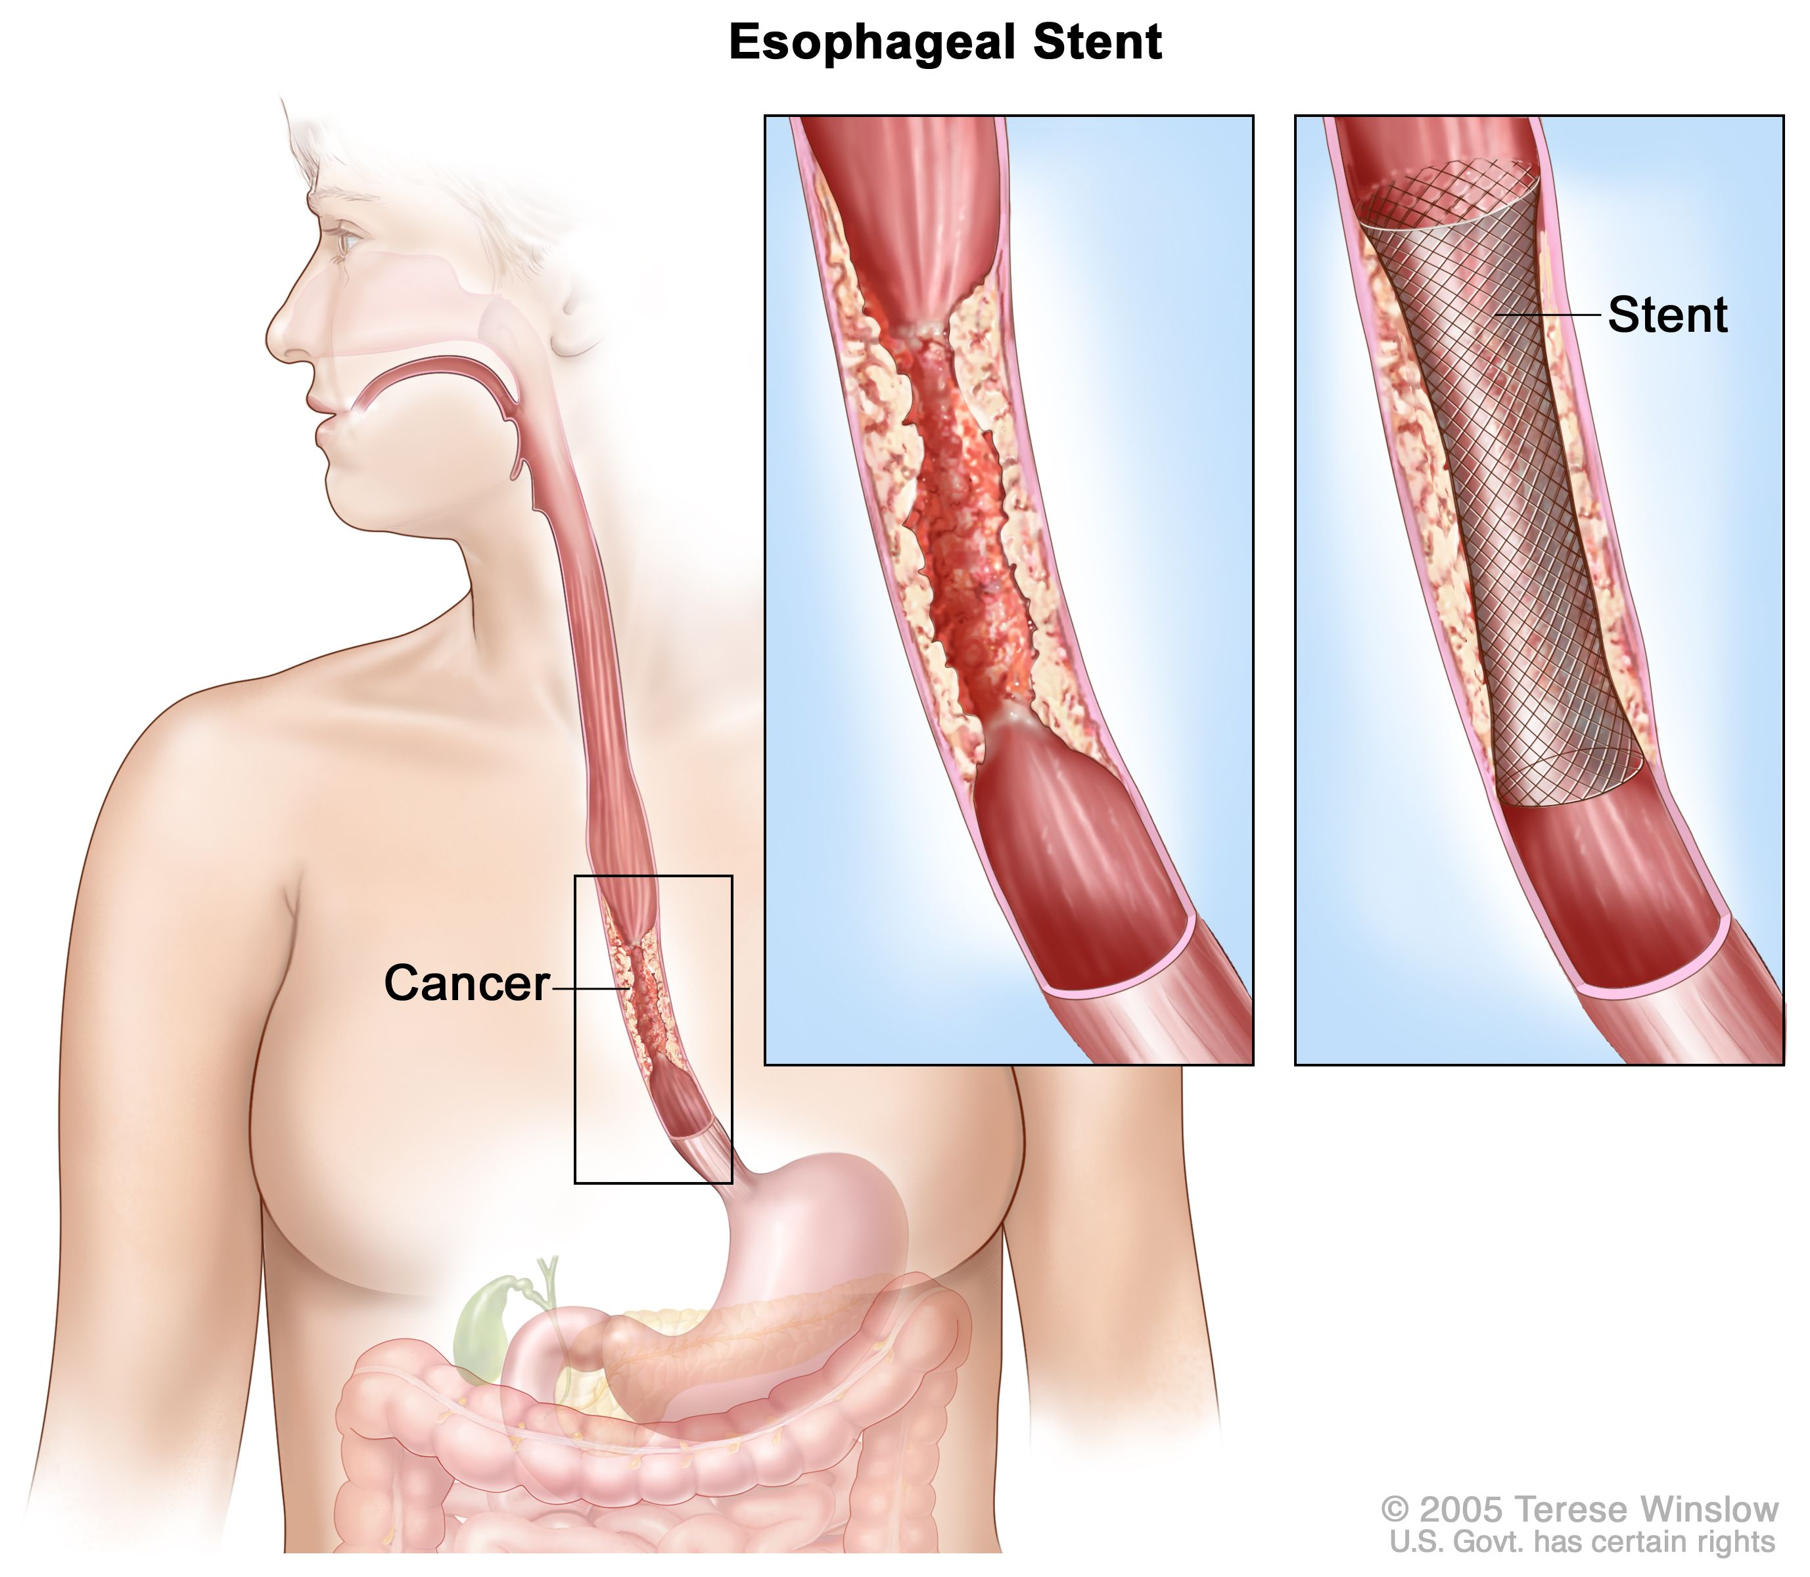
Endoluminal Stent
An endoluminal stent can be placed inside an esophageal cancer to improve eating

Slide 18
Endoluminal Stents
Advantages:
Outpatient endoscopic procedure (no surgery)
Can improve swallowing
Disadvantages:
Discomfort and reflux
Can make surgery to remove esophagus more complicated

Slide 19
Radiation Therapy - Esophagus
Radiation therapy to the esophagus can improve swallowing. There are two approaches:
Short Course
10 treatments over 2 weeks
Conventional Dosing
25-30 treatment over 5-6 weeks
Usually combined with low-dose chemo

Slide 20
Radiation Therapy - Bone
For patients with metastasis to bone causing pain
Radiation can provide pain relief
Typically 10 daily treatments over two weeks

Slide 21
Preparing for Cancer Treatment
Primary Care Physician
MyAtrium Portal
Exercise
Smoking Cessation

Slide 22
Primary Care Practitioner (PCP)
A PCP is critical to coordinate care between specialists.
We will update your PCP after each visit
If you do not have a PCP, call our referral line at (844) 235-6998

Slide 23
My Atrium Patient Portal
Critical to good communication with your cancer care team
Available for desktop or laptop or phone
Sign up at my.atriumhealth.org

Slide 24
Exercise
Important to reduce the risk of complications from cancer treatment
Goal is 30min/day of vigorous exercise 6 days/week
Working hard enough that you can’t carry a conversation
Start slow an build up
Every day counts! (Aim for some activity every day)

Slide 25
Smoking Cessation
Smoking makes it more difficult to get through cancer treatment
Increases risk of complications after surgery
Options for help with smoking cessation:
NC Quit Line 1-800-QUIT-NOW (1-800-784-8669)
American Lung Asssociation fredomfromsmoking.org
1:1 Smoking Cessation Counseling Clinics (Metro Charlotte)

Slide 26
Hospice
Hospice provides end-of-life care for patients whose priority is treatment of symptoms rather than systemic therapy of the cancer.
Usually provided in the home
Residential hospice is available as an alternative
Hospice team manages symptoms including pain managemnt

