Slide 1
Surgery of the Esophagus

Slide 2
Surgery for Esophageal Cancer
Surgery for esophageal cancer is generally performed in several situations:
Superficial Tumors (T1) that can’t be completely removed by endoscopy
Localized Tumors (T2N0)
Locally Advanced Tumors (T3 or N+) after preoperative therapy.

Slide 3
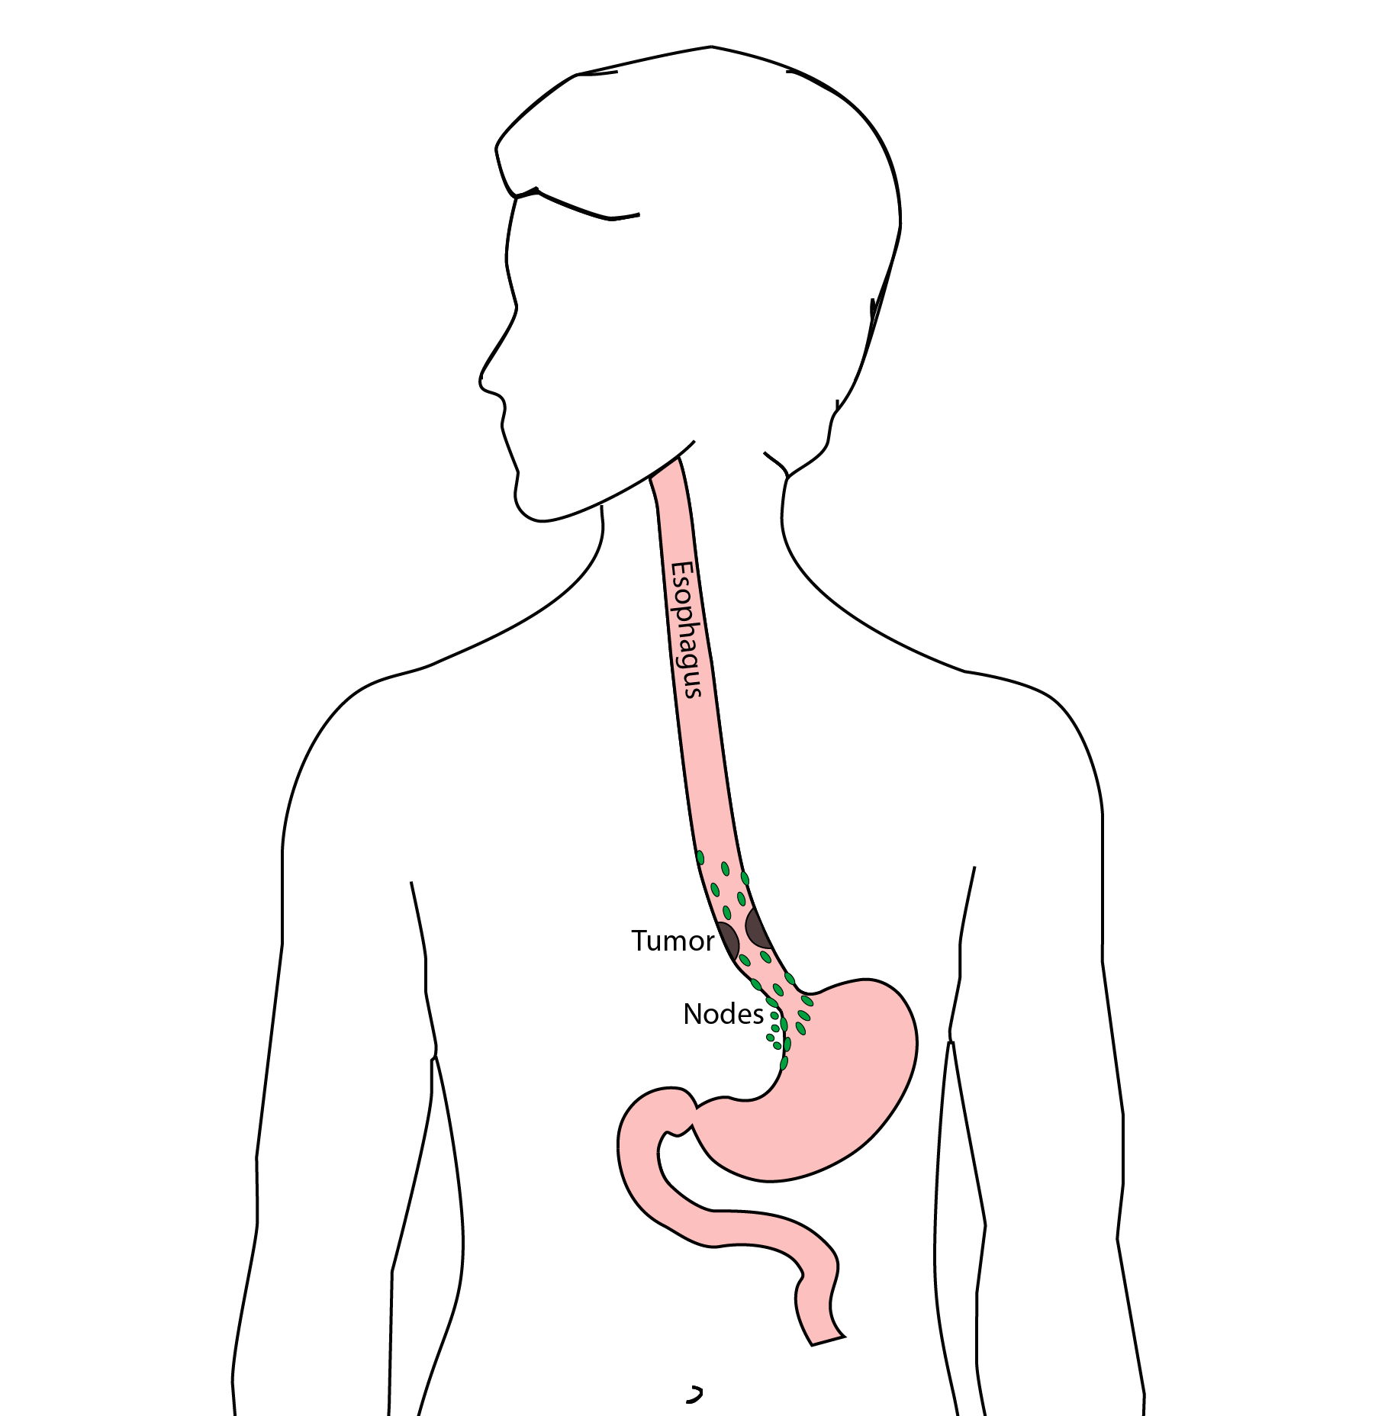
Goals of Surgery
Remove tumor from esophagus
Remove surrounding lymph nodes
Create a new esophagus

Slide 4
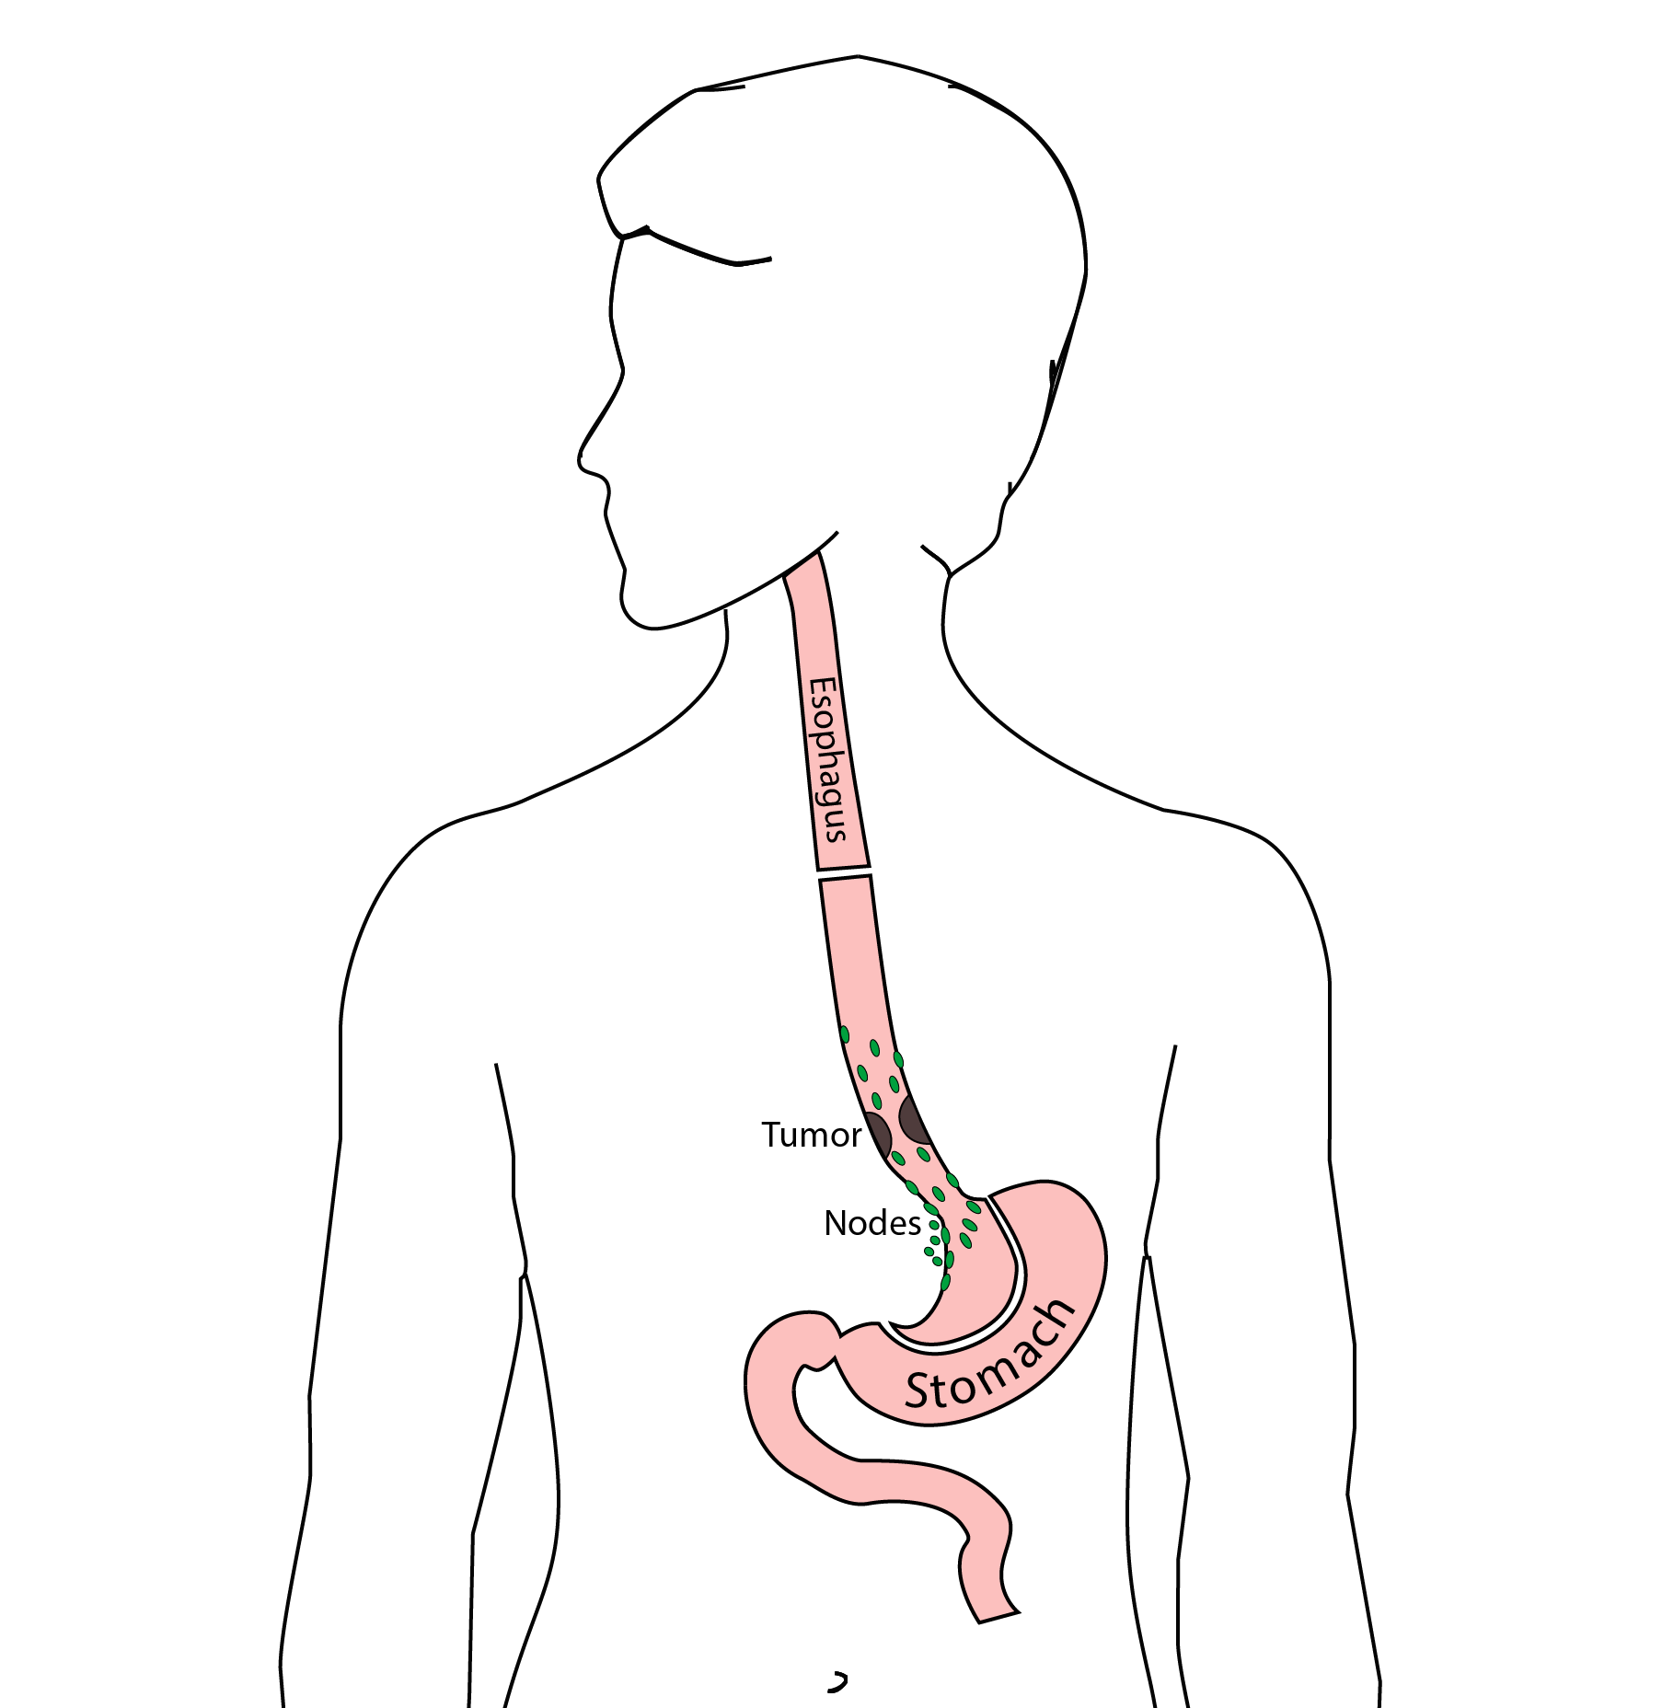
Resection
The Ivor Lewis esophagectomy, shown here, removes the lower 2/3 of the esophagus, the tumor, and the surrounding lymph nodes.

Slide 5
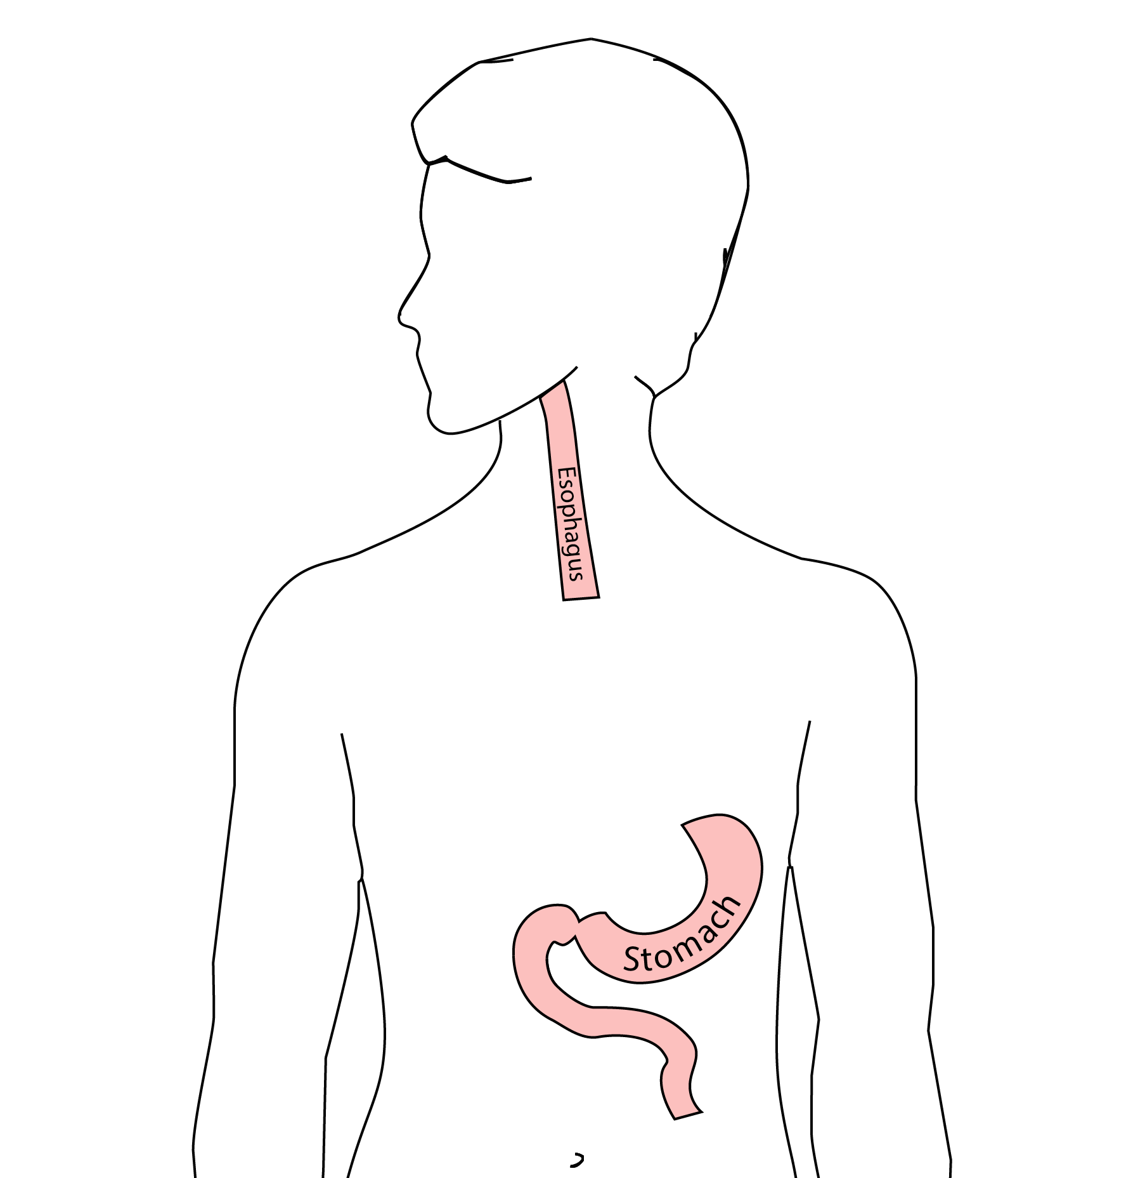
Reconstruction
A new esophagus is created from the stomach in the abdomen by fashioning it into a tube.

Slide 6
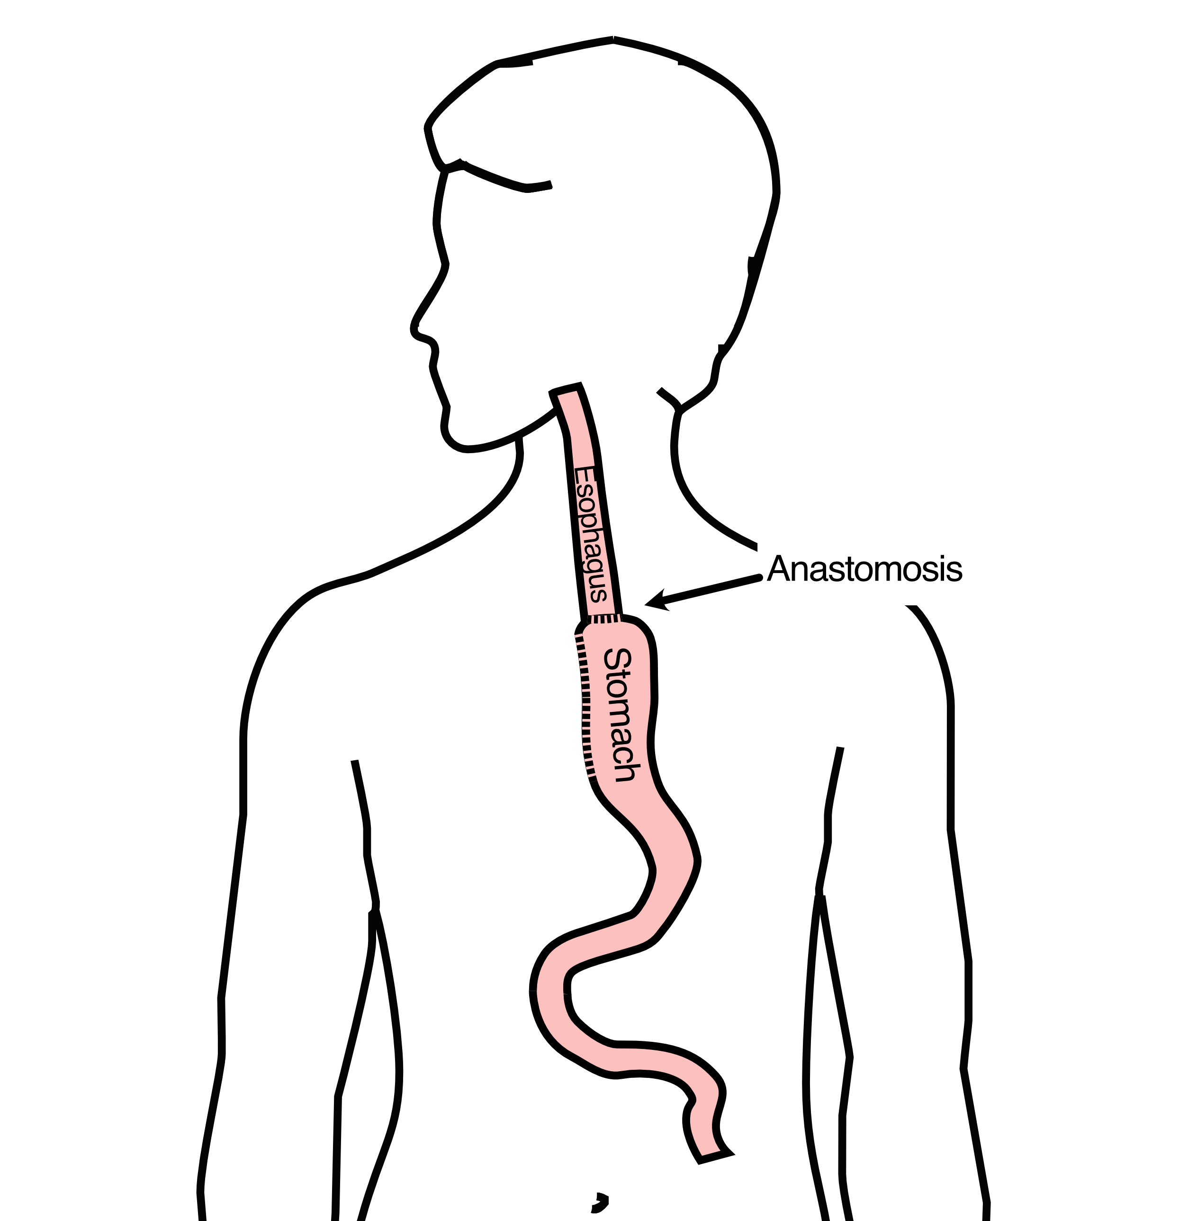
Ivor Lewis esophagectomy
The new esophagus is now brought up into the chest. A new connection is made between the esophagus and the stomach, called an anastomosis.

Slide 7
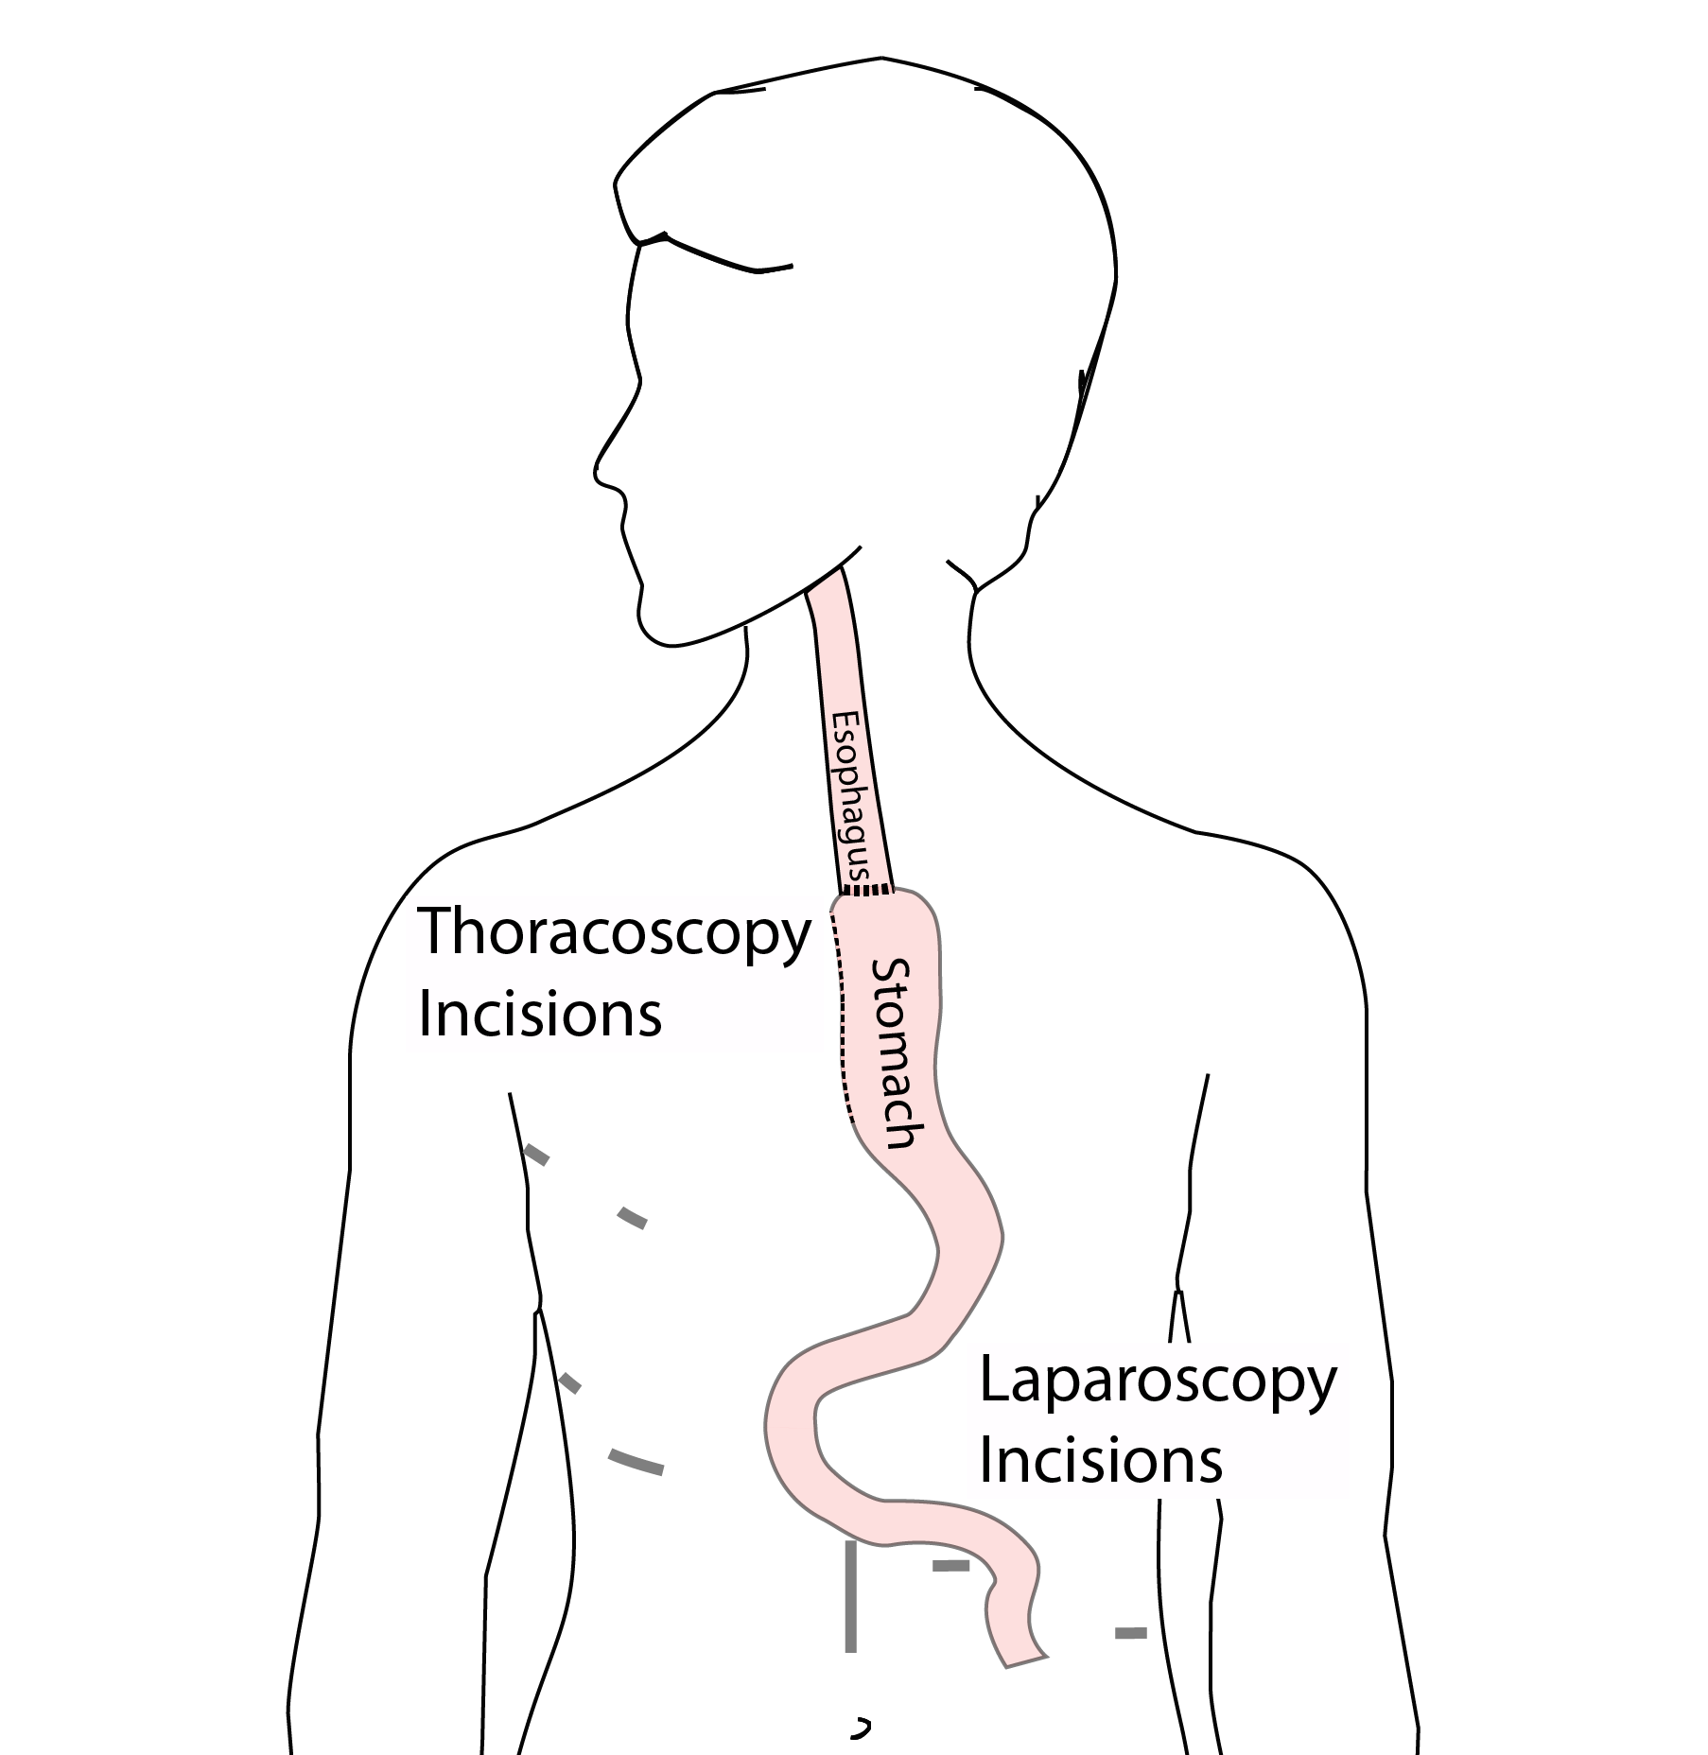
Minimally-invasive Ivor Lewis
Small incisions abdomen and chest
Surgical telescope and instruments
Smaller incisions $→$ faster recovery and less discomfort

Slide 8
Minimally-invasive Ivor Lewis
We have found this is the best option for most of our patients. In some cases, an open approach is still necessary.

Slide 9
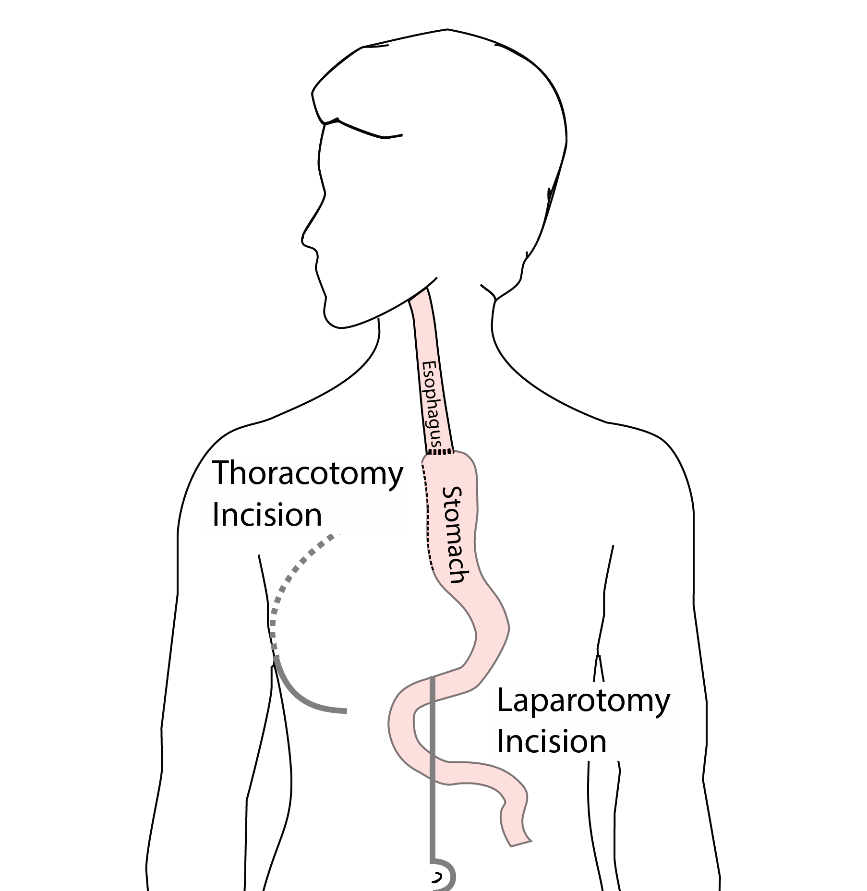
Open Ivor Lewis
In some cases, an open approach is still necessary.

Slide 10
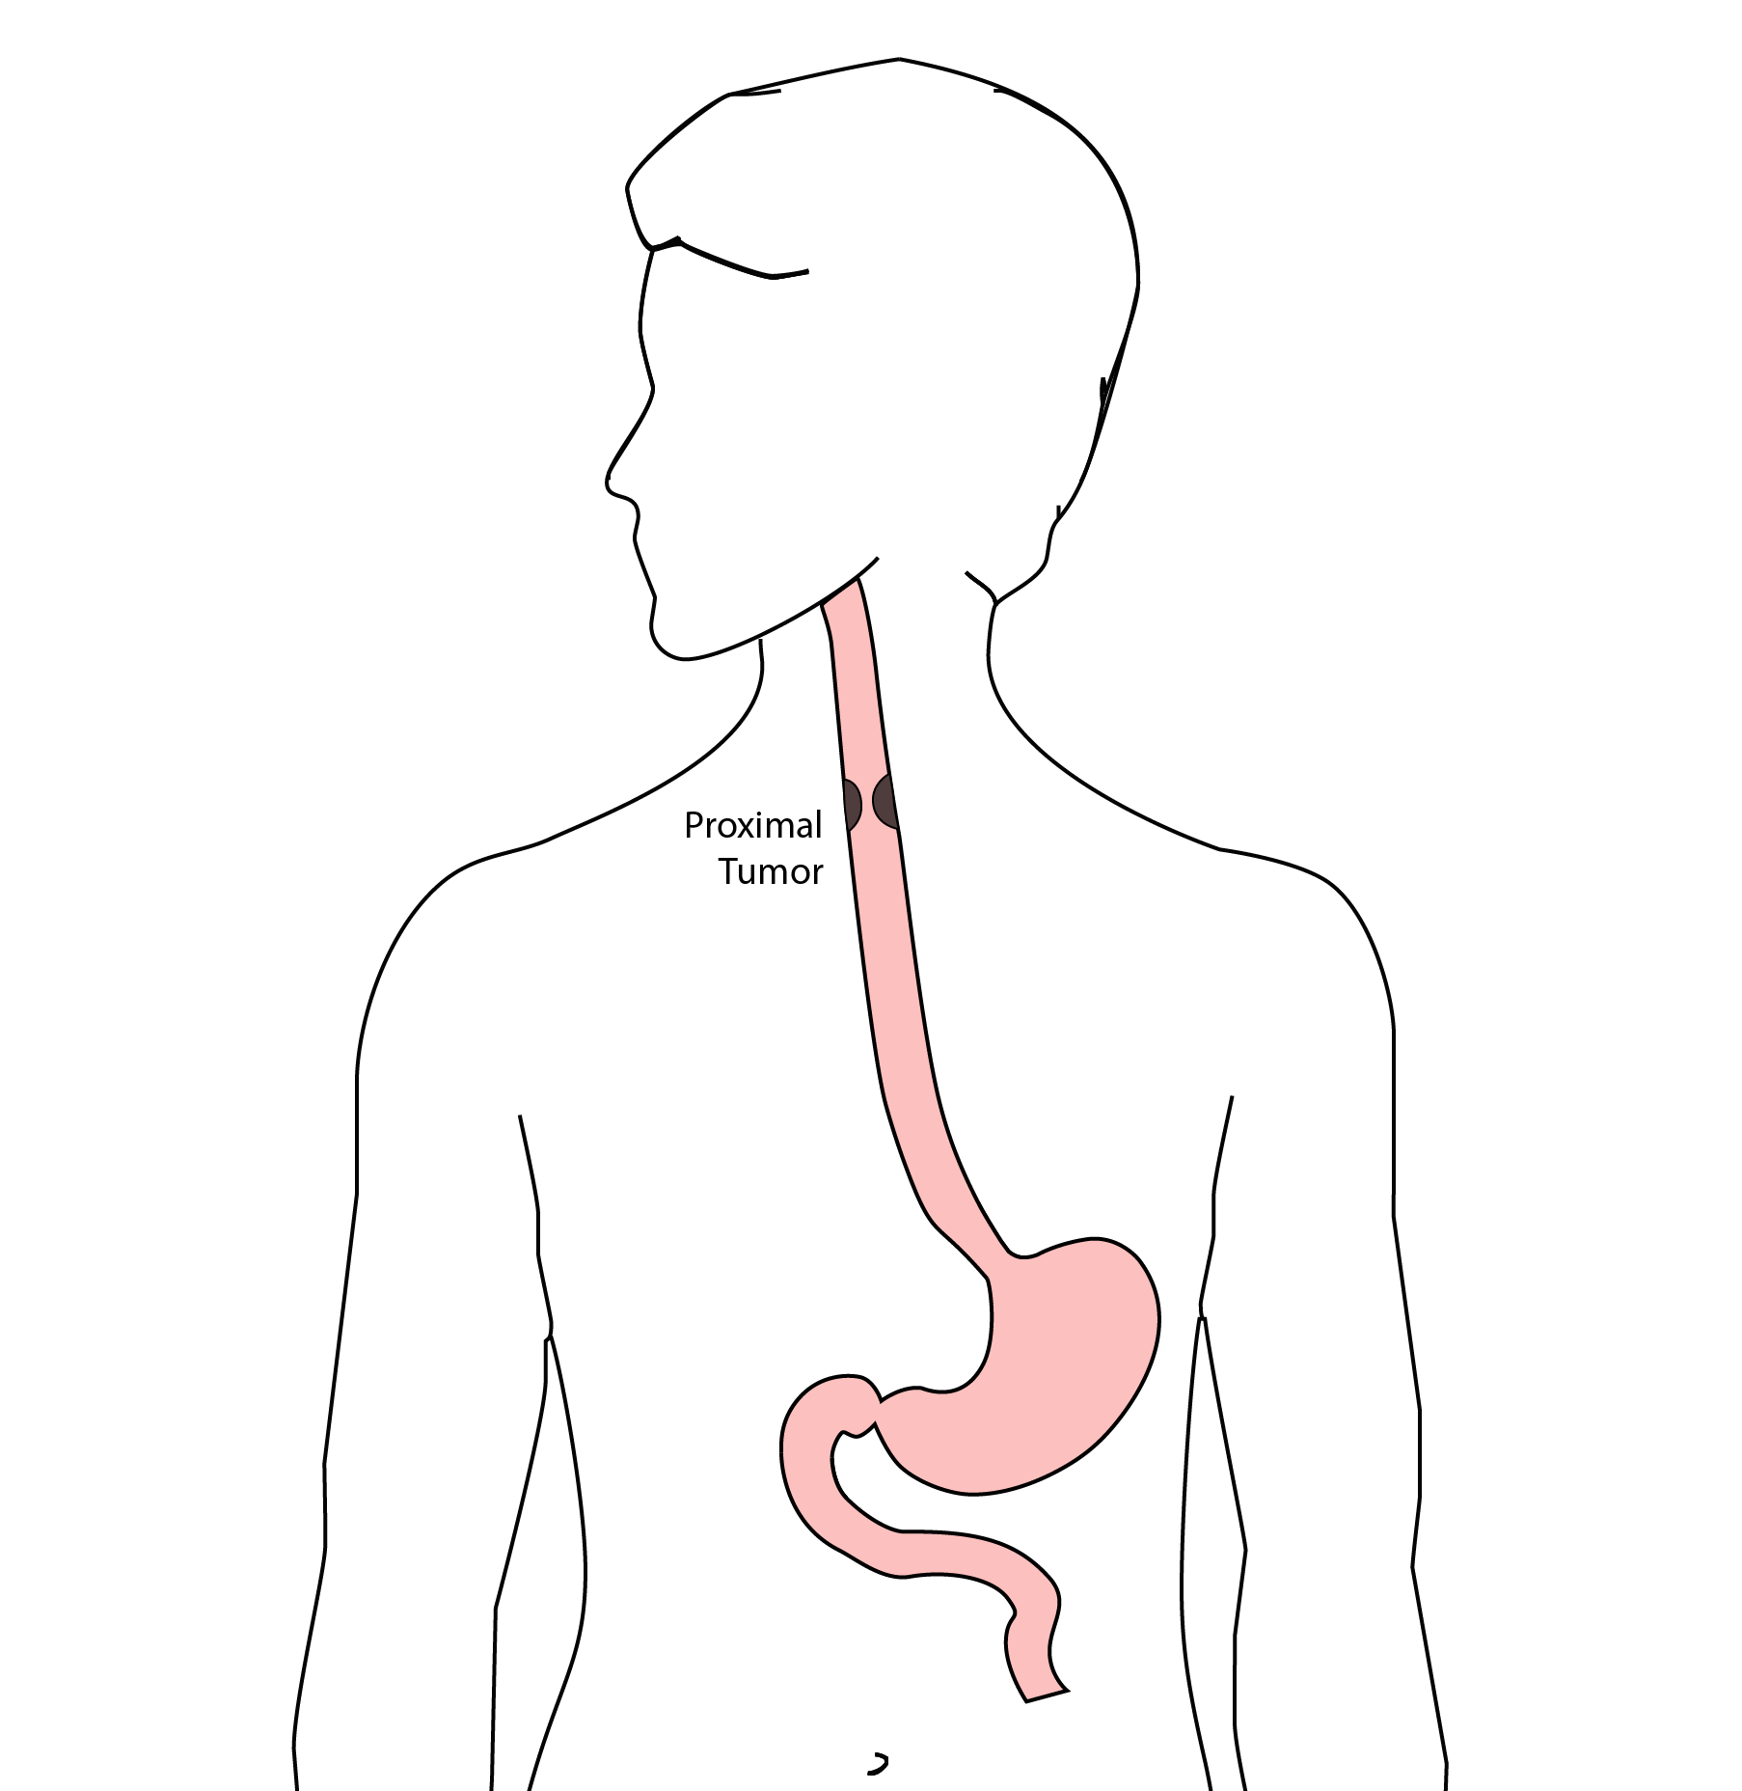
Total Esophagectomy
For patients with tumors in the upper esophagus, we need to remove more of the esophagus

Slide 11
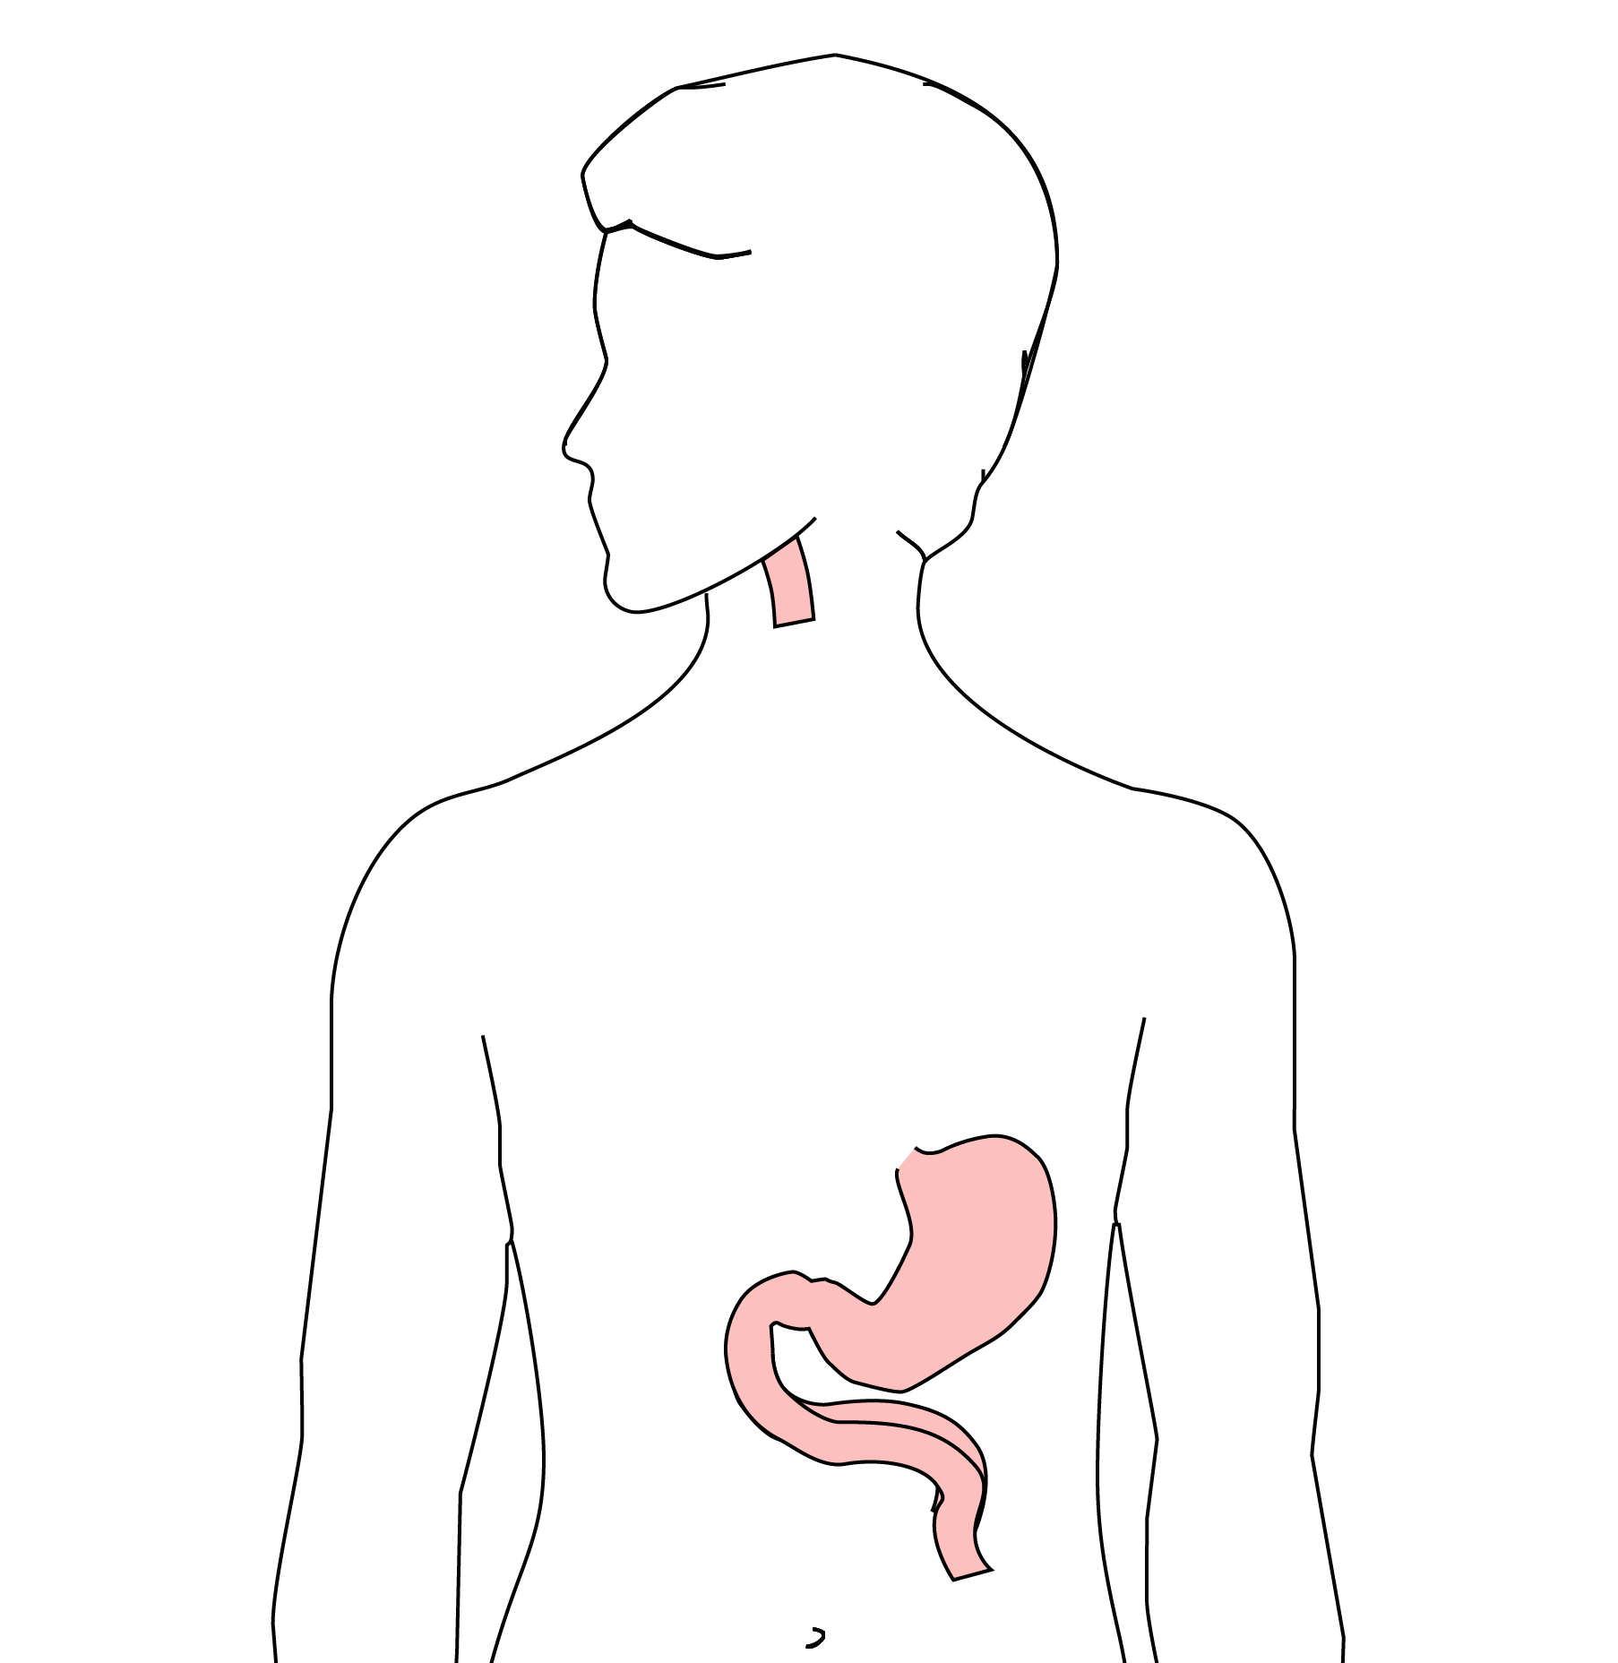
Total Esophagectomy
For those patients, we need to remove the whole esophagus

Slide 12
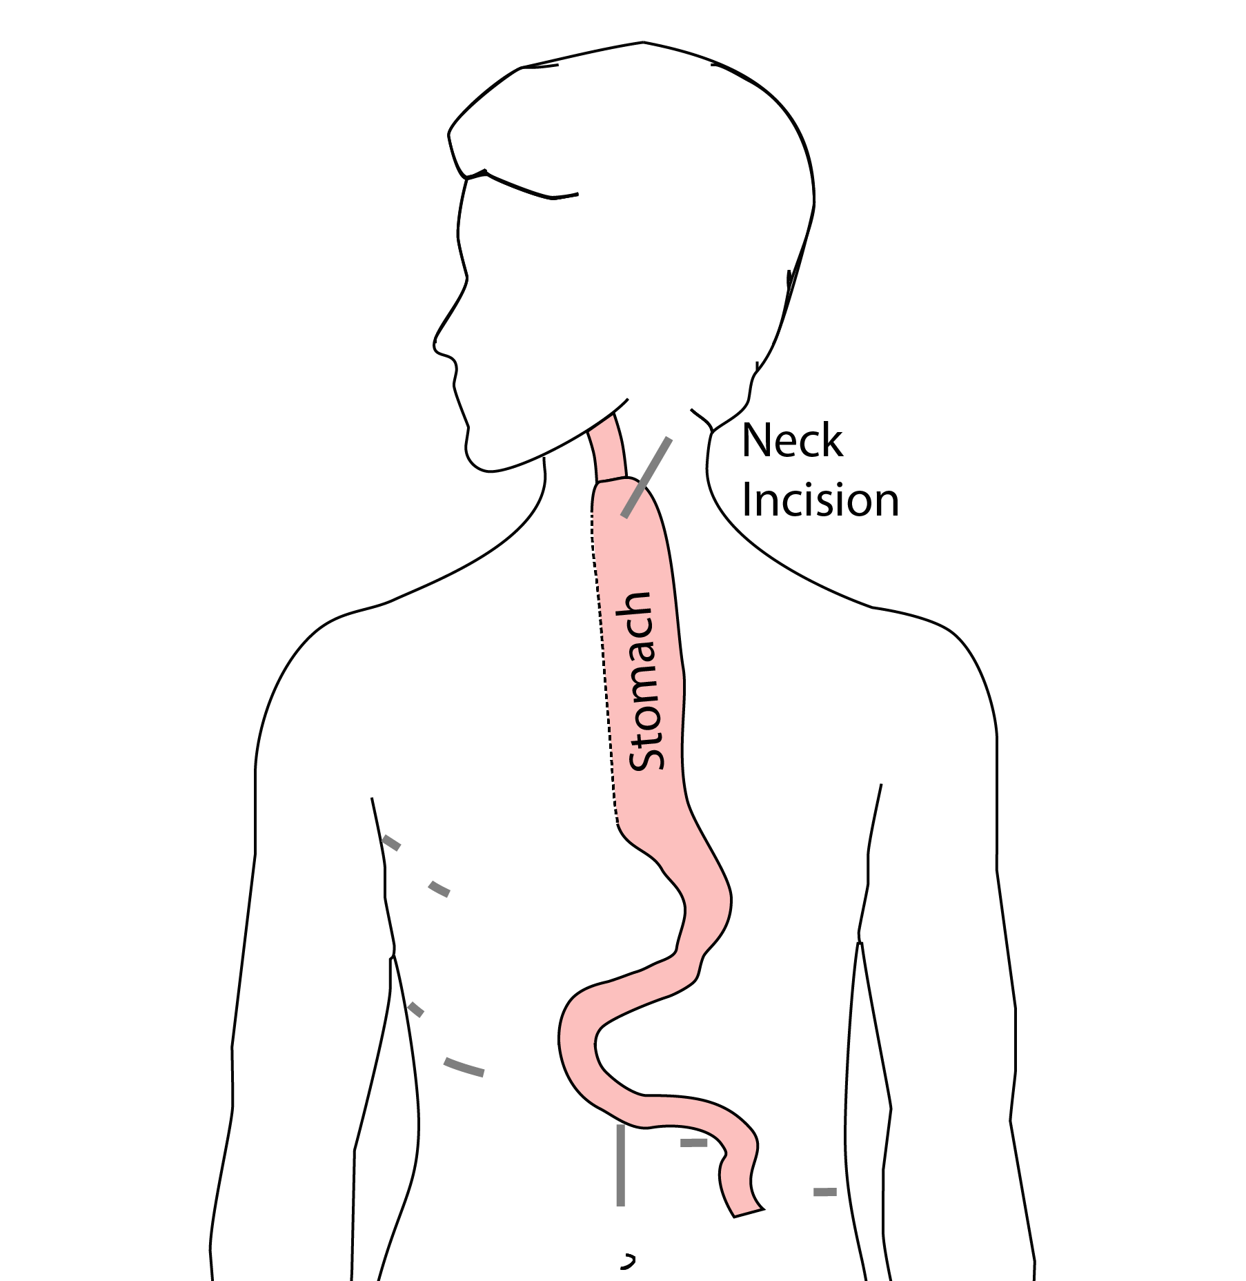
Minimally-invasive McKeown Esophagectomy
In this case, a connection between the esophagus and the stomach is made in the neck.

Slide 13
Risks of Surgery
An esophagectomy is a substantial operation, and in some cases there can be postoperative complications. We’re going to talk about two of these complications and what you can do to reduce your risk of complications:
Anastomotic leak
Pneumonia

Slide 14
Anastomotic Leak
The anastomosis is surgical connection between the esophagus and the stomach.

Slide 15
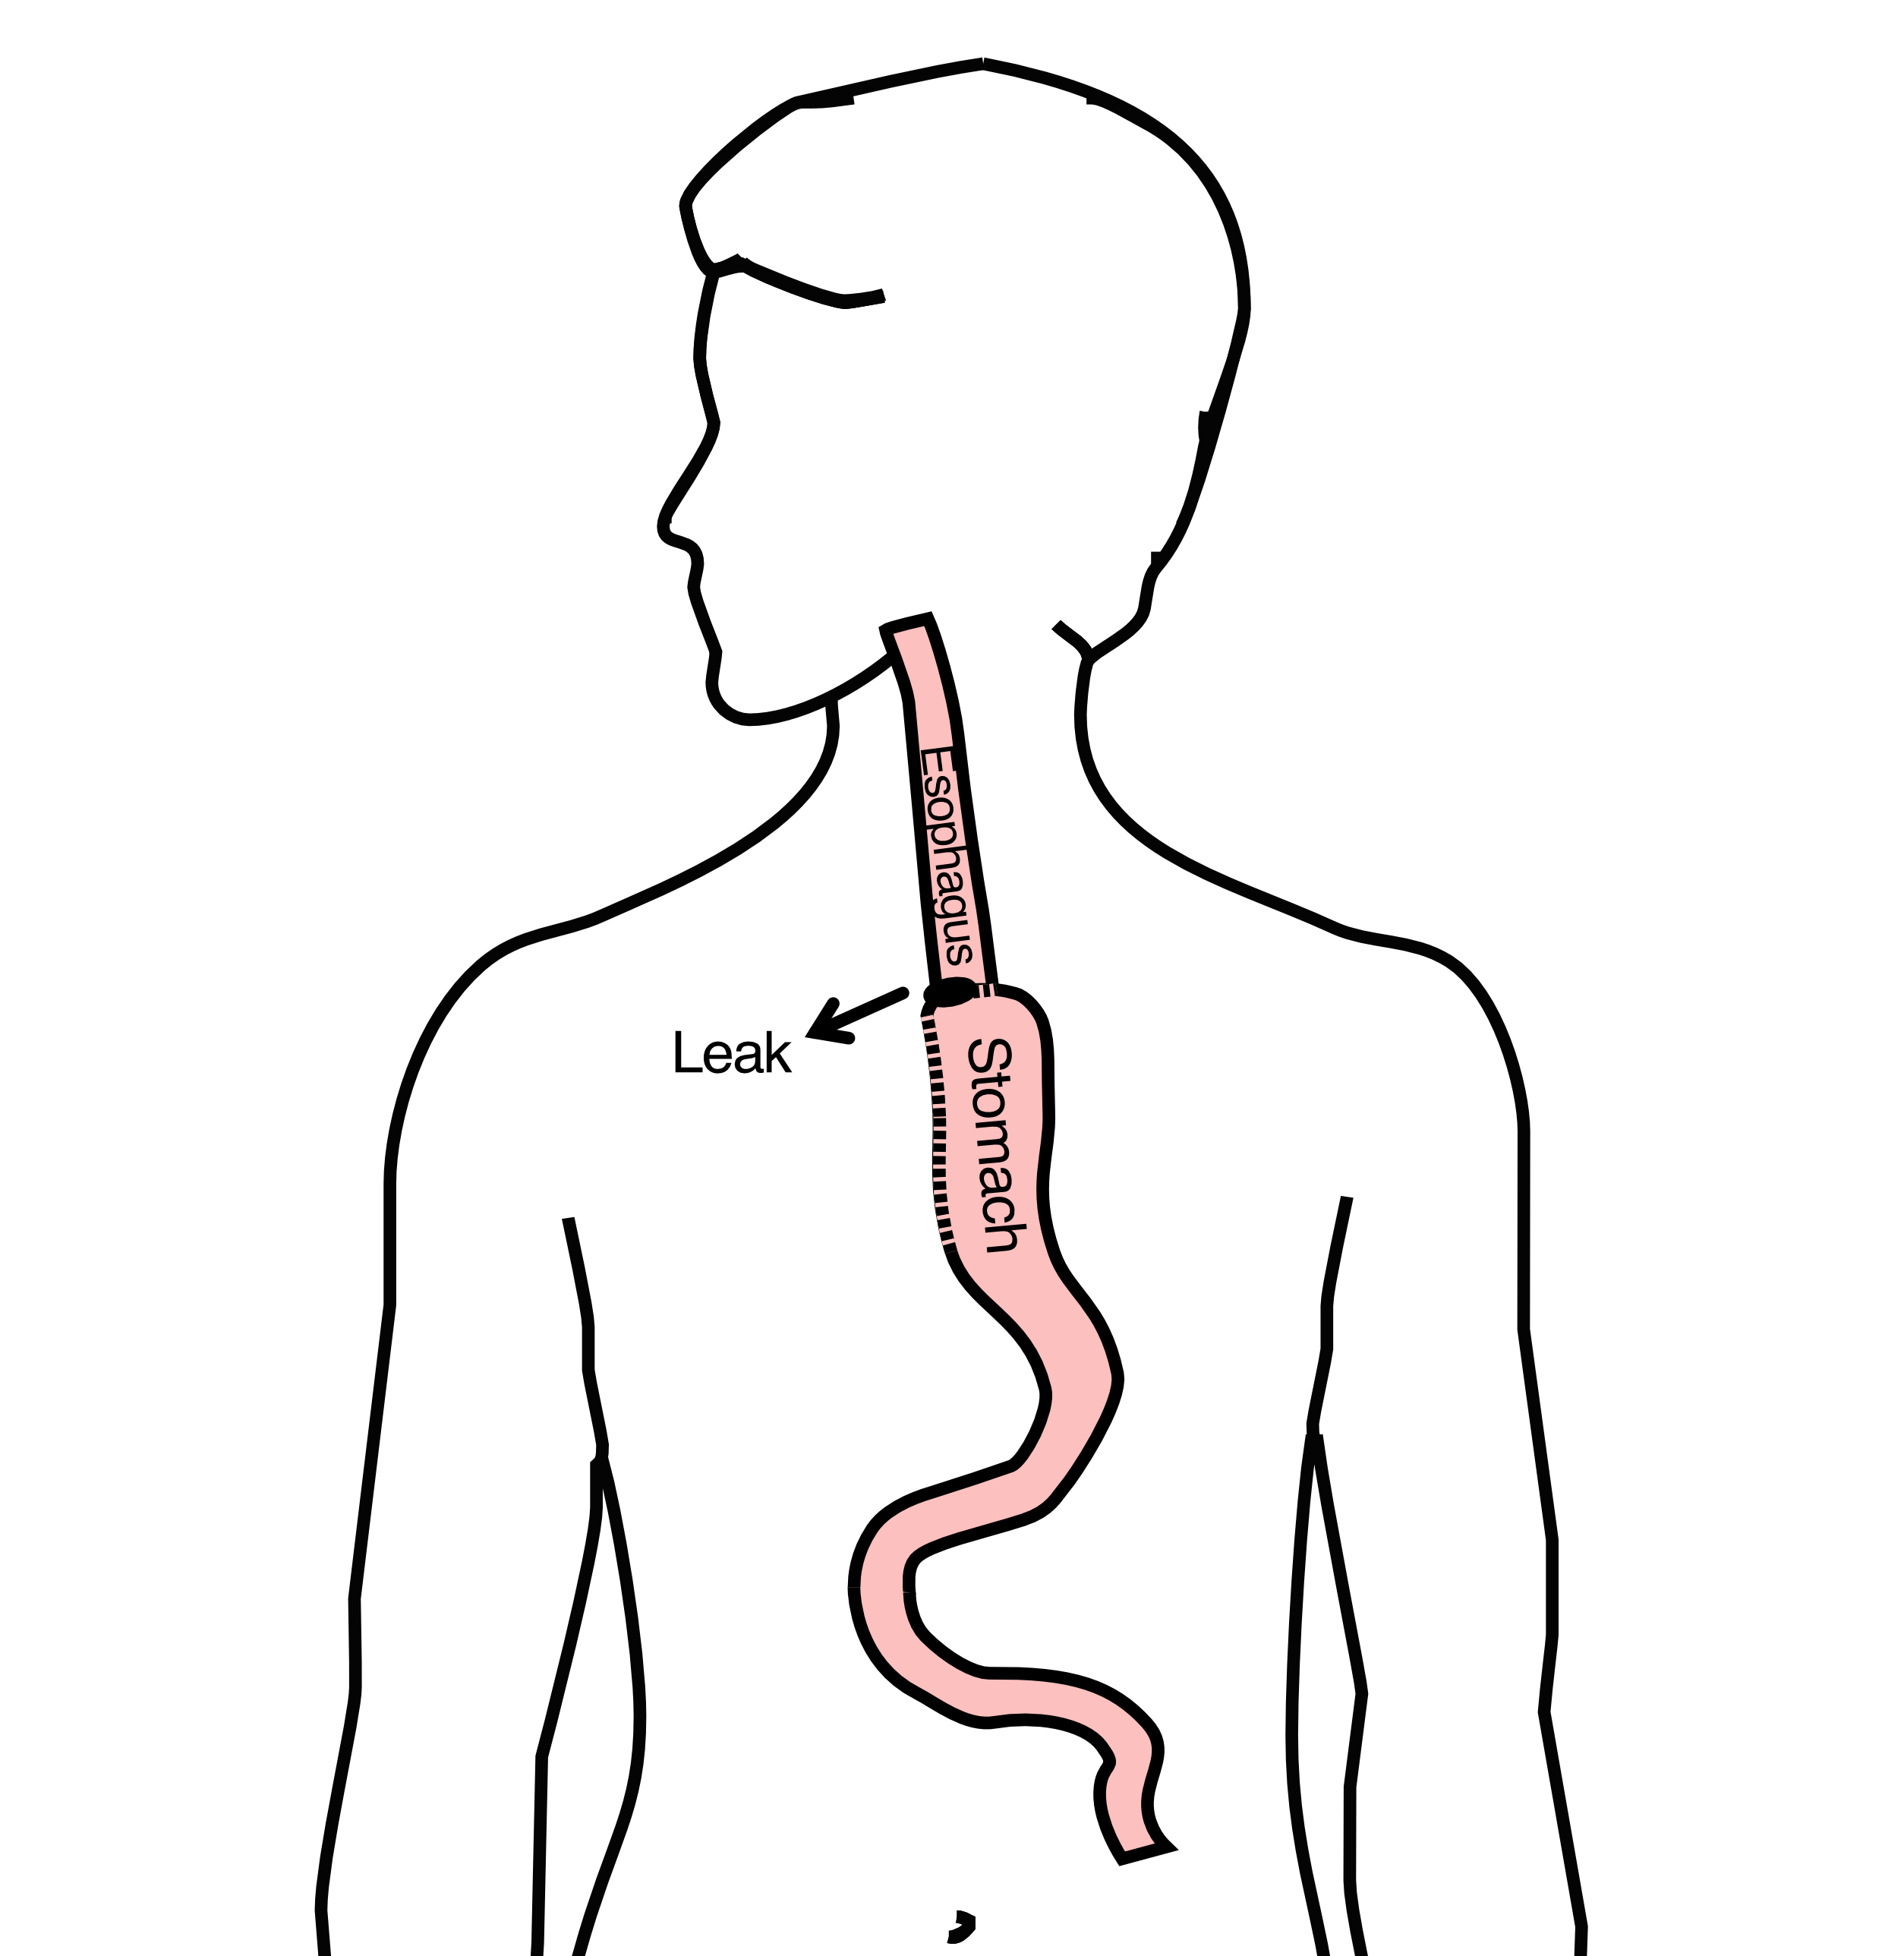
Anastomotic Leak
If anastomosis does not heal properly:
Leakage of fluid from the esophagus
Infection in the space between the lungs
Requires additional time in the hospital

Slide 16
Anastomotic Leak
If an anastomotic leak does occur:
Some leaks will seal on their own
A stent may be required to help healing
Occasionally additional surgey is required

Slide 17
Anastomotic Leak
Risk of a leak depends upon:
Type of operation performed
Overall nutritional status of patient
Experience of the surgeon

Slide 18
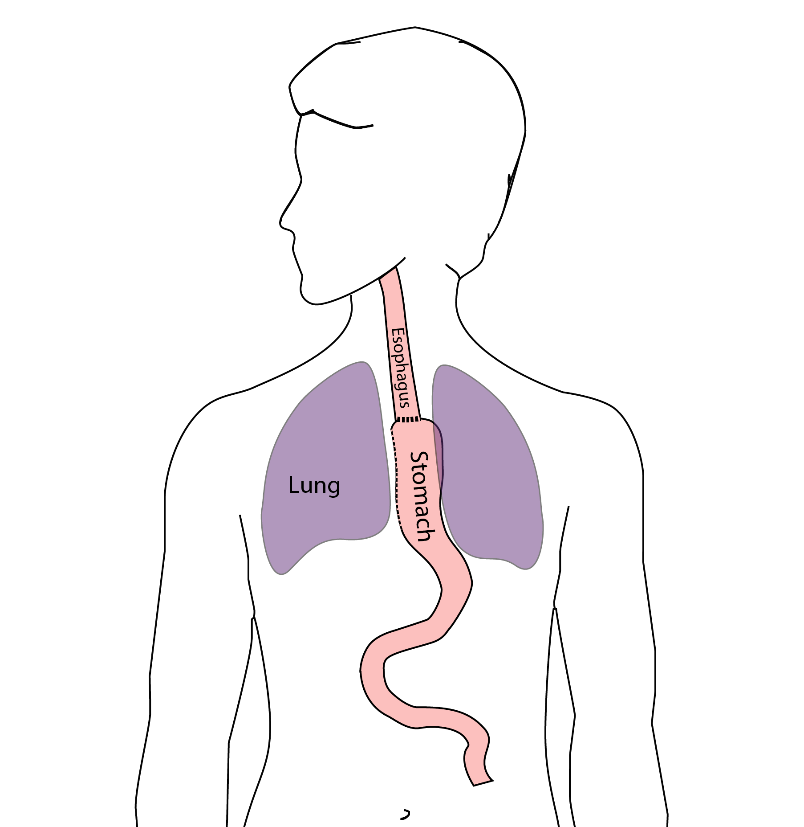
Pneumonia
Pneumonia can occurs in about 10-15% of patients after esophagectomy.
Pneumonia requires treatment with antibiotics and frequently requires a longer hospitalization.

Slide 19
Preventing Pneumonia
There are several ways to help prevent pneumonia after surgery:
Deep breathing
Coughing
Walking
After surgery, this means:
Sitting in a chair most of the day
Walking in the halls as soon as possible

Slide 20
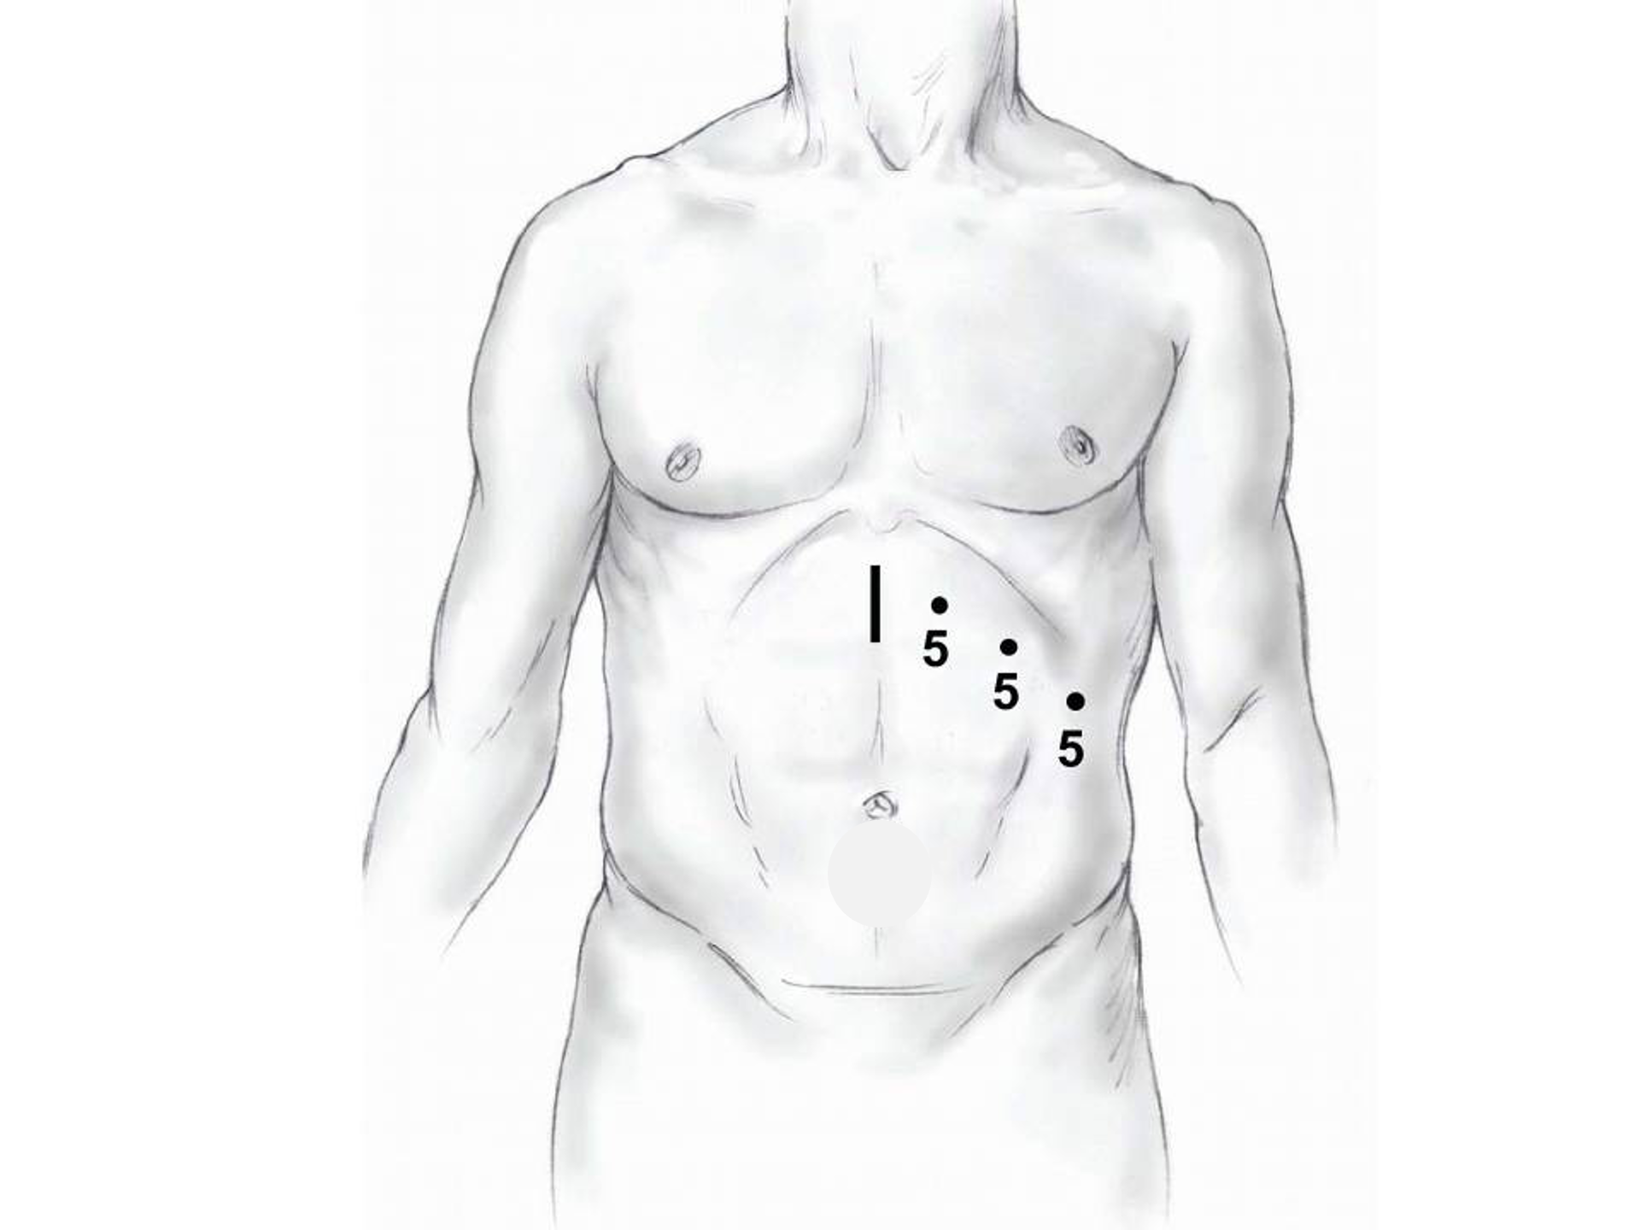
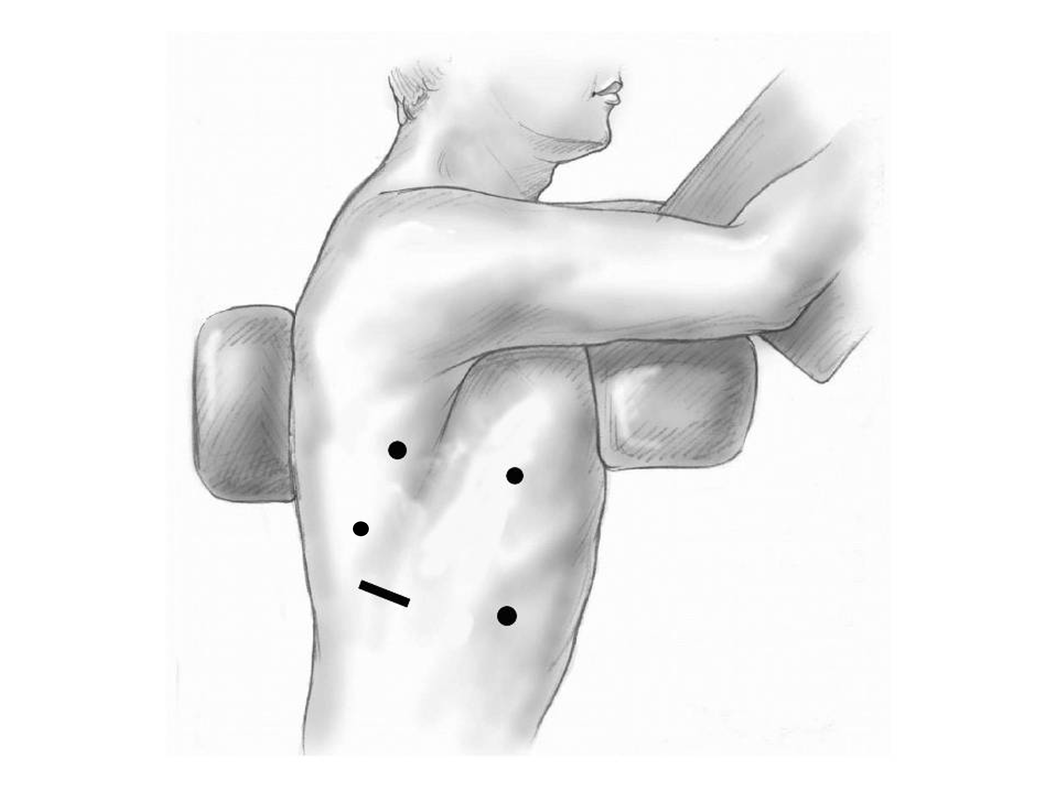
Minimally-invasive Esophagectomy

Slide 21
Risks of Surgery
Risks related to anesthesia
Heart attack (5%)
Irregular heart rhythm (15%)
Pneumonia (10%)
Blood clots in legs (<5%)
Pulmonary embolism (2%)

Slide 22
Risks of Surgery
Risks related to Surgery
Anastomotic leak (5%)
Stricture at anastomosis (15%)
Death within 90 days of surgery
Low risk patients = 2%
Intermediate risk = 10%
High risk = 30%

Slide 23
Risks of Surgery
 | Age <75 | Age >75
Normal Muscle (75%) | 2% | 10%
Low Muscle (25%) | 10% | 30%
Risks of Death within 90 Days of Surgery

Slide 24
Day Prior to Surgery
Clear liquids for 24 hours prior to surgery
Check with Pre-op nurse regarding medicines day prior to surgery
No tube feedings the night before surgery

Slide 25
Day of Surgery
Arrive at 5am – nothing to eat or drink after midnight.
OK to take medicines with a sip of water (or coffee) but no cream.
Surgery will be cancelled if you have cream or milk in the morning.
Waiting room for family and friends on 5th floor
Post-operative care in STICU (11th floor)

Slide 26
Anesthesia
Epidural catheter for pain control
Remains in place for 2-5 days
Dose can be adjusted as needed
Can make it more difficult to empty the bladder
May require foley (bladder) catheter to stay in place until epidural

Slide 27
Intensive Care Unit (1-2 days)
Multiple lines and tubes:
NG tube in nose (stays in 2-7 days)
Catheter in bladder (2-5 days)
Chest tube right chest (2-4 days)
Abdominal drains (2 or 3)

Slide 28
ICU
Catheter in bladder removed → make certain the bladder empties properly
Chest tube removed (day 2-4) → follow-up chest x-ray
Fluid emptied from drains every few hours
Start tube feedings by feeding
Feeding jejunostomy (stays in 8 weeks)

Slide 29
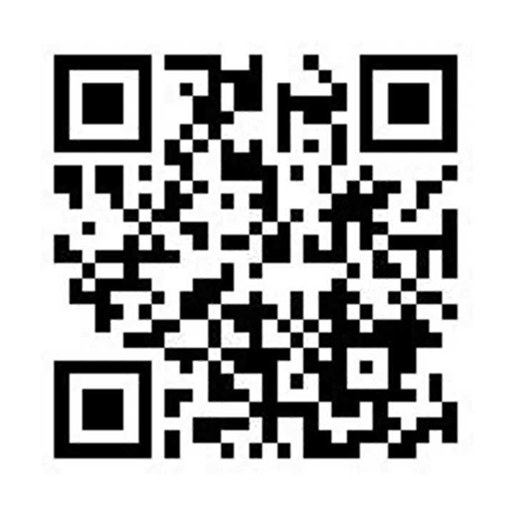
Feeding Jejunostomy
Feeding tube placed in small intestine
Pump feedings require 16 hours (overnight)
Run from 6pm to 10am

Slide 30
Feeding Jejunostomy - Typical Regimen
Jejunostomy tube feeds for 16 hours (6pm to 10am)
Men: 75mL/hour x 16 hours = 5 cartons
Women: 60mL/hour x 16 hours = 4 cartons
Water 240ml (8oz) via syringe 4x/day
Hospital nurses will teach you how to use the feeding tube pump
We want to make sure you can manage the pump before going home

Slide 31
Feeding Jejunostomy - Diabetes
Jejunostomy feeding tend to elevate blood sugars: Insulin may be required
Typical pattern:
Jejunostomy feeds 6pm to 10am
Insulin at 6pm (70/30)
Insulin at MN (70/30)
No insulin if feedings are not run

Slide 32
Activity
Up in chair most of the day
Walking in hallway with help from nurse/Physical Therapist
Goals:
Improve lung function
Prevent muscle loss

Slide 33
Nasogastric Tube (NG)
NG is placed trough the nose into the stomach to remove fluid from the stomach and allow healing.
NG tube is removed after confirmation by x-ray that the stomach is starting to empty properly

Slide 34
Nasogastric Tube (NG)
X-ray on the 2nd to 4th day after surgery
Will require standing up for 5-10 minutes
Dye is injected into the NG tube
If stomach empties, NG tube is removed

Slide 35
Modified Barium Swallow
Tests whether swallowing muscles are working properly
Performed after nasogastric (NG) tube removed
Drink a white chalky liquids in while x-rays are taken
70% have good swallowing function $→$ 1oz of water every hour

Slide 36
Protein Shakes
Most are taking protein shakes when they go home
Protein shakes are started after tolerating water - 2 oz per hour to start - 4 oz per hour if 2oz are tolerated well

Slide 37
Discharge
Goal: Ready to leave hospital day #6/7 after surgery
Tube feeds at night (6pm to 10am)
Protein shakes by mouth (70% of patients)
4oz every 2 hours
Water by mouth 2 oz at a time Water through feeding tube (8oz 4x/day)

Slide 38
Nutrition at Home
Most patients go home with:
Protein shakes by mouth 4oz at a time
Tube feeds at night (4-5 cartons)
Water through the feeding tube 8oz 4 times per day

Slide 39
Medicines at Home
Proton pump inhibitor (acid blocker) for one year
Reglan (metoclopramide) - stomach emptying: 6 weeks
Lopressor (metoprolol) - prevent atrial fibrillation: 2 weeks

Slide 40
Pain Medicines at Home
Acetaminophen 1000mg every 6 hours
Gabapentin 300mg every 8 hours
Oxycodone 5mg every 6 hours
In most cases, oxycodone is no longer needed by 6 weeks after surgery

Slide 41
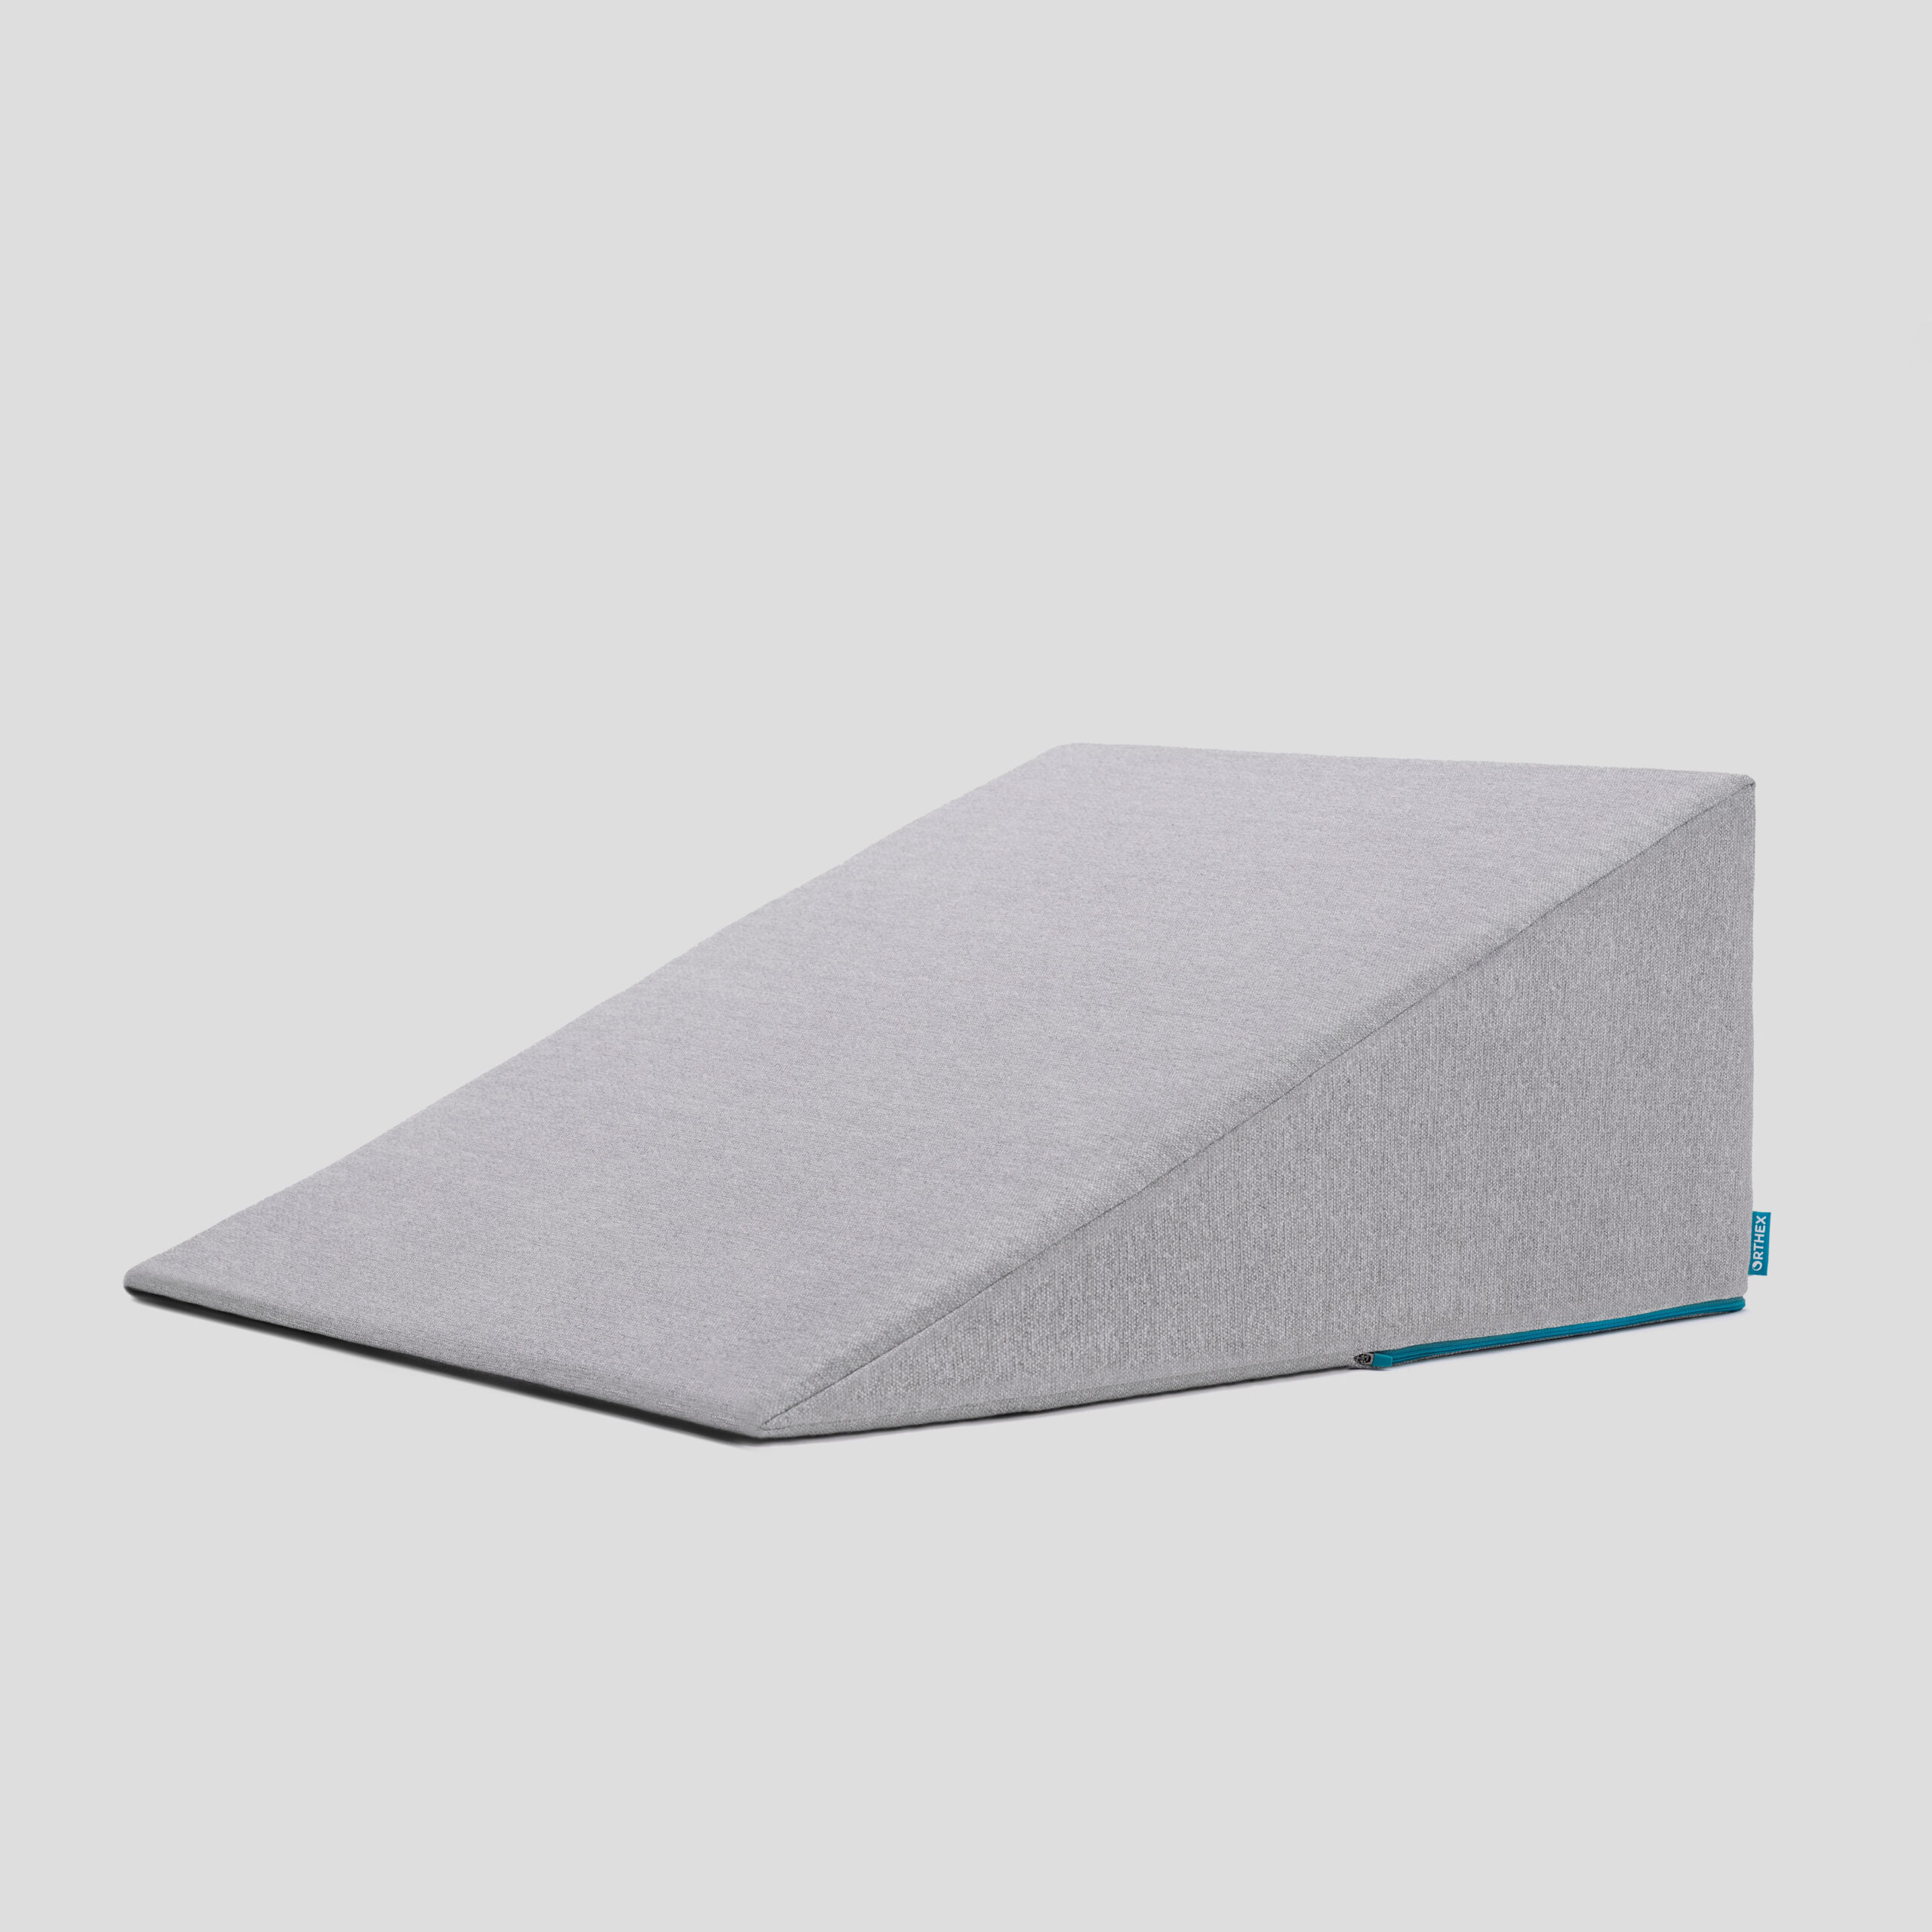
Sleeping
Reflux can occur the first few weeks/months after surgery
This improves over the first few months
A wedge pillow can be helpful for sleep

Slide 42
Postoperative Visit
You will be seen in the office 7-10 days after discharge
Adjust medicines
Remove staples
Remove drains (if needed)

Slide 43
Jejunostomy Removal (8 weeks after surgery)
Jejunostomy tube is removed in the office once you can take in enough nutrients by mouth
May take 30 minutes and some local anesthetic to loosen up the tube for removal.

Slide 44
Nutritional Monitoring after Surgery
You may have some difficulty absorbing some nutrients:
Iron
Vitamin B12
Vitamin D

Slide 45
Nutritional Monitoring after Surgery
About 3 months after the jejunostomy tube is removed, we will check blood levels:
Iron (ferritin)
Vitamin B12
Vitamin D.

Slide 46
Nutritional Replacements after Surgery
Vitamin or iron replacements can be ordered by your primary care physician, medical oncologist, or surgeon
If levels are low, repeat testing in several months may be needed.

Slide 47
Preparing for Cancer Treatment
Primary Care Physician
MyAtrium Portal
Exercise
Smoking Cessation

Slide 48
Primary Care Practitioner (PCP)
A PCP is critical to coordinate care between specialists.
We will update your PCP after each visit
If you do not have a PCP, call our referral line at (844) 235-6998

Slide 49
My Atrium Patient Portal
Critical to good communication with your cancer care team
Available for desktop or laptop or phone
Sign up at my.atriumhealth.org

Slide 50
Exercise
Important to reduce the risk of complications from cancer treatment
Goal is 30min/day of vigorous exercise 6 days/week
Working hard enough that you can’t carry a conversation
Start slow an build up
Every day counts! (Aim for some activity every day)

Slide 51
Smoking Cessation
Smoking makes it more difficult to get through cancer treatment
Increases risk of complications after surgery
Options for help with smoking cessation:
NC Quit Line 1-800-QUIT-NOW (1-800-784-8669)
American Lung Asssociation fredomfromsmoking.org
1:1 Smoking Cessation Counseling Clinics (Metro Charlotte)

Slide 52
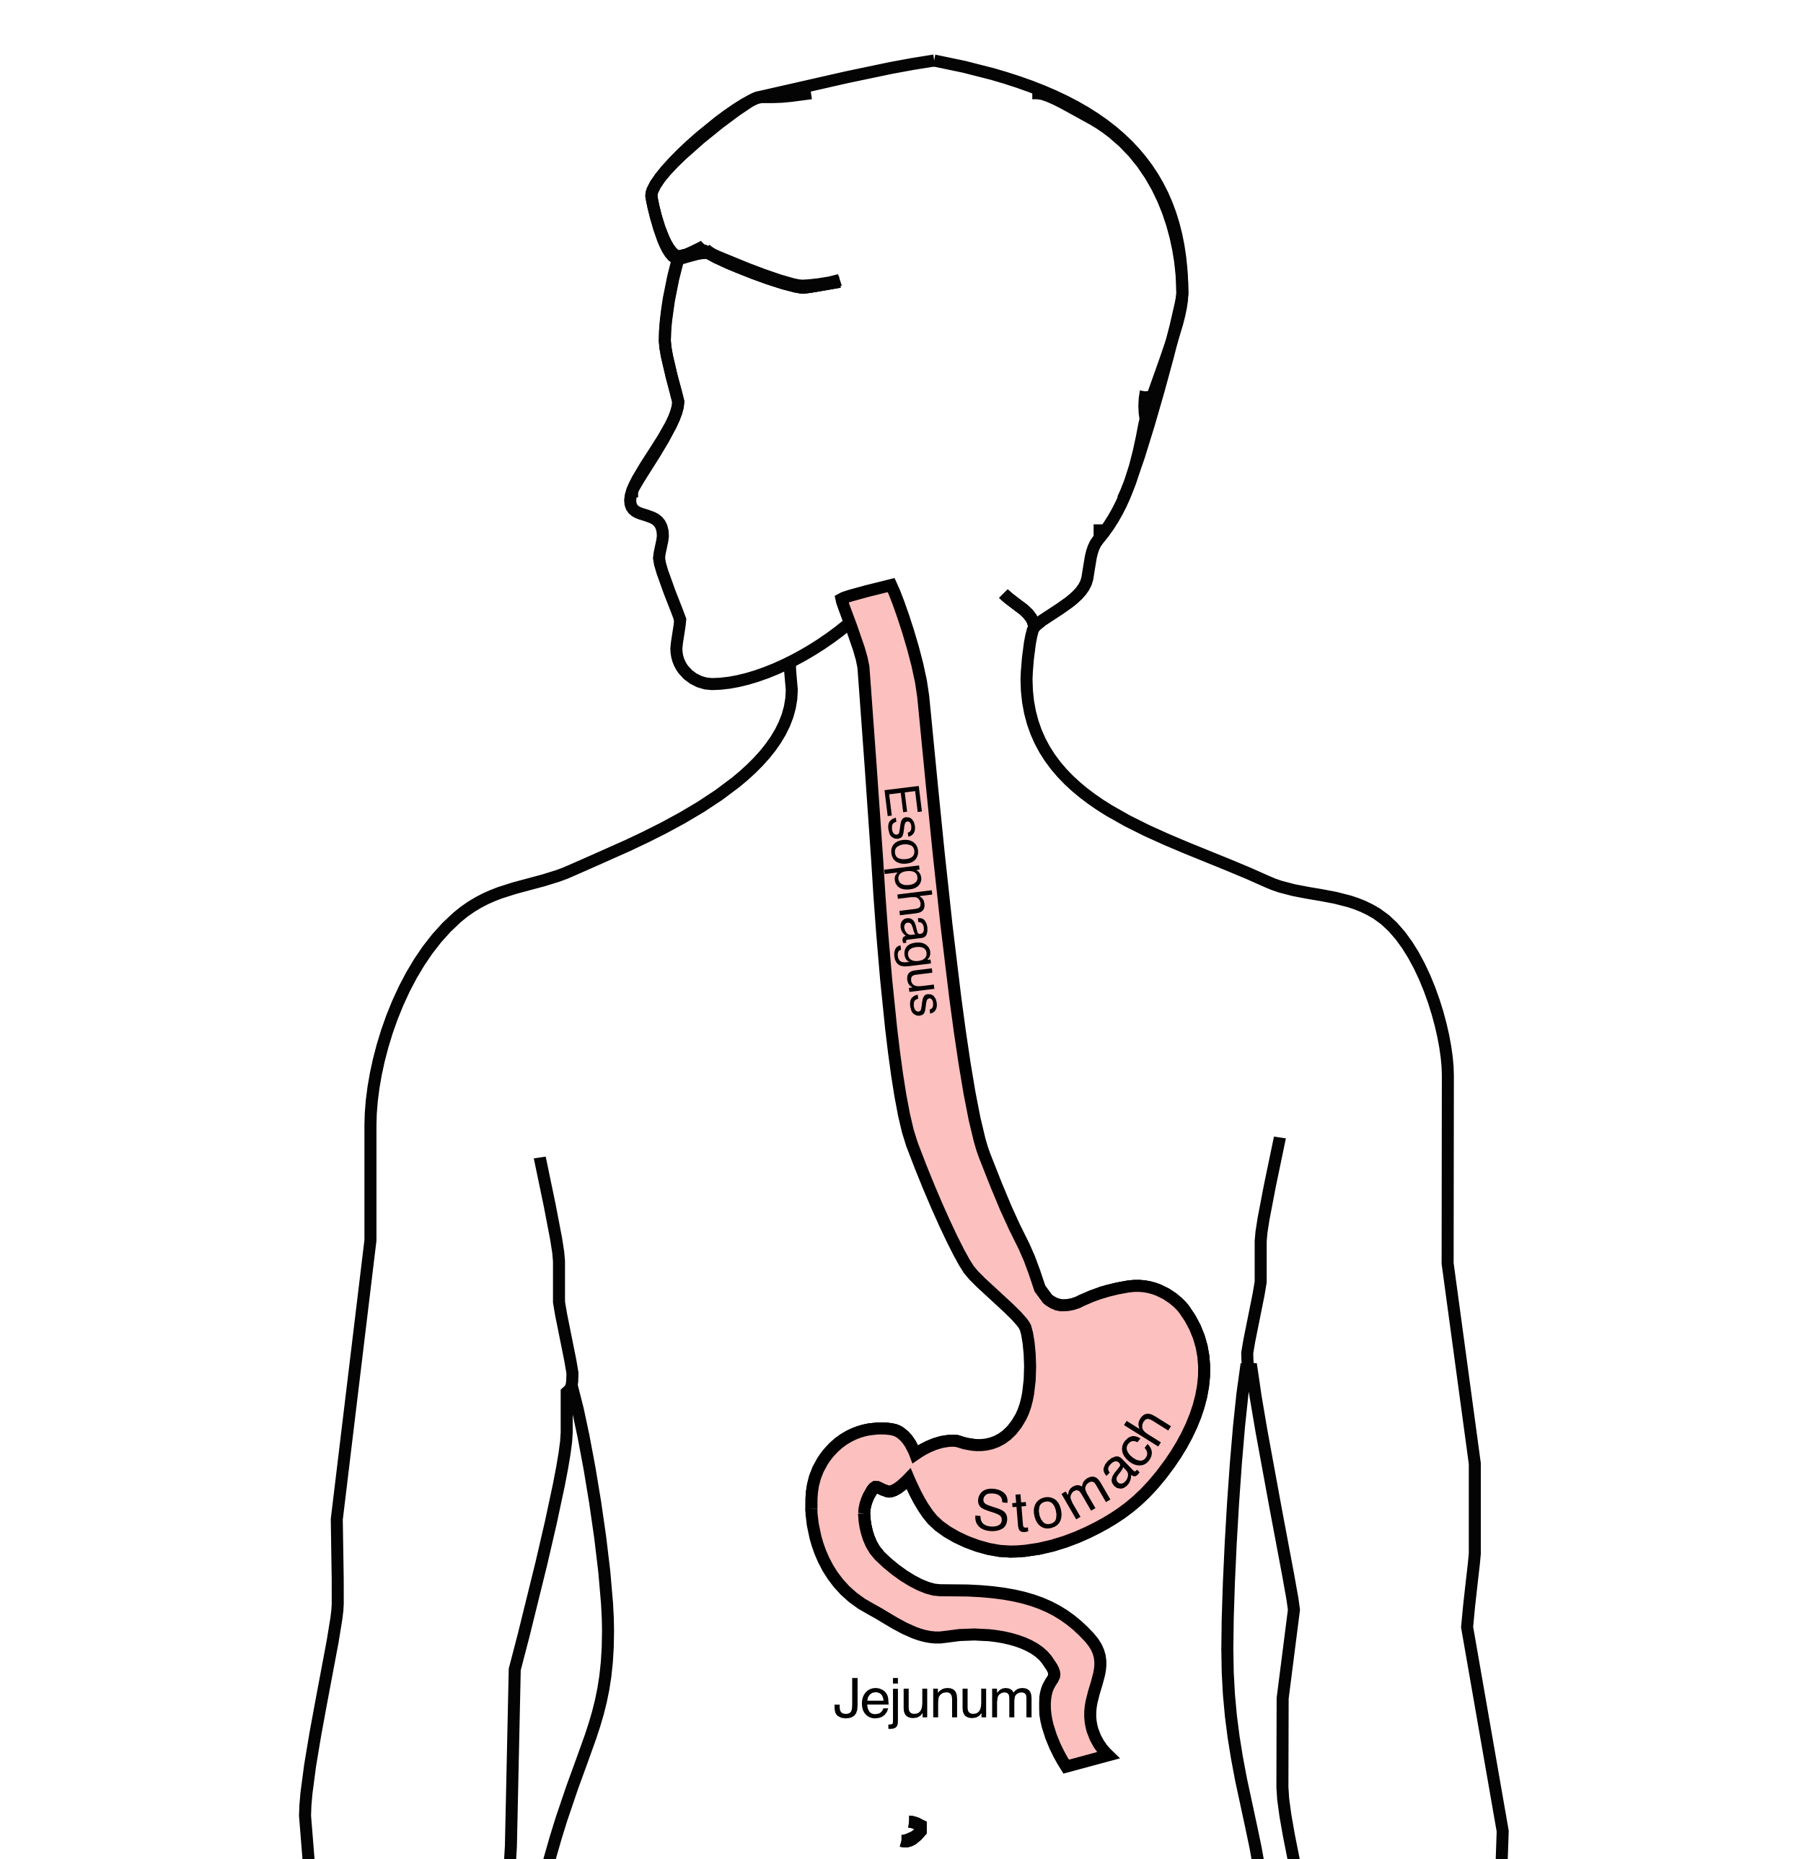
GI Tract Anatomy
Esophagus delivers food to the stomach
Stomach stores food and delivers it in small quantities to the jejunum
Jejunum begins digestion in the small intestines

Slide 53
Protein Needs
Men: Average 75 grams/day
Women: Average 60 grams/day

Slide 54
Protein Shakes
Protein Shakes can provide protein with minimal sugar
Protein Shakes

Slide 55
Feeding Tubes
Jejunostomy = Small Intestine
Gastrostomy = Stomach

Slide 56
Gastrostomy Tube
Feeding Gastrostomy
Feeding with a syringe several times per day.
Tube can be hidden underneath clothing
Tube does not interfere with eating by mouth
Removed easily in the office when no longer needed

Slide 57
Gastrostomy Tube Methods
A gastrostomy tube can be placed either by endoscopy, which is called a PEG tube
A gastrostomy tube can also be placed by laparoscopy, which is usually preferred if surgery on the esophagus is planned in the future.
Your surgeon will help you decide which kind of tube is best for you. This is especially important if you will need esophageal surgery in the future, as the stomach is frequently used to make a new esophagus

Slide 58
Gastrostomy Tube
Outpatient Placement (go home the same day)
Central venous port can be placed at the same time (if needed)

Slide 59
Jejunostomy tube
The other type of feeding tube is a jejunostomy.
A jejunostomy tube tube is placed into the small intestines. Because the small intestine is used to receiving food in small quantities, a jejunostomy tube requires the use of a pump to deliver feedings gradually over a matter of hours.
In general, feedings are done at night in order to allow you to be active during the day

Slide 60
Jejunostomy Video
A video is available to help become familiar with the feeding jejunostomy
Gastrostomy = Stomach

Slide 61
Epidural Catheter for Pain Control
Remains in place for 2-5 days
Dosage can be adjusted as needed
Can make it more difficult to urinate
May require foley catheter in bladder
Foley catheter removed after epidural removed

Slide 62
ICU Stay (2-4 days)
NG tube in nose to drain stomach and esophagus
Catheter in bladder
Chest tube right chest
Abdominal drains (usually 2)
Feeding jejunostomy (usually stays in 8 wks)

Slide 63
Ward - 6Tower
Jejunostomy feeds started
Nurses will instruct you and family how to operate the pump
Up in a chair most of the day
Walking in the halls
Start with assistance
Improves lung function
Prevents loss of muscle

Slide 64
Jejunostomy Feeds
Jejunostomy tube feeds
Start continuous (24 hours)
Convert to night-time only (16 hours)
Water administered through feeding tube
Usually 8oz 4 times/day
Important to prevent dehydration
Diabetic patients may need insulin

Slide 65
Jejunostomy Feeds with Diabetes
Jejunostomy feedings may cause blood sugars to be elevated
Insulin may be required along with feeds
Typical Pattern for tube feeds
Feeds run via pump from 6pm to 10am
Insulin at 6pm (70/30 insulin)
Insulin at Midnight (70/30 insulin)
No insulin if tube feedings are not run

Slide 66
Nasogastric (NG) Tube
Tube passed through nose into stomach
Drains fluid from stomach
Prevents vomiting
Upper GI X-ray on 2nd or 3rd day after surgery
If stomach empties well $→$ NG tube removed
Otherwise, X-ray repeated 2-3 days later

Slide 67
Swallowing Evaluation
Once NG tube has been removed:
Modified barium swallow in radiology Drink a white chalky liquid (barium) Look for proper swallowing function
70% of patients $⇒$ liquids started by mouth

Slide 68
Discharge
Goal: ready to leave day #6/7 after surgery
Night-time tube feedings (6pm to 10am)
Some nutrition by mouth (70% of patients)
1 oz of water per hour by mouth OR
Protein shakes 4oz every 2 hours
Water through tube 8oz four times per day
Home care nursing (feeding tube teaching)
Home infusion (tube feeding supplies)

Slide 69
Medicines at Home - Pain
Acetaminophen (Tylenol) 4000mg/day (1000mg 4 times/day)
Gabapentin 300mg 3 times/day (works best if taken every day)
Oxycodone
Take as needed in addition to Tylenol and gabapentin
Will begin reducing dosage at first postoperative visit
Most patients can discontinue by 4 weeks after surgery
NO DRIVING WHILE ON OXYCODONE

Slide 70
Medicines at Home - Non-steroidals
Non-steroidal anti-inflammatories (Celebrex)
200 mg every 12 hours starting 2 weeks after surgery
NO GOODY POWDERS OR BCs
(Can cause permanent scarring at the surgery site)

Slide 71
Medicines at Home - Acid Blockers
Acid blocker (Omeprazole, Nexium,etc)
Will stay on for at 1-2 years to prevent acid reflux
Important in preventing scarring at anastomosis (new connection between esophagus and stomach)
To administer through feeding tube, open capsule and resuspend beads in 60mL (2oz) of water

Slide 72
Medicines at Home
Reglan – Helps stomach empty
Will plan to stop after six weeks
0.1% risk of tardive dyskinesia (nervous tic)
Remeron – Helps improve appetite
Can cause vivid dreams
Used for several weeks after surgery
Will stop within first three months of surgery

Slide 73
Medicines at Home - Beta Blockers
Metroprolol – Beta Blocker
Slows heart rate and lowers blood pressure
Used around the time of surgery to prevent fast heart rhythms
In patients who were not taking a beta blocker prior to surgery, will plan to wean over a few weeks after surgery
For patients who were taking a beta blocker medicine prior to surgery, will return to prior dosage and drug after surgery

Slide 74
Nutrition after Surgery
At discharge home:
Protein shakes 4oz every 2 hrs
Tube feeds 4-5 cans at night (6pm-10am)
10-12 Days: Increase protein shakes
Tube feeds 3-4 cans at night
Three weeks: Post-esophagectomy Diet
8-12 weeks: Remove feeding tube (in office)

Slide 75
Transition from Tube Feeds $→$ Eating
Dietitian will calculate daily protein goal
Typically 60-75 grams protein/day
Each carton of tube feeding has 15 grams
75 grams protein = 5 cartons/night
As intake by mouth increases, tube feeds are reduced
Important that protein is spread out during the day (20gm/meal)
Three meals + 2-3 high-protein snacks

Slide 76
Post-esophagectomy Diet
Soft Consistency
High Protein
Avoid sugary liquids (can cause ‘dumping’)
Avoid raw vegetables (and salads)
Eating
Small, frequent meals
Sit up for 30-45 minutes after eating
Avoid eating within 2 hours of bedtime

Slide 77
Wedge Pillow
Surgery to remove the esophageal tumor will lead to a tendency for reflux.
The most helpful strategy is a 30 degree wedge pillow. T
his should be half as high as it is long.
Available at Walmart.com

Slide 78
Postoperative Visit
Check surgical site
Remove staples (if needed)
Adjust medicines as needed
Insulin (for diabetic patients on insulin)
Reduce beta blocker medicines
Advance diet
Reduce tube feeds

Slide 79
After surgery
Wean off medicines added after surgery
Pain medicines
Beta-blockers
Reglan
Remeron
Continue acid blockers for at least 1 year
May need additional systemic therapy afterwards
Chemotherapy
Immunotherapy (Optive = nivolumab)

Slide 80
Team Members
Primary Care Provider
Gastroenterologist
Medical Oncologist (chemotherapy)
Radiation Oncologist (radiation)
Surgeons
Jonathan Salo
Jeffrey Hagen
Michael Roach
Dietitian - Liz Koch
Nurses - Brandon Galloway & Kit Sluder
Schedulers - Stacey Singleton & Toney Bethea

