Slide 1

END TO END ML WITH SNOWFLAKE
The content of this presentation is proprietary and confidential information of kipi.ai. This presentation is not intended to be distributed to any third party without the prior written consent of kipi.ai

Slide 2
DATA SCIENCE
Project Life Cycle

Slide 3
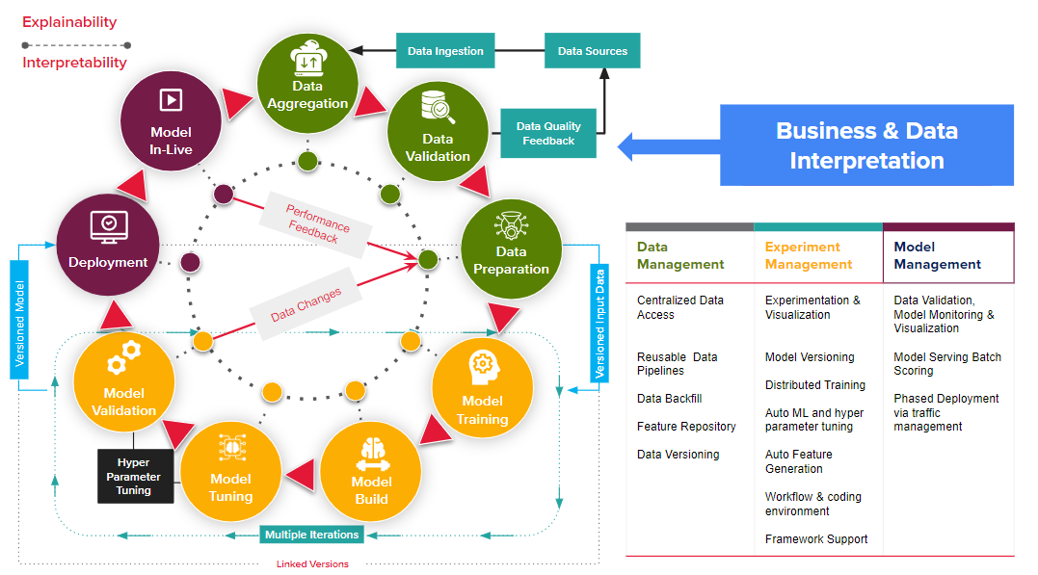
DATA SCIENCE PROJECT LIFE CYCLE

Slide 4
SNOWPARK

Slide 5
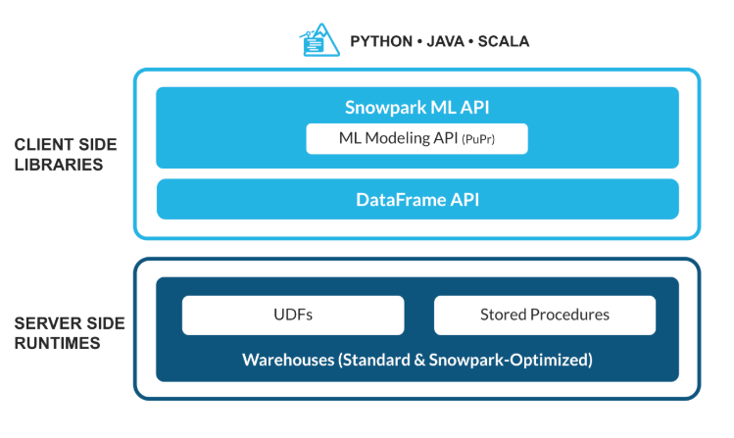
WHAT IS SNOWPARK
Snowflake Snowpark is a developer framework within the Snowflake Data Cloud that allows you to write and execute code directly inside Snowflake using languages like Python, Java, and Scala — not just SQL.
Key Components
Snowpark API
Snowpark DataFrame
User-Defined Functions (UDFs) and Stored Procedures
Snowpark for Python + Anaconda Integration

Slide 6
SNOWPARK KEY COMPONENTS
Snowpark API
Available in Python, Java, and Scala and
Lets you define DataFrames, transformations, and UDFs (user-defined functions).
Example: You can write Python code to manipulate tables, filter data, and apply logic — similar to Pandas and Spark
Snowpark DataFrame
Similar to pandas DataFrames, but operations are lazily executed and compiled into SQL that runs inside Snowflake. .
You can join, aggregate, and transform data in a Pythonic or JVM-native way.
User-Defined Functions (UDFs) and Stored Procedures
Write custom business logic in Python/Java/Scala and execute it in Snowflake.
Example: a Python function that performs sentiment analysis or complex calculations can be registered as a UDF.
Snowpark for Python + Anaconda Integration
Provides access to Anaconda’s data science libraries (like NumPy, pandas, scikit-learn) securely inside Snowflake — no need to install dependencies manually.

Slide 7
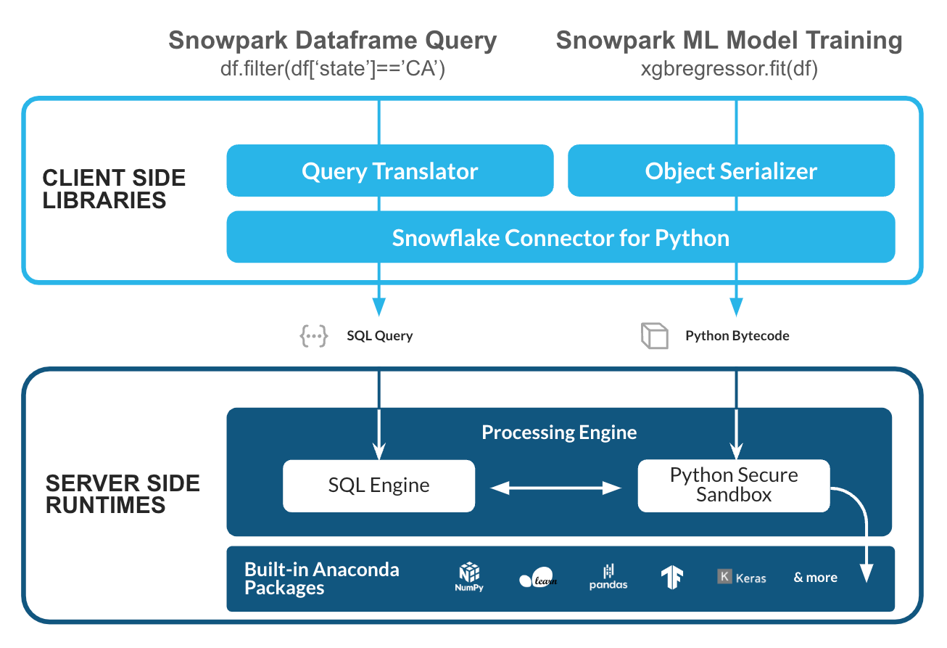
SNOWPARK API
The Snowpark DataFrame API is the core programming interface of Snowpark that lets you work with data in Snowflake using familiar DataFrame-style syntax — similar to pandas (Python) or Spark.
It provides a lazy, distributed, SQL-backed abstraction for working with structured data.

Slide 8
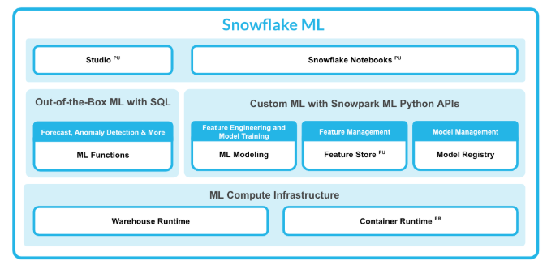
SNOWFLAKE ML
Snowflake now provides a complete, end-to-end Machine Learning (ML) workflow directly inside the Data Cloud. This includes:
Feature Engineering – preparing and transforming data for ML.
Snowpark ML Modelling Library – training, evaluating, and deploying models in Snowflake.
Feature Store – managing, sharing, and reusing ML features.
Model Registry – storing, versioning, and deploying trained models securely.
All of these run inside Snowflake’s compute layer, eliminating the need to move data out for ML development.

Slide 9
FEATURE
ENGINEERING

Slide 10
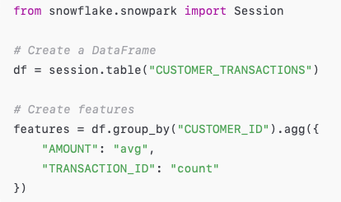
FEATURE ENGINEERING
Feature Engineering with Snowpark
Purpose: Transform raw data into meaningful, reusable features for ML models — entirely inside Snowflake.
Data Preparation using Snowpark DataFrame API : Filter, join, aggregate, and normalize data at scale using Python, Scala, or SQL.
Built-in ML Transformations : Snowpark ML provides transformers for scaling, encoding, and imputing (similar to scikit-learn pipelines).
In-Database Execution : Transformations execute where the data lives — no data export.
Reusable Feature Pipelines: Define pipelines once and reuse them for training and inference.

Slide 11
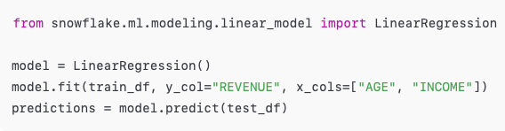
SNOWPARK ML MODELLING
Purpose:
Provides native machine learning algorithms and utilities for model training, evaluation, and inference inside Snowflake.
Key Features:
Built-in ML algorithms: Regression, classification, clustering, time series, etc.
Training inside Snowflake using snowflake.ml.modeling module.
Integration with Snowpark DataFrames for seamless data access.
Compatible with popular frameworks — export/import models from scikit-learn, XGBoost, TensorFlow, etc.
Distributed Training using Snowflake compute clusters for scalability.

Slide 12
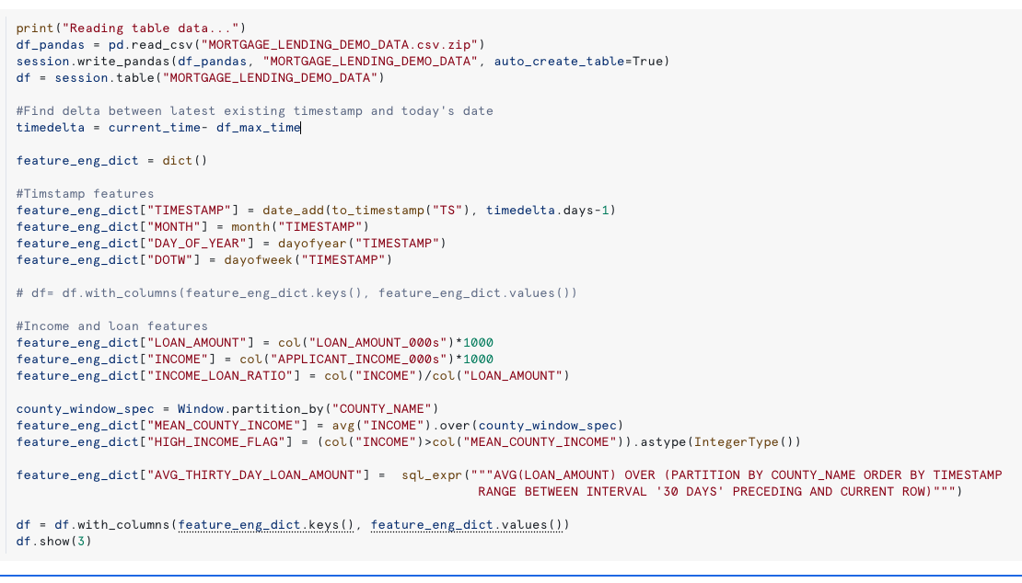
FEATURE ENGINEERING

Slide 13
FEATURE STORE

Slide 14
FEATURE STORE
A Feature Store in Snowflake is a centralized platform that lets data scientists and ML engineers define, manage, and reuse ML features directly within Snowflake. It integrates seamlessly with Snowpark ML, enabling consistent, production-grade feature engineering and serving without data movement.
Centralized Feature Management All ML features are defined, versioned, and catalogued in one place — ensuring teams can discover and reuse features efficiently.
Consistency Between Training and Inference Features used for model training and real-time inference come from the same definitions, eliminating training-serving skew.
Seamless Integration with Snowpark & Feature Engineering You can use Snowpark DataFrame APIs or SQL to build features, join datasets, and register them in the store
Governance, Lineage, and Reusability Each feature has metadata (source tables, transformation logic, owners, versions), improving explainability, compliance, and collaboration.
.

Slide 15
FEATURE STORE
A Feature is simply a derived data attribute used as an input to an ML model. Examples:
avg_transaction_amount_30d
loan_to_value_ratio
Feature Views are how you logically group and manage multiple related features inside the Snowflake Feature Store. (usually derived from the same source table or entity).
In Snowflake Feature Store,
Feature Entities represent the key business objects (like CUSTOMER_ID, ACCOUNT_ID, or LOAN_ID)
Feature Views represent a group of features derived for those entities.
So, a Feature View is always related to one or more Feature Entities. This relationship ensures that features are correctly joined, stored, and retrieved for the right business key

Slide 16
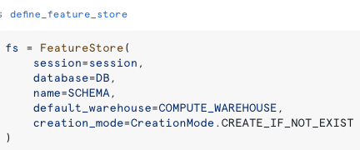
FEATURE STORE

Slide 17
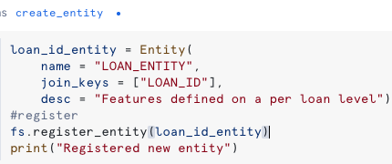
FEATURE STORE - ENTITY

Slide 18
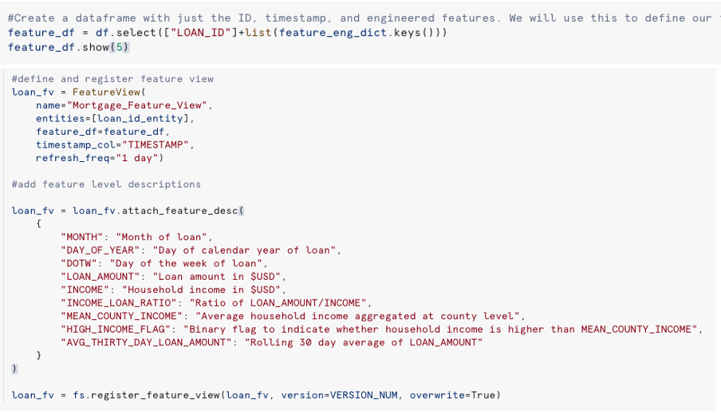
FEATURE STORE – FEATURE VIEW

Slide 19
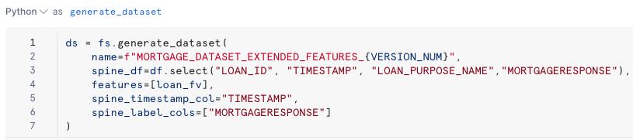
FEATURE STORE - GENERATE DATASET

Slide 20
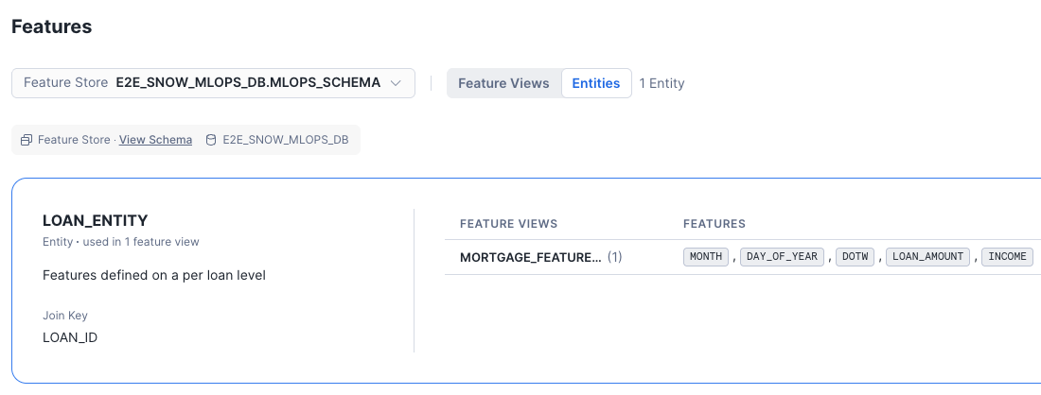
FEATURE STORE - SNOWSIGHT
Note: for every feature view, dynamic table created in the database schema

Slide 21
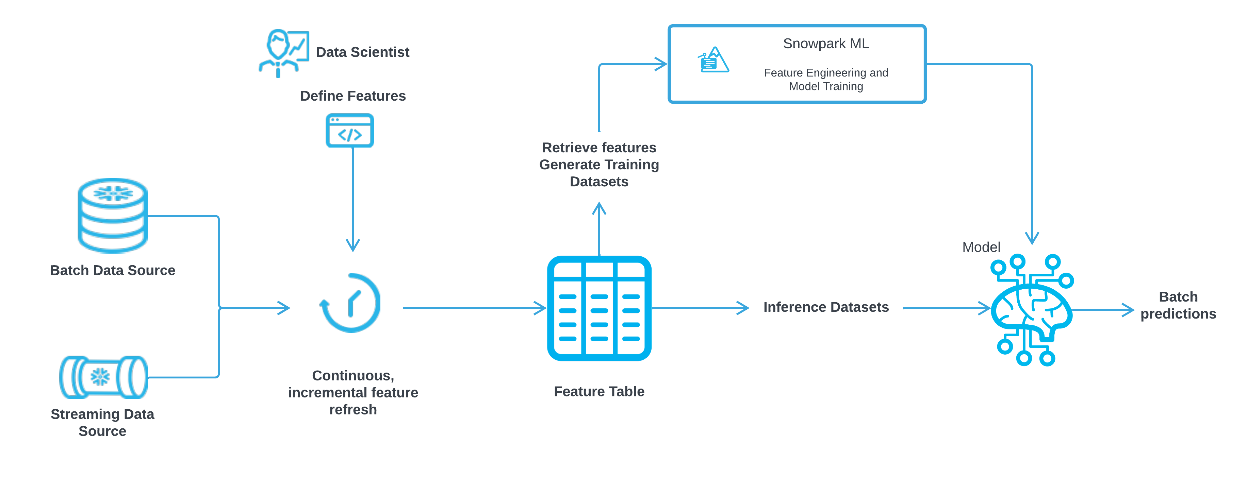
FEATURE STORE

Slide 22
MODEL
DEVELOPMENT

Slide 23
MODEL DEVELOPMENT
ML Development Flow
Feature Engineering → Model Training → Model Evaluation → Model Validation → Model Registration
Model Training STEPS
Train Test Split
Convert Snowpark DataFrame to Pandas DataFrame
Define Algorithm
Train the Model ( fit method) with train data with Labels.
Prediction( predict method) with test data
Evaluate the model ( ex. F1 Score , Precision , Recall)
Create the Model Registry object
Log the Base Model

Slide 24
MODEL DEVELOPMENT
Snowflake ML – Model Development Summary
End-to-End ML Development
Snowflake ML enables building machine learning and deep learning models directly within Snowflake.
Supports popular open-source frameworks (like scikit-learn, XGBoost, PyTorch, TensorFlow, etc.).
Flexible Development Environments
Provides multiple environments for developing and running ML workflows — interactive notebooks or automated jobs.
Efficient Data Access & Compute
Models are trained using data stored inside Snowflake, with high-performance compute and no infrastructure management required.
Option 1 – Snowflake Notebooks
Interactive development environment for experimentation and model building. Ideal for data exploration, feature engineering, and iterative ML workflows. Runs on Container Runtime for ML within Snowflake.
Option 2 – Snowflake ML Jobs
Automated execution of ML workflows from any environment (notebook, IDE, or CI/CD pipeline).
Useful for scheduled training, batch inference, or production ML pipelines.

Slide 25
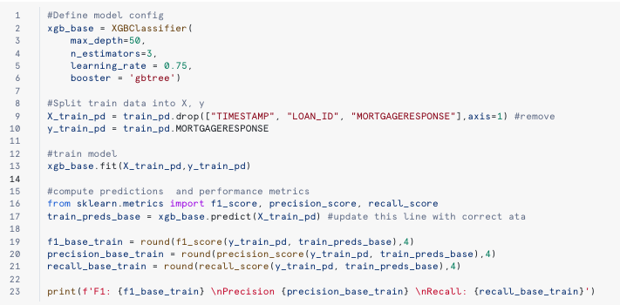
MODEL DEVELOPMENT

Slide 26
MODEL
REGISTRY

Slide 27
MODEL REGISTRY
The Snowflake Model Registry is a centralized system to store, version, govern, and serve ML models securely inside Snowflake.
After training, you log your model in the Snowflake Model Registry . After you have logged a model, you can invoke its methods (equivalent to functions or stored procedures) to perform model operations, such as inference , in a Snowflake virtual warehouse, or serve the model in Snowpark Container Services for GPU-based inference.
Works with Python-based ML models developed in the Snowflake ML ecosystem or model trained externally.
Models built with Snowflake ML Functions (like FORECAST) are not managed in the registry.
Core Capabilities
Versioning & Metadata – Stores model versions, metrics, and metadata.
Inference Serving – Runs distributed inference using Python, SQL, or REST API endpoints.
Lifecycle Management – Supports dev → test → prod transitions with governance.
Monitoring & Drift Detection – Integrated with Snowflake ML Observability for performance tracking.
Secure Access Control – Uses Role-Based Access Control (RBAC) for permissions.

Slide 28
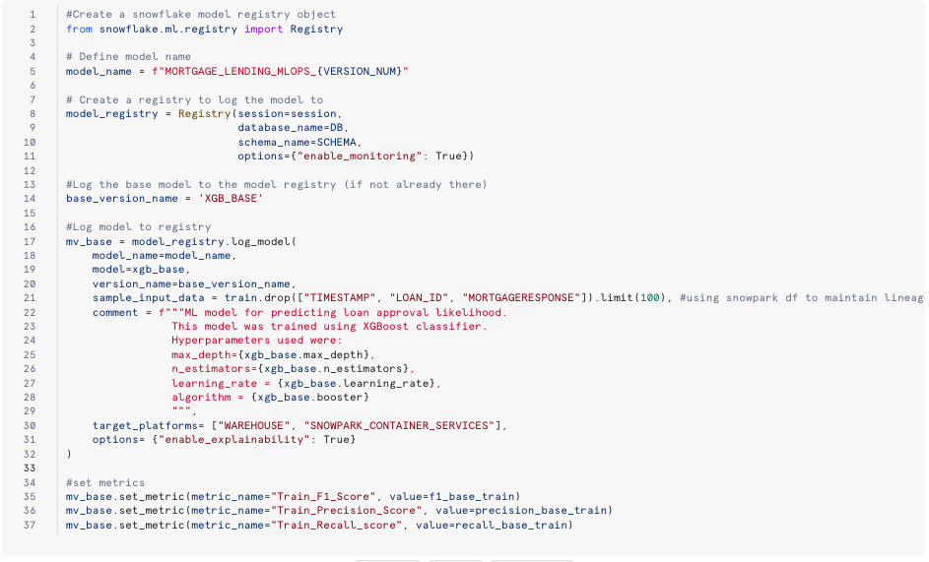
MODEL REGISTRY

Slide 29
HYPER PARAMETER
OPTIMIZATION

Slide 30
Hyperparameter Tuning
Hyperparameter tuning means finding the best settings (parameters) that control how your machine learning model learns — so it performs as well as possible. These “settings” are called hyperparameters — things you set before training the model.
Snowflake provides built-in tools and APIs to make hyperparameter tuning fast, scalable, and easy — directly inside Snowflake's compute environment.
It automatically distributes training jobs across Snowflake compute nodes.
You define your training logic once, and Snowflake runs parallel experiments with different hyperparameter combinations.
Snowflake’s Hyperparameter Optimization (HPO) API does not run on Virtual Warehouses. It runs on Snowpark Container Services (Container Runtime for ML) instead.

Slide 31
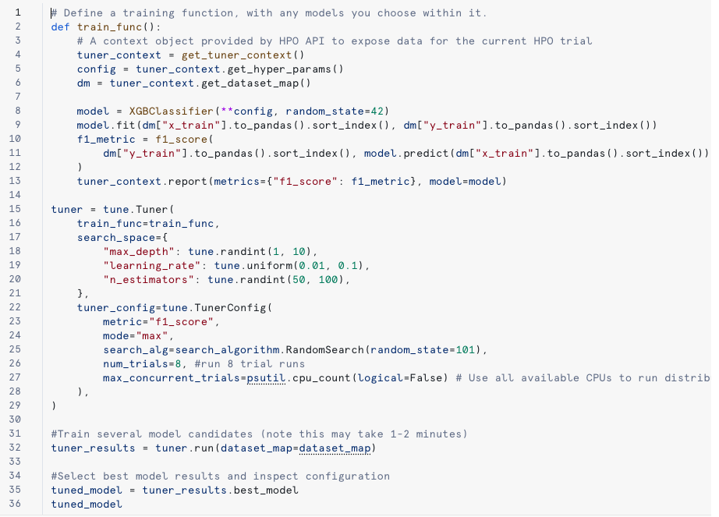
Hyperparameter Tuning

Slide 32
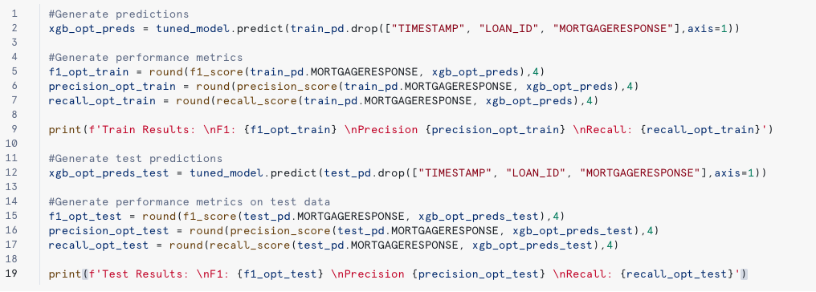
Hyperparameter Tuning

Slide 33
MODEL
EXPLAINABLITY

Slide 34
MODEL EXPLAINABLITY
Model explainability means understanding how and why a machine learning model makes its predictions.
It helps you answer questions like:
Why did the model predict “loan approved” instead of “loan denied”?
Which features (inputs) had the most impact on this prediction?
How sensitive is the model to changes in certain inputs?
Types of Model Explainability
Global Explainability
Understands the model’s behavior overall — what features generally matter most.
Feature importance plots, SHAP summary
Local Explainability
Explains a single prediction — why the model predicted a specific outcome.
SHAP values for one row, LIME explanations
Notes:
Local Explainability
Explains a single prediction — why the model predicted a specific outcome.
SHAP values for one row, LIME explanations

Slide 35
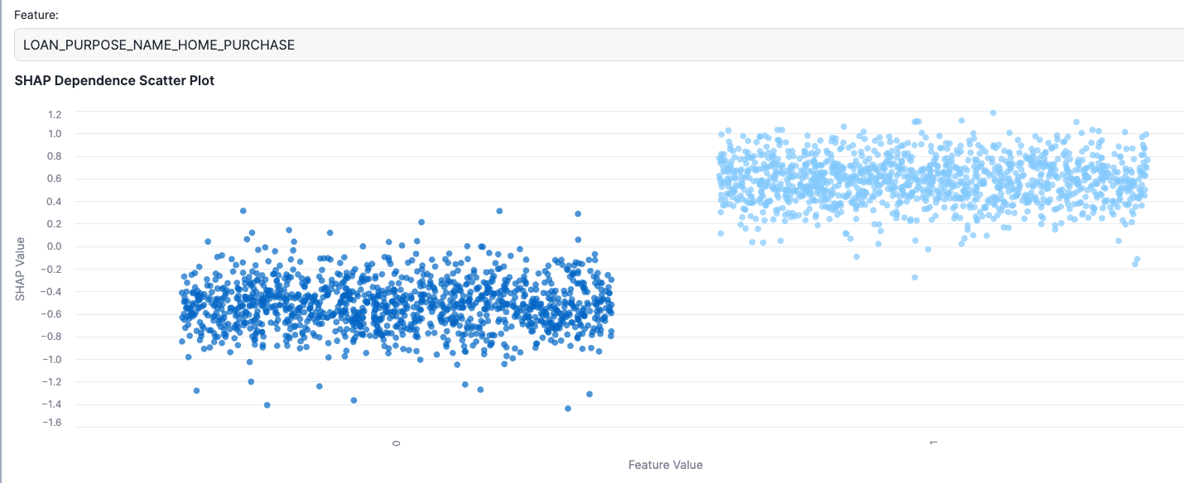
SHAP – DEPENDENCE SCATTER PLOT
Notes:
Local Explainability
Explains a single prediction — why the model predicted a specific outcome.
SHAP values for one row, LIME explanations

Slide 36
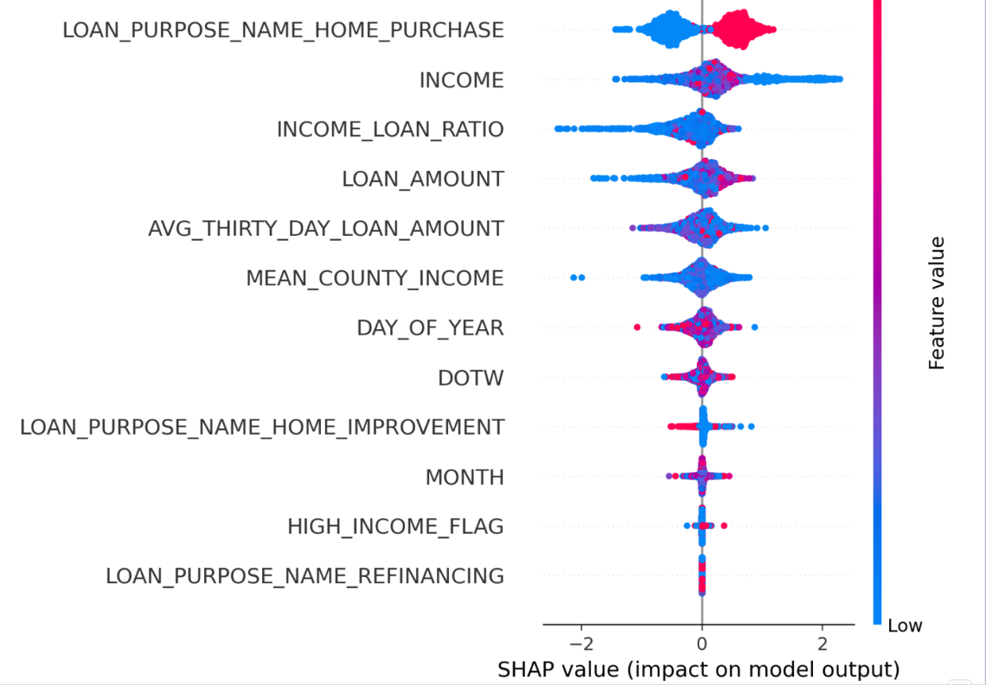
SHAP - SUMMARY PLOT
Notes:
Local Explainability
Explains a single prediction — why the model predicted a specific outcome.
SHAP values for one row, LIME explanations

Slide 37
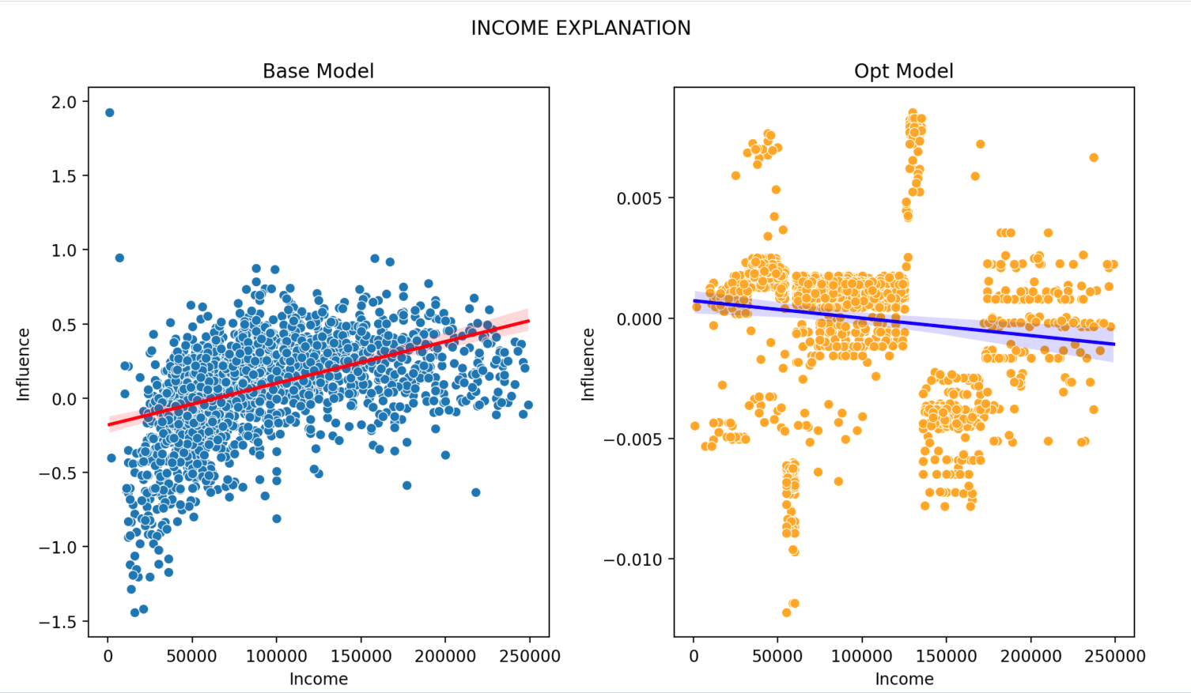
SHAP – SCATTER PLOT
Notes:
Local Explainability
Explains a single prediction — why the model predicted a specific outcome.
SHAP values for one row, LIME explanations

Slide 38
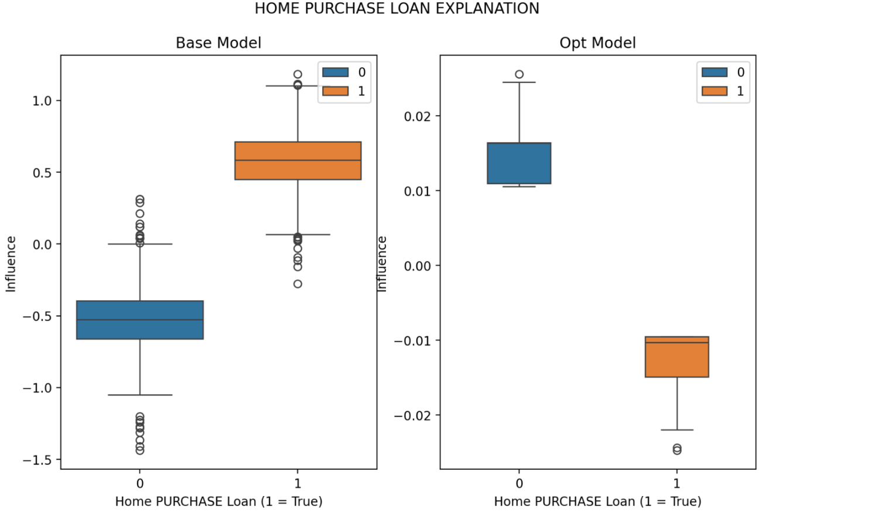
SHAP – BOX PLOT
Notes:
Local Explainability
Explains a single prediction — why the model predicted a specific outcome.
SHAP values for one row, LIME explanations

Slide 39
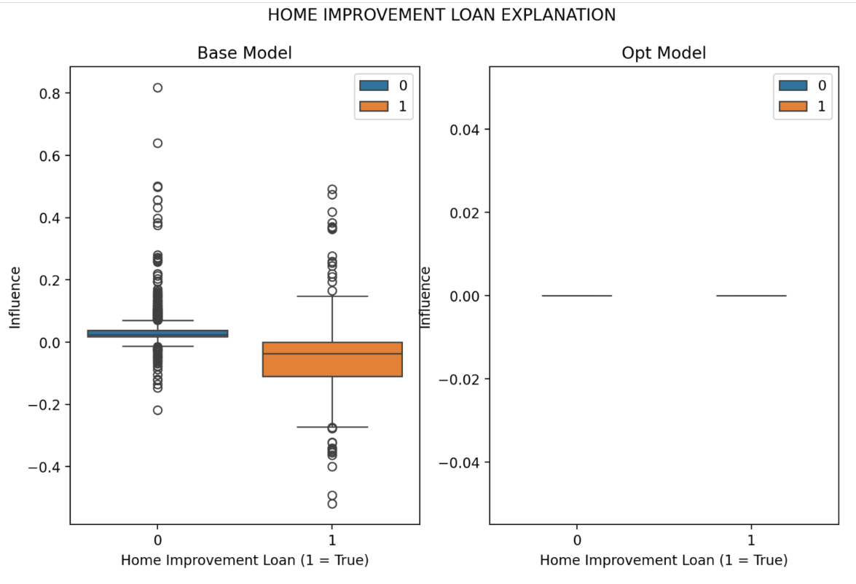
SHAP – BOX PLOT
Notes:
Local Explainability
Explains a single prediction — why the model predicted a specific outcome.
SHAP values for one row, LIME explanations

Slide 40
ML OBSERVABLITY

Slide 41
ML OBSERVABLITY
Machine Learning (ML) Observability means monitoring, analysing, and understanding how your ML models behave in production — similar to how application observability monitors software systems.
It helps answer:
Is the model still accurate after deployment?
Has data drifted compared to what the model was trained on?
Are predictions biased or degrading over time?
When should we retrain the model?
Notes:
Local Explainability
Explains a single prediction — why the model predicted a specific outcome.
SHAP values for one row, LIME explanations

Slide 42
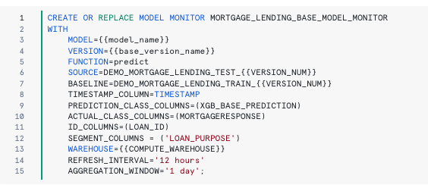
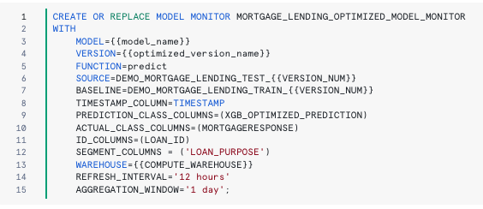
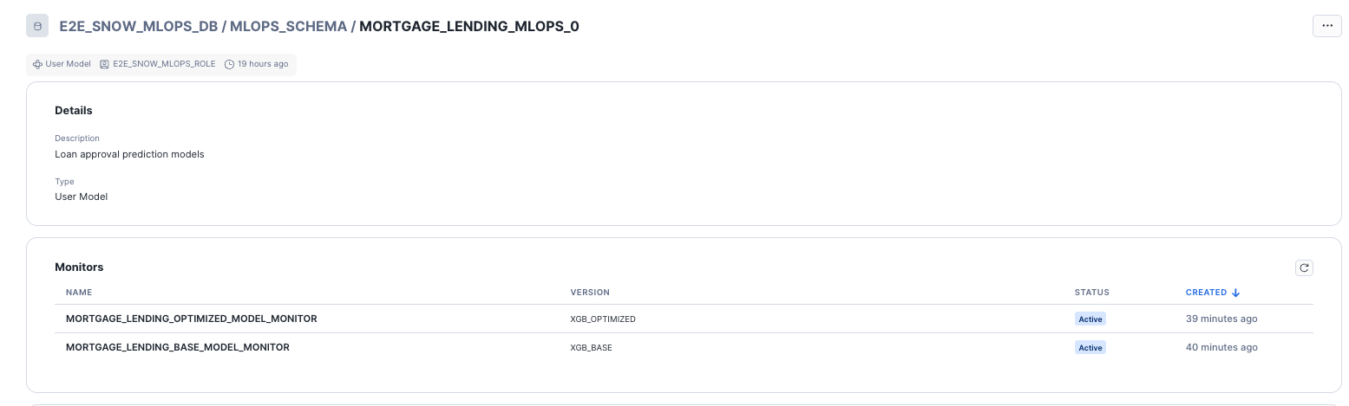
ML OBSERVABLITY
Notes:
Local Explainability
Explains a single prediction — why the model predicted a specific outcome.
SHAP values for one row, LIME explanations

Slide 43
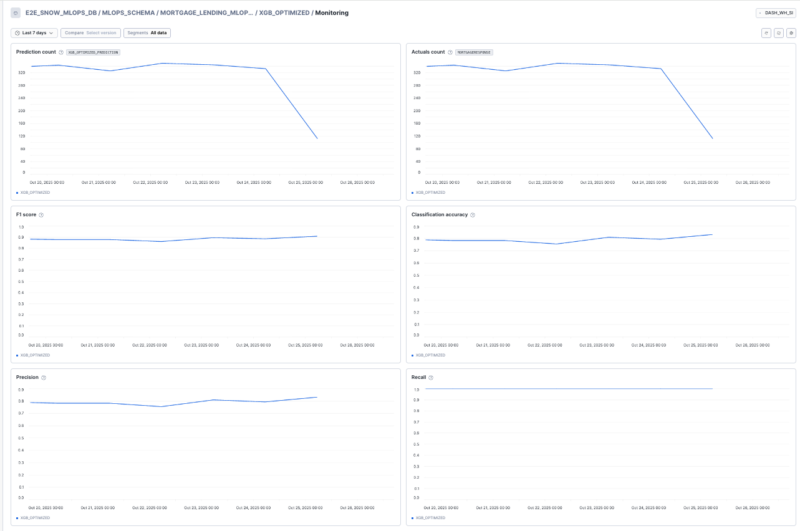
ML OBSERVABLITY
Notes:
Local Explainability
Explains a single prediction — why the model predicted a specific outcome.
SHAP values for one row, LIME explanations

Slide 44
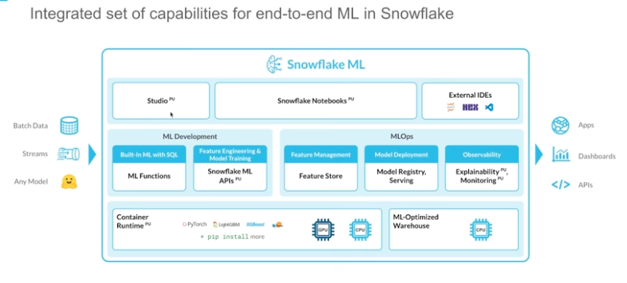
END TO END ML IN SNOWFLAKE
Notes:
Local Explainability
Explains a single prediction — why the model predicted a specific outcome.
SHAP values for one row, LIME explanations

Slide 45


THANK YOU!
Let’s stay in touch
© 2022 by kipi.bi
www.kipi.ai

