Slide 1
a
b
c
d
Notes:
Fig 1. Empirical data from ultimatum game experiments. Meta-analysis mean offers, mean ATs, offer-AT gap, and rejection rates (a). Offer distributions across studies (b). AT distribution from Strategy method studies (c). Relative rejection rates of responders with the dashed line indicating a linear decrease from 1.0 to 0. (d). See S1 Appendix for sources of these data.
From: Empirical Data-12-8-25.xlsx (Figure 1 tab)

Slide 2
Population
Group: Mean Offer
≤ 0 < ≤.1 < ≤ .2 < ≤ .3 <
≤ .4 < ≤ .5 < ≤ .6 < ≤ 1
Group
R
P
P
R
P
R
A
P
R
P
R
R
P
If the population size is less than N_{max}, then the offspring agent, A, enters its parental group or disperses to a neighboring group.
Random pairing of proposers (P) and responders (R) to play the UG
Sufficient resources & IBI satisfied
Both p and q mutate at rate r.
A new repro-ductive cycle begins
Another agent is randomly selected from the group. The offspring randomly inherits p from one parent q from the other.
Neither sufficient resources nor IBI satisfied
Agent reproductive cycle
Notes:
Fig 2. Model diagram of the levels represented in the model, including IBIs. At the top is a portion of the population from Fig 3. In the middle, an arbitrary group is blown up to show agents randomly assigned to play UGs. At the bottom is a depiction of an IBI with an offspring in the parental group.

Slide 3
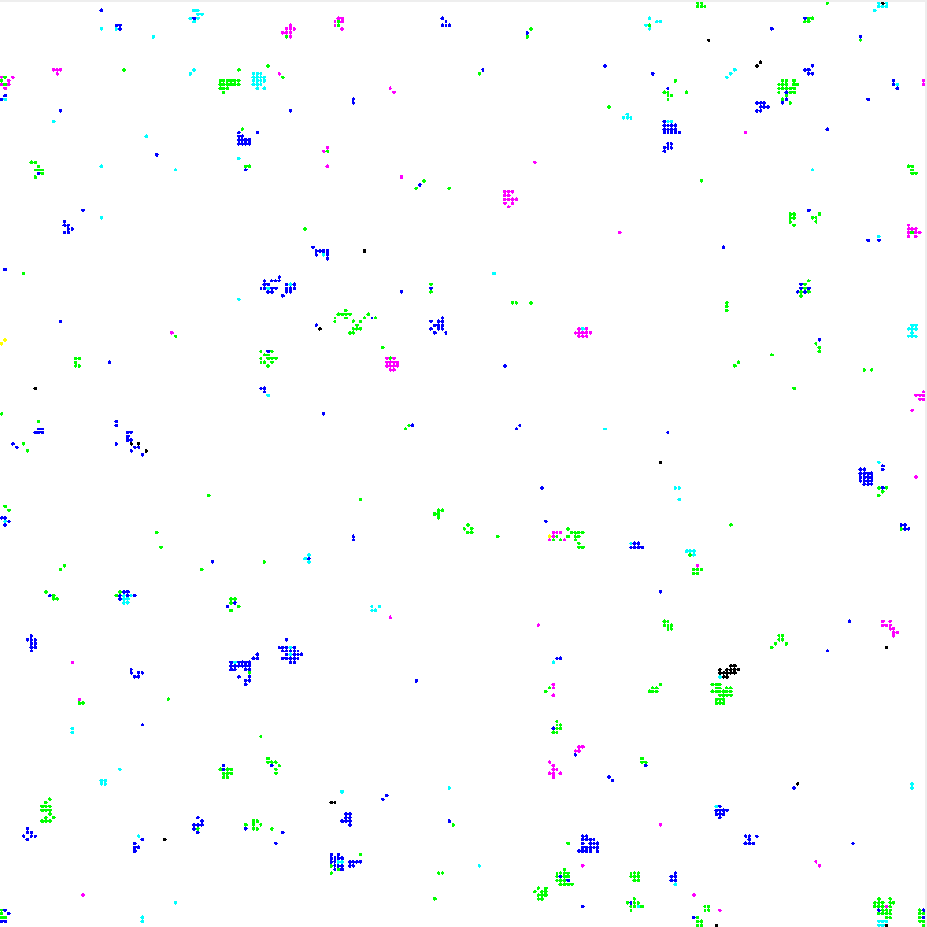
≤ 0 < ≤.1 < ≤ .2 < ≤ .3 < ≤ .4 < ≤ .5 < ≤ .6 < ≤ 1
Notes:
Fig 3. Example spatial distribution of groups. Parameters were G_{max} = 20, N_{max} =10,000, m = 150, after 200 generations in 250 × 250 discrete space (see Table 2 for a description of these parameters). Groups are color-coded by the average offer of their members. The dashed rectangular region is the portion of the population represented in Fig 2.

Slide 4
Random
Zero
a
Offer
AT
b
With IBIs
c
d
Without IBIs
Notes:
Fig 4 Evolutionary trajectories for individual simulations in well-mixed populations. Parameter values were m = 150 and s_{μ} = 0.5μ with (a, b) and without (c, d) IBIs, and for Random and Zero initial conditions.
From: MaterDataTimeWM_12-8-2025.xlsx (Figure 4)

Slide 5
With IBIs
Without IBIs
a
b
Offer
IBI
AT
Rejection
c
m
d
25
500
e
f
g
m
h
25
50
100
150
200
300
400
500
Notes:
Fig 5. Simulation results for well-mixed populations with and without IBIs. Simulations started with Random initial conditions and s_{μ} = 0.5μ. The top row plots mean offers, mean ATs, and mean rejection rates with (a) and without (b) IBIs. The middle rows are offer distributions for m = 25 to 500 (in shades of blue with m = 25 shaded white and m = 150 shaded black for reference) with (c) and without (d) IBIs, and AT distributions with (e) and without (f) IBIs. The bottom row illustrates relative rejection rates (dashed lines indicate a linear decline from 1.0 for offers of 0 to offers ≥ 0.5 ) with (g) and without (h) IBIs.
From: MasterDataWM1-12-8-2025.xlsx (Figure 5)

Slide 6
G_{max}
Random
Zero
a
b
20
Offer
AT
c
d
40
e
f
100
Notes:
Fig 6. Offer and AT evolutionary trajectories for individual simulations for two initial conditions: Random and Zero in group-structured populations for G_{max} = 20 (a, b), G_{max} = 40 (c, d), and G_{max} = 100 (e, f).
From: MaterDataTimeS7-8-12-8-2025.xlsx (Figure 6)

Slide 7
G_{max}
With IBIs
Without IBIs
a
f
0.0μ
0.5μ
Offer
0.1μ
0.75μ
AT
0.25μ
Rejection
20
b
g
40
c
h
60
d
i
80
e
j
100
Notes:
Fig 7. The effect of maximum group size, resource variation, and m on measures of UG evolved behavior with and without IBIs. IBI length ranged from m = 25 to 500 with (a-e) and without IBIs (f-j). The resource standard deviation was varied, s_{μ} = 0.0 to 0.75μ..
From (With IBIs): MasterDataS7-12-7-2025.xlsx (Figure 7)
From (Without IBIs): MasterDataS-IBI7-12-7-2025.xlsx (Figure 7)

Slide 8
With IBIs
Without IBIs
a
b
c
d
Notes:
Fig 8. Mean offers and offer-AT gaps averaged over m. Data are from Fig 7 for different levels of resource variation (s_{μ} = 0.0 to 0.75μ) for agents with (a, c) and without (b, d) IBIs.
From (With IBIs): MasterDataS7-12-7-2025.xlsx (Figure 8)
From (Without IBIs): MasterDataS-IBI7-12-7-2025.xlsx (Figure 8)

Slide 9
With IBIs
a
b
c
d
Without IBIs
e
f
g
h
Notes:
Fig 9. Simulation results for group-structured populations with and without IBIs (G_{max} = 20, m = 150, and s_{μ} = 0.5μ). Simulation results with IBIs are plotted for mean offers, ATs, offer-AT gaps, and rejections (a), offer distribution (b), AT distribution (c), and relative rejection rates (dashed lines indicate a linear decline from 1.0 for offers of 0.0 to 0.0 for offers ≥ 0.5, d). Simulation results without IBIs are plotted for mean offers, ATs, offer-AT gaps, and rejections (e), offer distribution (f), AT distribution (g), and relative rejection rates (h).
From (With IBIs): MasterDataS7-12-7-2025.xlsx (Figure 9)
From (Without IBIs): MasterDataS-IBI7-12-7-2025.xlsx (Figure 9)

Slide 10
a
r = 0.001
0.01
0.1
Offer
AT
Reject
,,
,,
,,
Well-Mixed
b
G_{max} = 20
c
G_{max} = 40
d
G_{max} = 100
Notes:
Fig 10. Different mutation rates, r, in well-mixed and group-structured populations with IBIs: well-mixed populations (a); group-structured populations, G_{max} = 20 (b), G_{max} = 40 (c), and G_{max} = 100 (d).
From (Well mixed): MasterDataWM1-12-9-2025 (Figure 10)
From (Gmax 20, 40, 100): MasterDataS7-12-7-2025.xlsx (Figure 10)

Slide 11
a
b
c
d
Notes:
Fig 11. Simulation results for group-structured populations with IBIs and a mutation rate of r = 0.1 (G_{max} = 20, m = 150, and s_{μ} = 0.5μ). Simulation results are plotted for mean offers, ATs, offer-AT gaps, rejections (a), offer distribution (b), acceptance threshold distribution (c), and relative rejection rates (dashed lines indicate a linear decline from 1.0 for offers of 0.0 to 0.0 for offers ≥ 0.5, d).
From: MasterDataMR7m-0.1-12-9-2025.xlsx (Figure 11)

Slide 12
a
d
G_{max} = 20
b
e
G_{max} = 40
c
f
G_{max} = 100
0.1
Dispersion Rate
Density
Offer
0.2
0.3
0.4
0.5
Offer
0.016
0.032
AT
AT
Reject
,,
,,
,,
,,
,,
Reject
,,
,,
Notes:
Fig 11. Simulation results for group-structured populations with IBIs and a mutation rate of r = 0.1 (G_{max} = 20, m = 150, and s_{μ} = 0.5μ). Simulation results are plotted for mean offers, ATs, offer-AT gaps, rejections (a), offer distribution (b), acceptance threshold distribution (c), and relative rejection rates (dashed lines indicate a linear decline from 1.0 for offers of 0 to offers ≥ 0.5, d).
From (Dispersion): MasterDatadispersion-12-9-2025.xlsx (Figure 12)
From (Density): MasterDataDensity-12-9-2025.xlsx (Figure 12)

Slide 13
Notes:
Fig 13. Comparison of asexual and sexual reproduction group-structured populations averaged over G_{max} = 20 to 100, m = 25 to 500, and s_{μ} = 0.0 to 0.75μ.
From: MasterDataS7-12-7-2025.xlsx (Figure 13)

Slide 14
a
b
c
d
e
Notes:
Fig 14. Comparison of simulations with different population sizes (G_{max} = 60, m = 200, and s_{μ} = 0.5μ). Results for N_{max} = 10,000 are solid colors, and for N_{max} = 30,000 are patterned colors. Simulation results are plotted for mean offers, ATs, offer-AT gaps, and rejections (a), offer distribution (b), AT distribution (c), and relative rejection rates (dashed lines indicate a linear decline from 1.0 for offers of 0.0 to 0.0 for offers ≥ 0.5, d).
From: MasterDataS60-12-9-2025.xlsx (Figure 14)

Slide 15
G_{max}
Resource shortage (θα > θ)
Resource surplus (θα < θ)
a
e
20
b
f
40
c
g
60
d
h
100
Notes:
Fig 15. The effects of resource shortages and surpluses, group size, and m on evolved offers (solid lines) and ATs (dashed lines) with IBIs. Resource shortage ranged from α = 1.01 to 1.1 in increments of 0.01 (a-d) and resource surplus α = 0.99 to 0.9 in increments of 0.01 (e-h). The resource standard deviation was varied, s_{μ} = 0.5μ. The veridical axis is 0.0 to 0.9 for a and e and 0.0 to 0.6 for the remainder.
MasterDataResourceThreshold100-3-14-26.xlsx
MasterDataResourceThreshold60-3-5-26.xlsx
MasterDataResourceThreshold40-3-2-26.xlsx
MasterDataResourceThreshold20-3-6-26.xlsx

Slide 16
G_{max}
a
20
b
40
c
60
d
100
Notes:
Fig 16. The effects of different rules for groups with odd numbers of agents in relation to m and G_{max}. The four rules depicted are HGR (a) used in all simulations above, FGR (b), KR (c), and NPR (d). The vertical axis in all figures ranges from 0.0 to 0.7.
MasterDataRules.xlsx

Slide 17
Appendix B Figures

Slide 18
a
b
G_{max}
G_{max}
c
d
G_{max}
G_{max}
Notes:
Fig A. Population structure descriptive statistics: Mean number of groups (a), mean number of agents per group (b), and cluster size of group with standard deviations (c), and mean number of agents in clusters.
From: MasterDataS7-12-7-2025.xlsx (Fig. A)

Slide 19
Notes:
Fig B. Distribution of mean offers across 96 studies. Cochard et al. (2021) performed a meta-analysis of 42 papers and a book containing 96 studies on UG experiments conducted in 30 countries from 1983 to 2011. Studies were excluded if games were repeated with the same participants, repeated games where the mean offer is revealed after each round of play, asymmetric uncertainty, UGs with more than two participants or computerized participants, stakes less than $4, proposers earn proposer position, lack of total anonymity, participants played a game prior to the UG, the Nash perfect sub-game equilibrium was revealed to participants before deciding, and UGs were framed as seller/buyer experiments. The data are supplementary data from Cochard et al. (2021). Offer means, and standard deviations are binned in increments of 5%, plotted the frequency of studies in each bin (blue bars), and calculated the mean offer (solid green circles) and standard deviations bars. The green dashed horizontal line is the mean over the 96 studies (41.5%).
From: Empirical Data-12-8-25.xlsx (Fig B)

Slide 20
Notes:
Fig C. Mean offers (gray columns) and ATs (blue columns) with standard deviations across 14 societies from Heinrich et al. (2010). The dashed black line is the mean offer across societies, and the dashed blue line is the mean AT across societies. The overall offer-AT gap is 0.23. UG’s were conducted in the following societies: Hadza (HA), Sanquianga (SQ), Isanga (IS), Au (AU), Yaswa (YA), Tsimane (TS), Dolgan/Nganasan (DO), Sururunga (SU), Guslii (GU), Maragoli (MA), Shaur (SH), Samburu (SA), Accra (AC), and U.S./Rural Missouri (US). These data were plotted from Table S4 in the Supporting Online Material provides the descriptive statistics for each of the three games Heinrich et al. (2010).
From: Empirical Data-12-8-25.xlsx (Fig C)

Slide 21
Payoff/Sum
w = 0.001
w = 1.0
w = 0.01
w = 5.0
w = 0.1
w = 10.0
Notes:
Fig D. Normalized exponential, exp(wp_{i} ), probability distributions for different selection intensities calculated from the top-left payoff distribution. The payoff distribution was generated by drawing random values from a uniform distribution in the range [0, 0.5]. The top-right probability distribution is the payoff distribution divided by its sum. The remainder of the distributions are Normalized exponential, exp(wp_{i} ), probability distributions.
From: Exponential Normalization.xlsx (Fig D)

