Slide 1
SIESTA Initialization
Mark Cianciosa
11/18/2022

Slide 2
Working Quantities
VMEC
SIESTA
m : 0 → mpol – 1
n : -ntor → ntor
Current and pressure profiles are fixed.
Stellarator Symmetric
rmnc Radial flux surface coefficients (Full Grid).
zmns Vertical flux surface coefficients (Full Grid).
lmns Field line angle (Full Grid).
Stellarator Asymmetric
rmns
zmnc
lmnc
m : 0 → mpolin
n : -ntorin → ntorin
Computational grid is fixed.
Stellarator Symmetric
jpresch_m_n_r_ Jacobian ⨉ Pressure (Half Grid)
JBsupssh_m_n_r_ Jacobian ⨉ B^{s} (Half Grid)
JBsupuch_m_n_r_ Jacobian ⨉ B^{u} (Half Grid)
JBsupuch_m_n_r_ Jacobian ⨉ B^{v} (Half Grid)
Stellarator Asymmetric
jpressh_m_n_r_
JBsupsch_m_n_r_
JBsupush_m_n_r_
JBsupush_m_n_r_

Slide 3
SIESTA initialization Fixed Boundary
Setup real space and fourier space grid sizes based on nsin, mpolin, ntorin
Create spline functions of the VMEC rmnc, zmns, lmns, currumnc, currvmnc, phi’, chi’.
Flip sign of n modes.
Interpolate VMEC quantities from VMEC (s) to SIESTA sqrt(s) radial grid.
SIESTA presf = 0 for m != 0, n != 0
Load r, drdu, drdv, z, dzdu, dzdv on the real space grid.
Construct Metric coordinate metric elements.
A_{j}=G_{ji}A^{i}, A^{j}=G^{ji}A_{i}, Sqrt(g)
Initialize solver
Recompute lmns on SIESTA grid.

Slide 4
Recompute lambda on the SIESTA grid.
Assume a nested flux surface solution.
There should be no radial currents.
In fouirer space this becomes.
Magnetic field components are defined in terms of lambda in real space as
Lambda is a sum of the fourier quantities.
This is now a linear solve.

Slide 5
SIESTA initialization Fixed Boundary (Continued)
Setup real space and fourier space grid sizes based on nsin, mpolin, ntorin
Create spline functions of the VMEC rmnc, zmns, lmns, currumnc, currvmnc, phi’, chi’.
Flip size of n modes.
Interpolate VMEC quantities from VMEC (s) to SIESTA sqrt(s) radial grid.
SIESTA presf = 0 for m != 0, n != 0
Load r, drdu, drdv, z, dzdu, dzdv on the real space grid.
Construct Metric coordinate metric elements.
A_{j}=G_{ji}A^{i}, A^{j}=G^{ji}A_{i}, Sqrt(g)
Initialize solver
Recompute lmns on SIESTA grid.
Initialize B field.
jbsupsmnsh = 0
jBsupu00ch = chi’
jBsupv00ch = phi’
jBsupumnch = phi’(-nNlambda_{mn})
jBsupvmnch = phi’(mNlambda_{mn})
Initialize Pressure
jpijh = pijh*sqrt(g) -> jpmnch

Slide 6
SIESTA initialization Free Boundary
Setup real space and fourier space grid sizes based on nsin, mpolin, ntorin
Create spline functions of the VMEC rmnc, zmns, lmns, currumnc, currvmnc, phi’, chi’.
Flip size of n modes.
Extend VMEC grid
Interpolate VMEC quantities from VMEC (s) to SIESTA sqrt(s) radial grid.
SIESTA presf = 0 for m != 0, n != 0
Load r, drdu, drdv, z, dzdu, dzdv on the real space grid.
Construct Metric coordinate metric elements.
A_{j}=G_{ji}A^{i}, A^{j}=G^{ji}A_{i}, Sqrt(g)
Initialize solver
Extend Fields
Initialize B field.
jbsupsmnh = 0
jBsupu00h = chi’
jBsupv00h = phi’
jBsupumnh = phi’(-nNlambda_{mn})
jBsupumnh = phi’(mNlambda_{mn})
Initialize Pressure
jpijh = pijh/sqrt(g) -> jpmnch

Slide 7
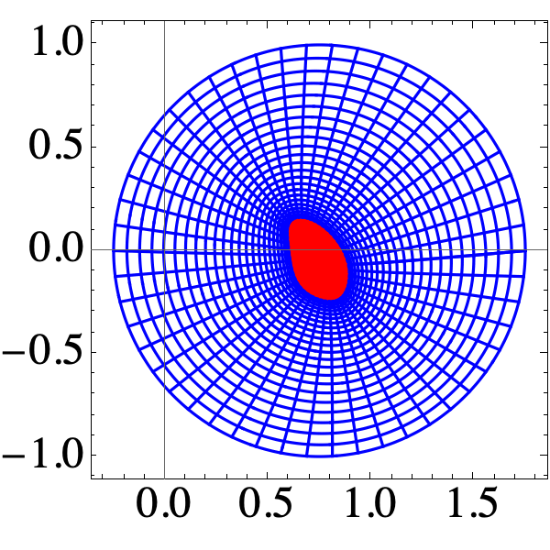
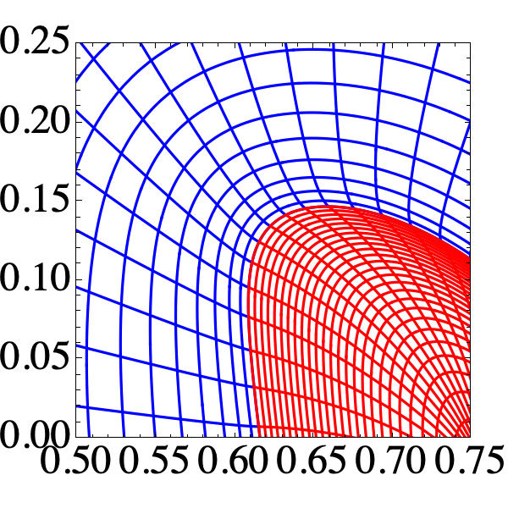
GRID Extension
Load Vessel Fourier Coefficients.
Compute vessel volume to scale s_vessel to s_edge.
Scale number of extended grid points.
Truncate the extended grid to NSIN_EXT.

Slide 8
Field Extension
Compute vector potential on the extended grid.
Linearly interpolate vector potential to the gird axis.
A(s=0) = 0
Match vector potential to the VMEC currents.
Take Curl of the vector potential.
Convert to real space.
Remove jacobian
Convert fields to conjugate form
Convert back to fourier space
Solve for A such that
Set pressure outside the VMEC boundary to zero.

Slide 9
Notable Quantities
Toroidal Current
Toroidal Flux
Poloidal Flux

