Slide 1
ZZZZZZZZZZZZ: Murder
Are you sitting at work bored out of your skull?
Have an extra ten minutes with nothing to do?
No energy and need something to amp you up?
THEN…
We’ve got just the game for you.
A simple, addictive, fast-paced game that has just enough frustration thrown in to make you want to
restart the game time and time again…

Slide 2
“ZZZZZZZZZZZZZZ” is our take on the game “VVVVV”
This is a side-scroller game, with three simple commands.
The ‘left arrow’ key will move your character to the left.
The ‘right arrow’ key will move your character to the right.
The ‘z’ key allows you to reverse gravity which sends your character from the floor to the ceiling or ceiling to floor in order to avoid the many obstacles throughout the maze.
There are six levels or maps that you must navigate your character through. As you move through the game the levels get progressively more difficult. To add to the frustration level there are ‘Death-Zone Spikes’ in each room that will take you out of the game in an instant.
Our targeted audience is the Action/Adventure gamer and anyone who has at least three functioning fingers and a
good bit of patience.

Slide 3
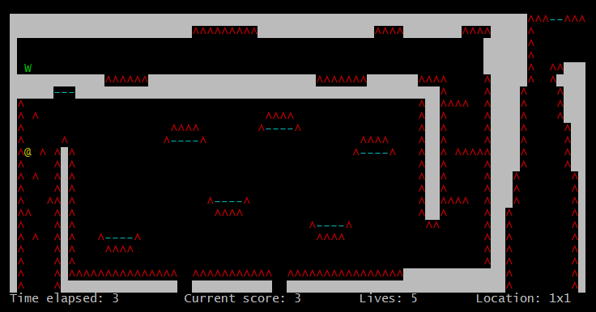
The first map in our maze, the character is the green W, the yellow @ is a goal spot for extra points, the blue lines are gravity reversers, and the red spikes are not good for you. Your job is to try and navigate your character through the maze, earning points and not dying.

Slide 4
Benefits of our code:
The benefits of our code lies within it’s coding style and organization.
It is robust, modular, easy to follow, and can be modified fairly easily.
This modularity adds to the games robustness.
It is coded in four separate modules, each of which handles different aspects of the game. This separation of code allows for easier debugging and quick modifications to the overall game.
Details of this modularity will follow on the next slide.
At this point in time we are in the Beta testing phase and are “ready to go” on game improvements and other add-ins as requested.

Slide 5
Technical Details:
File name and type | defs.h | engine.h engine.c | game.h game.c | map.h map.c | high_score.h high_score.c
Purpose | The defs.h file contains the global definitions that are shared across files. | The engine is the main part of the code. It controls the various timers, character movement, character status, and the pause menu within the game. | This is the main() section of the code. It initializes the ncurses functions deals with memory management, and sets the initial conditions for the game. | Here is the code that is responsible for reading and deciphering the six maps used to construct the world for this game. | This is where the scoring functions live. We read and write to a permanent file that contains the top ten high scores. This file is created when the makefile is run.
Lines of Code | header=67 | header = 38 source = 347 | header = 22 source = 273 | header = 53 source = 130 | header = 30 source = 139

Slide 6
Future Development:
Given the means, we would plan on adding the following list of items to the current version of the game.
List not in any particular order.
Expand the world with more maps.
Add more color to the maps.
Add the BLINK effect to the Death-Zones (dependent on terminal capabilities).
Change the character to a more human-like form.
Animate parts of the maze and obstacles.
Continual play instead of quitting after five lives.

Slide 7
Who are we?
Team RamRod consists of:
Chris Sims
Ryan Winter
Tanya Burmeister
Steve Monette
We utilized the SpringLoops system for version control which allowed us to enter tickets regarding issues, assign tasks, and to maintain the current version of the software.
SpringLoops uses git commands on the command line to push changes to the code.
Once learned, it made cooperation on this project very easy.
http://www.springloops.com/v2/

Slide 8
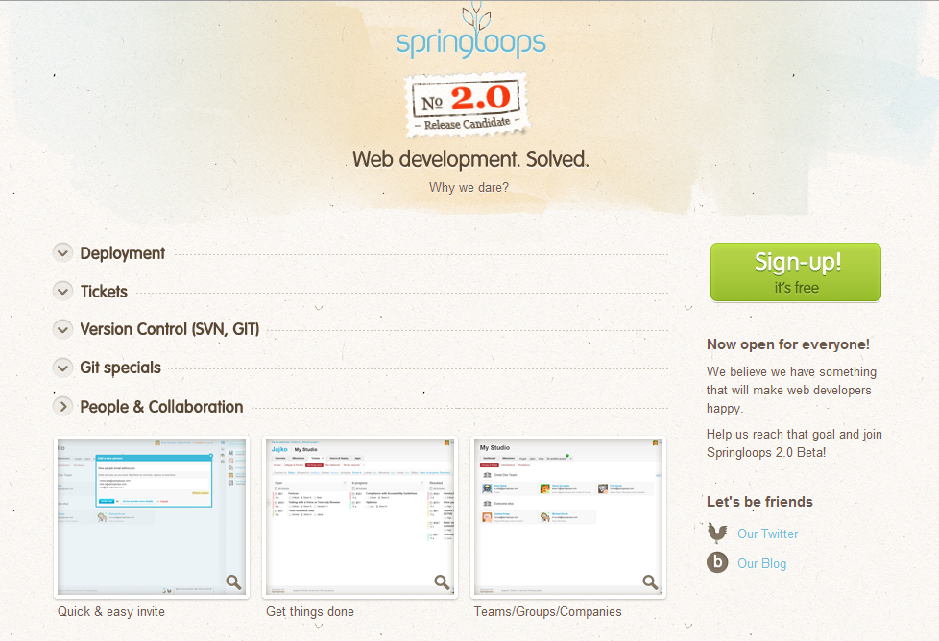

Slide 9
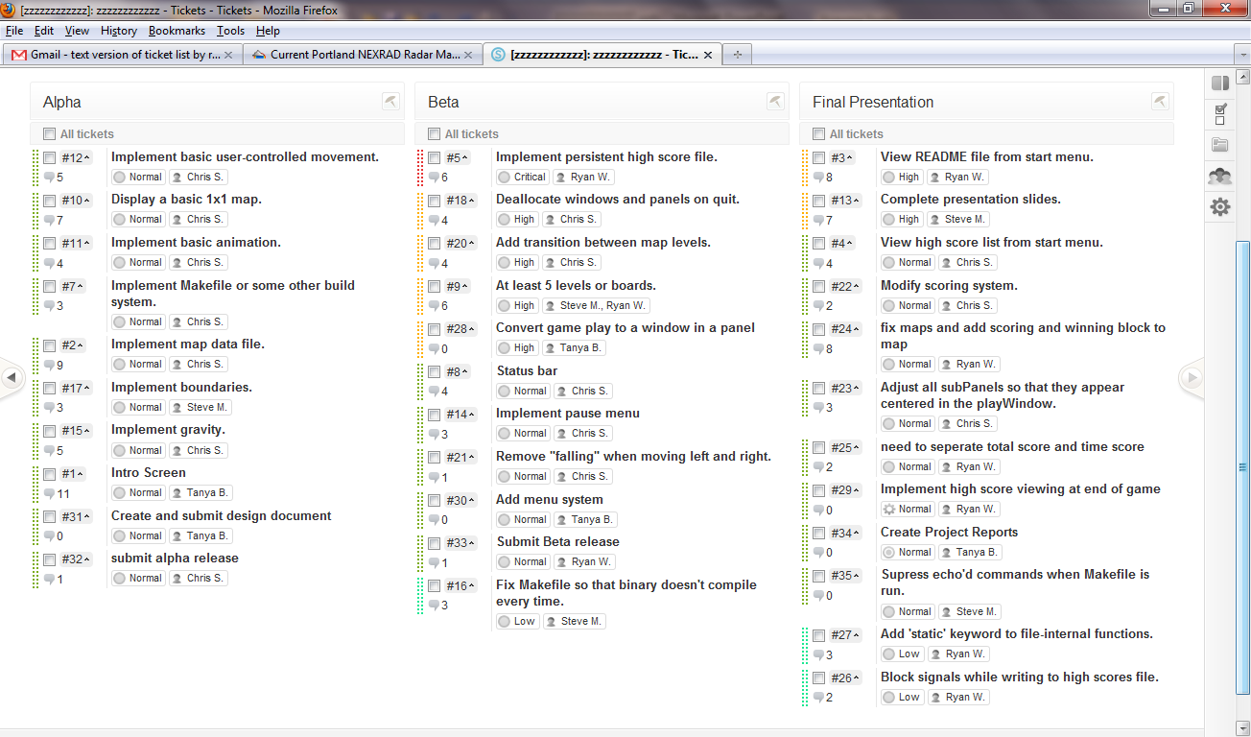

Slide 10
Follow Up:
Challenges: One of the more difficult parts to code was the issue of how to reverse gravity on command and to work that in with the other key presses and events that happen while the character is falling.
The solution was to use different functions, to process the movement keys, gravity direction, characters next location checking, and the system timers that drove those events.
This was a collaborative effort with each of us picking tasks that we were suited for. Our group had varying levels of programming experience in C. With the use of the ncurses library, and being exposed to more complex coding styles each of us has expanded our programming horizons.
Thanks …
Now lets get that Live Demo started…

