Slide 1
Java Messaging Service
(JMS)
v110427
JMS

Slide 2
Goals
Understand the basic concepts behind messaging and the Java Messaging Service (JMS) API
Be able to define a destination using a JMS provider
Be able to create a Java SE JMS producer and consumer
  publisher/subscriber
  sender/receiver
v110427
JMS

Slide 3
Objectives
Messaging Overview
JMS Overview
JMS Examples
JMS API Detail
v110427
JMS

Slide 4
Messaging
Communication between applications that exchange messages
  Message forms a single, encapsulated, unit of communication between applications
De-couples Producer and Consumer of the Message
Message-Oriented-Middleware (MOM)
  category of application communication
  uses asynchronous message passing versus synchronous request/reply
Advantages
  Producer and Consumer operate independently
    Messages can be persisted when consumer unavailable
    Messages can be retrieved even after producer is unavailable
  Qualities of service can be applied independent of clients
  Resource utilization can be applied by messaging provider
v110427
JMS

Slide 5
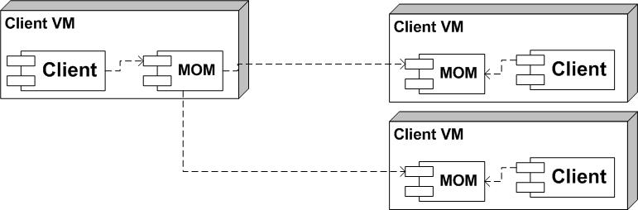
MOM Architecture: Direct Connections
Producer/Consumer communicate over a TCP/IP connection
Directly aware of state of link
Producer cannot send messages when Consumer unavailable
Consumer cannot receive messages when Producer unavailable
Separate messages must be sent to separate clients
  Producer must be aware of what Consumer needs
Security and QoS must be implemented by entirely within clients
Good for realtime status networks
v110427
JMS

Slide 6
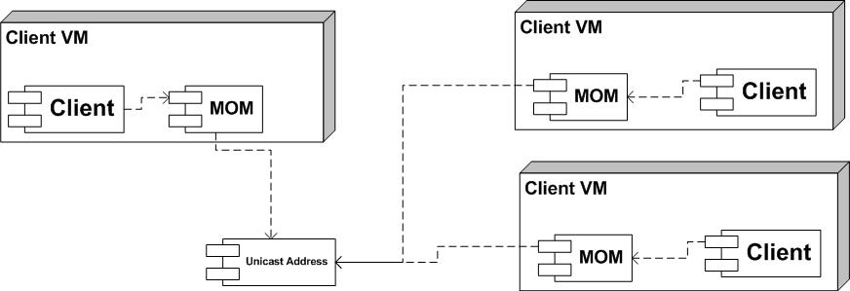
MOM Architecture: Unicast Connections
Producer/Consumer communicate over a Uni-cast IP
No concept of an end-to-end link
Producer issues messages whether Consumer available or not
  MOM can add acknowledgment and queuing mechanisms
Consumer cannot receive messages when Producer unavailable
Producer only needs to send one message
  Consumers able to control when they receive
Security and QoS must be implemented by entirely within clients
Good for high performance publish/subscribe networks
v110427
JMS

Slide 7
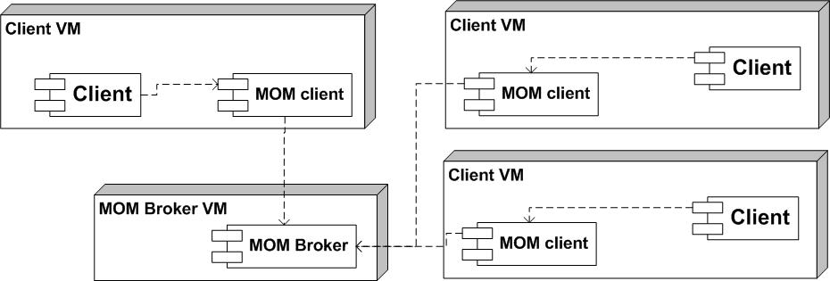
MOM Architecture: Broker-based
Producer/Consumer communicate to a separate broker
No concept of an end-to-end link
Producer issues messages whether Consumer available or not
  application can add acknowledgment mechanisms
Consumer can receive messages when Producer unavailable
Producer only needs to send one message
  Consumers able to control when they receive
Security and QoS can be implemented within broker (thin client)
Good for fully decoupling messaging complexity from clients
v110427
JMS

Slide 8
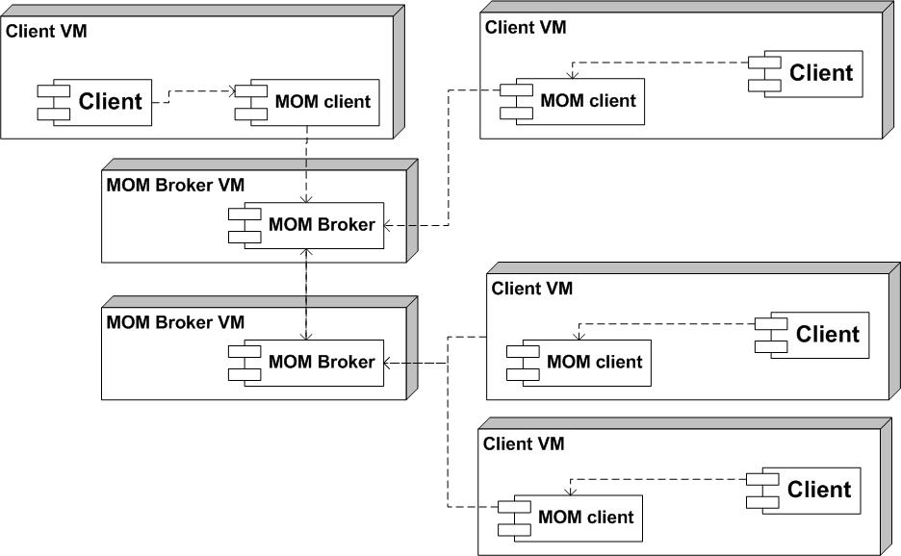
MOM Architecture: Multi-Broker
Clients unaware
of physical topology
MOM Brokers link can
  honor time-of-day bandwidth constraints
  conserve bandwidth between sites
  by only sending what is needed
  point of site-to-site firewall control
  form alternate route routing
v110427
JMS

Slide 9

Messaging Domains: Key Concepts
Producer
  produces message
Destination
  target of produced message
  source of consumed message
  hosted by messaging provider
Consumer
  consumes message
v110427
JMS

Slide 10
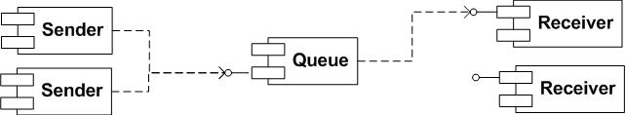
Messaging Domains: Queuing
Sender
  a Producer
  sends message to a Queue with a specific target/intent
Queue
  a Destination
  delivers message to, at most, one receiver
Receiver
  a Consumer
  intended target of message
v110427
JMS

Slide 11
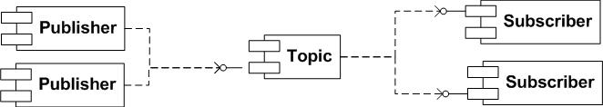
Messaging Domains: Publish/Subscribe
Publisher
  a Producer
  publishes message to Topic with no specific target/intent
Topic
  a Destination
  delivers message to active Subscribers
Subscriber
  a Consumer
  has registered interest in a Topic
    durable subscription – lives beyond active client connection
    non-durable subscription – only exists during client connection
v110427
JMS

Slide 12
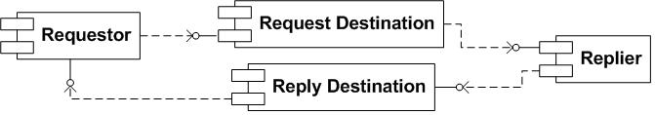
Messaging Domains: Request/Reply
Requestor
  sends message to a destination appropriate to be available to a Replier
  receives reply for request
Request Destination
  can be Topic or Queue
Reply Destination
  can be Topic or Queue (typically a Queue)
Replier
  receives request message from destination
  sends reply message to destination specified in request
v110427
JMS

Slide 13
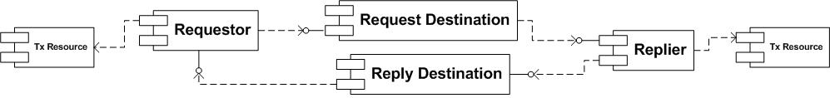
Messaging and Transactions
Each interaction with Destination can be made part of an existing ACID transaction
  Transaction #1
    Requestor
      begins some work
      sends message to a destination appropriate to be available to a Replier
  Transaction #2
    Replier
      receives request message from destination
      performs work
      sends reply message to destination specified in request
  Transaction #3
    Requestor
      receives reply for request
      completes work
v110427
JMS

Slide 14
JMS Background
Vendor-neutral API to access enterprise messaging systems.
  Similar API role as JDBC
    JDBC is an API for accessing RDBMS
    JMS is an API for accessing enterprise messaging systems
API between the application (JMS client) and the messaging provider (JMS provider); not between providers
  Similar non-role as JDBC
    JDBC won't cause data inserted into an HSQL instance to magically show up in an Oracle instance
    JMS won't cause a message sent to a JBossMQ destination to magically show up in a BEA instance's destination
Its a Java API; no other languages addressed
  JMS providers accommodate other language clients using proprietary non-Java APIs
v110427
JMS

Slide 15
Not Specified By JMS
Security
  How are destinations secured
Load Balancing/Fault Tolerance
  How do Topics scale to many publishers/subscribers
  How does a provider account for broker failure
Error Notifications
  What happens when storage exhausted
  FIFO?, LIFO? retention
Administration
  How are destinations and connection factories added
Message Repository
  How is storage allocated
Wire Protocol
  RMI? SOAP/HTTP? Other?
Interoperability with non-Java clients
v110427
JMS

Slide 16
JMS Examples
Notifier
  Publish/Subscribe
    non-durable and durable subscriptions
  One-way Message traffic
Scheduler
  Request/Reply
    request queue
    temporary response queue
    dead letter queue
  Transactional receive/send
  Load distribution
Security
  Layered on Scheduler
  read/write access control for all queues
  user/password login
v110427
JMS

Slide 17
JMS Notifier Example
`-- src
|-- main
| `-- java
| `-- ejava
| `-- examples
| `-- jmsnotifier
| |-- Publisher.java
| `-- Subscriber.java
`-- test
`-- resources
|-- jmsNotifier-ant.xml
|-- jmsNotifier-jms-service.xml
|-- jmsNotifier.properties
|-- jndi.properties
`-- log4j.xml
v110427
JMS

Slide 18
JMS Notifier: jmsNotifier-jms-service.xml
Placed in JBOSS_HOME/servers/default/deploy directory
<?xml version="1.0" encoding="UTF-8"?>
<!-- Destination descriptor for the jmsNotifier example -->
<server>
<mbean code="org.jboss.jms.server.destination.TopicService"
name="jboss.messaging.destination:service=Topic,name=jmsNotifierTopic1"
xmbean-dd="xmdesc/Topic-xmbean.xml">
<depends optional-attribute-name="ServerPeer">
jboss.messaging:service=ServerPeer
</depends>
<depends>jboss.messaging:service=PostOffice</depends>
</mbean>
</server>
v110427
JMS

Slide 19
JMS Notifier: jmsNotifier-ant.xml
publisher target(s) run Publisher
<target name="publisher">
<java classname="ejava.examples.jmsnotifier.Publisher">
<classpath>
<path refid="demo.classpath"/>
</classpath>
<arg value="-jndi.name.connFactory"/>
<arg value="${jndi.name.connFactory}"/>
<arg value="-jndi.name.destination"/>
<arg value="${jndi.name.testTopic}"/>
<arg value="-name"/>
<arg value="${publisher.name}"/>
<arg value="-sleep"/>
<arg value="${publisher.sleep}"/>
<arg value="-max"/>
<arg value="${publisher.max}"/>
</java>
</target>
v110427
JMS

Slide 20
JMS Notifier: jmsNotifier-ant.xml
subscriber target(s) run Subscriber
<target name="subscriber">
<java classname="ejava.examples.jmsnotifier.Subscriber">
<classpath>
<path refid="demo.classpath"/>
</classpath>
<arg value="-jndi.name.connFactory"/>
<arg value="${jndi.name.connFactory}"/>
<arg value="-jndi.name.destination"/>
<arg value="${jndi.name.testTopic}"/>
<arg value="-name"/>
<arg value="${subscriber.name}"/>
<arg value="-sleep"/>
<arg value="${subscriber.sleep}"/>
<arg value="-max"/>
<arg value="${subscriber.max}"/>
<arg value="-durable"/>
<arg value="${subscriber.durable}"/>
<arg value="-selector"/>
<arg value="${subscriber.selector}"/>
</java>
</target>
v110427
JMS

Slide 21
JMS Notifier: jmsNotifier.properties
m2.repo and jboss.home must be set by local environment
M2_REPO=${m2.repo}
JBOSS_HOME=${jboss.home}
javaee.classpath=${M2_REPO}/javax/javaee/javaee/5/javaee-5.jar
commons.logging.classpath=${M2_REPO}/commons-logging/commons-logging/1.0.4/commons-logging-1.0.4.jar:${M2_REPO}/xerces/xercesImpl/2.6.2/xercesImpl-2.6.2.jar
log4j.classpath=${M2_REPO}/log4j/log4j/1.2.13/log4j-1.2.13.jar
jbossall-client.classpath=${JBOSS_HOME}/client/jbossall-client.jar
jndi.name.connFactory=ConnectionFactory
jndi.name.testTopic=topic/ejava/examples/jmsNotifier/topic1
publisher.name=Publisher0
publisher.sleep=1000
publisher.max=0
subscriber.name=Subscriber0
subscriber.sleep=0
subscriber.max=0
subscriber.durable=false
subscriber.selector=
v110427
JMS

Slide 22
Running Publisher
jmsNotifier> mvn process-test-resources; ant -f target/test-classes/jmsNotifier-ant.xml init publisher
...
init:
[copy] Copying 1 file to /apps/jboss/server/default/deploy
publisher:
[java] Publisher args:-jndi.name.connFactory ConnectionFactory -jndi.name.destination topic/ejava/examples/jmsNotifier/topic1 -name Publisher0 -sleep 1000 -max 0
[java] -publisher Publisher0 starting: maxCount=0, sleepTime1000
[java] -published message(1):ID:19-11645872898981
[java] -published message(2):ID:19-11645872909152
[java] -published message(3):ID:19-11645872919193
...
v110427
JMS

Slide 23
Running Subscriber0
Subscriber0 receives all messages
jmsNotifier> mvn process-test-resources; ant -f target/test-classes/jmsNotifier-ant.xml subscriber -emacs
...
subscriber:
-subscriber Subscriber0 starting:durable=false, selector=
-Subscriber0 received message #5, msgId=ID:20-1164587642313196, body=count = 196
-Subscriber0 received message #6, msgId=ID:20-1164587643325197, body=count = 197
-Subscriber0 received message #7, msgId=ID:20-1164587644330198, body=count = 198
-Subscriber0 received message #8, msgId=ID:20-1164587645337199, body=count = 199
-Subscriber0 received message #9, msgId=ID:20-1164587646342200, body=count = 200
-Subscriber0 received message #10, msgId=ID:20-1164587647350201, body=count = 201
-Subscriber0 received message #11, msgId=ID:20-1164587648354202, body=count = 202
-Subscriber0 received message #12, msgId=ID:20-1164587649358203, body=count = 203
-Subscriber0 received message #13, msgId=ID:20-1164587650366204, body=count = 204
v110427
JMS

Slide 24
Running Subscriber0
Subscriber1 receives all messages matching selector
jmsNotifier> ant -f target/test-classes/jmsNotifier-ant.xml subscriber1 -emacs
...
subscriber1:
-subscriber Subscriber1 starting:durable=false, selector=count-((count/4)*4)=0
-Subscriber1 received message #1, msgId=ID:20-1164587642313196, body=count = 196
-Subscriber1 received message #2, msgId=ID:20-1164587646342200, body=count = 200
-Subscriber1 received message #3, msgId=ID:20-1164587650366204, body=count = 204
v110427
JMS

Slide 25
JMS Scheduler
`-- src
|-- main
| `-- java
| `-- ejava
| `-- examples
| `-- jmsscheduler
| |-- Requestor.java
| `-- Worker.java
`-- test
`-- resources
|-- jmsScheduler-ant.xml
|-- jmsScheduler-jms-service.xml
|-- jmsScheduler.properties
|-- jndi.properties
`-- log4j.xml
v110427
JMS

Slide 26
JMS Scheduler: jmsScheduler-jms-service.xml
Placed in JBOSS_HOME/server/default/deploy
<?xml version="1.0" encoding="UTF-8"?>
<!-- destinations for jmsScheduler example -->
<server>
<mbean code="org.jboss.jms.server.destination.QueueService“
name="jboss.messaging.destination:service=Queue,name=jmsSchedulerRequestQueue“
xmbean-dd="xmdesc/Queue-xmbean.xml">
<depends optional-attribute-
name="ServerPeer">jboss.messaging:service=ServerPeer
</depends>
<depends>jboss.messaging:service=PostOffice</depends>
</mbean>
<mbean code="org.jboss.jms.server.destination.QueueService"
name="jboss.messaging.destination:service=Queue,name=jmsSchedulerDLQ"
xmbean-dd="xmdesc/Queue-xmbean.xml">
<depends
optional-attribute-
name="ServerPeer">jboss.messaging:service=ServerPeer</depends>
<depends>jboss.messaging:service=PostOffice</depends>
</mbean>
</server>
v110427
JMS

Slide 27
JMS Scheduler: jmsScheduler-ant.xml
requestor target(s) run Requestor
<target name="requestor">
<java classname="ejava.examples.jmsscheduler.Requestor">
<classpath>
<path refid="demo.classpath"/>
</classpath>
<arg value="-jndi.name.connFactory"/>
<arg value="${jndi.name.connFactory}"/>
<arg value="-jndi.name.destination"/>
<arg value="${jndi.name.testQueue}"/>
<arg value="-jndi.name.DLQ"/>
<arg value="${jndi.name.DLQ}"/>
<arg value="-name"/>
<arg value="${requestor.name}"/>
<arg value="-sleep"/>
<arg value="${requestor.sleep}"/>
<arg value="-max"/>
<arg value="${requestor.max}"/>
</java>
</target>
v110427
JMS

Slide 28
JMS Scheduler: jmsScheduler-ant.xml
worker target(s) run Worker
<target name="worker">
<java classname="ejava.examples.jmsscheduler.Worker">
<classpath>
<path refid="demo.classpath"/>
</classpath>
<arg value="-jndi.name.connFactory"/>
<arg value="${jndi.name.connFactory}"/>
<arg value="-jndi.name.destination"/>
<arg value="${jndi.name.testQueue}"/>
<arg value="-jndi.name.DLQ"/>
<arg value="${jndi.name.DLQ}"/>
<arg value="-name"/>
<arg value="${worker.name}"/>
<arg value="-max"/>
<arg value="${worker.max}"/>
</java>
</target>
v110427
JMS

Slide 29
JMS Scheduler: jmsScheduler.properties
m2.repo and jboss.home must be set by local environment
M2_REPO=${m2.repo}
JBOSS_HOME=${jboss.home}
javaee.classpath=${M2_REPO}/javax/javaee/javaee/5/javaee-5.jar
commons.logging.classpath=${M2_REPO}/commons-logging/commons-logging/1.0.4/commons-logging-1.0.4.jar:${M2_REPO}/xerces/xercesImpl/2.6.2/xercesImpl-2.6.2.jar
jbossall-client.classpath=${JBOSS_HOME}/client/jbossall-client.jar
log4j.classpath=${M2_REPO}/log4j/log4j/1.2.13/log4j-1.2.13.jar
jndi.name.connFactory=ConnectionFactory
jndi.name.testQueue=queue/ejava/examples/jmsScheduler/requestQueue
jndi.name.DLQ=queue/ejava/examples/jmsScheduler/DLQ
requestor.name=Requestor0
requestor.sleep=5000
requestor.max=10
requestor1.name=Requestor1
requestor1.sleep=10
requestor1.max=0
worker.name=Worker0
worker.max=0
v110427
JMS

Slide 30
jmsScheduler: Requestor0
Requestor sends request to queue and tracks reply
jmsScheduler> mvn process-test-resources; ant -f target/test-classes/jmsScheduler-ant.xml init requestor -emacs
...
Requestor args:-jndi.name.connFactory ConnectionFactory -jndi.name.destination queue/ejava/examples/jmsScheduler/requestQueue -jndi.name.DLQ queue/ejava/examples/jmsScheduler/DLQ -name Requestor0 -sleep 5000 -max 10
-requester Requestor0 starting: maxCount=10, sleepTime5000
-published message(1):ID:30-11645891529921
-outstanding requests=1
-recieved response for:1, from Worker0, outstanding=0
-published message(2):ID:30-11645891580212
-outstanding requests=1
-recieved response for:2, from Worker1, outstanding=0
-published message(3):ID:30-11645891630903
-outstanding requests=1
...
-recieved response for:6, from Worker0, outstanding=0
-published message(7):ID:30-11645891831377
-outstanding requests=1
...
-recieved response for:10, from Worker0, outstanding=0
-requester Requestor0 stopping, count=10
v110427
JMS

Slide 31
jmsScheduler: Worker0
Worker0 takes next request, processes, and replies
jmsScheduler> ant -f target/test-classes/jmsScheduler-ant.xml worker -emacs
worker:
Worker args:-jndi.name.connFactory ConnectionFactory -jndi.name.destination queue/ejava/examples/jmsScheduler/requestQueue -jndi.name.DLQ queue/ejava/examples/jmsScheduler/DLQ -name Worker0 -max 0 -worker Worker0 starting
-Worker0 received message #1, req=1, replyTo=QUEUE.JMS_TQ3, delay=0
-committing session
-Worker0 received message #2, req=3, replyTo=QUEUE.JMS_TQ3, delay=0
-committing session
-Worker0 received message #3, req=5, replyTo=QUEUE.JMS_TQ3, delay=10
-committing session
-Worker0 received message #4, req=6, replyTo=QUEUE.JMS_TQ3, delay=10
-committing session
-Worker0 received message #5, req=7, replyTo=QUEUE.JMS_TQ3, delay=10
-committing session
-Worker0 received message #6, req=8, replyTo=QUEUE.JMS_TQ3, delay=100
-committing session
-Worker0 received message #7, req=9, replyTo=QUEUE.JMS_TQ3, delay=100
-committing session
-Worker0 received message #8, req=10, replyTo=QUEUE.JMS_TQ3, delay=0
-committing session
v110427
JMS

Slide 32
jmsScheduler: Worker1
Worker1 competes for requests
Quits after 3 requests
  2 completed successfully
  3rd never committed
jmsScheduler> ant -f target/test-classes/jmsScheduler-ant.xml worker1 -emacs
Buildfile: target/test-classes/jmsScheduler-ant.xml
worker1:
Worker args:-jndi.name.connFactory ConnectionFactory -jndi.name.destination queue/ejava/examples/jmsScheduler/requestQueue -jndi.name.DLQ queue/ejava/examples/jmsScheduler/DLQ -name Worker1 -max 3 -worker Worker1 starting
-Worker1 received message #1, req=2, replyTo=QUEUE.JMS_TQ3, delay=0
-committing session
-Worker1 received message #2, req=4, replyTo=QUEUE.JMS_TQ3, delay=10
-committing session
-Worker1 received message #3, req=6, replyTo=QUEUE.JMS_TQ3, delay=10
-worker Worker1 stopping
v110427
JMS

Slide 33
JMS Security
-- src
|-- main
| `-- java
| `-- ejava
| `-- examples
| `-- jmssecurity
| |-- SecureRequestor.java
| `-- SecureWorker.java
`-- test
`-- resources
|-- ddl
| |-- jmsSecurity_delete.ddl
| `-- jmsSecurity_populate.ddl
|-- jmsSecurity-ant.xml
|-- jmsSecurity-auth.conf //<!-- not used
|-- jmsSecurity-jms-service.xml
|-- jmsSecurity.properties
|-- jndi.properties
`-- log4j.xml
v110427
JMS

Slide 34
jmsSecurity: jmsSecurity-jms-service.xml
Copied to JBOSS_HOME/server/default/deploy
<server>
<mbean code="org.jboss.mq.server.jmx.Queue" name="jboss.mq.destination:service=Queue,name=ejava/examples/jmsSecurity/requestQueue">
<depends optional-attribute-name="DestinationManager">
jboss.mq:service=DestinationManager
</depends>
<attribute name="ReceiversImpl">
org.jboss.mq.server.ReceiversImplLinkedList
</attribute>
<depends optional-attribute-name="SecurityManager">
jboss.mq:service=SecurityManager
</depends>
<attribute name="SecurityConf">
<security>
<role name="requestorRole" read="false" write="true" create="false"/>
<role name="workerRole" read="true" write="false" create="false"/>
</security>
</attribute>
</mbean>
v110427
JMS

Slide 35
jmsSecurity: jmsSecurity-jms-service.xml
Copied to JBOSS_HOME/server/default/deploy
<mbean code="org.jboss.mq.server.jmx.Queue" name="jboss.mq.destination:service=Queue,name=ejava/examples/jmsSecurity/responseQueue">
...
<attribute name="SecurityConf">
<security>
<role name="requestorRole" read="true" write="false" create="false"/>
<role name="workerRole" read="false" write="true" create="false"/>
</security>
</attribute>
</mbean>
<mbean code="org.jboss.mq.server.jmx.Queue" name="jboss.mq.destination:service=Queue,name=ejava/examples/jmsSecurity/DLQ">
...
<attribute name="SecurityConf">
<security>
<role name="requestorRole" read="false" write="true" create="false"/>
<role name="workerRole" read="false" write="true" create="false"/>
</security>
</attribute>
</mbean>
</server>
v110427
JMS

Slide 36
jmsSecurity: populate.ddl
Executed against DefaultDS data source
  http://localhost:8080/jmx-console
    jboss
      database=localDB,service=Hypersonic
        startDatabaseManager()
insert into JMS_USERS values('requestor', 'password', null)
insert into JMS_ROLES values('requestorRole', 'requestor')
insert into JMS_USERS values('worker', 'password', null)
insert into JMS_ROLES values('workerRole', 'worker')
v110427
JMS

Slide 37
JMS Security:jmsSecurity-ant.xml
requestor target(s) run Requestor
  requestor valid and authorized
  requestor1 invalid login
  requestor2 unauthorized access to queues
worker target(s) run Worker
  worker valid login and authorized
  worker1 invalid login
  worker2 unauthorized access to queues
v110427
JMS

Slide 38
JMS Security: Requestors
jmsSecurity> mvn process-test-resources; ant -f target/test-classes/jmsSecurity-ant.xml init requestor
[java] args:-jndi.name.connFactory ConnectionFactory -jndi.name.requestQueue queue/ejava/examples/jmsSecurity/requestQueue -jndi.name.responseQueue queue/ejava/examples/jmsSecurity/responseQueue -jndi.name.DLQ queue/ejava/examples/jmsSecurity/DLQ -name Requestor0 -sleep 5000 -max 10 -loginConfig jmsSecurity -username requestor -password password
[java] -creating JMS connection with account=requestor/password
[java] -published message(1):ID:33-11645906664501
[java] -outstanding requests=1
jmsSecurity> mvn process-test-resources; ant -f target/test-classes/jmsSecurity-ant.xml init requestor1
[java] args:-jndi.name.connFactory ConnectionFactory -jndi.name.requestQueue queue/ejava/examples/jmsSecurity/requestQueue -jndi.name.responseQueue queue/ejava/examples/jmsSecurity/responseQueue -jndi.name.DLQ queue/ejava/examples/jmsSecurity/DLQ -name Requestor1 -sleep 5000 -max 10 -loginConfig jmsSecurity -username requestor -password bad-password
[java] -creating JMS connection with account=requestor/bad-password
[java] javax.jms.JMSSecurityException: User: requestor is NOT authenticated
jmsSecurity> mvn process-test-resources; ant -f target/test-classes/jmsSecurity-ant.xml init requestor2
[java] args:-jndi.name.connFactory ConnectionFactory -jndi.name.requestQueue queue/ejava/examples/jmsSecurity/requestQueue -jndi.name.responseQueue queue/ejava/examples/jmsSecurity/responseQueue -jndi.name.DLQ queue/ejava/examples/jmsSecurity/DLQ -name Requestor2 -sleep 5000 -max 10 -loginConfig jmsSecurity -username john -password needle
[java] -creating JMS connection with account=john/needle
[java] -using responseQueue=QUEUE.ejava/examples/jmsSecurity/responseQueue
[java] javax.jms.JMSSecurityException: Connection not authorized to subscribe to destination: ejava/examples/jmsSecurity/responseQueue
v110427
JMS

Slide 39
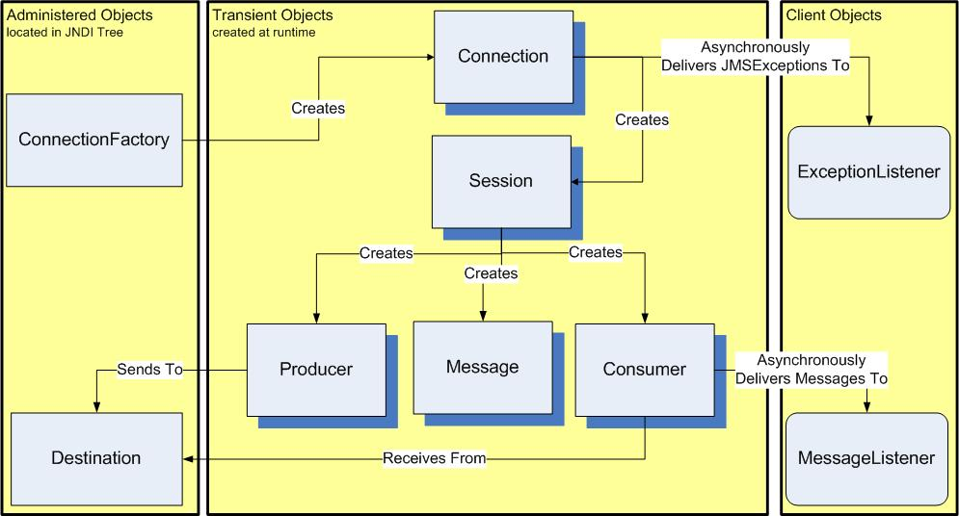
JMS API
v110427
JMS

Slide 40
JMS API
Destination
  an identifier for a queue or topic in the provider
ConnectionFactory
  encapsulates a set of properties for creating connections to provider
Connection
  represents a physical connection to the provider
Session
  a context for sending/receiving messages for a Thread
  factory for creating remaining JMS objects
Message
  unit of communication
MessageProducer
  used to send messages
MessageConsumer
  used to receive messages
MessageListener
  optionally implemented by client to receive messages asynchronously
ExceptionListener
  optionally implemented by client to receive JMSExceptions relative to the connection
v110427
JMS

Slide 41
ConnectionFactory
Administered Object
  commonly obtained from JNDI
  Parent interface for specialized factories
    TopicConnectionFactory, QueueConnectionFactory, XAConnectionFactory
Encapsulates a set of connection attributes set by administrator
  clientId
  listen address
    ConnectionFactory connFactory = (ConnectionFactory)jndi.lookup(connFactoryJNDIName);
    Connection connection = null;
    try {
    connection = connFactory.createConnection();
    }
    finally {
    if (connection != null) { connection.close(); }
    }
v110427
JMS

Slide 42
Connection
Client's active connection to JMS provider
  typically represents an open tcp/ip socket to provider
  allocates resources outside of client JVM
Authentication performed when created
Supports an ExceptionListener
Thread-safe object
  heavyweight
  no designed need for multiple connections
Parent interface for specialized factories
  TopicConnection, QueueConnection, XAConnection
Created in stopped state
  stopped – no messages being delivered
  started – messages can be received
Messages can be sent in both started and stopped state
v110427
JMS

Slide 43
Session
Single Threaded context for producing and consuming message
  Session session = null;
  try {
  session = connection.createSession(false,//isTransacted
  Session.AUTO_ACKNOWLEDGE);//ackMode
  ...
  }
  finally {
  if (session != null) { session.close(); }
  }
Parent interface for specialized factories
  TopicSession, QueueSession, XASession
Typical to use single session as part of a transaction
  synchronously block on receive
  send result
  commit
Receiving and sending on separate threads need separate sessions
v110427
JMS

Slide 44
Session (cont.)
isTransacted – form local transaction within provider
  false – session either joins JTA or no tx outside JTA
session = connection.createSession(false,//isTransacted
  Session.AUTO_ACKNOWLEDGE);//ackMode
  ...
  producer.send(message); //automatically committed
  true – session forms its own transaction context
session = connection.createSession(true,//isTransacted
  Session.AUTO_ACKNOWLEDGE);//ackMode
  ...
  Message message1 = consumer.receive();
  producer.send(message2);
  ...
  session.commit(); //commit outstanding session messages
  -or-
  session.rollback(); //rollback outstanding session messages
v110427
JMS

Slide 45
Session (cont.)
Session retains consumed messages until acknowledged
Acknowledgement Modes
session = connection.createSession(false,//transacted
  Session.AUTO_ACKNOWLEDGE);//ackMode
  AUTO_ACKNOWLEDGE
    message automatically acknowledged by session when client receives (receive()) or processes (onMessage) message
  CLIENT_ACKLNOWLEDGE
    messages are manually acknowledged
    any acknowledged message acknowledges all prior messages consumed
  message.acknowledge(); //manually ack this and all
  //preceding messages
  DUPS_OK_ACKNOWLEDGE
    similar to AUTO_ACKNOWLEDGE
    session lazily acknowledges messages
    can result in duplicate messages
v110427
JMS

Slide 46
Session (cont.)
Factory for TemporaryTopics and TemporaryQueues
Topic tempTopic = session.createTemporaryTopic();
Queue tempQueue = session.createTemporaryQueue();
May optionally create queues and topics
  not portable
Topic topic = session.createTopic(topicName);
Queue queue = session.createQueue(queueName);
v110427
JMS

Slide 47
Session (cont.)
Factory for QueueBrowsers
  look at messages on queue without removing them
  QueueBrowser qbrowser =
  session.createBrowser((Queue)destination);
  for (Enumeration e = qbrowser.getEnumeration();
  e.hasMoreElements(); ) {
  Message m = (Message) e.nextElement();
  log.debug("browsing message=" + m.getJMSMessageID());
  }
  changes in queue between getting enumeration and accessing message undefined by specification
v110427
JMS

Slide 48
Session (cont.)
Factory for provider-specific messages
  Message message = session.createMessage();
  <T>Message message = session.create<T>Message();
Factory for MessageProducers and MessageConsumers
  MessageProducer producer =
    session.createProducer(destination);
  producer.send(message);
  MessageConsumer consumer =
    session.createConsumer(destination);
  Message message = consumer.receive();
v110427
JMS

Slide 49
MessageConsumer
Used to receive messages from a destination
Parent interface for specialized message consumers
  TopicSubscriber
  QueueReceiver
Two approaches to receive messages
  Client may poll message consumer for messages
  Client have messages asynchronously delivered as they arrive
v110427
JMS

Slide 50
MessageConsumer (cont.)
Client may poll message consumer for messages
  MessageConsumer.receive(timeout) : Message
private class SyncClient implements MyClient {
private MessageConsumer consumer;
public SyncClient(MessageConsumer consumer) {
this.consumer = consumer;
}
public int getCount() { return count; }
public Message getMessage() throws JMSException {
Message message=consumer.receiveNoWait();
return message;
}
}
...
MessageConsumer syncConsumer = session.createConsumer(destination);
SyncClient syncClient = new SyncClient(syncConsumer);
Message message = syncClient.getMessage();
v110427
JMS

Slide 51
MessageConsumer (cont.)
Client may implement an interface to have message consumer asynchronously deliver them as they arrive
  MessageListener.onMessage(Message message)
  callback may not throw an exception
private class AsyncClient implements MessageListener {
LinkedList<Message> messages = new LinkedList<Message>();
public void onMessage(Message message) {
try {
messages.add(message); //process message
} catch (JMSException ex) {
log.fatal("error handling message", ex);
}
}
public Message getMessage() {
return (messages.isEmpty() ? null : messages.remove());
}
}
...
MessageConsumer asyncConsumer = session.createConsumer(destination);
AsyncClient asyncClient = new AsyncClient();
asyncConsumer.setMessageListener(asyncClient);
Message message = asyncClient.getMessage();
v110427
JMS

Slide 52
MessageConsumer (cont.)
Selectors can be applied to reduce noise to MessageConsumer
  sql-like selector based on JMS and user properties
  null or empty string equivalent to no selector
String selector1 = "level in ('warn', 'fatal')";
asyncConsumer = session.createConsumer(destination, selector1);
AsyncClient asyncClient = new AsyncClient();
asyncConsumer.setMessageListener(asyncClient);
...
String selector2 = "level in ('info','warn', 'fatal')";
syncConsumer = session.createConsumer(destination, selector2);
SyncClient syncClient = new SyncClient(syncConsumer);
...
String levels[] = {"debug", "info", "warn", "fatal"};
MessageProducer producer = session.createProducer(destination);
Message message = session.createMessage();
for (String level : levels) {
message.setStringProperty("level", level);
producer.send(message);
}
... //for Topics
assertEquals(2, asyncClient.getCount());
assertEquals(3, syncClient.getCount());
v110427
JMS

Slide 53
MessageConsumer (cont.)
Durable subscriptions can be used for TopicSubscribers
  messages stored while TopicSubscriber not physically connected
  consumes resources on server
MessageConsumer nonDurableConsumer =
session.createConsumer(destination);
...
nonDurableConsumer.receive(); //won't receive messages sent while
//physically disconnected
//the Connection.clientID is needed for Durable Subscriptions
connection.setClientID("testDurableSubscription");
...
MessageConsumer durableConsumer =
session.createDurableSubscriber((Topic)destination,"async1");
...
durableConsumer.receive(); //will receive messages not yet consumed
//that have been sent after initial
//registration
v110427
JMS

Slide 54
MessageProducer
Used to send messages to a destination
Parent interface for specialized message consumers
  TopicPublisher
  QueueSender
Created from Session
  MessageProducer producer =
    session.createProducer(destination);
  destination can be null
Can set other defaults with MessageProducer properties
  deliveryMode
  priority
  timeToLive
Can set certain optimizations
  disableTimestamp
  disableMessageID
v110427
JMS

Slide 55
MessageProducer (cont.)
Priority
  int value (0 lowest, 9 highest)
    0-4 normal, 4 default, and 5-9 expedited
  int priorities[] = {9,0,8,1,7,2,6,3,6,4,5};
  for (int i=0; i<msgCount; i++) {
  for (int priority : priorities) {
  producer.setPriority(priority);
  producer.send(message);
  }
  -onMessage received (1):ID:842-11642396791971, priority=9
  -onMessage received (2):ID:842-11642396792013, priority=8
  -onMessage received (3):ID:842-11642396792035, priority=7
  -onMessage received (4):ID:842-11642396792057, priority=6
  -onMessage received (5):ID:842-11642396792129, priority=6
  -onMessage received (6):ID:842-116423967921511, priority=5
  -onMessage received (7):ID:842-116423967921410, priority=4
  -onMessage received (8):ID:842-11642396792118, priority=3
  -onMessage received (9):ID:842-11642396792046, priority=2
  -onMessage received (10):ID:842-11642396792024, priority=1
  -onMessage received (11):ID:842-11642396792002, priority=0
v110427
JMS

Slide 56
MessageProducer (cont.)
Priority
  can alternately be specified on send
  producer.send(message,
  Message.DEFAULT_DELIVERY_MODE,
  priority,
  Message.DEFAULT_TIME_TO_LIVE);
  -onMessage received (1):ID:844-11642400027451, priority=9
  -onMessage received (2):ID:844-11642400027533, priority=8
  -onMessage received (3):ID:844-11642400027605, priority=7
  -onMessage received (4):ID:844-11642400027707, priority=6
  -onMessage received (5):ID:844-11642400027789, priority=6
  -onMessage received (6):ID:844-116424000283911, priority=5
  -onMessage received (7):ID:844-116424000278110, priority=4
  -onMessage received (8):ID:844-11642400027748, priority=3
  -onMessage received (9):ID:844-11642400027676, priority=2
  -onMessage received (10):ID:844-11642400027574, priority=1
  -onMessage received (11):ID:844-11642400027482, priority=0
v110427
JMS

Slide 57
MessageProducer (cont.)
Priority
  MessageProducer, not message, priority used
  message.setJMSPriority(priority);
  producer.send(message);
  -sent (0)msgId=ID:847-11642402118871, priority=4
  -sent (0)msgId=ID:847-11642402118902, priority=4
  -sent (0)msgId=ID:847-11642402118933, priority=4
  -sent (0)msgId=ID:847-11642402118954, priority=4
  -sent (0)msgId=ID:847-11642402118985, priority=4
  -sent (0)msgId=ID:847-11642402119156, priority=4
  -sent (0)msgId=ID:847-11642402119217, priority=4
  -sent (0)msgId=ID:847-11642402119238, priority=4
  -sent (0)msgId=ID:847-11642402119269, priority=4
  -sent (0)msgId=ID:847-116424021192910, priority=4
  -sent (0)msgId=ID:847-116424021193111, priority=4
v110427
JMS

Slide 58
MessageProducer (cont.)
Time To Live (TTL)
  Used to timeout undelivered messages
  0 indicates no timeout
  long ttlMsecs[] = {100, 0, 10000, 100, 10000};
  for (long ttl : ttlMsecs) {
  producer.setTimeToLive(ttl);
  producer.send(message);
  }
-sent msgId=ID:863-11642421904101, expiration=1164242190510, 97msecs
-sent msgId=ID:863-11642421904142, expiration=0, 0msecs
-sent msgId=ID:863-11642421904163, expiration=1164242200416, 10000msecs
-sent msgId=ID:863-11642421904174, expiration=1164242190517, 100msecs
-sent msgId=ID:863-11642421904185, expiration=1164242200418, 10000msecs
-waiting 1000msecs for some messages to expire
-onMessage received (1):ID:863-11642421904142, expiration=0, 0msecs
-onMessage received (2):ID:863-11642421904163, expiration=1164242200416, 8981msecs
-onMessage received (3):ID:863-11642421904185, expiration=1164242200418, 8976msecs
v110427
JMS

Slide 59
MessageProducer (cont.)
Time To Live (TTL)
  can alternately specify on send
  producer.send(message,
  Message.DEFAULT_DELIVERY_MODE,
  Message.DEFAULT_PRIORITY,
  ttl);
-sent msgId=ID:864-11642421925561, expiration=1164242192656, 99msecs
-sent msgId=ID:864-11642421925592, expiration=0, 0msecs
-sent msgId=ID:864-11642421925833, expiration=1164242202583, 9998msecs
-sent msgId=ID:864-11642421925884, expiration=1164242192688, 98msecs
-sent msgId=ID:864-11642421925915, expiration=1164242202591, 9995msecs
-waiting 1000msecs for some messages to expire
-onMessage received (1):ID:864-11642421925592, expiration=0, 0msecs
-onMessage received (2):ID:864-11642421925833, expiration=1164242202583, 8965msecs
-onMessage received (3):ID:864-11642421925915, expiration=1164242202591, 8971msecs
v110427
JMS

Slide 60
MessageProducer (cont.)
Delivery Mode
  pertains only to transit of message to destination
  no impact on actual delivery, timeout, or storage issues
  PERSISTENT
    instructs provider to log message to persistent storage before completing the send
    more robust, slower
  NON_PERSISTENT
    allows provider to buffer messages prior performing any logging to persistent storage
    more efficient, faster
producer.send(message,
mode.mode, Message.DEFAULT_PRIORITY, Message.DEFAULT_TIME_TO_LIVE);
-total messages per test=10000
-mode:NON_PERSISTENT total=5066msecs , ave=0.5066msecs
-mode:PERSISTENT total=5746msecs , ave=0.5746msecs
v110427
JMS

Slide 61
Messages
Contents
  Header
    standard header fields
  Properties
    application-specific properties
    supports message filtering (using selectors)
  Body
    Stream – stream of Java primitive values
    Map – string names and Java primitive values
    Text – java.lang.String body (supports XML)
    Object – Serializable Object body
    Bytes – raw byte format
v110427
JMS

Slide 62
Message Header
JMSMessageID : String
  unique key
  assigned a provider-supplied value on send
  values start with “ID:”
  disabled with MessageProvider.setDisableMessageID()
  can be optionally changed by recipient
JMSTimestamp : long
  time when message given to provider to be sent
  assigned by during send
  not actual time sent (queuing, re-transmit, etc.)
  diabled with MessageProvider.setDisableTimestamp()
v110427
JMS

Slide 63
Message Header (cont.)
JMSCorrelationID : String
  links message to something
    another message – JMSMessageID value
      must start with “ID:”
    processing context – application String value
      must not start with “ID:”
    provider-specific legacy format value
      contains raw byte[]
JMSCorrelationIDAsBytes : byte[]
  used only by providers with legacy correlationID formats
  not portable
v110427
JMS

Slide 64
Message Header (cont.)
JMSReplyTo : Destination
  signals a request for a reply
  sets Destination for reply
    producer.send(replyTo, message, ...);
JMSDestination : Destination
  contains the Destination messages was sent to
  set during send()
  received messages contain Destination sent to
JMSDeliveryMode : int
  set during send()
JMSRedelivered : boolean
  an indication that message has been received, but not successfully ackowledged, before
v110427
JMS

Slide 65
Message Header (cont.)
JMSType : String
  no meaning or format defined by spec
  spec suggests flexible use of field at deployment time to be portable across providers
JMSExpiration : long
  a point in time, after which, the undelivered message may be expired from storage
  calculation of the time-to-live value and GMT
  assigned during send()
  0 value indicates message does not expire
  spec does not define a notification of expiration (or delivery!)
JMSPriority : int
  0 (lowest) to 9 (highest)
v110427
JMS

Slide 66
Example Header Values
log.debug("message2.JMSMessageID=" + message2.getJMSMessageID());
log.debug("message2.JMSTimestamp=" + message2.getJMSTimestamp());
try { log.debug("message2.JMSCorrelationIDAsBytes=" +
message2.getJMSCorrelationIDAsBytes());
} catch (JMSException ex) {
  log.debug("message2.JMSCorrelationIDAsBytes=" + ex); }
log.debug("message2.JMSCorrelationID=" +message2.getJMSCorrelationID());
...
log.debug("message2.JMSPriority=" + message2.getJMSPriority());
-message2.JMSMessageID=ID:154-11643934309001
-message2.JMSTimestamp=1164393430900
-message2.JMSCorrelationIDAsBytes=javax.jms.JMSException:
  JMSCorrelationID is a string
-message2.JMSCorrelationID=null
-message2.JMSReplyTo=null
-message2.JMSDestination=TOPIC.ejava/jms/topic1
-message2.JMSDeliveryMode=2
-message2.JMSRedelivered=false
-message2.JMSType=null
-message2.JMSExpiration=0
-message2.JMSPriority=4
v110427
JMS

Slide 67
ReplyTo Example: request
Create a set of separate ReplyTo queues
producer = session.createProducer(destination);
Destination replyDestinations[] = {
session.createTemporaryQueue(),
session.createTemporaryQueue(),
...
};
for(Destination replyTo : replyDestinations) {
replyConsumers.add(session.createConsumer(replyTo));
}
Send a “request” with the replyTo destination
Message message = session.createMessage();
Map<String, Message> responses = new HashMap<String, Message>();
for(Destination replyTo : replyDestinations) {
message.setJMSReplyTo(replyTo);
producer.send(message);
responses.put(message.getJMSMessageID(), null);
}
v110427
JMS

Slide 68
ReplyTo Example: reply
Create reply objects
public void setSession(Session session) throws JMSException {
producer = session.createProducer(null);
reply = session.createMessage();
}
Send reply to requested destination
public void onMessage(Message message) {
  try {
  //process request
  Destination replyDestination = message.getJMSReplyTo();
  reply.setJMSCorrelationID(message.getJMSMessageID());
  producer.send(replyDestination, reply);
  } catch (JMSException ex) {
  ...
  }
}
v110427
JMS

Slide 69
ReplyTo Example: handle response
Check for replies
for(int d=0; d<replyDestinations.length; d++) {
Message m = replyConsumers.get(d).receiveNoWait();
if (m != null) {
responses.put(message.getJMSCorrelationID(), m);
}
}
Sample output
-sent (1)msgId=ID:27-11643888726611, replyTo=QUEUE.JMS_TQ21
-sent (2)msgId=ID:27-11643888726652, replyTo=QUEUE.JMS_TQ22
-sent (3)msgId=ID:27-11643888726663, replyTo=QUEUE.JMS_TQ23
-sent (4)msgId=ID:27-11643888726674, replyTo=QUEUE.JMS_TQ24
-onMessage received (1):ID:27-11643888726611, replyTo=QUEUE.JMS_TQ21
-onMessage received (2):ID:27-11643888726652, replyTo=QUEUE.JMS_TQ22
-onMessage received (3):ID:27-11643888726663, replyTo=QUEUE.JMS_TQ23
-onMessage received (4):ID:27-11643888726674, replyTo=QUEUE.JMS_TQ24
v110427
JMS

Slide 70
Message Properties
Supports application-defined header fields
Names
  String
  cannot be null
  cannot be empty strings
  “JMSX” property name prefix is reserved
    JMXGroupID
    JMSXGroupSeq
  JMS_vendor_name – property prefix is reserved
Values
  boolean, byte, short, int, long, float, double, String
  accessed through typed setters/getters or setObjectProperty/getObjectProperty
v110427
JMS

Slide 71
Message Properties (cont.)
Names retrieved using getPropertyNames()
Read/Write by sender
Read-only by receiver
  Message.clearProperties() permits write access to property area
  Header values are never read-only
v110427
JMS

Slide 72
Message Properties (cont.)
Example using Message properties
Message message = session.createMessage();
message.setBooleanProperty("booleanProperty", true);
message.setByteProperty("byteProperty", (byte)0x01);
message.setDoubleProperty("doubleProperty", 1.01);
message.setFloatProperty("floatProperty", (float)1.02);
message.setIntProperty("intProperty", 3);
message.setLongProperty("longProperty", 5L);
message.setObjectProperty("intPropertyAsObject", 3);
message.setShortProperty("shortProperty", (short)4);
message.setStringProperty("stringProperty", "hello JMS world");
producer.send(message);
Message message2 = consumer.receive(1000);
-message2.byteProperty (:java.lang.Byte)=1
-message2.longProperty (:java.lang.Long)=5
-message2.shortProperty (:java.lang.Short)=4
-message2.doubleProperty (:java.lang.Double)=1.01
-message2.stringProperty (:java.lang.String)=hello JMS world
-message2.intPropertyAsObject (:java.lang.Integer)=3
-message2.floatProperty (:java.lang.Float)=1.02
-message2.booleanProperty (:java.lang.Boolean)=true
-message2.intProperty (:java.lang.Integer)=3
-message2.JMSXDeliveryCount (:java.lang.Integer)=1
v110427
JMS

Slide 73
Message Forms
StreamMessage
  stream of Java primitive values
MapMessage
  string names and Java primitive values
TextMessage
  java.lang.String body (supports XML)
ObjectMessage
  Serializable Object body
BytesMessage
  raw byte format
Message
  only contains JMS Header and application properties
v110427
JMS

Slide 74
Example MessageTest Framework
private class Replier implements MessageListener {
private MessageProducer producer;
public void onMessage(Message request) {
try {
Message reply = null;
if (request instanceof StreamMessage) {
reply = getReply((StreamMessage)request);
}
else ...
reply.setJMSCorrelationID(
request.getJMSMessageID());
producer.send(replyDestination, reply);
} catch (Exception ex) {
log.fatal("error handling message", ex);
}
}
protected Message getReply(<T>Message request)
throws JMSException {
... //detailed on following slides
return reply;
}
}
v110427
JMS

Slide 75
StreamMessage
used to send a stream of Java primitive values
  filled and read sequentially
based on java.io.DataInput/OutputStream interfaces
values can be accessed explicitly
  streamMessage.writeInt(3)
  int value = streamMessage.readInt();
values can be accessed generically
  streamMessage.writeObject(new Integer(3));
  Object value = streamMessage.readObject();
write-only mode
  first created
  clearBody() called
    used by sender to re-use a previously sent message
read-only mode
  when received
  when reset() called
    used to reset the stream to the first byte
v110427
JMS

Slide 76
StreamMessage Example
Example request
  StreamMessage request = session.createStreamMessage();
  request.writeString("add");
  request.writeInt(2);
  request.writeInt(3);
  request.setJMSReplyTo(replyDestination);
  producer.send(request);
  StreamMessage response = (StreamMessage)replyConsumer.receive();
  int result = response.readInt();
  assertEquals("wrong answer:" + result, 5, result);
Example reply
  String operator = request.readString();
  int operand1 = request.readInt();
  int operand2 = request.readInt();
  int result = ("add".equals(operator) ? operand1 + operand2 : -1);
  StreamMessage reply = session.createStreamMessage();
  reply.writeInt(result);
v110427
JMS

Slide 77
MapMessage
Used to send name/primitive value pairs
  name – String
  value – Java primitive
Values can be accessed explicitly
  mapMessage.setInt(“name”, 3);
  int value = mapMessage.getInt(“name”);
Values can be accessed generically
  mapMessage.setObject(“name”, new Integer(3));
  Object value = mapMessage.getObject(“name”);
read/write mode
  when created
  clearBody() called
read-only mode
  when received
v110427
JMS

Slide 78
MapMessage Example
Example request
  MapMessage request = session.createMapMessage();
  request.setString("operator", "add");
  request.setInt("operand1", 2);
  request.setInt("operand2", 3);
  request.setJMSReplyTo(replyDestination);
  producer.send(request);
  MapMessage response = (MapMessage)replyConsumer.receive();
  int result = response.getInt("result");
  assertEquals("wrong answer:" + result, 5, result);
Example reply
  String operator = request.getString("operator");
  int operand1 = request.getInt("operand1");
  int operand2 = request.getInt("operand2");
  int result = ("add".equals(operator) ? operand1 + operand2 : -1);
  MapMessage reply = session.createMapMessage();
  reply.setInt("result", result);
v110427
JMS

Slide 79
TextMessage
Sends a String message
Used for text.based messages
  XML
  Property lists
Only a single value, only accessed as String
  textMessage.setText(“hello world”);
  String value = textMessage.getText();
read/write mode
  when created
  clearBody() called
read-only
  when received
v110427
JMS

Slide 80
TextMessage Example
Example TextMessage request
  TextMessage request = session.createTextMessage();
  Properties props = new Properties();
  props.put("operator", "add");
  props.put("operand1", new Integer(2).toString());
  props.put("operand2", new Integer(3).toString());
  StringWriter bodyText = new StringWriter();
  props.list(new PrintWriter(bodyText));
  request.setText(bodyText.toString());
  request.setJMSReplyTo(replyDestination);
  producer.send(request);
  TextMessage response = (TextMessage)replyConsumer.receive();
  String resultStr = response.getText();
  int result = Integer.parseInt(resultStr);
  assertEquals("wrong answer:" + result, 5, result);
v110427
JMS

Slide 81
TextMessage Example
Example TextMessage reply
  Properties props = new Properties();
  props.load(new ByteArrayInputStream(request.getText().getBytes()));
  String operator = props.getProperty("operator");
  int operand1 = Integer.parseInt(props.getProperty("operand1"));
  int operand2 = Integer.parseInt(props.getProperty("operand2"));
  int result = ("add".equals(operator) ? operand1 + operand2 : -1);
  TextMessage reply = session.createTextMessage();
  reply.setText(new Integer(result).toString());
v110427
JMS

Slide 82
ObjectMessage
Sends a Serializable Object
Only a single value, accessed as Serializable
  objectMessage.setObject(new Integer(3));
  Object value = (Object)objectMessage.getObject();
read/write
  when created
  clearBody() called
read-only
  when received
v110427
JMS

Slide 83
ObjectMessage Example
Example ObjectMessage request
  ObjectMessage request = session.createObjectMessage();
  Map<String, Serializable> body = new HashMap<String,Serializable>();
  body.put("operator", "add");
  body.put("operand1", new MyInteger(2)); //use a custom class as an
  body.put("operand2", new MyInteger(3)); //example of serializable
  request.setObject((Serializable)body);
  request.setJMSReplyTo(replyDestination);
  producer.send(request);
  ObjectMessage response = (ObjectMessage)replyConsumer.receive();
  int result = ((MyInteger)response.getObject()).getValue();
  assertEquals("wrong answer:" + result, 5, result);
v110427
JMS

Slide 84
ObjectMessage Example
Example ObjectMessage reply
  Map<String, Object> body = (Map<String, Object>)request.getObject();
  String operator = (String)body.get("operator");
  int operand1 = ((MyInteger)body.get("operand1")).getValue();
  int operand2 = ((MyInteger)body.get("operand2")).getValue();
  int result = ("add".equals(operator) ? operand1 + operand2 : -1);
  ObjectMessage reply = session.createObjectMessage();
  reply.setObject(new MyInteger(result));
Example Serializable Application Class used
  //this class is used to provide an example of a custom class sent
  //within a serializable payload
  private class MyInteger implements Serializable {
  private static final long serialVersionUID = 1L;
  private int value;
  public MyInteger(int value) { this.value = value; }
  public int getValue() { return value; }
  }
v110427
JMS

Slide 85
BytesMessage
Send a stream of uninterpreted bytes
  based on java.io.DataInput/OutputStream
intended for messages with legacy formats
  available for use for messages with binary content
  legacy messages may not permit
    use of full set of JMS Headers
    any JMS Properties
values can be accessed explicitly
  bytesMessage.writeInt(3);
  int value = bytesMessage.readInt();
values can be written (but not read) generically
  bytesMessage.writeObject(new Integer(3));
write-only mode
  when created
  clearBody() called
read-only
  when received
  reset() called
v110427
JMS

Slide 86
BytesMessage Example
Example BytesMessage request
  ByteArrayOutputStream bos = new ByteArrayOutputStream();
  bos.write("add".getBytes());
  bos.write(2);
  bos.write(3);
  BytesMessage request = session.createBytesMessage();
  request.writeBytes(bos.toByteArray());
  request.setJMSReplyTo(replyDestination);
  producer.send(request);
  BytesMessage response = (BytesMessage)replyConsumer.receive();
  int result = response.readInt();
  assertEquals("wrong answer:" + result, 5, result);
v110427
JMS

Slide 87
BytesMessage Example
Example BytesMessage reply
  log.debug("body=" + request.getBodyLength() + " bytes");
  byte buffer[] = new byte[10];
  request.readBytes(buffer, 3);
  String operator = new String(buffer);
  int operand1 = request.readByte();
  int operand2 = request.readByte();
  int result = (operator.startsWith("add") ? operand1 + operand2 :-1);
  BytesMessage reply = session.createBytesMessage();
  reply.writeInt(result);
v110427
JMS

Slide 88
(Simple) Message Example
Example request
  Message request = session.createMessage();
  request.setStringProperty("operator", "add");
  request.setIntProperty("operand1", 2);
  request.setIntProperty("operand2", 3);
  request.setJMSReplyTo(replyDestination);
  producer.send(request);
  Message response = replyConsumer.receive();
  int result = response.getIntProperty("result");
  assertEquals("wrong answer:" + result, 5, result);
Example reply
  String operator = request.getStringProperty("operator");
  int operand1 = request.getIntProperty("operand1");
  int operand2 = request.getIntProperty("operand2");
  int result = ("add".equals(operator) ? operand1 + operand2 : -1);
  Message reply = session.createMessage();
  reply.setIntProperty("result", result);
v110427
JMS

Slide 89
Queue/Topic Requestor
Meant to simplify request/reply scenarios
  Too simple for realistic use!
    no timeouts
    no mixing of request/reply destination types
  users encouraged to create more robust implementations
Helper is provided
  a non-transacted session
  destination
Helper creates
  temporary destination
Example
  QueueRequest requestor = new QueueRequestor(session, targetQueue);
  Message reply = resquestor(request);
  TopicRequest requestor = new TopicRequestor(session, targetTopic);
  Message reply = resquestor(request);
v110427
JMS

Slide 90
Summary
Messaging Overview
  decouples Producer from Consumer
JMS Overview
  Java API for interfacing with enterprise messaging providers
JMS Examples
  defining destinations
  publish/subscribe
  request/reply queuing
  access controls
  transactional receive/send
  DLQ
JMS API Detail
  see JMS Javadoc
v110427
JMS

Slide 91
References
Java Messaging Service API
  http://java.sun.com/javaee/5/docs/api/javax/jms/package-summary.html
“Enterprise JavaBeans 3.0, 5th Edition”; Burke & Monsen-Haefel; ISBN 0-596-00978-X; O'Reilly
v110427
JMS

