Slide 1
Data Access Objects
v120911
DAOs

Slide 2
Goals
Understand Data Access Pattern roles
  Data Access Object (DAO)
  Business Logic
  Business Object
  Data Transfer Object (DTO)
Understand how Business Objects relate to Data Transfer Objects (DTOs)
Introduce RDBMS as a way of implementing DAOs
v120911
DAOs

Slide 3
Objectives
Data Access Object Pattern
Relational Databases
Basic SQL Commands
v120911
DAOs

Slide 4
Data Access Object (DAO)
Pattern
v120911
DAOs

Slide 5
Context and Problem
Context
  Access to data varies depending on the source of data
Problem
  Interfaces to these sources vary
    Relational Database Management Systems (RDBMS)
    Lightweight Directory Access Protocol (LDAP)
    Mainframe
    Flat files
  Even standard RDMS interfaces can vary
v120911
DAOs

Slide 6
Forces
Many components within an application need access to data
Interfaces to data vary by technology and vendor
  least common denominator option for portability may not be feasible in all cases
  May make use of vendor extensions
Impact of unique interfaces significant when exposed to many component and component types
  components need more abstraction and shielding from the details of the persistent store
v120911
DAOs

Slide 7
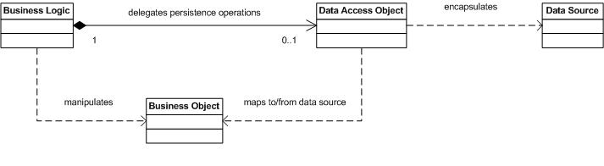
Solution
Use a data access object (DAO) to abstract and encapsulate the data source
v120911
DAOs

Slide 8
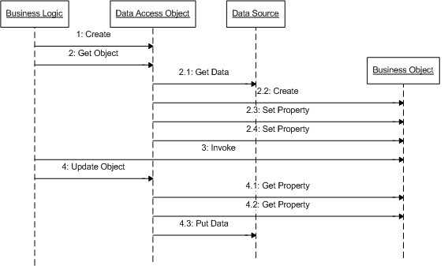
DAO Pattern Interactions
v120911
DAOs

Slide 9
DAO Pattern Roles
Business Logic
  the object within the business domain that needs access to data (e.g., session bean)
  knows when/why data is needed, but not how
Data Access Object (DAO)
  abstracts the access details from the business object
  knows how data is accessed, but not when/why
Business Object
  an entity within the business logic
  a data carrier of information to/from the DAO
Data Source
  physically stores the data (e.g., database)
v120911
DAOs

Slide 10
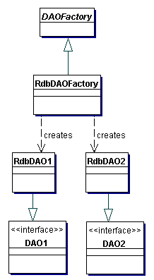
DAO Factory Strategy
Design to allow multiple approaches to DAOs using a DAOFactory
v120911
DAOs

Slide 11
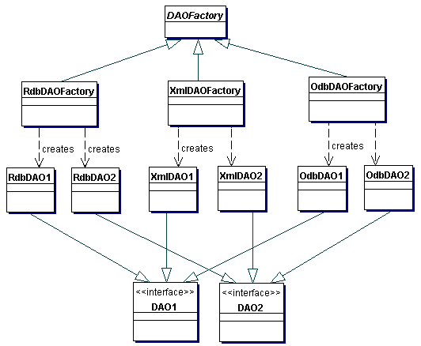
DAO Factory Structure
v120911
DAOs

Slide 12
Consequences
Centralizes All Data Access into a Separate Layer
  Easier to maintain
  Enables Transparency
    access implementation details are hidden within DAO
  Enables Easier Migration
    client layers are encapsulated from changes
Reduces Code Complexity in Business Logic
  no details, such as SQL, in business logic
Harder to abstract with EJB2.x Container Managed Persistence (CMP) frameworks
EJB3 Java Persistence API provides a significant amount of abstraction
v120911
DAOs

Slide 13
DAO Interface
package ejava.examples.dao;
import java.util.Collection;
import ejava.examples.daoex.bo.Book;
public interface BookDAO {
Book create(Book book) throws DAOException;
Book update(Book book) throws DAOException;
Book get(long id) throws DAOException;
boolean remove(Book book) throws DAOException;
Collection<Book> findAll(long start, long count)
throws DAOException;
}
v120911
DAOs

Slide 14
DAO Implementation
package ejava.examples.dao.jdbc;
...
import ejava.examples.daoex.BookDAO;
import ejava.examples.daoex.DAOException;
import ejava.examples.daoex.bo.Book;
public class JDBCBookDAO implements BookDAO {
public Book create(Book book) throws DAOException { ...
public Book update(Book book) throws DAOException { ...
public Book get(long id) throws DAOException { ...
public boolean remove(Book book) throws DAOException { ...
public Collection<Book> findAll(int start, int count)
throws DAOException { ...
}
v120911
DAOs

Slide 15
Wrapped Exceptions
package ejava.examples.daoex;
public class DAOException extends RuntimeException {
//??public class DAOException extends Exception {
private static final long serialVersionUID = 1L;
public DAOException() {}
public DAOException(String message) { super(message); }
public DAOException(String message, Throwable rootCause) {
super(message, rootCause);
}
public DAOException(Throwable rootCause) {
super(rootCause);
}
}
try {
...
}
catch (<T> ex) {
throw new DAOException(“troubles”, ex);
}
* be careful that Resource
Level Exception is not
propogated all the way back
to remote client. May cause
ClassNotFoundExceptions
v120911
DAOs

Slide 16
Relating Business Objects
to
Data Transfer Objects (DTOs)
v120911
DAOs

Slide 17
DTO Pattern
Context
  Business Objects represent too much information or behavior to transfer to remote client
Problem
  Client may get information they don't need
  Client may get information they can't handle
  Client may get information they are not authorized to use
  Client may get too much information/behavior to be useful (e.g., entire database serialized to client)
Forces
  Some clients are local and can share object references with business logic
  Handling specifics of remote clients outside of core scope of business logic
v120911
DAOs

Slide 18
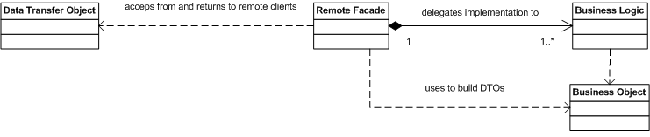
DTO/Remote Facade Solution
Layer a Remote Facade over Business Logic
Remote Facade constructs Data Transfer Objects (DTOs) from Business Objects that are appropriate for remote client view
Remote Facade uses DTOs to construct or locate Business Objects to communicate with Business Logic
v120911
DAOs

Slide 19
DTO Pattern Roles
Data Transfer Object
  represent a subset of the state of the application at a point in time
  not dependent on Business Objects or server-side technologies
    doing so would require sending Business Objects to client
    XML and Web services provide the “ultimate isolation” in DTO implementation
Remote Facade
  uses Business Logic to perform core business logic
  layered on to of Business Logic to translate between Business Objects and DTOs
Business Logic
  continues to perform core duties as described in DAO Pattern
v120911
DAOs

Slide 20
DTO Pattern Consequences
Clients only get what they need
Clients only get what they understand
Clients only get what they are authorized to use
Remote and Local interfaces to services are different
  makes it harder to provide location transparency
Lightweight Business Objects can be used as DTOs
  Remote Facade must make sure they are “pruned” of excess related items before transferring to client
  Remote Facade must make sure they are “cleaned” of DAO persistence classes before transferring to client
v120911
DAOs

Slide 21
Relational Databases
and
SQL
v120911
DAOs

Slide 22
Relational Database and SQL Review
Relational databases based upon mathematical set theory (Codd 1970)
Controversial in the mid-80’s but now the standard for corporate data repositories
Theoretical operations to manipulate and relate information in tables
v120911
DAOs

Slide 23
Relational Databases
Based on tables where a row represents an instance of data and columns represent a specific attribute
Keys uniquely identify a row in a table
Rows in different tables are associated via a key
v120911
DAOs

Slide 24
SQL
Structured Query Language
Standard language (mostly true to theoretical set operations) to manipulate relational data
  SQL-86
    first published
  SQL-89, 92, 1999, 2003
    various revisions
  SQL-2006
    latest release
    most later activity centered around XML
v120911
DAOs

Slide 25
Common SQL Operations
Creating tables and indexes
  Constraints; keys, NOT NULL
Inserting and Updating Data
Selecting Data
  Views
Removing Data
v120911
DAOs

Slide 26
Image Table
IMAGE_ID IMAGE_TYPE FILENAME URL
1 gif image1 http://host/dir/image1
2 gif image2 ftp://host/dir/image2
v120911
DAOs

Slide 27
Image Decoder Table
IMAGE_TYPE DECODER_PROGRAM LIC_START LIC_END
gif c:\gifdecoder 12/01/1998 12/01/1999
jpg d:\tools\jpgdecoder 06/01/1999 12/01/2010
v120911
DAOs

Slide 28
Tables and Keys
DECODER
DECODER
Primary
Keys
IMAGE_TYPE DECODER_PROGRAM
gif c:\gifdecoder …
...
Foreign
Key
IMAGE
IMAGE_ID IMAGE_TYPE FILENAME URL
1 gif Image1 …
...
v120911
DAOs

Slide 29
Example Data Types
INT - signed integer value. Implementation-dependent # bits
NUMERIC(total length, number of decimal places)
  NUMERIC(8,4) - 3 digits, a decimal point, and 4 decimal places
REAL - floating point number
BIT - single boolean value
DATE - year, month, day
TIME, TIMESTAMP - date/time
VARCHAR(length) - variable length string <= length
BLOB - Binary Large Object
v120911
DAOs

Slide 30
Creating Tables
Syntax for table creation is *mostly* standard among database vendors
        CREATE TABLE DECODER (
        IMAGE_TYPE CHAR(3) NOT NULL,
        DECODER_PROGRAM VARCHAR(256),
        LIC_START DATE,
        LIC_END DATE,
        CONSTRAINT DecodePK PRIMARY KEY(IMAGE_TYPE)
        );
creates a table with 4 columns and no rows
v120911
DAOs

Slide 31
Image Tables (Cont)
        CREATE TABLE IMAGE (
        IMAGE_ID INT NOT NULL,
        IMAGE_TYPE CHAR(3),
        FILENAME VARCHAR(40),
        URL VARCHAR(128),
        CONSTRAINT ImagePK PRIMARY KEY(image_id),
        CONSTRAINT ImageFK1
        FOREIGN KEY(IMAGE_TYPE) REFERENCES DECODER(IMAGE_TYPE)
        );
v120911
DAOs

Slide 32
Adding constraints
Database can help maintain data integrity
Can be specified with column definition or at the end of ‘create table’
NOT NULL
Primary Keys
Foreign Keys
Check Conditions
v120911
DAOs

Slide 33
NULLs
Special condition that indicates an absence of a value
Some columns may be required to have a value
decoder_program VARCHAR(128) NOT NULL
v120911
DAOs

Slide 34
Primary Keys
Primary Key uniquely identifies a row
  Only 1 Primary Key allowed per table
  Can not be NULL (absence of a value)
  image_id INT PRIMARY_KEY OR
  constraint (IMAGE_KEY) PRIMARY KEY(image_id)
v120911
DAOs

Slide 35
Foreign Keys
Refers to a PRIMARY KEY in another table
Used to relate tables together
Foreign key (image_type) REFERENCES Image_Decoder(image_type)
ON DELETE CASCADE – delete dependent row when row in master table is deleted
v120911
DAOs

Slide 36
CHECK Constraint
Expression that must be true for all table rows
Grade NUMBER CHECK (Grade BETWEEN 0 and 100)
v120911
DAOs

Slide 37
Dropping Tables
Removes data and deletes table definition
DROP TABLE DECODER
v120911
DAOs

Slide 38
Inserting Rows
  INSERT INTO Image
  ( IMAGE_ID, IMAGE_TYPE, FILENAME, URL)
  VALUES
  ( 1, ‘jpg’, ‘image1’, ‘http://host/dir/image1’)
v120911
DAOs

Slide 39
Selecting Rows
SELECT image_type from IMAGE
  WHERE filename=‘image1’
SELECT DECODER.decoder_program FROM DECODER, Image
  WHERE IMAGE.filename=‘image1’
    AND IMAGE.image_type=DECODER.image_type
  The Join operation can be viewed as creating a virtual table on the fly from rows in two or more tables
SELECT * from IMAGE GROUP by image_type
v120911
DAOs

Slide 40
Updating Rows
UPDATE IMAGE
  SET url=‘http://newhost/image1’
  WHERE filename=‘image1’
The where clause may select multiple rows e.g. WHERE image_id < 50
If the WHERE clause is excluded, the SET operation is applied to every row in the table
v120911
DAOs

Slide 41
Deleting Rows
DELETE from IMAGE
  WHERE image_id=2
  Entire row is removed from the table
DELETE from IMAGE
  Every row is removed from the table!!!
v120911
DAOs

Slide 42
Basic Where Clauses
Operators
  =, <, >, <=, >=, != (or <>)
    WHERE image_id = 2
  LIKE - wildcard comparison
    WHERE decoder_program LIKE ‘c:%’
  ISNULL - checks for null value
  IN - contained in a set (usually for subqueries)
    WHERE image_id IN (1,2)
    WHERE image_id IN
    SELECT image_id FROM AnotherTable WHERE ….
v120911
DAOs

Slide 43
Views
Creates a dynamic table resulting from columns in one or more source tables
CREATE VIEW Conditions AS select readings.temperature, location_name, latitude FROM readings, locations WHERE readings.location_id=locations.location_id
Update Difficulties Exist
v120911
DAOs

Slide 44
SQL Data Types
Numeric
Temporal
Character
Locator-Based Data Types
  Arrays, CLOBS, and BLOBs
v120911
DAOs

Slide 45
Numeric Data Types
SQL defines many different numeric types
Numeric types are classified as either exact or approximate
v120911
DAOs

Slide 46
Exact Numeric Data Types
  Precision (P) = Number of significant digits
  Scale (S) = Number of decimal places
  INTEGER, SMALLINT
  DECIMAL(P,S), NUMERIC(P,S)
    DECIMAL can be represented with a greater than requested Precision
    java.math.BigDecimal
v120911
DAOs

Slide 47
Approximate Numeric Data Types
  Mantissa and exponent representation
  Value = mantissa * 10 to the exponent
  FLOAT(P), REAL, DOUBLE PRECISION
v120911
DAOs

Slide 48
Temporal Data Types
DATE – Day, Month, and Year
TIME – Hour, Minute, Seconds
TIMESTAMP – Date + Time + Nanoseconds
Wide variance between vendor implementations
v120911
DAOs

Slide 49
Character Data Types
Printable characters enclosed in single quotes
Fixed length CHARACTER(n) and CHAR(n)
  Fixed length string of characters
  Maps to java.lang.String; padded if necessary
Varying character arrays (VARCHAR(n))
  1..N characters
  Maps to java.lang.String.
  NOTE: Use VARCHAR2(n) in Oracle
v120911
DAOs

Slide 50
Locator-Based data types
For data values that may be too large to always materialize on the client
Reference to data on server; hence locator
Arrays
  Actually violate 1NF which disallows repeating data in a single table
  Create type email_va as varray(3) of VARCHAR2(25)
BLOBs – large amounts of binary data
CLOBs – large amounts of character data
v120911
DAOs

Slide 51
SQL Summary
SQL is a non-procedural language for manipulating sets.
De-facto standard for enterprise data repositories
Different paradigm than procedural/object-oriented languages like Java
v120911
DAOs

Slide 52
Summary
DAO Pattern
  isolates data access details away from other components
SQL
  industry standard language understood by RDBMS
v120911
DAOs

Slide 53
References
http://java.sun.com/blueprints/corej2eepatterns/Patterns/DataAccessObject.html
v120911
DAOs

