Slide 1
JDBC and
Data Access Objects

Slide 2
Goals
Understand Data Access Pattern roles
  Data Access Object (DAO)
  Business Logic
  Business Object
  Data Transfer Object (DTO)
Understand how Business Objects relate to Data Transfer Objects (DTOs)
Introduce SQL as a way of implementing DAOs
Introduce JDBC as a way of interfacing with a SQL database

Slide 3
Objectives
Data Access Object Pattern
Relational Databases
Basic SQL Commands
JDBC Introduction
Example SQL/JDBC DAO Implementation

Slide 4
Data Access Object (DAO)
Pattern

Slide 5
Context and Problem
Context
  Access to data varies depending on the source of data
Problem
  Interfaces to these sources vary
    Relational Database Management Systems (RDBMS)
    Lightweight Directory Access Protocol (LDAP)
    Mainframe
    Flat files
  Even standard RDMS interfaces can vary

Slide 6
Forces
Many components within an application need access to data
Interfaces to data vary by technology and vendor
  least common denominator option for portability may not be feasible in all cases
  May make use of vendor extensions
Impact of unique interfaces significant when exposed to many component and component types
  components need more abstraction and shielding from the details of the persistent store

Slide 7
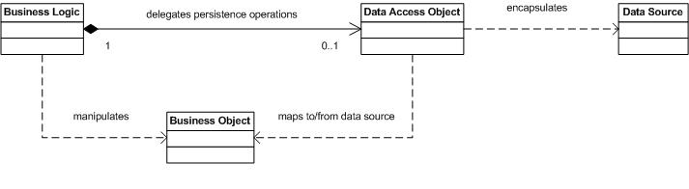
Solution
Use a data access object (DAO) to abstract and encapsulate the data source

Slide 8
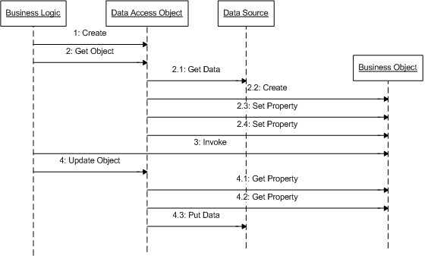
DAO Pattern Interactions

Slide 9
DAO Pattern Roles
Business Logic
  the object within the business domain that needs access to data (e.g., session bean)
  knows when/why data is needed, but not how
Data Access Object (DAO)
  abstracts the access details from the business object
  knows how data is accessed, but not when/why
Business Object
  an entity within the business logic
  a data carrier of information to/from the DAO
Data Source
  physically stores the data (e.g., database)

Slide 10
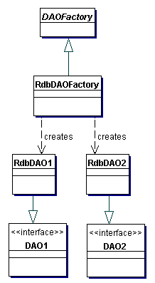
DAO Factory Strategy
Design to allow multiple approaches to DAOs using a DAOFactory

Slide 11
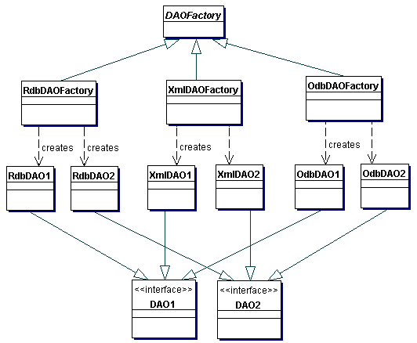
DAO Factory Structure

Slide 12
Consequences
Centralizes All Data Access into a Separate Layer
  Easier to maintain
  Enables Transparency
    access implementation details are hidden within DAO
  Enables Easier Migration
    client layers are encapsulated from changes
Reduces Code Complexity in Business Logic
  no details, such as SQL, in business logic
Harder to abstract with EJB2.x Container Managed Persistence (CMP) frameworks
EJB3 Java Persistence API provides a significant amount of abstraction

Slide 13
DAO Interface
package ejava.examples.dao;
import java.util.Collection;
import ejava.examples.dao.domain.Book;
public interface BookDAO {
Book create(Book book) throws DAOException;
Book update(Book book) throws DAOException;
Book get(long id) throws DAOException;
boolean remove(Book book) throws DAOException;
Collection<Book> findAll(long start, long count)
throws DAOException;
}

Slide 14
DAO Implementation
package ejava.examples.dao.jdbc;
...
import ejava.examples.dao.BookDAO;
import ejava.examples.dao.DAOException;
import ejava.examples.dao.domain.Book;
public class JDBCBookDAO extends JDBCDAOBase implements BookDAO {
public Book create(Book book) throws DAOException { ...
public Book update(Book book) throws DAOException { ...
public Book get(long id) throws DAOException { ...
public boolean remove(Book book) throws DAOException { ...
public Collection<Book> findAll(int start, int count)
throws DAOException { ...
}

Slide 15
Wrapped Exceptions
package ejava.examples.dao;
public class DAOException extends Exception {
private static final long serialVersionUID = 1L;
public DAOException() {}
public DAOException(String message) { super(message); }
public DAOException(String message, Throwable rootCause) {
super(message, rootCause);
}
public DAOException(Throwable rootCause) {
super(rootCause);
}
}
try {
...
}
catch (<T> ex) {
throw new DAOException(“troubles”, ex);
}
* be careful that Resource
Level Exception is not
propogated all the way back
to remote client. May cause
ClassNotFoundExceptions

Slide 16
Relating Business Objects
to
Data Transfer Objects (DTOs)

Slide 17
DTO Pattern
Context
  Business Objects represent too much information or behavior to transfer to remote client
Problem
  Client may get information they don't need
  Client may get information they can't handle
  Client may get information they are not autorized to use
  Client may get too much information/behavior to be useful (e.g., entire database serialized to client)
Forces
  Some clients are local and can share object references with business logic
  Handling specifics of remote clients outside of core scope of business logic

Slide 18
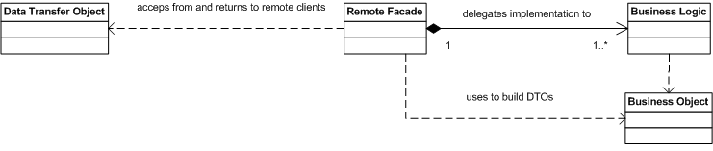
DTO/Remote Facade Solution
Layer a Remote Facade over Business Logic
Remote Facade constructs Data Transfer Objects (DTOs) from Business Objects that are appropriate for remote client view
Remote Facade uses DTOs to construct or locate Business Objects to communicate with Business Logic

Slide 19
DTO Pattern Roles
Data Transfer Object
  represent a subset of the state of the application at a point in time
  not dependent on Business Objects or server-side technologies
    doing so would require sending Business Objects to client
    XML and Web services provide the “ultimate isolation” in DTO implementation
Remote Facade
  uses Business Logic to perform core business logic
  layered on to of Business Logic to translate between Business Objects and DTOs
Business Logic
  continues to perform core duties as described in DAO Pattern

Slide 20
DTO Pattern Consequences
Clients only get what they need
Clients only get what they understand
Clients only get what they are authorized to use
Remote and Local interfaces to services are different
  makes it harder to provide location transparency
Lightweight Business Objects can be used as DTOs
  Remote Facade must make sure they are “pruned” of excess related items before transferring to client
  Remote Facade must make sure they are “cleaned” of DAO persistence classes before transferring to client

Slide 21
Relational Databases
and
SQL

Slide 22
Relational Database and SQL Review
Relational databases based upon mathematical set theory (Codd 1970)
Controversial in the mid-80’s but now the standard for corporate data repositories
Theoretical operations to manipulate and relate information in tables

Slide 23
Relational Databases
Based on tables where a row represents an instance of data and columns represent a specific attribute
Keys uniquely identify a row in a table
Rows in different tables are associated via a key

Slide 24
SQL
Structured Query Language
Standard language (mostly true to theoretical set operations) to manipulate relational data
  SQL-86
    first published
  SQL-89, 92, 1999, 2003
    various revisions
  SQL-2006
    latest release
    most later activity centered around XML

Slide 25
Common SQL Operations
Creating tables and indexes
  Constraints; keys, NOT NULL
Inserting and Updating Data
Selecting Data
  Views
Removing Data

Slide 26
Image Table
IMAGE_ID IMAGE_TYPE FILENAME URL
1 gif image1 http://host/dir/image1
2 gif image2 ftp://host/dir/image2

Slide 27
Image Decoder Table
IMAGE_TYPE DECODER_PROGRAM LIC_START LIC_END
gif c:\gifdecoder 12/01/1998 12/01/1999
jpg d:\tools\jpgdecoder 06/01/1999 12/01/2010

Slide 28
Tables and Keys
DECODER
DECODER
Primary
Keys
IMAGE_TYPE DECODER_PROGRAM
gif c:\gifdecoder …
...
Foreign
Key
IMAGE
IMAGE_ID IMAGE_TYPE FILENAME URL
1 gif Image1 …
...

Slide 29
Example Data Types
INT - signed integer value. Implementation-dependent # bits
NUMERIC(total length, number of decimal places)
  NUMERIC(8,4) - 3 digits, a decimal point, and 4 decimal places
REAL - floating point number
BIT - single boolean value
DATE - year, month, day
TIME, TIMESTAMP - date/time
VARCHAR(length) - variable length string <= length
BLOB - Binary Large Object

Slide 30
Creating Tables
Syntax for table creation is *mostly* standard among database vendors
        CREATE TABLE DECODER (
        IMAGE_TYPE CHAR(3) NOT NULL,
        DECODER_PROGRAM VARCHAR(256),
        LIC_START DATE,
        LIC_END DATE,
        CONSTRAINT DecodePK PRIMARY KEY(IMAGE_TYPE)
        );
creates a table with 4 columns and no rows

Slide 31
Image Tables (Cont)
        CREATE TABLE IMAGE (
        IMAGE_ID INT NOT NULL,
        IMAGE_TYPE CHAR(3),
        FILENAME VARCHAR(40),
        URL VARCHAR(128),
        CONSTRAINT ImagePK PRIMARY KEY(image_id),
        CONSTRAINT ImageFK1
        FOREIGN KEY(IMAGE_TYPE) REFERENCES DECODER(IMAGE_TYPE)
        );

Slide 32
Adding constraints
Database can help maintain data integrity
Can be specified with column definition or at the end of ‘create table’
NOT NULL
Primary Keys
Foreign Keys
Check Conditions

Slide 33
NULLs
Special condition that indicates an absence of a value
Some columns may be required to have a value
decoder_program VARCHAR(128) NOT NULL

Slide 34
Primary Keys
Primary Key uniquely identifies a row
  Only 1 Primary Key allowed per table
  Can not be NULL (absence of a value)
  image_id INT PRIMARY_KEY OR
  constraint (IMAGE_KEY) PRIMARY KEY(image_id)

Slide 35
Foreign Keys
Refers to a PRIMARY KEY in another table
Used to relate tables together
Foreign key (image_type) REFERENCES Image_Decoder(image_type)
ON DELETE CASCADE – delete dependent row when row in master table is deleted

Slide 36
CHECK Constraint
Expression that must be true for all table rows
Grade NUMBER CHECK (Grade BETWEEN 0 and 100)

Slide 37
Dropping Tables
Removes data and deletes table definition
DROP TABLE DECODER

Slide 38
Inserting Rows
  INSERT INTO Image
  ( IMAGE_ID, IMAGE_TYPE, FILENAME, URL)
  VALUES
  ( 1, ‘jpg’, ‘image1’, ‘http://host/dir/image1’)

Slide 39
Selecting Rows
SELECT image_type from IMAGE
  WHERE filename=‘image1’
SELECT DECODER.decoder_program FROM DECODER, Image
  WHERE IMAGE.filename=‘image1’
    AND IMAGE.image_type=DECODER.image_type
  The Join operation can be viewed as creating a virtual table on the fly from rows in two or more tables
SELECT * from IMAGE GROUP by image_type

Slide 40
Updating Rows
UPDATE IMAGE
  SET url=‘http://newhost/image1’
  WHERE filename=‘image1’
The where clause may select multiple rows e.g. WHERE image_id < 50
If the WHERE clause is excluded, the SET operation is applied to every row in the table

Slide 41
Deleting Rows
DELETE from IMAGE
  WHERE image_id=2
  Entire row is removed from the table
DELETE from IMAGE
  Every row is removed from the table!!!

Slide 42
Basic Where Clauses
Operators
  =, <, >, <=, >=, != (or <>)
    WHERE image_id = 2
  LIKE - wildcard comparison
    WHERE decoder_program LIKE ‘c:%’
  ISNULL - checks for null value
  IN - contained in a set (usually for subqueries)
    WHERE image_id IN (1,2)
    WHERE image_id IN
    SELECT image_id FROM AnotherTable WHERE ….

Slide 43
Views
Creates a dynamic table resulting from columns in one or more source tables
CREATE VIEW Conditions AS select readings.temperature, location_name, latitude FROM readings, locations WHERE readings.location_id=locations.location_id
Update Difficulties Exist

Slide 44
SQL Data Types
Numeric
Temporal
Character
Locator-Based Data Types
  Arrays, CLOBS, and BLOBs

Slide 45
Numeric Data Types
SQL defines many different numeric types
Numeric types are classified as either exact or approximate

Slide 46
Exact Numeric Data Types
  Precision (P) = Number of significant digits
  Scale (S) = Number of decimal places
  INTEGER, SMALLINT
  DECIMAL(P,S), NUMERIC(P,S)
    DECIMAL can be represented with a greater than requested Precision
    java.math.BigDecimal

Slide 47
Approximate Numeric Data Types
  Mantissa and exponent representation
  Value = mantissa * 10 to the exponent
  FLOAT(P), REAL, DOUBLE PRECISION

Slide 48
Temporal Data Types
DATE – Day, Month, and Year
TIME – Hour, Minute, Seconds
TIMESTAMP – Date + Time + Nanoseconds
Wide variance between vendor implementations

Slide 49
Character Data Types
Printable characters enclosed in single quotes
Fixed length CHARACTER(n) and CHAR(n)
  Fixed length string of characters
  Maps to java.lang.String; padded if necessary
Varying character arrays (VARCHAR(n))
  1..N characters
  Maps to java.lang.String.
  NOTE: Use VARCHAR2(n) in Oracle

Slide 50
Locator-Based data types
For data values that may be too large to always materialize on the client
Reference to data on server; hence locator
Arrays
  Actually violate 1NF which disallows repeating data in a single table
  Create type email_va as varray(3) of VARCHAR2(25)
BLOBs – large amounts of binary data
CLOBs – large amounts of character data

Slide 51
SQL Summary
SQL is a non-procedural language for manipulating sets.
De-facto standard for enterprise data repositories
Different paradigm than procedural/object-oriented languages like Java

Slide 52
Java Database Connectivity
(JDBC)

Slide 53
JDBC Drivers
Type 1 - JDBC-ODBC bridge
  provides JDBC API access via ODBC drivers
  requires some binary code be loaded on client machine
Type 2
  native-API partly Java technology-enabled driver
  converts JDBC calls into calls on the client API for DBMS
  requires some binary code be loaded on client machine
Type 3
  net-protocol fully Java technology-enabled driver
  translates JDBC API calls into DBMS-independent net protocol
Type 4
  native-protocol fully Java technology-enabled driver
  converts JDBC technology calls into the network protocol used by DBMSs directly

Slide 54
Key JDBC Classes/Interfaces
DriverManager
  starting point for client to get dedicated connections to server
Driver
  provides database-specific implementation for interfaces
Connection
  represents an open conversation with the server
Statement
  used to expres SQL statements to database
ResultSet
  used to return SQL results from database
SQLException
  used to report errors or warning executing SQL

Slide 55
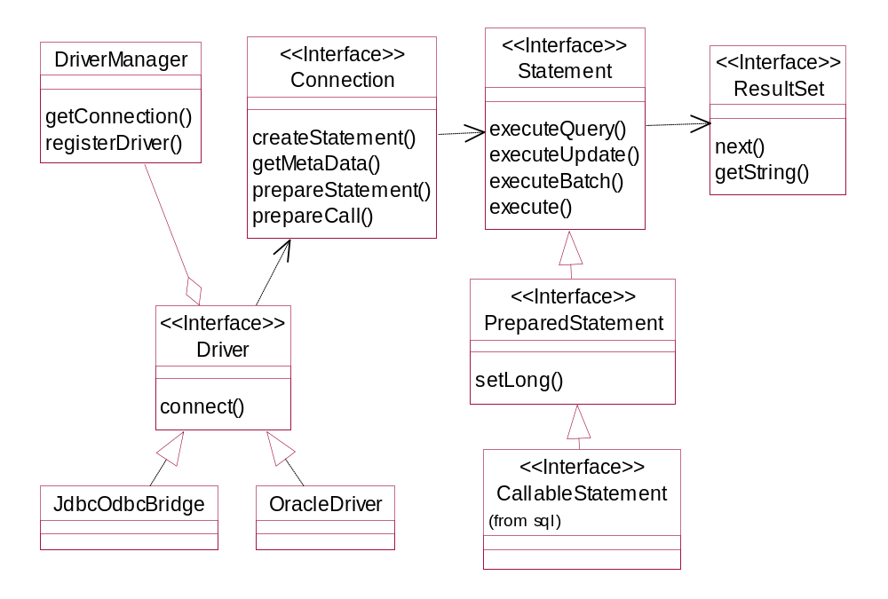

Slide 56
Example Program
Step 1 - Load the Driver
//ConnectDemo.java
private static void loadDriver()
throws ClassNotFoundException {
log.debug("loading driver " + dbDriver);
Class.forName(dbDriver);
}
(ConnectDemo.java:loadDriver:24) -loading driver org.hsqldb.jdbcDriver

Slide 57
Driver Loading
Drivers may also be loaded by specifying the property jdbc.drivers. A list of drivers to be loaded can be specified in a colon-separated list.
  java -Djdbc.drivers=com.pointbase.jdbc.jdbcUniversalDriver myProg
What is the advantage of using this property instead of explicitly calling Class.forName ?
More than one driver can be loaded into memory and can even connect to the same database. Drivers are tried in priority order (from left to right)

Slide 58
Driver Loading (cont.)
The driver’s static initializer is called by the JVM when the class is loaded
The static initializer must register with the Driver Manager
    public class MyDriver implements java.sql.Driver {
      static{
        new MyDriver();
        }
      public MyDriver() {
        java.sql.DriverManager.register( this );
      }
    }

Slide 59
Example Program
Step 2 - Obtain a Connection
private static Connection getConnection() throws SQLException{
log.debug("getting connection for " + dbUrl +
", user=" + dbUser +
", password=" + dbPassword);
return DriverManager.getConnection(
dbUrl, dbUser, dbPassword);
}
(ConnectDemo.java:getConnection:29)
-getting connection for jdbc:hsqldb:hsql://localhost:9001, user=sa, password=
// jdbc:oracle:thin:@aplcen.apl.jhu.edu:1521:PTE

Slide 60
What Driver creates the Connection ?
URL specifies the driver (subprotocol) and the data source/database system
    Ex. jdbc:odbc:MyDataSource
The Driver Manager locates an appropriate driver (by calling each driver's getConnection(url) method) and returns a connection from the first driver that handles the subprotocol.
Subprotocol specifies a particular kind of database connectivity that may be supported by more than one driver

Slide 61
JDBC URLs
jdbc:driver:databasename
Database name parameter is actually free-form and only interpreted by the driver
Examples
  jdbc:odbc:datasource;dataoptions
  jdbc:oracle:thin:@aplcen.apl.jhu.edu:1521:PTE
  jdbc:cloudscape:corej2ee
  jdbc:cloudscape:rmi:corej2ee;create=true
DriverManager simply passes the URL to all drivers until one returns a connection

Slide 62
DriverManager
package java.sql;
public class DriverManager {
public static synchronized Connection getConnection(
String url, String username, String password) {...
public static synchronized Connection getConnection(
String url, Properties props) { ...
public static synchronized Connection getConnection(
String url)
public static synchronized Driver getDriver(
String url) { ...
public static synchronized void registerDriver(
java.sql.Driver driver) { ...
public static synchronized void deregisterDriver(
Driver driver) { ...
public static synchronized java.util.Enumeration<Driver> getDrivers()
{ ...
public static void setLoginTimeout(
int seconds) { ...
public static java.io.PrintWriter getLogWriter()
{ ...
public static void setLogWriter(
java.io.PrintWriter out) { ...
public static void println(
String message) { ...

Slide 63
Driver
package java.sql;
public interface Driver {
Connection connect(String url, java.util.Properties info)
throws SQLException;
boolean acceptsURL(String url)
throws SQLException;
DriverPropertyInfo[] getPropertyInfo(
String url, java.util.Properties info)
throws SQLException;
int getMinorVersion();
boolean jdbcCompliant();
}

Slide 64
Connection
package java.sql;
public interface Connection {
Statement createStatement() throws SQLException;
PreparedStatement prepareStatement(
String sql)throws SQLException;
CallableStatement prepareCall(
String sql) throws SQLException;
PreparedStatement prepareStatement(String sql, int resultSetType,
int resultSetConcurrency)throws SQLException;
CallableStatement prepareCall(
String sql, int resultSetType, int resultSetConcurrency)
throws SQLException;
Statement createStatement(
int resultSetType, int resultSetConcurrency,
int resultSetHoldability) throws SQLException;
PreparedStatement prepareStatement(String sql, int resultSetType,
int resultSetConcurrency, int resultSetHoldability)
throws SQLException;
CallableStatement prepareCall(String sql, int resultSetType,
int resultSetConcurrency,
int resultSetHoldability) throws SQLException;
PreparedStatement prepareStatement(
String sql, int autoGeneratedKeys) throws SQLException;
PreparedStatement prepareStatement(
String sql, int columnIndexes[]) throws SQLException;
PreparedStatement prepareStatement(
String sql, String columnNames[])throws SQLException;
...

Slide 65
Connection
package java.sql;
public interface Connection {
...
void setAutoCommit(
boolean autoCommit) throws SQLException;
boolean getAutoCommit() throws SQLException;
void commit() throws SQLException;
void rollback() throws SQLException;
void close() throws SQLException;
boolean isClosed() throws SQLException;
void setTransactionIsolation(int level) throws SQLException;
int getTransactionIsolation() throws SQLException;
SQLWarning getWarnings() throws SQLException;
void clearWarnings() throws SQLException;
Savepoint setSavepoint() throws SQLException;
Savepoint setSavepoint(String name) throws SQLException;
void rollback(Savepoint savepoint) throws SQLException;
void releaseSavepoint(Savepoint savepoint) throws SQLException;
...

Slide 66
Example Program
Step 3 - Execute a Query
private static void accessDatabase() throws SQLException {
Connection conn = null; Statement st = null; ResultSet rs = null;
try {
conn = getConnection();
st = conn.createStatement();
rs = st.executeQuery("select * from IMAGE");
while (rs.next()) {
String imageId = rs.getString("IMAGE_ID");
...
log.info(imageId + ...
}
}
finally {
log.debug("closing resources");
try { rs.close(); } catch (Throwable ignored) {}
try { st.close(); } catch (Throwable ignored) {}
try { conn.close(); } catch (Throwable ignored) {}
log.debug("resources closed");
}
}
accessDatabase:47) -1, jpg, image1, http://host/dir/image1
accessDatabase:47) -2, gif, image2, http://host/dir/image2
accessDatabase:54) -closing resources
accessDatabase:58) -resources closed

Slide 67
Executing Statements
executeQuery() is used for Select statements
executeUpdate() is used for table creation and table modifications
JDBC 2.0 adds executeBatch to execute multiple statements (for efficiency)

Slide 68
Example Program
Step 4 - Process Results
while (rs.next()) {
String imageId = rs.getString("IMAGE_ID");
String imageType = rs.getString("IMAGE_TYPE");
String fileName = rs.getString("FILENAME");
String url = rs.getString("URL");
log.info(imageId +
", " + imageType +
", " + fileName +
", " + url);
}
The ResultSet cursor was positioned before the first row upon completion of the execute method

Slide 69
Example Program
Step 5 - Release Resources
rs.close();
st.close();
con.close();

Slide 70
Statement
Represents a basic SQL statement
Created from a connection
Use executeQuery for queries
  Result rs=st.executeQuery(“SELECT * FROM Image”);
Use executeUpdate for SQL statements that don’t return results
  DDL commands for creating, dropping tables
  Update/Delete
  Returns the number of rows affected

Slide 71
Statement (Cont)
Use execute() if you don’t know the type of request being submitted e.g. the user is typing it in
  Returns true if a result set is available
  Call getResultSet() to retrieve the results
Only one result set is associated with a statement at a time i.e A statement represents one SQL statement at a time

Slide 72
Statement (Cont)
An SQL statement may return multiple result sets or update counts
getMoreResults() : boolean
getUpdateCount() : int
This condition is rare and are normally the result of a stored procedure or database-specific functionality

Slide 73
Statement
package java.sql;
public interface Statement {
...
ResultSet executeQuery(String sql) throws SQLException;
int executeUpdate(String sql) throws SQLException;
SQLWarning getWarnings() throws SQLException;
void clearWarnings() throws SQLException;
boolean execute(String sql) throws SQLException;
ResultSet getResultSet() throws SQLException;
int getUpdateCount() throws SQLException;
boolean getMoreResults() throws SQLException;
int getResultSetType() throws SQLException;
void addBatch( String sql ) throws SQLException;
void clearBatch() throws SQLException;
int[] executeBatch() throws SQLException;
boolean getMoreResults(int current) throws SQLException;
ResultSet getGeneratedKeys() throws SQLException;
int executeUpdate(String sql, int autoGeneratedKeys) throws SQLException;
int executeUpdate(String sql, int columnIndexes[]) throws SQLException;
int executeUpdate(String sql, String columnNames[]) throws SQLException;
boolean execute(String sql, int autoGeneratedKeys) throws SQLException;
boolean execute(String sql, int columnIndexes[]) throws SQLException;
boolean execute(String sql, String columnNames[]) throws SQLException;
...

Slide 74
Statement
package java.sql;
public interface Statement {
...
int getMaxFieldSize() throws SQLException;
void setMaxFieldSize(int max) throws SQLException;
int getMaxRows() throws SQLException;
void setMaxRows(int max) throws SQLException;
void setEscapeProcessing(boolean enable) throws SQLException;
int getQueryTimeout() throws SQLException;
void setQueryTimeout(int seconds) throws SQLException;
void cancel() throws SQLException;
void setCursorName(String name) throws SQLException;
boolean execute(String sql) throws SQLException;
void setFetchDirection(int direction) throws SQLException;
int getFetchDirection() throws SQLException;
void setFetchSize(int rows) throws SQLException;
int getFetchSize() throws SQLException;
int getResultSetConcurrency() throws SQLException;
void addBatch( String sql ) throws SQLException;
void clearBatch() throws SQLException;
Connection getConnection() throws SQLException;
ResultSet getGeneratedKeys() throws SQLException;
int getResultSetHoldability() throws SQLException;
...

Slide 75
Prepared Statement
Pre-compiled SQL Statement
Better performance if a statement will be issued multiple times
PreparedStatement ps =
  con.prepareStatement(“SELECT * FROM Image WHERE image_id= ?”);
  for( int i=0; i<10; i++) {
  ps.setInt(1, i);
  ResultSet rs = ps.executeQuery();
  // Do something with the result set
  }

Slide 76
Callable Statement
JDBC Object that supports stored procedures
Only required for stored procedures that return results. Otherwise, use statement or preparedStatement

Slide 77
ResultSet
Encapsulates query results
    while(rs.next()) {
      String fname = rs.getString(“FILENAME”);
    }
Column name is case-insensitive
JDBC 1.0 only allowed forward-navigation
Column number may be used instead of name. (Column numbers start at 1)

Slide 78
Transactions
Grouping of statements into one logical unit of work
Each statement must succeed or the transaction is rolled back
Steps
  start transaction
  execute statements
  commit or rollback the transaction

Slide 79
JDBC Transaction API
Responsibility of the Connection Object
By default, each operation is a transaction
setAutoCommit(true)
To perform multiple statements in a transaction:
  con.setAutoCommit(false);
  // execute statements
  con.commit();

Slide 80
Isolation Levels
When are changes to the database visible to the rest of the system?
Isolation Modes:
  TRANSACTION_NONE
    Transactions are either disabled or not supported
  TRANSACTION_READ_UNCOMMITTED
    Dirty reads
    Other transactions can see the results of uncommitted other transactions
    If the other transaction rolls back, other applications can be left with incorrect data
  TRANSACTION_READ_COMMITTED
  TRANSACTION_REPEATABLE_READ
    Once an application performs a read, it will always get those results when it reads that row
    Even if another transaction modifies the row
    Reader must commit() before the new value can be read
  TRANSACTION_SERIALIZABLE
    Features of Transaction repeatable read
    Also, does not see rows inserted by another transaction

Slide 81
Transaction Methods
conn.setTransactionIsolation()
Database metadata identifies transaction level support of database
Each transaction requires their own Connection object

Slide 82
Savepoints
Introduced in JDBC 3.0
Allows partial rollback or commit of a transaction

Slide 83
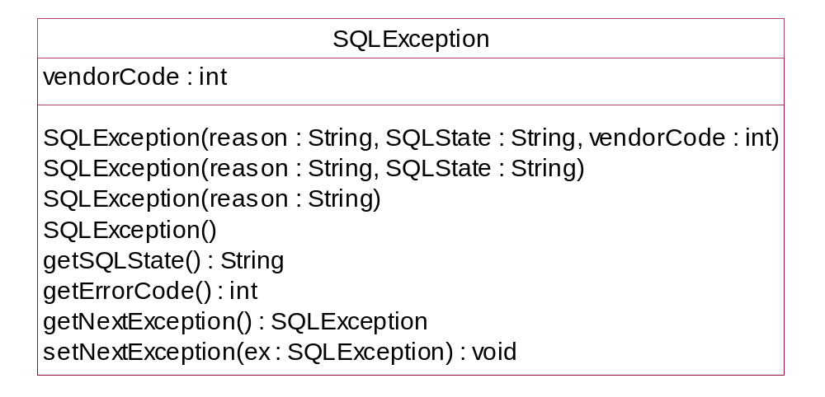
Exceptions and Warnings
SQLException

Slide 84
SQL Warning
Set when condition is not serious enough to warrant an exception
getWarnings() method of Connection, Statement, ResultSet.
Encapsulates same information as SQLException (actually extends it)

Slide 85
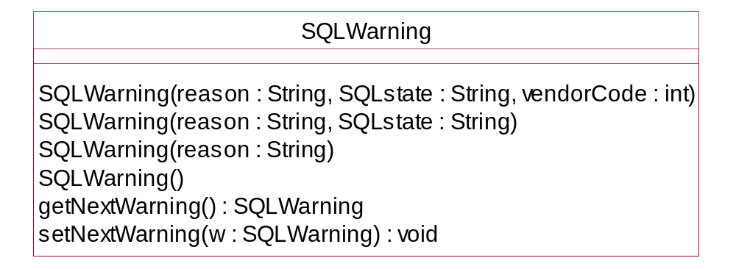
SQL Warning

Slide 86
JDBC Summary
Thin Java API for access to SQL databases
Allows portable access to databases from different vendors
Still need to know SQL
Different driver implementation strategies
Evolving

Slide 87
JDBC/SQL-based
DAO
Example

Slide 88
Schema
create sequence DAO_BOOK_SEQ as int start with 100 increment by 1;
create table DAO_BOOK_UID (
ID bigint
);
insert into DAO_BOOK_UID (ID) VALUES (
NEXT VALUE FOR DAO_BOOK_SEQ );
create table DAO_BOOK (
ID bigint not null,
VERSION bigint not null,
TITLE varchar(64),
AUTHOR varchar(64),
DESCRIPTION varchar(2000),
PAGES int,
CONSTRAINT dao_BookPK PRIMARY KEY(ID)
);

Slide 89
Example DAO Test Client
Connection connection;
BookDAO dao;
protected void setUp() throws Exception {
connection = getConnection();
connection.setAutoCommit(false);
JDBCBookDAO.setConnection(connection);
dao = new JDBCBookDAO();
}
public void testCreate() throws Exception {
Book book = new Book(nextId());
book.setTitle("a");
book.setAuthor("b");
book.setDescription("testCreate");
book.setPages(20);
try {
Book book2 = dao.create(book);
connection.commit();
assertNotNull(book2);
}
catch (Exception ex) {
connection.rollback();
fail("" + ex);
}
}

Slide 90
Connection Sharing using ThreadLocal
package ejava.examples.dao.jdbc;
import java.sql.*;
public class JDBCDAOBase {
static ThreadLocal<Connection> connection =
new ThreadLocal<Connection>();
public static void setConnection(Connection conn) {
connection.set(conn);
}
protected Connection getConnection()
throws IllegalStateException {
Connection conn = connection.get();
if (conn == null) {
throw new IllegalStateException(
"Connection has not been set");
}
return conn;
}

Slide 91
Resource Helpers
protected static void closeConnection() throws SQLException {
Connection conn = connection.get();
if (conn != null) {
connection.set(null);
conn.close();
}
}
protected void close(Statement st) {
try { st.close();}
catch (Throwable ignored) {}
}
protected void close(ResultSet rs) {
try { rs.close();}
catch (Throwable ignored) {}
}

Slide 92
Inserting Object (and calling a private setter)
public Book create(Book book) throws DAOException {
long id = (book.getId() == 0) ? getNextId() : book.getId();
PreparedStatement st = null;
try {
st = getConnection().prepareStatement(
"INSERT INTO " + TABLE_NAME + " "
+ "(ID, VERSION, TITLE, AUTHOR, DESCRIPTION, PAGES) "
+ "VALUES(?, ?, ?, ?, ?, ?)");
st.setLong(1, id);
st.setLong(2, 0);
st.setString(3, book.getTitle());
st.setString(4, book.getAuthor());
st.setString(5, book.getDescription());
st.setInt(6, book.getPages());
if (st.executeUpdate() != 1) {
throw new DAOException("unable to insert Book");
}
book.setVersion(0);
if (book.getId()==0) {
//use reflection to get private setId method of Book class
Method setId = Book.class.getDeclaredMethod(
"setId", new Class[] { int.class });
setId.setAccessible(true);
setId.invoke(book, new Object[] { id });
}
return book;
} catch (Exception ex) {
throw new DAOException(ex);
} finally {
close(st);
}
}

Slide 93
Generating an ID
public int getNextId() throws DAOException {
Statement st = null;
ResultSet rs = null;
try {
st = getConnection().createStatement();
st.executeUpdate("UPDATE DAO_BOOK_UID " +
"SET ID=NEXT VALUE FOR DAO_BOOK_SEQ”);
rs = st.executeQuery("SELECT ID FROM DAO_BOOK_UID”);
rs.next();
return rs.getInt(1);
}
catch (SQLException ex) {
throw new DAOException(ex);
}
finally {
close(rs);
close(st);
}
}

Slide 94
Updating Database
public Book update(Book book) throws DAOException {
if (book.getId() == 0) {
throw new DAOException("Book does not have primary key");
}
PreparedStatement st = null;
try {
long version = getVersion(book.getId());
st = getConnection().prepareStatement("UPDATE " + TABLE_NAME + " " +
"SET VERSION=?, TITLE=?, AUTHOR=?, DESCRIPTION=?, PAGES=? " +
"WHERE ID=?");
st.setLong(1, ++version);
st.setString(2, book.getTitle());
st.setString(3, book.getAuthor());
st.setString(4, book.getDescription());
st.setInt(5, book.getPages());
st.setLong(6, book.getId());
int count = st.executeUpdate();
if (count == 0) {
throw new DAOException("Object not found:" + book.getId());
}
book.setVersion(version);
return book;
} catch (SQLException ex) {
throw new DAOException(ex);
} finally {
close(st);
}
}

Slide 95
Getting Version (Helper)
protected long getVersion(long id) throws SQLException, DAOException {
long version = 0;
Statement st = null;
ResultSet rs = null;
try {
st = getConnection().createStatement();
rs = st.executeQuery("SELECT VERSION FROM " +
TABLE_NAME + " WHERE ID=" + id);
if (!rs.next()) {
throw new DAOException("Object not found");
}
version = rs.getLong(1);
} finally {
close(rs);
close(st);
}
return version;
}

Slide 96
Getting Object By ID
public Book get(long id) throws DAOException {
Book book = null;
Statement st = null;
ResultSet rs = null;
try {
st = getConnection().createStatement();
rs = st.executeQuery(
"SELECT VERSION, AUTHOR, TITLE, DESCRIPTION, PAGES "
+ "FROM " + TABLE_NAME + " " + "WHERE ID=" + id);
if (!rs.next()) {
throw new DAOException("Object not found");
}
book = new Book(id);
book.setVersion(rs.getLong(1));
book.setAuthor(rs.getString(2));
book.setTitle(rs.getString(3));
book.setDescription(rs.getString(4));
book.setPages(rs.getInt(5));
return book;
} catch (SQLException ex) {
throw new DAOException(ex);
} finally {
close(rs);
close(st);
}
}

Slide 97
Removing Object
public boolean remove(Book book) throws DAOException {
Statement st = null;
try {
st = getConnection().createStatement();
int count = st.executeUpdate("DELETE FROM "
+ TABLE_NAME + " WHERE ID="
+ book.getId());
return count == 1;
} catch (SQLException ex) {
throw new DAOException(ex);
} finally {
close(st);
}
}

Slide 98
Finding Objects
public Collection<Book> findAll(int start, int count)
throws DAOException {
Statement st = null;
ResultSet rs = null;
try {
st = getConnection().createStatement(
ResultSet.TYPE_SCROLL_INSENSITIVE,
ResultSet.CONCUR_READ_ONLY);
rs = st.executeQuery("SELECT * FROM " + TABLE_NAME);
Collection<Book> collection = new ArrayList<Book>();
rs.absolute(start);
int i=0;
while (rs.next() && i++<count) {
Book b = new Book(rs.getLong("ID"));
b.setAuthor(rs.getString("AUTHOR"));
b.setDescription(rs.getString("DESCRIPTION"));
b.setPages(rs.getInt("PAGES"));
b.setTitle(rs.getString("TITLE"));
b.setVersion(rs.getLong("VERSION"));
collection.add(b);
}
return collection;
} catch (SQLException ex) {
throw new DAOException(ex);
} finally {
close(st);
}
}

Slide 99
Summary
DAO Pattern
  isolates data access details away from other components
SQL
  industry standard language understood by RDBMS
JDBC
  Java standard API for communicating with RDMS
    passing SQL
    retrieving results
SQL/JDBC Example DAO
  provides a reasonable example of using SQL/JDBC to implement a DAO
  provides example usage of DAO interface
  provides example usage of ThreadLocal

Slide 100
References
http://java.sun.com/blueprints/corej2eepatterns/Patterns/DataAccessObject.html

