Slide 1
Enterprise Java
(605.784)
Development Environment
Overview

Slide 2
Goals
Become familiar with the development environment used for class

Slide 3
Objectives
Directory Structure
Tasks to Build Simple Application
Quicklook at Testing with JUnit
Scripting Tasks with Ant
Integrating Better Logging
Automate Project Development with Maven
Leverage IDE using Eclipse

Slide 4
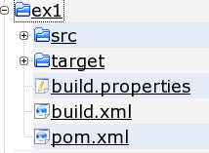
Project Directory Structure
src
  project source files
  primary CM artifact
target
  built items
  deleted on cleanup
(Ant)
  build.xml
    built script
  build.properties
(Maven)
  pom.xml
    project definition

Slide 5
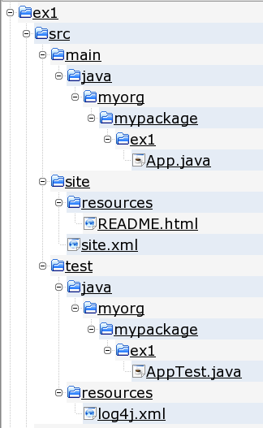
Source (“src”) Directory Structure
main
  product source
  java
    java classes
  resources
    deployment descriptors
    property files
test
  product test classes/files
  java
    test classes
  resources
    runtime properties
site
  product documentation
  resources
    raw documents

Slide 6
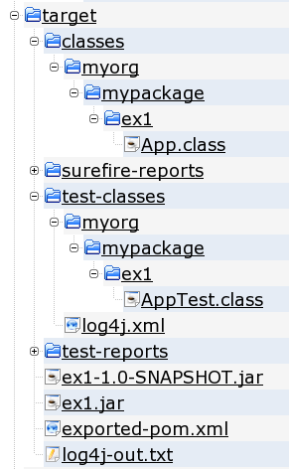
Build (“target”) Directory Structure
classes
  product compiled classes
  product resource files
test-classes
  compiled test classes
  test resource files
xxx-reports
  test reports
xxx.jar
  product archive
  “jar” packaging
log4j-out.txt
  log file from unit testing

Slide 7
Build Tasks: Build Product Archive
Compile Product Class(es)
> javac src/main/java/myorg/mypackage/ex1/App.java -d target/classes
> jar cvf target/ex1.jar -C target/classes .
added manifest
adding: myorg/(in = 0) (out= 0)(stored 0%)
adding: myorg/mypackage/(in = 0) (out= 0)(stored 0%)
adding: myorg/mypackage/ex1/(in = 0) (out= 0)(stored 0%)
adding: myorg/mypackage/ex1/App.class(in = 519) (out= 350)(deflated 32%)
> jar tf target/ex1.jar
META-INF/
META-INF/MANIFEST.MF
myorg/
myorg/mypackage/
myorg/mypackage/ex1/
myorg/mypackage/ex1/App.class
Build Product Archive
Inspect Product Archive

Slide 8
Build Tasks: Build and Run Tests
Build Test Class(es)
> javac -classpath target/ex1.jar:$JUNIT_REPO/junit-4.0.jar \
src/test/java/myorg/mypackage/ex1/AppTest.java \
-d target/test-classes
> java -classpath target/ex1.jar:$JUNIT_REPO/junit-4.0.jar:\
target/test-classes \
junit.textui.TestRunner myorg.mypackage.ex1.AppTest
.testApp
Here's One!
Time: 0.013
OK (1 test)
Run Unit Tests

Slide 9
Quicklook at Testing with Junit (3.x):App.java
package myorg.mypackage.ex1;
public class App {
public int returnOne() {
return 1;
}
public static void main( String[] args ) {
System.out.println( "Hello World!" );
}
}

Slide 10
Quicklook at Testing with Junit (3.x): AppTest.java
package myorg.mypackage.ex1;
import junit.framework.Test;
import junit.framework.TestCase;
import junit.framework.TestSuite;
/**
* Unit test for simple App.
*/
public class AppTest extends TestCase {
public AppTest( String testName ) {
super( testName );
}
public static Test suite() {
return new TestSuite( AppTest.class );
}
public void testApp() {
App app = new App();
assertTrue("app didn't return 1", app.returnOne() == 1);
}

Slide 11
Scripting Tasks with Ant:
Primary build.xml Structure
#ex1 build.properties
unit.classpath=/home/jcstaff/.m2/repository/junit/junit/4.0/junit-4.0.jar
<?xml version="1.0" encoding="utf-8" ?>
<!-- ex1 build.xml -->
<project name="ex1" default="" basedir=".">
<property file="build.properties"/>
<property name="artifactId" value="ex1"/>
<property name="src.dir" value="${basedir}/src"/>
<property name="build.dir" value="${basedir}/target"/>
<target name="echo">
<echo>basedir=${basedir}</echo>
<echo>artifactId=${artifactId}</echo>
<echo>src.dir=${src.dir}</echo>
<echo>build.dir=${build.dir}</echo>
<echo>junit.classpath=${junit.classpath}</echo>
</target>
</project>
> ant echo
Searching for build.xml ...
Buildfile: /home/jcstaff/proj/ejava-javaee/solutions/ex1/build.xml
echo:
[echo] basedir=/home/jcstaff/proj/ejava-javaee/solutions/ex1
[echo] artifactId=ex1
[echo] src.dir=/home/jcstaff/proj/ejava-javaee/solutions/ex1/src
[echo] build.dir=/home/jcstaff/proj/ejava-javaee/solutions/ex1/target
[echo] junit.classpath=/home/jcstaff/.m2/repository/junit/junit/4.0/junit-4.0.jar

Slide 12
Scripting Tasks with Ant:
Building the Product Archive
<target name="package">
<mkdir dir="${build.dir}/classes"/>
<javac srcdir="${src.dir}/main/java"
destdir="${build.dir}/classes"
debug="true"
source="1.5"
target="1.5">
<classpath>
</classpath>
</javac>
<jar destfile="${build.dir}/${artifactId}.jar">
<fileset dir="${build.dir}/classes"/>
</jar>
</target>
> ant package
Searching for build.xml ...
Buildfile: /home/jcstaff/proj/ejava-javaee/solutions/ex1/build.xml
package:
[mkdir] Created dir: /home/jcstaff/proj/ejava-javaee/solutions/ex1/target/classes
[javac] Compiling 1 source file to /home/jcstaff/proj/ejava-javaee/solutions/ex1/target/classes
[jar] Building jar: /home/jcstaff/proj/ejava-javaee/solutions/ex1/target/ex1.jar
BUILD SUCCESSFUL
Total time: 1 second

Slide 13
Scripting Tasks with Ant:
Compiling Test Classes
<project name="ex1" default="test" basedir=".">
...
<target name="test" depends="package">
<mkdir dir="${build.dir}/test-classes"/>
<javac srcdir="${src.dir}/test/java"
destdir="${build.dir}/test-classes"
debug="true"
source="1.5"
target="1.5">
<classpath>
<pathelement location="${build.dir}/${artifactId}.jar"/>
<pathelement path="${junit.classpath}"/>
</classpath>
</javac>
</target>

Slide 14
Scripting Tasks with Ant:
Adding Test Invocation
<mkdir dir="${build.dir}/test-reports"/>
<junit printsummary="true" fork="true">
<classpath>
<pathelement path="${junit.classpath}"/>
<pathelement location="${build.dir}/${artifactId}.jar"/>
<pathelement location="${build.dir}/test-classes"/>
</classpath>
<batchtest fork="true" todir="${build.dir}/test-reports">
<fileset dir="${build.dir}/test-classes">
<include name="**/*Test*.class"/>
</fileset>
</batchtest>
<formatter type="plain"/>
<formatter type="xml"/>
</junit>

Slide 15
Scripting Tasks with Ant:
Running 'test' Target
> ant test
Searching for build.xml ...
Buildfile: /home/jcstaff/proj/ejava-javaee/solutions/ex1/build.xml
package:
[javac] Compiling 1 source file to /home/jcstaff/proj/ejava-javaee/solutions/ex1/target/classes
[jar] Building jar: /home/jcstaff/proj/ejava-javaee/solutions/ex1/target/ex1.jar
test:
[mkdir] Created dir: /home/jcstaff/proj/ejava-javaee/solutions/ex1/target/test-classes
[javac] Compiling 1 source file to /home/jcstaff/proj/ejava-javaee/solutions/ex1/target/test-classes
[mkdir] Created dir: /home/jcstaff/proj/ejava-javaee/solutions/ex1/target/test-reports
[junit] Running myorg.mypackage.ex1.AppTest
[junit] Tests run: 1, Failures: 0, Errors: 0, Time elapsed: 0.04 sec
BUILD SUCCESSFUL
Total time: 1 second

Slide 16
Integrating Better Logging:
Apache Commons Logging API
package myorg.mypackage.ex1;
import org.apache.commons.logging.Log;
import org.apache.commons.logging.LogFactory;
public class App {
private static Log log = LogFactory.getLog(App.class);
public int returnOne() {
//System.out.println( "Here's One!" );
log.debug( "Here's One!" );
return 1;
}
public static void main( String[] args ) {
//System.out.println( "Hello World!" );
log.info( "Hello World!" );
}
}

Slide 17
Integrating Better Logging:
Configuring Log4J Logging Provider (log4j.xml)
<?xml version="1.0" encoding="UTF-8"?>
<!DOCTYPE log4j:configuration SYSTEM "log4j.dtd">
<log4j:configuration
xmlns:log4j="http://jakarta.apache.org/log4j/"
debug="false">
<appender name="CONSOLE" class="org.apache.log4j.ConsoleAppender">
...
</appender>
<appender name="logfile" class="org.apache.log4j.RollingFileAppender">
...
</appender>
<logger name="myorg.mypackage">
<level value="debug"/>
<appender-ref ref="logfile"/>
</logger>
<root>
<priority value="info"/>
<appender-ref ref="CONSOLE"/>
</root>
</log4j:configuration>

Slide 18
Integrating Better Logging:
Configuring Log4J Logging Provider
> ant test
Searching for build.xml ...
Buildfile: /home/jcstaff/proj/ejava-javaee/solutions/ex1/build.xml
package:
[mkdir] Created dir: /home/jcstaff/proj/ejava-javaee/solutions/ex1/target/classes
[javac] Compiling 1 source file to /home/jcstaff/proj/ejava-javaee/solutions/ex1/target/classes
[jar] Building jar: /home/jcstaff/proj/ejava-javaee/solutions/ex1/target/ex1.jar
test:
[mkdir] Created dir: /home/jcstaff/proj/ejava-javaee/solutions/ex1/target/test-classes
[javac] Compiling 1 source file to /home/jcstaff/proj/ejava-javaee/solutions/ex1/target/test-classes
[copy] Copying 1 file to /home/jcstaff/proj/ejava-javaee/solutions/ex1/target/test-classes
[mkdir] Created dir: /home/jcstaff/proj/ejava-javaee/solutions/ex1/target/test-reports
[junit] Running myorg.mypackage.ex1.AppTest
[junit] INFO 01-09 12:58:52,224 (AppTest.java:testApp:26) -testApp
[junit] DEBUG 01-09 12:58:52,232 (App.java:returnOne:11) -Here's One!
[junit] Tests run: 1, Failures: 0, Errors: 0, Time elapsed: 0.018 sec
BUILD SUCCESSFUL
Total time: 3 seconds

Slide 19
Automating Project Dev with Maven:
Initial pom.xml
<?xml version="1.0"?>
<project>
<modelVersion>4.0.0</modelVersion>
<groupId>myorg.myproject</groupId>
<artifactId>ex1</artifactId>
<name>My First Simple Project</name>
<version>1.0-SNAPSHOT</version>
<dependencies>
<dependency>
<groupId>commons-logging</groupId>
<artifactId>commons-logging</artifactId>
<version>1.0.4</version>
</dependency>
<dependency>
<groupId>junit</groupId>
<artifactId>junit</artifactId>
<version>4.0</version>
<scope>test</scope>
</dependency>
<dependency>
<groupId>log4j</groupId>
<artifactId>log4j</artifactId>
<version>1.2.13</version>
<scope>test</scope>
</dependency>
</dependencies>
...

Slide 20
Automating Project Dev with Maven:
Initial pom.xml
...
<build>
<plugins>
<plugin>
<groupId>org.apache.maven.plugins</groupId>
<artifactId>maven-compiler-plugin</artifactId>
<configuration>
<source>1.5</source>
<target>1.5</target>
</configuration>
</plugin>
</plugins>
</build>
</project>

Slide 21
Automating Project Dev with Maven:
Build/Test
> mvn package
[INFO] Scanning for projects...
[INFO]
----------------------------------------------------------------------------
[INFO] Building My First Maven Project
[INFO] task-segment: [package]
[INFO]
----------------------------------------------------------------------------
[INFO] [resources:resources]
[INFO] Using default encoding to copy filtered resources.
[INFO] [compiler:compile]
Compiling 1 source file to
/home/jcstaff/proj/ejava-javaee/solutions/ex1/target/classes
[INFO] [resources:testResources]
[INFO] Using default encoding to copy filtered resources.
[INFO] [compiler:testCompile]
Compiling 1 source file to
/home/jcstaff/proj/ejava-javaee/solutions/ex1/target/test-classes
[INFO] [surefire:test]
[INFO] Surefire report directory:
/home/jcstaff/proj/ejava-javaee/solutions/ex1/target/surefire-reports
...

Slide 22
Automating Project Dev with Maven:
Build/Test
...
-------------------------------------------------------
T E S T S
-------------------------------------------------------
Running myorg.mypackage.ex1.AppTest
INFO 01-09 16:42:09,648 (AppTest.java:testApp:26) -testApp
DEBUG 01-09 16:42:09,660 (App.java:returnOne:11) -Here's One!
Tests run: 1, Failures: 0, Errors: 0, Skipped: 0, Time elapsed: 0.035 sec
Results :
Tests run: 1, Failures: 0, Errors: 0, Skipped: 0
[INFO] [jar:jar]
[INFO] Building jar:
/home/jcstaff/proj/ejava-javaee/solutions/ex1/target/ex1-1.0-SNAPSHOT.jar
[INFO]
------------------------------------------------------------------------
[INFO] BUILD SUCCESSFUL
[INFO]
------------------------------------------------------------------------
[INFO] Total time: 3 seconds
[INFO] Finished at: Fri Sep 01 16:42:09 EDT 2006
[INFO] Final Memory: 4M/11M
[INFO]
-----------------------------------------

Slide 23
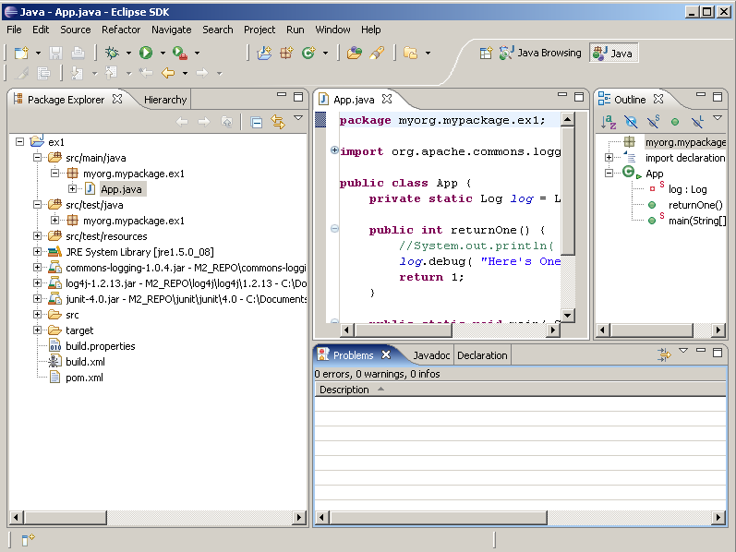
Leveraging IDE using Eclipse:
Importing Maven Project
> mvn eclipse:add-maven-repo -Declipse.workspace=C:/Documents...
> mvn eclipse:eclipse

Slide 24
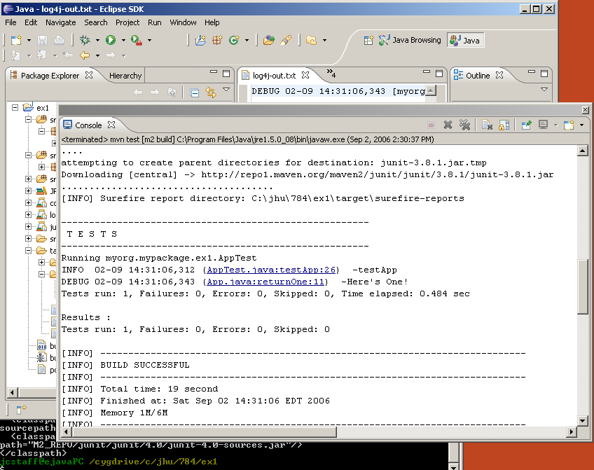
Leveraging IDE using Eclipse:
Adding Maven Tasks

Slide 25
Leveraging IDE using Eclipse:
Adding Maven Tasks

Slide 26
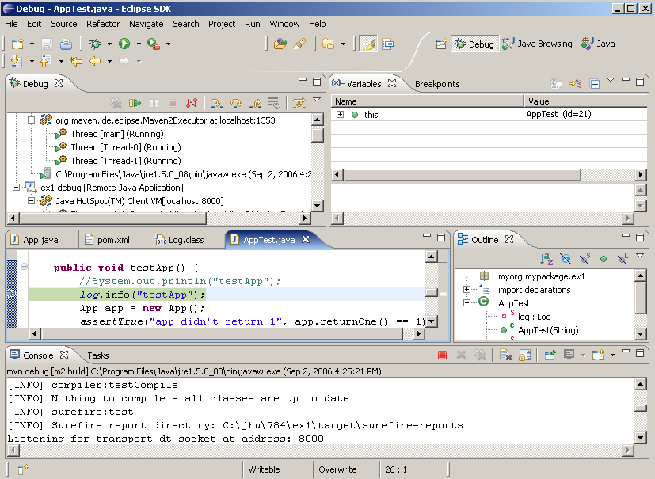
Leveraging IDE using Eclipse:
Using Debugger

Slide 27
Summary
  Directory Structure
    based on Maven
  Tasks to Build Simple Application
    compile, archive, test
  Junit Testing
    test-driven development is a common best practice
  Ant Build Tool
    industry standard portable scripting tool
  Log4j
    use of logging frameworks is a common best practice
  Maven Build System
    up-and-coming build system
  Eclipse IDE
    great support for Java development and debugging

Slide 28
References
Exercise 0: Development Environment Setup
Exercise 1: First Simple Application

