Slide 1
Java EE
Security

Slide 2
Goals
Understand the basic concepts behind Java EE Security
Be able to define an access control policy for our applications
  EJB Tier
  Web Tier
Be able to define and use an authentication provider

Slide 3
Objectives
Java EE Access Control Points
EJB Access Control
Java Authentication and Authorization Service (JAAS)
Web Tier Access Control
Run-As

Slide 4
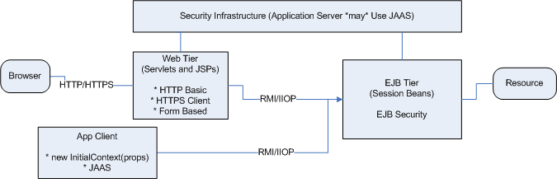
Java EE Access Control Points

Slide 5
EJB Security

Slide 6
EJB Access Control: Annotations
@PermitAll
public String pingAll() {
return getInfo("pingAll");
}
@RolesAllowed({"user"})
public String pingUser() {
return getInfo("pingUser");
}
@RolesAllowed({"admin"})
public String pingAdmin() {
return getInfo("pingAdmin");
}
@DenyAll
public String pingExcluded() {
return getInfo("pingExcluded");
}

Slide 7
EJB Access Control: ejb-jar.xml
<assembly-descriptor>
<method-permission>
<unchecked/>
<method>
<ejb-name>SecurePingEJB</ejb-name>
<method-name>pingAll</method-name>
</method>
</method-permission>
<method-permission>
<role-name>admin</role-name>
...
<method-name>pingAdmin</method-name>
</method>
</method-permission>
<method-permission>
<excluded/>
...
<method-name>pingExcluded</method-name>
</method>
</method-permission>
</assembly-descriptor>

Slide 8
Programmatic Security
Permits access control down to object level
@PermitAll
public void internalCheck() {
if (ctx.isCallerInRole(“internalRole”)) { ... }
}
ejb-jar.xml – map internal role-name to security-role
  <enterprise-beans>
  <session>
  <ejb-name>SecurePingEJB</ejb-name>
  <security-role-ref>
  <description>role-name checked within EJB
  </description>
  <role-name>internalRole</role-name>
  <role-link>admin</role-link>
  </security-role-ref>
  </session>
  </enterprise-beans>
  <assembly-descriptor>
  <security-role>
  <role-name>admin</role-name>
  </security-role>
  </assembly-descriptor>

Slide 9
JBoss Server Setup: conf/login-config.xml
<application-policy name = "ejavaDomain">
<authentication>
<login-module
code="org.jboss.security.auth.spi.UsersRolesLoginModule"
flag="sufficient"> <!-- first provide a quick back door -->
<module-option name="unauthenticatedIdentity">anonymous
</module-option>
</login-module>
<login-module
code="org.jboss.security.auth.spi.DatabaseServerLoginModule"
flag="required"> <!-- now delegate realistic DB module -->
<module-option name = "unauthenticatedIdentity">anonymous
</module-option>
<module-option name = "dsJndiName">java:/ejavaDS</module-option>
<module-option name = "principalsQuery">
SELECT PASSWD FROM EJAVA_Users WHERE USERID=?</module-option>
<module-option name = "rolesQuery">
SELECT Role, 'Roles' FROM EJAVA_UserRoles WHERE USERID=?
</module-option>
</login-module>
</authentication>
</application-policy>

Slide 10
EJB Setup: jboss.xml
<jboss>
<!-- full jndi name not resolving from EJB tier?
<security-domain>java:/jaas/ejavaDomain</security-domain>
-->
<security-domain>ejavaDomain</security-domain>
<!-- this is not being used? -->
<unauthenticated-principal>guest</unauthenticated-principal>
<enterprise-beans>
<session>
<ejb-name>SecurePingEJB</ejb-name>
<jndi-name>
ejava/examples/secureping/SecurePingEJB/remote
</jndi-name>
<local-jndi-name>
ejava/examples/secureping/SecurePingEJB/local
</local-jndi-name>
</session>
</enterprise-beans>
</jboss>

Slide 11
JBoss Server Setup: UserRolesLoginModule
> cat ./securePingApp/securePingEJB/target/classes/users.properties
status1=password
status2=password
user1=password
user2=password
user3=password
admin1=password
admin2=password
known=password
cat ./securePingApp/secure/PingEJB/target/classes/roles.properties
known:
status1:status
status2:status
user1:user,status
user2:user,status
user3:user,status
admin1:admin,user,status
admin2:admin,user,status

Slide 12
JBoss Server Setup: DatabaseServerLoginModule
securePing_create.ddl
  CREATE TABLE EJAVA_Users(
  userId VARCHAR(32) PRIMARY KEY,
  passwd VARCHAR(64)
  )
  CREATE TABLE EJAVA_UserRoles(
  userId VARCHAR(32),
  Role VARCHAR(32)
  )
securePing_populate.ddl
  insert into EJAVA_Users values('admin3', 'password')
  insert into EJAVA_UserRoles values('admin3', 'admin')
  insert into EJAVA_UserRoles values('admin3', 'user')
  insert into EJAVA_Users values('user4', 'password')
  insert into EJAVA_UserRoles values('user4', 'user')

Slide 13
Client Authentication
JAAS Intro

Slide 14
Java Authentication and Authorization Service (JAAS)
Part of J2SE/Java SE SDK
  Introduced as an optional package in v1.3
  Fully integrated by v1.4
Enables services to
  authenticate users
    determine who is executing code in all Java platforms
      application, applet, bean, servlet, etc.
  enforce access controls upon users
    ensure users have the proper rights to perform actions
Extends legacy Java security architecture
  was just checking where code came from
    “Where the code came from”
  now adds Principal-based checking
    “Who is executing the code”

Slide 15
Primary JAAS Classes
LoginContext
  instantiated by Application
Configuration
  referenced by LoginContext
  defines authentication technologies to use
LoginModules
  implement authentication technologies
    prompt for username/password
    read voice or fingerprint sample
  updates a Subject
Subject
  represents user running the code

Slide 16
Common Classes
Shared by both JAAS Authentication and Authorization
  javax.security.auth package
Subject
  represents the source of the request
  grouping of related information for an source/Person
    Principals
    Credentials
Principal
  associated with Subject when authentication successful
    name Principal(“John Doe”)
    ssn Principal(“123-45-6789”)
Credential
  security-related attributes
  public (public keys)
  private (passwords, private keys)

Slide 17
Authentication Classes and Interfaces
Authentication Steps
  application instantiates LoginContext
    CallbackHandler adminLogin = //
    LoginContext lc =
    new LoginContext("securePingTest", adminLogin);
  LoginContext consults a Configuration
    java -Djava.security.auth.login.config=.../securePingTest-auth.conf ...
    securePingTest-auth.conf
      securePingTest {
      // jBoss LoginModule
      org.jboss.security.ClientLoginModule required
      ;
      };
    loads LoginModules
  application invokes LoginContext.login() method
    lc.login();
    invokes all loaded LoginModules
    each LoginModule attempts to authenticate the Subject
  LoginContext now contains authenticated Subject

Slide 18
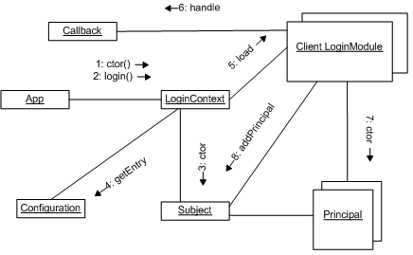
JAAS Login

Slide 19
Authenticated Subject
LoginContext lc = new LoginContext("securePingTest", adminLogin);
lc.login();
log.info("subject=" + lc.getSubject());
for (Principal p: lc.getSubject().getPrincipals()) {
log.info("principal=" + p + ", " + p.getClass().getName());
}
log.info(lc.getSubject().getPrivateCredentials().size() +
" private credentials");
log.info(lc.getSubject().getPublicCredentials().size() +
" public credentials");
-name callback
-password callback
-subject=Subject:
Principal: admin3
-principal=admin3, org.jboss.security.SimplePrincipal
-0 private credentials
-0 public credentials

Slide 20
Authentication Classes and Interfaces
LoginContext
  Constructors
    LoginContext(String name)
    LoginContext(String name, Subject subject)
    LoginContext(String name, CallbackHandler cbh)
    LoginContext(String name, Subject subject, CallbackHandler cbh)
    LoginContext(String name, Subject subject, CallbackHandler cbh, Configuration loginConfig);
    name – a key into the Configuration to determine LoginModules to configure
    new subjects are optionally created or manually supplied
  login()
  getSubject()
  logout()

Slide 21
Authentication Classes and Interfaces
LoginModule
  interface
  implementors supply techniques for different kinds of authentication technologies
    username/password-based authentication
    biometric authentication
  application writer just configures and uses LoginModule
    org.jboss.security.ClientLoginModule
  framework allows for new techniques

Slide 22
Authentication Classes and Interfaces
CallbackHandler
  used to communicate with user to obtain information
  one primary method to implement
    void handle(Callback[] callbacks)
    throws java.io.IOException,
    UnsupportedCallbackException;
  LoginModule passes array of Callbacks to handler
    NameCallback – get username
    PasswordCallback – get user password
Callback
  javax.security.auth.callback package
    defines Callback interface
    several implementations
      NameCallback, etc.

Slide 23
Authentication Classes and Interfaces
import javax.security.auth.callback.*;
public class BasicCallbackHandler implements CallbackHandler {
...
public void handle(Callback[] callbacks)
throws UnsupportedCallbackException {
for (Callback cb : callbacks) {
if (cb instanceof NameCallback) {
//go get name_
((NameCallback)cb).setName(name_);
}
else if (cb instanceof PasswordCallback) {
//go get password_
((PasswordCallback)cb).setPassword(password_);
}
else {
throw new UnsupportedCallbackException(cb);
}
}
}

Slide 24
Authorization Classes
Server-side; not seen by EJB
Pre-requisites
  user is authenticated using LoginContext
  authenticated Subject must be associated with AccessControlContext
  principal-based entries defined in a Policy
Policy
  abstract class for system-wide access control policy
AuthPermission
  encapsualtes basic permissions for JAAS
PrivateCredentialPermission
  used to protect private credentials for a Subject

Slide 25
Client/EJB Test Drive: EJB Code
@RolesAllowed({"admin"})
public String pingAdmin() {
return getInfo("pingAdmin");
}
private String getInfo(String prefix) {
StringBuilder text = new StringBuilder();
text.append("called " + prefix);
try {
text.append(", principal="+ ctx.getCallerPrincipal().getName());
text.append(", isUser=" + ctx.isCallerInRole("user"));
text.append(", isAdmin=" + ctx.isCallerInRole("admin"));
text.append(", isInternalRole=" +
ctx.isCallerInRole("internalRole"));
}
catch (Throwable ex) {
text.append(", error calling Session Context:" + ex);
}
String result = text.toString();
return result;
}

Slide 26
Client/EJB Test Drive: Client CallBackHanders
//create different types of logins
knownLogin = new BasicCallbackHandler();
((BasicCallbackHandler)knownLogin).setName("known");
((BasicCallbackHandler)knownLogin).setPassword("password");
userLogin = new BasicCallbackHandler();
log.debug("using user username=" + userUser); //”user1”
((BasicCallbackHandler)userLogin).setName(userUser);
((BasicCallbackHandler)userLogin).setPassword("password");
adminLogin = new BasicCallbackHandler();
log.debug("using admin username=" + adminUser); //”admin1”
((BasicCallbackHandler)adminLogin).setName(adminUser);
((BasicCallbackHandler)adminLogin).setPassword("password");

Slide 27
Client/EJB Test Drive: Anonymous Client
try {
log.info(securePing.pingAdmin());
fail("didn't detect anonymous user");
}
catch (Exception ex) {
log.info("expected exception thrown:" + ex);
}
-expected exception thrown:javax.ejb.EJBAccessException: Authorization failure; nested exception is: java.lang.SecurityException: Insufficient permissions, principal=null, requiredRoles=[admin], principalRoles=[]

Slide 28
Client/EJB Test Drive: Known Client
try {
LoginContext lc = new LoginContext("securePingTest",
knownLogin);
lc.login();
log.info(securePing.pingAdmin());
lc.logout();
fail("didn't detect known, but non-admin user");
}
catch (Exception ex) {
log.info("expected exception thrown:" + ex);
}
-expected exception thrown:javax.ejb.EJBAccessException: Authorization failure; nested exception is: java.lang.SecurityException: Insufficient permissions, principal=known, requiredRoles=[admin], principalRoles=[]

Slide 29
Client/EJB Test Drive: User Client
try {
LoginContext lc = new LoginContext("securePingTest",
userLogin);
lc.login();
log.info(securePing.pingAdmin());
lc.logout();
fail("didn't detect non-admin user");
}
catch (Exception ex) {
log.info("expected exception thrown:" + ex);
}
-expected exception thrown:javax.ejb.EJBAccessException: Authorization failure; nested exception is: java.lang.SecurityException: Insufficient permissions, principal=user1, requiredRoles=[admin], principalRoles=[user, status]

Slide 30
Client/EJB Test Drive: Admin Client
try {
LoginContext lc = new LoginContext("securePingTest",
adminLogin);
lc.login();
log.info(securePing.pingAdmin());
lc.logout();
}
catch (Exception ex) {
log.info("error calling pingAdmin:" + ex, ex);
fail("error calling pingAdmin:" +ex);
}
-called pingAdmin, principal=admin1, isUser=true, isAdmin=true, isInternalRole=false

Slide 31
Web Tier Access Control

Slide 32
Web Tier Access Control
HTTP Basic Authentication
  supported by HTTP protocol
  based on username/password
    browser collects information from client
    authenticates user into a realm
  not secure; passwords sent simple base64 encoding
  target server not authenticated
  short-comings overcome by layering over TLS (HTTPS)
HTTPS Client Authentication
  based on public key/private key
Form Based Authentication
  permits the use of JSP/HTML forms to gather user info

Slide 33
web.xml: admin/* security constraint
<security-constraint>
<web-resource-collection>
<web-resource-name>admin-only</web-resource-name>
<url-pattern>/model/admin/*</url-pattern>
</web-resource-collection>
<auth-constraint>
<role-name>admin</role-name>
</auth-constraint>
<user-data-constraint>
<transport-guarantee>CONFIDENTIAL</transport-guarantee>
</user-data-constraint>
</security-constraint>
<login-config>
<auth-method>FORM</auth-method>
<form-login-config>
<form-login-page>/WEB-INF/content/Login.jsp
</form-login-page>
<form-error-page>/WEB-INF/content/Login.jsp
</form-error-page>
</form-login-config>
</login-config>

Slide 34
web.xml: servlet mapping
<servlet>
<servlet-name>Handler</servlet-name>
<servlet-class>
ejava.examples.secureping.web.SecurePingHandlerServlet
</servlet-class>
</servlet>
<servlet-mapping>
<servlet-name>Handler</servlet-name>
<url-pattern>/model/admin/handler</url-pattern>
</servlet-mapping>
<servlet-mapping>
<servlet-name>Handler</servlet-name>
<url-pattern>/model/user/handler</url-pattern>
</servlet-mapping>
<servlet-mapping>
<servlet-name>Handler</servlet-name>
<url-pattern>/model/handler</url-pattern>
</servlet-mapping>

Slide 35
jboss-web.xml: security-domain
<?xml version="1.0" encoding="UTF-8"?>
<!DOCTYPE jboss-web PUBLIC
"-//JBoss//DTD Web Application 2.4//EN"
"http://www.jboss.org/j2ee/dtd/jboss-web_4_0.dtd">
<jboss-web>
<security-domain>java:/jaas/ejavaDomain</security-domain>
</jboss-web>

Slide 36
FORM Login.jsp/html
<html>
<body>
<h1>Login Required</h1>
<form action="j_security_check" method="POST">
User Name:
<input type="text" size="20" name="j_username"><p/>
Password:
<input type="password" size="10" name="j_password"><p/>
<input type="submit" value="Login">
</form>
</body>
<html>

Slide 37
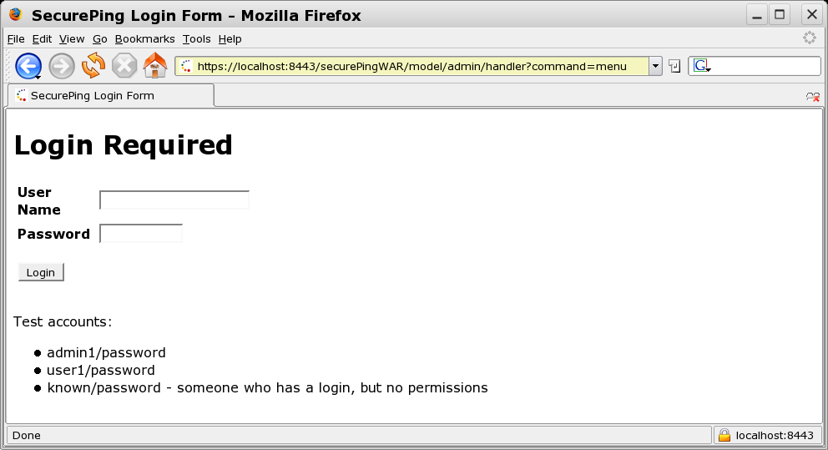
FORM Based Authentication
  transport-guarantee=CONFIDENTIAL

Slide 38
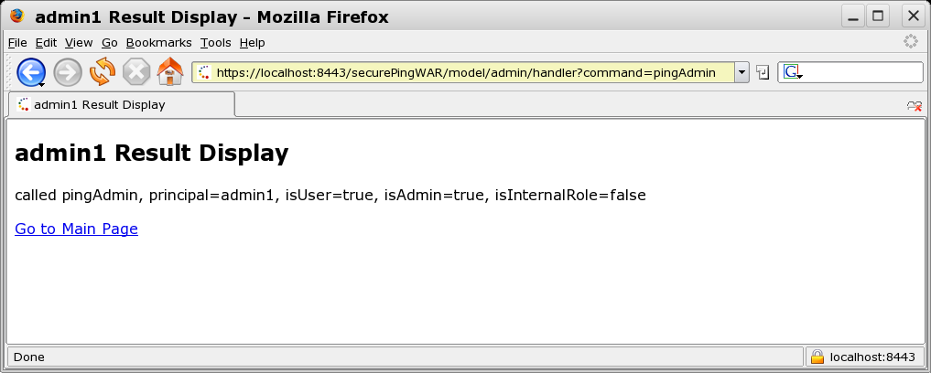
Web Authentication Context Passed to EJB

Slide 39
web.xml: user/* security constraint
<security-constraint>
<web-resource-collection>
<web-resource-name>user-access</web-resource-name>
<url-pattern>/model/user/*</url-pattern>
</web-resource-collection>
<auth-constraint>
<role-name>user</role-name>
</auth-constraint>
<user-data-constraint>
<transport-guarantee>NONE</transport-guarantee>
</user-data-constraint>
</security-constraint>
<login-config>
<auth-method>BASIC</auth-method>
</login-config>

Slide 40
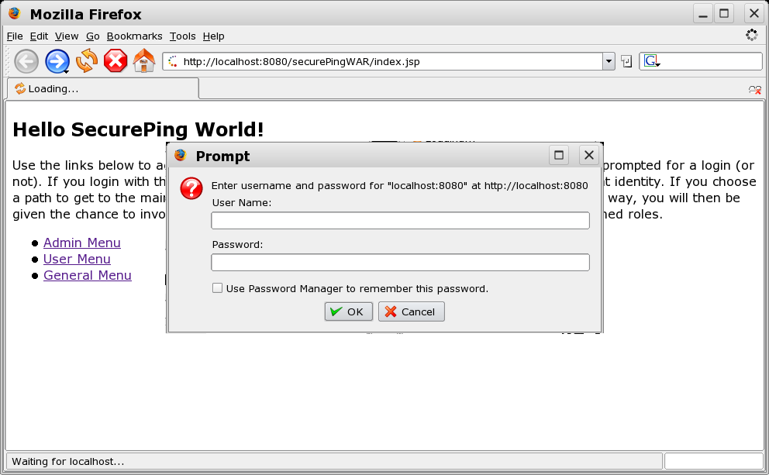
BASIC Authentication

Slide 41
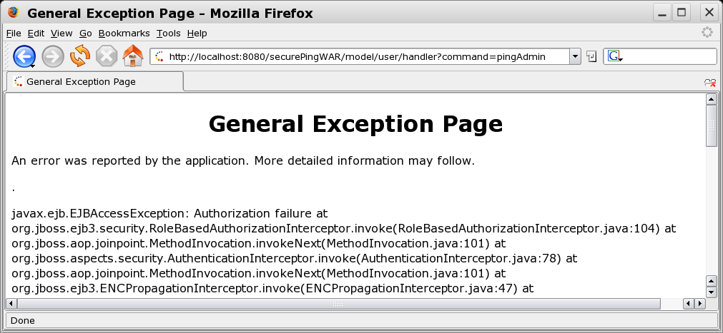
Web Subject not Authorized by EJB Tier

Slide 42
run-as
caller-identity
  default
  uses caller Principal and roles
role-name
  uses a named role
  allows methods to be invoked on behalf of a user

Slide 43
run-as:ejb-jar.xml
<session>
<ejb-name>SecurePingClientEJB</ejb-name>
<ejb-ref>
<ejb-ref-name>ejb/SecurePingEJB</ejb-ref-name>
<ejb-ref-type>Session</ejb-ref-type>
<remote>ejava.examples.secureping.ejb.SecurePingEJB</remote>
<injection-target>
<injection-target-class>
ejava.examples.secureping.ejb.SecurePingClientEJB
</injection-target-class>
<injection-target-name>
securePingServer
</injection-target-name>
</injection-target>
</ejb-ref>
<security-identity>
<run-as>
<role-name>admin</role-name>
</run-as>
</security-identity>
</session>

Slide 44
run-as:jboss.xml
<security-domain>ejavaDomain</security-domain>
<enterprise-beans>
<session>
<ejb-name>SecurePingClientEJB</ejb-name>
<jndi-name>
ejava/examples/secureping/SecurePingClientEJB/remote
</jndi-name>
<local-jndi-name>
ejava/examples/secureping/SecurePingClientEJB/local
</local-jndi-name>
<ejb-ref>
<ejb-ref-name>ejb/SecurePingEJB</ejb-ref-name>
<jndi-name>
ejava/examples/secureping/SecurePingEJB/remote
</jndi-name>
</ejb-ref>
<security-identity>
<run-as-principal>admin1</run-as-principal>
</security-identity>
</session>
</enterprise-beans>

Slide 45
run-as: thread output
run-as is allowing all users call pingAdmin method
real principal name supplied by ctx.getPrincipal() by both EJBs
-*** testPingAdmin ***
-called pingAdmin, principal=anonymous, isUser=false, isAdmin=false, isInternalRole=false:called pingAdmin, principal=anonymous, isUser=false, isAdmin=false, isInternalRole=false
-called pingAdmin, principal=known, isUser=false, isAdmin=false, isInternalRole=false:called pingAdmin, principal=known, isUser=false, isAdmin=false, isInternalRole=false
-called pingAdmin, principal=user1, isUser=true, isAdmin=false, isInternalRole=false:called pingAdmin, principal=user1, isUser=true, isAdmin=false, isInternalRole=false
-called pingAdmin, principal=admin1, isUser=true, isAdmin=true, isInternalRole=false:called pingAdmin, principal=admin1, isUser=true, isAdmin=true, isInternalRole=false

Slide 46
Summary
Java EE
  requires provider to provider authentication
  defines access control specifications for components
Java EE does not
  dictate the authentication mechanisms used
  dictate the access control mechanisms used
EJB Access Control
  class/method level
JBoss Login Modules
JAAS
Web Tier Access Control
run-as

Slide 47
References
“Enterprise JavaBeans 3.0, 5th Edition”; Burke & Monsen-Haefel; ISBN 0-596-00978-X; O'Reilly
Sun Developer Network (SDN), JAAS Reference Documentation http://java.sun.com/products/jaas/reference/docs/index.html
Java EE 5 Specification http://jcp.org/aboutJava/communityprocess/final/jsr244/index.html

