Slide 1
Java Persistence:
Object Inheritance
Mapping

Slide 2
Goals
Be able to map a inheritance relationships between classes to the database using class annotations and ORM descriptors

Slide 3
Objectives
Strategies
  Single Table Per Class
  Table per Concrete Class
  Table per Class (Join)
Non-entity inheritance
Mixed Strategies

Slide 4
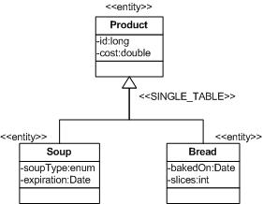
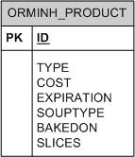
Single Table Inheritance Strategy

Slide 5
Single Table Inheritance Strategy Summary
Advantages
  simplest to implement
    single table to administer
  performs better than all other inheritance strategies
    no complex joins
Disadvantages
  unused fields
  all fields must be nullable
    less able to enforce constraints within database
  not normalized
More Suitable for hierarchies with subtypes
  that primarily differ in behavior only
  that do not have unique data requirement

Slide 6
Single Table: Example DB Schema
  create table ORMINH_PRODUCT (
  TYPE varchar(32) not null,
  id bigint generated by default as identity (start with 1),
  cost double not null,
  bakedOn date,
  slices integer,
  soupType varchar(255),
  expiration date,
  primary key (id)
  );

Slide 7
Single Table: Example Java Mapping
@Entity
@Table(name="ORMINH_PRODUCT")
@Inheritance(strategy=InheritanceType.SINGLE_TABLE)
@DiscriminatorColumn(name="TYPE",
discriminatorType=DiscriminatorType.STRING,
length=32)
public abstract class Product {
private long id;
private double cost;
@Id @GeneratedValue
public long getId() { return id; }
private void setId(long id) { this.id = id; }
...
@Transient
public abstract String getName();

Slide 8
Single Table: Example Java Mapping (cont.)
@Entity
@DiscriminatorValue("BREAD_TYPE")
public class Bread extends Product {
private int slices;
private Date bakedOn;
@Temporal(TemporalType.DATE)
public Date getBakedOn() {
return bakedOn;
}
public void setBakedOn(Date bakedOn) {
this.bakedOn = bakedOn;
}
@Transient
public String getName() { return "Bread"; }
...

Slide 9
Single Table: Example Java Mapping (cont.)
@Entity
public class Soup extends Product {
public enum SoupType {
UNKNOWN("Unknown"),
CHICKEN_NOODLE("Chicken Noodle"),
NEW_ENGLAND_CLAM_CHOWDER("New England Clam Chowder"),
TOMATO("Tomato");
private String text;
private SoupType(String text) { this.text = text; }
public String text() { return text; }
};
private SoupType type = SoupType.UNKNOWN;
private Date expiration;
@Temporal(TemporalType.DATE)
public Date getExpiration() { return expiration; }
@Enumerated(EnumType.STRING)
public SoupType getSoupType() { return type; }
@Transient
public String getName() { return type.text() + "Soup";}
...

Slide 10
@DiscriminatorColumn Annotation
  public interface DiscriminatorColumn extends ... {
    defines a column in table to signify row type
  String name() default “DTYPE”
    name of column that holds row type
  DiscriminatorType discriminatorType() default STRING
    data type of “name” column
  String columnDefinition();
    explicit column definition
  int length()
    length of varchar for STRING type
  enum DiscriminatorType
  STRING
  CHAR
  INTEGER

Slide 11
@DiscriminatorValue Annotation
  public interface DiscriminatorValue extends ... {
    defines column value for discriminator column
  String value()
      default
        for String – entity name
        for CHAR – vendor-specific value
        for INTEGER – vendor-specific value

Slide 12
Single Table: Example Usage
ejava.examples.orm.inheritance.annotated.Soup soup = new Soup();
soup.setCost(2.12);
final long lifetime = 365L*24*60*60*1000;
soup.setExpiration(new Date(System.currentTimeMillis() + lifetime));
soup.setSoupType(Soup.SoupType.CHICKEN_NOODLE);
em.persist(soup);
ejava.examples.orm.inheritance.annotated.Bread bread = new Bread();
bread.setBakedOn(new Date());
bread.setCost(2.25);
bread.setSlices(24);
em.persist(bread);
em.flush();
em.clear();
assertFalse("bread still managed", em.contains(bread));
assertFalse("soup still managed", em.contains(soup));

Slide 13
Single Table: Example Usage (cont.)
List<Product> products =
em.createQuery("select p from Product p").getResultList();
assertTrue("unexpected number of products:" + products.size(),
products.size() == 2);
for(Product p: products) {
  log.info("product found:" + p);
}
  //query specific tables for columns
int rows = em.createNativeQuery(
"select ID, TYPE, COST, SOUPTYPE, EXPIRATION, BAKEDON, SLICES " +
" from ORMINH_PRODUCT")
.getResultList().size();
assertEquals("unexpected number of product rows:" + rows, 2, rows);

Slide 14
Single Table: Example Usage (cont.)
-product found:ejava.examples.orm.inheritance.annotated.Soup@dd23cf, id=1, cost=2.12, type=CHICKEN_NOODLE, expiration=2007-10-08
-product found:ejava.examples.orm.inheritance.annotated.Bread@5a25f3, id=2, cost=2.25, slices=24, baked=2006-10-08
select * from ORMINH_PRODUCT
TYPE ID COST BAKEDON SLICES EXPIRATION SOUPTYPE
---------- -- ---- ---------- ------ ---------- --------------
Soup 1 2.12 (null) (null) 2007-10-08 CHICKEN_NOODLE
BREAD_TYPE 2 2.25 2006-10-08 24 (null) (null)

Slide 15
@Inheritance Annotation
public interface Inheritance extends ...{
InheritanceType strategy() default SINGLE_TABLE
enum InheritanceType
SINGLE_TABLE
  one single root table per class heirarchy
TABLE_PER_CLASS
  one table per concrete class
JOINED
  one table per class in hierachy

Slide 16
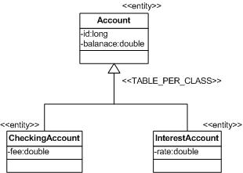
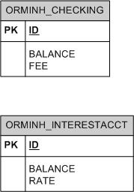
Table per Concrete Class Inheritance Strategy

Slide 17
Table per Concrete Class Inheritance Strategy Summary
Advantages
  may have nullable fields
  permits constraints to be defined within database
Disadvantages
  not normalized
  redundant columns in multiple tables
  more work for provider to implement
    may require multiple selects
    may require SQL UNIONS
      not supported by all databases
  least desirable from a performance and portability standpoint
More Suitable for hierarchies with subtypes
  that do not need to be manipulated with sibling types

Slide 18
Table per Concrete Class: Example DB Schema
  create table ORMINH_CHECKING (
  id bigint not null,
  balance double not null,
  fee double not null,
  primary key (id)
  );
  create table ORMINH_INTERESTACCT (
  id bigint not null,
  balance double not null,
  rate double not null,
  primary key (id)
  );
  create table dual_ORMINH_SEQ (
  zero integer
  );
  insert into dual_ORMINH_SEQ values (0);
  create sequence ORMINH_SEQ start with 1;

Slide 19
Table per Concrete Class: Example Java Mapping
@Entity
@Inheritance(strategy=InheritanceType.TABLE_PER_CLASS)
@SequenceGenerator(
name="orminhSeq", //required logical name
sequenceName="ORMINH_SEQ" //name in database
)
public abstract class Account {
private long id;
private double balance;
@Id @GeneratedValue(strategy=GenerationType.SEQUENCE,
generator="orminhSeq")
public long getId() { return id; }
public void deposit(double amount) throws AccountException{
setBalance(getBalance() + amount);
}
public abstract void withdraw(double amount) throws AccountException;
public void processInterest() {}
...

Slide 20
Table per Concrete Class: Example Java Mapping (cont.)
@Entity
@Table(name="ORMINH_CHECKING")
public class CheckingAccount extends Account {
private double fee;
public void withdraw(double amount)
throws AccountException {
super.setBalance(super.getBalance() - fee);
}
public double getFee() {
return fee;
}
public void setFee(double fee) {
this.fee = fee;
}
...

Slide 21
Table per Concrete Class: Example Java Mapping (cont.)
@Entity
@Table(name="ORMINH_INTERESTACCT")
public class InterestAccount extends Account {
private double rate;
public void withdraw(double amount)
throws AccountException {
super.setBalance(super.getBalance() - amount);
}
public void processInterest() {
super.setBalance(super.getBalance() * (1 + rate));
}
...

Slide 22
Table per Concrete Class: Example Usage
ejava.examples.orm.inheritance.annotated.CheckingAccount checking =
new CheckingAccount();
checking.setFee(0.50);
em.persist(checking);
ejava.examples.orm.inheritance.annotated.InterestAccount savings =
new InterestAccount();
savings.setRate(0.25);
em.persist(savings);
em.flush();
em.clear();
assertFalse("checking still managed", em.contains(checking));
assertFalse("savings still managed", em.contains(savings));

Slide 23
Table per Concrete Class: Example Usage (cont.)
List<Account> accounts =
em.createQuery("select a from CheckingAccount a").getResultList();
accounts.addAll(
em.createQuery("select a from InterestAccount a").getResultList());
assertTrue("unexpected number of accounts:" + accounts.size(),
accounts.size() == 2);
for(Account a: accounts) {
log.info("account found:" + a);
}
//query specific tables for columns
int rows = em.createNativeQuery(
"select ID, BALANCE, FEE from ORMINH_CHECKING")
.getResultList().size();
assertEquals("unexpected number of checking rows:" + rows, 1, rows);
rows = em.createNativeQuery(
"select ID, BALANCE, RATE from ORMINH_INTERESTACCT")
.getResultList().size();
assertEquals("unexpected number of interestacct rows:" + rows, 1, rows);

Slide 24
Table per Concrete Class: Example Usage (cont.)
-account found:ejava.examples.orm.inheritance.annotated.CheckingAccount@1751a9e, id=50, balance=0.0, fee=0.5
-account found:ejava.examples.orm.inheritance.annotated.InterestAccount@cb754f, id=51, balance=0.0, rate=0.25
select * from ORMINH_CHECKING
ID BALANCE FEE
-- ------- ---
50 0.0 0.5
select * from ORMINH_INTERESTACCT
ID BALANCE RATE
-- ------- ----
51 0.0 0.25

Slide 25
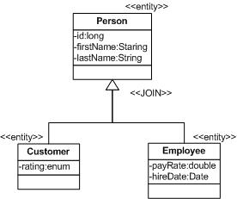
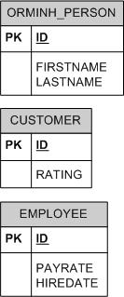
Table per Sub-class (Join) Inheritance Strategy

Slide 26
Table per Sub-class Inheritance Strategy Summary
Advantages
  normalized
  may have nullable fields
  permits constraints to be defined within database
Disadvantages
  requires join
More Suitable for hierarchies with subtypes
  that have unique property requirements
  require database constraints
  queried across sibling types

Slide 27
Table per Sub-class (Join):Example DB Schema
  create table ORMINH_CUSTOMER (
  id bigint not null,
  rating varchar(255),
  primary key (id)
  );
  create table ORMINH_EMPLOYEE (
  id bigint not null,
  hireDate date,
  payrate double not null,
  primary key (id)
  );
  create table ORMINH_PERSON (
  id bigint generated by default as identity (start with 1),
  firstName varchar(255),
  lastName varchar(255),
  primary key (id)
  );
  alter table ORMINH_CUSTOMER add constraint FK6D5464A42122B7AC foreign key (id) references ORMINH_PERSON;
  alter table ORMINH_EMPLOYEE add constraint FK9055CB742122B7AC foreign key (id) references ORMINH_PERSON;

Slide 28
Table per Sub-class (Join):Example Java Mapping
@Entity
@Table(name="ORMINH_PERSON")
@Inheritance(strategy=InheritanceType.JOINED)
public class Person {
private long id;
private String firstName;
private String lastName;
@Id @GeneratedValue
public long getId() { return id; }
private void setId(long id) { this.id = id; }
...

Slide 29
Table per Sub-class (Join):Example Java Mapping (cont.)
@Entity
@Table(name="ORMINH_EMPLOYEE")
public class Employee extends Person {
private double payrate;
private Date hireDate;
@Temporal(TemporalType.DATE)
public Date getHireDate() {
return hireDate;
}
public void setHireDate(Date hireDate) {
this.hireDate = hireDate;
}
...

Slide 30
Table per Sub-class (Join):Example Java Mapping (cont.)
@Entity
@Table(name="ORMINH_CUSTOMER")
public class Customer extends Person {
public enum Rating { GOLD, SILVER, BRONZE }
private Rating rating;
@Enumerated(EnumType.STRING)
public Rating getRating() {
return rating;
}
public void setRating(Rating rating) {
this.rating = rating;
}
...

Slide 31
Table per Sub-class (Join):Example Usage
ejava.examples.orm.inheritance.annotated.Employee employee =
new Employee();
employee.setFirstName("john");
employee.setLastName("doe");
employee.setHireDate(new Date());
employee.setPayrate(10.00);
em.persist(employee);
ejava.examples.orm.inheritance.annotated.Customer customer =
new Customer();
customer.setFirstName("jane");
customer.setLastName("johnson");
customer.setRating(Customer.Rating.SILVER);
em.persist(customer);
em.flush();
em.clear();
assertFalse("employee still managed", em.contains(employee));
assertFalse("customer still managed", em.contains(customer));

Slide 32
Table per Sub-class (Join):Example Usage (cont.)
List<Person> people =
em.createQuery("select p from Person p").getResultList();
assertTrue("unexpected number of people:" + people.size(),
people.size() == 2);
for(Person p: people) {
log.info("person found:" + p);
}
//query specific tables for columns
int rows = em.createNativeQuery(
"select ID, FIRSTNAME, LASTNAME from ORMINH_PERSON")
.getResultList().size();
assertEquals("unexpected number of person rows:" + rows, 2, rows);
rows = em.createNativeQuery(
"select ID, RATING from ORMINH_CUSTOMER")
.getResultList().size();
assertEquals("unexpected number of customer rows:" + rows, 1, rows);
rows = em.createNativeQuery(
"select ID, PAYRATE, HIREDATE from ORMINH_EMPLOYEE")
.getResultList().size();
assertEquals("unexpected number of employee rows:" + rows, 1, rows);

Slide 33
Table per Sub-class (Join):Example Usage (cont.)
-person found:ejava.examples.orm.inheritance.annotated.Employee@6c5356, id=1, firstName=john, lastName=doe, payrate=10.0
-person found:ejava.examples.orm.inheritance.annotated.Customer@1d349e2, id=2, firstName=jane, lastName=johnson, rating=SILVER
select * from ORMINH_PERSON
ID FIRSTNAME LASTNAME
-- --------- --------
1 john doe
2 jane johnson
select * from ORMINH_EMPLOYEE
ID HIREDATE PAYRATE
-- ---------- -------
1 2006-10-08 10.0
select * from ORMINH_CUSTOMER
ID RATING
-- ------
2 SILVER

Slide 34
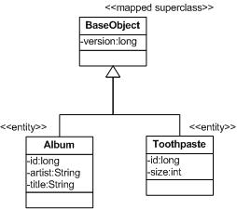
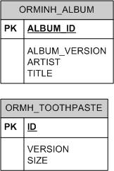
Non-Entity Inheritance Strategy
* Note: In this example, the implementation of BaseObject actually has an id
attribute that the derived classes make use of. However, it is marked as @Transient in
the base class and @Id in the derived Entity classes since MappedSuperClasses do not have
primary keys. This specific example could have also used TABLE_PER_CLASS
because of the availability of an id property in the base class.

Slide 35
Non-Entity Inheritance: Example DB Schema
create table ORMINH_ALBUM (
ALBUM_ID bigint generated by default as identity
(start with 1),
ALBUM_VERSION bigint,
artist varchar(255),
title varchar(255),
primary key (ALBUM_ID)
);
create table ORMINH_TOOTHPASTE (
id bigint generated by default as identity
(start with 1),
version bigint not null,
size integer not null,
primary key (id)
);

Slide 36
Non-Entity Inheritance: Example Java Mapping
@MappedSuperclass
public abstract class BaseObject {
private long id;
private long version;
@Transient //needed to keep from seeing duplicate id fields
public long getId() {
return id;
}
protected void setId(long id) {
this.id = id;
}
public long getVersion() {
return version;
}
public void setVersion(long version) {
this.version = version;
}
@Transient
public abstract String getName();

Slide 37
Non-Entity Inheritance: Example Java Mapping (cont.)
@Entity
@Table(name="ORMINH_ALBUM")
@AttributeOverrides({
@AttributeOverride(name="version", column=@Column(name="ALBUM_VERSION")),
})
public class Album extends BaseObject {
private String artist;
private String title;
@Id @GeneratedValue //sibling independent id
  @Column(name="ALBUM_ID")
public long getId() { return super.getId(); }
protected void setId(long id) { super.setId(id); }
@Transient
public String getName() {
return artist + ":" + title;
}
...

Slide 38
Non-Entity Inheritance: Example Java Mapping (cont.)
@Entity
@Table(name="ORMINH_TOOTHPASTE")
public class ToothPaste extends BaseObject {
private int size;
@Id @GeneratedValue //sibling independent id
public long getId() { return super.getId(); }
protected void setId(long id) { super.setId(id); }
@Transient
public String getName() {
return "" + size + "oz toothpaste";
}
...

Slide 39
Non-Entity Inheritance: Example Usage
ejava.examples.orm.inheritance.annotated.Album album =
new Album();
album.setArtist("Lynyrd Skynyrd");
album.setTitle("One More for the Road");
em.persist(album);
ejava.examples.orm.inheritance.annotated.ToothPaste toothpaste=
new ToothPaste();
toothpaste.setSize(10);
em.persist(toothpaste);
em.flush();
em.clear();
assertFalse("album still managed", em.contains(album));
assertFalse("toothpaste still managed",
em.contains(toothpaste));

Slide 40
Non-Entity Inheritance: Example Usage (cont.)
List<BaseObject> objects =
em.createQuery("select a from Album a").getResultList();
objects.addAll(em.createQuery(
  "select tp from ToothPaste tp").getResultList());
assertTrue("unexpected number of objects:" + objects.size(),
objects.size() == 2);
for(BaseObject o: objects) {
log.info("object found:" + o);
}
//query specific tables for columns
int rows = em.createNativeQuery(
"select ALBUM_ID, ALBUM_VERSION, ARTIST, TITLE " +
" from ORMINH_ALBUM")
.getResultList().size();
assertEquals("unexpected number of album rows:" + rows, 1, rows);
rows = em.createNativeQuery(
"select ID, VERSION, SIZE " +
" from ORMINH_TOOTHPASTE")
.getResultList().size();
assertEquals("unexpected number of toothpaste rows:" + rows, 1, rows);

Slide 41
Non-Entity Inheritance: Example Usage (cont.)
-object found:ejava.examples.orm.inheritance.annotated.Album@1fb050c, id=1, name=Lynyrd Skynyrd:One More for the Road
-object found:ejava.examples.orm.inheritance.annotated.ToothPaste@946d22, id=1, name=10oz toothpaste
select * from ORMINH_ALBUM
ALBUM_ID ALBUM_VERSION ARTIST TITLE
-------- ------------- -------------- ---------------------
1 0 Lynyrd Skynyrd One More for the Road
select * from ORMINHTOOTHPASTE
ID VERSION SIZE
-- ------- ----
1 0 10

Slide 42
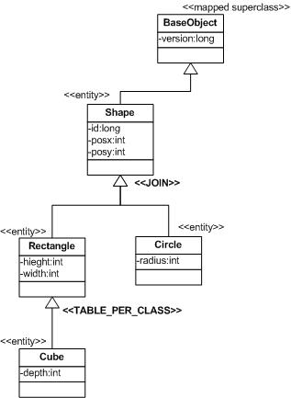
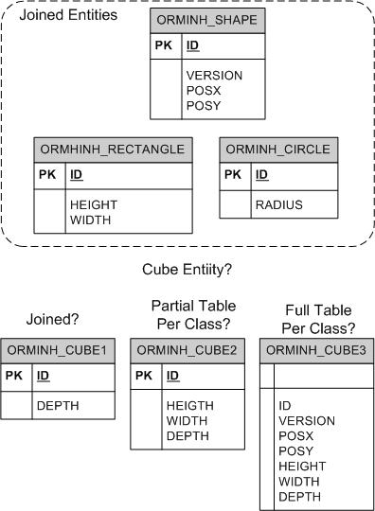
Mixed Inheritance Strategy

Slide 43
Mixed Strategy: Example DB Schema
create table ORMINH_CIRCLE (
id bigint not null,
radius integer not null,
primary key (id)
);
create table ORMINH_CUBE (
id bigint not null,
depth integer not null,
primary key (id)
);
create table ORMINH_RECTANGLE (
id bigint not null,
height integer not null,
width integer not null,
primary key (id)
);
create table ORMINH_SHAPE (
id bigint generated by default as identity (start with 1),
version bigint not null,
posx integer not null,
posy integer not null,
primary key (id)
);
alter table ORMINH_CIRCLE add constraint FKFF2F1F1632C97600 foreign key (id) references ORMINH_SHAPE;
alter table ORMINH_CUBE add constraint FK84203FB112391CE foreign key (id) references ORMINH_RECTANGLE;
alter table ORMINH_RECTANGLE add constraint FK1FFF614932C97600 foreign key (id) references ORMINH_SHAPE;
JOIN Strategy Used

Slide 44
Mixed Strategy Inheritance: Example Java Mapping
@MappedSuperclass
public abstract class BaseObject {
@Entity @Table(name="ORMINH_SHAPE")
@Inheritance(strategy=InheritanceType.JOINED)
public abstract class Shape extends BaseObject {
@Entity @Table(name="ORMINH_RECTANGLE")
public class Rectangle extends Shape {
@Entity
@Inheritance(strategy=InheritanceType.TABLE_PER_CLASS) //ignored!!!
@Table(name="ORMINH_CUBE")
public class Cube extends Rectangle {

Slide 45
Summary
Inheritance Strategies
  Single Table per Hierarchy
    simple, fast, not normalized, no database constraints
  Table per Concrete Class
    not normalized, difficult to handle polymorphically
    least portable across databases
  Table per Sub-class (Join)
    normalized, able to constrain
  Non-entity Inheritance
    similar to Table per Concrete Class
Mixed Strategies
  undefined by spec

Slide 46
References
“Enterprise JavaBeans 3.0, 5th Edition”; Burke & Monsen-Haefel; ISBN 0-596-00978-X; O'Reilly

