Slide 1
Web Tier
(HTML, JSP, Servlets, and WARs)
v121106
Web Tier

Slide 2
Goals
Deploy Data Access Tier within 2-Tier Web Application
  Understand basic HTML concepts for building a web-based user interface
  Create views with JavaServer Pages (JSP)
  Access business logic with Servlets
  Define web application within WAR
v121106
Web Tier

Slide 3
Objectives
Basic HTML
Forms
JavaServer Pages
Servlets
Filters
Scenario
Building/Development
v121106
Web Tier

Slide 4
HTML
Hypertext Markup Language
Regular text with 'markup' elements specifying the desired appearance and layout information
Generated
  statically (document authoring tools)
  dynamically (Servlet-based technologies)
Interpreted by browsers
Tags are well defined
Indentation and spaces not significant
v121106
Web Tier

Slide 5
Basic HTML Example: index.jsp
<!DOCTYPE HTML PUBLIC "-//W3C//DTD HTML 4.01//EN"
"http://www.w3.org/TR/html4/strict.dtd">
<html>
<body>
<h2>Hello Java EE World!</h2>
<ul>
<li><a href="admin/CreateStudent.jsp">
      Create Student</a></li>
<li><a href="admin/GenerateStudents.jsp">
      Generate Students</a></li>
<li><a href="admin/FindStudents.jsp">
      Find Students</a></li>
</ul>
</body>
</html>
v121106
Web Tier

Slide 6
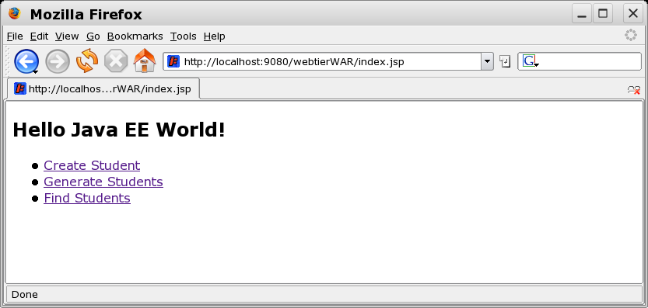
Basic HTML Examples: index.jsp
v121106
Web Tier

Slide 7
Assorted HTML Tags
Main Document Sections
  <HTML>, <HEAD>, <BODY>
Headings
  <H1>, <H2>, ..., <H6>
Forced Paragraph Breaks
  <P> (</P> is optional)
Lists
  numbered - <OL></OL>
  un-numbered - <LI></LI>
  list item - <LI></LI>
Hyperlinks
  <A HREF=”url”>link text</A>
...
v121106
Web Tier

Slide 8
Forms
method
  get
    input values placed in URL
    can be book-marked and cached
  post
    input values placed in body of HTML
    normally used for non-repeat actions (e.g., purchase)
action
  url of processing script
input fields
  text fields, check boxes, etc.
action buttons
  submit, cancel, etc.
v121106
Web Tier

Slide 9
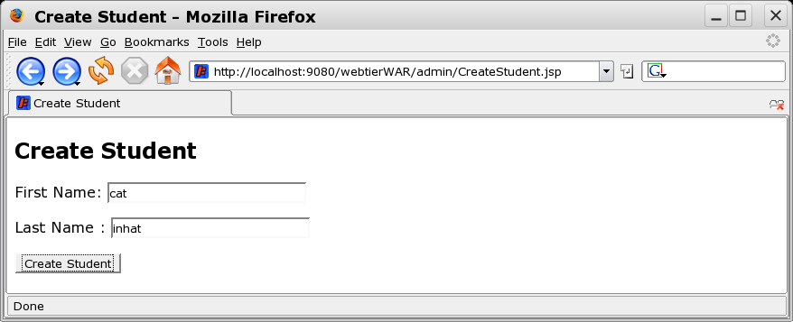
Form Example: CreateStudent.jsp
<form method="get"
action="<%=request.getContextPath()%>/admin/jpa/registrarAdmin">
First Name: <input type="text" name="firstName" size="25"/><p/>
Last Name : <input type="text" name="lastName" size="25"/><p/>
<input type="submit" name="command" value="Create Student"/>
</form>
v121106
Web Tier

Slide 10
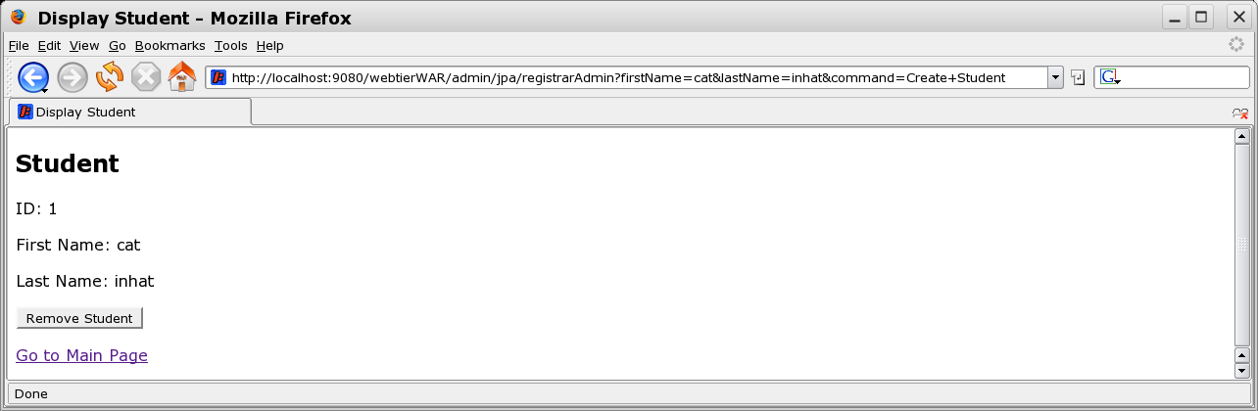
Form Example: Result
request.getContextPath()
action
http://localhost:9080/ webtierWAR /admin/jpa/registrarAdmin?
firstName=cat&lastName=inhat&command=Create+Student
input
v121106
Web Tier

Slide 11
Form Submission
application/x-www-form-urlencoded
  name1=val1&name2=val2&namex=val+x
  space ==> “+”
  non-alphanumeric ==> %xx
    ~ ==> %7E
    / ==> %2F
v121106
Web Tier

Slide 12
Form Summary
Provide simple mechanism to gather user input
Commonly implemented as HTML or JSP
v121106
Web Tier

Slide 13
JavaServer Pages
Document-centric specification
  similar to HTML
  markup code embedded in document
    example: add current date
      <%= new Date() %>
Compliment Servlets
  Servlets provide an algorithm-centric programming model
    good for interfacing with business logic and other infrastructure code
  JSPs
    good for rendering information
v121106
Web Tier

Slide 14
JSP Example: DisplayStudents.jsp
<!DOCTYPE HTML PUBLIC "-//W3C//DTD HTML 4.01//EN"
"http://www.w3.org/TR/html4/strict.dtd">
<jsp:directive.page errorPage="/WEB-INF/content/ErrorPage.jsp" />
<jsp:directive.page import="java.util.*"/>
<jsp:directive.page import="org.apache.commons.logging.*"/>
<jsp:directive.page import="ejava.examples.webtier.bo.*"/>
<html>
<title>Student Display</title>
<body>
<h2>Student Display</h2>
<jsp:scriptlet>
List students = (List)request.getAttribute("students");
int index = ((Integer)request.getAttribute("index")).intValue();
int count = ((Integer)request.getAttribute("count")).intValue();
int nextIndex = ((Integer)request.getAttribute("nextIndex")).intValue();
String firstName = (String)request.getAttribute("firstName");
String lastName = (String)request.getAttribute("lastName");
String ctxRoot = request.getContextPath();
</jsp:scriptlet>
v121106
Web Tier

Slide 15
JSP Example: DisplayStudents.jsp
<form method="get"
action="<%=request.getContextPath()%>/admin/jpa/registrarAdmin">
<ul>
<jsp:scriptlet>
for(Object o: students) {
Student s=(Student)o;
</jsp:scriptlet>
<li><a href= "<%=ctxRoot%>/admin/jpa/registrarAdmin?command=Get%20Student&id=<%=s.getId()%>">
id=<%=s.getId()%>, <%=s.getFirstName()%>, <%=s.getLastName()%></a></li>
<jsp:scriptlet>
}
</jsp:scriptlet>
</ul><p/>
Index: <%=index%> Count: <%=count%>
Index: <input type="hidden" name="index" value="<%=nextIndex%>"/>
Count: <input type="hidden" name="count" value="<%=count%>"/><p/>
First Name: <input type="text" name="firstName" value="<%=firstName%>"/>
Last Name: <input type="text" name="lastName" value="<%=lastName%>"/><p/>
<input type="submit" name="command" value="Find Students"/>
</form>
...
v121106
Web Tier

Slide 16
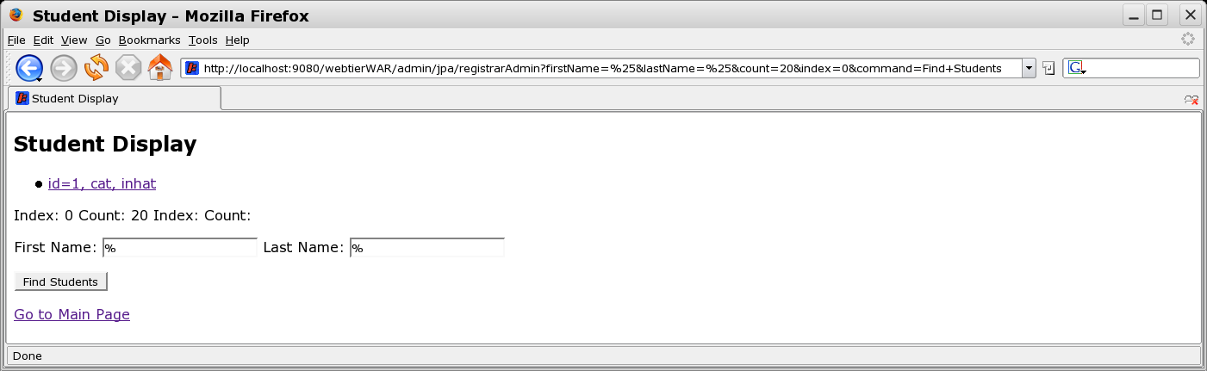
JSP Example: Result
v121106
Web Tier

Slide 17
JSP Basics
Two forms
  shorthand <% %>
    legacy format
    not-XML compliant
    terse
  xml <jsp:x></jsp:x>
    can be validated and used with XML tools
    verbose
v121106
Web Tier

Slide 18
Comments
JSP Comments are stripped out before HTML sent to browser
  <%-- JSP Comment Stripped Out --%>
HTML Comments sent to browser, but contents are ignored
  <!-- HTML Comment seen and ignored -->
v121106
Web Tier

Slide 19
Directives
Guide the compilation of the page
Shorthand
  <%@page import=”java.util.*”%>
XML
  <jsp:directive.page import="java.util.*"/>
Useful directives
  errorPage – names error page to call for uncaught exception
    <jsp:directive.page errorPage="/WEB-INF/content/ErrorPage.jsp" />
  isErrorPage – defines implicit java.lang.Throwable
    <%@ page isErrorPage="true" %>
v121106
Web Tier

Slide 20
JSP Declarations
Shorthand
  <%! %>
XML
  <jsp:declaration></jsp:declaration>
Inserts code at object-scope
  <jsp:declaration>
    int i=0;
    void print() { System.out.println(“” + i++); }
  </jsp:declaration>
This code must be thread-safe
Used by scriptlet code
  <jsp:scriptlet>
    print();
  </jsp:scriptlet>
v121106
Web Tier

Slide 21
Scriptlets
Shorthand
  <% %>
XML
  <jsp:scriptlet></jsp:scriptlet>
Inserts code into service method
<ul>
<jsp:scriptlet>
for(Object o: students) {
Student s=(Student)o;
</jsp:scriptlet>
<li><a href= "...">
id=<%=s.getId()%>, <%=s.getFirstName()%>, <%=s.getLastName()%></a></li>
<jsp:scriptlet>
}
</jsp:scriptlet>
</ul>
v121106
Web Tier

Slide 22
Expressions
Inserts String value of object/expression
Shorthand
  <%= %>
XML
  <jsp:expression></jsp:expression>
Example
  <a href= "<%=ctxRoot%>/admin/jpa/registrarAdmin?command=Get%20Student&id=<%=s.getId()%>">id=<%=s.getId()%>, <%=s.getFirstName()%>, <%=s.getLastName()%></a>
v121106
Web Tier

Slide 23
Implicit Objects
Automatically defined for use
Example values
  request
    HttpServletRequest
  response
    HttpServletResponse
  session
    HttpSession
Example Usage
<jsp:scriptlet>
List students = (List)request.getAttribute("students");
</jsp:scriptlet>
v121106
Web Tier

Slide 24
JSP File Placement
target/webtierWAR
|-- WEB-INF
| |-- classes
| |-- content
| | |-- DisplayException.jsp
| | |-- DisplayStudent.jsp
| | |-- DisplayStudents.jsp
| | |-- ErrorPage.jsp
| | `-- UnknownCommand.jsp
|-- admin
| |-- CreateStudent.jsp
| |-- FindStudents.jsp
| `-- GenerateStudents.jsp
`-- index.jsp
JSPs below WEB-INF cannot
be called directly from client
useful technique to protect
JSPs that require certain
properties to be supplied
Directory-scoped JSPs
directly callable by client
permit access control constraints
to be defined based on url-pattern
(“/admin/*”)
Globally-scoped JSPs
directly callable by client
generally do not have access
controls applied
v121106
Web Tier

Slide 25
Servlets
Server-based Java classes
May generate dynamic web-content
  typically provides access to business logic to obtain goal
  typically delegates rendering of information to JSPs
May access any supporting technology
  JDBC
  EJB
  javax.persistence
  etc.
More efficient than legacy CGI script approaches
  threads versus processes
  objects versus files
v121106
Web Tier

Slide 26
Basic Servlet Form
public class RegistrarHandlerServlet extends HttpServlet {
public void init() { ... }
protected void doGet(HttpServletRequest request,
        HttpServletResponse response)
        throws ServletException, IOException {
... //implement service request
}
protected void doPost(HttpServletRequest request,
HttpServletResponse response)
throws ServletException, IOException {
doGet(request, response); //delgate to single method
}
public void destroy() { ... }
v121106
Web Tier

Slide 27
Example Servlet
Student student = new Student();
student.setFirstName(request.getParameter("firstName"));
student.setLastName(request.getParameter("lastName"));
try {
log.debug("creating new student:" + student);
Student newStudent = registrar.addStudent(student);
request.setAttribute("student", newStudent);
log.debug("new student created:" + student);
RequestDispatcher rd = getServletContext().getRequestDispatcher(
"/WEB-INF/content/DisplayStudent.jsp");
rd.forward(request, response);
} catch (RegistrarException ex) {
request.setAttribute("exception", ex);
RequestDispatcher rd = getServletContext().getRequestDispatcher(
"/WEB-INF/content/DisplayException.jsp");
rd.forward(request, response);
}
v121106
Web Tier

Slide 28
Redirection
Web Browser Redirection
  response.sendRedirect(String url)
  response.sendError(int code, String message)
Server-side Redirection
    RequestDispatcher rd =
    getServletContext().getRequestDispatcher(urlString);
    rd.forward(request, respose);
  urlString can be WEB-INF/(content) that is protected from direct client access
v121106
Web Tier

Slide 29
Thread Safety
Servlet class is instantiated once
Each request is executed in a separate thread
Objects declared within service methods are inherently thread-safe
Objects declared at the object/class scope must be protected from concurrent thread access
v121106
Web Tier

Slide 30
Filters
Permits code to be added prior to and after a Servlet or JSP is invoked
Uses
  short-circuit call depending on a test
  perform logging operations
  perform caching
  could replace functionality of Servlet
v121106
Web Tier

Slide 31
Filter Example: JPAFilter
public class JPAFilter implements Filter {
private static Log log = LogFactory.getLog(JPAFilter.class);
private String puName = "webtier";
private Properties emfProperties = new Properties();
public void init(FilterConfig config) throws ServletException {
log.debug("filter initializing JPA DAOs");
new JPADAOTypeFactory();
DAOTypeFactory daoType = DAOFactory.getDAOTypeFactory();
log.debug("filter got typeFactory:" + daoType.getName());
for(Enumeration e=config.getInitParameterNames();
e.hasMoreElements(); ) {
String key = (String)e.nextElement();
String value=(String)config.getInitParameter(key);
emfProperties.put(key, value);
}
log.debug("emfProperties=" + emfProperties);
}
v121106
Web Tier

Slide 32
Filter Example: JPAFilter
public void doFilter(ServletRequest request,
ServletResponse response,
FilterChain chain) throws IOException, ServletException {
EntityManager em = getEntityManager();
if (!em.getTransaction().isActive()) {
log.debug("filter: beginning JPA transaction");
em.getTransaction().begin();
}
chain.doFilter(request, response);
if (em.getTransaction().isActive()) {
if (em.getTransaction().getRollbackOnly()==true) {
em.getTransaction().rollback();
}
else {
em.flush(); em.clear();
em.getTransaction().commit();
}
}
}
v121106
Web Tier

Slide 33
Filter Example: JPAFilter
private EntityManager getEntityManager() throws ServletException {
if (JPAUtil.peekEntityManager() == null) {
JPAUtil.setEntityManagerFactoryProperties(emfProperties);
}
return JPAUtil.getEntityManager(puName);
}
public void destroy() {
JPAUtil.close();
}
v121106
Web Tier

Slide 34
Registering Servlet: web.xml
<web-app xmlns:xsi="http://www.w3.org/2001/XMLSchema-instance"
xsi:schemaLocation="http://java.sun.com/xml/ns/j2ee
http://java.sun.com/xml/ns/javaee/web-app_2_5.xsd"
xmlns="http://java.sun.com/xml/ns/j2ee"
version="2.5">
<servlet>
<servlet-name>RegistrarAdmin</servlet-name>
<servlet-class>
ejava.examples.webtier.web.RegistrarHandlerServlet
</servlet-class>
<init-param>
<param-name>level</param-name>
<param-value>admin</param-value>
</init-param>
</servlet>
<servlet-mapping>
<servlet-name>RegistrarAdmin</servlet-name>
<url-pattern>/admin/jpa/registrarAdmin</url-pattern>
</servlet-mapping>
v121106
Web Tier

Slide 35
Registering Filter: web.xml
<filter>
<filter-name>JPAFilter</filter-name>
<filter-class>ejava.examples.webtier.web.JPAFilter</filter-class>
<init-param>
<param-name>hibernate.jndi.naming.factory.initial</param-name>
<param-value>org.jnp.interfaces.LocalOnlyContextFactory</param-value>
</init-param>
<init-param>
<param-name>hibernate.jndi.java.naming.factory.url.pkgs</param-name>
<param-value>org.jboss.naming:org.jnp.interfaces</param-value>
</init-param>
</filter>
<filter-mapping>
<filter-name>JPAFilter</filter-name>
<url-pattern>/jpa/*</url-pattern>
<url-pattern>/admin/jpa/*</url-pattern>
<url-pattern>/user/jpa/*</url-pattern>
</filter-mapping>
v121106
Web Tier

Slide 36
Servlet, Filter, War layout
target/webtierWAR
|-- WEB-INF
| |-- classes
| | `-- ejava
| | `-- examples
| | `-- webtier
| | `-- web
| | |-- JNDIHelper.class
| | |-- JPADAOInit.class
| | |-- JPAFilter.class
| | |-- RegistrarHandlerServlet$1.class
| | |-- RegistrarHandlerServlet$CreateStudent.class
| | |-- RegistrarHandlerServlet$GenerateStudents.class
| | |-- RegistrarHandlerServlet$GetStudent.class
| | |-- RegistrarHandlerServlet$GetStudents.class
| | |-- RegistrarHandlerServlet$Handler.class
| | |-- RegistrarHandlerServlet$RemoveStudent.class
| | `-- RegistrarHandlerServlet.class
v121106
Web Tier

Slide 37
Servlet, Filter, War layout
target/webtierWAR
|-- WEB-INF
| |-- content
| | |-- DisplayException.jsp
| | |-- DisplayStudent.jsp
| | |-- DisplayStudents.jsp
| | |-- ErrorPage.jsp
| | `-- UnknownCommand.jsp
| |-- web-jboss.xml
| `-- web.xml
|-- admin
| |-- CreateStudent.jsp
| |-- FindStudents.jsp
| `-- GenerateStudents.jsp
`-- index.jsp
|
...
v121106
Web Tier

Slide 38
Servlet, Filter, War layout
target/webtierWAR
|-- WEB-INF
| |-- lib
| | |-- antlr-2.7.6.jar
| | |-- asm-1.5.3.jar
| | |-- asm-attrs-1.5.3.jar
| | |-- cglib-2.1_3.jar
| | |-- commons-collections-2.1.1.jar
| | |-- commons-logging-1.0.4.jar
| | |-- dom4j-1.6.1.jar
| | |-- ehcache-1.2.3.jar
| | |-- hibernate-3.2.1.ga.jar
| | |-- hibernate-annotations-3.2.1.ga.jar
| | |-- hibernate-entitymanager-3.2.1.ga.jar
| | |-- hsqldb-1.8.0.4.jar
| | |-- javassist-3.3.ga.jar
| | |-- jboss-archive-browsing-5.0.0alpha-200607201-119.jar
| | |-- jta-1.0.1B.jar
| | |-- log4j-1.2.13.jar
| | |-- persistence-api-1.0.jar
| | |-- webtierBL-1.0.2007.1-SNAPSHOT.jar
| | |-- webtierBO-1.0.2007.1-SNAPSHOT.jar
| | |-- webtierDA-1.0.2007.1-SNAPSHOT.jar
| | `-- webtierJPA-1.0.2007.1-SNAPSHOT.jar
v121106
Web Tier

Slide 39
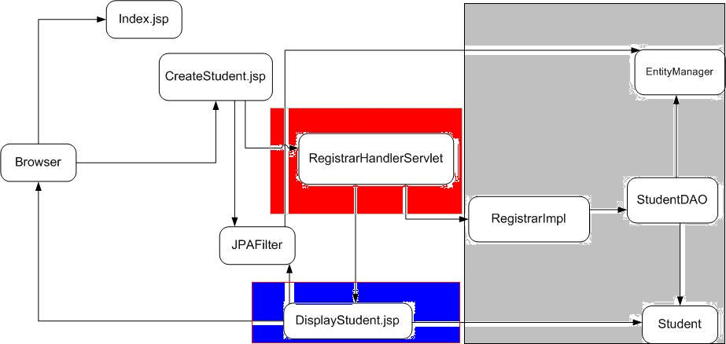
Example Sequence
Model
Controller
View
v121106
Web Tier

Slide 40
Accessing EJBs: ejbsessionBankWAR
Injection
  @EJB Teller teller; //using EJB-specific manner
  @Inject Teller teller; //using CDI
JNDI
  Obtain a JNDI Context
    using default InitialContext from container
      InitialContext jndi = new InitialContext();
    using custom InitialContext from properties
      InitialContext jndi = new InitialContext(jndiProperties);
  Obtain JNDI Name of EJB
    using web.xml servlet config property
      String jndiName = config.getInitParameter("teller.jndi.name");
  Lookup EJB
    Teller teller = (Teller)jndi.lookup(jndiName);
v121106
Web Tier

Slide 41
Build Details
v121106
Web Tier

Slide 42
pom.xml: jetty profile
<profile>
<id>jetty</id>
<build>
<plugins>
<plugin>
<groupId>org.mortbay.jetty</groupId>
<artifactId>maven-jetty-plugin</artifactId>
<version>6.1.26</version>
<configuration>
<scanIntervalSeconds>10</scanIntervalSeconds>
<connectors>
<connector implementation="org.mortbay.jetty.nio.SelectChannelConnector">
<port>9080</port>
<maxIdleTime>60000</maxIdleTime>
</connector>
</connectors>
</configuration>
</plugin>
</plugins>
</build>
v121106
Web Tier

Slide 43
Business Objects: webtierBO
|-- webtierBO
| |-- assembly.xml
| |-- pom.xml
| `-- src
| |-- main
| | `-- java
| | `-- ejava
| | `-- examples
| | `-- webtier
| | `-- bo
| | |-- Grade.java
| | |-- Person.java
| | `-- Student.java
v121106
Web Tier

Slide 44
Data Access Interface: webtierDA
|-- webtierDA
| |-- assembly.xml
| |-- pom.xml
| `-- src
| |-- main
| | `-- java
| | `-- ejava
| | `-- examples
| | `-- webtier
| | `-- dao
| | |-- DAOFactory.java
| | |-- DAOTypeFactory.java
| | |-- StudentDAO.java
| | `-- StudentDAOException.java
v121106
Web Tier

Slide 45
JPA Data Access: webtierJPA
|-- webtierJPA
| |-- assembly.xml
| |-- pom.xml
| `-- src
| |-- main
| | |-- java
| | | `-- ejava
| | | `-- examples
| | | `-- webtier
| | | `-- jpa
| | | |-- JPADAOTypeFactory.java
| | | |-- JPAUtil.java
| | | `-- StudentJPADAO.java
| | `-- resources
| | `-- META-INF
| | |-- orm.xml
| | `-- persistence.xml
v121106
Web Tier

Slide 46
Business Logic: webtierBL
|-- webtierBL
| |-- assembly.xml
| |-- pom.xml
| `-- src
| |-- main
| | `-- java
| | `-- ejava
| | `-- examples
| | `-- webtier
| | `-- bl
| | |-- Registrar.java
| | |-- RegistrarException.java
| | `-- RegistrarImpl.java
v121106
Web Tier

Slide 47
Summary
  HTML
    used to express content to browser
  Forms
    used to gather inputs from user within browser
  JavaServer Pages
    used to render dynamic content (HTML) using business objects
  Servlets
    used to access business logic/back-end systems
  Filters
    used to intercept calls into/out of Servlet/JSP
  Scenario
    Proper usage of tiers
  Structure/Development using Jetty
v121106
Web Tier

Slide 48
References
v121106
Web Tier

