Slide 1
Session Beans

Slide 2
Goals
Be able to deploy business logic to the EJB tier
  hosted by the container
    resource management
    threading
    security
    transactions
  accessed by other local business logic and local web tier
  accessed by remote clients

Slide 3
Objectives
Rationale
Stateless Session Bean
Stateful Session Bean
Example Session Bean

Slide 4
Overview
Entity Beans
  model business data in system
Session Beans
  model interactions between other beans
  taskflow

Slide 5
Associated Design Patterns
Session Façade
Remote Facade/Data Transfer Objects
Value Object Assembler

Slide 6
Session Façade
Context
  multi-tiered application
  non-trivial business logic and data
Problem
  potential tight coupling between clients and complex business objects
  too many method invocations between clients and business objects
  business methods exposed for misuse by clients

Slide 7
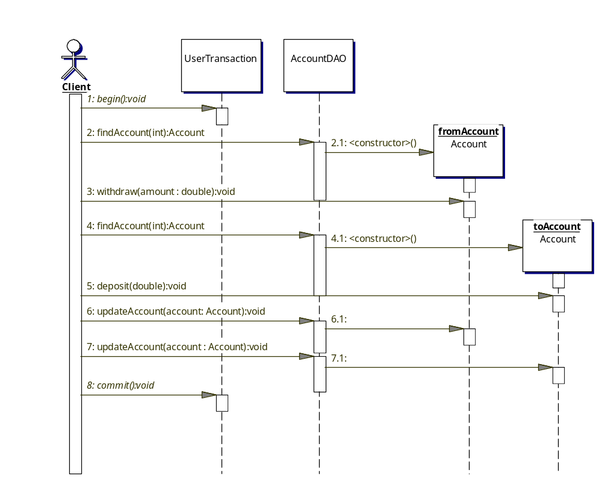
Example Workflow Task

Slide 8
Session Façade
Forces
  hide complex interactions behind a simple client interface
  reduce the number of business objects exposed to the client across the network
  hide implementation, interactions, and dependencies of business components
Solution
  Use a Session Bean to encapsulate the interactions required with the business objects

Slide 9
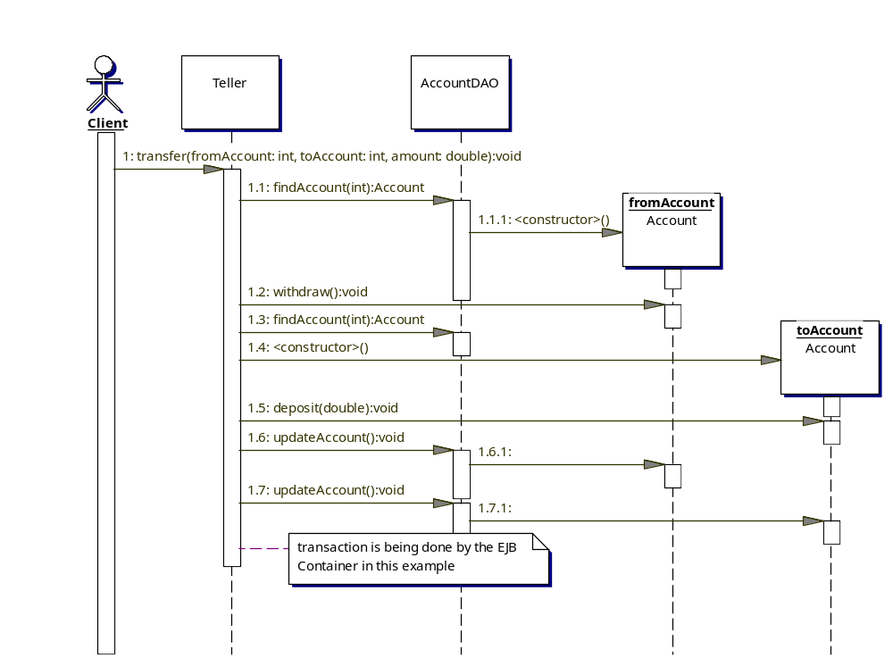
Session Beans Eliminate Workflow Complexity in Client

Slide 10
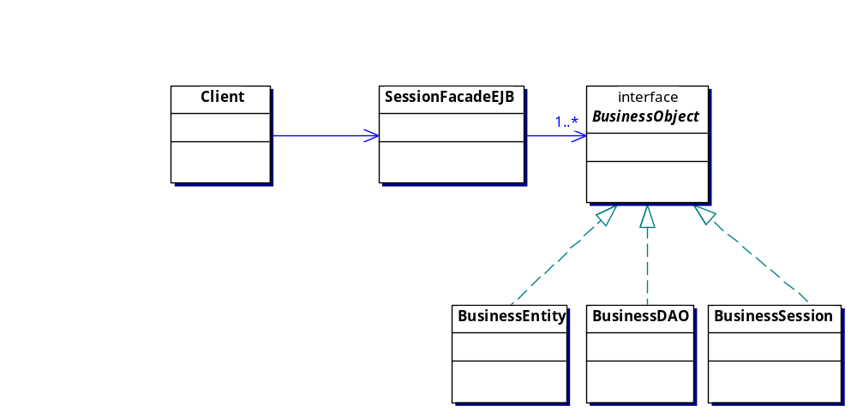
Session Façade Participants

Slide 11
Session Facade
Consequences
  Simplifies complex systems
  May appear to be a no value pass-thru in simple systems
    should involve more that one business object per facade
    should have more than one façade per system
  Decouples the business objects from being aware of one another
  Improves perceived network performance
  Centralizes security and transactions

Slide 12
Remote Facade
Context
  Adding a remote interface to a fine-grain object model
Problem
  Object-Oriented programming promotes small methods
    allowing for control and substitution of behavior
    increases understanding
    increases number of method calls
  Fine grain methods and frequent method calls do not scale across remote interfaces
  Course-grain methods can improve performance and add scale, but obscure the simplicity of the object model

Slide 13
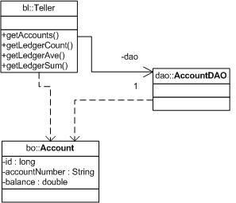
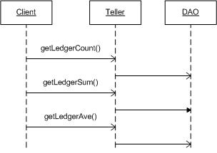
Local Objects and Methods

Slide 14
Remote Facade
Forces
  core service layer (business logic and its business objects) contains fine grain methods and objects
  a significant number of fine-grain remote calls will not work
Solution
  add a Remote Facade
    a course-grain facade over a service layer
    contains no business logic; it calls it
    translates course-grain methods and objects into fine-grain method calls and objects to/from service layer
    bulk accessors wrap fine-grain access methods
  service layer does not have a remote interface
    fine grain business objects used might not be Serializable

Slide 15
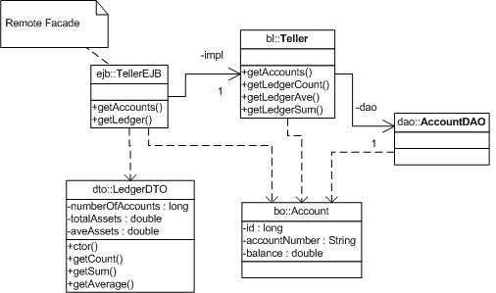
Remote Facade Encapsulates Local Objects

Slide 16
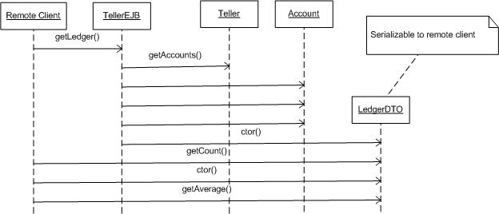
Remote Facade Encapsulates Local Logic

Slide 17
DTO Pattern
Context
  Business Objects represent too much information or behavior to transfer to remote client
Problem
  Client may get information they don't need
  Client may get information they can't handle
  Client may get information they are not autorized to use
  Client may get too much information/behavior to be useful (e.g., entire database serialized to client)
Forces
  Some clients are local and can share object references with business logic
  Handling specifics of remote clients outside of core scope of business logic

Slide 18
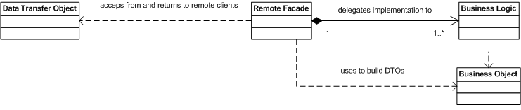
DTO/Remote Facade Solution
Layer a Remote Facade over Business Logic
Remote Facade constructs Data Transfer Objects (DTOs) from Business Objects that are appropriate for remote client view
Remote Facade uses DTOs to construct or locate Business Objects to communicate with Business Logic

Slide 19
DTO Pattern Roles
Data Transfer Object
  represent a subset of the state of the application at a point in time
  not dependent on Business Objects or server-side technologies
    doing so would require sending Business Objects to client
    XML and Web services provide the “ultimate isolation” in DTO implementation
Remote Facade
  uses Business Logic to perform core business logic
  layered on to of Business Logic to translate between Business Objects and DTOs
Business Logic
  continues to perform core duties as described in DAO Pattern

Slide 20
DTO Pattern Consequences
Clients only get what they need
Clients only get what they understand
Clients only get what they are authorized to use
Remote and Local interfaces to services are different
  makes it harder to provide location transparency
Lightweight Business Objects can be used as DTOs
  Remote Facade must make sure they are “pruned” of excess related items before transferring to client
  Remote Facade must make sure they are “cleaned” of DAO persistence classes before transferring to client

Slide 21
Use Cases and Session Beans
Session Bean per Use Case too fine grain
  CreateAccountEJB
  DepositEJB
  WithdrawEJB
  TransferEJB
Group cohesive Use Cases into a larger-grain Session Bean
  TellerEJB
    createAccount(), deposit(), withdraw(), transfer()

Slide 22
Use of Session versus Entity Beans
Session Beans
  implementation of a task
  interaction between other beans
  direct database access
    bulk operations
  examples
    TaxDistrict.calcTax(double cost)
    Teller.transfer(long fromAccount, long toAccount, double amount)
    Registrar.listStudents(String course)

Slide 23
Use of Session versus Entity Beans (cont.)
Entity Beans
  represent shared data in the database
  provide a type-safe, complete view of shared information
  interacts with data generally at the individual object/row level
  examples
    Account, Student
    Account.setOwner(String taxId), Account.getOwner()
    Account.withdraw(double amount),
    Account.deposit(double amount)

Slide 24
Stateless/Stateful Session Beans
Stateless
  maintains no conversational state
    each method is ignorant of what went before it and what will happen after it
  maintains implementation state
    sharable between separate client invocations
  a set of procedures or batch commands that take in a set of parameters and return a result

Slide 25
Stateless/Stateful Session Beans
Stateful
  maintains conversational state
    object can cache values between calls
      ex. iterator
    idle timeout period or client command ends lifetime
  maintains implementation state
    not sharable between separate clients/objects
      all resources are allocated to perform the work of one Stateful Session bean instance. That instance is tied to the state of the client
  able to react to transaction states
    ex. Publish error message on transaction rollback

Slide 26
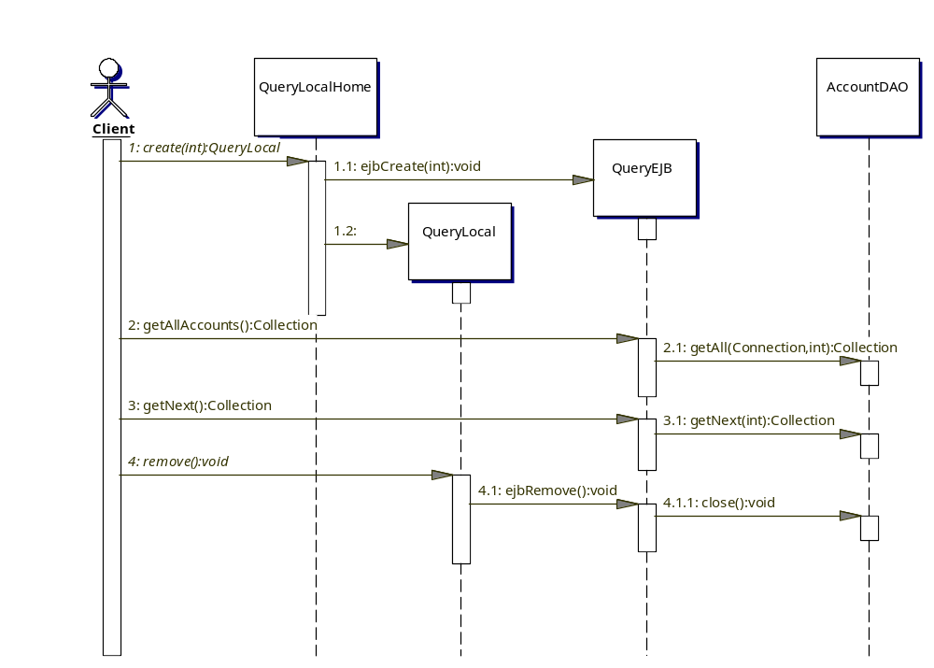
Stateful Session Bean Example (Iteration)

Slide 27
Stateless/Stateful
Stateless
  can contain cached implementations
    JDBC DataSources
    JMS Publishers
    cached EAI state
    all non-visible to calling client
Stateful
  may contain all of the above and add client conversational state

Slide 28
Stateless/Stateful
Stateless
  Cheapest to implement, deploy, scale
Stateful
  should only be used within the scope of a single HttpRequest
  should not be used at HttpSession Scope
    multiple threads would access same instance

Slide 29
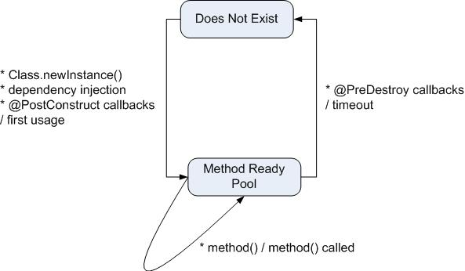
Stateless Session Bean Lifecycle

Slide 30
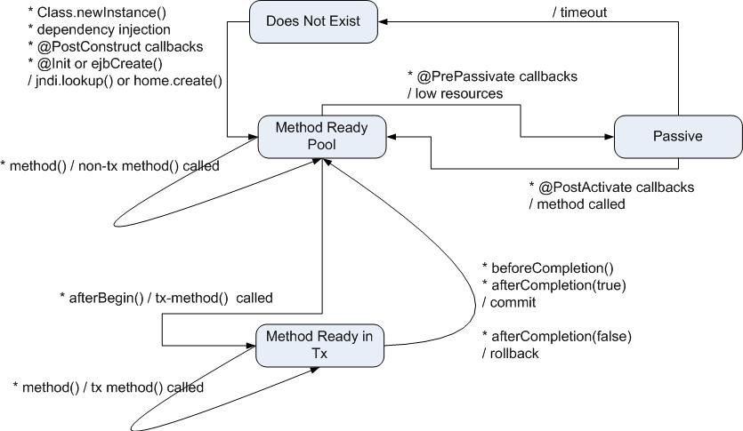
Stateful Session Bean Lifecycle

Slide 31
Example Session Bean: Business Interface
package ejava.examples.ejbsessionbank.bl;
import java.util.List;
import ejava.examples.ejbsessionbank.bo.Account;
import ejava.examples.ejbsessionbank.bo.LedgerDTO;
public interface Teller {
Account createAccount(String accNum) throws BankException;
Account getAccount(String acctNum) throws BankException;
Account closeAccount(String acctNum) throws BankException;
void updateAccount(Account account) throws BankException;
List<Account> getOverdrawnAccounts(int index, int count)
throws BankException;
List<Account> getAccounts(int index, int count)
throws BankException;
LedgerDTO getLedger() throws BankException;
}

Slide 32
Example Session Bean: Local and Remote Interfaces
package ejava.examples.ejbsessionbank.ejb;
import ejava.examples.ejbsessionbank.bl.Teller;
@javax.ejb.Local
public interface TellerLocal extends Teller {
}
package ejava.examples.ejbsessionbank.ejb;
import ejava.examples.ejbsessionbank.bl.Teller;
@javax.ejb.Remote
public interface TellerRemote extends Teller {
}

Slide 33
Example Session Bean: Bean Class
package ejava.examples.ejbsessionbank.ejb;
import java.util.List;
import javax.annotation.*;
import javax.ejb.*;
import javax.persistence.*;
import org.apache.commons.logging.*;
import ejava.examples.ejbsessionbank.bl.*;
import ejava.examples.ejbsessionbank.bo.*;
import ejava.examples.ejbsessionbank.da.*;
import ejava.examples.ejbsessionbank.jpa.JPAUtil;
@Stateless
public class TellerEJB implements TellerLocal, TellerRemote {
Log log = LogFactory.getLog(TellerEJB.class);

Slide 34
Example Session Bean: Bean Class
protected EntityManager em;
protected Teller teller;
@Resource
protected SessionContext ctx;
@Resource(name="daoClass")
protected String daoClassName;
@PersistenceContext(unitName="ejbsessionbank")
public void setEm(EntityManager em) {
log.debug("container setting entity manager:" + em);
this.em = em;
}

Slide 35
Example Session Bean: Bean Class
@PostConstruct
public void init() {
log.debug("init(), daoClass=" + daoClassName);
teller = new TellerImpl();
try {
AccountDAO dao = (AccountDAO)Thread.currentThread()
.getContextClassLoader()
.loadClass(daoClassName)
.newInstance();
((TellerImpl)teller).setAcctDAO(dao);
}
catch (Exception ex) {
throw new EJBException("error loading dao class:" +
daoClassName);
}
JPAUtil.setEntityManager(em);
}

Slide 36
Example Session Bean: Bean Class
@PreDestroy
public void close() {
log.debug("close");
JPAUtil.setEntityManager(null);
teller = null;
}

Slide 37
Example Session Bean: Bean Class
public Account createAccount(String accountNumber) throws BankException{
try {
return teller.createAccount(accountNumber);
}
catch (AccountDAOException ex) {
ctx.setRollbackOnly();
log.fatal("internal error creating account:" + ex);
throw new BankException("internal error creating account:" +ex);
}
}

Slide 38
Example Session Bean Client: Junit Testcase
public class TellerRemoteTest extends TestCase {
InitialContext jndi;
String jndiName = System.getProperty("jndi.name",
"TellerEJB/remote");
public void setUp() throws Exception {
jndi = new InitialContext();
}
public void testCreateAccount() throws Exception {
log.info("*** testCreateAccount ***");
Account account=null;
TellerRemote teller = (TellerRemote)jndi.lookup(jndiName);
log.debug("creating account, teller=" + teller);
account = teller.createAccount("1234");
log.debug("account created:" + account);
}
}

Slide 39
Example Session Bean Client: jndi.properties
# src/test/resources/jndi.properties
java.naming.factory.initial=${java.naming.factory.initial}
java.naming.provider.url=${java.naming.provider.url}
java.naming.factory.url.pkgs=${java.naming.factory.url.pkgs}
# pom.xml
<profile>
<id>jboss</id>
<properties>
<java.naming.factory.initial>org.jnp.interfaces.NamingContextFactory
</java.naming.factory.initial>
<java.naming.provider.url>jnp://localhost:1099
</java.naming.provider.url>
<java.naming.factory.url.pkgs>org.jboss.naming:org.jnp.interfaces
</java.naming.factory.url.pkgs>
</properties>

Slide 40
EJB pom.xml
<modelVersion>4.0.0</modelVersion>
<groupId>ejava.javaee.ejb</groupId>
<artifactId>ejbsessionBankEJB</artifactId>
<packaging>ejb</packaging>
<name>Session Bank EJB</name>
...
<plugin>
<groupId>org.apache.maven.plugins</groupId>
<artifactId>maven-ejb-plugin</artifactId>
<version>2.1</version>
<configuration>
<ejbVersion>3.0</ejbVersion>
<archive>
<manifest> <addClasspath>true</addClasspath> </manifest>
</archive>
<generateClient>true</generateClient>
<clientExcludes>
<clientExclude>META-INF/*</clientExclude>
<clientExclude>**/ejb/*EJB.class</clientExclude>
</clientExcludes>
</configuration>
</plugin>

Slide 41
Summary
Integrates Bean activity (“task script”)
Server-side code for client
  Stateless and Stateful
Server-side cache for client
  Stateful
POJO with minor amount of class metadata

Slide 42
References
“Enterprise JavaBeans 3.0, 5th Edition”; Burke & Monsen-Haefel; ISBN 0-596-00978-X; O'Reilly
“Mobile Design Patterns and Architectures”, http://www.titu.jyu.fi/modpa/ (MODPA)
  Remote Facade
    http://www.titu.jyu.fi/modpa/Patterns/pattern-RemoteFacade.html
“Patterns of Enterprise Archecture, Chapter 15: Remote Facade”; Martin Fowler
  http://www.theserverside.com/tt/articles/content/FowlerPatterns/Fowler_ch15.pdf

