Slide 1
Java EE 5TM
Introduction
v110830
Intro to JavaEE

Slide 2
Goals
Become familiar with the Java EE Architecture
  Understand the purpose of Java SE, Java ME, and Java EE
  Understand the purpose of each Java EE Container
  Understand the purpose of each Java EE API
Understand the difference between an API and Provider
Understand there are significant variations in Java EE architectures
v110830
Intro to JavaEE

Slide 3
Java Technology Levels
Note: Java Technology went through a name change a while back.
J2SE 5.0 stayed J2SE 5.0
J2SE 6.0 is called Java SE 6
J2EE 5.0 became Java EE 5
J2ME will become Java ME
Java Platform, Standard Edition
  Java SE (J2SE)
  core language
Java Platform, Micro Edition
  Java ME (J2ME)
  targeted at small devices
    PDAs
    cell phones
Java Platform, Enterprise Edition
  Java EE (J2EE)
  targeted at enterprise deployments
    persistence
    distributed systems
    web-based applications
    transactions
    security
v110830
Intro to JavaEE

Slide 4
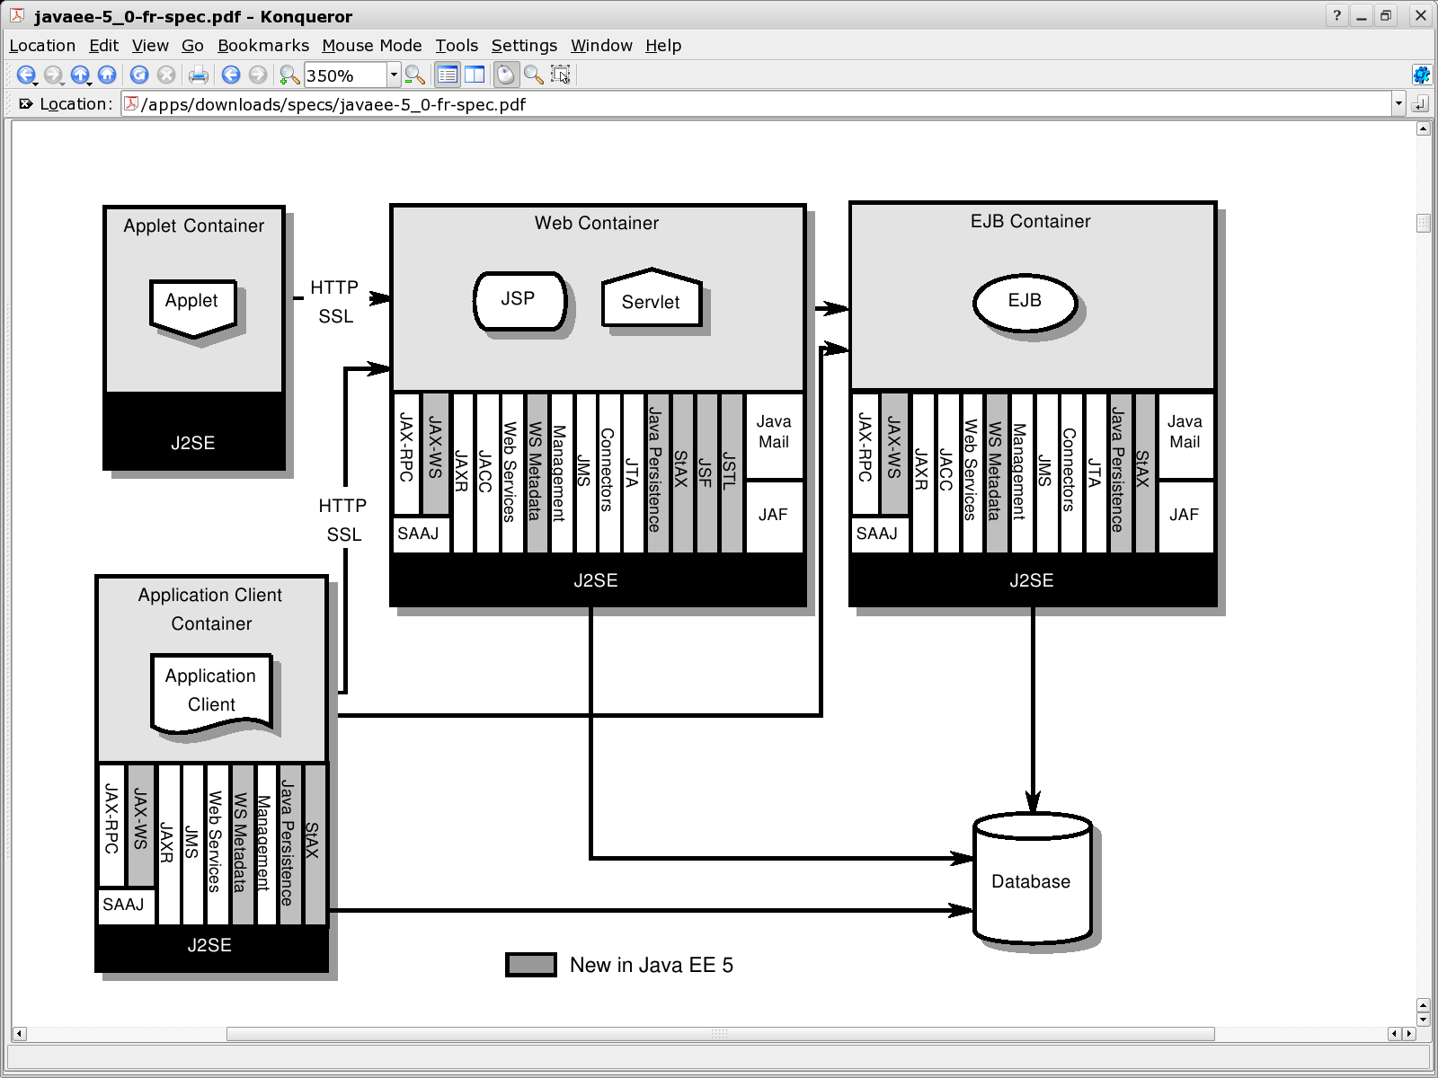
Java EE Architecture
v110830
Intro to JavaEE

Slide 5
Java EE Architecture
Does not imply physical partitioning into machines, processes, etc.
No “all or nothing” requirement
  use what you need
v110830
Intro to JavaEE

Slide 6
Containers
Provide Java EE runtime environments with J2SE v5.0
Provide required services to application components
  example services: JMS, JTA
  application components: Applets, Java applications, Servlets/JSPs, and EJBs
Understand application component deployment formats
Interposes between application components to transparently inject services required
  transactions, security checks, resource pooling
Synonymous with application server from the application developer point of view
v110830
Intro to JavaEE

Slide 7
Application Components
Application Client
  Java programs that execute outside of the EJB, Web, and Applet Containers
  Typically GUI-based
Applets
  GUI components
  typically execute in Web browser
Web Applications
  accessed through HTTP
  primarily generate HTML and XML output
  Servlets, JSPs, JSF, etc.
Enterprise Java Beans (EJB)
  execute in managed environment that include transactions
  typically provide business logic for Java EE application
v110830
Intro to JavaEE

Slide 8
Resource Adapters
System-level software component
Extends functionality of Container
  Provides connectivity with external resource managers or native language components
  Implement existing (e.g., JDBC, JMS) or alternate APIs
Plugin into Java EE environment to provide system-level support for
  Resource Pooling
  Transactions
  Security
v110830
Intro to JavaEE

Slide 9
Standard Services
Communications Services
  HTTP
    J2SE java.net package defines client-side API
    Java EE defines server-side API defined within servlet, JSP, JSF, and Web service interfaces
  HTTPS
    use of HTTP over SSL for transport level security
  Java Message Service (JMS)
    API for messaging
    support for publish-subscribe and point-to-point
v110830
Intro to JavaEE

Slide 10
CORBA Support Services
RMI-IIOP
  APIs (javax.rmi) to allow RMI-style programming independent of underlying protocol
    J2SE native RMI Protocol (JRMP)
    CORBA IIOP protocol
  Permit Java EE application components to access CORBA services compatible with RMI programming restrictions
  Permit CORBA clients to access EJB components
  Using dependency injection versus JNDI lookup eliminates the need for applications to use most of API
Java IDL
  Permit Java EE application components to invoke CORBA services, independent of the RMI API
v110830
Intro to JavaEE

Slide 11
Coordination Services
Java Naming and Directory Interface (JNDI)
  API for naming and directory access
Java Transaction API (JTA)
  application-level API to demarcate transaction boundaries
  provider-level API between transaction and resource managers
v110830
Intro to JavaEE

Slide 12
Persistence Services
Java Database Connectivity (JDBC) API
  API for connectivity with relational databases
Java Persistence API
  API for managing persistence and object/relational mapping
  Required in Java EE
  Can be used in J2SE environments (is part of Java SE 6)
v110830
Intro to JavaEE

Slide 13
XML and Web Service Services
Java API for XML Processing (JAXP)
  integrated API support for separate
    SAX, DOM, and StAX (Streaming API for XML) XML parsing APIs
    XSLT transform engines
Java API for XML-based RPC (JAX-RPC)
  legacy API for Web services
Java API for XML Web Services (JAX-WS)
  follow-on to JAX-RPC
  primary API for Web services
  includes SOAP and RESTful Web service bindings
  uses Java Architecture for XML Binding (JAXB) to define Java to XML bindings
  uses SOAP w/ Attachments API for Java (SAAJ) to manipulate low level SOAP msgs
Web Services Metadata
  defines Java language annotations for developing Web services
Java API for XML Registries (JAXR)
  API for client access to XML registry servers
v110830
Intro to JavaEE

Slide 14
Security Services
Java Authentication and Authorization Service (JAAS)
  enables services to authenticate and enforce access controls
  Java implementation of standard Plugable Authentication Module (PAM)
Java Authorization Service Provider Contract for Containers (JACC)
  defines contract between Java EE application server and authorization service provider
v110830
Intro to JavaEE

Slide 15
System Services
Java EE Connector Architecture (was J2CA)
  provider-level interface for Resource Adapters to integrate Enterprise Information Systems into Java EE servers.
    connection management
      resource pooling
    transaction management
      integrate transactions across multiple resource managers
      import transaction contexts into server
    security access
    thread management
      allows resource adapter to allocate server threads for work
    message delivery
      integrate any messaging provider; not just JMS
    optional, generic API between application program and resource adapter
v110830
Intro to JavaEE

Slide 16
Management/Deployment Services
Management
  Defines API for managing Java EE servers
  Uses Java Management Extensions (JMX) API
Deployment
  Defines API between deployment tools and Java EE products
v110830
Intro to JavaEE

Slide 17
Other Services
JavaMail
  API and service provider for sending e-mail notifications
JavaBeans Activation Framework (JAF)
  API for handling MIME types
v110830
Intro to JavaEE

Slide 18
Java EE 5 APIs and Versions
J2SE v5.0
  JDBC, JNDI, RMI
Java Persistence 1.0
Common Annotations 1.0
EJB3.0
JMS 1.1
JTA 1.1
Servlet 2.5
JSP 2.1
StAX 1.0
Web Services 1.2
Web Services Metadata 2.0
JAX-WS 2.0
JAX-RPC 1.1
SAAJ 1.3
JAXR 1.0
JSTL 1.2
JSF 1.2
JSP Debugging 1.0
Java EE Management 1.1
Java EE Deployment 1.2
JACC 1.1
Connector 1.5
JavaMail 1.4
JAF 1.1
v110830
Intro to JavaEE

Slide 19
Java EE Product Extensions
Java EE products may supply implementations, in any form, for supplied Java EE APIs
  different QOS, sizing, scaling, performance, cost, etc.
Java EE products may provide additional APIs and protocols as extensions
Java EE products may not add classes to Java API packages or change any properties of an existing Java API classes.
Application use of product extensions is non-portable across Java EE products
v110830
Intro to JavaEE

Slide 20
Java EE Roles
Java EE Product Provider
  vendor (e.g., Sun, JBoss, BEA, IBM)
Application Component Provider
  Java, HTML, etc. developer
Application Assembler
  integrates components into an application
Deployer
  integrates application with resources of the runtime
System Administrator
  monitors and tunes application after deployment
Tool Provider
  ex. Maven Cargo plugin
System Component Provider
  ex. external JMS provider
v110830
Intro to JavaEE

Slide 21
Java EE Release Highlights
J2EE 1.3
  Connector API
  EJB (2.x) local interfaces and new CMP model
J2EE 1.4
  “Web services”
  Management, Deployment, JAAS
Java EE 5
  “Ease of Development”
  Annotations
  Dependency Injection
  Better defaults
  Java Persistance API, StAX, JAX-WS
Java EE 6
  Profiles; making some components optional
  More “Ease of Development”
v110830
Intro to JavaEE

Slide 22
Summary
v110830
Intro to JavaEE

Slide 23
References
JavaTM Platform, Enterprise Edition 5 (Java EE 5) Specification (http://jcp.org/en/jsr/detail?id=244)
v110830
Intro to JavaEE

