Slide 1
Computational Methods for Complex, High-Runtime Models

Slide 2
Often times, complex models are needed
Many decision-relevant models are complex + computationally intensive
Optimization (LP/MIP/IP/NLP) with time dependence
General Equilibrium
Dynamical/chaotic
DMDU leverages exploratory modeling over wide range of plausible scenarios
Statistical power for vulnerability analyses and optimization
Robustness
When one is used, it’s because it’s the best route to answer a question

Slide 3
Example use cases
Water resources modeling for resource planning
Energy modeling for decarbonization
Leverage an epidemiological model early in a pandemic
Large scale integrated geospatial models
Two projects…

Slide 4
Ex: MWD
Under what conditions is Metropolitan Water District’s 2015 Integrated Water Resources Plan (IRP) vulnerable?
IRPSIM: MWD in-house water resources model
Met developed it, familiar with it, trusted it
Modified to include climate and other exogenous uncertainties
https://www.rand.org/pubs/tools/TL320/tool/case-studies/southern-california.html

Slide 5
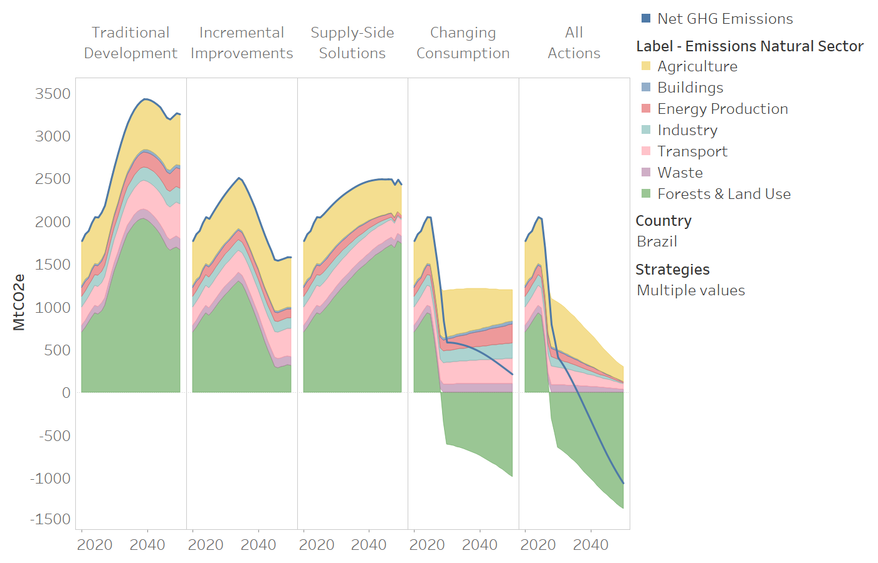
Ex: SISEPUEDE
Costs + benefits of decarbonization at the transformation level
70+ transformations in 130 potential strategies
2k input variables w/integrated LP
18 countries, 2015-2050 model period

Slide 6
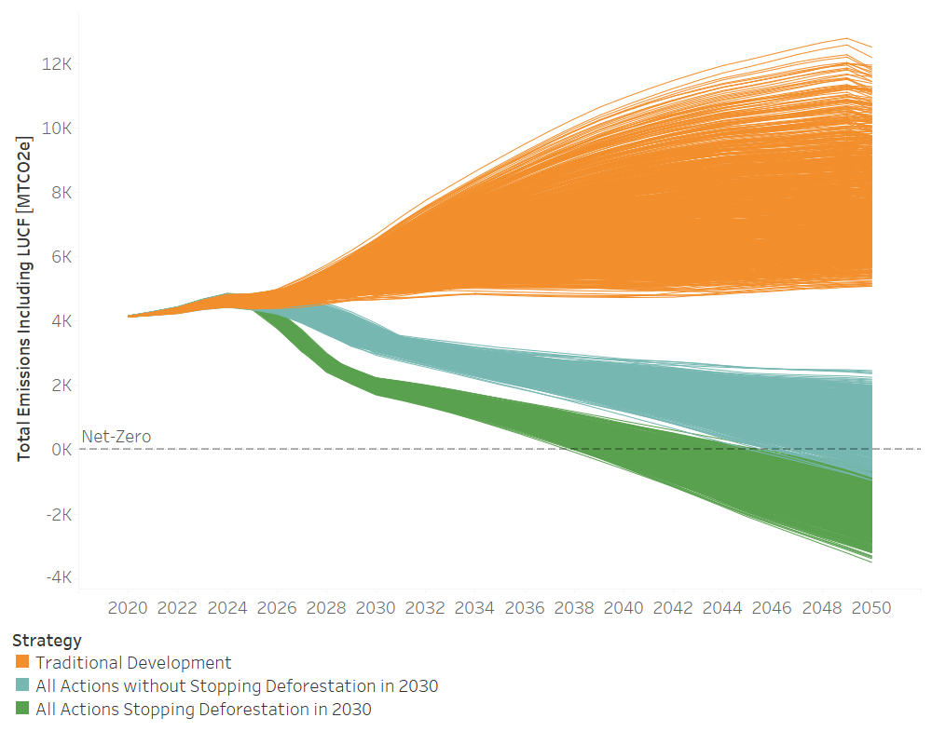
Ex: SISEPUEDE
1001 Emissions trajectories from model x 3 Strategies x 18 countries
54054 runs @ ≈3 min/run => 112 days, 15 hours
105 GB of data in 1 experiment
4 hours sounds a bit more palatable

Slide 7
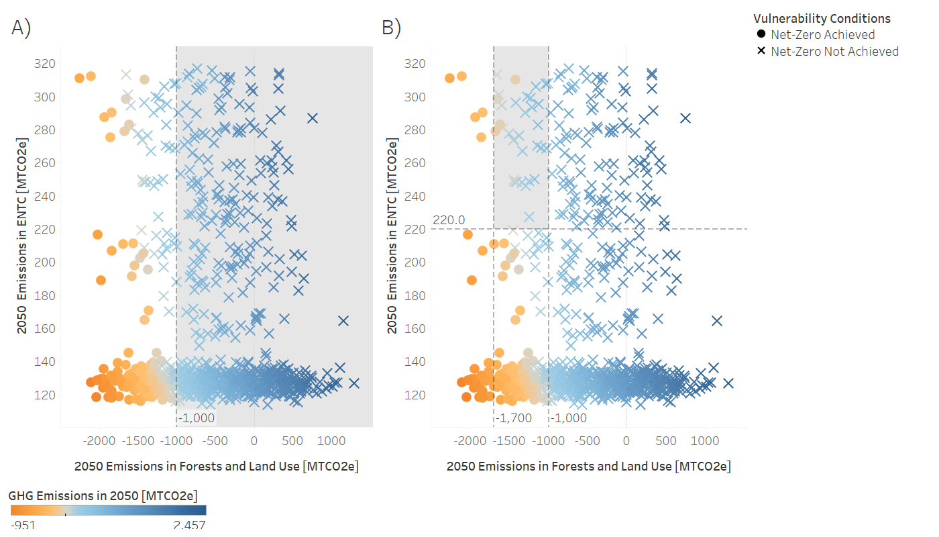

Slide 8
DMDU provides the modeling context
DMDU is often iterative, integrating stakeholder feedback to improve analyses
Ensemble runs may be executed multiple times under a range of evolving conditions (new uncertainties, new levers)
Modeling for DMDU should facilitate this process, not constrain it

Slide 9
The context has implications for process structure
Models should be valid under baseline and alternative conditions
System should:
allow for stakeholder feedback to affect model outcomes
produce plausible scenarios, including exogenous uncertainties and levers
execute model across scenarios
support visualization and analysis

Slide 10
Well-structured code, data, and models can overcome hurdles
High runtime models limit exploratory modeling using serial computing on local machines
Large designs can generate a lot of data, which can be infeasible to store in memory
Large datasets make post processing difficult
Also:
I wrote all this code, but 6 months later I can’t read it or reproduce what I did, and now I have to repeat work
Debugging is huge pain

Slide 11
Aren’t there options for self-contained analyses?
Python Packages:
Rhodium
Exploratory Modeling Analyst’s Workbench (EMA Workbench)
Treat problem similarly: create a model object, run experiments, specify policies, and visualize results
Not well-suited for problems at this scale
Analytica
Self-contained modeling system that facilitates fast evaluation over Monte Carlo trials
Expensive, difficult to share with others, not well suited for all modeling problems

Slide 12
You have to wear a lot of hats to construct these
Policy researcher
Modeler
Programmer
Data engineer
Data scientist
QA/QC

