Slide 1

Unobtrusive JavaScript with Asp.Net & JQuery
John Teague
  Owner, Principle Consultant,
  Avenida Software
    Custom Software Development
    Agile Coaching & Training
    TDD & XP Software Development
http://johnteague.lostechies.com
John Teague Avenida Software http://johnteague.lostechies.come

Slide 2
Before We Get Started
DemoWare Disclaimer
Using a Different JavaScript Library?
  Let’s not get into a Library war. If you are using a different library and you are happy with it, Good!!!
Have Your own Custom Library
  Just Stop!! Pick an existing library and stick with it. If it doesn’t do something exactly the way you want, customize and contribute to the community.
John Teague Avenida Software http://johnteague.lostechies.come

Slide 3
Topics to Cover
Unobtrusive JavaScript (UJS) & Progressive Enhancement
  What, Why, & How
JQuery
  DOM Element Selectors
  Event Handling
  HTML Manipulation and Traversal
  AJAX
JQuery & UJS in a WebForm apps
John Teague Avenida Software http://johnteague.lostechies.come

Slide 4
What is Unobtrusive JavaScript
Style of JavaScript Programming that allows you to add behavior to websites in a progressive fashion
A subset of Progressive Enhancement Web Site Architecture
  Includes UJS
  CSS
  Semantic HTML
John Teague Avenida Software http://johnteague.lostechies.come

Slide 5
Principles of
Unobtrusive JavaScript
Separation of behavior from HTML
Make No Assumptions about the browser’s capability and user preferences
Progressive Enhancement
  Build site for least functionality, progressively add style and functionality
Following W3C Standards
John Teague Avenida Software http://johnteague.lostechies.come

Slide 6
The Bad Old Days
Only Layout options were tables
All formatting had to be inline with font tags or element attributes
Behavior was inline with each element
Html was used for style, structure, and behavior
John Teague Avenida Software http://johnteague.lostechies.come

Slide 7
Moving To Semantic Markup
Use HTML to describe the semantic meaning and relationship of your content
  Using Html to describe visual appearance
  <br><br>
  <b><font size="2">Widget X</font></b>
  <br><br>
  <font size="1">Widget X is the greatest things since sliced bread.</font>
John Teague Avenida Software http://johnteague.lostechies.come

Slide 8
Semantic Style
<div id="widgetXContainter">
<h3>Widget X</h3>
<p>
Widget X is the greatest things since sliced bread.
</p>
</div>
John Teague Avenida Software http://johnteague.lostechies.come

Slide 9
Progressive Enhancement
Similar Concept to Grace Degradation except in reverse
Start by building your page to work on the lowest common denominator and build up to more capable browsers
No JavaScript
No CSS
John Teague Avenida Software http://johnteague.lostechies.come

Slide 10
UJS & Progressive Enhancement
No in-line event handlers
All code is contained in external .js files
The site remains usable without JavaScript
Existing links, buttons and forms are repurposed when JavaScript is available
JavaScript dependent elements are dynamically added to the page
John Teague Avenida Software http://johnteague.lostechies.come

Slide 11
Why follow UJS Principles
Allows for the broadest possible audience
  More and More people access web sites through mobile browsers
  Each have different JavaScript & CSS functionality
John Teague Avenida Software http://johnteague.lostechies.come

Slide 12
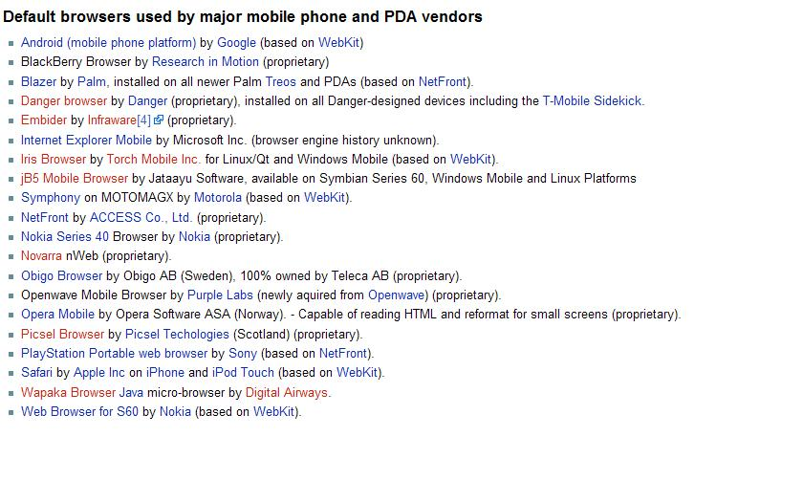
Mobile Browsers
John Teague Avenida Software http://johnteague.lostechies.come

Slide 13
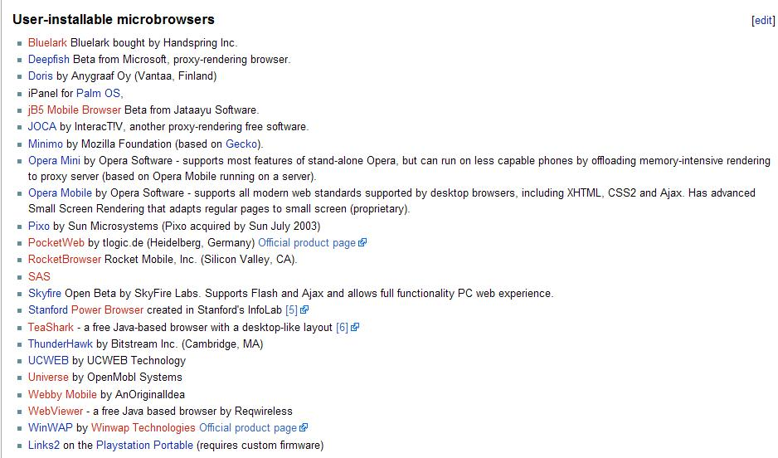
More Browsers
John Teague Avenida Software http://johnteague.lostechies.come

Slide 14
Why follow UJS Principles
Faster Page Loads
  Caching of CSS and JavaScript
  Faster processing of HTML
Easier to Maintain and Enhance Website
  Changing behavior for large set of events
  Changing Layout
John Teague Avenida Software http://johnteague.lostechies.come

Slide 15
Obtrusive JavaScript
Have you read our
<a href="javascript:window.open(
  'terms.html',
  'popup‘,
  'height=500,width=400,toolbar=no’);">
  terms and conditions</a>
John Teague Avenida Software http://johnteague.lostechies.come

Slide 16
Converted to Unobtrusive
HTML
  Have you read our<a id=“terms” href="terms.html” class="sidenote”>terms and conditions</a>
CSS
  CSS class sidenote
JavaScript
  Event Handler for the click event in a separate JavaScript file
John Teague Avenida Software http://johnteague.lostechies.come

Slide 17
jQuery
JavaScript library to help perform common and / or difficult client-side tasks
Advantages
  Cross Browser
  Light-weight
  Easy DOM selection & manipulation
  Pluggable architecture keeps file size down and easily extensible
John Teague Avenida Software http://johnteague.lostechies.come

Slide 18
Functions
Named
  var doSomething = function(arg1,arg2){
  //code goes here
  }
Inline or Anonymous
  function(){//code goes here}
John Teague Avenida Software http://johnteague.lostechies.come

Slide 19
Callbacks
A Callback is a parameter to a function that points to another function
  It can be a named function or an anonymous function
  Example, click handler:
    $(‘a’).click(function(){//click logic goes here})
    $(‘a’).click(clickFunction);
John Teague Avenida Software http://johnteague.lostechies.come

Slide 20
Objects
Named
  function UserObject(param){
  this.param1 = param;
  }
  var userObj = new UserObject(‘x’);
Anonymous
  Open and closed with brackets, properties defined with : and separated with ,
  {property1: “value”,
  property2: 123,
  function1: function(){}//or the name of a function
  }
John Teague Avenida Software http://johnteague.lostechies.come

Slide 21
jQuery Object
jQuery(‘selector’) or $(“selector”)
Returns a jQuery object with an array or selected elements and helper methods.
When we perform an action on the jQuery object, it will be performed on all DOM Elements encapsulated in it.
John Teague Avenida Software http://johnteague.lostechies.come

Slide 22
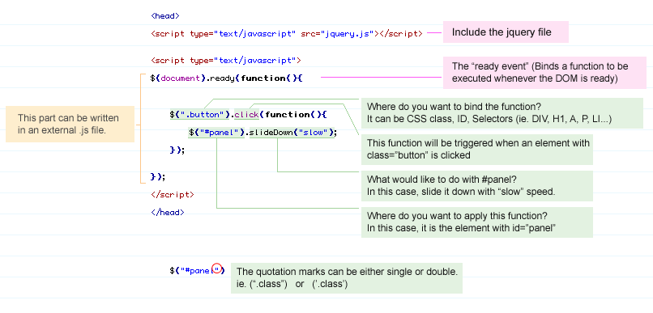
jQuery
Anatomy of a jQuery Page
http://www.webdesignerwall.com/tutorials/jquery-tutorials-for-designers/
John Teague Avenida Software http://johnteague.lostechies.come

Slide 23
Starting Code When the Page is loaded
Standard approach
  document.onload
    Does Not fire until entire page is loaded, including images
With jQuery
  $(document).ready(function);
  shortcut method:
    $(function);
  Function parameter can be either a named function or a anonymous function
    $(document).ready(function(){
    //Your Code Goes Here
    });
John Teague Avenida Software http://johnteague.lostechies.come

Slide 24
Selectors
Supports most CSS 1-3 selectors and xquery selectors
  Simple Examples:
    Select all elements: $(‘*’)
    Select all div elements: $(‘div’)
    Select element by id: $(‘#id’)
    Select all elements with class: $(‘.class’)
    Select a List of elements: $(‘h1,h2,h3’) //there is an easier way
John Teague Avenida Software http://johnteague.lostechies.come

Slide 25
Hierarchy Selectors
Ancestor Descendant Selectors
  Select all paragraphs inside and element
    $(‘#wrapper p’)
  Select all input elements on a form
    $(‘#myform input’)
Parent Child Selectors
  Find all child elements of a selector
    $(‘#element > *’)
Previous / Next Selectors
  Find all inputs that are next to a label
    $(‘label + input’)
John Teague Avenida Software http://johnteague.lostechies.come

Slide 26
Pseudo Class Filters
Convenience selectors modeled after CSS pseudo selectors
  :first :last
  :even :odd
  :eq(index) :gt(index) :lt(index)
  :header :hidden :visible
John Teague Avenida Software http://johnteague.lostechies.come

Slide 27
Attribute Filters
Filtering elements based on values of their attributes
  find input with name attribute = value
    $(‘input[name=??]’) –
  Find anchor tags that start with mailto:
    $(‘a[href^=mailto]’)
  Find anchor tags that end with ‘pdf’
    $(‘a[href$=pdf]’)
John Teague Avenida Software http://johnteague.lostechies.come

Slide 28
Traversing
The jQuery object has a list of dom elements,
Several helper methods are available when you need to find or modify the elements selected.
  find(selector)
  filter(selector)
  children(selector)
    $(‘div’).children().addClass(‘class’);
John Teague Avenida Software http://johnteague.lostechies.come

Slide 29
Manipulation
Changing Contents
  All manipulation methods have an overload that sets the value
    Html()
    Text()
    Val() – form fields
Insert Inside, Outside, and Around selected elements
Replace and Remove Contents of selected elements
John Teague Avenida Software http://johnteague.lostechies.come

Slide 30
CSS
Get the Style Property
  $(‘abc’).css(‘style-name’);
  $(‘abc’).css(‘style-name’,value);
  $(‘abc’).css({backgoundColor:’green’,color:’blue’);
Positioning, Height & Width
  $(‘abc’).offset()
    Returns object with left & top properties
Adding and Removing css classes
  $(‘abc’).addClass(‘class-name’);
  $(‘abc’).removeClass(‘class-name’);
  $(‘abc’).toggleClass(‘class-name’);
John Teague Avenida Software http://johnteague.lostechies.come

Slide 31
Events
Can attach events and trigger events
Use bind() method to bind to any event
Helper methods
  Click(function) change(function)
  Mouse events
Interaction event handlers
  Hover(mouseover, mouseout)
  Toggle(fn1,fn2,…)
John Teague Avenida Software http://johnteague.lostechies.come

Slide 32
Effects
Simple methods to show, hide and simple visual effects
  show(), show(‘fast’|’slow’)
  hide(), hide(‘fast’|’slow’)
  toggle();
Similar functions to fade in/out, slide in/out
Custom animations
More effects in the jQuery.UI library
John Teague Avenida Software http://johnteague.lostechies.come

Slide 33
Ajax
Provides a base ajax method and several specialized methods
  $.ajax(options)
    $.ajax({type:’post’,url:’remote.aspx’})
  $.get(url,data,callback);
  $.post(url,data,callback);
  $.load(url,data,callback);//loads html
  $.getJSON(url,data,callback);
John Teague Avenida Software http://johnteague.lostechies.come

