Slide 1
Realtime Web Apps with Node

Slide 2
What is Node (Mostly)
Server Side JavaScript environment built on top of Chrome V8 engine.
Notes:
True but not the most important aspects

Slide 3
Node Paradigm:
Designed for I/O intensive applications
Uses Event model with asynchronous handling
Single-threaded event loop reduces application complexity
Notes:
Low level abstrations over the OS – filesystem and networking
Few slightly higher abstractions – streams, event emitter, crypto, https
Npm module loading user-created modules
Unix philosophy of combining small utilties togheter to do more interesting things

Slide 4
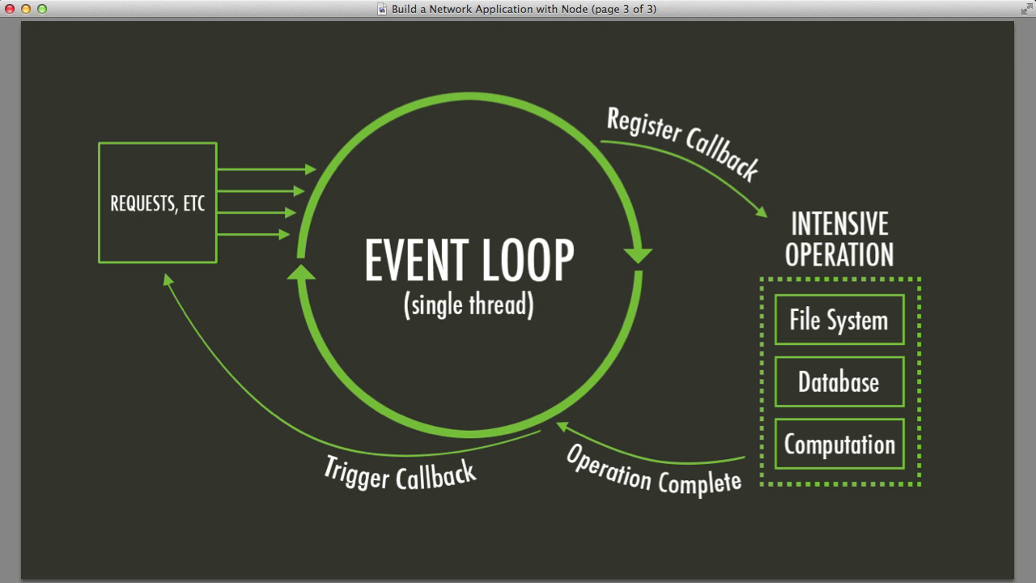
https://www.packtpub.com/build-network-application-with-node/video
Notes:
Doesn’t speed up individual request, creates faster processing of requests
Think of it like the function stack on the OS or CLR
Requests come in, functions are executed and callbacks are registered, request is not blocked
When result of function is returned, callback is executed and function is back on the event loop and the request completes

Slide 5
The Event Loop
Single Threaded (mostly)
I/O calls are asynchronous and don’t block the process
Process I/O results in async callbacks

Slide 6
Do Not Block the Event Loop!

Slide 7
The Standard Approach
var results = query(“select * from A”) //blocking

Slide 8
The Asych Approach
query(“select * from A”,function(data){
//callback for processing results
})//non-blocking

Slide 9
Full Node Definition
Node.js is a platform built on Chrome's JavaScript runtime for easily building fast, scalable network applications. Node.js uses an event-driven, non-blocking I/O model that makes it lightweight and efficient, perfect for data-intensive real-time applications that run across distributed devices.

Slide 10
Node on Windows
Can be hosted with IIS (iisnode project)
Can run as separate process (nssm)
Fully Supported on Azure
Edge.js to connect CLR libraries & Node
Forked version to run Windows 10 IoT core

Slide 11
Websockets
Bidirectional,long-lived open socket between browser and server
Full Duplex communication
Low latency
No Polling!

Slide 12
WebSocket Support

Slide 13

Websockets in the real world

Slide 14
Websockets in the real world
The Standard is rather complex
Multiple versions of the standards
Http Proxies can cause havoc
Can loose connectivity and can crash the browser
While the browser adoption rate is high, user connection rate is low

Slide 15
Solution: Use Framework with Fallbacks
socket.io
sockjs
SignalR (on Windows Server 2012)

Slide 16
Fallback Connection
Polling!
Long Polling
Server Sent Events / EventSource
Flash sockets
Iframe streaming

Slide 17
Nodejs Realtime Frameworks
ExpressJS + socket.io
Sails
SocketStream

Slide 18
Stop talking and show me some code!

Slide 19
What’s next
Getting Rid of the Middleman
with
Web RTC

Slide 20
WebRTC
HTML5 Rocks! tutorial
http://www.html5rocks.com/en/tutorials/webrtc/basics/
Peerjs – peer-peer webRTC framework
Holla – webRTC voice and video framework

