Slide 1
Battle of the Neighborhoods
Long Island City vs. Harbourfront East

Slide 2
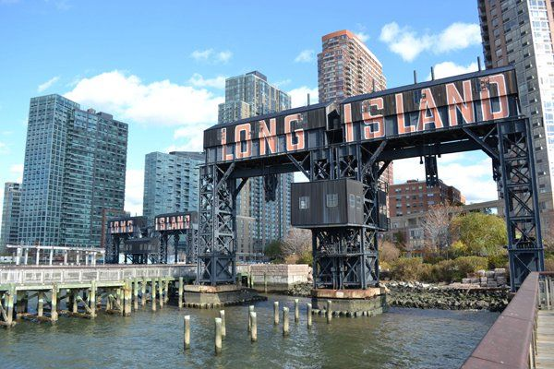
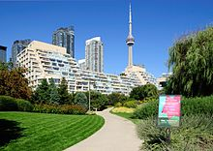
Comparing two contestants for Amazon’s HQ2
Long Island City, NY
Harbourfront East, ON
This Photo by Unknown Author is licensed under CC BY-SA
This Photo by Unknown Author is licensed under CC BY-SA

Slide 3
Problem statement
2017 Amazon released a request for proposal for a second Amazon headquarters in which could hire up to 50,000 employees
Over 200 cities and municipalities applied. The list was eventually reduced to 20 finalists. Two of which were Toronto (Harbourfront East) and New York (Long Island City).
In November 2018 New York and Northern Virginia were selected.
Toronto remains a competitive and attractive site for a large technology company’s headquarters.
Many factors go into a decision like this, but what similarities are there between the venues in Harbourfront East and Long Island City? Is there potential for investment, and what type, in Harbourfront East ahead of the next potential large corporate investment?

Slide 4
Description of the data
The data used for this project will be acquired from Wikipedia, publicly available geospatial data, as well as from FourSquare via their API.
First the New York data was assessed to find the specific location parameters for Long Island City. Then the Foursquare API was leveraged to bring in information pertaining to venues within Long Island City. At the end of the assessment the top ranked venue types within Long Island City were ranked utilizing k-mean clustering.
The same technique was applied to the Toronto data.
Both data sets were combined and k-mean clustering was used to find similarities and patterns

Slide 5
Long Island City Results

Slide 6
Harbourfront East Results

Slide 7
Combined Results after k-Mean Clustering

Slide 8
Results
The most common venues located within Long Island City are Coffee Shops, Hotels, Pizza places, Cafes, Mexican restaurants, Bars, Donut Shops, Cocktail Bars, Mediterranean Restaurants, and Convenience stores.
The most common venues located within Harbourfront East are Coffee Shops, Hotels, Aquariums, Pizza places, Cafes, Restaurants (general), Breweries, Scenic lookouts, Italian Restaurants, and Sports Bars.
Long Island City and Harbourfront East appear to be similar in that they both have a similar concentration of Coffee shops, hotels, Pizza places, and Cafes.

Slide 9
Discussion
It would appear that Long Island City and Harbourfront East are not too dissimilar compared to the venue data we analyzed.
The largest difference noted was the prevalence of aquariums and scenic lookouts located within Harbourfront East. These locations by their nature may be very difficult to repurpose or otherwise utilize for retail or hotel space.
there were a larger number of unclassified restaurants listed within Harbourfront East. It may be work further investigation to determine what types of restaurants these are and what their varieties may be.

Slide 10
Conclusion
it does appear that Harbourfront East and Long Island City are very similar, but with some unique differences in regard to the concentration of aquariums and scenic lookouts in Harbourfront East.
It would be worth further exploration to determine if these venues provide inflexible real estate constraints when considering the placement of a large corporate headquarters within the same vicinity.
it would be worth further investigation to classify the general restaurants listed within Harbourfront East to better determine the diversity of cuisine in the area. If a real estate developer were looking to emulate similar business found in Long Island City, they may consider investigating whether opening a convenience store or a donut/pastry shop would be worthwhile.

