Slide 1



Living literature review
A person decides
Anaí Oñate, UTE
Juan Carlos Torres, UTPL
Narration generated with an AI voice (ElevenLabs) and reviewed by the authors
1 / 10
Notes:
We present the living literature review. It keeps a review about artificial intelligence up to date. We built it. Anaí Oñate comes from U T E and Juan Carlos Torres from U T P L.

Slide 2


A review ages once it is delivered
New articles appear every week.
Question: impact of AI on young people's learning
2 / 10
Notes:
A literature review gets old the day it is delivered. New articles appear every week. Searching again, removing the repeated ones and deciding which to include almost never gets done by hand. That is why the review ends up outdated. This example began with a research question. What has been the impact of using artificial intelligence tools on the learning abilities of adolescents and young people? For this, two reviewers must find the new articles and decide on each one.

Slide 3



The tool
Who uses it
What it receives
What it delivers
Two reviewers
15 new articles weekly
Excel workbook, summary
Based on guide 10
3 / 10
Notes:
Two reviewers use it. Both work on the same workbook. Every week they receive a batch of fifteen new articles. Each article comes with the suggestion from artificial intelligence, the abstract and the link. The tool delivers an Excel workbook with pending, approved and rejected sheets, a dated history and the batches. It also includes a summary of what was approved. It is based on guide ten of the course.

Slide 4



How it works
People write the protocol
Scripts import, compare DOI
AI suggests and quotes
Two reviewers decide
Only what both approve enters
4 / 10
Notes:
First people prepare the protocol with the question, the criteria, the sources and the search strings. Then scripts import the batch from Open Alex, Crossref and Scopus. They also compare the D O I numbers to flag the repeated ones. Artificial intelligence only suggests include, exclude or insufficient evidence, and it quotes the abstract. Each reviewer approves or rejects separately in their own columns. The suggestion from artificial intelligence is only a proposal. An article enters the result only if both agree. Everything is recorded in a dated history. Rejected articles are kept so they do not reappear without a warning.

Slide 5
Evidence: first batch
15
10 and 5
7 of 15
new of 16 evaluated
approved and rejected
in Scopus by DOI
Proposal: records without abstract
5 / 10
Notes:
We tested the tool with a first batch. It evaluated sixteen records, discarded one and left fifteen new ones. The two reviewers approved ten and rejected five, with no disagreements. Everything was recorded with its date. Scopus found seven of the fifteen by D O I. A test with four cases separated one approved record, one rejected, one disagreement and one record with only one reviewer. Records without an abstract remain a proposal, because we have not tested them yet.

Slide 6



Limits and responsible use
AI suggests, a person decides
No personal data
Next: theoretical framework and article
6 / 10
Notes:
The tool does not decide. It suggests from the abstract and the reviewers decide. It works only with scientific articles, with no personal data except the published authors. Everything lives in an Excel workbook designed and owned by the authors. The next step is the theoretical framework and the scientific article. That is a human task beyond the tool.

Slide 7
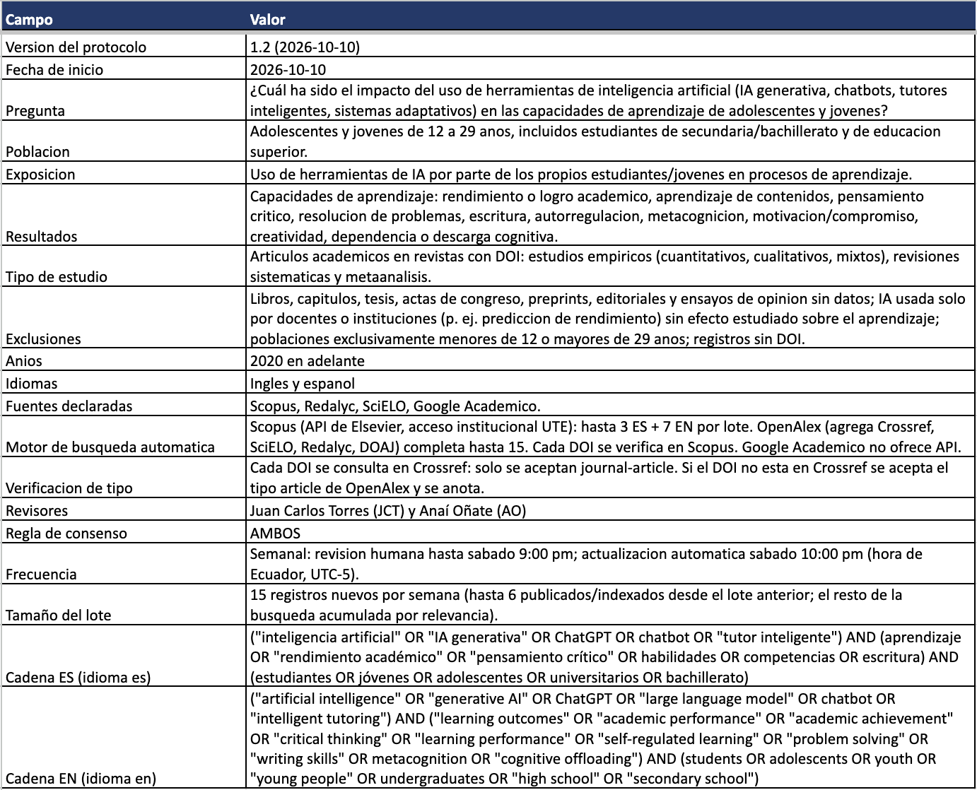
Input: Protocol sheet
The question, criteria and sources
7 / 10
Notes:
This is the Protocol sheet, which is the input of the tool. Here people write the research question of the project. They also define the population from twelve to twenty nine years old, the criteria and the sources. They set the search strings, the batch size and the consensus rule as well. It also records the protocol version and the start date. Everything the tool does starts from this sheet. Nothing runs without it.

Slide 8
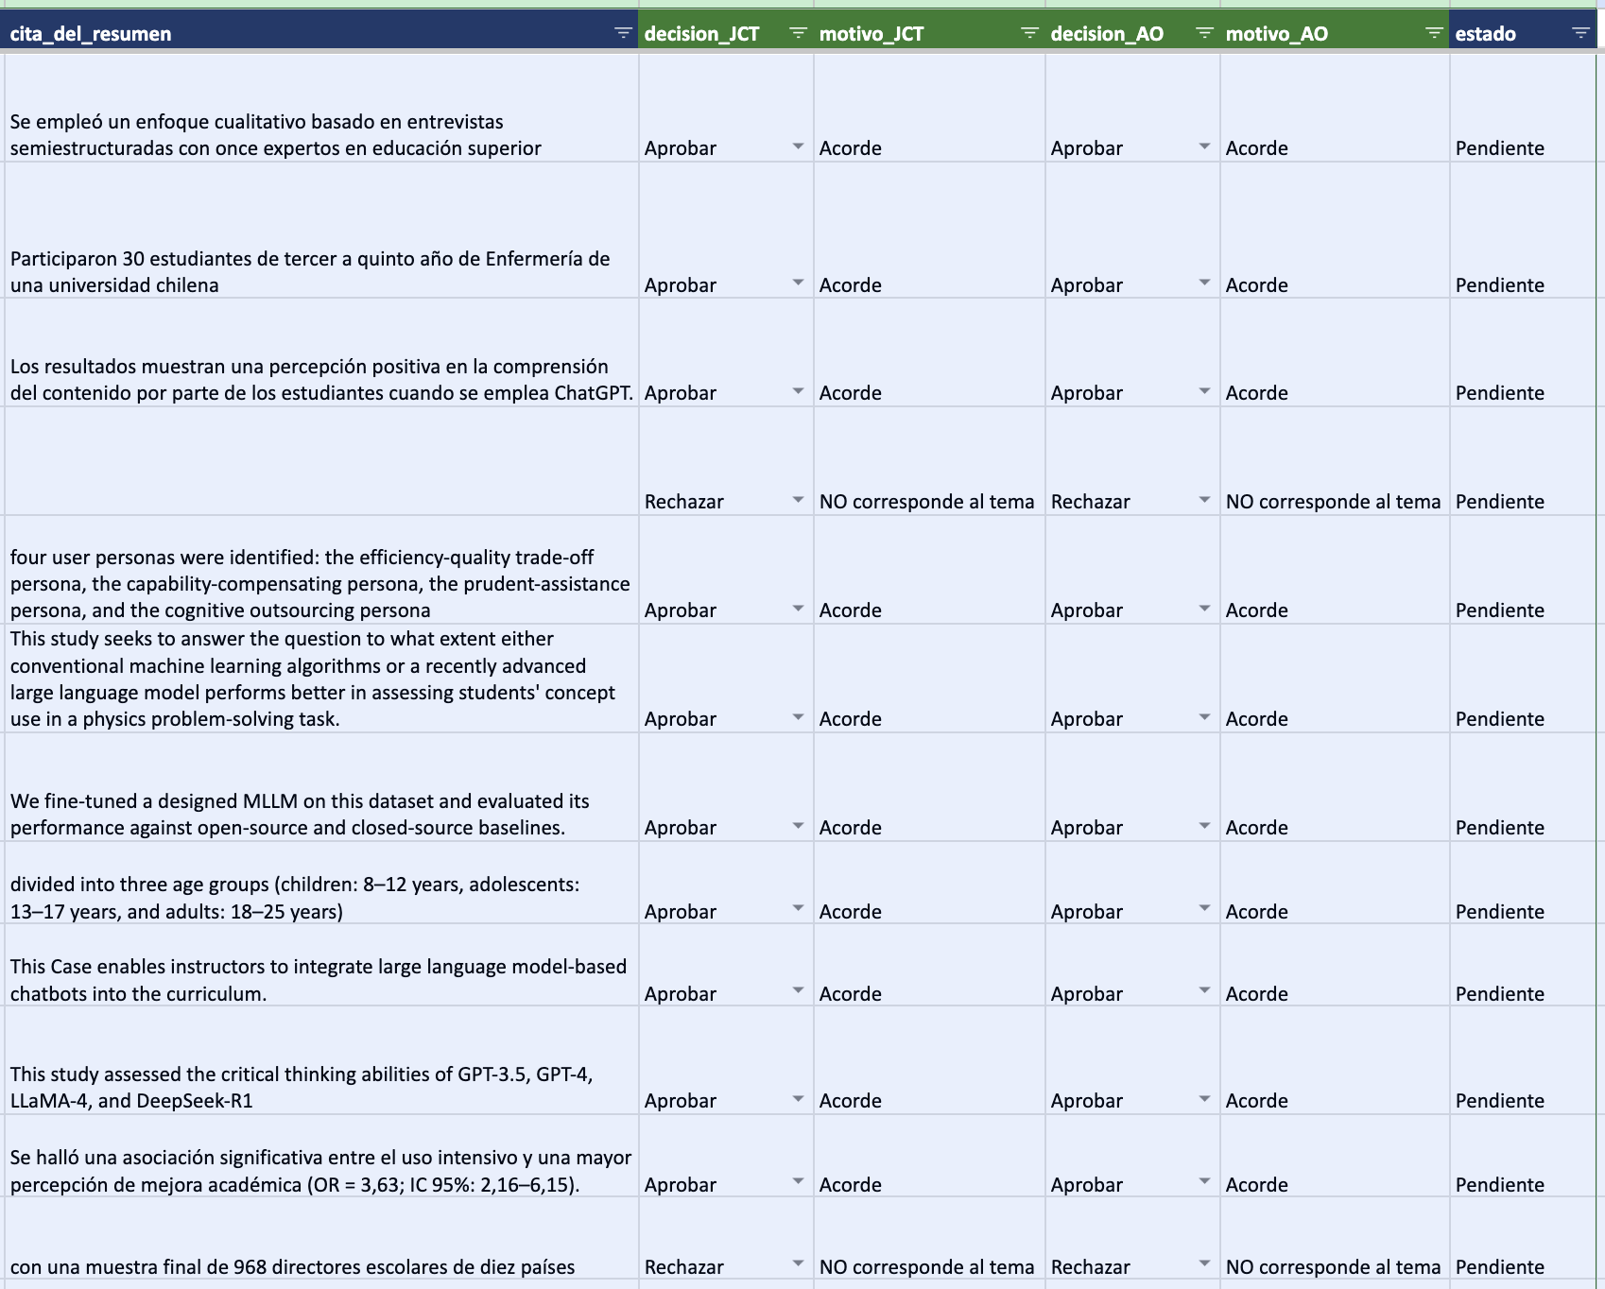
Output: Pending sheet
Abstract quote and each reviewer's decision
8 / 10
Notes:
This is the Pending sheet of the second batch. Each record shows the quote from the abstract that supports the suggestion. On the right are the decisions of each reviewer with their reason. The reasons are short, such as in agreement or not on topic. The two reviewers decide separately. The status stays pending until the weekly consolidation. Artificial intelligence proposes and people decide. Nothing moves until both reviewers have decided. The record moves to approved or rejected when both agree.

Slide 9
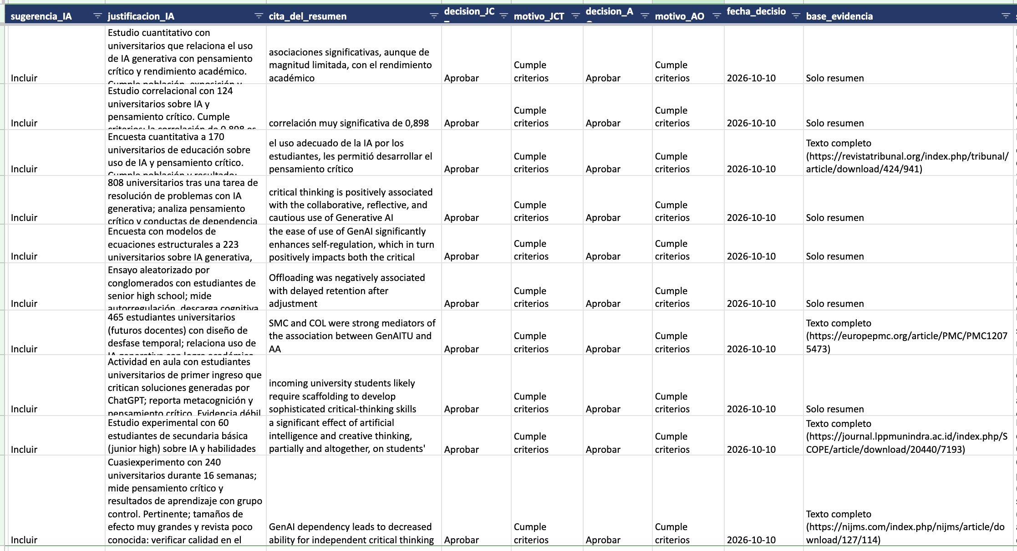
Review: Approved sheet
Each reviewer's decision, reason and date
9 / 10
Notes:
This is the Approved sheet, with the ten records of the first batch. It shows the decision of each reviewer, the reason and the date. It also tells whether the decision was based only on the abstract or on the full text. That way any colleague can see what was approved, when and on what basis. The link to the full text is included when it was used. Rejected records are kept in their own sheet.

Slide 10
Automatic search, human decision
Anaí Oñate, UTE
Juan Carlos Torres, UTPL
10 / 10
Notes:
The living literature review changes our work. The tool does the searching and the comparing, and we make the decisions every week. The next step is the theoretical framework and the article. We invite colleagues to adapt it to their own research question. Everything stays recorded with its date for anyone to check. Thank you for your attention.

