Slide 2
Day.Of.Week Page.Loads Unique.Visits First.Time.Visits Returning.Visits
1 1 2146 1582 1430 152
2 2 3621 2528 2297 231
3 3 3698 2630 2352 278
4 4 3667 2614 2327 287
5 5 3316 2366 2130 236
6 6 2815 1863 1622 241

Slide 3
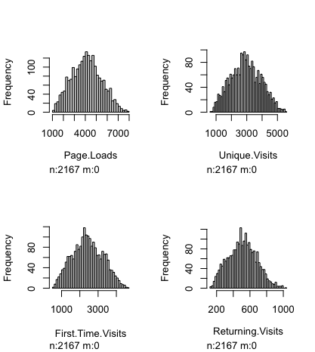

Slide 4
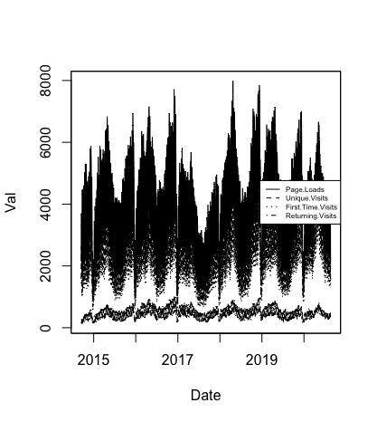

Slide 5
