Slide 1
Airline Passenger Satisfaction
What factors lead to customer satisfaction for an Airline?
Python Data Analysis Project
Jose V. Cuan
January 30, 2022
NYC Data Science Academy

Slide 2
INTRODUCTION
For my Python Data Analysis Project, I decided to use the dataset “Airline Passenger Satisfaction” from Kaggle (https://www.kaggle.com/teejmahal20/airline-passenger-satisfaction).
This dataset contains an airline passenger satisfaction (APS) survey (statistical data) which we will use to apply different python commands/techniques learned in class.

Slide 3
RESEARCH QUESTION:
What factors are highly correlated to a satisfied (or dissatisfied) passenger?
Can you predict passenger satisfaction?
Which Model can you use to predict APS and Why?

Slide 4
Python Library
import pandas as pd
import seaborn as sns
import matplotlib.pyplot as plt
import numpy as np
import missingno as msno
from pandas.plotting import scatter_matrix

Slide 5
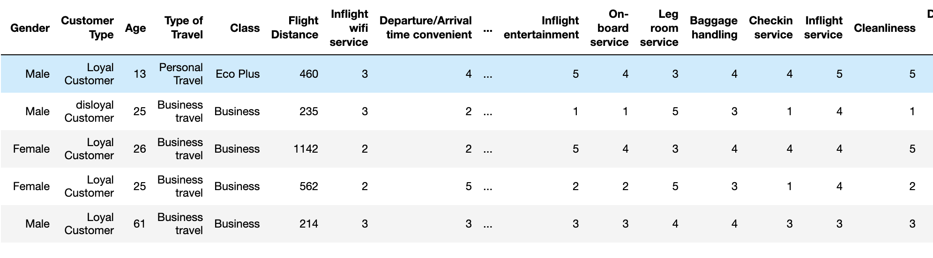
RAW “APS” DataFrame

Slide 6
Dataset Classification: type of Data
Categorical: "Gender", "Customer Type", "Type of Travel", "Class" and "Satisfaction".
Numerical: "Age", "Flight Distance", "Departure Delay" and "Arrival Delay".
Grade (1-5): Inflight wifi service, Departure/Arrival time convenient, Ease of Online booking, Gate location, Food and drink, Online boarding, Seat comfort, Inflight entertainment, On-board service, Leg room service, Baggage handling, Checkin service, Inflight service, and Cleanliness.
[ ] train_APS.nunique() # Observation of what Type of Data (Categorical or Numerical) is in the Dataset.

Slide 7
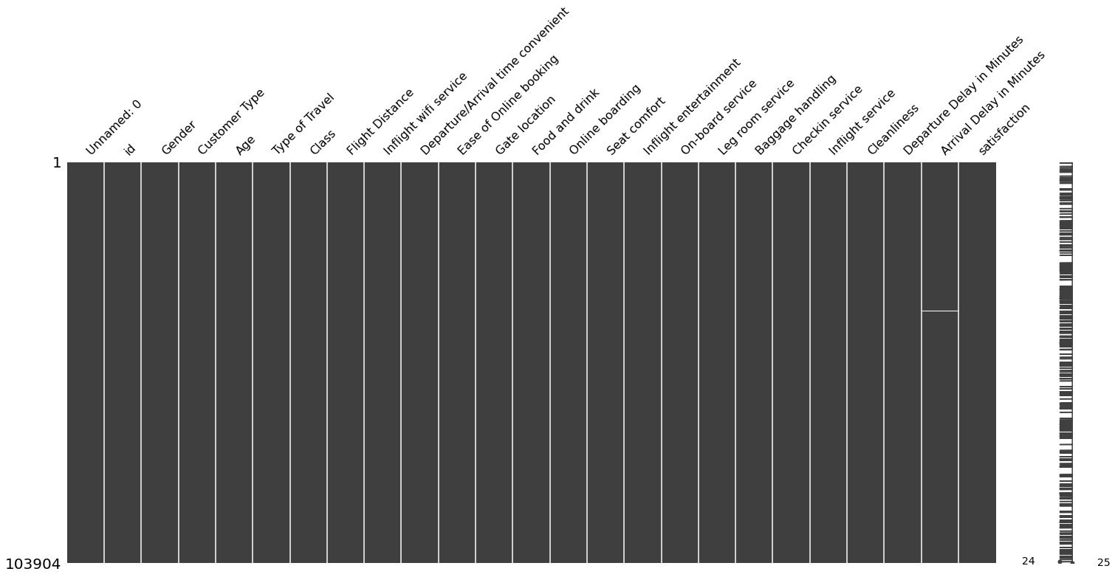
Data preparation: missing values
[ ] train_APS.isnull().sum()*100/len(train_APS) # Found less than 0.3% missing values on "Arrival Delay"
[ ] msno.matrix(train_APS) # heatmap to visualize missing data in a dataframe

Slide 8
Data analysis: encoding
Variable | Label Encoding
Gender | 1 (Male)
 | 0 (Female)
Customer Type | 1 (Loyal Customer)
 | 0 (Disloyal Customer)
Type of Travel | 1 (Business travel)
 | 0 (Personal travel)
Class | 2 (Business)
 | 1 (Eco Plus)
 | 0 (Eco)
Satisfaction | 1 (Satisfied)
 | 0 (dissatisfied)
[ ] train_APS['Gender'].replace(['Female', 'Male'], [0, 1], inplace=True)
[ ] train_APS['Customer Type'].replace(['disloyal Customer', 'Loyal Customer'], [0, 1], inplace=True)
[ ] train_APS['Type of Travel'].replace(['Personal Travel', 'Business travel'], [0, 1], inplace=True)
[ ] train_APS['Class'].replace(['Eco', 'Eco Plus', 'Business'], [0, 1, 2], inplace=True)
[ ] train_APS['satisfaction'].replace(['neutral or dissatisfied', 'satisfied'], [0, 1], inplace=True)

Slide 9
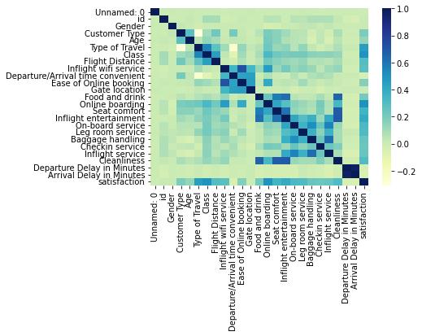
DATA analysis: visualization
[ ] sns.heatmap(train_APS.corr(), cmap='YlGnBu', xticklabels=True, yticklabels=True)

Slide 10
DATA analysis: visualization
Arrival Delay in Minutes Departure Delay in Minutes 0.965481
Ease of Online booking Inflight wifi service 0.715848
Cleanliness Inflight entertainment 0.691735
Seat comfort 0.678478
Food and drink Cleanliness 0.657648
Baggage handling Inflight service 0.628944
Inflight entertainment Food and drink 0.622374
Seat comfort 0.610614
Seat comfort Food and drink 0.574561
On-board service Inflight service 0.550725
Type of Travel Class 0.545185
On-board service Baggage handling 0.519252
Online boarding satisfaction 0.503447
Class satisfaction 0.494545
Ease of Online booking Gate location 0.458746
Online boarding Inflight wifi service 0.457002
Flight Distance Class 0.451495
Type of Travel satisfaction 0.448995
Departure/Arrival time convenient Gate location 0.444601
Ease of Online booking 0.437021
[ ] corr = train_APS.corr()
[ ] Rank_Corr_List = corr[corr<1].unstack().transpose().sort_values(ascending=False).drop_duplicates()
[ ] Rank_Corr_List.head(20)

Slide 11
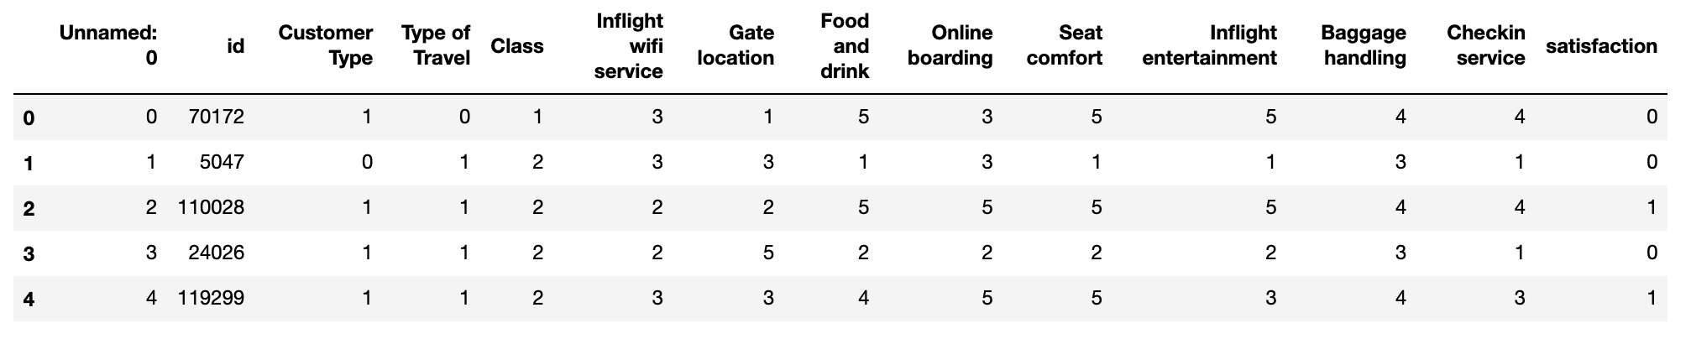
Data analysis: drop
[ ] train_APS.drop(['Gender', 'Age', 'Flight Distance', 'Departure/Arrival time convenient', 'Ease of Online booking', 'On-board service', 'Leg room service', 'Inflight service', 'Cleanliness', 'Departure Delay in Minutes', 'Arrival Delay in Minutes'], axis=1, inplace=True)
[] train_APS.head()

Slide 12
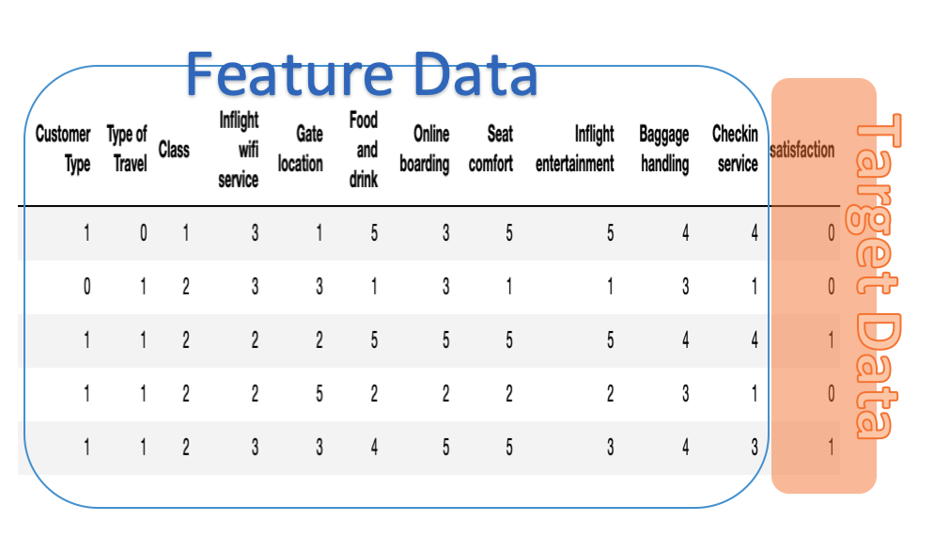
Prediction model: random forest
The target data, also known as the “label”, is the value we want to predict, in this case, the “satisfaction” of APS.
The features are all the variables/columns we select from the correlation heatmap (variables with high correlation).
[ ] train_labels = np.array(train_APS['satisfaction']) #Label or target data
[ ] train_APS = train_APS.drop('satisfaction', axis = 1) #Remove label from DF, to become feature data.
[ ] train_APS = np.array(train_APS)

Slide 13
Prediction model: training the model
[ ] from sklearn.model_selection import train_test_split
[ ] from sklearn.ensemble import RandomForestClassifier
[ ] from sklearn.metrics import accuracy_score, confusion_matrix, classification_report
[ ] %matplotlib inline
[ ] rf = RandomForestClassifier()
[ ] rf.fit(train_APS, train_labels)

Slide 14
Prediction model: testing the model
[ ] test_APS.dropna(subset = ['Arrival Delay in Minutes'], inplace=True)
[ ] test_APS['satisfaction'].replace(['neutral or dissatisfied', 'satisfied'], [0, 1], inplace=True)
[ ] test_APS['Customer Type'].replace(['disloyal Customer', 'Loyal Customer'], [0, 1], inplace=True)
[ ] test_APS['Type of Travel'].replace(['Personal Travel', 'Business travel'], [0, 1], inplace=True)
[ ] test_APS['Class'].replace(['Eco', 'Eco Plus', 'Business'], [0, 1, 2], inplace=True)
[ ] test_APS.drop(['Gender', 'Age', 'Flight Distance', 'Departure/Arrival time convenient', 'Ease of Online booking', 'On-board service', 'Leg room service', 'Inflight service', 'Cleanliness', 'Departure Delay in Minutes', 'Arrival Delay in Minutes'], axis=1, inplace=True)
[ ] test_labels = np.array(test_APS['satisfaction']) # Test Label
[ ] test_APS = test_APS.drop('satisfaction', axis = 1) #Remove label from DF
[ ] test_APS = np.array(test_APS)
[ ] predictions = rf.predict(test_APS) #Use RF predict on test data

Slide 15
Prediction model: final results

Slide 16
Prediction model: final results
[ ] accuracy_score(test_labels, predictions)
0.9578264395782644
[ ] matrix = confusion_matrix(test_labels, predictions)
[ ] matrix = matrix.astype('float') / matrix.sum(axis=1)[:, np.newaxis]
[ ] plt.figure(figsize=(16,7))
[ ] sns.set(font_scale=1.4)
[ ] sns.heatmap(matrix, annot=True, annot_kws={'size':10},
cmap=plt.cm.Greens, linewidths=0.2)
[ ] plt.xlabel('Predicted label')
[ ] plt.ylabel('True label')
[ ] plt.title('Confusion Matrix for Random Forest Model')
[ ] plt.show()

Slide 17
Thank you

