Slide 1
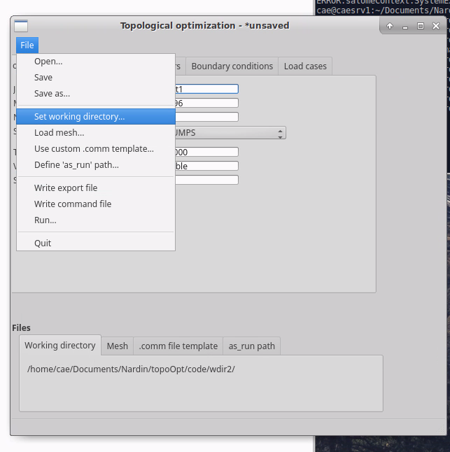
Select an existing directory, where all result files will be written
Select a mesh (MED file)
Define all options in “Job parameters” and “Optimization parameters” tabs
Selected files and paths are shown here

Slide 2
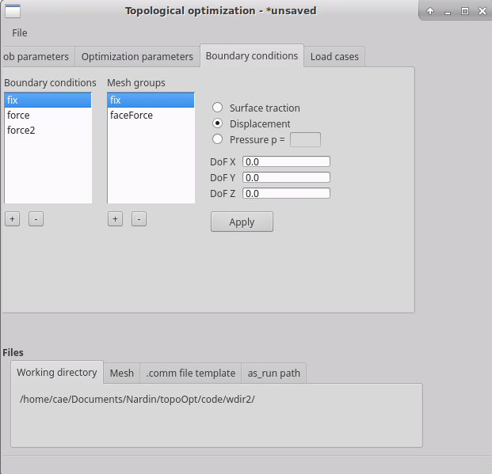
Define boundary conditions, based on mesh groups that are part of the selected mesh.
Boundary conditions options are displayed and can be edited, when a boundary condition is selected.
Make sure all rigid body motions are blocked.

Slide 3
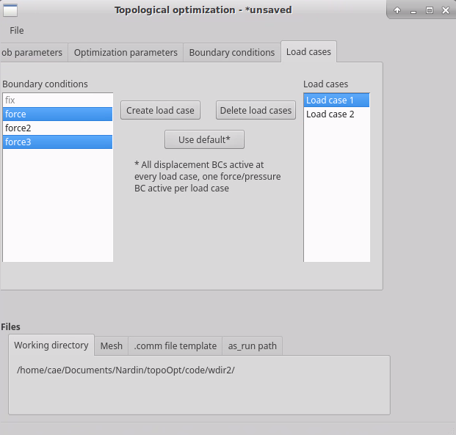
Combine boundary conditions to create load cases. Displacement boundary conditions are active for all load cases.
Select load cases to display the attributed boundary conditions
By default (button “Use default”), one load case is created per force boundary condition.

Slide 4
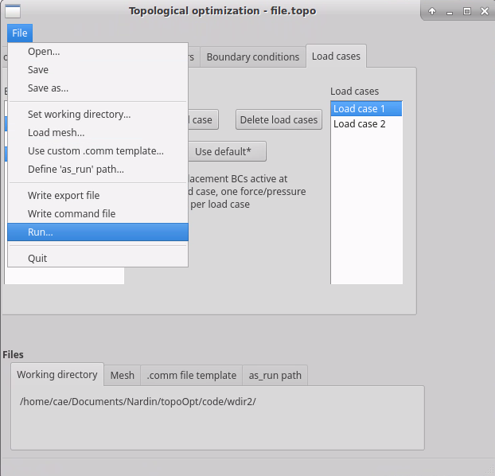
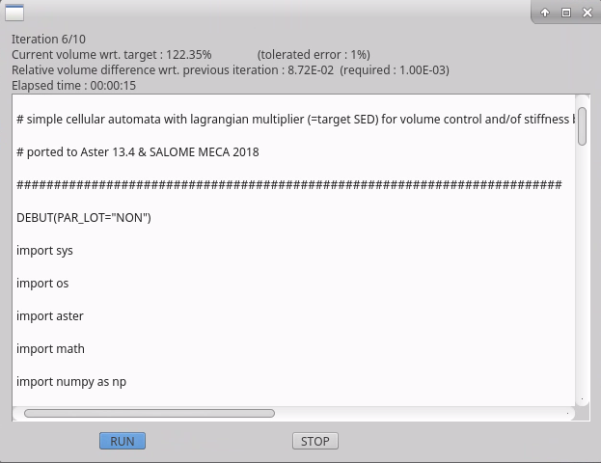
Open the Run dialog and run the optimization
Informations are displayed in real-time
The message file content is displayed here

Slide 5
Open the Run dialog and run the optimization
Informations are displayed in real-time
The message file content is displayed here

Slide 6
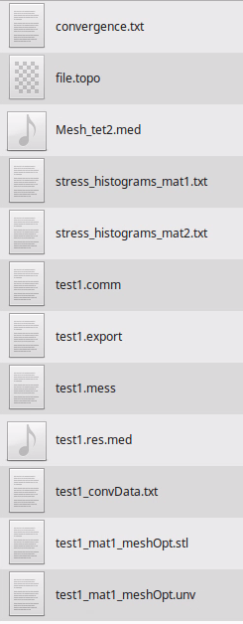
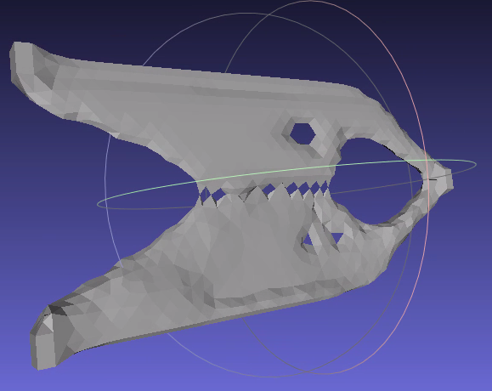
Results
Summary of SEDtarget and volume evolution
Stress histograms for both materials (if not bi-material, ignore “mat2”, which corresponds to voids)
Visualization file to open in Paraview
Smoothed STL file of the final shape

