Slide 1
Learning Sparse Latent Representations for Generator Model
Department of Computer Science
Hanao Li
Advisor: Professor Tian Han
Committee Member: Professor Yue Ning,
Professor Philippos Mordohai

Slide 2
Outline
Learning Generator Model
From Dense to Sparse Model
Our Proposed Method
Experimental Results

Slide 3
Outline
Learning Generator Model
From Dense to Sparse Model
Our Proposed Method
Experimental Results

Slide 4
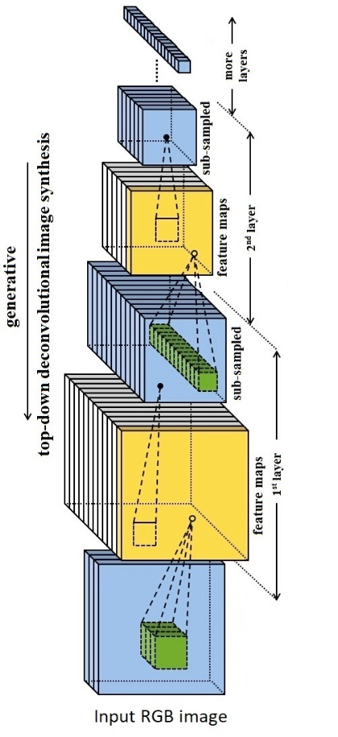
Introduction
Representation Learning from data.
Unsupervised Learning with unknown label.
Generator Model for modeling data distribution.
Low dimension is more efficient than High dimension.
Sparse is more useful than Dense representation.

Slide 5
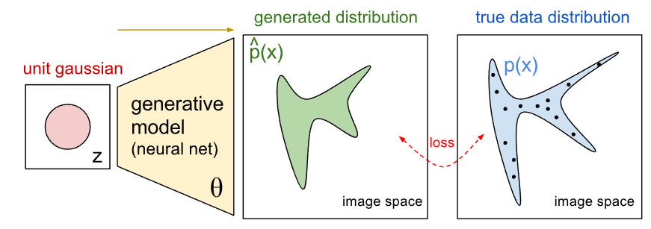
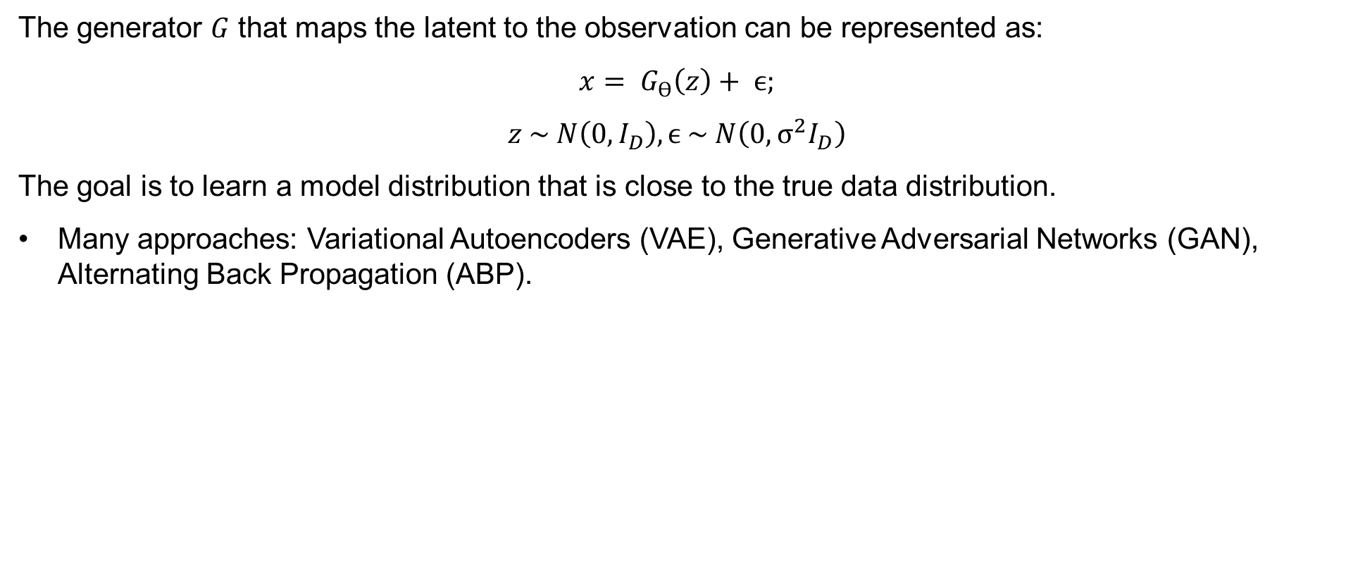
Generator Model
The generator $G$ that maps the latent to the observation can be represented as:
$$x= G_{ϴ}\left(z\right)+ ϵ;$$
$$z \sim N\left(0,I_{D}\right), ϵ \sim N\left(0, σ^{2}I_{D}\right)$$
The goal is to learn a model distribution that is close to the true data distribution.
Many approaches: Variational Autoencoders (VAE), Generative Adversarial Networks (GAN), Alternating Back Propagation (ABP).

Slide 6
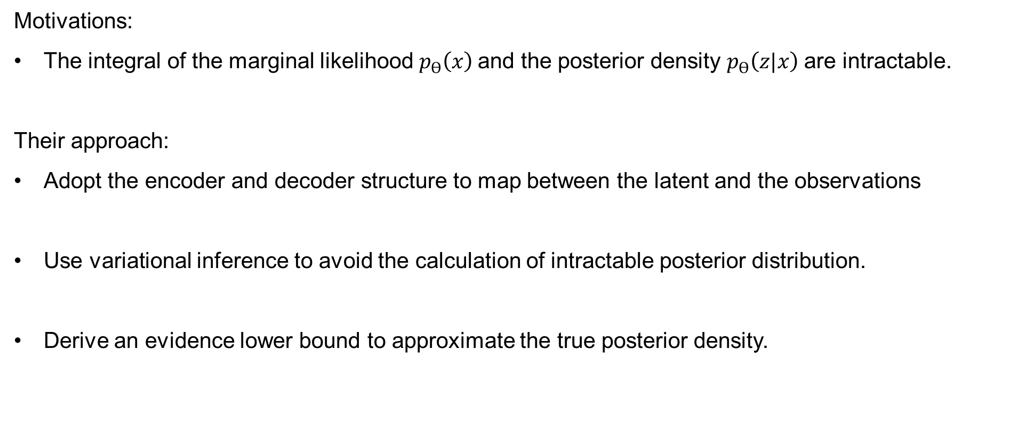
Variational Autoencoders [Kingma, D.P., Welling, M., 2013]
Motivations:
The integral of the marginal likelihood $p_{ϴ}\left(x\right)$and the posterior density $p_{ϴ}\left(z|x\right)$are intractable.
Their approach:
Adopt the encoder and decoder structure to map between the latent and the observations
Use variational inference to avoid the calculation of intractable posterior distribution.
Derive an evidence lower bound to approximate the true posterior density.

Slide 7
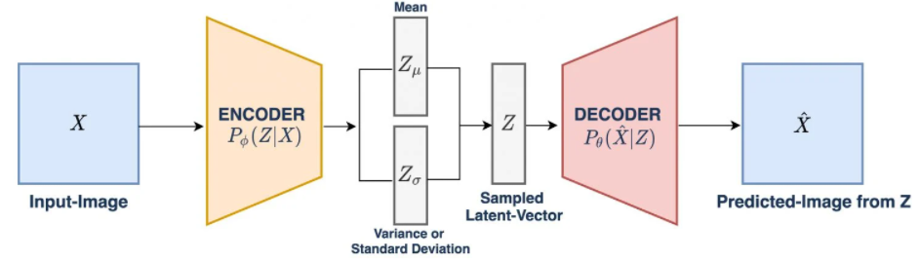
Variational Autoencoders
Graphical illustration of VAE model structure:

Slide 8
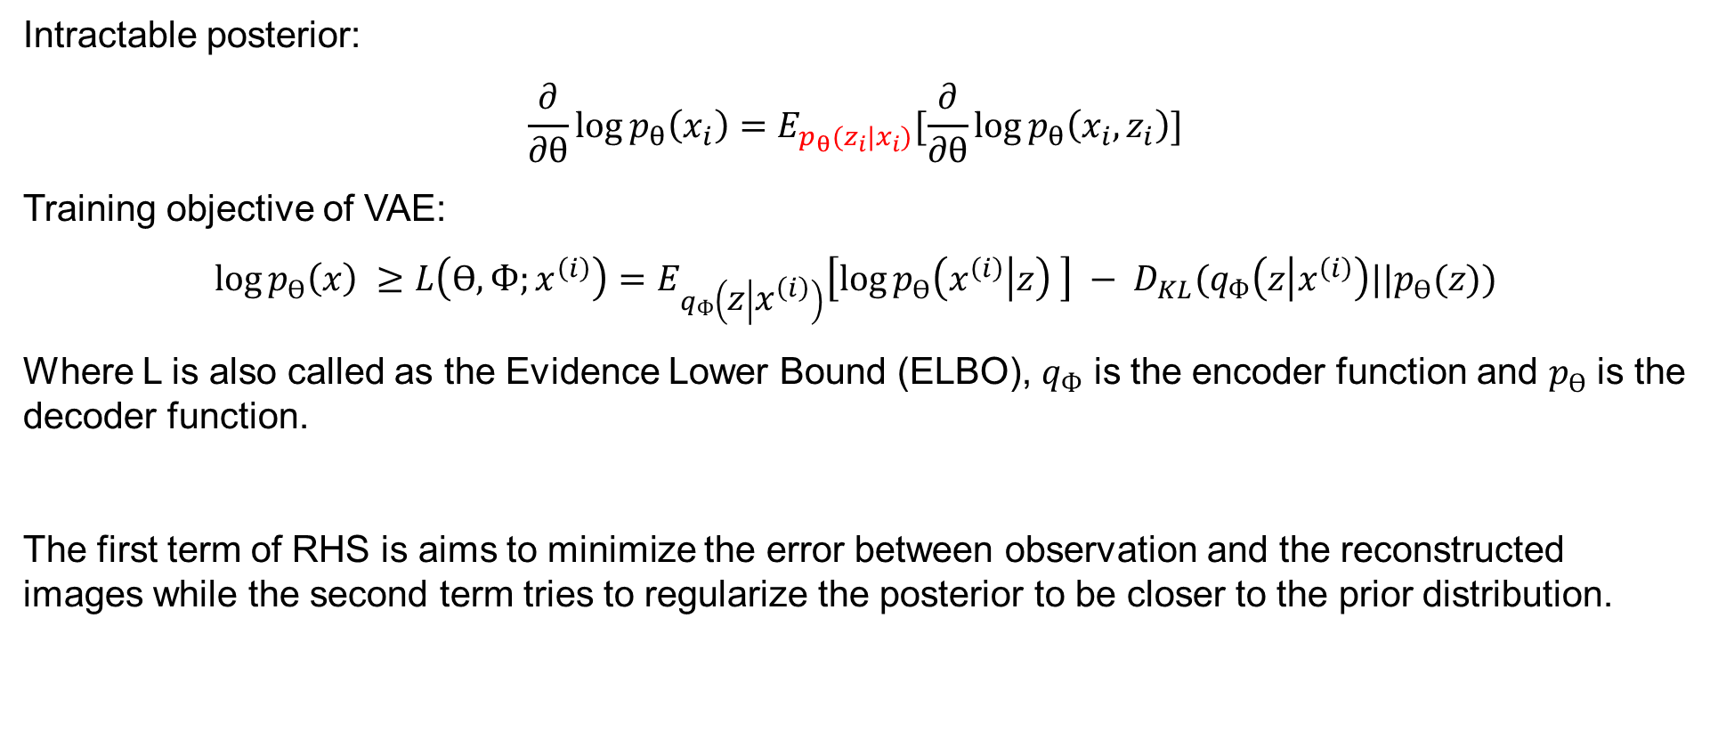
VAE Objective Function
Intractable posterior:
$$\frac{∂}{∂θ}\log{p_{θ}\left(x_{i}\right)}=E_{p_{θ}(z_{i}|x_{i})}[\frac{∂}{∂θ}\log{p_{θ}\left(x_{i},z_{i}\right)}]$$
Training objective of VAE:
$$\log{p_{ϴ}\left(x\right)} ≥L\left(ϴ, Ф;x^{\left(i\right)}\right)=E_{q_{Ф}\left(z | x^{\left(i\right)}\right)}\left[\log{p_{ϴ}\left(x^{\left(i\right)} | z\right)} \right] − D_{KL}(q_{Ф}\left(z | x^{\left(i\right)}\right)||p_{ϴ}(z))$$
Where L is also called as the Evidence Lower Bound (ELBO), $q_{Ф}$ is the encoder function and $p_{ϴ}$ is the decoder function.
The first term of RHS is aims to minimize the error between observation and the reconstructed images while the second term tries to regularize the posterior to be closer to the prior distribution.

Slide 9
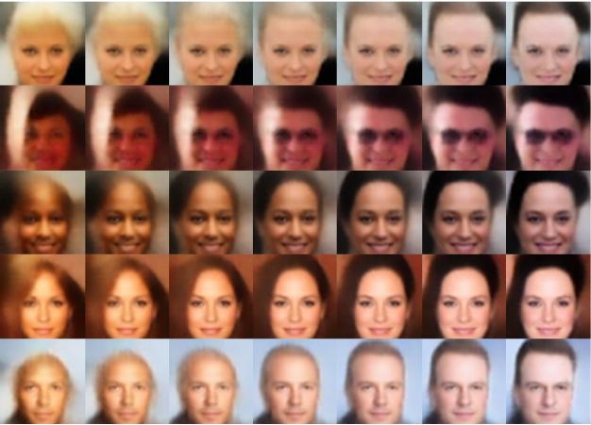
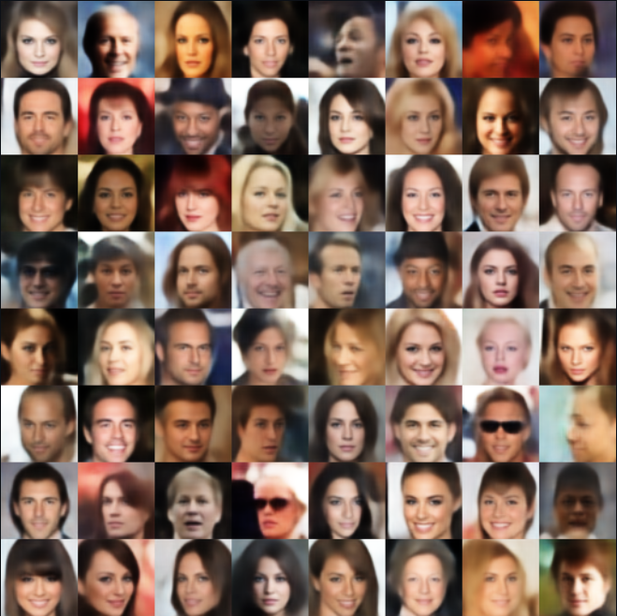
VAE Results
Latent Traversal
Image Reconstruction

Slide 10
Disadvantages of Variational Autoencoders
Due to the nature of variational models, they need to do approximations for the true posterior of the latent variables instead of doing exact inference.
These models need to carefully design an extra inference network to learn the mapping from observations to the latent representations.

Slide 11
Alternating Back-Propagation [Han,T., et al., 2017]
Motivations:
Both GAN and VAE that need to have an assisting network with another set of parameters.
Their approach:
The model uses a deep generative network to obtain a complex non-linear mapping from latent space to the observation.
It adopts persistent chain for MCMC sampling to infer the posterior distribution.

Slide 12
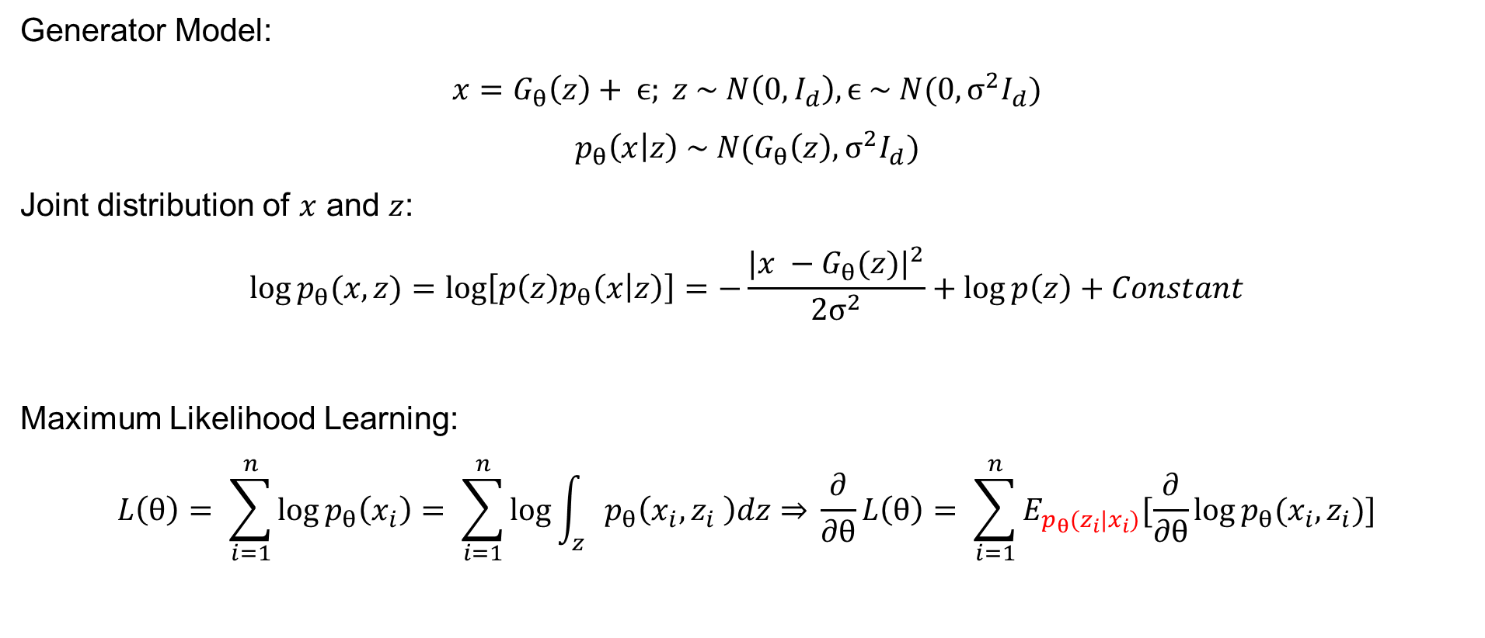
ABP Training Algorithm
Generator Model:
$$x=G_{θ}\left(z\right)+ ϵ; z \sim N\left(0, I_{d}\right),ϵ \sim N(0,σ^{2}I_{d})$$
$$p_{θ}\left(x | z\right) \sim N(G_{θ}\left(z\right),σ^{2}I_{d})$$
Joint distribution of $x$ and $z$:
$$\log{p_{θ}(x,z)}=\log\left[p\left(z\right)p_{θ}\left(x | z\right)\right]=−\frac{|{x −G_{θ}(z)|}^{2}}{2σ^{2}}+\log{p\left(z\right)}+Constant$$
Maximum Likelihood Learning:
$$L\left(θ\right)= \sum_{i=1}^{n}{\log{p_{θ}\left(x_{i}\right)= \sum_{i=1}^{n}{\log{\int_{z}{p_{θ}\left(x_{i},z_{i} \right)dz}}}}⇒ }\frac{∂}{∂θ}L\left(θ\right)= \sum_{i=1}^{n}{E_{p_{θ}(z_{i}|x_{i})}[\frac{∂}{∂θ}\log{p_{θ}(x_{i},z_{i})}]}$$

Slide 13
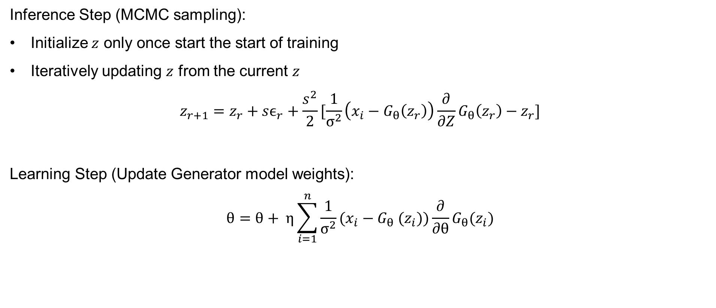
ABP Training Algorithm
Inference Step (MCMC sampling):
Initialize $z$ only once start the start of training
Iteratively updating $z$ from the current $z$
$$z_{r+1}=z_{r}+sϵ_{r}+\frac{s^{2}}{2}[\frac{1}{σ^{2}}\left(x_{i}−G_{θ}\left(z_{r}\right)\right)\frac{∂}{∂Z}G_{θ}\left(z_{r}\right)−z_{r}]$$
Learning Step (Update Generator model weights):
$$θ=θ+ η\sum_{i=1}^{n}{\frac{1}{σ^{2}}(x_{i}−G_{θ} (z_{i}))\frac{∂}{∂θ}G_{θ}(z_{i})}$$

Slide 14
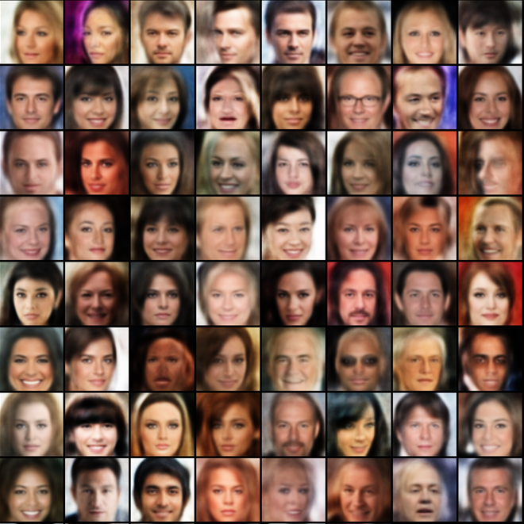
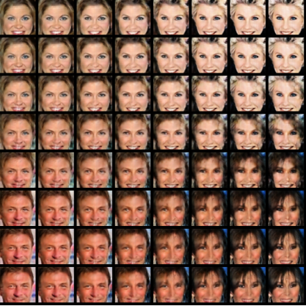
Alternating Back-Propagation
Image Reconstruction
Image Interpolation

Slide 15
Short-run Inference Model [Nijkamp, E., et al., 2020]
Motivations:
The persistent chain of MCMC might take too long.
The step size is not adaptable to the training of the model.
Their approach:
They propose non-persistent short run MCMC to infer the latent variables.
They use variational optimization to determine the optimal step size in MCMC.

Slide 16
Outline
Learning Generator Model
From Dense to Sparse Model
Our Proposed Method
Experimental Results

Slide 17
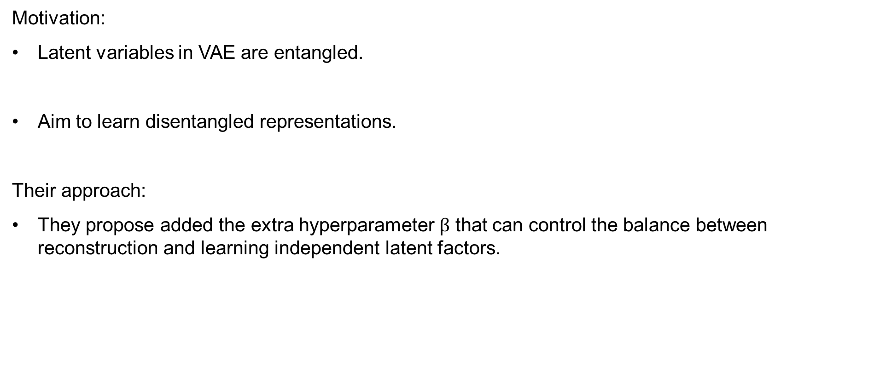
Beta-VAE [Higgins, I., et al., 2017]
Motivation:
Latent variables in VAE are entangled.
Aim to learn disentangled representations.
Their approach:
They propose added the extra hyperparameter $β$ that can control the balance between reconstruction and learning independent latent factors.

Slide 18
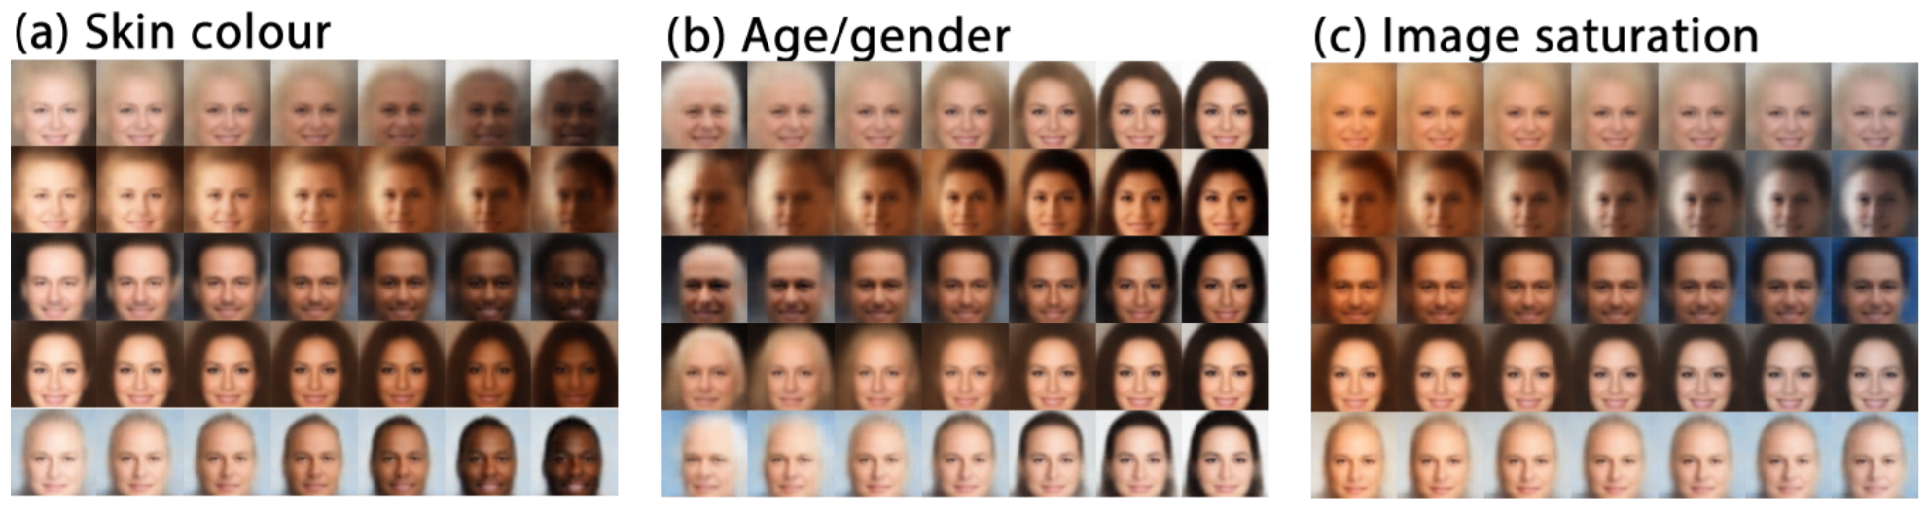

Beta-VAE
Modified loss:
$$log p_{ϴ}\left(x\right)≥L\left(ϴ, Ф;x^{\left(i\right)}\right)=E_{q_{Ф}\left(z | x^{\left(i\right)}\right)}\left[log p_{ϴ}\left(x^{\left(i\right)} | z\right)\right] − {β∗D}_{KL}(q_{Ф}\left(z | x^{\left(i\right)}\right)||p_{ϴ}(z))$$

Slide 19
Variational Sparse Coding [Tonolini, F., et al., 2018, 2020]
Motivation:
Disentangled model can not learn an effective meaningful latent representations.
If the latent space is large, many of them do not carry any information.
Their approach:
Learn the sparse representations with non-linear generative models.
Propose using spike and slab as prior with Dirac delta function centered at zero.

Slide 20

VSC Prior Distribution
Spike and Slab prior with Dirac delta function:
$$p_{s}\left(z\right)=\prod_{j=1}^{J}{(αN\left(z_{j};0,1\right)+\left(1−α\right)δ(z_{j}))}$$
Encoder for VSC:
$$q_{Ф}\left(z | x_{i}\right)= \prod_{j=1}^{J}{(γ_{i,j}N\left(z_{i,j};μ_{z,i,j},σ_{z,i,j}^{2}\right)+\left(1−γ_{i,j}\right)δ(z_{i,j}))}$$
Spike Variable Reparameterization:
$$T\left(η_{i, j}+ γ_{i,j} −1\right)=T\left(y\right)= \left\{\begin{aligned}1, y≥0 \\ 0, y<0\end{aligned}\right.=Sigmoid(cy)$$

Slide 21
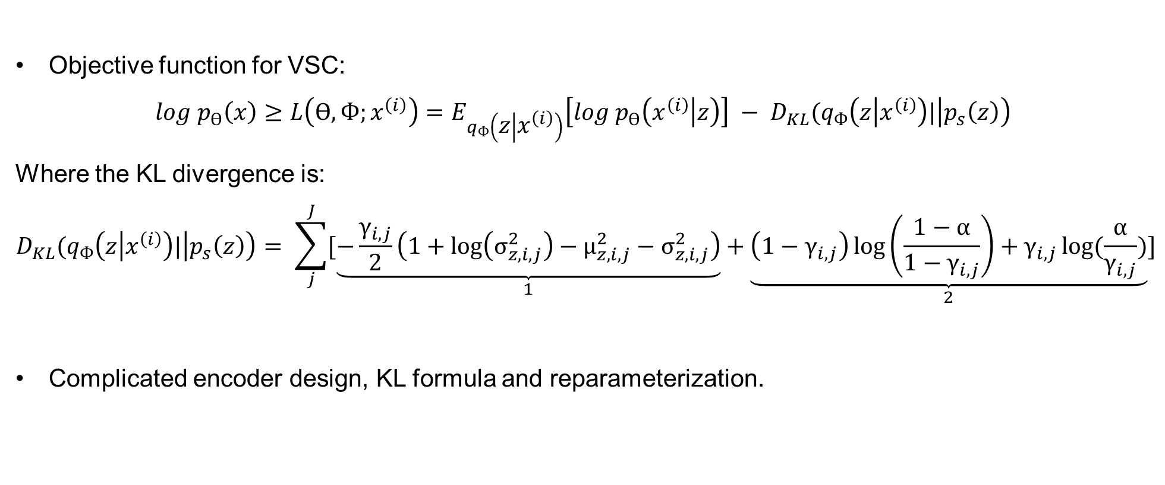
VSC Training Objective
Objective function for VSC:
$$log p_{ϴ}\left(x\right)≥L\left(ϴ, Ф;x^{\left(i\right)}\right)=E_{q_{Ф}\left(z | x^{\left(i\right)}\right)}\left[log p_{ϴ}\left(x^{\left(i\right)} | z\right)\right] − D_{KL}(q_{Ф}\left(z | x^{\left(i\right)}\right)|\left|p_{s}\left(z\right)\right)$$
Where the KL divergence is:
$$D_{KL}(q_{Ф}\left(z | x^{\left(i\right)}\right)|\left|p_{s}\left(z\right)\right)= \sum_{j}^{J}{[\underset{1}{\underbrace{−\frac{γ_{i,j}}{2}\left(1+\log\left(σ_{z,i,j}^{2}\right)−μ_{z,i,j}^{2}−σ_{z,i,j}^{2}\right)}}+\underset{2}{\underbrace{\left(1−γ_{i,j}\right)\log\left(\frac{1−α}{1−γ_{i,j}}\right)+γ_{i,j}\log{(\frac{α}{γ_{i,j}})}}}]}$$
Complicated encoder design, KL formula and reparameterization.

Slide 22
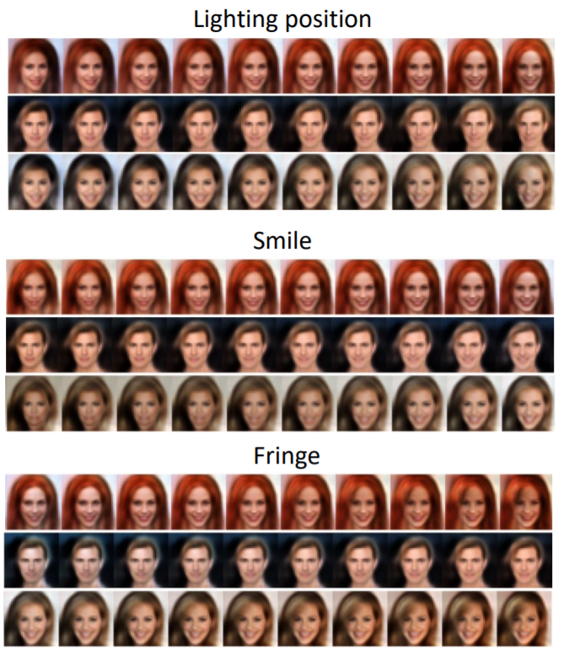
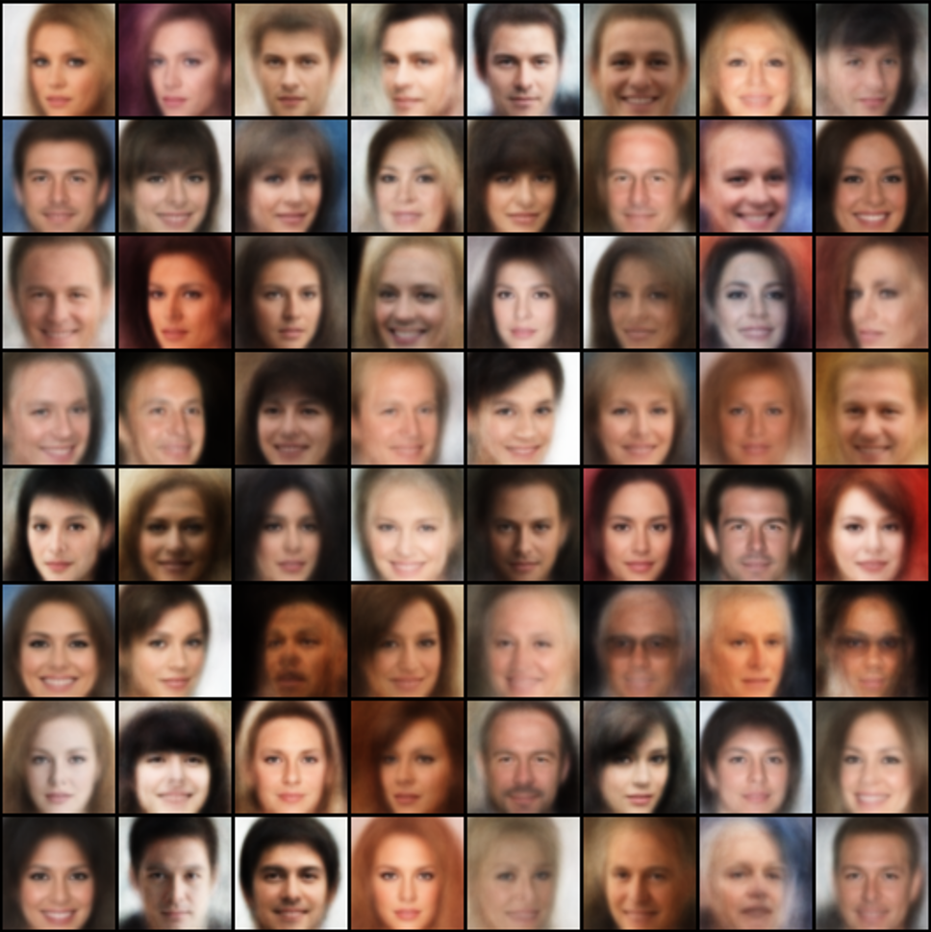
Variational Sparse Coding
Latent Traversal
Image Reconstruction

Slide 23
Outline
Learning Generator Model
From Dense to Sparse Model
Our Proposed Method
Experimental Results

Slide 24
Limitations and Motivations
Dense models are sensitive to noise and do not have explainability.
Disentangled representations are not as robust as sparse representations.
Learned latent codes from encoder approximation are not accurate and effective.
Sparse representations can increase explainability and robustness.

Slide 25
Our Approach
We use gradually sparsified spike and slab distribution as prior to train the generator model.
Only use one top-down generator network.
Infer latent variable with zero initialization and gradient-based inference.
We show empirically our model can learn efficient sparse latent representations.
We demonstrate increased explainability and boosted robustness in our experiments.

Slide 26
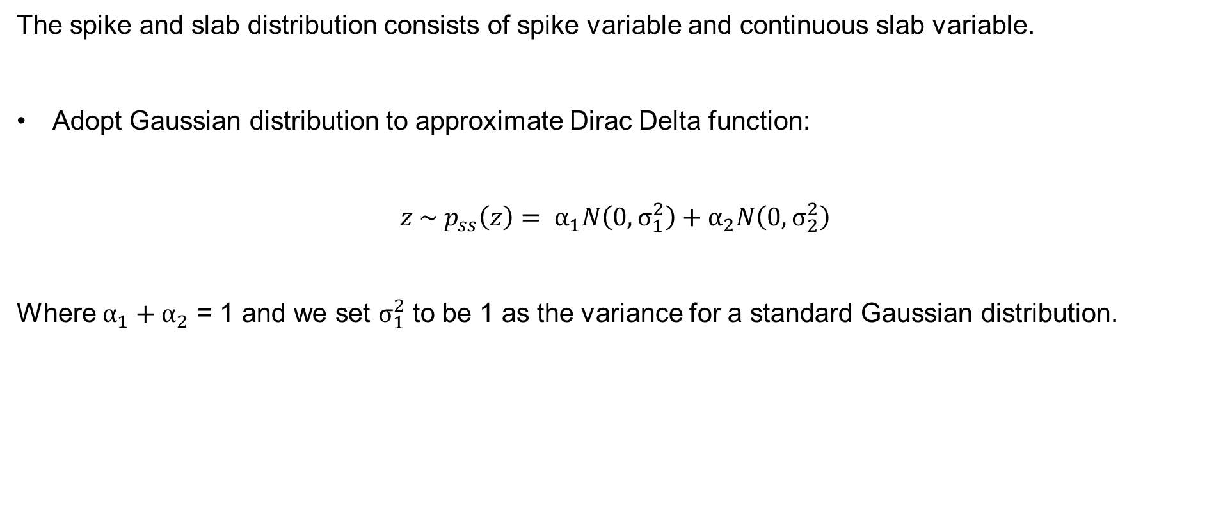
Spike and Slab Distribution
The spike and slab distribution consists of spike variable and continuous slab variable.
Adopt Gaussian distribution to approximate Dirac Delta function:
$$z \sim p_{ss}\left(z\right)= α_{1}N\left(0, σ_{1}^{2}\right)+α_{2}N\left(0,σ_{2}^{2}\right)$$
Where $α_{1}+α_{2}$ = 1 and we set $σ_{1}^{2}$ to be 1 as the variance for a standard Gaussian distribution.

Slide 27
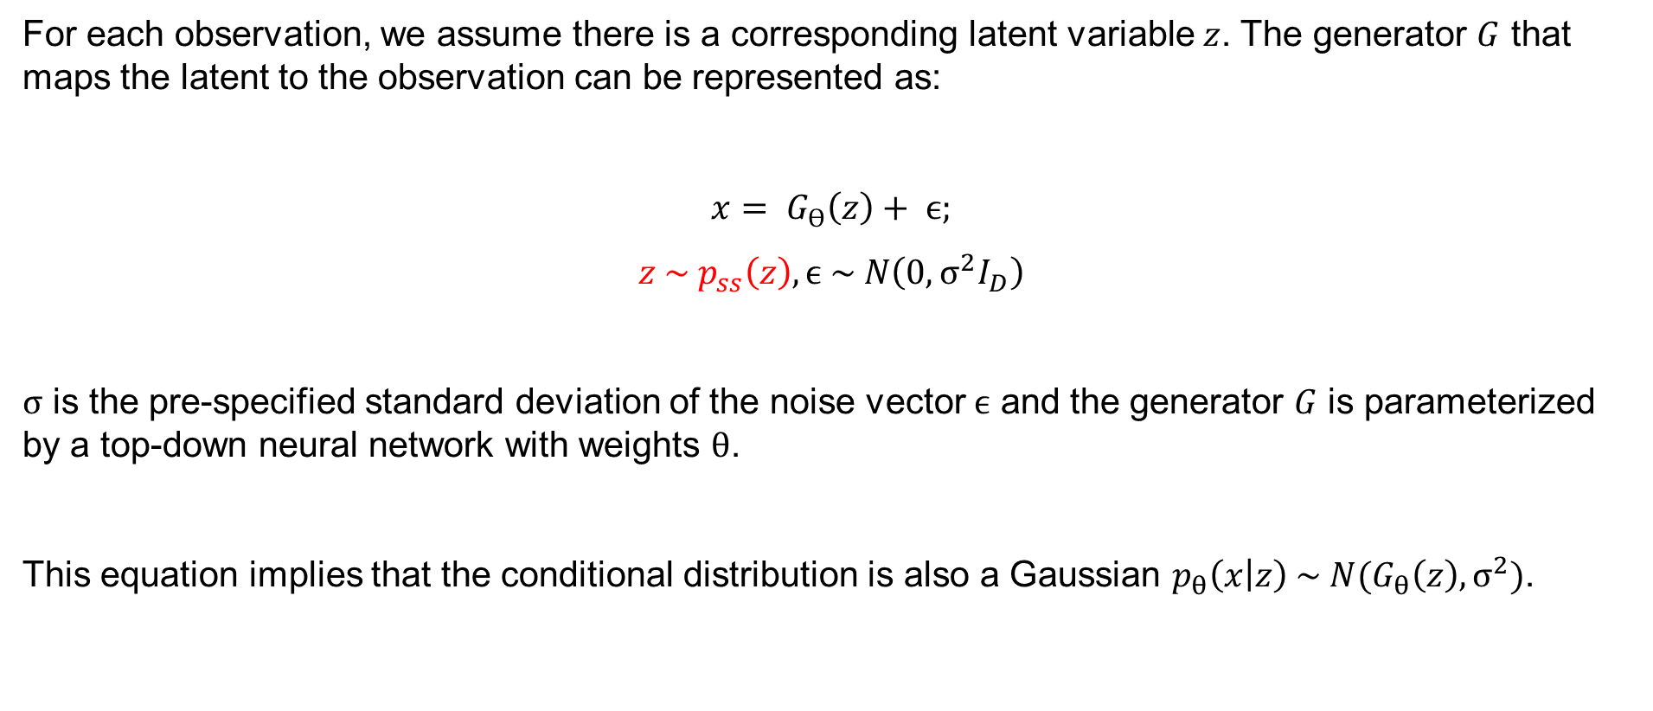
Generator Model
For each observation, we assume there is a corresponding latent variable $z$. The generator $G$ that maps the latent to the observation can be represented as:
$$x= G_{ϴ}\left(z\right)+ ϵ;$$
$$z \sim p_{ss}\left(z\right), ϵ \sim N\left(0, σ^{2}I_{D}\right)$$
$σ$ is the pre-specified standard deviation of the noise vector $ϵ$ and the generator $G$ is parameterized by a top-down neural network with weights $θ$.
This equation implies that the conditional distribution is also a Gaussian $p_{θ}\left(x | z\right) \sim N(G_{θ}\left(z\right), σ^{2})$.

Slide 28
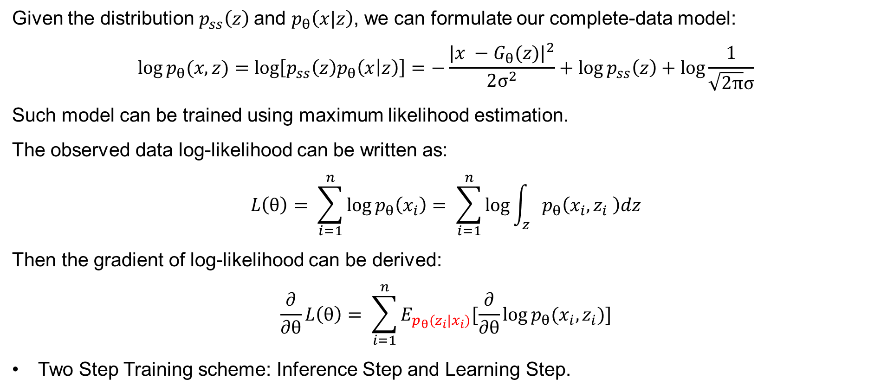
Model Training
Given the distribution $p_{ss}\left(z\right)$and $p_{θ}\left(x|z\right)$, we can formulate our complete-data model:
$$\log{p_{θ}(x,z)}=\log\left[p_{ss}\left(z\right)p_{θ}\left(x | z\right)\right]=−\frac{|{x −G_{θ}(z)|}^{2}}{2σ^{2}}+\log{p_{ss}\left(z\right)}+\log{\frac{1}{\sqrt{2π}σ}}$$
Such model can be trained using maximum likelihood estimation.
The observed data log-likelihood can be written as:
$$L\left(θ\right)= \sum_{i=1}^{n}{\log{p_{θ}\left(x_{i}\right)= \sum_{i=1}^{n}{\log{\int_{z}{p_{θ}\left(x_{i},z_{i} \right)dz}}}}}$$
Then the gradient of log-likelihood can be derived:
$$\frac{∂}{∂θ}L\left(θ\right)= \sum_{i=1}^{n}{E_{p_{θ}(z_{i}|x_{i})}[\frac{∂}{∂θ}\log{p_{θ}(x_{i},z_{i})}]}$$
Two Step Training scheme: Inference Step and Learning Step.

Slide 29
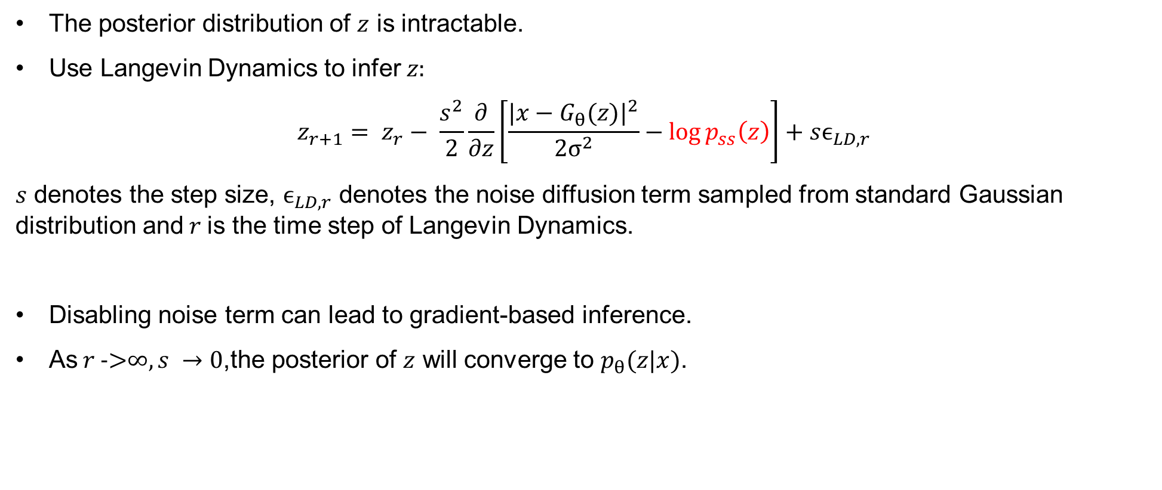
Latent Inference
The posterior distribution of $z$ is intractable.
Use Langevin Dynamics to infer $z:$
$$z_{r+1}= z_{r}− \frac{s^{2}}{2}\frac{∂}{∂z}\left[\frac{|x−G_{θ}(z)|^{2}}{2σ^{2}}−\log{p_{ss}\left(z\right)}\right]+sϵ_{LD,r}$$
$s$ denotes the step size, $ϵ_{LD,r}$ denotes the noise diffusion term sampled from standard Gaussian distribution and$r$is the time step of Langevin Dynamics.
Disabling noise term can lead to gradient-based inference.
As$r\text{ ->}∞, s →0$,the posterior of $z$ will converge to $p_{θ}(z|x)$.

Slide 30
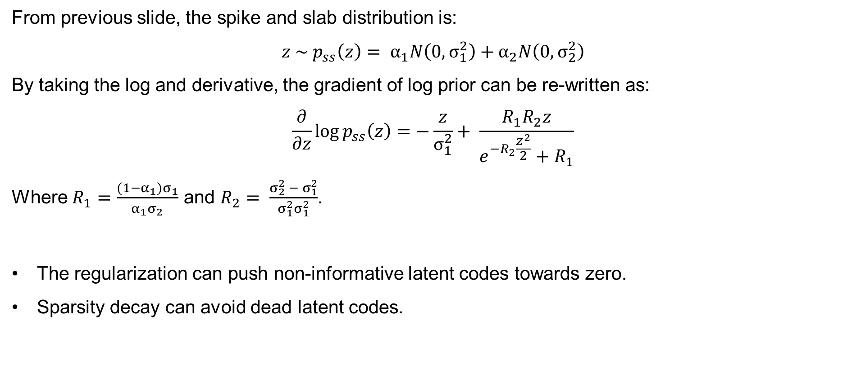
Penalized Gradient Descent
From previous slide, the spike and slab distribution is:
$$z \sim p_{ss}\left(z\right)= α_{1}N\left(0, σ_{1}^{2}\right)+α_{2}N\left(0,σ_{2}^{2}\right)$$
By taking the log and derivative, the gradient of log prior can be re-written as:
$$\frac{∂}{∂z}log{p_{ss}\left(z\right)=−\frac{z}{σ_{1}^{2}}}+ \frac{R_{1}R_{2}z}{e^{−R_{2}\frac{z^{2}}{2}}+R_{1}}$$
Where $R_{1}=\frac{(1−α_{1})σ_{1}}{α_{1}σ_{2}}$ and $R_{2}= \frac{σ_{2}^{2} − σ_{1}^{2}}{σ_{1}^{2}σ_{1}^{2}}$.
The regularization can push non-informative latent codes towards zero.
Sparsity decay can avoid dead latent codes.

Slide 31
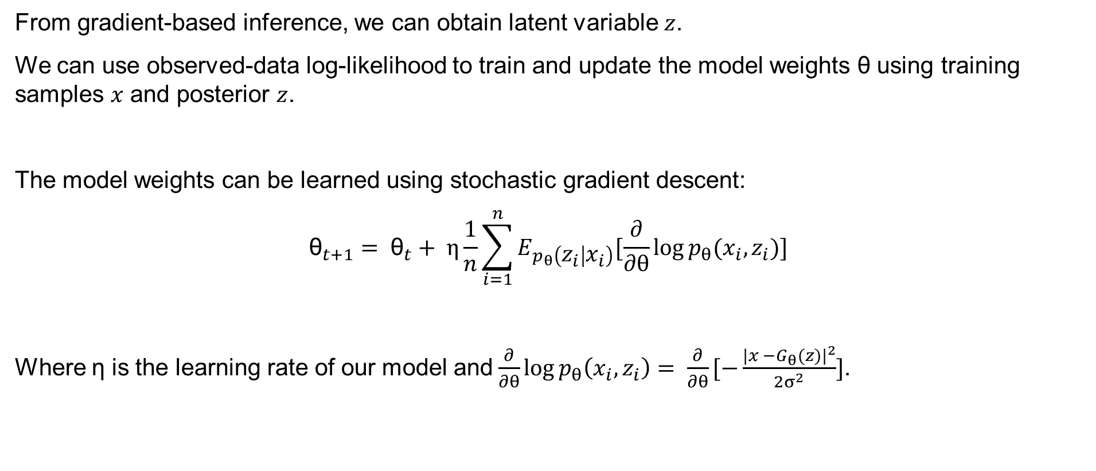
Model Learning
From gradient-based inference, we can obtain latent variable $z$.
We can use observed-data log-likelihood to train and update the model weights θ using training samples $x$ and posterior $z$.
The model weights can be learned using stochastic gradient descent:
$${\text{θ}}_{t+1}= {\text{θ}}_{t}+ η\frac{1}{n}\sum_{i=1}^{n}{E_{p_{θ}\left(z_{i} | x_{i}\right)}[\frac{∂}{∂θ}\log{p_{θ}(x_{i},z_{i})}]}$$
Where η is the learning rate of our model and$\frac{∂}{∂θ}\log{p_{θ}\left(x_{i},z_{i}\right)= }$ $\frac{∂}{∂θ}[−\frac{|{x −G_{θ}(z)|}^{2}}{2σ^{2}}]$.

Slide 32
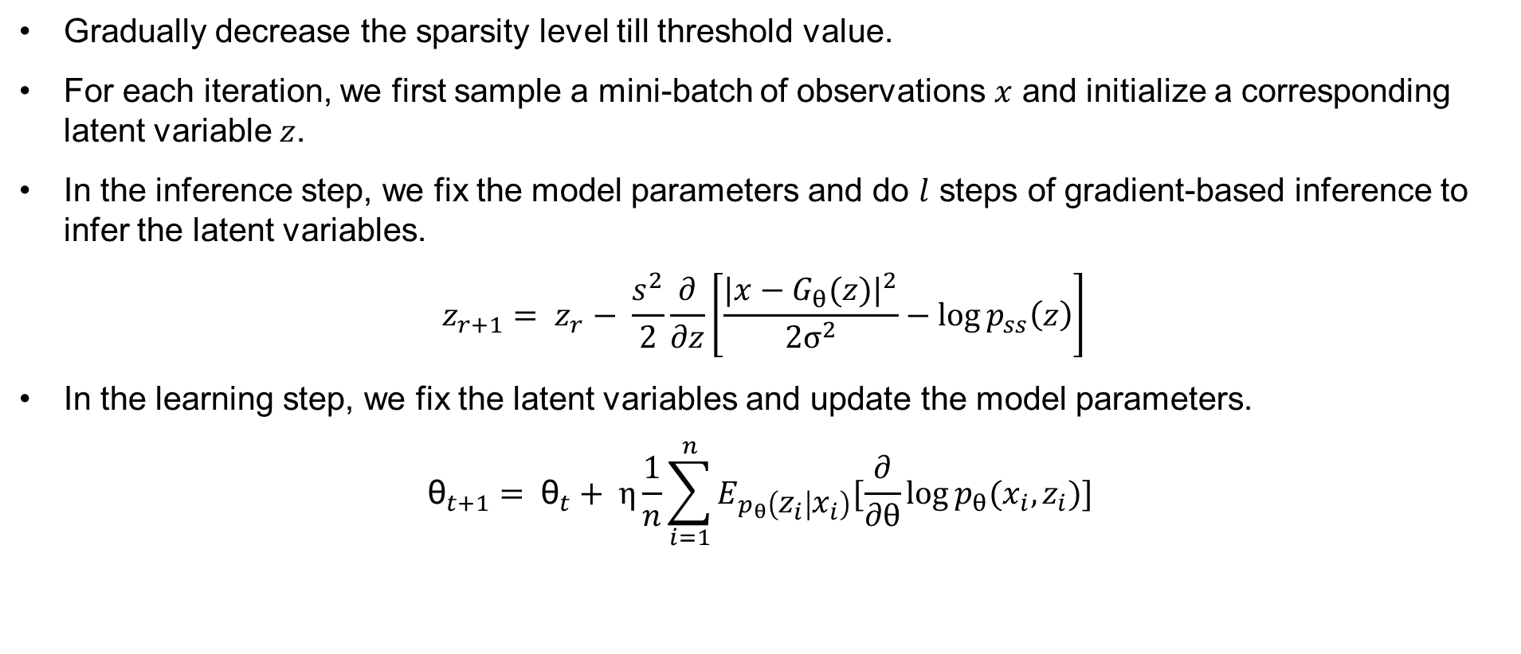
Learning Algorithm
Gradually decrease the sparsity level till threshold value.
For each iteration, we first sample a mini-batch of observations $x$ and initialize a corresponding latent variable $z$.
In the inference step, we fix the model parameters and do $l$ steps of gradient-based inference to infer the latent variables.
$$z_{r+1}= z_{r}− \frac{s^{2}}{2}\frac{∂}{∂z}\left[\frac{|x−G_{θ}(z)|^{2}}{2σ^{2}}−\log{p_{ss}\left(z\right)}\right]$$
In the learning step, we fix the latent variables and update the model parameters.
$${\text{θ}}_{t+1}= {\text{θ}}_{t}+ η\frac{1}{n}\sum_{i=1}^{n}{E_{p_{θ}\left(z_{i} | x_{i}\right)}[\frac{∂}{∂θ}\log{p_{θ}(x_{i},z_{i})}]}$$

Slide 33

Theoretical Understanding
Denote $p(C_{i}$) = $α_{i}$ as prior probability of component $i$.
The posterior $p\left(C_{i} | z\right)$can be represented as:
$$p\left(C_{i} | z\right)= \frac{α_{i}N(0,σ_{i}^{2})}{α_{i}N\left(0, σ_{i}^{2}\right)+ α_{j}N(0,σ_{j}^{2})}= \frac{\frac{α_{i}}{σ_{i}}}{\frac{α_{i}}{σ_{i}}+\frac{α_{j}}{σ_{j}}e^{z^{2}(\frac{1}{2σ_{i}^{2}}−\frac{1}{2σ_{j}^{2}})}}; i, j ∈\left\{1, 2\right\};i ≠j$$
Since $σ_{2}^{2}<σ_{1}^{2}$ , $\frac{1}{2σ_{i}^{2}}−\frac{1}{2σ_{j}^{2}}$ will always be negative.

Slide 34
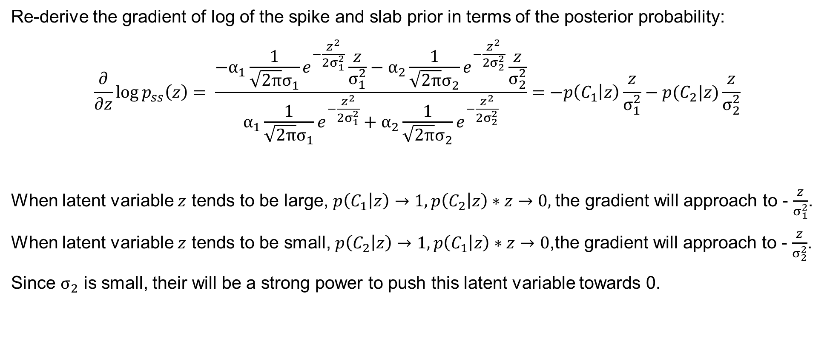
Theoretical Understanding
Re-derive the gradient of log of the spike and slab prior in terms of the posterior probability:
$$\frac{∂}{∂z}\log{p_{ss}\left(z\right)= \frac{−α_{1}\frac{1}{\sqrt{2π}σ_{1}}e^{−\frac{z^{2}}{2σ_{1}^{2}}}\frac{z}{σ_{1}^{2}}−α_{2}\frac{1}{\sqrt{2π}σ_{2}}e^{−\frac{z^{2}}{2σ_{2}^{2}}}\frac{z}{σ_{2}^{2}}}{α_{1}\frac{1}{\sqrt{2π}σ_{1}}e^{−\frac{z^{2}}{2σ_{1}^{2}}}+α_{2}\frac{1}{\sqrt{2π}σ_{2}}e^{−\frac{z^{2}}{2σ_{2}^{2}}}}}=−p\left(C_{1} | z\right)\frac{z}{σ_{1}^{2}}−p(C_{2}|z)\frac{z}{σ_{2}^{2}}$$
When latent variable $z$ tends to be large, $p\left(C_{1} | z\right)→1, p\left(C_{2} | z\right)∗z→0,$the gradient will approach to - $\frac{z}{σ_{1}^{2}}$.
When latent variable $z$ tends to be small, $p\left(C_{2} | z\right)→1, p\left(C_{1} | z\right)∗z→0$,the gradient will approach to - $\frac{z}{σ_{2}^{2}}$.
Since $σ_{2}$ is small, their will be a strong power to push this latent variable towards 0.

Slide 35
Outline
Learning Generator Model
From Dense to Sparse Model
Our Proposed Method
Experimental Results

Slide 36
Experimental Settings
We test the model on MNIST, Fashion-MNIST, Street View Housing Numbers (SVHN) and Celebrity (CelebA) datasets.
Test reconstruction, traversal, classification, and denoising tasks.
Ablation study on Langevin noise term and constant sparsity.

Slide 37
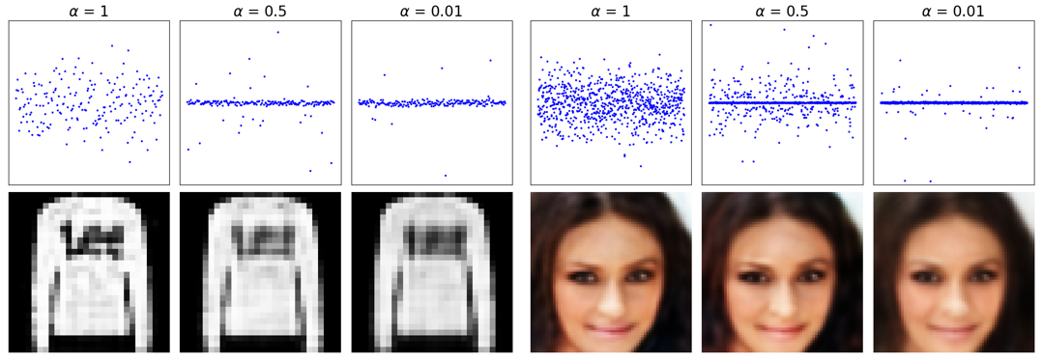
Results – Enforce Sparsity
Latent Representations with Different Levels of sparsity level α.

Slide 38
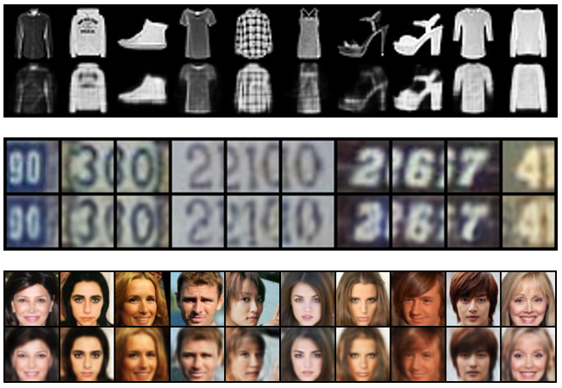
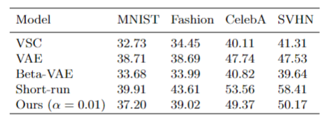
Results – Reconstruction
Reconstructed Images on various datasets.
Peak Signal-to-Noise Ratio (PSNR). Higher PSNR means better reconstruction quality.

Slide 39
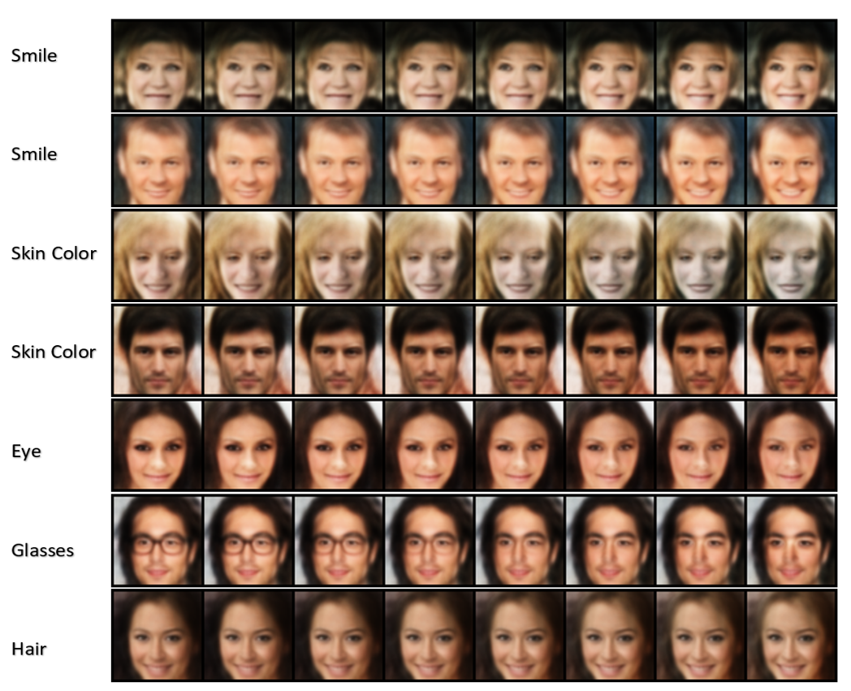
Results - Explainability
Latent Traversal using CelebA dataset.

Slide 40
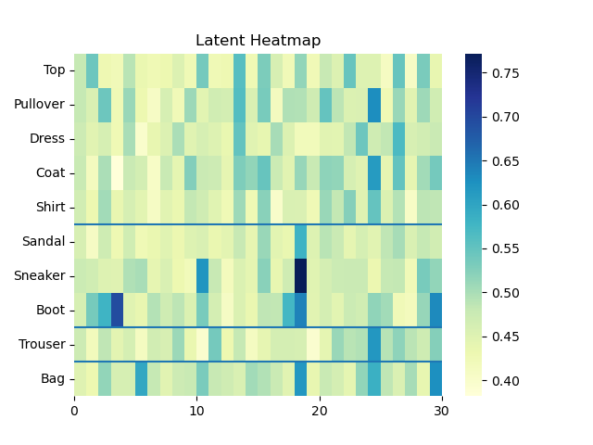
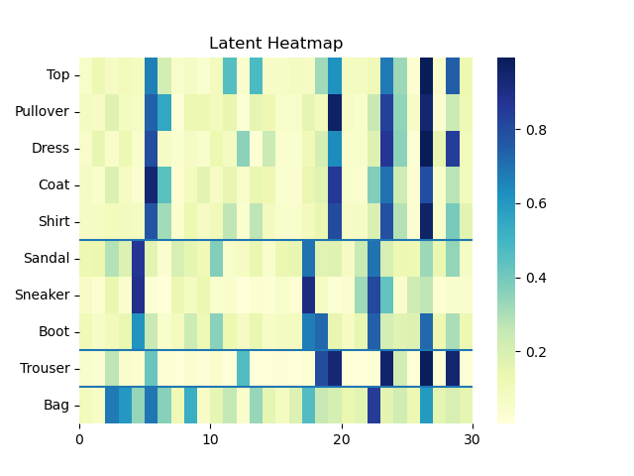
Results - Explainability
Heatmap of activated latent codes on Fashion-MNIST Dataset.
Left: Short-run Model Right: Our Model

Slide 41
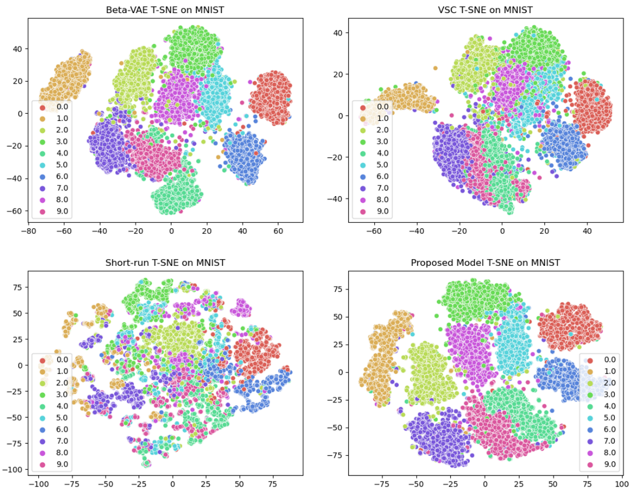
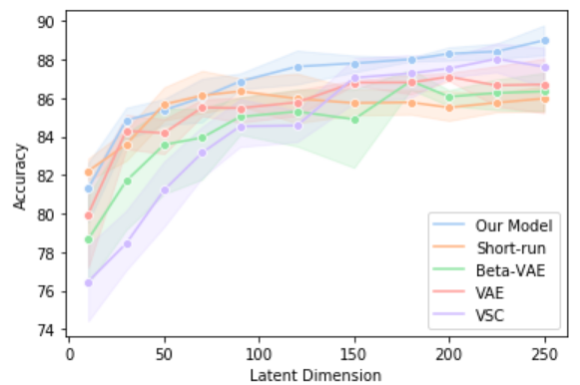
Boost Robustness - Classification
Classification Accuracy using learned latent codes with various dimensions.
T-SNE plots on MNIST dataset with 200 latent dimensions.

Slide 42
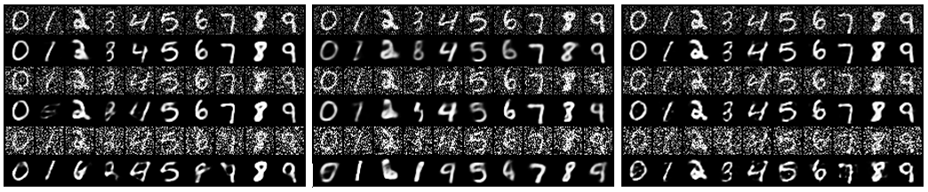
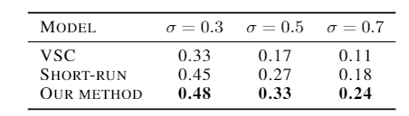
Boost Robustness - Denoise
Denoising on MNIST Dataset versus Gaussian noise with various variance added.
Left: Short-run. Middle: VSC. Right: Our model.
Performance on the Structural Similarity Index (SSIM). Higher SSIM implies better reconstruction in terms of luminance, contrast and structure.

Slide 43
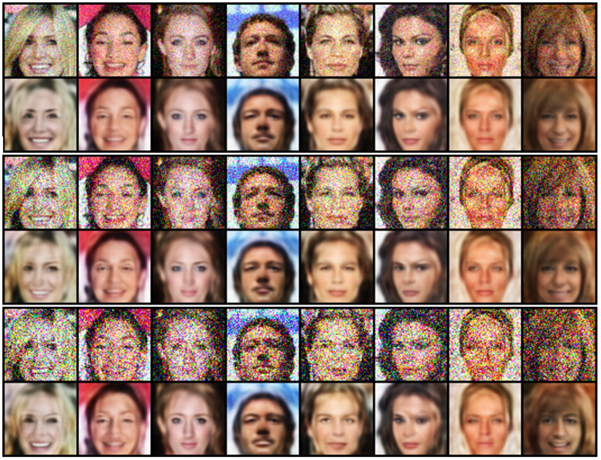
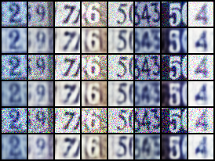
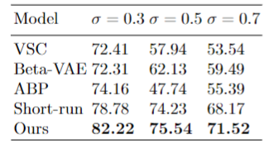
Boost Robustness - Denoise
Model classification accuracy on reconstructed images from noisy data.
Denoising on CelebA and SVHN Images using various Gaussian noise with different variances.

Slide 44
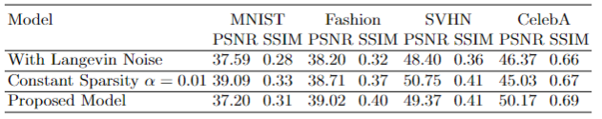
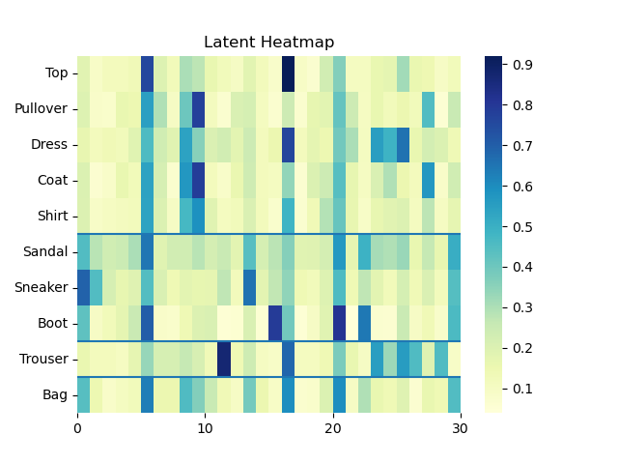
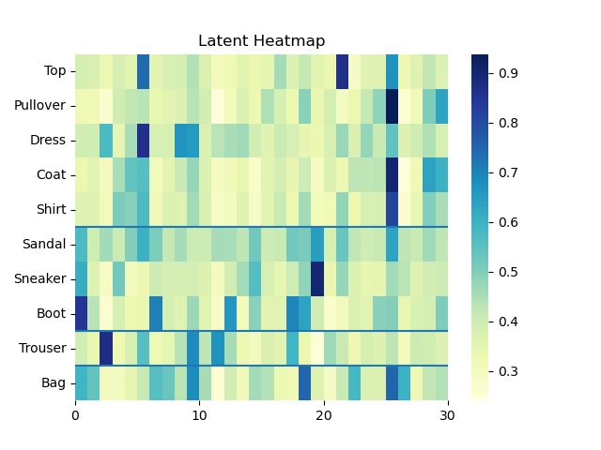
Ablation Study
PSNR and SSIM metric on different models.
Left: Model without sparsity decay. Middle: Model with Langevin Dynamics Noise. Right: Proposed Model.

Slide 45
Conclusions and Future Work
We present a new learning method to learn a sparse latent representation.
We show empirically our model can induce sparsity.
We demonstrate the learned representations can boost robustness and increase explainability in the task of denoising and classification.
Limitations:
The model is not able to generate images using latent variable directly from prior.
Future Work:
Apply on other realistic datasets such as ImageNet and video data.

Slide 46
Hanao Li
hli136@stevens.edu

