Slide 1
Fig. 1. Two-dimensional behavioral classification framework. Priority (vertical) and aggression (horizontal) are independent dimensions defining four behavioral quadrants.
Fig. 2. Passive agent latency as a function of aggression level across five scales (100 to 5,000 agents). Optimal zone 75-90% shaded. Three-run validated averages.
Fig. 3. Passive agent latency comparison across three assignment methods at 85% aggression. C-ConvAttempt (V13) achieves 17-21% further improvement over V12 C-Convergent.
Fig. 4. Complete performance comparison at 5,000 agents across all scheduling approaches. C-ConvAttempt achieves 68% improvement over the orderly baseline.
Fig. 5. Redis concurrency sweep — SET throughput and P50 latency (three-run validated, 200,000 operations per run). Bars show SET throughput peaking at 120,000 req/s in the optimal zone c=30 to c=100 — confirming the BPQT minimum effective pressure principle. The latency line remains flat through the optimal zone, then climbs 38x
Fig. 6. BPQT simulation vs Redis benchmark results, normalized to passive baseline = 1.0x. Both confirm consistent improvement trajectory. Redis magnitude larger due to pipeline batching vs individual agent movement.

Slide 2
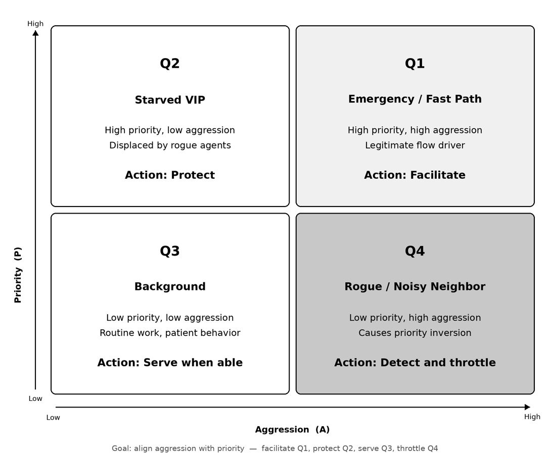

Slide 3
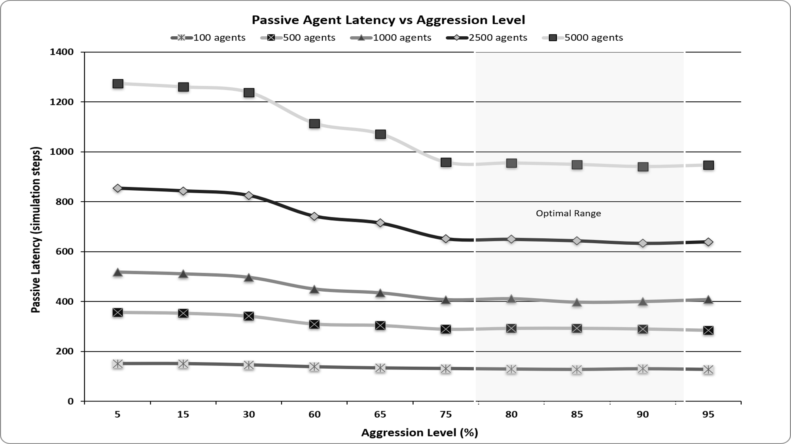

Slide 4
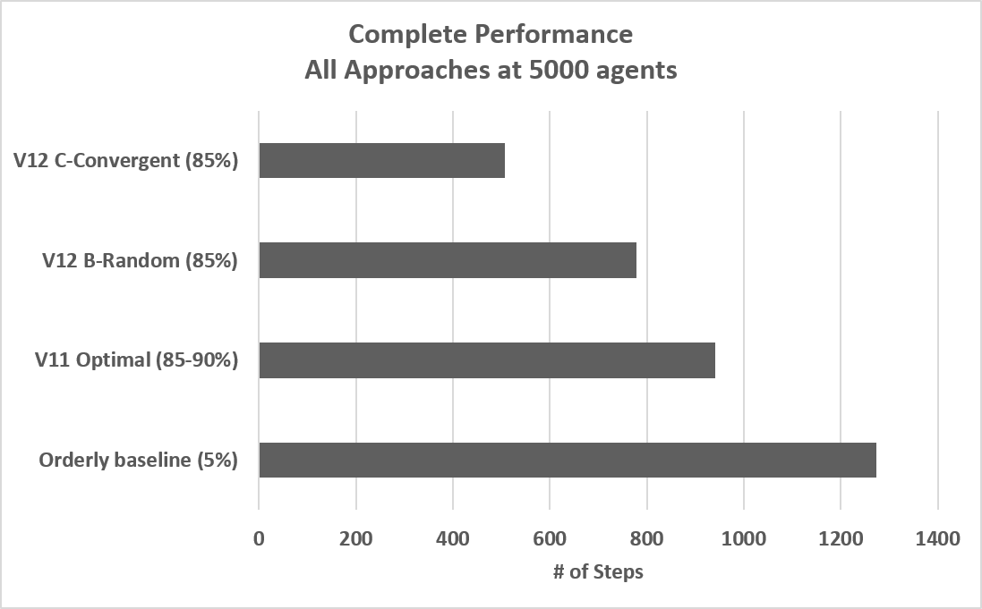

Slide 5
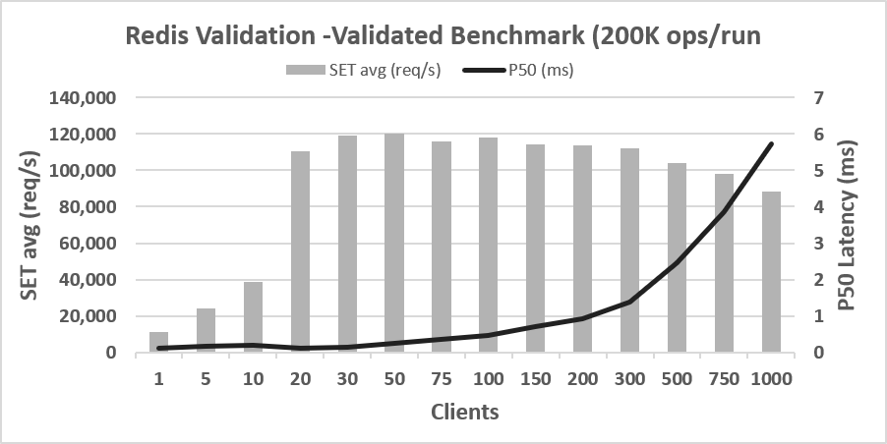

Slide 6
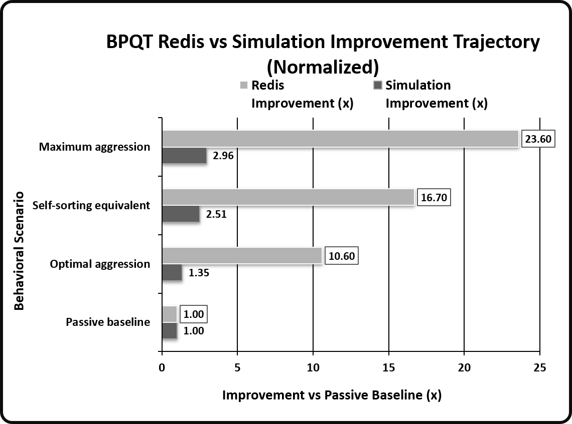

Slide 7
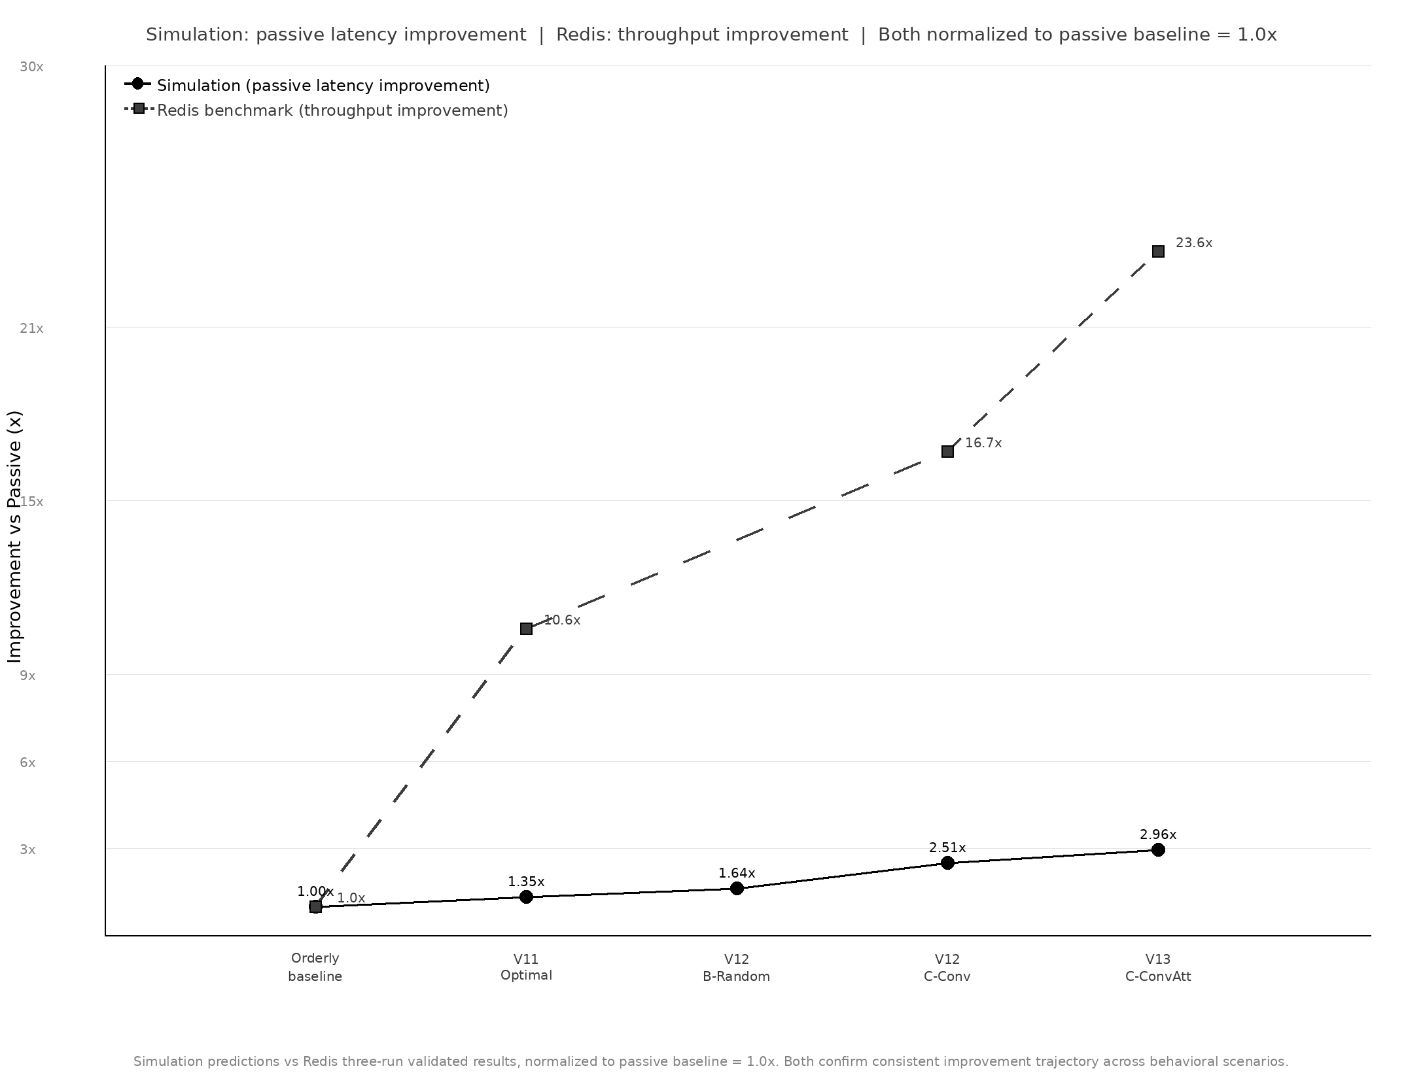

Slide 8
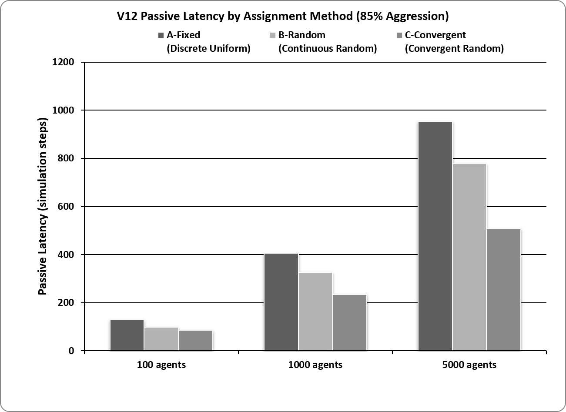

Slide 9
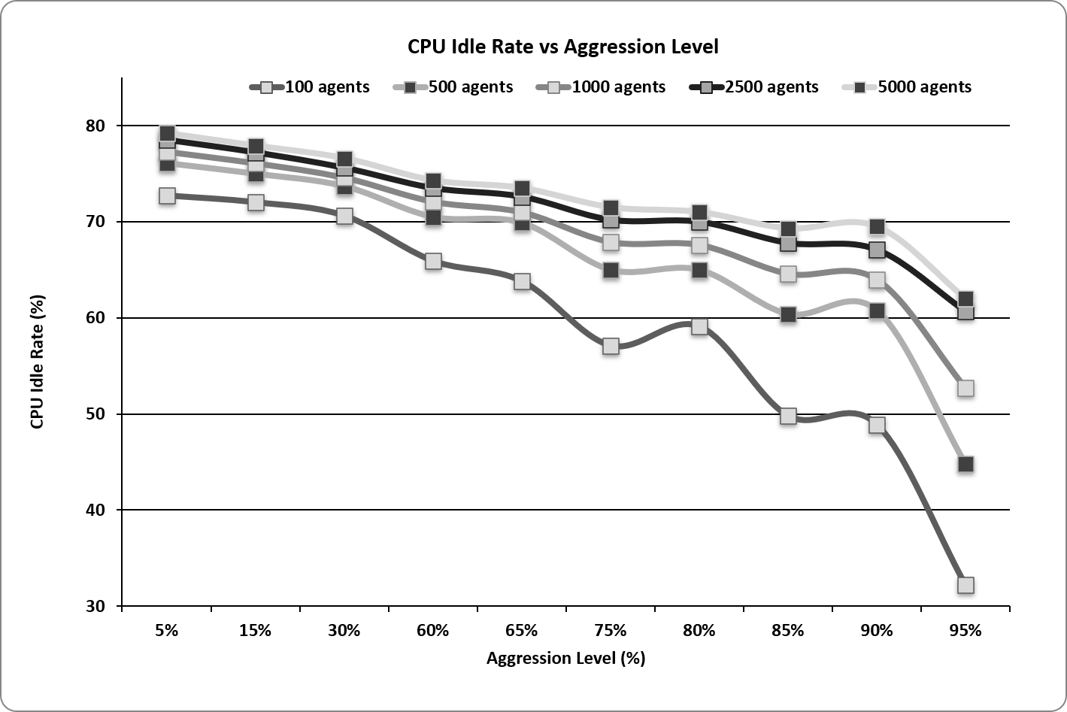

Slide 10
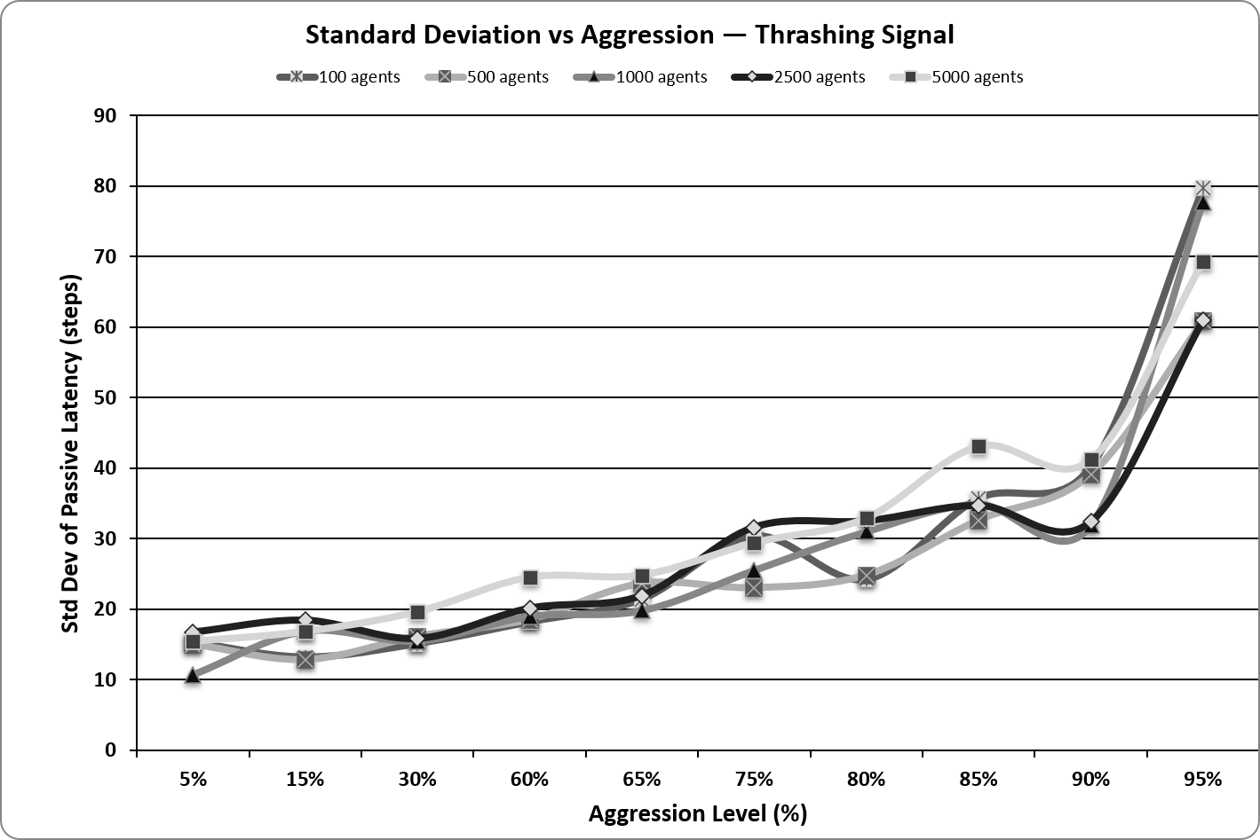

Slide 12
